Slide 1
Thermodynamics I
Chapter 6
Entropy
Mohsin Mohd Sies
Fakulti Kejuruteraan Mekanikal, Universiti Teknologi Malaysia

Slide 2
Entropy (Motivation)
The preferred direction implied by the 2nd Law can be better understood and quantified by the concept of entropy.
Entropy quantifies the 2nd Law and imposes the direction of processes.
Here we will study entropy and how processes will proceed only in the direction of increasing entropy.

Slide 3
Clausius Inequality
T_{H}
Q_{H}
Q_{H}
W
W_{irrev}
E_{rev}
E_{irrev}
Q_{L}
Q_{L,irrev}
T_{L}
Consider two heat engines between the same temperatures

Slide 4
Consider of the whole cycle
(a) E_{rev}

Slide 5
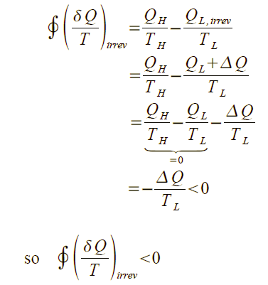
(b) E_{irrev}

Slide 6
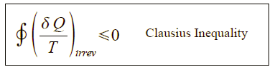
Combined to be:
= 0 if reversible
< 0 if irreversible
> 0 impossible

Slide 7
ENTROPY
2
B
A
1
Let's call this property entropy, S [kJ/K]
Does not depend on path; thermodynamic property!

Slide 8
Entropy , S = extensive property [kJ/K]
Specific entropy, s = intensive property [kJ/kg.K]
We have actually defined entropy change
From statistical thermodynamics, entropy ~ measure of molecular disorder
Work is an ordered form of energy (High quality)
No entropy transfer along with work transfer
Heat is a disordered form of energy (Low quality)
Entropy is transferred along with heat transfer
“Entropy = zero for pure crystal at 0 K”
Third Law of Thermodynamics
Entropy with a 0 K reference is called absolute entropy

Slide 9
T-ds Relations
To find the relationship between δQ and T so that the integration of δQ/T can be performed
- From the 1st Law (neglecting KE & PE)
(a)

Slide 10
- From the definition of enthalpy
From (a)
(b)

Slide 11
T-ds Relations
&
Can be used for ΔS of any process (rev. & irrev.)
Can be used for open & closed system

Slide 12
Entropy Change of Pure Substances
Can be obtained from Tds Relations in conjunction with other thermodynamic relations
For 2 phase substances like water and R-134a, use property tables
ΔS = S₂ – S₁
For ideal gas, from Tds relations
Assume C_{v}=constant
& integrate

Slide 13
Another relation,
Assume C_{p} =constant
& integrate

Slide 14
Entropy change
Both equations give the same result
Choose according to available data..

Slide 15
Isentropic Processes, ΔS = 0
For ideal gases, with constant C_{p} & C_{v}

Slide 16
Another one

Slide 17
Combined to become
Isentropic process for ideal gas,
constant C_{p} , C_{v}

Slide 18
Work for Open Systems
Reversible boundary work for closed systems
Open system reversible work, from 1st Law (single inlet/outlet)
neglecting ke & pe, & rearrange;
Reversible work for open system

Slide 19
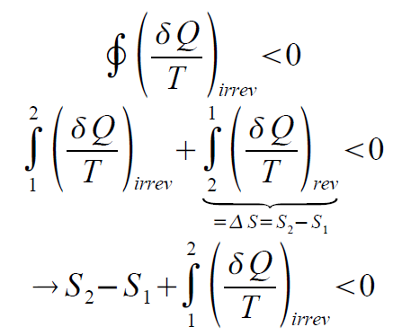
Increase in Entropy Principle
For reversible processes, entropy of universe (system surrounding) doesn't change, it is just transferred (along with heat transfer)
In real processes, irreversibilities cause entropy of universe to increase
Heat reservoirs don't have irreversibility
To simplify analysis, assume irreversibilities to exist only inside the system under study.
Inside the system, entropy transfer and generation occur.
2
Irreversible cycle since one of the processes is irreversible
irrev
rev
1
From Clausius Inequality;

Slide 20
Rearrange
Generalize for all processes
= when rev
> when irrev
< impossible
S_{gen}=entropy generated
= 0 when rev.
> 0 when irrev.
< 0 impossible

Slide 21
Entropy Generation for Closed System
Transfer of entropy (T where Q is transferred, usually at boundary
Change of system entropy
Entropy generation

Slide 22
S_{gen} is the measure of irreversibilities involved during process
ΔS surrounding or system may decrease (-ve), but ΔS total (surrounding + system) must be > 0
Entropy of universe always increases (Entropy increase principle)
No such thing as entropy conservation principle
For a process to occur, S_{gen}> 0

Slide 23
Entropy Generation for Closed System
For multiple heat transfers at different temperatures

Slide 24
Entropy Generation for Closed System
In rate form
In differential form
δS_{gen} - depends on the process (friction, ΔT etc.)
- not a property

Slide 25
Entropy Generation for Open Systems
Apart from heat, mass flows also carry entropy along with them
m_{out}
s_{out}
CV
m_{in}
s_{in}
Q_{in}

Slide 26
Entropy Generation for Open Systems
CV
m_{in}
s_{in}
Q_{in}
Rate of change of system entropy
Rate of entropy generation
Rate of entropy transfer

Slide 27
Steady Flow Process

Slide 28
Steady Flow Process
single inlet/outlet;

Slide 29
Reversible adiabatic process = isentropic process
Isentropic is not necessarily reversible adiabatic
Reversible process S_{gen} = 0
Produces W_{max}
Consumes W_{min}

Slide 30
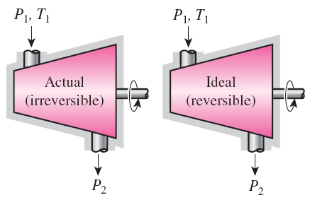
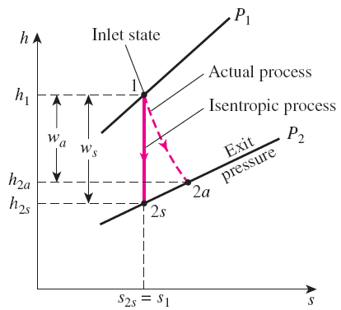

ISENTROPIC EFFICIENCIES OF STEADY-FLOW DEVICES
Also known as Adiabatic Efficiency or 2nd Law Efficiency
The isentropic process involves no irreversibilities and serves as the ideal process for adiabatic devices.
Isentropic Efficiency
of Turbines
The h-s diagram for the actual and isentropic processes of an adiabatic turbine.

Slide 31
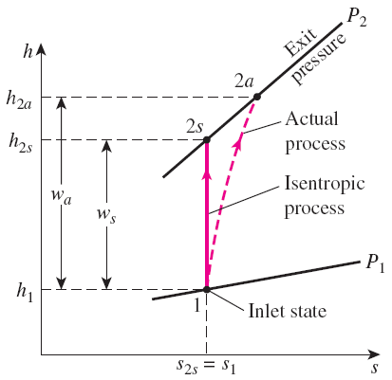
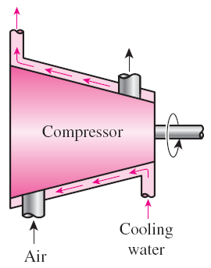
Isentropic Efficiencies of Compressors and Pumps
When kinetic and potential energies are negligible
Compressors are sometimes intentionally cooled to minimize the work input.
The h-s diagram of the actual and isentropic processes of an adiabatic compressor.

Slide 32
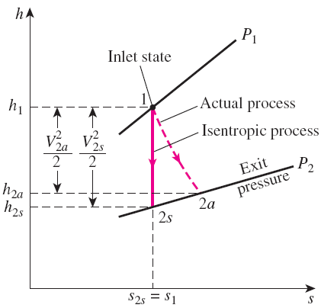
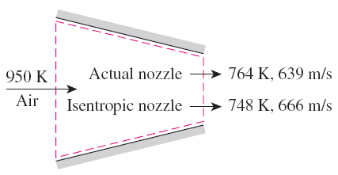

Isentropic Efficiency of Nozzles
If the inlet velocity of the fluid is small relative to the exit velocity, the energy balance is
The h-s diagram of the actual and isentropic processes of an adiabatic nozzle.
Then,
A substance leaves actual nozzles at a higher temperature (thus a lower velocity) as a result of friction.

