Slide 1
Thermodynamics I
Chapter 5
Second Law of Thermodynamics
Mohsin Mohd Sies
Fakulti Kejuruteraan Mekanikal, Universiti Teknologi Malaysia

Slide 2
Second Law of Thermodynamics
(Motivation)
Energy has quality apart from quantity. This results in a preferred direction of processes.
This preferred direction is described by the 2nd Law.
The 2nd Law can be understood by practical insights into the workings of heat engines.

Slide 3
2nd LAW of THERMODYNAMICS
1st Law – Energy Conservation
- amount, quantity
2nd Law – Direction of process
- quality
For a process to occur, 1st and 2nd Laws must be obeyed
Work – High quality energy (100% work can turn into heat)
Heat – Low quality energy (not 100% heat can turn into work)

Slide 4
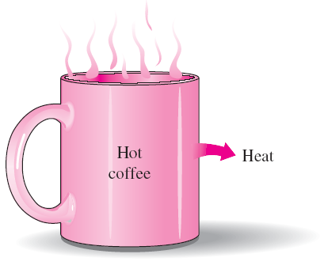
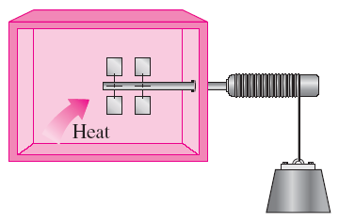
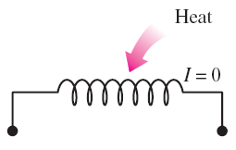
Observations
Transferring heat to a paddle wheel will not cause it to rotate.
A cup of hot coffee does not get hotter in a cooler room.
These processes cannot occur even though they are not in violation of the first law.
Transferring heat to a wire will not generate electricity.

Slide 5
MAJOR USES OF THE SECOND LAW
The second law may be used to identify the direction of processes.
The second law also asserts that energy has quality as well as quantity. The first law is concerned with the quantity of energy and the transformations of energy from one form to another with no regard to its quality. The second law provides the necessary means to determine the quality as well as the degree of degradation of energy during a process.
The second law of thermodynamics is also used in determining the theoretical limits for the performance of commonly used engineering systems, such as heat engines and refrigerators, as well as predicting the degree of completion of chemical reactions.

Slide 6
Heat Reservoir
A body which can receive/reject heat without resulting in temperature change
Source - reservoir supplies heat (heat leaves reservoir)
Sink - reservoir receives heat (heat enters reservoir)
Heat Engine
A device that converts heat into work
Characteristics
Receives heat from a heat source at high temperature, T_{H}
Only part of the heat is converted into work
The rest is rejected to another heat sink at low temperature, T_{L}
Engine works in a cycle (continuously)

Slide 7
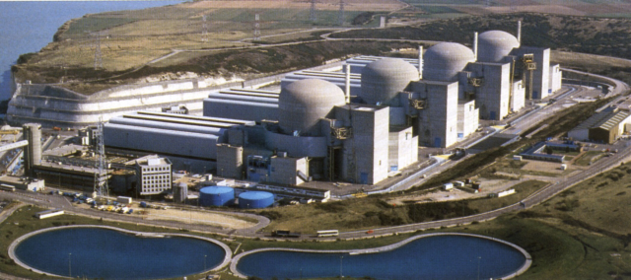
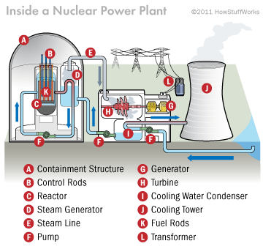
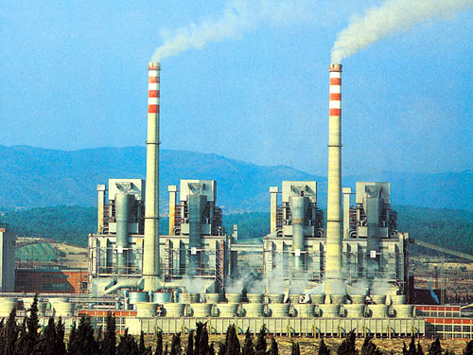
Examples of Heat Engines

Slide 8
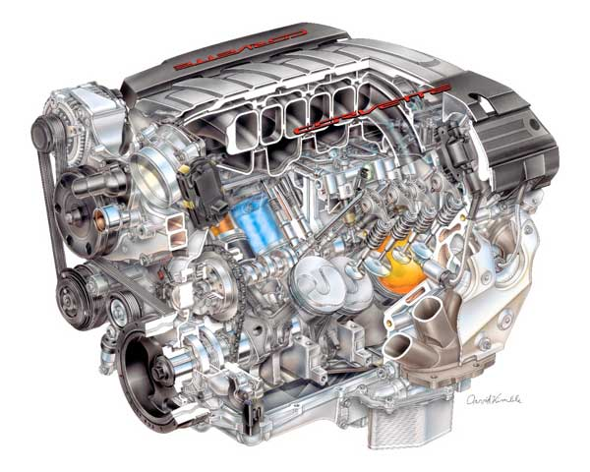
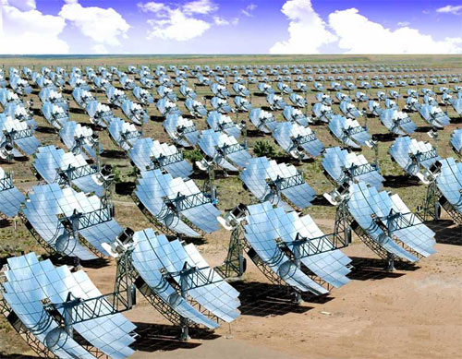
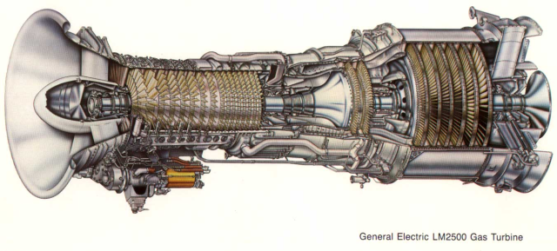
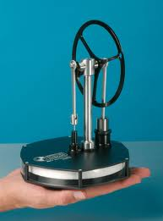
Examples of Heat Engines

Slide 9
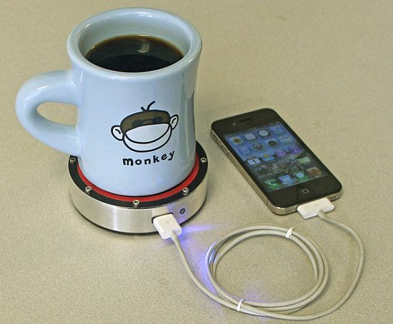
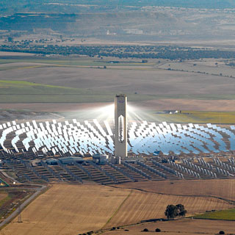
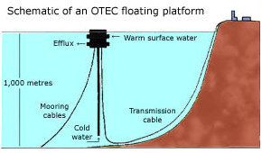
Examples of Heat Engines

Slide 10
High Temperature Heat Source
T_{H}
Q_{H} or Q_{in}
Heat
Engine
W_{out}
Q_{L} or Q_{out}
T_{L}
Low Temperature Heat Sink

Slide 11
2 factors limit efficiency
Irreversibilities
Side effect of heat transfer
Irreversibility
Friction
Electrical resistance
Mixing of different substances
Free expansion
Non-isothermal heat transfer
Etc.
Irreversible Process
Process where the above factors are present

Slide 12
Side Effect of Heat Transfer
Heat Transfer
Expansion (Work Output)
Temperature Increase (Energy Diverted)
If the diverted energy is not thrown away, engine temperature will finally reach heat source temperature, causing Q_{H} to stop (since no more delta_T), stopping the engine altogether.

Slide 13
Side Effect of Heat Transfer
For the engine to keep operating
  Need to cool the engine
  Need to reject heat, Q_{L}.
Rejected heat Q_{L},
  Cannot be recycled (Q_{L} at T_{L} cannot flow on its own to T_{H} to become heat source again)
  Efficiency will always be less than 100% (even if there’s no friction and other irreversibilities)

Slide 14
Reversible Process
After forward and reverse processes are done (system back to initial state), there is no change on the universe (system and surrounding)
Reversible because there is no irreversibilities
Internally reversible - irreversibilities assumed to exist only outside the system
Externally reversible - irreversibilities assumed to exist only inside the system

Slide 15
2nd Law of Thermodynamics
Kelvin-Planck Statement (Heat Engine)
“It is impossible for a device that works in a cycle (continuously) to receive heat supply from one heat reservoir and produces the same amount of work”
Clausius Statement (Heat Pump)
“It is impossible to construct a device that works in a cycle which does not produce any other effect except the transfer of an amount of heat from a cold to a hot body”

Slide 16
Refrigerator & Heat Pump (Reversed Heat Engine)
- To force heat at T_{L} to flow to T_{H} (work must be supplied)
T_{H}
Q_{H}
∃
W_{in}
Q_{L}
T_{L}

Slide 17
Refrigerator
- To achieve cooling effect by taking away heat (Q_{L}) from cold space
T_{H}
Q_{H}
∃
W_{in}
Q_{L}
Cooling Effect or Cooling Load
T_{L}
Coefficient of Performance for Refrigerators

Slide 18
Heat Pump
- To achieve heating effect by supplying heat (Q_{H}) to hot space using heat from cold surrounding
T_{H}
Q_{H}
Heating Effect
∃
W_{in}
Q_{L}
T_{L}
Coefficient of Performance for Heat Pumps

Slide 19
Reversible vs Real Heat Engines
Reversible Heat Engine/Reversed H.E
No irreversibilities in the engine (friction etc.)
All processes within the cycle are reversible processes (heat transfer done isothermally, etc.)
Real Heat Engine
- There exist irreversibilities (friction etc.)

Slide 20
Carnot Principles
T_{H}
3 heat engines between the same T_{H}, T_{L}
T_{L}
(due to heat rejection requirement)

Slide 21
Thermodynamic Temperature Scale
- From Carnot Principle (b)

Slide 22
Maximum Performance
General
Ideal/Max/Carnot/Reversible

Slide 23
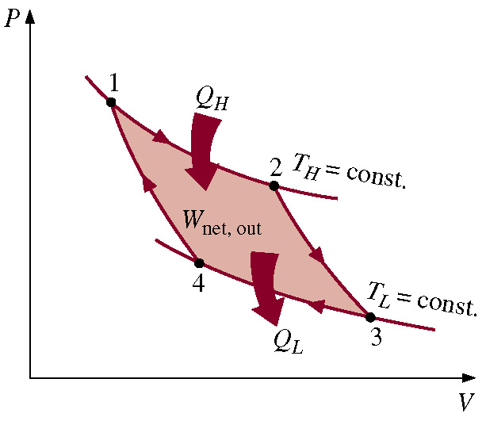
Carnot Cycle (Reversible Heat Engine)
2 isothermal processes (heat transfers)
2 reversible adiabatic processes

Slide 24
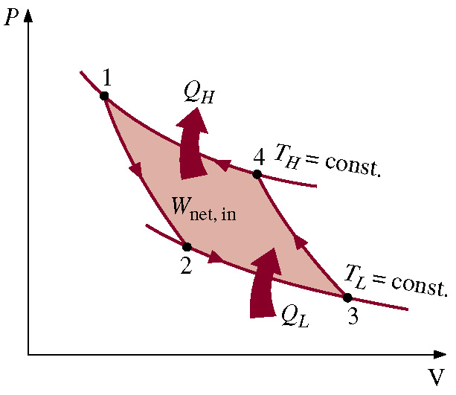
Reversed Carnot Cycle (for refrigerators/heat pumps)
- Same processes, but reversed direction

Slide 25
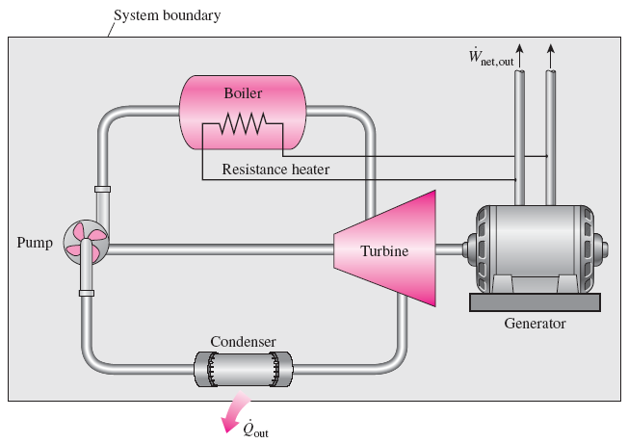
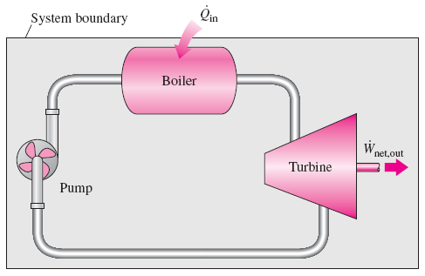
PERPETUAL-MOTION MACHINES
A perpetual-motion machine that violates the second law of thermodynamics (PMM2).
A perpetual-motion machine that violates the first law (PMM1).
Perpetual-motion machine: Any device that violates the first or the second law.
A device that violates the first law (by creating energy) is called a PMM1.
A device that violates the second law is called a PMM2.
Despite numerous attempts, no perpetual-motion machine is known to have worked. If something sounds too good to be true, it probably is.

Slide 26
Terms
Heat Reservoir
Source
Sink
Heat Engine
Irreversibility
Thermal Efficiency
Reversed Heat Engine
Coefficient of Performance
Carnot
Kelvin-Planck, Clausius
Heat Pump
Refrigerator
Perpetual Motion Machine

