Slide 1
Thermodynamics I
Chapter 4
First Law of Thermodynamics
Open Systems
Mohsin Mohd Sies
Fakulti Kejuruteraan Mekanikal, Universiti Teknologi Malaysia

Slide 2
First Law of Thermodynamics
(Motivation)
A system changes due to interaction with its surroundings.
Interaction study is possible due to conservation laws.
Various forms of conservation laws are studied in this chapter in the form of balance equations.

Slide 3
1ST LAW FOR OPEN SYSTEMS
Energy and Mass can enter/leave a system
Divided into two parts:
Conservation of Mass Principle
Conservation of Energy Principle1
W_{out}
m_{out}
Q_{out}
CV
W_{in}
m_{in}
Q_{in}

Slide 4
Mass Conservation (Mass Balance)
m_{out}
Mass Balance:
m_{CV}
m_{in}
Net change of mass of CV
Total of all mass entering
Total of all mass exiting
Rate of change of mass of CV
Total of all mass flow rates for all inlet channels
Total of all mass flow rates for all exit channels

Slide 5
Mass flow rates and Speed for a channel
A
For flow rates;
s
but
Thus;

Slide 6
Flow Work
For an amount of mass to cross a boundary, it needs a force (work) to push it; called Flow Work , w_{flow}
L
The force that pushes the fluid;
F
A
m, ρ, V
Work that is involved;

Slide 7
Conservation of Energy for Open Systems
Energy can enter/leave an open system via
Heat, Work AND Mass Flow Entering/Leaving
W_{out}
m_{out}
Q_{out}
E_{CV}
W_{in}
m_{in}
Net energy change of CV
Net energy transfer by heat/work
Total energy of entering mass
Total energy of exiting mass
Q_{in}

Slide 8
Energy of a Flowing Mass
An amount of mass possesses energy, E, e
e = u + ke + pe
but a flowing mass also possesses flow work, so
the Energy for a flowing mass; e_{flow}
e_{flow} = u + ke + pe + w_{flow}
= u + pv + ke + pe
but u + pv = h (enthalpy)
e_{flow} = h + ke + pe (energy for a flowing mass)

Slide 9
Energy Balance for an Open System
can be written as;
or;
Total of all work except flow work
For each inlet
For each outlet

Slide 10
but;
so;

Slide 11
Energy Balance in other forms;
Rate form;
(general form of Energy Balance for an Open System)

Slide 12
Steady Flow Process
Criteria;
All system properties (intensive & extensive) do not change with time
m_{cv}= constant; Δm_{CV}= 0
V_{CV}= constant; ΔV_{CV}= 0
E_{CV}= constant; ΔE_{CV}= 0
Fluid properties at all inlet/exit channels do not change with time (Values might be different for different channels)
Heat and work interactions do not change with time

Slide 13
Implication of Criterion 1
(Mass)
Δm_{CV}= 0,
From Mass Conservation;
Recall that
so

Slide 14
Implication of Criterion 1 (Mass) ctd.
for 1 inlet/ 1 exit;

Slide 15
Implication of Criterion 1
(Volume)
ΔV_{CV}= 0,
∴ W_{B} = 0 (boundary work = 0 )
ΔE_{CV}= Q – W + ΣE_{flow(in)} - ΣE_{flow(out)}
W = W_{electrical} + W_{shaft} + W_{boundary}+ W_{flow}+ W_{etc.}
0
in h
W not necessarily 0, only W_{B} is 0

Slide 16
Implication of Criterion 1
(Energy)
ΔE_{CV}= 0,
From Energy Conservation;
= 0
Rearrange to get Steady Flow Energy Equation
(SSSF)

Slide 17
SSSF
For each exit channel
For each inlet channel
z_{out}
z_{in}

Slide 18
SSSF energy equation for 1 inlet / 1 exit
Mass
1
2
or
Energy
( 1 inlet / 1 exit )
( Δ = exit – inlet )

Slide 19
SSSF energy equation for multiple channels but neglecting Δke, Δpe

Slide 20
SSSF Applications
For devices which are open systems
Nozzle & Diffuser
Turbine & compressor
Throttling valve @ porous plug
Mixing/Separation Chamber
Heat exchanger(boiler, condenser, etc)
(a)
(b)
2 categories;
1 inlet / 1 outlet
Multiple inlet / outlet
Analysis starts from the general SSSF energy equation;

Slide 21
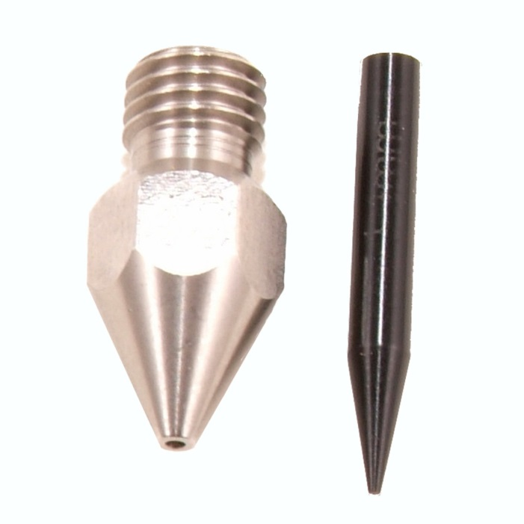
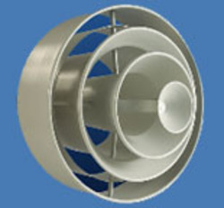
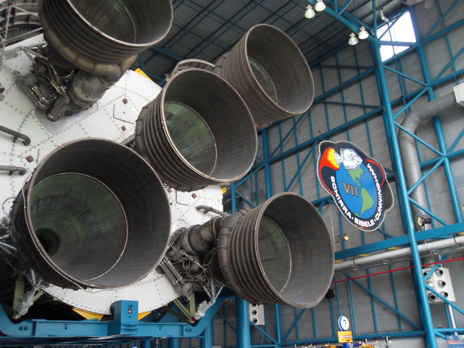
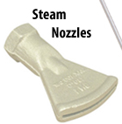
Nozzle & Diffuser ( ΔKE ≠ 0 ) (To change fluid velocity)

Slide 22
Nozzle & Diffuser ( ΔKE ≠ 0 ) (To change fluid velocity)
Nozzle
Diffuser
Assumptions
Const. volume → w_{B} = 0
No other work
Small difference in height → Δpe = 0
w_{CV} = 0
1 inlet / 1 outlet

Slide 23
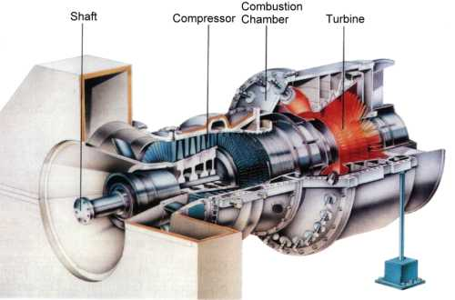
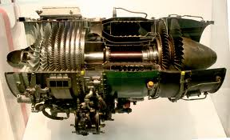
Turbine ( w_{CV} ≠ 0 )

Slide 24
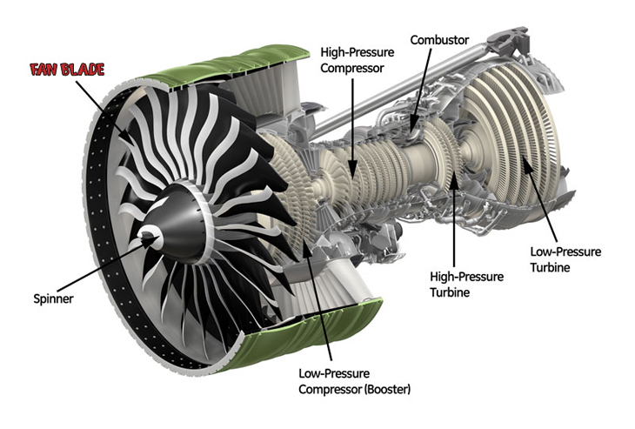
Turbine & Compressors ( w_{CV} ≠ 0 )

Slide 25
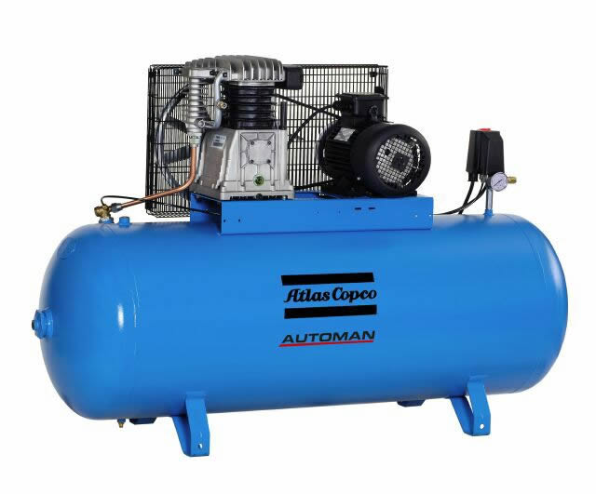
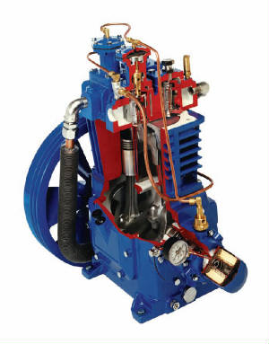
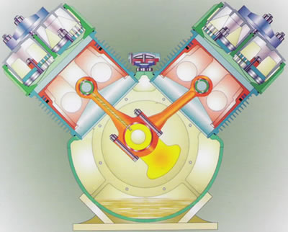
Compressors (Reciprocating) ( w_{CV} ≠ 0 )

Slide 26
Turbine & Compressor ( w_{CV} ≠ 0 )
Turbine
produces work (W +ve) from expansion of
fluid (ΔP -ve)
Compressor
increases pressure (ΔP +ve) using work supplied (W –ve)
Assumptions
Const. volume → w_{B} = 0
Involves other work
Small difference in height → Δpe = 0
w_{CV} ≠ 0

Slide 27
Turbine & Compressor ( w_{CV} ≠ 0 )
Turbine
Compressor
Assumptions
Const. volume → w_{B} = 0
Involves other work
Small difference in height → Δpe = 0
w_{CV} ≠ 0
1 inlet / 1 outlet
Commonly insulated (q=0), and also
Δke ≈ 0 (since Δke << Δh )

Slide 28
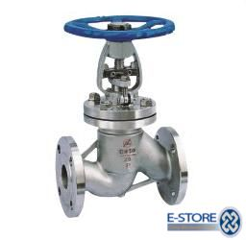
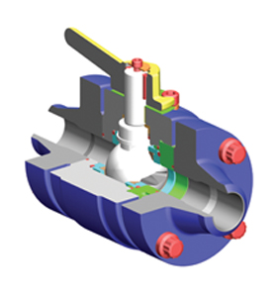
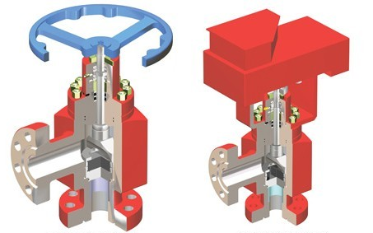
Throttling valve/Porous plug (const.enthalpy, h=c)
To reduce pressure without involving work

Slide 29
Throttling valve/Porous plug (const.enthalpy, h=c)
To reduce pressure without involving work
Assumptions
W = 0
Δke = 0 , Δpe = 0
Q ≈ 0 (system too small)
1 inlet / 1 outlet
For throttling valves

Slide 30
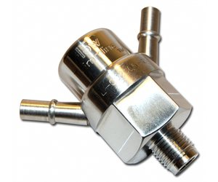
Mixing/Separation Chamber / T junction pipe
Assumptions
W_{B} = 0
Same pressure at all channels
Other assumptions made accordingly
also

Slide 31
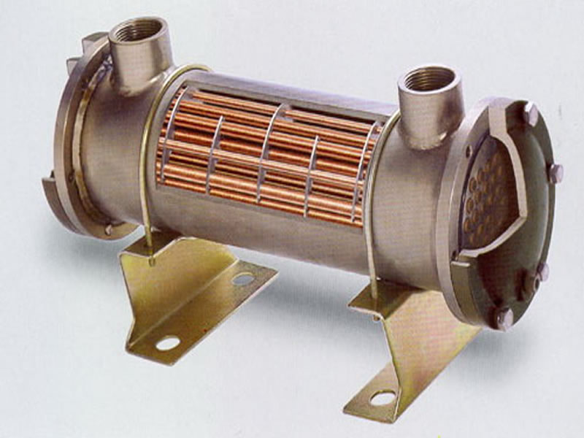
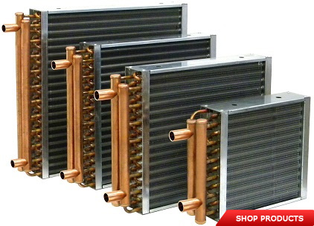
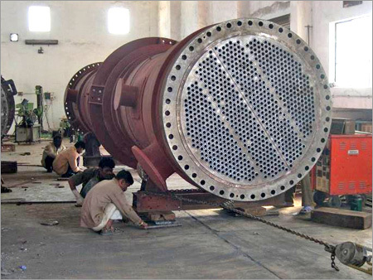
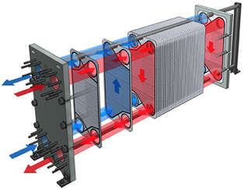
Heat Exchangers

Slide 32
Heat Exchangers
Assumptions (System encompasses
the whole heat exchanger)
No work involved, W = 0
Insulated, Q = 0
Δke = 0 , Δpe = 0
1
A
2
B
Q
3
4
also

Slide 33
General device (Black box analysis)
1
4
2
5
3
Assumptions made according to situation...
also

