Slide 1
Thermodynamics I
Chapter 3
Energy, Heat and Work
Mohsin Mohd Sies
Fakulti Kejuruteraan Mekanikal, Universiti Teknologi Malaysia

Slide 2
Energy, Heat and Work
(Motivation)
A system changes due to interaction with its surroundings.
Energy interaction is a major factor.
This chapter studies the nature of energy and its various forms and transfers so that we are able to follow its interaction with a system.

Slide 3
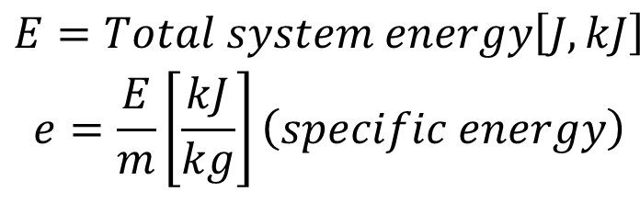
ENERGY & THE 1st LAW OF THERMO.
1st Law : concerning quantity of energy
Energy is conserved
(Amount of energy is constant, but can change forms)
(e.g. potential, kinetic, electrical, chemical, etc.)
$$\begin{matrix}E=Total system energy\left[J,kJ\right] \\ e=\frac{E}{m}\left[\frac{kJ}{kg}\right]\left(specific energy\right)\end{matrix}$$

Slide 4
Energy
Macroscopic – system energy which value depends on a reference point (Kinetic Energy (KE), Potential Energy (PE)
Microscopic – energy due to molecular interactions & activity (independent of any reference point) (Internal Energy, U)
Total System Energy

Slide 5
Kinetic Energy (KE)
Potential Energy (PE)

Slide 6
Internal Energy, U
Molecular movement (vibration, collision, etc)
sensible energy (molecular activity temperature)
Bond Energy between molecules (phase change)
latent energy (constant temperature)
Bond Energy between atoms in a molecule
chemical energy
Bond Energy between protons & neutrons in the nucleus
nuclear energy

Slide 7
Modes of Energy Transfer
Energy Interaction between System and Surrounding
Energy can cross the boundary (transferred) of a closed system by 2 methods;
HEAT & WORK

Slide 8
HEAT, Q [J, kJ]
Heat - Energy that is being transferred due to a temperature difference
Heat is a mode of energy transfer
Heat is not a property
Energy is related to states (property)
Heat is related to processes (not a property, depends on the path)
= rate of heat transfer
Amount of heat transferred during a process (depends on the path)

Slide 9
Heat (ctd.)
system
Q_{in}= +ve
Q_{out}= -ve
Adiabatic Process (Q = 0)
insulated
T_{system} = T_{surrounding}
Adiabatic ≠ Isothermal!
(T can change by other methods; energy can enter system by work)

Slide 10
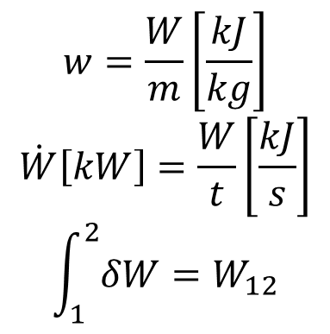
WORK, W [J, kJ]
Work -–Energy that is crossing the boundary other than heat
(electrical, stirrer, shaft, moving piston, etc.)
Not a property (related to process)
Mode of energy transfer
W_{in}= -ve
system
W_{out}= +ve
$$w=\frac{W}{m}\left[\frac{kJ}{kg}\right]$$
$$\dot{W}\left[kW\right]=\frac{W}{t}\left[\frac{kJ}{s}\right]$$
$$\int_{1}^{2}{δW}=W_{12}$$
= rate of work = power
Depends on path

Slide 11
Types of Work
Work
Electrical
Mechanical
Boundary
Gravitational
Acceleration
Shaft
Spring

Slide 12

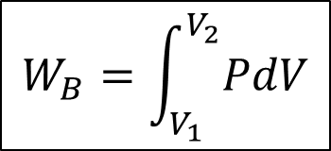
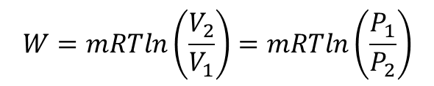
Boundary Work for Polytropic Processes
Boundary Work
$$W_{B}=\int_{V_{1}}^{V_{2}}{PdV}$$
Area under P-v graph
General Polytropic Work
( n ≠ 1 )
Const. Pressure Work (n=0)
Isothermal Work (n=1) ideal gas
$$W=mRTln\left(\frac{V_{2}}{V_{1}}\right)=mRTln\left(\frac{P_{1}}{P_{2}}\right)$$
Const. Volume Work (dv=0)
$$W_{b−constvol}=0$$

Slide 13
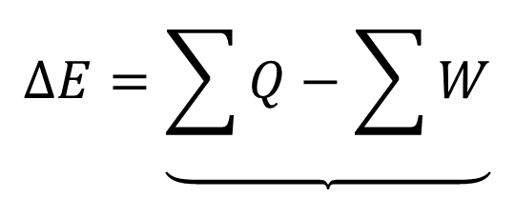
1st Law Closed System
W_{out}
Q_{out}
W_{in}
Q_{in}
$$∆E=\underbrace{\sum{Q}−\sum{W}}$$
Net change of system energy
Net total energy transfer in the form of heat and work

Slide 14
- Recall that System Energy consists of:
E_{system}= U + KE + PE
or
ΔE_{system}= ΔU + ΔKE + ΔPE
thus;
Q – W = ΔE_{system}= ΔU + ΔKE + ΔPE
Or can be called as the
1st Law/Energy Balance of a Closed System;
Q – W = ΔU + ΔKE + ΔPE
Net transfer of energy
Energy storage in different modes

Slide 15
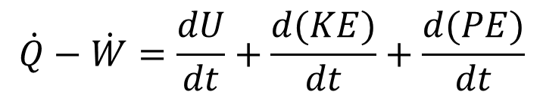
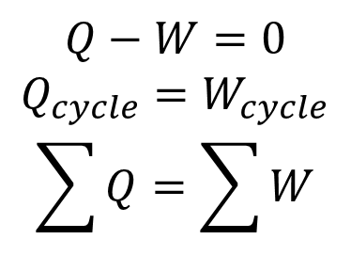
1st Law for Closed System in different forms;
Q – W = ΔU + ΔKE + ΔPE [kJ]
per unit mass;
q – w = Δu + Δke + Δpe [kJ/kg]
Rate form;
$$\dot{Q}−\dot{W}=\frac{dU}{dt}+\frac{d(KE)}{dt}+\frac{d(PE)}{dt}$$
[kW]
Cyclic Process ΔE =0
$$Q−W=0$$
$$Q_{cycle}=W_{cycle}$$
$$\sum{Q}=\sum{W}$$

Slide 16
summary;
Q – W = ΔU + ΔKE + ΔPE
mg(z₂-z₁)
m(u₂-u₁) water (Table)
mC_{v}(T₂-T₁) ideal gas
Electrical
Mechanical
  Boundary
  etc…

