Slide 1
SKMM 2413
Thermodynamics I
Mohsin Mohd Sies
Fakulti Kejuruteraan Mekanikal, Universiti Teknologi Malaysia

Slide 2
Synopsis
Thermodynamics is a basic science that deals with energy. This course introduces students to the basic principles of thermodynamics. It will discuss basic concepts and introduces the various forms of energy and energy transfer as well as properties of pure substances. A general relation for the conservation of energy principle will be developed and applied to closed systems and extended to open systems. The second law of thermodynamics will be introduced and applied to cycles, cyclic devices and processes.

Slide 3
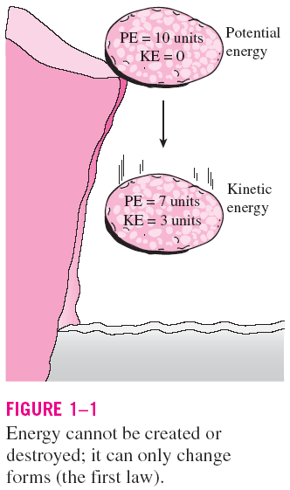
THERMODYNAMICS AND ENERGY
Thermodynamics: The science of energy.
Energy: The ability to cause changes.
The name thermodynamics stems from the Greek words therme (heat) and dynamis (power).
Conservation of energy principle: During an interaction, energy can change from one form to another but the total amount of energy remains constant.
Energy cannot be created or destroyed.
The first law of thermodynamics: An expression of the conservation of energy principle.
The first law asserts that energy is a thermodynamic property.

Slide 4
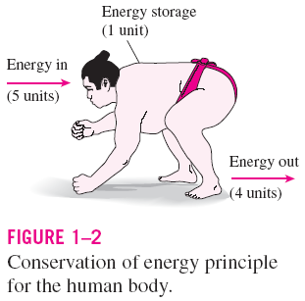
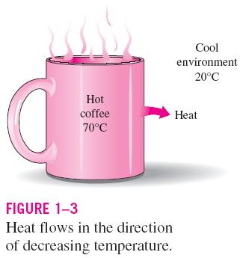
The second law of thermodynamics: It asserts that energy has quality as well as quantity, and actual processes occur in the direction of decreasing quality of energy.
Classical thermodynamics: A macroscopic approach to the study of thermodynamics that does not require a knowledge of the behavior of individual particles.
It provides a direct and easy way to the solution of engineering problems and it is used in this text.
Statistical thermodynamics: A microscopic approach, based on the average behavior of large groups of individual particles.
It is used in this text only in the supporting role.

Slide 5
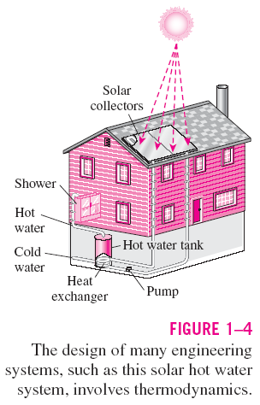
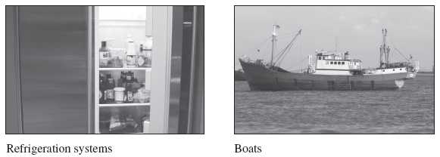
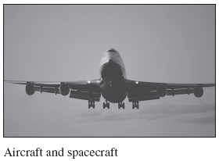
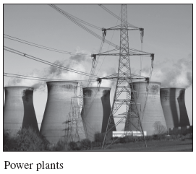
Application Areas of Thermodynamics
All activities in nature involve some interaction between energy and matter; thus, it is hard to imagine an area that does not relate to thermodynamics in some manner.

Slide 6
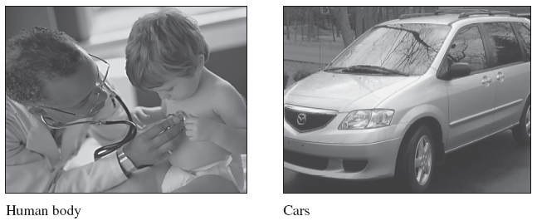
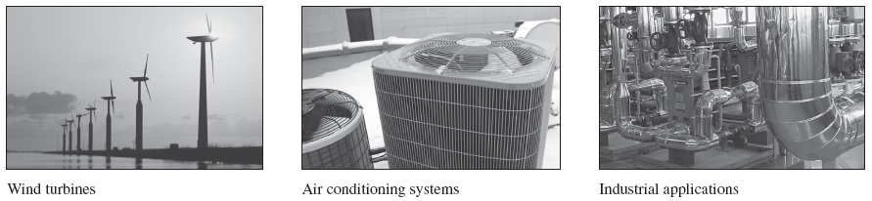

Slide 7
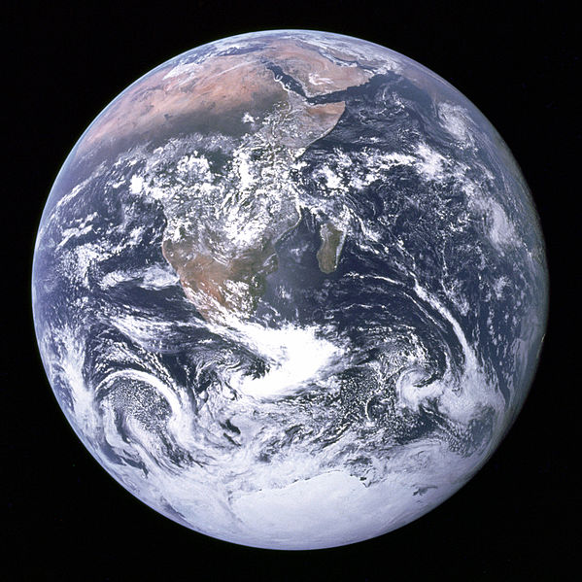
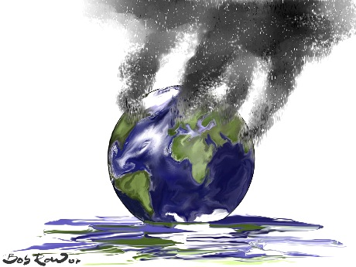

Slide 8
UNITS & DIMENSION
Physical Quantity = Dimension
(length, mass, time, temperature, velocity, volume, etc)
Measurement of Dimension = Unit
(meter, kg, seconds, …) SI system
Dimension
Primary - length (m)
mass (kg)
time (s)
temperature (K)
Secondary (Derived)
e.g Volume = length3
Velocity = length
time

Slide 9
Unit Addition
- all terms must have the same dimension, unit, & factor (dimensional homogeneity)
Unit Conversion
Quantities are multiplied with 1 (conversion factor)
(Quantities unchanged, but units have changed)
Except temperature conversion since it involves addition

Slide 10
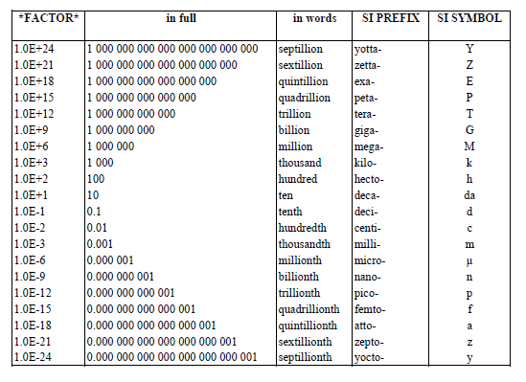
SI Prefix

Slide 11
Greek Alphabets
Capital | Lowercase | Name | Pronunciation |  | Capital | Lowercase | Name | Pronunciation
Α | α | ALPHA | AL-fuh |  | Ν | ν | NU | NOO
Β | β | BETA | BAY-tuh |  | Ξ | ξ | XI | KS-EYE
Γ | γ | GAMMA | GAM-uh |  | Ο | ο | OMICRON | OM-i-KRON
Δ | δ | DELTA | DEL-tuh |  | Π | π ϖ | PI | PIE
Ε | ε ϵ | EPSILON | EP-sil-on |  | Ρ | ρ | RHO | ROW
Ζ | ζ | ZETA | ZAY-tuh |  | Σ | σ ς | SIGMA | SIG-muh
Η | η | ETA | AY-tuh |  | Τ | τ | TAU | TAU
Θ | θ | THETA | THAY-tuh |  | Υ | υ | UPSILON | OOP-si-LON
Ι | ι | IOTA | eye-OH-tuh |  | Φ | ϕ φ | PHI | FEE
Κ | κ | KAPPA | KAP-uh |  | Χ | χ | CHI | K-EYE
Λ | λ | LAMBDA | LAM-duh |  | Ψ | ψ | PSI | SIGH
Μ | μ | MU | MYOO |  | Ω | ω | OMEGA | oh-MAY-guh

Slide 12
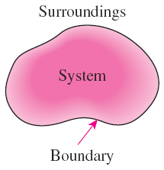
System: A quantity of matter or a region in space chosen for study.
Surroundings: The mass or region outside the system
Boundary: The real or imaginary surface that separates the system from its surroundings.
The boundary of a system can be fixed or movable.
Systems may be considered to be closed or open.

Slide 13
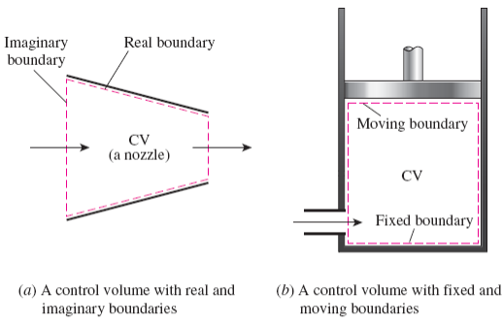
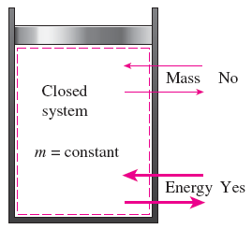
Closed system (Control mass): A fixed amount of mass. Energy can cross the boundary, but no mass can
Open system (control volume): A properly selected region in space.
It usually encloses a device that involves mass flow such as a compressor, turbine, or nozzle.
Both mass and energy can cross the boundary of a control volume.
Control surface: The boundaries of a control volume. It can be real or imaginary.

Slide 14
Property
Properties are characteristics of a system (e.g. Mass, volume, temperature, energy, pressure etc.)
Types of property
  Extensive
    The value depends on the size of the system (additive) (Volume V, mass m, Energy E, Internal Energy U)
  Intensive
    The value does not depend on the size of the system (not additive) (Temperature T, Pressure P)
    Specific Property (Independent of size)
      Specific Property = (Extensive Property) / (Mass)
      ex. Specific Volume v, Specific Energy e
e.g. Specific volume = Volume / mass
v [m³/kg] = V [m³] / m [kg]

Slide 15
State
A state is described by the system properties at that instant
If even only 1 of the properties changed; the state has changed
If all properties does not change with time; it is called steady state
If the properties at two different times are the same; both states are the same

Slide 16
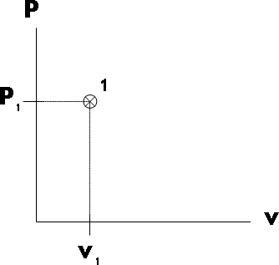
State Postulate
“The state of a simple, compressible system can be completely described by knowing only 2 properties which are intensive and independent” (other properties can be determined from other relations)
State can be shown on a property diagram

Slide 17
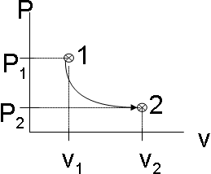
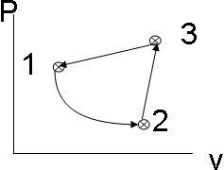
Process
When state changes; the system has undergone a process
If several processes occurred in series until it reaches the initial condition; the system has undergone a cycle (net change of any property = 0 after a cycle)

Slide 18
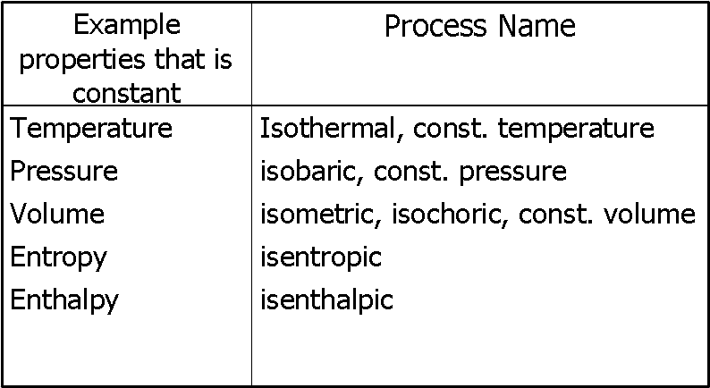
Constant Property Process
When the value of a property is constant during the process

Slide 19
Property (continued)
  A quantity is a property iff (if and only if) the difference between 2 states is not dependent on the process between those states (point function).
  If the difference of a function y is an exact differential (dy), that function is a thermodynamic property.
  Work, heat depends on the path (process), and thus not an exact differential, and not a property (path function)

Slide 20
Summary
We are studying a system
  Ex. Gas inside a piston-cylinder device
    Gas = system
    Surrounded by surrounding
    Separated by a boundary (inside surface of cylinder)
System has properties (T,p,v)
Properties describe the state of the system (State Postulate)
State can be shown on a property diagram
When state changes; the system underwent a process
If it returns to the initial state; the system underwent a cycle

Slide 21
Phase and Pure Substances
Phase - – a uniform amount of matter
Physical structure
(solid, liquid, gas)
Chemical composition
Pure Substance –
system with a uniform chemical composition

Slide 22
Equilibrium
  When there's no more change on any property
  - 4 things have to be in equilibrium
  Thermal equilibrium
  Phase equilibrium
  Mechanical Equilibrium
  Chemical equilibrium
  Equilibrium Process -
System always in equilibrium during process (process drawn as solid line on property diagram)
  Quasistatic Process = quasiequilibrium (quasi = almost)

Slide 23
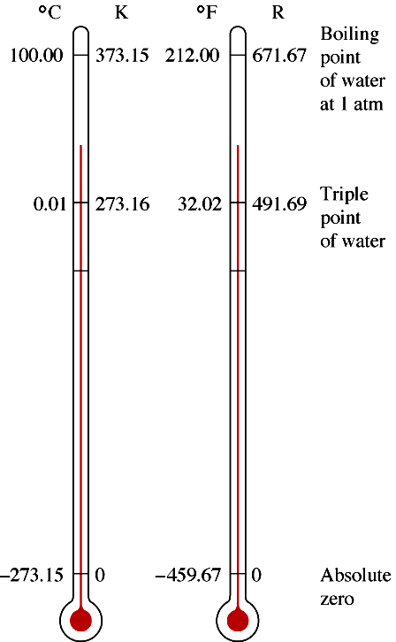
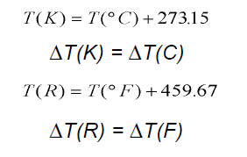
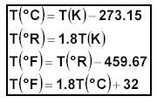
Temperature
A fundamental quantity – a measure of molecular activity

Slide 24
The Zeroth Law
Two systems in thermal equilibrium with a third system are in thermal equilibrium with each other.

Slide 25

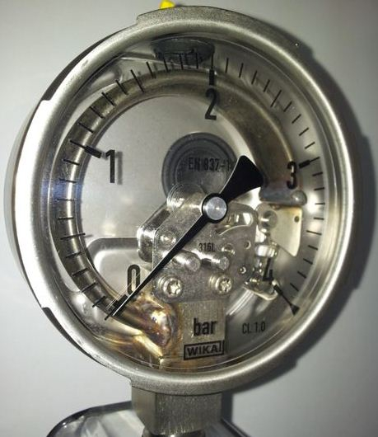
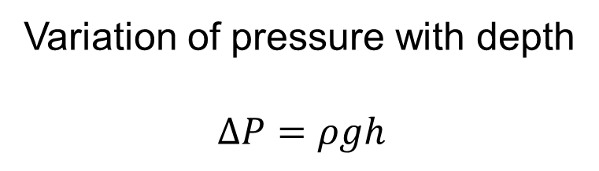
Pressure
Pressure: A normal force exerted by a fluid per unit area
Variation of pressure with depth
$$∆P=ρgh$$

Slide 26
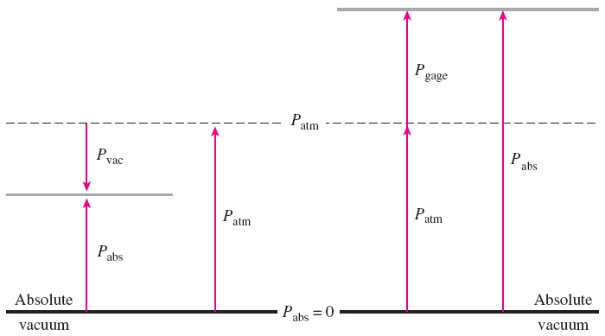

Absolute, Gauge, and Vacuum Pressures

Slide 27
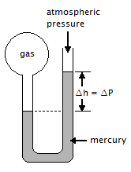
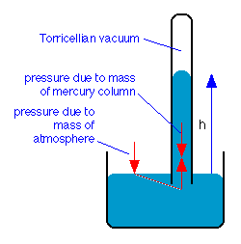
Manometer & Barometer

Slide 28
References
Cengel, Boles, Thermodynamics, An Engineering Approach, 6th Edition, McGraw Hill
Moran, Shapiro, Fundamentals of Engineering Thermodynamics, John Wiley.
Sonntag, Van Wylen, Borgnakke, Fundamentals of Thermodynamics, John Wiley.

