Slide 1
Chapter 12
Radiation: Processes and Properties
-Basic Principles and Definitions-

Slide 2
Chapter 12 : Thermal Radiation
Objectives :
Classify electromagnetic radiation and identify thermal radiation.
Understand the idealized blackbody and calculate the total and spectral blackbody emissive power.
Calculate the fraction of radiation emitted in a specified wavelength band using the blackbody radiation functions.
Understand the concept of radiation intensity and define spectral directional quantities using intensity.
Develop a clear understanding of the properties emissivity, absorptivity, reflectivity, and transmissivity on spectral and total basis.
Apply Kirchhoff’s law to determine the absorptivity of a surface when its emissivity is known.

Slide 3
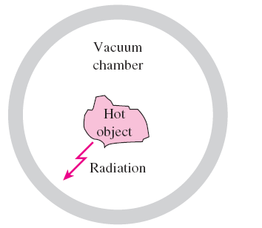
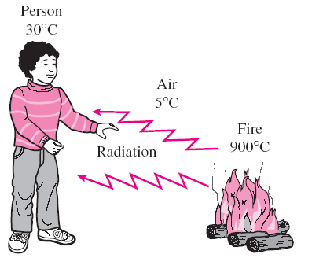
Chapter 10 : Thermal Radiation
Radiation phenomena:
Radiation differs from conduction and convection in that it does not require the presence of a material medium to take place.
Radiation transfer occurs in solids as well as liquids and gases.
A hot object in a vacuum chamber will eventually cool down and reach thermal equilibrium with its surroundings by a heat transfer mechanism: radiation.

Slide 4
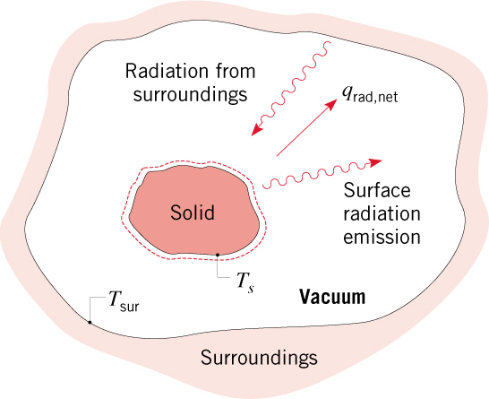
General Considerations
Attention is focused on thermal radiation, whose origins are associated
with emission from matter at an absolute temperature (K)
Emission is due to oscillations and transitions of the many electrons that comprise
matter, which are, in turn, sustained by the thermal energy of the matter.
Emission corresponds to heat transfer from the matter and hence to a reduction
in thermal energy stored by the matter.
Radiation may also be intercepted and absorbed by matter.
Absorption results in heat transfer to the matter and hence an increase in thermal energy stored by the matter.
Consider a solid of temperature
in an evacuated enclosure whose walls
are at a fixed temperature
What changes occur if T_{s} > T_{sur} ?

Slide 5
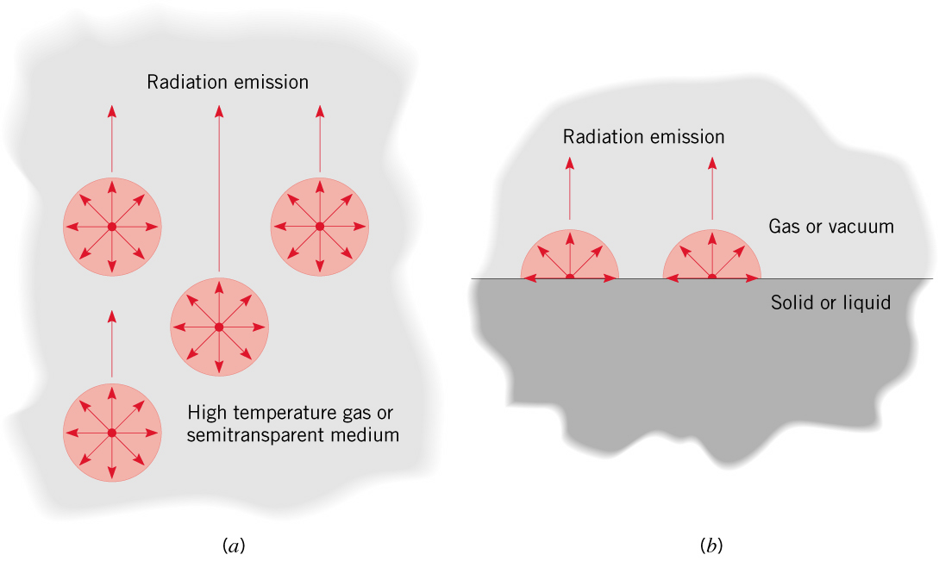
Emission from a gas or a semitransparent solid or liquid is a volumetric
phenomenon. Emission from an opaque solid or liquid is a surface phenomenon.
An opaque solid transmits no light, and therefore reflects, scatters, or absorbs all of it. E.g. mirrors and carbon black.
*For an opaque solid or liquid, emission originates from atoms and molecules
within 1 μm of the surface.
The dual nature of radiation:
In some cases, the physical manifestations of radiation may be explained
by viewing it as particles (aka photons or quanta).
In other cases, radiation behaves as an electromagnetic wave.

Slide 6
Chapter 10 : Thermal Radiation
Radiation phenomena:
Temperature is a measure of the strength of these activities at the microscopic level, and the rate of thermal radiation emission increases with increasing temperature.
Thermal radiation is continuously emitted by all matter whose temperature is above absolute zero.
In all cases, radiation is characterized by a wavelength, λ and frequency, ν which are related through the speed at which radiation propagates in the medium of interest:
Everything around us constantly emits thermal radiation.
c = c₀ /n
c, the speed of propagation of a wave in that medium
c₀ = 2.9979 × 10⁸ m/s, the speed of light in a vacuum
n, the index of refraction of that medium
n = 1 for air and most gases, n = 1.5 for glass, and n = 1.33 for water

Slide 7
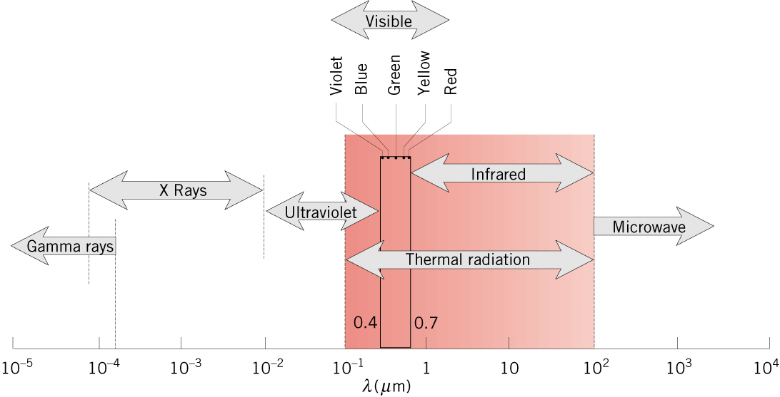
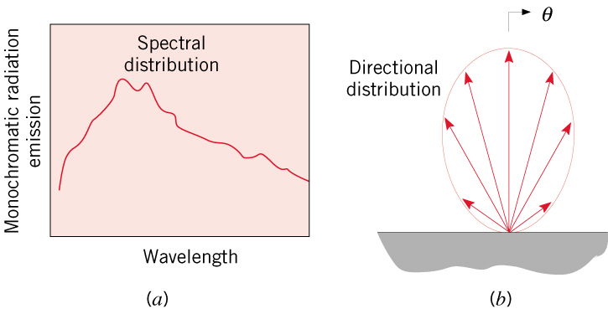
The Electromagnetic Spectrum
* Thermal radiation is confined to the infrared, visible and ultraviolet regions.
Light is simply the visible portion of the electromagnetic spectrum that lies between 0.4 and 0.7 μm.
Thermal radiation is confined to the infrared, visible and ultraviolet regions of the
spectrum 0.1 < λ < 100 μm .
The amount of radiation emitted by an opaque surface varies with wavelength, and we may speak of the spectral distribution over all wavelengths or of monochromatic/spectral components associated with particular wavelengths.

Slide 8
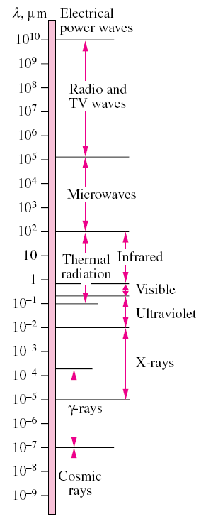
Chapter 10 : Thermal Radiation
The electromagnetic wave spectrum.
Brief About Light:
Light is simply the visible portion of the electromagnetic spectrum that lies between 0.40 and 0.76 μm.
A body that emits some radiation in the visible range is called a light source.
The sun is our primary light source.
The electromagnetic radiation emitted by the sun is known as solar radiation, and nearly all of it falls into the wavelength band 0.3–3 μm.
Almost half of solar radiation is light (i.e., it falls into the visible range), with the remaining being ultraviolet and infrared.

Slide 9
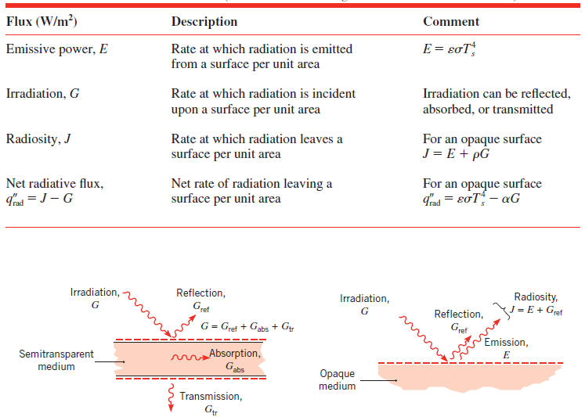
Radiation Heat Fluxes and Material Properties

Slide 10
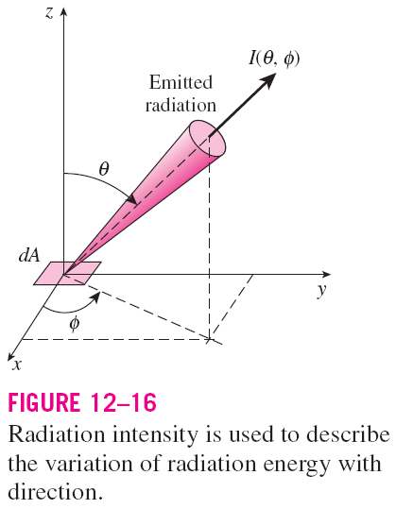
Chapter 10 : Thermal Radiation
Radiation Intensity & Directional Consideration
Radiation is emitted by all parts of a plane surface in all directions into the hemisphere above the surface, and the directional distribution of emitted (or incident) radiation is usually not uniform.
Therefore, we need a quantity that describes the magnitude of radiation emitted (or incident) in a specified direction in space.
This quantity is radiation intensity, denoted by I.

Slide 11
Radiation Intensity, I
Rate (dq) at which energy is emitted at wavelength lambda, at theta&phi direction, per unit area of emitting surface normal to this direction, per unit solid angle about this direction, and per unit wavelength interval dlambda.

Slide 12
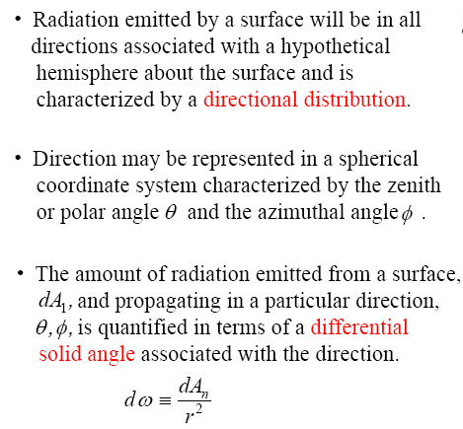
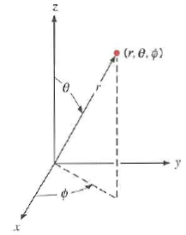
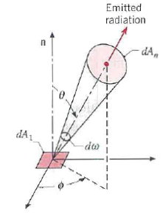

Chapter 10 : Thermal Radiation

Slide 13
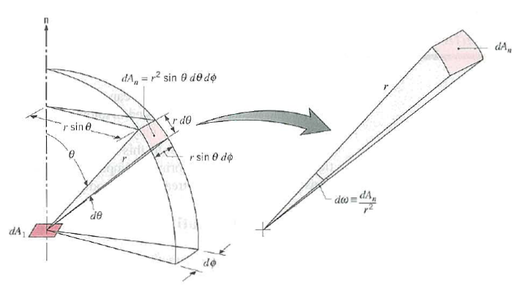
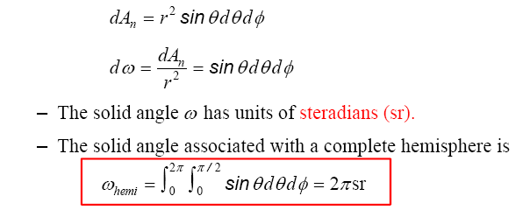
Chapter 10 : Thermal Radiation
→ Eq. (12.4)

Slide 14
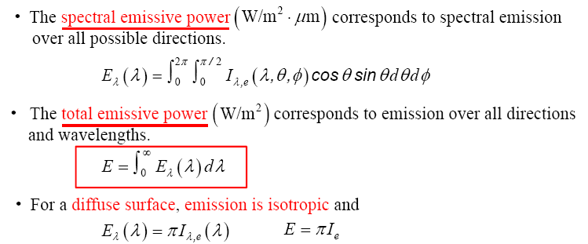
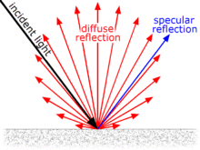
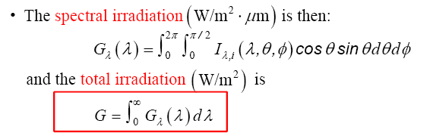
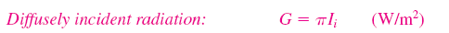
Chapter 10 : Thermal Radiation
Relation of Intensity to Emissive Power, E, Irradiation, G and Radiosity, J
→ Eq. (12.9)
I_{e} : total intensity of the emitted radiation
→ Eq. (12.14)
→ Eq. (12.17)

Slide 15
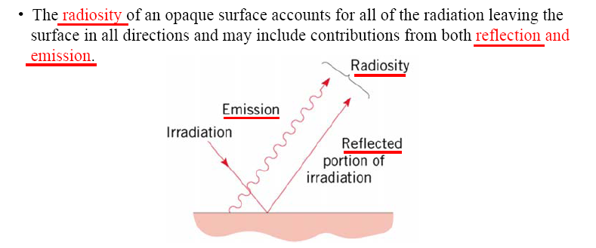
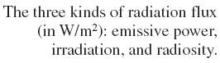
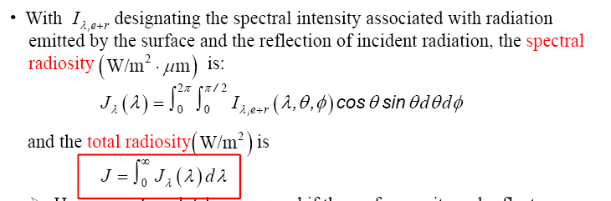
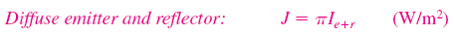
Chapter 10 : Thermal Radiation
→ Eq. (12.19)
→ Eq. (12.22)

Slide 16
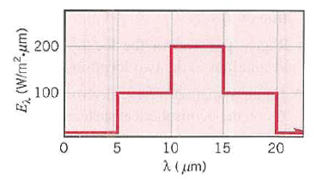
Chapter 10 : Thermal Radiation
Problem 12.10:
The spectral distribution of the radiation emitted by a diffuse surface may be approximated as follows.
What is the total emissive power ?
What is the total intensity of the radiation emitted in the normal direction and at an angle of 30° from the normal.

Slide 17
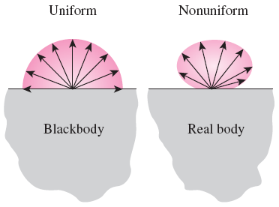

Chapter 10 : Thermal Radiation
Blackbody radiation
Different bodies may emit different amounts of radiation per unit surface area.
A blackbody emits the maximum amount of radiation by a surface at a given temperature.
It is an idealized body to serve as a standard against which the radiative properties of real surfaces may be compared.
A blackbody is a perfect emitter and absorber of radiation.
A blackbody absorbs all incident radiation, regardless of wavelength and direction.
The radiation energy emitted by a blackbody:
Emissive power of blackbody is known as:
Stefan–Boltzmann constant
A blackbody is said to be a diffuse emitter since it emits radiation energy uniformly in all directions

Slide 18
Chapter 10 : Thermal Radiation
Previous eq. gives the total emissive power from blackbody , which is the sum of the radiation emitted over all wavelengths. For a specific wavelength, we can calculate the spectral blackbody emissive power.
Spectral blackbody emissive power:
The amount of radiation energy emitted by a blackbody at a thermodynamic temperature T per unit time, per unit surface area, and per unit wavelength about the wavelength λ.
→ Eq. (12.24)
*Also known as “Planck’s law”

Slide 19
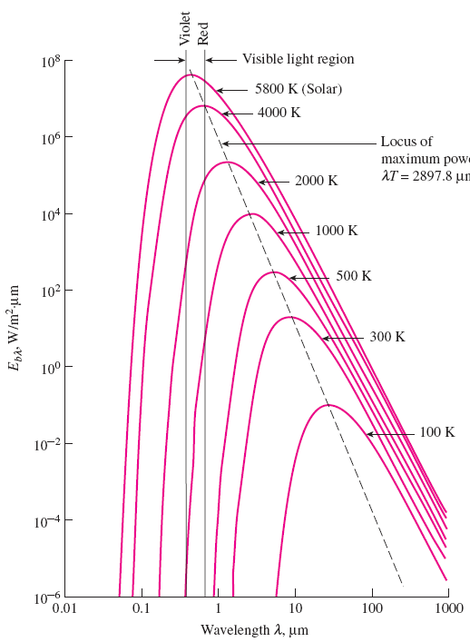
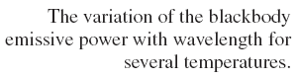
The wavelength at which the peak occurs for a specified temperature is given by Wien’s displacement law:
Figure 12.12

Slide 20
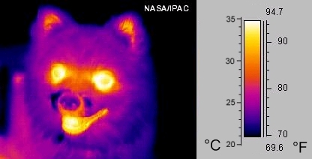
Chapter 10 : Thermal Radiation
An electrical heater starts radiating heat soon after is plugged, we can feel the heat but cannot be sensed by our eyes (within infrared region)
When temp reaches 1000K, heater starts emitting a detectable amount of visible red radiation (heater appears bright red)
When temp reaches 1500K, heater emits enough radiation and appear almost white to the eye (called white hot).
Although infrared radiation cannot be sensed directly by human eye, but it can be detected by infrared cameras.

Slide 21

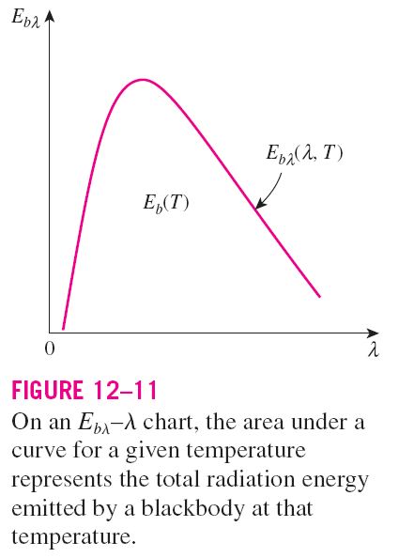
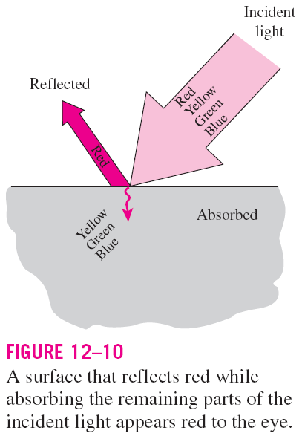
Chapter 10 : Thermal Radiation
The integration of the spectral blackbody emissive power over entire wavelength gives the total blackbody emissive power.
→ Eq. (12.26)

Slide 22
Chapter 10 : Thermal Radiation
Example: Radiation emission from blackbody
Consider a 20 cm diameter spherical ball at 800K suspended in air. Assuming the ball is closely approximates a blackbody, determine
The total blackbody emissive power
The total amount of radiation emitted by the ball in 5 min
The spectral blackbody emissive power at a wavelength of 3 μm.

Slide 23

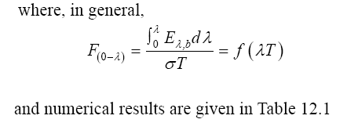
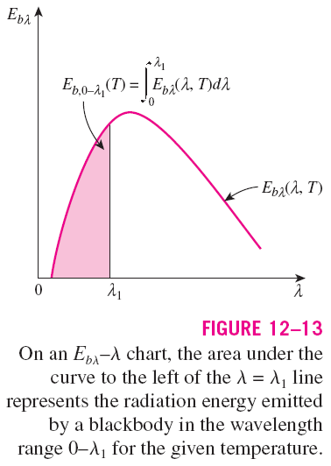
Chapter 10 : Thermal Radiation
The radiation energy emitted by a blackbody per unit area over a wavelength band from λ = 0 to λ is
→ Eq. (12.28)

Slide 24
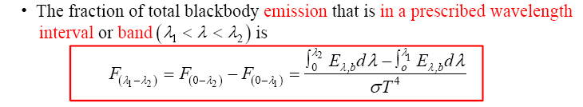
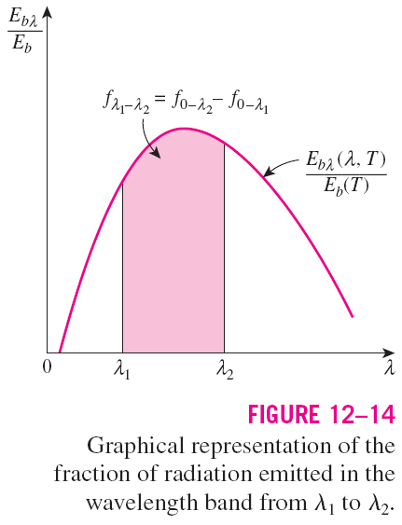
Chapter 10 : Thermal Radiation
→ Eq. (12.29)

Slide 25
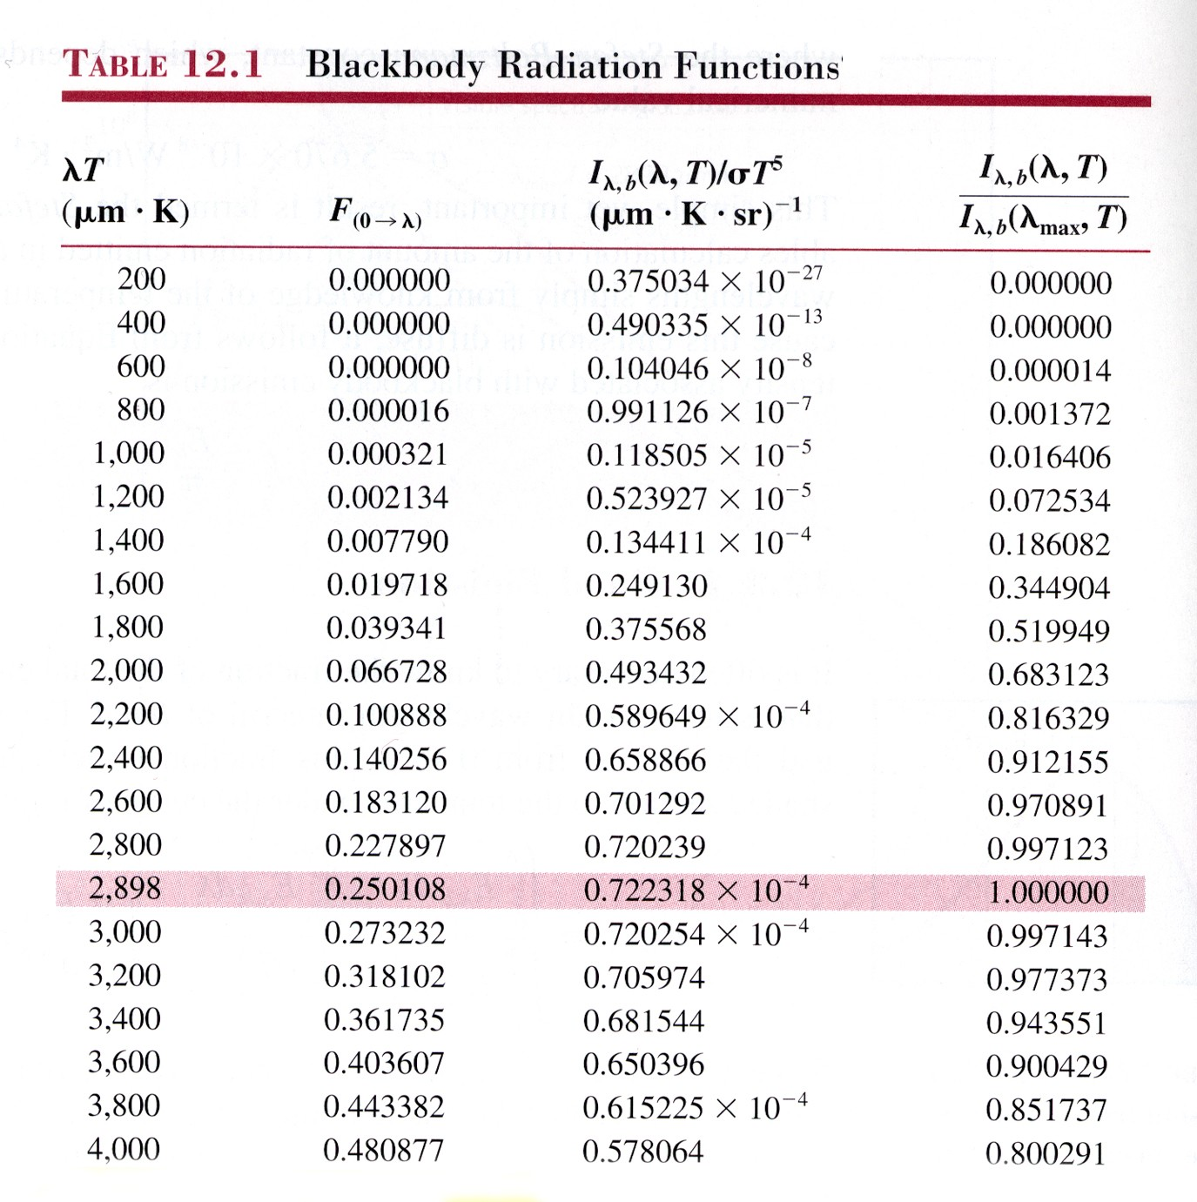
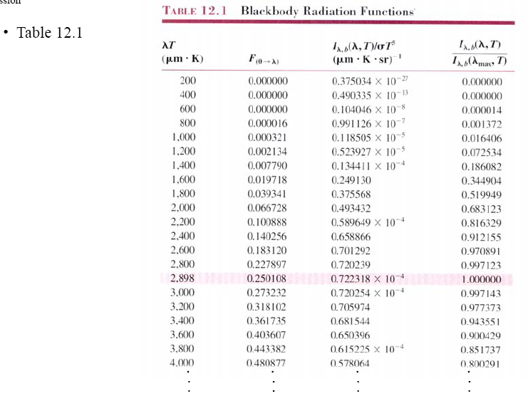
Chapter 10 : Thermal Radiation

Slide 26
Chapter 10 : Thermal Radiation
Example:
CCD (charged coupled device) image sensors, that are common in modern digital cameras, respond differently to light sources with different spectral distributions. Daylight and incandescent light maybe approximated as a blackbody at the effective surface temperature of 5800K and 2800K, respectively. Determine the fraction of radiation emitted within the visible spectrum wavelengths, from 0.40 μm (violet) to 0.76 μm (red), for each lighting sources.

Slide 27
Chapter 10 : Thermal Radiation
Emission from real surfaces: Radiative properties – emissivity, absorptivity,
reflectivity and transmissivity.
1. Emissivity, ε
The ratio of the radiation emitted by the surface at a given temperature to the radiation emitted by a blackbody at the same temperature. 0 ≤ ε ≤ 1.
Emissivity is a measure of how closely a surface approximates a blackbody (ε = 1).
The emissivity of a real surface varies with the temperature of the surface as well as the wavelength and the direction of the emitted radiation.
The emissivity of a surface at a specified wavelength is called spectral emissivity ε_{λ}. The emissivity in a specified direction is called directional emissivity ε_{θ} where θ is the angle between the direction of radiation and the normal of the surface.

Slide 28




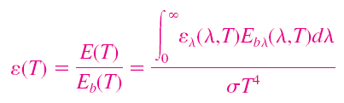
Chapter 10 : Thermal Radiation
Spectral directional emissivity
→ Eq. (12.30)
Total directional emissivity
→ Eq. (12.31)
Spectral hemispherical emissivity
→ Eq. (12.32)
Total hemispherical emissivity
→ Eq. (12.35)
This is the ratio of the total radiation energy emitted by the surface to the radiation emitted by a blackbody of the same surface area at the same temperature.
→ Eq. (12.36)

Slide 29
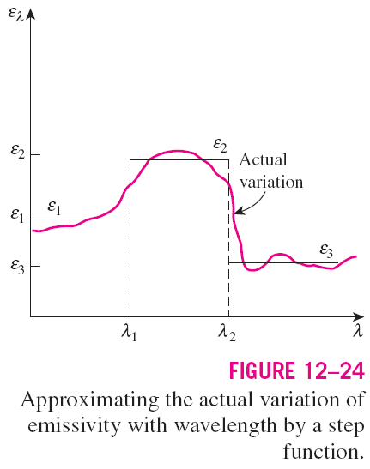
Chapter 10 : Thermal Radiation

Slide 30
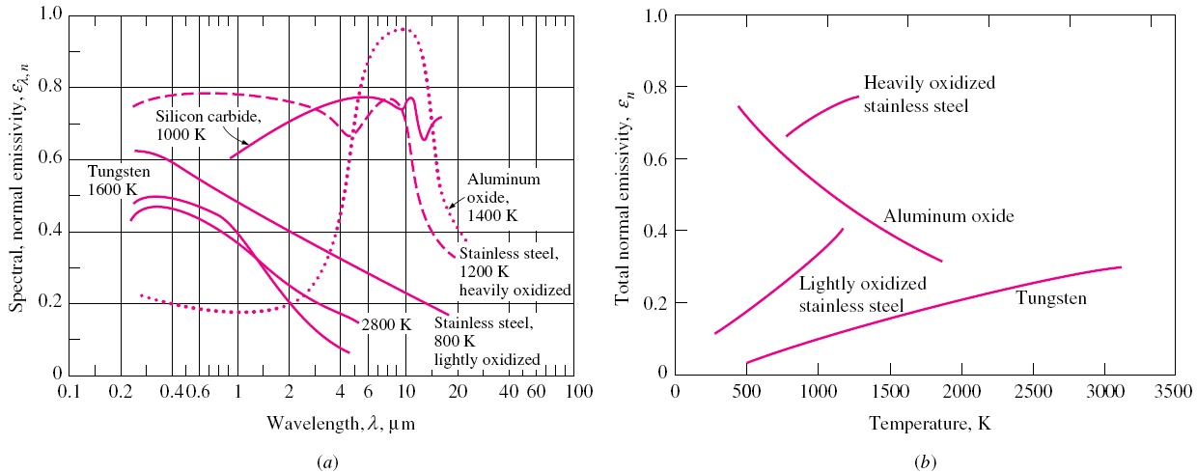
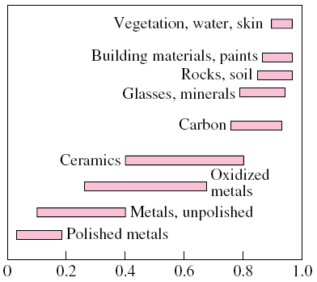
Chapter 9 : Thermal Radiation
Fig. 12.17
Fig. 12.18
The variation of normal emissivity with (a) wavelength and (b) temperature for various materials.
In radiation analysis, it is common practice to assume the surfaces to be diffuse emitters with an emissivity equal to the value in the normal (θ = 0) direction.
Typical ranges of emissivity for various materials.

Slide 31
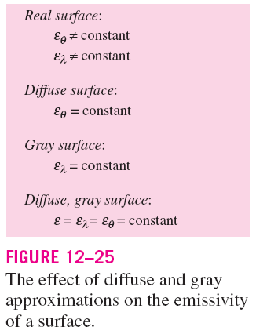
Chapter 10 : Thermal Radiation
A surface is said to be diffuse if its properties are independent of direction, and gray if its properties are independent of wavelength.
The gray and diffuse approximations are often utilized in radiation calculations.

Slide 32
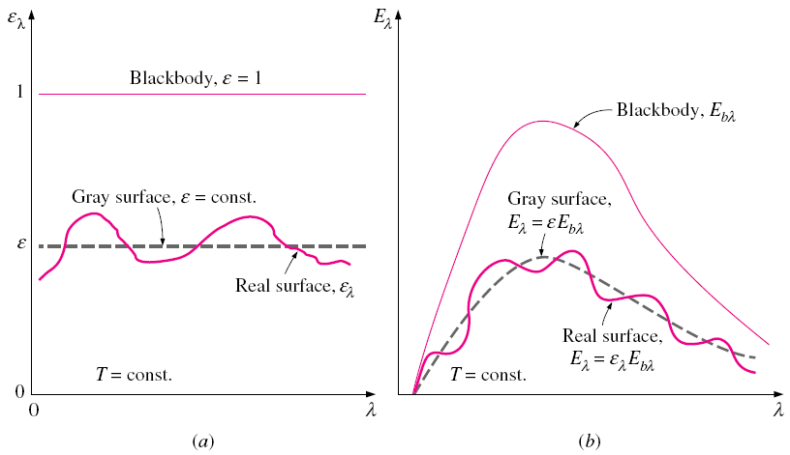
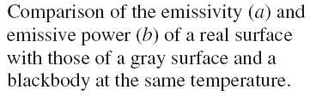
Chapter 9 : Thermal Radiation
*Gray surface = when its radiative properties is independent of wavelength

Slide 33
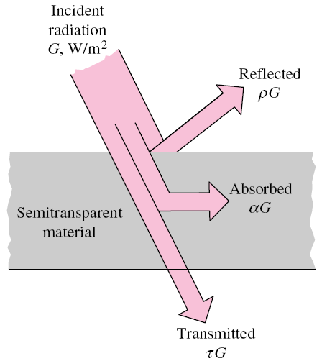


Chapter 10 : Thermal Radiation
2. Absorptivity, α
The fraction of irradiation absorbed by the surface. 0 ≤ α ≤ 1.
*Gray surface/body → α = ε
3. Reflectivity, ρ
The fraction reflected by the surface. 0 ≤ ρ ≤ 1.
4. Transmissivity, τ
The fraction transmitted by the surface. 0 ≤ τ ≤ 1.
*opaque surface = not transmitting light; not transparent
for opaque surfaces

Slide 34
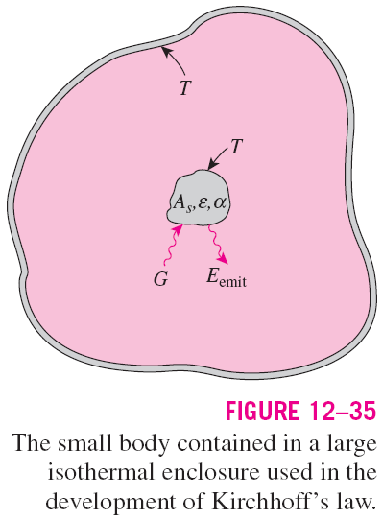



Chapter 10 : Thermal Radiation
Kirchhoff’s Law
The total hemispherical emissivity of a surface at temperature T is equal to its total hemispherical absorptivity for radiation coming from a blackbody at the same temperature.
Kirchhoff’s law
The emissivity of a surface at a specified wavelength, direction, and temperature is always equal to its absorptivity at the same wavelength, direction, and temperature.

Slide 35
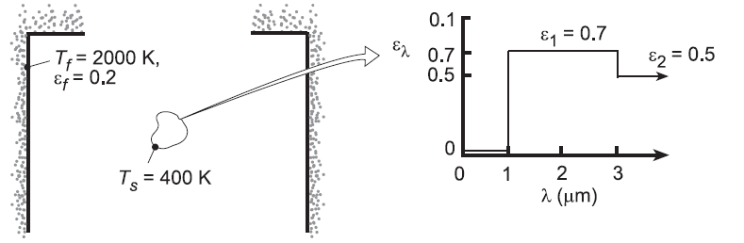
Chapter 10 : Thermal Radiation
Problem 12.44:
A small, opaque, diffuse object at T_{s} = 400K is suspended in a large furnace whose interior walls are at T_{f} = 2000K. The walls are diffuse and gray and have an emissivity of 0.20. The spectral, hemispherical emissivity for the surface of the small object is given below.
Determine the total emissivity and absorptivity of the surface.
Evaluate the reflected radiant flux and the net radiative flux to the surface
What is the spectral emissive power at λ = 2μm ?
What is the wavelength λ_{½} for which one-half of the total radiation emitted by the surface is in the spectral region λ ≥ λ_{½} ?

Slide 36
Chapter 10 : Thermal Radiation
Problem 12.66: Energy balances and radiative properties
Consider an opaque horizontal plate that is well insulated on its back side. The irradiation on the plate is 2500 W/m², of which 500 W/m² is reflected. The plate is at 227°C and has an emissive power of 1200 W/m². Air at 127°C flows over the plate with a heat transfer convection coefficient of 15 W/m²K.
Determine the emissivity, absorptivity and radiosity of the plate.
What is the net heat transfer rate per unit area

Slide 37
Summary of Terms
Irradiation, G
Spectral
Blackbody
Gray
Specular
Diffuse
Radiosity, J
Radiation Intensity, I
Opaque
Absorptivity
Emissivity
Reflectivity
Transmissivity

