Slide 1
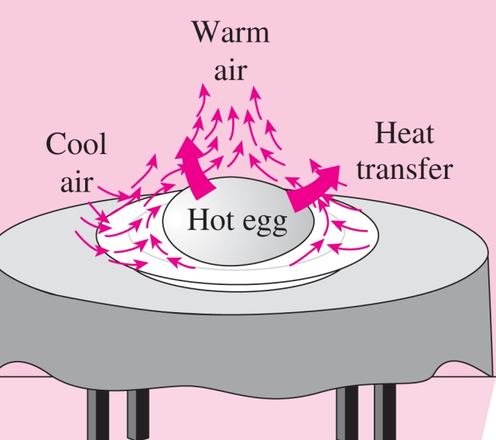
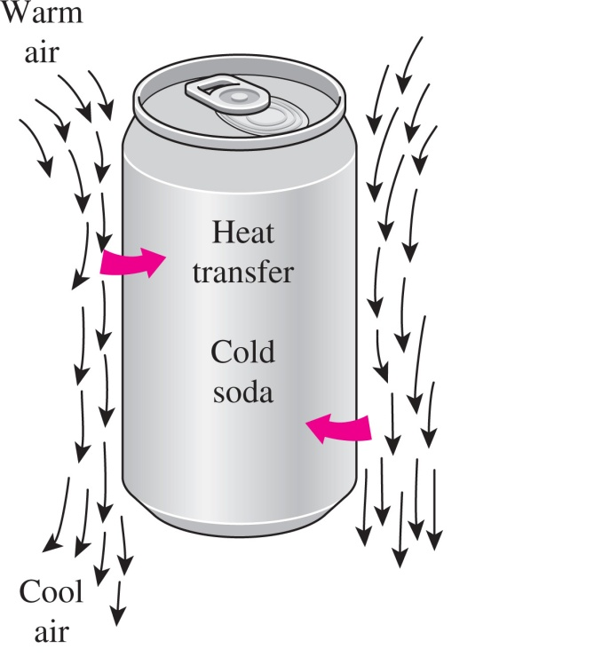
Chapter 8 : Natural Convection
Contents:
Physical consideration, governing equation
Analysis of vertical, horizontal & inclined plates
Analysis of cylinder, sphere & enclosures

Slide 2
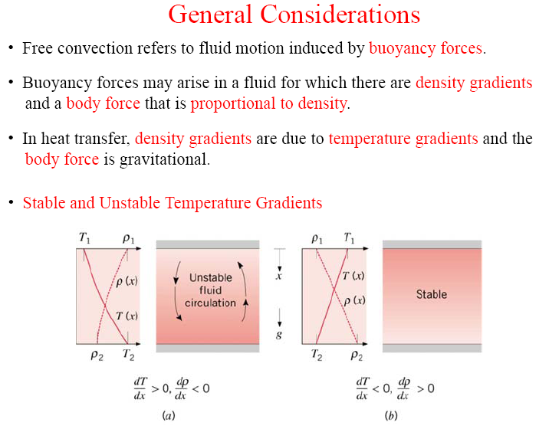
Chapter 8 : Natural Convection
What is buoyancy force ?
The upward force exerted by a fluid on a body completely or partially immersed in it in a gravitational field.
The magnitude of the buoyancy force is equal to the weight of the fluid displaced by the body.

Slide 3
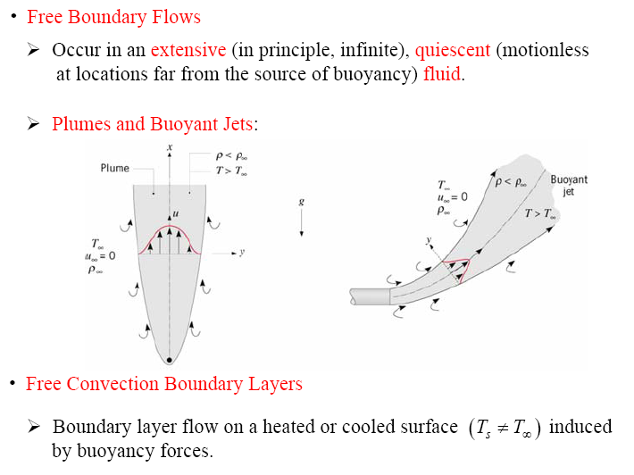
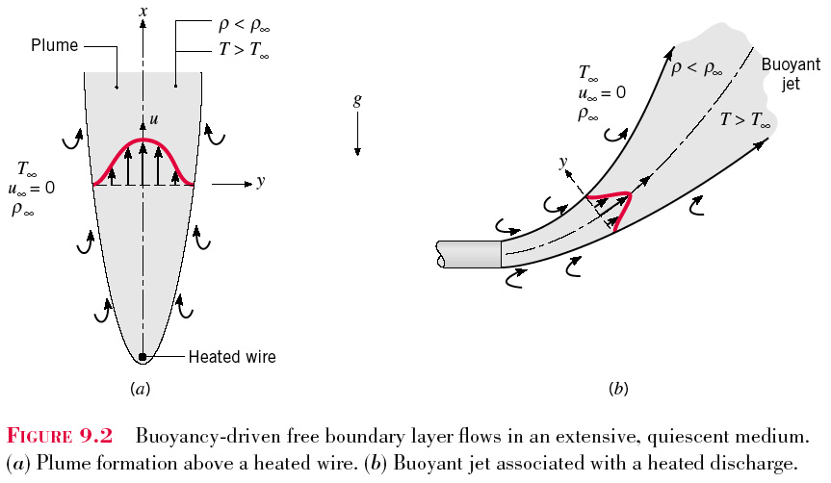
Chapter 8 : Natural Convection

Slide 4
Thermal expansion coefficient / Volume expansion coefficient: Variation of the density of a fluid with temperature at constant pressure.
Ideal gas
The larger the temperature difference between the fluid adjacent to a hot (or cold) surface and the fluid away from it, the larger the buoyancy force and the stronger the natural convection currents, and thus the higher the heat transfer rate.
The coefficient of volume expansion is a measure of the change in volume of a substance with temperature at constant pressure.

Slide 5
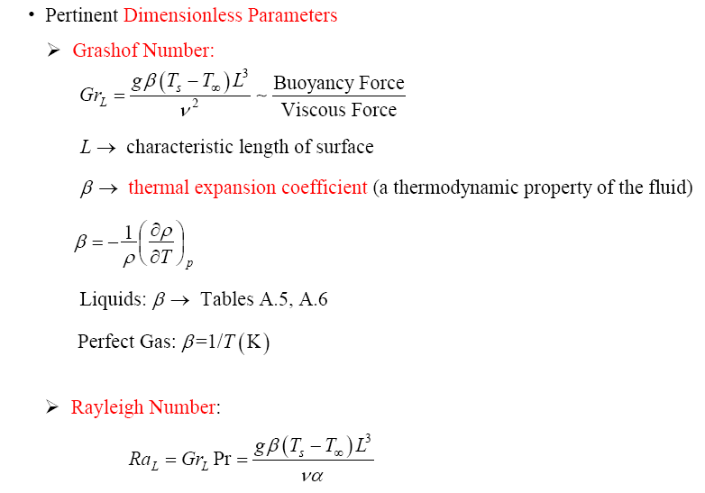
Chapter 8 : Natural Convection
- Ratio of buoyancy forces and thermal and momentum diffusivities.

Slide 6
Rayleigh Number, Ra=Gr.Pr
In fluid mechanics, the Rayleigh number for a fluid is a dimensionless number associated with buoyancy driven flow (also known as free convection or natural convection).
When the Rayleigh number is below the critical value for that fluid, heat transfer is primarily in the form of conduction; when it exceeds the critical value, heat transfer is primarily in the form of convection.
The Rayleigh number is defined as the product of the Grashof number, which describes the relationship between buoyancy and viscosity within a fluid, and the Prandtl number, which describes the relationship between momentum diffusivity and thermal diffusivity.
Hence the Rayleigh number itself may also be viewed as the ratio of buoyancy and viscosity forces times the ratio of momentum and thermal diffusivities.

Slide 7

Forced vs Natural Convection
When analyzing potentially mixed convection, a parameter called the Archimedes number(Ar) parametrizes the relative strength of free and forced convection.
The Archimedes number is the ratio of Grashof number and the square of Reynolds number, which represents the ratio of buoyancy force and inertia force, and which stands in for the contribution of natural convection.
When Ar >> 1, natural convection dominates and when Ar << 1, forced convection dominates.

Slide 8

Chapter 8 : Natural Convection
Natural convection over surfaces
1)
2)
3)
*C & n is depend on the geometry of the surface and flow regime.
n=1/4 → laminar flow
n-=1/3 → turbulent flow
1. What is the difference between Re_{L} and Ra_{L} ?
2. What is the transition range in a free convection boundary ?
${10}^{4}≤Ra≤{10}^{9}$ (Laminar)
${10}^{9}≤Ra≤{10}^{13}$ (Turbulent)
*All the properties are evaluated at the film temperature, T_{f}=(T_{s}+T∞)/2

Slide 9
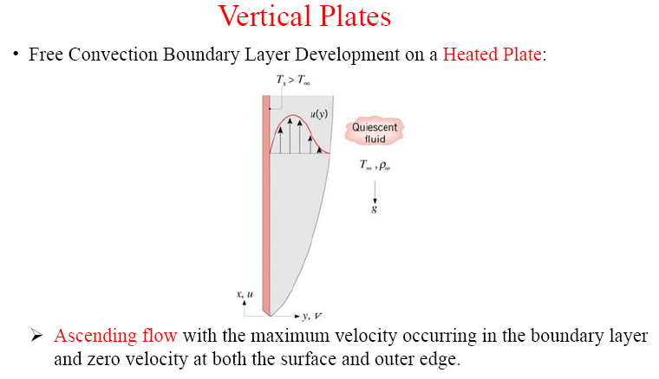
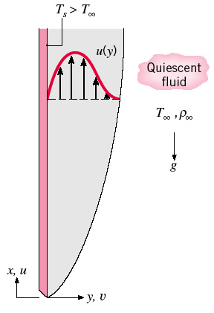
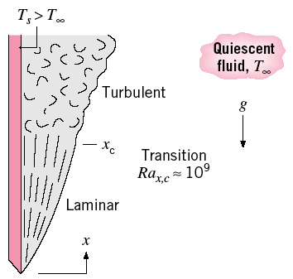
Chapter 8 : Natural Convection
Transition in a free convection layer depends on the relative magnitude of the buoyancy and viscous forces
*The smooth and parallel lines in (a) indicate that the flow is laminar, whereas the eddies and irregularities in (b) indicate that the flow is turbulent.

Slide 10

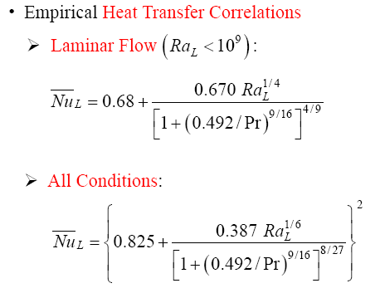
Chapter 8 : Natural Convection
General correlations for vertical plate
where,
→ Eq. (9.24)
Laminar | 10⁴ ≤ Ra_{L} ≤10⁹ | C = 0.59 | n = 1/4
Turbulent | 10⁹ ≤ Ra_{L} ≤10¹³ | C = 0.10 | n = 1/3
For wide range and more accurate solution, use correlation Churchill and Chu
→ Eq. (9.26)
→ Eq. (9.27)

Slide 11

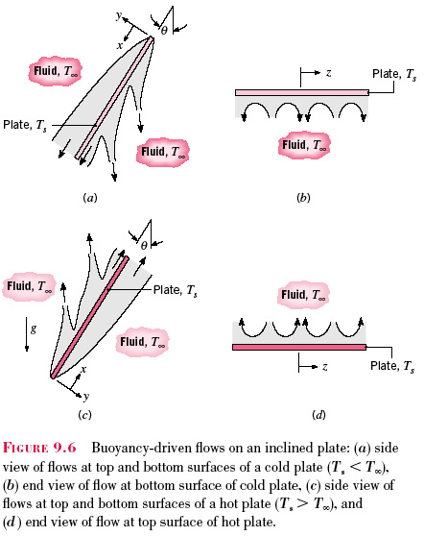
Chapter 8 : Natural Convection
For case of vertical cylinders, the previous Eqs. ( 9.24 to 9.27) are valid if the condition satisfied where
For case of inclined plates
In the case of a hot plate in a cooler environment, convection currents are weaker on the lower surface of the hot plate, and the rate of heat transfer is lower relative to the vertical plate case.
On the upper surface of a hot plate, the thickness of the boundary layer and thus the resistance to heat transfer decreases, and the rate of heat transfer increases relative to the vertical orientation.
In the case of a cold plate in a warmer environment, the opposite occurs.
Hot plate-cold env.
cold plate-hot env.

Slide 12
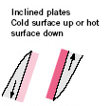
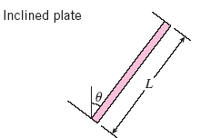
Chapter 8 : Natural Convection
at the top and bottom surfaces of cooled and heated inclined plates, respectively, it is recommended that
Use equation 9.26
but replace g → g cos θ
and only valid for 0 ≤ θ ≤ 60°

Slide 13
Chapter 8 : Natural Convection
Example:
Consider a 0.6m x 0.6m thin square plate in a room at 30°C. One side of the plate is maintained at a temperature of 90°C, while the other side is insulated. Determine the rate of heat transfer from the plate by natural convection if the plate is vertical.

Slide 14
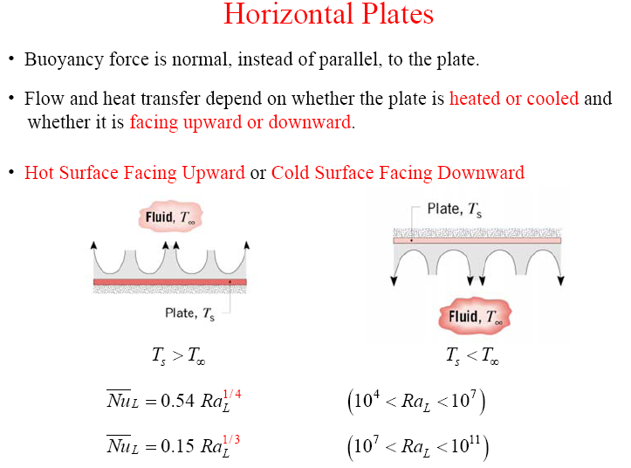
Chapter 8 : Natural Convection

Slide 15
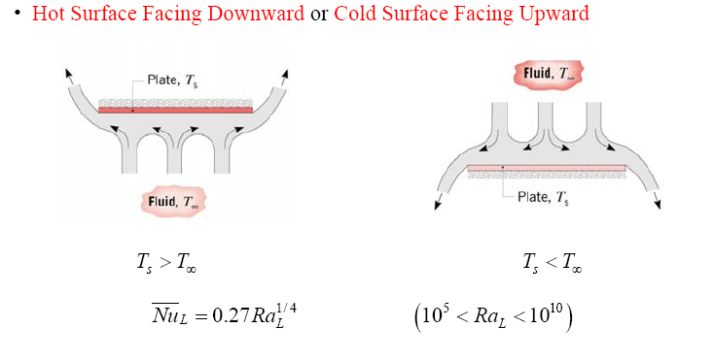
Chapter 8 : Natural Convection

Slide 16
Chapter 8 : Natural Convection
Example:
Consider a 0.6m x 0.6m thin square plate in a room at 30°C. One side of the plate is maintained at a temperature of 90°C, while the other side is insulated. Determine the rate of heat transfer from the plate by natural convection if the plate is
Vertical
Horizontal with hot surface facing up
Horizontal with hot surface facing down
Which position has the lowest heat transfer rate ? Why ?

Slide 17
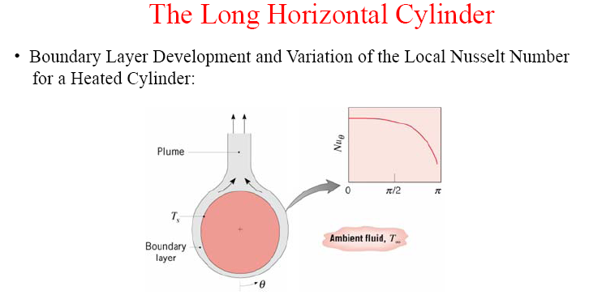
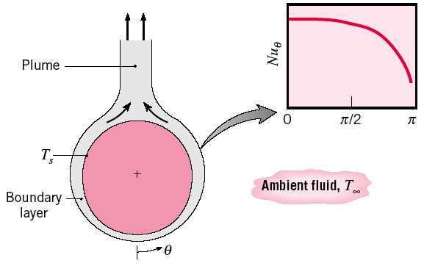
Chapter 8 : Natural Convection
The boundary layer over a hot horizontal cylinder starts to develop at the bottom, increasing in thickness along the circumference, and forming a rising plume at the top.
Therefore, the local Nusselt number is highest at the bottom, and lowest at the top of the cylinder when the boundary layer flow remains laminar.
The opposite is true in the case of a cold horizontal cylinder in a warmer medium, and the boundary layer in this case starts to develop at the top of the cylinder and ending with a descending plume at the bottom.

Slide 18

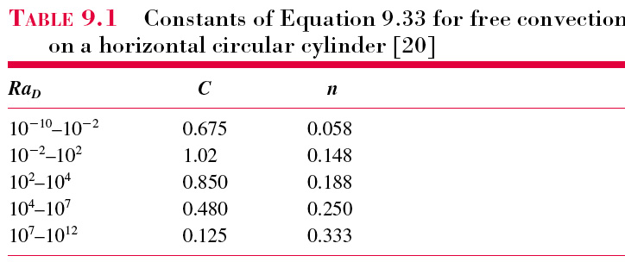

Chapter 8 : Natural Convection
General correlations for an isothermal cylinder
where,
→ Eq. (9.33)
For wide range of Ra, use correlation Churchill and Chu
→ Eq. (9.34)

Slide 19

Chapter 8 : Natural Convection
Spheres
In case of isothermal sphere, general correlations is proposed by Churchill
→ Eq. (9.35)
* Recommended when Pr ≥ 0.7 and Ra_{D} ≤ 10¹¹
In the limit as Ra_{D} → 0, Equation 9.35 reduces to Nu_{D} = 2, which corresponds to heat transfer by conduction between a spherical surface and a stationary infinite medium, as in Eqs. (7.48 & 7.49) – external convection for spherical object.

Slide 20

Chapter 8 : Natural Convection
Problem 9.54:
A horizontal uninsulated steam pipe passes through a large room whose walls and ambient air are at 300K. The pipe of 150 mm diameter has an emissivity of 0.85 and an outer surface temperature of 400K. Calculate the heat loss per unit length from the pipe.
Schematic
Assumptions
Fluid properties
Analysis of total heat loss per unit length, q/L or q’
- Calculate Ra_{D}
- Calculate Nu_{D}
- Calculate h_{D}
- finally, calculate total heat loss, q’
*If use Eq. 9.33, h_{D} = 6.15 W/m²K
*If use Eq. 9.34, h_{D} = 6.38 W/m²K
Within 4%

Slide 21
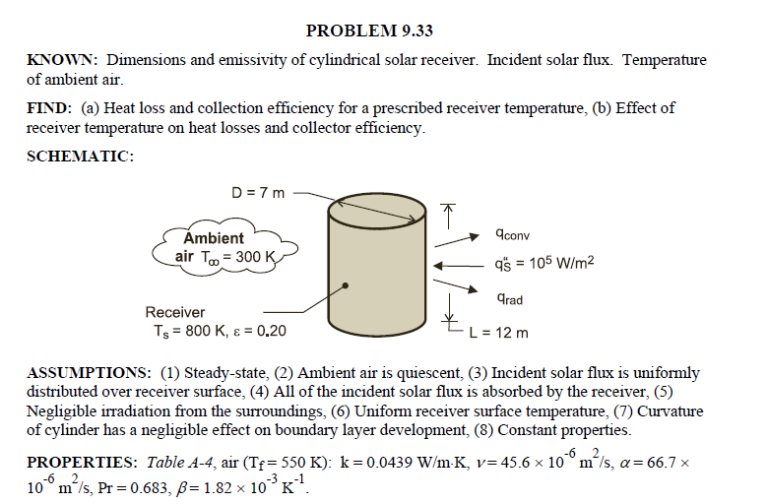

Slide 22
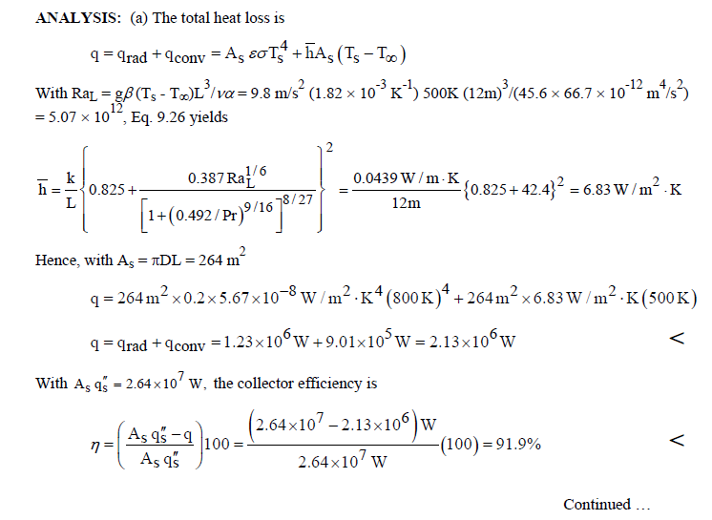

Slide 23
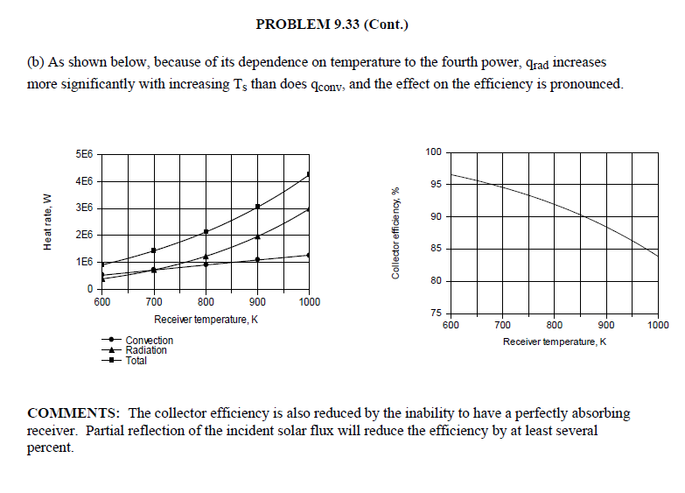

Slide 24
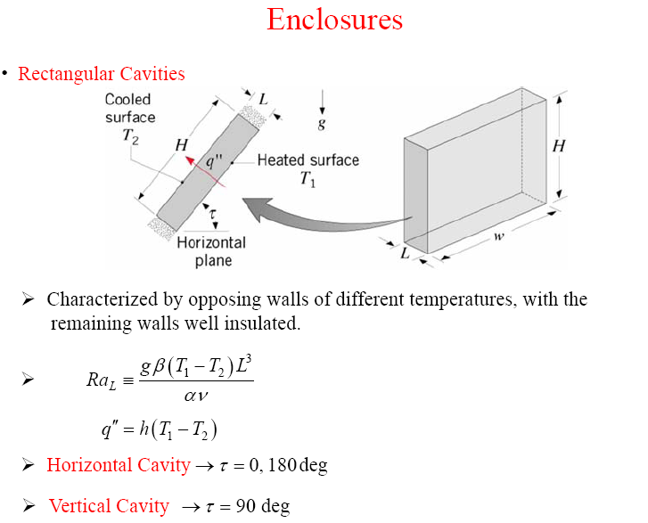
Chapter 8 : Natural Convection
Enclosures are frequently encountered in practice, and heat transfer through them is of practical interest.
Characteristic length Lc: the distance between the hot and cold surfaces.
T₁ and T₂: the temperatures of the hot and cold surfaces.
Fluid properties at

Slide 25
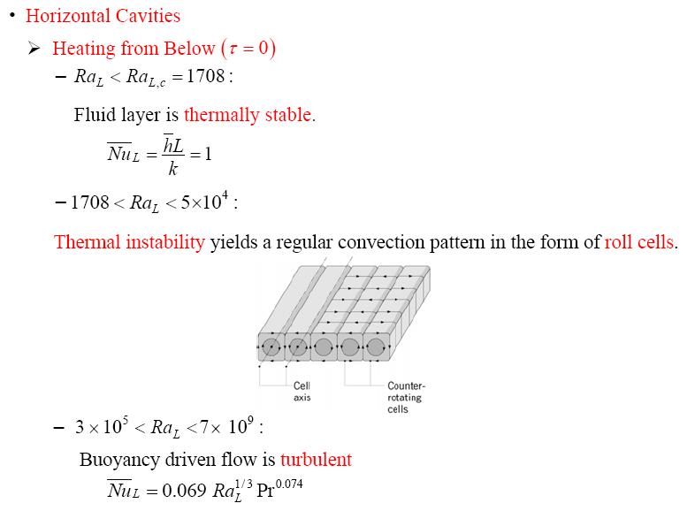
Chapter 8 : Natural Convection
- Flow is characterised by Ra_{D} value

Slide 26
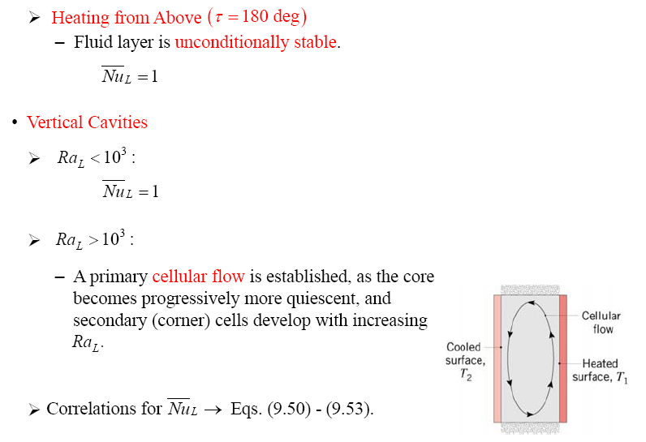
Chapter 8 : Natural Convection
Nu = 1

Slide 27
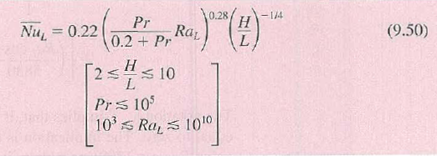
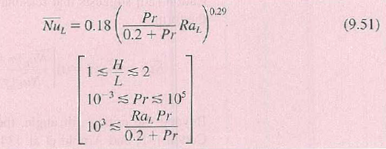
Chapter 8 : Natural Convection
Selection will be determined by the value of Ra_{L}, Pr and aspect ratio H/L:

Slide 28
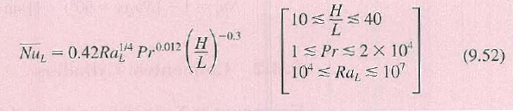
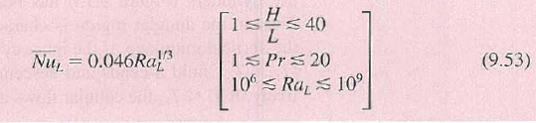
Chapter 8 : Natural Convection
For larger aspect ratios, the following correlations have been proposed:

Slide 29
Chapter 8 : Natural Convection
Example:
The vertical 0.8m high, 2m wide double pane window consists of two sheet of glass separated by a 2 cm air gap at atmospheric pressure. If the glass surface temperatures across the air gap are measured to be 12°C and 2°C, determine the rate of heat transfer through the window.
Schematic
Assumptions
Fluid properties at Tavg
Analysis of heat transfer
- Calculate Ra_{D}
- Calculate Nu_{D}
- Calculate h
- finally, calculate heat transfer

Slide 30
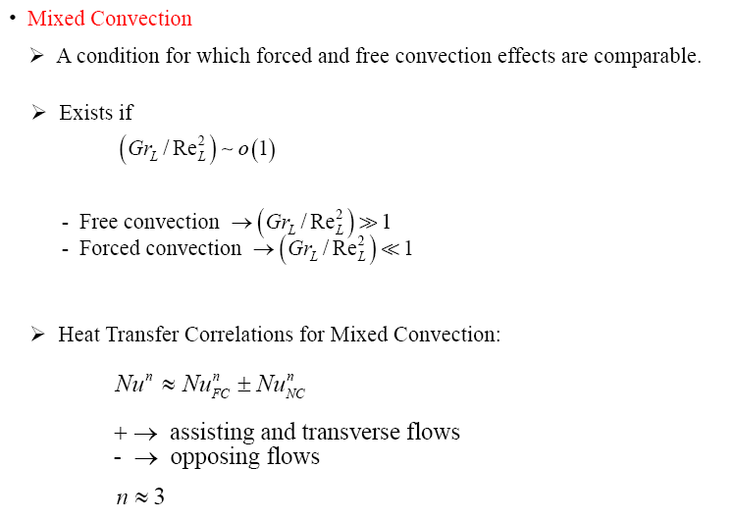
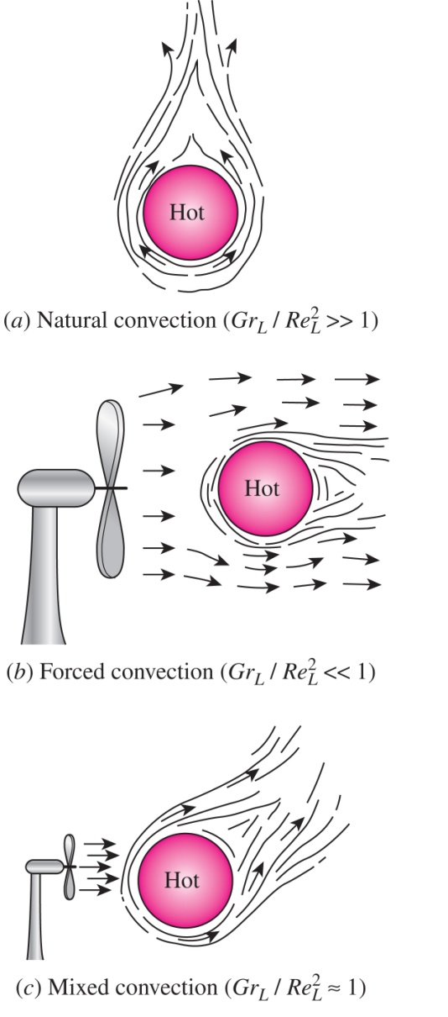
Chapter 8 : Natural Convection
FC – forced convection
NC – natural convection

