Slide 1
Chapter 8 : Convection – Internal Flow
Aim :
develop an appreciation for the physical phenomena associated with internal flow and to obtain convection coefficients
Contents:
Entrance region vs fully developed region
Hydrodynamic effect consideration
Thermal effect consideration
Determine temperature variation inside the flow by energy balance
Estimating the convection coefficient using correlation

Slide 2
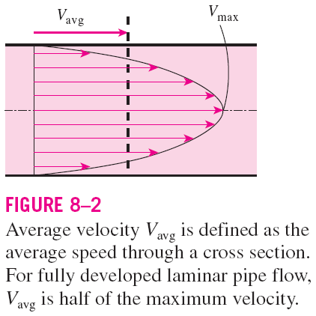
INTRODUCTION
Liquid or gas flow through pipes or ducts is commonly used in heating and cooling applications and fluid distribution networks.
The fluid in such applications is usually forced to flow by a fan or pump through a flow section.
The fluid velocity in a pipe changes from zero at the wall because of the no-slip condition to a maximum at the pipe center.
In fluid flow, it is convenient to work with an average velocity V_{avg}, which remains constant in incompressible flow when the cross-sectional area of the pipe is constant.
2

Slide 3
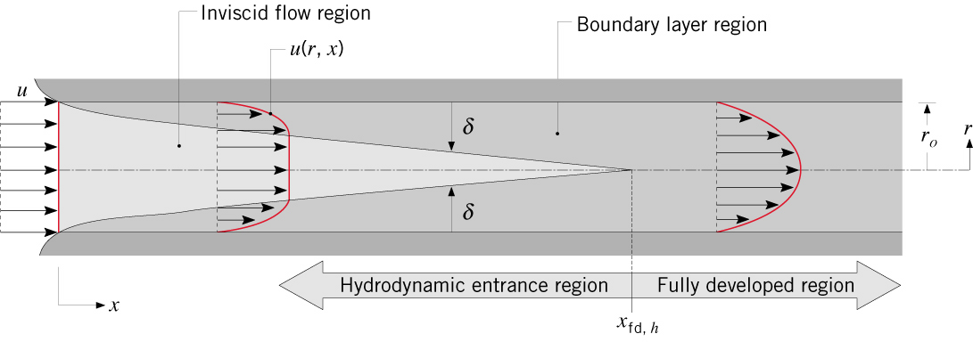
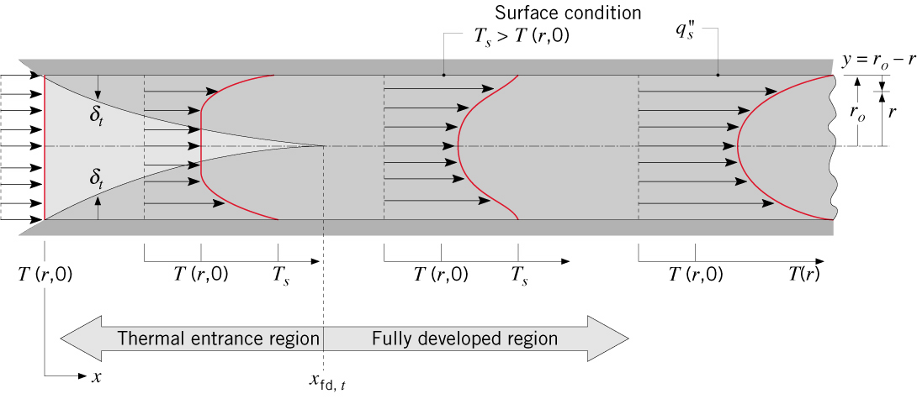
Chapter 8 : Convection – Internal Flow
Flow Conditions/profile : Entrance region vs. fully developed region
Must distinguish between entrance region and fully developed region.
In entrance region, the effect can be due to:
1. Hydrodynamic (velocity variation)
2. Thermal (temperature variation)
Hydrodynamic entrance region vs. Fully developed region
1
Thermal entrance region vs. Fully developed region
2

Slide 4
Entrance Conditions
Entrance Conditions
Hydrodynamic Effects:
Consider laminar flow with uniform velocity profile at inlet of a circular tube.
Velocity boundary layer develops on surface of tube and thickens with increasing x.
Inviscid region of uniform velocity shrinks as boundary layer grows.
Subsequent to boundary layer merger at the centerline, the velocity profile
becomes parabolic and invariant with x. The flow is then said to be hydrodynamically fully developed.
How would the fully developed velocity profile differ for turbulent flow?
-For turbulent flow, the profile is flatter due to turbulent mixing in radial direction

Slide 5
Entrance Conditions
Entrance Conditions
Thermal Effects:
- Assume laminar flow with uniform temperature, T(r,0) = T_{i}, at inlet of circular tube with uniform surface temperature or heat flux.
Thermal boundary layer develops on surface of tube and thickens with increasing x.
Isothermal core shrinks as boundary layer grows.
Subsequent to boundary layer merger, dimensionless forms of the temperature
profile (for T_{s} and q″_{s}) become independent of x. Conditions are then said to be thermally fully developed

Slide 6
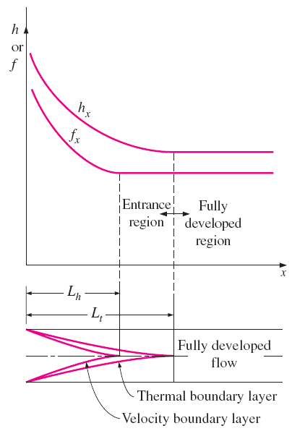
→ Why it is necessary to identify entrance region and fully developed region ?
Variation of the friction factor and the convection heat transfer coefficient in the flow direction for flow in a tube (Pr > 1).
Hydrodynamically fully developed:
Thermally fully developed:
Surface heat flux:
*Fully developed flow: The region in which the flow is both hydrodynamically and thermally developed.

Slide 7
In the thermally fully developed region of a tube, the local convection coefficient is constant (does not vary with x).
Therefore, both the friction (which is related to wall shear stress) and convection coefficients remain constant in the fully developed region of a tube.
The pressure drop and heat flux are higher in the entrance regions of a tube, and the effect of the entrance region is always to increase the average friction factor and heat transfer coefficient for the entire tube.
Variation of the friction factor and the convection heat transfer coefficient in the flow direction for flow in a tube (Pr > 1).
→ Next step : How to calculate the length of entrance region & fully developed region ?

Slide 8
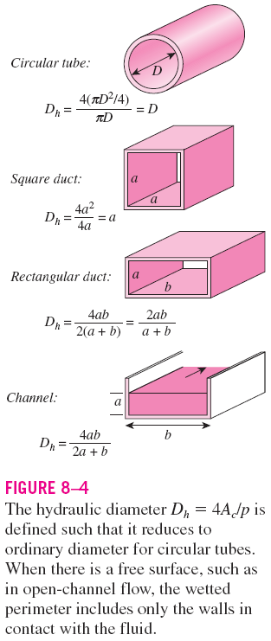


Chapter 8 : Convection – Internal Flow
Hydrodynamic Entry Length & Thermal Entry Length
Entry Length depend on whether the flows is laminar or turbulent, which in turn, depend on Reynolds number.
For a circular tube,
For flow through noncircular tubes, the Reynolds number as well as the Nusselt number, and the friction factor are based on the hydraulic diameter, D_{h}
The fluid properties in internal flow are usually evaluated at the bulk mean fluid temperature, which is the arithmetic average of the mean temperatures at the inlet and the exit: T_{b} = (T_{m, i} + T_{m, e})/2.

Slide 9




Chapter 8 : Convection – Internal Flow
For internal flow, onset of turbulence occurs at a critical Reynolds number of
Fully turbulent conditions exist for
Hydrodynamic entry length, x_{fd,h} : The length of the hydrodynamic entrance region.
Thermal entry length, x_{fd,t} : The length of the thermal entrance region.
Re_{D,c} ≈ 2300
Re_{D,c} ≈ 10,000
Laminar flow
Turbulent flow

Slide 10
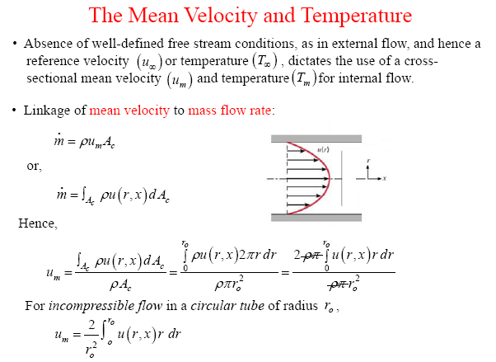
Chapter 7 : Convection – Internal Flow

Slide 11
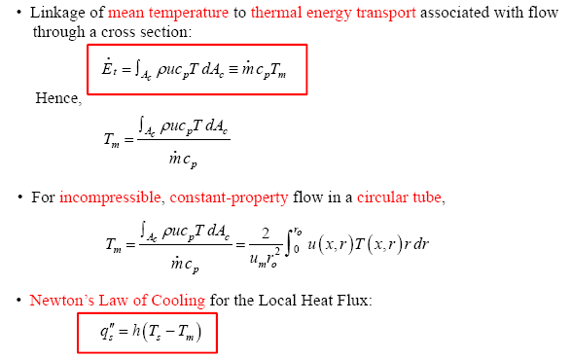
Chapter 7 : Convection – Internal Flow
In fluid flow, it is convenient to work with an average or mean temperature T_{m}, which remains constant at a cross section. The mean temperature T_{m} changes in the flow direction whenever the fluid is heated or cooled.

Slide 12
Chapter 7 : Convection – Internal Flow
Problem 8.6a:
Consider pressurised water, engine oil (unused) and NaK _(22-78%) flowing in a 20 mm diameter tube. Determine the mean velocity, the hydrodynamic entry length and the thermal entry length for each of the fluids when the fluid temperature is 366K and the flow rate is 0.01 kg/s

Slide 13
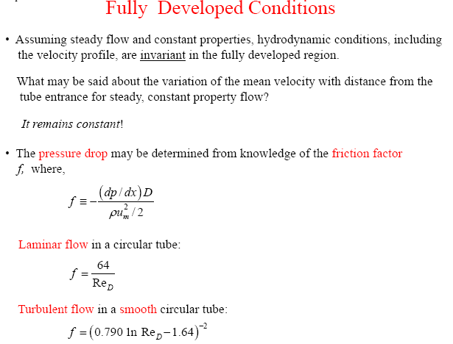
Chapter 7 : Convection – Internal Flow

Slide 14
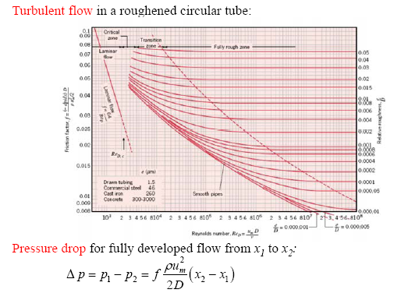


Chapter 7 : Convection – Internal Flow
and power requirement (to overcome the flow resistance associated with this pressure drop):

Slide 15
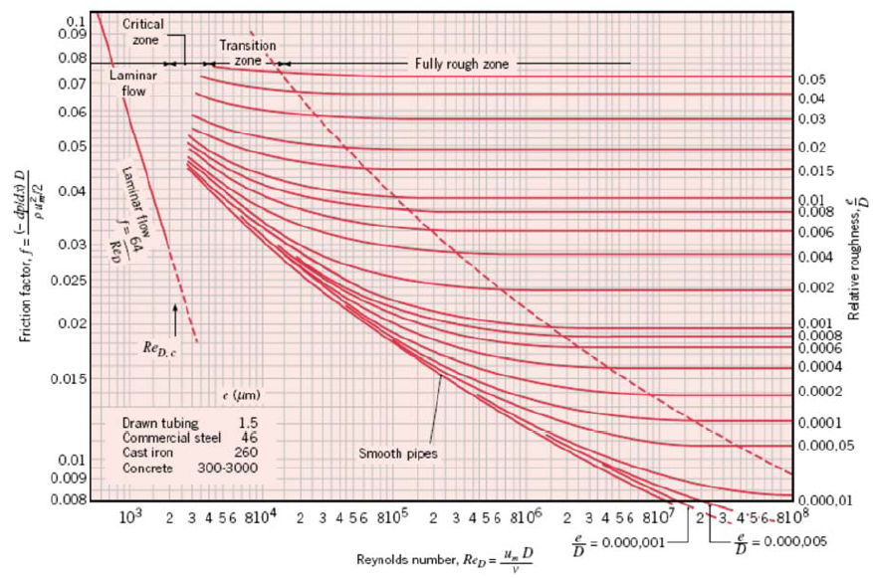

Slide 16
Chapter 7 : Convection – Internal Flow
Problem 8.3:
Water at 27°C flows with a mean velocity of 1 m/s through a 1 km pipe of 0.25 m inside diameter. Determine the pressure drop over the pipe length and the corrsponding pump power requirement if
the pipe is smooth
The pipe is made of cast iron

Slide 17
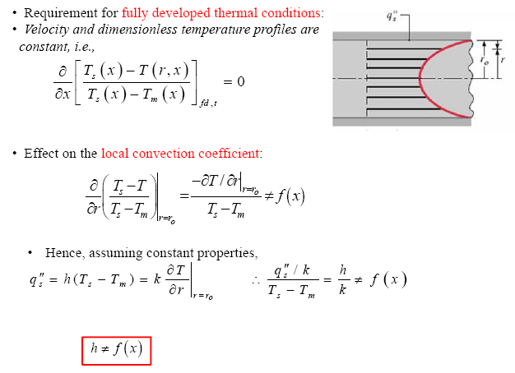
Chapter 7 : Convection – Internal Flow
*This mean, in thermally fully developed flow (for constant properties) the local convection coefficient is a constant, independent of x.

Slide 18
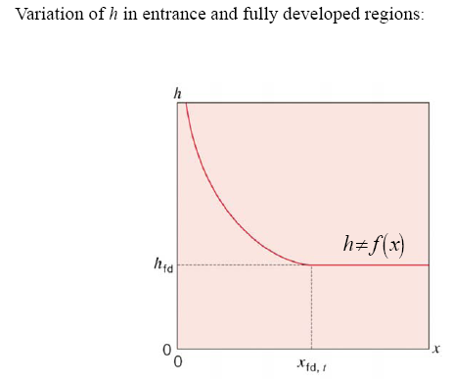
Chapter 7 : Convection – Internal Flow
Entrance region
Fully developed

Slide 19

GENERAL THERMAL ANALYSIS
Rate of heat transfer
The thermal conditions at the surface can be approximated to be
constant surface temperature
(T_{s}= const) or
constant surface heat flux (q_{s} = const).
The constant surface temperature condition is realized when a phase change process such as boiling or condensation occurs at the outer surface of a tube.
The constant surface heat flux condition is realized when the tube is subjected to radiation or electric resistance heating uniformly from all directions.
We may have either T_{s} = constant or q_{s} = constant at the surface of a tube, but not both.
Surface heat flux
h_{x} is the local heat transfer coefficient.
The heat transfer to a fluid flowing in a tube is equal to the increase in the energy of the fluid.

Slide 20
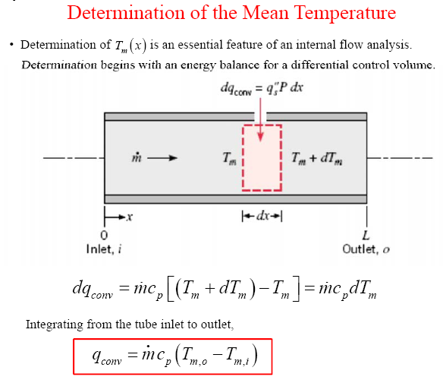
Chapter 7 : Convection – Internal Flow – Energy Balance
P = surface perimeter
= πD for a circular tube

Slide 21
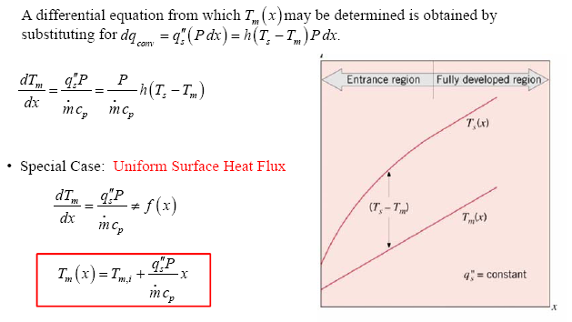

Chapter 7 : Convection – Internal Flow – Energy Balance
→ Eq. (8.40)
→ Eq. (8.38)

Slide 22
Chapter 7 : Convection – Internal Flow – Energy Balance
Problem 8.16a:
Atmospheric air enters the heated section of a circular tube at a flow rate of 0.005 kg/s and a temperature of 20°C. The tube diameter is 50 mm and fully developed conditions with h = 25 W/m²K exist over the entire length of 3 m. For the case of uniform surface heat flux at q”_{s}= 1000 W/m², determine the total heat transfer rate and the mean temperature of the air leaving the tube, T_{m,o}. What is the value of the surface temperature at the tube inlet T_{s,i} and outlet, T_{s,o} ?

Slide 23
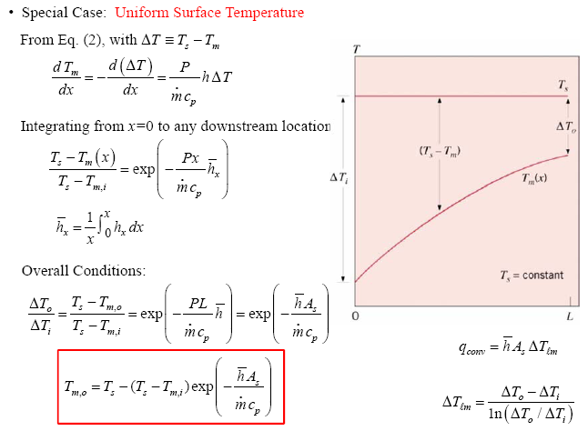
Chapter 7 : Convection – Internal Flow – Energy Balance
→ Eq. (8.41b)
Log mean temp. difference

Slide 24
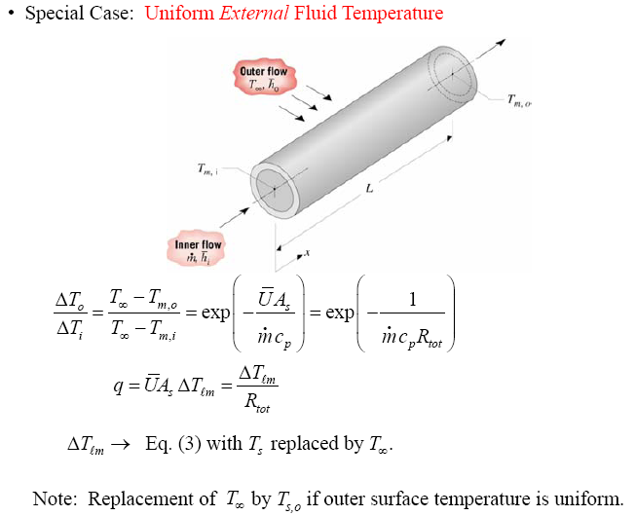


Chapter 7 : Convection – Internal Flow – Energy Balance
Ū is the average overall heat transfer (defined in Section 3.3.1)
→ Eqs. (8.45a) & (8.45b)

Slide 25
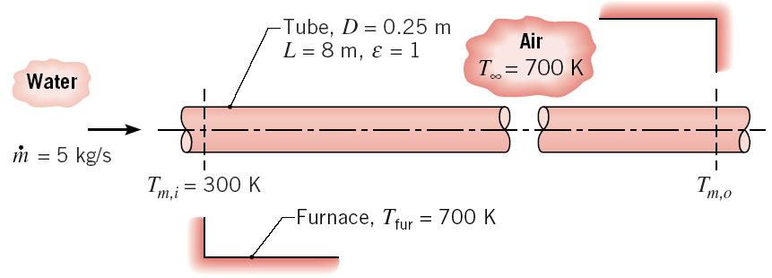
Chapter 7 : Convection – Internal Flow – Energy Balance
Problem 8.17b:
Water at 300K and a flow rate of 5 kg/s enters a black thin-walled tube, which passes through a large furnace whose walls and air are at a temperature of 700K. The diameter and length of the tube are 0.25 m and 8 m. Convection coefficient associated with water flow through the tube and air flow over the tube are 300 W/m²K and 50 W/m²K respectively. Determine the outlet temperature of the water.

Slide 26
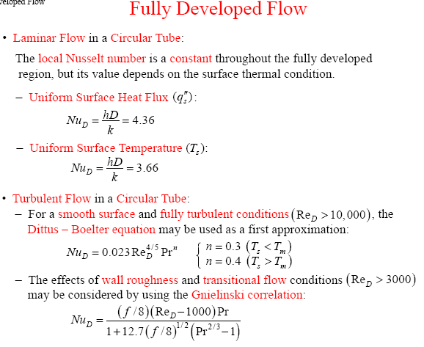
Chapter 7 : Convection – Internal Flow
→ Eq. (8.53)
→ Eq. (8.55)
→ Eq. (8.60) →
Validity:
0.7 ≤ Pr ≤ 160
Re_{D} ≥ 10,000
L/D ≥ 10
→ Eq. (8.62) →
Validity:
0.5 ≤ Pr ≤ 2000
3000 ≤ Re_{D} ≤ 5x10⁶

Slide 27
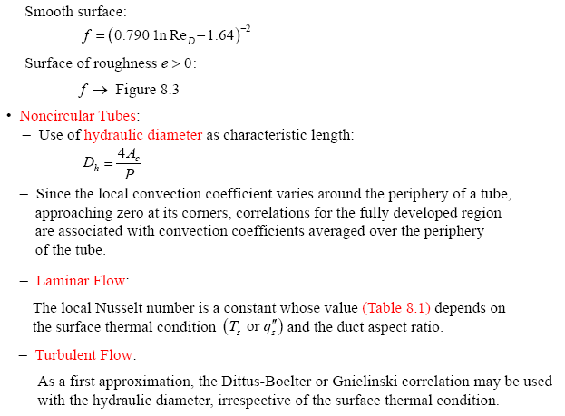
Chapter 7 : Convection – Internal Flow

Slide 28
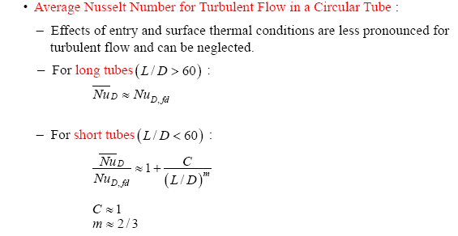
Other equations (Turbulent flow-fully developed)
When the variation in properties is large due to a large temperature difference:
→ Eq. (8.61)
All properties are evaluated at T_{b} except μ_{s}, which is evaluated at T_{s}.
→ Eq. (8.60), (8.61) or (8.62)

Slide 29
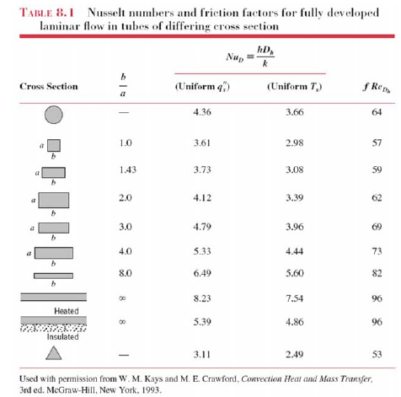
Chapter 7 : Convection – Internal Flow

Slide 30
Chapter 7 : Convection – Internal Flow
Problem 8.37a:
Atmospheric air enters a 10m long, 150 mm diameter uninsulated heating duct at 60°C and 0.04 kg/s. The duct surface temperature is approximately constant at 15 °C. What are the outlet air temperature, the heat rate and pressure drop for these conditions ?

Slide 31
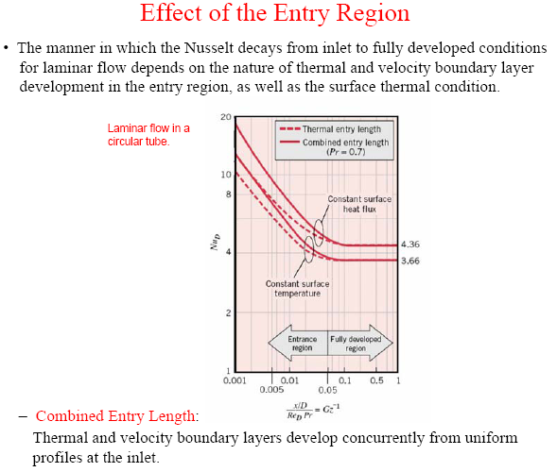
Chapter 7 : Convection – Internal Flow

Slide 32
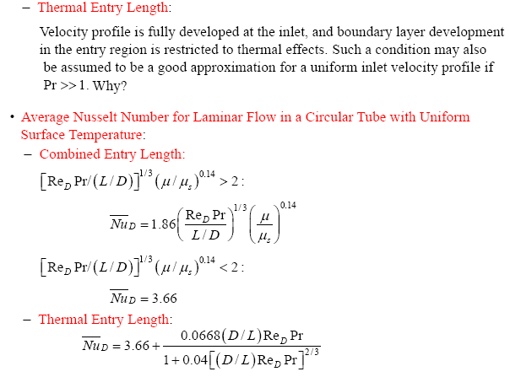
Chapter 7 : Convection – Internal Flow
→ Eq. (8.56)
Applicable to all situations where the velocity profile is already fully developed
Pr ≥ 5
→ Eq. (8.57)

Slide 33
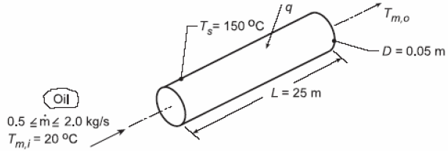
Chapter 7 : Convection – Internal Flow
Problem 8.22a:
Engine oil is heated by flowing through a circular tube of diameter 50mm and length 25m. The tube surface is maintained at 150°C. If the flow rate and inlet temperature of the oil are 0.5 kg/s and 20 °C, what is the outlet temperature ? What is the total heat transfer rate for the tube ?

