Slide 1
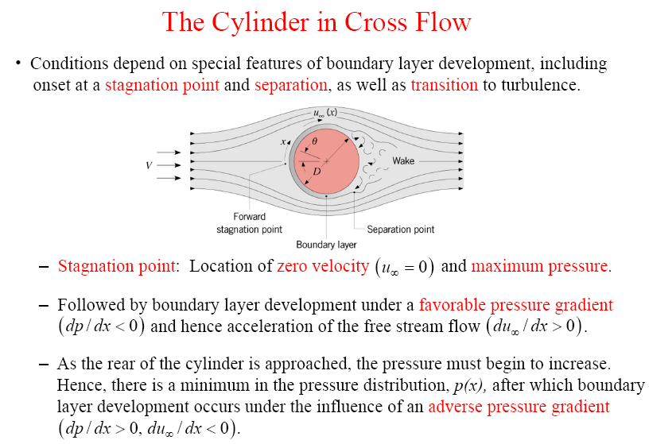
Chapter 7 : Convection – External Flow : Cylinder in cross flow
V – upstream velocity (approaching velocity)
u∞ - free stream velocity (relative velocity compare to the body)

Slide 2
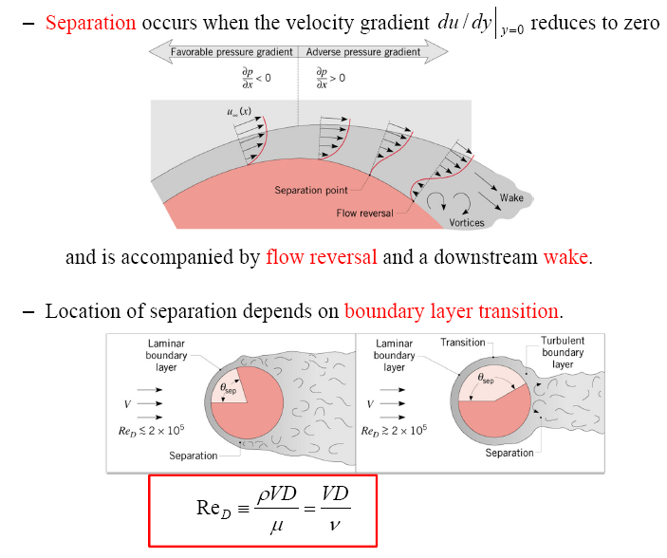
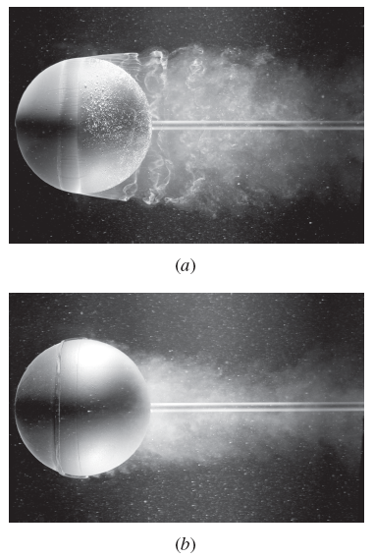
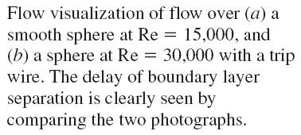
Chapter 7 : Convection – External Flow : Cylinder in cross flow
Re = 15,000
Re = 30,000
Re_{cr} ≅ 2 x 10⁵

Slide 3
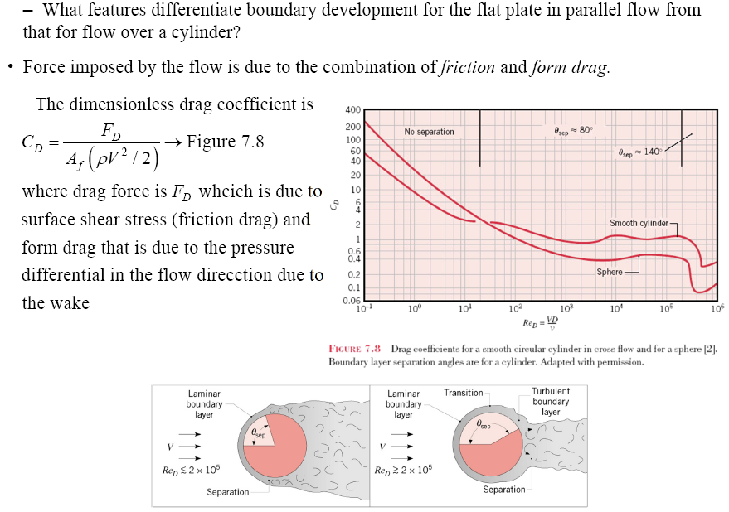
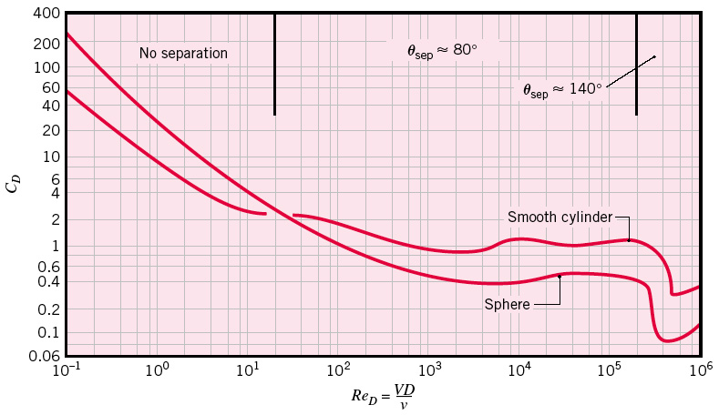
Chapter 7 : Convection – External Flow : Cylinder in cross flow
*A_{f} = frontal area
= projection area when looking from upstream
Why does the C_{D} suddenly drop when the flow becomes turbulent ?
Notes:
Why Cd drop at turbulent flow: turbulence moves the fluid separation point further back on the rear of the body, reducing the size of the wake and thus the magnitude of the pressure drag.

Slide 4
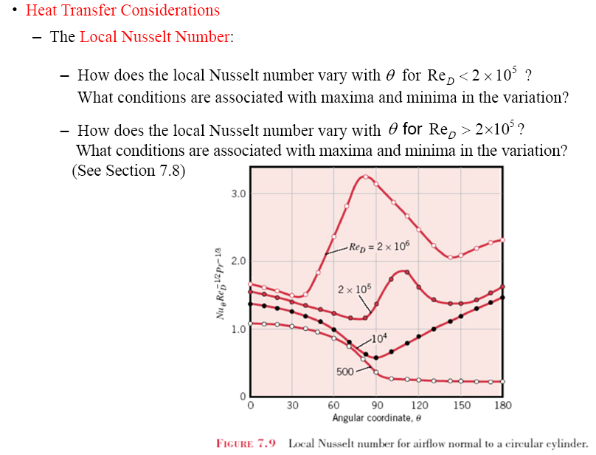
Chapter 7 : Convection – External Flow : Cylinder in cross flow
See Section 7.4.2
Flows across cylinders and spheres, in general, involve flow separation, which is difficult to handle analytically.
Flow across cylinders and spheres has been studied and several empirical correlations have been developed for the heat transfer coefficient.

Slide 5
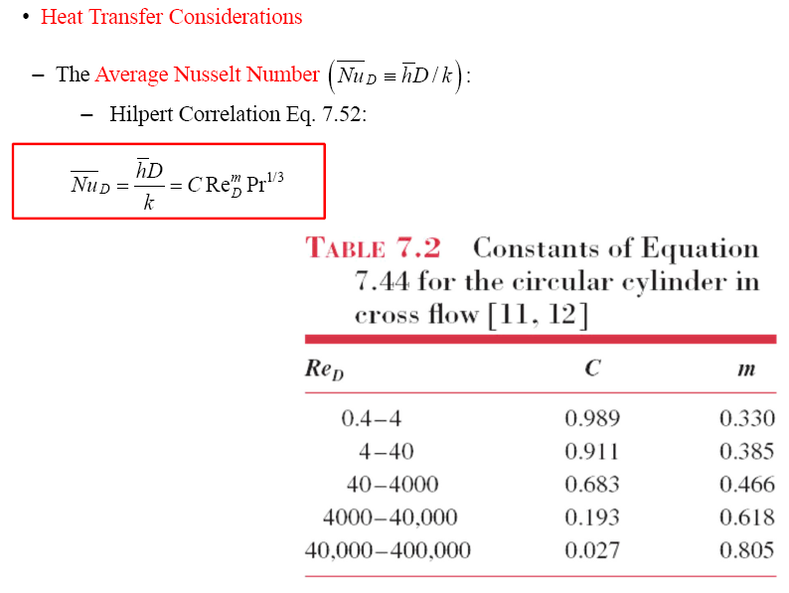
Chapter 7 : Convection – External Flow : Cylinder in cross flow
From standpoint engineering analysis, we are more interested in overall average value
Hilpert Correlation
→ Eq. (7.44)
*widely used for Pr ≥ 0.7
*all properties are evaluated at the film temperature, T_{f}

Slide 6
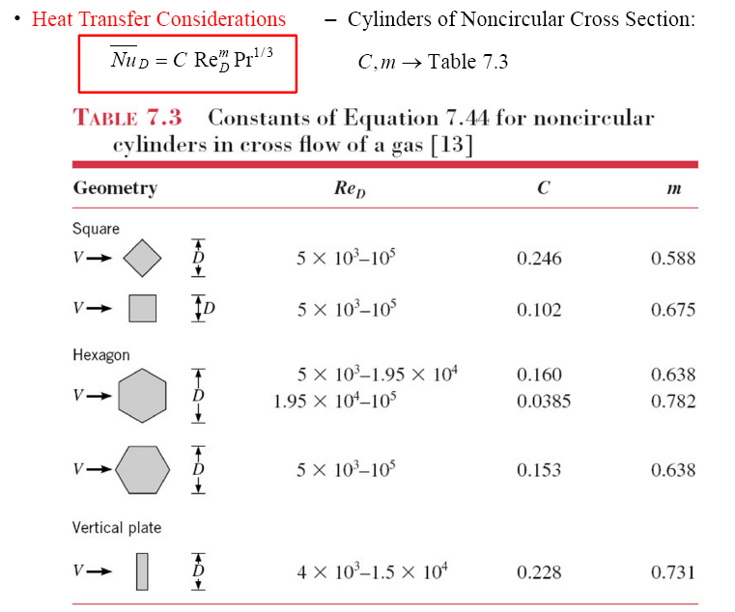
Chapter 7 : Convection – External Flow : Cylinder in cross flow

Slide 7

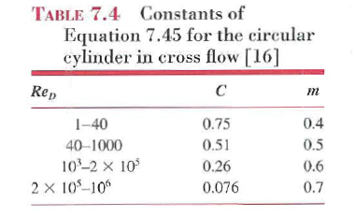
Chapter 7 : Convection – External Flow : Cylinder in cross flow
other correlations for circular cylinder in cross flow: Zukauskas Correlation
→ Eq. (7.45)
*all properties are evaluated at T∞ except Pr_{s} which is evaluated at T_{s}.
Valid for:
0.7 ≤ Pr ≤ 500 & 1 ≤ Re_{D} ≤ 10⁶
*If Pr ≥ 10, n = 0.36
Pr ≤ 10, n = 0.37

Slide 8
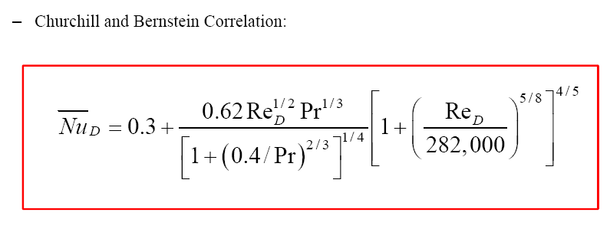
Chapter 7 : Convection – External Flow : Cylinder in cross flow
Another correlations for circular cylinder in cross flow: Churchill and Bernstein correlation
claimed as a single comprehensive equation that covers entire range of Re_{D} as well as Pr
→ Eq. (7.46)
*recommended for Re_{D}Pr ≥ 0.2
*all properties are evaluated at the film temperature , T_{f}

Slide 9
Chapter 7 : Convection – External Flow : Cylinder in cross flow
Problem 7.42:
A circular pipe of 25 mm outside diameter is placed in an airstream at 25°C and 1 atm pressure. The air moves in cross flow over the pipe at 15 m/s, while the outer surface of the pipe is maintained at 100°C.
What is the drag force exerted on the pipe per unit length?
What is the rate of heat transfer from the pipe per unit length?

Slide 10
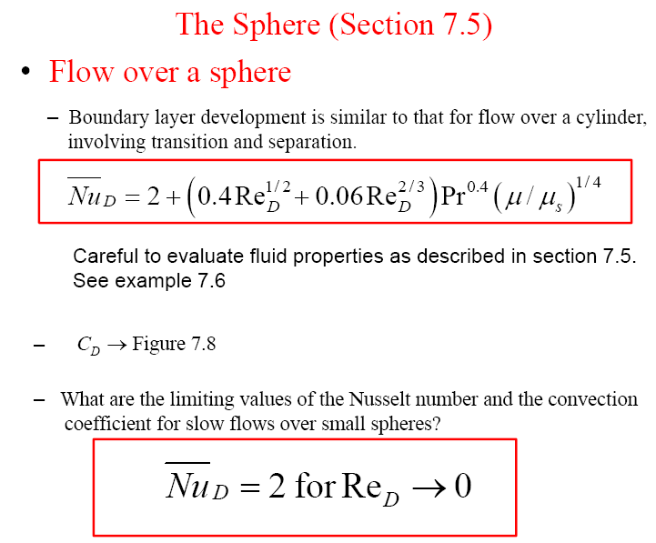
Chapter 7 : Convection – External Flow : Sphere
→ Eq. (7.48)
*all properties except μ_{s} are evaluated at T∞
*For low Re_{D} (Re_{D} ≤0.5), → C_{D} = 24/Re_{D}

Slide 11
Chapter 7 : Convection – External Flow : Sphere
Problem 7.67:
Consider a sphere with a diameter of 20 mm and a surface temperature of 60°C that is immersed in a fluid at a temperature of 30°C and a velocity of 2.5 m/s. Calculate,
The drag force and the heat rate when the fluid is (a) water and (b) air at atmospheric pressure
Explain why the results for the two fluids are so different
Fluid Re_{D} C_{D} F_{D}(N) Nu_{D} h_{D}(W/m₂K) Q(W)
water 61980 0.5 0.489 439 13540 510
Air 3088 0.4 0.000452 31.9 42.3 1.59
*A_{f} ≠ A_{s}
Reason:
Larger Re number associate with higher viscous shear and heat transfer
Drag force depends upon the fluid density
Since the k of water is nearly 20 times than air, there is a significant difference between h further Q

Slide 12
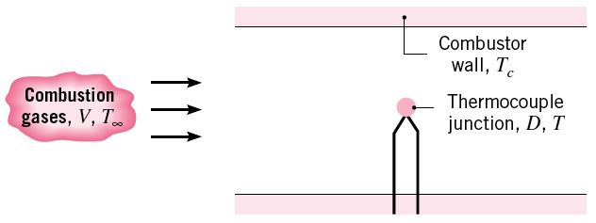
Chapter 7 : Convection – External Flow : Sphere
Problem 7.78:
A spherical thermocouple junction 1.0 mm in diameter is inserted in a combustion chamber to measure the temperature T∞ of the products of combustion. The hot gases have a velocity of 5 m/s.
If the thermocouple is at room temperature, T_{i} when it is inserted in the chamber, estimate the time required for the temperature difference, T∞ - T _{to} reach 2% of the initial temperature difference T∞ - T_{i} . Neglect radiation and conduction through the leads. Properties of junction; k=100 W/mK, c=385 J/kgK, ρ=8920 kg/m³. Combustion gases; k = 0.05 W/mK, ν = 50x10⁻⁶ m²/s and Pr = 0.69.
If the thermocouple junction has an emissivity of 0.5 and the cooled walls of the combustor are at T_{c} = 400K, what is the steady state temperature of the thermocouple junction if the combustion gases are at 1000K. Neglect conduction through the leads.

