Slide 1
Chapter 7
External Convection

Slide 2
Introduction
In Chapter 6 we obtained a non-dimensional form for the heat transfer coefficient, applicable for problems involving the formation of a boundary layer:
In this chapter we will obtain convection coefficients for different flow geometries, involving external flows:
  Flat plates
  Spheres, cylinders, airfoils, blades
In such flows, boundary layers develop freely
Notes:
.

Slide 3
Approach
Two approaches:
  Experimental or empirical: Experimental heat transfer measurements are correlated in terms of dimensionless parameters
  Theoretical approach: Solution of boundary layer equations.

Slide 4
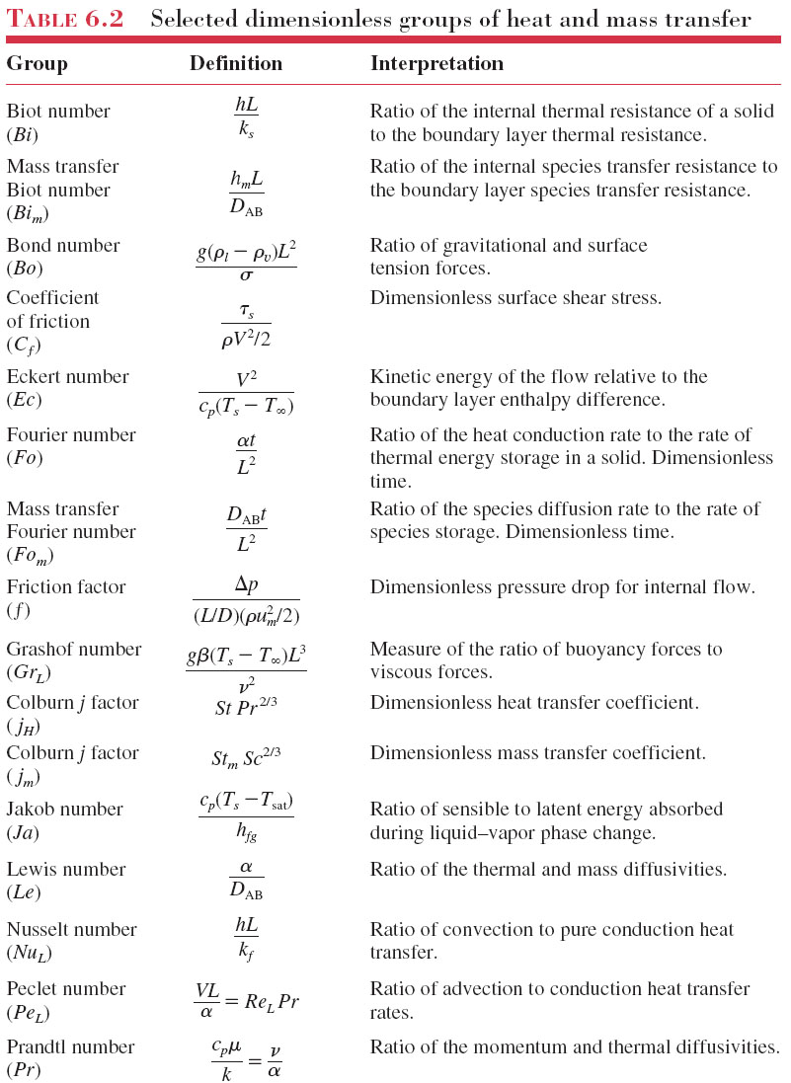

Slide 6
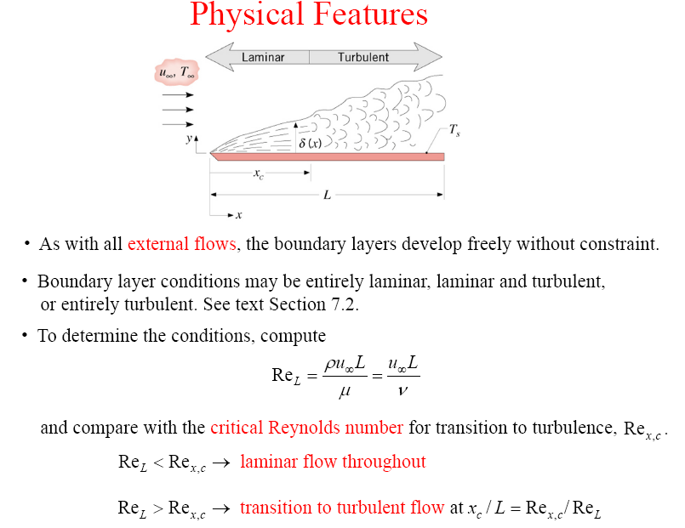
Chapter 7 : Convection – External Flow (Plate, Cylinder, Sphere)

Slide 7

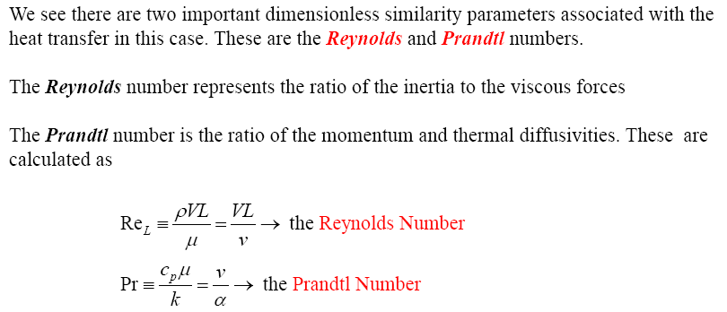
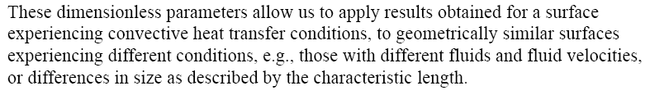
Chapter 7 : Convection – External Flow

Slide 8
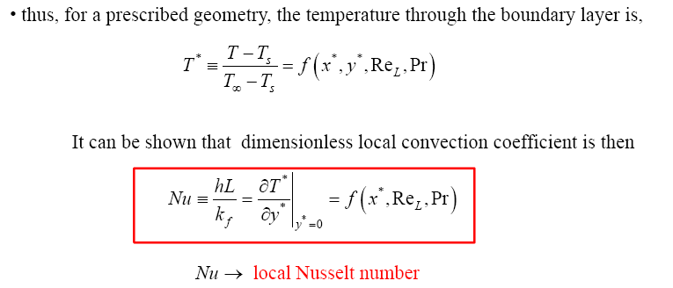
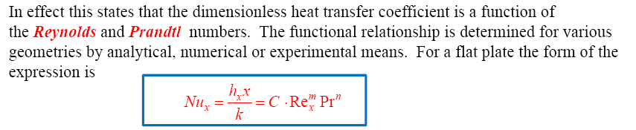

Chapter 7 : Convection – External Flow

Slide 9
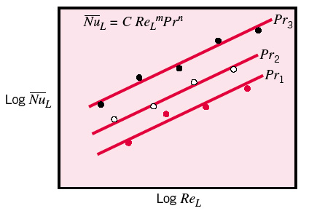
Chapter 7 : Convection – External Flow
Approaches to determine convection coefficients, h
Experimental
Heat transfer experiment (Section 7.1)
Correlating the data in term of dimensionless number
Establish equation
2. Analytical
Solving using boundary layer equation (Section 6.4)
Example analysis by similarity method (refer Section 7.2.1)
Step includes:
i) Obtain temperature profile T∗ for a particular geometry
ii) Evaluate local Nusselt number (Eq.6.31)
iii) Evaluate local convection coefficient
iv) Determine the average convection coefficient (Eq. 6.9)

Slide 10



Heat Transfer Convection
_
Local and average Nusselt numbers:
Average Nusselt number:
Film temperature:
Average friction coefficient:
Average heat transfer coefficient:
Heat transfer rate:
_
*The overbar indicates an average from x∗=0 (the boundary layer begins to develop) to the location interest.
_
_
_
10

Slide 11
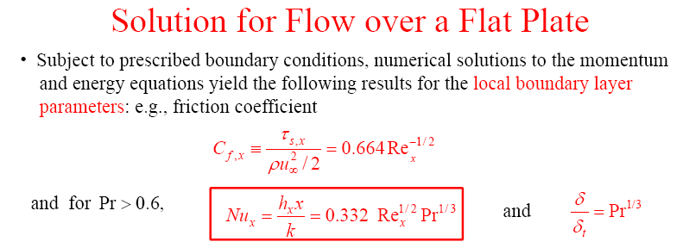
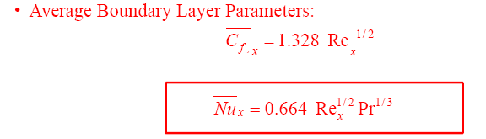
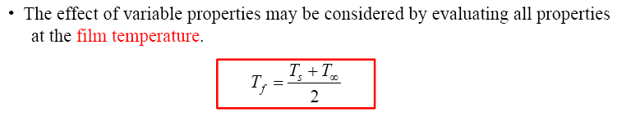
Chapter 7 : Convection – External Flow
(Isothermal)
Laminar flow
→ Eq. (7.18)
→ Eq. (7.21)
→ Eq. (7.24)
→ Eq. (7.25)

Slide 12




For small Prandtl number
where Pe is the Peclet number and can be obtained by
→ Eq. (7.26)
A single correlation for laminar over an isothermal plate, which applies all Prandtl number has been recommended by Churchill and Ozoe
and average value can be obtained by
→ Eq. (7.27)

Slide 13
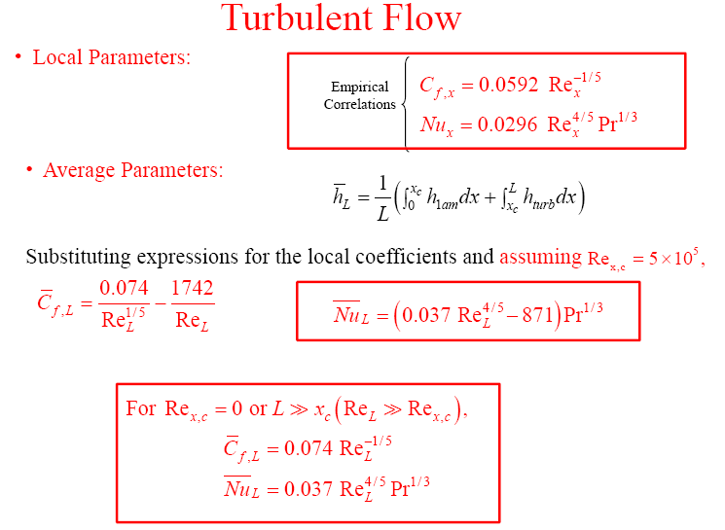
Chapter 7 : Convection – External Flow
→ Eq. (7.28)
→ Eq. (7.30)
2A
A
→ Eq. (7.31)
→ Eq. (7.33)
*when A = 871 for Re_{x,c} = 5 x10⁵
*for a completely
turbulent → Re_{x,c} = 0, A = 0

Slide 14



Uniform Heat Flux
For a flat plate subjected to uniform heat flux, the local Nusselt number is given by
→ Eq. (7.37)
→ Eq. (7.38)
These relations give values that are 36 percent higher for laminar flow and 4 percent higher for turbulent flow relative to the isothermal plate case.
If the heat flux is known, the rate of heat transfer to or from the plate and the surface temperature at a distance x are determined from
The average Nusselt number (laminar) is given by
→ Eq. (7.41)

Slide 15
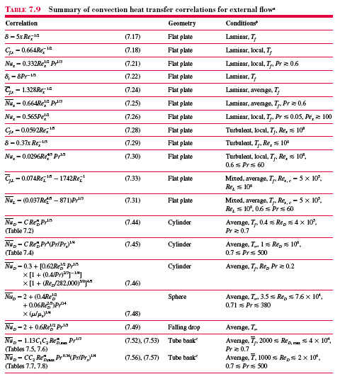

Slide 16
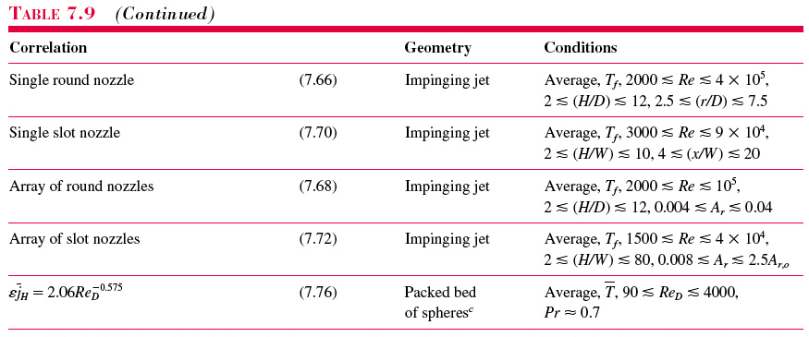

Slide 17
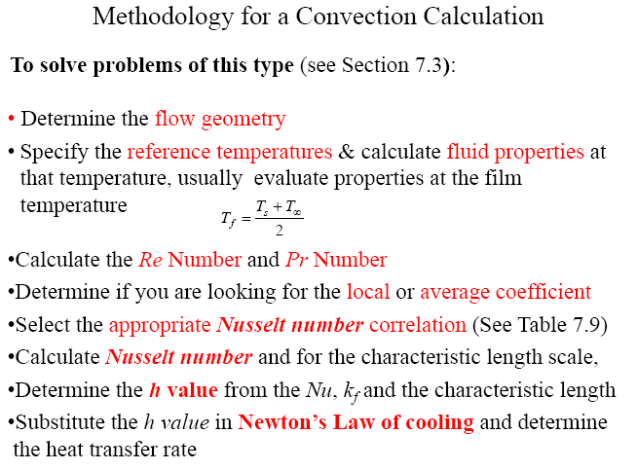
Chapter 7 : Convection – External Flow

Slide 18
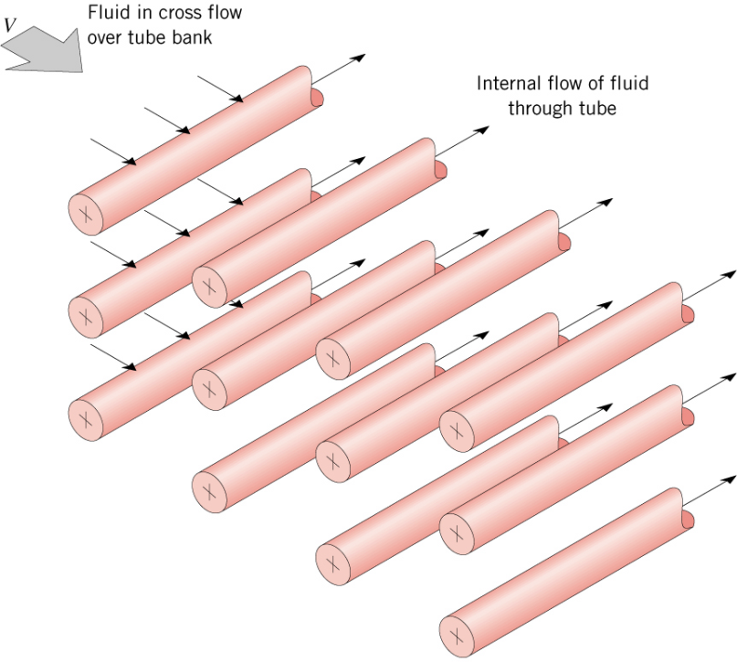
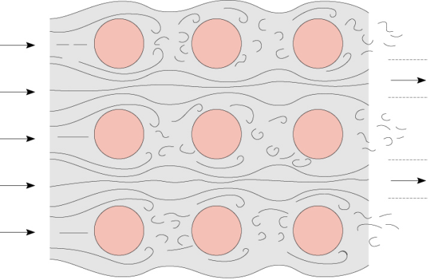
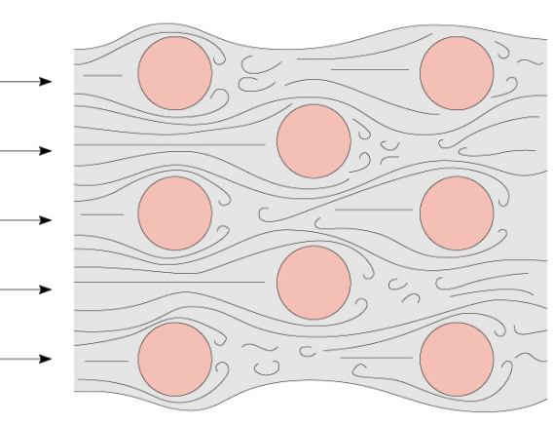
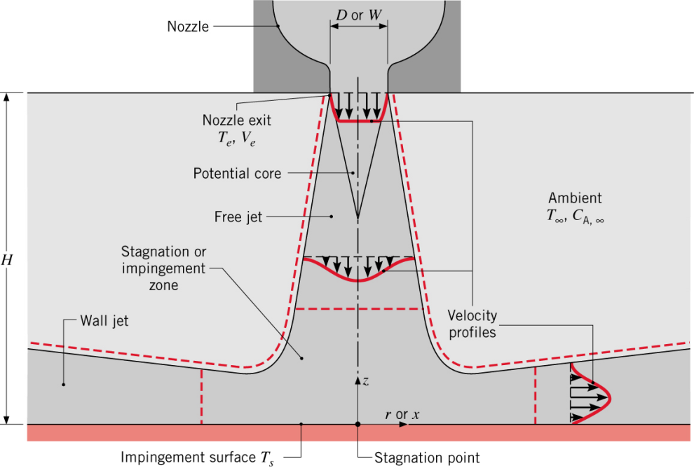
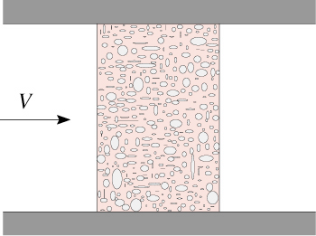
Other Applications (7.6-7.8)
Flow around tube banks
Packed beds
Impinging jets

Slide 19
Chapter 7 : Convection – External Flow
Example: 7.1
Air at a pressure of 6 kN/m² and a temperature of 300°C flows with a velocity of 10 m/s over a flat plate 0.5 m long. Estimate the cooling rate per unit width of the plat needed to maintain it at a surface temperature of 27°C.

Slide 20
Chapter 7 : Convection – External Flow
Example: 7.2 (combination laminar & turbulent)
Consider a hot automotive engine, which can be approximated as a 0.5m high, 0.4m wide and 0.8m long rectangular block. The bottom surface of the block is at a temperature of 100°C and has an emissivity of 0.95. The ambient air is at 20°C and the road surface is at 25°C. If the car travels at a velocity of 80 km/hr, determine
the total drag force and
the rate of heat transfer over the entire bottom surface of the engine block.
Assume the flow to be turbulent over the entire surface because of the constant agitation of the engine block.

