Slide 1
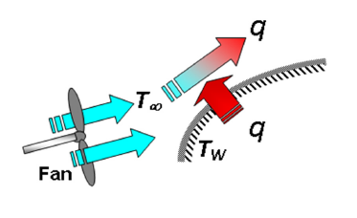
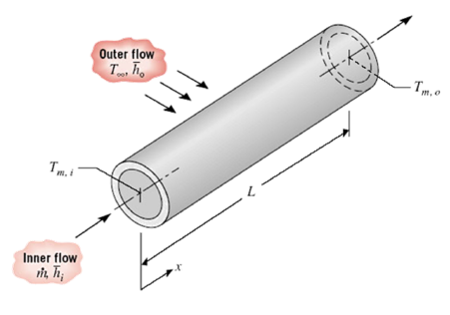
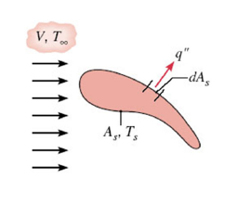
Convection

Slide 2
Introduction to Convection
Convection denotes energy transfer between a surface and a fluid moving over the surface.
The dominant contribution due to the bulk (or gross) motion of fluid particles.
In this chapter we will
  Introduce the convection transfer equations
  Discuss the physical mechanisms underlying convection
  Discuss physical origins and introduce relevant dimensionless parameters that can help us to perform convection transfer calculations in subsequent chapters.
Note similarities between heat, mass and momentum transfer.

Slide 3
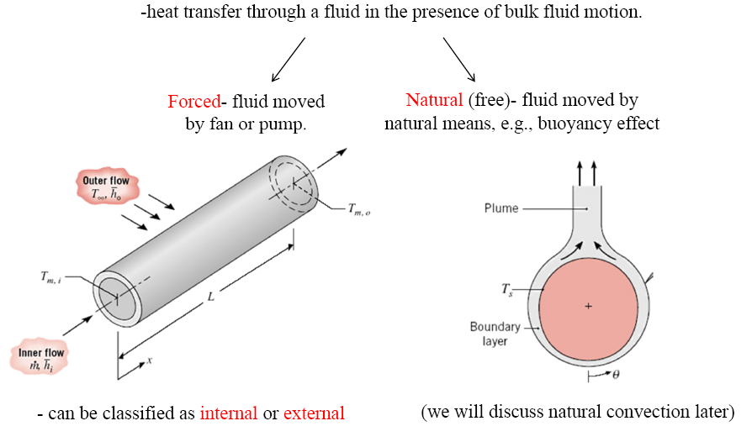
Chapter 6 : Introduction to Conduction – Flow & Thermal Considerations
Introduction – Convection heat transfer

Slide 4
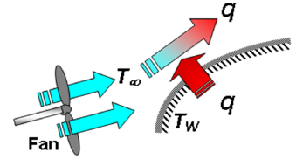
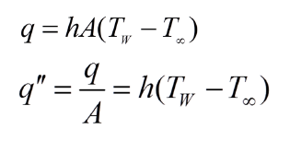
Chapter 6 : Introduction to Conduction – Flow & Thermal Considerations
6.1 Introduction – Convection heat transfer
Forced convection:
is achieved by subjecting the fluid to a pressure gradient (e.g., by a fan or pump), thereby forcing motion to occur according to the laws of fluid mechanics.
Convection heat transfer rate is calculated from Newton’s Law of Cooling
where h is called the convective heat transfer coefficient and has units of W/m²K
How about natural or free convection ?

Slide 5
Chapter 6 : Introduction to Conduction – Flow & Thermal Considerations
Introduction – Convection heat transfer
Typical values of h are:
Natural convection of air = 5 W/m²K
Natural convection of water around a pipe = 570
Forced conv. of air over plate at 30 m/s = 80
Water at 2 m/s over plate, ΔT=15K = 590
Liquid sodium at 5m/s in 1.3cm pipe = 75,000 at 370°C
The heat transfer coefficient contains all the parameters which influence convection heat transfer

Slide 6
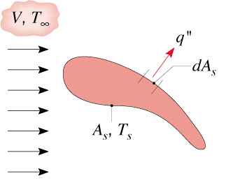
Heat Transfer Coefficient
Recall Newton’s law of cooling for heat transfer between a surface of arbitrary shape, area A_{s} and temperature T_{s} and a fluid:
Generally flow conditions will vary along the surface, so q” is a local heat flux and h a local convection coefficient.
The total heat transfer rate is
where
is the average heat transfer coefficient
14

Slide 7
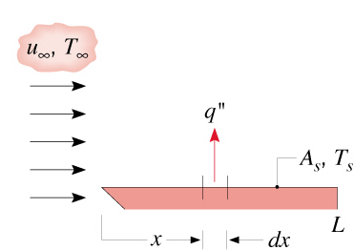
Heat Transfer Coefficient
For flow over a flat plate:
How can we estimate heat transfer coefficient?
15

Slide 8
The Central Question for Convection
Convection heat transfer strongly depends on
  Fluid properties - dynamic viscosity, thermal conductivity, density, and specific heat
  Flow conditions - fluid velocity, laminar, turbulence.
  Surface geometry – geometry, surface roughness of the solid surface.
In fact, the question of convection heat transfer comes down to determining the heat transfer coefficient, h.
This MAINLY depends on the velocity and thermal boundary layers.

Slide 9
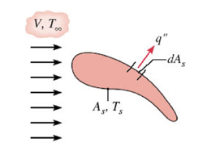
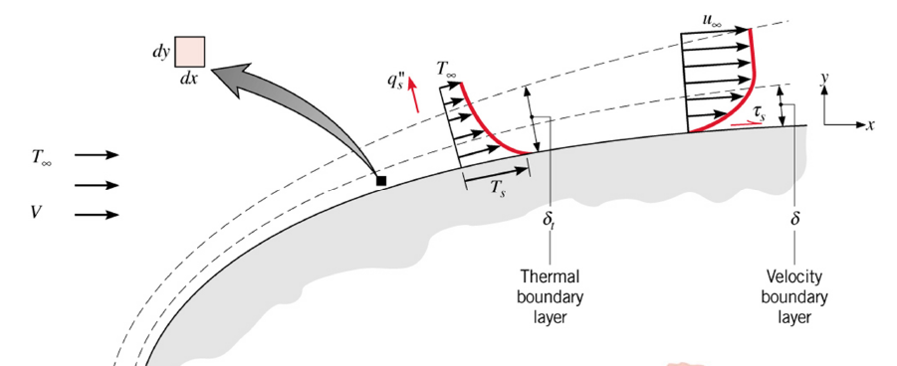
Chapter 6 : Introduction to Conduction – Flow & Thermal Considerations
What is Velocity & Thermal Boundary Layers ?

Slide 10
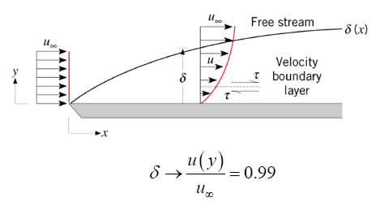
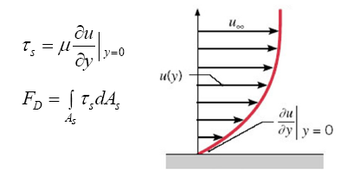
Chapter 6 : Introduction to Conduction – Flow & Thermal Considerations
Velocity Boundary Layers – Physical meaning/features
A consequence of viscous effects associated with relative motion between a fluid and a surface
A region of the flow characterised by shear stresses and velocity gradients.
A region between the surface and the free stream whose thickness, δ increases in the flow direction.
why does δ increase in the flow direction ?
- the viscous effects penetrate further into the free stream along the plate and δ increases
Manifested by a surface shear stress, τ_{s} that provides a drag force, F_{D}

Slide 11
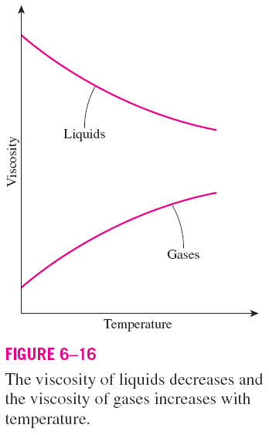

Surface Shear Stress
Shear stress: Friction force per unit area.
The shear stress for most fluids is proportional to the velocity gradient, and the shear stress at the wall surface is expressed as
μ dynamic viscosity
kg/m⋅s or N⋅s/m², or Pa⋅s
1 poise = 0.1 Pa ⋅ s
The fluids that obey the linear relationship above are called Newtonian fluids.
Most common fluids such as water, air, gasoline, and oils are Newtonian fluids.
Blood and liquid plastics are examples of non-Newtonian fluids. In this text we consider Newtonian fluids only.

Slide 12



Kinematic viscosity,
m²/s or stoke
1 stoke = 1 cm²/s = 0.0001 m²/s
The viscosity of a fluid is a measure of its resistance to deformation, and it is a strong function of temperature.
Surface shear stress:
C_{f} is the friction coefficient or
skin friction coefficient.
Friction force over the entire surface:
The friction coefficient is an important parameter in heat transfer studies since it is directly related to the heat transfer coefficient and the power requirements of the pump or fan.

Slide 13
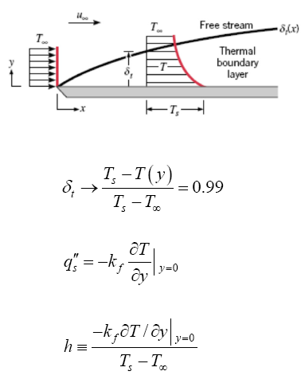
Chapter 6 : Introduction to Conduction – Flow & Thermal Considerations
Thermal Boundary Layers – Physical meaning/features
A consequence of heat transfer between the surface and fluid
A region of the flow characterised by temperature gradients and heat fluxes
A region between the surface and the free stream whose thickness, δ_{t} increases in the flow direction.
why does δ increase in the flow direction ?
- the heat transfer effects penetrate further into the free stream along the plate and δ increases
Manifested by a surface heat fluxes, q”_{s} and a convection heat transfer coefficient, h
If (Ts – T∞) is constant, how do q”_{s} and h vary in the flow directions ?
- The temperature gradient at the wall, h and q”_{s} decrease with increasing x

Slide 14
Boundary Layers - Summary
Velocity boundary layer (thickness δ(x)) characterized by the presence of velocity gradients and shear stresses - Surface friction, C_{f}
Thermal boundary layer (thickness δ_{t}(x)) characterized by temperature gradients – Convection heat transfer coefficient, h
Concentration boundary layer (thickness δ_{c}(x)) is characterized by concentration gradients and species transfer – Convection mass transfer coefficient, h_{m}
18

Slide 15
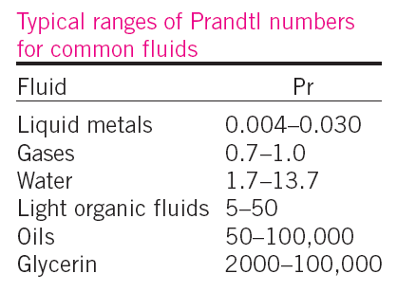
Prandtl Number
The relative thickness of the velocity and the thermal boundary layers is best described by the dimensionless parameter Prandtl number
The Prandtl numbers of gases are about 1, which indicates that both momentum and heat dissipate through the fluid at about the same rate.
Heat diffuses very quickly in liquid metals (Pr << 1) and very slowly in oils (Pr >> 1) relative to momentum.
Consequently the thermal boundary layer is much thicker for liquid metals and much thinner for oils relative to the velocity boundary layer.
15

Slide 16

Nusselt Number
In convection studies, it is common practice to nondimensionalize the governing equations and combine the variables, which group together into dimensionless numbers in order to reduce the number of total variables.
Nusselt number: Dimensionless convection heat transfer coefficient.
L_{c} is the characteristic length.
The Nusselt number represents the enhancement of heat transfer through a fluid layer as a result of convection relative to conduction across the same fluid layer.
The larger the Nusselt number, the more effective the convection.
A Nusselt number of Nu = 1 for a fluid layer represents heat transfer across the layer by pure conduction.
Heat transfer through a fluid layer of thickness L and temperature difference ΔT.

Slide 17
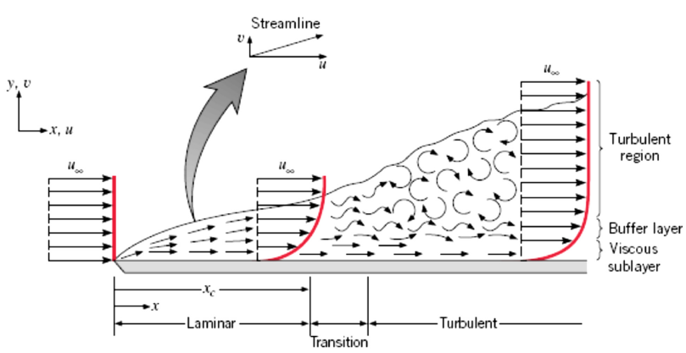
Chapter 6 : Introduction to Conduction – Flow & Thermal Considerations
Boundary Layer Transition
How would you characterise conditions in the laminar region ?

Slide 18
Chapter 6 : Introduction to Conduction – Flow & Thermal Considerations
Boundary Layer Transition
How would you characterise conditions in the laminar region ?
1. Fluid motion is highly ordered, clear indication of streamline
2. Velocity components in both x-y directions
3. For y-component, contribute significantly to the transfer of energy through the boundary layer

Slide 19
Chapter 6 : Introduction to Conduction – Flow & Thermal Considerations
Boundary Layer Transition
How would you characterise conditions in the laminar region ?
1. Fluid motion is highly ordered, clear indication of streamline
2. Velocity components in both x-y directions
3. For y-component, contribute significantly to the transfer of energy through the boundary layer
In turbulent region ?

Slide 20
Chapter 6 : Introduction to Conduction – Flow & Thermal Considerations
Boundary Layer Transition
In turbulent region?
1. Fluid motion is highly irregular, characterised by velocity fluctuation
2. Fluctuations enhance the transfer of energy, and hence increase surface friction as well as convection heat transfer rate
3. Due to fluid mixing (by fluctuations), turbulent boundary layer thicknesses are larger and boundary layer profiles ( v & T) are flatter than laminar.

Slide 21
Chapter 6 : Introduction to Conduction – Flow & Thermal Considerations
Boundary Layer Transition
What conditions are associated with transition from laminar to turbulent flow ?
at leading edge of laminar flow, small disturbances are amplified and transition to turbulent flow begins
In transition region → the flow fluctuates between laminar and turbulent flows.
How to classify these type of flows ?

Slide 22

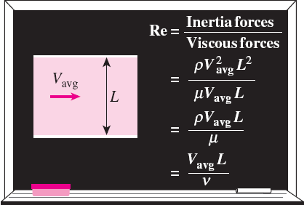

Reynolds Number
At large Reynolds numbers, the inertial forces, which are proportional to the fluid density and the square of the fluid velocity, are large relative to the viscous forces, and thus the viscous forces cannot prevent the random and rapid fluctuations of the fluid (turbulent).
At small or moderate Reynolds numbers, the viscous forces are large enough to suppress these fluctuations and to keep the fluid “in line” (laminar).
The transition from laminar to turbulent flow depends on the geometry, surface roughness, flow velocity, surface temperature, and type of fluid.
The flow regime depends mainly on the ratio of inertial forces to viscous forces (Reynolds number).
Critical Reynolds number, Re_{x,c}: The Reynolds number at which the flow becomes turbulent.
The value of the critical Reynolds number is different for different geometries and flow conditions.
i.e for flow over a flat plate:
22

Slide 23
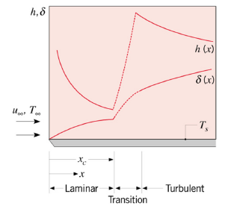
Chapter 6 : Introduction to Conduction – Flow & Thermal Considerations
Boundary Layer Transition
- Effect of transition on boundary layer thickness and local convection coefficient

Slide 24
Boundary Layer Approximations
Need to determine the heat transfer coefficient, h
In general, h=f (k, c_{p}, ρ, μ, V, L)
We can apply the Buckingham pi theorem, or obtain exact solutions by applying the continuity, momentum and energy equations for the boundary layer.
In terms of dimensionless groups:
(x*=x/L)
Local and average Nusselt numbers (based on local and average heat transfer coefficients)
where:
Prandtl number
Reynolds number
(defined at distance x)
20

Slide 25
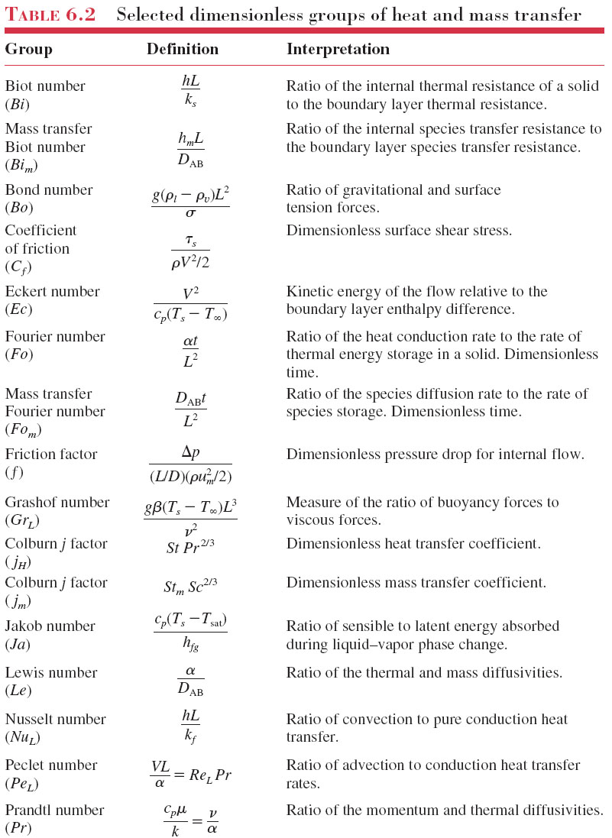

Slide 27
The Convection Transfer Equations
Motion of a fluid is governed by the fundamental laws of nature:
  Conservation of mass, energy and chemical species
  Newton’s second law of motion.
Need to express conservation of energy by taking also into account the bulk motion of the fluid.

Slide 28
Reminder: Conservation of Mass
υ
y
u
w
x
z
Mass balance:
All mass flow rates in
-
All mass flow rates out
=
Rate of accumulation

Slide 29
Differential Continuity Equation
(7.1a)
For steady-state conditions
(7.1b)
For incompressible fluids
(7.1c)

Slide 30
Reminder: Conservation of Momentum
Rate of momentum in
Rate of momentum out
Sum of forces acting on system
Rate of accumulation of momentum
-
+
=
Estimation of net rate of momentum out of element
y
x
z
7.15

Slide 31
Reminder: Conservation of Momentum
Estimation of forces acting on the element: Pressure, gravity, stresses
y
x
z
Stresses are related to deformation rates (velocity gradients), through Newton’s law.

Slide 32
Differential Momentum Balance
(Navier-Stokes Equations)
x-component :
(7.2a)
y-component :
(7.2b)
z-component :
(7.2c)

Slide 33
Conservation of Energy
Energy Conservation Equation
(2.1)
z
q_{z+dz}
q_{y}
Reminder:
Previously we considered only heat transfer due to conduction and derived the “heat equation”
q_{x}
q_{x+dx}
q_{y+dy}
x
y
q_{z}

Slide 34
Conservation of Energy
Must consider that energy is also transferred due to bulk fluid motion (advection)
Kinetic and potential energy
Work due to pressure forces
y
x

Slide 35
Thermal Energy Equation
For steady-state, two dimensional flow of an incompressible fluid with constant properties:
(7.3)
Net outflow of heat due to bulk fluid motion (advection)
Net inflow of heat due to conduction
rate of energy generation per unit volume
where
(7.4)
represents the viscous dissipation: Net rate at which mechanical work is irreversibly converted to thermal energy, due to viscous effects in the fluid

