Slide 1
Chapter 5 : Transient Conduction
Many heat transfer problems are time dependent
Changes in operating conditions in a system cause temperature variation with time, as well as location within a solid, until a new steady state (thermal equilibrium) is obtained.
In this chapter we will develop procedures for determining the time dependence of the temperature distribution
Real problems may include finite and semi-infinite solids, or complex geometries, as well as two and three dimensional conduction
Solution techniques involve the lumped capacitance method, exact and approximate solutions, and finite difference methods.
We will focus on the Lumped Capacitance Method, which can be used for solids within which temperature gradients are negligible (Sections 5.1-5.2)

Slide 2
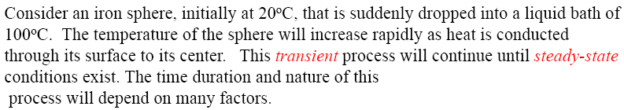
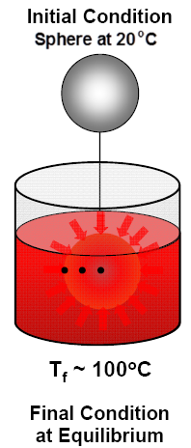
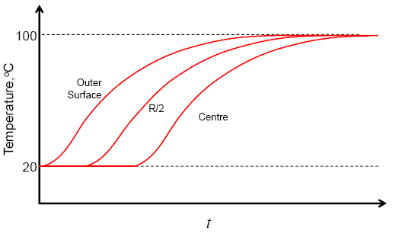
Chapter 5 : Transient Conduction

Slide 3
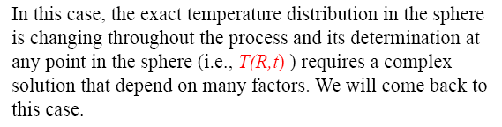
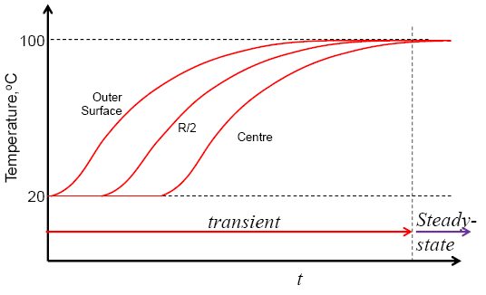
Chapter 5 : Transient Conduction

Slide 4
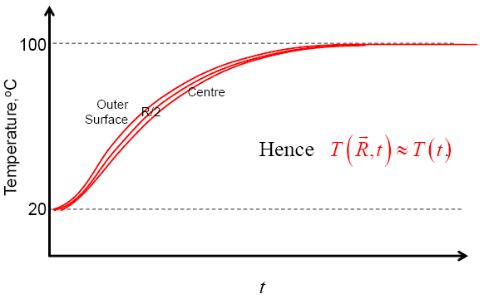
Chapter 5 : Transient Conduction
We first will look at a simpler case, based on the assumption of a spatially uniform temperature distribution in the sphere throughout the transient process. In reality this is an approximation of the actual process and is based on the assumption that the thermal resistance in the sphere is much less than the resistance at the surface due to convection.

Slide 5
Lumped Capacitance Method
If the thermal conductivity of the solid is very high, resistance to conduction within the solid will be small compared to resistance to heat transfer between solid and surroundings.
Temperature gradients within the solid will be negligible, i.e.. the temperature of the solid is spatially uniform at any instant.
T
x

Slide 6
Lumped Capacitance Method
Starting from an overall energy balance on the solid:
The time required for the solid to reach a temperature T is:
(5.1)
where
The temperature of the solid at a specified time t is:
(5.2)
The total energy transfer, Q, occurring up to some time t is:
(5.3)

Slide 7
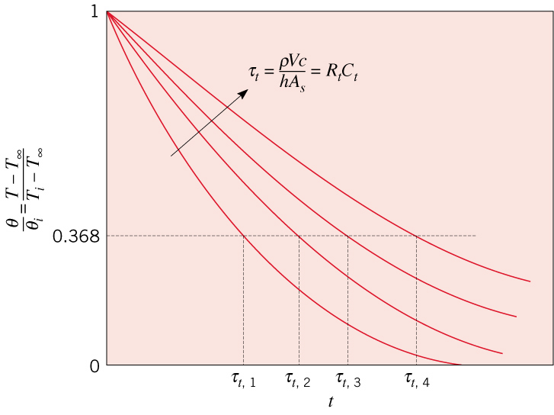
Transient Temperature Response
Based on eq. (5.2), the temperature difference between solid and fluid decays exponentially.
Let’s define a thermal time constant
R_{t} is the resistance to convection heat transfer,
C_{t} is the lumped thermal capacitance of the solid
Increase in R_{t} or C_{t} causes solid to respond more slowly and more time will be required to reach thermal equilibrium.

Slide 8
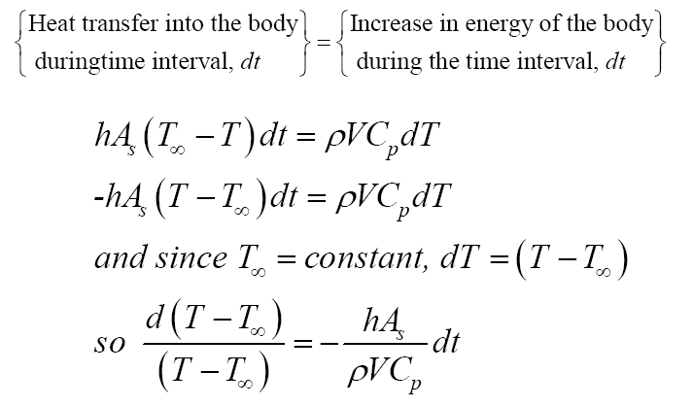
Chapter 5 : Transient Conduction
5.1 The Lumped Capacitance Method
For the previous case, we may use the Lumped Capacitance Method, LCM
Using energy balance on the sphere,

Slide 9
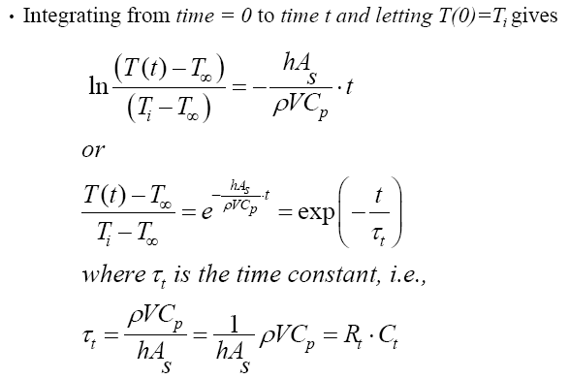
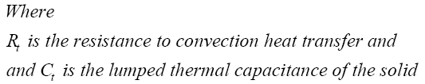
Chapter 5 : Transient Conduction
→ Eq. (5.5)
*can be used to determine the time required, t, for the solid to reach certain temperature
→ Eq. (5.7)

Slide 10
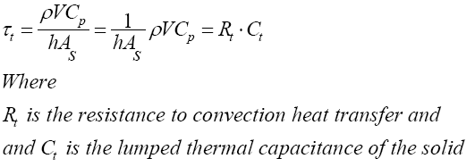
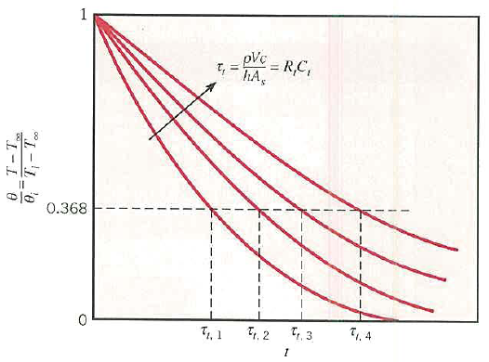
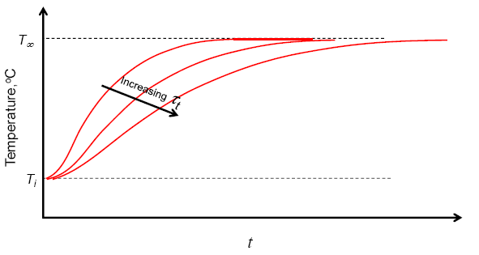
Chapter 5 : Transient Conduction
The thermal time constant is defined as:
→ Eq. (5.7)
* Any increase in R_{t} or C_{t} will cause a solid to respond more slowly and will increase the time required to reach thermal equilibrium.

Slide 11


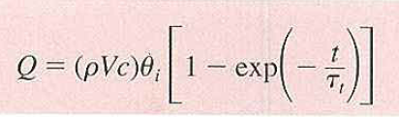
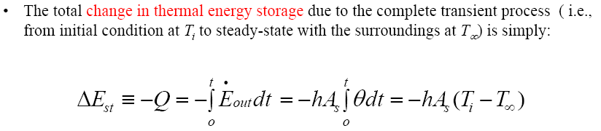
Chapter 5 : Transient Conduction
To calculate the total energy transfer, Q during transient process
Substituting with this term,
we obtain
→ Eq. (5.8a)
For the previous case, the total change in thermal energy storage due to complete transient process (from T_{i} to T∞) is simply:

Slide 12
Validity of Lumped Capacitance Method
Need a suitable criterion to determine validity of method. Must relate relative magnitudes of temperature drop in the solid to the temperature difference between surface and fluid.
What should be the relative magnitude of ΔT solid versus ΔT solid/liquid for the lumped capacitance method to be valid?

Slide 13
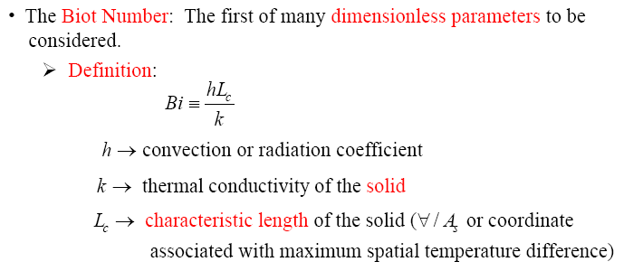

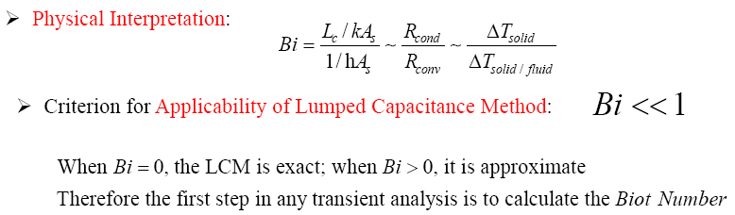
Chapter 5 : Transient Conduction
5.2 Validity of the Lumped Capacitance Method

Slide 14



Chapter 5 : Transient Conduction
**
Using definition of Biot Number,
equation 5.5 (in textbook) can be simplified to
→ Eq. (5.11)
*where Fo is known as Fourier number which is frequently used as a nondimensional time parameter for characterising transient conduction problem.
→ Eq. (5.13)

Slide 15
Biot and Fourier Numbers
The lumped capacitance method is valid when
where the characteristic length: L_{c}=V/A_{s}=Volume of solid/surface area
We can also define a “dimensionless time”, the Fourier number:
Eq. (5.2) becomes:
(5.4)

Slide 16
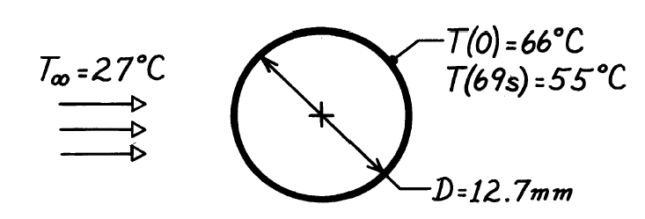
Example
The heat transfer coefficient for air flowing over a sphere is to be determined by observing the temperature-time history of a sphere fabricated from pure copper. The sphere, which is 12.7 mm in diameter, is at 66°C before it is inserted into an air stream having a temperature of 27°C. A thermocouple on the outer surface of the sphere indicates 55°C, 69 s after the sphere is inserted in the air stream.
Calculate the heat transfer coefficient, assuming that the sphere behaves as a spacewise isothermal object. Is your assumption reasonable?

Slide 17
Example 5.1:
The temperature of a gas stream is to be measured by a thermocouple whose junction can be approximated as a sphere. The properties of the junction are k = 20 W/mK, ρ = 8500 kg/m³, c_{p} = 400 J/kgK and convection coefficient between the junction and the gas is h = 400 W/m²K. Determine the junction diameter needed for the thermocouple to have a time constant of 1 second.
If the junction is at 25°C and is placed in a gas stream that is at 200°C, how long will it take for the junction to reach 199°C.

Slide 18
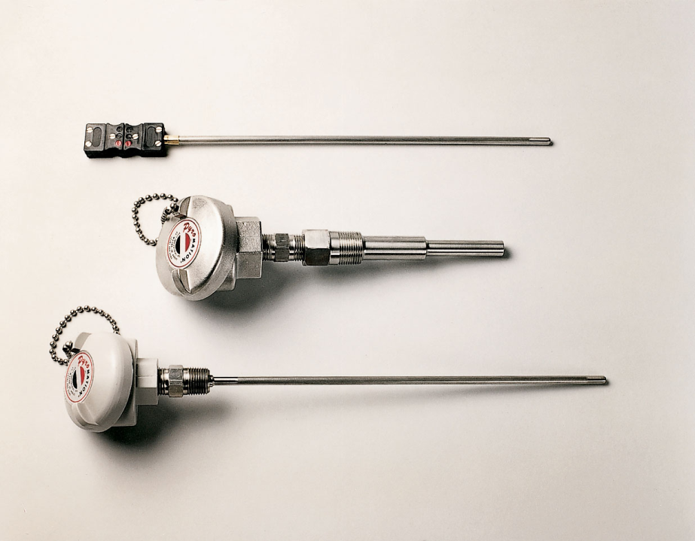
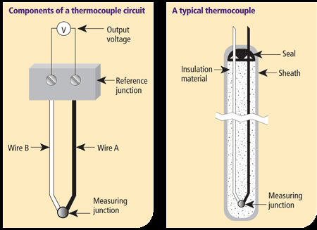
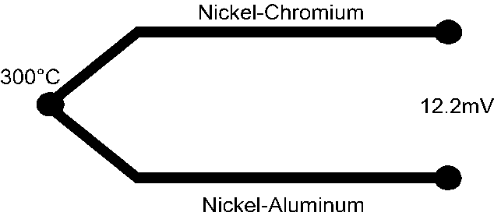

Slide 19
Problem 5.12:
Thermal energy storage systems commonly involve a packed bed of solid spheres, through which a hot gas flows if the system is being charged, or a cold gas if it is being discharged.
Consider a packed bed of 75mm diameter aluminium spheres (k = 240 W/mK, ρ = 2700 kg/m³, c_{p} = 950 J/kgK) and a charging process for which gas eneters the storage unit at a temperature of 300°C. If the initial temperature of the spheres is 25°C and convection coefficient is 75 W/m2K, how long does it take to accumulate 90% of the maximum possible thermal energy ? What is the corresponding temperature at the centre of the sphere ? Is there any advantage to using copper instead of aluminium ?

Slide 20
Other transient problems
When the lumped capacitance analysis is not valid, we must solve the partial differential equations analytically or numerically
Exact and approximate solutions may be used
Tabulated values of coefficients used in the solutions of these equations are available
Transient temperature distributions for commonly encountered problems involving semi-infinite solids can be found in the literature

Slide 21
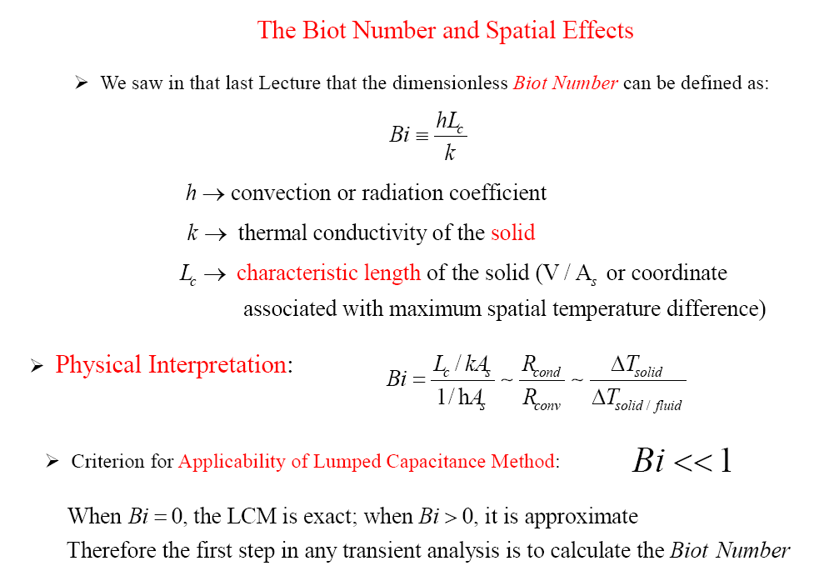
Transient Conduction : Spatial Effects & The role of analytical solutions

Slide 22

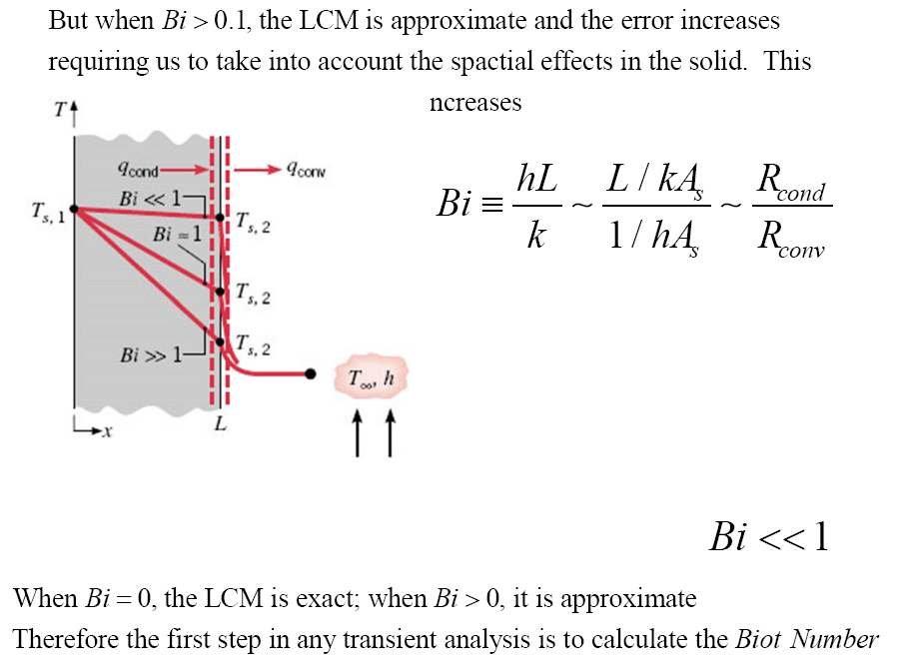
Transient Conduction : Spatial Effects & The role of analytical solutions

Slide 23
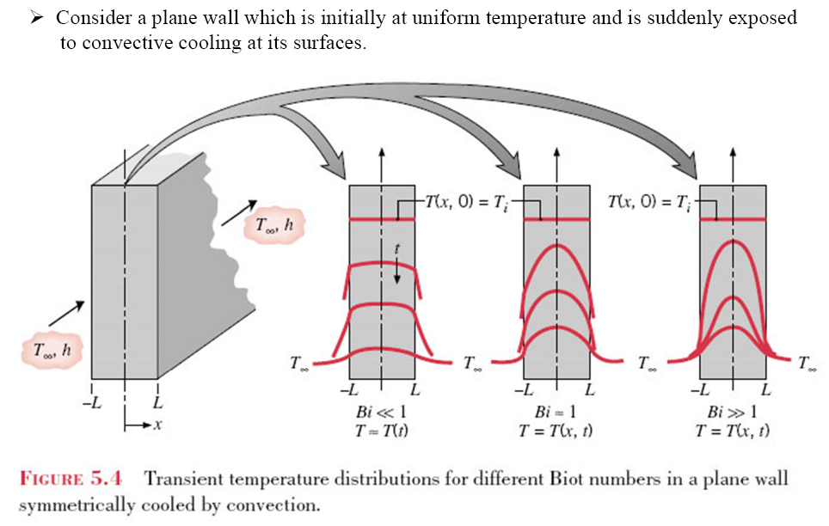
Transient Conduction : Spatial Effects & The role of analytical solutions

Slide 24
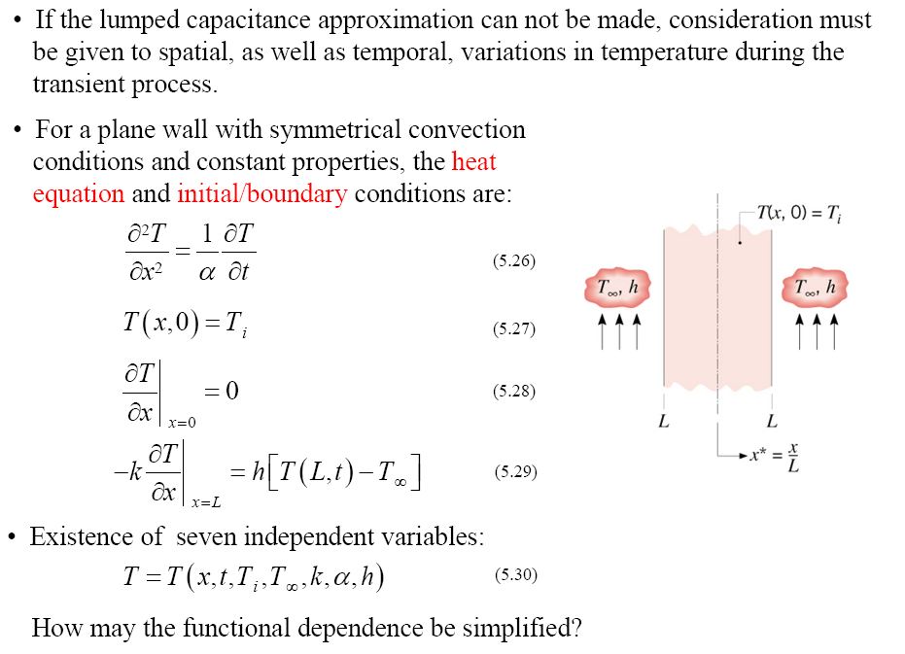
Transient Conduction : Spatial Effects & The role of analytical solutions
Spatial Effects - Solution to the Heat Equation for a plane wall with symmetrical convection conditions

Slide 25

Nondimensionalized One-Dimensional Transient Conduction Problem

Slide 26
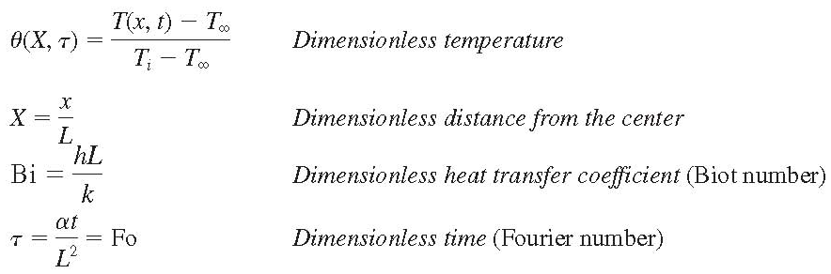
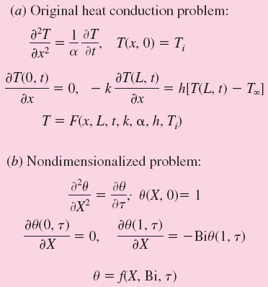
Nondimensionalization reduces the number of independent variables in one-dimensional transient conduction problems from 8 to 3, offering great convenience in the presentation of results.

Slide 27




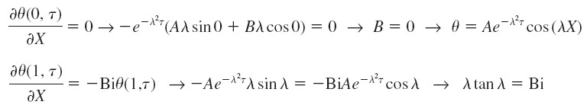




Exact Solution of One-Dimensional Transient Conduction Problem

Slide 28
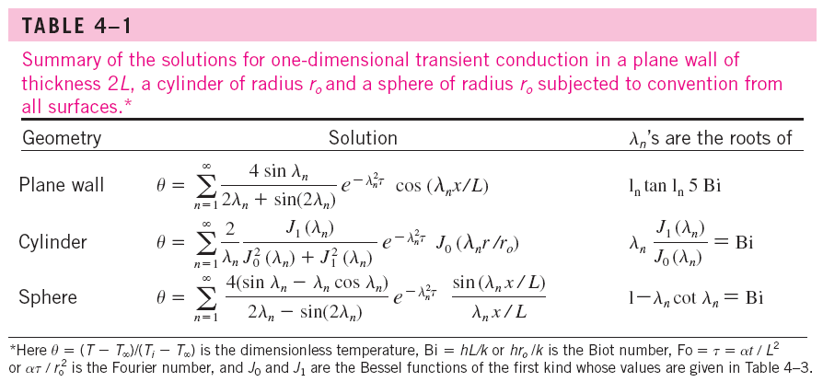

Slide 29
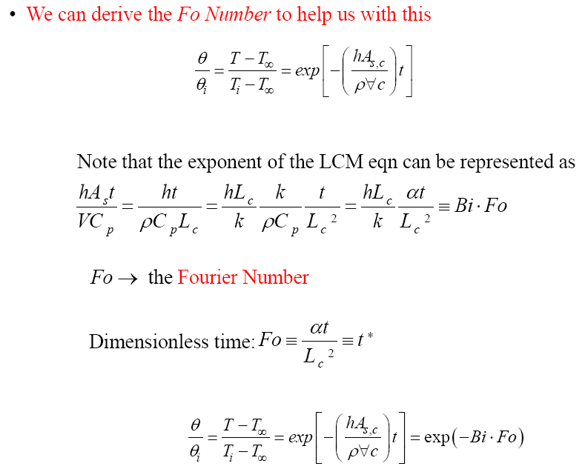

Transient Conduction : Spatial Effects & The role of analytical solutions
Thermal diffusivity,
Fo = ratio of the heat conduction rate to the rate of thermal energy storage

Slide 30
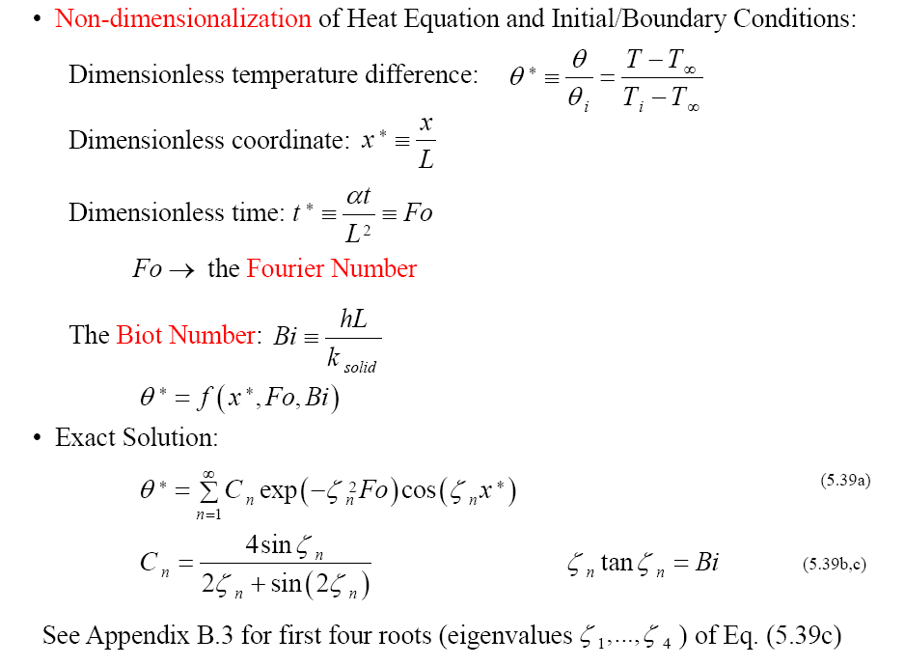
Transient Conduction : Spatial Effects & The role of analytical solutions
→ for spatial effects consideration, temperature distribution is a function of coordinate, Fourier and Biot number

Slide 31
The analytical solutions of transient conduction problems typically involve infinite series, and thus the evaluation of an infinite number of terms to determine the temperature at a specified location and time.

Slide 32
Approximate Analytical and Graphical Solutions
The terms in the series solutions converge rapidly with increasing time, and for τ > 0.2, keeping the first term and neglecting all the remaining terms in the series results in an error under 2 percent.
Solution with one-term approximation

Slide 33
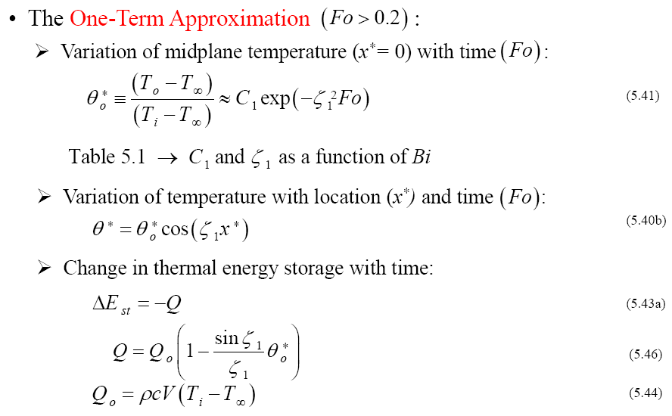
Transient Conduction : Spatial Effects & The role of analytical solutions

Slide 34
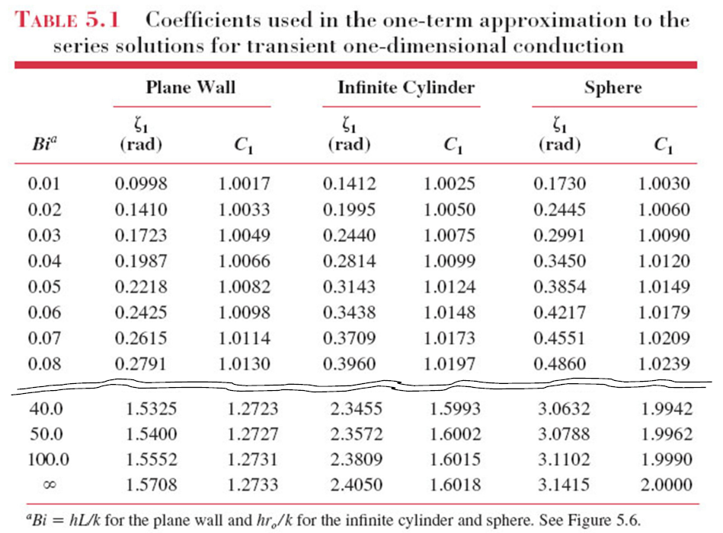
Transient Conduction : Spatial Effects & The role of analytical solutions

Slide 35
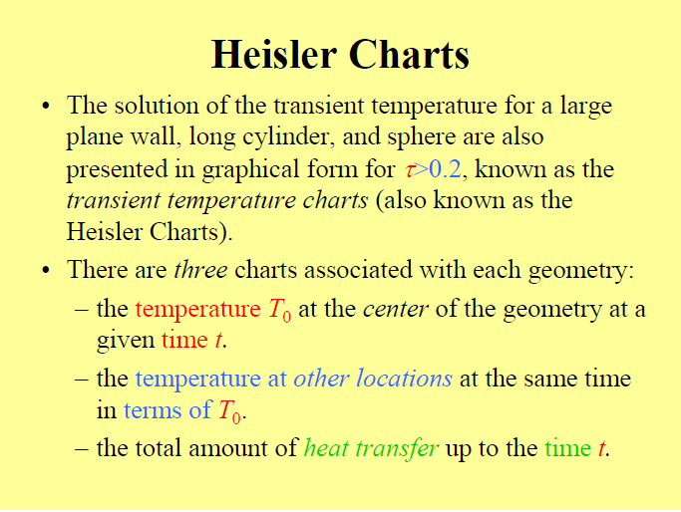

Slide 36
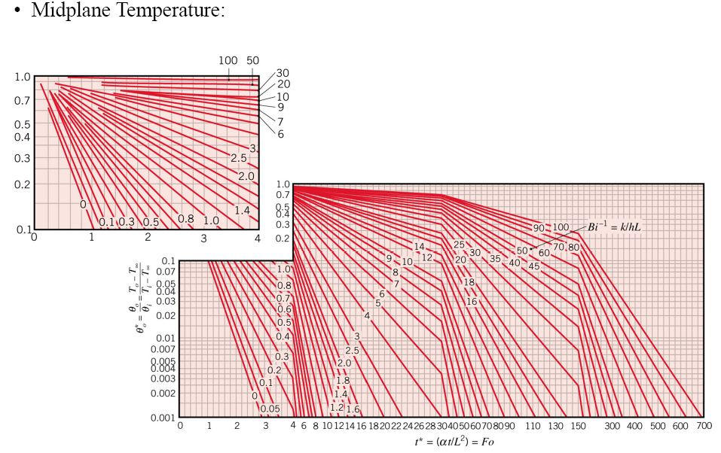
Transient Conduction : Spatial Effects & The role of analytical solutions
Graphical representation of the one-term approximation : The Heisler Charts
*This chart is not available for Wiley Textbook Asia 5th Edition, supplemental material is available as a stand-alone purchase.

Slide 37
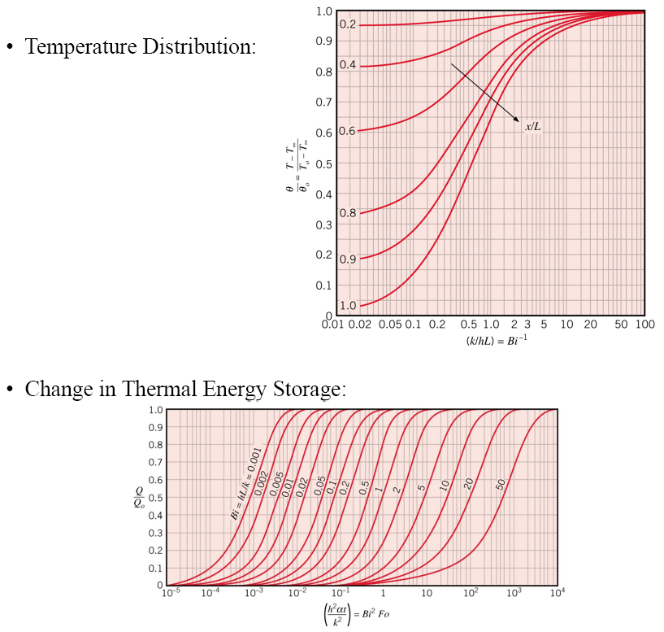
Transient Conduction : Spatial Effects & The role of analytical solutions

Slide 38
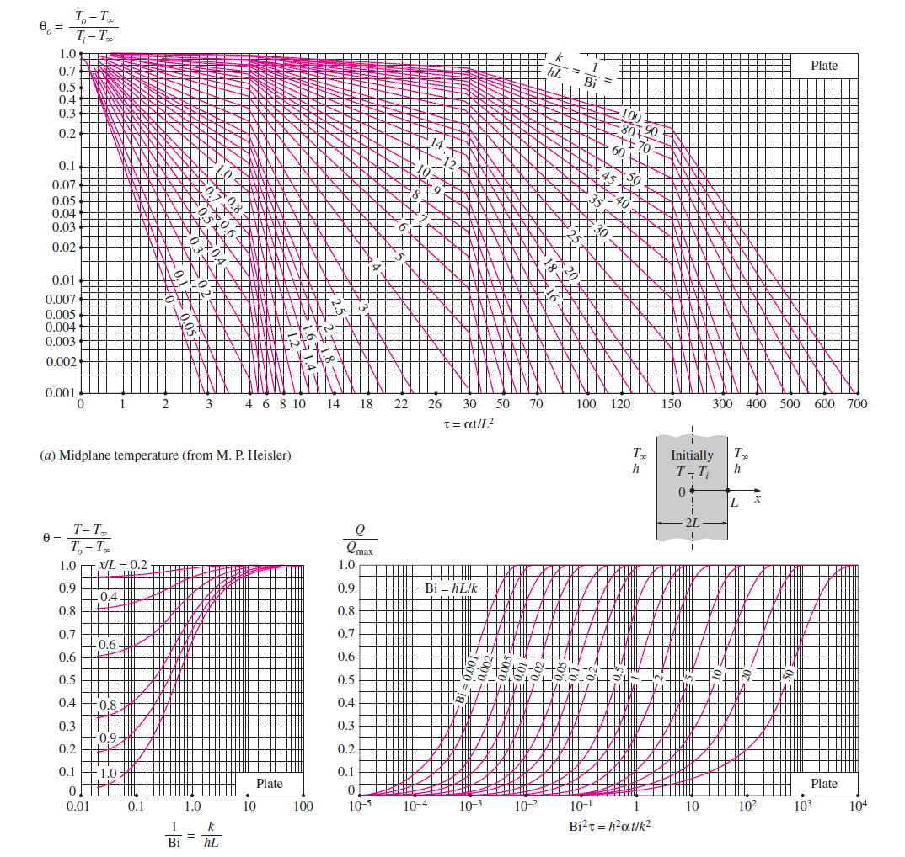

Slide 39
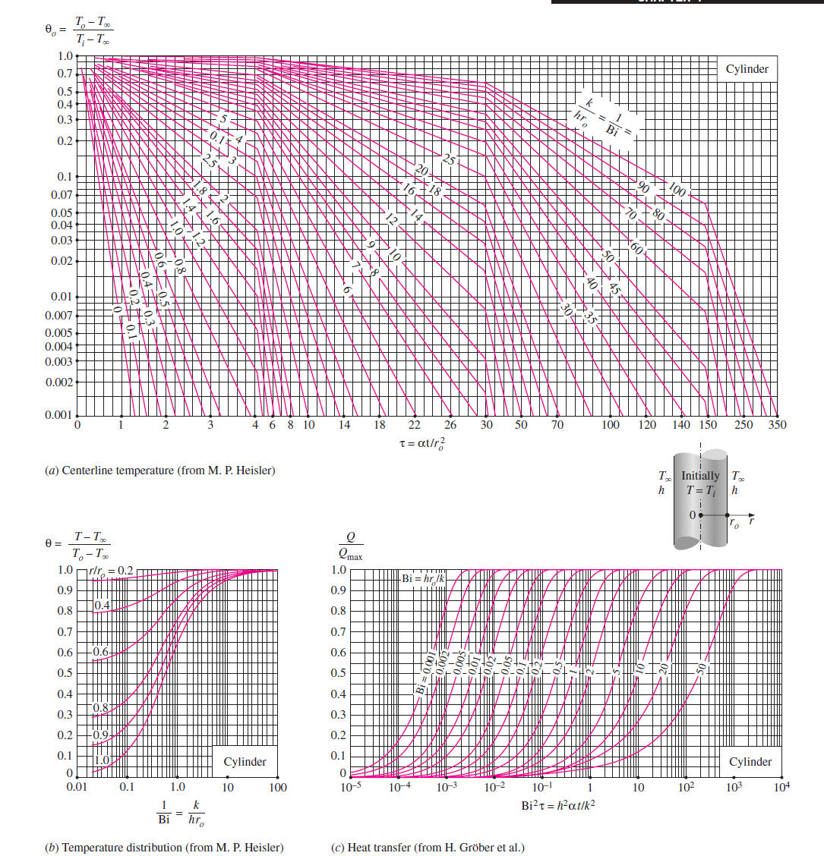

Slide 40
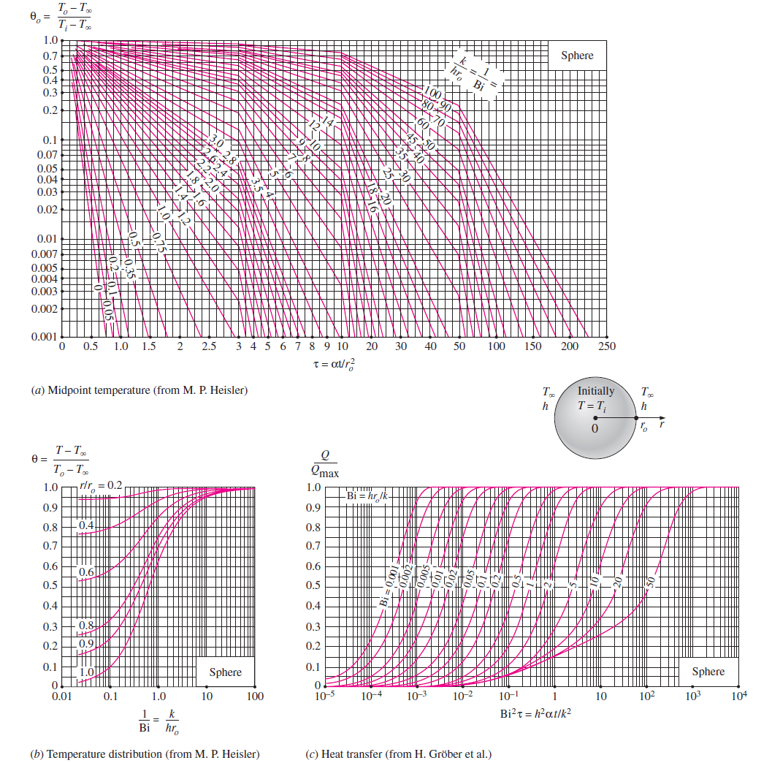

Slide 41
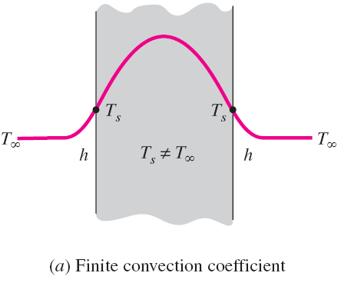
The dimensionless temperatures anywhere in a plane wall, cylinder, and sphere are related to the center temperature by
The specified surface temperature corresponds to the case of convection to an environment at T∞ with a convection coefficient h that is infinite.

Slide 42
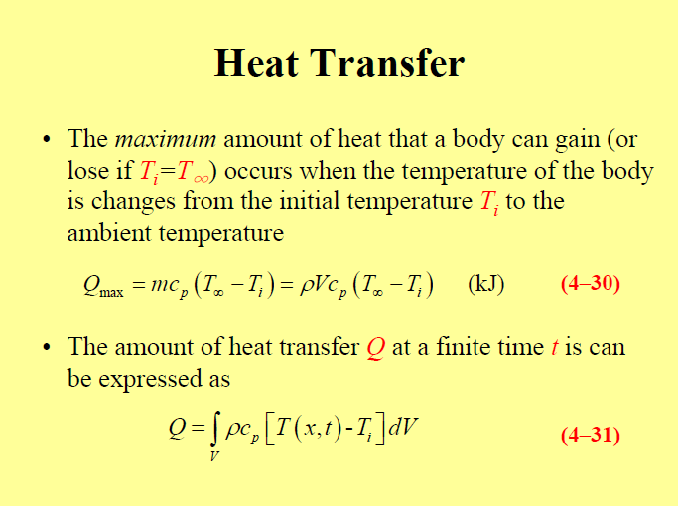

Slide 43
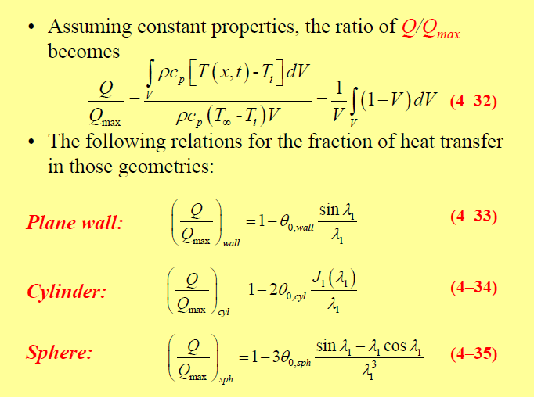
Θ

Slide 44
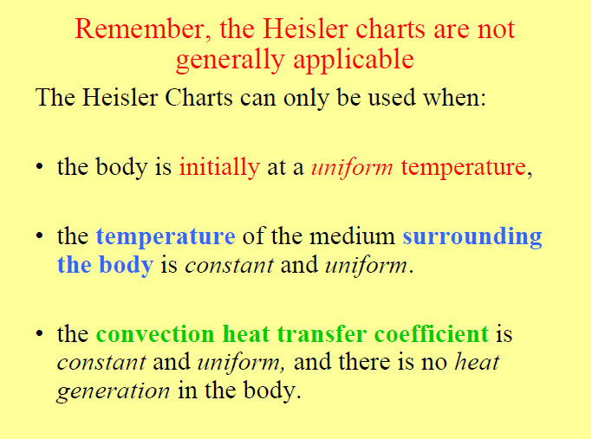

Slide 45


The fraction of total heat transfer Q/Q_{max} up to a specified time t is determined using the Gröber charts.

Slide 46
The physical significance of the Fourier number
in
The Fourier number is a measure of heat conducted through a body relative to heat stored.
A large value of the Fourier number indicates faster propagation of heat through a body.
Fourier number at time t can be viewed as the ratio of the rate of heat conducted to the rate of heat stored at that time.

Slide 47
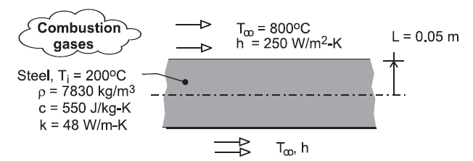
Transient Conduction : Spatial Effects & The role of analytical solutions
Problem 5.37
Annealing is a process by which steel is reheated and then cooled to make it less brittle. Consider the reheat stage for a 100 mm thick steel plate (ρ=7830 kg/m³, c=550 J/kgK, k=48 W/mK) which is initially at a uniform temperature of T_{i} = 200°C and is to be heated to a minimum temperature of 550°C. Heating is effected in a gas-fired furnace, where products of combustion at T∞ = 800°C maintain a convection coefficient of h = 250 W/m²K on both surfaces of the plate. How long should the plate be left in the furnace ?

Slide 48
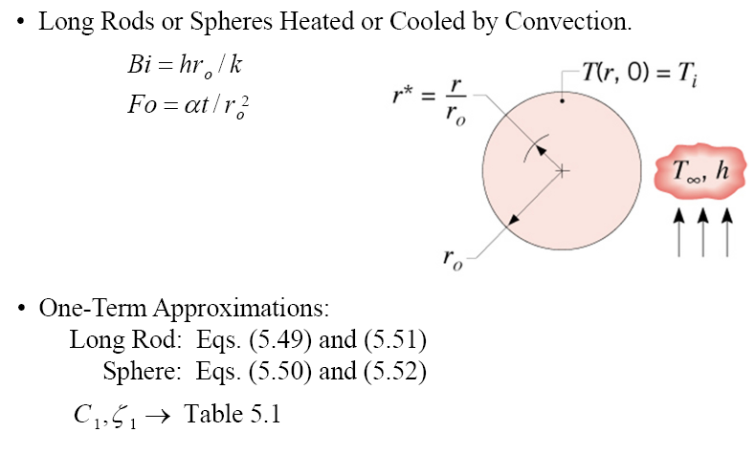
Transient Conduction : Spatial Effects & The role of analytical solutions
Radial Systems : Infinite cylinder & sphere

Slide 49



Transient Conduction : Spatial Effects & The role of analytical solutions
Textbook (Until Chapter 5.6)
Long rod (infinite cylinder):
*J₁ and J₀ are Bessel functions of the first kind (canonical function). Their values are tabulated in Appendix B4
Sphere:

Slide 50
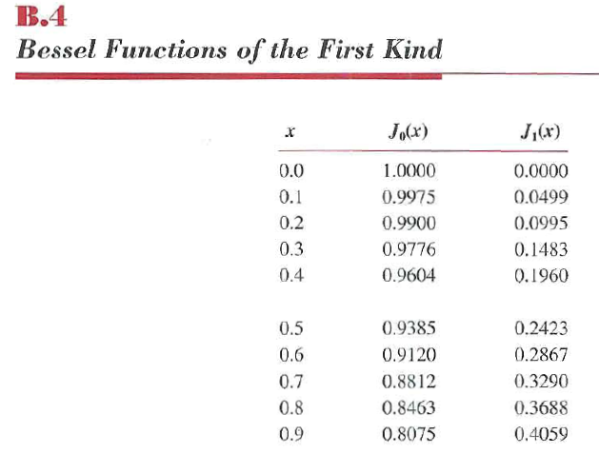
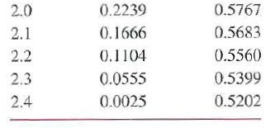

Slide 51
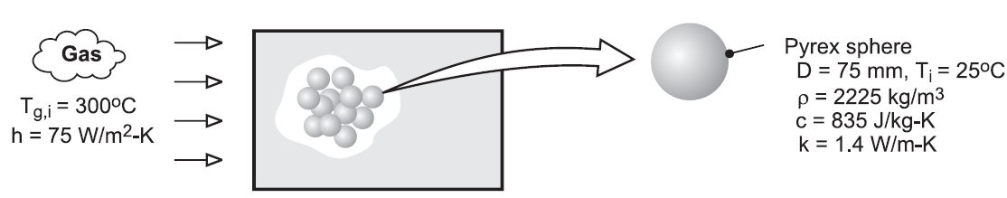
Transient Conduction : Spatial Effects & The role of analytical solutions
Problem 5.63
Consider the packed bed and the operating conditions of Problem 5.12, but with Pyrex sphere (ρ=2225 kg/m³, c=835 J/kgK, k=1.4 W/mK) used instead of aluminium.
How long does it take a sphere near the inlet of the system to accumulate 90% of the maximum possible thermal energy?
What is the corresponding temperature at the centre of the sphere?
What is the temperature at the surface of the sphere?
(

