Slide 1

Bessel Functions
Bessel functions, are canonical solutions y(x) of Bessel's differential equation:
α (the order of the Bessel function)
Bessel functions are also known as cylinder functions or cylindrical harmonics because they are found in the solution to Laplace's equation in cylindrical coordinates.

Slide 2
Applications of Bessel functions
Electromagnetic waves in a cylindrical waveguide
Heat conduction in a cylindrical object
Modes of vibration of a thin circular (or annular) artificial membrane (such as a drum or other membranophone)
Diffusion problems on a lattice
Solutions to the radial Schrödinger equation (in spherical and cylindrical coordinates) for a free particle
Solving for patterns of acoustical radiation
Frequency-dependent friction in circular pipelines

Slide 3

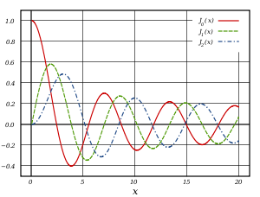
Bessel functions of the first kind : J_{α}

Slide 4

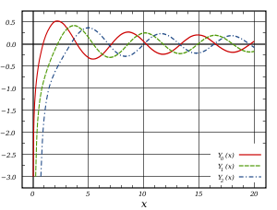
Bessel functions of the second kind : Y_{α}

Slide 5
Circular membrane

Slide 6

Modified Bessel Equation

Slide 7

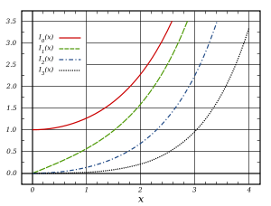
Modified Bessel functions : I_{α}, K_{α}

Slide 8
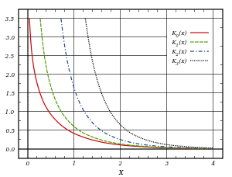
Modified Bessel functions : I_{α}, K_{α}

