Slide 1
One-Dimensional Steady-State Conduction
Conduction problems may involve multiple directions and time-dependent conditions
Inherently complex – Difficult to determine temperature distributions
One-dimensional steady-state models can represent accurately numerous engineering systems
In this chapter we will
  Learn how to obtain temperature profiles for common geometries with and without heat generation.
  Introduce the concept of thermal resistance and thermal circuits

Slide 2
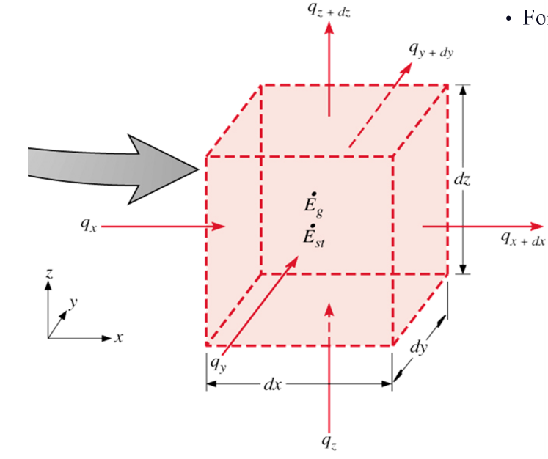

Chapter 2 : Introduction to Conduction
For cartesian coordinates
(2.17)

Slide 3
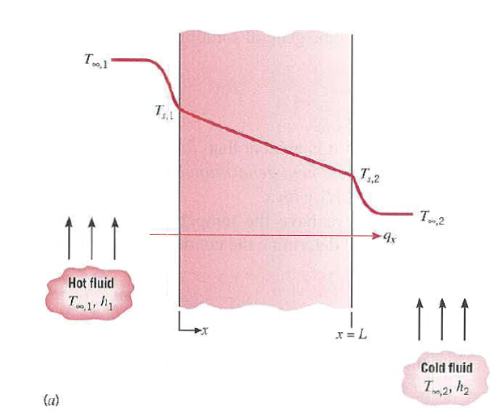
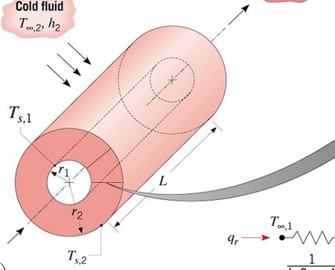
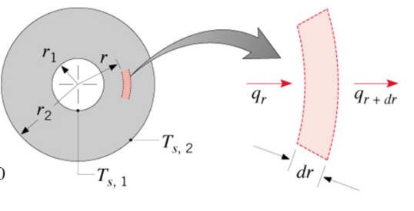
Chapter 3 : One-dimensional, Steady state conduction (without thermal generation)
3.1 Methodology of a conduction analysis
Specify appropriate form of the heat equation
Solve for the temperature distribution
Apply Fourier’s law to determine the heat flux
Simplest case:
- One-dimensional, steady state conduction with no thermal energy generation
Common geometries:
The plane wall: described in rectangular (x) coordinate. Area perpendicular to direction of heat transfer is constant (independent of x).
Cylindrical wall : radial conduction through tube wall
Spherical wall : radial conduction through shell wall

Slide 4
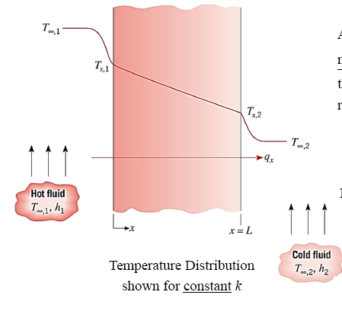


Chapter 3 : One-dimensional, Steady state conduction (without thermal generation)
3.2 The plane wall – temperature distribution
Using Eq. (2.2) in Chapter 2, by
assuming steady-state conditions and no internal heat generation (i.e. q = 0), then the 1-D heat conduction equation reduces to:
.
For constant k and A, second order differential equation:
This mean:
Heat flux (q”_{x}) is independent of x
Heat rate (q_{x}) is independent of x
Boundary conditions: T(0) = T_{s,1}
T(L) = T_{s,2}

Slide 5
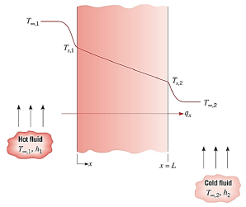
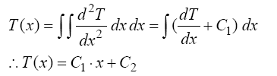



Chapter 3 : One-dimensional, Steady state conduction (without thermal generation)
1-D heat conduction equation for steady-state conditions and no internal heat generation (i.e. q = 0), is
.
for constant k and A
Integrate twice to get T(x)
For boundary conditions: T(0) = T_{s,1} and T(L) = T_{s,2}
at x = 0, T(x) = T_{s,1} and C₂ = T_{s,1}
at x = L, T(x) = T_{s,2} and T_{s,2} = C₁ L + C₂ = C₁ L + T_{s,1}
this gives, C₁ = (T_{s,2} – T_{s,1})/2
Using value of C₁ and C₂, the function of T(x) is
and
*From here, apply Fourier’s law to get heat transfer, q_{x}

Slide 6


Chapter 3 : One-dimensional, Steady state conduction (without thermal generation)
Heat flux for plane wall (simplest case):
Heat rate for plane wall (simplest case):

Slide 7
Chapter 3 : One-dimensional, Steady state conduction (without thermal generation)
Example: Temp distribution problem
Consider a large plane wall of thickness L = 0.2 m, thermal conductivity k = 1.2 W/mK, and surface area, A = 15m². The two sides of the wall are maintained at constant temperatures of T₁ = 120°C and T₂ = 50°C. Determine,
The temperature distribution equation within the wall
Value of temperature at thickness of 0.1m
The rate of heat conduction through the wall under steady conditions

Slide 8
Thermal Resistance
Based on the previous solution, the conduction heat transfer rate can be calculated:
.
(3.2a)
Similarly for heat convection, Newton’s law of cooling applies:
.
(3.2b)
And for radiation heat transfer:
.
(3.2c)
Recall electric circuit theory - Ohm’s law for electrical resistance:

Slide 9
Thermal Resistance
We can use this electrical analogy to represent heat transfer problems using the concept of a thermal circuit (equivalent to an electrical circuit).
.
Compare with equations 3.2a-3.2c
The temperature difference is the “potential” or driving force for the heat flow and the combinations of thermal conductivity, convection coefficient, thickness and area of material act as a resistance to this flow:

Slide 10


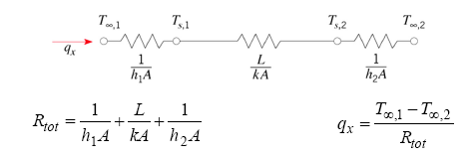
Chapter 3 : One-dimensional, Steady state conduction (without thermal generation)
3.2.1 Thermal resistances & Thermal circuits
Interestingly, there exists an analogy between the diffusion of heat and electrical charge. For example if an electrical resistance is associated with the conduction of electricity, a thermal resistance may be associated with the conduction of heat.
Defining thermal resistance for conduction in a plane wall:
For convection :
For previous simplest case, thermal circuit for plane wall with adjoining fluids:

Slide 11


Chapter 3 : One-dimensional, Steady state conduction (without thermal generation)
3.2.1 Thermal resistances & Thermal circuits
In case of radiation :
(3.13)
where,
(1.9)
Surface temperature
Surrounding temperature

Slide 12
Chapter 3 : One-dimensional, Steady state conduction (without thermal generation)
Example: (Problem 3.2a)
The rear window of an automobile is defogged by passing warm air over its inner surface. If the warm air is at T_{∞,i} = 40°C and the corresponding convection coefficient is h_{i} = 30 W/m²K, what are the inner and outer surface temperatures of 4-mm thick window glass, if the outside ambient air temperature is T_{∞,o} = -10°C and the associated convection coefficient is h_{o} = 65 W/m²K.

Slide 13
Chapter 3 : One-dimensional, Steady state conduction (without thermal generation)
Example (problem 3.5):
The walls of a refrigerator are typically constructed by sandwiching a layer of insulation between sheet metal panels. Consider a wall made from fibreglass insulation of thermal conductivity, k_{i} = 0.046 W/mK and thickness L_{i} = 50 mm and steel panels, each of thermal conductivity k_{p} = 60 W/mK and thickness L_{p} = 3 mm. If the wall separates refrigerated air at T_{∞,o} = 25°C, what is the heat gain per unit surface area ?
Coefficients associated with natural convection at the inner and outer surfaces can be approximated as h_{i} = h_{o} = 5 W/m²K

Slide 14
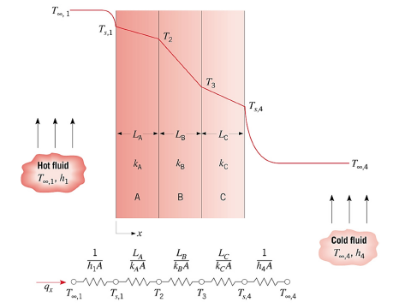
Chapter 3 : One-dimensional, Steady state conduction (without thermal generation)
3.2.2 The composite wall (with negligible contact resistance)

Slide 15



Chapter 3 : One-dimensional, Steady state conduction (without thermal generation)
The composite wall (series type)
Composite wall with negligible contact resistance:
where,
Overall heat transfer coefficient:
* A modified form of Newton’s Law of cooling to encompass multiple resistances to heat transfer

Slide 16
Composite Walls
What is the heat transfer rate for this system?
.
Alternatively
where U is the overall heat transfer coefficient and ΔT the overall temperature difference.

Slide 17
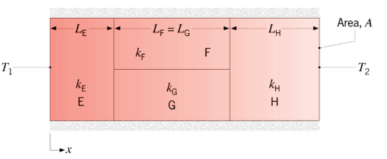
Chapter 3 : One-dimensional, Steady state conduction (without thermal generation)
The composite wall (parallel type)

Slide 18
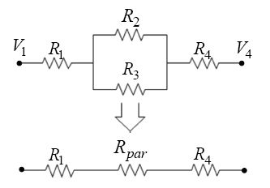
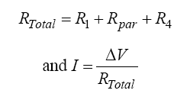

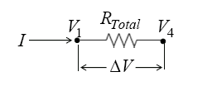
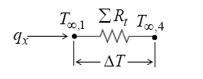

Chapter 3 : One-dimensional, Steady state conduction (without thermal generation)
The composite wall (parallel type)
Electric analogy of thermal circuits
- To solve a parallel resistance network like that shown opposite, we can reduce the network to and equivalent resistance
For electrical circuits:
For thermal circuits:

Slide 19
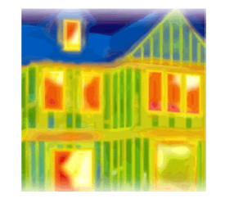
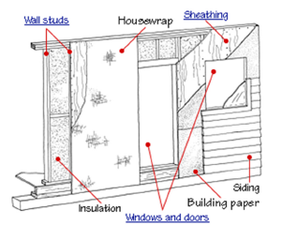
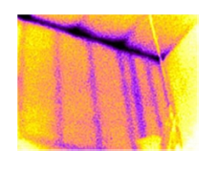
Chapter 3 : One-dimensional, Steady state conduction (without thermal generation)
Example: parallel resistances
*IR (infrared) photos show that the heat transfer through the built-up walls is more complex than predicted by a simple parallel-resistance.

Slide 20
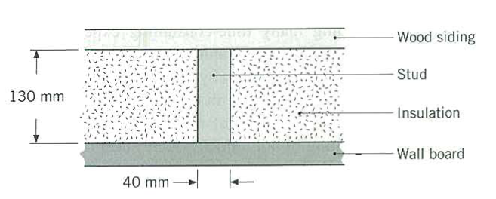
Chapter 3 : One-dimensional, Steady state conduction (without thermal generation)
Example: (3.15)
Consider a composite wall that includes an 8-mm thick hardwood siding, 40 mm by 130 mm hardwood studs on 0.65 m centers with glass fibre insulation (paper faced, 28 kg/m3) and a 12 mm layer of gypsum wall board.
What is the thermal resistance associated with a wall that is 2.5 m high by 6.5 m wide (having 10 studs, each 2.5 m high)

Slide 21
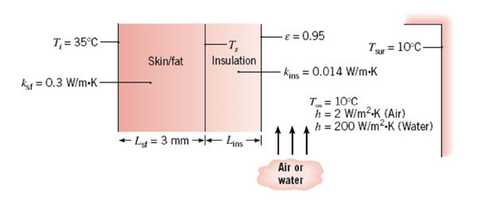
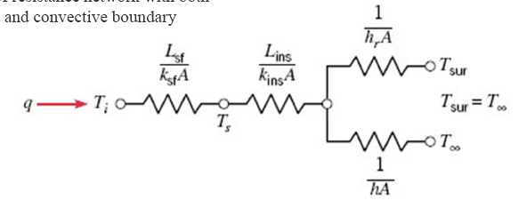
Chapter 3 : One-dimensional, Steady state conduction (without thermal generation)
Example of resistance network with both radiative and convective boundary (Example 3.1)

Slide 22
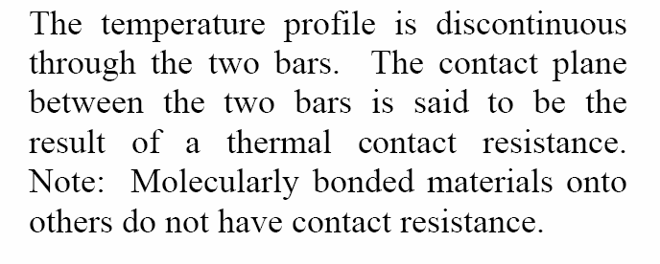
Contact Resistance

Slide 23
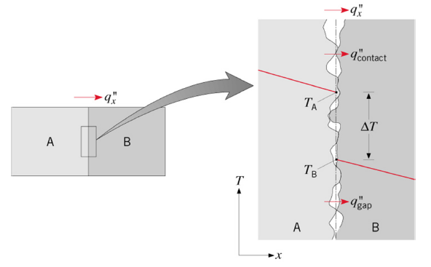

Chapter 3 : One-dimensional, Steady state conduction (without thermal generation)
3.3 Contact resistance
It is important to recognise that, in composite systems, the temperature drop across the interface between material may be appreciable (present analysis is neglected).
This attributed is due to thermal contact resistance R_{t,c}
*values depend on: materials A and B, surface finishes, interstitial conditions and contact pressure

Slide 24
Composite Walls – with contact resistances

Slide 25
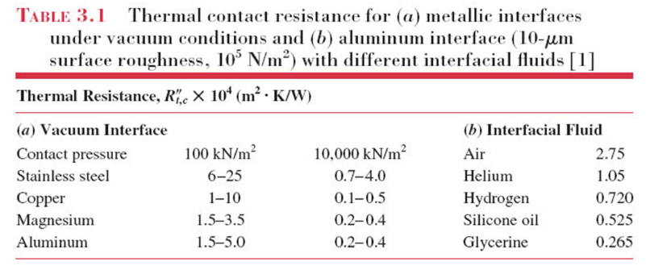
Chapter 3 : One-dimensional, Steady state conduction (without thermal generation)

Slide 26
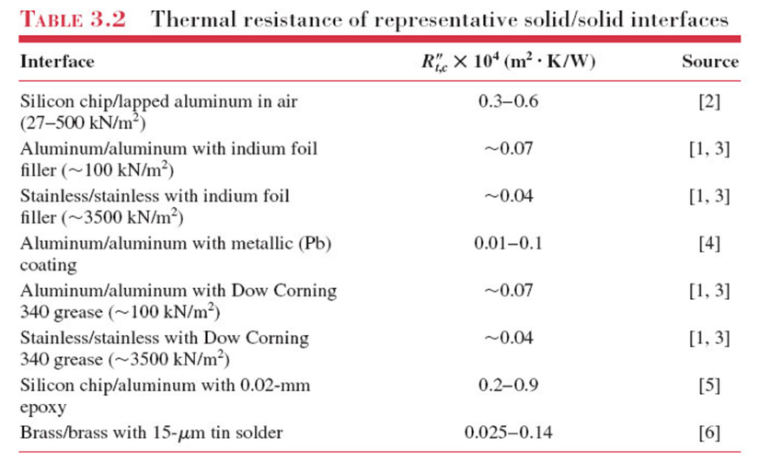
Chapter 3 : One-dimensional, Steady state conduction (without thermal generation)

Slide 27

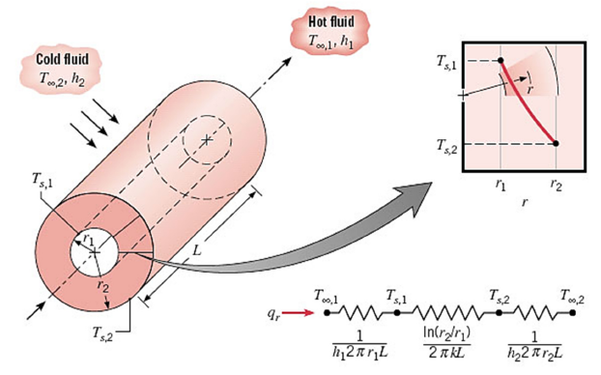



Chapter 3 : One-dimensional, Steady state conduction (without thermal generation)
3.3 Radial systems: cylindrical wall
General heat equation for cylinder (from Chap. 2)
For 1-D steady state, with no heat generation
Integrate twice to get temperature distribution, T(r). For example, for constant temperature boundary:
From T(r), heat flux for cylinder

Slide 28




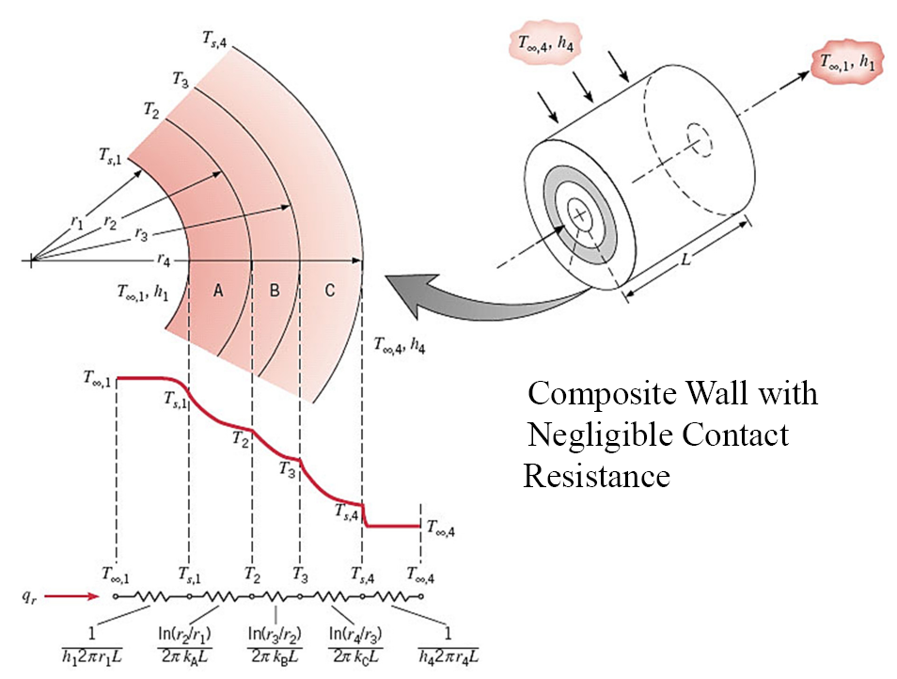
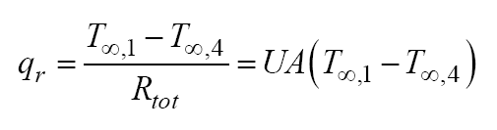
Chapter 3 : One-dimensional, Steady state conduction (without thermal generation)
The thermal resistance for radial conduction
In case of cylinder with composite wall (negligible contact resistance)

Slide 29
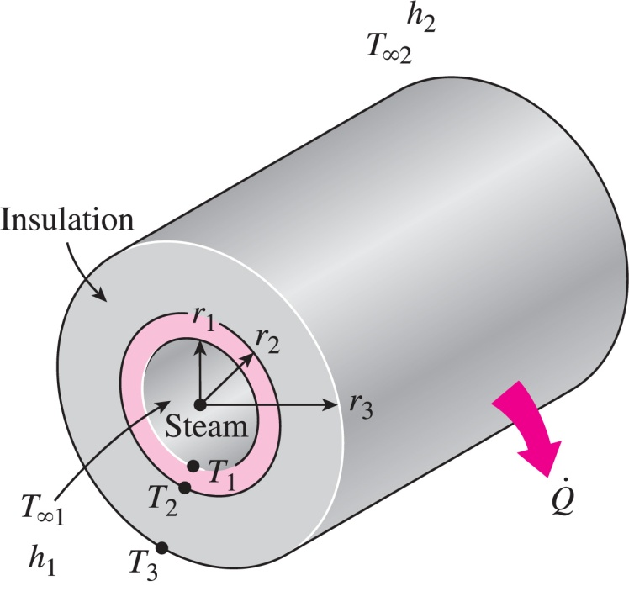
Chapter 3 : One-dimensional, Steady state conduction (without thermal generation)
Critical radius for insulation
Adding more insulation to a wall → decrease heat transfer
The thicker the insulation, the lower the heat transfer through the wall
However, adding insulation to a cylindrical pipe or a spherical shell is a different matter.
Additional insulation increase the conduction resistance of the insulation layer but decrease the convection resistance of the surface because of the increase in the outer surface area for convection
Hence, knowledge of critical radius of insulation is required

Slide 30

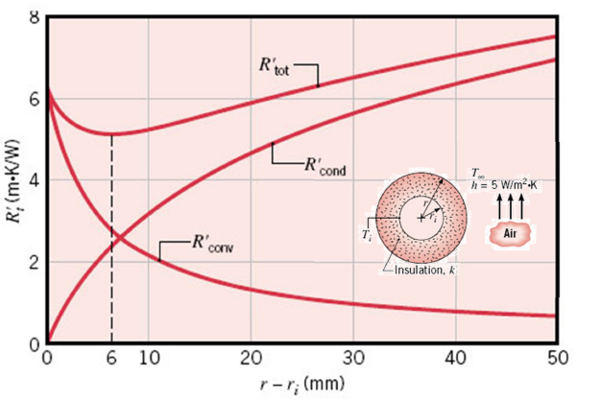
Chapter 3 : One-dimensional, Steady state conduction (without thermal generation)
Critical radius for insulation: see example 3.5 in Textbook for details
Insulation prop.
Outside conv. coeff.
If r_{i} < r_{cr}, R_{tot} decreases and the heat rate therefore increases with insulation
If r_{i} > r_{cr}, R_{tot} increases and therefore heat rate decreases with insulation

Slide 31
Chapter 3 : One-dimensional, Steady state conduction (without thermal generation)
Example 3.39: cylinder
A stainless steel (AISI 304) tube used to transport a chilled pharmaceutical has an inner diameter of 36 mm and a wall thickness of 2 mm. The pharmaceutical and ambient air are at temperatures of 6°C and 23°C, respectively, while the corresponding inner and outer convection coefficients are 400 W/m²K and 6 W/m²K, respectively.
What is the heat gain per unit tube length (W/m) ?
What is the heat gain per unit length if a 10-mm thick layer of calcium silicate insulation (k_{ins} = 0.050 W/mK) is applied to the tube. Discuss the result with the knowledge of r_{crit} .
(12.6 W/m, 7.7 W/m)

Slide 32


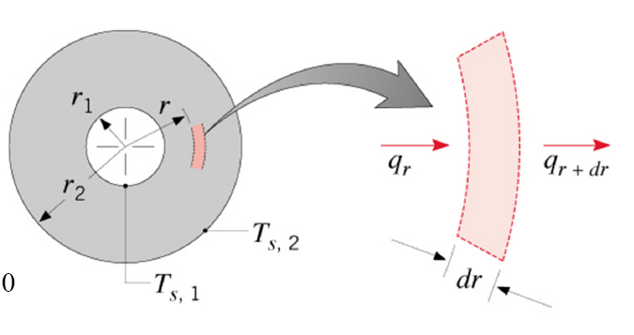
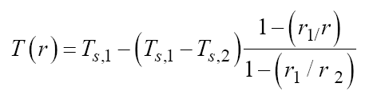
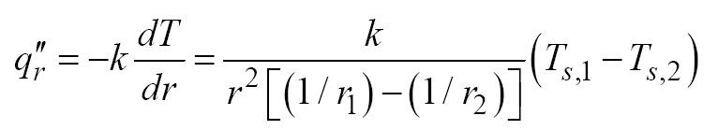
Chapter 3 : One-dimensional, Steady state conduction (without thermal generation)
3.4 Radial systems: spherical wall
General heat equation for sphere (from Chap. 2)
For 1-D steady state, with no heat generation
Integrate twice to get temperature distribution for constant k, T(r)
From T(r), heat flux for sphere

Slide 33
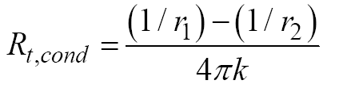
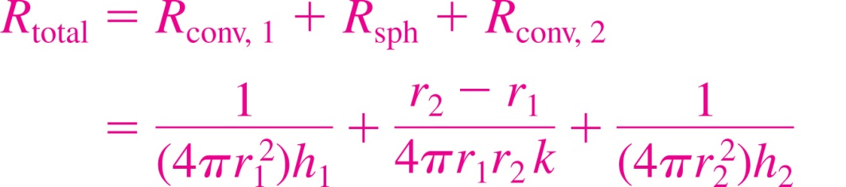
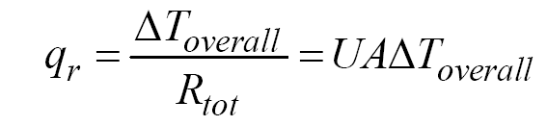
Chapter 3 : One-dimensional, Steady state conduction (without thermal generation)
The thermal resistance for radial conduction in sphere
The total thermal resistance due to conduction and convection in sphere
In case of sphere with composite shell (negligible contact resistance)

Slide 34
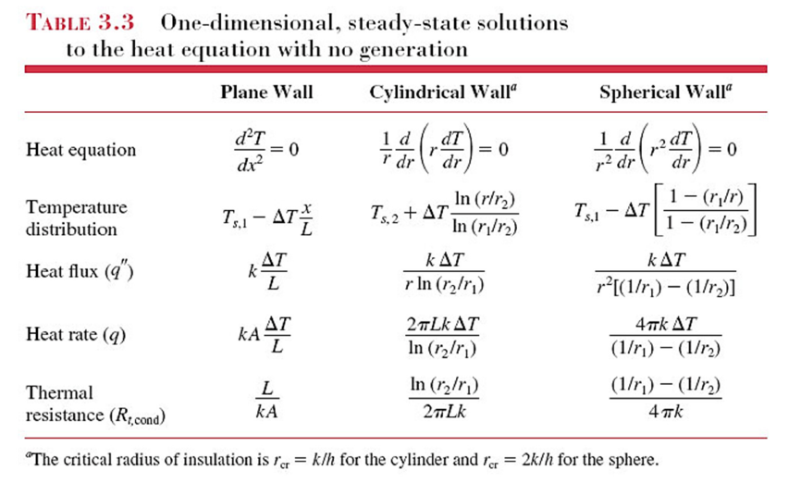
Chapter 3 : One-dimensional, Steady state conduction (without thermal generation)
Summary

Slide 35
Chapter 3 : One-dimensional, Steady state conduction (without thermal generation)
Example 3.54:
A storage tank consists of a cylindrical section that has a length and inner diameter of L=2m and D_{i}=1m, respectively, and two hemispherical end sections. The tank is constructed from 20 mm thick glass (Pyrex) and is exposed to ambient air for which the temperature is 300K and the convection coefficient is 10 W/m²K. The tank is used to store heated oil, which maintains the inner surface at a temperature of 400K. Determine the electrical power that must be supplied to a heater submerged in the oil if the prescribed conditions are to be maintained. Radiation effects may be neglected, and the Pyrex may be assumed to have a thermal conductivity of 1.4 W/mK.

