Slide 1
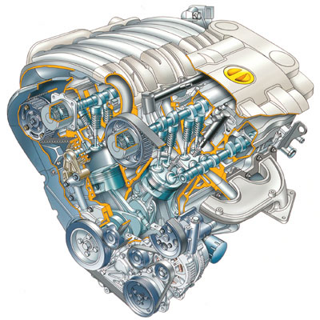
Thermodynamics II
Chapter 4
Internal Combustion Engines
Mohsin Mohd Sies
Fakulti Kejuruteraan Mekanikal,
Universiti Teknologi Malaysia

Slide 2
Coverage
Introduction
Operation of IC Engines
Ideal Cycles
  Otto Cycle
  Diesel Cycle
  Dual Cycle
Parameters
  Power
  Mean Effective Pressure
  Compression Ratio
  Cut-off Ratio
  Thermal Efficiency
Reciprocating Engine Performance
  Dynamometer
  Rates
  Mean Piston Speed
  Power
  Mean Effective Pressure
  Thermal Efficiency
  Volumetric Efficiency
  Mechanical Efficiency
  Specific Fuel Consumption

Slide 3

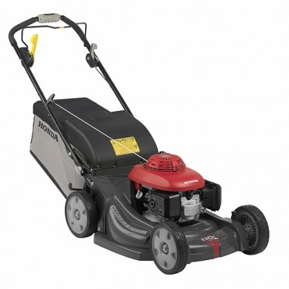
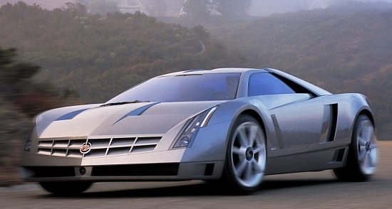
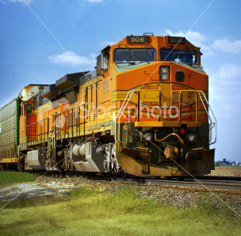
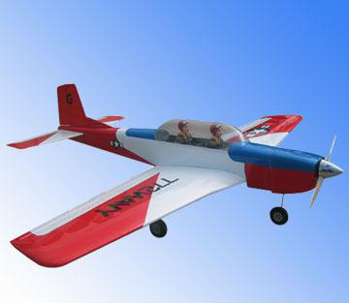
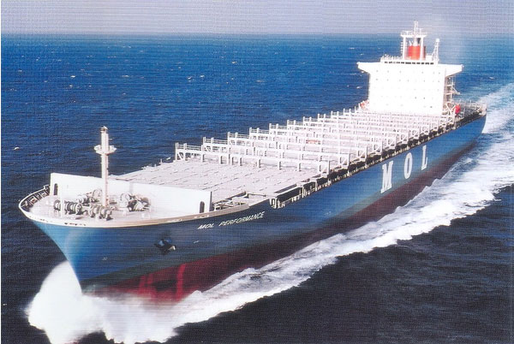
Internal Combustion Engines
The internal combustion engine is an engine in which the combustion of fuel-oxidizer mixture occurs in a confined space for the purpose of converting the combustion heat into mechanical work
Applied in:
automotive
rail transportation
power generation
ships
aviation
garden appliances

Slide 4
IC Engine Operation
IC Engines operate as
  4 stroke
  2 stroke
  Petrol
  Diesel

Slide 5
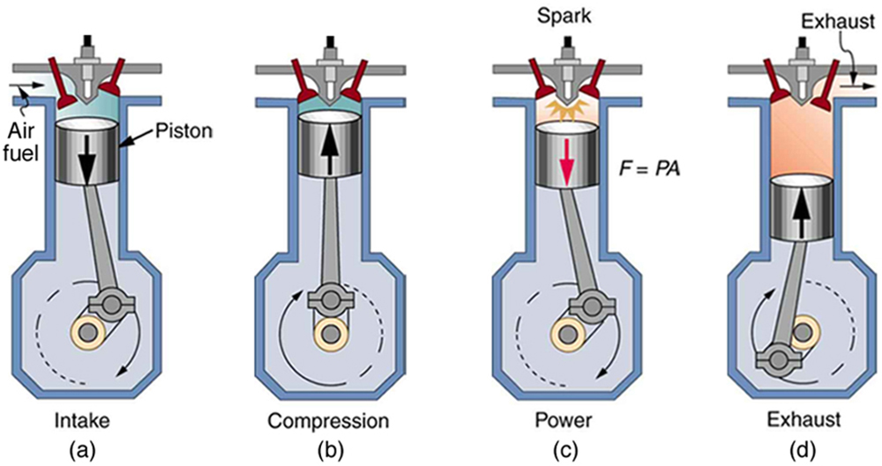
4 Stroke Cycle Processes

Slide 6
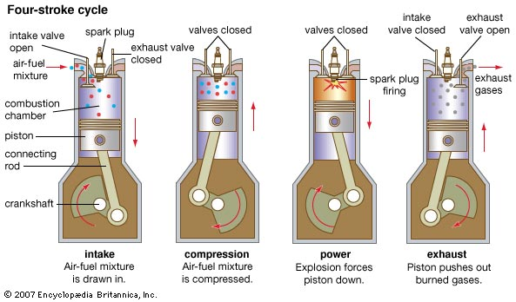
4 Stroke Cycle Processes

Slide 7
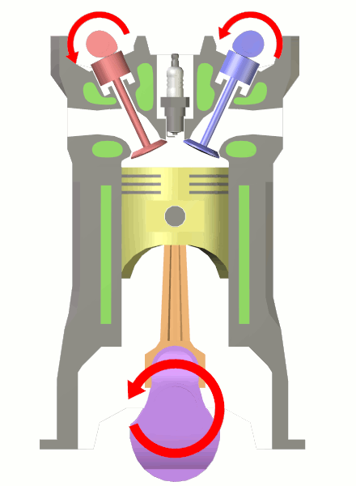
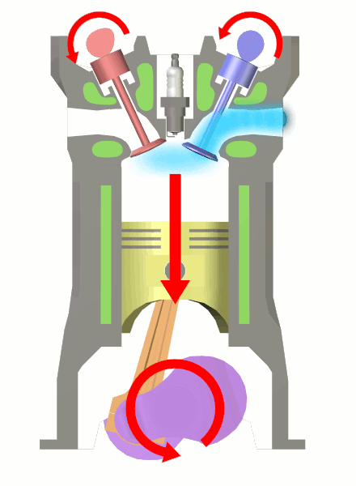
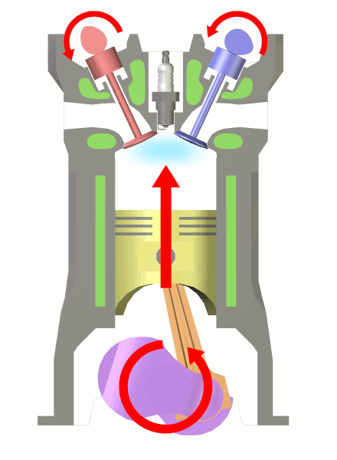
Internal Combustion Engines
– four stroke (Otto)
starting position
1. intake
2. compression
a. piston starts moving down
b. intake valve opens
c. air-fuel mixture gets in
a. piston moves up
b. both valves closed
c. air-fuel mixture gets compressed

Slide 8
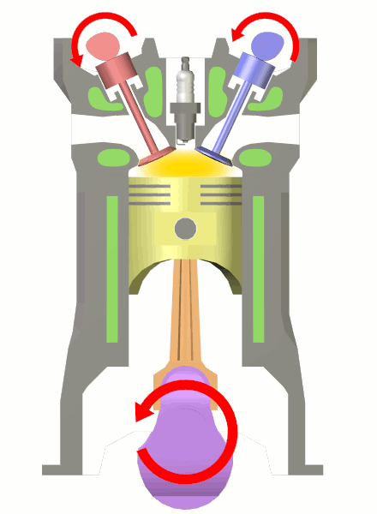
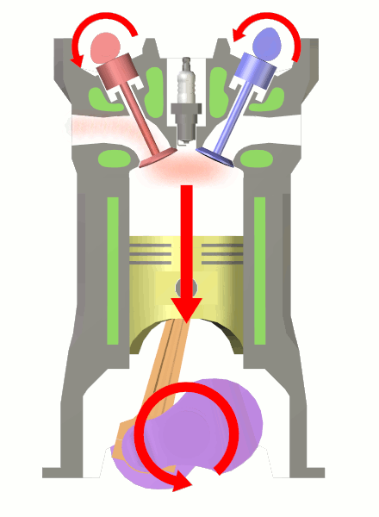
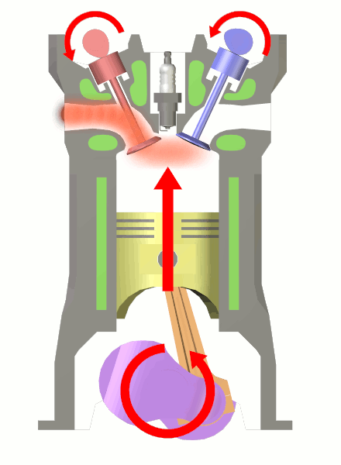
Internal Combustion Engines
– four stroke -
ignition
3. power
4. exhaust
a. air-fuel mixture explodes driving the piston down
a. piston moves up
b. exhaust valve opens c. exhaust leaves the cylinder

Slide 9
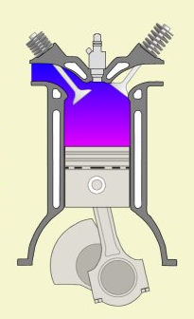
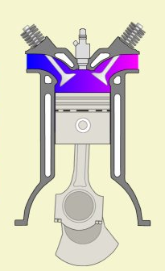
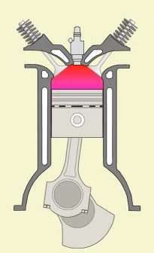
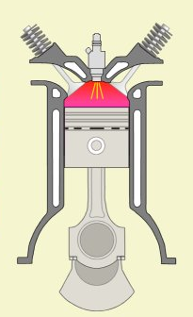
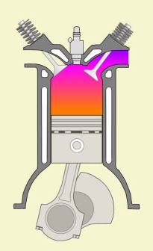
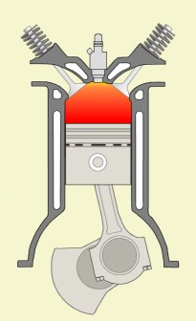
Internal Combustion Engines
– 4 Stroke (Diesel)
air intake
exhaust /intake
compression
fuel injection
exhaust
combustion

Slide 10
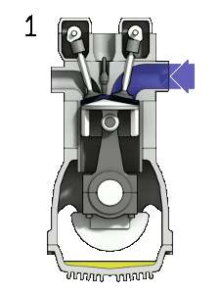
Four-stroke cycle (or Otto cycle)
1. Induction
2. Compression
3. Power
4. Exhaust

Slide 11
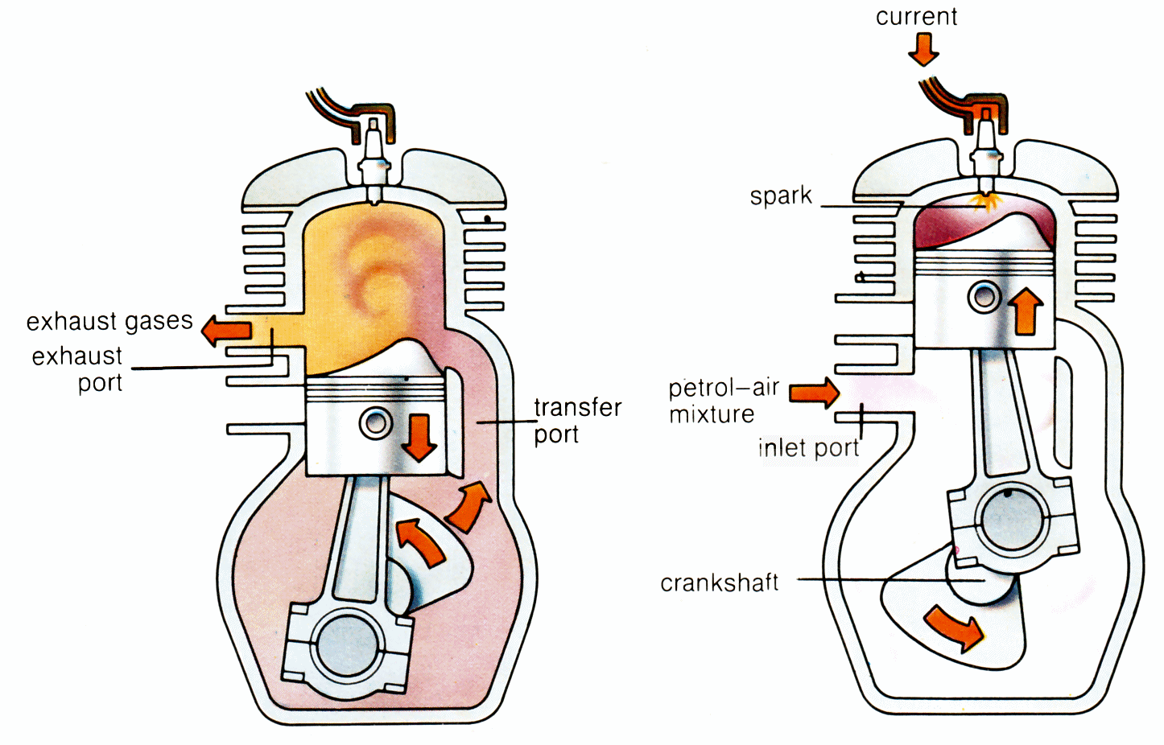
Internal Combustion Engines – two stroke
1. Power / Exhaust
2. Intake / Compression
ignition
piston moves downward compressing fuel-air mixture in the crankcase
exhaust port opens
inlet port opens
compressed fuel-air mixture rushes into the cylinder
piston upward movement provides further compression

Slide 12
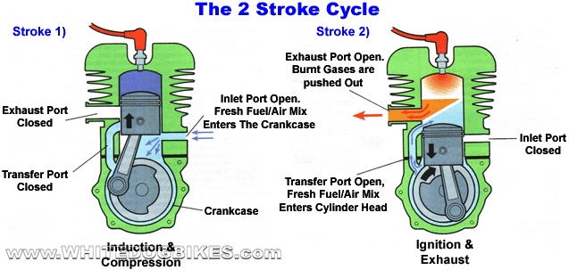
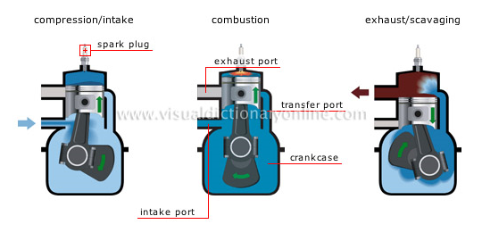

Slide 13
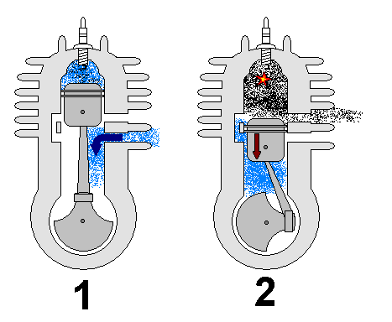
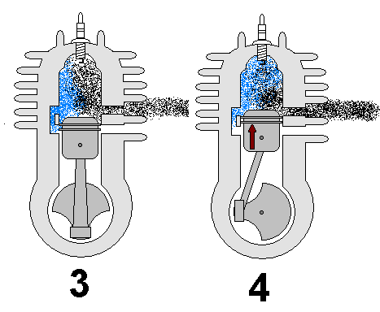
2 Stroke Cycle Processes
Intake / Compression
Power / Exhaust (& Transfer)

Slide 14
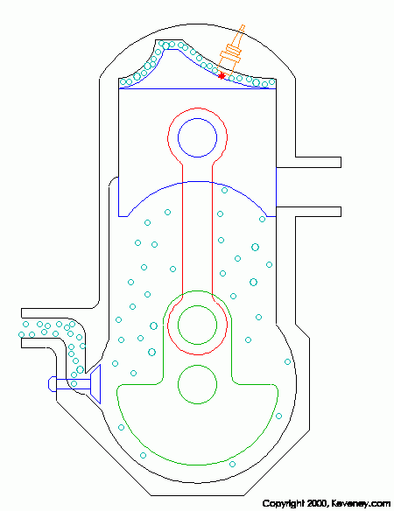
2 Stroke Cycle

Slide 15
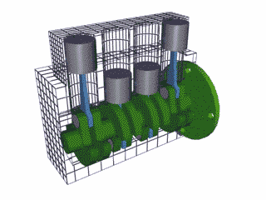
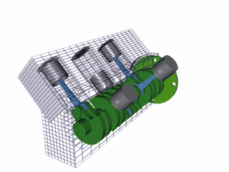
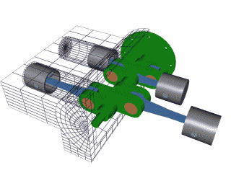
Configuration
Inline - The cylinders are arranged in a line, in a single bank
V - The cylinders are arranged in two banks, set at an angle to one another.
Flat - The cylinders are arranged in two banks on opposite sides of the engine
Radial

Slide 16
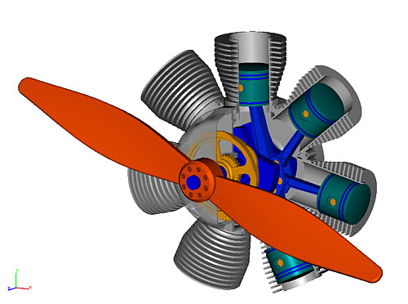
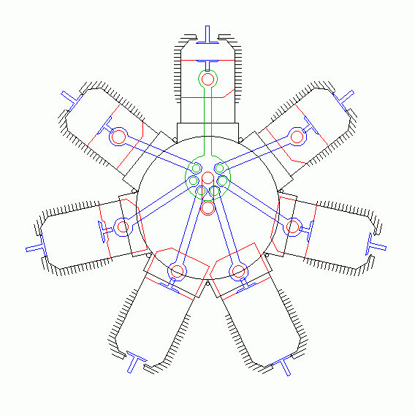
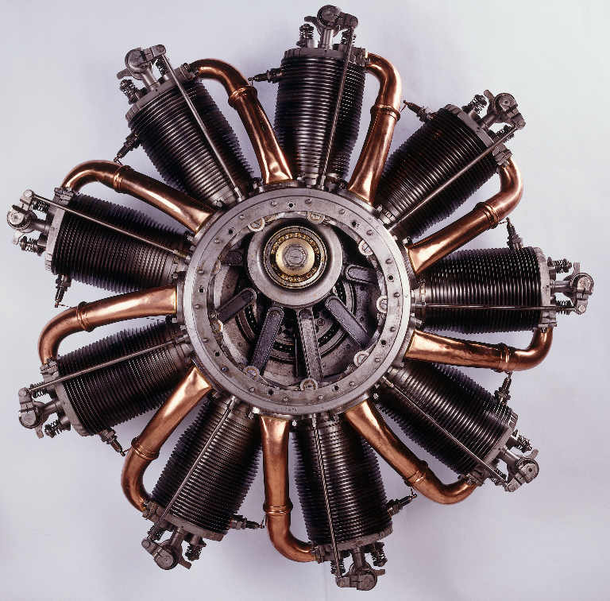
Internal Combustion Engines
– Radial

Slide 17
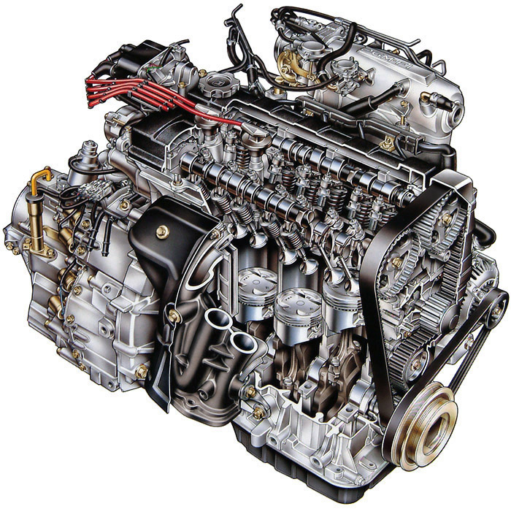
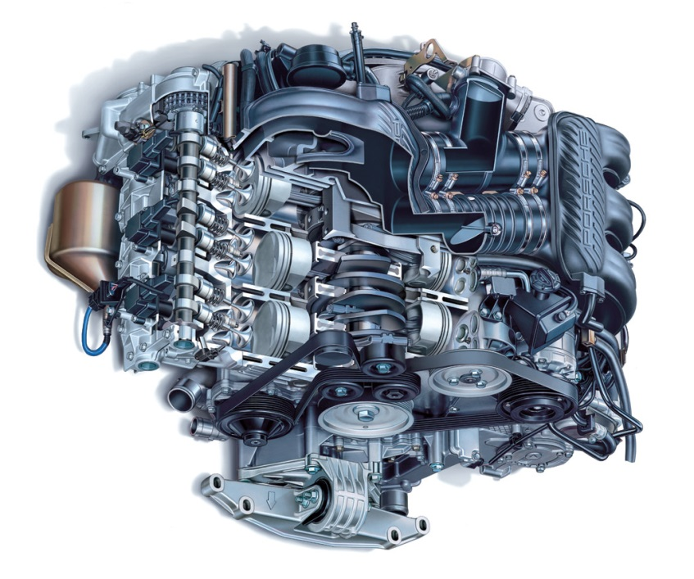
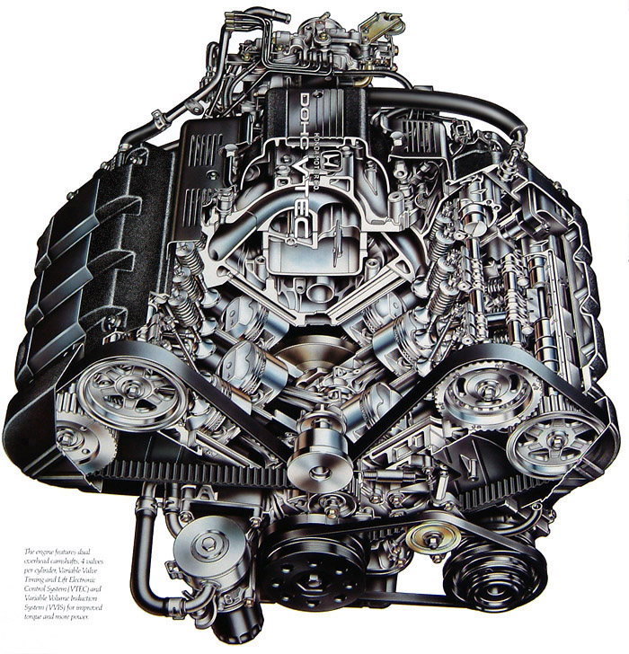
Internal Combustion Engines
– multi-cylinder -
inline
flat
“boxer”
V

Slide 18
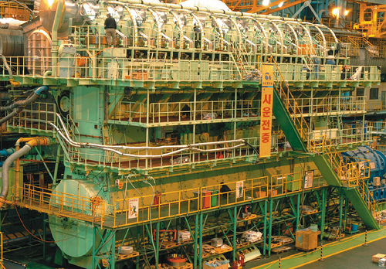
Internal Combustion Engines
– multi-cylinder -
14 cylinder Diesel engine (80 MW)

Slide 19
4 Stroke vs 2 Stroke
Each process in own stroke
1 cycle = 2 crank revolution
1 power stroke per 2 crank rev.
More economical fuel consumption
Less pollution
More complicated mechanically
Processes share strokes
1 cycle = 1 crank revolution
1 power stroke per crank rev.
Less economical (fuel short circuiting)
More pollution
Simpler & lighter construction

Slide 20
Petrol vs Diesel
Petrol as fuel
Otto Cycle
Spark Ignition (SI) (spark plug)
Compression ratio ~7:1 to ~11:1
Fuel-Air Mixture induced (carburetor)
Less economical fuel consumption
Diesel as fuel
Diesel Cycle
Compression Ignition (CI) (no spark plug)
Compression ratio ~12:1 to ~24:1
Only air is induced (fuel injection)
More economical fuel consumption

Slide 21
Petrol vs Diesel (cont.)
Less pollution
Lighter & cheaper
More pollution
Heavier & more expensive
Both can be implemented using either 4 stroke or 2 stroke

Slide 22
Classification
Conventional Reciprocating Internal Combustion Engine
By Mechanical Operation
By Thermodynamic Cycle
4 Stroke
2 Stroke
Otto
Diesel
Petrol (Otto)
(SI)
Diesel (CI)
4 Stroke
2 Stroke

Slide 23
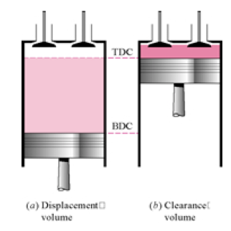
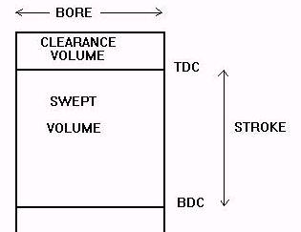
Piston-cylinder terminologies
TDC – Top Dead Center
BDC – Bottom Dead Center

Slide 24
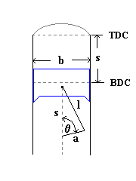
Piston-cylinder terminologies
b – Bore, Diameter
s – Stroke
l – Connecting Rod Length
a – Crank Throw = ½ stroke

Slide 25
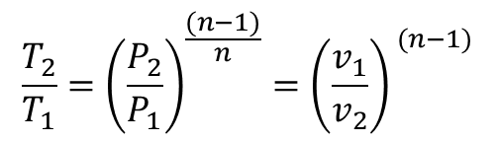
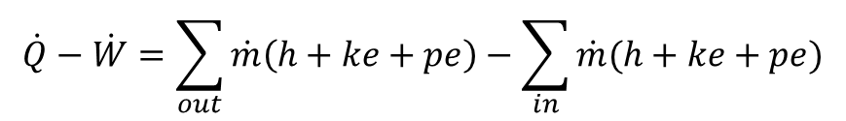

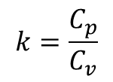

Review
SSSF Energy Equation
$$\dot{Q}−\dot{W}=\sum_{out}{\dot{m}\left(h+ke+pe\right)}−\sum_{in}{\dot{m}(h+ke+pe)}$$
Relationship of P, v, T between two states under polytropic process for ideal gases
$$\frac{T_{2}}{T_{1}}={\left(\frac{P_{2}}{P_{1}}\right)}^{\frac{(n−1)}{n}}={\left(\frac{v_{1}}{v_{2}}\right)}^{ (n−1)}$$
For an isentropic process
$$n=k$$
Specific Heat Ratio
$$k=\frac{C_{p}}{C_{v}}$$
$$C_{p}−C_{v}=R$$

Slide 26
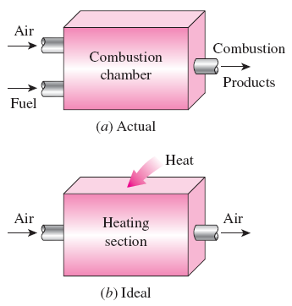
AIR-STANDARD ASSUMPTIONS
Air-standard assumptions:
The working fluid is air, which continuously circulates in a closed loop and always behaves as an ideal gas.
All the processes that make up the cycle are internally reversible.
The combustion process is replaced by a heat-addition process from an external source.
The exhaust process is replaced by a heat-rejection process that restores the working fluid to its initial state.
The combustion process is replaced by a heat-addition process in ideal cycles.
Cold-air-standard assumptions: When the working fluid is considered to be air with constant specific heats at room temperature (25°C).
Air-standard cycle: A cycle for which the air-standard assumptions are applicable.

Slide 27
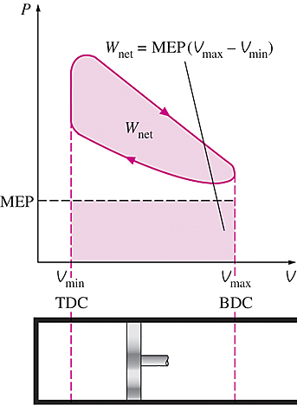
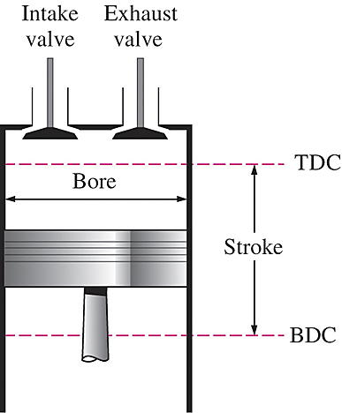
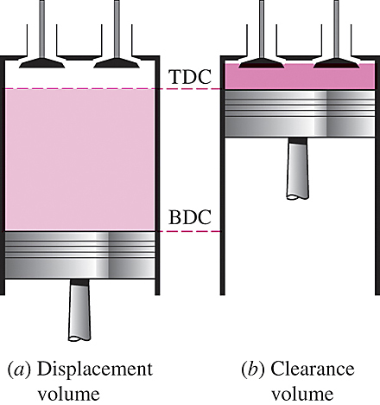
AN OVERVIEW OF RECIPROCATING ENGINES
Compression ratio
Mean effective pressure
Spark-ignition (SI) engines
Compression-ignition (CI) engines
Nomenclature for reciprocating engines.

Slide 28
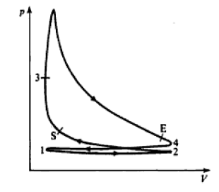
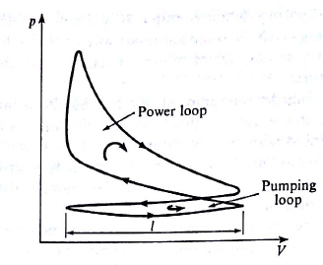
P-v diagram of real engines

Slide 29
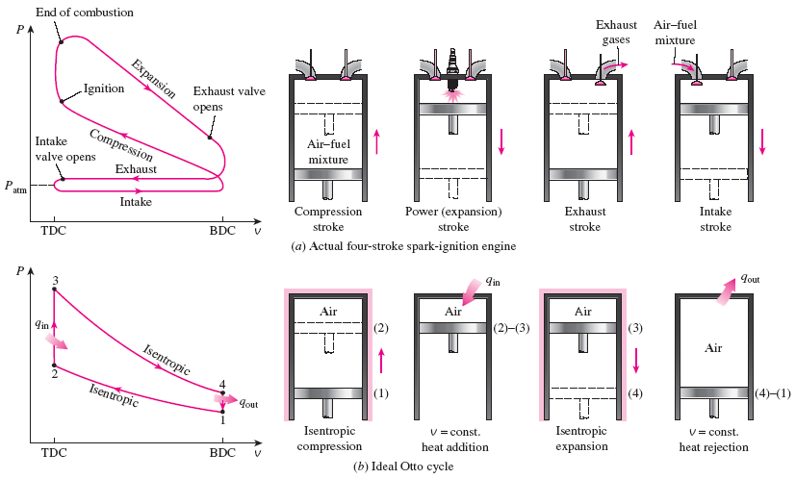
OTTO CYCLE: THE IDEAL CYCLE FOR SPARK-IGNITION ENGINES
Actual and ideal cycles in spark-ignition engines and their P-v diagrams.

Slide 30


The two-stroke engines are generally less efficient than their four-stroke counterparts but they are relatively simple and inexpensive, and they have high power-to-weight and power-to-volume ratios.
Four-stroke cycle
1 cycle = 4 stroke = 2 revolution
Two-stroke cycle
1 cycle = 2 stroke = 1 revolution
T-s diagram of the ideal Otto cycle.
Schematic of a two-stroke reciprocating engine.

Slide 31




In SI engines, the compression ratio is limited by autoignition or engine knock.
The thermal efficiency of the Otto cycle increases with the specific heat ratio k of the working fluid.
Thermal efficiency of the ideal Otto cycle as a function of compression ratio (k = 1.4).

Slide 32


DIESEL CYCLE: THE IDEAL CYCLE
FOR COMPRESSION-IGNITION ENGINES
In diesel engines, only air is compressed during the compression stroke, eliminating the possibility of autoignition (engine knock). Therefore, diesel engines can be designed to operate at much higher compression ratios than SI engines, typically between 12 and 24.
1-2 isentropic compression
2-3 constant-volume heat addition
3-4 isentropic expansion
4-1 constant-volume heat rejection.
In diesel engines, the spark plug is replaced by a fuel injector, and only air is compressed during the compression process.

Slide 33



Cutoff ratio
for the same compression ratio
Thermal efficiency of the ideal Diesel cycle as a function of compression and cutoff ratios (k=1.4).

Slide 34

Dual cycle: A more realistic ideal cycle model for modern, high-speed compression ignition engine.
QUESTIONS ???
Diesel engines operate at higher air-fuel ratios than gasoline engines. Why?
Despite higher power to weight ratios, two-stroke engines are not used in automobiles. Why?
The stationary diesel engines are among the most efficient power producing devices (about 50%). Why?
What is a turbocharger? Why are they mostly used in diesel engines compared to gasoline engines.
P-v diagram of an ideal dual cycle.

Slide 35
Performance Parameters
Can be measured by two ways
  Indicator equipment
  Dynamometer
Some parameters obtained
  Mean Piston Speed
  Mean Effective Pressure
  Power
  Mechanical Efficiency
  Thermal Efficiency
  Specific Fuel Consumption
  Volumetric Efficiency

Slide 36
Indicator
Consists of
  Pressure Indicator (Pressure transducer)
  Crank angle encoder (crank angle gives cylinder volume)
  Tachometer (engine speed)
Purpose – to obtain pressure inside cylinder
Produces P-v diagram (Indicator diagram) of in-cylinder gas.
All parameters obtained from indicator diagram has prefix ‘indicated’. (indicated mean effective pressure, indicated power, etc.)

Slide 37

Indicator

Slide 38
Dynamometer
A dynamometer is coupled to the engine crankshaft
Measures torque at crankshaft
Torque measured by braking the engine and balancing the resulting torque with a load arm
Along with engine speed from tachometer, we can calculate engine power
All parameters obtained from dyno measurement are prefixed by ‘brake’.
Difference of in-cylinder (indicated) and crankshaft (brake) is the loss due to friction.

Slide 39

Dynamometer

Slide 40


Rates
To convert between a quantity and its rates, multiply with N’ (number of power strokes per second)
N = speed
Thus, for power – work, mass flow rate – mass, etc.

Slide 41

Mean Piston Speed
Useful to compare between different engines

Slide 42

Indicated Mean Effective Pressure
Indicated Mean Effective Pressure (IMEP = P_{i})
The constant depends on the scale of the recorder. For mechanical indicator, it is the spring constant.

Slide 43

Indicated Mean Effective Pressure

Slide 44

Indicated Work, Indicated Power

Slide 45

Brake Power
From the dynamometer reading of torque
where W = dyno load, R = dyno arm length,
Brake Power (shaft power) is given by

Slide 46

Friction Power, Mechanical Efficiency
Friction power is the power lost during transmission from in-cylinder (indicated power) to the crankshaft (brake power)
FP = IP – BP
So, we can define the mechanical efficiency of the engine
Normal values around 80 – 90%

Slide 47
Brake Mean Effective Pressure (BMEP)
From mechanical efficiency, we can write
Combining with expression of IP (indicated power)
To make expression of BP look similar to IP
Where P_{b} is called the brake mean effective pressure (BMEP)
Can also be related as
BMEP is independent of engine size

Slide 48




Thermal Efficiency
Thermal efficiency is basically
If we use indicated power for net power, we get indicated thermal efficiency
If brake power is used, we get brake thermal efficiency
We can also relate mechanical efficiency

Slide 49


Specific Fuel Consumption (SFC)
A measure of engine economy
Can be used to compare performance of engines of different sizes.
Noticing the ratio in brake thermal efficiency, we can also write brake thermal efficiency as
[kg/kW.hr]

Slide 50



Volumetric Efficiency
Breathing capacity of the engine
The free air condition is the atmospheric condition, P₀, T₀. So, m_{d} is
Can also be defined in terms of volumes
with
In terms of rates,

