Slide 1
Thermodynamics II
Chapter 3
Compressors
Mohsin Mohd Sies
Fakulti Kejuruteraan Mekanikal, Universiti Teknologi Malaysia

Slide 2
Coverage
Introduction
Indicated Work, Mechanical Efficiency
Condition for Minimum Work
Isothermal Efficiency
Compressors with Clearance
Volumetric Efficiency, Free Air Delivery
Multistage Compression
Ideal Intermediate Pressure

Slide 3
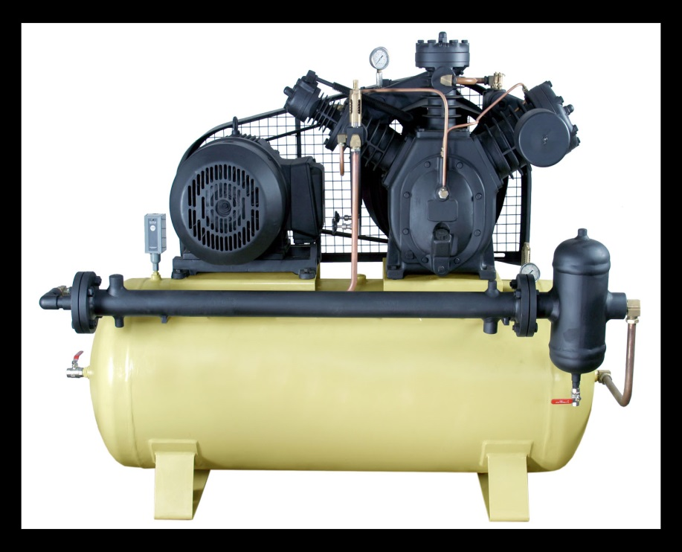
Introduction
Compressed air is air kept under a pressure that is greater than atmospheric pressure.
In industry, compressed air is so widely used that it is often regarded as the fourth utility, after electricity, natural gas and water.

Slide 4
Usages
Compressed air is used for many purposes, including:
Pneumatics, the use of pressurized gases to do work
  Pneumatic post, using capsules to move paper and small goods through tubes.
  Air tools
  HVAC control systems
Vehicle propulsion (compressed air vehicle)
Energy storage (compressed air energy storage)
Air brakes, including:
  railway braking systems
  road vehicle braking systems
Scuba diving, for breathing and to inflate buoyancy devices
Refrigeration using a vortex tube
Gas dusters for cleaning electronic components that cannot be cleaned with water
Air-start systems in engines
Ammunition propulsion in:
  Air guns, Airsoft equipment, Paintball equipment

Slide 5
Compressor types
Positive Displacement Machines
(high pressure ratio, low mass flow rates)
  Rotating
    Screw compressors (Lysholm)
    Scroll compressor
    Roots blowers
  Alternating (Reciprocating Compressor)
Turbocompressors
(low pressure ratio, high mass flow rates)
  Centrifugal compressor
  Axial compressor
  Mixed-flow compressor

Slide 6
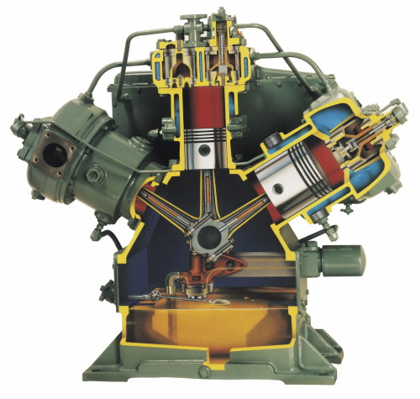

Slide 7
Reciprocating Compressor
Single Acting

Slide 8
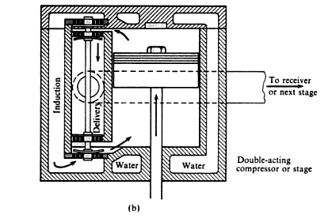
Reciprocating Compressor
Double Acting

Slide 9
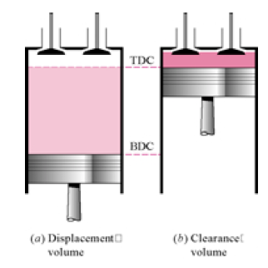
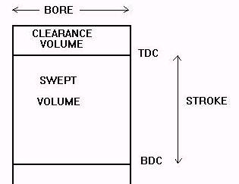
Piston-cylinder terminologies
TDC – Top Dead Center
BDC – Bottom Dead Center

Slide 10
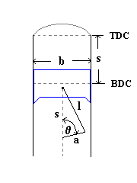
Piston-cylinder terminologies
b – Bore, Diameter
s – Stroke
l – Connecting Rod Length
a – Crank Throw = ½ stroke

Slide 11
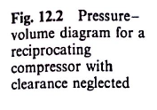
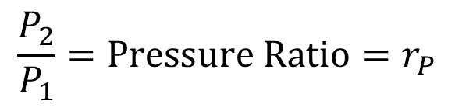
$$\frac{P_{2}}{P_{1}}=\text{Pressure} \text{Ratio}=r_{P}$$

Slide 12
Compressor Operation
Process d – a : Intake or Induction
  Piston moves from TDC to BDC
  Intake valve opens and air induced into cylinder
  Pressure P₁ and temperature T₁ remain constant.
Process a – b : Compression
  Intake valve closes and piston moves towards TDC
  Compression follows the polytropic process Pv^{n}=c until P₂ is reached.

Slide 13
Compressor Operation
Process b – c : Delivery
  Delivery valve opens
  Compressed air exits and delivered.
  Pressure P₂ and temperature T₂ remain constant.
Process c – d : Expansion
  Both valves remain closed as the cycle returns to the initial state
  Constant volume if without clearance
  Polytropic expansion if with clearance

Slide 14
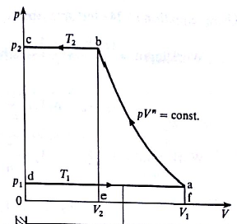
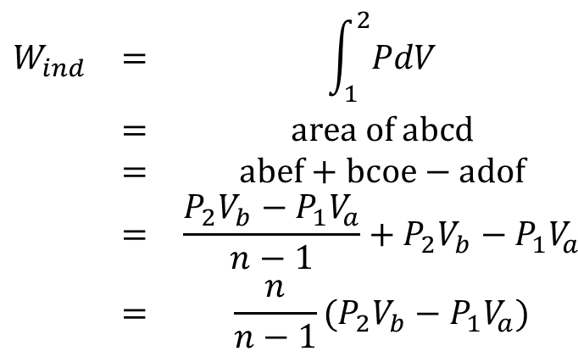
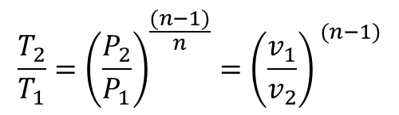
Indicated Work
- Indicated by P-v diagram, (P-v diagram = Indicator diagram)
For a cycle
$$\begin{matrix}W_{ind} & = & \int_{1}^{2}{PdV} \\ & = & \text{area} \text{of} \text{abcd} \\ & = & \text{abef}+\text{bcoe}−\text{adof} \\ & = & \frac{P_{2}V_{b}−P_{1}V_{a}}{n−1}+P_{2}V_{b}−P_{1}V_{a} \\ & = & \frac{n}{n−1}(P_{2}V_{b}−P_{1}V_{a})\end{matrix}$$
Recall polytropic relationship between two states
$$\frac{T_{2}}{T_{1}}={\left(\frac{P_{2}}{P_{1}}\right)}^{\frac{(n−1)}{n}}={\left(\frac{v_{1}}{v_{2}}\right)}^{ (n−1)}$$

Slide 15
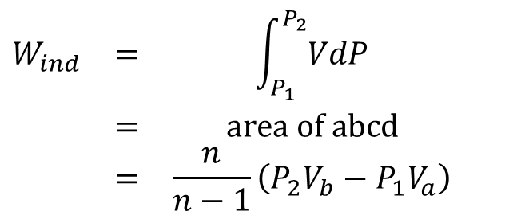
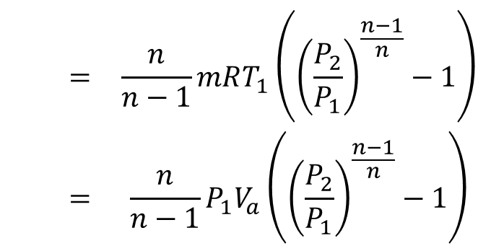
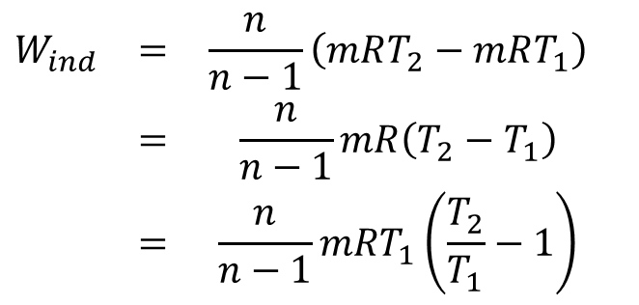
Indicated Work
Can also be considered as open system
$$\begin{matrix}W_{ind} & = & \int_{P_{1}}^{P_{2}}{VdP} \\ & = & \text{area} \text{of} \text{abcd} \\ & = & \frac{n}{n−1}\left(P_{2}V_{b}−P_{1}V_{a}\right)\end{matrix}$$
And since PV = mRT
$$\begin{matrix}W_{ind} & = & \frac{n}{n−1}\left(mRT_{2}−mRT_{1}\right) \\ & = & \frac{n}{n−1}mR\left(T_{2}−T_{1}\right) \\ & = & \frac{n}{n−1}mRT_{1}\left(\frac{T_{2}}{T_{1}}−1\right)\end{matrix}$$
$$\begin{matrix} & = & \frac{n}{n−1}mRT_{1}\left({\left(\frac{P_{2}}{P_{1}}\right)}^{\frac{n−1}{n}}−1\right) \\ & = & \frac{n}{n−1}P_{1}V_{a}\left({\left(\frac{P_{2}}{P_{1}}\right)}^{\frac{n−1}{n}}−1\right)\end{matrix}$$

Slide 16


Power (and Rates)
Has to take into account single or double acting
W_{ind} is work per cycle of P-v diagram.
If single acting, one cycle per crank revolution
If double acting, two cycles per crank revolution (one cycle each for both sides of piston face).
  Mass flow rate is doubled accordingly.
$$\begin{matrix}\dot{W} & = & \frac{n}{n−1}\dot{m}RT_{1}\left({\left(\frac{P_{2}}{P_{1}}\right)}^{\frac{n−1}{n}}−1\right) \\ & = & \frac{n}{n−1}P_{1}\dot{V}\left({\left(\frac{P_{2}}{P_{1}}\right)}^{\frac{n−1}{n}}−1\right)\end{matrix}$$
$$\dot{m}=m×N×action$$

Slide 17
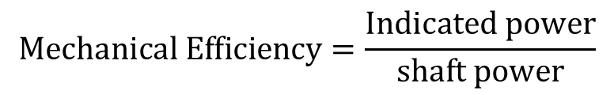
Mechanical Efficiency
The actual power input into the compressor is larger than the indicated power, to overcome friction and other losses.
Shaft power = Indicated power + Friction power loss
$$\text{Mechanical} \text{Efficiency}=\frac{\text{Indicated} \text{power}}{\text{shaft} \text{power}}$$
Other losses can also be taken into account accordingly

Slide 18
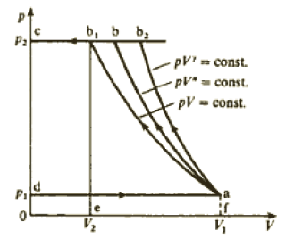
Condition for Minimum Work
We aim to reduce the input work
d-a is the stroke, determined by cylinder design and measurement
P₂ is desired delivery pressure. As long as P₂ is reached, the compressor has done its job.
Only the compression process can be adjusted by varying n, the polytropic index.
Isothermal process (n=1) results in minimum work (smallest area).
Compressors are cooled by water jackets or cooling fins

Slide 19
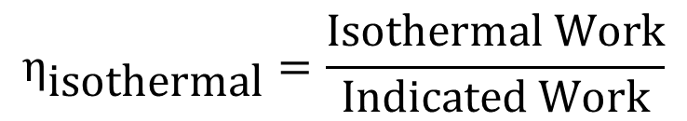
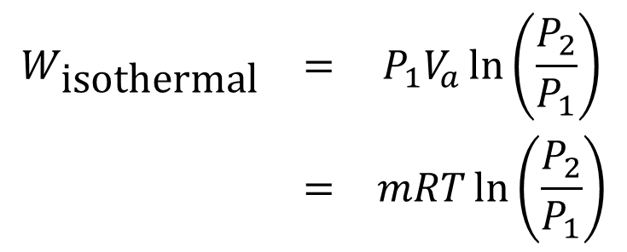
Isothermal Work, Isothermal Efficiency
Integrating by isothermal process, Pv=c
$$\begin{matrix}W_{\text{isothermal}} & = & P_{1}V_{a}\ln\left(\frac{P_{2}}{P_{1}}\right) \\ & = & mRT\ln\left(\frac{P_{2}}{P_{1}}\right)\end{matrix}$$
Isothermal efficiency
$$η_{\text{isothermal}}=\frac{\text{Isothermal} \text{Work}}{\text{Indicated} \text{Work}}$$

Slide 20
Compressors with Clearance
Clearance is needed for free movements of piston and valves
Clearance volume is V_{c}.
When delivery is completed (b-c), there is still compressed air at P₂ and T₂ in the clearance volume.
When intake stroke begins at V_{c}, no outside air can enter yet until the residual compressed air has expanded down to P₁ and T₁.
Thus, having clearance reduces the volume of inducted air from (V_{a}-V_{c}) originally to only (V_{a}-V_{d})

Slide 21
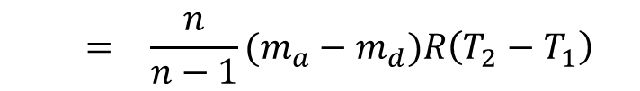
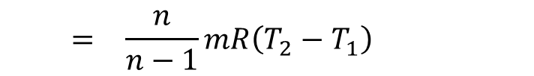
Compressors with Clearance
Mass of air, m_{a} = m_{b}, and m_{d} = m_{c}
The amount of air handled, m = m_{a} – m_{d} = m_{b} – m_{c}
W_{ind} = area abcd
= area abef – area cefd
$$\begin{matrix}W_{ind} & = & \frac{n}{n−1}m_{a}R\left(T_{2}−T_{1}\right)−\frac{n}{n−1}m_{d}R\left(T_{2}−T_{1}\right)\end{matrix}$$
$$\begin{matrix} & = & \frac{n}{n−1}(m_{a}−m_{d})R\left(T_{2}−T_{1}\right)\end{matrix}$$
$$\begin{matrix} & = & \frac{n}{n−1}mR\left(T_{2}−T_{1}\right)\end{matrix}$$
Even though Work depends on clearance, but work per unit mass does not depend on it.

Slide 22
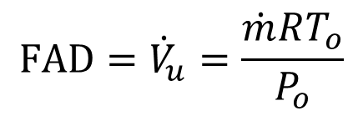
Free Air Delivery, FAD
FAD is the amount of air handled (delivered) by the compressor.
FAD is given as the volumetric flow rate of air (measured at free air conditions P_{o} and T_{o})
$$\text{FAD}={\dot{V}}_{u}=\frac{\dot{m}RT_{o}}{P_{o}}$$
Actually, this is easier given by the mass flow rate since it does not depend on P and T

Slide 23
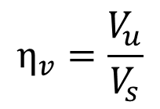
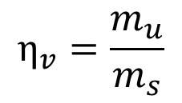
Volumetric Efficiency
$$η_{v}=\frac{m_{u}}{m_{s}}$$
The mass of gas entering
The mass of gas that should fill the swept volume at the same reference condition (free air condition)
The volume of gas entering measured at free air condition
$$η_{v}=\frac{V_{u}}{V_{s}}$$
The swept volume of cylinder

Slide 24
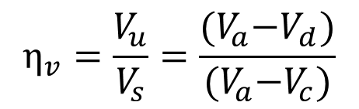
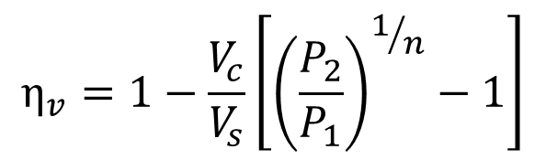
Volumetric Efficiency
$$η_{v}=\frac{V_{u}}{V_{s}}=\frac{{(V}_{a}−V_{d})}{{(V}_{a}−V_{c})}$$
$$η_{v}=1−\frac{V_{c}}{V_{s}}\left[{\left(\frac{P_{2}}{P_{1}}\right)}^{1/n}−1\right]$$
The result above is assuming that the in-cylinder condition (T₁, P₁) is the same as free air condition (T_{o}, P_{o})

Slide 25
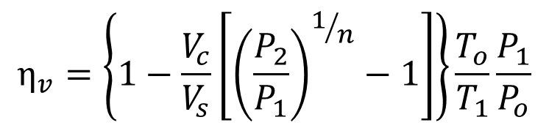
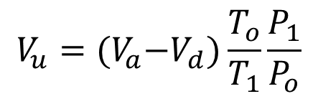
Volumetric Efficiency
The entering air is actually being heated by the hot cylinder walls and there has to be a pressure difference (P_{o} – P₁) so that air can flow into the cylinder.
We can use the unchanging mass to get the correction factor to account for these differences
$$V_{u}={(V}_{a}−V_{d})\frac{T_{o}}{T_{1}}\frac{P_{1}}{P_{o}}$$
$$η_{v}=\left\{1−\frac{V_{c}}{V_{s}}\left[{\left(\frac{P_{2}}{P_{1}}\right)}^{1/n}−1\right]\right\}\frac{T_{o}}{T_{1}}\frac{P_{1}}{P_{o}}$$

Slide 26
Multistage Compression
For a given V_{s}, increasing r_{p} will
  decrease η_{v}.
  Increase delivery temperature
To achieve high pressures while avoiding those problems
  Do Multistage Compression
At some intermediate pressure P_{i}, the gas is sent to a smaller cylinder to be compressed further.
This also allows us to cool the gas (intercooling) to reduce compression work.

Slide 27
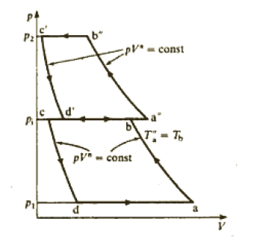
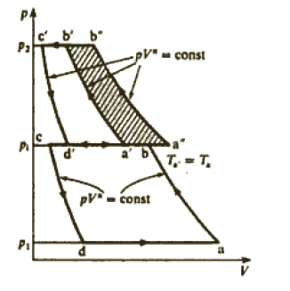


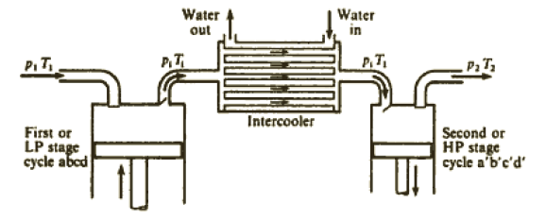
Multistage Compression

Slide 28
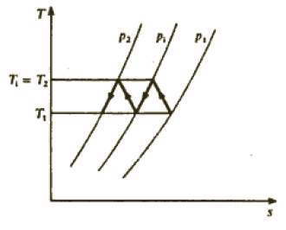
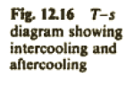
Multistage Compression
Complete Intercooling if
  Intermediate temperature T_{i} is cooled back to the same temperature as T₁.

Slide 29
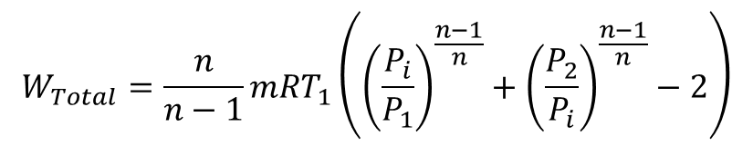
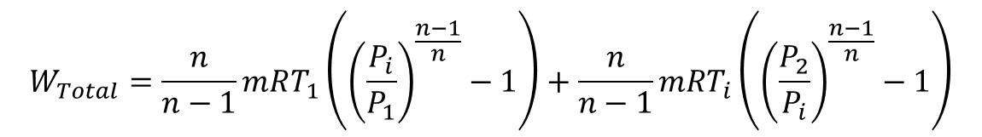
Optimum Intermediate Pressure
The chosen P_{i} affects the amount of compression work that has to be supplied.
An optimum P_{i} will give us the minimum compressor work.
Let’s assume complete intercooling.
W_{total} = W_{Low Stage} + W_{High Stage}
$$W_{Total}=\frac{n}{n−1}mRT_{1}\left({\left(\frac{P_{i}}{P_{1}}\right)}^{\frac{n−1}{n}}−1\right)+\frac{n}{n−1}mRT_{i}\left({\left(\frac{P_{2}}{P_{i}}\right)}^{\frac{n−1}{n}}−1\right)$$
Since T_{i} = T₁ ,
$$W_{Total}=\frac{n}{n−1}mRT_{1}\left({\left(\frac{P_{i}}{P_{1}}\right)}^{\frac{n−1}{n}}+{\left(\frac{P_{2}}{P_{i}}\right)}^{\frac{n−1}{n}}−2\right)$$

Slide 30
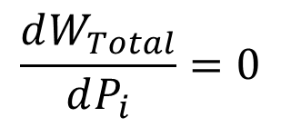
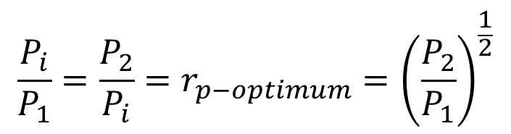
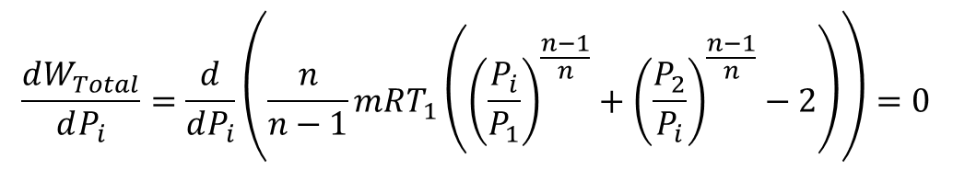


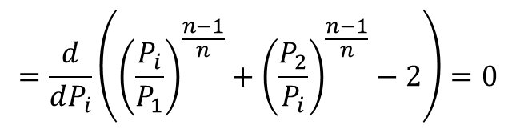
Optimum Intermediate Pressure
For a fixed P₁, T₁ and P₂, we can the optimum P_{i} that gives us minimum W_{total} by
$$\frac{dW_{Total}}{dP_{i}}=0$$
$$\frac{dW_{Total}}{dP_{i}}=\frac{d}{dP_{i}}\left(\frac{n}{n−1}mRT_{1}\left({\left(\frac{P_{i}}{P_{1}}\right)}^{\frac{n−1}{n}}+{\left(\frac{P_{2}}{P_{i}}\right)}^{\frac{n−1}{n}}−2\right)\right)=0$$
$$=\frac{d}{dP_{i}}\left({\left(\frac{P_{i}}{P_{1}}\right)}^{\frac{n−1}{n}}+{\left(\frac{P_{2}}{P_{i}}\right)}^{\frac{n−1}{n}}−2\right)=0$$
$${P_{i}}^{2}=P_{2}P_{1}$$
$$\frac{P_{i}}{P_{1}}=\frac{P_{2}}{P_{i}}=r_{p−optimum}={\left(\frac{P_{2}}{P_{1}}\right)}^{\frac{1}{2}}$$
$$P_{i−optimum}=\sqrt[2]{P_{2}P_{1}}$$

Slide 31
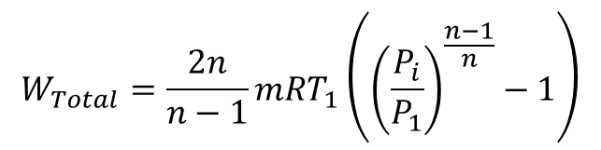
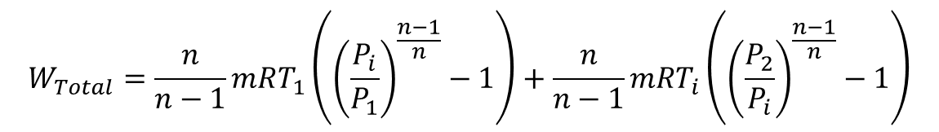
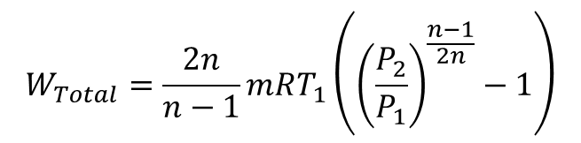
Optimum Intermediate Pressure
So, for minimum compressor work
  Complete intercooling
  Same pressure ratio for all stages
This can be generalized to more than two stages
$$W_{Total}=\frac{n}{n−1}mRT_{1}\left({\left(\frac{P_{i}}{P_{1}}\right)}^{\frac{n−1}{n}}−1\right)+\frac{n}{n−1}mRT_{i}\left({\left(\frac{P_{2}}{P_{i}}\right)}^{\frac{n−1}{n}}−1\right)$$
$$W_{Total}=\frac{2n}{n−1}mRT_{1}\left({\left(\frac{P_{i}}{P_{1}}\right)}^{\frac{n−1}{n}}−1\right)$$
$$W_{Total}=\frac{2n}{n−1}mRT_{1}\left({\left(\frac{P_{2}}{P_{1}}\right)}^{\frac{n−1}{2n}}−1\right)$$

Slide 32
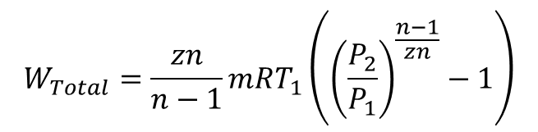

Optimum Intermediate Pressure
This can be generalized to more than two stages (z = number of stages, P1 = intake pressure, P2 = final pressure)
For minimum compressor work
  Complete intercooling
  Same pressure ratio for all stages
$$r_{p−optimum}={\left(\frac{P_{2}}{P_{1}}\right)}^{\frac{1}{z}}$$
$$W_{Total}=\frac{zn}{n−1}mRT_{1}\left({\left(\frac{P_{2}}{P_{1}}\right)}^{\frac{n−1}{zn}}−1\right)$$

