Slide 1
Thermodynamics II
Chapter 2
Gas Turbines
Mohsin Mohd Sies
Fakulti Kejuruteraan Mekanikal, Universiti Teknologi Malaysia
Mehmet Kanoglu - University of Gaziantep
Copyright © The McGraw-Hill Companies, Inc. Permission required for reproduction or display.

Slide 2
Objectives
Evaluate the performance of gas power cycles for which the working fluid remains a gas throughout the entire cycle.
Develop simplifying assumptions applicable to gas power cycles.
Analyze both closed and open gas power cycles.
Solve problems based on the Brayton cycle; the Brayton cycle with regeneration; and the Brayton cycle with intercooling, reheating, and regeneration.
Analyze jet-propulsion cycles.
2

Slide 3
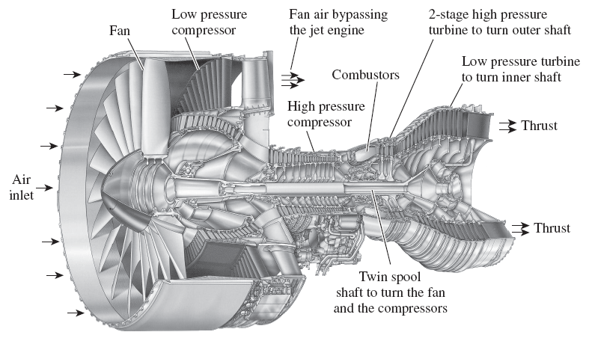
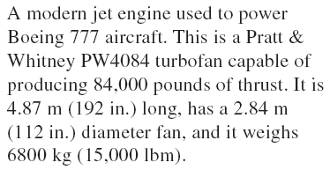
3

Slide 4
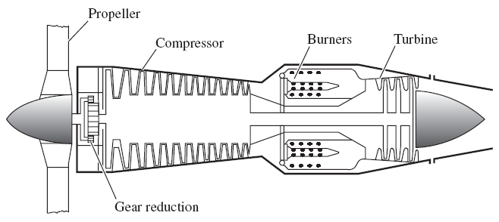
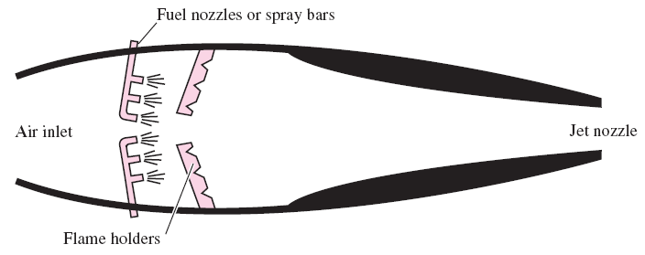
Various engine types:
Turbofan, Propjet, Ramjet, Sacramjet, Rocket
A turboprop engine.
A ramjet engine.
4

Slide 5
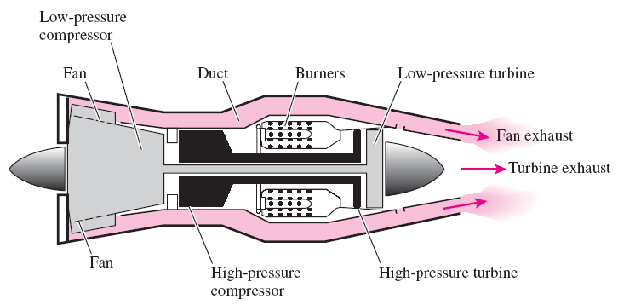
Modifications to Turbojet Engines
The first airplanes built were all propeller-driven, with propellers powered by engines essentially identical to automobile engines.
Both propeller-driven engines and jet-propulsion-driven engines have their own strengths and limitations, and several attempts have been made to combine the desirable characteristics of both in one engine.
Two such modifications are the propjet engine and the turbofan engine.
The most widely used engine in aircraft propulsion is the turbofan (or fanjet) engine wherein a large fan driven by the turbine forces a considerable amount of air through a duct (cowl) surrounding the engine.
A turbofan engine.
5

Slide 6
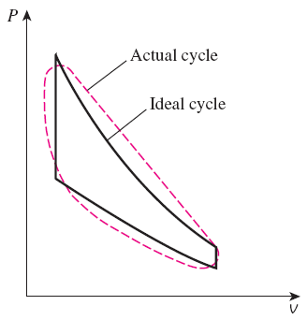
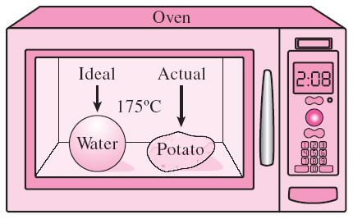
BASIC CONSIDERATIONS IN THE ANALYSIS OF POWER CYCLES
Thermal efficiency of heat engines:
Most power-producing devices operate on cycles.
Ideal cycle: A cycle that resembles the actual cycle closely but is made up totally of internally reversible processes.
Reversible cycles such as Carnot cycle have the highest thermal efficiency of all heat engines operating between the same temperature levels. Unlike ideal cycles, they are totally reversible, and unsuitable as a realistic model.
Modeling is a powerful engineering tool that provides great insight and simplicity at the expense of some loss in accuracy.
The analysis of many complex processes can be reduced to a manageable level by utilizing some idealizations.
6

Slide 7
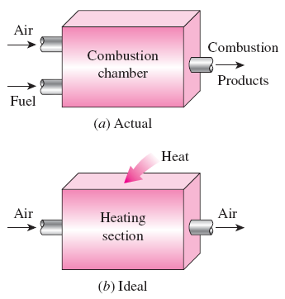
AIR-STANDARD ASSUMPTIONS
Air-standard assumptions:
The working fluid is air, which continuously circulates in a closed loop and always behaves as an ideal gas.
All the processes that make up the cycle are internally reversible.
The combustion process is replaced by a heat-addition process from an external source.
The exhaust process is replaced by a heat-rejection process that restores the working fluid to its initial state.
The combustion process is replaced by a heat-addition process in ideal cycles.
Cold-air-standard assumptions: When the working fluid is considered to be air with constant specific heats at room temperature (25°C).
Air-standard cycle: A cycle for which the air-standard assumptions are applicable.
7

Slide 8
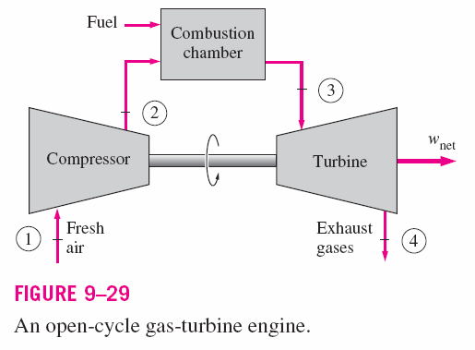
Brayton Cycle: Ideal Cycle for Gas-Turbine Engines
Gas turbines usually operate on an open cycle (Fig. 9–29).
Air at ambient conditions is drawn into the compressor, where its temperature and pressure are raised. The high pressure air proceeds into the combustion chamber, where the fuel is burned at constant pressure.
The high-temperature gases then enter the turbine where they expand to atmospheric pressure while producing power output.
Some of the output power is used to drive the compressor.
The exhaust gases leaving the turbine are thrown out (not re-circulated), causing the cycle to be classified as an open cycle.
8

Slide 9
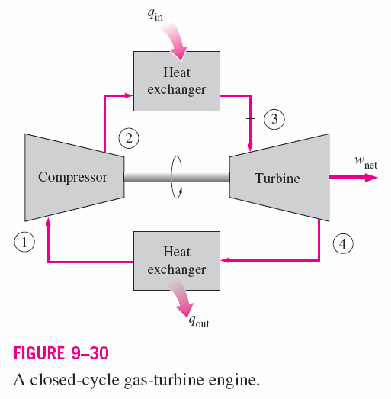
Closed Cycle Model
The open gas-turbine cycle can be modelled as a closed cycle, using the air-standard assumptions (Fig. 9–30).
The compression and expansion processes remain the same, but the combustion process is replaced by a constant-pressure heat addition process from an external source.
The exhaust process is replaced by a constant-pressure heat rejection process to the ambient air.
9

Slide 10
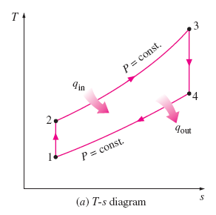
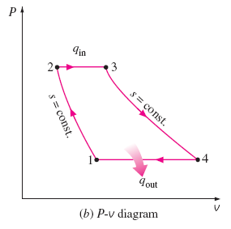

The Brayton Cycle
The ideal cycle that the working fluid undergoes in the closed loop is the Brayton cycle. It is made up of four internally reversible processes:
1-2 Isentropic compression;
2-3 Constant-pressure heat addition;
3-4 Isentropic expansion;
4-1 Constant-pressure heat rejection.
The T-s and P-v diagrams of an ideal Brayton cycle are shown in Fig. 9–31.
Note: All four processes of the Brayton cycle are executed in steady-flow devices thus, they should be analyzed as steady-flow processes.
10

Slide 11
Thermal Efficiency
The energy balance for a steady-flow process can be expressed, on a unit–mass basis, as
The heat transfers to and from the working fluid are:
The thermal efficiency of the ideal Brayton cycle,
Constant specific heats
where
is the pressure ratio.
11

Slide 12
Specific Heats, C_{p}
Using variable specific heats is the exact way to find enthalpies.
However, in this course, we will take a simpler approximation by taking constant specific heats.
Nevertheless, we take into account the changing specific heats by using c_{pa} of air in the compressors, and c_{pg} of burned gas in the combustor and turbines.

Slide 13
Problem
Ideal and Actual Gas-Turbine (Brayton) Cycles
9–73
A simple Brayton cycle using air as the working fluid has a pressure ratio of 8. The minimum and maximum temperatures in the cycle are 310 K and 1160 K, respectively. Assuming an isentropic efficiency of 75 percent for the compressor and 82 percent for the turbine, determine:
  the air temperature at the turbine exit,
  the net work output, and
  the thermal efficiency.
Assume variable specific heats conditions.
13

Slide 14
Problem
Ideal and Actual Gas-Turbine (Brayton) Cycles
9–77
A stationary gas-turbine power plant operates on a simple ideal Brayton cycle with air as the working fluid. The air enters the compressor at 95 kPa and 290 K and the turbine at 760 kPa and 1100 K. Heat is transferred to air at a rate of 35,000 kJ/s.
Determine the power delivered by this plant:
  assuming constant specific heats at room temperature, and
  accounting for the variation of specific heats with temperature.
14

Slide 15
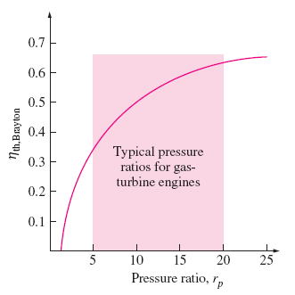
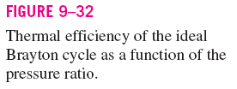
Parameters Affecting Thermal Efficiency
The thermal efficiency of an ideal Brayton cycle depends on the pressure ratio, rp of the gas turbine and the specific heat ratio, k of the working fluid.
The thermal efficiency increases with both of these parameters, which is also the case for actual gas turbines.
A plot of thermal efficiency versus the pressure ratio is shown in Fig. 9–32, for the case of k =1.4.
15

Slide 16
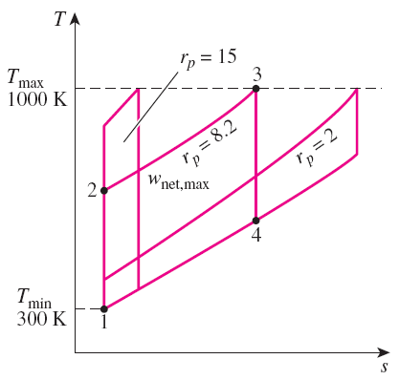
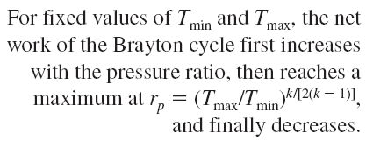
The two major application areas of gas-turbine engines are aircraft propulsion and electric power generation.
The highest temperature in the cycle is limited by the maximum temperature that the turbine blades can withstand. This also limits the pressure ratios that can be used in the cycle.
The air in gas turbines supplies the necessary oxidant for the combustion of the fuel, and it serves as a coolant to keep the temperature of various components within safe limits. An air–fuel ratio of 50 or above is not uncommon.
16

Slide 17
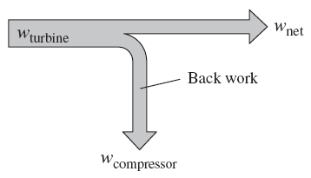
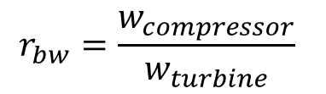
Back Work Ratio
The fraction of the turbine work used to drive the compressor is called the back work ratio.
BWR is defined as the ratio of compressor work to the turbine work
$$r_{bw}=\frac{w_{compressor}}{w_{turbine}}$$
The BWR in gas turbine power plant is very high, normally one-half of turbine work output is used to drive the compressor

Slide 18
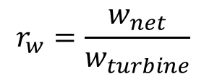
Work Ratio
The fraction of the turbine work that becomes the net work is called the work ratio.
Work Ratio is defined as the ratio of net work to the turbine work
$$r_{w}=\frac{w_{net}}{w_{turbine}}$$

Slide 19
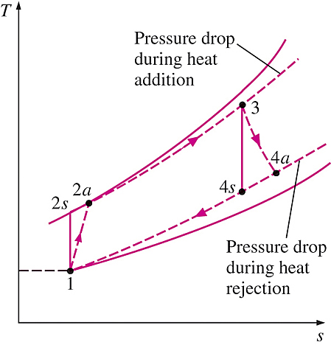
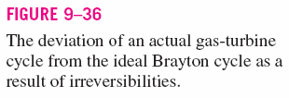
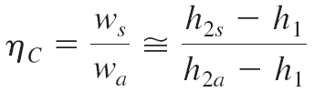
Actual Gas-Turbine Cycles
Some pressure drop occurs during the heat-addition and heat rejection processes.
The actual work input to the compressor is more, and the actual work output from the turbine is less, because of irreversibilities.
Deviation of actual compressor and turbine behavior from the idealized isentropic behavior can be accounted
for by utilizing isentropic efficiencies of the turbine and compressor.
Turbine:
Compressor:
19

Slide 20
Problem
Ideal and Actual Gas-Turbine (Brayton) Cycles
Class Exercise
9–78
Air enters the compressor of a gas-turbine engine at 300 K and 100 kPa, where it is compressed to 700 kPa and 580 K. Heat is transferred to air in the amount of 950 kJ/kg before it enters the turbine.
For a turbine efficiency of 86 percent, determine:
(a) the fraction of turbine work output used to drive the compressor,
(b) the thermal efficiency.
Assume:
(a) variable specific heats for air.
(b) constant specific heats at 300 K.
20

Slide 21
Improvements of Gas Turbine’s Performance
The early gas turbines (1940s to 1959s) found only limited use despite their versatility and their ability to burn a variety of fuels, because its thermal efficiency was only about 17%. Efforts to improve the cycle efficiency are concentrated in three areas:
Increasing the turbine inlet (or firing) temperatures.
  The turbine inlet temperatures have increased steadily from about 540°C (1000°F) in the 1940s to 1425°C (2600°F) and even higher today.
Increasing the efficiencies of turbo-machinery components (turbines, compressors).
  The advent of computers and advanced techniques for computer-aided design made it possible to design these components aerodynamically with minimal losses.
Adding modifications to the basic cycle (intercooling, regeneration or recuperation, and reheating).
  The simple-cycle efficiencies of early gas turbines were practically doubled by incorporating intercooling, regeneration (or recuperation), and reheating.
21

Slide 22
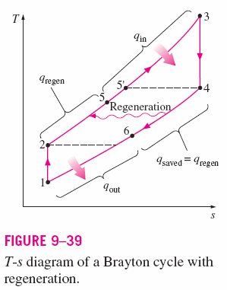
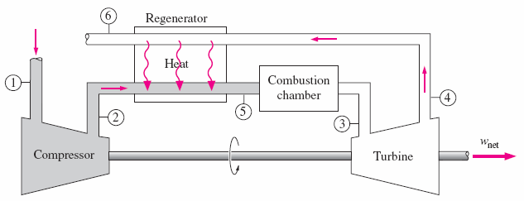

Brayton Cycle With Regeneration
Temperature of the exhaust gas leaving the turbine is higher than the temperature of the air leaving the compressor.
The air leaving the compressor can be heated by the hot exhaust gases in a counter-flow heat exchanger (a regenerator or recuperator) – a process called regeneration (Fig. 9-38 & Fig. 9-39).
The thermal efficiency of the Brayton cycle increases due to regeneration since less fuel is used for the same work output.
Note:
The use of a regenerator is recommended only when the turbine exhaust temperature is higher than the compressor exit temperature.
22

Slide 23
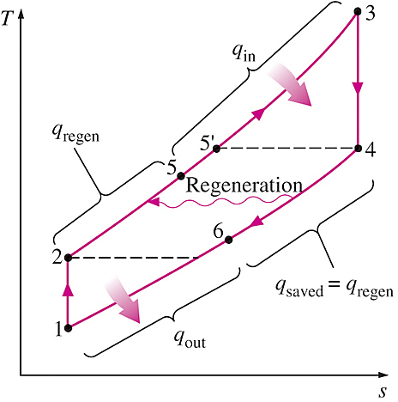

Effectiveness of the Regenerator
Assuming the regenerator is well insulated and changes in kinetic and potential energies are negligible, the actual and maximum heat transfers from the exhaust gases to the air can be expressed as
Effectiveness of the regenerator,
Effectiveness under cold-air standard assumptions,
If written in terms of temperatures only, it is also called the thermal ratio
Thermal efficiency under cold-air standard assumptions,
23

Slide 24
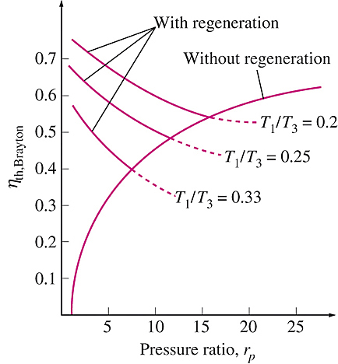
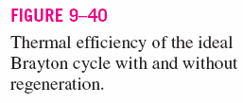
Factors Affecting Thermal Efficiency
Thermal efficiency of Brayton cycle with regeneration depends on:
a) ratio of the minimum to
maximum temperatures, and
b) the pressure ratio.
Regeneration is most effective at lower pressure ratios and small minimum-to-maximum temperature ratios.
Can regeneration be used at high pressure ratios?
24

Slide 25
Problem
Brayton Cycles with Regeneration
9–91
The 7FA gas turbine manufactured by General Electric is reported to have an efficiency of 35.9 percent in the simple-cycle mode and to produce 159 MW of net power. The pressure ratio is 14.7 and the turbine inlet temperature is 1288°C. The mass flow rate through the turbine is 1,536,000 kg/h.
Taking the ambient conditions to be 20°C and 100 kPa, determine:
the isentropic efficiency of the turbine and the compressor,
the thermal efficiency of this gas turbine if a regenerator with an effectiveness of 80 percent is added.
Assume constant specific heats at 300 K.
25

Slide 26
Problem
Brayton Cycles with Regeneration
9–96
A Brayton cycle with regeneration using air as the working fluid has a pressure ratio of 7. The minimum and maximum temperatures in the cycle are 310 and 1150 K respectively.
Assuming an isentropic efficiency of 75 percent for the compressor and 82 percent for the turbine and an effectiveness of 65 percent for the regenerator, determine:
(a) the air temperature at the turbine exit,
(b) the net work output, and
(c) the thermal efficiency.
Answers: (a) 783 K, (b) 108.1 kJ/kg, (c) 22.5 percent
26

Slide 27
Problem
Brayton Cycles with Regeneration
9–98
Air enters the compressor of a regenerative gas-turbine engine at 300 K and 100 kPa, where it is compressed to 800 kPa and 580 K. The regenerator has an effectiveness of 72 percent, and the air enters the turbine at 1200 K.
For a turbine efficiency of 86 percent, determine:
  the amount of heat transfer in the regenerator, and
  the thermal efficiency.
Answers: (a) 152.5 kJ/kg, (b) 36.0 percent
27

Slide 28
Old Exam Question
Brayton Cycles with Regeneration
A gas turbine plant with reheating is fitted with an exhaust heat exchanger. Compression is done in a single stage with a pressure ratio of 8, while expansion is done in two turbine stages. The high pressure turbine drives the compressor while the low pressure turbine supplies the net work of the plant. Inlet temperatures for the turbines are the same at 1073 K and the inlet temperature of the compressor is 303 K. The main combustion chamber (not including the reheater) supplies heat at a rate of 380 kJ/kg of working fluid.
Sketch the cycle on a T-s diagram, determine the temperature at each point, and calculate;
Thermal ratio of the heat exchanger
Thermal efficiency of the plant
The ratio of the fuel flow rate to the working fluid flow rate, provided that the calorific value of the fuel be 43000 kJ/kg fuel.
Given : c_{p} = 1.005 kJ/kg.K and γ = 1.4 for air
c_{p} = 1.15 kJ/kg.K and γ = 1.333 for gas
28

Slide 29
Old Exam Question
Brayton Cycles with Regeneration
A regenerative gas turbine engine consists of one compressor and two turbine stages. Air enters the compressor at 1 bar, 27ºC and is compressed to 4 bars. The isentropic efficiency of the compressor is 80%, while the thermal ratio of the regenerator is 90%. The high pressure turbine drives the compressor via a shaft with a mechanical efficiency of 85%. The inlet temperature of the high pressure turbine is 1200K. The low pressure turbine produces 100 kW as the net work for the plant. Each turbine has an isentropic efficiency of 87%. Sketch the component diagram, T-s diagram, and determine;
Air mass flow rate (kg/s)
Thermal efficiency
Given : c_{p} = 1.005 kJ/kg.K and γ = 1.4 for air
c_{p} = 1.15 kJ/kg.K and γ = 1.333 for gas
29

Slide 30
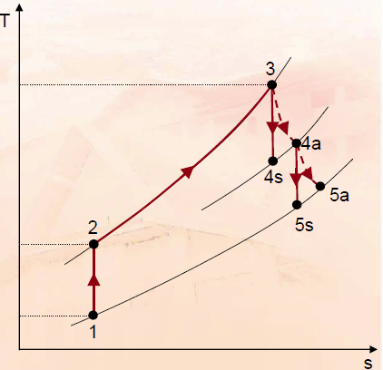

Slide 31
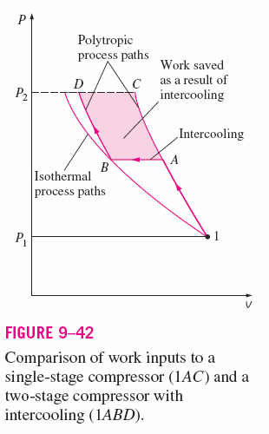
Brayton Cycle with Intercooling, Reheating & Regeneration
The net work output of a gas-turbine cycle can be increased by either:
a) decreasing the compressor work, or
b) increasing the turbine work, or
c) both.
The compressor work input can be decreased by carrying out the compression process in stages and cooling the gas in between (Fig. 9-42), using multistage compression with intercooling.
The work output of a turbine can be increased by expanding the gas in stages and reheating it in between, utilizing a multistage expansion with reheating.
31

Slide 32
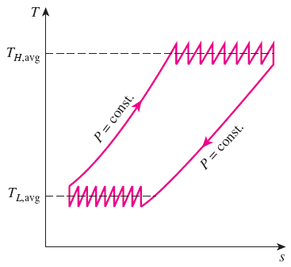
Brayton Cycle with Intercooling, Reheating & Regeneration
Intercooling and reheating always decreases thermal efficiency unless accompanied by regeneration. Why?
Therefore, in gas turbine power plants, intercooling and reheating are always used in conjunction with regeneration.
As the number of compression and expansion stages increases, the gas-turbine cycle with intercooling, reheating, and regeneration approaches the Ericsson cycle.

Slide 33
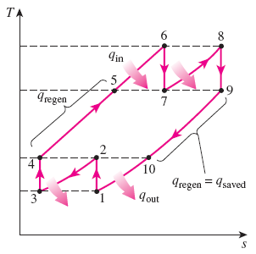
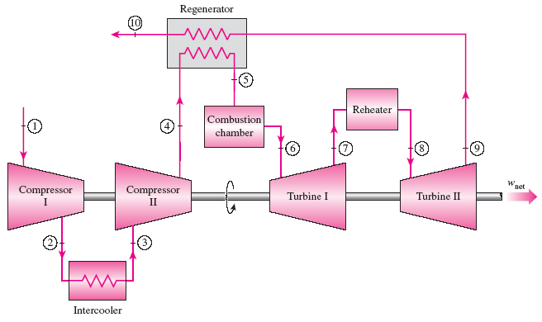
THE BRAYTON CYCLE WITH INTERCOOLING, REHEATING, AND REGENERATION
For minimizing work input to compressor and maximizing work output from turbine:
Tmax limited by materials,
Tmin limited by environment
A gas-turbine engine with two-stage compression with intercooling, two-stage expansion with reheating, and regeneration and its T-s diagram.
33

Slide 34
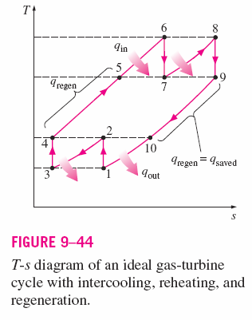



Conditions for Best Performance
The work input to a two-stage compressor is minimized when
equal pressure ratios are maintained across each stage.
Complete intercooling is performed
This procedure also maximizes the turbine work output.
Thus, for best performance we have,
$$T_{3}=T_{1}$$
$$T_{3}=T_{1}$$
34

Slide 35
Problem
Brayton Cycle with Intercooling, Reheating, and Regeneration
9–108
Consider an ideal gas-turbine cycle with two stages of compression and two stages of expansion. The pressure ratio across each stage of the compressor and turbine is 3. The air enters each stage of the compressor at 300 K and each stage of the turbine at 1200 K. Determine:
  the back work ratio, and
  the thermal efficiency of the cycle
assuming:
no regenerator is used, and
a regenerator with 75 percent effectiveness is used.
35

Slide 36
Problem
Brayton Cycle with Intercooling, Reheating, and Regeneration
9–110
Consider a regenerative gas-turbine power plant with two stages of compression and two stages of expansion. The overall pressure ratio of the cycle is 9. The air enters each stage of the compressor at 300 K and each stage of the turbine at 1200 K.
Determine the minimum mass flow rate of air needed to develop net power output of 110 MW.
Answer: 250 kg/s.
36

