Slide 1
Core Thermal Design
Mohsin Mohd Sies
Muhammad Syahir Sarkawi
Universiti Teknologi Malaysia
mohsin@utm.my
http://www.mohsin-sies.com

Slide 2
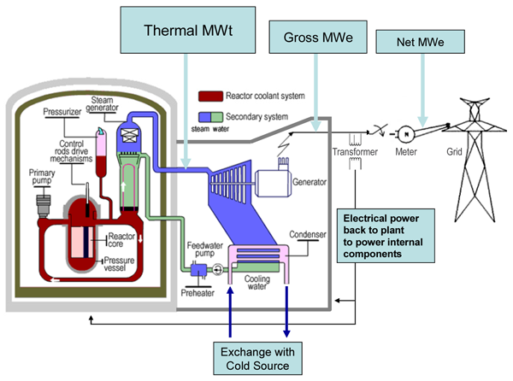

Slide 3
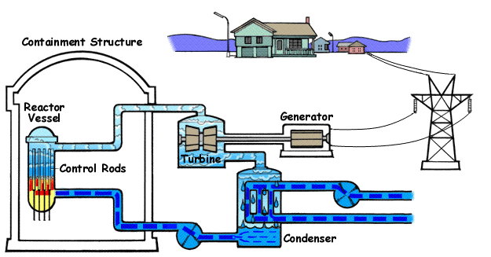

Slide 4
Motivation
Thermal (not nuclear) considerations limit the amount of reactor power generation
Temperatures anywhere in the core must not exceed material property limitations (fuel, cladding)
Otherwise fuel element damage might result in release of large quantities of radioactive material into coolant, or in-core fuel meltdown.

Slide 5
Motivation: Why Thermal Design Matters
Thermal (NOT nuclear) considerations limit reactor power generation
A 1,000 MW(electric) reactor generates ~3,300 MW(thermal) of heat
~30,000 fuel rods must be cooled simultaneously
Temperature rise from inlet to outlet: 20-35°C
Failure to remove heat → catastrophic temperature rise in seconds
Temperatures MUST NOT exceed material property limits (fuel, cladding)

Slide 6
Introduction

Slide 7
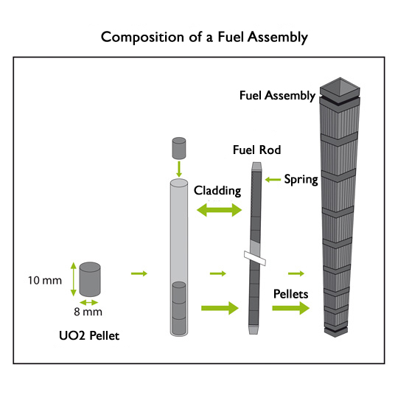
Introduction
Reactors must be designed in such a way that the fission products always remain confined within the fuel; throughout
  the operational lifetime of the core,
  during shutdown,
  under accident conditions,
  when the fuel may be denied normal cooling
The reactor power generation is limited by thermal rather than nuclear

Slide 8
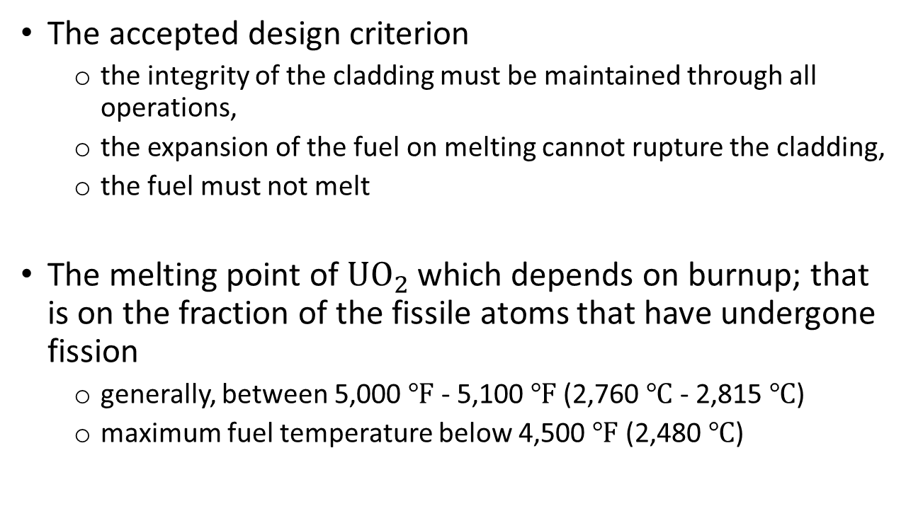
Introduction
The accepted design criterion
  the integrity of the cladding must be maintained through all operations,
  the expansion of the fuel on melting cannot rupture the cladding,
  the fuel must not melt
The melting point of $UO_{2}$ which depends on burnup; that is on the fraction of the fissile atoms that have undergone fission
  generally, between 5,000 $℉$ - 5,100 $℉$ (2,760 $℃$ - 2,815 $℃$)
  maximum fuel temperature below 4,500 $℉$ (2,480 $℃$)

Slide 9
General Considerations

Slide 10

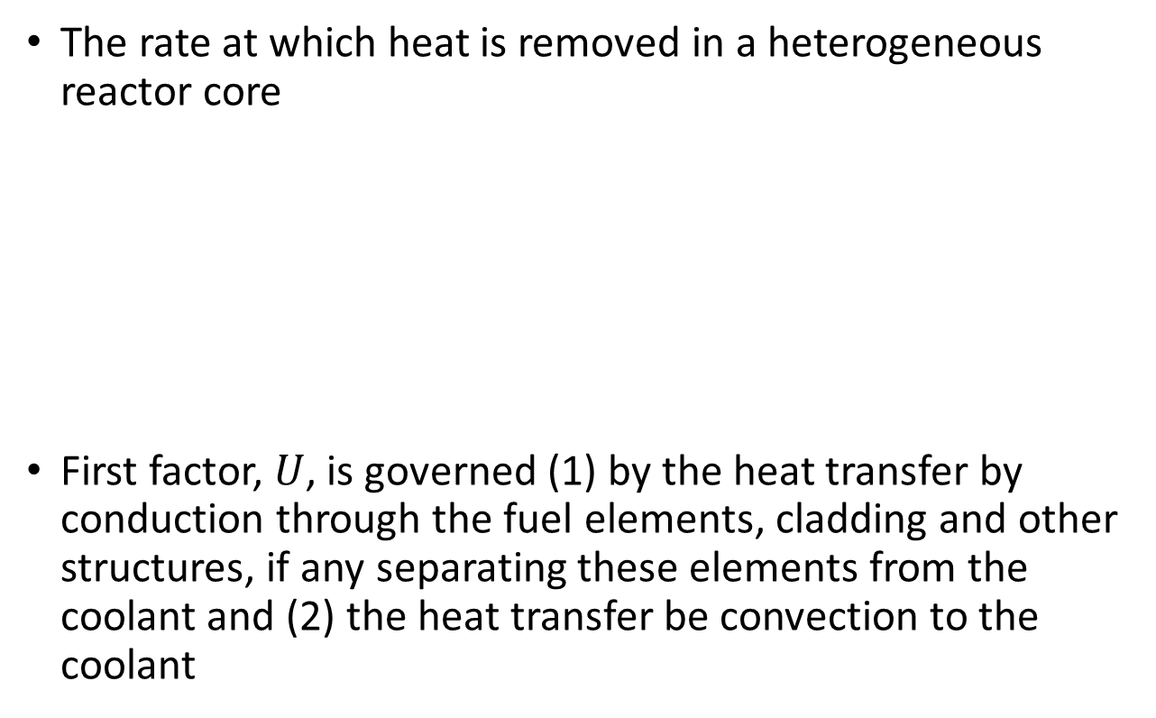
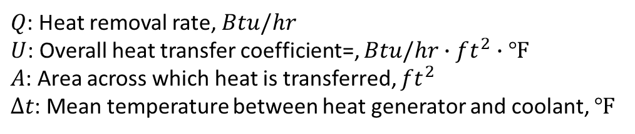
General Considerations
The rate at which heat is removed in a heterogeneous reactor core
First factor, $U$, is governed (1) by the heat transfer by conduction through the fuel elements, cladding and other structures, if any separating these elements from the coolant and (2) the heat transfer be convection to the coolant
$$Q=UAΔt$$
(1)
$Q$: Heat removal rate, $Btu/hr$
$U$: Overall heat transfer coefficient=, $Btu/hr∙ft^{2}∙℉$
$A$: Area across which heat is transferred, $ft^{2}$
$Δt$: Mean temperature between heat generator and coolant, $℉$

Slide 11
General Considerations
Cladding
Coolant
Fuel pellet
Small gap
Figure 1: Cross-sections of a conventional fuel pellet

Slide 12
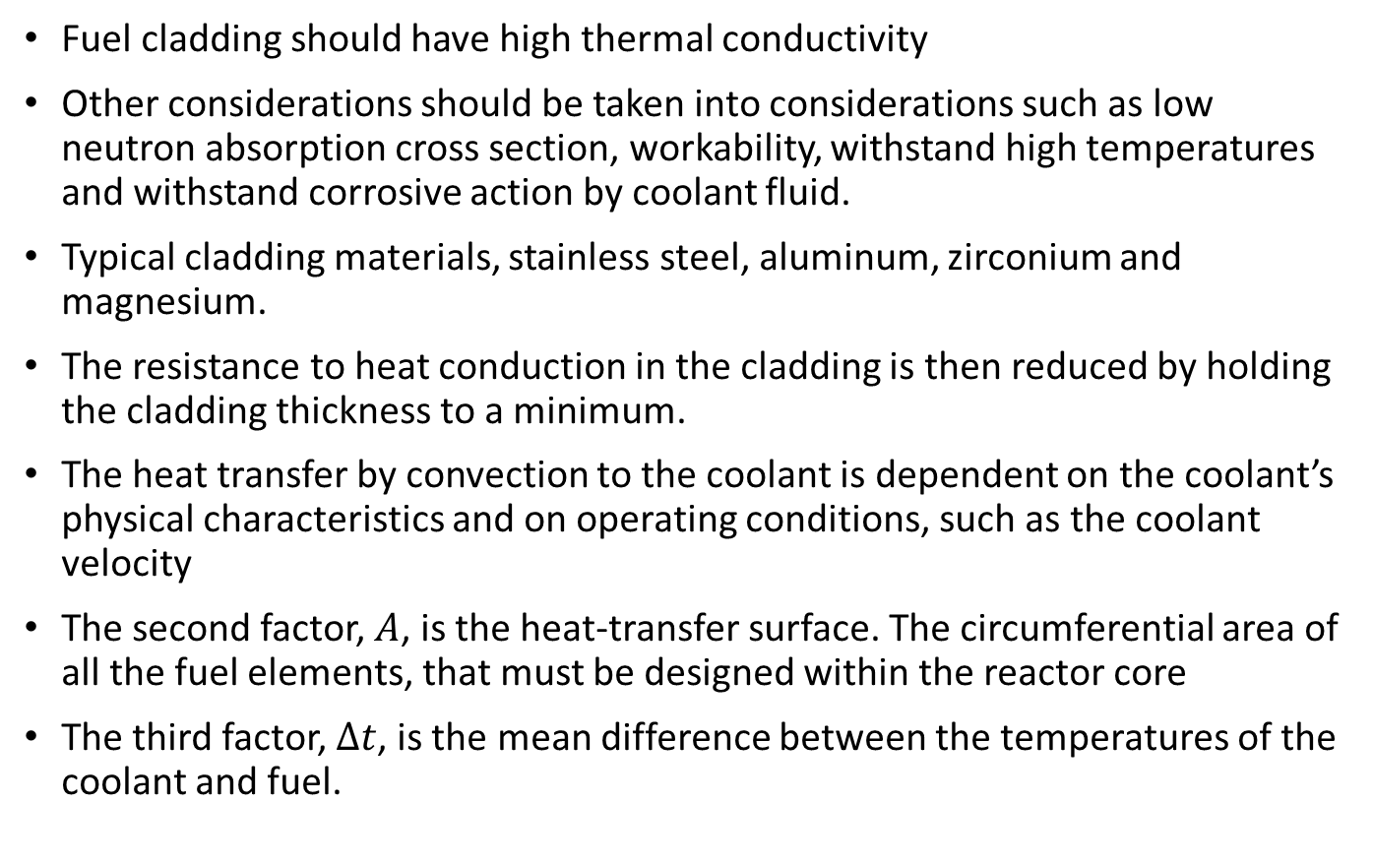
General Considerations
Fuel cladding should have high thermal conductivity
Other considerations should be taken into considerations such as low neutron absorption cross section, workability, withstand high temperatures and withstand corrosive action by coolant fluid.
Typical cladding materials, stainless steel, aluminum, zirconium and magnesium.
The resistance to heat conduction in the cladding is then reduced by holding the cladding thickness to a minimum.
The heat transfer by convection to the coolant is dependent on the coolant’s physical characteristics and on operating conditions, such as the coolant velocity
The second factor, $A$, is the heat-transfer surface. The circumferential area of all the fuel elements, that must be designed within the reactor core
The third factor, $Δt$, is the mean difference between the temperatures of the coolant and fuel.

Slide 13
Three Barriers Concept (Defense in Depth)
Barrier | Material | Limit | Function
1st | Fuel pellet (UO₂) | 2,800°C (melting) | Contains fission products
2nd | Cladding (Zircaloy) | 1,200°C (2,200°F) | Containment barrier
3rd | Reactor Coolant System | N/A | Confines radioactivity

Slide 14
Fuel Centerline Temperature: 1,200°C Design Limit
UO₂ ductility degrades above 1,600°C
Pellet densification & fission gas release accelerates above 1,200°C
At melting (2,800°C): fuel swells, pressurizes rod internally
Design margin: 40-50% to melting point
Safety factor: 2.3× on absolute melting point
Historical context: Three Mile Island (1979) → centerline temps exceeded 2,800°C

Slide 15
Cladding Temperature & DNB Ratio Limits
Cladding Inner Surface Temperature (1,260°C):
Ductility loss → brittle fracture risk
Stress corrosion cracking susceptibility increases above 1,050°C
Creep strain limits: <1% to preserve cooling geometry
Departure from Nucleate Boiling (DNB) Ratio > 1.25 (PWR):
Nucleate boiling: h = 10,000-100,000 W/m²·K
Film boiling: h = 1,000-5,000 W/m²·K (10-100× drop)
Cladding temperature spikes 100-200°F in seconds after DNB
DNBR = 1.25 means actual heat flux = 80% of CHF (20% safety margin)

Slide 16
Operational Lifetime: Normal Operation
Full Power (100%):
Typical: 18-24 months between refueling
Fuel burnup: 40-60 GWd/MTU (gigawatt-days per metric ton uranium)
Load Following (70-110% power):
Ramping rates: 3-5% power change per minute
Slower ramps provide better thermal margin
Low Power Operation (20-50%):
Testing, startups at reduced temperature
Different thermal challenges than full power

Slide 17
Accident Conditions & Design Basis
Design Basis Accidents (DBA):
Loss of Coolant Accident (LOCA): Core partially uncovered
Loss of Flow: Pump trip with degraded heat removal
Reactivity Insertion: Control rod withdrawal
Core remains coolable; limited fuel damage allowed
Design Extension Conditions (DEC):
Beyond DBA but within engineering analysis capability
Core geometry remains maintainable, coolability preserved
Core Denied Normal Cooling:
Current reactors: ~2,000 seconds without cooling
Advanced designs (AP1000): >24 hours with passive cooling

Slide 18
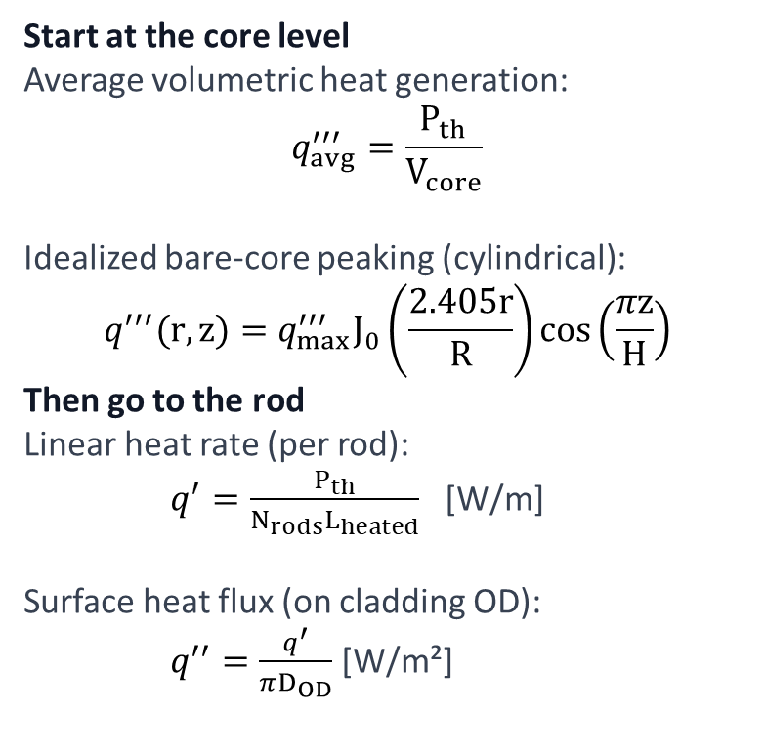
From Fission to Heat Flux
Neutron flux → volumetric heat generation → linear heat rate → surface heat flux → coolant boiling
Start at the core level
Average volumetric heat generation:
$$q_{avg}^{′′′}=\frac{P_{th}}{V_{core}}$$
Idealized bare-core peaking (cylindrical):
$$q^{′′′}(r,z)=q_{max}^{′′′}J_{0}\left(\frac{2.405r}{R}\right)cos\left(\frac{πz}{H}\right)$$
Then go to the rod
Linear heat rate (per rod):
$q^{′}=\frac{P_{th}}{N_{rods}L_{heated}}$ [W/m]
Surface heat flux (on cladding OD):
$q^{′′}=\frac{q^{′}}{πD_{OD}}$ [W/m²]
Unit ladder
Pth [W]
q‴ [W/m³]
q′ [W/m]
q″ [W/m²]
Common mistake: mixing “per rod” vs “per assembly”.

Slide 19
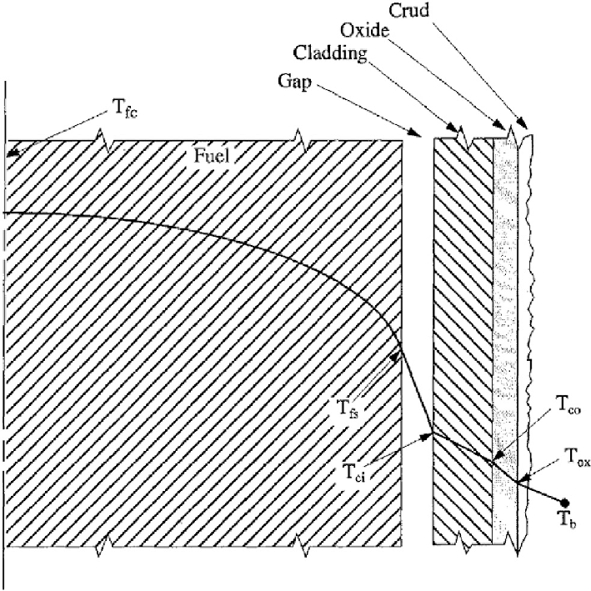
Gap Conductance Model
h_gap = (k_He / t_gap) + h_contact
where:
k_He = 0.2 W/m·K (helium thermal conductivity)
t_gap = 0.1 mm initially (gap thickness)
h_contact = mechanical contact dependent
Typical Values:
BOL: 1,500-2,500 W/m²·K (gas conduction + partial contact)
Mid-life: 3,000-8,000 W/m²·K (full contact + high pressure)
EOL: 2,000-5,000 W/m²·K (fission gas release reduces pressure)

Slide 20
Heat Flux Definition: LHGR with Example
Linear Heat Generation Rate = Heat per unit length of rod
Example: 27.3 kW rod / 366 cm height = 27,300 W ÷ 366 = 74.6 W/cm
Typical PWR Values (3000 MWth plant):
Core average LHGR: 170 W/cm (at full power)
Radial peak (F_r = 1.20): 204 W/cm
With axial peak (F_z = 1.35): 275 W/cm theoretical max
Design limit: 220 W/cm (20% margin includes uncertainties)
Heat Flux Conversion: 220 W/cm → q'' ≈ 760 kW/m² (0.76 MW/m²)

Slide 21
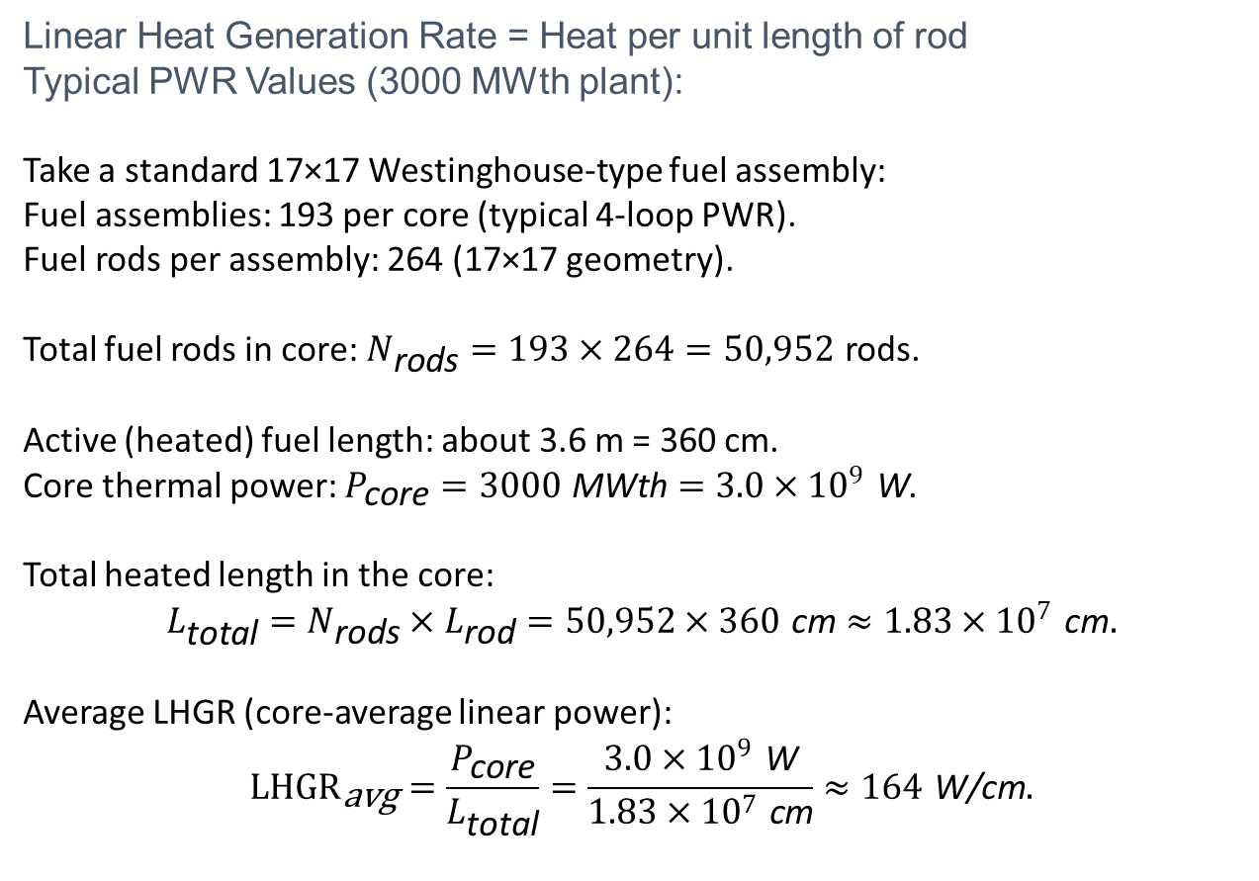
Heat Flux Definition: LHGR with Example
Linear Heat Generation Rate = Heat per unit length of rod
Typical PWR Values (3000 MWth plant):
Take a standard 17×17 Westinghouse‑type fuel assembly:
Fuel assemblies: 193 per core (typical 4‑loop PWR).​
Fuel rods per assembly: 264 (17×17 geometry).​
Total fuel rods in core: $N_{\text{rods}}=193×264=50,952$ rods.​
Active (heated) fuel length: about 3.6 m = 360 cm.​
Core thermal power: $P_{\text{core}}=3000 \text{MWth}=3.0×{10}^{9} \text{W}$.
Total heated length in the core:
$$L_{\text{total}}=N_{\text{rods}}×L_{\text{rod}}=50,952×360 \text{cm}≈1.83×{10}^{7} \text{cm}.$$
Average LHGR (core‑average linear power):
$${LHGR}_{\text{avg}}=\frac{P_{\text{core}}}{L_{\text{total}}}=\frac{3.0×{10}^{9} \text{W}}{1.83×{10}^{7} \text{cm}}≈164 \text{W}\text{/}\text{cm}.$$

Slide 22
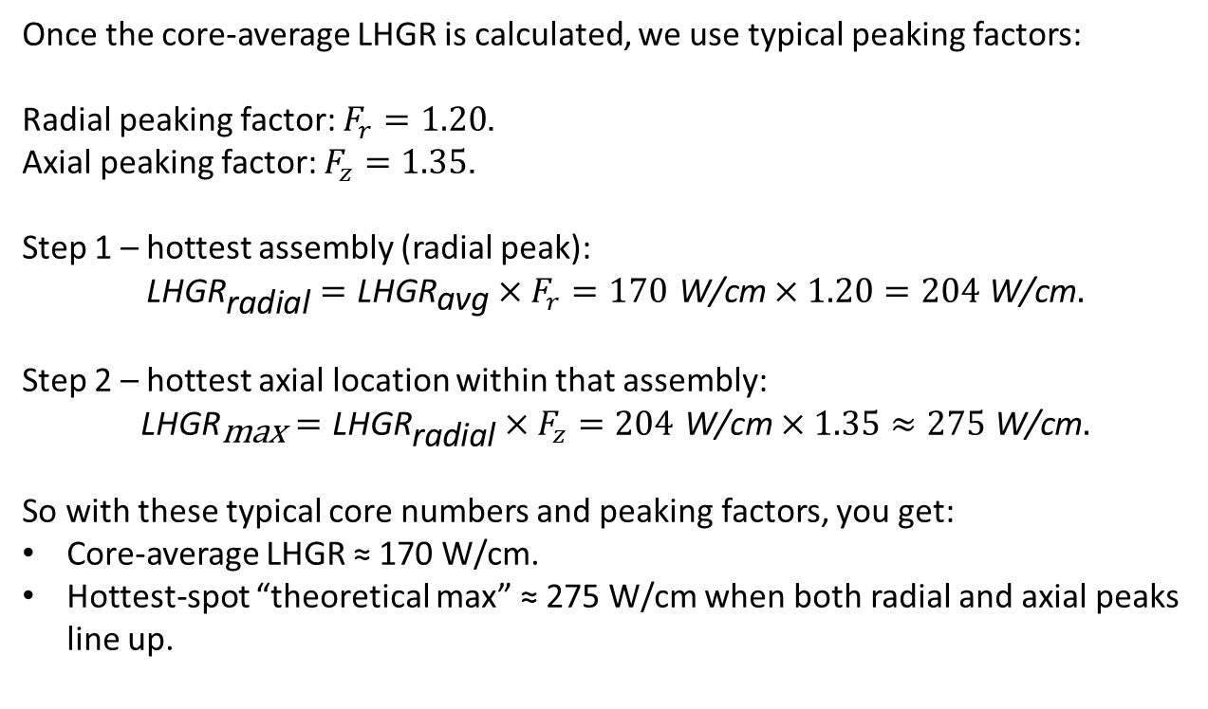
LHGR: Axial theoretical max Example
Once the core‑average LHGR is calculated, we use typical peaking factors:
Radial peaking factor: $F_{r}=1.20$.
Axial peaking factor: $F_{z}=1.35$.
Step 1 – hottest assembly (radial peak):
$${\text{LHGR}}_{\text{radial}}={\text{LHGR}}_{\text{avg}}×F_{r}=170 \text{W}\text{/}\text{cm}×1.20=204 \text{W}\text{/}\text{cm}.$$
Step 2 – hottest axial location within that assembly:
$${\text{LHGR}}_{\text{max}}={\text{LHGR}}_{\text{radial}}×F_{z}=204 \text{W}\text{/}\text{cm}×1.35≈275 \text{W}\text{/}\text{cm}.$$
So with these typical core numbers and peaking factors, you get:
Core‑average LHGR ≈ 170 W/cm.
Hottest‑spot “theoretical max” ≈ 275 W/cm when both radial and axial peaks line up.

Slide 23
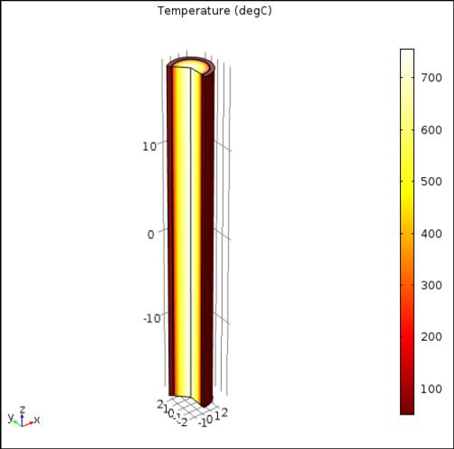
Temperature vs. Heat Flux (PWR Example)
For single-phase liquid cooling:
Fuel centerline relies on entire thermal path:
ΔT_fuel + ΔT_gap + ΔT_clad + ΔT_convection
Example: 220 W/cm rod at hottest elevation (q'' = 760 kW/m²):
Bulk coolant: 320°C (outlet region)
Convection ΔT (h = 50,000 W/m²·K): 760,000/50,000 = 15.2°C
Clad outer surface: 320 + 15.2 = 335.2°C
Clad inner (k=18, t=0.57mm): +~25°C = 360°C
Gap ΔT (h_gap=2000 W/m²·K): 760,000/2,000 = 380°C
Fuel pellet outer: 360 + 380 = 740°C
Fuel centerline (k=3.5 W/m·K): +460°C = 1,200°C ← Design limit!

Slide 24
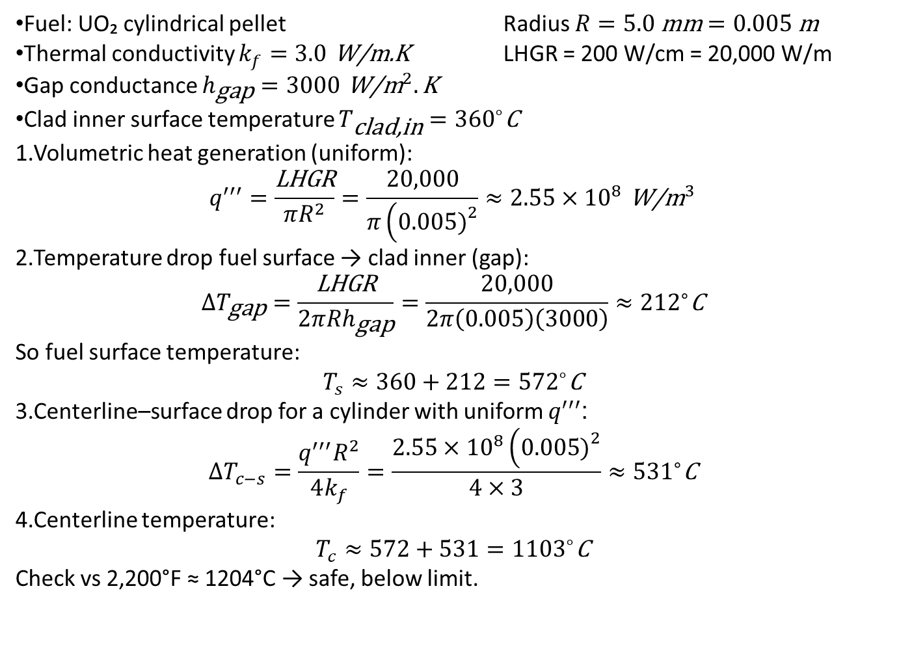
Problem 1 – Fuel centerline temperature
Fuel: UO₂ cylindrical pellet Radius $R=5.0 \text{mm}=0.005 \text{m}$
Thermal conductivity $k_{f}=3.0 \text{W}\text{/}\text{m}\text{.}\text{K}$ LHGR = 200 W/cm = 20,000 W/m
Gap conductance $h_{\text{gap}}=3000 {\text{W}\text{/}\text{m}}^{2}.\text{K}$
Clad inner surface temperature $T_{\text{clad}\text{,}\text{in}}={360}^{∘}\text{C}$
Volumetric heat generation (uniform):
$$q^{′′′}=\frac{\text{LHGR}}{πR^{2}}=\frac{20,000}{π\left(0.005{\left.)\right.}^{2}\right.}≈2.55×{10}^{8} {\text{W}\text{/}\text{m}}^{3}$$
Temperature drop fuel surface → clad inner (gap):
$$ΔT_{\text{gap}}=\frac{\text{LHGR}}{2πRh_{\text{gap}}}=\frac{20,000}{2π\left(0.005\right)\left(3000\right)}≈{212}^{∘}\text{C}$$
So fuel surface temperature:
$$T_{s}≈360+212={572}^{∘}\text{C}$$
Centerline–surface drop for a cylinder with uniform $q^{′′′}$:
$$ΔT_{c−s}=\frac{q^{′′′}R^{2}}{4k_{f}}=\frac{2.55×{10}^{8}\left(0.005{\left.)\right.}^{2}\right.}{4×3}≈{531}^{∘}\text{C}$$
Centerline temperature:
$$T_{c}≈572+531={1103}^{∘}\text{C}$$
Check vs 2,200°F ≈ 1204°C → safe, below limit.

Slide 25
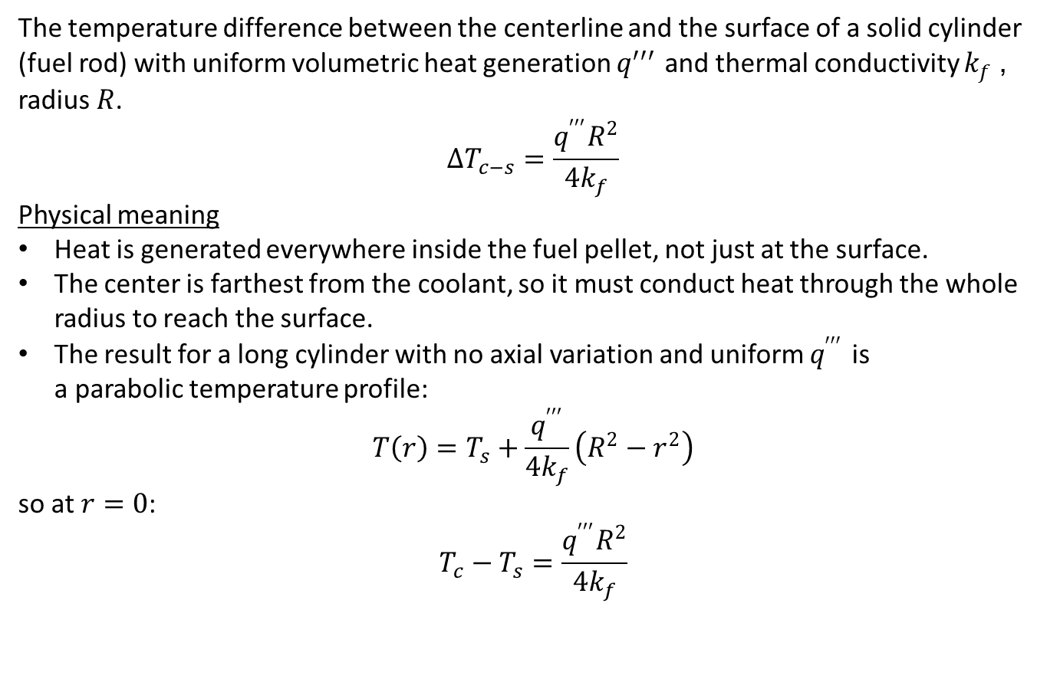
Fuel centerline temperature
The temperature difference between the centerline and the surface of a solid cylinder (fuel rod) with uniform volumetric heat generation $q^{′′′}$ and thermal conductivity $k_{f}$, radius $R$.​
$$ΔT_{c−s}=\frac{q^{′′′}R^{2}}{4k_{f}}$$
Physical meaning
Heat is generated everywhere inside the fuel pellet, not just at the surface.
The center is farthest from the coolant, so it must conduct heat through the whole radius to reach the surface.
The result for a long cylinder with no axial variation and uniform $q^{′′′}$ is a parabolic temperature profile:
$$T\left(r\right)=T_{s}+\frac{q^{′′′}}{4k_{f}}\left(R^{2}−r^{2}\right)$$
so at $r=0$:
$$T_{c}−T_{s}=\frac{q^{′′′}R^{2}}{4k_{f}}$$

Slide 26
Core Thermal Design Considerations

Slide 27
Core Thermal Design
Core thermal design is an art of compromise
An iterative process (interdependence of heat flux and water density)
Overall plant characteristics is influenced by thermal hydraulic considerations

Slide 28
Core Thermal Design
Once core basic lattice has been determined from nuclear, hydraulic, and heat transfer, the overall size of core becomes a sole function of thermal considerations
Parameters
  Fuel temperature distribution (most important)
  Specific power
  Power density
  Heat flux

Slide 29
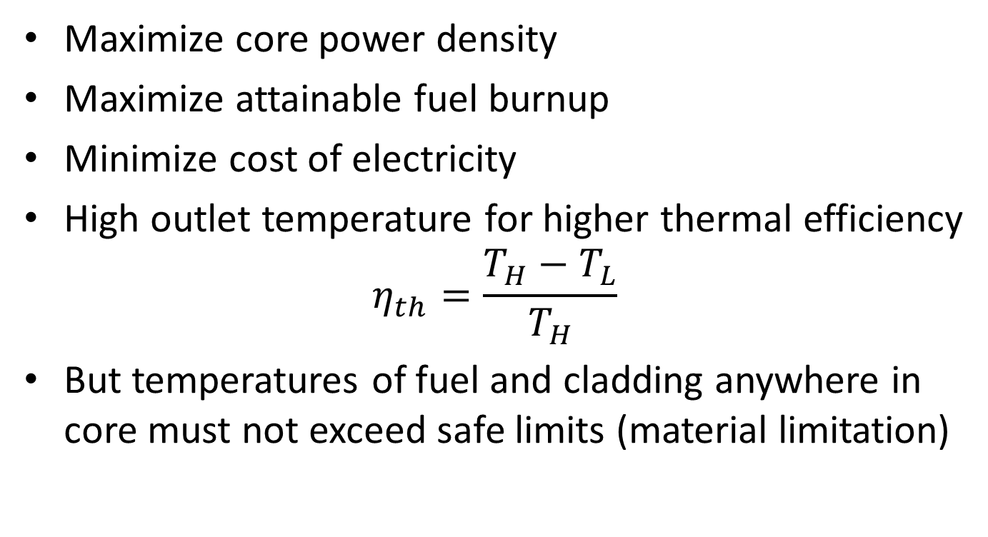
Core Design Objectives
Maximize core power density
Maximize attainable fuel burnup
Minimize cost of electricity
High outlet temperature for higher thermal efficiency
$$η_{th}=\frac{T_{H}−T_{L}}{T_{H}}$$
But temperatures of fuel and cladding anywhere in core must not exceed safe limits (material limitation)

Slide 30
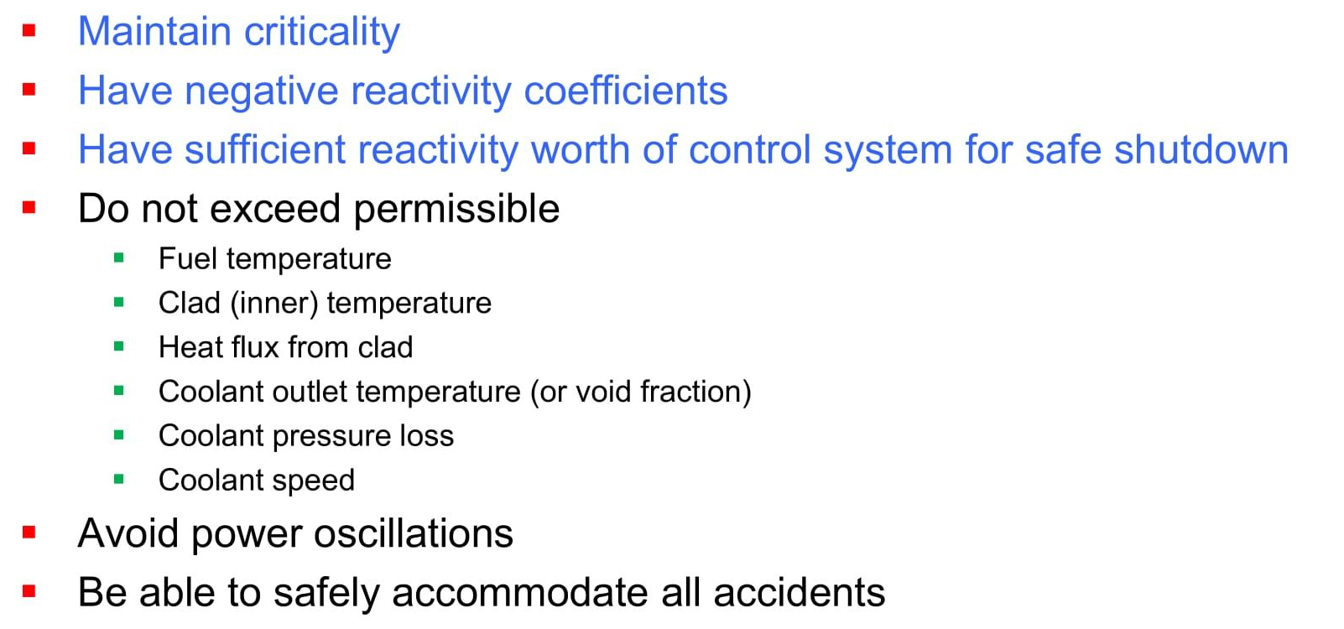
Design Constraints

Slide 31
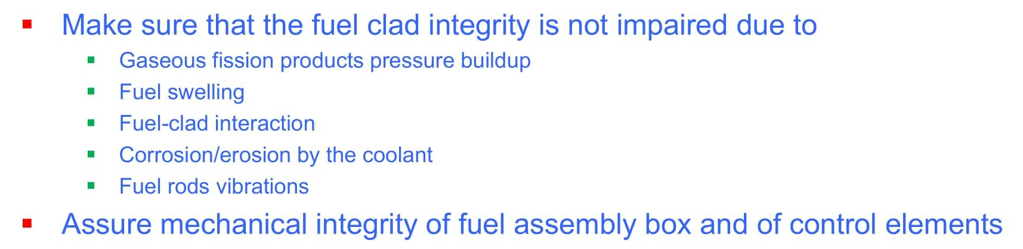
Design Constraints

Slide 32
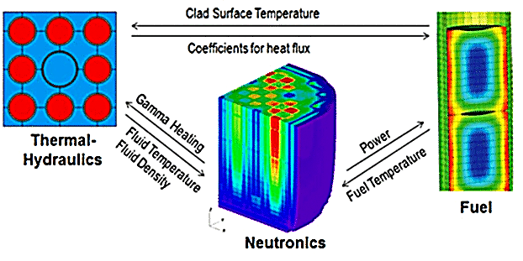
Thermal Reactor Design
3 aspects of design considerations
  Nuclear Design
  Thermal-hydraulics Design
  Mechanical/Material Design

Slide 33
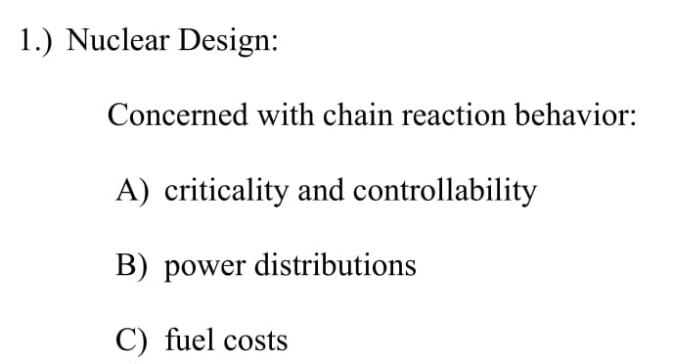
Nuclear Design

Slide 34
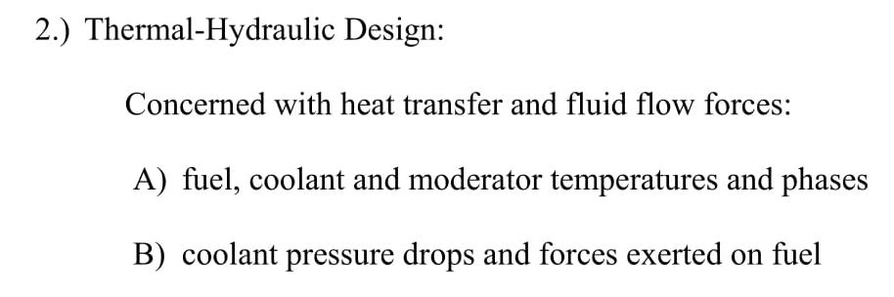
Thermal-hydraulics Design

Slide 35
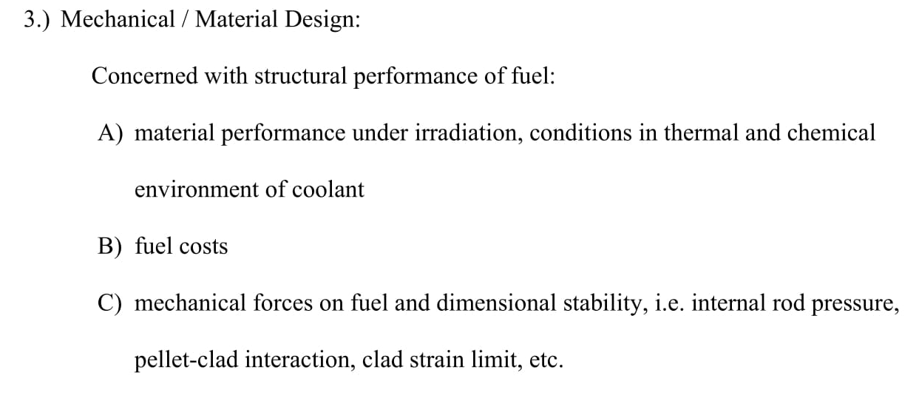
Mechanical/Materials Design

Slide 36
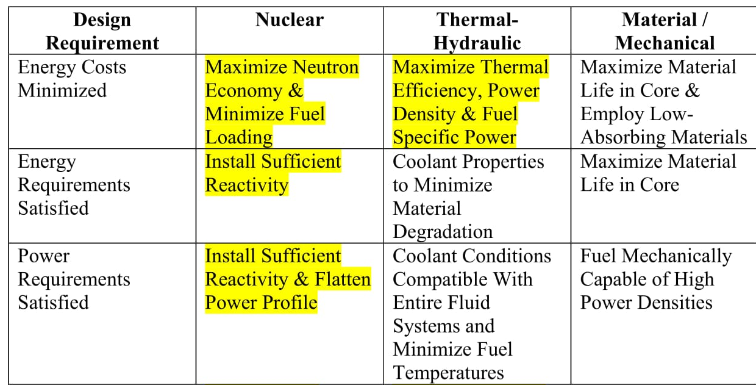
Impact on various design areas

Slide 37
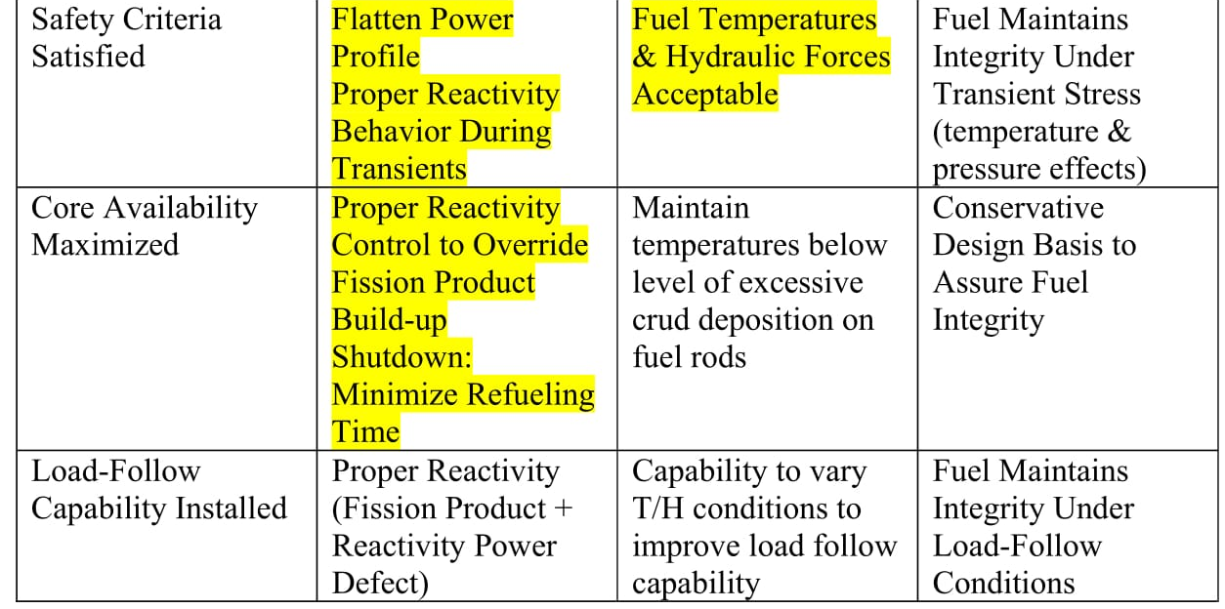
Impact on various design areas

Slide 38
Limits and
Safety Aspects

Slide 39
Thermal Design Safety Aspects
DNB Ratio
Hot channel, hot spot factors
Thermal limits
  Fuel centerline temperature
  Cladding inner surface temperature
Values change with fuel burnup!

Slide 40
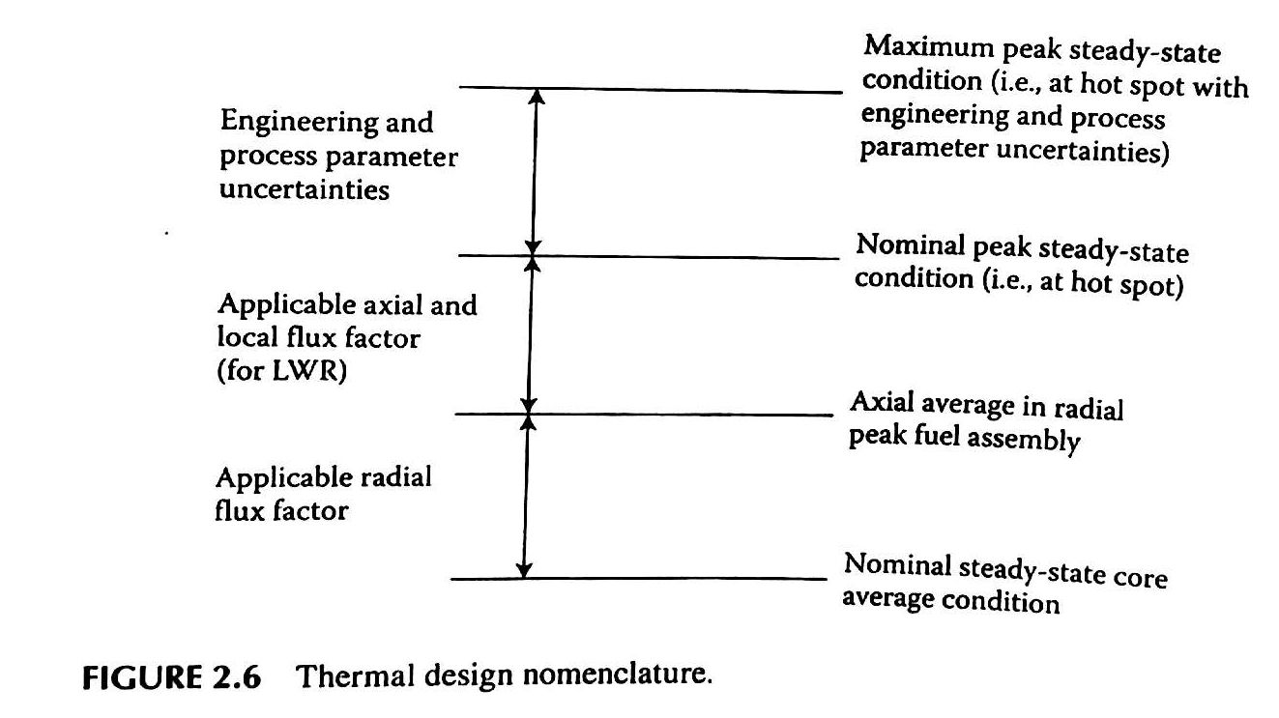
Thermal Design Nomenclature
(Nominal, Average, Peak, Maximum)

Slide 41
Thermal Design Nomenclature: From Core Average to Limiting Hot Spot
Key idea:
Thermal design proceeds by successive peaking and uncertainty amplification, moving from a benign average to a conservative worst-case local condition.
Vertical progression (bottom → top):
Nominal core-average condition
  Total reactor power
  Core-average heat flux
  Core-average coolant temperature rise
Radial peaking applied
  Selects the hottest fuel assembly
  Accounts for radial neutron flux distribution
Axial + local peaking applied
  Selects hot axial elevation
  Selects hottest fuel pin / subchannel
Engineering & process uncertainties applied
  Manufacturing tolerances
  Flow maldistribution
  Instrumentation uncertainty

Slide 42
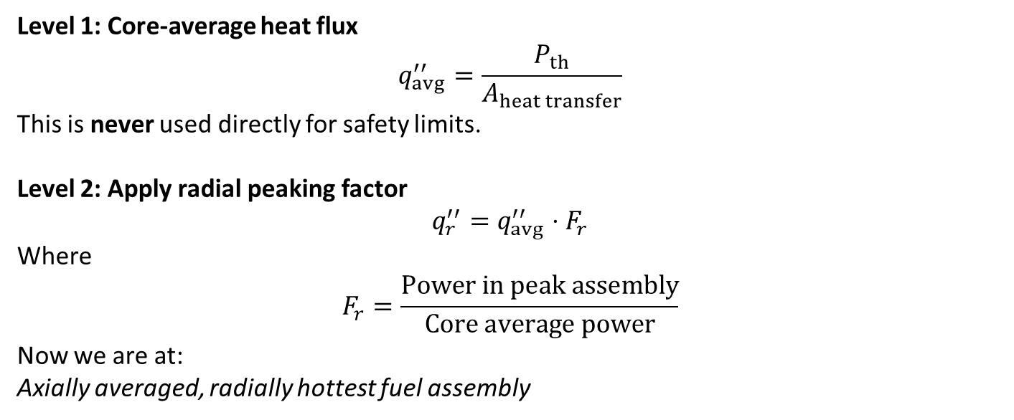
Thermal Design Nomenclature: From Core Average to Limiting Hot Spot
Level 1: Core-average heat flux
$$q_{avg}^{′′}=\frac{P_{th}}{A_{heat transfer}}$$
This is never used directly for safety limits.
Level 2: Apply radial peaking factor
$$q_{r}^{′′}=q_{avg}^{′′}⋅F_{r}$$
Where
$$F_{r}=\frac{Power in peak assembly}{Core average power}$$
Now we are at:
Axially averaged, radially hottest fuel assembly

Slide 43
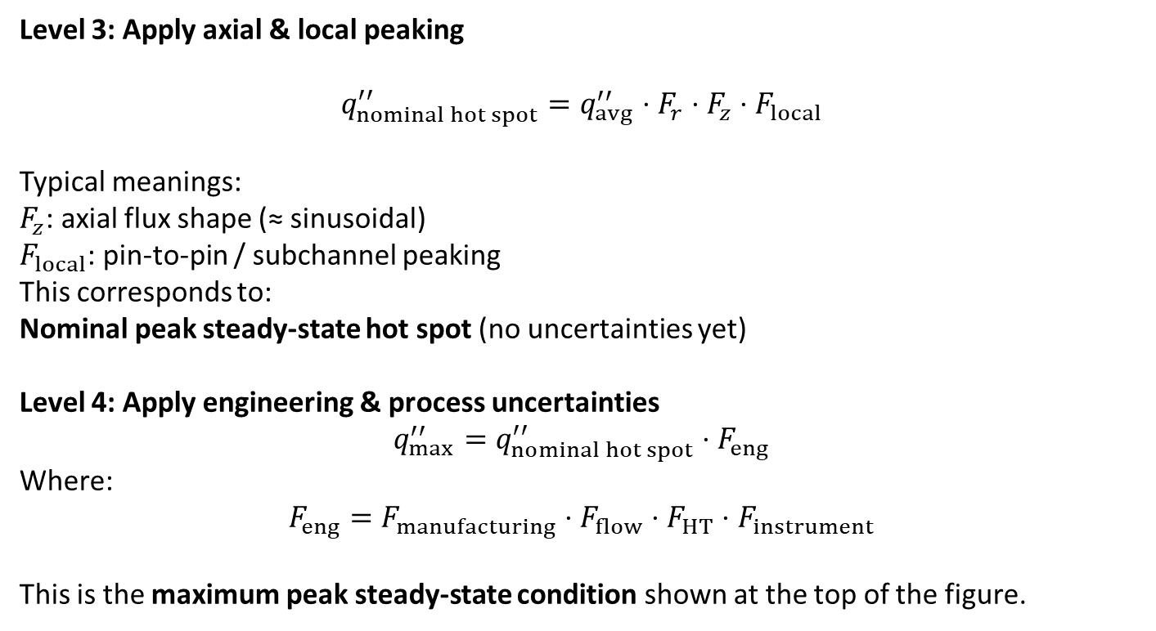
Thermal Design Nomenclature: From Core Average to Limiting Hot Spot
Level 3: Apply axial & local peaking
$$q_{nominal hot spot}^{′′}=q_{avg}^{′′}⋅F_{r}⋅F_{z}⋅F_{local}$$
Typical meanings:
$F_{z}$: axial flux shape (≈ sinusoidal)
$F_{local}$: pin-to-pin / subchannel peaking
This corresponds to:
Nominal peak steady-state hot spot (no uncertainties yet)
Level 4: Apply engineering & process uncertainties
$$q_{max}^{′′}=q_{nominal hot spot}^{′′}⋅F_{eng}$$
Where:
$$F_{eng}=F_{manufacturing}⋅F_{flow}⋅F_{HT}⋅F_{instrument}$$
This is the maximum peak steady-state condition shown at the top of the figure.

Slide 44
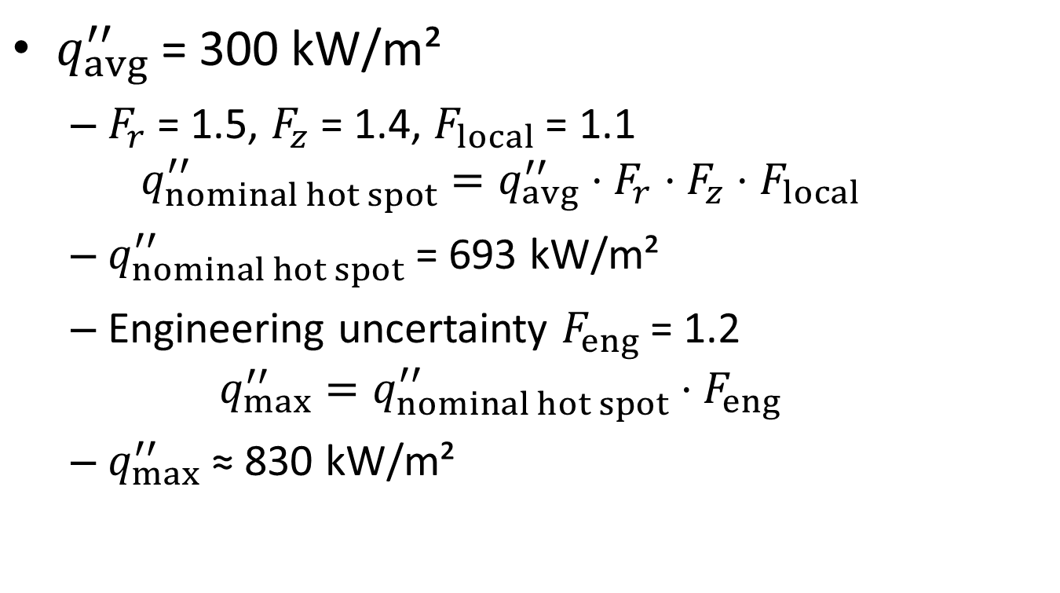
Example – Power Peaking
$q_{avg}^{′′}$= 300 kW/m²
  $F_{r}$= 1.5, $F_{z}$= 1.4, $F_{local}$= 1.1
  $$q_{nominal hot spot}^{′′}=q_{avg}^{′′}⋅F_{r}⋅F_{z}⋅F_{local}$$
  $q_{nominal hot spot}^{′′}$= 693 kW/m²
  Engineering uncertainty $F_{eng}$= 1.2
  $$q_{max}^{′′}=q_{nominal hot spot}^{′′}⋅F_{eng}$$
  $q_{max}^{′′}$≈ 830 kW/m²

Slide 45
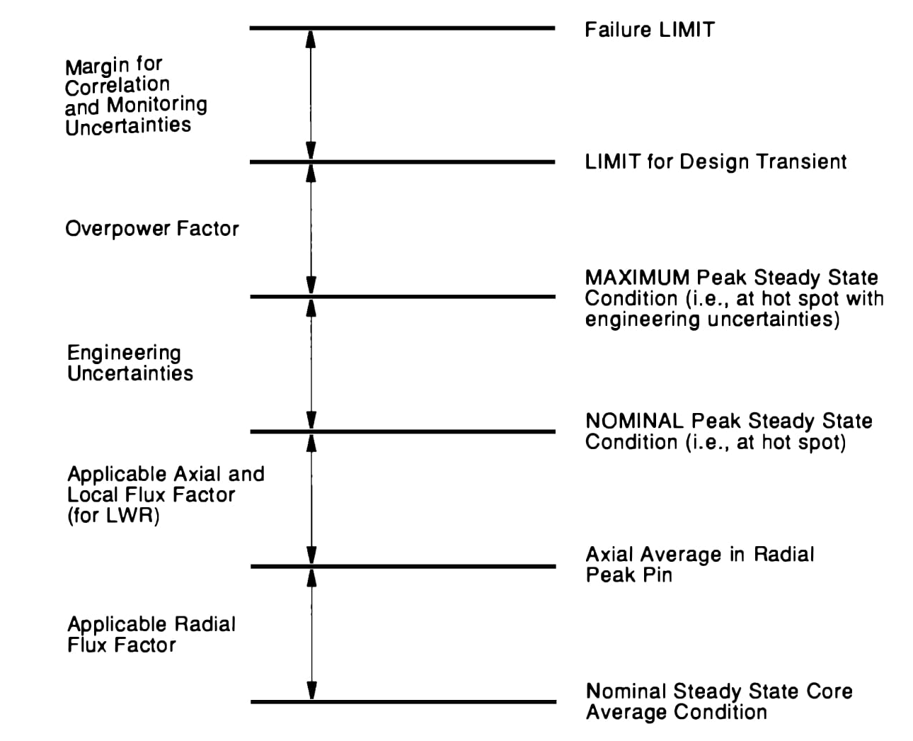
Thermal Design Margin

Slide 46
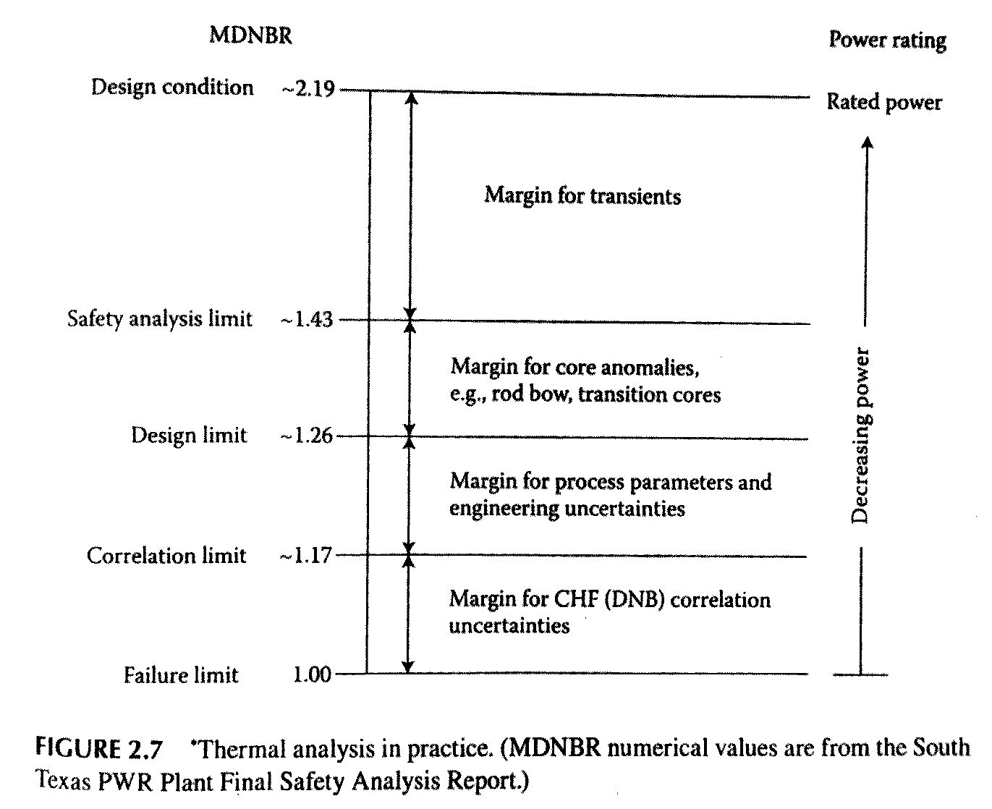
Thermal Design Limits

Slide 47
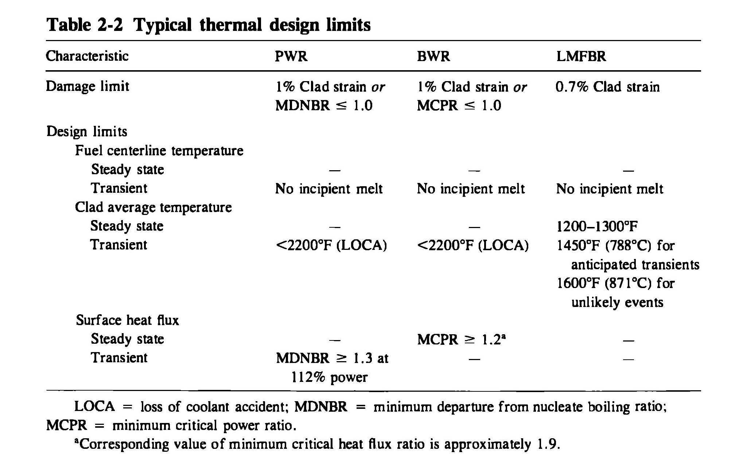
Thermal Design Limits

Slide 48
Thermal Design Limits
Parameter | Typical Limit | Why it matters
Fuel centerline T | < ~2200°C | Prevent fuel melting
Cladding T | < ~1200°C | Avoid oxidation & burst
DNBR / MDNBR | > 1.17–1.3 | Prevent DNB
Heat flux | Below CHF | Avoid burnout

Slide 49
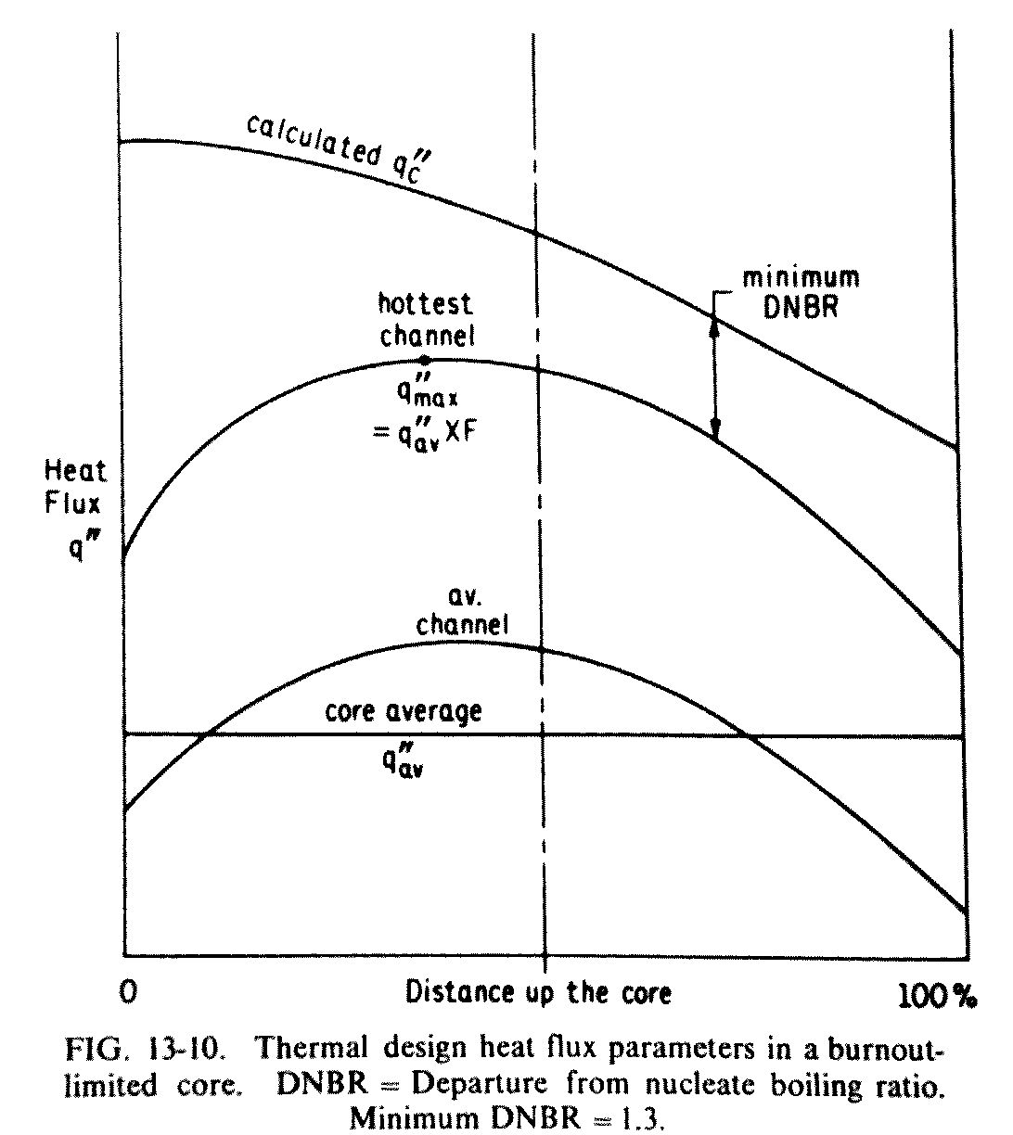
DNB Ratio

Slide 50
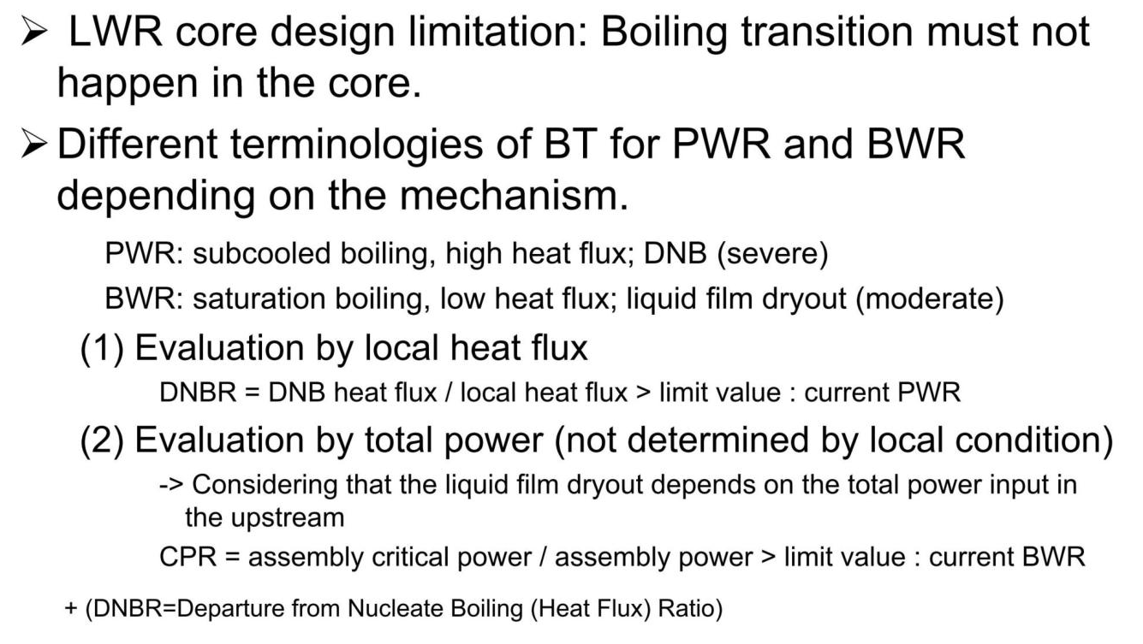
Boiling Crisis for LWR

Slide 51
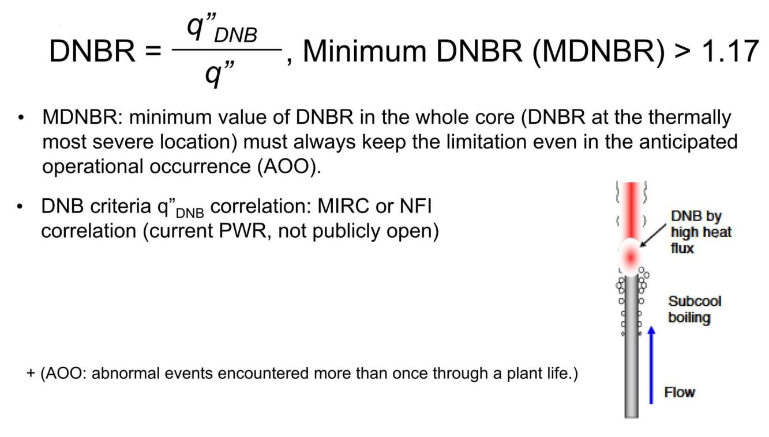
Evaluation by Local Heat Flux (PWR)

Slide 52
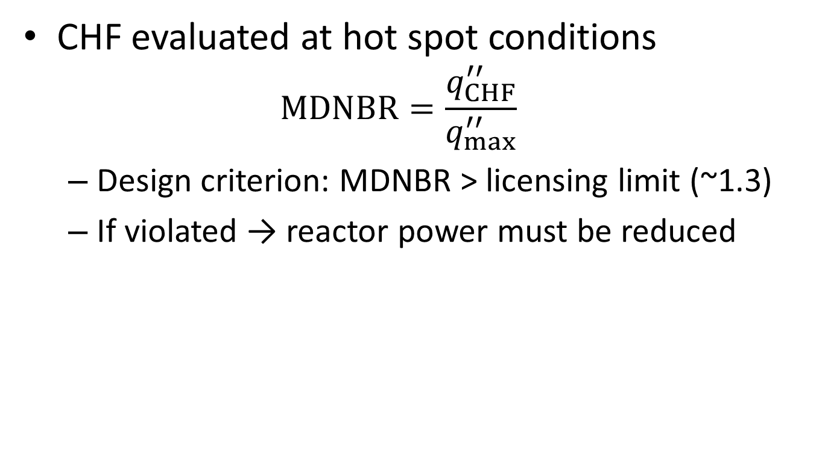
PWR: CHF and MDNBR Evaluation
CHF evaluated at hot spot conditions
  $$MDNBR=\frac{q_{CHF}^{′′}}{q_{max}^{′′}}$$
  Design criterion: MDNBR > licensing limit (~1.3)
  If violated → reactor power must be reduced

Slide 53
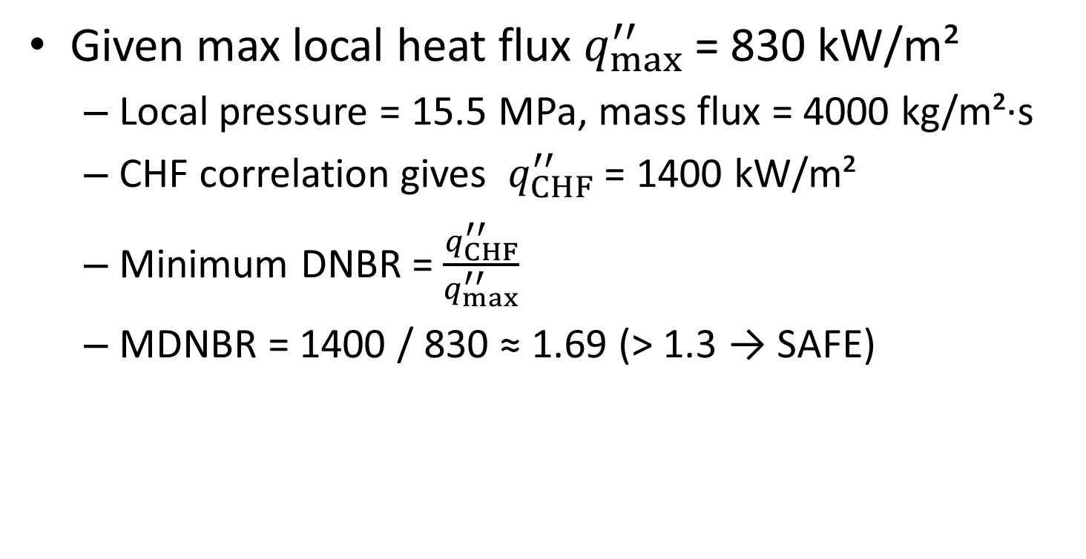
Example – PWR & MDNBR
Given max local heat flux $q_{max}^{′′}$= 830 kW/m²
  Local pressure = 15.5 MPa, mass flux = 4000 kg/m²·s
  CHF correlation gives $q_{CHF}^{′′}$= 1400 kW/m²
  Minimum DNBR = $\frac{q_{CHF}^{′′}}{q_{max}^{′′}}$
  MDNBR = 1400 / 830 ≈ 1.69 (> 1.3 → SAFE)

Slide 54
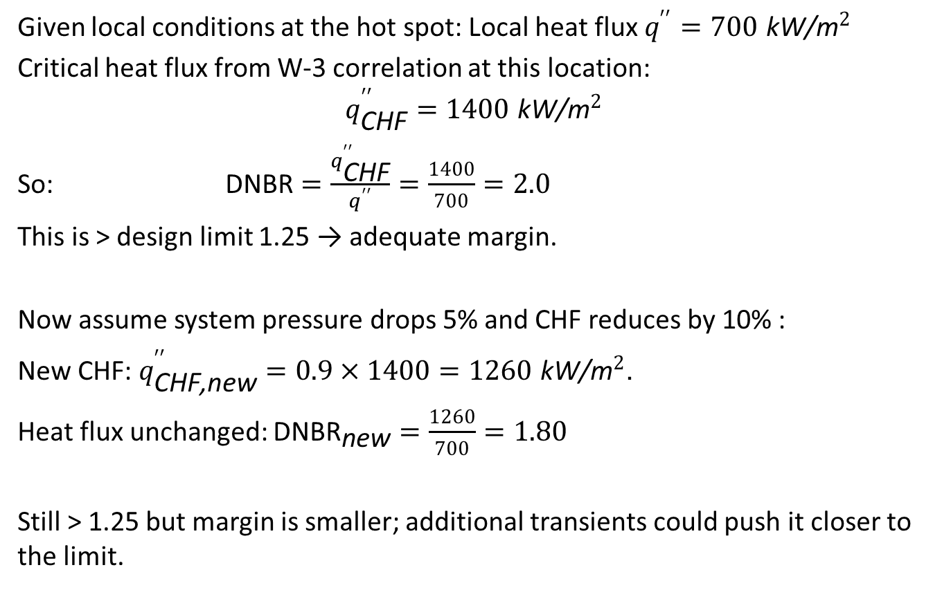
Example – DNBR with W‑3 style data
Given local conditions at the hot spot: Local heat flux $q^{′′}=700 {\text{kW}\text{/}\text{m}}^{2}$
Critical heat flux from W‑3 correlation at this location:
$$q_{\text{CHF}}^{′′}=1400 {\text{kW}\text{/}\text{m}}^{2}$$
So: $\text{DNBR}=\frac{q_{\text{CHF}}^{′′}}{q^{′′}}=\frac{1400}{700}=2.0$
This is > design limit 1.25 → adequate margin.​
Now assume system pressure drops 5% and CHF reduces by 10% :
New CHF: $q_{\text{CHF}\text{,}\text{new}}^{′′}=0.9×1400=1260 {\text{kW}\text{/}\text{m}}^{2}$.
Heat flux unchanged: ${\text{DNBR}}_{\text{new}}=\frac{1260}{700}=1.80$
Still > 1.25 but margin is smaller; additional transients could push it closer to the limit.

Slide 55
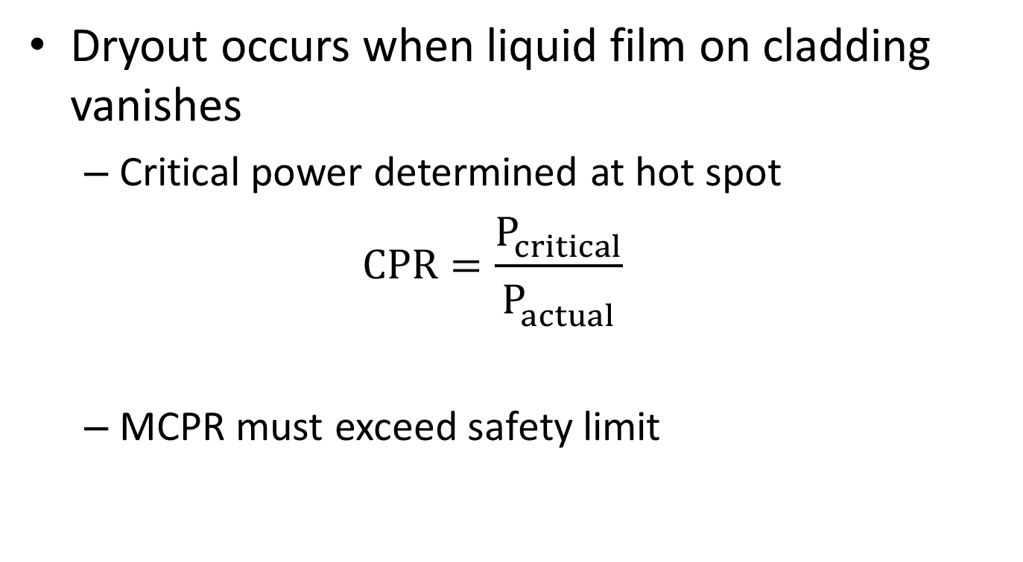
BWR: Dryout and Critical Power Ratio (CPR)
Dryout occurs when liquid film on cladding vanishes
  Critical power determined at hot spot
  $$CPR=\frac{P_{critical}^{}}{P_{actual}^{}}$$
  MCPR must exceed safety limit

Slide 56
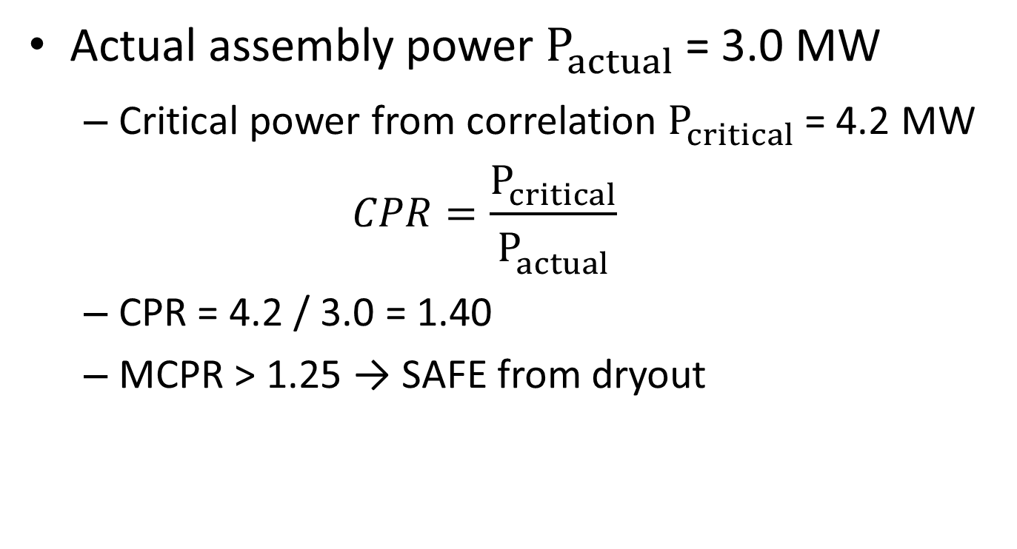
Example – BWR Dryout / CPR
Actual assembly power $P_{actual}^{}$ = 3.0 MW
  Critical power from correlation $P_{critical}^{}$ = 4.2 MW
  $$CPR=\frac{P_{critical}^{}}{P_{actual}^{}}$$
  CPR = 4.2 / 3.0 = 1.40
  MCPR > 1.25 → SAFE from dryout

Slide 57
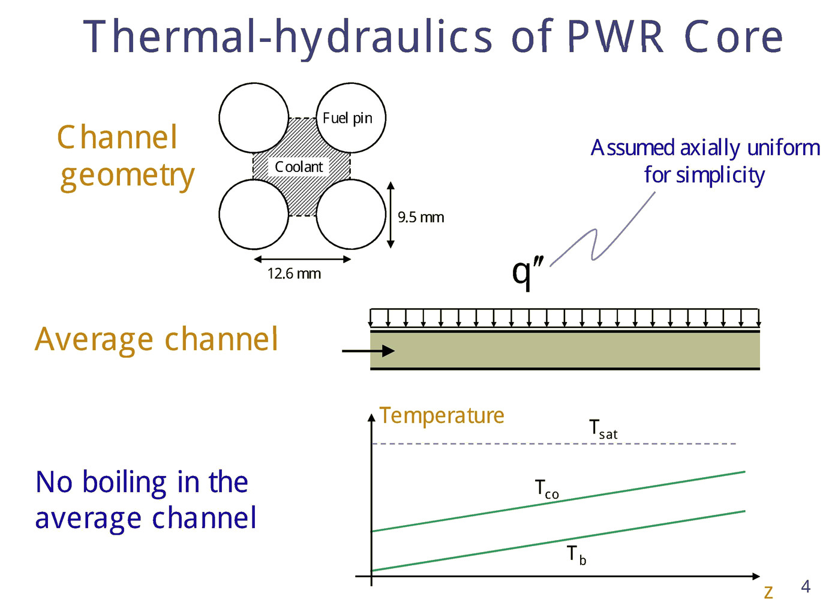

Slide 58
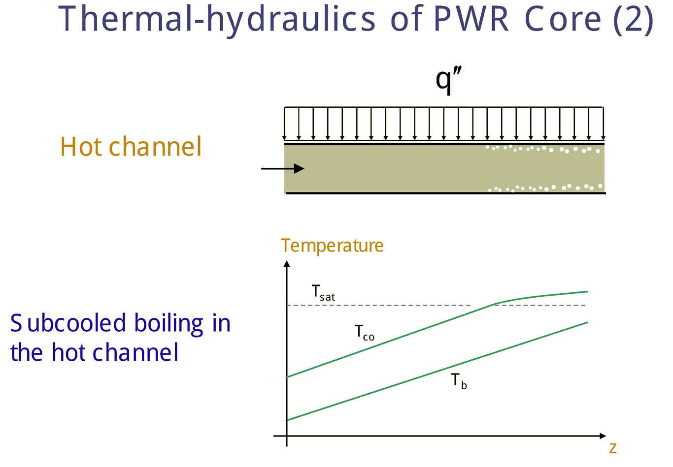

Slide 59
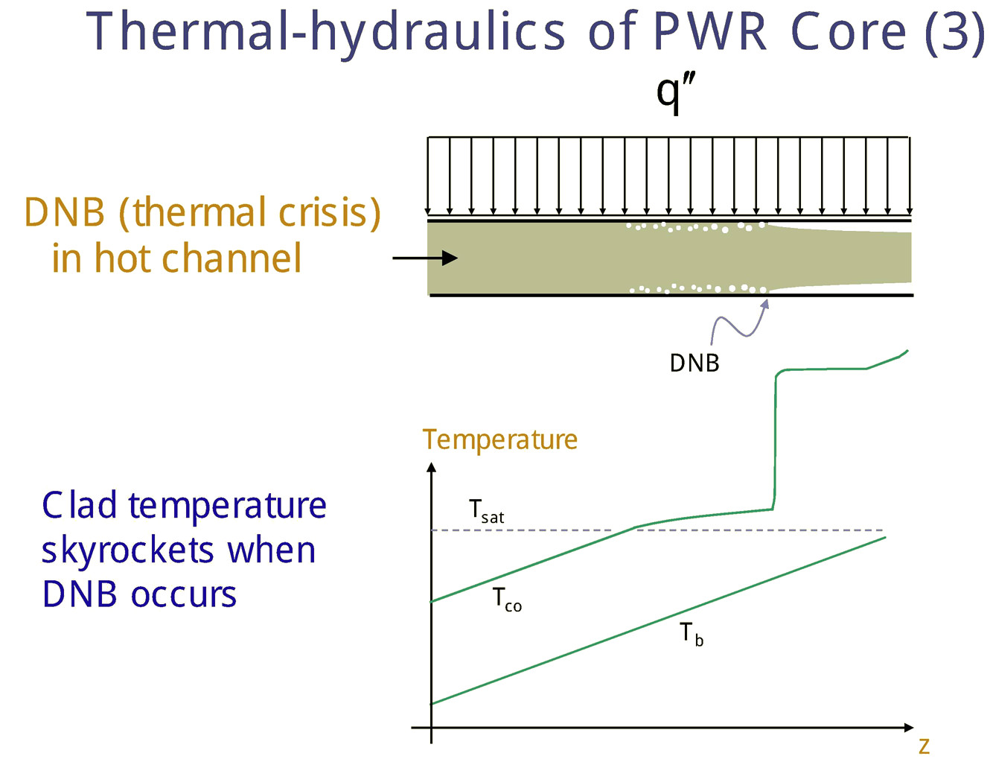

Slide 60
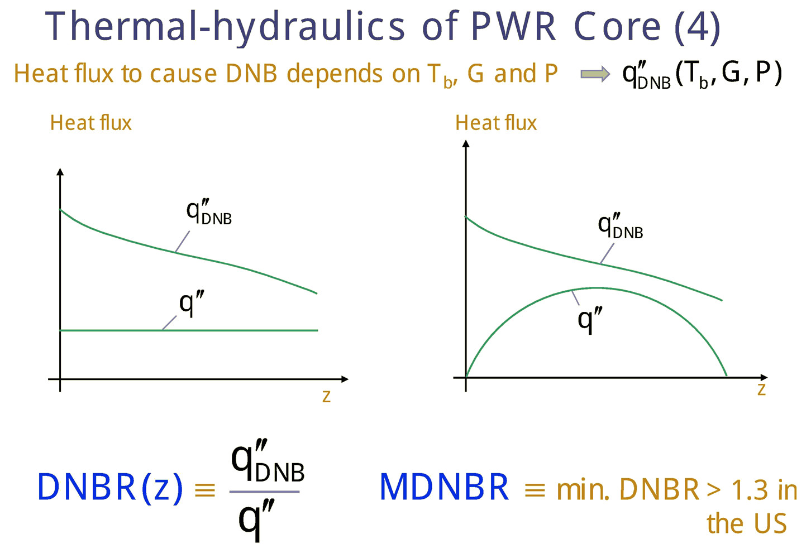

Slide 61
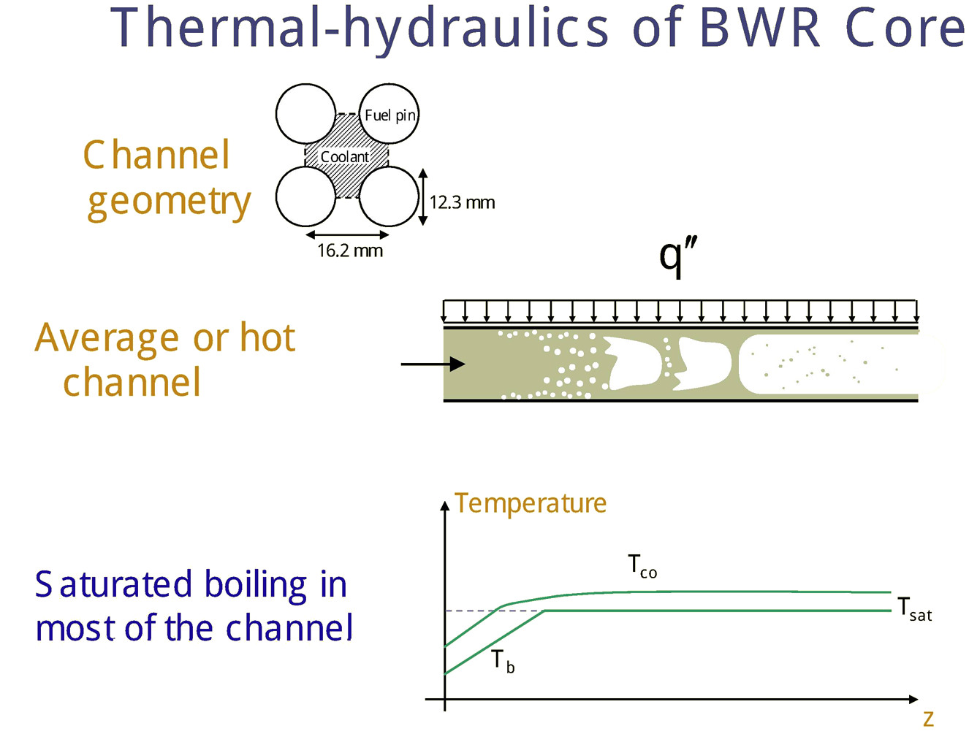

Slide 62
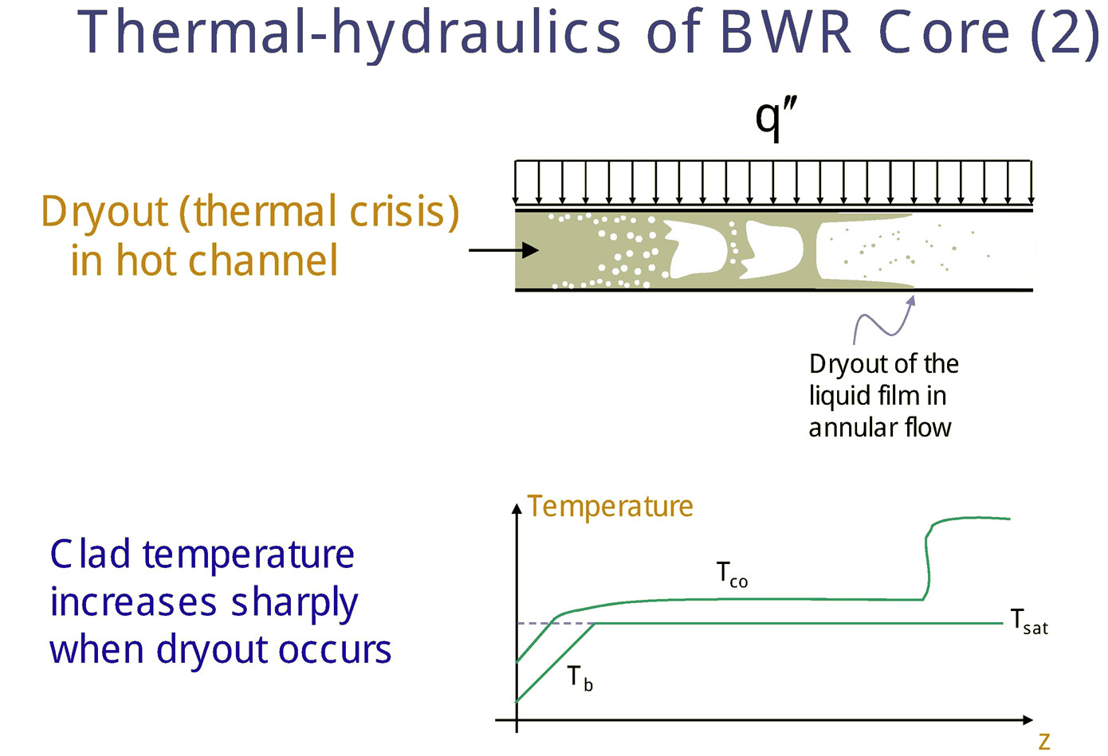

Slide 63
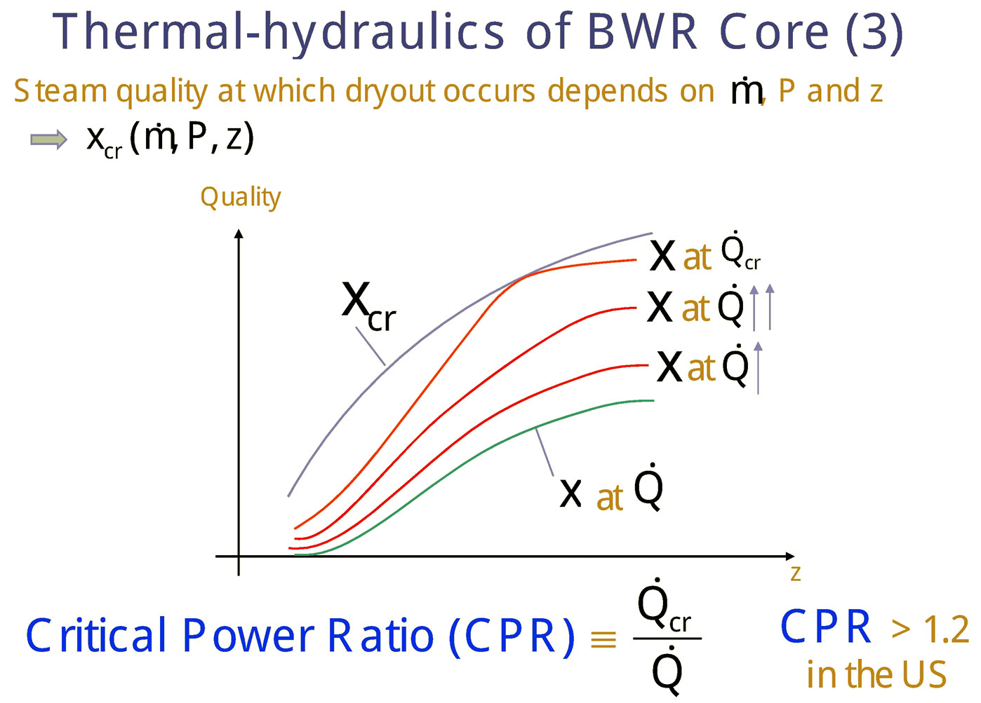

Slide 64
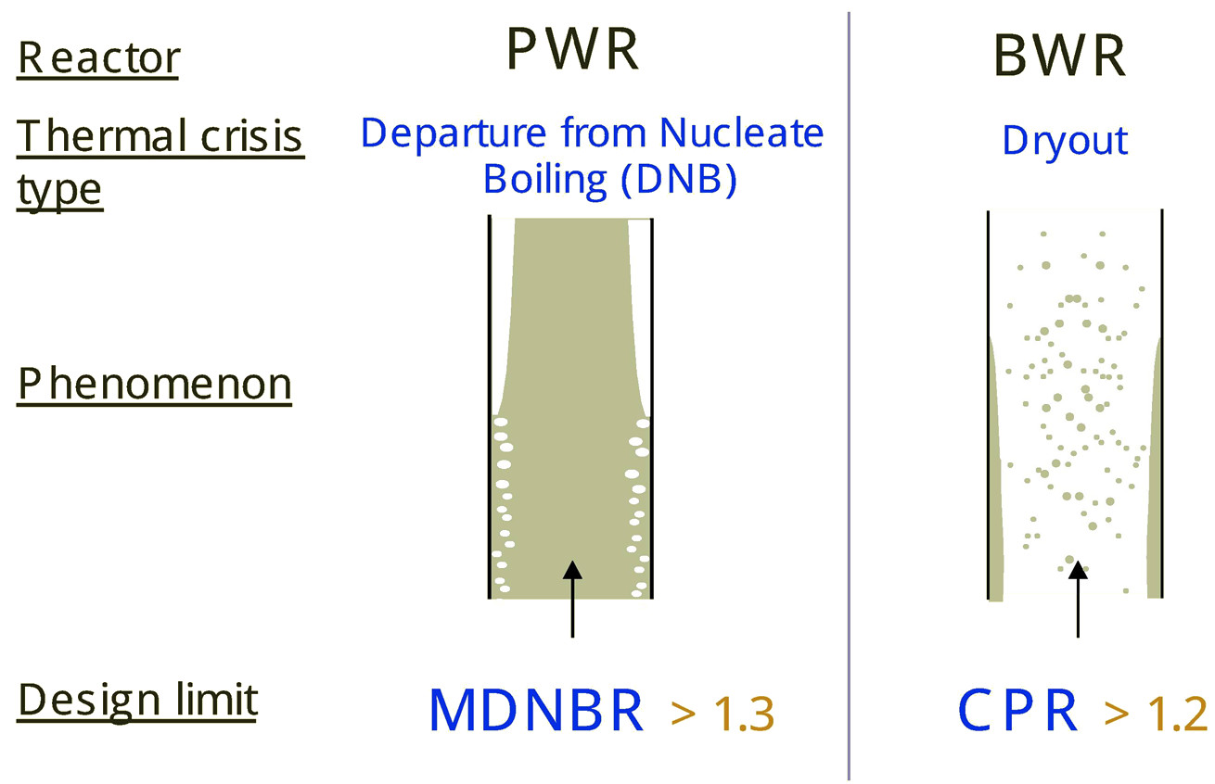
Thermal Crisis Summary
MDNBR > 1.17 (Japan)

Slide 65
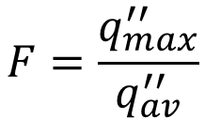

Hot Channel & Hot Spot Factor
Hot spot factor (hot-channel factor) is safety factor or margin multiplied to the calculated nominal fluxes.
In any reactor, the extent to which $q_{max}^{′′}$ exceeds the average heat flux in the core is given by the hot channel factor, also called the hot spot factor, F.
$$F=\frac{q_{max}^{′′}}{q_{av}^{′′}}$$
(4)
$q_{av}^{′′}$: is the average heat flux in the core

Slide 66
Hot-spot Factors
Deviation from nominal values are contributed by
  Nuclear hot-spot factors
  Engineering hot-spot factors

Slide 67
Nuclear Hot-spot Factors
Deviations due to
  Partially inserted control rods
  Nonhomogeneities
    Moderator (boiling)
    Fuel
    Structural and other materials

Slide 68
Engineering Hot-spot Factors
Deviations due to
  Mechanical subfactors
    Manufacturing tolerances (clad thickness)
    Warping of fuel elements
  Flow distribution subfactors
    Maldistribution of coolant flow
    Heat transfer coefficient, h
    Fuel element dimensions

Slide 69
Hot Channel & Hot Spot Factor
(Engineering Hot Spot Factor)
Manufacturing tolerances in the fuel assemblies ,may result in slight bowing of the fuel rods, leading to reduced coolant flow and excessive heating of a portion of the fuel.

Slide 70
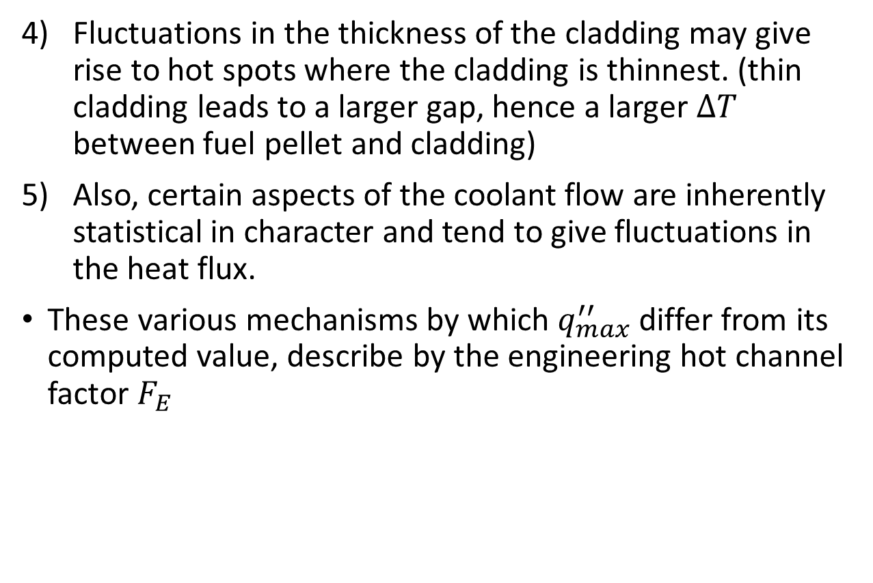
Hot Channel & Hot Spot Factor
(Engineering Hot Spot Factor)
Fluctuations in the thickness of the cladding may give rise to hot spots where the cladding is thinnest. (thin cladding leads to a larger gap, hence a larger $∆T$ between fuel pellet and cladding)
Also, certain aspects of the coolant flow are inherently statistical in character and tend to give fluctuations in the heat flux.
These various mechanisms by which $q_{max}^{′′}$ differ from its computed value, describe by the engineering hot channel factor $F_{E}$

Slide 71
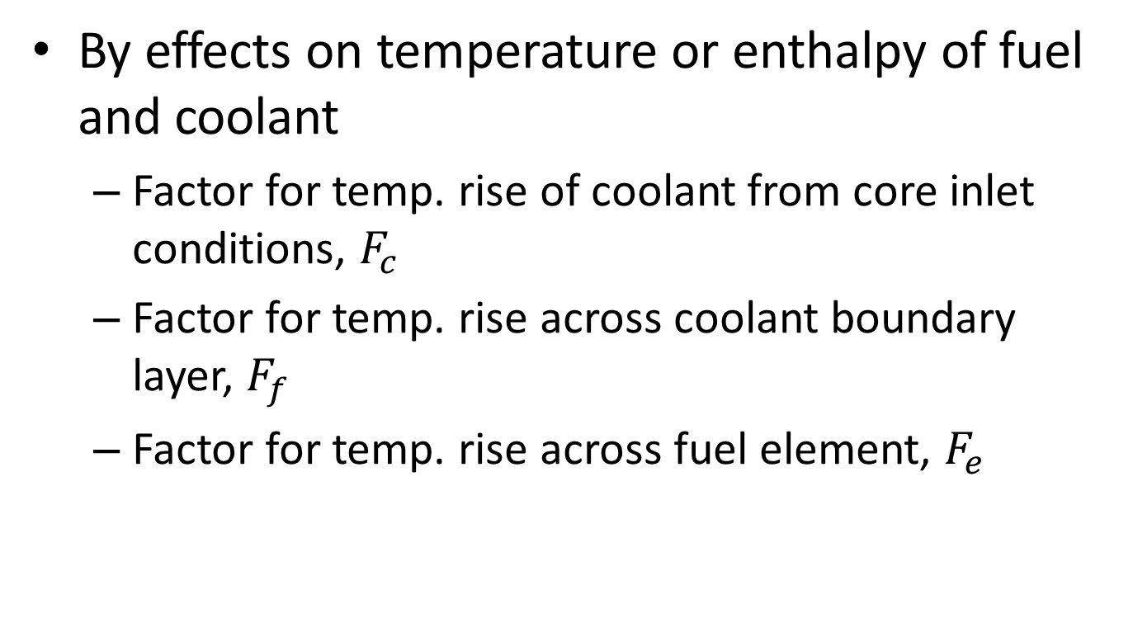
Hot-spot Factors (classified by effects)
By effects on temperature or enthalpy of fuel and coolant
  Factor for temp. rise of coolant from core inlet conditions, $F_{c}$
  Factor for temp. rise across coolant boundary layer, $F_{f}$
  Factor for temp. rise across fuel element, $F_{e}$

Slide 72


Slide 73
Overall Hot-spot Factor
Combining hot-spot subfactors, f, to get overall hot-spot factor, F.
Methods;
  Multiplicative
    All deviation factors are assumed to take place simultaneously at the same point.
    Overly conservative result
  Statistical
    Many deviation factors are independent of each other
    Small probability of occurring at the same point
    More realistic result

Slide 74


Hot Channel & Hot Spot Factor
(Overall Hot Spot Factor)
The overall hot channel is then
Each of the individual mechanisms is described, in turn, by an engineering hot channel factor, $F_{E,x}$
The engineering subfactors are obtained from data on fabricated reactor components or from tests.
For instance, the amount of fissile material $m_{l}$ per unit length of the fuel rods. For a given thermal flux, $q_{max}^{′′}$ is very nearly proportional to $m_{l}$. When measurements of $m_{l}$ are carried out on manufactured rods, it is found that the actual values $m_{l}$ form a normal distribution about some mean or average value ${\overline{m}}_{l}$ shown in Figure 3
$$F=F_{N}F_{E}$$
(6)

Slide 75


Figure 3: Normal distribution of measured values of $m_{l}$
All values of $m_{l}$ are presumably possible. However, specific values of $m_{l}$ become less and less likely with increasing deviation from the mean.

Slide 76



Hot Channel & Hot Spot Factor
It shown that probability that $m_{l}$ exceeds ${\overline{m}}_{l}$ by more than $3σ$, where $σ$ is standard deviation pf the distribution (1.35 per 1,000 an unlikely occurrence)
In those situations like the one just described, in which $q_{max}^{′′}$ is proportional to a normally distributed engineering variable $x$, the engineering subfactor is defined as
$$F_{E,x}=\frac{\overline{x}+3σ(x)}{\overline{x}}=1+\frac{3σ(x)}{\overline{x}}$$
(7)
$\overline{x}$: is the value of $x$
$σ\left(x\right)$: is the standard deviation

Slide 77

Hot Channel & Hot Spot Factor Example

Slide 78

Problem 3 – Hot‑spot factor, multiplicative vs statistical
Nominal local heat flux: $q_{\text{nom}}^{′′}=500 {\text{kW}\text{/}\text{m}}^{2}$
Independent hot‑spot subfactors (1σ‑type):
$f_{1}$ nuclear radial = 1.10
$f_{2}$ nuclear axial = 1.15
$f_{3}$ manufacturing = 1.05
$f_{4}$ flow maldistribution = 1.06
$f_{5}$ CHF correlation bias = 1.04​
(a) Multiplicative (deterministic, conservative)
$$F_{\text{mult}}=\prod{f_{i}}=1.10×1.15×1.05×1.06×1.04≈1.54$$
Peak heat flux:
$$q_{\text{max}\text{,}\text{mult}}^{′′}=1.54×500≈770 {\text{kW}\text{/}\text{m}}^{2}$$

Slide 79

(b) Statistical – root sum of squares (RSS for random parts)
Treat $f_{1},f_{2}$ as systematic (always applied), and $f_{3},f_{4},f_{5}$ as random.
Systematic factor:
$$F_{\text{sys}}=f_{1}f_{2}=1.10×1.15=1.265$$
Random deviations: $δ_{i}=f_{i}−1$:
$δ_{3}=0.05$, $δ_{4}=0.06$, $δ_{5}=0.04$
RSS combination:
$$δ_{\text{RSS}}=\sqrt{{0.05}^{2}+{0.06}^{2}+{0.04}^{2}}=\sqrt{0.0025+0.0036+0.0016}=\sqrt{0.0077}≈0.088$$
Effective random factor:
$$F_{\text{rand}}=1+δ_{\text{RSS}}≈1.088$$
Overall statistical hot‑spot factor:
$$F_{\text{stat}}=F_{\text{sys}}×F_{\text{rand}}≈1.265×1.088≈1.38$$
Peak heat flux (statistical):
$$q_{\text{max}\text{,}\text{stat}}^{′′}≈1.38×500≈690 {\text{kW}\text{/}\text{m}}^{2}$$
So statistical method gives lower but still conservative hot‑spot than pure multiplication.

Slide 80


Example - Hot Channel & Hot Spot Factor
The thermal design calculation gives a calculated nominal hot-channel linear heat rate
$$q_{\text{calc}}^{′}=18 \text{kW}\text{/}\text{m}$$
We will compute an engineering hot-channel factor $F_{E}$ to find $q_{\text{max}}^{′}$
$$q_{\text{max}}^{′}=q_{\text{calc}}^{′} F_{E}$$
(And in full form with nuclear peaking:$q_{\text{max}}^{′}=q_{avg}^{′}F_{N}F_{E})$
Given 3 independent uncertainty contributors (typical independent contributors to “hotness”)
Fuel loading (manufacturing): mean $x_{1}=0.457 \text{lb}\text{/}\text{ft}$, standard deviation $σ_{1}=0.0122 \text{lb}\text{/}\text{ft}$
Flow maldistribution: fractional standard deviation $σ_{2,\text{frac}}=0.020$ (i.e. 2%)
Heat transfer coefficient $h$: fractional standard deviation $σ_{3,\text{frac}}=0.010$ (i.e. 1%)

Slide 81


Example - Hot Channel & Hot Spot Factor
Individual “3σ” subfactors (per Lamarsh)
Lamarsh defines an engineering subfactor for a variable $x$as
$$F_{E,x}=\frac{x+3σ\left(x\right)}{x}=1+3\frac{σ\left(x\right)}{x}$$
So for contributor (1),
$$\frac{σ_{1}}{x_{1}}=\frac{0.0122}{0.457}=0.02670$$
$$F_{E,1}=1+3\left(0.02670\right)=1.0801$$
For (2) and (3), since they’re already fractional:
$$F_{E,2}=1+3\left(0.020\right)=1.060$$
$$F_{E,3}=1+3\left(0.010\right)=1.030$$

Slide 82


Example - Hot Channel & Hot Spot Factor
Multiplicative method (for comparison)
$$F_{E,\text{mult}}=F_{E,1}F_{E,2}F_{E,3}=1.0801\left(1.060\right)\left(1.030\right)=1.1792$$
Then
$$q_{\max{,}\text{mult}}^{′}=18\left(1.1792\right)=21.23 \text{kW}\text{/}\text{m}$$
Statistical method (simple “RSS of σ” approach)
If the contributors are independent and deviations are small, combine fractional standard deviations by root-sum-square (RSS):
$$σ_{\text{tot}}=\sqrt{ (0.02670{\left.)\right.}^{2}+(0.020{\left.)\right.}^{2}+(0.010{\left.)\right.}^{2}}=0.03482$$
Then take a one-sided 3σ bound for the combined effect:
$$F_{E,\text{stat}}=1+3σ_{\text{tot}}=1+3\left(0.03482\right)=1.1045$$
So
$$q_{\max{,}\text{stat}}^{′}=18\left(1.1045\right)=19.88 \text{kW}\text{/}\text{m}$$

Slide 83
Core Design Walkthrough

Slide 84
Reactor Design
The final reactor design necessarily represents a series of compromises between nuclear and thermal-hydraulic factors which all made in the interest of safety and economy.
In designing a reactor, there is overlap between those problem that are specifically nuclear
  The neutron flux
  Power distributions
  Transient behavior
Thermal Hydraulics
  Those factors involving the removal of heat from the system

Slide 85
Reactor Design
Once core basic lattice has been determined from nuclear, hydraulic, and heat transfer, the overall size of core becomes a sole function of thermal considerations
Parameters
  Fuel temperature distribution (most important)
  Specific power
  Power density
  Heat flux

Slide 86
Reactor Design
Consider the design of a specified type of power reactor having a given thermal power output.
The first problem is the selection of the core materials
  Chosen on previous experience, availability and cost
  The amount and enrichment of the fuel including estimates of core lifetime and radiation damage to the fuel elements.
Second, a fuel lattice arrangement is then computed for the proposed fuel.
  The operating parameters of the reactor-the neutron flux,
  The power and temperature distributions,
  The coolant density and/or void distribution
  The temperature and heat flux along the hot channel

Slide 87
Reactor Design
Such computations are inherently iterative, at least for some types of reactors.
With the PWR and BWR, it is necessary to know the water density as a function of position to compute the neutron flux and the power distribution.
However, the power distribution must be known before the water density.
We must assume some density distribution to start with, say, unity throughout the core.
The flux and power distributions are computed with this water density and a new density distribution is determined from the computed heat flux.

Slide 88
Reactor Design
The neutron flux and power distributions are now computed using this new density distribution, and this in turn leads to a third density distribution.
The calculations are obtained until the density distribution provides a power distribution that gives the same density distribution.

Slide 89
Reactor Design
During early stage in the design of the core, the neutron flux is usually obtained from a multigroup diffusion calculation using only a few groups.
To reduce computation costs, multigroup calculations with many groups are normally performed in the final stages of the design.
If the reactor is water cooled, the DNB ratio is next computed as a function of distance along the hottest channel.
The minimum DNBR must equal to some preset limiting value.

Slide 90

Reactor Design
If the computed DNBR is not equal to this value then the parameters of the lattice or the coolant flow are changed, the previous calculations of the core are repeated and a new DNBR is obtained.
These computations are repeated until minimum value of DNBR is found.
Also determines the maximum heat flux, $q_{max}^{′′}$ does not necessarily occur at the point where the DNBR is smallest.

Slide 91


Reactor Design
If the reactor is not water cooled, $q_{max}^{′′}$ is determined solely by the limiting value of the fuel temperature,
The overall hot channel factor, F, is obtained using the methods discussed earlier. The average heat flux throughout the core can then be computed from
This provides the reactor with the desired margin of safety.
$$q_{av}^{′′}=\frac{q_{max}^{′′}}{F}$$
(8)

Slide 92





Reactor Design
Once $q_{av}^{′′}$ is known, the total heat transfer area can be found from
Finally, from the heat transfer and the dimensions of the fuel rods, it is possible to compute the total number of rods required in the reactor.
$$q_{av}^{′′}=\frac{P}{A_{t}}$$
(8)
$$L_{f}=\frac{1}{πd}A_{t}$$
$$M_{t}=\frac{d^{2}ρ}{4d}A_{t}$$
(9)
(10)
$d$ & $ρ$ : are the fuel material diameter and density
$L_{f}$: total length
$M_{t}$: total mass

Slide 93
Reactor Design
This number will undoubtedly be different from the one used at the start of the design.
Many of the foregoing calculations must be repeated until a completely self-consistent reactor is obtained.
At this point, detailed multigroup and two-dimensional neutron diffusion calculations can be undertaken, along with various transient analyses and lifetime-burnup computations, to refine the design.

Slide 94



Reactor Design Exercise
A PWR has a core consists of fuel rods 10 ft long and 0.6 in. in diameter. The reactor operates at a thermal power of 3,000 MW; it has a maximum calculated heat flux of 539,000 Btu/hr-$ft^{2}$ and an overall hot channel factor of 2.80. Calculate the total heat transfer area and the number of fuel rods in the core.
The average heat flux is given by:
$$q_{av}^{′′}=\frac{q_{max}^{′′}}{F}$$
$$=\frac{539,000}{2.80}=192,500\frac{Btu}{hr.ft^{2}}$$

Slide 95






Reactor Design Exercise
With the reactor power of 3,000 MWt = $3,000 ×3.412×{10}^{6}\frac{Btu}{hr},$ the heat transfer area is
$$=\frac{3,000 ×3.412×{10}^{6}}{192,500}=53,174 ft^{2}$$
$$A=P/q_{av}^{′′}$$
The surface area of each fuel rod is 10 $×\left(\frac{0.6π}{12}\right)=0.5π ft^{2}$
The total number of rods is then
$$n=\frac{A}{0.5π}$$
$$=\frac{53,174}{0.5π}=33,852 fuel rods$$

Slide 96
Plant and Core Thermal Design Procedure

Slide 97
Core Thermal Design
The detailed design of a core, however is a compromise between
  nuclear,
  material,
  structural,
  hydraulic,
  heat-transfer,
  economic
considerations, usually involving on iterative procedure to arrive at an optimum.

Slide 98

Core Thermal Design
The most important parameter in the thermal design (hydraulic and heat transfer) is the fuel temperature distribution.
The specific power (kW(t)/kg), power density (kW(t)/liter) and heat flux (Btu/hr ${ft}^{2}$) for once a basic fuel lattice have chosen.
They must be limited so that, together with the designed heat removal system (h) they would not result in temperatures that exceed fuel element material limitations and therefore in fuel element failure.

Slide 99
Plant and Core Thermal Design
Procedure
In thermally designing a core one begins with several basic requirements, obtained from the power plant and steam cycle as the following:
The net power output in MW(e) is determined by the electric utility ordering the plant, based on demand.
The type of reactor is selected by the electric utility based on competitive or sometimes on a desire to gain experience in a new field or type of power plant or reactor.
The system cycle is designed, including the number of feedwater heaters, reheat stages, etc,. and the main and auxiliary power components selected and the main steam conditions established.

Slide 100
Reactor and Core Thermal Design
Procedure
Based on previous parameters, the net thermal efficiency of the power plant is determined.
The reactor output in MW(t) is now computed.
A basic fuel lattice (cell or subassembly) is determined from nuclear, hydraulic and heat-transfer considerations.
  These include fuel type and enrichment, cladding, fuel elment diameter, moderator to fuel ratio, etc.
  Often the choice of fuel type and fuel element diameter are predicted on the existence of manufacturing facilities for a particular type and size.

Slide 101


Reactor and Core Thermal Design
Procedure
For a liquid-cooled core (PWR, BWR, etc.), a critical (burnout) heat flux is obtained from appropriate data or correlation. This may be reduced by a safety margin
An overall hot-spot factor $F$ is determined.
The core average heat flux, $q_{av}^{′′}$ may now be determined
$$q_{av}^{′′}=\frac{q_{max}^{′′}}{F}$$
(11)

Slide 102





Reactor and Core Thermal Design
Procedure
From $q_{av}^{′′}$, the total heat transfer surface (cladding surface) are $A_{t}$, is determined
From the known fuel element cladding diameter $d_{c}$ the total length, $L_{f}$, and total mass, $M_{f}$, of the fuel are determined
$$A_{t}=\frac{Q_{t}}{q_{av}^{′′}}$$
(11)
$Q_{t}$: is the total thermal energy output of the core, obtained in step 5
$$L_{f}=\frac{1}{πd}A_{t}$$
$$M_{t}=\frac{d^{2}ρ}{4d}A_{t}$$
(9)
(10)
$d$ & $ρ$ : are the fuel material diameter and density
$L_{f}$: total length
$M_{t}$: total mass

Slide 103
Reactor and Core Thermal Design
Procedure
The overall core shape is now determined, e.g., an upright cylinder of a certain height to diameter ratio, commensurate with pressure drops, reactor pressure vessel diameter, etc.
The maximum fuel cladding and centre line temperatures are now checked using the individual hot-spot factors to ascertain that they do not exceed material limitations
Further reading on max temperature:
https://www.nuclear-power.net/nuclear-engineering/heat-transfer/heat-generation/temperature-profile-nuclear-fuel/
https://allthingsnuclear.org/dlochbaum/nuclear-safety-temperature-calculations-wheres-jethro/

Slide 104
Reactor and Core Thermal Design
Procedure
The number and type of the control rods, are designed into the system and checked against nuclear, control and excess reactivity requirements for the new and equilibrium cores, e.g., a certain excess reactivity should be built into the core to overcome fuel depletion effects and still maintain good control rod position in the core.
The reactor vessel, core support structure, thermal shields, biological shields, etc. are now designed

Slide 105

Example – Simple design iteration
Target core thermal power: $P=3000 \text{MWth}$ PWR.
Assume:
50,000 rods, each active length 3.6 m → total heated length
$L_{\text{tot}}=1.8×{10}^{7} \text{cm}$.
Coolant mass flow chosen such that average outlet enthalpy rise corresponds to 30°C at density 700 kg/m³.

Slide 106

Example – Simple design iteration
Iteration 1 – initial guess
Assume uniform coolant density 700 kg/m³.
Neutronics gives flat power distribution → average LHGR:
$${\text{LHGR}}_{1}=\frac{P}{L_{\text{tot}}}=\frac{3.0×{10}^{9}}{1.8×{10}^{7}}≈167 \text{W}\text{/}\text{cm}$$
Thermal calc with this LHGR predicts outlet temperature 325°C and density actually 650 kg/m³ (due to heating and some void).
Density is lower than assumed, which softens moderation → real power should shift slightly toward bottom of core.

Slide 107

Example – Simple design iteration
Iteration 2 – update density and power
Use new density profile (650 kg/m³ near top, 700 near bottom) in neutronics.
Power shifts: mid‑core region now 10% higher than average; bottom 5% lower.
Recompute LHGR peak at mid‑core:
$167×1.10≈184 \text{W}\text{/}\text{cm}$.
Thermal calc with this shape shows DNBR minimum 1.30 and outlet 328°C; updated density profile is now 645–700 kg/m³

Slide 108
Example – Simple design iteration
Iteration 3 – convergence
Repeat; changes in density and power shape between iteration 2 and 3 are <0.5%.
DNBR ≥ 1.25 everywhere, centerline T < 1200°C, so limits satisfied.
Result: self‑consistent design after a few iterations

Slide 109

Example – Trade‑off analysis (conservative vs aggressive core)
Two options: PWR, 1000 MWe net, 33% efficiency → 3000 MWth core.
Option A – Conservative
Enrichment: 4.0 wt% U‑235
Core height: 3.9 m, diameter: 3.7 m → volume ≈ 44 m³
Power density: $3000/44≈68 {\text{MW}\text{/}\text{m}}^{3}$
Average LHGR: 160 W/cm
Minimum DNBR at full power: 1.80
Peak fuel centerline $T_{c}$ at EOL: 1050°C
Cycle length: 16 months
Fuel cost index (relative): 1.0
Capital cost index: 1.05 (larger vessel, more fuel assemblies)

Slide 110


Example – Trade‑off analysis (conservative vs aggressive core)
Option B – Aggressive
Enrichment: 5.0 wt% U‑235
Core height: 3.6 m, diameter: 3.3 m → volume ≈ 31 m³
Power density: $3000/31≈97 {\text{MW}\text{/}\text{m}}^{3}$
Average LHGR: 190 W/cm
Minimum DNBR at full power: 1.35
Peak fuel centerline $T_{c}$ at EOL: 1150°C (closer to 1200°C limit)
Cycle length: 22 months (more burnup per batch)
Fuel cost index: 0.9 (fewer assemblies, but higher enrichment)
Capital cost index: 0.95 (smaller vessel, less structural material)
Comparison:
Option A: lower power density and more generous thermal margins (DNBR, $T_{c}$), but higher capital cost and shorter cycles.
Option B: more compact and economical per MW, but tighter safety margins and more demanding analysis/licensing.

Slide 111
References
Todreas, Kazimi, Nuclear Systems, Thermal Hydraulic Fundamentals, CRC Press
Lamarsh, Introduction to Nuclear Engineering, Prentice-Hall
M M ElWakil, Nuclear Heat Transport, International Textbook Company
Buongiorno, Notes on Two Phase Flow, Boiling Heat Transfer, and Boiling Crises in PWRs and BWRs, MIT
Buongiorno, Boiling Crisis in LWRs, MIT
Reactor Thermal Engineering IIb, ITP @ JAEA, August 2010

Slide 112

Classification of Plant States

