Slide 1
SKTN 3224
Thermal Hydraulics & Lab
Mohsin Mohd Sies
Nuclear Engineering,
School of Chemical and Energy Engineering,
Universiti Teknologi Malaysia

Slide 2
Two Phase Flow
Two-phase flow
  Simultaneous flow of any two phases (liquid-gas/vapor, solid-gas, liquid-solid) of a single substance
  Examples: reactor fuel channels, steam generators, kettle on a hot stove
  Also referred to as “Single-component two-phase flow”
Two-component flow
  Simultaneous flow of liquid and gas of two substances
  Examples: oil-gas pipelines, soft drink, steam-water-air flow at discharge of safety valve.
  Also referred to as “Two-component, two-phase flow”

Slide 3
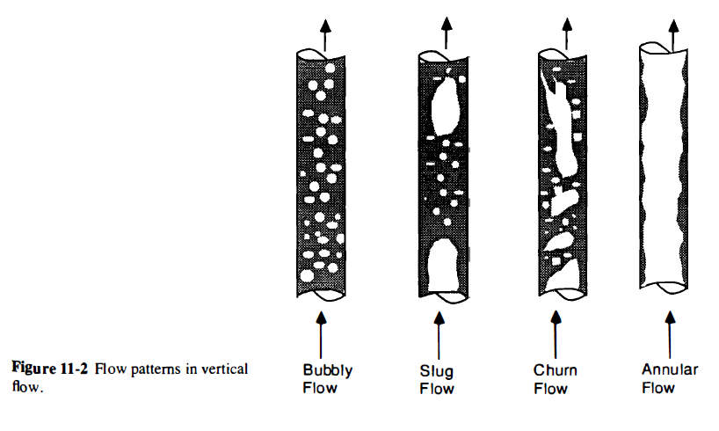
Two Phase Flow

Slide 4
Parameters
G, Mass flux
x, quality
α, Void fraction
S, slip ratio
Q, volumetric flux
β, volumetric flow ratio

Slide 5
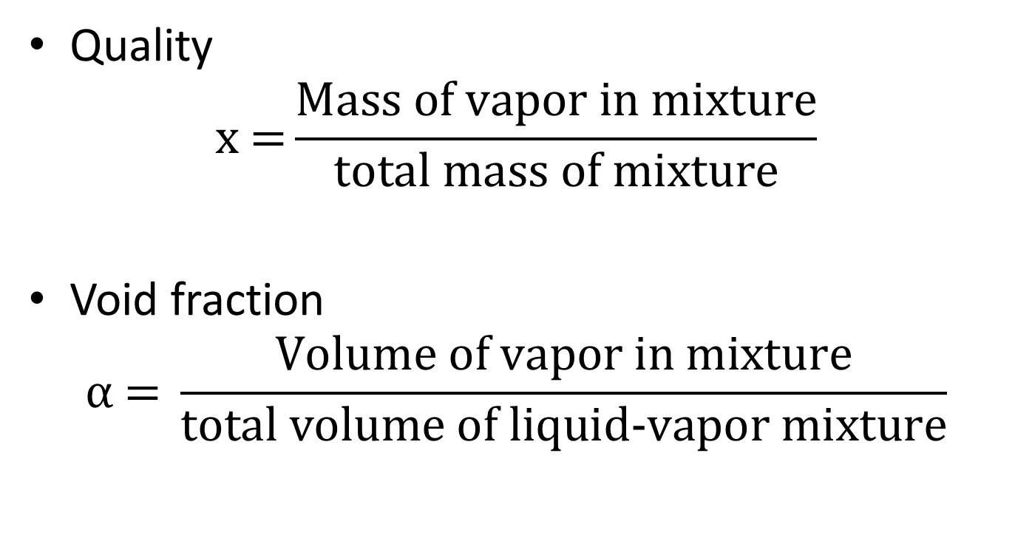
Quality and Void Fraction
Quality
$$\text{x}\text{ =}\frac{\text{Mass} \text{of} \text{vapor} \text{in} \text{mixture}}{\text{total} \text{mass} \text{of} \text{mixture}}$$
Void fraction
$$α \text{=} \frac{\text{Volume} \text{of} \text{vapor} \text{in} \text{mixture}}{\text{total} \text{volume} \text{of} \text{liquid}\text{−}\text{vapor} \text{mixture}}$$

Slide 6

Relationship between x and α
For non flow system
$$α=\frac{xv_{g}}{v_{f}+xv_{fg}}$$
or
$$α=\frac{1}{1+\left(\frac{1−x}{x}\right)\left(\frac{v_{f}}{v_{g}}\right)}$$

Slide 7
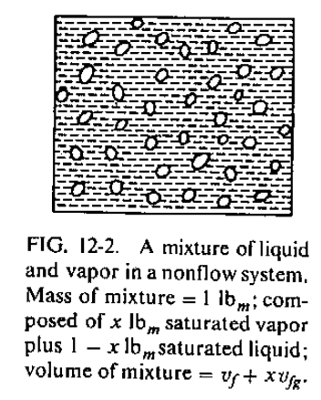
Relationship between x and α
For non flow system

Slide 8
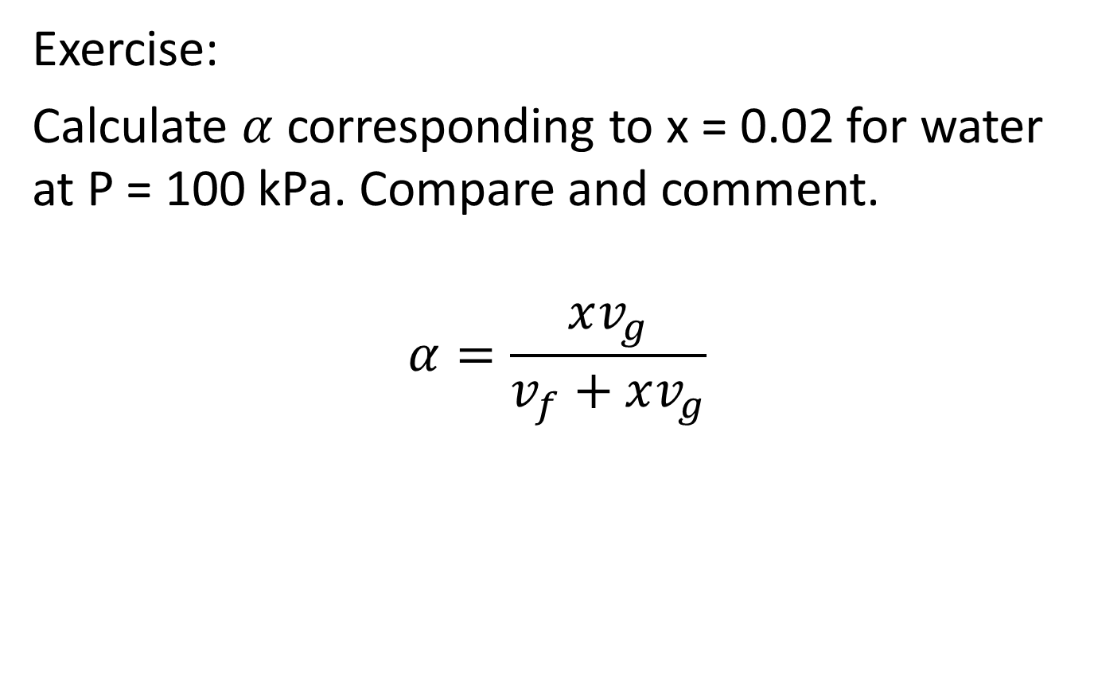
Exercise:
Calculate $α$ corresponding to x = 0.02 for water at P = 100 kPa. Compare and comment.
$$α=\frac{xv_{g}}{v_{f}+xv_{g}}$$

Slide 9
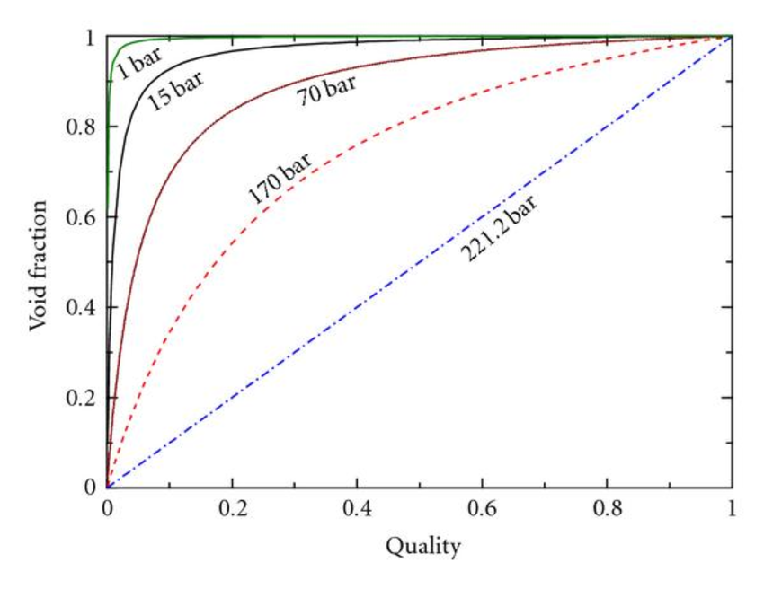
Relationship between x and α

Slide 10
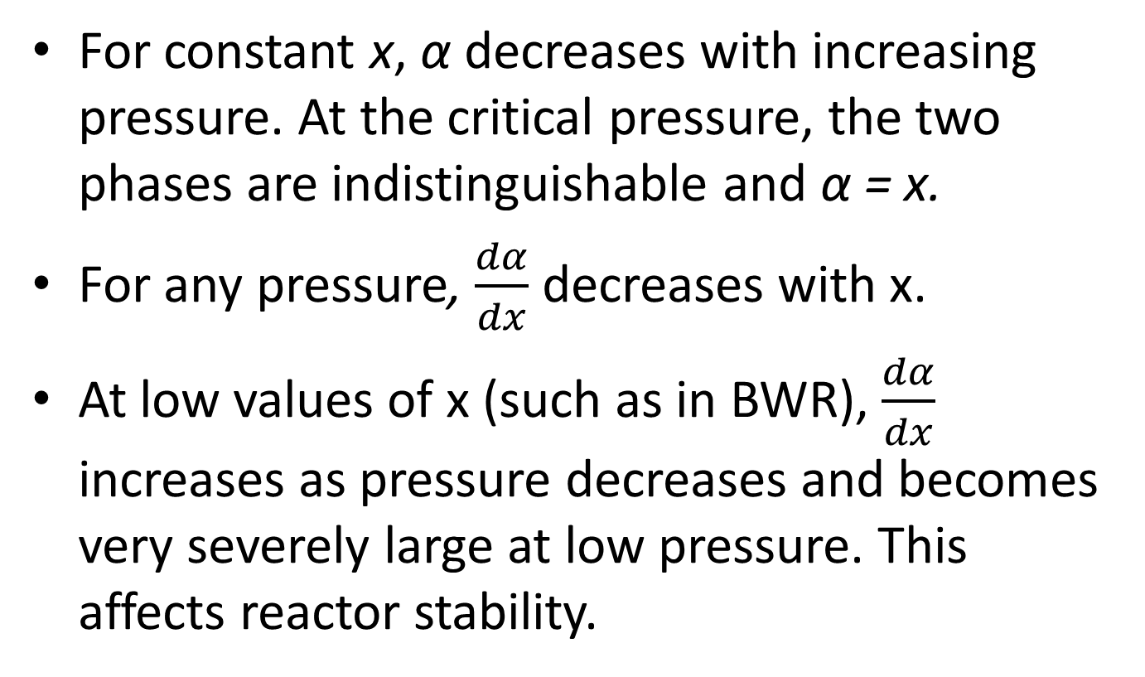
Relationship between x and α
For constant x, α decreases with increasing pressure. At the critical pressure, the two phases are indistinguishable and α = x.
For any pressure, $\frac{dα}{dx}$ decreases with x.
At low values of x (such as in BWR), $\frac{dα}{dx}$ increases as pressure decreases and becomes very severely large at low pressure. This affects reactor stability.

Slide 11
Void Fraction for Flow Systems
Ratio of Vapor flow area to total flow area
Depends strongly on pressure, mass flux, and quality
Applied to calculate the acceleration pressure drop in steady-state homogeneous code
Large number of correlations proposed
Solved from conservation equations in two-fluid reactor safety codes

Slide 12
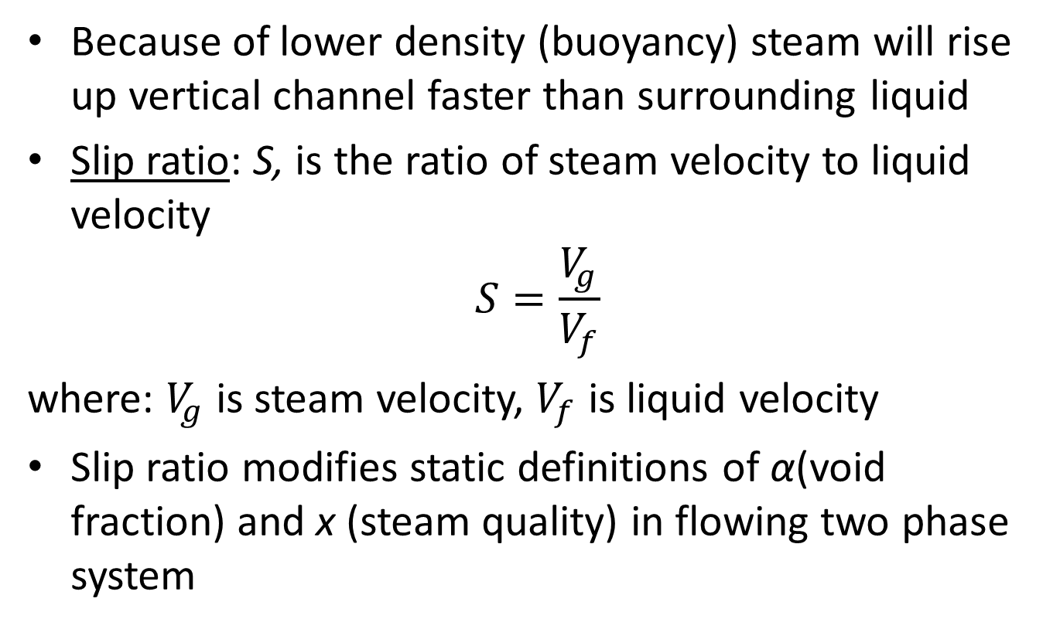
Steam Rises Faster in Channel Than Liquid
Because of lower density (buoyancy) steam will rise up vertical channel faster than surrounding liquid
Slip ratio: S, is the ratio of steam velocity to liquid velocity
$$S=\frac{V_{g}}{V_{f}}$$
where: $V_{g}$ is steam velocity, $V_{f}$ is liquid velocity
Slip ratio modifies static definitions of α(void fraction) and x (steam quality) in flowing two phase system

Slide 13
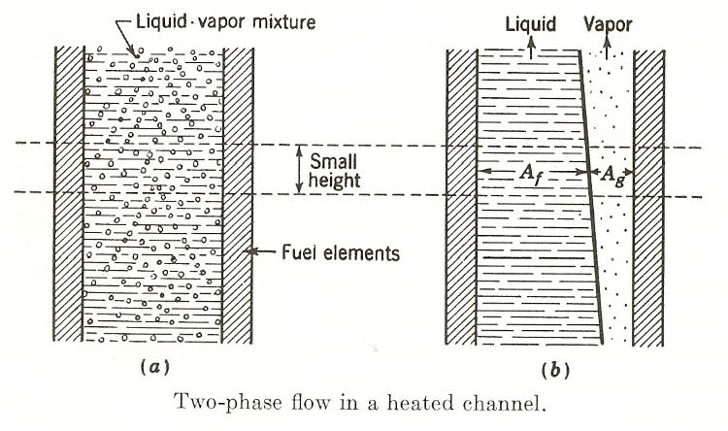
Relative Velocities Are Different

Slide 14
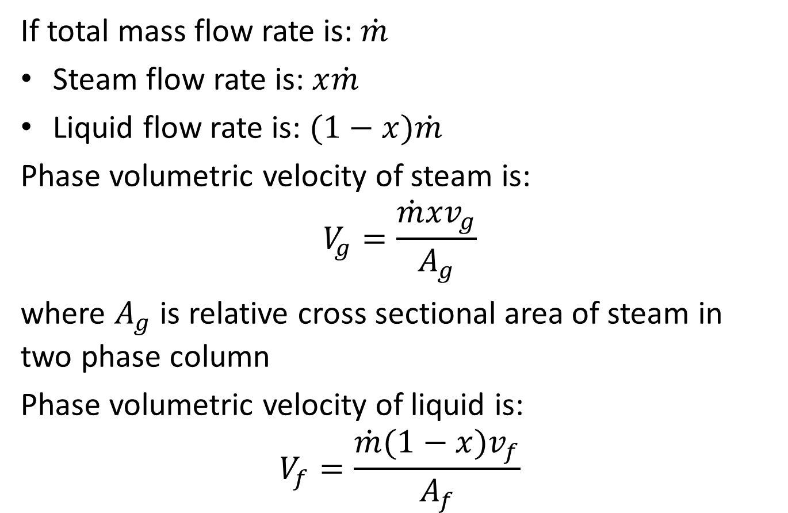
Relative Velocities Are Different
If total mass flow rate is: $\dot{m}$
Steam flow rate is:$x\dot{m}$
Liquid flow rate is: $(1−x)\dot{m}$
Phase volumetric velocity of steam is:
$$V_{g}=\frac{\dot{m}xv_{g}}{A_{g}}$$
where $A_{g}$ is relative cross sectional area of steam in two phase column
Phase volumetric velocity of liquid is:
$$V_{f}=\frac{\dot{m}(1−x)v_{f}}{A_{f}}$$

Slide 15
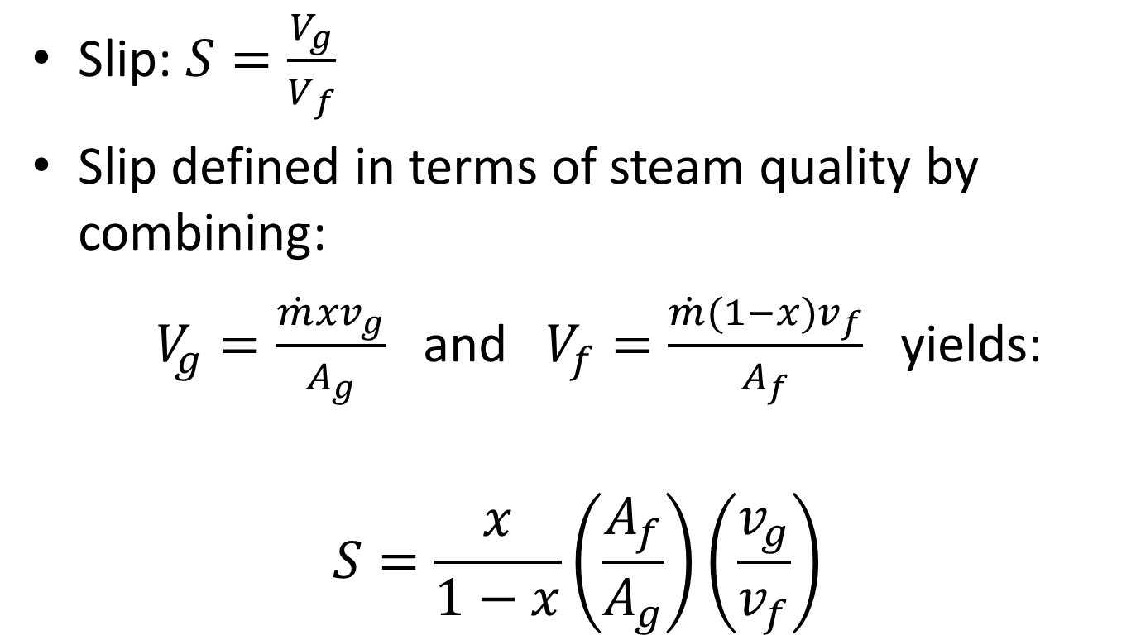
Definition of Slip in Terms of Steam Quality and Void Fraction
Slip: $S=\frac{V_{g}}{V_{f}}$
Slip defined in terms of steam quality by combining:
$V_{g}=\frac{\dot{m}xv_{g}}{A_{g}}$ and $V_{f}=\frac{\dot{m}(1−x)v_{f}}{A_{f}}$ yields:
$$S=\frac{x}{1−x}\left(\frac{A_{f}}{A_{g}}\right)\left(\frac{v_{g}}{v_{f}}\right)$$

Slide 16
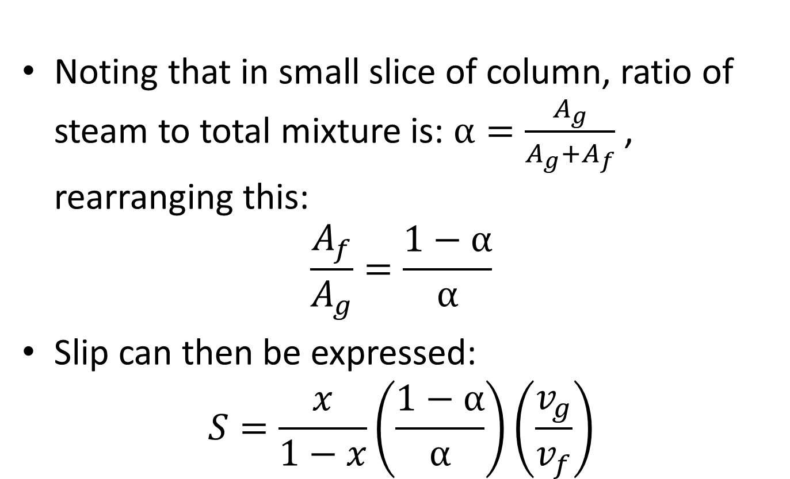
Definition of Slip in Terms of Steam Quality and Void Fraction
Noting that in small slice of column, ratio of steam to total mixture is: $α=\frac{A_{g}}{A_{g}+A_{f}}$ , rearranging this:
$$\frac{A_{f}}{A_{g}}=\frac{1−α}{α}$$
Slip can then be expressed:
$$S=\frac{x}{1−x}\left(\frac{1−α}{α}\right)\left(\frac{v_{g}}{v_{f}}\right)$$

Slide 17
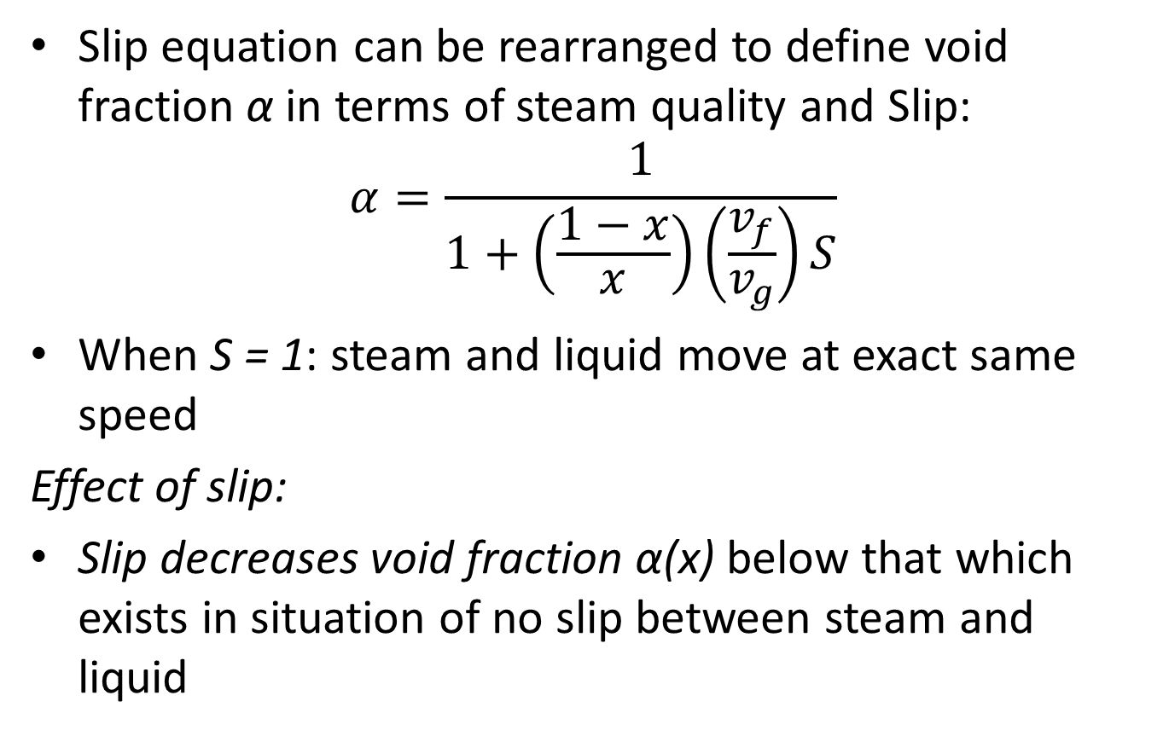
Definition of Slip in Terms of Steam Quality and Void Fraction
Slip equation can be rearranged to define void fraction α in terms of steam quality and Slip:
$$α=\frac{1}{1+\left(\frac{1−x}{x}\right)\left(\frac{v_{f}}{v_{g}}\right)S}$$
When S = 1: steam and liquid move at exact same speed
Effect of slip:
Slip decreases void fraction α(x) below that which exists in situation of no slip between steam and liquid

Slide 18
Void Fraction Sensitivities:
Sensitivity of Void fraction α to Mixture Quality and Slip can be seen by computing α(χ) for a spectrum of pressure and assumed Slip values
S = 1 implies homogeneous steam/water flow (moving together)

Slide 19
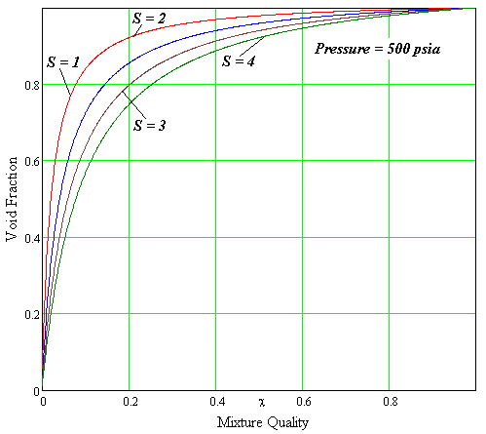
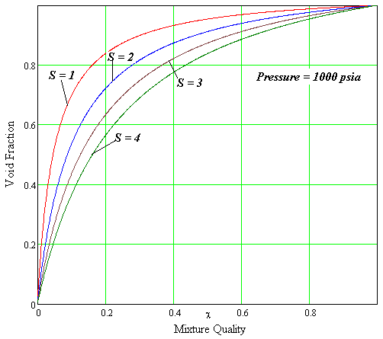
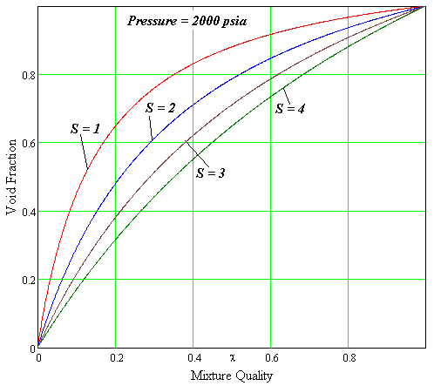
Void Fraction Sensitivities:

Slide 20
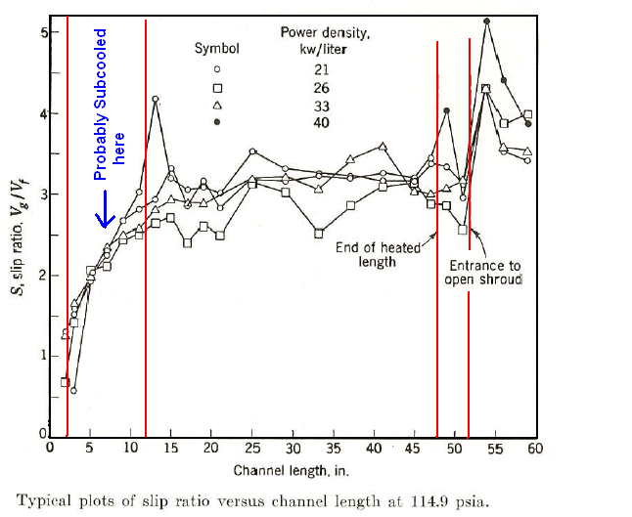
Example Slip Ratio for BWR Fuel Channel

Slide 21
What Does Slip Mean to the Core Fluid Flow?
Low S value (S = 1) implies:
Voids and water travel about same speed
Higher S value (S = 2,3) implies:
Steam carries out higher enthalpy thus heat is removed faster
Voids swept out of channel faster which is benefit for neutron economy
Predicting Slip from first principles is not easy
Designers rely upon tests and scaling-up from previous

Slide 22
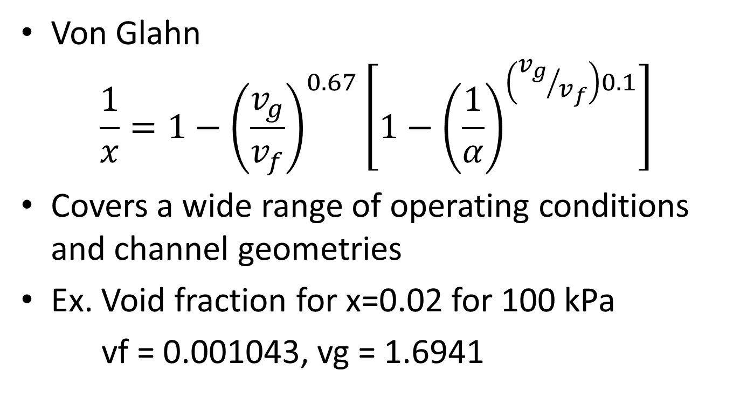
Empirical correlation for void fraction
Von Glahn
$$\frac{1}{x}=1−{\left(\frac{v_{g}}{v_{f}}\right)}^{0.67}\left[1−{\left(\frac{1}{α}\right)}^{\left({v_{g}}/{v_{f}}\right)0.1}\right]$$
Covers a wide range of operating conditions and channel geometries
Ex. Void fraction for x=0.02 for 100 kPa
vf = 0.001043, vg = 1.6941

Slide 23
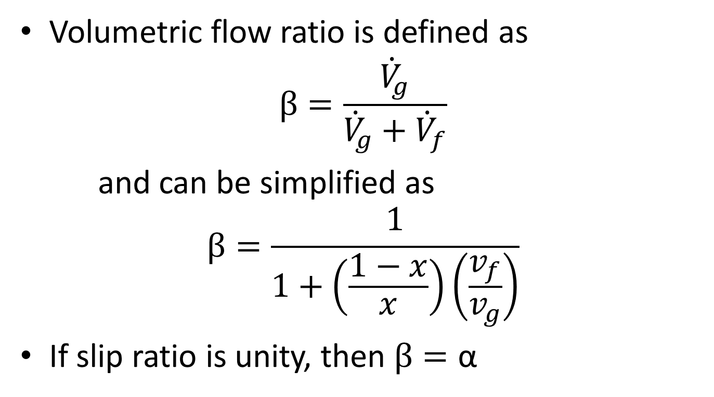
β , Volumetric Flow Ratio
Volumetric flow ratio is defined as
$$β=\frac{{\dot{V}}_{g}}{{\dot{V}}_{g}+{\dot{V}}_{f}}$$
and can be simplified as
$$β=\frac{1}{1+\left(\frac{1−x}{x}\right)\left(\frac{v_{f}}{v_{g}}\right)}$$
If slip ratio is unity, then $β=\text{α}$

Slide 24

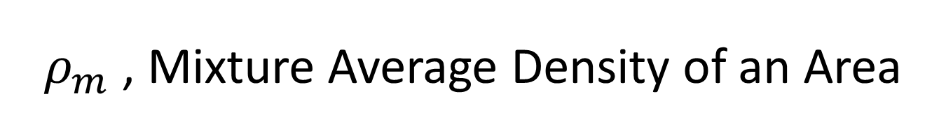
$ρ_{m}$ , Mixture Average Density of an Area
Useful in calculating pressure drop, the mixture average density of an area, or also called the average density is defined as
$$ρ_{m}=αρ_{g}+(1−α)ρ_{f}$$

Slide 25
Flow Regimes
The two-phase flow in a heated tube exhibits different flow boiling regimes, depending on the relative amounts of the liquid and the vapor phases.

Slide 26
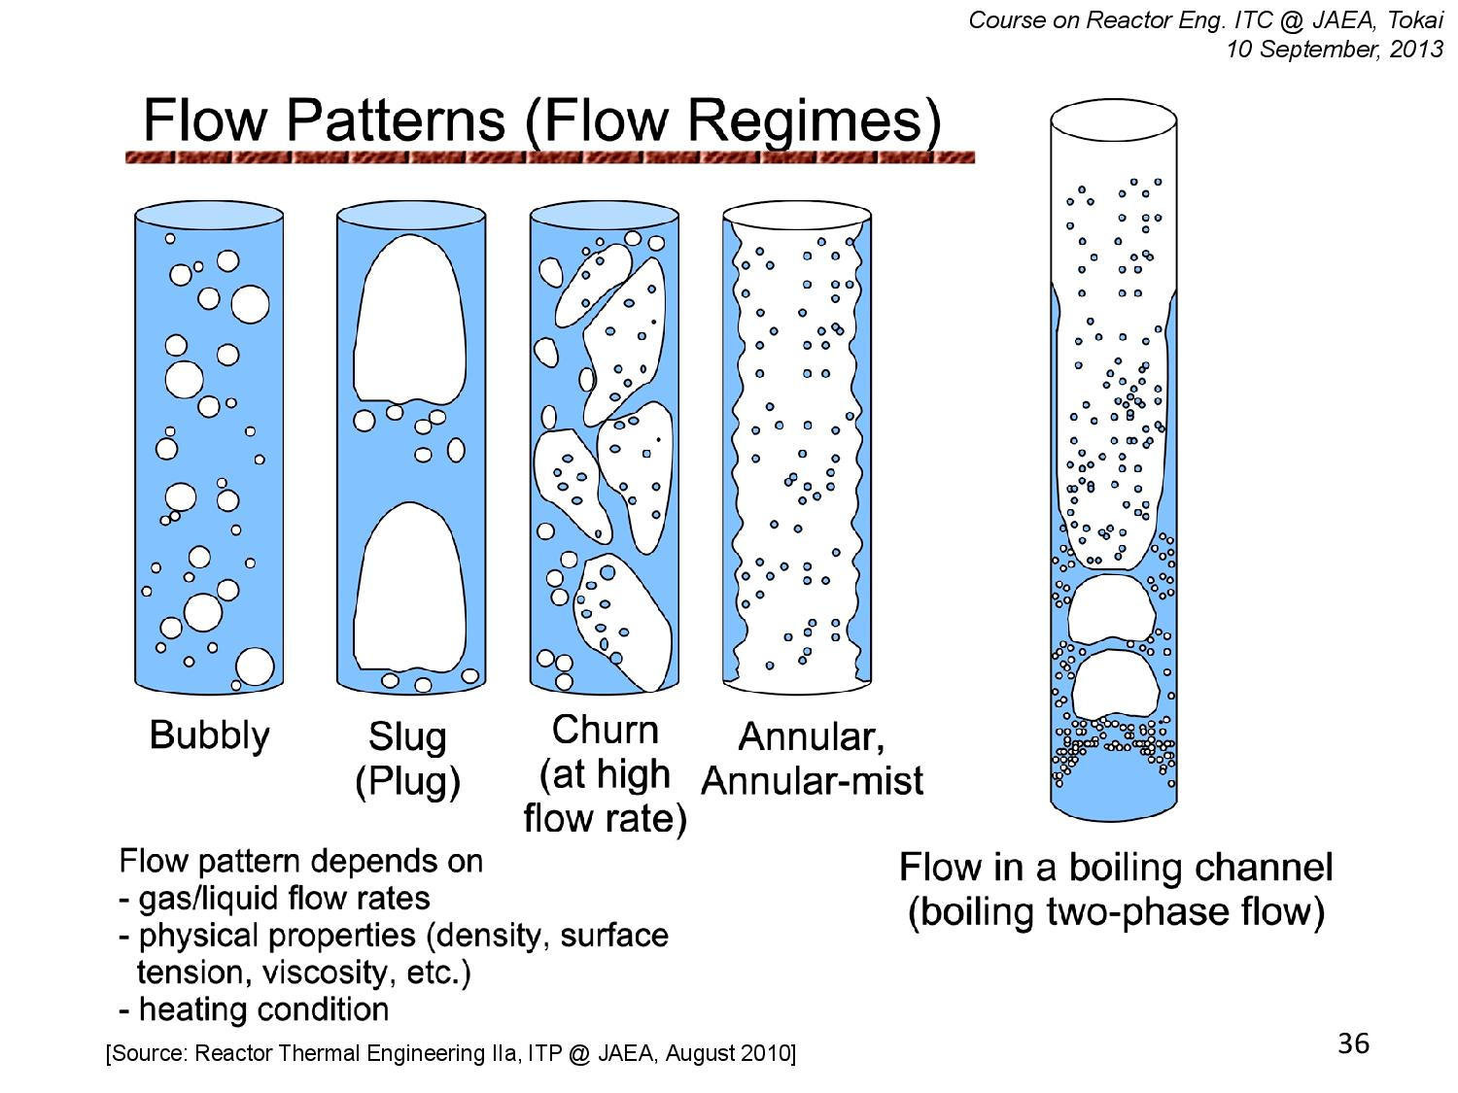

Slide 27
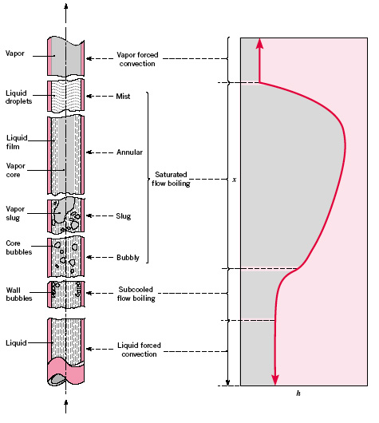
Flow Regime

Slide 28
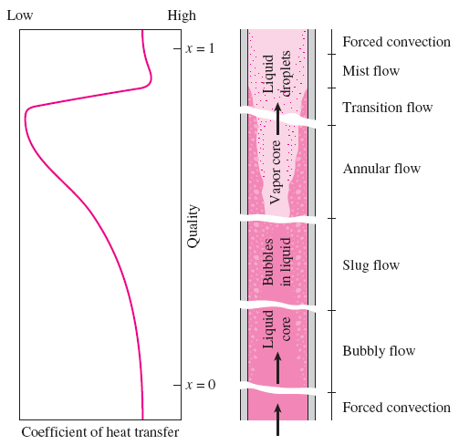

Slide 29
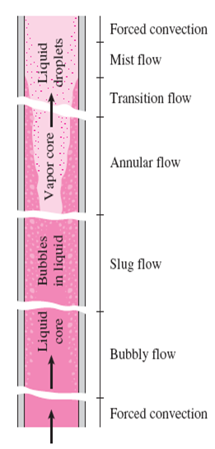
Liquid single-phase flow
  In the inlet region the liquid is subcooled and heat transfer to the liquid is by forced convection (assuming no subcooled boiling).
Bubbly flow
  Individual bubbles
  Low mass qualities
Slug flow
  Bubbles coalesce into slugs of vapor.
  Moderate mass qualities
Annular flow
  Core of the flow consists of vapor only, and liquid adjacent to the walls.
  Very high heat transfer coefficients
Mist flow
  A sharp decrease in the heat transfer coefficient
Vapor single-phase flow
  The liquid phase is completely evaporated and vapor is superheated.

Slide 30
Flow Map
Hewitt and Roberts
1969

Slide 31
Flow Instabilities
Kelvin-Helmholtz instability
https://www.youtube.com/watch?v=9lowHks4su8
Rayleigh-Taylor Instability
Ledinegg Instability

Slide 32
Flow Instabilities
Types of flow instabilities
Static instability
  Ledinegg instability (flow excursion)
  Geysering
  Terrain-induced instability (offshore oil well lines)
  Relaxation instability (Flow regime transition)
Dynamic instability
  Density-wave oscillations
  Pressure drop oscillations
  Flow regime-induced instabilities
  Acoustic instabilities

Slide 33
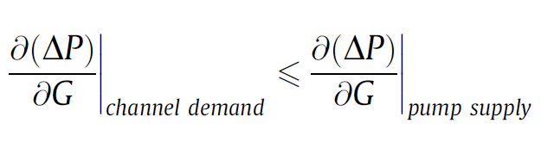
Ledinegg Instability
In heated channels (e.g. coffee percolator), when the slope of the demand pressure drop–mass flux curve becomes algebraically smaller than the loop supply pressure drop–mass flux curve:

Slide 34
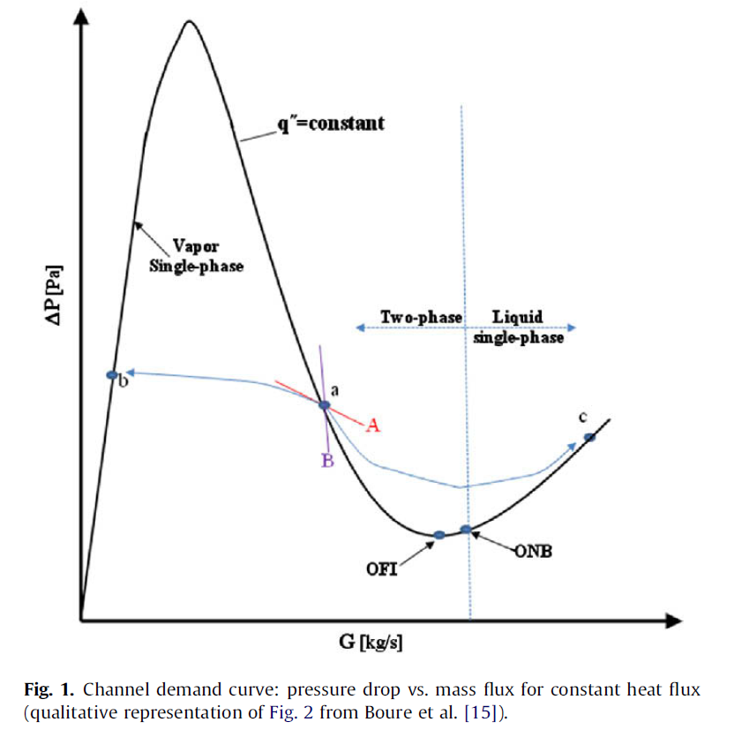
Ledinegg Instability

Slide 35
Ledinegg Instability
When the flow rate is large, the flow is liquid single-phase (the right region of the curve).
As the mass flux is continuously reduced while other conditions are unchanged, boiling will commence at some pressure drop (designated as onset of nucleate boiling (ONB) on the curve).
Further reduction in the mass flux will gradually cause vigorous boiling.

Slide 36
Ledinegg Instability
Since frictional and accelerational pressure drops tend to increase as the void fraction (and mass quality) increases, a point can be reached in which the DP - G slope reaches a minimum.
This point is frequently termed the onset of flow instability (OFI)
To maintain system stability, the pump supply curve needs to be considered.

Slide 37
Ledinegg Instability
If the slope of the pump supply curve (Curve A) has a smaller negative value compared to that of the demand curve, the system is unstable.
This situation occurs because the pump cannot counteract even a small perturbation in mass flux from the equilibrium condition (Point a), and a spontaneous shift to a more stable flow condition will occur (e.g., from Point a to Point b or Point c in Fig. 1).

Slide 38
Ledinegg Instability
On the other hand, if the pump supply curve (Curve B) has a greater negative slope than that of the demand curve, the system is stable.
This can be achieved, for instance, by installing a constant displacement pump, which has an almost infinite slope (i.e., G is fixed regardless of the pressure drop).

Slide 39
Ledinegg Instability
Maintaining the stability of the flow can also be achieved by installing a throttling valve at the inlet of the channel, which can moderate the negative slope of the demand curve if the added pressure drop across the inlet restrictor is high enough
One obvious consequence of utilizing a throttling valve is the increased pressure drop required to deliver the flow through the system.

Slide 40
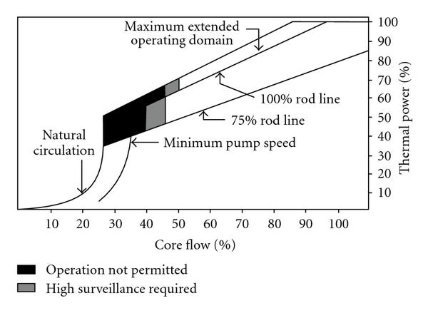
BWR Flow Instabilities

Slide 41
Two Phase Flow Models
Main models
Homogeneous equilibrium mixture model (HEM)
Thermal equilibrium mixture model
  Drift Flux Model
Two-fluid (separate flow) model

Slide 42
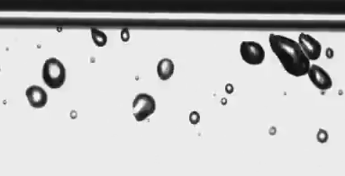
Two Phase Flow Models
Vapor-liquid interactions
Mass exchange
Surface tension
Momentum
Energy exchange
Volume/density interactions
Etc.

Slide 43
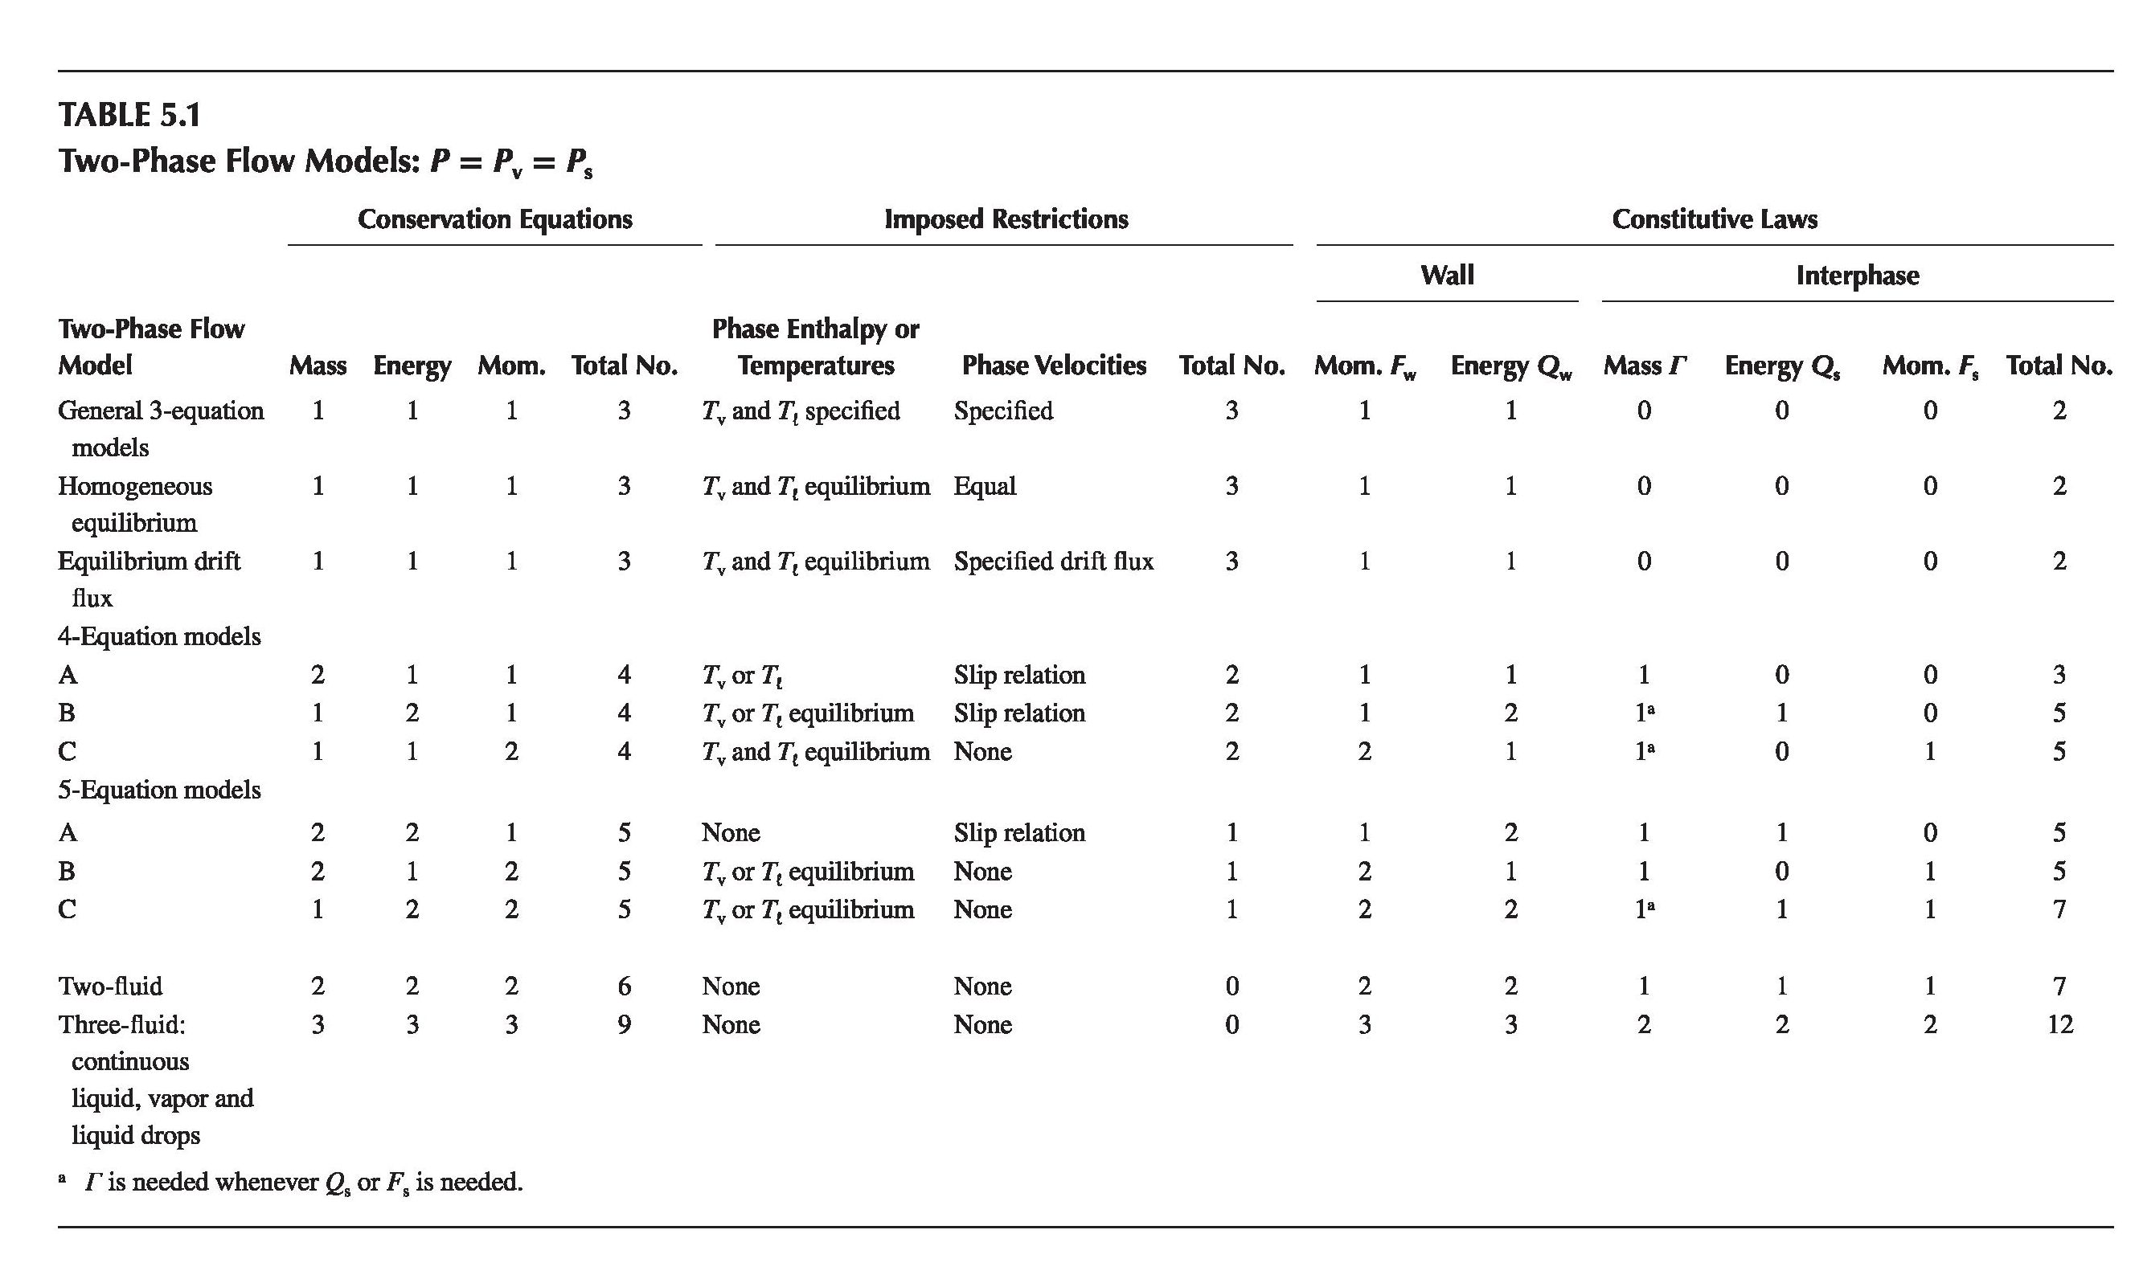

Slide 44
Table 5.1 summarizes the possible models and the implied need for additional constitutive relations for each case. The main models can be summarized as follows:
1. The homogeneous equilibrium mixture model (HEM). Here, the two phases move with the same velocity and also exist at the same temperature (i.e., they are at the saturation temperature for the prevailing pressure). The mixture can then be treated as a single fluid. This model is particularly useful for high pressure and high-flow-rate conditions.

Slide 45
2. A thermal equilibrium mixture model with an algebraic relation between the velocities (or a slip ratio) of the two phases. A widely used such model is the drift flux model. This model is different from the HEM only in allowing the two phases to have different velocities that are related via a predetermined relation. This model is useful for low pressure and/or low-flow rate flows under steady-state or near-steady-state conditions.

Slide 46
3. The two-fluid (separate flow) model allows the phases to be in thermal nonequilibrium as well as to have unequal velocities. In this case, each phase has three independent conservation equations. The two-fluid model is needed for fast transients when nonequilibrium conditions can be expected to be significant. Examples of such situations are steam bubble collapse, opening of a pressurizer relief valve with a water slug in the trap downstream of the valve and dissolved gas coming out of solution and then causing cavitation in a pump, or filling of a container that generates a pressure surge at the time when the last void collapses (only the build up to the surge is 2 phase).

Slide 47
Pressure Drop in Two Phase Flow
Types of pressure drop:
Friction pressure drop
Acceleration pressure drop
Pressure drop at restrictions:
  Sudden expansion (pressure rise)
  Sudden contraction (pressure drop)
  Orifices

Slide 48
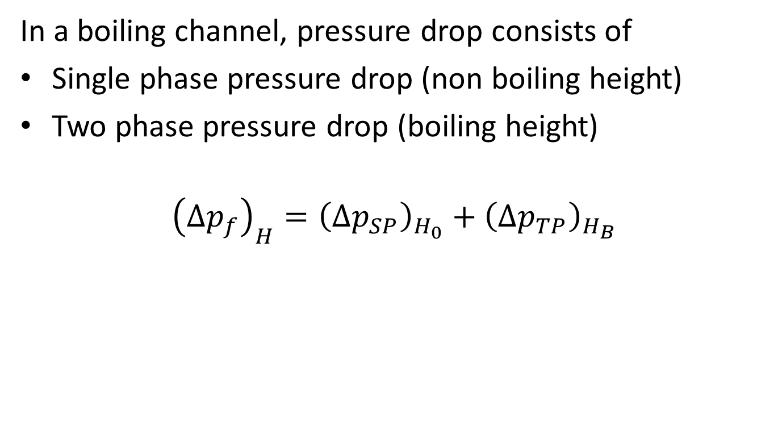
Friction Pressure Drop
In a boiling channel, pressure drop consists of
Single phase pressure drop (non boiling height)
Two phase pressure drop (boiling height)
$${\left(∆p_{f}\right)}_{H}={\left(∆p_{SP}\right)}_{H_{0}}+{\left(∆p_{TP}\right)}_{H_{B}}$$

Slide 49
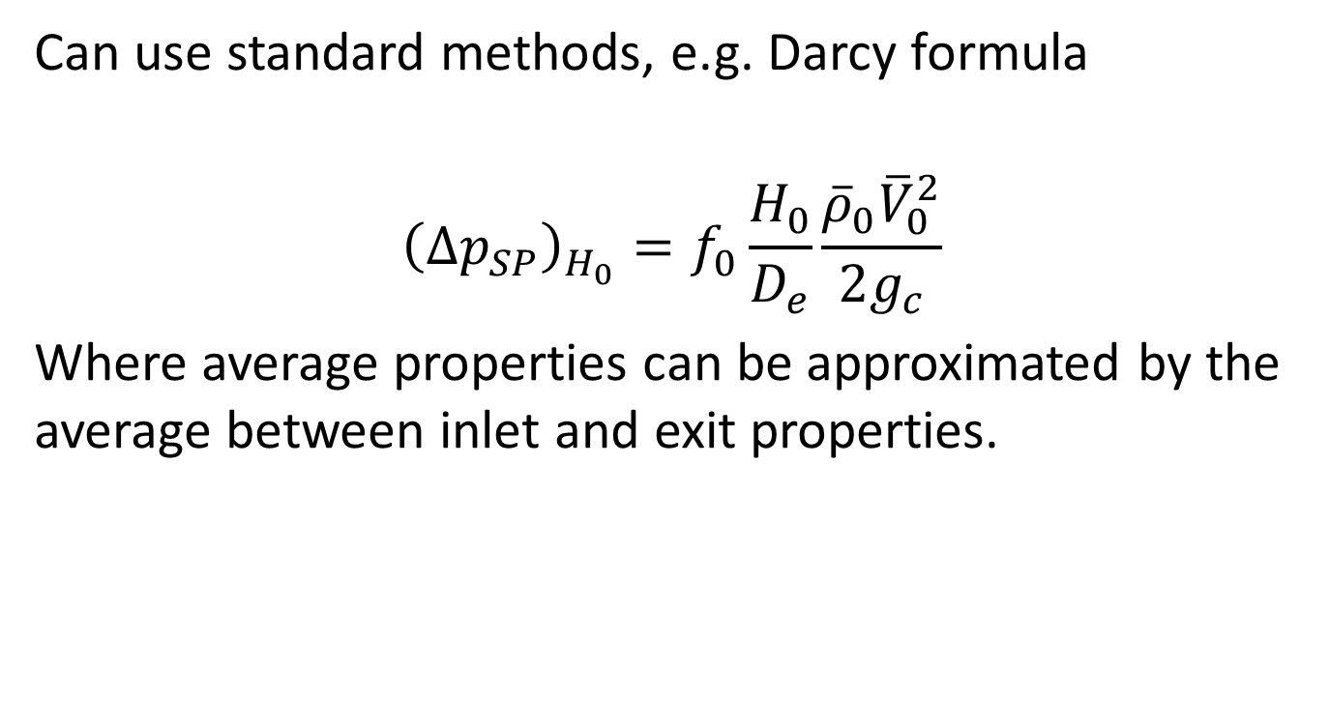
Single Phase Friction Pressure Drop
Can use standard methods, e.g. Darcy formula
$${\left(∆p_{SP}\right)}_{H_{0}}=f_{0}\frac{H_{0}}{D_{e}}\frac{{\overline{ρ}}_{0}{\overline{V}}_{0}^{2}}{2g_{c}}$$
Where average properties can be approximated by the average between inlet and exit properties.

Slide 50
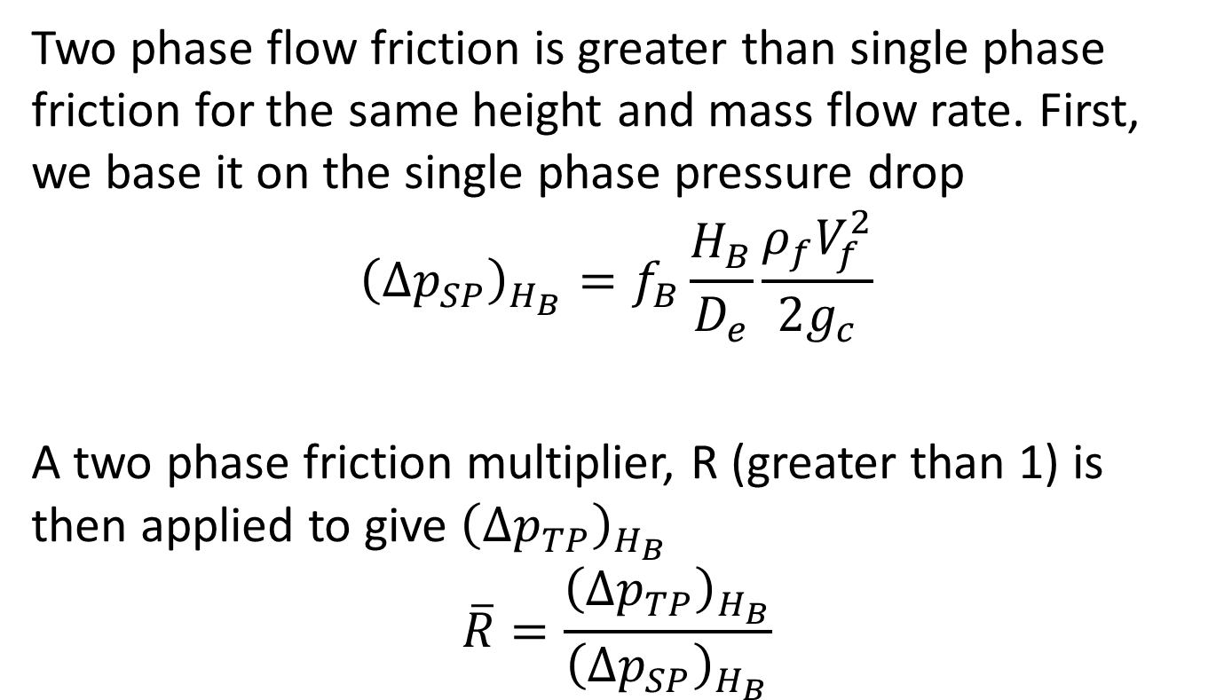
Two Phase Friction Pressure Drop
Two phase flow friction is greater than single phase friction for the same height and mass flow rate. First, we base it on the single phase pressure drop
$${\left(∆p_{SP}\right)}_{H_{B}}=f_{B}\frac{H_{B}}{D_{e}}\frac{ρ_{f}V_{f}^{2}}{2g_{c}}$$
A two phase friction multiplier, R (greater than 1) is then applied to give ${\left(∆p_{TP}\right)}_{H_{B}}$
$$\overline{R}=\frac{{\left(∆p_{TP}\right)}_{H_{B}}}{{\left(∆p_{SP}\right)}_{H_{B}}}$$

Slide 51

Total Friction Pressure Drop
$${\left(∆p_{f}\right)}_{H}=\left(f_{0}\frac{H_{0}}{D_{e}}\frac{{\overline{ρ}}_{0}{\overline{V}}_{0}^{2}}{2g_{c}}\right)+\overline{R}\left(f_{B}\frac{H_{B}}{D_{e}}\frac{ρ_{f}V_{f}^{2}}{2g_{c}}\right)$$
$${\left(∆p_{f}\right)}_{H}=\left(f_{B}\frac{ρ_{f}V_{f}^{2}}{2g_{c}D_{e}}\right)\left(H_{0}+\overline{R}H_{B}\right)$$

Slide 52
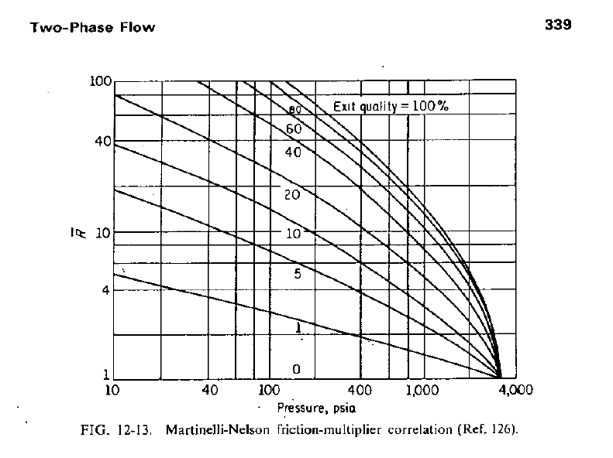
Martinelli-Nelson Friction Multiplier

Slide 53
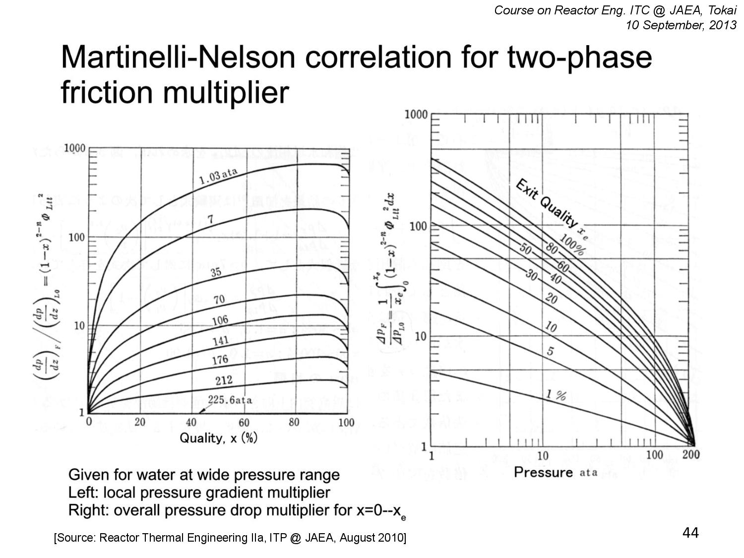

Slide 54
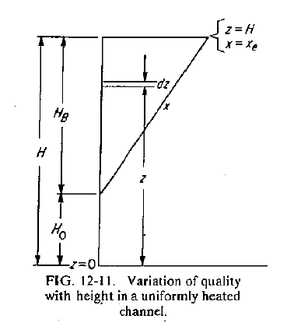
Boiling & Non-boiling Heights
H_{O} = Non-boiling height
H_{B} = Boiling height
x_{e} = exit quality

Slide 55
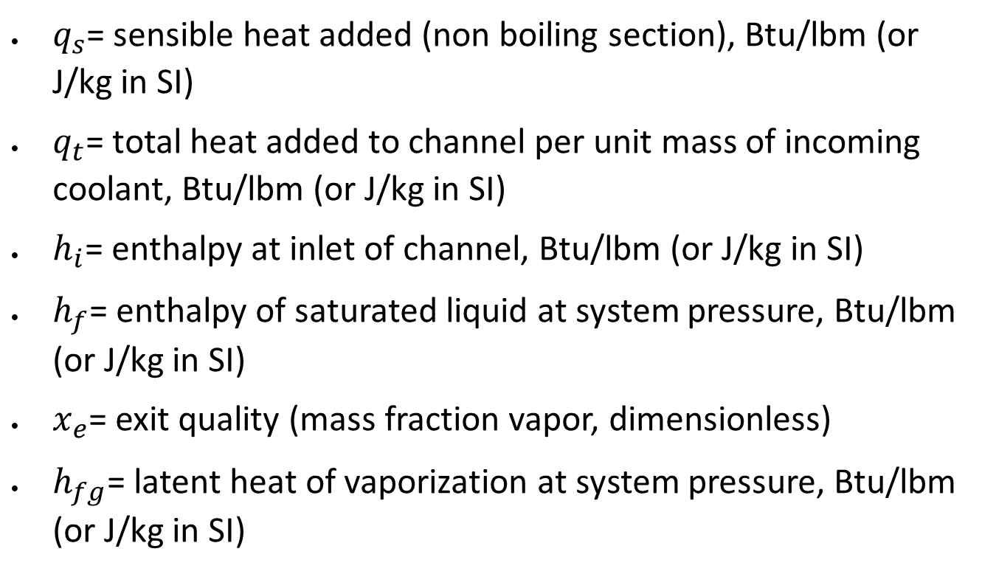
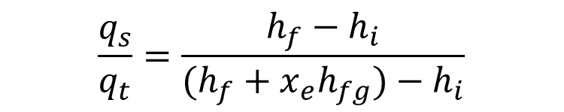
Non Boiling-to-Total Heat Ratio
$$\frac{q_{s}}{q_{t}}=\frac{h_{f}−h_{i}}{(h_{f}+x_{e}h_{fg})−h_{i}}$$
$q_{s}$= sensible heat added (non boiling section), Btu/lbm (or J/kg in SI)
$q_{t}$= total heat added to channel per unit mass of incoming coolant, Btu/lbm (or J/kg in SI)
$h_{i}$= enthalpy at inlet of channel, Btu/lbm (or J/kg in SI)
$h_{f}$= enthalpy of saturated liquid at system pressure, Btu/lbm (or J/kg in SI)
$x_{e}$= exit quality (mass fraction vapor, dimensionless)
$h_{fg}$= latent heat of vaporization at system pressure, Btu/lbm (or J/kg in SI)

Slide 56
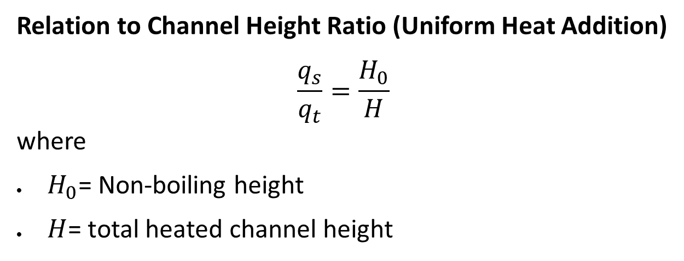
Uniform Heat Addition
Relation to Channel Height Ratio (Uniform Heat Addition)
$$\frac{q_{s}}{q_{t}}=\frac{H_{0}}{H}$$
where
$H_{0}$= Non-boiling height
$H$= total heated channel height

Slide 57
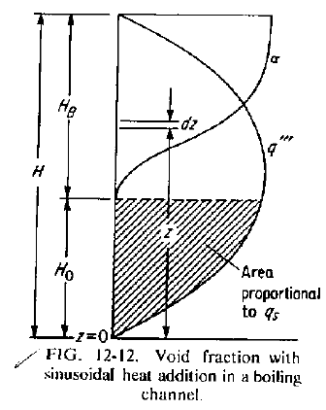
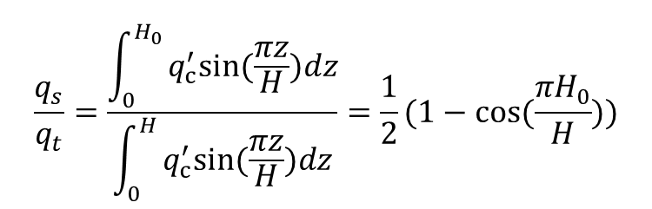
Sinusoidal Heat Addition
$$\frac{q_{s}}{q_{t}}=\frac{\int_{0}^{H_{0}}{q_{c}^{′}sin⁡(\frac{πz}{H})dz}}{\int_{0}^{H}{q_{c}^{′}sin⁡(\frac{πz}{H})dz}}=\frac{1}{2}(1−cos⁡(\frac{πH_{0}}{H}))$$

Slide 58
Example 12.2
A 6 ft high BWR channel has an equivalent diameter of 0.145 ft, and fuel cladding corresponding to smooth-drawn tubing. It receives heat sinusoidally and operates at a pressure of 1000 psia, an exit quality of 8 percent, an inlet velocity of 3 fps, and inlet water temperature of 522 F. Compute the friction drop in the channel. Assume that the friction multipliers apply to sinusoidal heating.

Slide 59
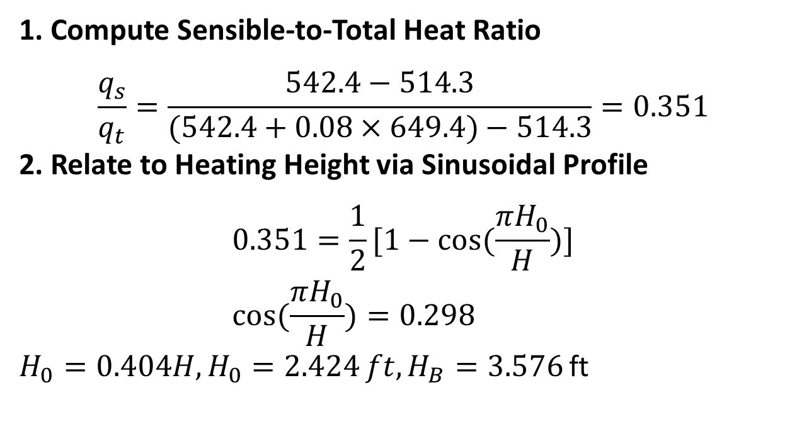
Example 12.2
1. Compute Sensible-to-Total Heat Ratio
$$\frac{q_{s}}{q_{t}}=\frac{542.4−514.3}{(542.4+0.08×649.4)−514.3}=0.351$$
2. Relate to Heating Height via Sinusoidal Profile
$$0.351=\frac{1}{2}[1−cos⁡(\frac{πH_{0}}{H})] \\ cos⁡(\frac{πH_{0}}{H})=0.298$$
$H_{0}=0.404H,H_{0}=2.424 ft,H_{B}=3.576$ ft

Slide 60
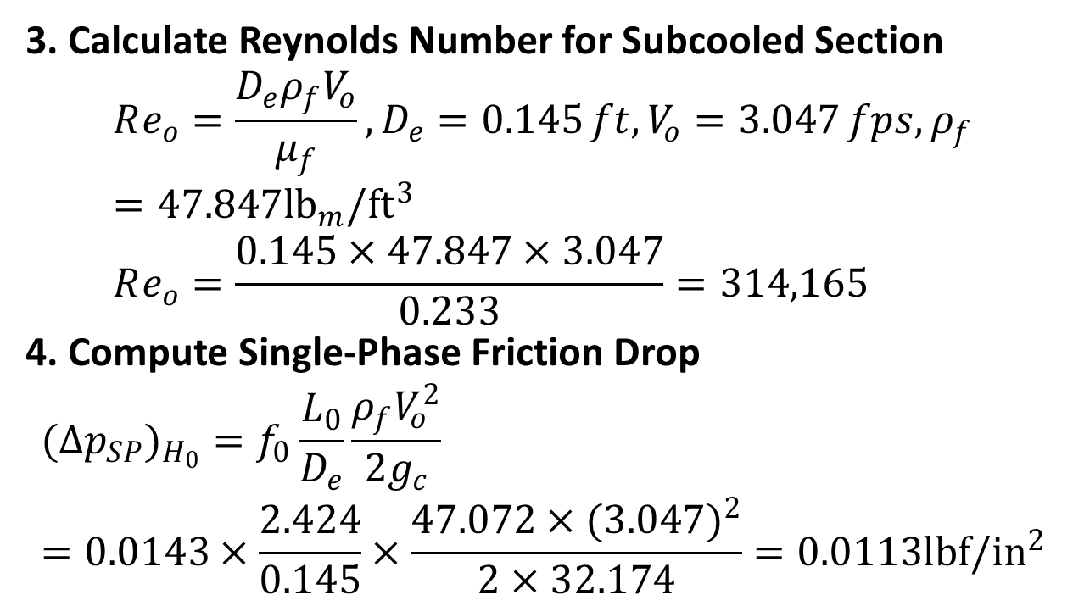
Example 12.2
3. Calculate Reynolds Number for Subcooled Section
$$Re_{o}=\frac{D_{e}ρ_{f}V_{o}}{μ_{f}},D_{e}=0.145 ft,V_{o}=3.047 fps,ρ_{f}=47.847{lb}_{m}/{ft}^{3} \\ Re_{o}=\frac{0.145×47.847×3.047}{0.233}=314,165$$
4. Compute Single-Phase Friction Drop
$$(Δp_{SP})_{H_{0}}=f_{0}\frac{L_{0}}{D_{e}}\frac{ρ_{f}V_{o}^{2}}{2g_{c}} \\ =0.0143×\frac{2.424}{0.145}×\frac{47.072×(3.047)^{2}}{2×32.174}=0.0113{lbf/in}^{2}$$

Slide 61
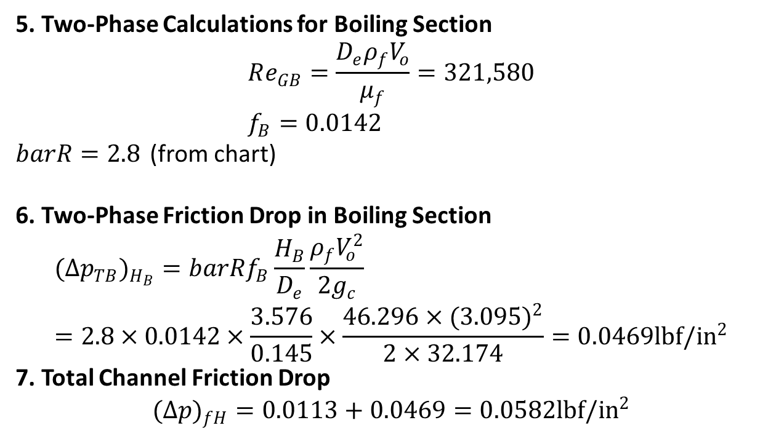
Example 12.2
5. Two-Phase Calculations for Boiling Section
$$Re_{GB}=\frac{D_{e}ρ_{f}V_{o}}{μ_{f}}=321,580 \\ f_{B}=0.0142$$
$barR=2.8$ (from chart)
6. Two-Phase Friction Drop in Boiling Section
$$(Δp_{TB})_{H_{B}}=barRf_{B}\frac{H_{B}}{D_{e}}\frac{ρ_{f}V_{o}^{2}}{2g_{c}} \\ =2.8×0.0142×\frac{3.576}{0.145}×\frac{46.296×(3.095)^{2}}{2×32.174}=0.0469{lbf/in}^{2}$$
7. Total Channel Friction Drop
$$(Δp)_{fH}=0.0113+0.0469=0.0582{lbf/in}^{2}$$

Slide 62
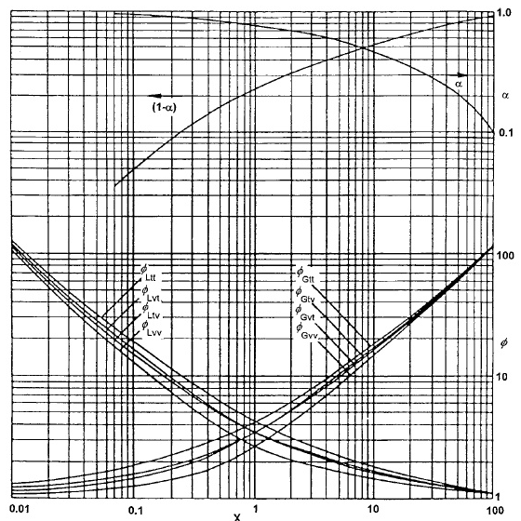
Lockhart-Martinelli Variation Curve

Slide 63
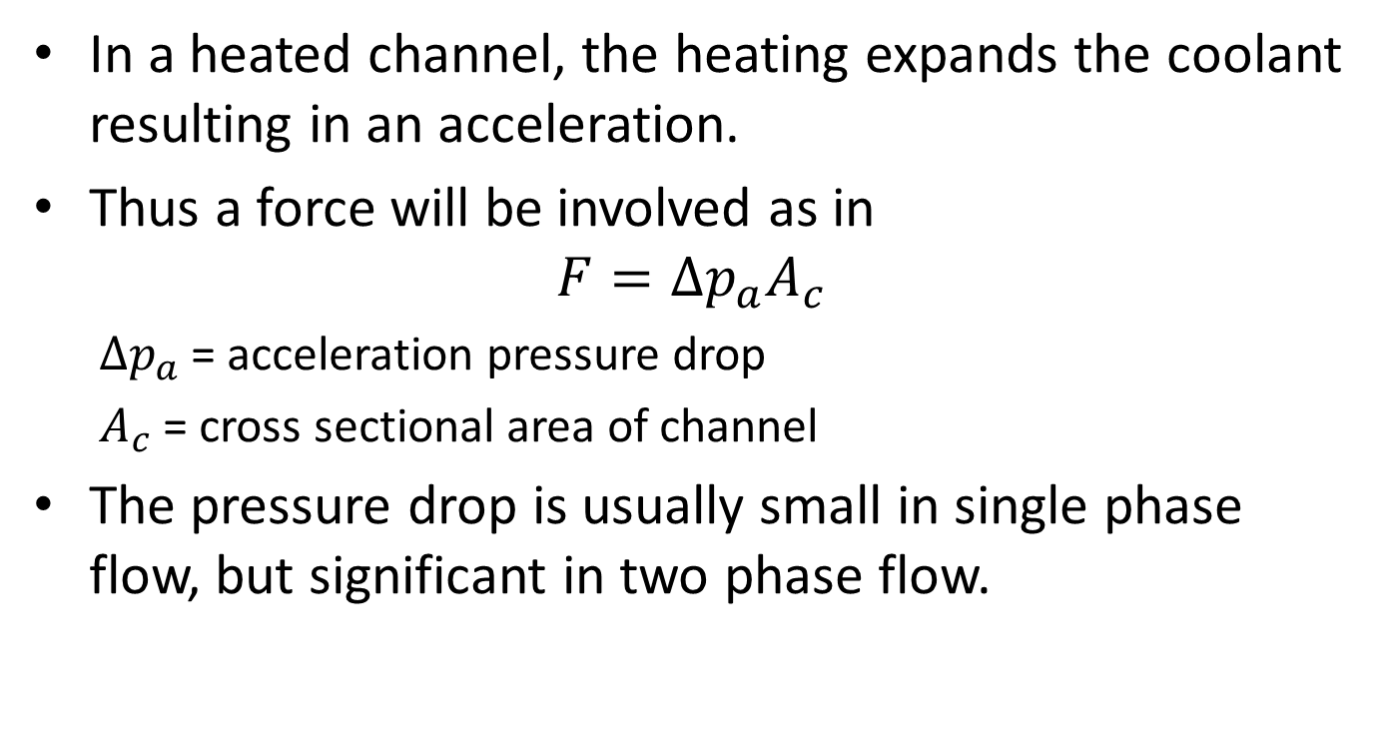
Acceleration Pressure Drop
In a heated channel, the heating expands the coolant resulting in an acceleration.
Thus a force will be involved as in
$$F=∆p_{a}A_{c}$$
  $∆p_{a}$ = acceleration pressure drop
  $A_{c}$ = cross sectional area of channel
The pressure drop is usually small in single phase flow, but significant in two phase flow.

Slide 64
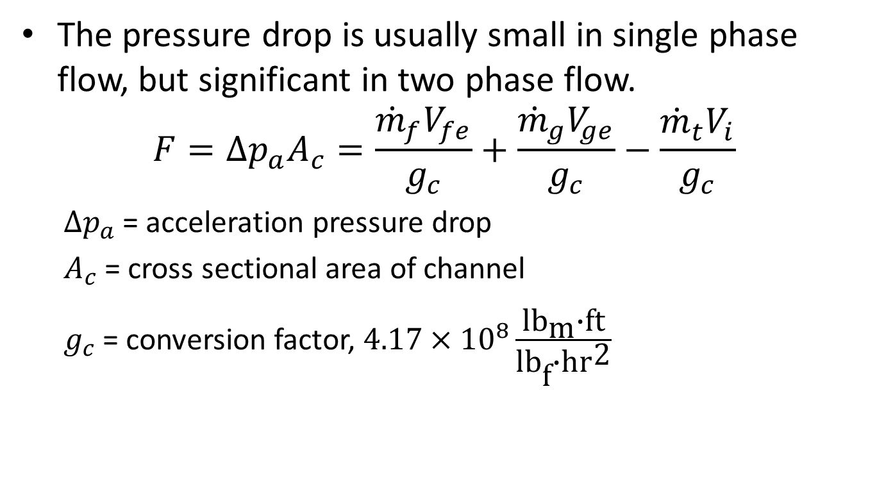
Acceleration Pressure Drop
The pressure drop is usually small in single phase flow, but significant in two phase flow.
$$F=∆p_{a}A_{c}=\frac{{\dot{m}}_{f}V_{fe}}{g_{c}}+\frac{{\dot{m}}_{g}V_{ge}}{g_{c}}−\frac{{\dot{m}}_{t}V_{i}}{g_{c}}$$
  $∆p_{a}$ = acceleration pressure drop
  $A_{c}$ = cross sectional area of channel
  $g_{c}$ = conversion factor, $4.17×{10}^{8}\frac{{\text{lb}}_{\text{m}}\text{∙}\text{ft}}{{\text{lb}}_{\text{f}}\text{∙}{\text{hr}}^{\text{2}}}$

Slide 65
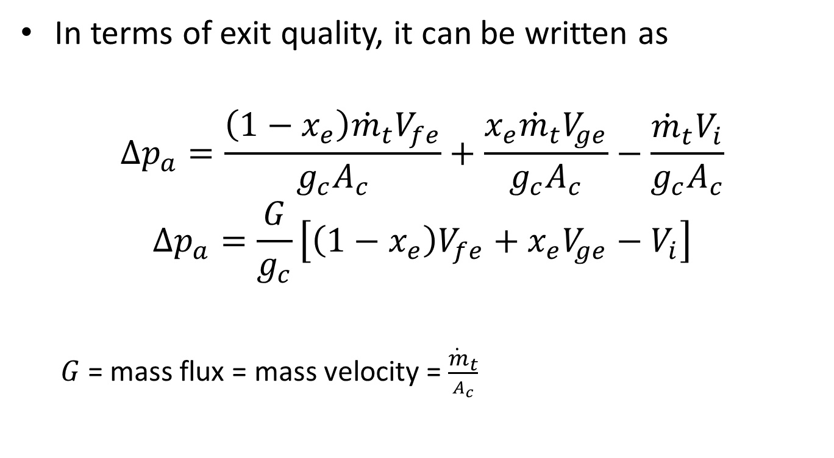
Acceleration Pressure Drop
In terms of exit quality, it can be written as
$$∆p_{a}=\frac{\left(1−x_{e}\right){\dot{m}}_{t}V_{fe}}{g_{c}A_{c}}+\frac{x_{e}{\dot{m}}_{t}V_{ge}}{g_{c}A_{c}}−\frac{{\dot{m}}_{t}V_{i}}{g_{c}A_{c}}$$
$$∆p_{a}=\frac{G}{g_{c}}\left[\left(1−x_{e}\right)V_{fe}+x_{e}V_{ge}−V_{i}\right]$$
  $G$ = mass flux = mass velocity = $\frac{{\dot{m}}_{t}}{A_{c}}$

Slide 66
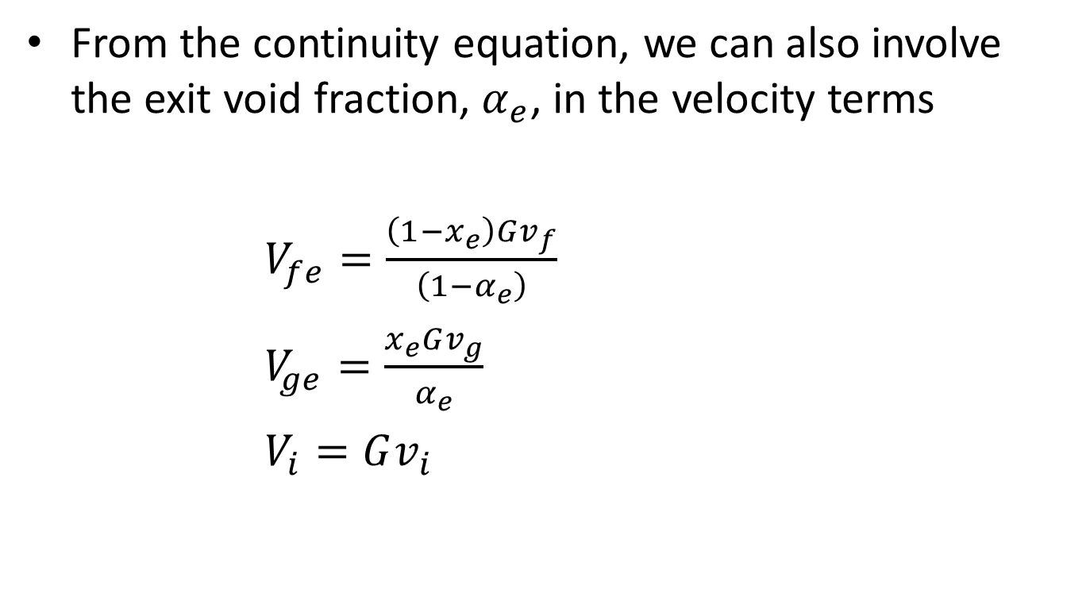
Acceleration Pressure Drop
From the continuity equation, we can also involve the exit void fraction, $α_{e}$, in the velocity terms
$V_{fe}=\frac{\left(1−x_{e}\right)Gv_{f}}{\left(1−α_{e}\right)}$
$V_{ge}=\frac{x_{e}Gv_{g}}{α_{e}}$
$V_{i}=Gv_{i}$

Slide 67

Acceleration Pressure Drop
Thus, acceleration pressure drop can be written as
$$∆p_{a}=\frac{G^{2}}{g_{c}}\left[\frac{{\left(1−x_{e}\right)}^{2}}{\left(1−α_{e}\right)}v_{f}+\frac{{x_{e}}^{2}}{α_{e}}v_{g}−v_{i}\right]$$
The terms in the square bracket is called the acceleration multiplier , r, with units of ${{ft}^{3}}/{{lb}_{m}}$
$$r=\left[\frac{{\left(1−x_{e}\right)}^{2}}{\left(1−α_{e}\right)}v_{f}+\frac{{x_{e}}^{2}}{α_{e}}v_{g}−v_{i}\right]$$
Thus, acceleration pressure drop is also written as
$$∆p_{a}=\frac{G^{2}}{g_{c}}r$$

Slide 68
Example 12.3
Compute the acceleration pressure drop for the conditions of Ex 12.2. Assume a sensible value of S.

