Slide 1
SETN 3224
Thermal Hydraulics & Lab
Mohsin Mohd Sies
Nuclear Engineering,
Faculty of Chemical and Energy Engineering,
Universiti Teknologi Malaysia

Slide 2

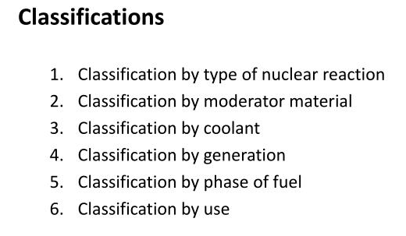
Nuclear Reactor Types
https://aris.iaea.org/

Slide 3
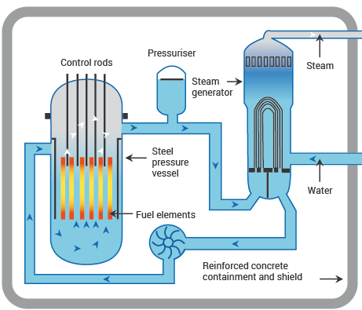
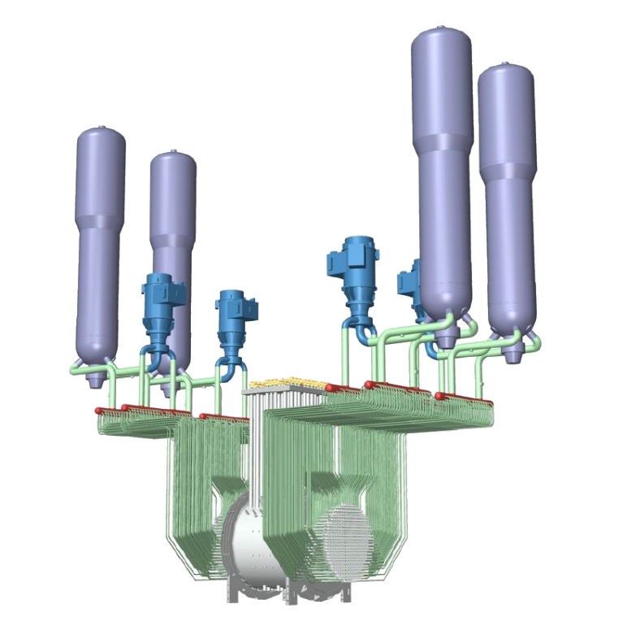
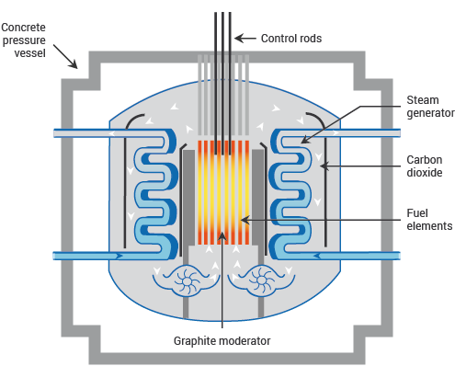
Classification by Coolant
Water cooled
  PWR
  PHWR
  BWR
Liquid Metal cooled reactor
Gas cooled reactor
Molten Salt reactor

Slide 4
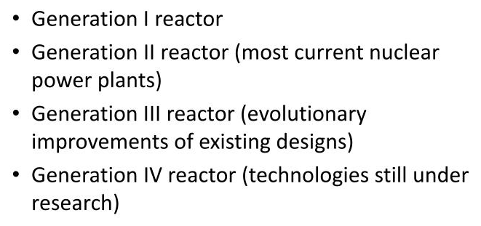
Classification by Generation

Slide 5
What is thermal hydraulics?
Thermal hydraulics (T/H) is the study and/or analysis of a fluid that is influenced by the addition of heat.
The fluid could be a multicomponent, multi-phase fluid that is usually flowing or accelerating in a fixed structure, e.g., piping system or large vessel.
The heat can be added in many different ways.
  For example, heat can be added to the fluid from conduction through a heat exchanger or by radiation heat transfer from extremely hot rods.

Slide 6
Course Map: Nuclear Thermal-Hydraulics
Heat generation → Fuel radial conduction → Gap/clad → Coolant convection/boiling
Heated channel & core hydraulics (ΔP, G, Re, boiling, x, α)
Two-phase & CHF/DNBR margins
System TH & transients: natural circulation, LOCA/SBO response
Safety links: inventory, containment heat removal, cooldown timelines
Notes:
Insert after 'What is Thermal-Hydraulics'.

Slide 7
Symbols & Units (Used Throughout)
q″ (W/m²), q‴ (W/m³), k (W/m·K), h (W/m²·K), G (kg/m²·s), Re, Pr
x: quality; α: void fraction; S: slip ratio; ΔP_fric, K-loss
CHF, DNBR; T_sat, ΔT_sub; ρ, μ; c_p; h_fg
Default: SI units. Temperatures in K (or °C noted).
Notes:
Define symbols early to reduce cognitive load.

Slide 8
Nuclear thermal hydraulics
Nuclear reactor thermal hydraulics and safety, which deal with energy production and utilization.
May include the following:
  Single- and two-phase phenomena in heated microchannels (convective heat transfer, boiling, onset of flow instability, flow regimes, single- and two-phase pressure drop)
  Single- and two-phase phenomena in tube bundles (flow visualization, two-phase flow patterns)
  Enhancement of boiling heat transfer
  Interphase transfer processes in two-phase flow
  Hydrodynamics of countercurrent two-phase flow

Slide 9
Typical LWR Reference Numbers
Quantity | Typical Value | Notes
Primary pressure | 15.5 MPa | PWR
Core inlet/outlet T | ~290–325 °C | Hot leg
Mass flux G | 1500–4000 kg/m²·s | Subchannel range
Rod OD / Pitch | 9.5–10.7 mm / 12–15 mm | Assembly dependent
UO₂ k | ≈2–3 W/m·K | High T
h (single-phase) | 20–100 kW/m²·K | Boiling increases h
Notes:
Quick reference for exercises.

Slide 10
Nuclear thermal hydraulics
Further areas of study:
  Thermal hydraulics of the accelerator-based production of tritium (apt) system
  Transport of radioactive trace species and aerosols in bubbles
  Condensation in two-phase flow systems with noncondensables
  Modeling of nonequilibrium two-phase mist flow
  Hydrodynamics of three-phase flow systems (i.e., gas, liquid, solid particles)

Slide 11
PLANT CHARACTERISTICS ↔ THERMAL HYDRAULICS
Thermal hydraulic considerations are important when selecting overall plant characteristics.
Primary system temperature and pressure are key characteristics related to both the coolant selection and plant thermal performance.
This thermal performance is dictated by the bounds of the maximum allowable primary coolant outlet temperature and the minimum achievable condenser coolant inlet temperature.

Slide 12
Other plant characteristics strongly coupled with thermal hydraulic considerations.
Primary coolant temperature
  Corrosion behavior, though strongly dependent on water chemistry control, is also temperature-dependent.
  The reactor vessel resistance to brittle fracture degrades with accumulated neutron fluence. Vessel behavior under low-temperature, high-pressure transients from operating conditions is carefully evaluated to ensure that the vessel has retained the required material toughness over its lifetime.

Slide 13
Other plant characteristics strongly coupled with thermal hydraulic considerations.
Primary system inventory
  The time response during accidents and less severe transients strongly depends on coolant inventories. The reactor vessel inventory above the core is important to behavior in primary system rupture accidents. For a PWR, in particular, the pressurizer and steam generator inventories dictate transient response for a large class of situations.
  During steady-state operation the inlet plenum serves as a mixing chamber to homogenize coolant flow into the reactor. The upper plenum serves a similar function in multiple-loop plants with regard to the intermediate heat exchanger/steam generator while at the same time protecting reactor vessel nozzles from thermal shock in transients.

Slide 14
Other plant characteristics strongly coupled with thermal hydraulic considerations.
System arrangement
  The arrangement of reactor core and intermediate heat exchanger/steam generator thermal centers is crucial to the plant’s capability to remove heat by natural circulation.
  Orientation of pump shafts and heat exchanger tubes coupled with support designs and impingement velocities is important relative to prevention of troublesome vibration problems.

Slide 15
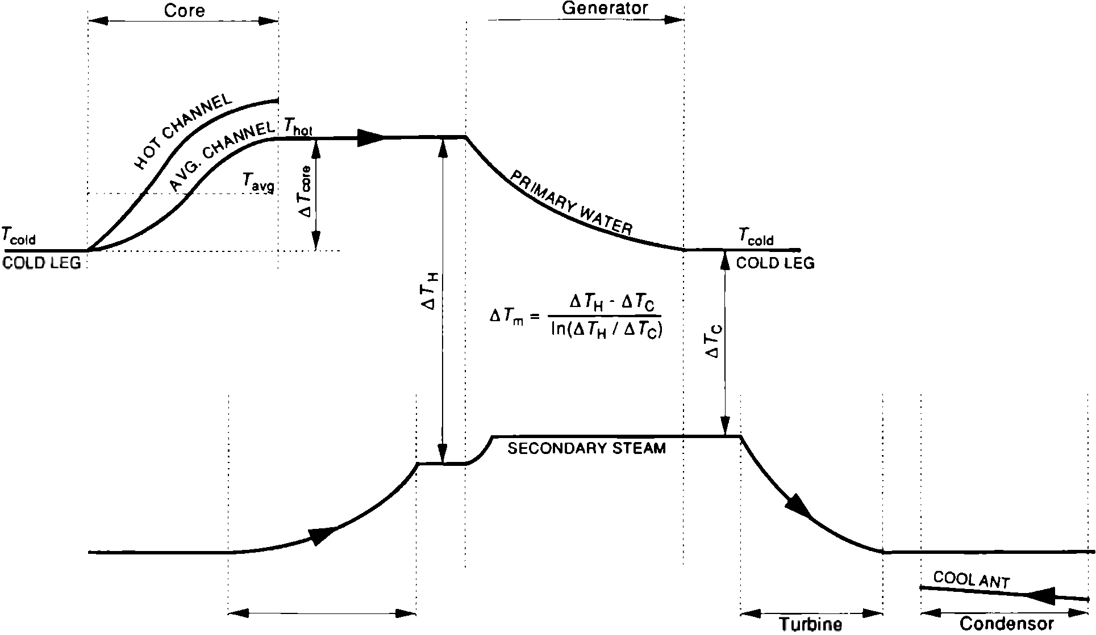
Relations among reactor plant temperatures for a typical PWR. (Adapted from Tong)

Slide 16
Light-Water Reactor Thermal Conditions
Condition | PWR | BWR
Primary coolant outlet temperature | 326.8°C | 286.1°C
Primary coolant system pressure | 15.51 MPa | 7.14 MPa
Turbine steam saturation conditions Pressure Temperature | 5.7 MPa 272.3°C | 7.14 MPa 287.2°C
Plant thermal efficiencya | 33.7% | 32.0%

Slide 17
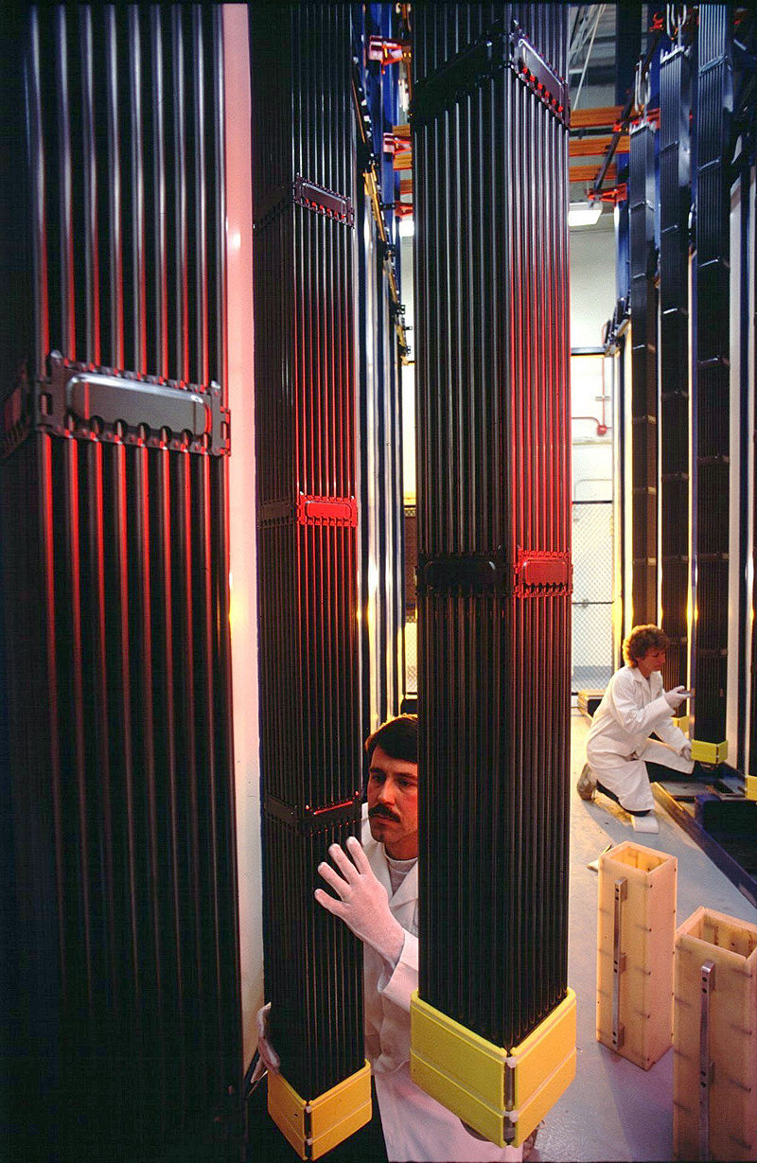
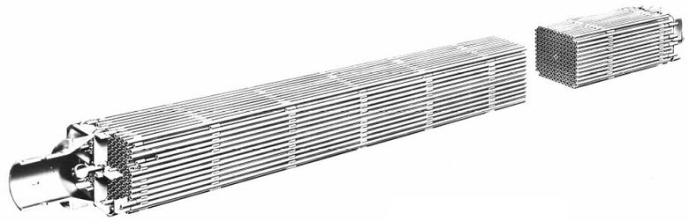
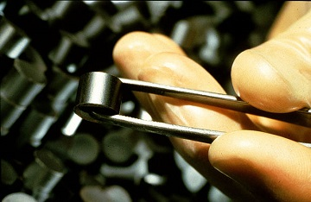
Fuel types

Slide 18
Fuel Conduction (Cylinder): Equations & Assumptions
Volumetric source q‴, radius R; steady, 1D radial conduction, constant k
T(r) = T_s + (q‴/(4k))·(R² − r²)
ΔT_centerline-surface = q‴·R²/(4k)
Linear heat rate: q′ = q‴·πR² ⇒ q‴ = q′/(πR²)
Assumptions: steady; no axial conduction; uniform properties; no internal sinks
Notes:
Use before Bessel/axial shapes.

Slide 19
Fuel→Coolant Heat Path (Resistance Ladder)
UO₂ centerline → UO₂ surface (k_UO₂ ≈ 2–3 W/m·K at high T)
Gap conductance (h_gap ≈ 5–10 kW/m²·K; fill-gas & power dependent)
Zr-alloy cladding conduction (k ≈ 16 W/m·K)
Coolant film convection: single-phase h ≈ 20–100 kW/m²·K (nucleate boiling higher)
Bulk coolant → subchannel → assembly → core outlet
Notes:
Place before detailed conduction math.

Slide 20
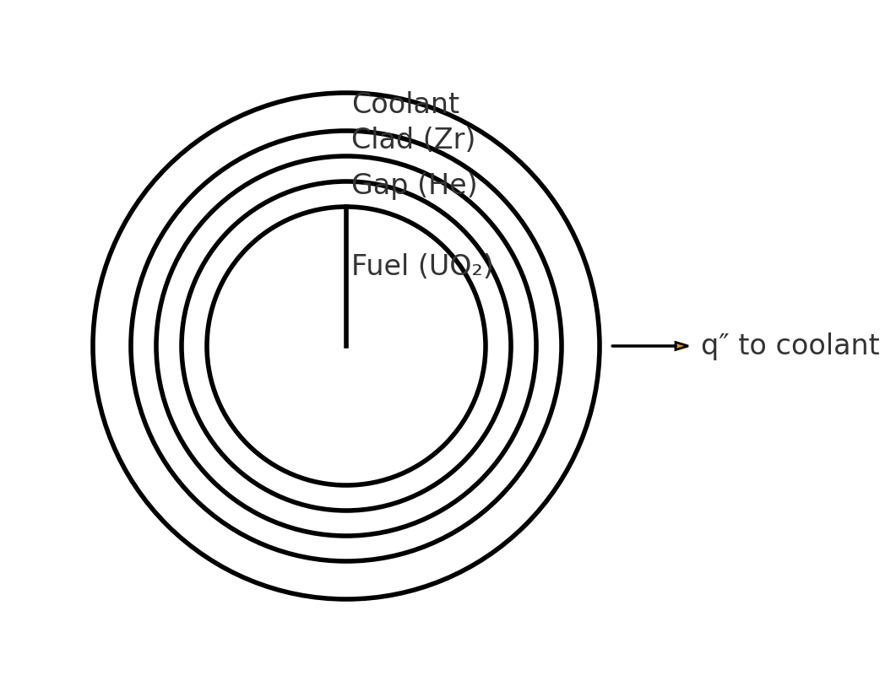
Fuel–Gap–Clad–Coolant Schematic
Heat path and thermal resistances used in fuel-temperature estimates
Notes:
Re-use this schematic across conduction/film/gap discussions.

Slide 21
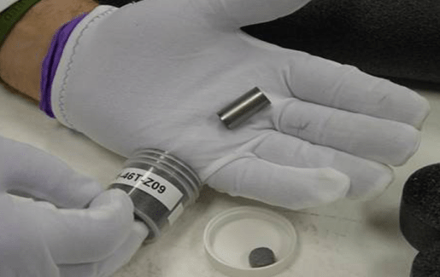
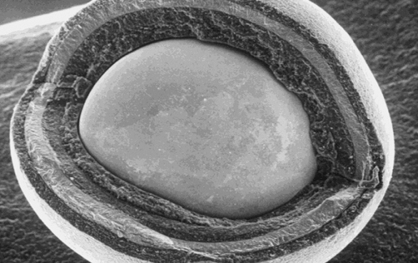
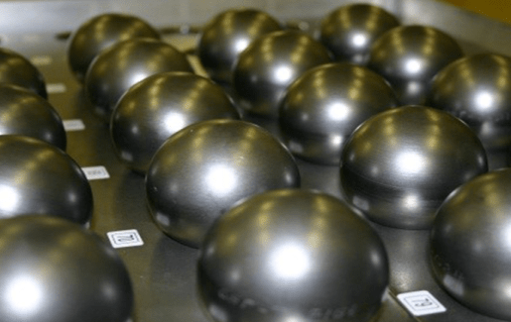
TRISO - TRi-structural ISOtropic particle fuel
Fuel particle
~ 1 mm size
uranium, carbon and oxygen fuel kernel.
encapsulated by three layers of carbon- and ceramic-based materials

Slide 22
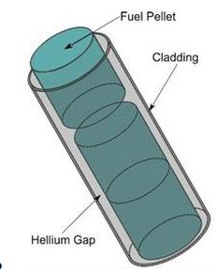
Heat Generation in Nuclear Reactors

Slide 23
Reactor heat-generation modes
Fission heat release (prompt)
Decay heat release (after shutdown)
Radioisotope heat release (activation & stored activity)

Slide 24
Reactor heat-generation modes (at a glance)
Mode | What it is | Typical magnitude / timeline | Where heat deposits | Thermal‑hydraulic implications
Fission heat (prompt) | Heat released while the chain reaction runs: fission fragments (dominant), prompt gamma, neutron slowing‑down | ≈93–95% of recoverable energy appears immediately as heat during operation | Mostly fuel; some gamma/neutron energy in clad/coolant/structures | Sets fuel ΔT ladder; determines q′, q″, DNBR/CHF margin, flow & ΔP sizing
Decay heat (after shutdown) | Beta/gamma decays of fission products and actinides after scram | ~6–7% at 1 s → ~3% at 1 min → ~1–2% at 1 h → <1% at 1 day (after long prior operation) | Mostly fuel (gamma also heats near‑field materials) | Early cooldown sizing: SG heat removal (PWR), RCIC/HPCI (BWR), then RHR; boil‑off/SBO timelines; SFP loads
RCIC — Reactor Core Isolation Cooling (BWR), HPCI — High-Pressure Coolant Injection (BWR), SFP — Spent Fuel Pool

Slide 25
Reactor heat-generation modes (at a glance)
Mode | What it is | Typical magnitude / timeline | Where heat deposits | Thermal‑hydraulic implications
Radioisotope / activation heat | Decay of activation products and transported/retained radioactivity outside the fuel (e.g., N-16, CRUD, filters/resins, activated internals; spent fuel ex‑core) | Small vs core fission/decay during operation; locally important (filters, SFP) and long‑lived (spent fuel) | Coolant/primary piping, internals, filters/resins, SFP | Local cooling & shielding; primary gamma fields (e.g., N-16 in PWRs); ensure SFP cooling capacity

Slide 26
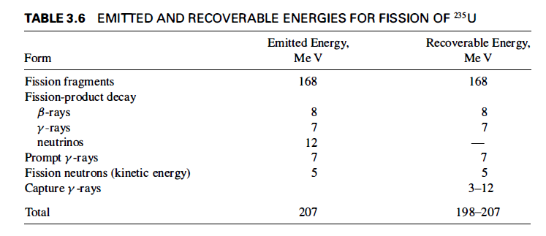
Fission Heat Release

Slide 27
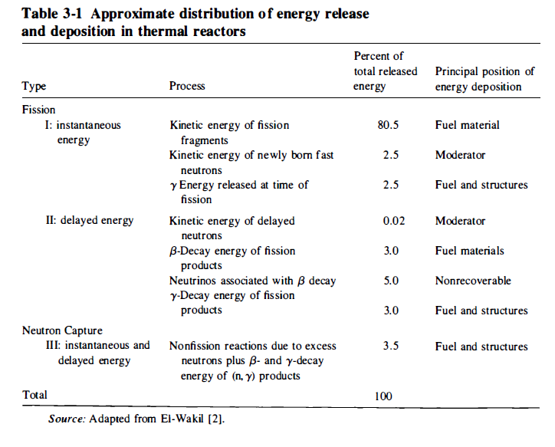
Fission Heat Release

Slide 28
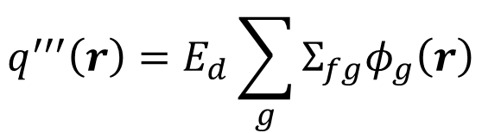


Volumetric heat generation in thermal reactor
$$q^{′′′}\left(r\right)=E_{d}{\overline{Σ}}_{fr}φ_{T}\left(r\right)$$
$E_{d}$ – Energy deposited
${\overline{Σ}}_{fr}$ - Thermal fission cross section
$φ_{T}\left(r\right)$ - Thermal neutron flux
For multigroup
$$q^{′′′}\left(r\right)=E_{d}\sum_{g}{Σ_{fg}φ_{g}\left(r\right)}$$

Slide 29
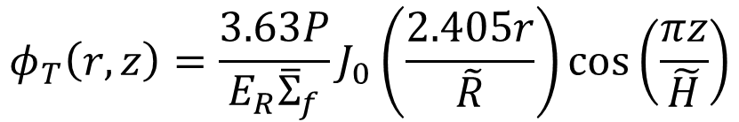
Neutron flux for bare, finite cylinder
$$φ_{T}\left(r,z\right)=\frac{3.63P}{E_{R}{\overline{Σ}}_{f}}J_{0}\left(\frac{2.405r}{\tilde{R}}\right)\cos\left(\frac{πz}{\tilde{H}}\right)$$
P is the total power of the reactor
E_{R} is the recoverable energy per fission in joules,
Flux profile sinusoidal axially, Bessel function radially

Slide 30
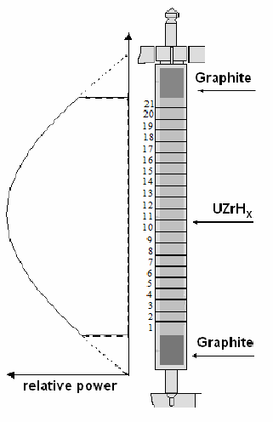

Slide 31
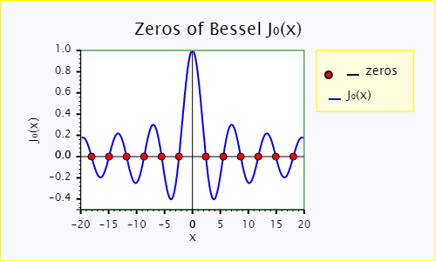
Bessel Function

Slide 32

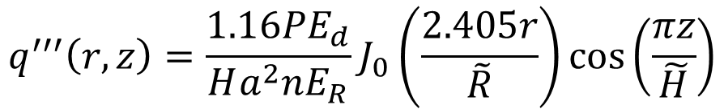
Volumetric heat release
$$q^{′′′}\left(r,z\right)=\frac{1.16PE_{d}}{Ha^{2}nE_{R}}J_{0}\left(\frac{2.405r}{\tilde{R}}\right)\cos\left(\frac{πz}{\tilde{H}}\right)$$
a – radius of fuel
Max heat release
$$q_{\text{max}}^{′′′}\left(r,z\right)=\frac{1.16PE_{d}}{Ha^{2}nE_{R}}$$

Slide 33
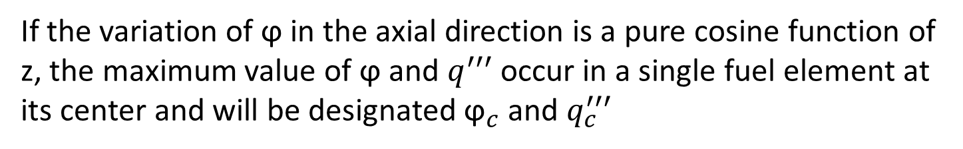
Heat generated by a single fuel element
The neutron flux in a single fuel element is not constant.
The axial variations in flux, and consequently volumetric thermal source strength, however, follow those in the core at the position where the fuel element is, and must be taken into account.
If the variation of ϕ in the axial direction is a pure cosine function of z, the maximum value of ϕ and $q^{′′′}$ occur in a single fuel element at its center and will be designated ${\text{ϕ}}_{c}$ and $q_{c}^{′′′}$

Slide 34
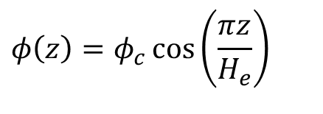
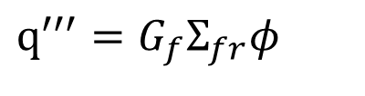

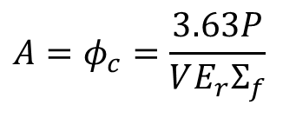
Heat Production in Fuel Elements (Fuel Rods)
Heat production per unit volume
$$q^{′′′}=G_{f}Σ_{fr}φ$$
G is the energy per reaction
In the thermal reactor
$$q^{′′′}\left(z\right)=G_{f}Σ_{fr}φ\left(z\right)$$
The spatial dependence of the flux depends on the geometry and structure of the reactor.
For the case of sinusoidal flux
$$φ\left(z\right)=​​​​​​​​​​​​​​​​​​​​​φ_{c}\cos\left(\frac{πz}{H_{e}}\right)$$
$$A=​​​​​​​​​​​​​​​​​​​​​φ_{c}=\frac{3.63P}{VE_{r}Σ_{f}}$$

Slide 35

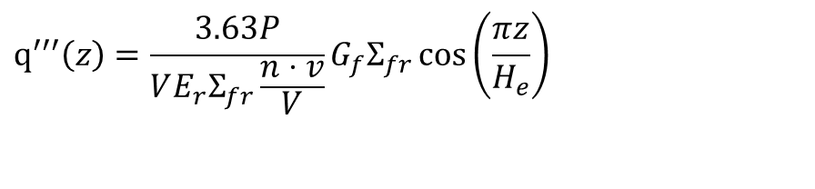
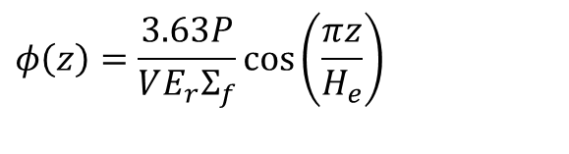

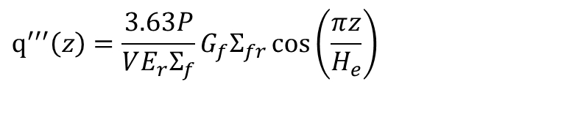
$$φ\left(z\right)=\frac{3.63P}{VE_{r}Σ_{f}}\cos\left(\frac{πz}{H_{e}}\right)$$
P is the total power of the reactor
E_{R} is the recoverable energy per fission in joules,
V is the fuel volume in cm³ , and
are its outer dimensions in centimeters to the
extrapolated boundaries
$$R_{e} \text{and} H_{e}$$
$$q^{′′′}\left(z\right)=\frac{3.63P}{VE_{r}Σ_{f}}G_{f}Σ_{fr}\cos\left(\frac{πz}{H_{e}}\right)$$
$$q^{′′′}\left(z\right)=G_{f}Σ_{fr}φ\left(z\right)$$
$$v \text{is} \text{the} \text{reactor} \text{rod} \text{volume} \left(πHa^{2}\right)\text{ \& }V \text{is} \text{the} \text{reactor} \text{volume} \left(πHR^{2}\right)$$
$$q^{′′′}\left(z\right)=\frac{3.63P}{VE_{r}Σ_{fr}\frac{n⋅v}{V}}G_{f}Σ_{fr}\cos\left(\frac{πz}{H_{e}}\right)$$

Slide 36
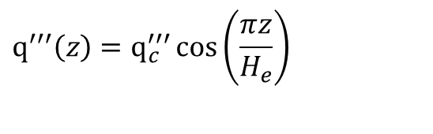
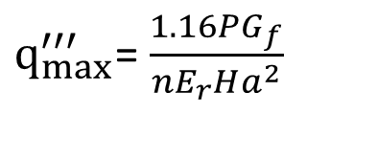
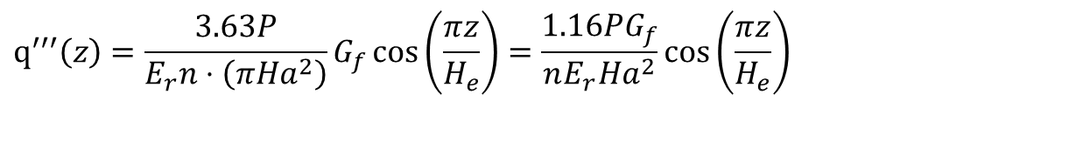
$$q^{′′′}\left(z\right)=\frac{3.63P}{E_{r}n⋅\left(πHa^{2}\right)}G_{f}\cos\left(\frac{πz}{H_{e}}\right)=\frac{1.16PG_{f}}{nE_{r}Ha^{2}}\cos\left(\frac{πz}{H_{e}}\right)$$
The heat production occurs in the middle z=0 of the central rod (R=0)
$q_{max}^{′′′}$= $\frac{1.16PG_{f}}{nE_{r}Ha^{2}}$
The maximum rate of heat production in a noncentral rod located at r not equal to zero
$$q^{′′′}\left(z\right)=q_{c}^{′′′}\cos\left(\frac{πz}{H_{e}}\right)$$
The total rate at which heat is produced in any fuel rod is given by the integral (Ref. El Wakil)

Slide 37
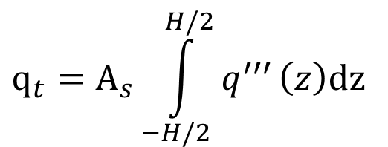
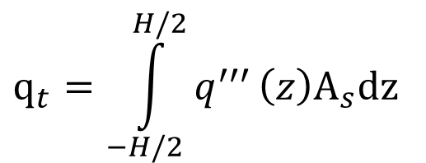
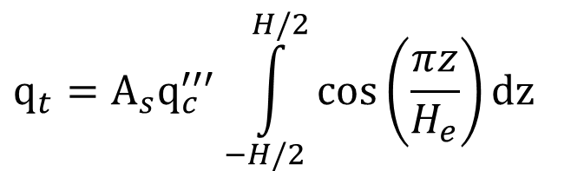

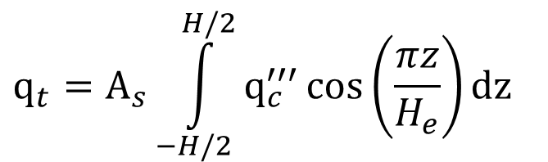
$$q_{t}=\int_{−H/2}^{H/2}{q^{′′′}}\left(z\right)A_{s}dz$$
$$A_{s}=πa^{2}$$
$$q_{t}=A_{s}\int_{−H/2}^{H/2}{q^{′′′}}\left(z\right)dz$$
$$q_{t}=A_{s}\int_{−H/2}^{H/2}{q_{c}^{′′′}\cos\left(\frac{πz}{H_{e}}\right)}dz$$
$$q_{t}=A_{s}q_{c}^{′′′}\int_{−H/2}^{H/2}{\cos\left(\frac{πz}{H_{e}}\right)}dz$$

Slide 38
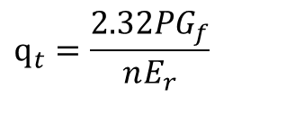
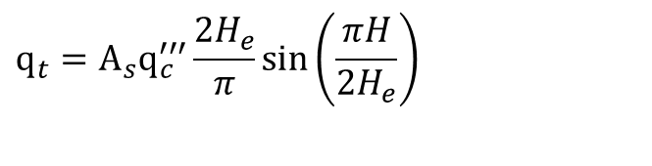
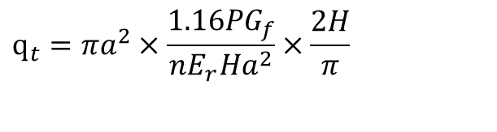
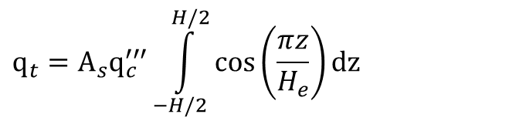
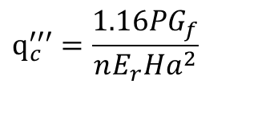


$$q_{t}=A_{s}q_{c}^{′′′}\int_{−H/2}^{H/2}{\cos\left(\frac{πz}{H_{e}}\right)}dz$$
$$q_{t}=A_{s}q_{c}^{′′′}\frac{2H_{e}}{π}\sin\left(\frac{πH}{2H_{e}}\right)$$
Where the extrapolation lengths may be neglected, this equation reduces to
$$A=​​​​​​​​​​​​​​​​​​​​​φ_{c}=\frac{3.63P}{VE_{r}Σ_{f}}$$
This equation used to approximate the flux in a reactor where the fuel is contained in separate fuel rods,
$$q_{c}^{′′′}=\frac{1.16PG_{f}}{nE_{r}Ha^{2}}$$
$$A_{s}=πa^{2}$$
$$q_{t}=πa^{2}×\frac{1.16PG_{f}}{nE_{r}Ha^{2}}×\frac{2H}{π}$$
$$q_{t}=\frac{2.32PG_{f}}{nE_{r}}$$

Slide 39
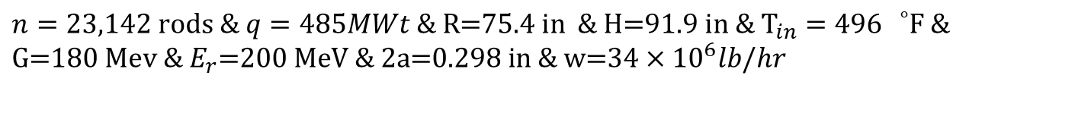
Exercise 1
A small PWR plant operates at a power of 485 MWt. The core, which is approximately 75.4 in. in diameter and 91.9 in high, consists of a square lattice of 23,142 fuel tubes of thickness 0.021 in and inner diameter of 0.298 in. The tubes are filled with 3.40 w/o-enriched U0₂ . The core is cooled by water, which enters at the bottom at 496°F and passes through the core at a rate of 34 x 10⁶ lb/hr at 2,015 psia. Compute
the average temperature of the water leaving the core;
the average power density in kW/liter;
(c) the maximum heat production rate, assuming the reactor core is bare.
$$n=23,142 \text{rods}\text{ \& }q=485MWt\text{ \& }\text{R}\text{=75.4 }\text{in}\text{ \& }\text{H}\text{=91.9 }\text{in}\text{ \& }{\text{T}}_{in}=496 {}_{}^{∘}{\text{F}\text{ \&}} \\ \text{G}\text{=180 }\text{Mev}\text{ \& }E_{r}\text{=200 }\text{MeV}\text{ \& }\text{2}\text{a}\text{=0.298 }\text{in}\text{ \& }\text{w}\text{=34}×\text{1}{\text{0}}^{6}lb/hr$$

Slide 40
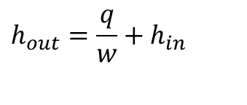

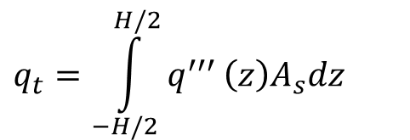
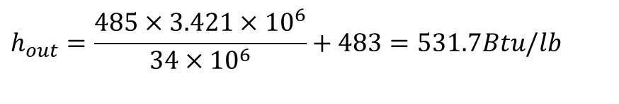
the average temperature of the water leaving the core;
$$q=w\left(h_{out}−h_{in}\right)$$
$$h_{out}=\frac{q}{w}+h_{in}$$
$$q_{t}=\int_{−H/2}^{H/2}{q^{′′′}}\left(z\right)A_{s}dz$$
$$h_{out}=\frac{485×3.421×10^{6}}{\text{34}×\text{1}{\text{0}}^{6}}+483=531.7Btu/lb$$
$$when h_{out}=531.7Btu/Ib ⇒T_{out}\text{= 536.2 }°\text{F}$$

Slide 41
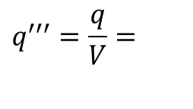
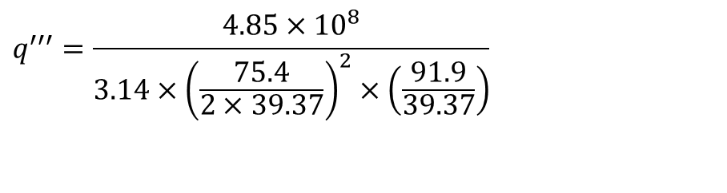
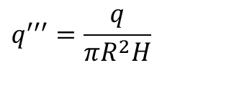
(b) the average power density in kW/liter;
$$q^{′′′}=\frac{q}{V}=$$
$$q^{′′′}=\frac{q}{πR^{2}H}$$
$$q^{′′′}=\frac{4.85×10^{8}}{3.14×{\left(\frac{75.4}{2×39.37}\right)}^{2}×\left(\frac{91.9}{39.37}\right)}$$
$$q^{′′′}=\text{72125}.\text{68 }\text{kW}\text{/}{\text{m}}^{3}=\text{72}\text{.}\text{12 }\text{kW}\text{/}\text{L}$$

Slide 42

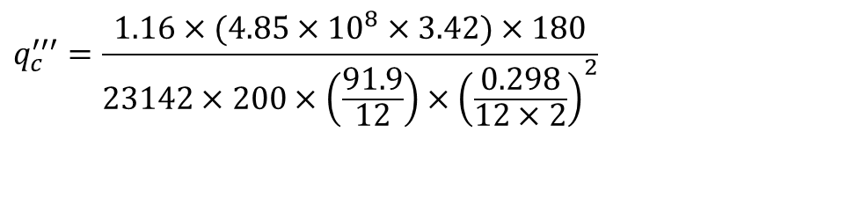

(c) the maximum heat production rate, assuming the reactor core is bare.
$$q_{c}^{′′′}=\frac{1.16PG_{f}}{nE_{r}Ha^{2}}$$
$$q_{c}^{′′′}=\frac{1.16×(4.85×10^{8}×3.42)×180}{23142×200×\left(\frac{91.9}{12}\right)×{\left(\frac{0.298}{12×2}\right)}^{2}}$$
$$q_{c}^{′′′}=6.54×10^{7}Btu/hr.ft^{3}$$

Slide 43


Slide 44


Slide 45



Slide 46


The total heat generated in core- general
The individual fuel elements in a heterogeneous core are subjected to different values of:
Midplane Neutron flux
Midplane Volumetric thermal source strengths
$$φ_{c}$$
$${q_{c}}^{′′′}$$
In a homogeneous core, there are no individual fuel elements.

Slide 47
The total heat generated in core-general
However, the two cases can be treated in a like manner, provided that
The number of fuel elements in the heterogeneous core is sufficiently large.
The fuel type and enrichment do not vary in the heterogeneous reactor

Slide 48
Decay Heat: What & Why
Prompt fission power drops at scram; decay heat persists
Dominates early cooldown and inventory/boil-off sizing
Key driver for SG/RHR/containment heat removal in first hour
*SG – Steam Generator, RHR – Residual Heat Removal
Notes:
Under Nuclear Heat Generation cluster.

Slide 49
In reactor shutdown, the reactor power does not immediately drop to zero but falls off rapidly according to a negative period.
Eventually determined by the half-life of the longest-lived delayed neutron group
After shutdown, a reactor therefore continues to generate power, 𝑷_{ts} , a function of time.

Slide 50
The amount of such power generation depends on
(a) The level of power before shutdown, 𝑷_{ts}
(b) The length of time the reactor was operating, 𝒕₀

Slide 51

First-Cut Correlation (Todreas, Kazimi)
For steady pre-trip power P₀, t in seconds:
$\frac{P_{dec}\left(t\right)}{P_{0}} ≈ 0.066 t^{−0.2}$ (Todreas, Kazimi)
$$\text{(}\text{with} \text{(}\text{t}\text{)} \text{in} \text{seconds}\text{, \sim }\text{1 }\text{s} \text{to}\text{ \sim }\text{1 }\text{day}\text{)}$$
Rules of thumb: 1 s ~6.6%; 1 min ~2.9%; 10 min ~1.8%; 1 h ~1.3%; 1 day ~0.7%
Notes:
Power-law behavior consistent with textbook guidance for first-pass sizing.

Slide 52
Worked Example: PWR Trip from Full Power
Given: P₀ = 3000 MWth
At 1 s: ~198 MW; 60 s: ~87 MW; 3600 s: ~39 MW
Implication: Early heat removal must exceed these values with margin
Notes:
Have students sanity-check against system capacities.

Slide 53
Effect of Prior Power History
Recent lower power ⇒ proportionally lower decay heat
Irradiation duration affects earliest terms
Advanced multi-term standards can be introduced later

Slide 54

Decay Heat (Lamarsh)

Slide 55


Slide 56



Slide 57
Where Decay Heat Enters the Course
Cooldown/SG/RHR sizing calculations
SBO/SBLOCA boil-off timelines and inventory
Pool heat-up and natural circulation experiments
System-level transient problems and case studies
* SBO – Station Black Out, SBLOCA – Small Break Loss of Coolant Accident

Slide 58

Core Axial Temperature Profiles

Slide 59


Core Axial Temperature Profiles

Slide 60

Core Axial Temperature Profiles
Symbols (Lamarsh):
$T_{b0}$: Inlet bulk coolant temperature (K)
$w$: Coolant mass flow rate (kg/s)
$c_{p}$: Coolant specific heat (J/kg·K)
$H$: Heated length (m)
$V_{f}$: Fuel volume (m³)
$A_{f}$: Fuel cross-sectional area (m²)
h: Heat transfer coefficient (W/m²·K)
$C_{c}$: Cladding outer circumference (m)
$r_{f}$: Fuel radius (m)
$k_{f}$: Fuel thermal conductivity (W/m·K)
$q_{max}^{′′′}$: Peak volumetric heat generation rate (W/m³)

Slide 61

Core Axial Temperature Profiles
Typical parameter values (SI):
Heated length ($H=3.66 \text{m}$)
Fuel radius ($r_{f}=4.0 \text{mm}$), cladding outer radius ($r_{o}=4.75 \text{mm}$)
Peak volumetric heat ($q_{max}^{′′′}=2.5×{10}^{8} \text{W} {\text{m}}^{−3}$
Fuel conductivity ($k_{f}=3 \text{W} {\text{m}}^{{−1\text{K}}^{−1}}$)
Convective HTC ($h=2.0×{10}^{4} \text{W} {\text{m}}^{{−2\text{K}}^{−1}}$)
Channel mass flow ($w=0.06 \text{kg} {\text{s}}^{−1}$)
Coolant ($c_{p}=4200 \text{J} {\text{kg}}^{{−1\text{K}}^{−1}}$)
Inlet bulk temperature ($T_{b0}=570 \text{K}$)

Slide 62
Exercise 1 (Upgraded): Small PWR Mass/Energy Balance
Given: thermal power P, core flow ṁ, inlet T_in; assume average c_p
Neglect leakage & γ-heating; treat c_p constant over ΔT
(a) Compute T_out via ṁ c_p (T_out−T_in)=P
(b) Subcooled margin at exit: T_sat − T_out (use system pressure)
(c) Sensitivity: if ṁ drops 10%, find new T_out
Notes:
Solution outline in notes: T_out = T_in + P/(ṁ c_p)

Slide 63
Boiling Curve & DNBR Preview
Nucleate boiling region: typical LWR operation
Critical Heat Flux (CHF): avoid the 'cliff' via DNBR margin
DNBR = CHF limit / actual q″; DNBR > 1 ⇒ margin
Sets up later: correlations, maps, subchannel methods
Notes:
Place after LWR thermal conditions slide.

Slide 64
Quick Clicker: Which Resistance Dominates?
At low power: gap (h_gap small) often limits fuel surface T
At higher power: UO₂ conduction ΔT centerline→surface dominates
Which reduces wall T more—doubling h_gap or +20% h_film? Why?
Notes:
Use 60–90 seconds; debrief with resistance ladder.

