Slide 1
SETN 3224
Thermal Hydraulics & Lab
Mohsin Mohd Sies
Nuclear Engineering,
Faculty of Chemical and Energy Engineering,
Universiti Teknologi Malaysia

Slide 2

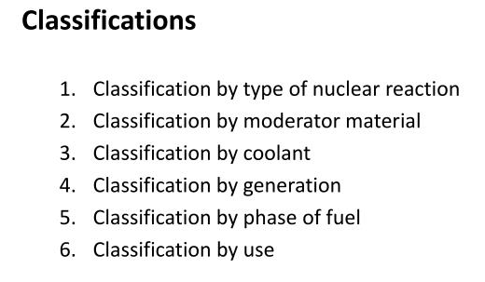
Nuclear Reactor Types
https://aris.iaea.org/

Slide 3
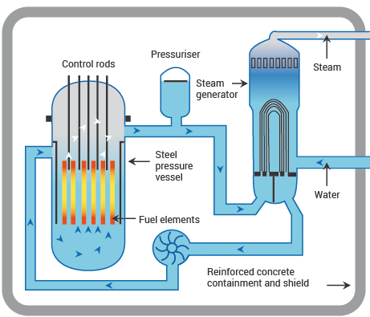
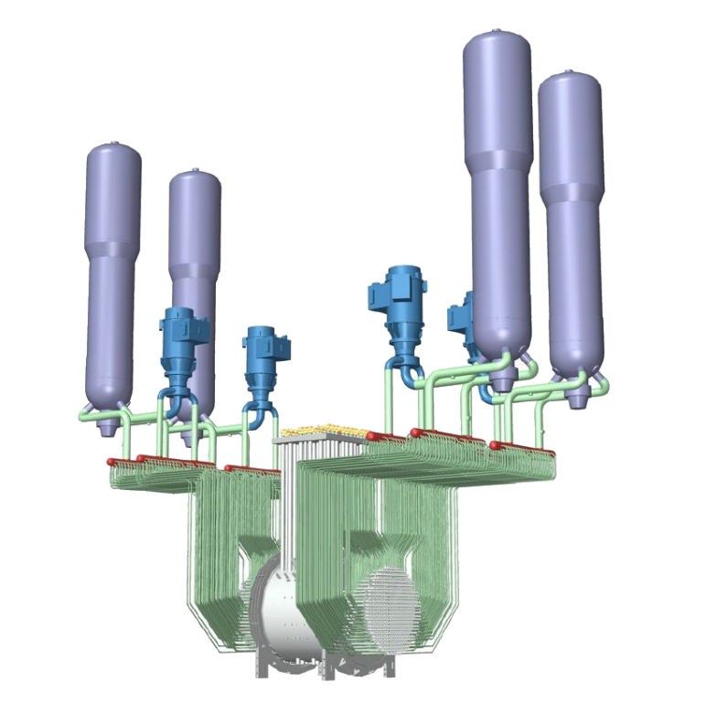
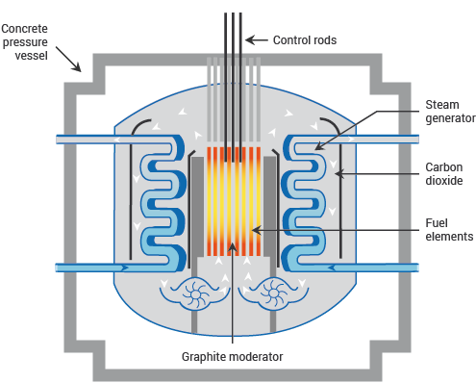
Classification by Coolant
Water cooled
  PWR
  PHWR
  BWR
Liquid Metal cooled reactor
Gas cooled reactor
Molten Salt reactor

Slide 4
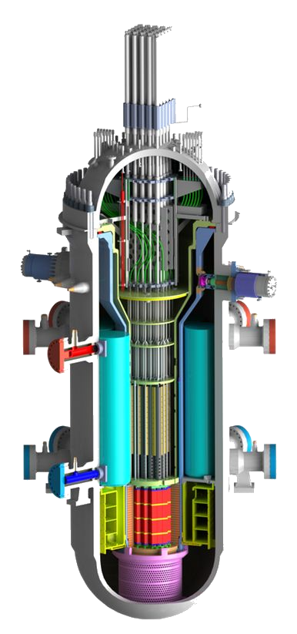
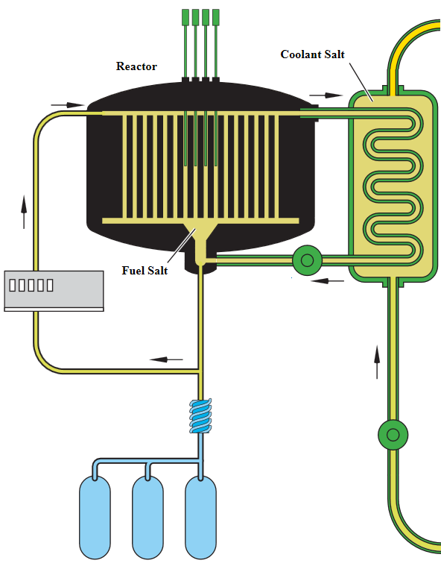
Classification by Coolant
SMR
MSR

Slide 5
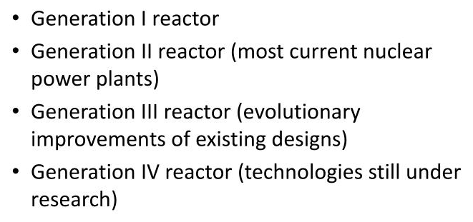
Classification by Generation

Slide 6
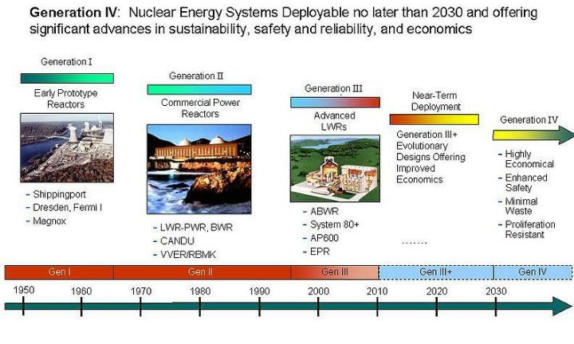
Classification by Generation

Slide 7
What is thermal hydraulics?
Thermal hydraulics (T/H) is the study and/or analysis of a fluid that is influenced by the addition of heat.
The fluid could be a multicomponent, multi-phase fluid that is usually flowing or accelerating in a fixed structure, e.g., piping system or large vessel.
The heat can be added in many different ways.
  For example, heat can be added to the fluid from conduction through a heat exchanger or by radiation heat transfer from extremely hot rods.

Slide 8
Nuclear thermal hydraulics
Nuclear reactor thermal hydraulics and safety, which deal with energy production and utilization.
May include the following:
  Single- and two-phase phenomena in heated microchannels (convective heat transfer, boiling, onset of flow instability, flow regimes, single- and two-phase pressure drop)
  Single- and two-phase phenomena in tube bundles (flow visualization, two-phase flow patterns)
  Enhancement of boiling heat transfer
  Interphase transfer processes in two-phase flow
  Hydrodynamics of countercurrent two-phase flow

Slide 9
Nuclear thermal hydraulics
Further areas of study:
  Thermal hydraulics of the accelerator-based production of tritium (apt) system
  Transport of radioactive trace species and aerosols in bubbles
  Condensation in two-phase flow systems with noncondensables
  Modeling of nonequilibrium two-phase mist flow
  Hydrodynamics of three-phase flow systems (i.e., gas, liquid, solid particles)

Slide 10
PLANT CHARACTERISTICS ↔ THERMAL HYDRAULICS
Thermal hydraulic considerations are important when selecting overall plant characteristics.
Primary system temperature and pressure are key characteristics related to both the coolant selection and plant thermal performance.
This thermal performance is dictated by the bounds of the maximum allowable primary coolant outlet temperature and the minimum achievable condenser coolant inlet temperature.

Slide 11
Other plant characteristics strongly coupled with thermal hydraulic considerations.
Primary coolant temperature
  Corrosion behavior, though strongly dependent on water chemistry control, is also temperature-dependent.
  The reactor vessel resistance to brittle fracture degrades with accumulated neutron fluence. Vessel behavior under low-temperature, high-pressure transients from operating conditions is carefully evaluated to ensure that the vessel has retained the required material toughness over its lifetime.

Slide 12
Other plant characteristics strongly coupled with thermal hydraulic considerations.
Primary system inventory
  The time response during accidents and less severe transients strongly depends on coolant inventories. The reactor vessel inventory above the core is important to behavior in primary system rupture accidents. For a PWR, in particular, the pressurizer and steam generator inventories dictate transient response for a large class of situations.
  During steady-state operation the inlet plenum serves as a mixing chamber to homogenize coolant flow into the reactor. The upper plenum serves a similar function in multiple-loop plants with regard to the intermediate heat exchanger/steam generator while at the same time protecting reactor vessel nozzles from thermal shock in transients.

Slide 13
Other plant characteristics strongly coupled with thermal hydraulic considerations.
System arrangement
  The arrangement of reactor core and intermediate heat exchanger/steam generator thermal centers is crucial to the plant’s capability to remove heat by natural circulation.
  Orientation of pump shafts and heat exchanger tubes coupled with support designs and impingement velocities is important relative to prevention of troublesome vibration problems.

Slide 14
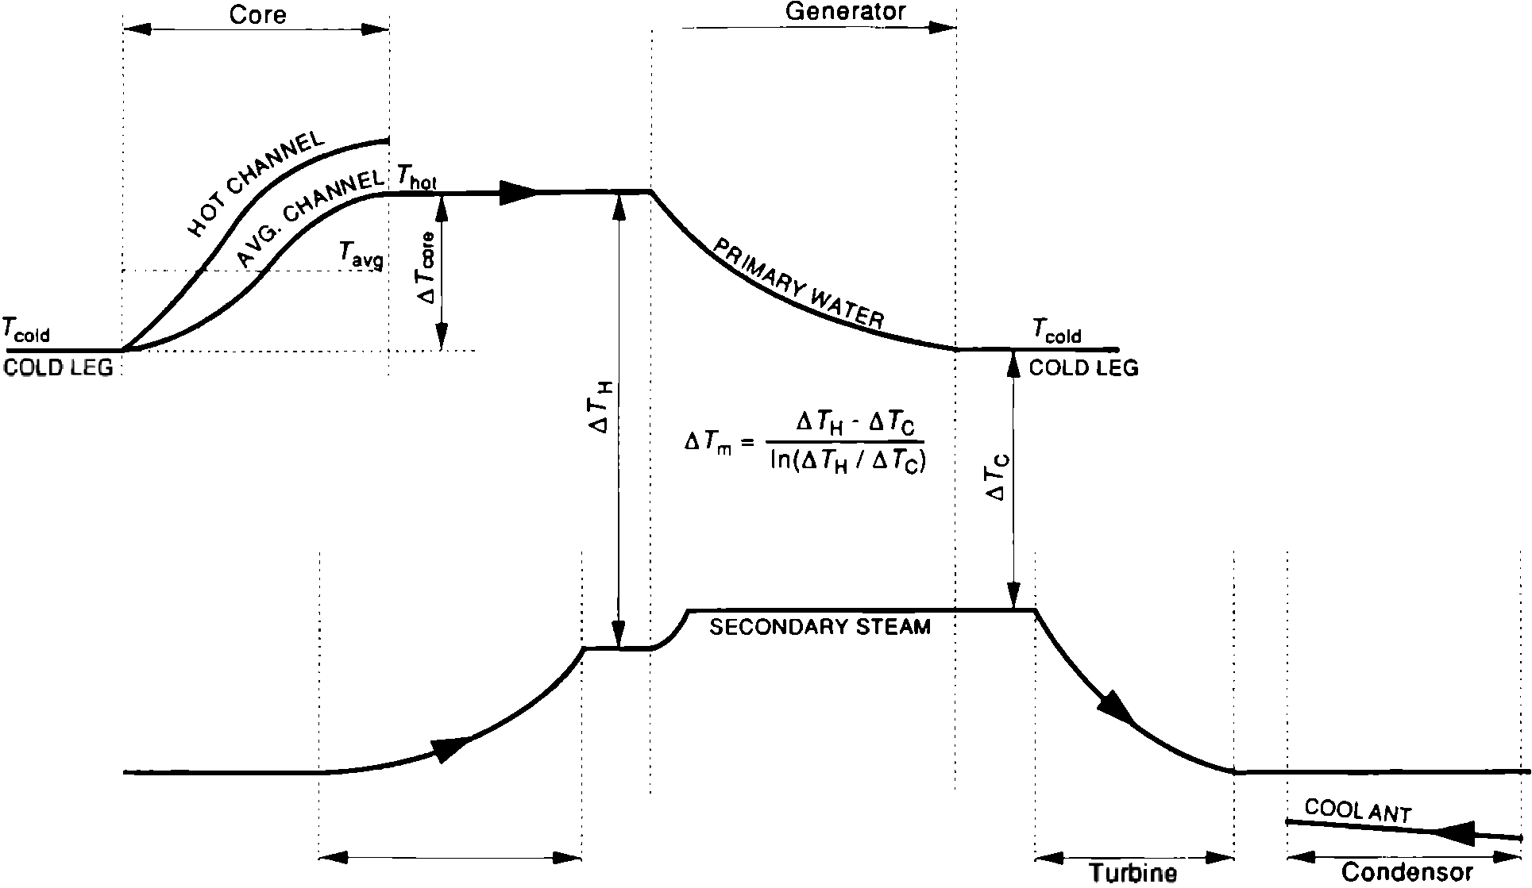
Relations among reactor plant temperatures for a typical PWR. (Adapted from Tong)

Slide 15
Light-Water Reactor Thermal Conditions
Condition | PWR | BWR
Primary coolant outlet temperature | 326.8°C | 286.1°C
Primary coolant system pressure | 15.51 MPa | 7.14 MPa
Turbine steam saturation conditions Pressure Temperature | 5.7 MPa 272.3°C | 7.14 MPa 287.2°C
Plant thermal efficiencya | 33.7% | 32.0%

Slide 16
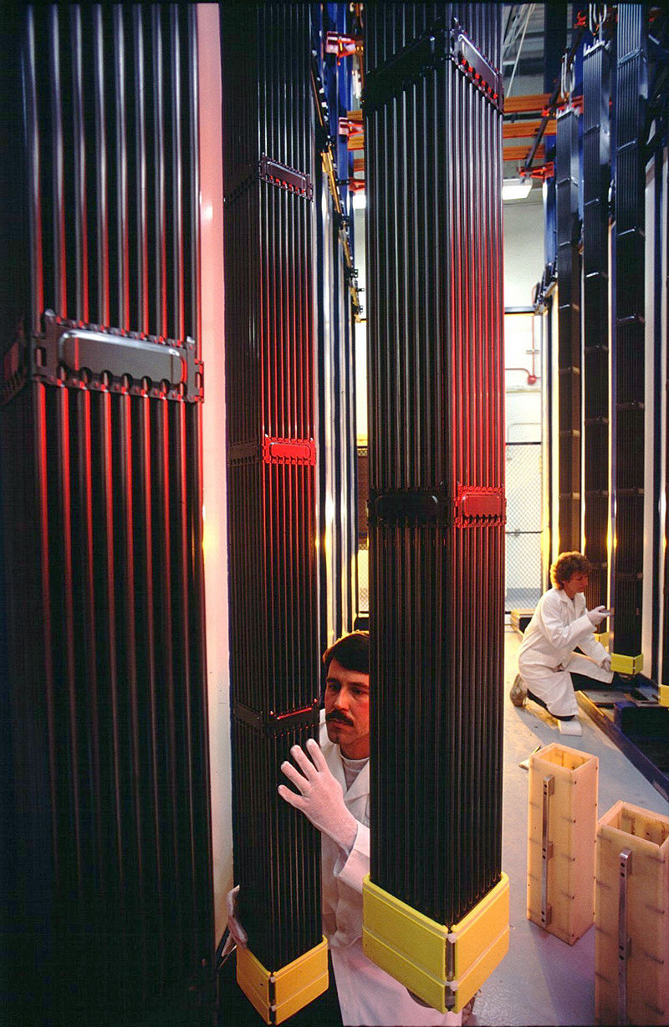
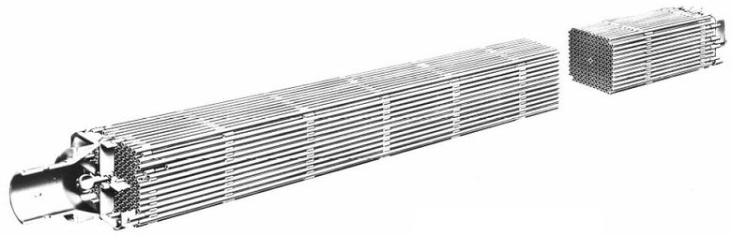

Fuel types

Slide 17
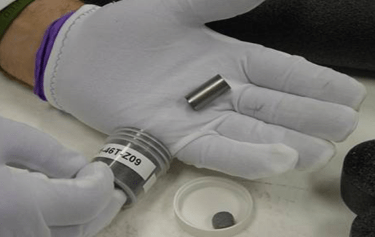
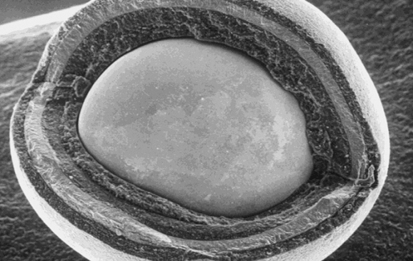
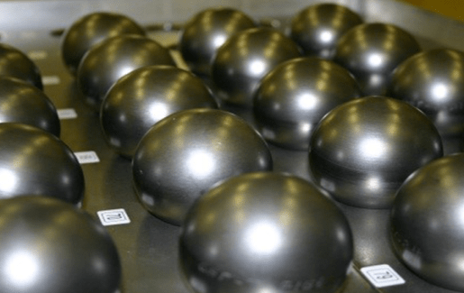
TRISO - TRi-structural ISOtropic particle fuel
Fuel particle
~ 1 mm size
uranium, carbon and oxygen fuel kernel.
encapsulated by three layers of carbon- and ceramic-based materials

Slide 18
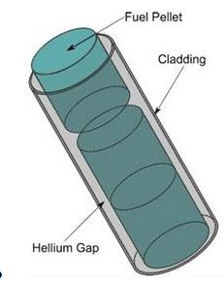
Heat Generation in Nuclear Reactors

Slide 19
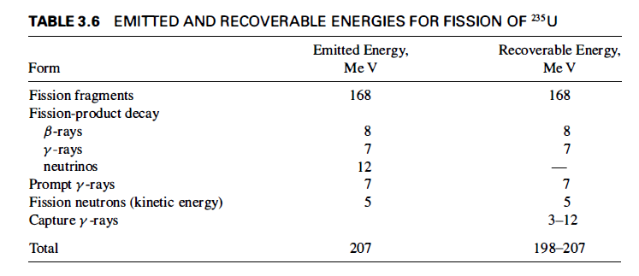
Fission Heat Release

Slide 20
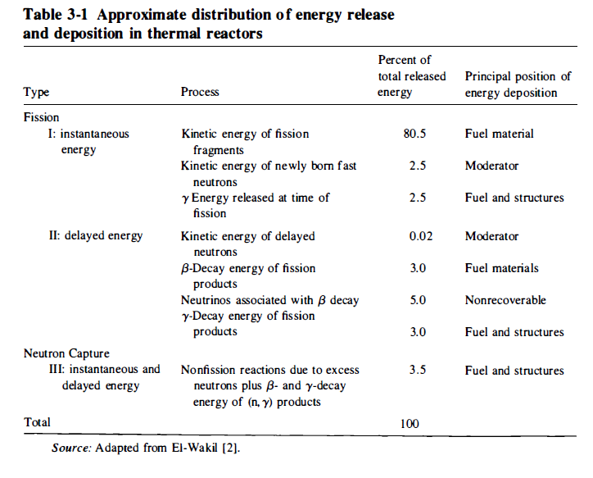
Fission Heat Release

Slide 21
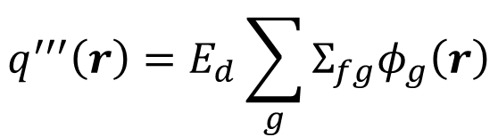


Volumetric heat generation in thermal reactor
$$q^{′′′}\left(r\right)=E_{d}{\overline{Σ}}_{fr}φ_{T}\left(r\right)$$
$E_{d}$ – Energy deposited
${\overline{Σ}}_{fr}$ - Thermal fission cross section
$φ_{T}\left(r\right)$ - Thermal neutron flux
For multigroup
$$q^{′′′}\left(r\right)=E_{d}\sum_{g}{Σ_{fg}φ_{g}\left(r\right)}$$

Slide 22
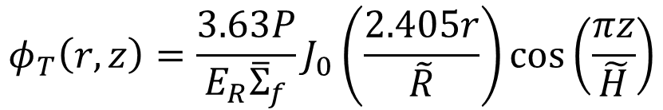
Neutron flux for bare, finite cylinder
$$φ_{T}\left(r,z\right)=\frac{3.63P}{E_{R}{\overline{Σ}}_{f}}J_{0}\left(\frac{2.405r}{\tilde{R}}\right)\cos\left(\frac{πz}{\tilde{H}}\right)$$
P is the total power of the reactor
E_{R} is the recoverable energy per fission in joules,
Flux profile sinusoidal axially, Bessel function radially

Slide 23
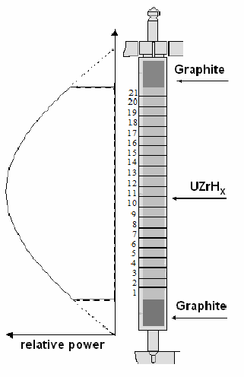

Slide 24
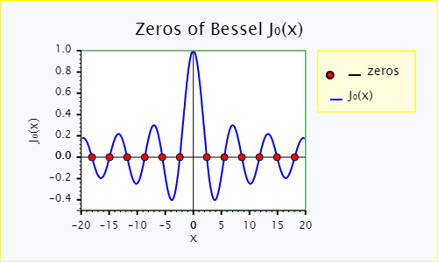
Bessel Function

Slide 25

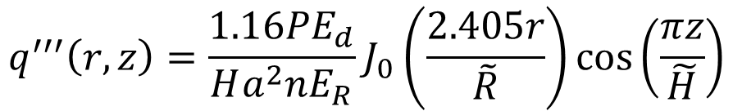
Volumetric heat release
$$q^{′′′}\left(r,z\right)=\frac{1.16PE_{d}}{Ha^{2}nE_{R}}J_{0}\left(\frac{2.405r}{\tilde{R}}\right)\cos\left(\frac{πz}{\tilde{H}}\right)$$
Max heat release
$$q_{\text{max}}^{′′′}\left(r,z\right)=\frac{1.16PE_{d}}{Ha^{2}nE_{R}}$$

Slide 26
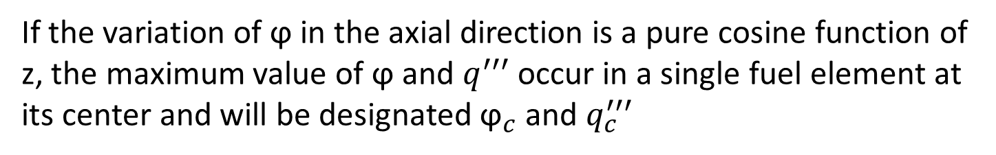
Heat generated by a single fuel element
The neutron flux in a single fuel element is not constant.
The axial variations in flux, and consequently volumetric thermal source strength, however, follow those in the core at the position where the fuel element is, and must be taken into account.
If the variation of ϕ in the axial direction is a pure cosine function of z, the maximum value of ϕ and $q^{′′′}$ occur in a single fuel element at its center and will be designated ${\text{ϕ}}_{c}$ and $q_{c}^{′′′}$

Slide 27
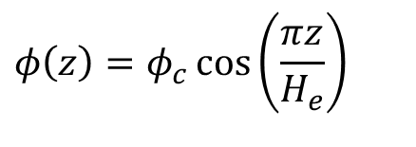
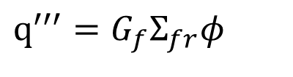

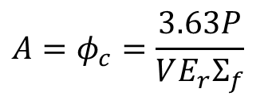
Heat Production in Fuel Elements (Fuel Rods)
Heat production per unit volume
$$q^{′′′}=G_{f}Σ_{fr}φ$$
G is the energy per reaction
In the thermal reactor
$$q^{′′′}\left(z\right)=G_{f}Σ_{fr}φ\left(z\right)$$
The spatial dependence of the flux depends on the geometry and structure of the reactor.
For the case of sinusoidal flux
$$φ\left(z\right)=​​​​​​​​​​​​​​​​​​​​​φ_{c}\cos\left(\frac{πz}{H_{e}}\right)$$
$$A=​​​​​​​​​​​​​​​​​​​​​φ_{c}=\frac{3.63P}{VE_{r}Σ_{f}}$$

Slide 28

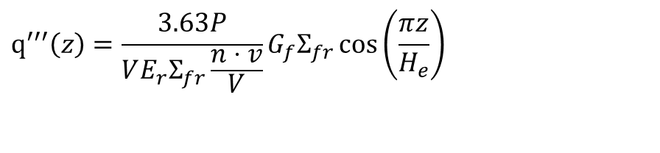
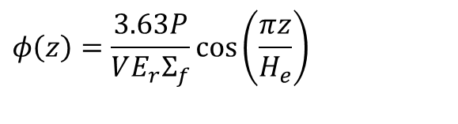

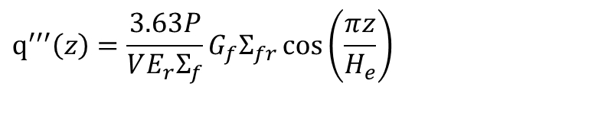
$$φ\left(z\right)=\frac{3.63P}{VE_{r}Σ_{f}}\cos\left(\frac{πz}{H_{e}}\right)$$
P is the total power of the reactor
E_{R} is the recoverable energy per fission in joules,
V is the fuel volume in cm³ , and
are its outer dimensions in centimeters to the
extrapolated boundaries
$$R_{e} \text{and} H_{e}$$
$$q^{′′′}\left(z\right)=\frac{3.63P}{VE_{r}Σ_{f}}G_{f}Σ_{fr}\cos\left(\frac{πz}{H_{e}}\right)$$
$$q^{′′′}\left(z\right)=G_{f}Σ_{fr}φ\left(z\right)$$
$$v \text{is} \text{the} \text{reactor} \text{rod} \text{volume} \left(πHa^{2}\right)\text{ \& }V \text{is} \text{the} \text{reactor} \text{volume} \left(πHR^{2}\right)$$
$$q^{′′′}\left(z\right)=\frac{3.63P}{VE_{r}Σ_{fr}\frac{n⋅v}{V}}G_{f}Σ_{fr}\cos\left(\frac{πz}{H_{e}}\right)$$

Slide 29
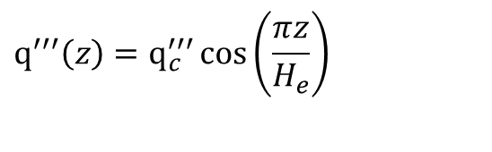
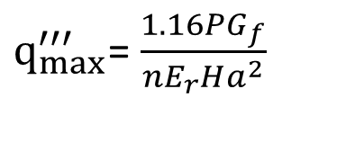
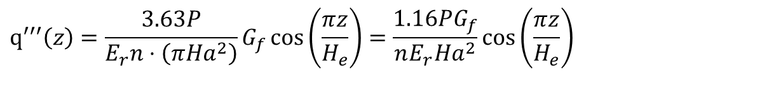
$$q^{′′′}\left(z\right)=\frac{3.63P}{E_{r}n⋅\left(πHa^{2}\right)}G_{f}\cos\left(\frac{πz}{H_{e}}\right)=\frac{1.16PG_{f}}{nE_{r}Ha^{2}}\cos\left(\frac{πz}{H_{e}}\right)$$
The heat production occurs in the middle z=0 of the central rod (R=0)
$q_{max}^{′′′}$= $\frac{1.16PG_{f}}{nE_{r}Ha^{2}}$
The maximum rate of heat production in a noncentral rod located at r not equal to zero
$$q^{′′′}\left(z\right)=q_{c}^{′′′}\cos\left(\frac{πz}{H_{e}}\right)$$
The total rate at which heat is produced in any fuel rod is given by the integral (Ref. El Wakil)

Slide 30
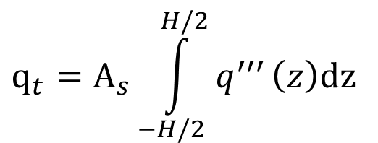
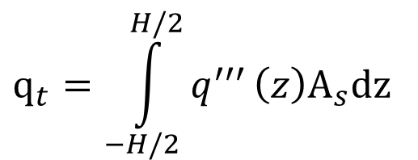
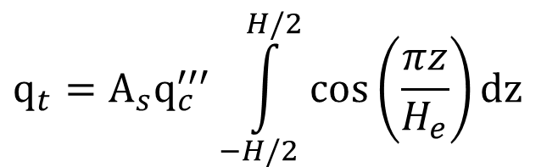

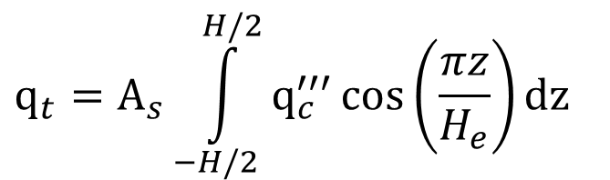
$$q_{t}=\int_{−H/2}^{H/2}{q^{′′′}}\left(z\right)A_{s}dz$$
$$A_{s}=πa^{2}$$
$$q_{t}=A_{s}\int_{−H/2}^{H/2}{q^{′′′}}\left(z\right)dz$$
$$q_{t}=A_{s}\int_{−H/2}^{H/2}{q_{c}^{′′′}\cos\left(\frac{πz}{H_{e}}\right)}dz$$
$$q_{t}=A_{s}q_{c}^{′′′}\int_{−H/2}^{H/2}{\cos\left(\frac{πz}{H_{e}}\right)}dz$$

Slide 31
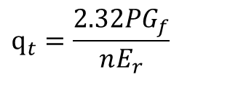
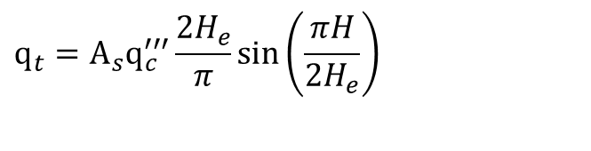
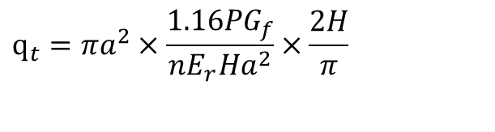
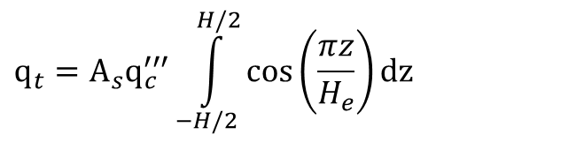
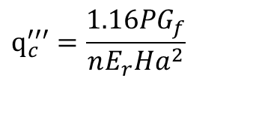


$$q_{t}=A_{s}q_{c}^{′′′}\int_{−H/2}^{H/2}{\cos\left(\frac{πz}{H_{e}}\right)}dz$$
$$q_{t}=A_{s}q_{c}^{′′′}\frac{2H_{e}}{π}\sin\left(\frac{πH}{2H_{e}}\right)$$
Where the extrapolation lengths may be neglected, this equation reduces to
$$A=​​​​​​​​​​​​​​​​​​​​​φ_{c}=\frac{3.63P}{VE_{r}Σ_{f}}$$
This equation used to approximate the flux in a reactor where the fuel is contained in separate fuel rods,
$$q_{c}^{′′′}=\frac{1.16PG_{f}}{nE_{r}Ha^{2}}$$
$$A_{s}=πa^{2}$$
$$q_{t}=πa^{2}×\frac{1.16PG_{f}}{nE_{r}Ha^{2}}×\frac{2H}{π}$$
$$q_{t}=\frac{2.32PG_{f}}{nE_{r}}$$

Slide 32
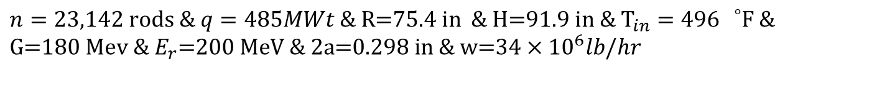
Exercise 1
A small PWR plant operates at a power of 485 MWt. The core, which is approximately 75.4 in. in diameter and 91.9 in high, consists of a square lattice of 23,142 fuel tubes of thickness 0.021 in and inner diameter of 0.298 in. The tubes are filled with 3.40 w/o-enriched U0₂ . The core is cooled by water, which enters at the bottom at 496°F and passes through the core at a rate of 34 x 10⁶ lb/hr at 2,015 psia. Compute
the average temperature of the water leaving the core;
the average power density in kW/liter;
(c) the maximum heat production rate, assuming the reactor core is bare.
$$n=23,142 \text{rods}\text{ \& }q=485MWt\text{ \& }\text{R}\text{=75.4 }\text{in}\text{ \& }\text{H}\text{=91.9 }\text{in}\text{ \& }{\text{T}}_{in}=496 {}_{}^{∘}{\text{F}\text{ \&}} \\ \text{G}\text{=180 }\text{Mev}\text{ \& }E_{r}\text{=200 }\text{MeV}\text{ \& }\text{2}\text{a}\text{=0.298 }\text{in}\text{ \& }\text{w}\text{=34}×\text{1}{\text{0}}^{6}lb/hr$$

Slide 33
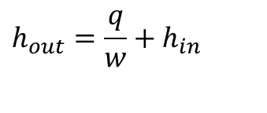

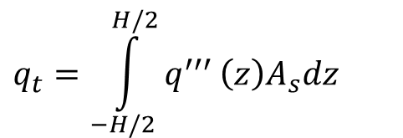
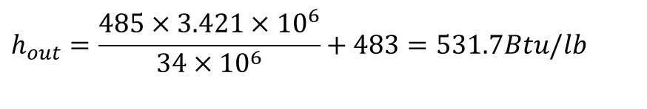
the average temperature of the water leaving the core;
$$q=w\left(h_{out}−h_{in}\right)$$
$$h_{out}=\frac{q}{w}+h_{in}$$
$$q_{t}=\int_{−H/2}^{H/2}{q^{′′′}}\left(z\right)A_{s}dz$$
$$h_{out}=\frac{485×3.421×10^{6}}{\text{34}×\text{1}{\text{0}}^{6}}+483=531.7Btu/lb$$
$$when h_{out}=531.7Btu/Ib ⇒T_{out}\text{= 536.2 }°\text{F}$$

Slide 34
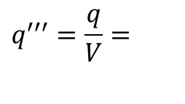
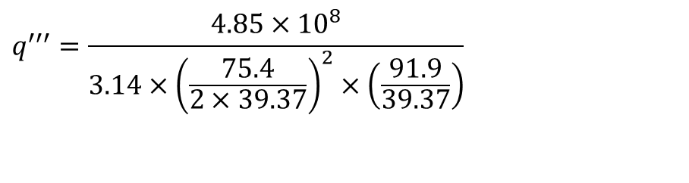
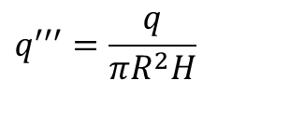
(b) the average power density in kW/liter;
$$q^{′′′}=\frac{q}{V}=$$
$$q^{′′′}=\frac{q}{πR^{2}H}$$
$$q^{′′′}=\frac{4.85×10^{8}}{3.14×{\left(\frac{75.4}{2×39.37}\right)}^{2}×\left(\frac{91.9}{39.37}\right)}$$
$$q^{′′′}=\text{72125}.\text{68 }\text{kW}\text{/}{\text{m}}^{3}=\text{72.12 }\text{kW}\text{/}\text{L}$$

Slide 35



(c) the maximum heat production rate, assuming the reactor core is bare.
$$q_{c}^{′′′}=\frac{1.16PG_{f}}{nE_{r}Ha^{2}}$$
$$q_{c}^{′′′}=\frac{1.16×(4.85×10^{8}×3.42)×180}{23142×200×\left(\frac{91.9}{12}\right)×{\left(\frac{0.298}{12×2}\right)}^{2}}$$
$$q_{c}^{′′′}=6.54×10^{7}Btu/hr.ft^{3}$$

Slide 36


Slide 37


Slide 38



Slide 39


The total heat generated in core- general
The individual fuel elements in a heterogeneous core are subjected to different values of:
Midplane Neutron flux
Midplane Volumetric thermal source strengths
$$φ_{c}$$
$${q_{c}}^{′′′}$$
In a homogeneous core, there are no individual fuel elements.

Slide 40
The total heat generated in core-general
However, the two cases can be treated in a like manner, provided that
The number of fuel elements in the heterogeneous core is sufficiently large.
The fuel type and enrichment do not vary in the heterogeneous reactor

