Slide 1
SKTN 2393 Numerical Methods for Nuclear Engineers
Chapter 8
Ordinary Differential Equations
Initial Value Problems & Boundary Value Problems
Mohsin Mohd Sies
Nuclear Engineering,
School of Chemical and Energy Engineering,
Universiti Teknologi Malaysia

Slide 2

Differential Equation
Differential Equation – composed of an unknown function & its derivatives
1 independent variable – ODE (ordinary diff. eq)
More than 1 independent variable – PDE (partial diff. eqn.)
$$\frac{dv}{dt}=g−\frac{c}{m}v$$
v = unknown function (dependent variable)
t = independent variable

Slide 3
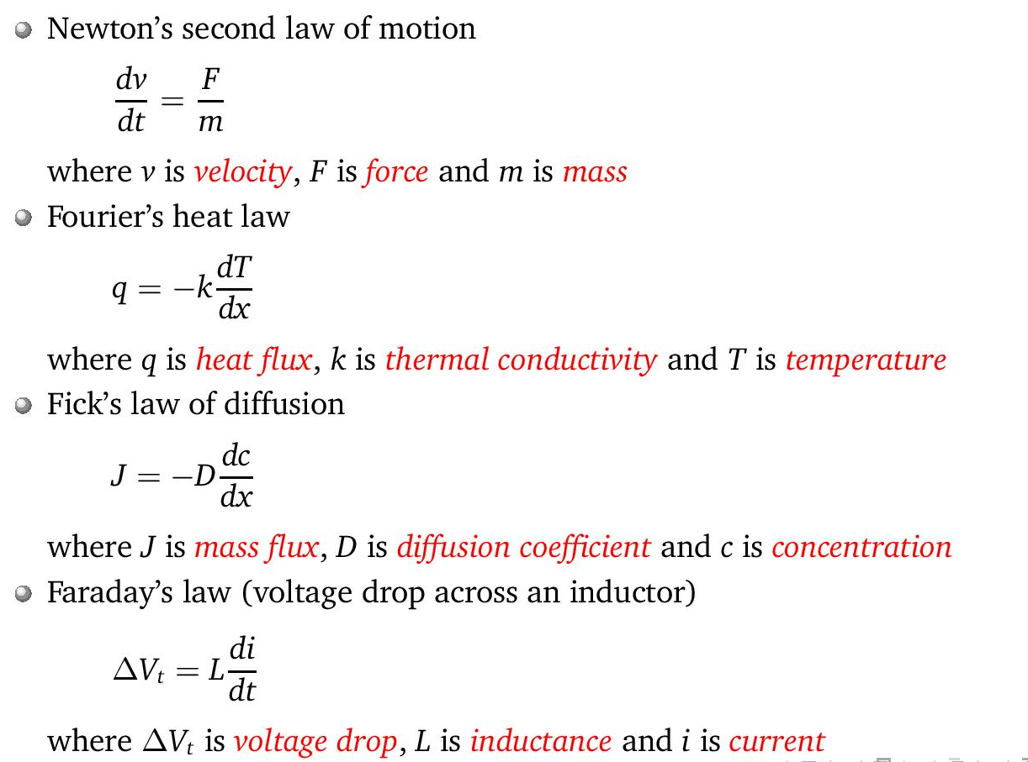
Sample Engineering Problems

Slide 4

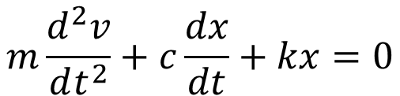


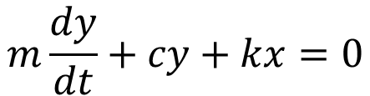



Order of Diff. Eqn.
Order – highest order of derivative present
Reducing higher order to 1st order eqns.
Define new variable
getting
$$\frac{dv}{dt}=g−\frac{c}{m}v$$
$$\text{1}\text{st} \text{order} \text{ODE}$$
$$m\frac{d^{2}v}{dt^{2}}+c\frac{dx}{dt}+kx=0$$
$$\text{2}\text{nd} \text{order} \text{ODE}$$
$$y=\frac{dx}{dt}$$
$$m\frac{dy}{dt}=\frac{d^{2}x}{dt^{2}}$$
$$\text{so}$$
$$m\frac{dy}{dt}+cy+kx=0$$

Slide 5


Linearity
Linear ODE is of form
Linear because no products or nonlinear functions (sin, cos etc.) of the dependent variable y & its derivatives
Linear ODE can be solved analytically
Linearize (if possible) nonlinear ODE to solve analytically
Many diff. eqn. in engineering cannot be solved analytically
$$a_{n}\left(x\right)y^{(n)}+⋯+a_{1}\left(x\right)y^{′}+a_{0}\left(x\right)y=f(x)$$
$$y^{\left(n\right)}=n^{th} \text{derivative} \text{of} \text{y}$$
$$a\left(x\right), f\left(x\right)=\text{functions} \text{of} \text{x}$$

Slide 6


Homogeneity
$$a_{n}\left(x\right)y^{(n)}+⋯+a_{1}\left(x\right)y^{′}+a_{0}\left(x\right)y=f(x)$$
$$f\left(x\right)=0$$
homogeneous
$$f\left(x\right)≠0$$
Non-homogeneous

Slide 7
Conditions
When integrating, an arbitrary constant c is introduced
Infinite number of solutions that can satisfy integral (solution not unique)
Need auxiliary conditions to find unique sol'n (initial condition, boundary conditions)

Slide 8
Initial Condition
Also known as initial value
Condition of y specified at x=0
For n^{th} order ODE; need n conditions
If all conditions specified at x=0; initial value problem (IVP)
If conditions specified at various values of x; boundary value problem (BVP)
IVP; many cases we know initial conditions & want to know how the system progresses
Artillery (ballistics), tsunami, heat transfer, string wave, etc.

Slide 9
Systems of Equations
Many practical problems in engineering and science require the solution of a system of simultaneous ordinary differential equations rather than a single equation:
Solution requires that n initial conditions be known at the starting value of x.

Slide 10
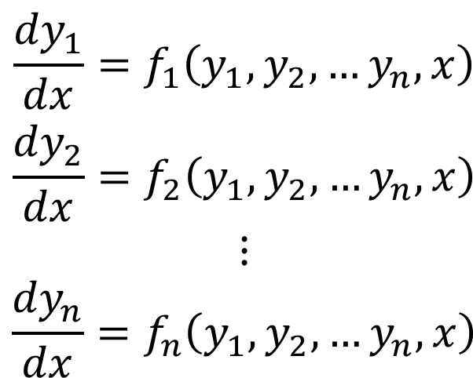
Canonical Form
Simultaneous Diff. Eq. – derivative term is explicit on the left hand side
$$\begin{aligned}\frac{{dy}_{1}}{dx}=f_{1}\left(y_{1},y_{2},…y_{n},x\right) \\ \frac{{dy}_{2}}{dx}=f_{2}\left(y_{1},y_{2},…y_{n},x\right) \\ ⋮ \\ \frac{{dy}_{n}}{dx}=f_{n}\left(y_{1},y_{2},…y_{n},x\right)\end{aligned}$$
Solution methods are based on this form

Slide 11
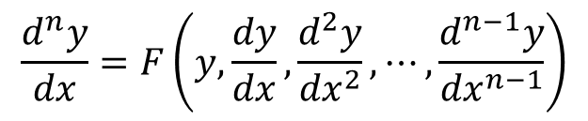
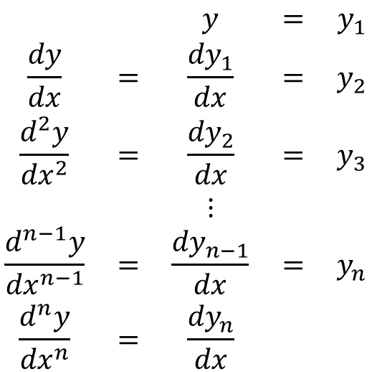
Higher order differential equations can be transformed into canonical form and become a set of simultaneous 1st order differential equations
Written as
Using transformation
$$a_{n}\left(x\right)\frac{d^{n}y}{{dx}^{n}}+a_{n−1}\left(x\right)\frac{d^{n−1}y}{{dx}^{n−1}}+⋯+a_{1}\left(x\right)\frac{dy}{dx}+a_{0}\left(x\right)y=g\left(x\right)$$
$$\frac{d^{n}y}{dx}=F\left(y,\frac{dy}{dx},\frac{d^{2}y}{{dx}^{2}},⋯,\frac{d^{n−1}y}{{dx}^{n−1}}\right)$$
$$\begin{matrix} & & y & = & y_{1} \\ \frac{dy}{dx} & = & \frac{{dy}_{1}}{dx} & = & y_{2} \\ \frac{d^{2}y}{{dx}^{2}} & = & \frac{{dy}_{2}}{dx} & = & y_{3} \\ & & ⋮ & & \\ \frac{d^{n−1}y}{{dx}^{n−1}} & = & \frac{{dy}_{n−1}}{dx} & = & y_{n} \\ \frac{d^{n}y}{{dx}^{n}} & = & \frac{{dy}_{n}}{dx} & & \end{matrix}$$

Slide 12



Get a set of canonical form
Using vector notation
$$\begin{matrix}\frac{{dy}_{1}}{dx} & = & f_{1}\left(y_{1},y_{2},…y_{n},x\right) & = & y_{2} \\ \frac{{dy}_{2}}{dx} & = & f_{2}\left(y_{1},y_{2},…y_{n},x\right) & = & y_{3} \\ \frac{{dy}_{n−1}}{dx} & = & f_{n−1}\left(y_{1},y_{2},…y_{n},x\right) & = & y_{n} \\ & & ⋮ & & \\ \frac{{dy}_{n}}{dx} & = & f_{n}\left(y_{1},y_{2},…,y_{n},x\right) & = & F\left(y_{1},y_{2},…,y_{n},x\right)\end{matrix}$$
$$\frac{d\vec{y}}{dx}=\vec{f}\left(\vec{y},x\right)$$
$$\vec{y}=\left[\begin{aligned}y_{1} \\ y_{2} \\ ⋮ \\ y_{n}\end{aligned}\right] , \vec{f}=\left[\begin{aligned}f_{1} \\ f_{2} \\ ⋮ \\ f_{n}\end{aligned}\right]$$

Slide 13
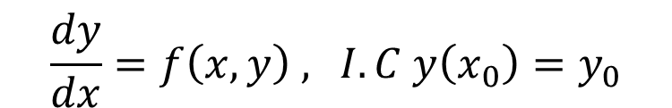
Solution concept
Consider single 1st order diff. eq
2 solution approaches
Integrating function f(x,y) using numerical integration
Finite difference approximation of the derivatives (our focus)
Euler's methods
Runge-Kutta methods
Multistep methods
$$\frac{dy}{dx}=f\left(x,y\right) \text{, }I.C y\left(x_{0}\right)=y_{0}$$

Slide 14
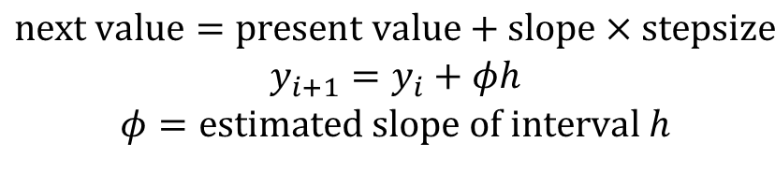
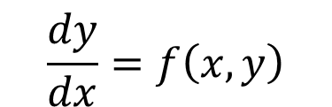
Euler's Method
Actually a subset of Runge-Kutta
Simplest & oldest
But error accumulates & solution deviates more & more (so not commonly used)
We are trying to solve
Numerical scheme
Done step by step to trace progression of solution
Different methods use different ways to estimate slope
$$\frac{dy}{dx}=f\left(x,y\right)$$
$$\begin{aligned}\text{ne}\text{xt} \text{value}=\text{present} \text{value}+\text{slope}×\text{stepsize} \\ y_{i+1}=y_{i}+φh \\ φ=\text{estimated} \text{slope} \text{of} \text{interval} h\end{aligned}$$

Slide 15
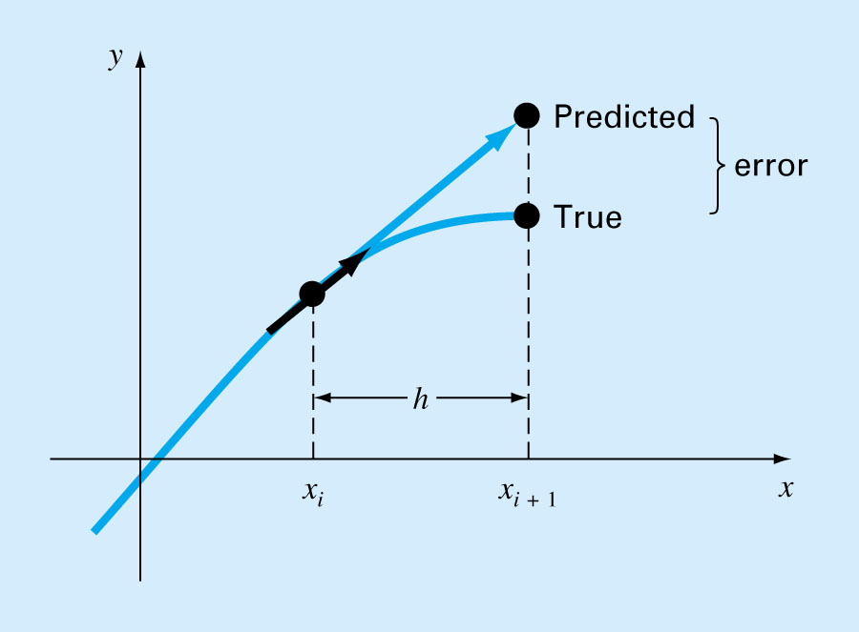

Slide 16
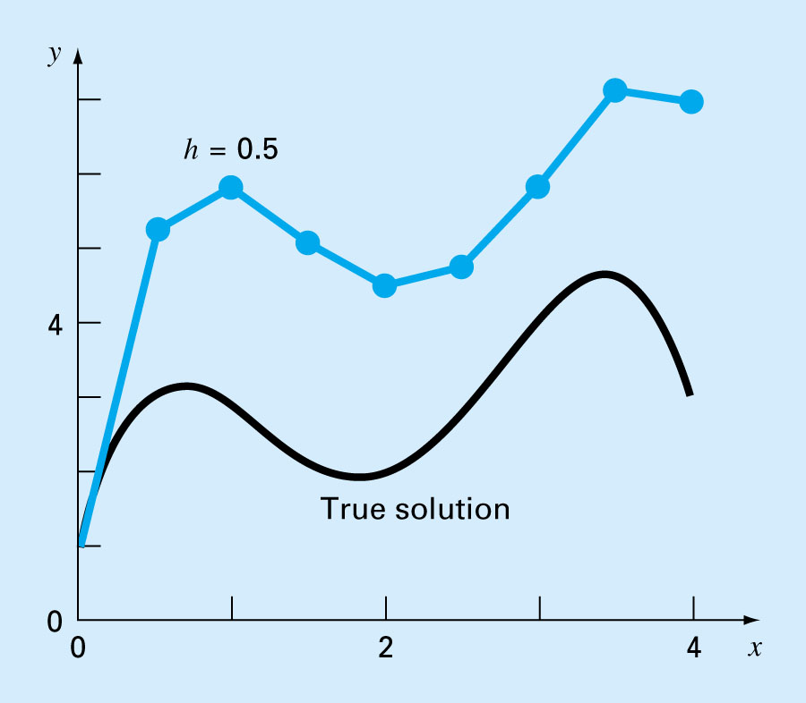
Solution Progress

Slide 17
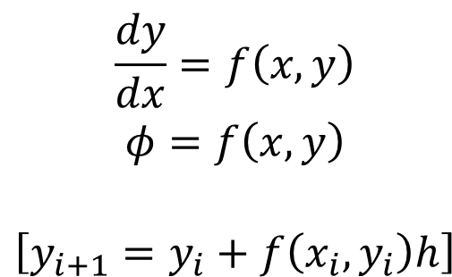
Euler-Cauchy/Point Slope Method
Slope at i used for whole interval h
If Diff. Eq is
$$\begin{aligned}\frac{dy}{dx}=f\left(x,y\right) \\ φ=f\left(x,y\right) \\ \\ \left[y_{i+1}=y_{i}+f\left(x_{i},y_{i}\right)h\right]\end{aligned}$$
Already the expression of slope!
That is why we use the canonical form

Slide 18
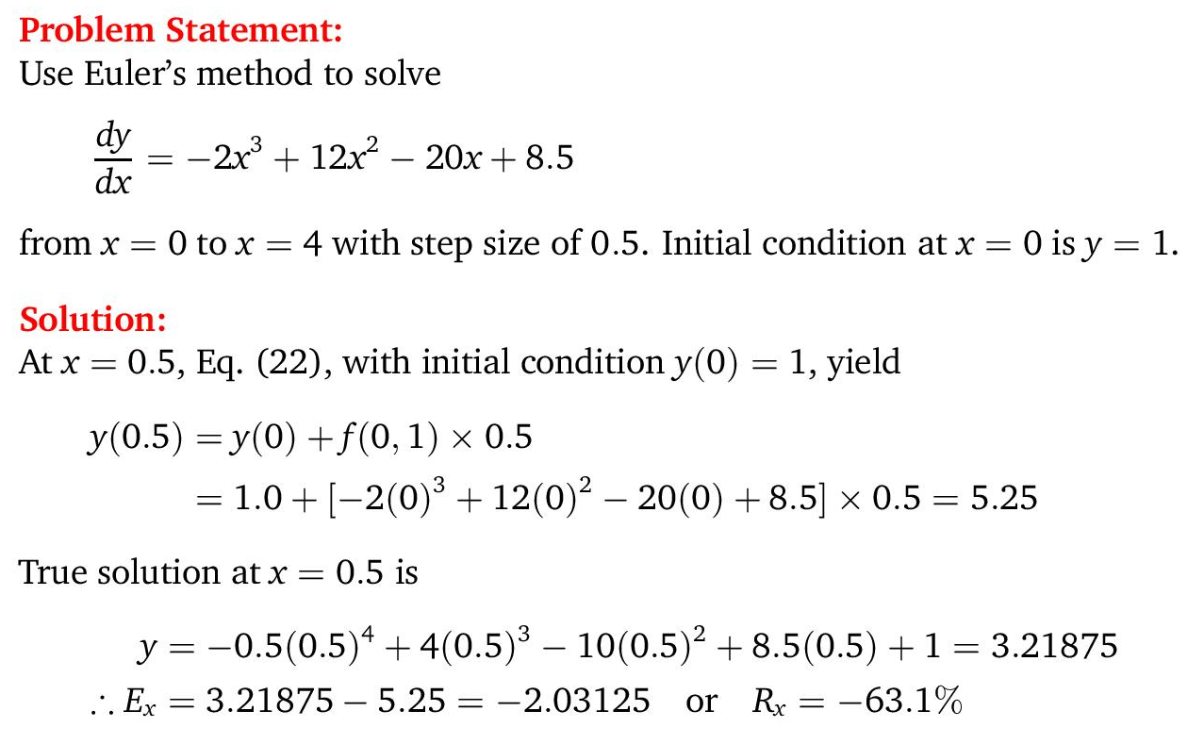
Example

Slide 19
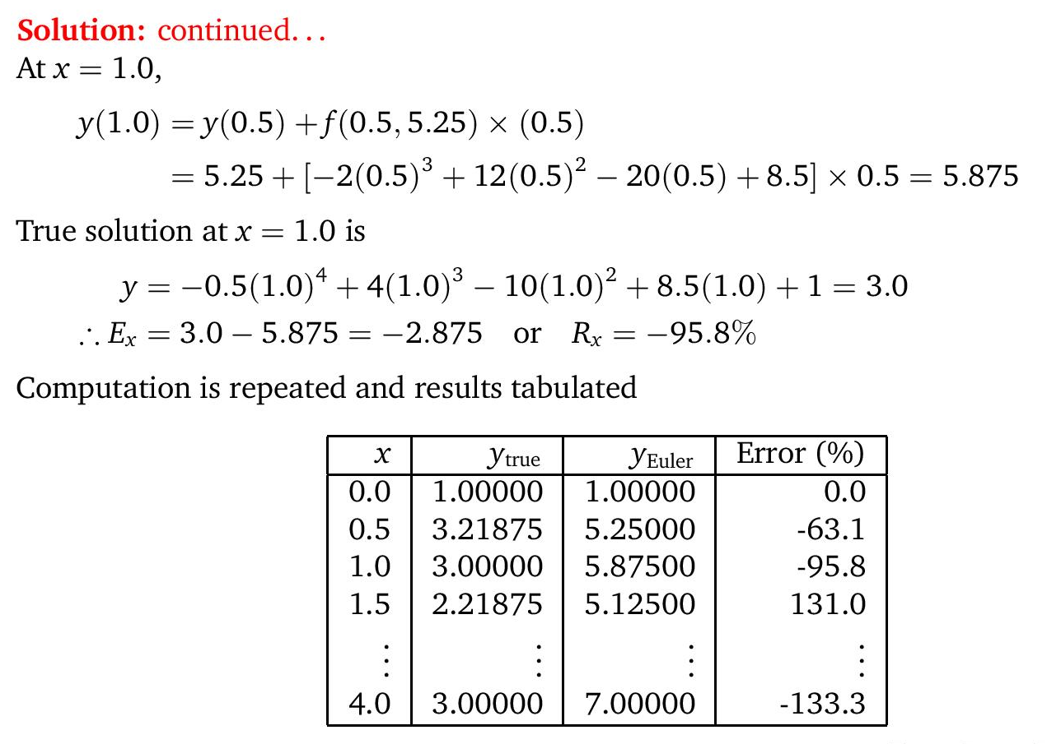
Example

Slide 20
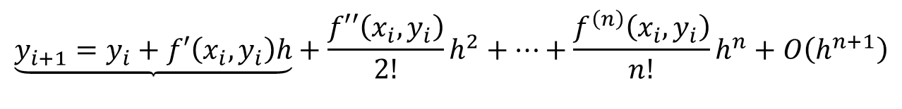
Euler's Method
Can also be derived from Taylor's series
Reduce error by
Reducing stepsize (until roundoff error dominates)
Taking more terms in Taylor series (reduce truncation error)
  Higher order derivatives from chain rule
  Gets more complicated very quickly
Use other methods (other estimates of slope)
$$\underset{}{\underbrace{y_{i+1}=y_{i}+f′\left(x_{i},y_{i}\right)h}}+\frac{f′′\left(x_{i},y_{i}\right)}{2!}h^{2}+…+\frac{f^{\left(n\right)}\left(x_{i},y_{i}\right)}{n!}h^{n}+O\left(h^{n+1}\right)$$

Slide 21
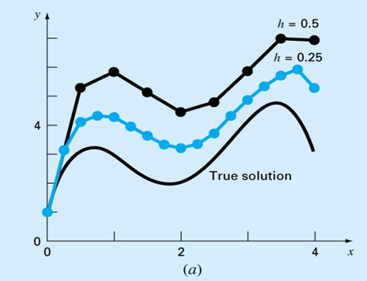
Reducing Stepsize to Improve Accuracy

Slide 22
Heun's Method (predictor-corrector)
Use average of slopes at both ends of interval
Know slope at i
Extrapolate linearly to estimate y_{i+1} (predictor)
Use prediction to estimate slope at i+1
Get average of slopes
Use average of slopes in Euler's equation (corrector)

Slide 23
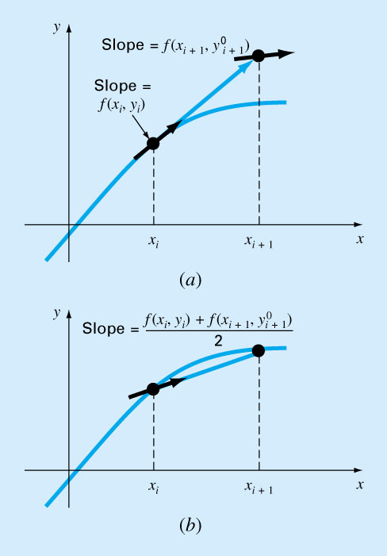
Heun's Method

Slide 24
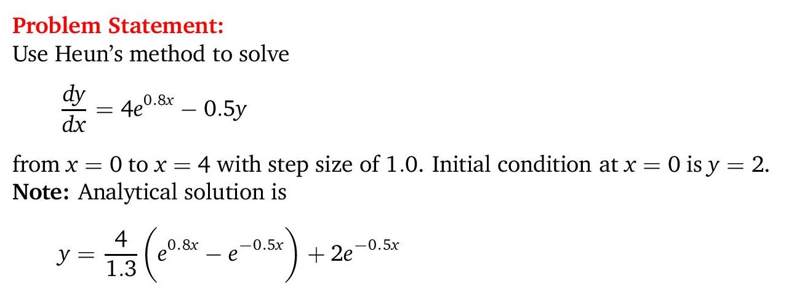
Example

Slide 25
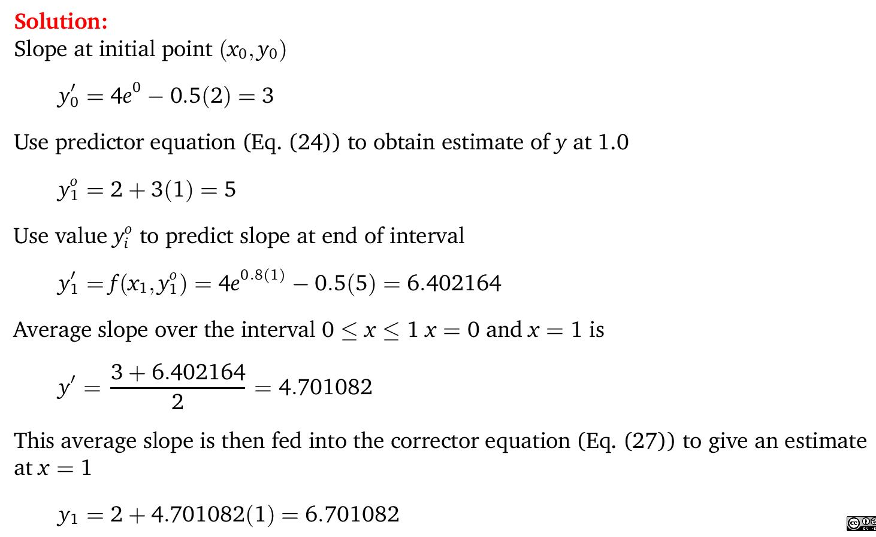
Example

Slide 26
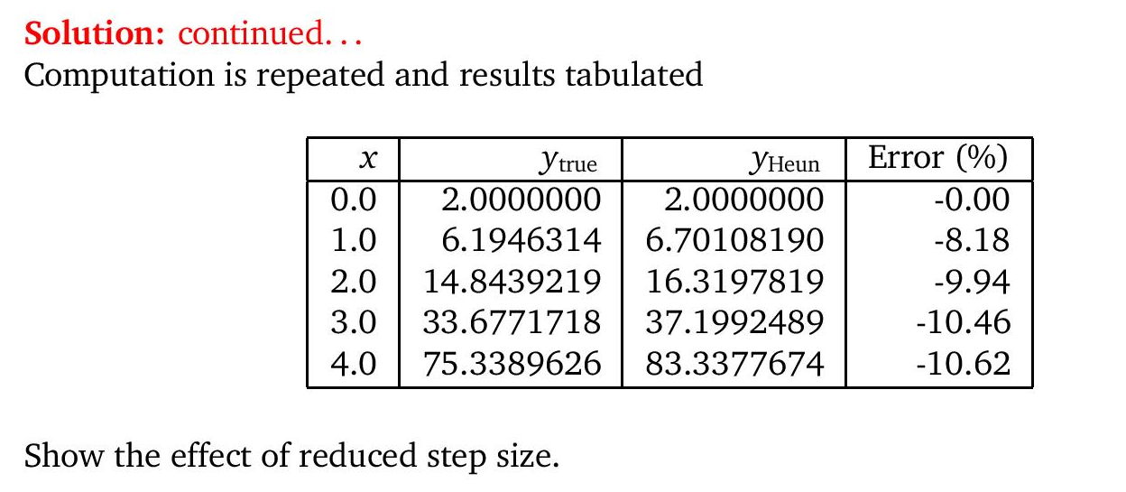
Example

Slide 27
Midpoint Method
Also known as Improved Polygon Method
Use slope at midpoint for whole interval
Use Euler's method to predict y at midpoint of interval
Use this value to estimate slope at midpoint
Use this slope for whole interval in Euler's method

Slide 28
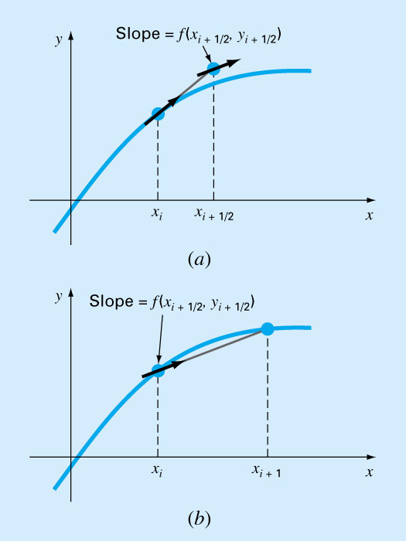
Midpoint Method

Slide 29
Runge-Kutta Methods (RK)
Taylor series method requires computing derivatives of f(x,y)
RK methods do not require it, but gives equivalent accuracy
RK needs only 1 initial point to start (self starting)
But RK needs to evaluate several f(x,y) for each step (slower)

Slide 30

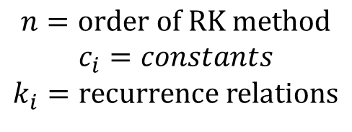
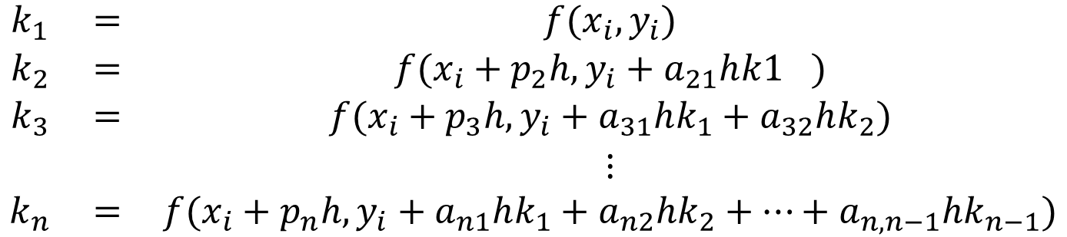
RK
General form of RK
$$y_{i+1}=y_{i}+α\left(x_{i},y_{i},h\right)h$$
$$α\left(x_{i},y_{i},h\right)= \text{increment} \text{function} ≈\text{slope} \text{of} \text{interval}$$
$$α\left(x_{i},y_{i},h\right)=c_{1}k_{1}+c_{2}k_{2}+⋯+c_{n}k_{n}$$
$$\begin{aligned}n=\text{order} \text{of} \text{RK} \text{method} \\ c_{i}=constants \\ k_{i}=\text{recurrence} \text{relations}\end{aligned}$$
$$\begin{matrix}k_{1} & = & f(x_{i},y_{i}) \\ k_{2} & = & f(x_{i}+p_{2}h,y_{i}+a_{21}h{k1}_{}) \\ k_{3} & = & f(x_{i}+p_{3}h,y_{i}+a_{31}hk_{1}+a_{32}hk_{2}) \\ & & ⋮ \\ k_{n} & = & f(x_{i}+p_{n}h,y_{i}+a_{n1}hk_{1}+a_{n2}hk_{2}+⋯+a_{n,n−1}hk_{n−1})\end{matrix}$$

Slide 31
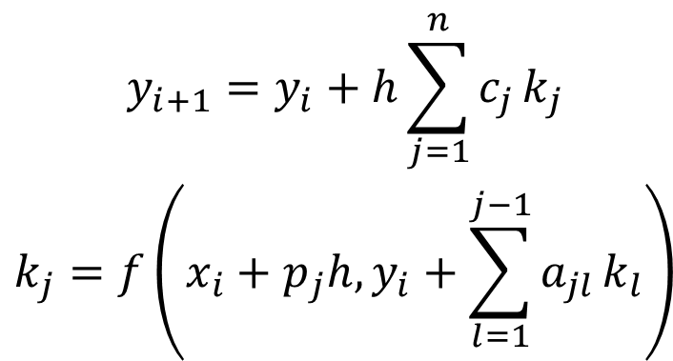
RK in Compact Form
$$\begin{aligned}y_{i+1}=y_{i}+h\sum_{j=1}^{n}{c_{j}}k_{j} \\ k_{j}=f\left(x_{i}+p_{j}h,y_{i}+\sum_{l=1}^{j−1}{a_{jl}}k_{l}\right)\end{aligned}$$
Marching Formula

Slide 32
General Procedure for RK
6 steps
Select n for desired accuracy
Use Taylor expansion using (n+1) terms
Express each derivative by f, by chain rule
Rewrite Taylor series
Rewrite RK using n terms
Expand f using Taylor series for 2 variables
Equate y_{i+1} from both approaches & get coefficients

Slide 33
2nd Order RK
From previous steps, we get 3 equations but 4 unknowns
No unique solution
Assume a value for 1 constant, and get the rest
Different methods specifies different c₂
Midpoint method; c₂=1
Heun's method; c₂=1/2
Ralston's method; c₂=2/3

Slide 34
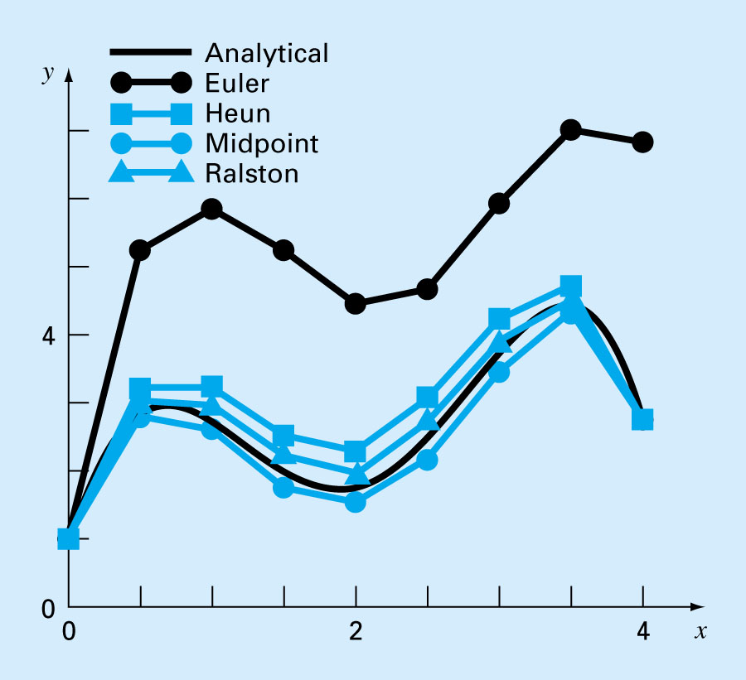
2nd Order RK

Slide 35
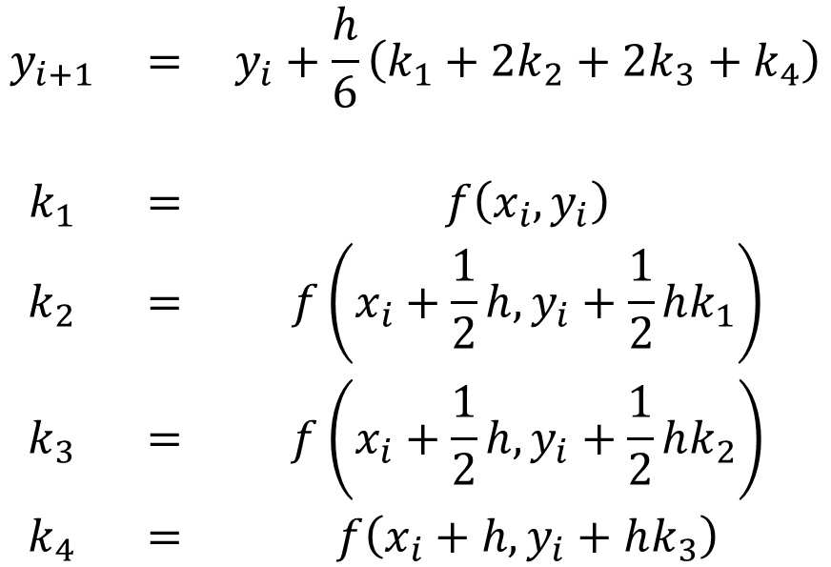
4th Order RK
Most popular, also called the classical 4th Order RK
4th order accurate
Method by Runge:
$$\begin{matrix}y_{i+1} & = & y_{i}+\frac{h}{6}\left(k_{1}+2k_{2}+2k_{3}+k_{4}\right) \\ & & \\ k_{1} & = & f\left(x_{i},y_{i}\right) \\ k_{2} & = & f\left(x_{i}+\frac{1}{2}h,y_{i}+\frac{1}{2}hk_{1}\right) \\ k_{3} & = & f\left(x_{i}+\frac{1}{2}h,y_{i}+\frac{1}{2}hk_{2}\right) \\ k_{4} & = & f\left(x_{i}+h,y_{i}+hk_{3}\right)\end{matrix}$$

Slide 36
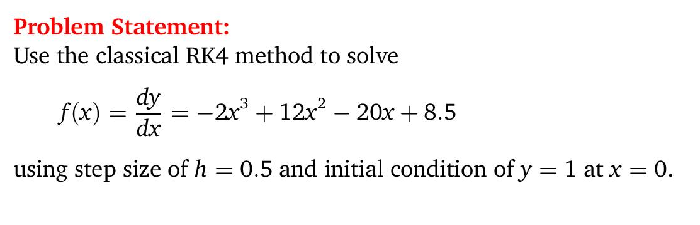
Example

Slide 37
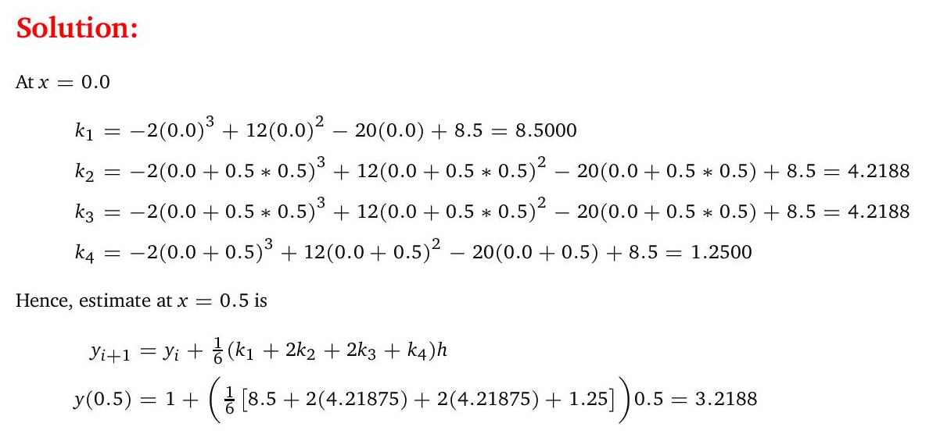
Example

Slide 38
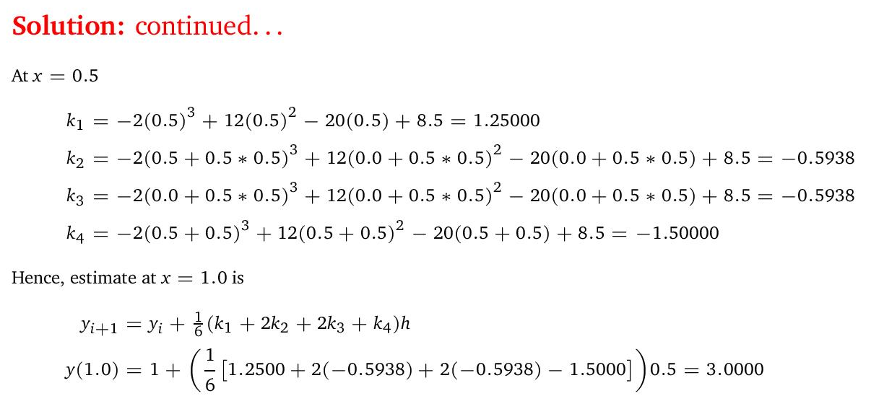
Example

Slide 39
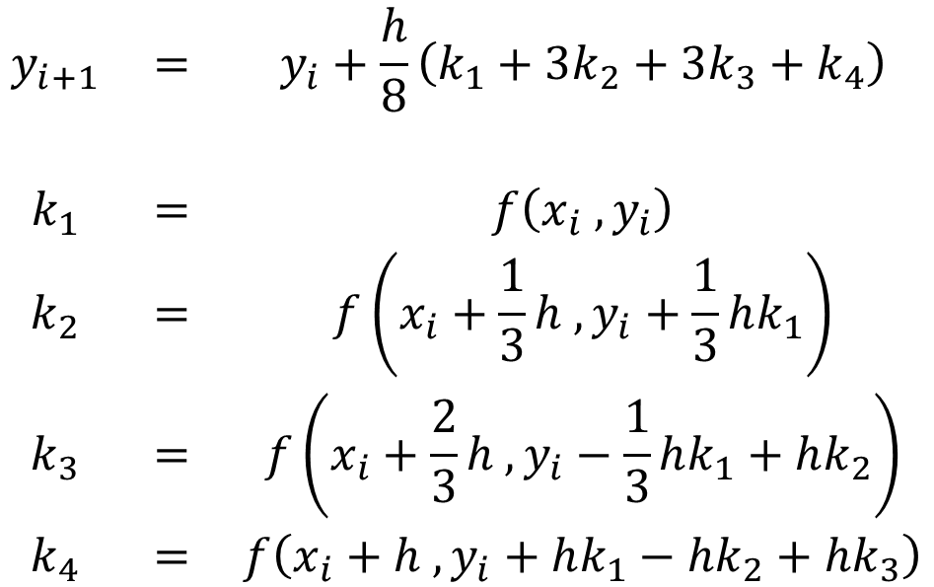
Method by Kutta
$$\begin{matrix}y_{i+1} & = & y_{i}+\frac{h}{8}\left(k_{1}+3k_{2}+3k_{3}+k_{4}\right) \\ & & \\ k_{1} & = & f\left(x_{i} ,y_{i}\right) \\ k_{2} & = & f\left(x_{i}+\frac{1}{3}h ,y_{i}+\frac{1}{3}hk_{1}\right) \\ k_{3} & = & f\left(x_{i}+\frac{2}{3}h ,y_{i}−\frac{1}{3}hk_{1}+hk_{2}\right) \\ k_{4} & = & f\left(x_{i}+h ,y_{i}+hk_{1}−hk_{2}+hk_{3}\right)\end{matrix}$$

Slide 40
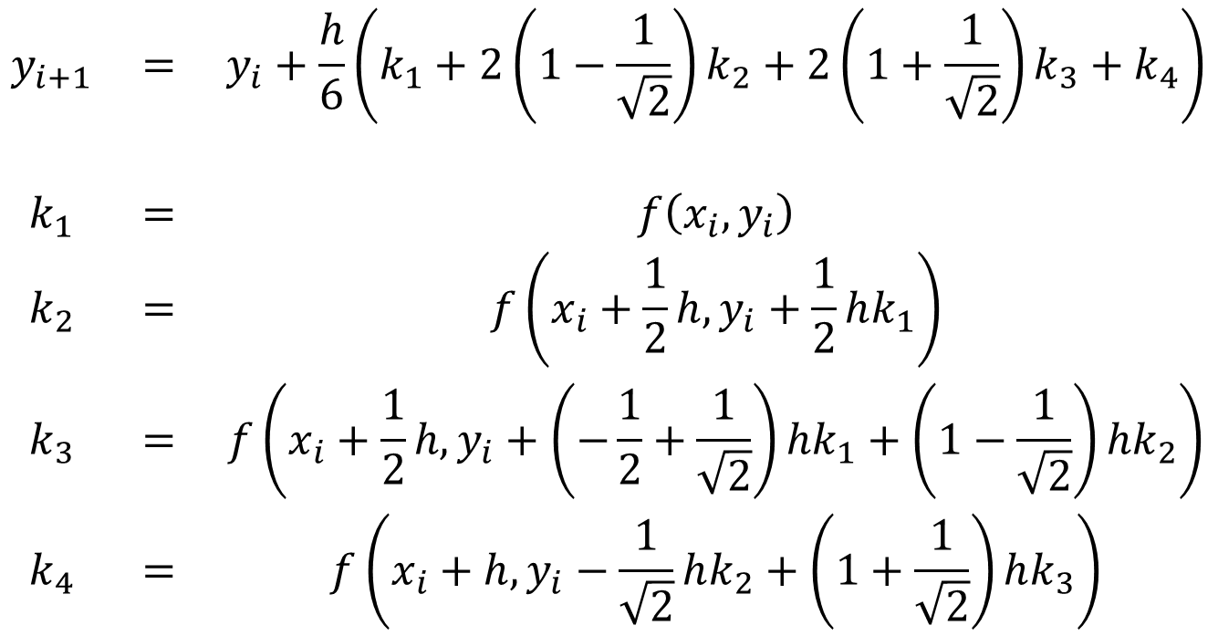
Runge-Kutta-Gill Method
$$\begin{matrix}y_{i+1} & = & y_{i}+\frac{h}{6}\left(k_{1}+2\left(1−\frac{1}{\sqrt{2}}\right)k_{2}+2\left(1+\frac{1}{\sqrt{2}}\right)k_{3}+k_{4}\right) \\ & & \\ k_{1} & = & f\left(x_{i},y_{i}\right) \\ k_{2} & = & f\left(x_{i}+\frac{1}{2}h,y_{i}+\frac{1}{2}hk_{1}\right) \\ k_{3} & = & f\left(x_{i}+\frac{1}{2}h,y_{i}+\left(−\frac{1}{2}+\frac{1}{\sqrt{2}}\right)hk_{1}+\left(1−\frac{1}{\sqrt{2}}\right)hk_{2}\right) \\ k_{4} & = & f\left(x_{i}+h,y_{i}−\frac{1}{\sqrt{2}}hk_{2}+\left(1+\frac{1}{\sqrt{2}}\right)hk_{3}\right)\end{matrix}$$

Slide 41


Example – Simultaneous ODE
Using Euler’s method as a start, for instructional purpose
Solve the following set of differential equations using Euler’s method, assuming that at x = 0, y₁ = 4, and y₂ = 6. Integrate to x = 2 with a step size of 0.5.
$$\frac{dy_{1}}{dx}=−0.5y_{1}$$
$$\frac{dy_{2}}{dx}=4−0.3y_{2}−0.1y_{1}$$

Slide 42
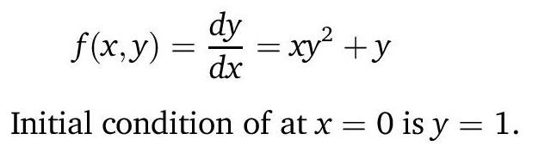
Example – Matlab/Octave (ode23, lsode)
Matlab uses ode23, Octave also has ode23 in addition to lsode to solve differential equations
Use the builtin ode23 function to solve
Comment on the slight difference in using ode23 vs lsode and warning on using ode23 in Octave

Slide 43
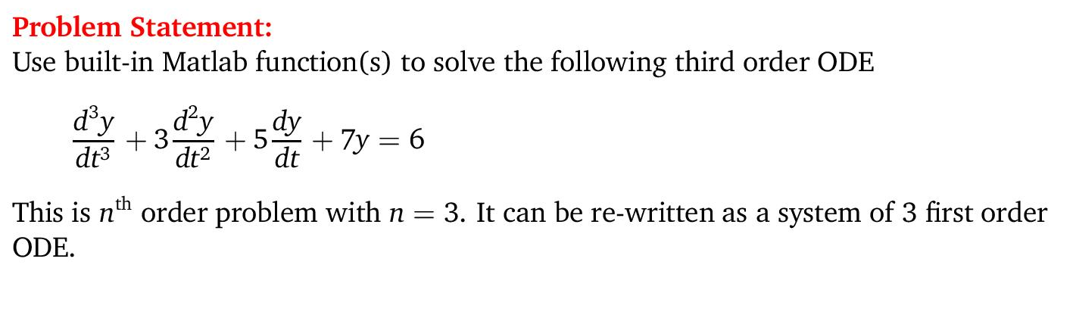
Example – Simultaneous ODE – Matlab/Octave

Slide 44
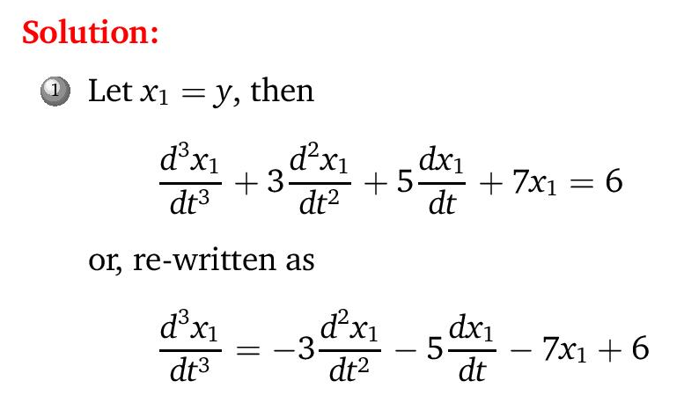
Example – Simultaneous ODE – Matlab/Octave

Slide 45
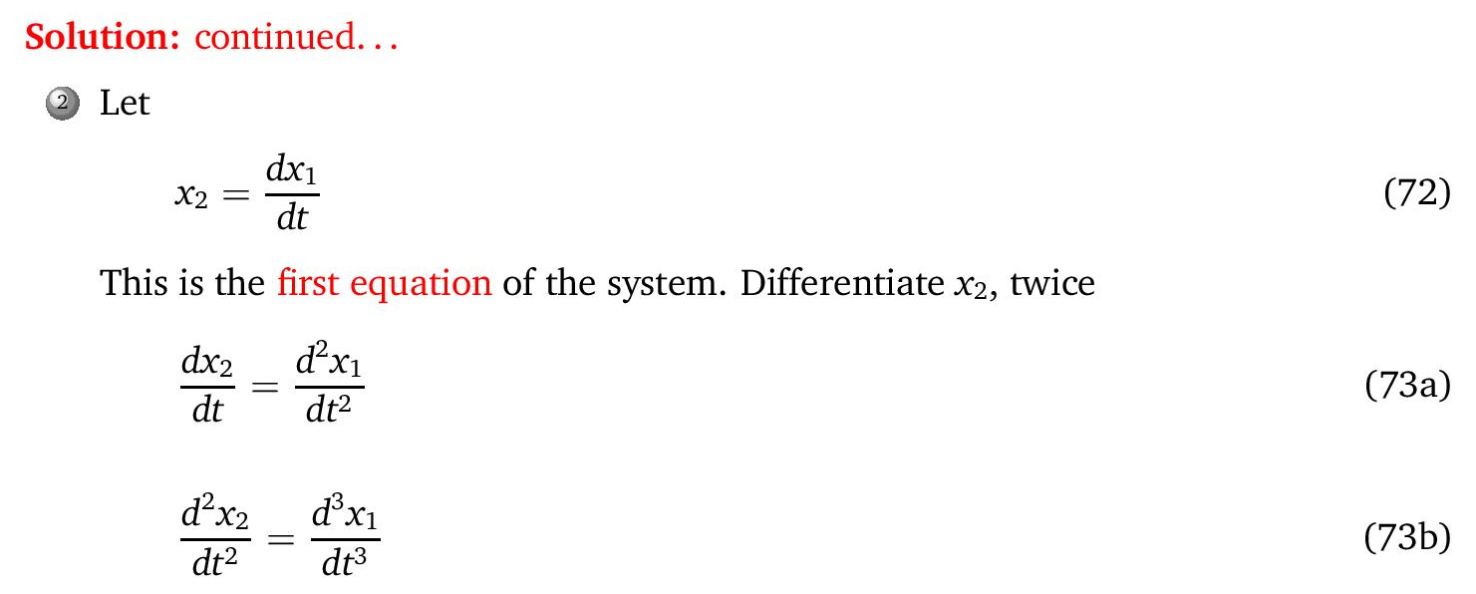
Example – Simultaneous ODE – Matlab/Octave

Slide 46
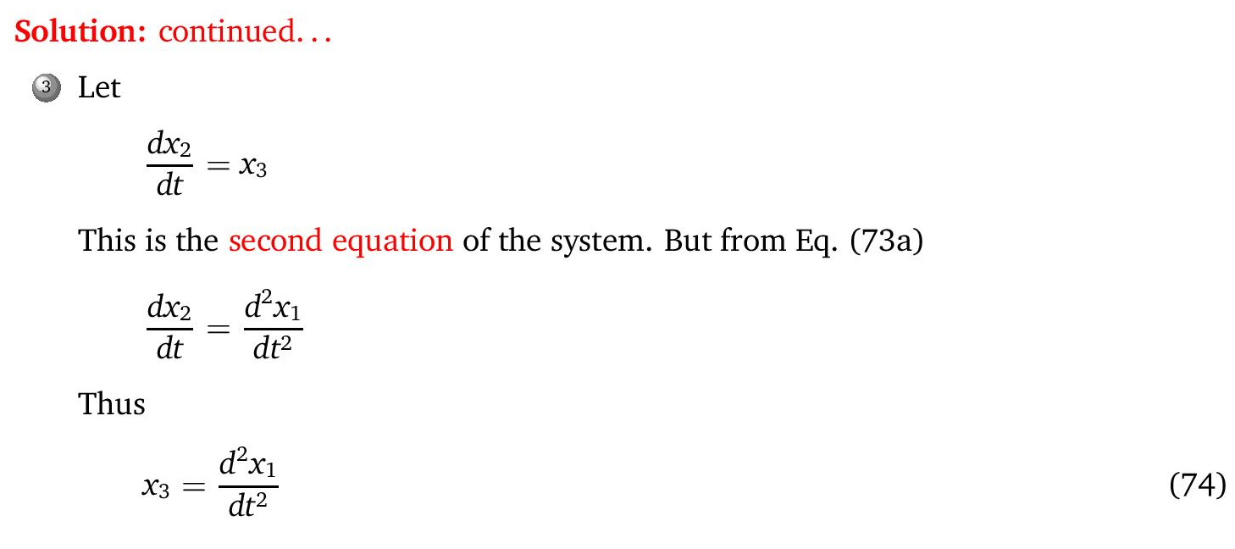
Example – Simultaneous ODE – Matlab/Octave

Slide 47
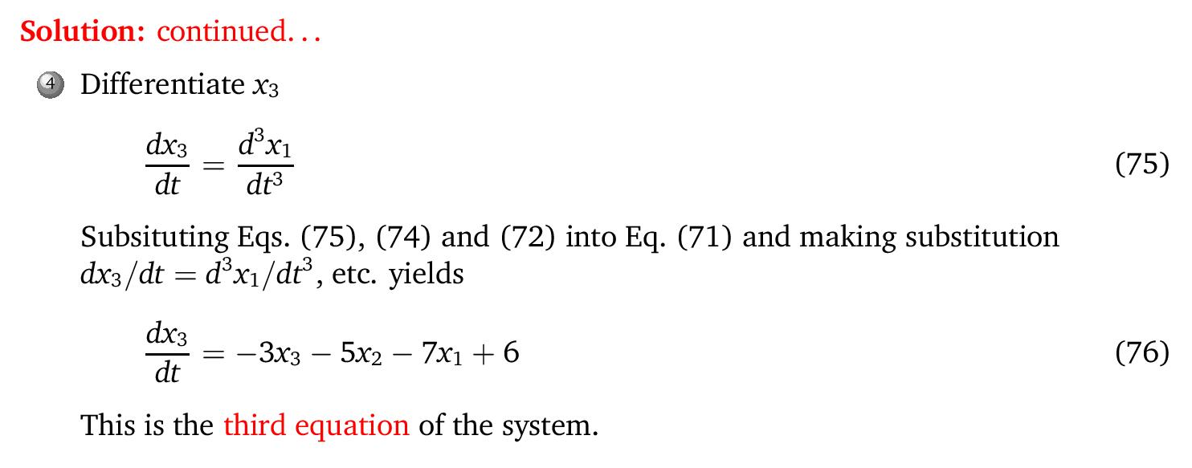
Example – Simultaneous ODE – Matlab/Octave

Slide 48
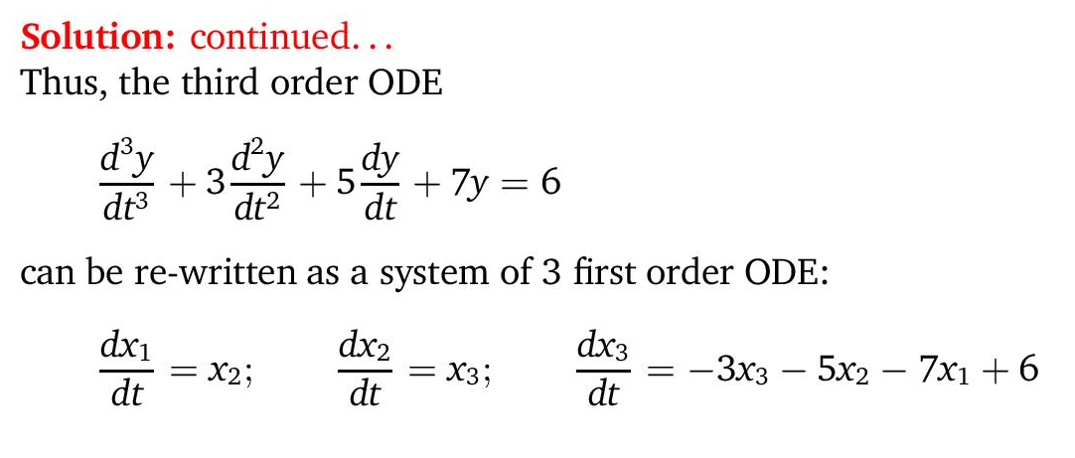
Example – Simultaneous ODE – Matlab/Octave

Slide 49
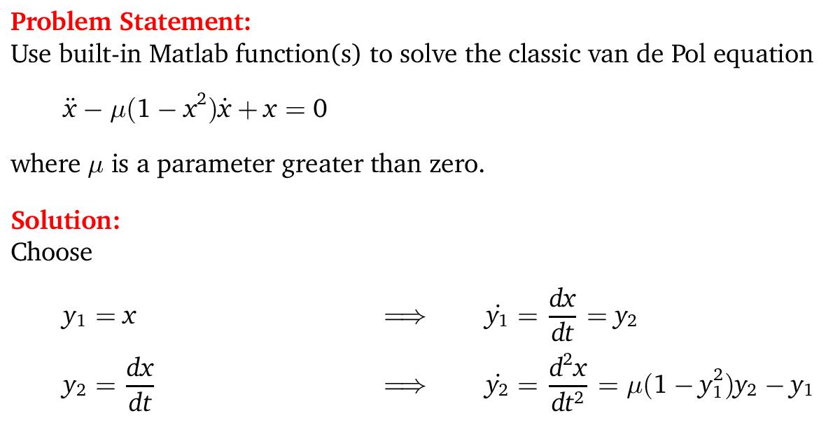
Example – Simultaneous ODE – Matlab/Octave

Slide 50
Multistep Methods
Previously, need info at single point (x_{i} ,y_{i} ) to march to next point y_{i+1} (single step method)
Single-step
  Self-starting
  Stepsize can be changed between iterations

Slide 51
Multistep Methods
Require info at more than one point
Not self-starting (so, use with self-starting methods)
Cannot change stepsize during iterative process
Require only one derivative per step vs. four for 4th order RK
Open (explicit) or Closed (implicit)
Explicit –
  y_{i+1} in terms y_{i} , y_{i-1} , and other previous points.
  Explicit method can become unstable depending on the stepsize
Implicit –
  y_{i+1} in terms of y_{i+1} also, plus other previous points
  Implicit methods are unconditionally stable

Slide 52
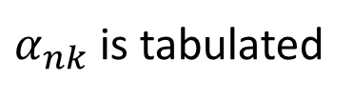
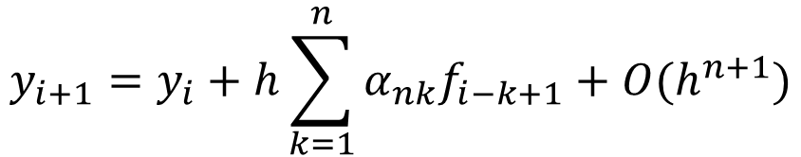
Adams Method
Taylor series expansion to derive Adam's
Adams-Bashforth open formulas
  Taylor expansion y around y_{i} to express y_{i+1} Replace derivatives with finite differences
  Use backward difference to get Adams-Bashforth
  General Adams-Bashforth formula of n^{th} order
$$y_{i+1}=y_{i}+h\sum_{k=1}^{n}{α_{nk}f_{i−k+1}+O(h^{n+1})}$$
$α_{nk}$ is tabulated

Slide 53
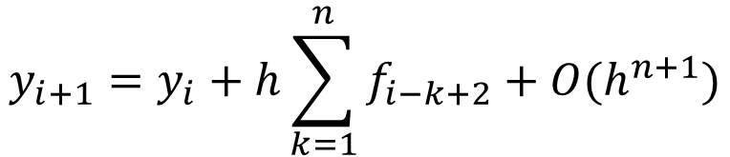
Adams-Moulton Closed
Backwards Taylor expansion (negative step length, Δ = -h)
Replace derivatives with backwards difference
General Adams-Moulton
Implicit – so, iteration needed
$$y_{i+1}=y_{i}+h\sum_{k=1}^{n}{f_{i−k+2}+O(h^{n+1})}$$

Slide 54
Predictor-Corrector Methods
Use explicit & implicit in combination
In each interval; explicit (predictor) followed by implicit (corrector)
Procedure
  Select h & Є, compute x_{i} = x₀ + ih
  From I.C, use 4th order RK to find y₁, y₂, y₃
  For i=3,4..., use Adams-Bashforth & Adams-Moulton
  Iterate until convergence, if not, reduce stepsize

Slide 55
BVP – Boundary Value Problems

Slide 56
Boundary Value Problem (BVP)
BVP – Differential equation with conditions specified at different values of independent variable, usually at both ends (BC – Boundary Conditions)
Examples;
  Vibration of string (BC; string fixed at both ends)
  Heat transfer of fin (BC; T fixed at one end, conduction=convection at other end)
  Tranverse deflection of beam under load

Slide 57

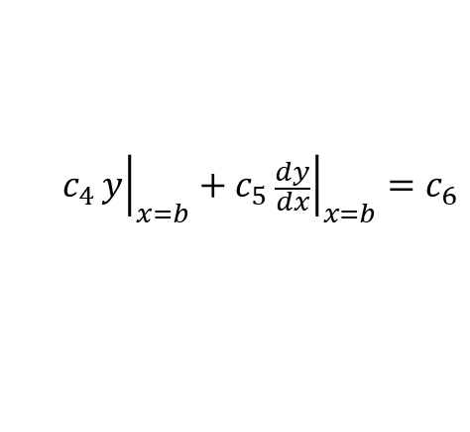




BVP
Since 2 or more conditions specified; differential equation is necessarily 2nd order or higher.
$$\frac{d^{2}y}{{dx}^{2}}=f(x,y,\frac{dy}{dx})$$
$$a≤x≤b$$
$$B.C y\left(a\right)=α$$
$$y\left(b\right)=β$$
BC can be in mixed forms (in terms of y and dy/dx)
$$c_{1}{\left.y\right|}_{x=a}+c_{2}{\left.\frac{dy}{dx}\right|}_{x=a}=c_{3}$$
$$c_{4}{\left.y\right|}_{x=b}+c_{5}{\left.\frac{dy}{dx}\right|}_{x=b}=c_{6}$$
BVP is non-homogeneous if BC or differential equation itself has at least one nonzero term independent of y & its derivatives

Slide 58

Boundary Value Problem (BVP)

Slide 59

BVP example – Heat Transfer in a Rod

Slide 60
BVP example – Heat Transfer in a Rod
(Heat transfer coefficient)
Boundary Conditions
Analytical Solution:

Slide 61
Solution Methods
Shooting Method (may not converge, but faster if it does) – based on converting into IVP
Finite Difference Method
  Finite Difference approximation of differential equation is obtained at a number of mesh points (nodes)
  Converts diff. eqn to a set of simultaneous algebraic eqns.

Slide 62
Shooting Method
Given BC at x=0 and x=L (endpoints)
  Guess another BC at x=0 (and solve as IVP)
  At x=L, the solution misses the given BC at x=L
  Improve guess at x=0 and redo
  Repeat until BC at x=L is hit by solution
OK for linear problems
For nonlinear problems;
  Recast as “root finding” problem
  Also called the Newton-Raphson method
Difficult for higher order problems, need to assume 2 or more conditions

Slide 63

Shooting Method – Improving Guess for BC
For 2nd order problems, the second BC at x(0) can be taken as the assumed derivative value at that point, written as Y⁽¹⁾(0)
With these two conditions at x(0), we can solve it as an IVP
However, this solution will miss the given BC of the original problem by the amount Δh⁽¹⁾ .
Choose a different guess for the initial condition Y⁽²⁾(0)
Redo the IVP and it will also miss the given BC but by an amount Δh⁽²⁾ .
For linear ODEs, a simple linear interpolation can give us the correct initial condition Y⁽³⁾(0) that will result in zero miss Δh⁽³⁾ = 0.
$$\frac{{∆h}^{(1)}−{∆h}^{(2)}}{Y^{(1)}−Y^{(2)}}=\frac{0−{∆h}^{(2)}}{Y^{(3)}−Y^{(2)}}$$

Slide 64
Shooting method example – Heat Transfer in a Rod
(Heat transfer coefficient)
Boundary Conditions
Demonstrate in class

Slide 65

Shooting Method

Slide 66
Finite Difference Method
  Range [a,b] is discretized into a finite number of nodes
  Derivatives in the original governing equation are substituted with finite difference formulas
  Apply finite differenced governing equation to each node
  Get a set of simultaneous equations
  Solve using matrix methods
  Not necessary to convert n^{th} order diff. eqn to n 1st order diff. eqns
    Since finite difference formulas are available for higher order derivatives

Slide 67






Finite Difference method example – Heat Transfer in a Rod
(Heat transfer coefficient)
Boundary Conditions
Demonstrate in class
$$T_{1}$$
$$T_{2}$$
$$T_{3}$$
$$T_{4}$$
$$T_{5}$$
$$T_{6}$$

Slide 68
Heat Transfer in a Rod example
Finite differences are substituted for the derivatives in the original equation.
Finite differences equation applies for each of the interior nodes. The first and last interior nodes, T_{i-1} and T_{i+1}, respectively, are specified by the boundary conditions.
Thus, a linear equation transformed into a set of simultaneous algebraic equations can be solved efficiently.

Slide 69
Solution of 2nd Order Equation – fictitious nodes
Requires finite difference approximation of y' and y’’
Divide interval [a,b] into N parts
Use central difference for greater accuracy
With mixed BC, and using central difference
  End up with fictitious node (not a problem!)
This fictitious node is actually the way to incorporate the derivative boundary condition into the problem
  From the derivative BC, using central difference, we can express the fictitious node in terms of the other real nodes

Slide 70

Finite Difference method example – Heat Transfer in a Rod
$$\begin{aligned}\frac{d^{2}T}{{\text{dx}}^{2}}+h^{′}(T_{a}−T)=0 \\ T_{a}=\text{20} \\ L=\text{10} m \\ h^{′}=0\text{.}\text{01} m^{−2} \\ \\ \frac{dT}{dx}\left(0\right)=T^{′}(a) \\ T(L)=T_{2}=\text{200}\end{aligned}$$
(Heat transfer coefficient)
Boundary Conditions
Demonstrate in class

Slide 71


Finite Difference method example – Heat Transfer in a Rod
Using central difference for the derivative BC
$$\frac{dT}{dx}=\frac{T_{1}−T_{−1}}{2∆x}$$
We can solve for the fictitious node
$$T_{−1}=T_{1}−2∆x\frac{dT}{dx}$$
And incorporate into the system matrix

