Slide 1
SKTN 2393 Numerical Methods for Nuclear Engineers
Chapter 7
Numerical Integration
Mohsin Mohd Sies
Nuclear Engineering,
School of Chemical and Energy Engineering,
Universiti Teknologi Malaysia

Slide 2
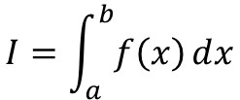
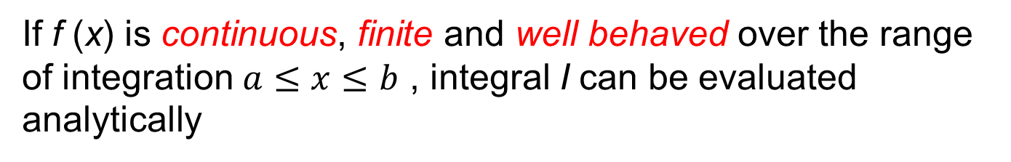
Introduction
Many engineering problems require the evaluation of the integral
$$I=\int_{a}^{b}{f\left(x\right)ⅆx}$$
where f (x) is integrand and a and b are limits of integration. One of the major use of integral calculus was the calculation of areas and volumes of irregularly shaped region.
If f (x) is continuous, finite and well behaved over the range of integration $a≤x≤b$ , integral I can be evaluated analytically

Slide 3
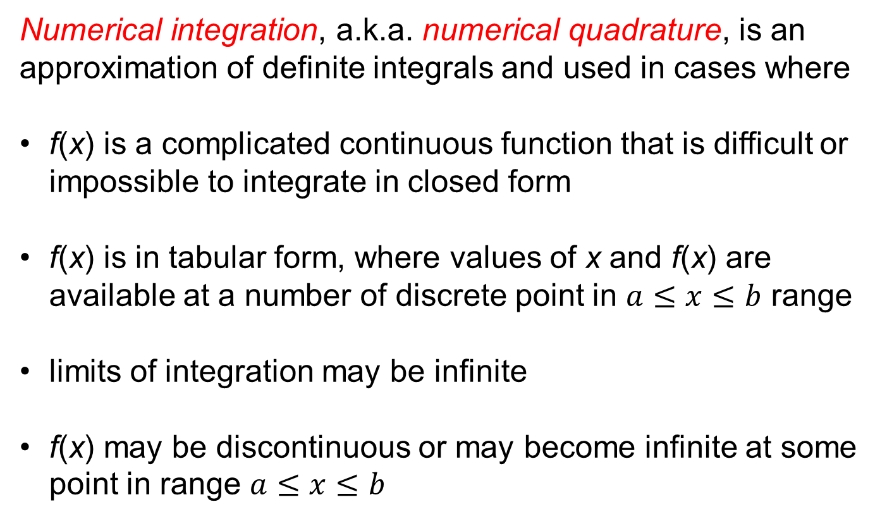
Introduction
Numerical integration, a.k.a. numerical quadrature, is an approximation of definite integrals and used in cases where
f(x) is a complicated continuous function that is difficult or impossible to integrate in closed form
f(x) is in tabular form, where values of x and f(x) are available at a number of discrete point in $a≤x≤b$ range
limits of integration may be infinite
f(x) may be discontinuous or may become infinite at some point in range $a≤x≤b$

Slide 4
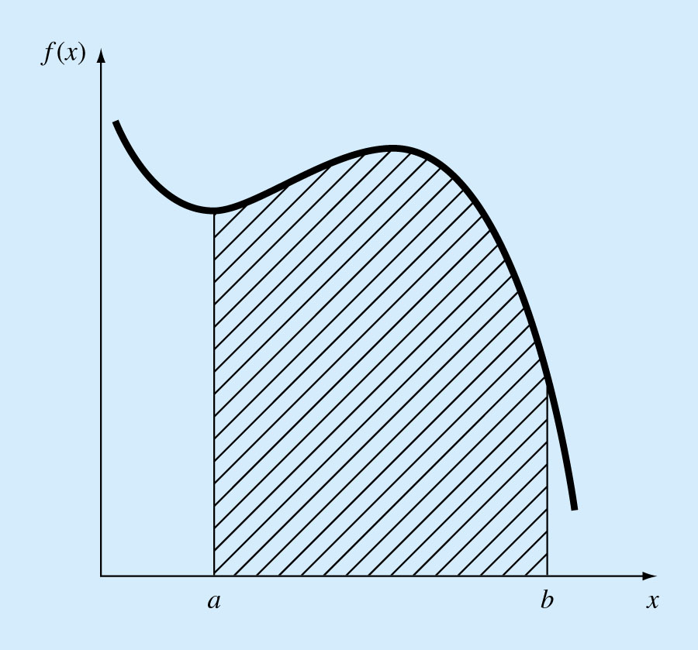
Introduction
Integral of function f (x) between limits a and b denotes the area under the curve of f (x) between limits a and b

Slide 5
Introduction
Functions to be integrated numerically are in two forms:
A table of values. We are limited by the number of points that are given.
A function. We can generate as many values of f(x) as needed to attain acceptable accuracy.

Slide 6
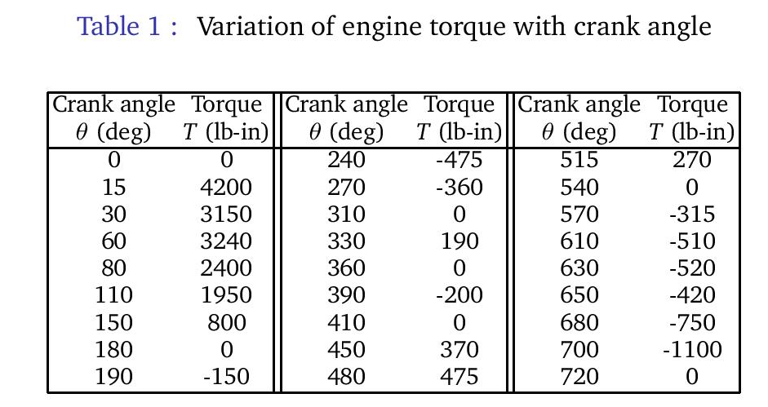
Sample Engineering Problems
Problem Statement:
The variation of torque of an engine with the angular displacement of the crank is shown in Table 1. Use a graphical method to determine the energy generated during a cycle by integrating the torque-displacement function over a cycle. Hint: Work = (Torque)× (Angular displacement)

Slide 7
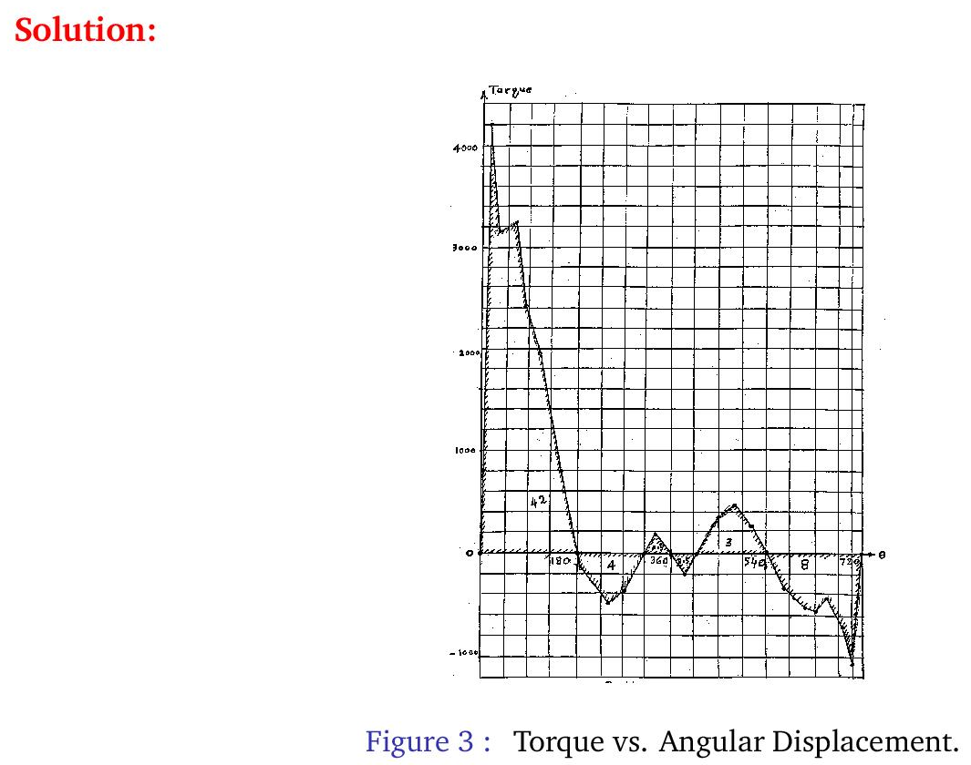

Slide 8
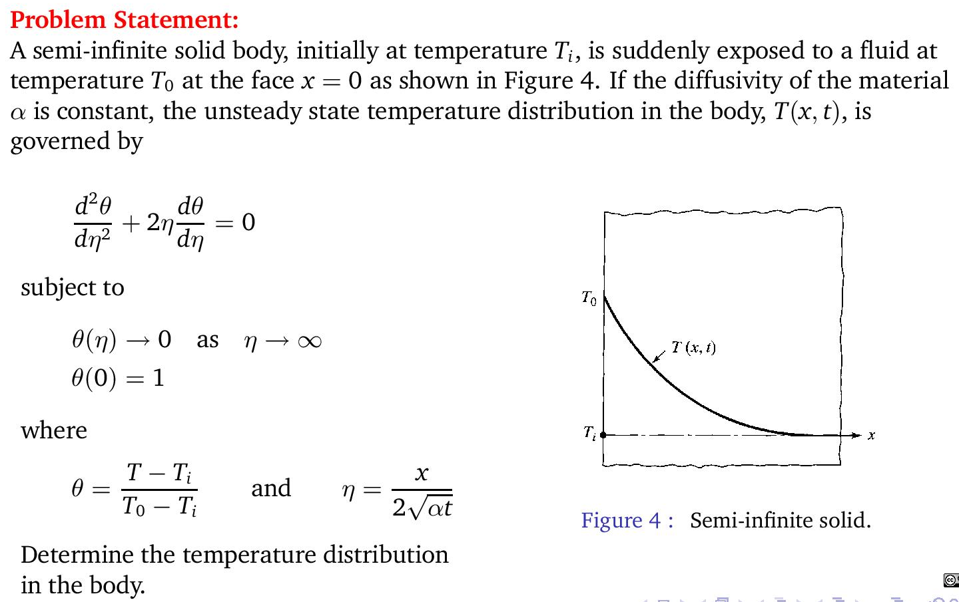
Sample Engineering Problems

Slide 9
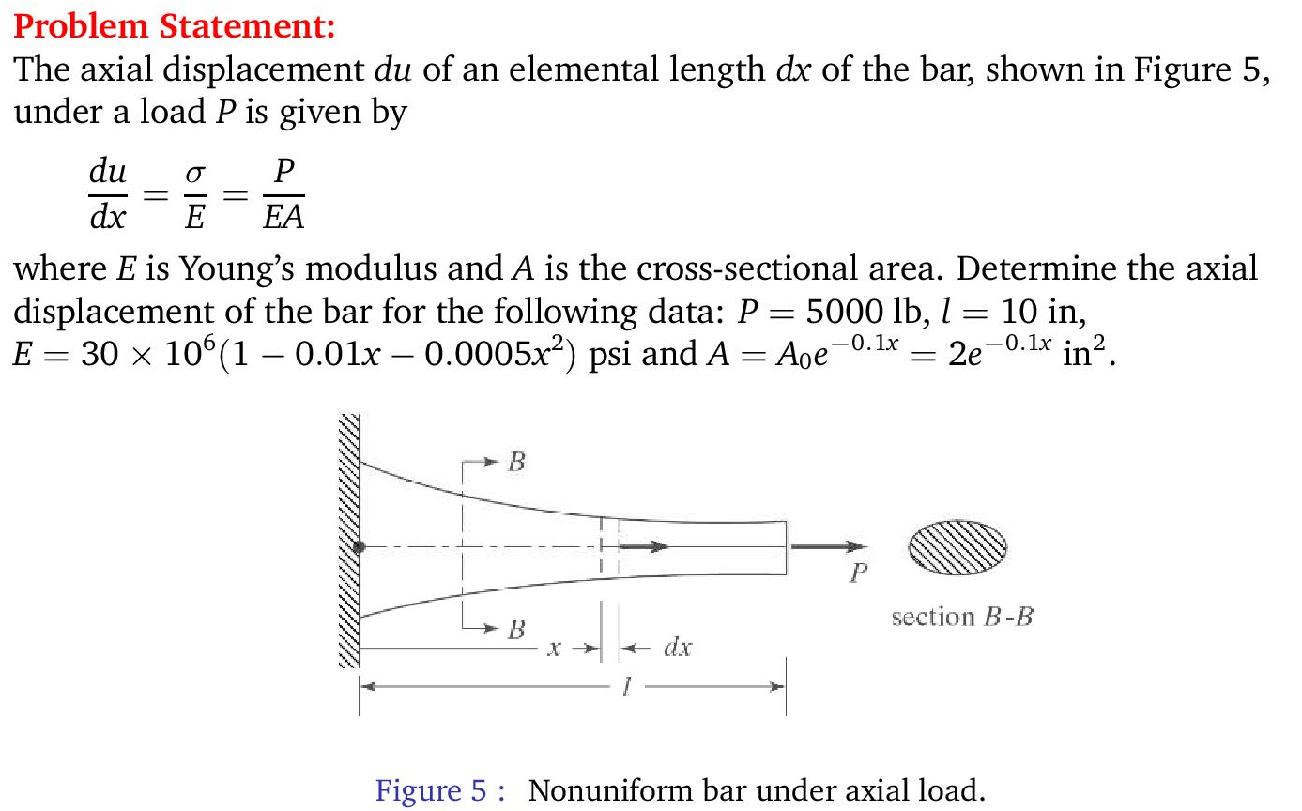
Sample Engineering Problems

Slide 10
Methods Available
Newton-Cotes Quadrature
Rectangular Rule
Trapezoidal Rule
Simpson’s 1/3 Rule
Simpson’s 3/8 Rule
Gauss Quadrature
Gauss-Legendre Formula
Gauss-Chebyshev Formula
Gauss-Hermite Formula

Slide 11
Newton-Cotes Integration Formulas
The Newton-Cotes formulas are the most common numerical integration schemes.
They are based on the strategy of replacing a complicated function or tabulated data with an approximating function that is easy to integrate:
A polynomial of order n is the preferred approximating function since it is easy to integrate.

Slide 12
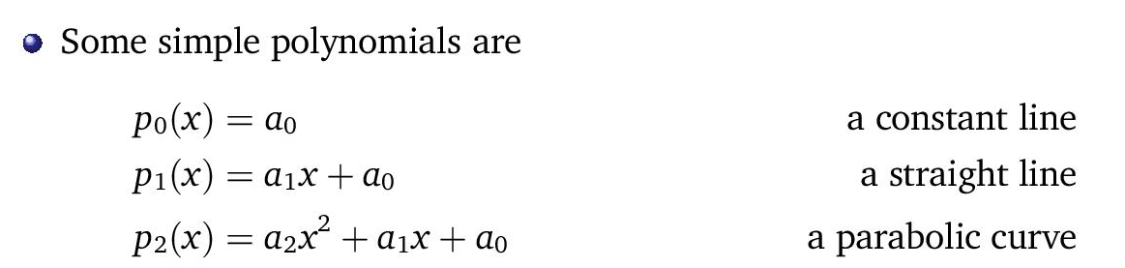
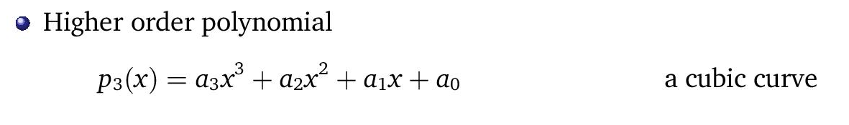
Approximating Functions

Slide 13
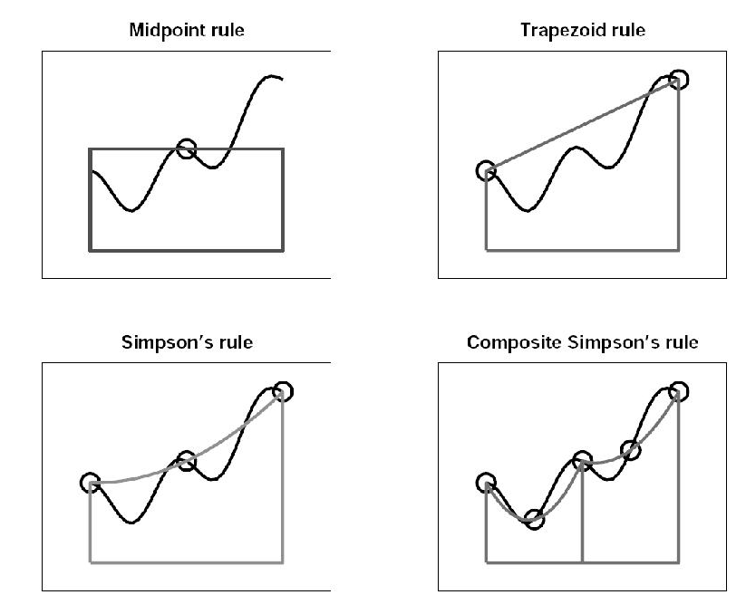
Approximating Functions

Slide 14


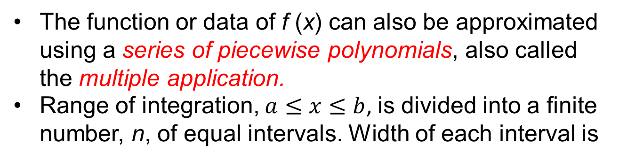
Newton-Cotes - Multiple Application
The function or data of f (x) can also be approximated using a series of piecewise polynomials, also called the multiple application.
Range of integration, $a≤x≤b$, is divided into a finite number, n, of equal intervals. Width of each interval is
Discrete points or nodes in the range of integration is given by

Slide 15
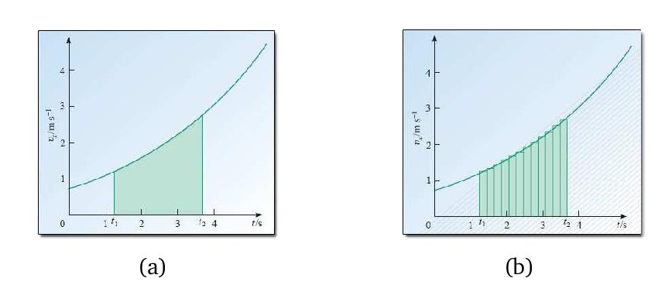
Newton-Cotes - Multiple Application

Slide 16
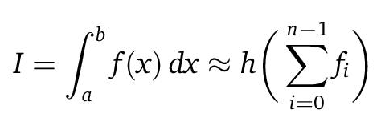
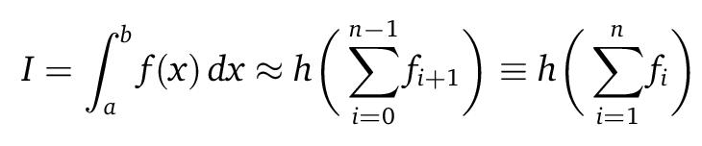
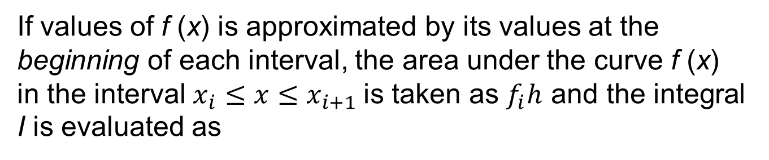
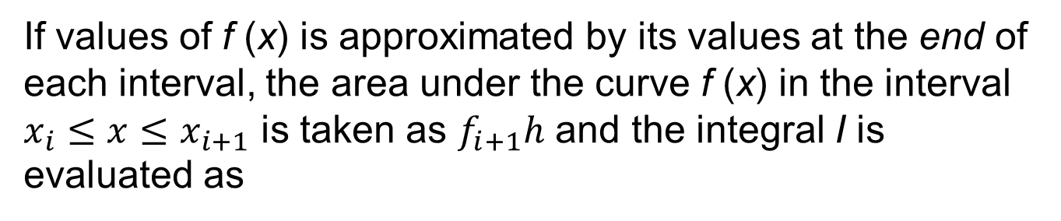
Rectangular Rule
If values of f (x) is approximated by its values at the beginning of each interval, the area under the curve f (x) in the interval $x_{i}≤x≤x_{i+1}$is taken as $f_{i}h$ and the integral I is evaluated as
If values of f (x) is approximated by its values at the end of each interval, the area under the curve f (x) in the interval $x_{i}≤x≤x_{i+1}$ is taken as $f_{i+1}h$ and the integral I is evaluated as

Slide 17
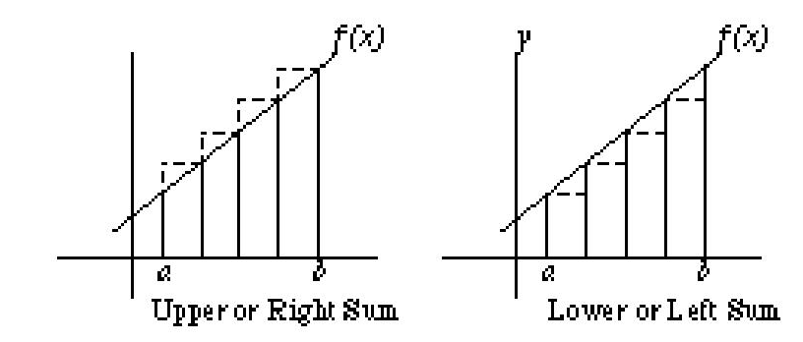
Rectangular Rule
Under- and over-estimation of integral I

Slide 18
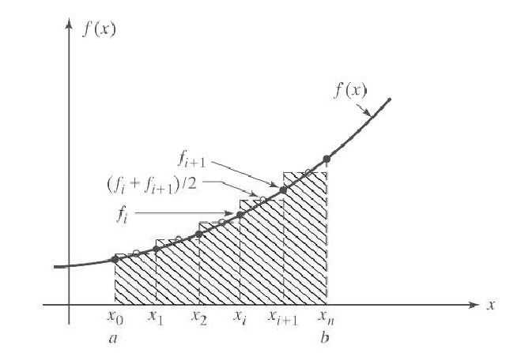
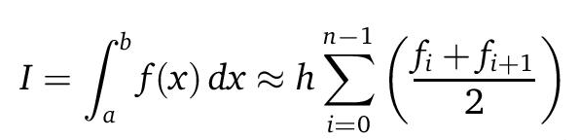
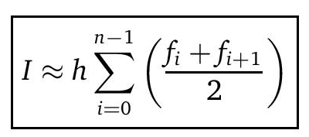
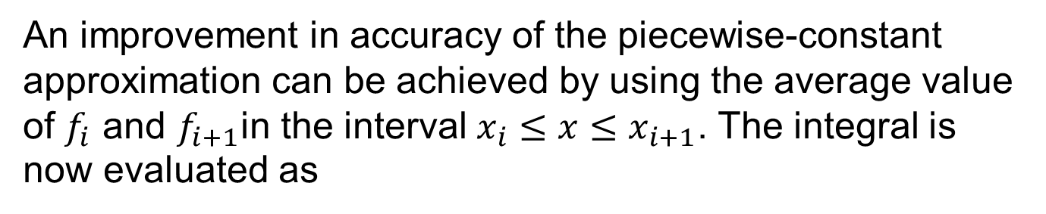
Rectangular Rule – Midpoint Method
An improvement in accuracy of the piecewise-constant approximation can be achieved by using the average value of $f_{i}$ and $f_{i+1}$in the interval $x_{i}≤x≤x_{i+1}$. The integral is now evaluated as

Slide 19
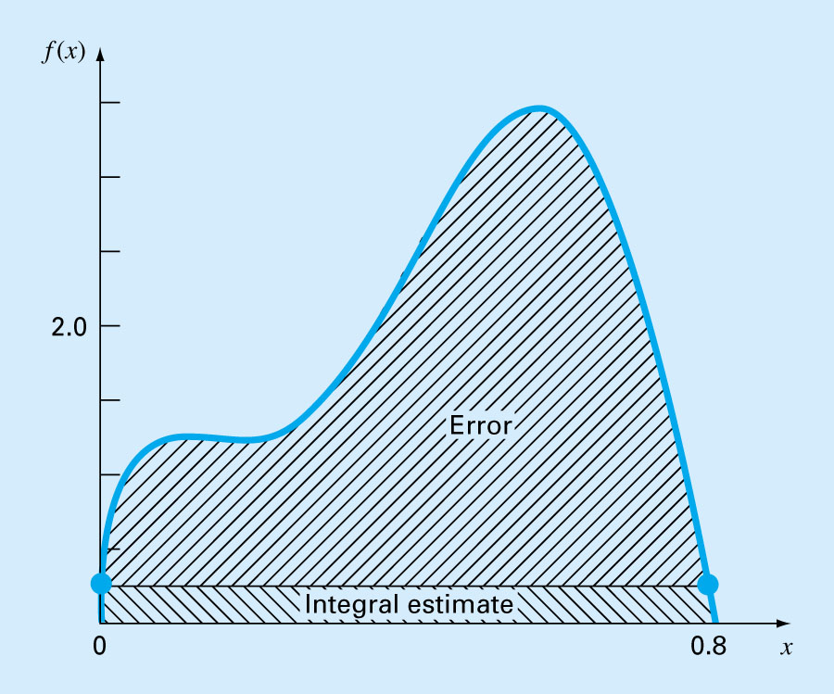
Rectangular Rule
Choosing interval h that is too large can lead to very large errors

Slide 20
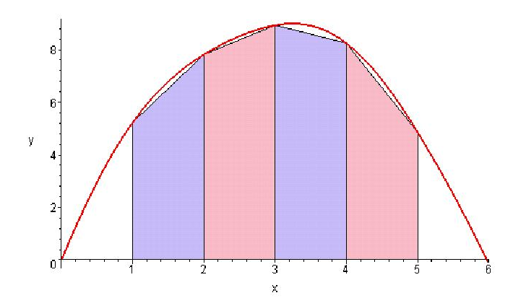
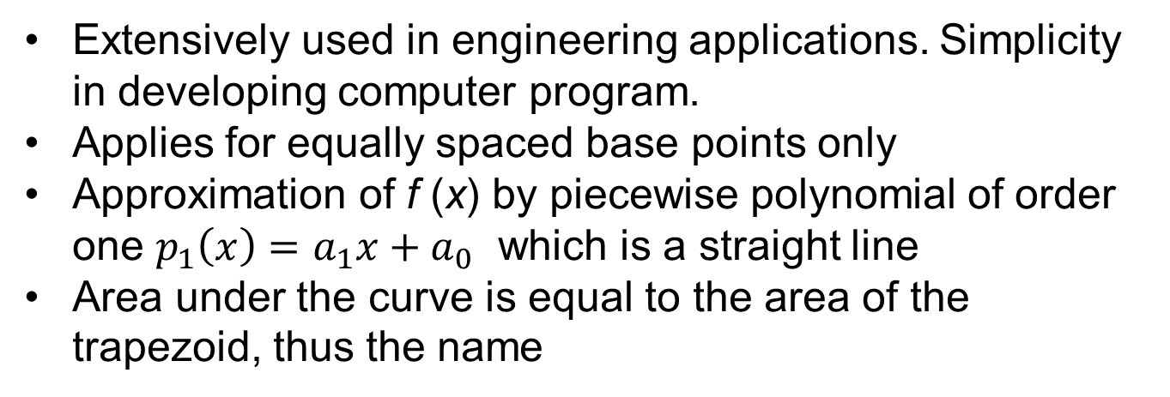
Trapezoidal Rule
Extensively used in engineering applications. Simplicity in developing computer program.
Applies for equally spaced base points only
Approximation of f (x) by piecewise polynomial of order one $p_{1}\left(x\right)=a_{1}x+a_{0}$ which is a straight line
Area under the curve is equal to the area of the trapezoid, thus the name

Slide 21
Trapezoidal Rule
The Trapezoidal rule is the first of the Newton-Cotes closed integration formulas, corresponding to the case where the polynomial is first order:
The area under this first order polynomial is an estimate of the integral of f(x) between the limits of a and b:
Trapezoidal rule

Slide 22
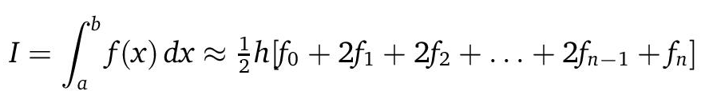
Trapezoidal Rule – Multiple Application
One way to improve the accuracy of the trapezoidal rule is to divide the integration interval from a to b into a number of segments and apply the method to each segment.
The areas of individual segments can then be added to yield the integral for the entire interval.
Substituting the trapezoidal rule for each interval yields
where h is the (equally spaced) increment between two adjacent nodes.

Slide 23
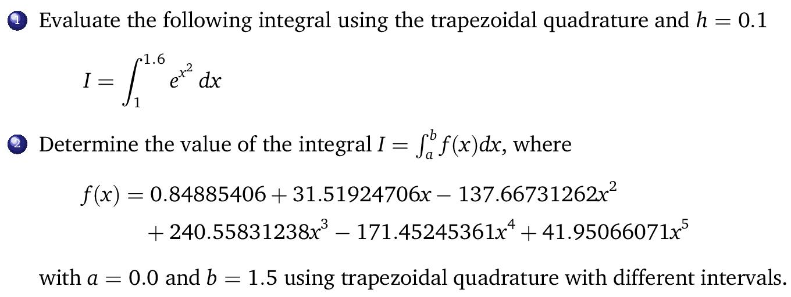
Example
f(x) = 0.84885406 + 31.51924706x − 137.66731262x^2 + 240.55831238x^3 − 171.45245361x^4 + 41.95066071x^5

Slide 24
Simpson’s Rules
Accuracy of the trapezoidal rule can be improved by increasing the number of segments n or reducing step size h; but this eventually leads to increase in round-off error.
Another way to get more accurate estimate of integral is to use higher order polynomials for approximating the function f (x)
The formulas that result from taking the integrals under such polynomials are called Simpson’s rules.

Slide 25
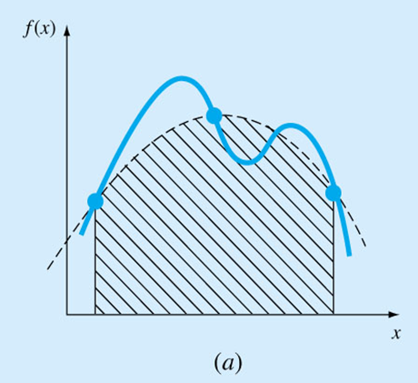
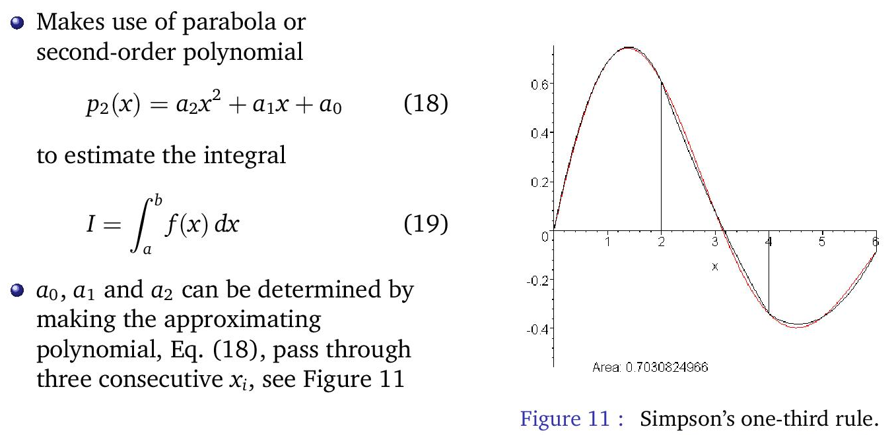
Simpson’s 1/3 Rule
Results when a second-order interpolating polynomial is used.

Slide 26
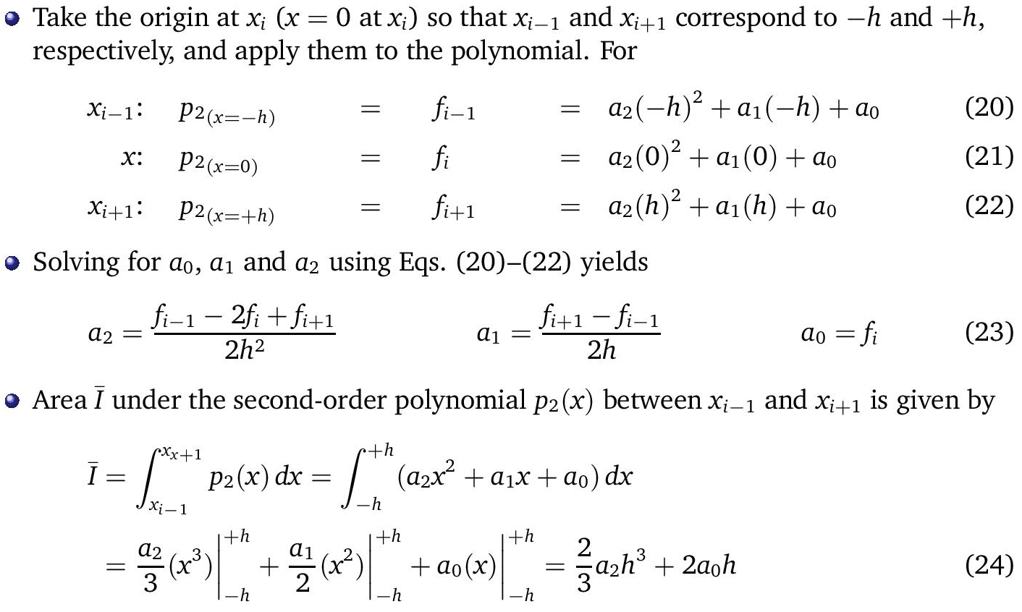
Simpson’s 1/3 Rule

Slide 27
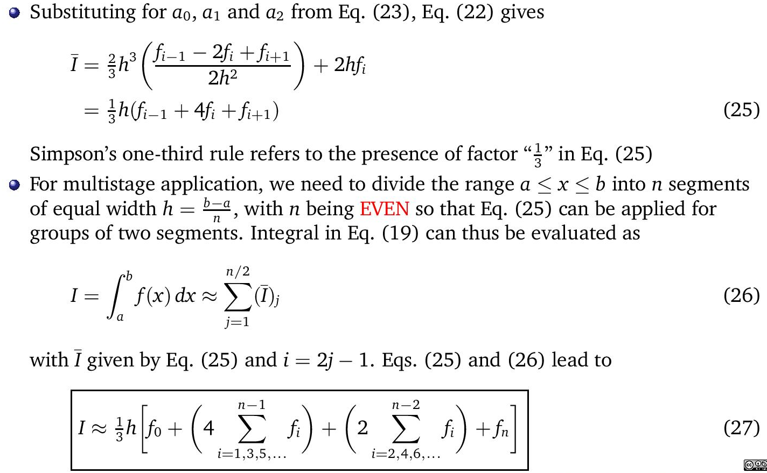
Simpson’s 1/3 Rule

Slide 28
Simpson’s 1/3 Rule – Multiple Application
Just as the trapezoidal rule, Simpson’s rule can be improved by dividing the integration interval into a number of segments of equal width.
Yields accurate results and considered superior to trapezoidal rule for most applications.
However, it is limited to cases where values are equispaced.
Further, it is limited to situations where there are an even number of segments and odd number of points.

Slide 29
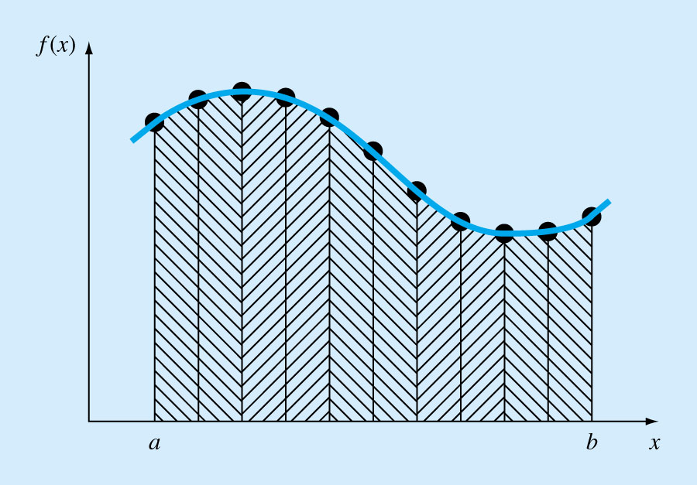
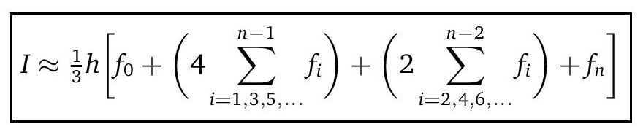
Simpson’s 1/3 Rule – Multiple Application

Slide 30
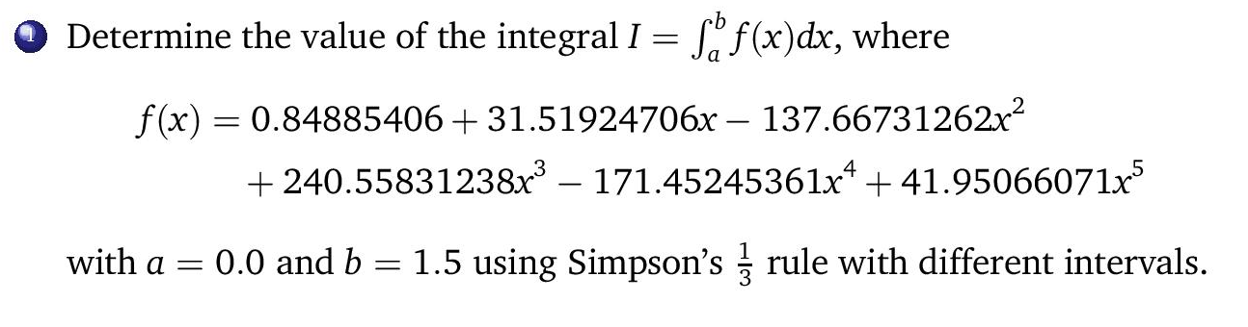
Example

Slide 31
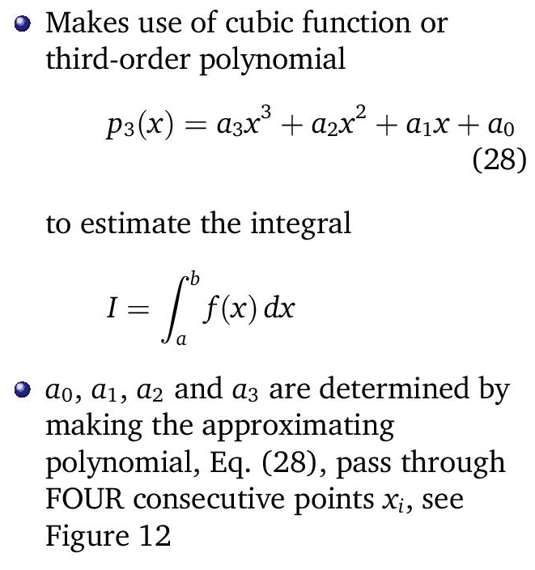
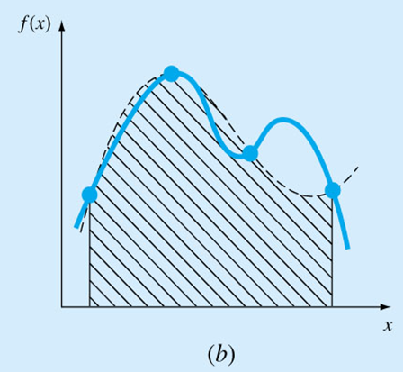
Simpson’s 3/8 Rule

Slide 32
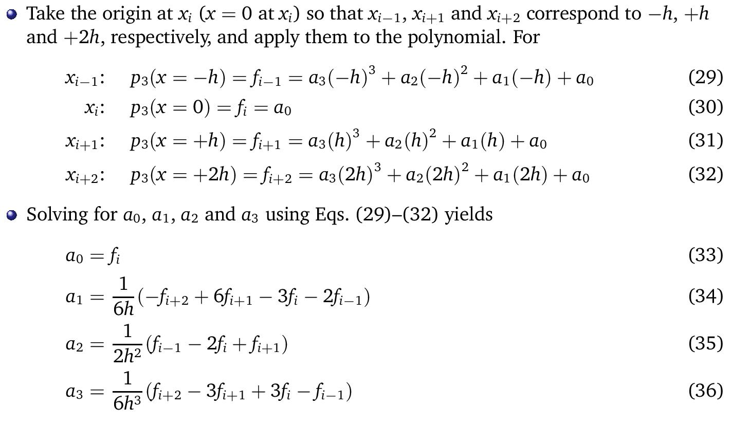
Simpson’s 3/8 Rule

Slide 33
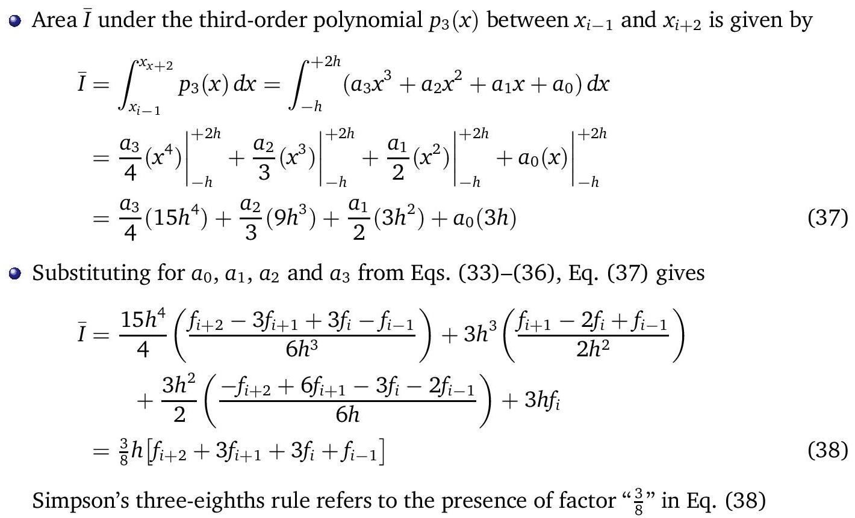
Simpson’s 3/8 Rule

Slide 34
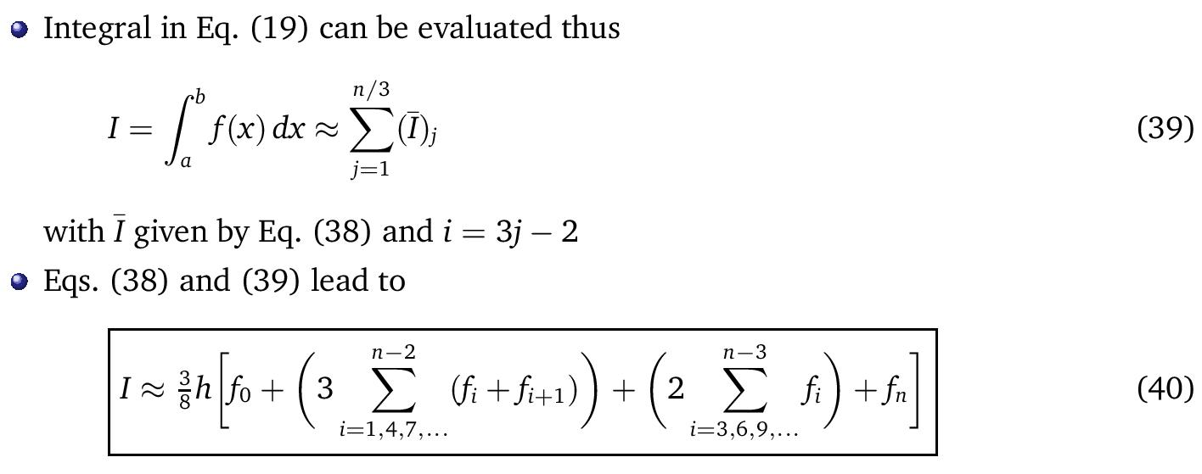
Simpson’s 3/8 Rule – Multiple Application

Slide 35
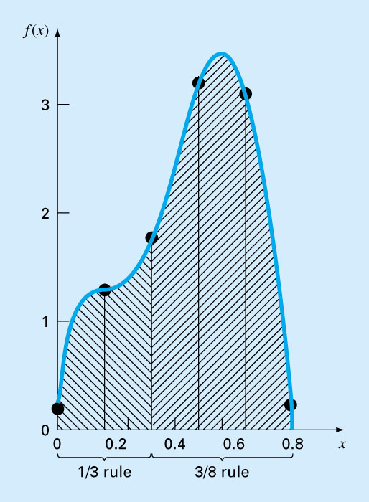
Segments not divisible by 3

Slide 36
Integration with Unequal Segments
Equal segments might not be appropriate
Function vary very slowly
Function vary very abruptly
Experimental data may be unequally spaced
If need fewer number of function values without affecting accuracy
Approach
Curve fitting of data points; get continuous function; then use equal segments with Newton-Cotes
Use data directly with Newton-Cotes – h depends on data spacing

Slide 37
Integration with Unequal Segments
If possible, use Simpson's 1/3 Rule or 3/8 Rule
  Check for consecutive segments of equal spacing
    N segments divisible by 2 - 1/3 Rule
    N segments divisible by 3 - 3/8 Rule
If adjacent segments of unequal lengths; use Trapezoidal Rule on each segment

Slide 38
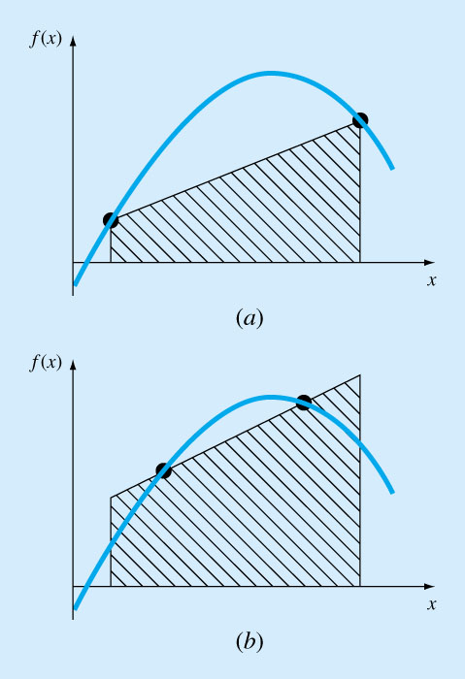
Gauss Quadrature
Gauss quadrature implements a strategy of positioning any two points on a curve to define a straight line that would balance the positive and negative errors.
Hence the area evaluated under this straight line provides an improved estimate of the integral.

Slide 39
Gauss Quadrature
The magic points that will balance the positive and negative errors can be obtained using the method of undetermined coefficients
The limits of integration is based on [-1,1] to simplify and generalize the derivation
Applying Gauss Quadrature will involve a change of variables to transform the limits from [a,b] to [-1,1]

Slide 40
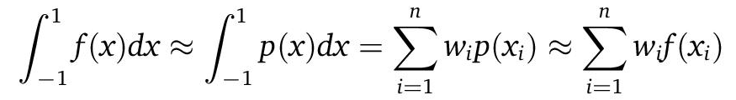
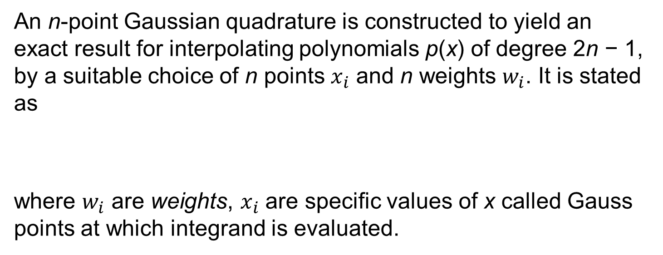
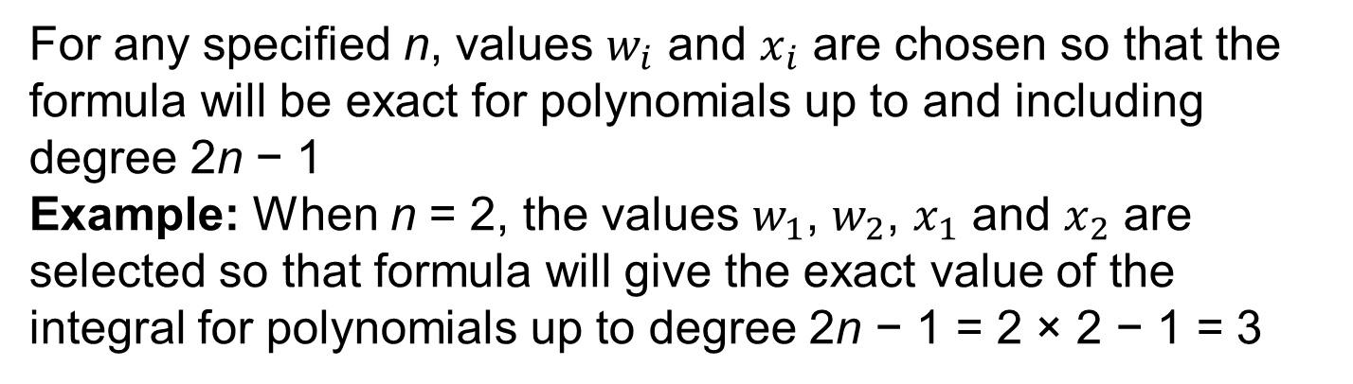
Gauss Quadrature
An n-point Gaussian quadrature is constructed to yield an exact result for interpolating polynomials p(x) of degree 2n − 1, by a suitable choice of n points $x_{i}$ and n weights $w_{i}$. It is stated as
where $w_{i}$ are weights, $x_{i}$ are specific values of x called Gauss points at which integrand is evaluated.
For any specified n, values $w_{i}$ and $x_{i}$ are chosen so that the formula will be exact for polynomials up to and including degree 2n − 1
Example: When n = 2, the values $w_{1}$, $w_{2}$, $x_{1}$ and $x_{2}$ are selected so that formula will give the exact value of the integral for polynomials up to degree 2n − 1 = 2 × 2 − 1 = 3

Slide 41
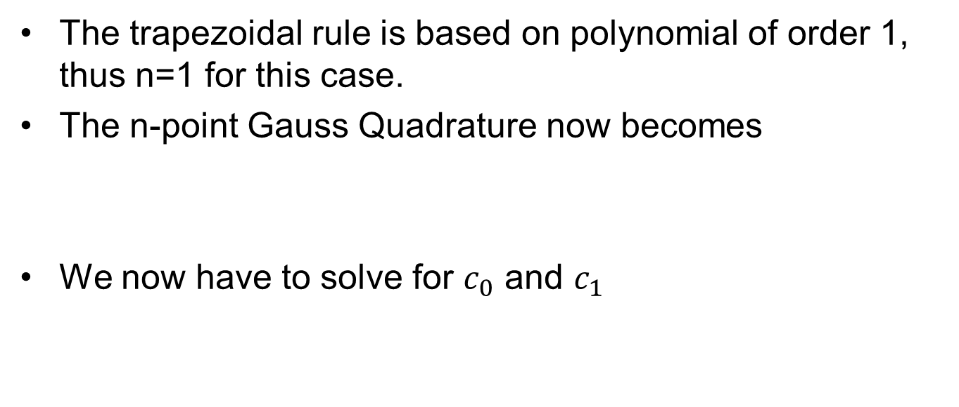
Method of Undetermined Coefficients – Demonstration using Trapezoidal Rule
The trapezoidal rule is based on polynomial of order 1, thus n=1 for this case.
The n-point Gauss Quadrature now becomes
We now have to solve for $c_{0}$ and $c_{1}$

Slide 42
Method of Undetermined Coefficients – Demonstration using Trapezoidal Rule
The trapezoidal rule yields exact results when the function being integrated is a constant or a straight line, such as y=1 and y=x;
these requirements become the source of the two equations to find the two unknowns
Solve simultaneously
Trapezoidal rule

Slide 43
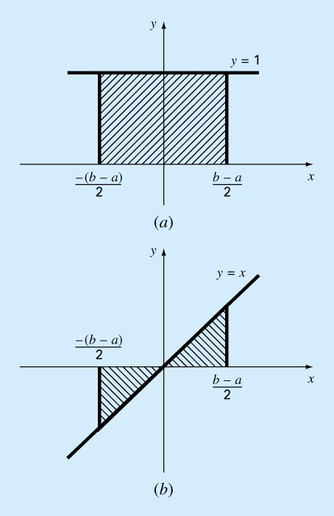
Method of Undetermined Coefficients – Demonstration using Trapezoidal Rule

Slide 44
Method of Undetermined Coefficients – Derivation of the Two-Point Gauss-Legendre formula
The object of Gauss quadrature is to determine the equations of the form
However, in contrast to trapezoidal rule that uses fixed end points a and b, the function arguments x₀ and x₁ are not fixed end points but unknowns.
Thus, four unknowns to be evaluated require four conditions.
First two conditions are obtained by assuming that the above equation for I fits the integral of a constant and a linear function exactly.
The other two conditions are obtained by extending this reasoning to a parabolic and a cubic functions.

Slide 45
Solved simultaneously
Resulting “magic points”
Yields an integral estimate that is third order accurate

Slide 46
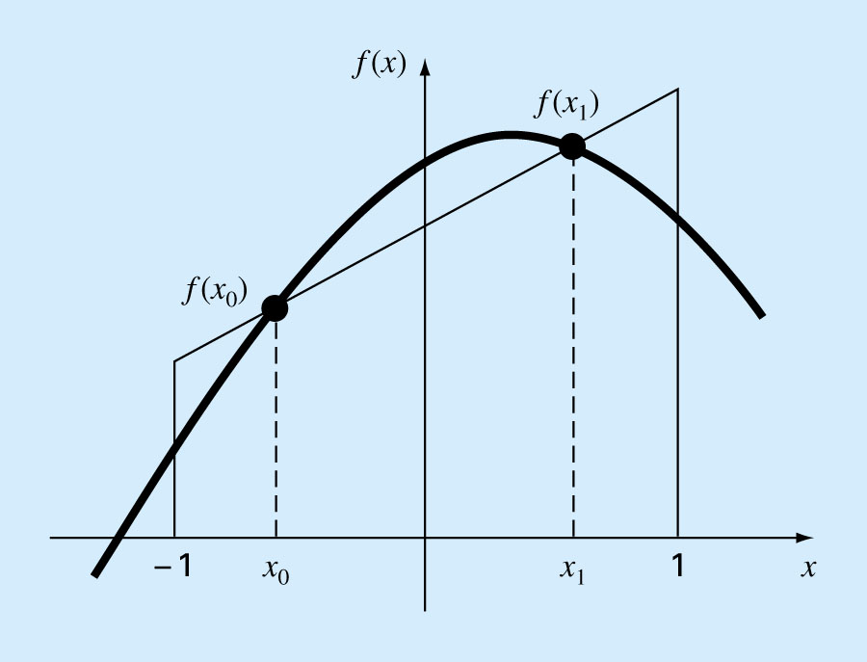

Slide 47
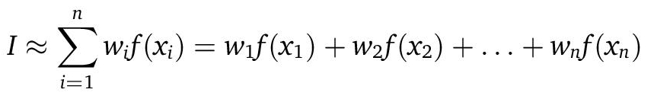
Higher Point Gauss Quadrature Formulae
They can be developed in the general form
where n = number of points.
Values for w’s and x’s for up to and including the five-point formula are summarized in the table on the next page

Slide 48
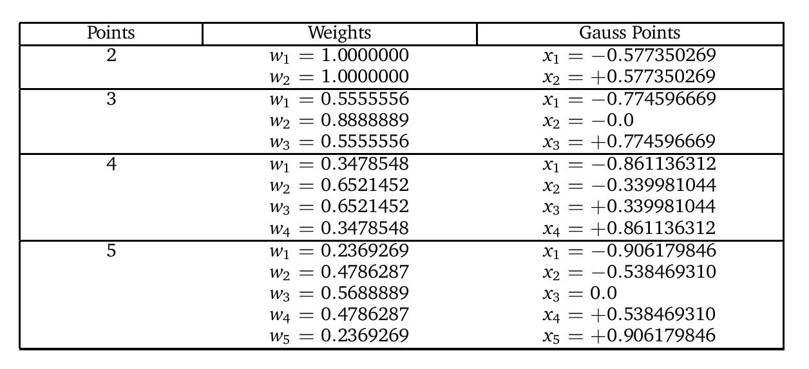

Slide 49

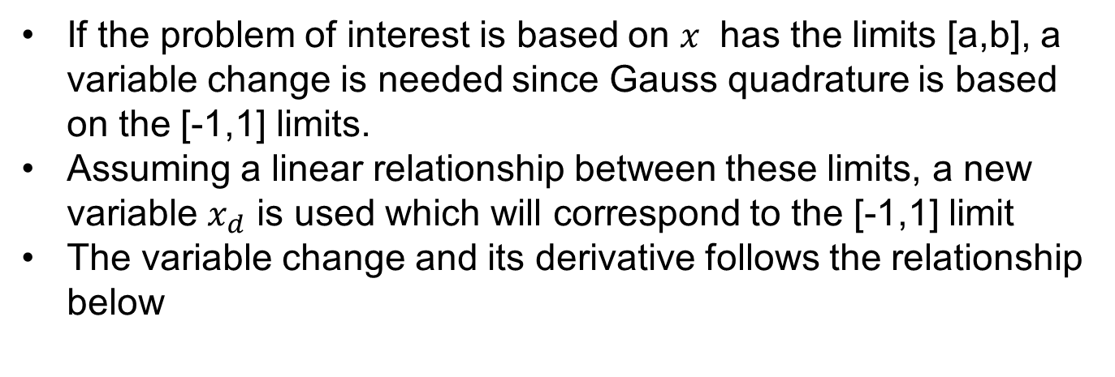

Change of variables and limits
If the problem of interest is based on $x$ has the limits [a,b], a variable change is needed since Gauss quadrature is based on the [-1,1] limits.
Assuming a linear relationship between these limits, a new variable $x_{d}$ is used which will correspond to the [-1,1] limit
The variable change and its derivative follows the relationship below
$$x=\frac{\left(b−a\right)+(b−a)x_{d}}{2}$$
$$dx=\frac{(b−a) }{2}dx_{d}$$

Slide 50

Example

Slide 51

Example - Matlab

Slide 52

Example - Matlab

Slide 53

Example - Matlab

Slide 54
Improper Integrals
  Infinite limits
    In program, use different values of n until successive tries does not change I significantly (within tolerance limit)
  Singularities
    Break around the singularity
    Approach from left and right
    Select small value of ε & compute I = I₁ + I₂
    Select smaller value of ε and repeat
    Stop when successive I doesn't change significantly (within tolerance limit)
  Other methods – math tricks (integration by parts, change of variables...

