Slide 1
SKTN 2393 Numerical Methods for Nuclear Engineers
Chapter 6
Differentiation
Mohsin Mohd Sies
Nuclear Engineering,
School of Chemical and Energy Engineering,
Universiti Teknologi Malaysia

Slide 2
Differentiation
Most engineering and scientific problems involve derivatives
Temperature distribution
Response of mass-spring to excitation (gun recoil, shock absorbers, etc.)
Many others..

Slide 3
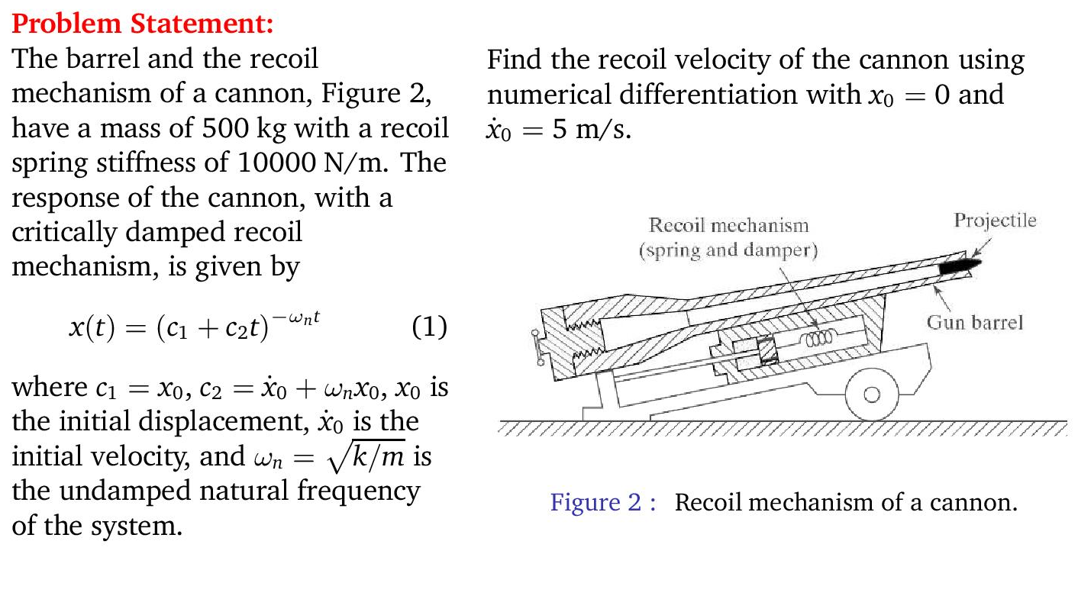
Engineering Application

Slide 4
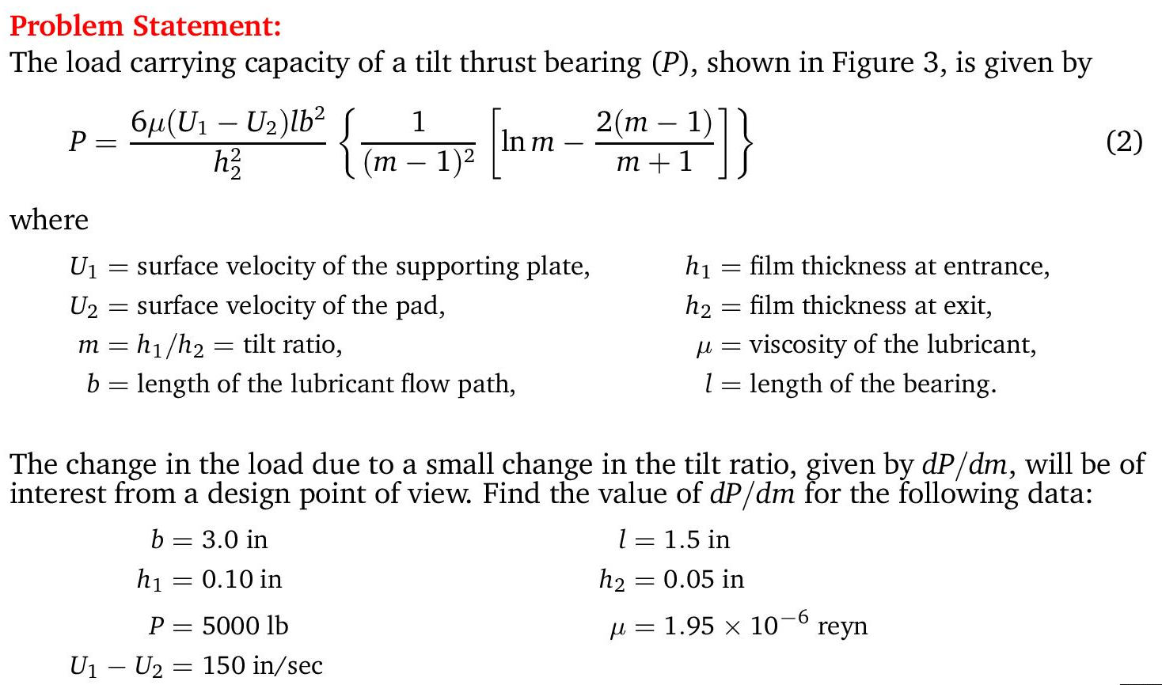
Engineering Application

Slide 5
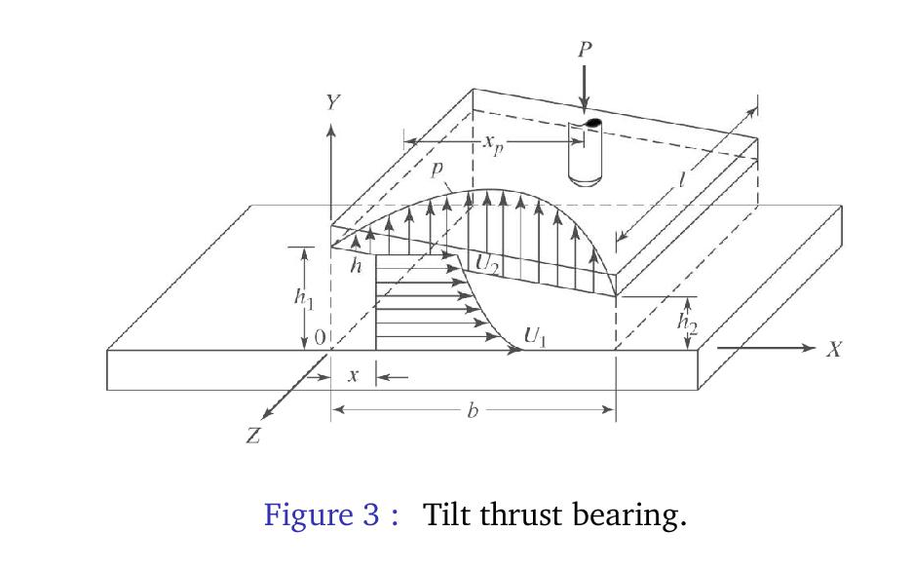
Engineering Application

Slide 6
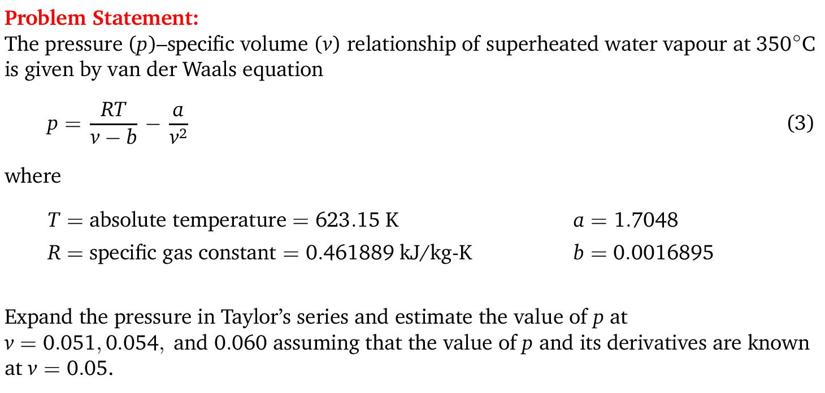
Engineering Application

Slide 7
Differentiation
The function to be differentiated will typically be in one of the following three forms:
  A simple continuous function such as polynomial, an exponential, or a trigonometric function.
  A complicated continuous function that is difficult or impossible to differentiate or integrate directly.
  A tabulated function (tabulated data) where values of x and f(x) are given at a number of discrete points, as is often the case with experimental or field data.

Slide 8
Strategy for Continuous Functions
Since we already know what the function is,
  Generate as many function points as needed
  Use the generated function values to estimate the derivative based on finite difference formulas
  Finite difference formulas use only function values to give estimates of derivatives

Slide 9
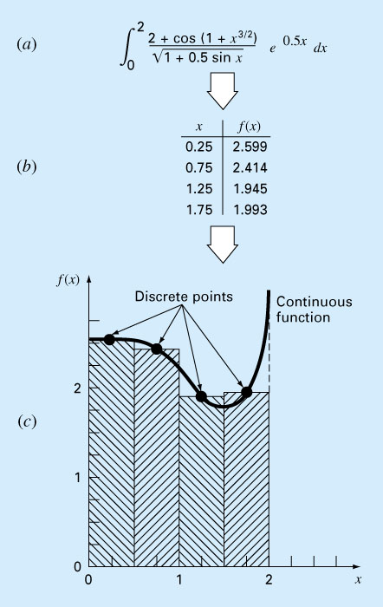

Slide 10
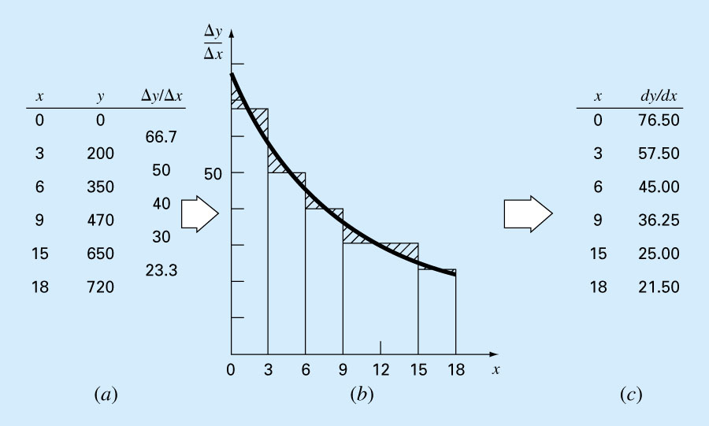

Slide 11
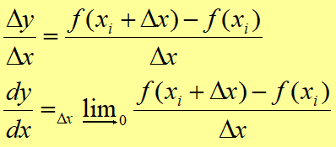
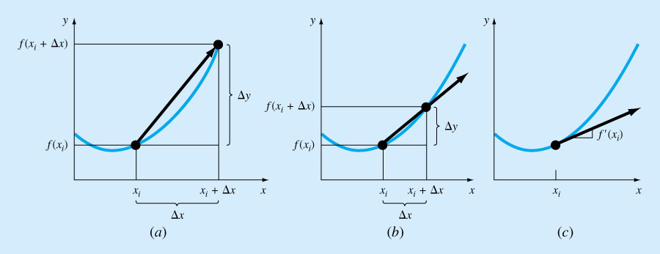
Definition of Derivatives

Slide 12
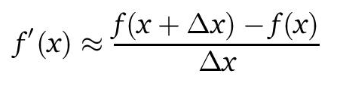
Derivative approximated as finite differences;

Slide 13
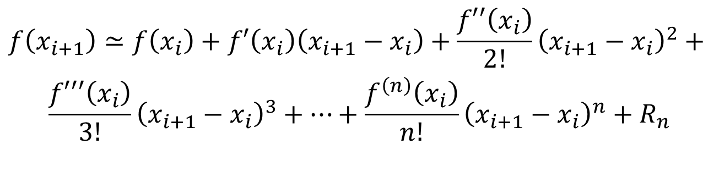
Based on Taylor Series
$$\begin{aligned}f\left(x_{i+1}\right)≃f\left(x_{i}\right)+f′\left(x_{i}\right)\left(x_{i+1}−x_{i}\right)+\frac{f′′\left(x_{i}\right)}{2!}{\left(x_{i+1}−x_{i}\right)}^{2}+ \\ \frac{f′′′\left(x_{i}\right)}{3!}{\left(x_{i+1}−x_{i}\right)}^{3}+…+\frac{f^{\left(n\right)}\left(x_{i}\right)}{n!}{\left(x_{i+1}−x_{i}\right)}^{n}+R_{n}\end{aligned}$$

Slide 14
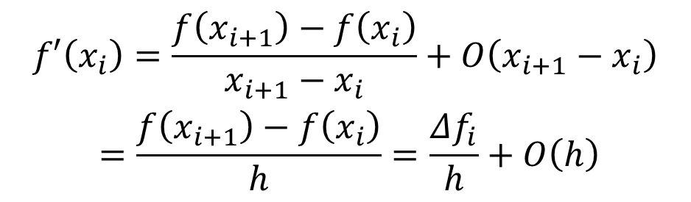
Finite divided difference
Truncating 2nd order & higher terms & rearrange, we get the first forward difference (also called the two point forward difference)
$$\begin{aligned}f′\left(x_{i}\right)=\frac{f\left(x_{i+1}\right)−f\left(x_{i}\right)}{x_{i+1}−x_{i}}+O\left(x_{i+1}−x_{i}\right) \\ =\frac{f\left(x_{i+1}\right)−f\left(x_{i}\right)}{h}=\frac{Δf_{i}}{h}+O\left(h\right)\end{aligned}$$
which is first order accurate

Slide 15
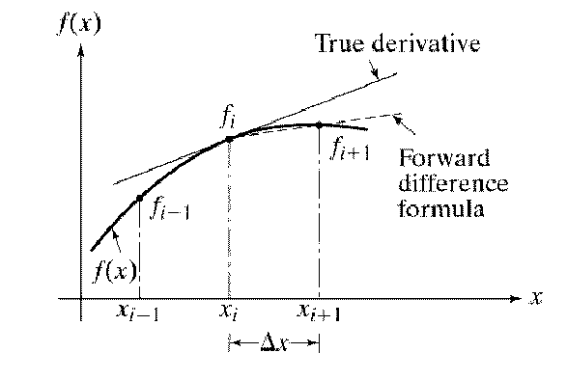

Slide 16
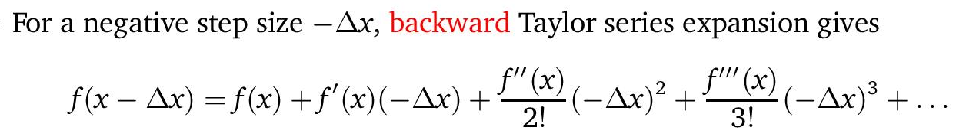
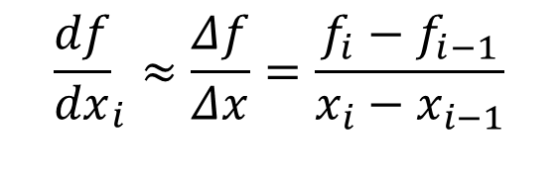
Backward Difference
Truncating 2nd order & higher terms & rearrange, we get the first backward difference (also called the two point backward difference)
$${\frac{df}{dx}}_{i}≈\frac{Δf}{Δx}=\frac{f_{i}−f_{i−1}}{x_{i}−x_{i−1}}$$
which is also first order accurate

Slide 17
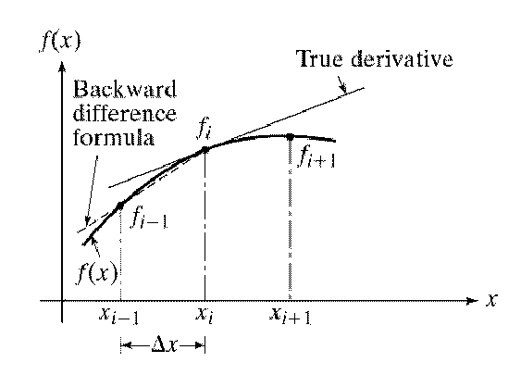

Slide 18
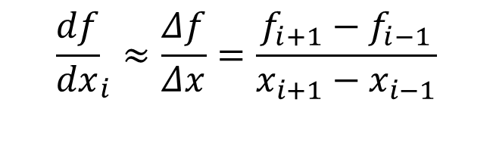
Central Difference
Subtracting the backward Taylor from the forward Taylor gives us the centered difference formula
$${\frac{df}{dx}}_{i}≈\frac{Δf}{Δx}=\frac{f_{i+1}−f_{i−1}}{x_{i+1}−x_{i−1}}$$
which is second order accurate

Slide 19
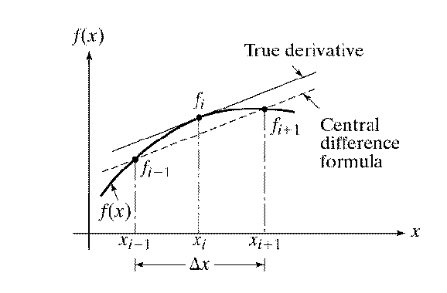

Slide 20
Increasing the Accuracy
Common ways to increase accuracy are:
Decrease step size h.
Taking more terms in the Taylor series.
For example, to get higher accuracy first derivatives, the second order term has to be retained. This term can be evaluated using the centered difference formula for f’’

Slide 21
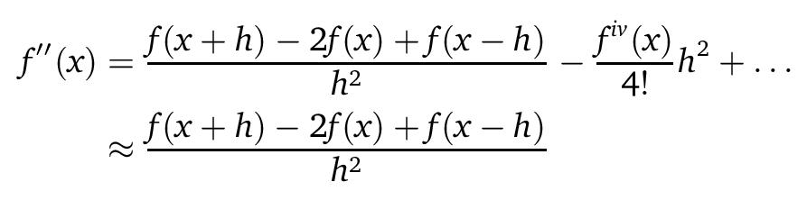
Increasing the Accuracy
Adding the backward to the forward Taylor series gives us the centered difference formula for f’’.
This can be substituted into the Taylor series for forward or backward difference derivation.

Slide 22
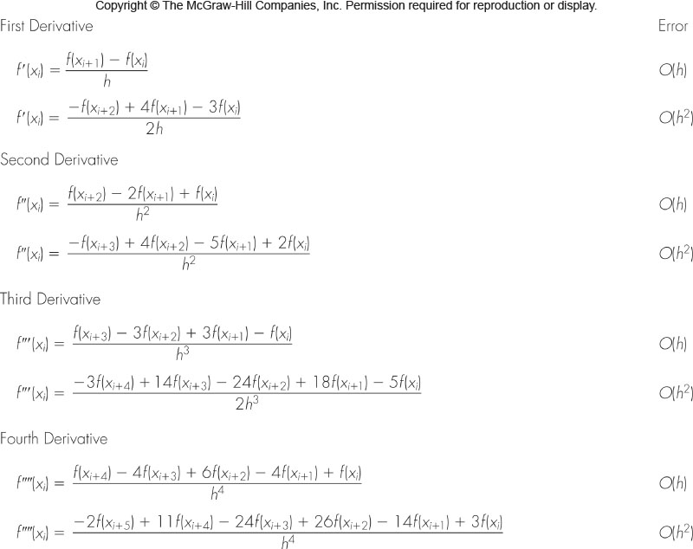
Forward Difference Formulas

Slide 23
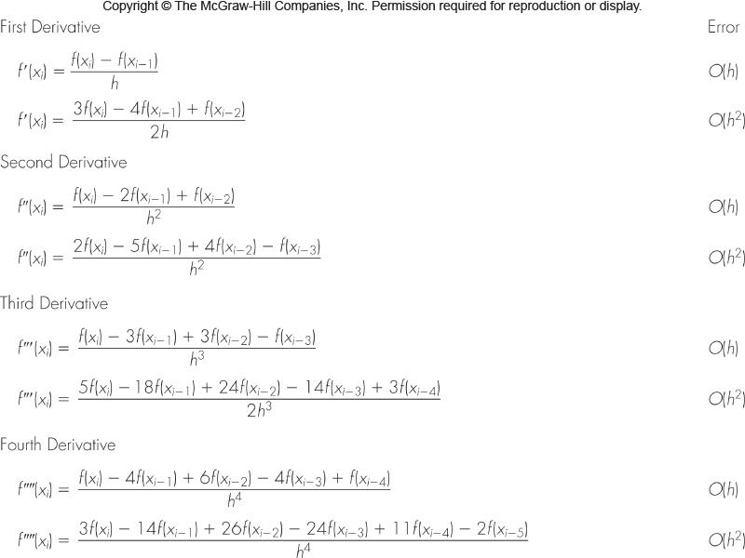
Backward Difference Formulas

Slide 24
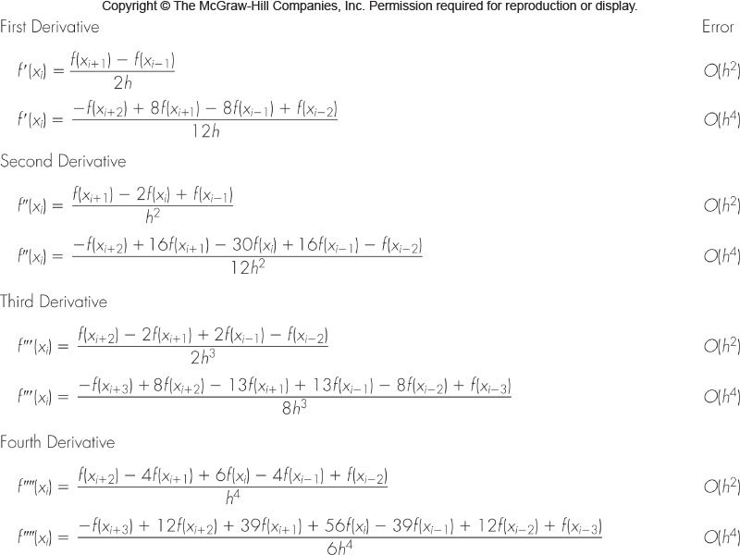
Centered Difference Formulas

Slide 25
Strategy for Tabulated Data
Tabulated data can be equally spaced or non-equally spaced
The strategy is to fit a polynomial to the data and differentiate the polynomial.
The polynomial fit can either be
  Direct fit polynomials
  Lagrange polynomials
  Divided difference polynomials

Slide 26
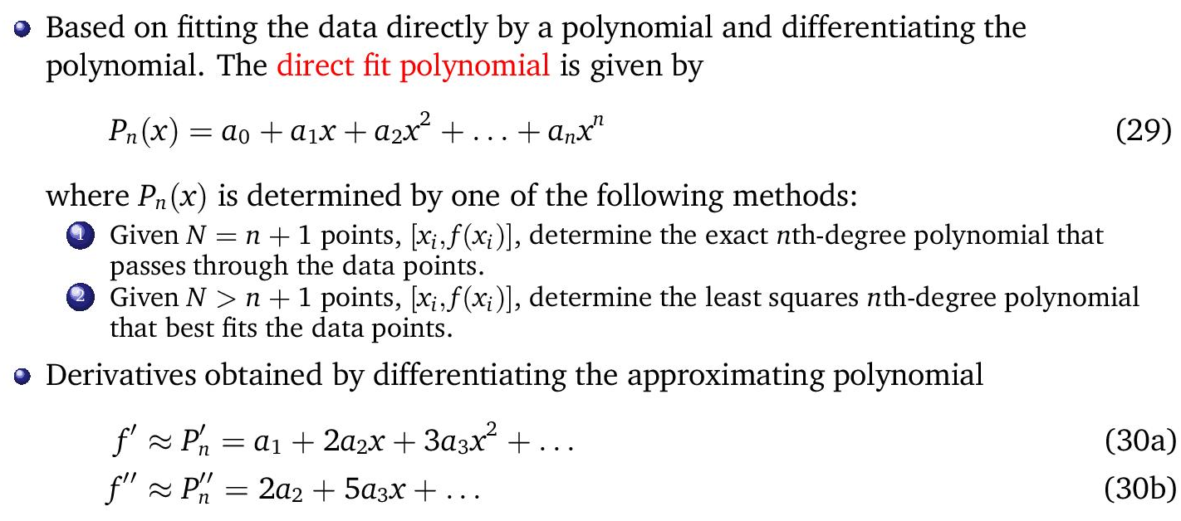
Direct Fit Polynomials

Slide 27
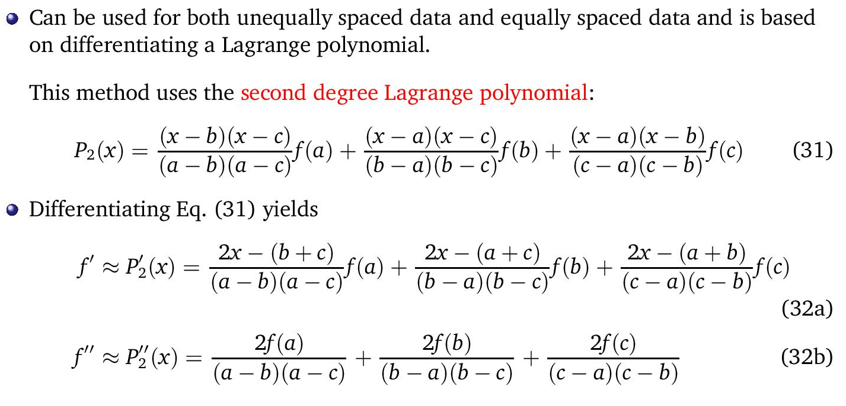
Lagrange Polynomials

Slide 28
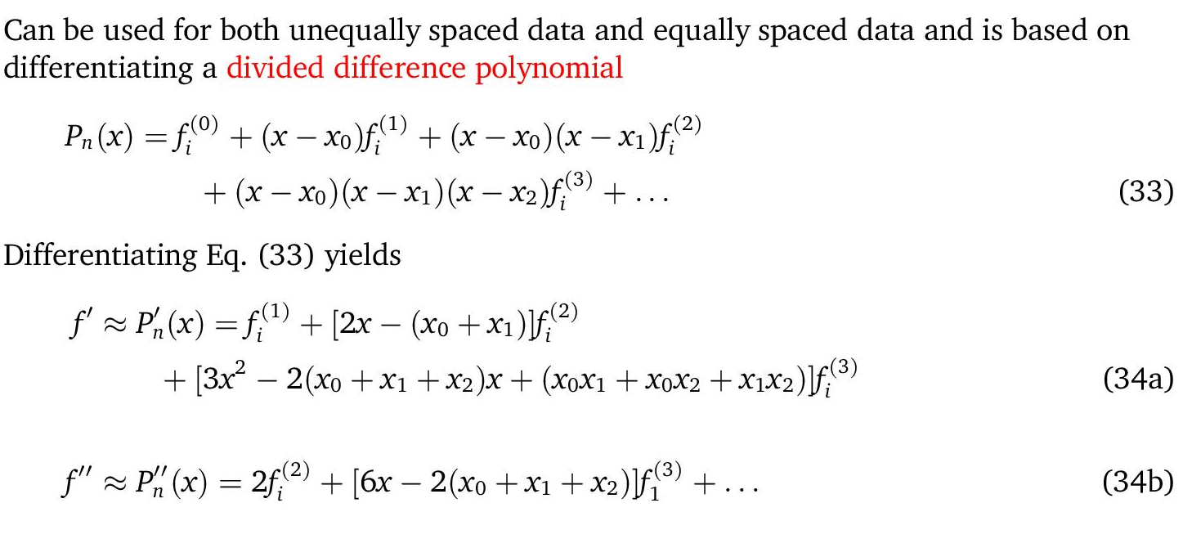
Divided Difference Polynomials

Slide 29
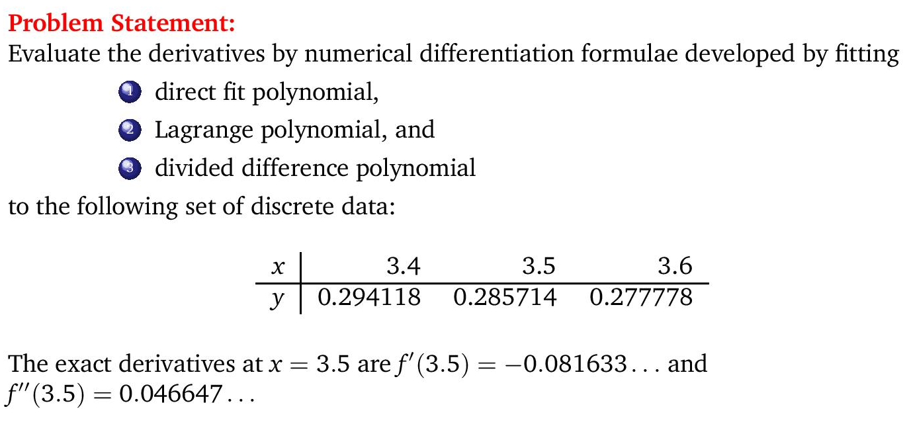
Example

Slide 30
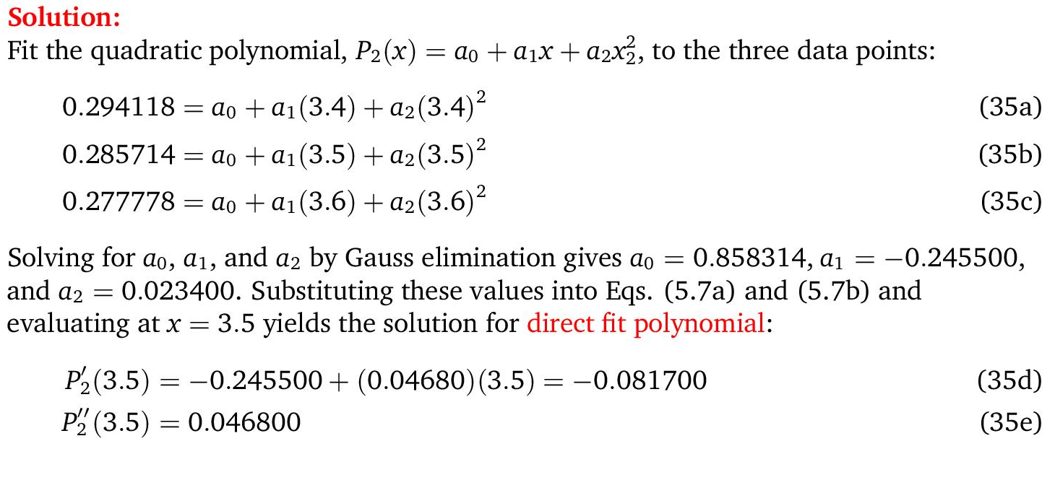
Example

Slide 31
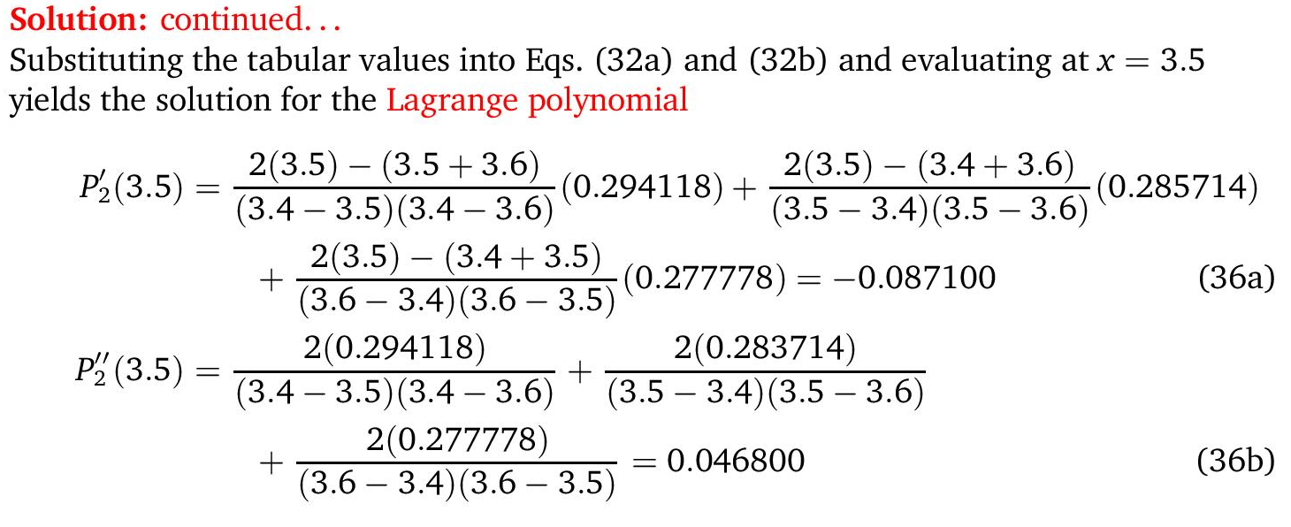
Example

Slide 32
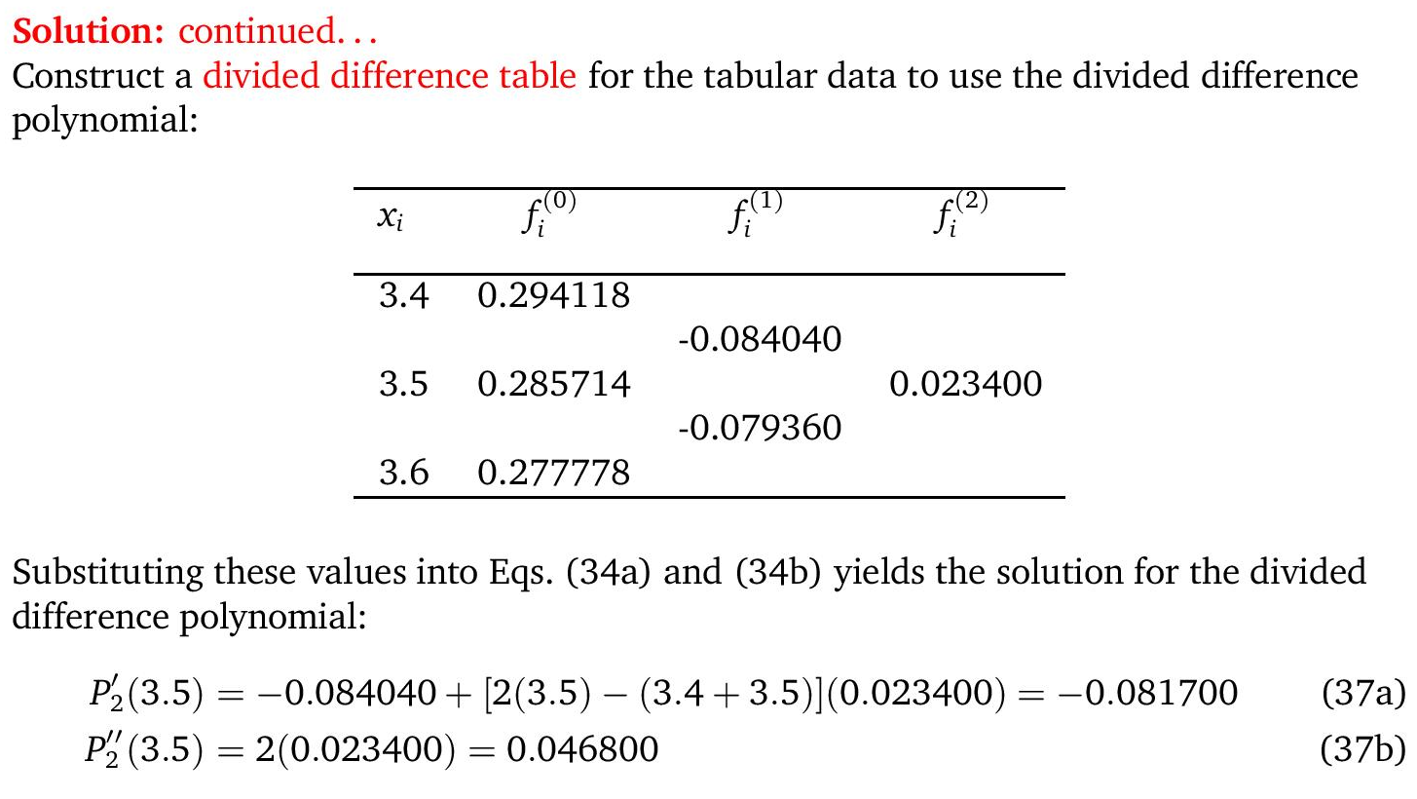
Example

Slide 33
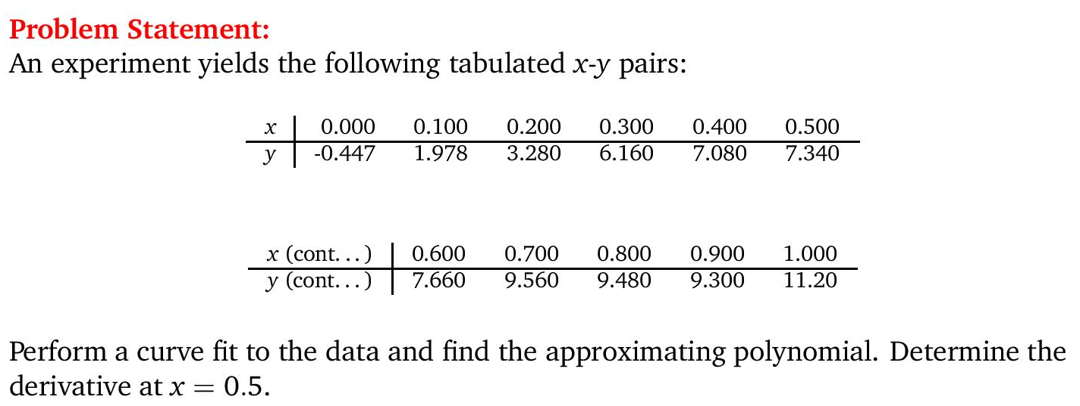
Example (Matlab)

Slide 34
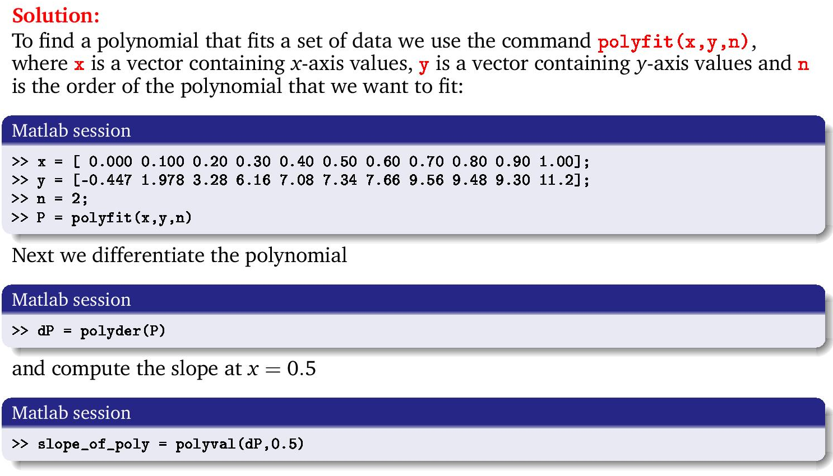
Example (Matlab)

Slide 35
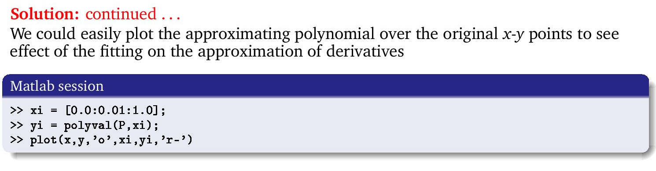
Example (Matlab)

