Slide 1
SKTN 2393 Numerical Methods for Nuclear Engineers
Chapter 5
Curve Fitting and Interpolation
Mohsin Mohd Sies
Nuclear Engineering,
School of Chemical and Energy Engineering,
Universiti Teknologi Malaysia

Slide 2
CURVE FITTING
Describes techniques to fit curves (curve fitting) to discrete data to obtain intermediate estimates.
There are two general approaches for curve fitting:
Regression:
  Data exhibit a significant degree of scatter. The strategy is to derive a single curve that represents the general trend of the data.
Interpolation:
  Data is very precise. The strategy is to pass a curve or a series of curves that must touch each of the points.

Slide 3
Introduction
In engineering, two types of applications are encountered:
  Trend analysis. Predicting values of dependent variable, may include extrapolation beyond data points or interpolation between data points.
  Hypothesis testing. Comparing existing mathematical model with measured data.

Slide 4
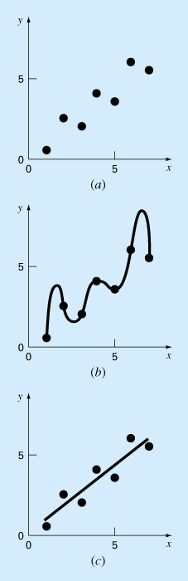

Slide 5
Mathematical Background
Arithmetic mean. The sum of the individual data points (yi) divided by the number of points (n).
Standard deviation. The most common measure of a spread for a sample.

Slide 6
Mathematical Background (cont’d)
Variance. Representation of spread by the square of the standard deviation.
or
Coefficient of variation. Has the utility to quantify the spread of data.

Slide 7
Least Squares Regression
Chapter 17
Linear Regression
Fitting a straight line to a set of paired observations: (x₁, y₁), (x₂, y₂),…,(x_{n}, y_{n}).
y = a₀+ a₁ x + e
a₁ - slope
a₀ - intercept
e - error, or residual, between the model and the observations

Slide 8
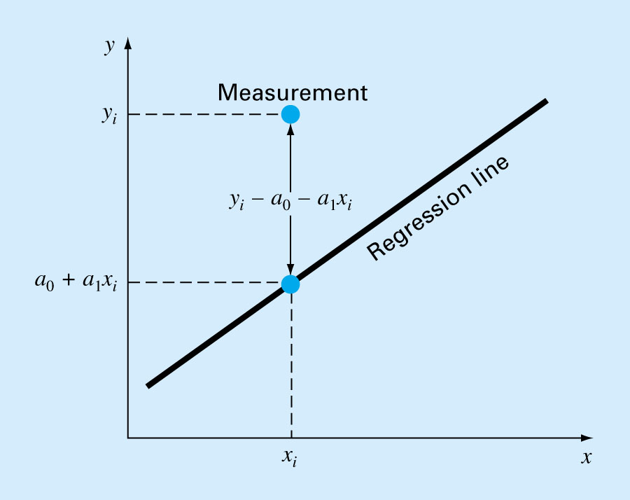
Linear Regression: Residual

Slide 9
Linear Regression: Question
How to find a₀ and a₁ so that the error would be minimum?

Slide 10
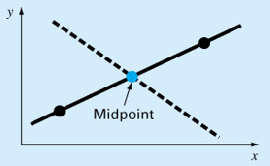
Linear Regression: Criteria for a “Best” Fit
e₁
e₁= -e₂
e₂

Slide 11
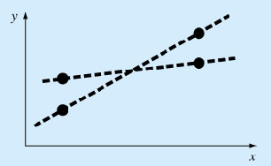
Linear Regression: Criteria for a “Best” Fit

Slide 12
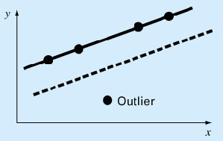
Linear Regression: Criteria for a “Best” Fit

Slide 13
Linear Regression: Least Squares Fit
Yields a unique line for a given set of data.

Slide 14
Linear Regression: Least Squares Fit
The coefficients a₀ and a₁ that minimize S_{r} must satisfy the following conditions:

Slide 15
Linear Regression:
Determination of a_{o} and a₁
2 equations with 2 unknowns, can be solved simultaneously

Slide 16
Linear Regression:
Determination of ao and a1

Slide 18
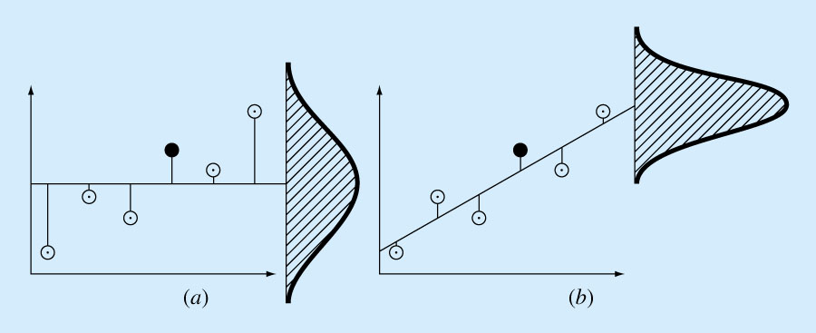

Slide 19
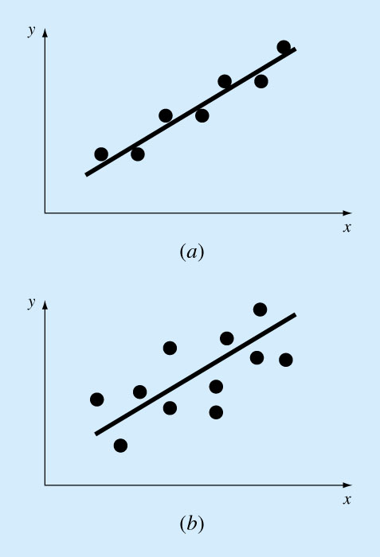

Slide 20
Error Quantification of Linear Regression
Total sum of the squares around the mean for the dependent variable, y, is S_{t}
Sum of the squares of residuals around the regression line is S_{r}

Slide 21
Error Quantification of Linear Regression
S_{t}-S_{r} quantifies the improvement or error reduction due to describing data in terms of a straight line rather than as an average value.
r^{2:} coefficient of determination
r : correlation coefficient

Slide 22
Error Quantification of Linear Regression
For a perfect fit:
S_{r}= 0 and r = r² =1, signifying that the line explains 100 percent of the variability of the data.
For r = r² = 0, S_{r} = S_{t}, the fit represents no improvement.

Slide 23
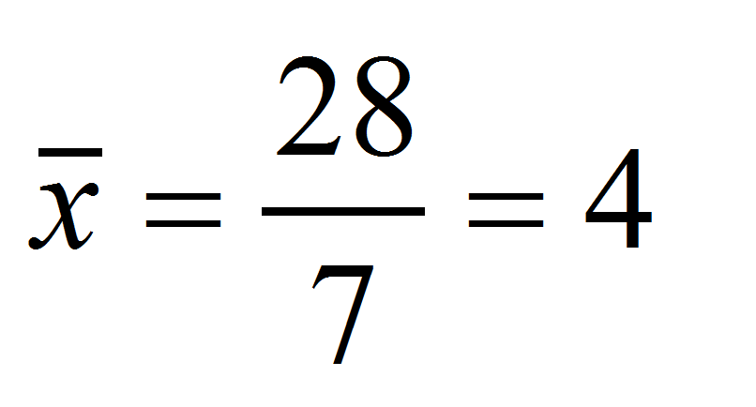
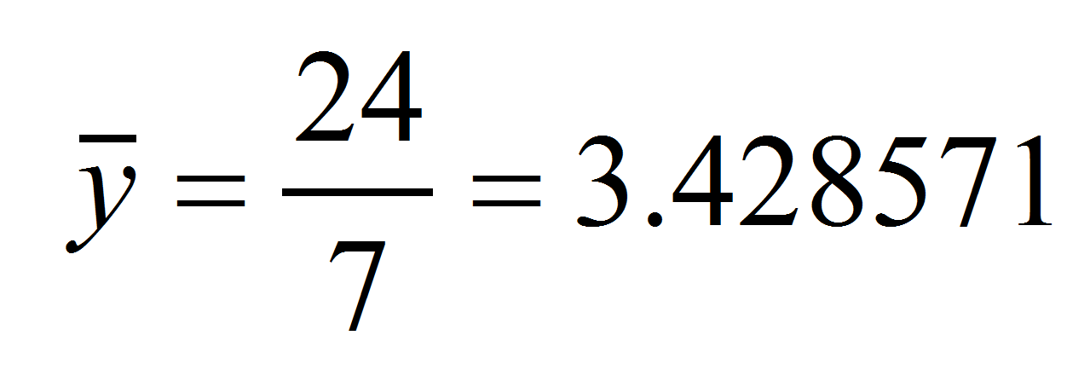
Least Squares Fit of a Straight Line: Example
Fit a straight line to the x and y values in the following Table:
x_{i} | y_{i} | x_{i}y_{i} | x_{i}²
1 | 0.5 | 0.5 | 1
2 | 2.5 | 5 | 4
3 | 2 | 6 | 9
4 | 4 | 16 | 16
5 | 3.5 | 17.5 | 25
6 | 6 | 36 | 36
7 | 5.5 | 38.5 | 49
28 | 24 | 119.5 | 140

Slide 24
Least Squares Fit of a Straight Line: Example (cont’d)
Y = 0.07142857 + 0.8392857 x

Slide 25
Least Squares Fit of a Straight Line: Example (Error Analysis)
x_{i} y_{i}
1 0.5
2 2.5
3 2.0
4 4.0
5 3.5
6 6.0
7 5.5
8.5765 0.1687 0.8622 0.5625
2.0408 0.3473 0.3265 0.3265
0.0051 0.5896 6.6122 0.7972
4.2908 0.1993
28 24.0 22.7143 2.9911

Slide 26
Least Squares Fit of a Straight Line: Example (Error Analysis)
The standard deviation (quantifies the spread around the mean):
The standard error of estimate (quantifies the spread around the regression line)
Because , the linear regression model has good fitness

Slide 27
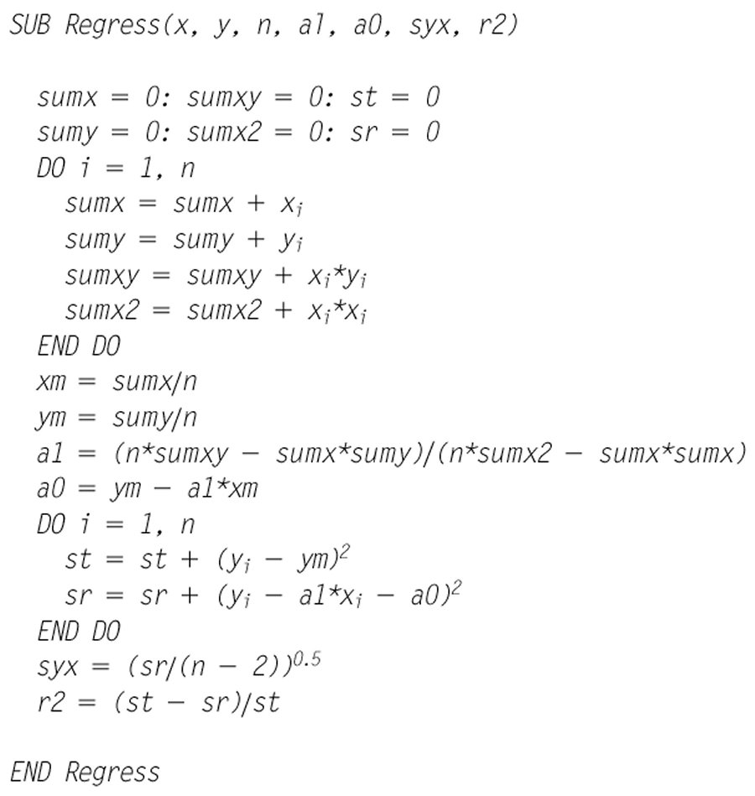
Algorithm for linear regression

Slide 28
Linearization of Nonlinear Relationships
The relationship between the dependent and independent variables is linear.
However, a few types of nonlinear functions can be transformed into linear regression problems.
The exponential equation.
The power equation.
The saturation-growth-rate equation.

Slide 29
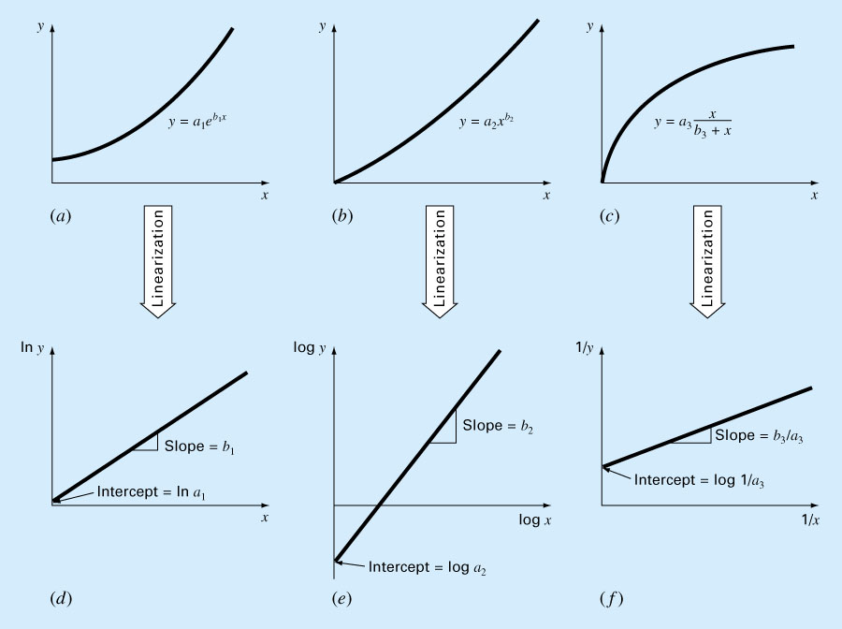

Slide 30
Linearization of Nonlinear Relationships
1. The exponential equation.
y* = a_{o} + a₁ x

Slide 31
Linearization of Nonlinear Relationships
2. The power equation
y* = a_{o} + a₁ x*

Slide 32
Linearization of Nonlinear Relationships
3. The saturation-growth-rate equation
y* = 1/y
a_{o} = 1/a₃
a₁ = b₃/a₃
x* = 1/x

Slide 33
Example
Fit the following Equation:
to the data in the following table:
x_{i} y_{i}
1 0.5
2 1.7
3 3.4
4 5.7
5 8.4
15 19.7
X*=log x_{i} Y*=logy_{i}
0 -0.301
0.301 0.226
0.477 0.534
0.602 0.753
0.699 0.922
2.079 2.141

Slide 34
Example
 | Xi | Yi | X*_{i}=Log(X) | Y*_{i}=Log(Y) | X*Y* | X*^2
 | 1 | 0.5 | 0.0000 | -0.3010 | 0.0000 | 0.0000
 | 2 | 1.7 | 0.3010 | 0.2304 | 0.0694 | 0.0906
 | 3 | 3.4 | 0.4771 | 0.5315 | 0.2536 | 0.2276
 | 4 | 5.7 | 0.6021 | 0.7559 | 0.4551 | 0.3625
 | 5 | 8.4 | 0.6990 | 0.9243 | 0.6460 | 0.4886
Sum | 15 | 19.700 | 2.079 | 2.141 | 1.424 | 1.169

Slide 35
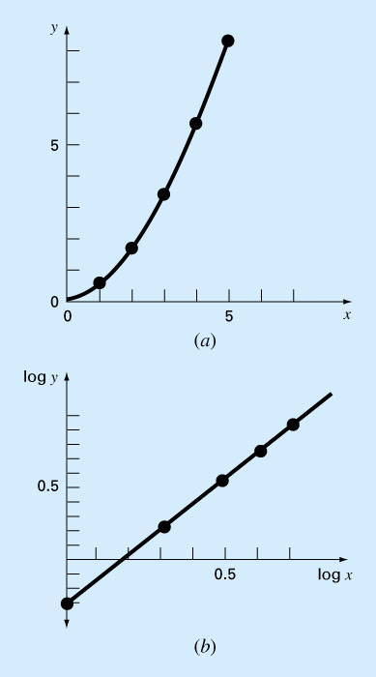
Linearization of Nonlinear Functions: Example
log y=-0.334+1.75log x

Slide 36
Polynomial Regression
Some engineering data is poorly represented by a straight line.
For these cases a curve is better suited to fit the data.
The least squares method can readily be extended to fit the data to higher order polynomials.

Slide 37
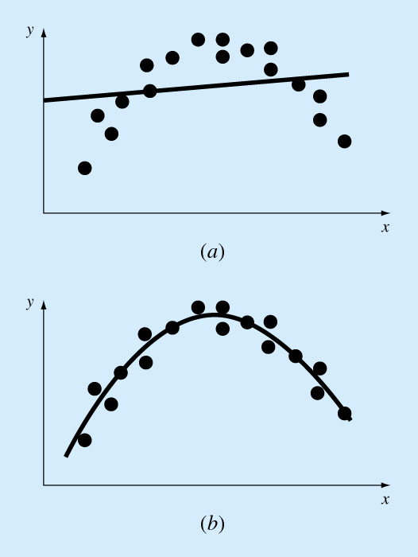
Polynomial Regression (cont’d)
A parabola is preferable

Slide 38
Polynomial Regression (cont’d)
A 2nd order polynomial (quadratic) is defined by:
The residuals between the model and the data:
The sum of squares of the residual:

Slide 39
Polynomial Regression (cont’d)
3 linear equations with 3 unknowns (a_{o},a₁,a₂), can be solved

Slide 40
Polynomial Regression (cont’d)
A system of 3x3 equations needs to be solved to determine the coefficients of the polynomial.
The standard error & the coefficient of determination

Slide 41
Polynomial Regression (cont’d)
General:
The mth-order polynomial:
A system of (m+1)x(m+1) linear equations must be solved for determining the coefficients of the mth-order polynomial.
The standard error:
The coefficient of determination:

Slide 42
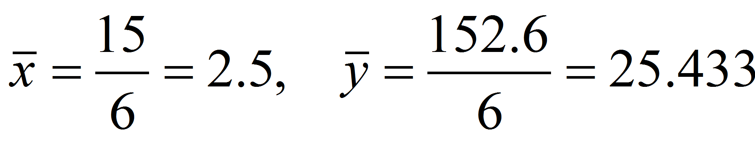
Polynomial Regression- Example
Fit a second order polynomial to data:
x_{i} | y_{i} | x_{i}² | x_{i}³ | x_{i}⁴ | x_{i}y_{i} | x_{i}²y_{i}
0 | 2.1 | 0 | 0 | 0 | 0 | 0
1 | 7.7 | 1 | 1 | 1 | 7.7 | 7.7
2 | 13.6 | 4 | 8 | 16 | 27.2 | 54.4
3 | 27.2 | 9 | 27 | 81 | 81.6 | 244.8
4 | 40.9 | 16 | 64 | 256 | 163.6 | 654.4
5 | 61.1 | 25 | 125 | 625 | 305.5 | 1527.5
15 | 152.6 | 55 | 225 | 979 | 585.6 | 2489

Slide 43
Polynomial Regression- Example (cont’d)
The system of simultaneous linear equations:

Slide 44
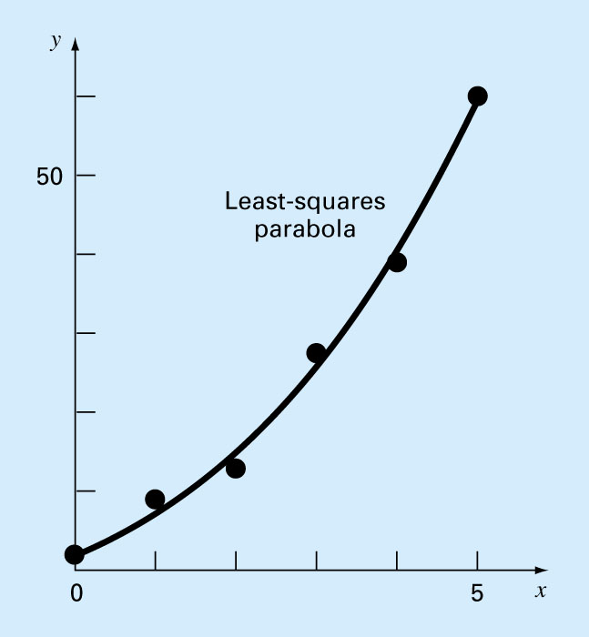
Polynomial Regression- Example (cont’d)
x_{i} | y_{i} | y_{model} | e_{i}² | (y_{i}-y`)²
0 | 2.1 | 2.4786 | 0.14332 | 544.42889
1 | 7.7 | 6.6986 | 1.00286 | 314.45929
2 | 13.6 | 14.64 | 1.08158 | 140.01989
3 | 27.2 | 26.303 | 0.80491 | 3.12229
4 | 40.9 | 41.687 | 0.61951 | 239.22809
5 | 61.1 | 60.793 | 0.09439 | 1272.13489
15 | 152.6 |  | 3.74657 | 2513.39333
The standard error of estimate:
The coefficient of determination:

Slide 45

Next Part:
Interpolation

Slide 46
Interpolation - Introduction
Estimation of intermediate values between precise data points. The most common method is polynomial interpolation:
Polynomial interpolation is used when the point determined are very precise. The curve representing the behavior has to pass through every point (has to touch).
There is one and only one nth-order polynomial that fits n+1 points

Slide 47
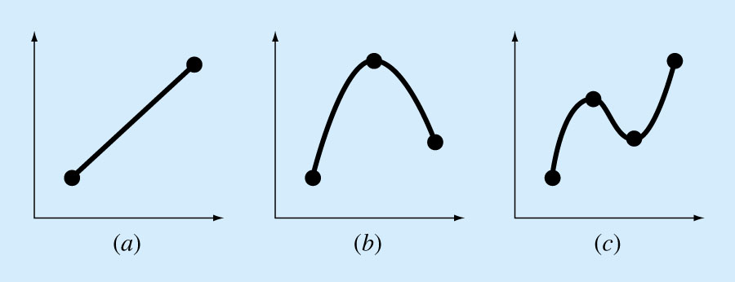
Introduction
n = 3
n = 4
n = 2
First order (linear)
2nd order (quadratic)
3rd order (cubic)

Slide 48
Interpolation
Polynomials are the most common choice of interpolation because they are easy to:
  Evaluate
  Differentiate, and
  Integrate.

Slide 49
Introduction
There are a variety of mathematical formats in which this polynomial can be expressed:
  The Newton polynomial (sec. 18.1)
  The Lagrange polynomial (sec. 18.2)

Slide 50
Newton’s Divided-Difference
Interpolating Polynomials
Linear Interpolation/
Is the simplest form of interpolation, connecting two data points with a straight line.
f₁(x) designates that this is a first-order interpolating polynomial.
Slope and a finite divided difference approximation to 1st derivative
Linear-interpolation formula

Slide 51
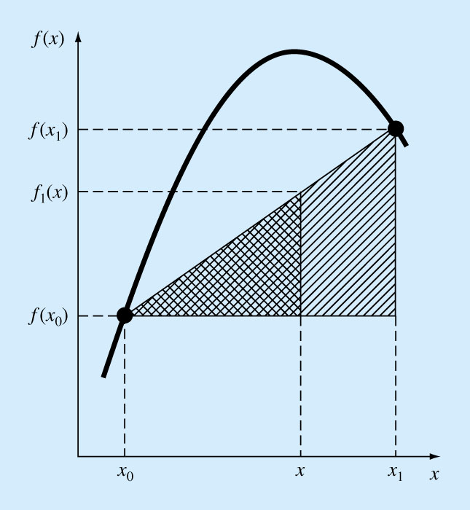
Figure
18.2

Slide 52
Quadratic Interpolation/
If three data points are available, the estimate is improved by introducing some curvature into the line connecting the points.
A simple procedure can be used to determine the values of the coefficients.

Slide 53
General Form of Newton’s Interpolating Polynomials
Bracketed function evaluations are finite divided differences

Slide 54
Lagrange Interpolating Polynomials
The general form for n+1 data points is:
designates the “product of”

Slide 55
Lagrange Interpolating Polynomials
Linear version (n = 1):
Used for 2 points of data: (x_{o},f(x_{o})) and (x₁,f(x₁)),

Slide 56
Lagrange Interpolating Polynomials
Second order version (n = 2):

Slide 57
Lagrange Interpolating Polynomials - Example
Use a Lagrange interpolating polynomial of the first and second order to evaluate ln(2) on the basis of the data:

Slide 58
Lagrange Interpolating Polynomials – Example (cont’d)
First order polynomial:

Slide 59
Lagrange Interpolating Polynomials – Example (cont’d)
Second order polynomial:

Slide 60
Lagrange Interpolating Polynomials – Example (cont’d)

Slide 61
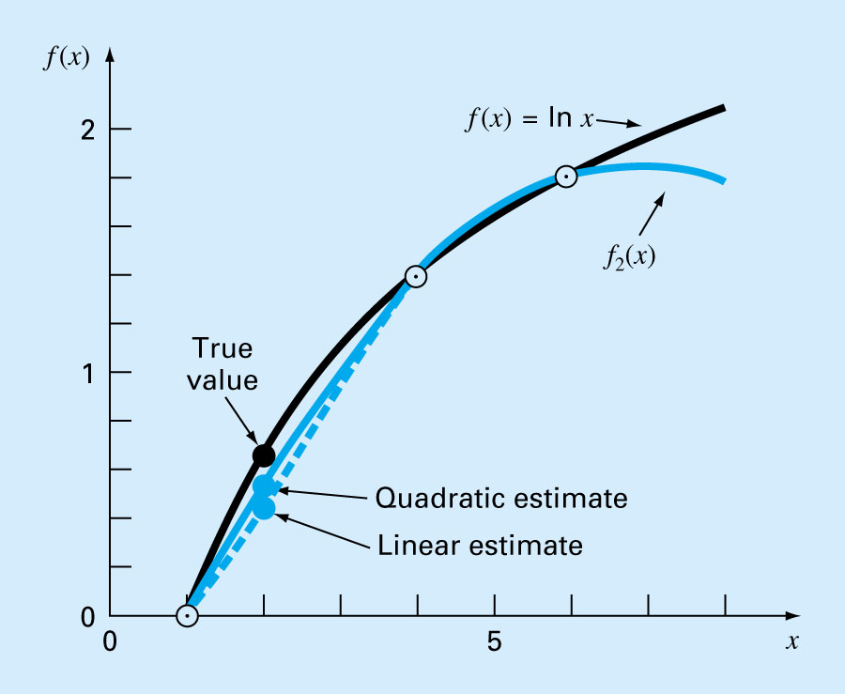
Lagrange Interpolating Polynomials – Example (cont’d)

Slide 62
Coefficients of an Interpolating Polynomial
Although “Lagrange” polynomials are well suited for determining intermediate values between points, they do not provide a polynomial in conventional form:
Since n+1 data points are required to determine n+1 coefficients, simultaneous linear systems of equations can be used to calculate “a”s.

Slide 63
Coefficients of an Interpolating Polynomial (cont’d)
Where “x”s are the knowns and “a”s are the unknowns.

Slide 64
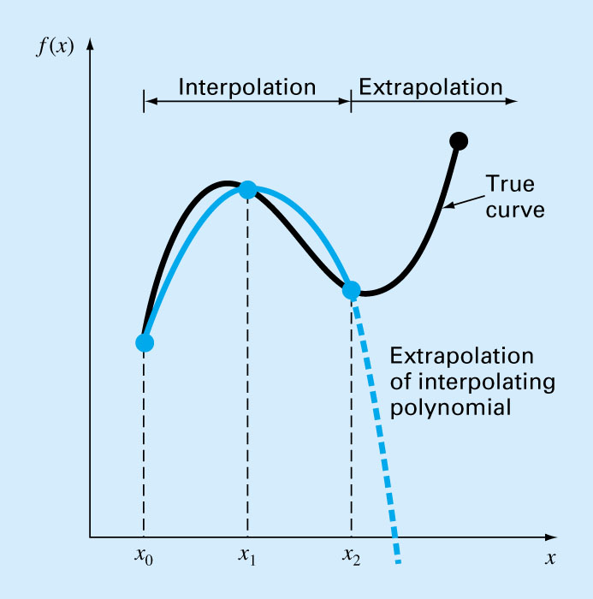
Possible divergence of an extrapolated production

Slide 65
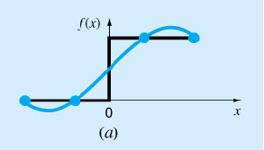
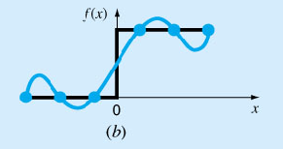
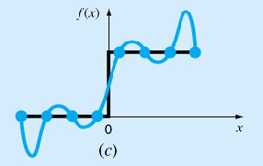
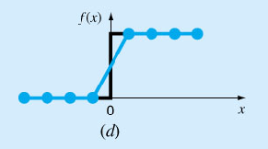
Why Spline Interpolation?
Apply lower-order polynomials to subsets of data points. Spline provides a superior approximation of the behavior of functions that have local, abrupt changes.
20

Slide 66
Spline Interpolation
Polynomials are the most common choice of interpolants.
There are cases where polynomials can lead to erroneous results because of round off error and overshoot.
Alternative approach is to apply lower-order polynomials to subsets of data points. Such connecting polynomials are called spline functions.

Slide 67
Why Splines ?
22

Slide 68
Why Splines ?
Figure : Higher order polynomial interpolation is a bad idea
23

Slide 69
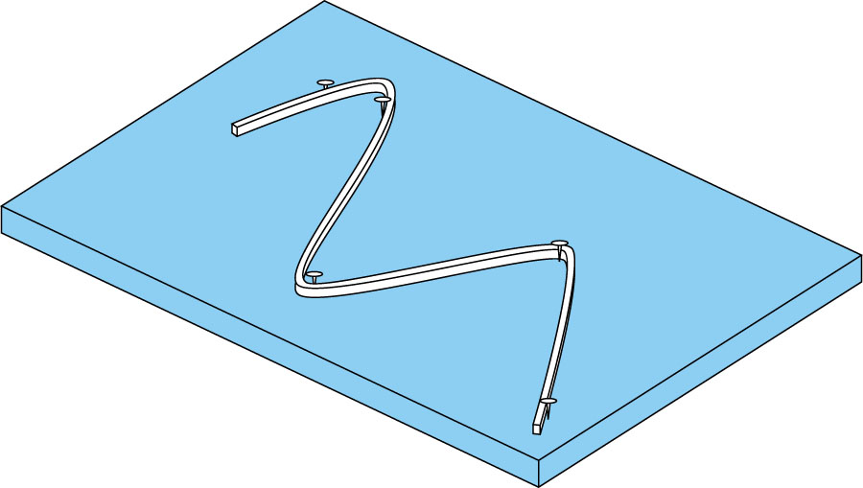
Spline Interpolation
The concept of spline is using a thin , flexible strip (called a spline) to draw smooth curves through a set of points….natural spline (cubic)

Slide 70
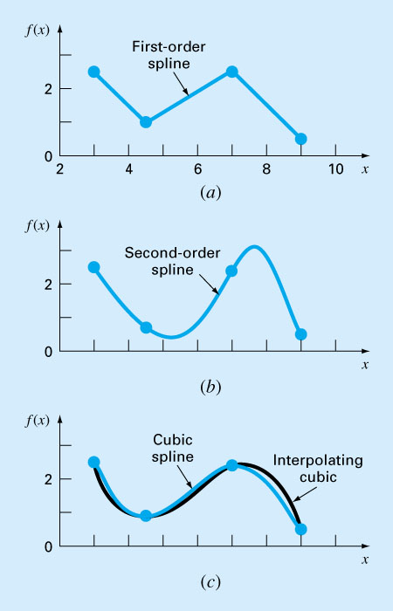

Slide 71
Linear Spline
The first order splines for a group of ordered data points can be defined as a set of linear functions:

Slide 72
Linear spline - Example
Fit the following data with first order splines. Evaluate the function at x = 5.
x f(x)
3.0 2.5
4.5 1.0
7.0 2.5
9.0 0.5

Slide 73
Linear Spline
The main disadvantage of linear spline is that they are not smooth. The data points where 2 splines meets called (a knot), the changes abruptly.
The first derivative of the function is discontinuous at these points.
Using higher order polynomial splines ensure smoothness at the knots by equating derivatives at these points.

Slide 74
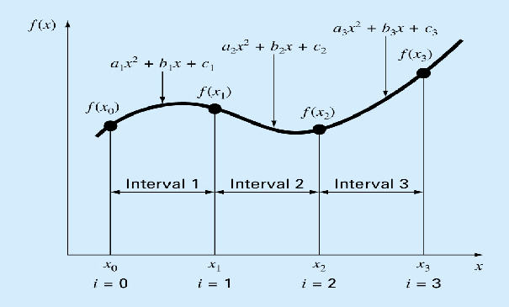
Quadric Splines
Objective: to derive a second order polynomial for each interval between data points.
Terms: Interior knots and end points
For n+1 data points:
i = (0, 1, 2, …n),
n intervals,
3n unknown constants (a’s, b’s and c’s)

Slide 75
Quadric Splines (3n conditions)
The function values of adjacent polynomial must be equal at the interior knots 2(n-1).
The first and last functions must pass through the end points (2).

Slide 76
Quadric Splines (3n conditions)
The first derivatives at the interior knots must be equal (n-1).
Assume that the second derivate is zero at the first point (1)
(The first two points will be connected by a straight line)

Slide 77
Quadric Splines - Example
Fit the following data with quadratic splines. Estimate the value at x = 5.
Solutions:
There are 3 intervals (n=3), 9 unknowns.
x | 3.0 | 4.5 | 7.0 | 9.0
f(x) | 2.5 | 1.0 | 2.5 | 0.5

Slide 78
Quadric Splines - Example
Equal interior points:
For first interior point (4.5, 1.0)
The 1st equation:
The 2nd equation:

Slide 79
Quadric Splines - Example
For second interior point (7.0, 2.5)
The 3rd equation:
The 4th equation:

Slide 80
Quadric Splines - Example
First and last functions pass the end points
For the start point (3.0, 2.5)
For the end point (9, 0.5)

Slide 81
Quadric Splines - Example
Equal derivatives at the interior knots.
For first interior point (4.5, 1.0)
For second interior point (7.0, 2.5)
Second derivative at the first point is 0

Slide 82
Quadric Splines - Example

Slide 83
Quadric Splines - Example
Solving these 8 equations with 8 unknowns

Slide 84
Cubic Splines
Objective: to derive a third order polynomial for each interval between data points.
Terms: Interior knots and end points
For n+1 data points:
i = (0, 1, 2, …n),
n intervals,
4n unknown constants (a’s, b’s ,c’s and d’s)

Slide 85
Cubic Splines (4n conditions)
The function values must be equal at the interior knots (2n-2).
The first and last functions must pass through the end points (2).
The first derivatives at the interior knots must be equal (n-1).
The second derivatives at the interior knots must be equal (n-1).
The second derivatives at the end knots are zero (2), (the 2nd derivative function becomes a straight line at the end points)

Slide 86
Alternative technique to get Cubic Splines
The second derivative within each interval [x_{i-1,} x_{i} ] is a straight line. (the 2nd derivatives can be represented by first order Lagrange interpolating polynomials.
A straight line connecting the first knot f’’(x_{i-1}) and the second knot f’’(x_{i})
The second derivative at any point x within the interval

Slide 87
Cubic Splines
The last equation can be integrated twice
2 unknown constants of integration can be evaluated by applying the boundary conditions:
1. f(x) = f (x_{i-1}) at x_{i-1}
2. f(x) = f (x_{i}) at x_{i}
Unknowns:
i = 0, 1,…, n

Slide 88
Cubic Splines
For each interior point x_{i} (n-1):
This equation result with n-1 unknown second derivatives where, for boundary points:
f˝(x_{o}) = f˝(x_{n}) = 0

Slide 89
Cubic Splines - Example
Fit the following data with cubic splines
Use the results to estimate the value at x=5.
Solution:
Natural Spline:
x | 3.0 | 4.5 | 7.0 | 9.0
f(x) | 2.5 | 1.0 | 2.5 | 0.5

Slide 90
Cubic Splines - Example
For 1st interior point (x₁ = 4.5)
-
-
-
Apply the following equation:
x | 3.0 | 4.5 | 7.0 | 9.0
f(x) | 2.5 | 1.0 | 2.5 | 0.5

Slide 91
Cubic Splines - Example
Since
For 2nd interior point (x₂ = 7 )
x | 3.0 | 4.5 | 7.0 | 9.0
f(x) | 2.5 | 1.0 | 2.5 | 0.5

Slide 92
Cubic Splines - Example
Apply the following equation:
Since

Slide 93
Cubic Splines - Example
Solve the two equations:
The first interval (i=1), apply for the equation:

Slide 94
Cubic Splines - Example
The 2nd interval (i =2), apply for the equation:
The 3rd interval (i =3),
For x = 5:

Slide 95
Credits:
Chapra, Canale
The Islamic University of Gaza, Civil Engineering Department

