Slide 1
SKTN 2393 Numerical Methods for Nuclear Engineers
Chapter 4
Eigenvalues
Mohsin Mohd Sies
Nuclear Engineering,
School of Chemical and Energy Engineering,
Universiti Teknologi Malaysia

Slide 2
Matrix Eigenvalues
Eigenvalue = characteristic value of a square matrix
Common fields of application: vibration, oscillation systems, elasticity.
  We can think of eigenvalues as the characteristic “natural mode” of a system.

Slide 3
Engineering applications
Spring mass system (vibration)
  Mode & frequency
Buckling of column under loading
Electrical engineering
  Frequency & phase angle
Chemical reactions
Macroeconomics
  Balanced profitability vs balanced growth for all sectors

Slide 4
Eigenvalues in Nuclear Engineering
Some common eigenvalue calculations include the simulation of nuclear reactors, spent fuel pools, nuclear weapons, and other fissile systems.
The transport equation becomes an eigenvalue equation if a fissionable source is present since then the source of neutrons will depend on the flux of neutrons itself

Slide 5
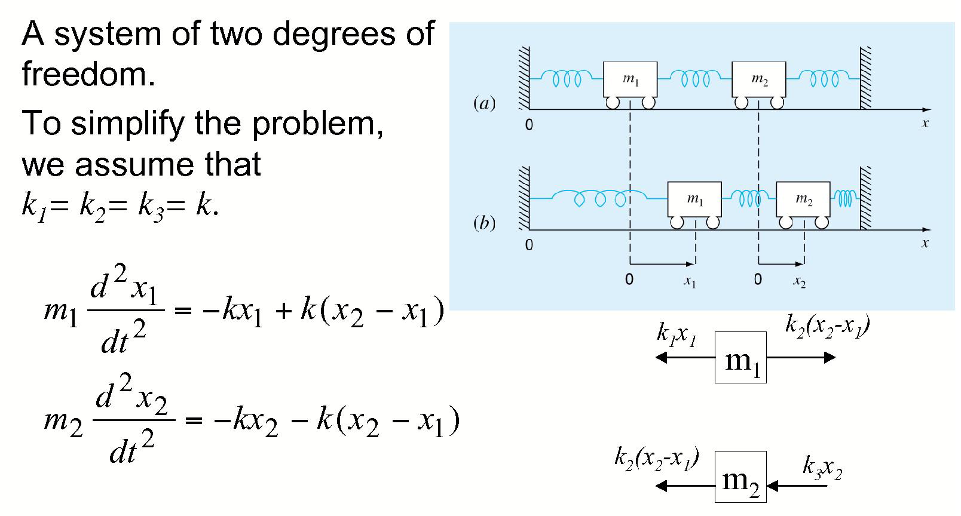
Physics of Eigenvalues & Eigenvectors

Slide 6
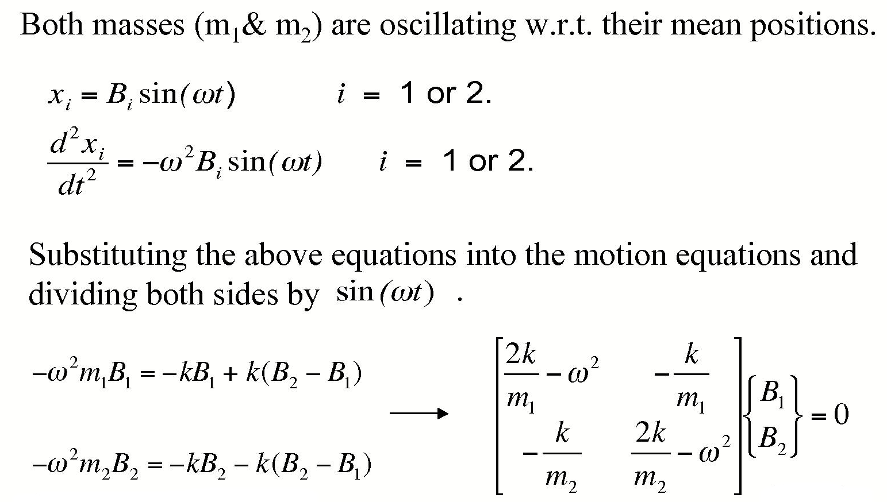
Physics of Eigenvalues

Slide 7
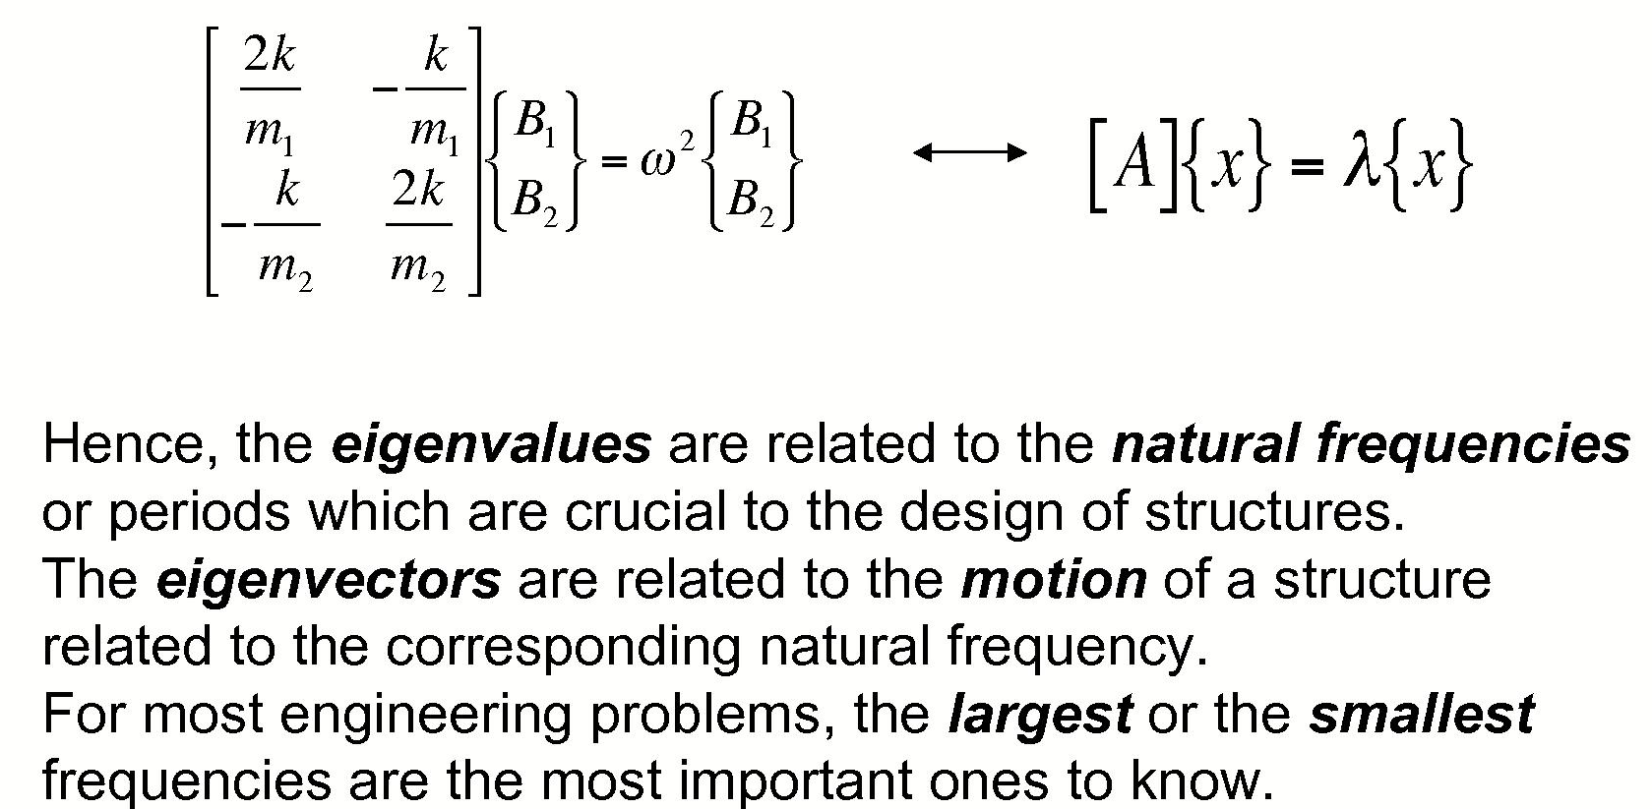
Physics of Eigenvalues

Slide 8
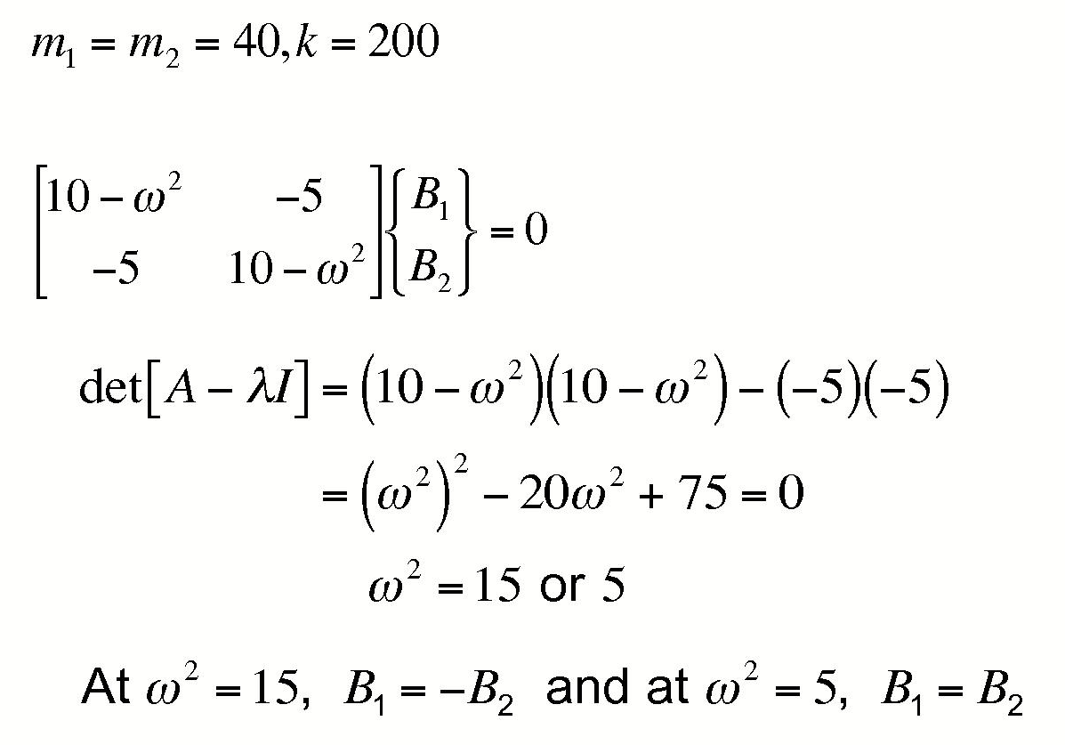
Eigenvalue Example

Slide 9
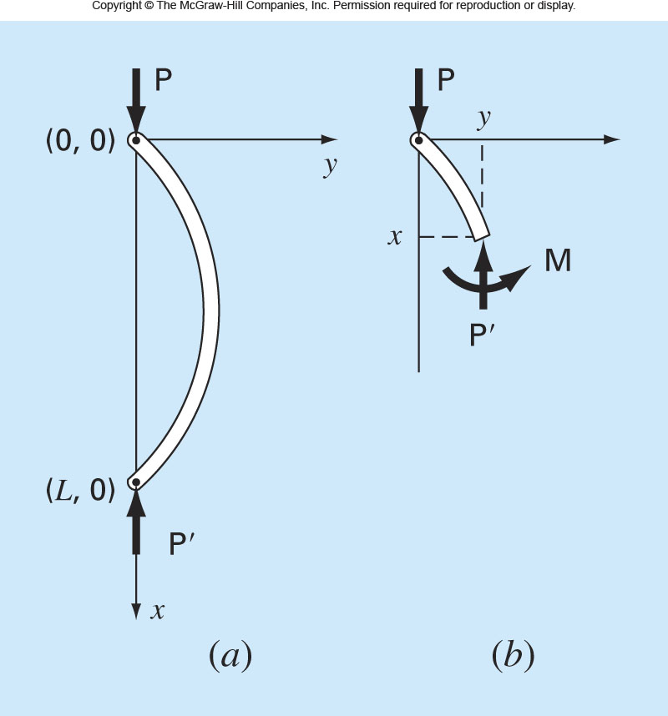

Slide 10
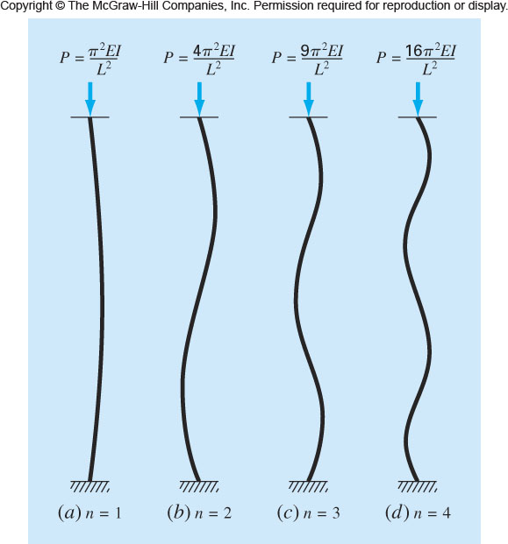

Slide 11
Eigenvalues
For a non-homogeneous system of linear algebraic equations
[A]{x} = {B}
If [A] has non-zero determinant (linearly independent system)
  System has unique solution; only one {x} can satisfy equation

Slide 12
Eigenvalues
For homogeneous systems
[A]{x} = 0
Solution is not unique; several {x}'s can satisfy equation
We can write
[A]{x} = λ {x}
λ = scalar that satisfies system
= eigenvalue of [A] (can be many)
[A] = square matrix
{x} = eigenvector
λ, {x} = eigenpair

Slide 13
This deceptively simple equation says that for the square matrix A, there is a vector x such that multiplying x by the matrix A gives the same result as multiplying it with just a scalar, λ.
Multiplying a matrix A with a vector x would usually change the vector’s direction, but some special vectors do not change direction after being multiplied with A.
That multiplication will just result in the stretching or shrinking of the vector without changing its direction. This is the same as multiplying it with a scalar constant.
These special vectors are called eigenvectors.

Slide 14

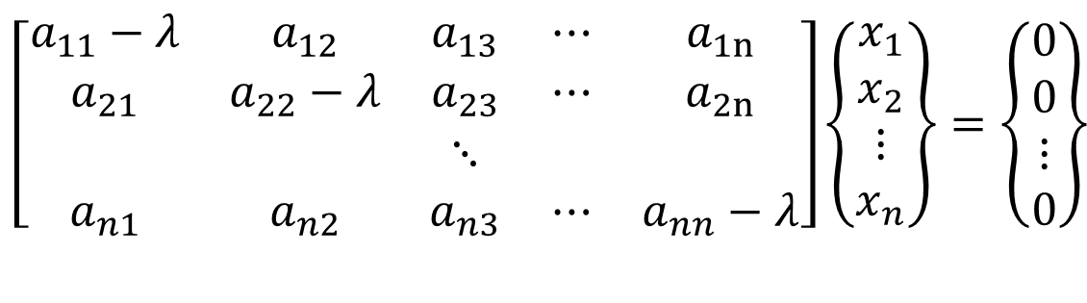

$$\left[A\right]\left\{\vec{X}\right\}=λ\left\{\vec{X}\right\}$$
Can be written as
$$\left\{\left[A\right]−λ\left[I\right]\right\}\left\{\vec{X}\right\}=0$$
Expanded to become
$$\left[\begin{matrix}a_{11}−λ & a_{12} & a_{13} & ⋯ & a_{1n} \\ a_{21} & a_{22}−λ & a_{23} & ⋯ & a_{2n} \\ & & ⋱ & & \\ a_{n1} & a_{n2} & a_{n3} & ⋯ & a_{nn}−λ\end{matrix}\right]\left\{\begin{matrix}x_{1} \\ x_{2} \\ ⋮ \\ x_{n}\end{matrix}\right\}=\left\{\begin{matrix}0 \\ 0 \\ ⋮ \\ 0\end{matrix}\right\}$$

Slide 15


Standard Form of Eigenvalue Problem
General Form of Eigenvalue Problem
$$\left[A\right]\left\{\vec{X}\right\}=λ\left\{\vec{X}\right\}$$
$$\left[A\right]\left\{\vec{X}\right\}=λ\left[B\right]\left\{\vec{X}\right\}$$
General form can be converted to standard form (solution methods employ standard form)

Slide 16
Methods for Solving Eigenvalue Problems
Determinant search method
  Characteristic polynomial
Iterative
  Power method
  Vector iteration, subspace iteration, etc.
Transformation
  Jacobi
  Givens
  Householder

Slide 17
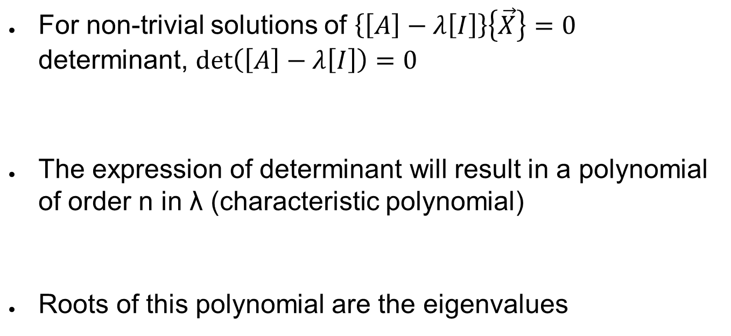

Determinant search
For non-trivial solutions of $\left\{\left[A\right]−λ\left[I\right]\right\}\left\{\vec{X}\right\}=0$
determinant, $\text{det}\left(\left[A\right]−λ\left[I\right]\right)=0$
The expression of determinant will result in a polynomial of order n in λ (characteristic polynomial)
Roots of this polynomial are the eigenvalues
$$\left|\left[A\right]−λ\left[I\right]\right|=0$$
$$λ^{n}−p_{1}λ^{n−1}−⋯−p_{n−2}λ^{2}−p_{n−1}λ−p_{n}=0$$

Slide 18
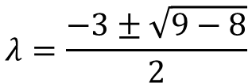
2 X 2 Example
1 -2 1 - λ -2
3 -4 3 -4 - λ
A = so A - λI =
det(A - λI) = (1 - λ)(-4 - λ) – (3)(-2)
= λ² + 3 λ + 2
Set λ² + 3 λ + 2 to 0
Then
So the two values of λ are -1 and -2.
*How to obtain eigenvectors?
$$λ=\frac{−3±\sqrt{9−8}}{2}$$

Slide 19
Eigenvalue Example

Slide 20
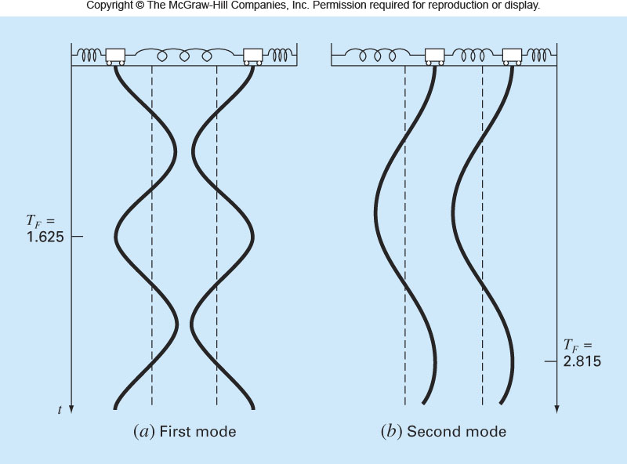

Slide 21
Faddeev-Leverrier Method
For large order [A]'s, expanding determinant to get the polynomial is tedious
Use Faddeev-Leverrier Method to get polynomial
If the characteristic polynomial is written as
$$λ^{n}−p_{1}λ^{n−1}−⋯−p_{n−2}λ^{2}−p_{n−1}λ−p_{n}=0$$

Slide 22
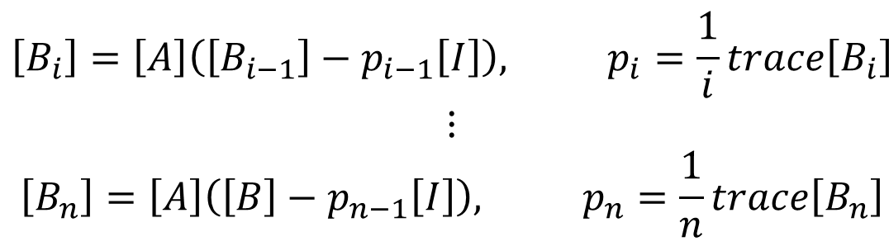
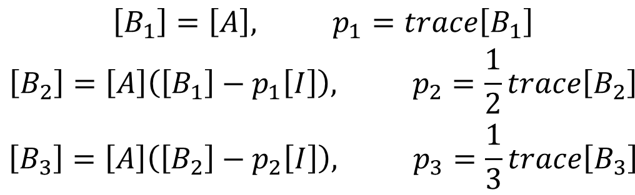
Faddeev-Leverrier Method
Get polynomial coefficients p₁,p₂,...p_{n} from sequence of matrices [B_{i}]
succinctly;
$$\begin{matrix}\left[B_{1}\right]=\left[A\right], p_{1}=trace\left[B_{1}\right] \\ \left[B_{2}\right]=\left[A\right]\left(\left[B_{1}\right]−p_{1}\left[I\right]\right), p_{2}=\frac{1}{2}trace\left[B_{2}\right] \\ \left[B_{3}\right]=\left[A\right]\left(\left[B_{2}\right]−p_{2}\left[I\right]\right), p_{3}=\frac{1}{3}trace\left[B_{3}\right]\end{matrix}$$
$$\begin{matrix}\left[B_{i}\right]=\left[A\right]\left(\left[B_{i−1}\right]−p_{i−1}\left[I\right]\right), p_{i}=\frac{1}{i}trace\left[B_{i}\right] \\ ⋮ \\ \left[B_{n}\right]=\left[A\right]\left(\left[B\right]−p_{n−1}\left[I\right]\right), p_{n}=\frac{1}{n}trace\left[B_{n}\right]\end{matrix}$$

Slide 23
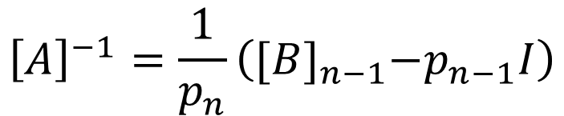
Faddeev-Leverrier Method
This method can also give us the inverse of the matrix A
$${\left[A\right]}^{−1}=\frac{1}{p_{n}}\left({[B]}_{n−1}−p_{n−1}I\right)$$

Slide 24
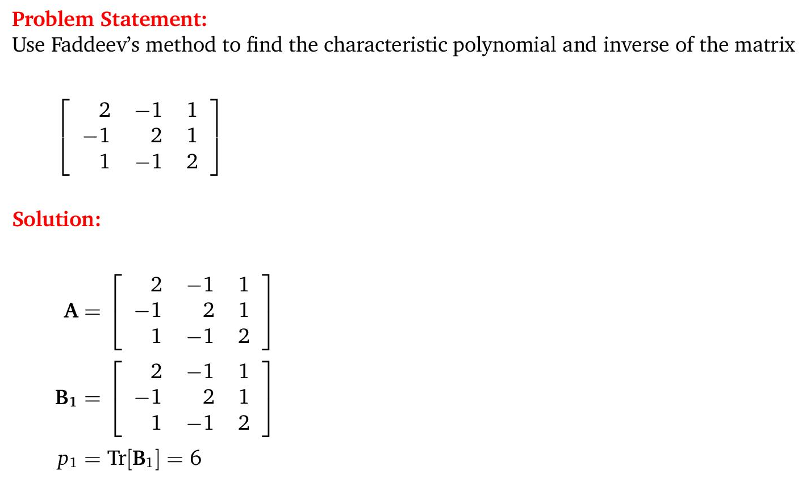
Example

Slide 25
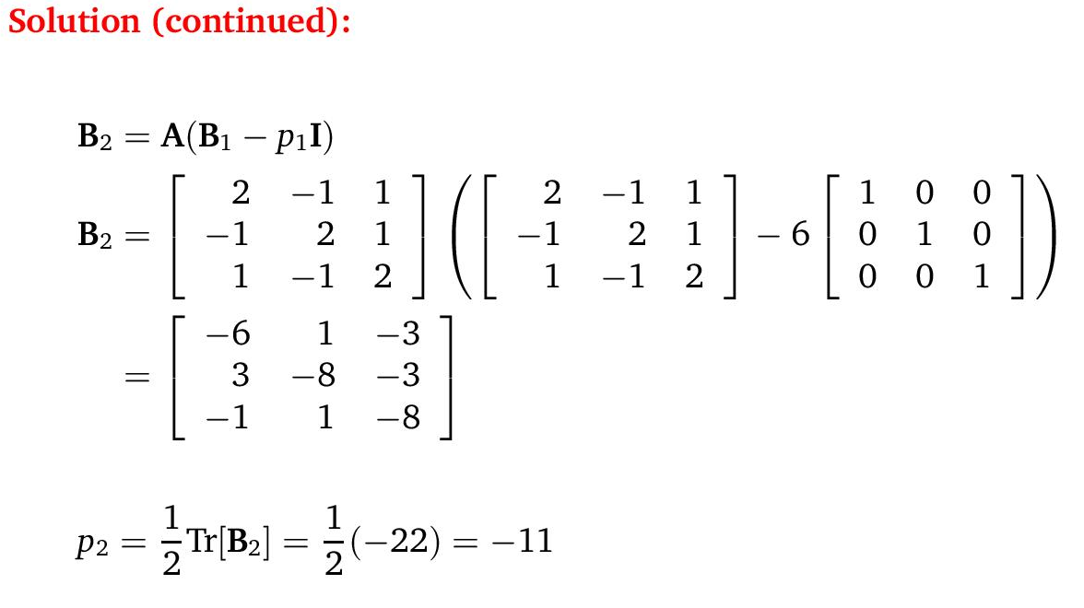

Slide 26
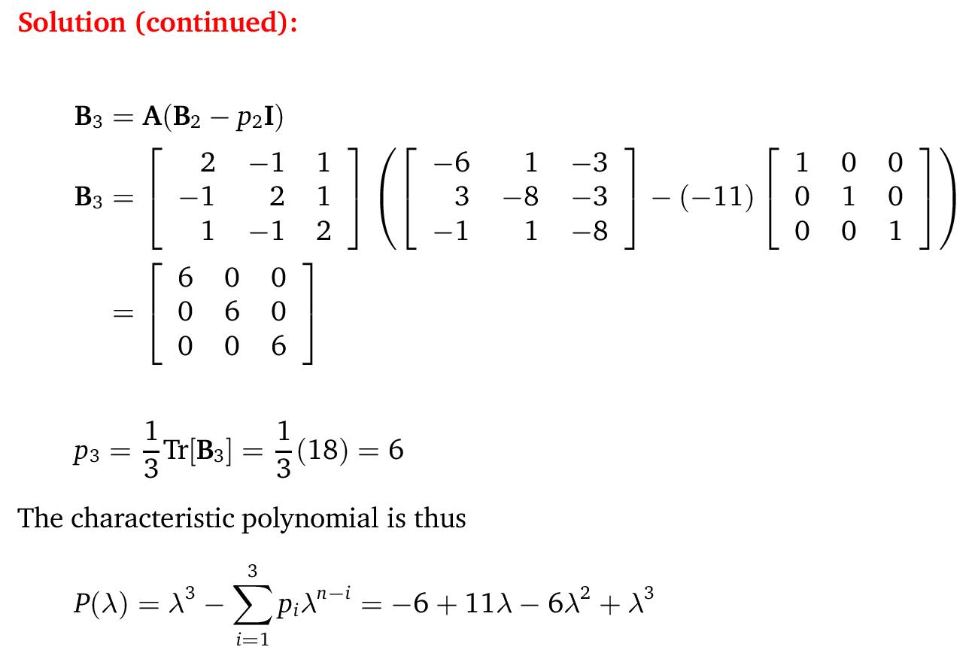

Slide 27
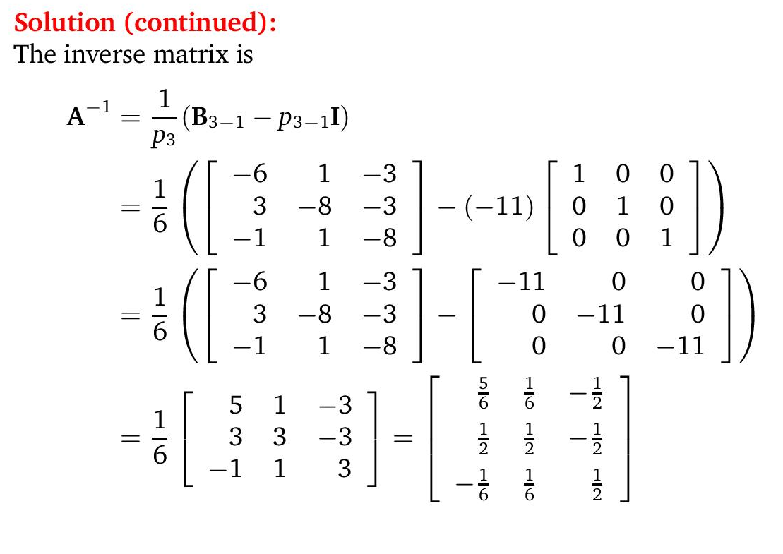

Slide 28
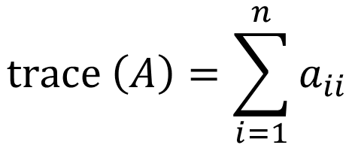
Trace of a matrix
Trace = the sum of the diagonal elements of a square (n x n) matrix
$$\text{trace} \left(A\right)=\sum_{i=1}^{n}{a_{ii}}$$
Some facts about eigenvalues:
• The product of the eigenvalues=det|A|
• The sum of the eigenvalues=trace(A)

Slide 29
Power Method
Can be used to get largest eigenvalue
Lowest & other eigenvalues obtained with slight modifications
Eigenvectors obtained as by-product (no separate steps needed)
Rayleigh quotient to find eigenvalue for a given eigenvector

Slide 30
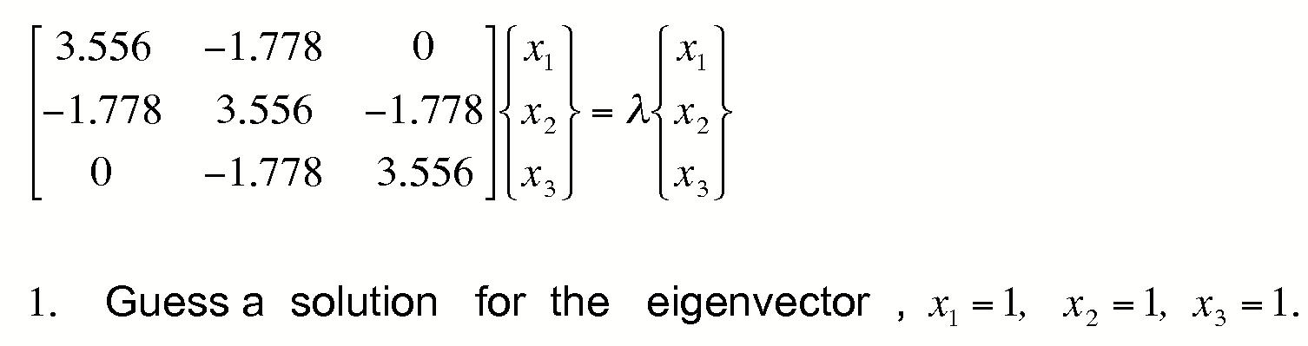
Power Method
  The Power Method is an iterative procedure for determining the dominant (largest) eigenvalue of the matrix A and the corresponding eigenvector.
  Example

Slide 31
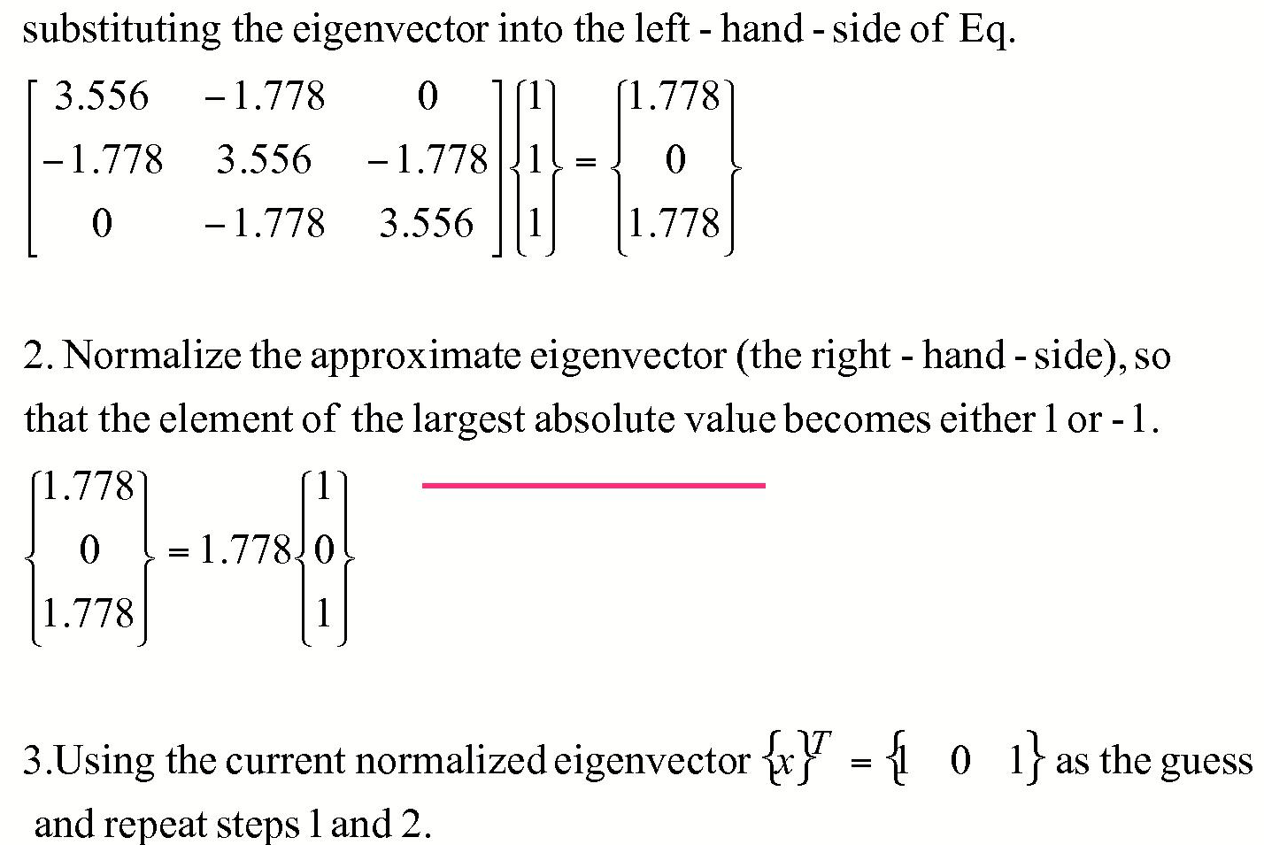
Example of Power Method (Cont.)

Slide 32
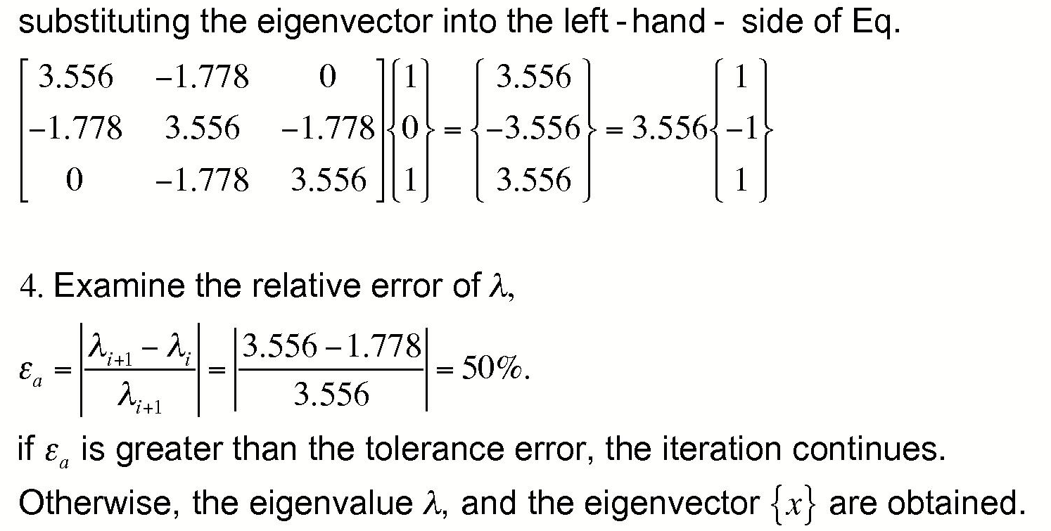
Example of Power Method (Cont.)

Slide 33
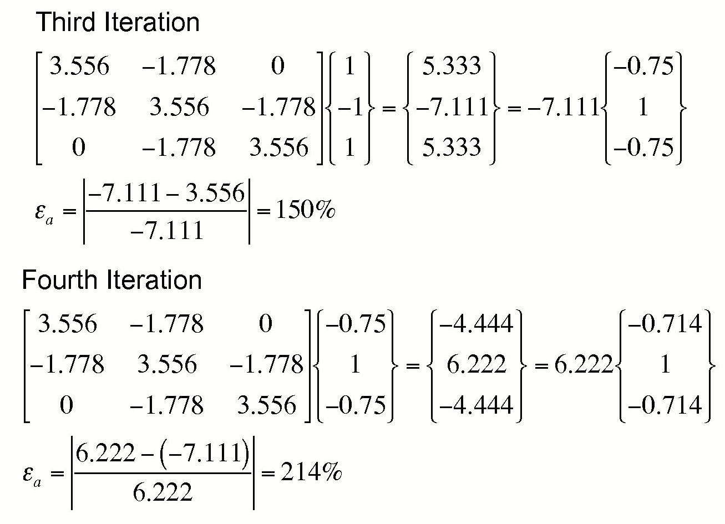
Example of Power Method (Cont.)

Slide 34
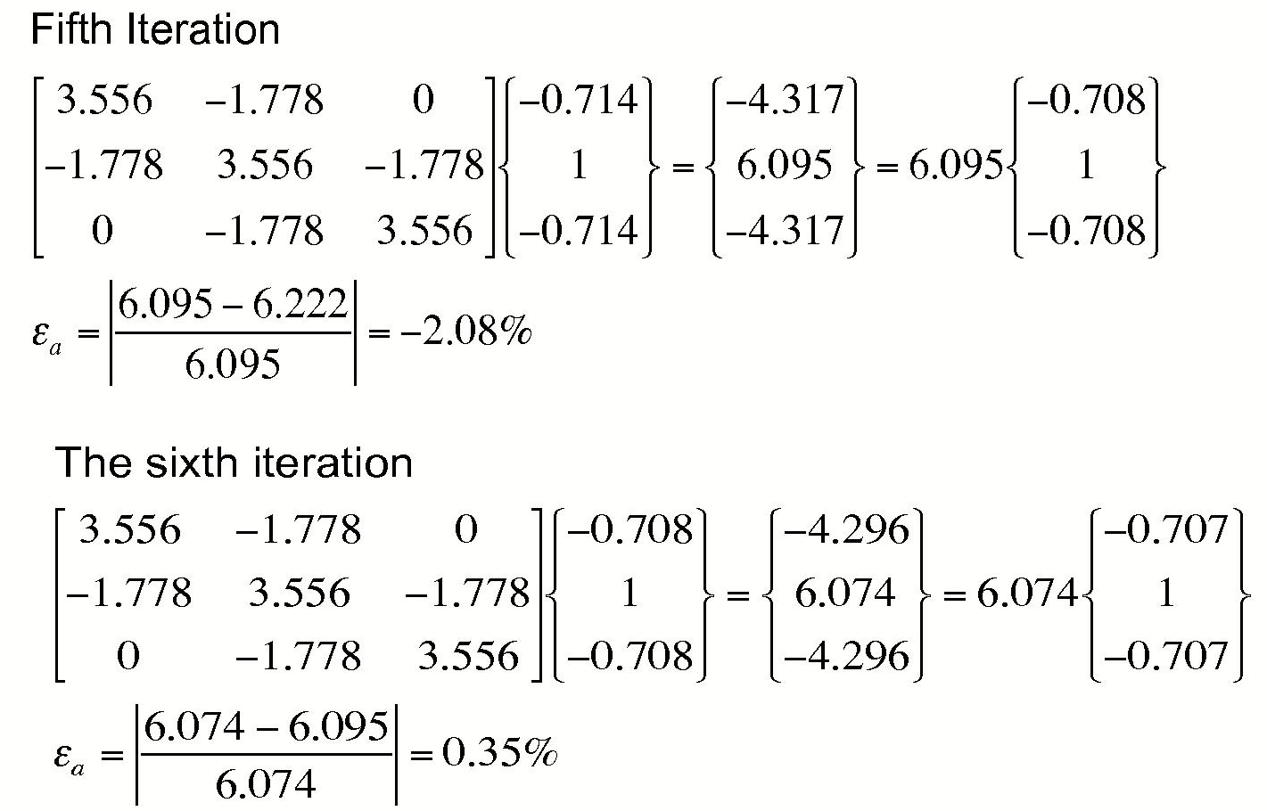
Example of Power Method (Cont.)

Slide 35
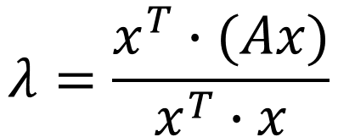
Rayleigh Quotient
This is to find the eigenvalue if we know the eigenvector
$$λ=\frac{x^{T}∙(Ax)}{x^{T}∙x}$$

Slide 36
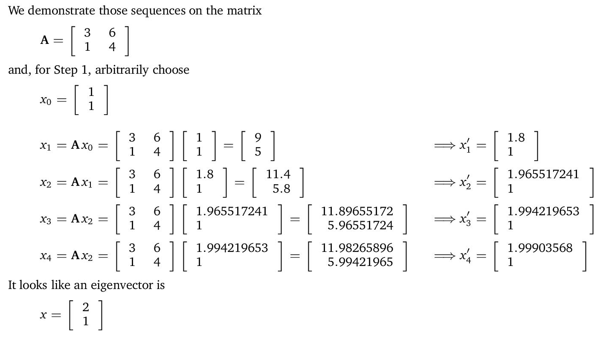
Example
Normalizing

Slide 37
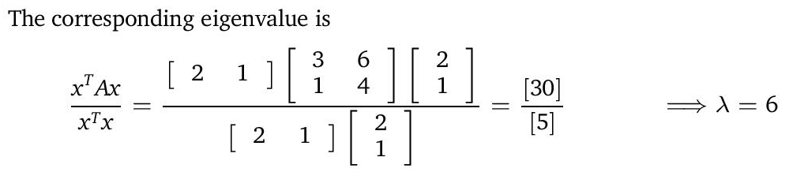
Employing Rayleigh quotient,

Slide 38
Inverse Power Method
  The Power Method can be modified to provide the smallest (lowest) (magnitude) eigenvalue and its eigenvector. The modified method is known as the inverse power method
  The smallest eigenvalue λ in the matrix A corresponds to 1/ λ the largest eigenvalue in the inverse matrix A⁻¹.

Slide 39
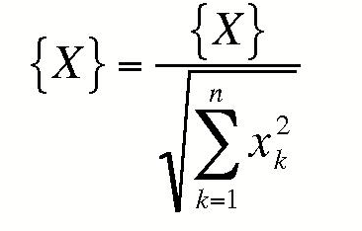
General I-P Method
  The combination of Power Method and I-P method can be use to determine all the eigenvalues and their related eigenvectors.
  Deflation Hotelling’s Method for symmetric matrices
    First, normalize the largest eigenvector found by the sum of the squares of the elements in the eigenvector

Slide 40
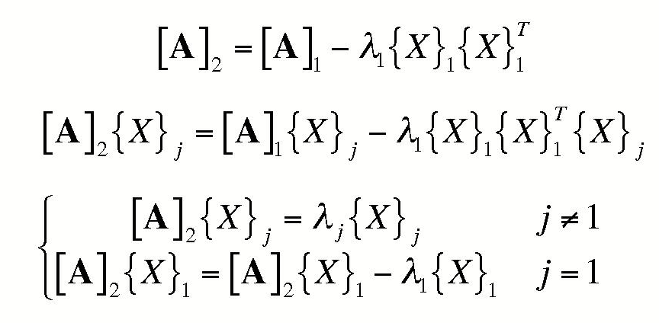
General I-P Method
  Then create new A₂ matrix
  The new A₂ matrix has the same eigenvalues as A₁ except that the largest eigenvalue has been replaced with 0

Slide 41
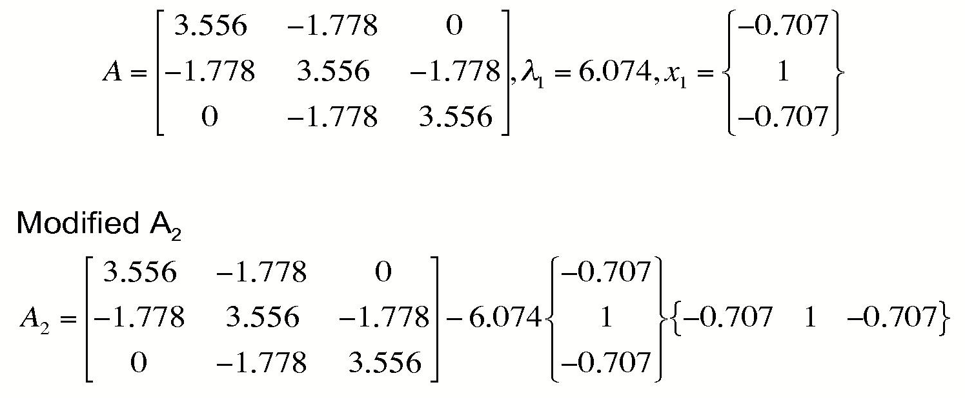
Hotelling’s Method

Slide 42
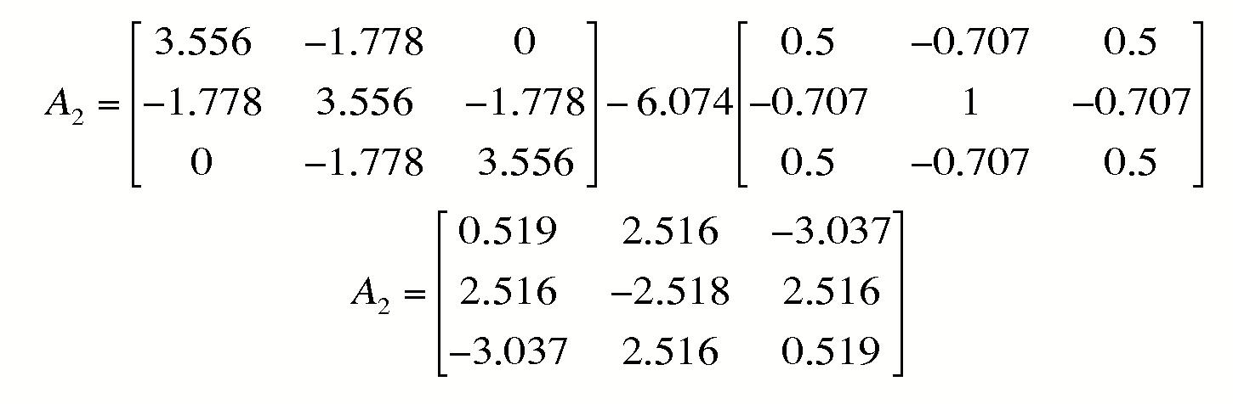
Hotelling’s Method

Slide 43
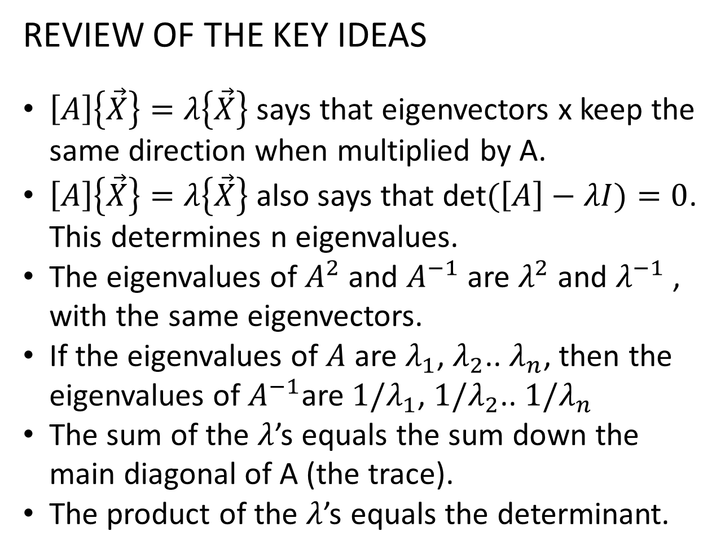
REVIEW OF THE KEY IDEAS
$\left[A\right]\left\{\vec{X}\right\}=λ\left\{\vec{X}\right\}$ says that eigenvectors x keep the same direction when multiplied by A.
$\left[A\right]\left\{\vec{X}\right\}=λ\left\{\vec{X}\right\}$ also says that det$(\left[A\right]−λI)=0$. This determines n eigenvalues.
The eigenvalues of $A^{2}$ and $A^{−1}$ are $λ^{2}$ and $λ^{−1}$ , with the same eigenvectors.
If the eigenvalues of $A$ are $λ_{1}$, $λ_{2}$.. $λ_{n}$, then the eigenvalues of $A^{−1}$are ${1/λ}_{1}$, $1/λ_{2}$.. $1/λ_{n}$
The sum of the $λ$’s equals the sum down the main diagonal of A (the trace).
The product of the $λ$’s equals the determinant.

Slide 44
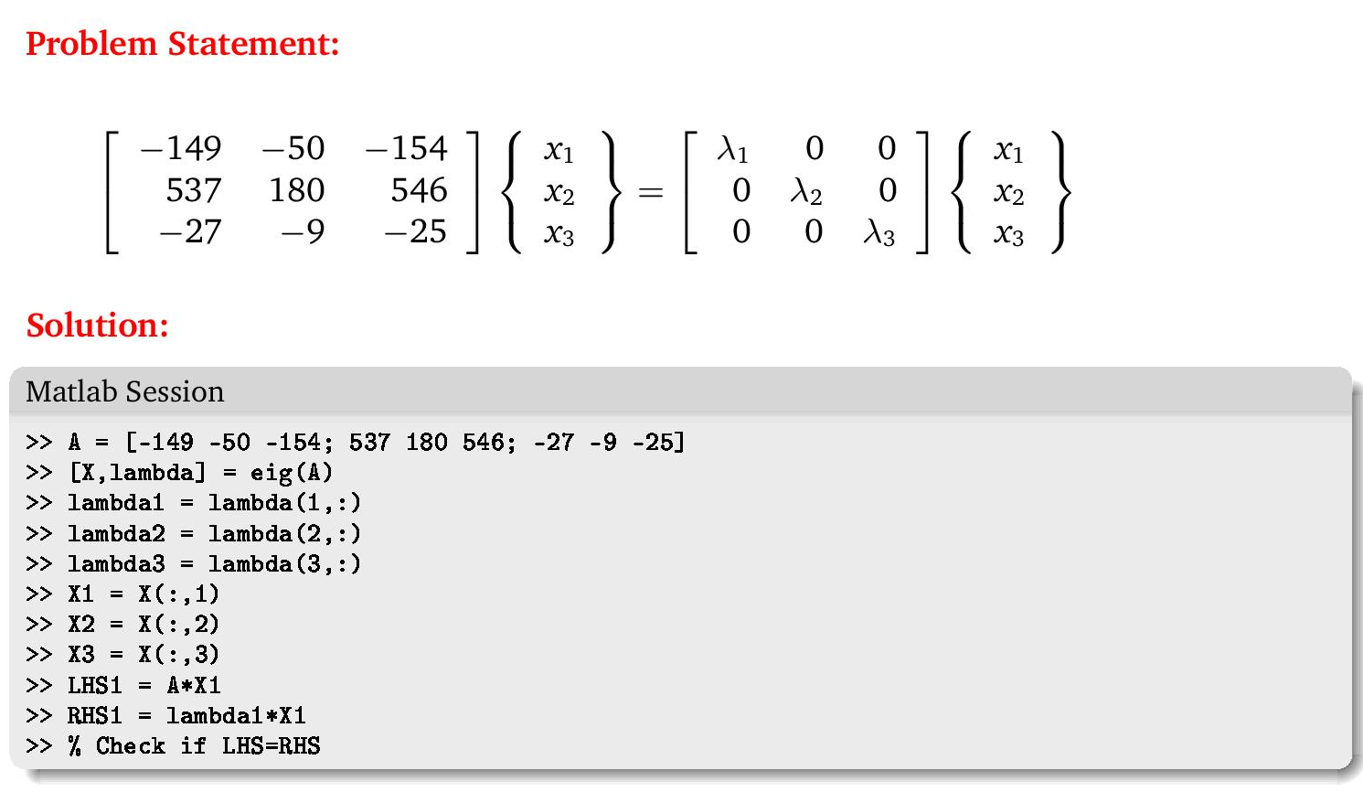
Matlab eig function

