Slide 1
SKTN 2393 Numerical Methods for Nuclear Engineers
Chapter 3
Simultaneous Linear Equations
Mohsin Mohd Sies
Nuclear Engineering,
School of Chemical and Energy Engineering,
Universiti Teknologi Malaysia

Slide 2
Motivation
Many applications of engineering lead to a system of linear algebraic equations, involving thousands of simultaneous linear equations that need to be solved.
Samples of engineering applications include
  force analysis of statically determinate structures
  flow of current in electrical circuits
  force analysis of mechanisms
  finite element analysis of heat flow and stress analysis problems
  flow of fluid in pipe network
  least-square curve-fitting calculations.

Slide 3
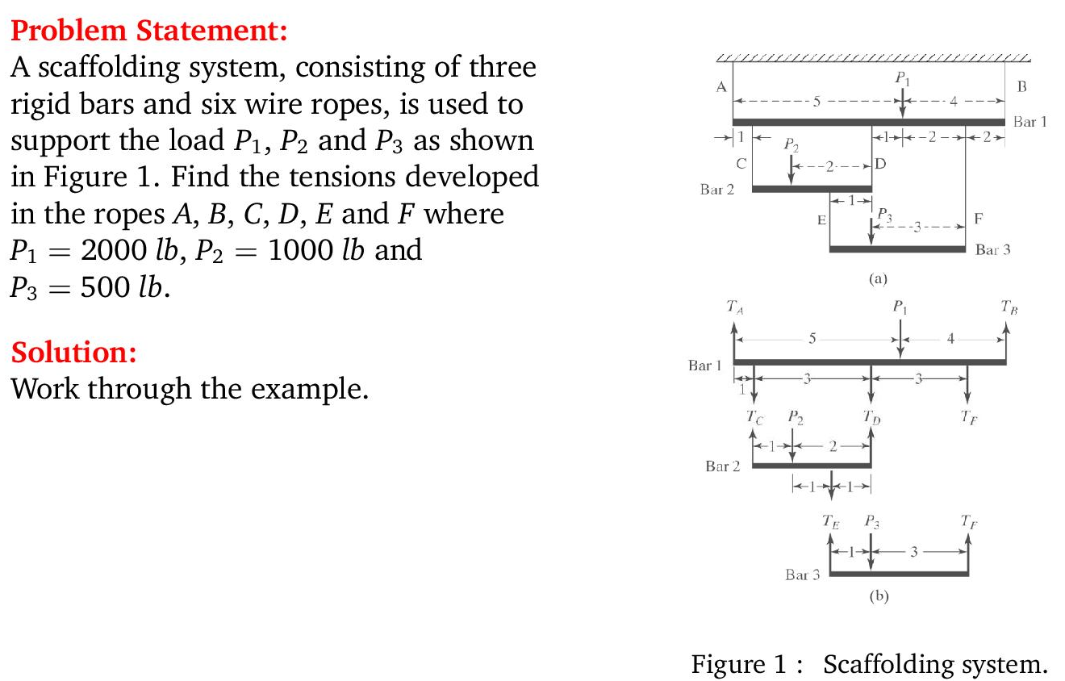
Application Example

Slide 4
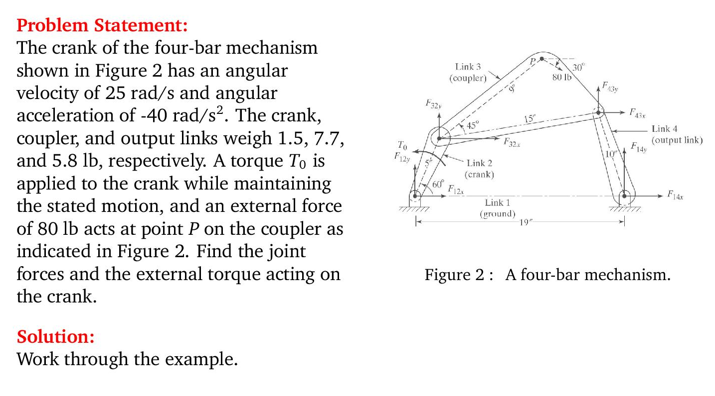
Application Example

Slide 5
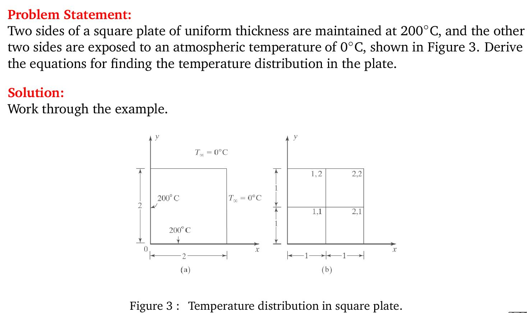
Application Example

Slide 6
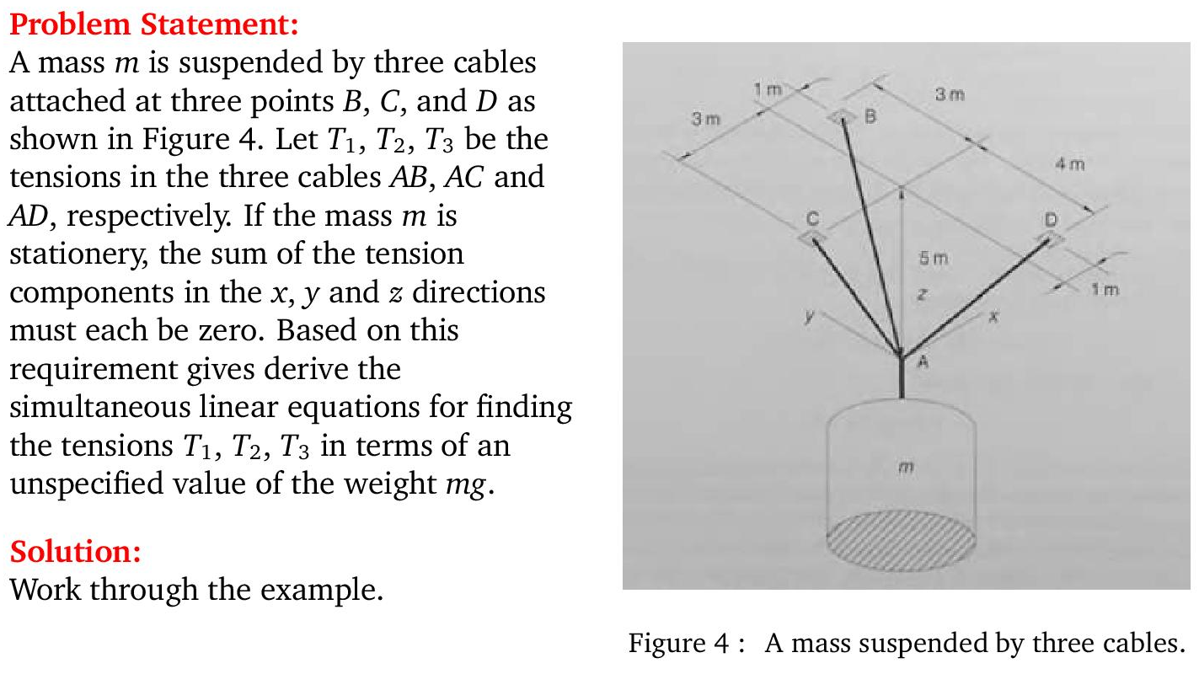
Application Example

Slide 7
Linear Algebraic Equations
An equation of the form ax+by+c=0 or equivalently ax+by=-c is called a linear equation in x and y variables.
ax+by+cz=d is a linear equation in three variables, x, y, and z.
Change the form of the equation in a form suitable for programming, employing indices instead of different variables x, y and z.
Thus, a linear equation in n variables is
a₁x₁+a₂x₂+ … +a_{n}x_{n} = b
A solution of such an equation consists of real numbers c₁, c₂, c₃, … , c_{n}. If you need to work more than one linear equations, a system of linear equations must be solved simultaneously.

Slide 8
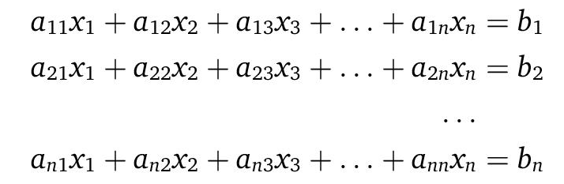
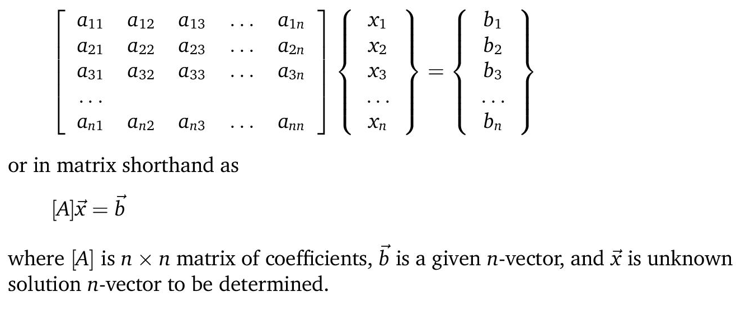
Which can be written in the form of

Slide 9
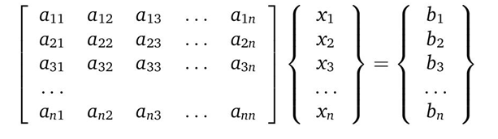
Engineering view
We can roughly look at the problem [A]{x} = {B} as
System matrix
System response
Forcing function
(Stimuli)
(External ‘load’)

Slide 10
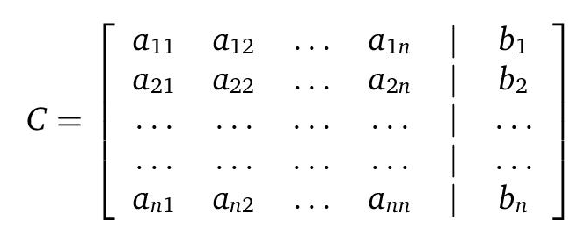
Augmented matrix

Slide 11
Solving Small Numbers of Equations
There are many ways to solve a system of linear equations:
  Graphical method
  Cramer’s rule
  Method of elimination
  Computer methods
For n ≤ 3

Slide 12
Graphical Method
For two equations:
Solve both equations for x_{2:}

Slide 13
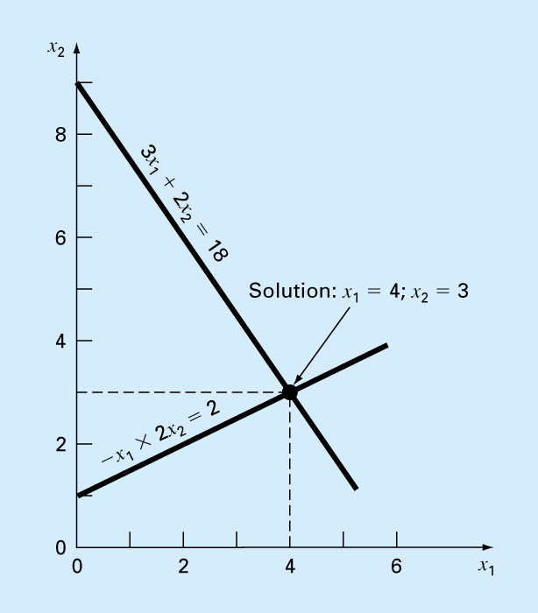
Plot x₂ vs. x₁ on rectilinear paper, the intersection of the lines present the solution.
Fig. 9.1

Slide 14
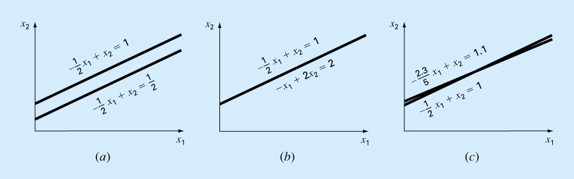
Figure 9.2

Slide 15
Determinants and Cramer’s Rule
Determinant can be illustrated for a set of three equations:
Where [A] is the coefficient matrix:

Slide 16
Assuming all matrices are square matrices, there is a number associated with each square matrix [A] called the determinant, D, of [A]. If [A] is order 1, then [A] has one element:
[A]=[a₁₁]
D=a₁₁
For a square matrix of order 3, the minor of an element a_{ij} is the determinant of the matrix of order 2 by deleting row i and column j of [A].

Slide 18
Cramer’s rule expresses the solution of a systems of linear equations in terms of ratios of determinants of the array of coefficients of the equations. For example, x₁ would be computed as:

Slide 19
Elimination Methods
(Direct Methods)

Slide 20
Method of Elimination
The basic strategy is to successively solve one of the equations of the set for one of the unknowns and to eliminate that variable from the remaining equations by substitution.
The elimination of unknowns can be extended to systems with more than two or three equations; however, the method becomes extremely tedious to solve by hand.

Slide 21
Naive Gauss Elimination
Extension of method of elimination to large sets of equations by developing a systematic scheme or algorithm to eliminate unknowns and to back substitute.
As in the case of the solution of two equations, the technique for n equations consists of two phases:
  Forward elimination of unknowns
  Back substitution

Slide 22
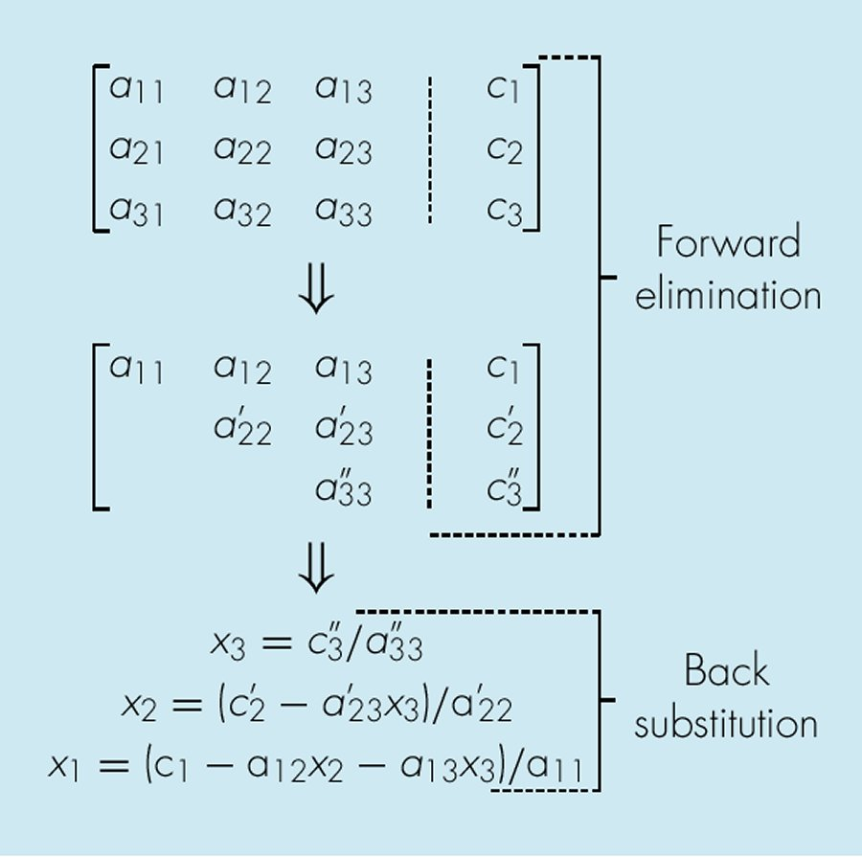
Fig. 9.3

Slide 23
Forward Elimination
The goal is to construct an equivalent upper-triangular system Ux = b that can be solved by the method of upper-triangular linear systems
Two linear systems of dimension n × n are said to be equivalent provided that their solution sets are the same.
When certain elementary operations are applied to a given set of system, the solution sets do not change

Slide 24
Forward Elimination
Elementary Operations: The following operations applied to a linear system yield an equivalent system:
Operation | Description
Interchanges | The order of two equations can be changed
Scaling | Multiplying an equation by a non-zero constant
Replacement | An equation can be replaced by the sum of itself and a nonzero multiple of any other equation

Slide 25
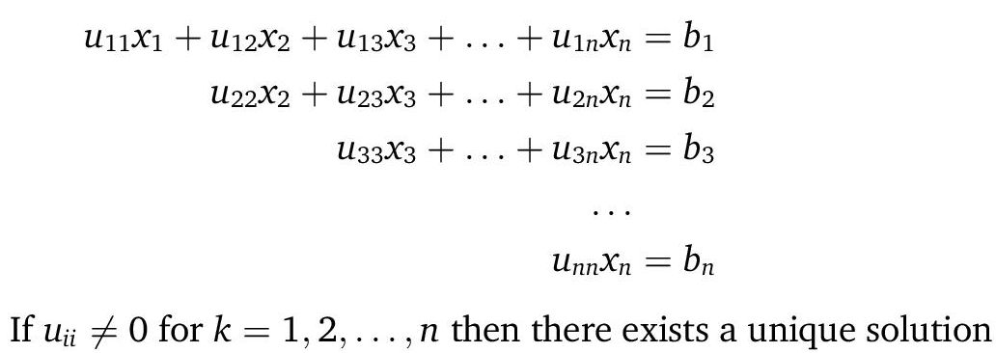
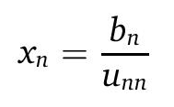
Upper Triangulation
Solve the last equation first

Slide 26
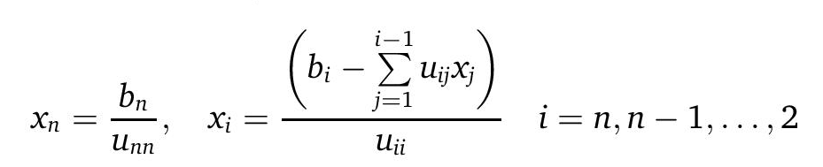
Back-substitution
This can easily be coded, employing for loops using the equation below

Slide 27
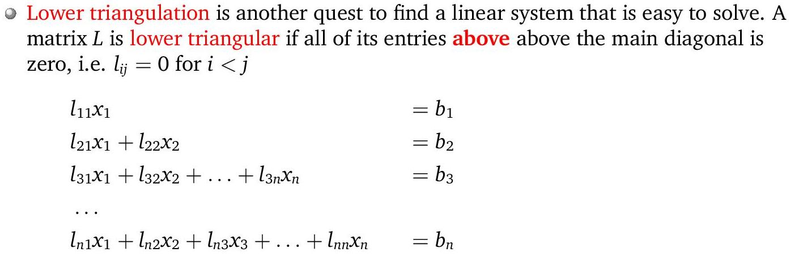
Lower Triangulation
Elimination can also be used to produce a lower triangular system

Slide 28
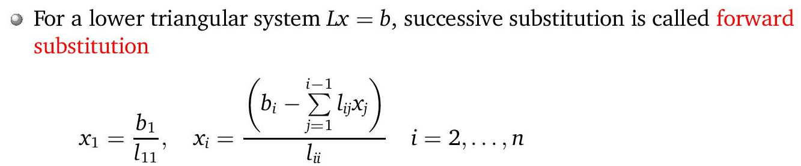
Forward-substitution
This can also be easily coded, employing for loops using the equation below

Slide 29
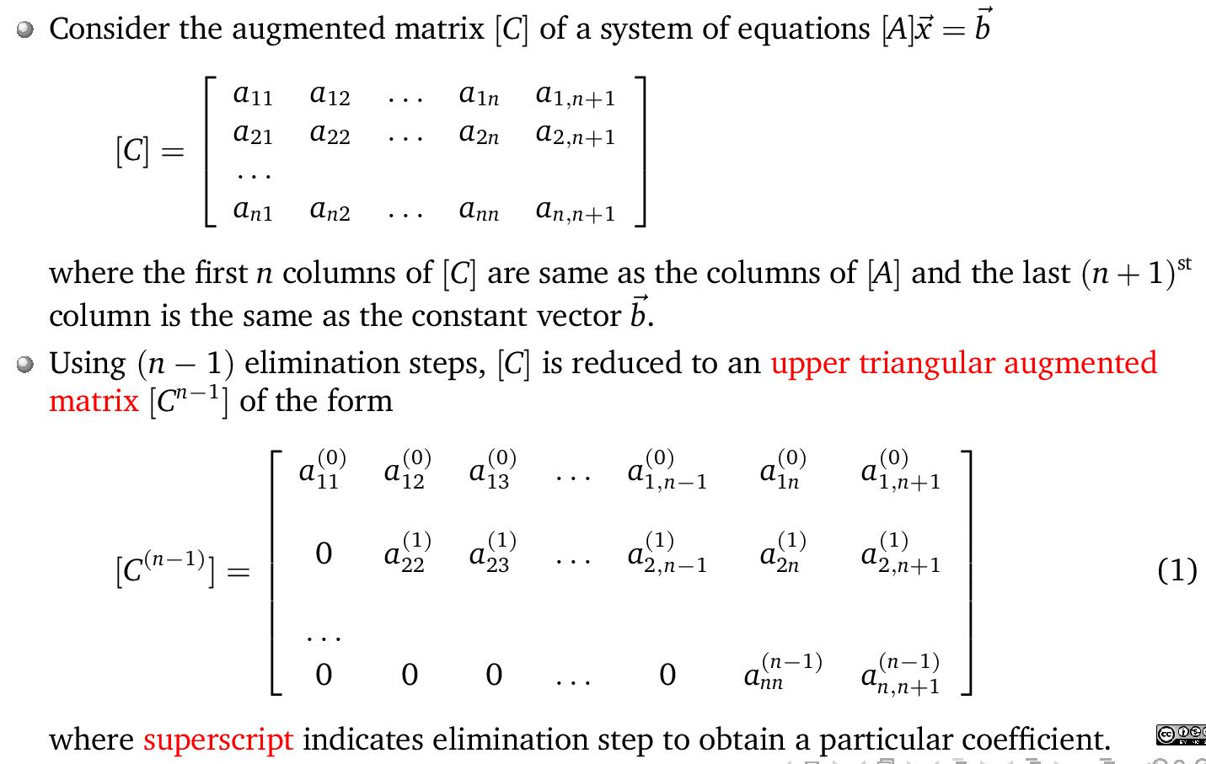
Elimination Procedure

Slide 30
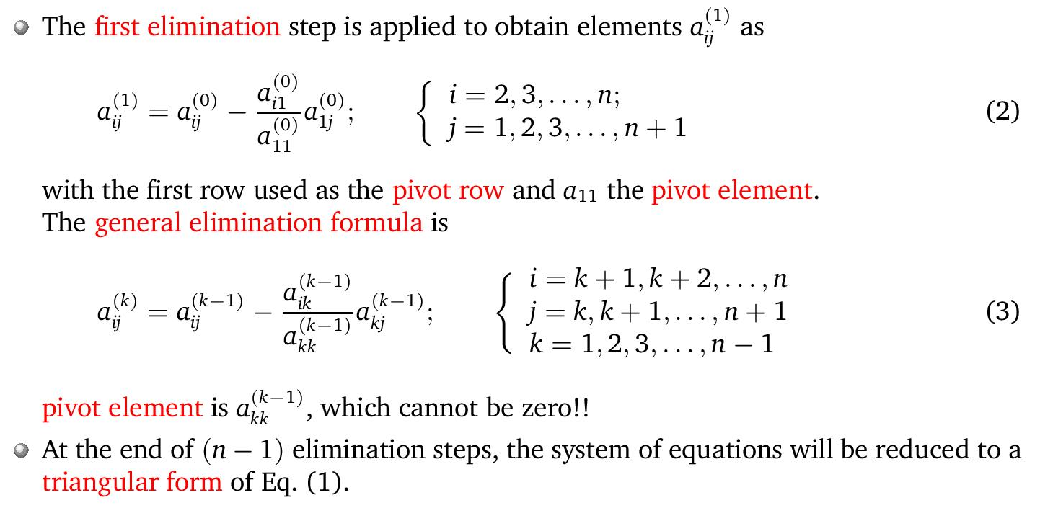
Elimination Procedure

Slide 31
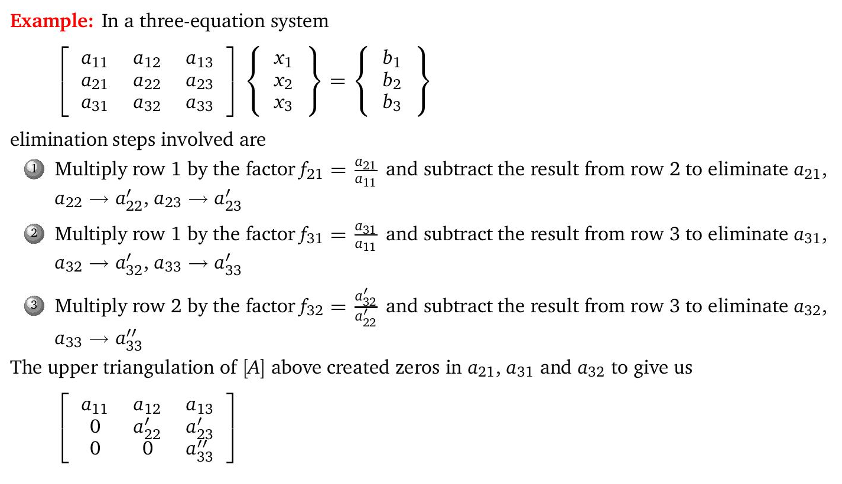
Elimination Procedure

Slide 32
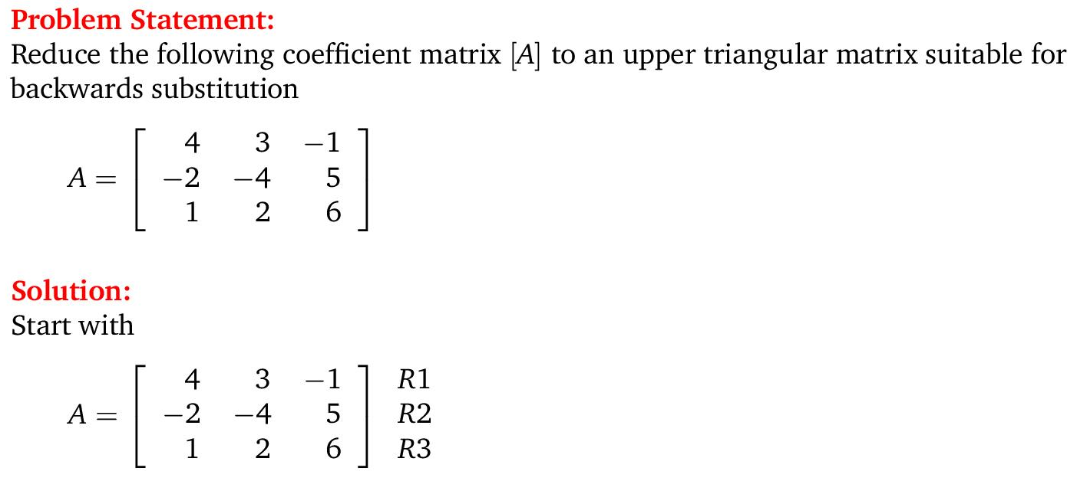
Elimination Procedure example

Slide 33
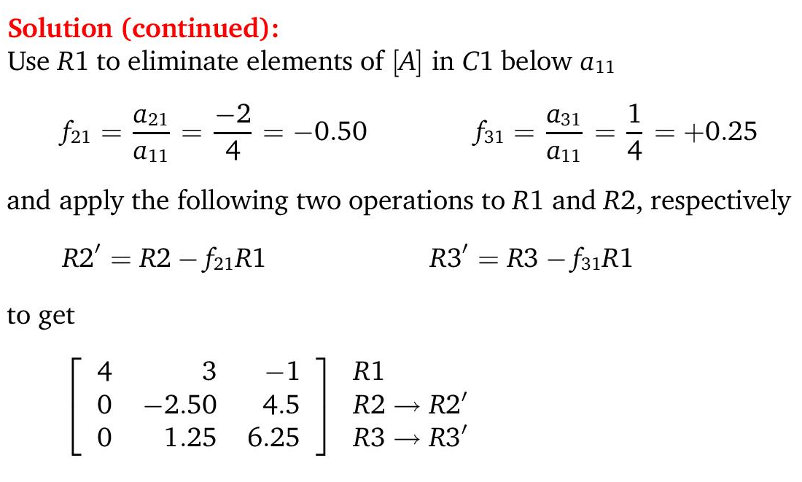
Elimination Procedure example

Slide 34
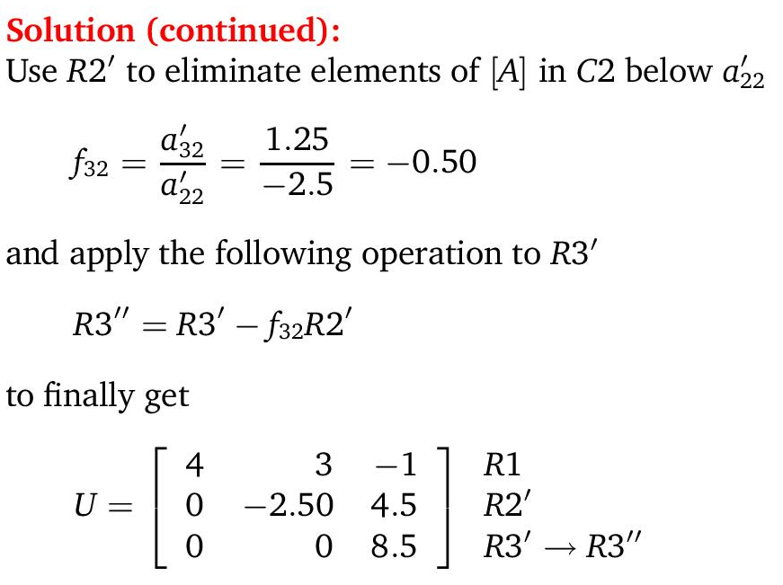
Elimination Procedure example

Slide 35
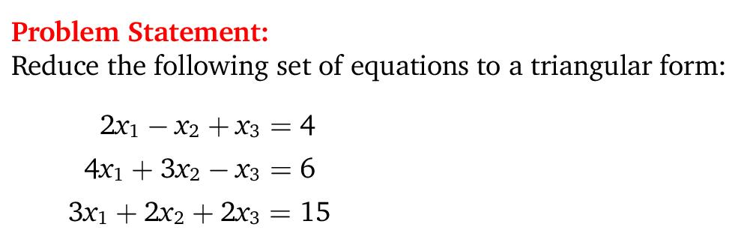
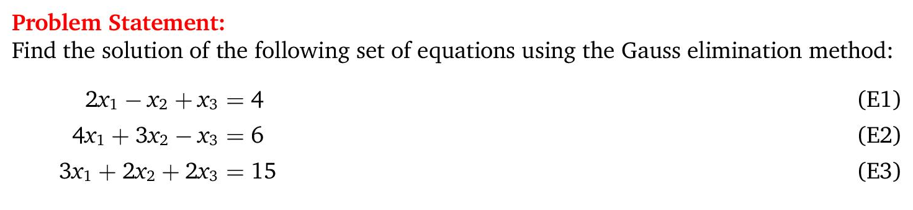
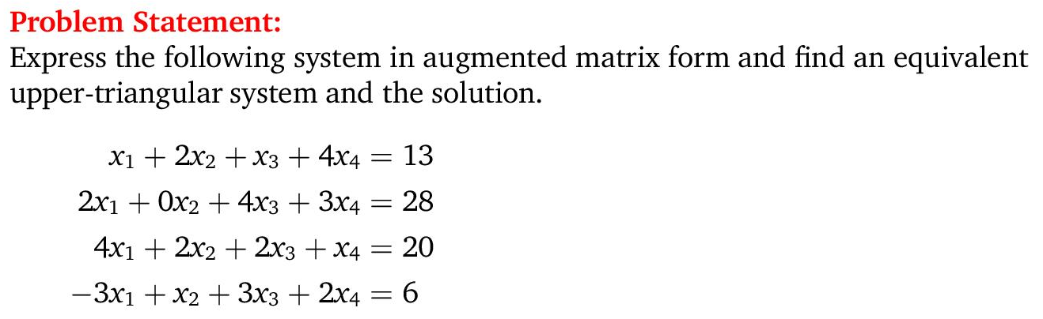

Slide 36
Pitfalls of Elimination Methods
Division by zero. It is possible that during both elimination and back-substitution phases a division by zero can occur.
  (avoid by pivoting)
Round-off errors.
  Important with >100 eqns
  Substitute answer into original eqn to check
Ill-conditioned systems.
  Systems where small changes in coefficients result in large changes in the solution.
  Alternatively, it happens when two or more equations are nearly identical, resulting a wide ranges of answers to approximately satisfy the equations.
  Determinant close to zero
  Since round off errors can induce small changes in the coefficients, these changes can lead to large solution errors.

Slide 37
Singular systems. When two equations are identical, we would loose one degree of freedom and be dealing with the impossible case of n-1 equations for n unknowns. For large sets of equations, it may not be obvious however.
The fact that the determinant of a singular system is zero can be used and tested by computer algorithm after the elimination stage.
We may use Matlab/Octave to check the determinant of a system using det(A)
If a zero diagonal element is created, calculation is terminated.

Slide 38
Techniques for Improving Solutions
Use of more significant figures.
Pivoting. If a pivot element is zero, normalization step leads to division by zero. The same problem may arise, when the pivot element is close to zero. Problem can be avoided:
  Partial pivoting. Switching the rows so that the largest element is the pivot element.
  Complete pivoting. Searching for the largest element in all rows and columns then switching.

Slide 39
Pivoting
Rearrange equations (switch equations)
  To avoid zero in pivot element
  Partial pivoting
    Find largest coefficient available in column below pivot element
    Switch rows so that largest element becomes pivot element
  Complete pivoting
    Columns AND rows searched for largest element

Slide 40
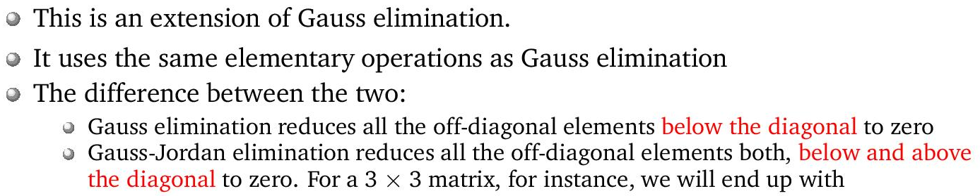
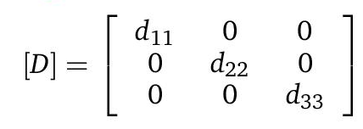
Gauss-Jordan
  All rows are normalized by dividing them by their pivot elements.
  Elimination step results in an identity matrix.
  Consequently, it is not necessary to employ back substitution to obtain solution.

Slide 41
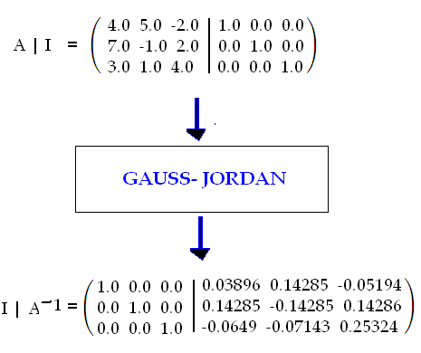


Matrix Inverse by Gauss-Jordan
  Gauss-Jordan elimination also provides a convenient way to calculate the matrix inverse.
  Augment the matrix with an identity matrix, then perform full elimination until the identity matrix appears on the opposite side.
  The resulting matrix on its opposite is the inverse.
$$\left[\left.A\right|I\right]$$
$$\left[\left.I\right|A^{−1}\right]$$

Slide 42
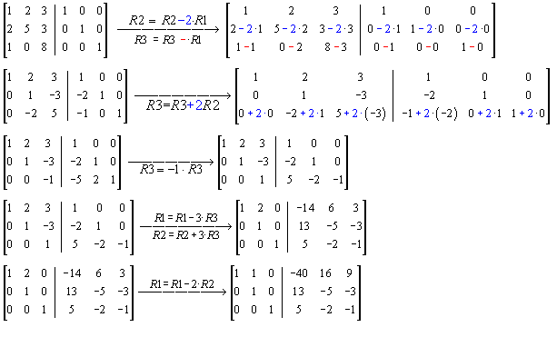
Matrix Inverse by Gauss-Jordan

Slide 43
LU Decomposition
In Gauss elimination;
Forward elimination
Major computational effort
Low computational effort
can be used for different {B}'s
Backward substitution
Very inefficient to study the same system [A] under different cases of {B}
LU Decomposition
Separates elimination of [A] (decomposition)
from manipulations of {B} (right hand side)

Slide 44
LU Decomposition
Decomposes [A] into [L] and [U] matrices
[U] is an upper triangular matrix
[L] is a lower triangular matrix
[A]{x} = {B}
[A]{x} – {B} = 0 reduced to become
[U]{x} – {D} = 0 with [L] such that
[L]{ [U]{x} – {D} } = [A]{x} – {B} so
[L][U] = [A] & [L]{D} = {B}

Slide 45
2 Step Strategy
LU Decomposition step :
[A] factored (decomposed) into [U] & [L] matrices
Substitution step :
[L] & [U] used to determine {x} for a given {B}
  First get {D} from [L]{D} = {B}
  by forward substitution
  Then get solution {x} from [U]{x} – {D} = 0
  by back substitution

Slide 46
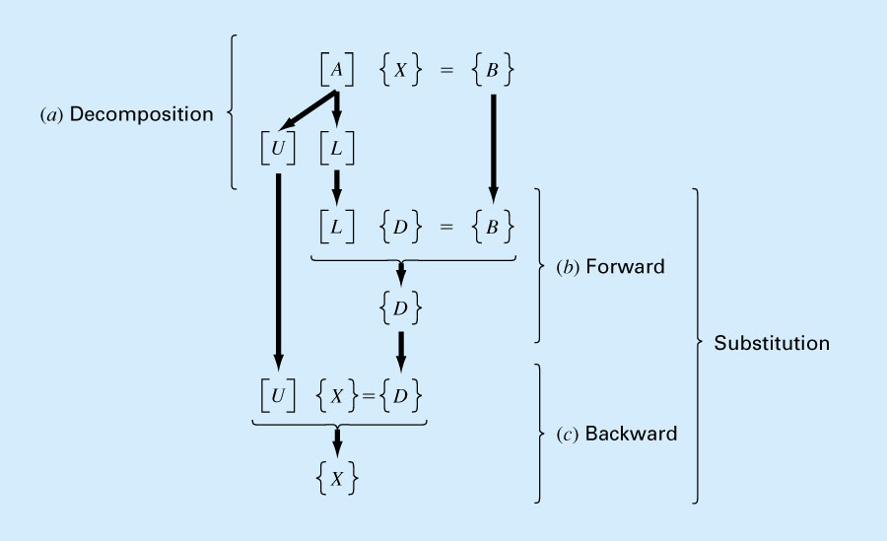

Slide 47
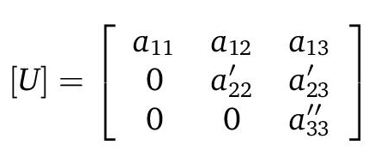
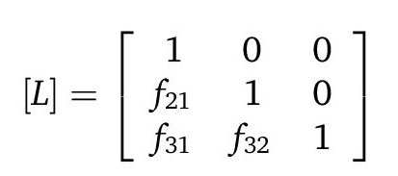
Doolittle decomposition
The same as performing Gauss Elimination
Produces [L] matrix with 1's on the diagonal
The scaling factors during Gauss Elimination are actually used as the elements for [L]

Slide 48
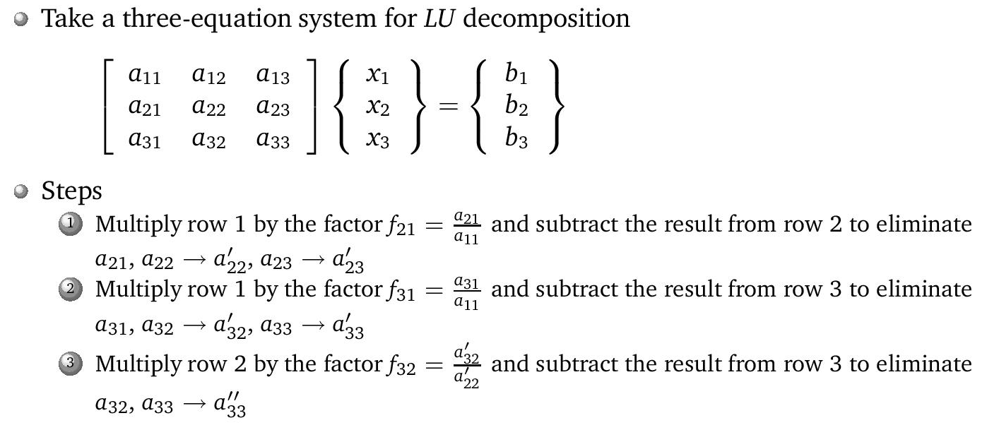
Doolittle decomposition

Slide 49
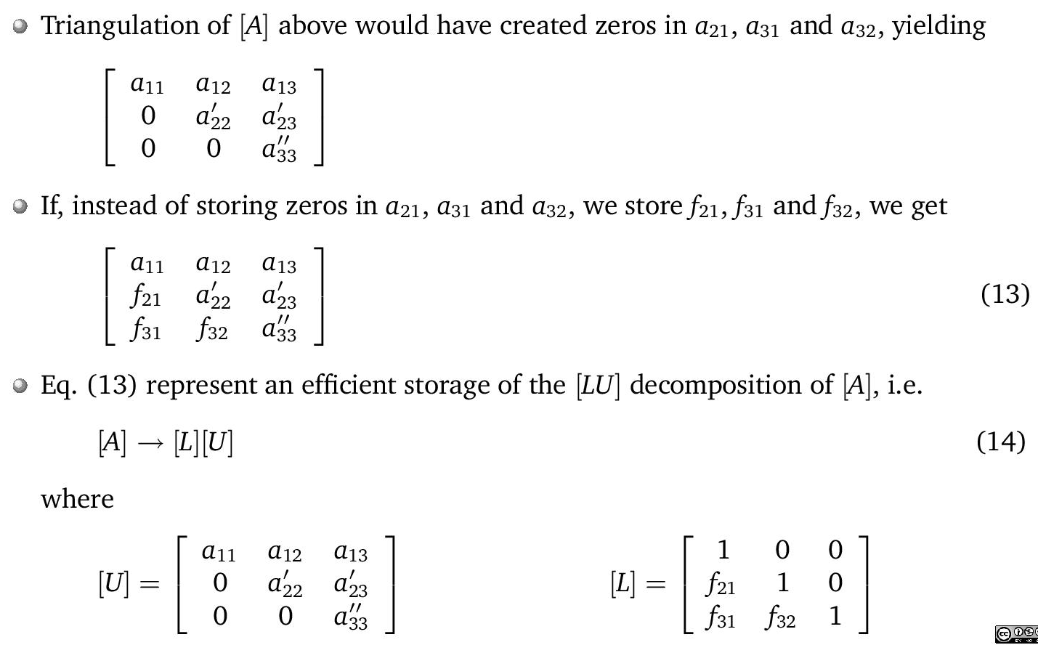
Doolittle decomposition

Slide 50
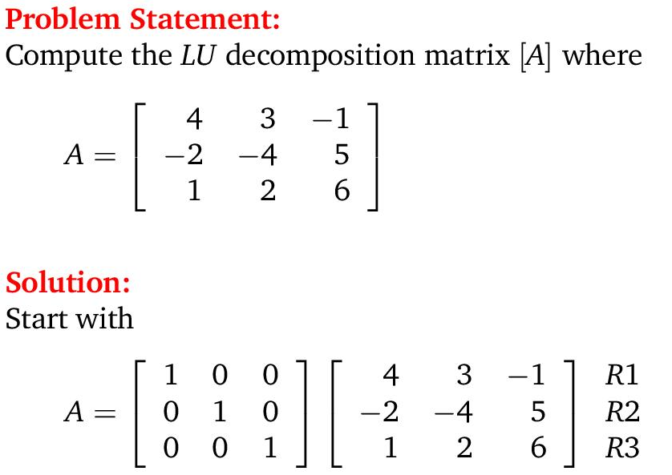
Example: Doolittle decomposition

Slide 51
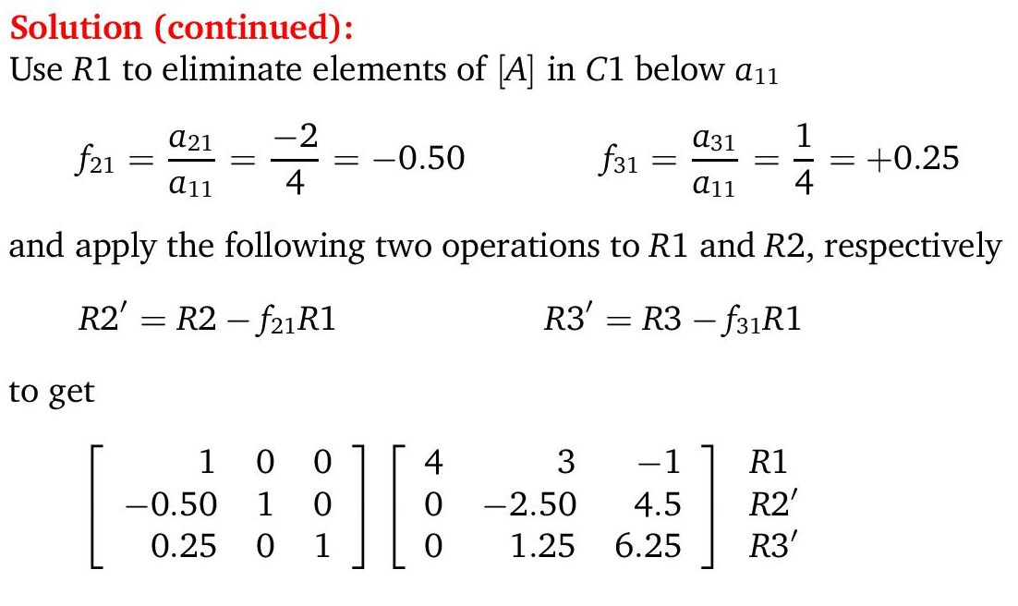
Example: Doolittle decomposition

Slide 52
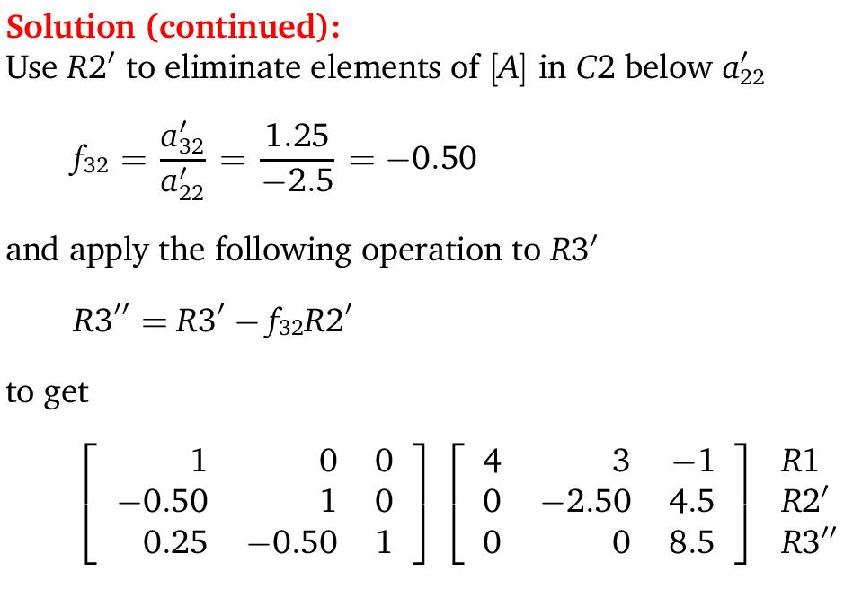
Example: Doolittle decomposition

Slide 53
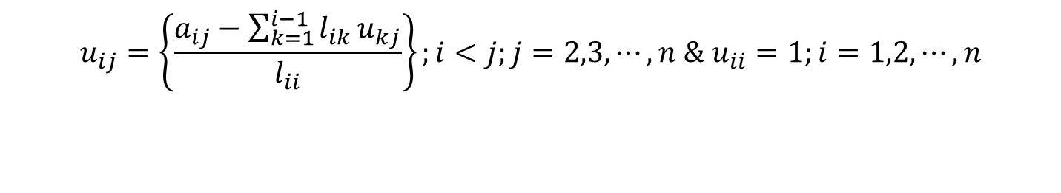
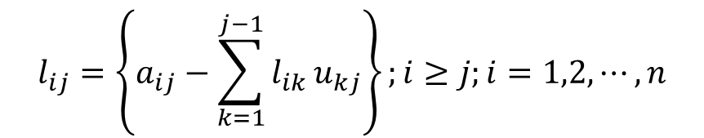
Crout Decomposition
Involves [U] with 1's on the diagonal
Computation process will sweep through columns and rows
Elements of [L] and [U] are given by
$$l_{ij}=\left\{a_{ij}−\sum_{k=1}^{j−1}{l_{ik}}u_{kj}\right\};i≥j;i=1,2,⋯,n$$
$$u_{ij}=\left\{\frac{a_{ij}−\sum_{k=1}^{i−1}{l_{ik}}u_{kj}}{l_{ii}}\right\};i<j;j=2,3,⋯,n \& u_{ii}=1;i=1,2,⋯,n$$

Slide 54
Features of LU Decomposition
Once [A] is decomposed, we may use the same [L] & [U] for different {B}'s
  So, we can easily play with the system, [A], under different situations, {B}.
Efficient storage (computer memory usage)
  [L] & [U] needn't be stored separately
  We already knew upper part of [L] are 0's & lower part of [U] also 0's
  So combine [L] & [U] into a single matrix
  Original [A] not used anymore after decomposition; so can be deleted from memory & replaced with the combined [L][U] matrix

Slide 55
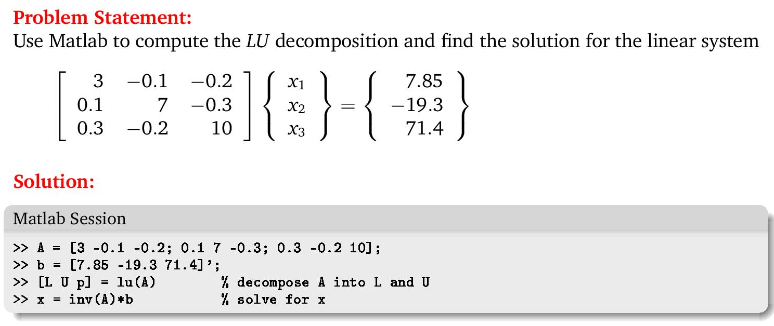
LU Decomposition with Matlab/Octave

Slide 56
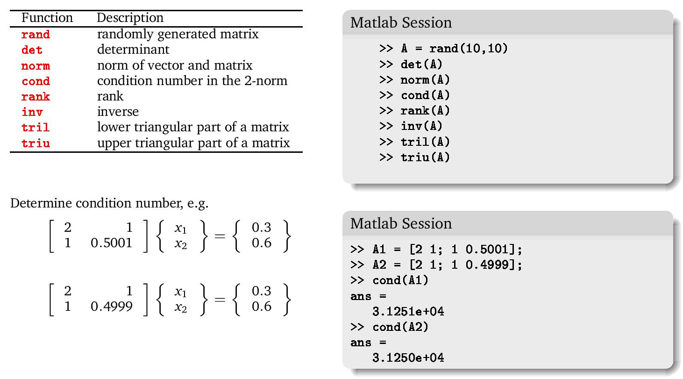
Matlab/Octave built-in matrix functions (some of them)

Slide 57
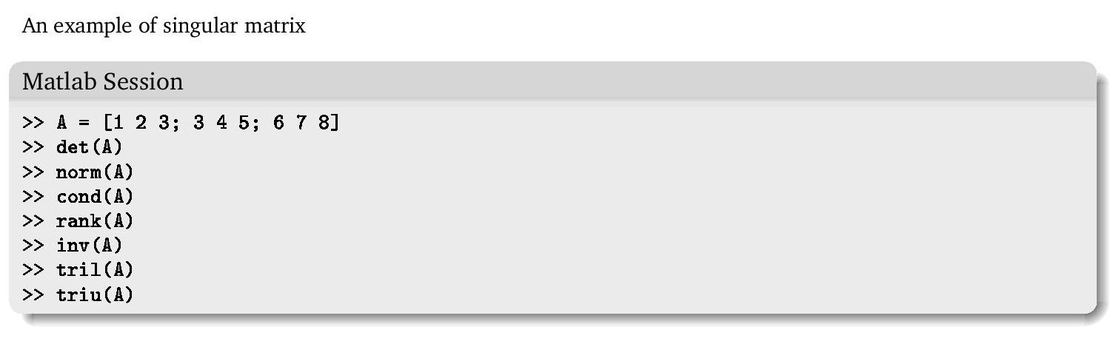
Using Matlab functions to analyze matrix properties

Slide 58
Iterative Methods
(Indirect Methods)

Slide 59
Iterative Methods
Good for sparse matrices
Jacobi Iteration
Gauss-Seidel Iteration
The system [A]{X}={B} is reshaped by solving the first equation for x₁, the second equation for x₂, and the third for x₃, …and n^{th} equation for x_{n}.

Slide 60
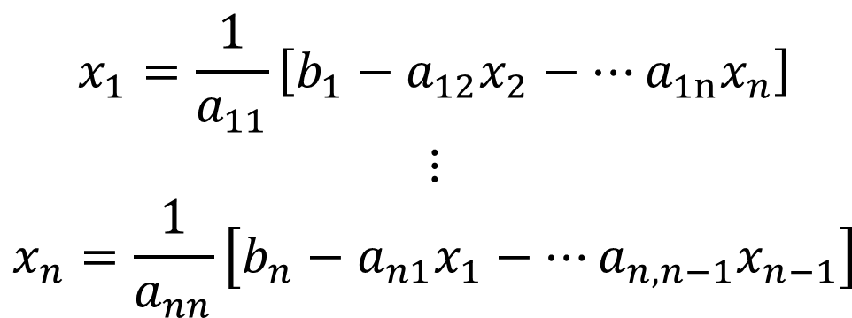
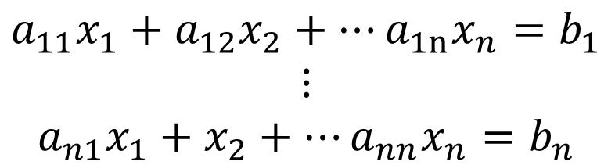
Iterative Method Concept
Given a system of linear equation
Direct solution for x;
$$\begin{matrix}a_{11}x_{1}+a_{12}x_{2}+⋯a_{1n}x_{n}=b_{1} \\ ⋮ \\ a_{n1}x_{1}+x_{2}+⋯a_{nn}x_{n}=b_{n}\end{matrix}$$
$$\begin{matrix}x_{1}=\frac{1}{a_{11}}\left[b_{1}−a_{12}x_{2}−⋯a_{1n}x_{n}\right] \\ ⋮ \\ x_{n}=\frac{1}{a_{nn}}\left[b_{n}−a_{n1}x_{1}−⋯a_{n,n−1}x_{n−1}\right]\end{matrix}$$

Slide 62
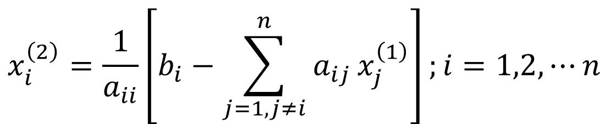
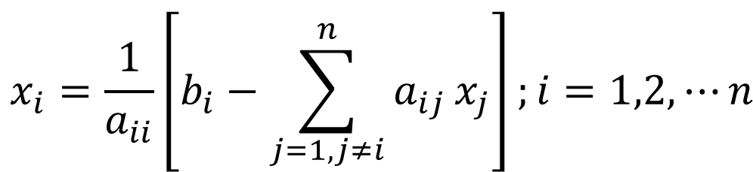
Compact form
Iteration
$$x_{i}=\frac{1}{a_{ii}}\left[b_{i}−\sum_{j=1,j≠i}^{n}{a_{ij}}x_{j}\right];i=1,2,⋯n$$
$$x_{i}^{\left(2\right)}=\frac{1}{a_{ii}}\left[b_{i}−\sum_{j=1,j≠i}^{n}{a_{ij}}x_{j}^{\left(1\right)}\right];i=1,2,⋯n$$

Slide 63
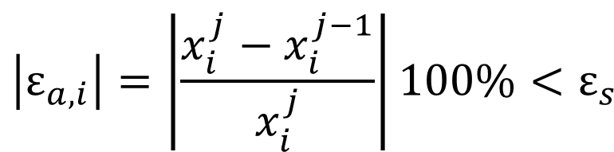
Solve Iteratively
Start with initial guess for x's, simplest is x_{i}=0
Iterate using newly obtained values of x’s, comparing error with previous values
Convergence when
$$\left|ε_{a,i}\right|=\left|\frac{x_{i}^{j}−x_{i}^{j−1}}{x_{i}^{j}}\right|100\%<ε_{s}$$

Slide 64
Jacobi Iteration
Gauss-Seidel Iteration
All x's for each iteration unmodified during iteration
x's modified during iteration as new values of x's are calculated

Slide 65
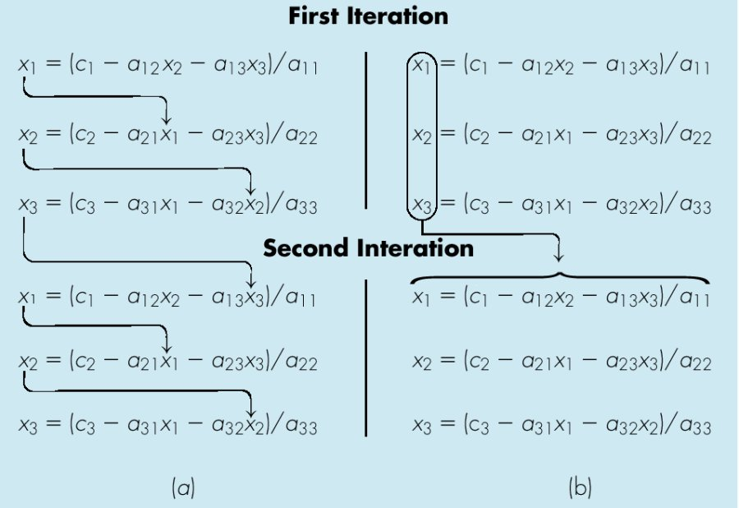
Gauss-Seidel
Jacobi Iteration

Slide 66
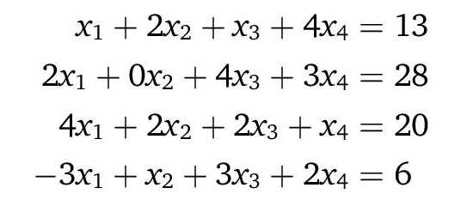
Example
Solve for x using Jacobi and Gauss-Seidel iterations.

Slide 67
Convergence
Gauss-Seidel may not converge
    Diagonally dominant (guaranteed convergence)
Relaxation for improved convergence
    New value of x is modified by a weighted average
    Weighting factor = relaxation factor = λ

Slide 83
To be continued

