Slide 1
SKTN 2393 Numerical Methods for Nuclear Engineers
Chapter 2
Nonlinear Equations
Mohsin Mohd Sies
Nuclear Engineering,
School of Chemical and Energy Engineering,
Universiti Teknologi Malaysia

Slide 2
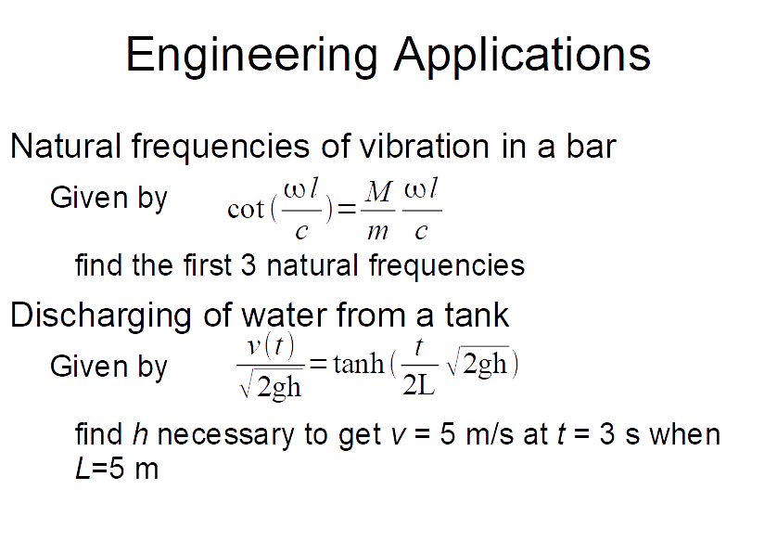

Slide 3
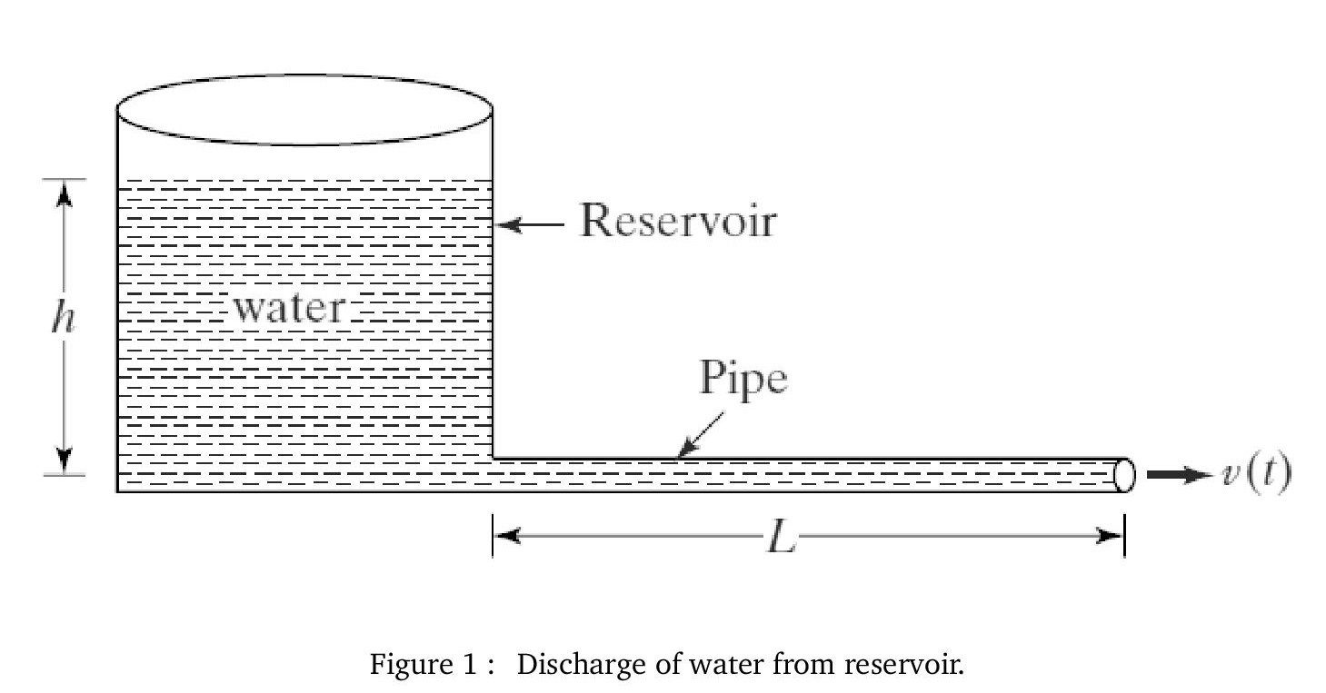

Slide 4
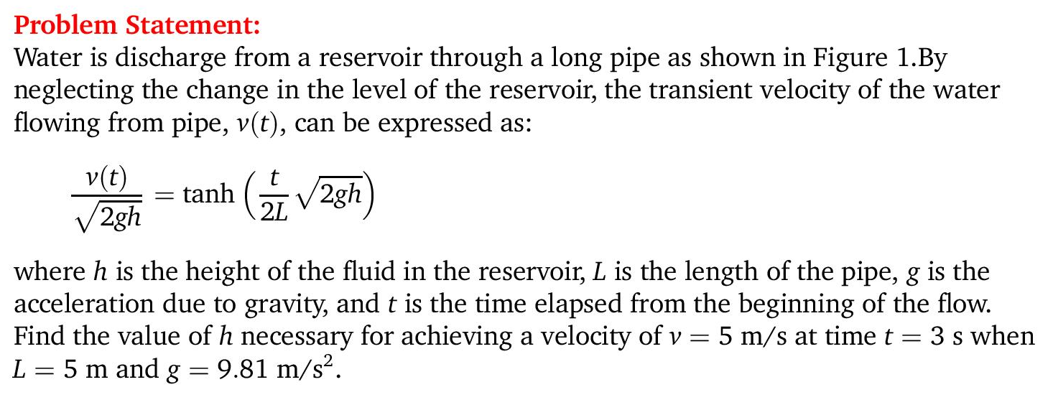

Slide 5
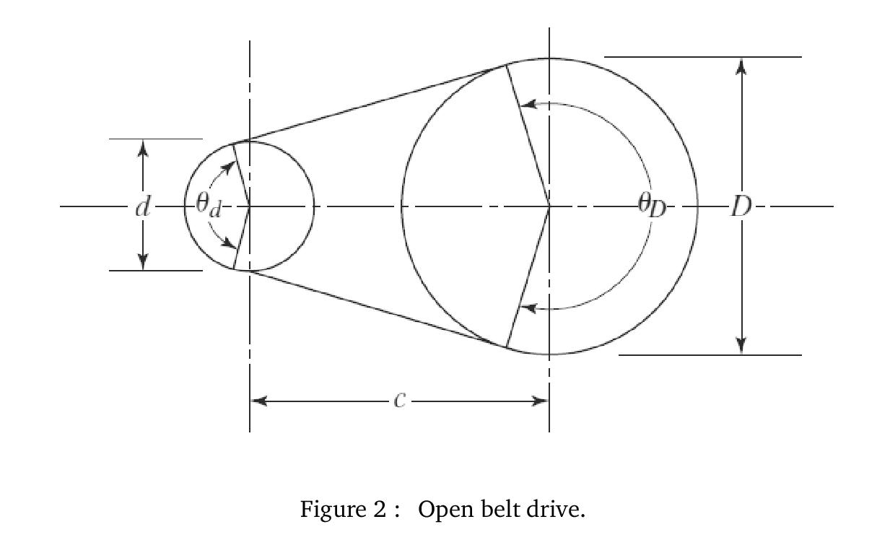

Slide 6
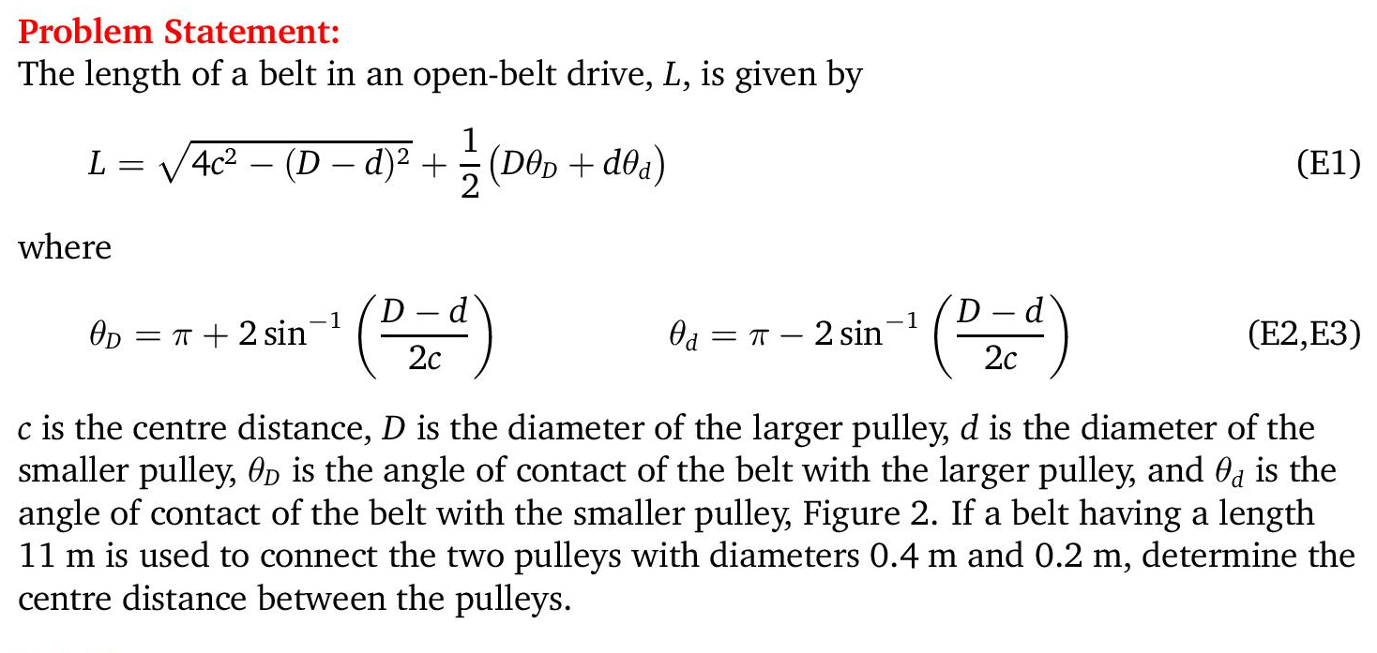

Slide 7
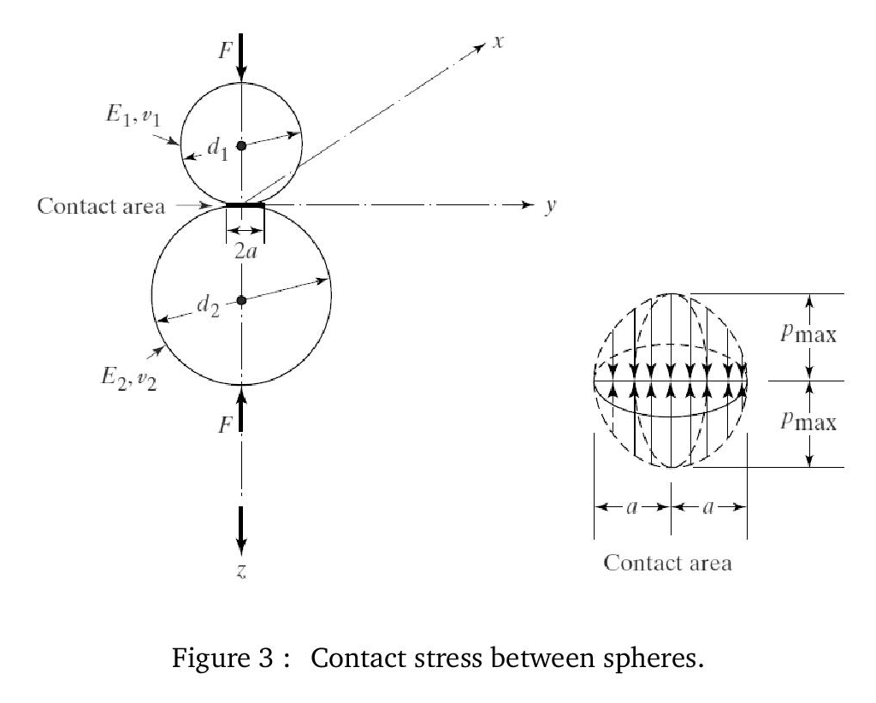

Slide 8
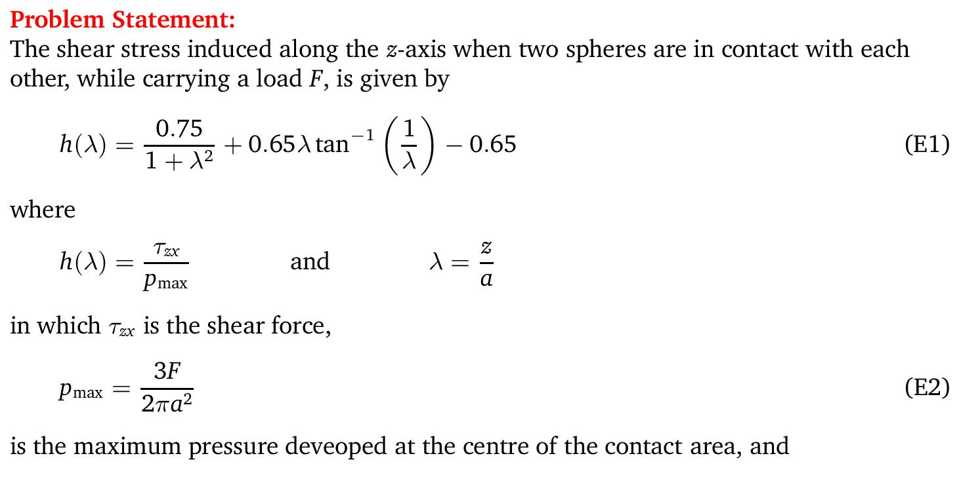

Slide 9
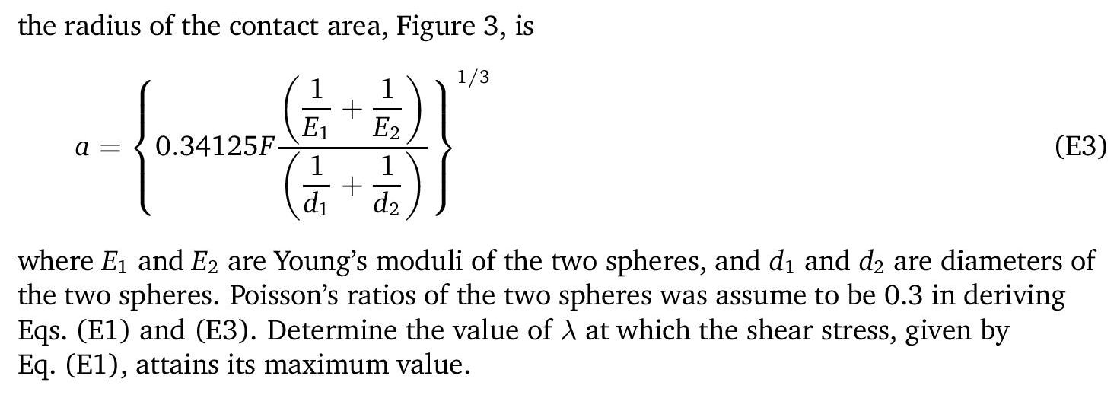

Slide 10
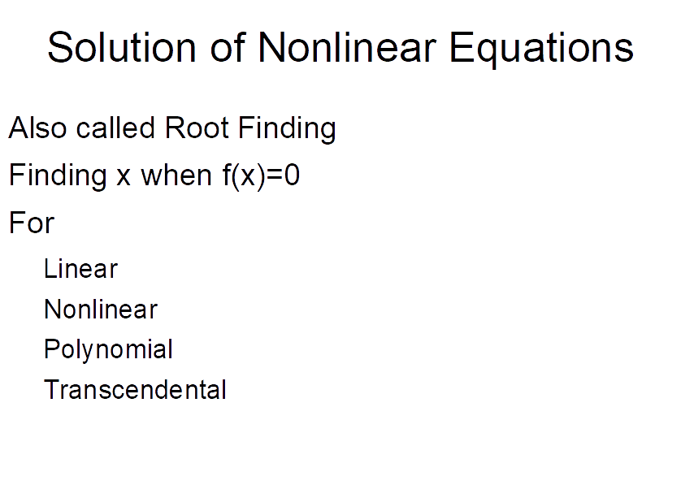

Slide 11
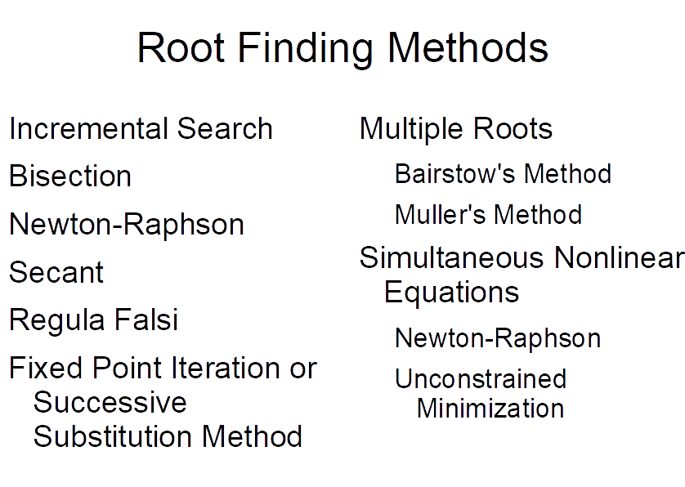

Slide 12
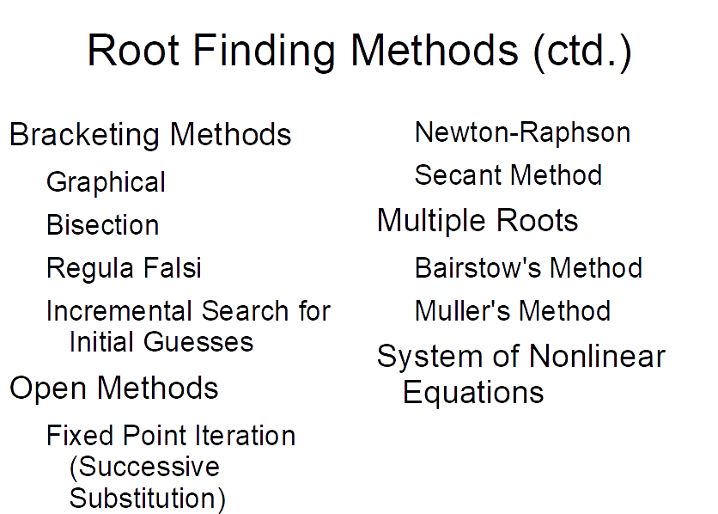

Slide 13
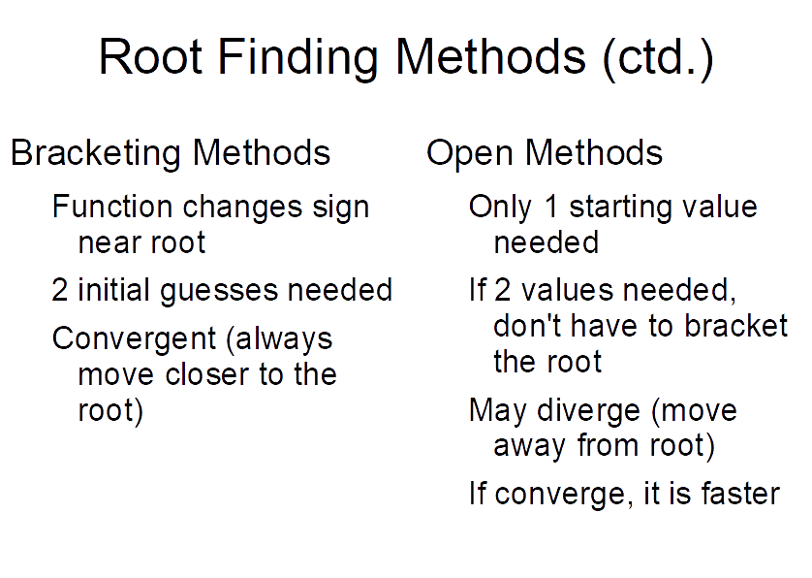

Slide 14
Nonlinear Equation
Solvers
Bracketing
Bisection
False Position
(Regula-Falsi)
Graphical
Open Methods
Newton Raphson
Secant
All Iterative

Slide 15
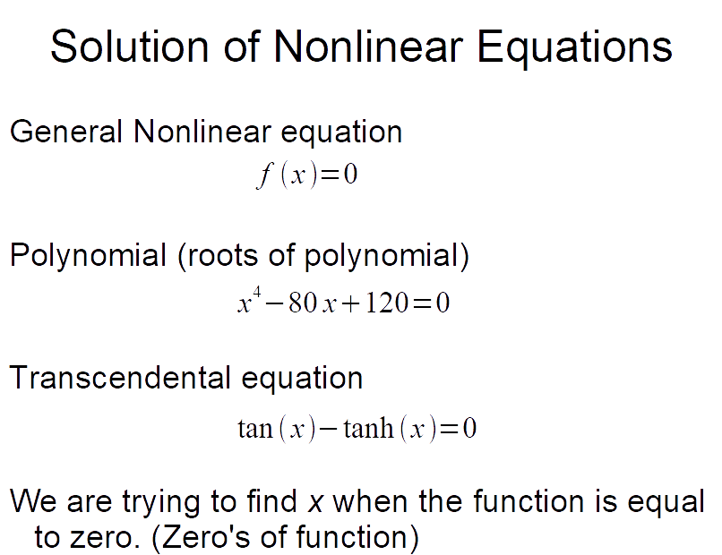

Slide 16
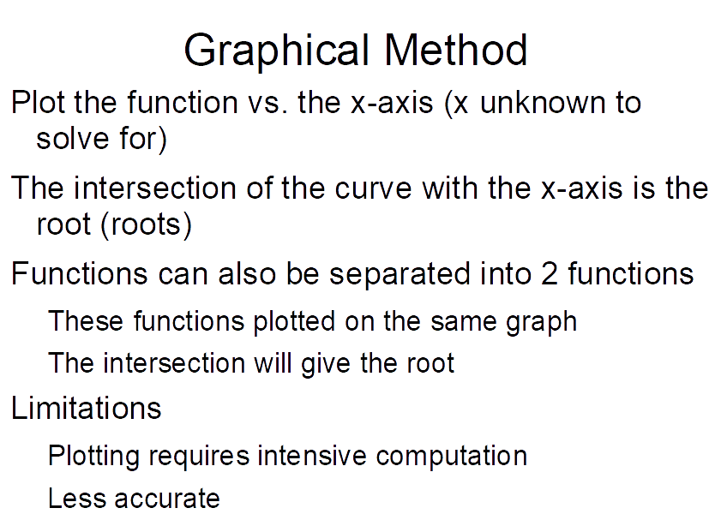

Slide 17
Bracketing Methods

Slide 18

Key concept (sign change)
To detect a sign change, $f_{L}∙f_{U}<0$
This can be used as the conditional statement during coding

Slide 19
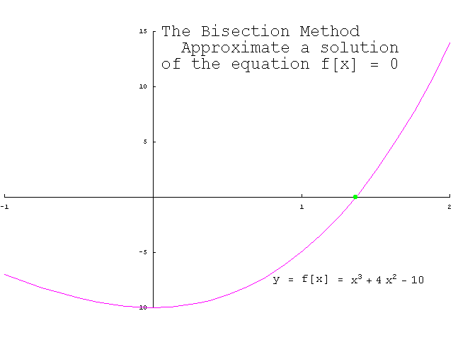
Bisection Method

Slide 20
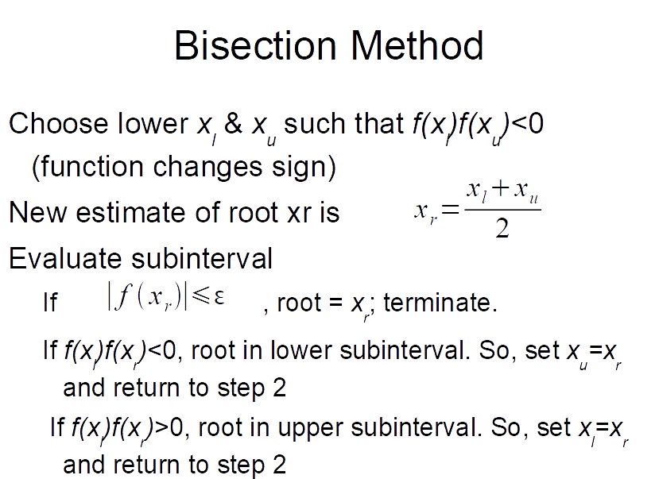

Slide 21
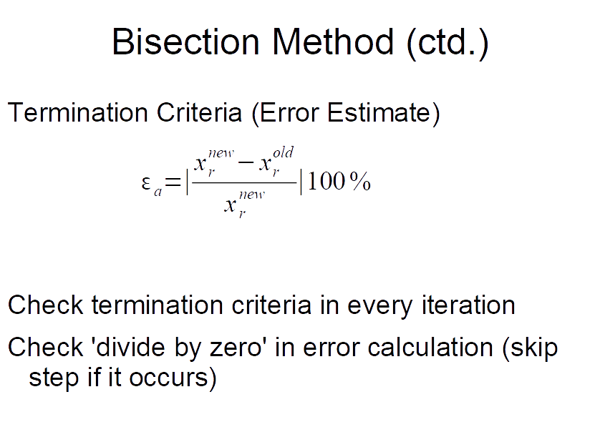

Slide 22
Evaluation of Method
Pros
Easy
Always find root
Number of iterations required to attain an absolute error can be computed a priori.
Cons
Slow
Know a and b that bound root
Multiple roots
No account is taken of f(x_{l}) and f(x_{u}), if f(x_{l}) is closer to zero, it is likely that root is closer to x_{l} .

Slide 23
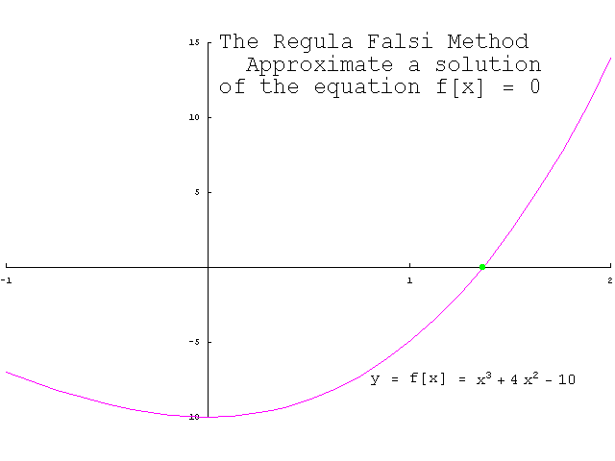
Regula Falsi

Slide 24
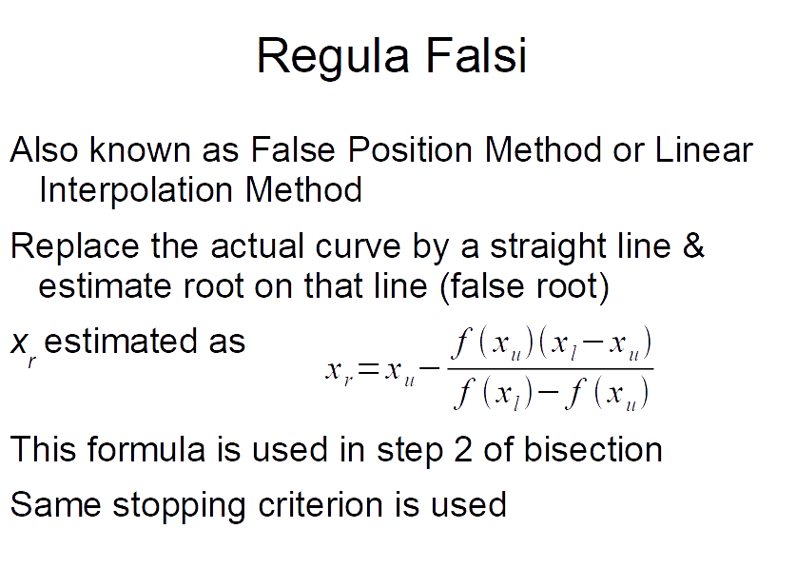

Slide 25
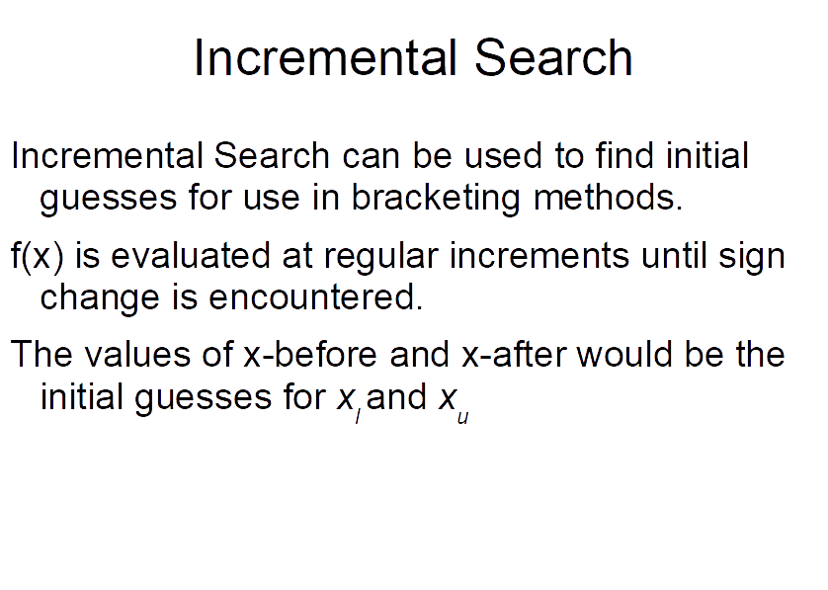

Slide 26
Open Methods

Slide 27
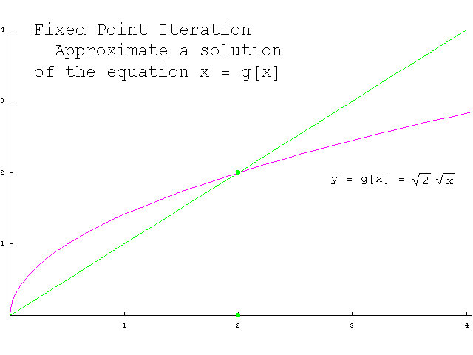
Fixed Point Iteration

Slide 28
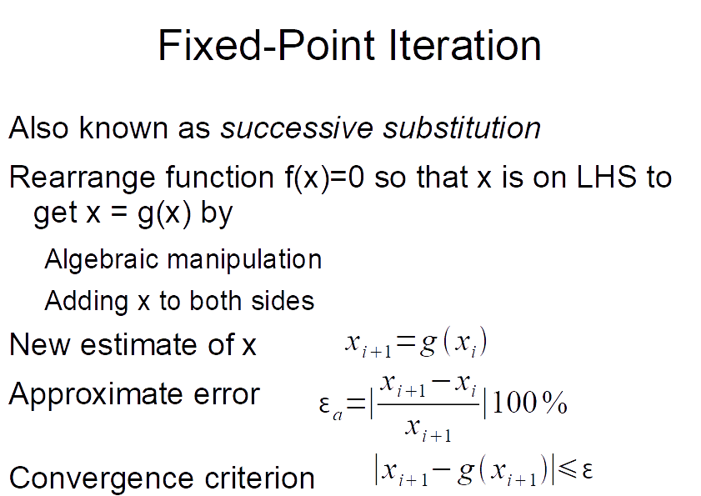

Slide 29
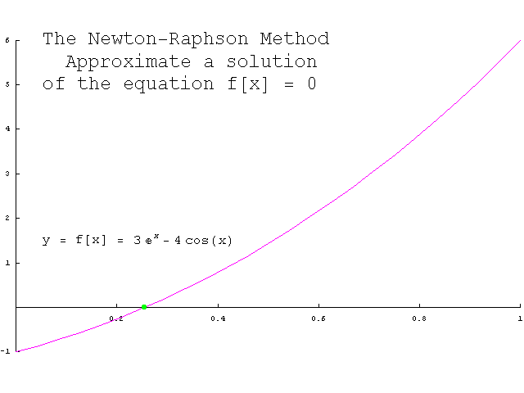
Newton Raphson

Slide 30
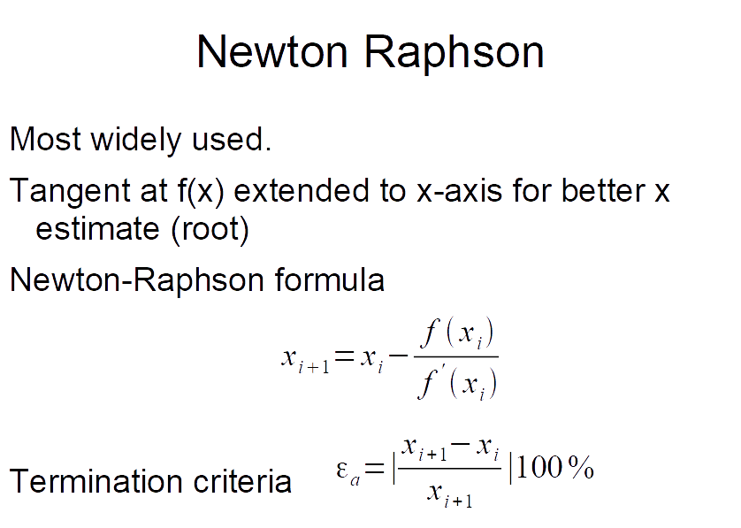

Slide 31
Newton-Raphson Method
Based on Taylor series expansion:
Solve for
Newton-Raphson formula

Slide 32
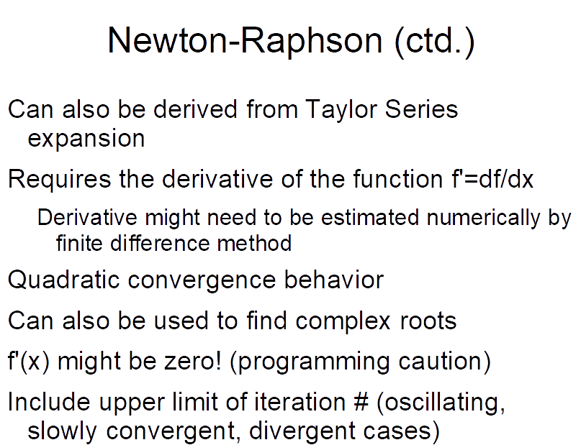

Slide 33
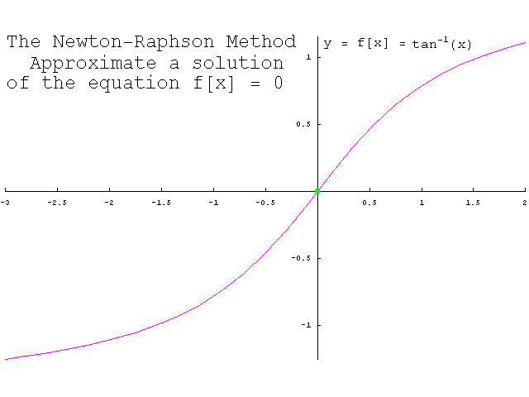
Newton Raphson (ctd.)

Slide 34
Newton Raphson (ctd.)

Slide 35
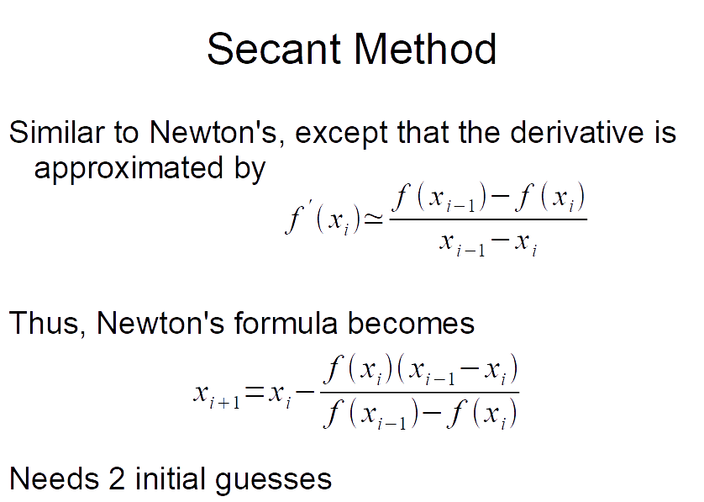

Slide 36
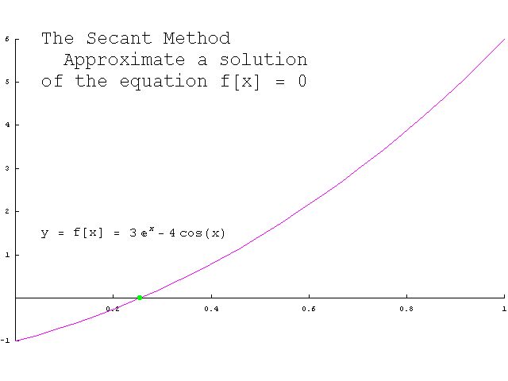
Secant Method (ctd.)

Slide 37
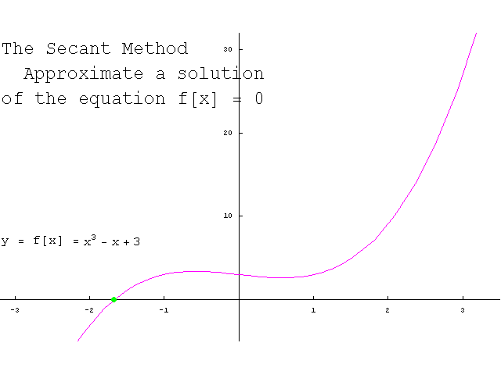
Secant Method (ctd.)

Slide 38
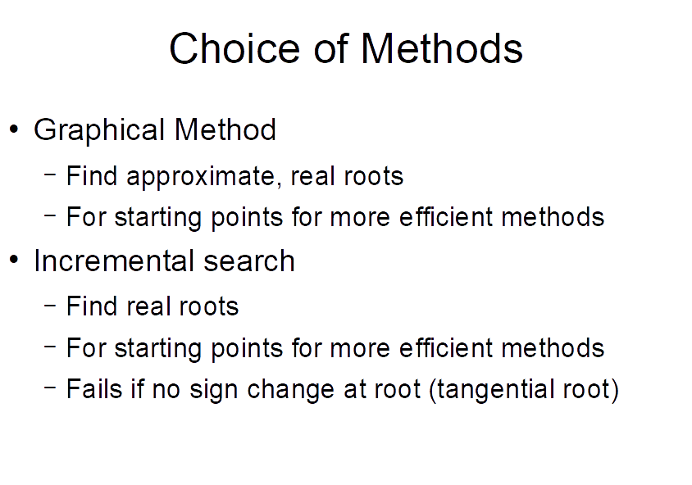

Slide 39
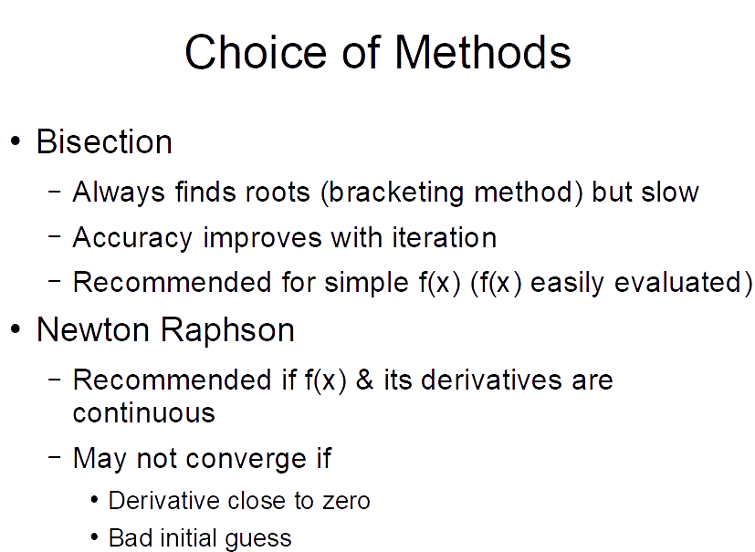

Slide 40
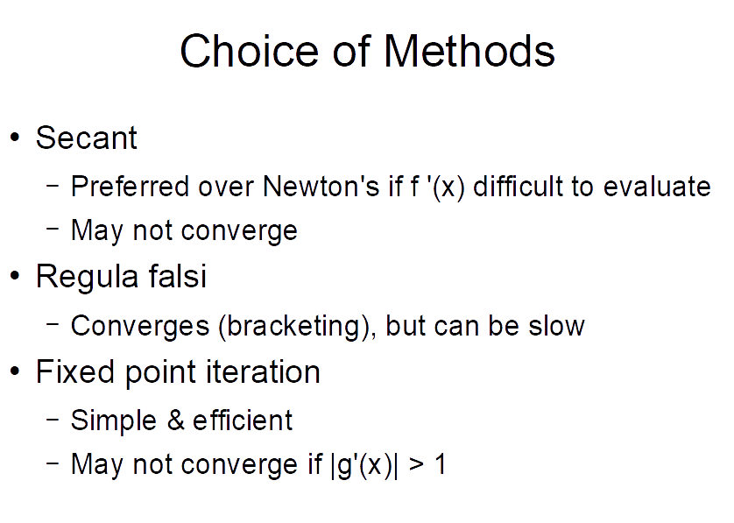

Slide 41
Matlab Built-in Function
fzero(‘function’,initial_guess)
function is a separate function.m file describing our specific problem that we are trying to solve.

Slide 42
Examples
Falling parachutist problem
Problem 8.18

