Slide 1
SKTN 2393
Numerical Methods for
Nuclear Engineers
Mohsin Mohd Sies
Nuclear Engineering,
School of Chemical and Energy Engineering,
Universiti Teknologi Malaysia

Slide 2

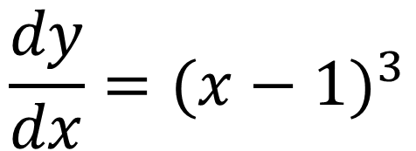
Solve this!
$$\frac{dy}{dx}={(x−1)}^{3}$$
Given that
$$y\left(0\right)=2$$

Slide 3
Solving Engineering Problems
From physical problem to solution
  Develop Model
  Apply Fundamental Principles
  Obtain Governing Equations
  Solution of Governing Equations
  Interpretation of Solution

Slide 4
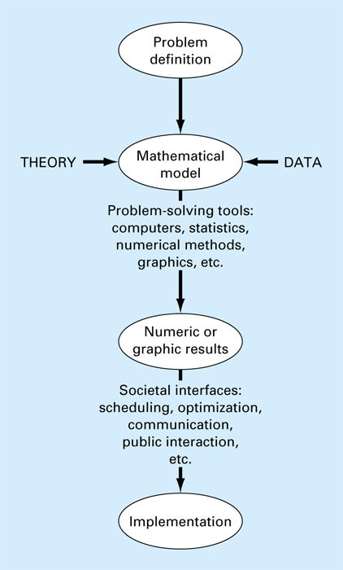
Fig. 1.1

Slide 5
A mathematical model is represented as a functional relationship of the form
Dependent independent forcing
Variable = f variables, parameters, functions
Dependent variable: Characteristic that usually reflects the state of the system
Independent variables: Dimensions such as time ans space along which the systems behavior is being determined
Parameters: reflect the system’s properties or composition
Forcing functions: external influences acting upon the system

Slide 6
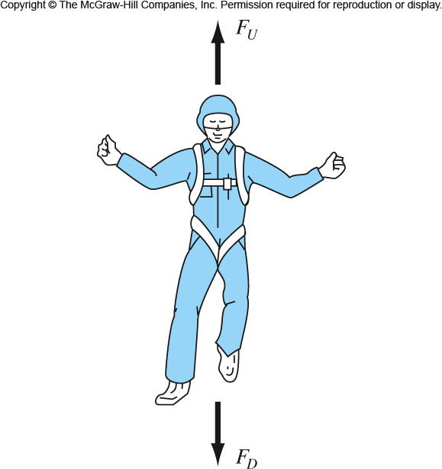
Falling Parachutist
Problem

Slide 7
Develop Model
Model is developed to represent all important characteristics of the physical system
  Identify system
  Identify external influences on system (load, input, output)
  Material properties (Ideal gas, real gas, Newtonian fluid, Elastic/plastic etc.)

Slide 8
Apply Fundamental Principles
Apply Physical Laws
  Equilibrium equation
  Newton's Law of motion
  Conservation of mass
  Conservation of momentum
  Conservation of energy
  Accounting principle (change = input - output)

Slide 10
Obtain governing equation
Apply simplifying assumptions on the physical laws
Derive final governing equation

Slide 11
This is a differential equation and is written in terms of the differential rate of change dv/dt of the variable that we are interested in predicting.
If the parachutist is initially at rest (v=0 at t=0), using calculus
Independent variable
Dependent variable
Forcing function
Parameters

Slide 12
Solution of governing equation
The problem may now appear mathematically as a set of
  linear/nonlinear algebraic equations
  Transcendental equations
  Ordinary differential equations (ODE)
  Partial differential equations (PDE)
  Eigenvalue problem
The set of simultaneous equations is readily handled using matrices.

Slide 13
Solutions of governing equations
Two types of solutions
  Closed form mathematical expression leading to analytical solution
  Closed form not possible, thus needs approximated numerical solution (computers)
This is the “big picture” of this course.

Slide 14
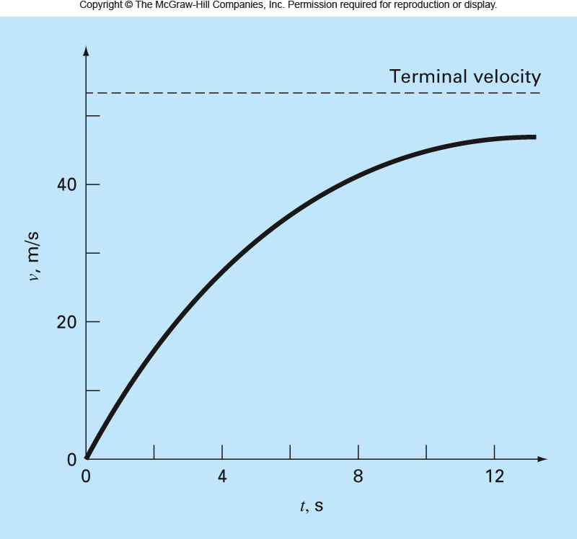

Slide 15
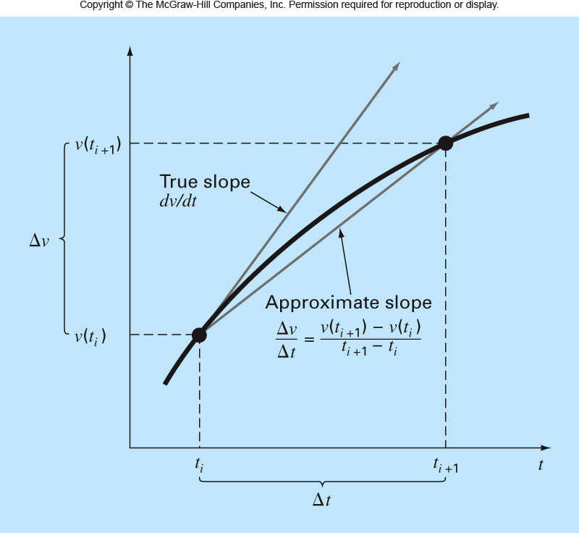

Slide 16
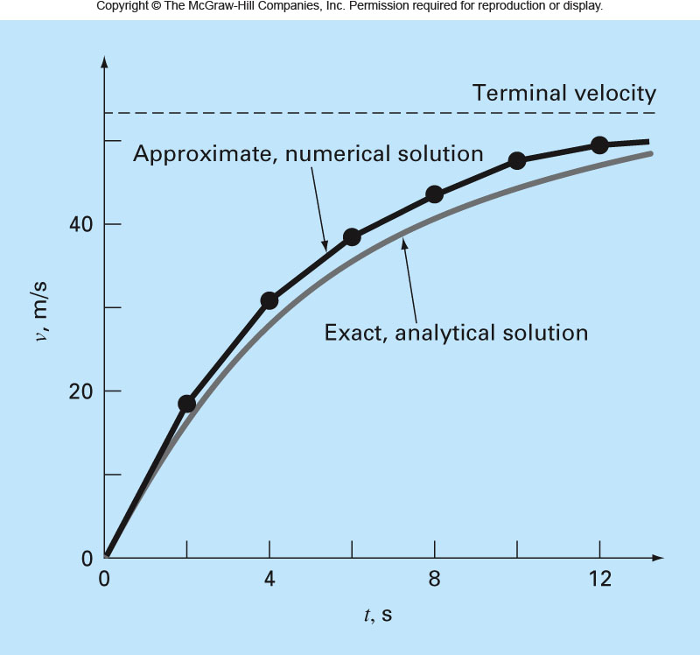

Slide 17
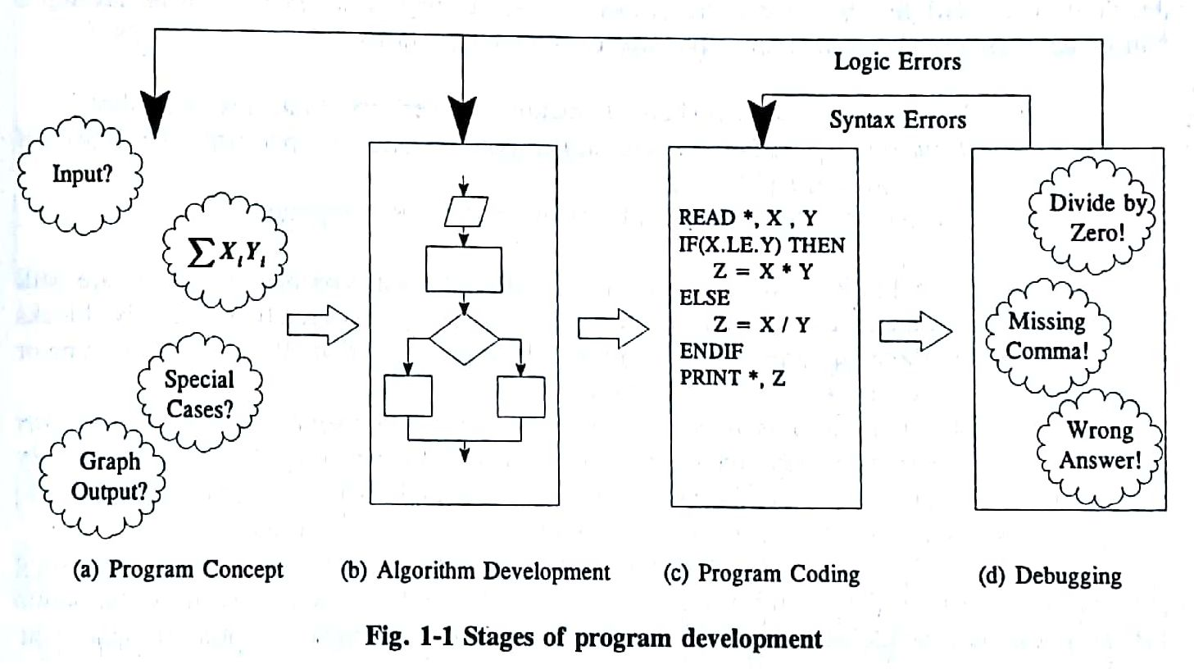
Solution of governing equation

Slide 18
Interpretation of Solution
Reality Check
  Test with simple, known cases
Graphics representation better conveys the meaning of solution
  Graphs
  Bar charts
  Contour plots

Slide 19
Verification (Reality Check)
In some engineering work, actual physical experiments must be carried out to verify one’s findings.
Starting today, get into the habit of asking yourself if your solution to a problem makes sense.
Asking your instructor if you have come up with the right answer or checking the back of your textbook to match answers are not good approaches in the long run.
You need to develop the means to check your results by asking yourself the appropriate questions.
Remember, once you start working for hire, there are no answer books. You will not want to run to your boss to ask if you did the problem right!

Slide 20
Softwares
Languages
  FORTRAN
  Matlab
  C, C++, Python, etc
Libraries
  Netlib (www.netlib.org)
  LAPACK
  EISPACK
  LINPACK
  IMSL, etc

Slide 21
Softwares
Others
Octave, Scilab
Maxima, Maple
Mathematica, Mathcad
R (statistical)
OpenDX, Paraview, Viz5D (plotting, visualization)

Slide 22
Taylor Series
Non-elementary functions such as trigonometric, exponential, and others are expressed in an approximate fashion using Taylor series when their values, derivatives, and integrals are computed.
Any smooth function can be approximated as a polynomial. Taylor series provides a means to predict the value of a function at one point in terms of the function value and its derivatives at another point.

Slide 23
Taylor Series
(x_{i+1}-x_{i})= h step size (define first)
Remainder term, R_{n}, accounts for all terms from (n+1) to infinity.

Slide 24
Any smooth function can be approximated as a polynomial.
f(x_{i+1}) ≈ f(x_{i}) zero order approximation, only true if x_{i+1} and x_{i} are very close to each other.
f(x_{i+1}) ≈ f(x_{i}) + f′(x_{i}) (x_{i+1}-x_{i}) first order approximation, in form of a straight line

Slide 25
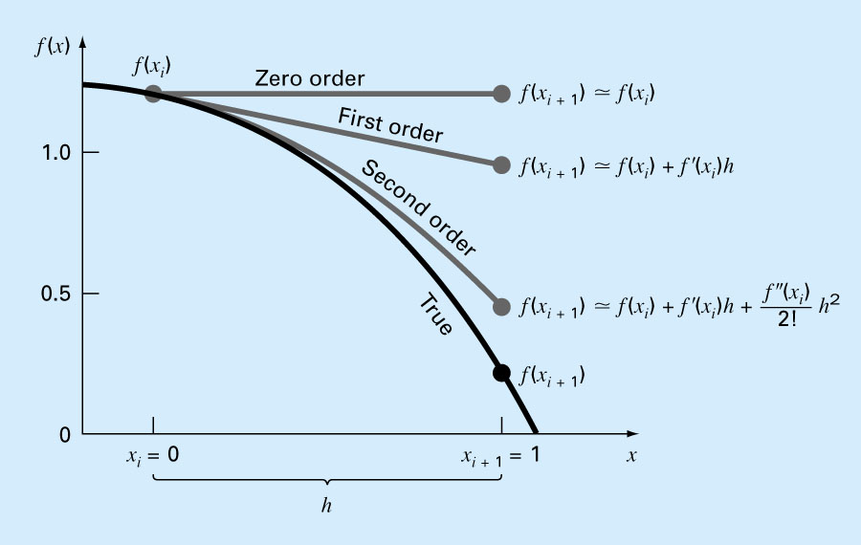

Slide 26
Precision and Accuracy
Accuracy. How close is a computed or measured value to the true value
Precision (or reproducibility). How close is a computed or measured value to previously computed or measured values.
Inaccuracy (or bias). A systematic deviation from the actual value.
Imprecision (or uncertainty). Magnitude of scatter.

Slide 27
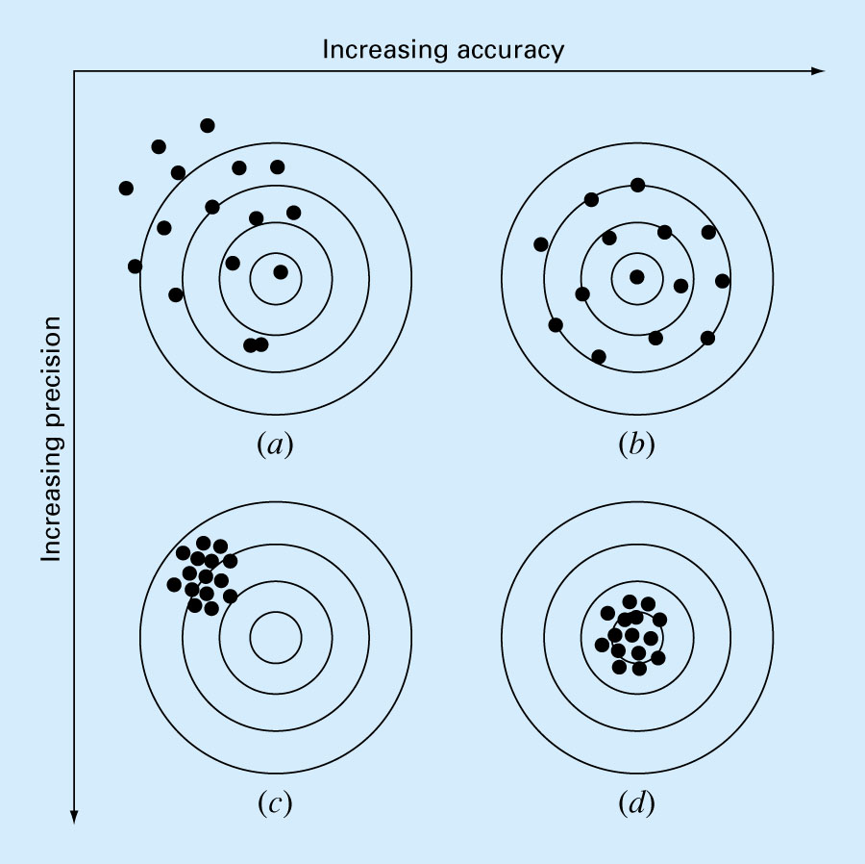

Slide 28
Errors
For many engineering problems, we cannot obtain analytical solutions.
Numerical methods yield approximate results, results that are close to the exact analytical solution. We cannot exactly compute the errors associated with numerical methods.
  Only rarely given data are exact, since they originate from measurements. Therefore there is probably error in the input information.
  Algorithm itself usually introduces errors as well, e.g., unavoidable round-offs, etc …
  The output information will then contain error from both of these sources.
How confident we are in our approximate result?
The question is “how much error is present in our calculation and is it tolerable?”

Slide 29
Errors
Types
  Absolute
  Relative

Slide 30
Error Definitions
True Value = Approximation + Error
E_{t} = True value – Approximation (+/-)
True error (Absolute Error)

Slide 31
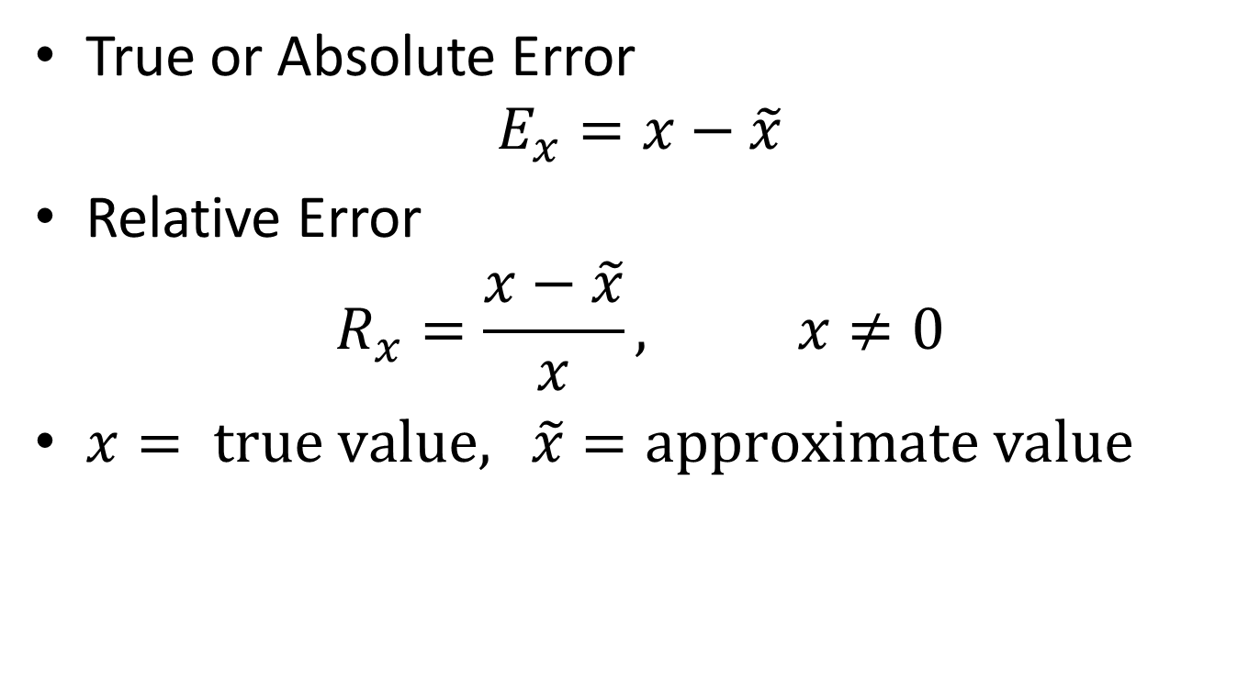
Errors
True or Absolute Error
$E_{x}=x−\tilde{x}$
Relative Error
$R_{x}=\frac{x−\tilde{x}}{x}, x≠0$
$x= \text{true} \text{value}\text{, }\tilde{x}=\text{approximate} \text{value}$

Slide 32
In Absence of True Value
For numerical methods, the true value will be known only when we deal with functions that can be solved analytically (simple systems). In real world applications, we usually do not know the answer a priori. Then
Iterative approach, example Newton’s method
(+ / -)

Slide 33
Tolerance
Use absolute value.
Computations are repeated until stopping criterion is satisfied.
If the following criterion is met
you can be sure that the result is correct to at least n significant figures.
Pre-specified % tolerance based on the knowledge of your solution

Slide 34
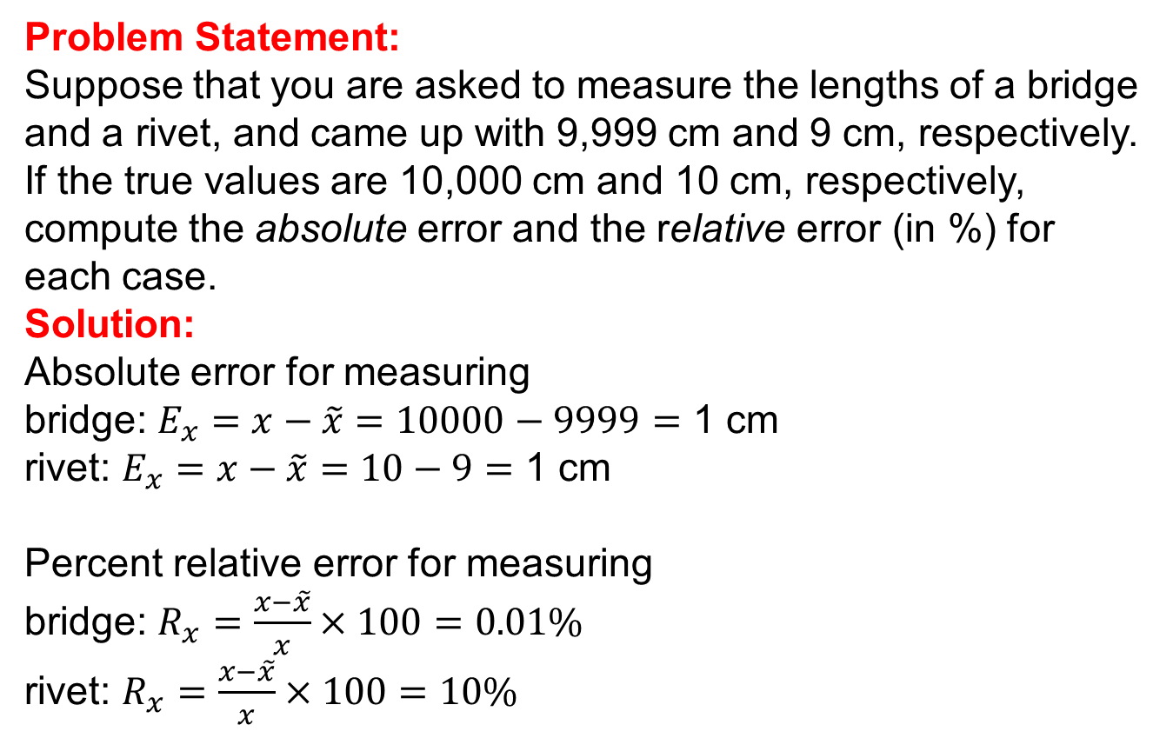
Error (Example Problem)
Problem Statement:
Suppose that you are asked to measure the lengths of a bridge and a rivet, and came up with 9,999 cm and 9 cm, respectively. If the true values are 10,000 cm and 10 cm, respectively, compute the absolute error and the relative error (in %) for each case.
Solution:
Absolute error for measuring
bridge: $E_{x}=x−\tilde{x}=10000−9999=$ 1 cm
rivet: $E_{x}=x−\tilde{x}=10−9=$ 1 cm
Percent relative error for measuring
bridge: $R_{x}=\frac{x−\tilde{x}}{x}×100=0.01\%$
rivet: $R_{x}=\frac{x−\tilde{x}}{x}×100=10\%$

Slide 35
Sources of Error
Errors in mathematical modeling:
  simplifying approximation,
  assumption made in representing physical system by mathematical equations
Blunders:
  undetected programming errors,
  silly mistakes
Errors in input:
  due to unavoidable reasons e.g. errors in data transfer,
  uncertainties associated with measurements

Slide 36
Sources of Error
Machine errors:
  rounding,
  chopping,
  overflow,
  underflow
Truncation errors associated with mathematical process:
  approximate evaluation of an infinite series,
  integral involving infinity

Slide 37
Round-off Errors
Numbers such as π, e, or cannot be expressed by a fixed number of significant figures.
Computers use a base-2 representation, they cannot precisely represent certain exact base-10 numbers.
Fractional quantities are typically represented in computer using “floating point” form, e.g.,
Integer part
exponent
mantissa
Base of the number system used

Slide 38
Chopping
Example:
π=3.14159265358 to be stored on a base-10 system carrying 7 significant digits.
π=3.141592 chopping error ε_{t}=0.00000065
If rounded
π=3.141593 ε_{t}=0.00000035
Some machines use chopping, because rounding adds to the computational overhead. Since number of significant figures is large enough, resulting chopping error is negligible.

Slide 39
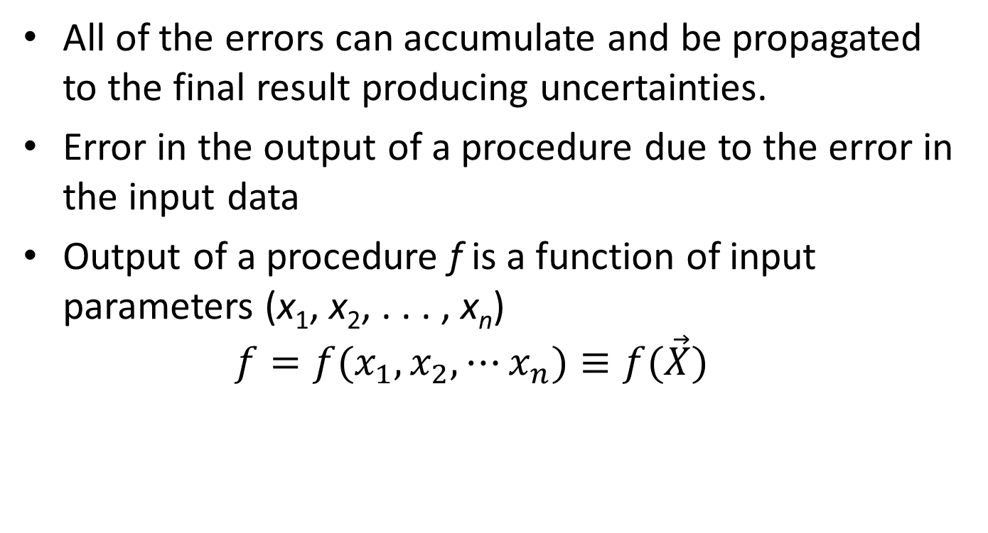
Error Propagation
All of the errors can accumulate and be propagated to the final result producing uncertainties.
Error in the output of a procedure due to the error in the input data
Output of a procedure f is a function of input parameters (x₁, x₂, . . . , x_{n})
$f=f(x_{1},x_{2},⋯x_{n})≡f(\vec{X})$

Slide 40
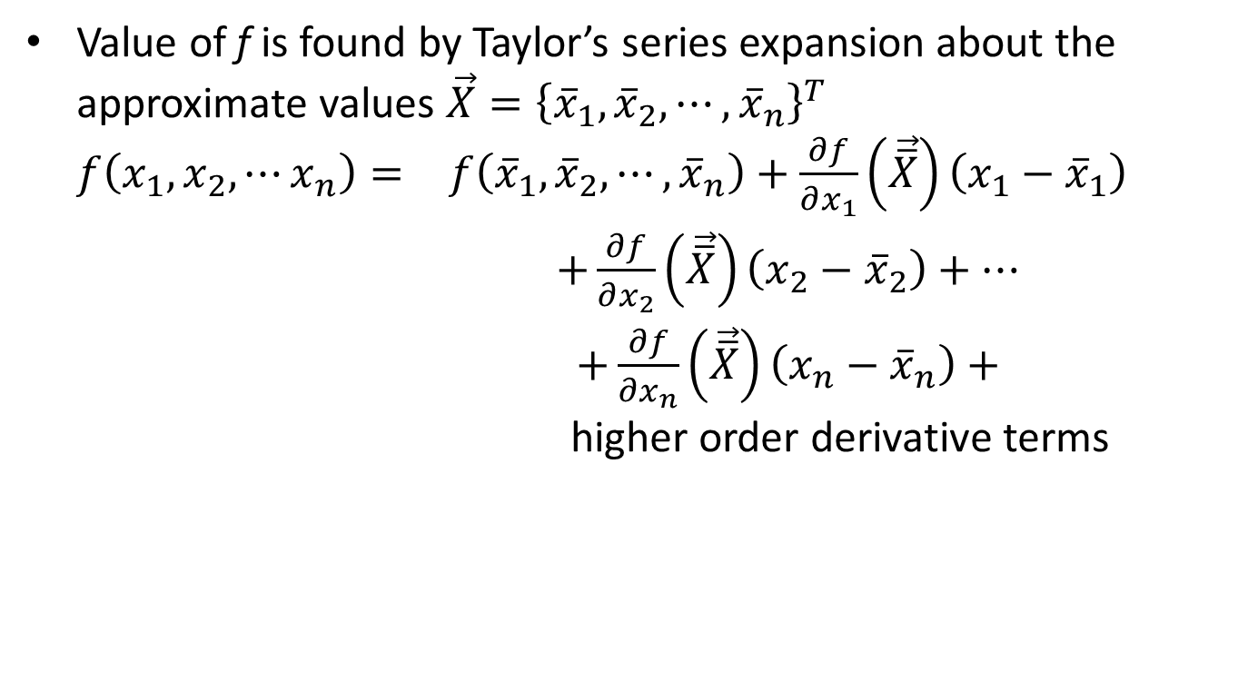
Error Propagation
Value of f is found by Taylor’s series expansion about the approximate values $\vec{X}={\left\{{\overline{x}}_{1},{\overline{x}}_{2},⋯,{\overline{x}}_{n}\right\}}^{T}$
$\begin{matrix}f\left(x_{1},x_{2},⋯x_{n}\right)= & f\left({\overline{x}}_{1},{\overline{x}}_{2},⋯,{\overline{x}}_{n}\right)+\frac{∂f}{∂x_{1}}\left(\vec{\overline{X}}\right)\left(x_{1}−{\overline{x}}_{1}\right) \\ & +\frac{∂f}{∂x_{2}}\left(\vec{\overline{X}}\right)\left(x_{2}−{\overline{x}}_{2}\right)+⋯ \\ & +\frac{∂f}{∂x_{n}}\left(\vec{\overline{X}}\right)\left(x_{n}−{\overline{x}}_{n}\right)+\end{matrix}$ higher order derivative terms

Slide 41


Error Propagation
Neglecting higher order derivative terms, the error in the output can be expressed as
and denoting errors in input parameters as
we can estimate propagation error as

Slide 42



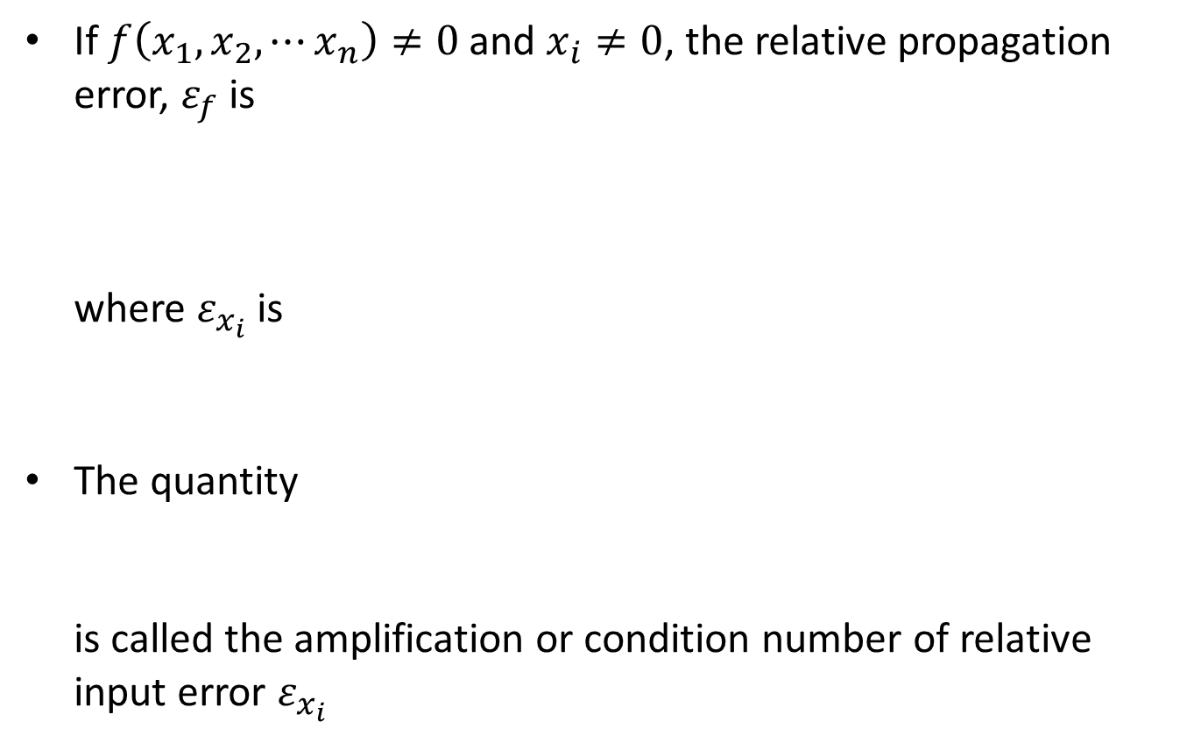
Error Propagation
If $f\left(x_{1},x_{2},⋯x_{n}\right)≠0$ and $x_{i}≠0$, the relative propagation error, $ε_{f}$ is
where $ε_{x_{i}}$ is
The quantity
is called the amplification or condition number of relative input error $ε_{x_{i}}$

Slide 43
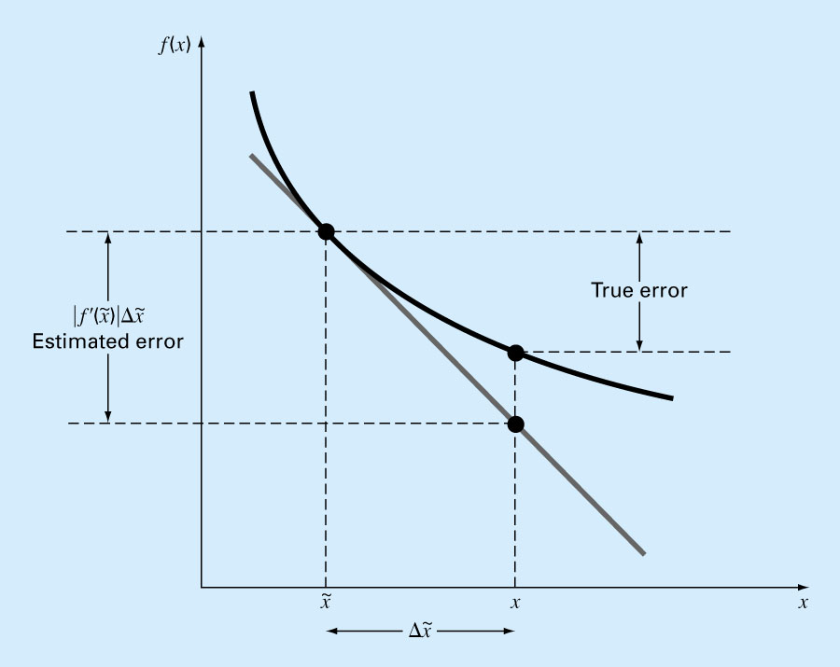
Error Propagation

Slide 44
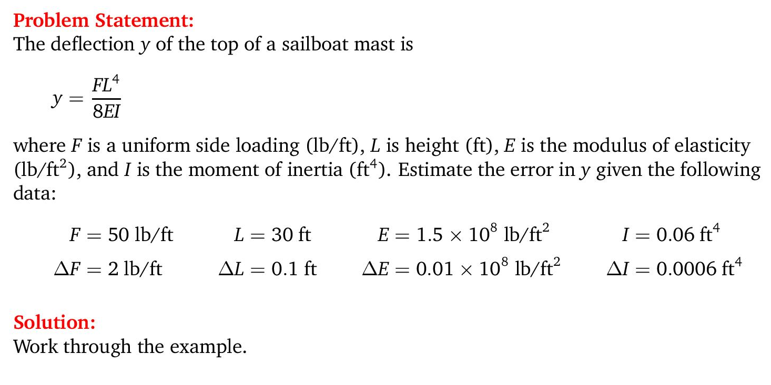
Propagation of Error (Example)

Slide 45
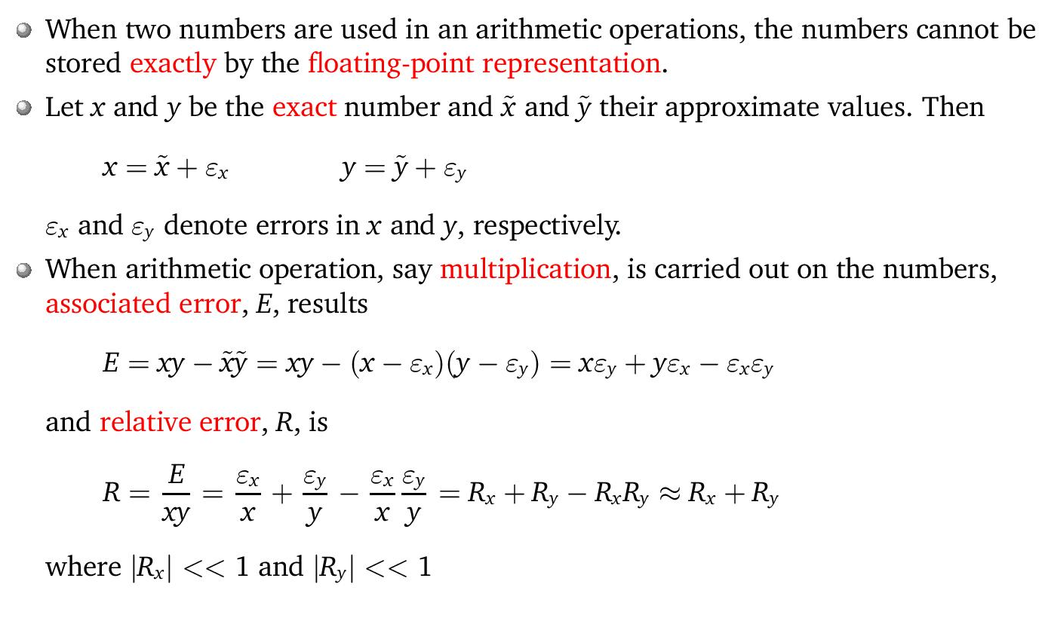
Propagation of Error (Arithmetic Operation)

