Slide 1
SKTN 2123
Strength of Materials
Deflection of Beams and Shafts
Mohsin Mohd Sies
Nuclear Engineering,
School of Chemical and Energy Engineering,
Universiti Teknologi Malaysia

Slide 2
The Elastic Curve
For elastic curve, positive internal moment tends to bend the beam concave upward, and vice versa.
There must be an inflection point at point C, where the curve changes from concave up to concave down, since this is a point of zero moment.

Slide 3
The Elastic Curve
Moment-Curvature Relationship
Due to loading, deformation of the beam is caused by both the internal shear force and bending moment.
If material is homogeneous and behaves in a linear-elastic manner, Hooke’s law applies thus,
ρ = radius of curvature at a specific point
M = internal moment in the beam at the point
E = material’s modulus of elasticity
I = beam’s moment of inertia computed about the neutral axis
EI = flexural rigidity

Slide 4
Slope and Displacement by Integration
For most problems the flexural rigidity will be constant along the length of the beam.
The slope and displacement, v, relationship of the beam is
Each integration is used to solve for all the constants to obtain a unique solution for a particular problem.

Slide 5
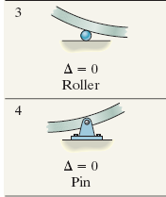
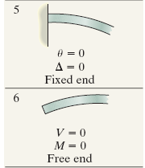

Slope and Displacement by Integration
Boundary and Continuity Conditions
The constants of integration are determined by evaluating the functions for shear, moment, slope, or displacement.
These values are called boundary conditions.
$$∆=v\text{ (}\text{displacement}\text{)}$$

Slide 6
Example 12.2
The simply supported beam supports the triangular distributed loading. Determine its maximum deflection. EI is constant.
Solution:
Due to symmetry only one x coordinate is needed for the solution,
The equation for the distributed loading is .Hence,

Slide 7
Solution:
Integrating twice, we have
For boundary condition,
Hence,
For maximum deflection at x = L/2,

Slide 8
Example 12.4
The beam is subjected to a load P at its end. Determine the displacement at C. EI is constant.
Solution:
Due to the loading 2 x-coordinates will be considered,
From A to B
from C to B
Using the free-body diagrams,
Thus,

Slide 9
Solution:
And
The four constants of integration are determined using three boundary conditions,
Solving, we obtain
Thus solving the equations,
When x₂ = 0, we get

Slide 10
Discontinuity Functions
When expressing load or internal moment of the beam, we need to use discontinuity functions.
1) Macaulay Functions
X is the point along the beam and a is the location on the beam where a “discontinuity” occurs.
General equation can used for distributed loadings:

Slide 11
Discontinuity Functions
The Macaulay functions below describe both the uniform load and triangular load.

Slide 12
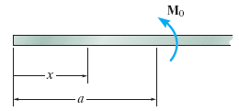
Discontinuity Functions
Singularity Functions
The functions are used to describe the point location forces or couple moments acting on a beam.
i) To describe a force,
=
ii) To describe a couple moment,
=
iii) Integration of both equations will give

Slide 13
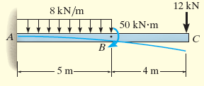
Example 12.5
Determine the equation of the elastic curve for the cantilevered beam, EI is constant.
Solution:
The boundary conditions require zero slope and displacement at A.
The support reactions at A have been calculated by statics and are shown on the free-body diagram,

Slide 14
Solution:
Since
Integrating twice, we have
Since dv/dx = 0, x = 0, C₁ = 0; and v = 0, C₂ = 0. Thus

Slide 15
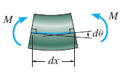
Slope and Displacement by the Moment-Area Method
The moment-area method finds the slope and displacement at specific points on the elastic curve of a beam or shaft.
THEOREM 1
Angle between the tangents at any 2 points on the elastic curve equals the area under the M/EI diagram between these two points.

Slide 16
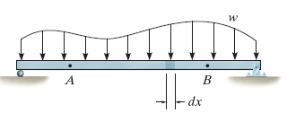
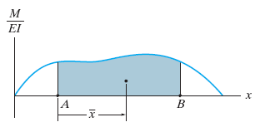
Slope and Displacement by the Moment-Area Method
THEOREM 2
Tangent at A on the elastic curve with respect to the tangent extended from B equals to the moment of the area under M/EI diagram. This moment is computed about A where the vertical deviation is to be determined.
or

Slide 17
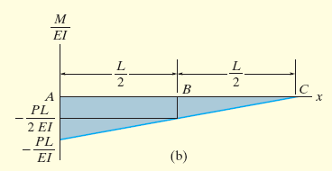
Example 12.7
Determine the slope of the beam at points B and C. EI is constant.
Solution:
M/EI diagram will be drawn first.
The force P causes the beam to deflect as shown.
By the construction, the angle between tan A and tan B is equivalent to θ_{B/A}, where
Using moment-area theorem,

Slide 18

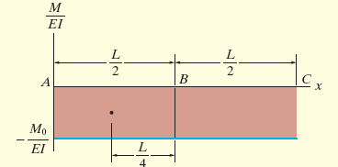
Example 12.8
Determine the displacement of points B and C of the beam. EI is constant.
Solution:
M/EI diagram will be drawn first.
The couple moment at C causes the beam to deflect as shown, thus
Using moment-area theorem, we have
Since both answers are negative, they indicate that points B and C lie below the tangent at A.

Slide 19
Example 12.12
Determine the displacement at point C for the steel overhanging beam.
Take E_{st} = 200 GPa, I = 50 x 10⁶ mm⁴.
Solution:
M/EI diagram will be drawn first.
The loading causes the beam to deflect as shown, thus
Using moment-area theorem, we have
By input the given values,

Slide 20
Method of Superposition
satisfies the 2 requirements for principle of superposition.
1) Load is linearly related to the deflection.
2) Load is assumed not to change significantly.
Using tabulated results from Appendix C, we are able to find the slope and displacement at a point on a beam subjected to loadings.

Slide 21
Example 12.13
Determine the displacement at point C and the slope at the support A of the beam. EI is constant.
Solution:
The loading can be separated into two component parts.
The displacement at C and slope at A are found using the table,
=
+
For the 8-kN concentrated force,
Total displacement at C and the slope at A are

Slide 22
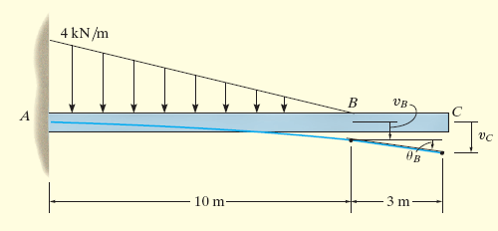
Example 12.15
Determine the displacement at the end C of the cantilever beam. EI is constant.
Solution:
From Appendix C, the slope and displacement at B are
Since angle is small, the displacement at C becomes

Slide 23
Statically Indeterminate Beams and Shafts
A member is classified as statically indeterminate if
To determine the reactions on a beam that is statically indeterminate:
Specify the redundant reactions.
Find the redundants through compatibility conditions.
Apply redundants and solve the reactions.

Slide 24
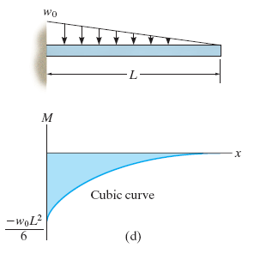
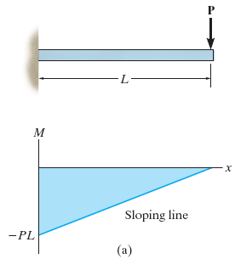
Statically Indeterminate Beams and Shafts
There are 3 methods to solve the redundants.
1) Method of Integration
Requires two integrations of the differential equation:
2) Moment-Area Method
Calculation of both the area under the MEI diagram and the centroidal location of this area.

Slide 25
Statically Indeterminate Beams and Shafts
3) Method of Superposition
Solve for the redundant loadings on axially loaded bars and torsionally loaded shafts.
=
+

Slide 26
Example 12.18
The beam is fixed supported at both ends and is subjected to the uniform loading. Determine the reactions at the supports. Neglect the effect of axial load.
Solution:
From the free-body diagram,
From slope and elastic curve,
From the boundary conditions, we get C₁ = C₂ =0, thus

Slide 27
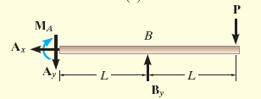
Example 12.19
The beam is subjected to the concentrated loading, determine the reactions at the supports. EI is constant.
Solution:
Using the method of superposition, we draw the separate
M/EI diagrams for the redundant reaction B_{y} and the load P.
Since , then
Applying Theorem 2 of moment-area theorem,
The reactions at A on the free-body diagram are

Slide 28
Example 12.21
Determine the reactions at the roller support B of the beam, then draw the shear and moment diagrams. EI is constant.
Solution:
By inspection, the beam is statically indeterminate to the
first degree.
Taking positive displacement as downward, the compatibility equation at B is
=
Displacements can be obtained from Appendix C.
+

Slide 29
Solution:
Substituting into Eq. 1 and solving yields

Slide 30
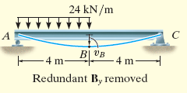
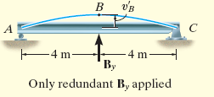
Example 12.22
Determine the reactions on the beam. Due to the loading and poor construction, the roller support at B settles 12 mm. Take E = 200GPa and I = 80(10⁶) mm⁴
Solution:
By inspection, the beam is indeterminate to the first degree.
With reference to point B, using units of meters, we require
=
Using the table in Appendix C,
+

Slide 31
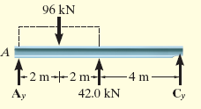
Solution:
Thus Eq. 1 becomes
Substituting E and I, we have
We can calculate the reactions at A and C using the equations of equilibrium.

