Slide 1
SKTN 2123
Strength of Materials
Stress Transformation
Mohsin Mohd Sies
Nuclear Engineering,
School of Chemical and Energy Engineering,
Universiti Teknologi Malaysia

Slide 2
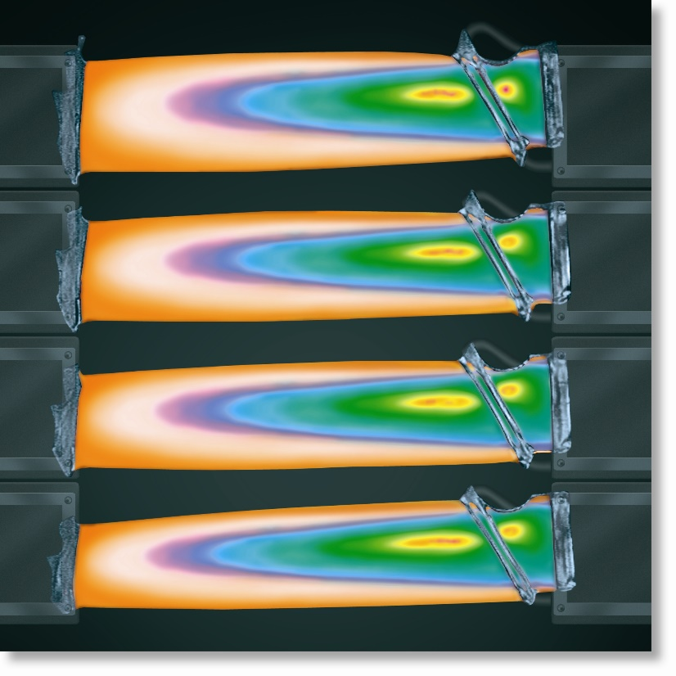
CHAPTER OBJECTIVES
Derive equations for
transforming stress
components between
coordinate systems of
different orientation
Use derived equations to
obtain the maximum normal
and maximum shear stress
at a point
Determine the orientation of elements upon which the maximum normal and maximum shear stress acts

Slide 3
CHAPTER OBJECTIVES
Discuss a method for
determining the absolute
maximum shear stress at a
point when material is
subjected to plane and
3-dimensional states of stress

Slide 4
CHAPTER OUTLINE
Plane-Stress Transformation
General Equations of Plane Stress Transformation
Principal Stresses and Maximum In-Plane Shear Stress
Mohr’s Circle – Plane Stress
Stress in Shafts Due to Axial Load and Torsion
Stress Variations Throughout a Prismatic Beam
Absolute Maximum Shear Stress

Slide 5
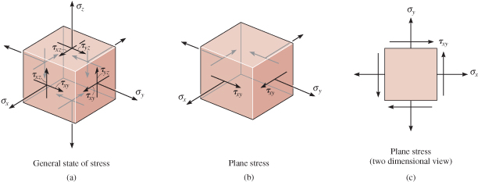
9.1 PLANE-STRESS TRANSFORMATION
General state of stress at a pt is characterized by six independent normal and shear stress components.
In practice, approximations and simplifications are done to reduce the stress components to a single plane.

Slide 6
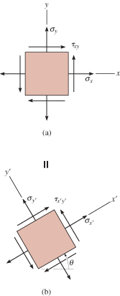
9.1 PLANE-STRESS TRANSFORMATION
The material is then said to be
subjected to plane stress.
For general state of plane stress at a
pt, we represent it via normal-stress
components, σ_{x}, σ_{y} and shear-stress
component τ_{xy}.
Thus, state of plane stress at the pt is
uniquely represented by three
components acting on an element
that has a specific orientation at
that pt.

Slide 7
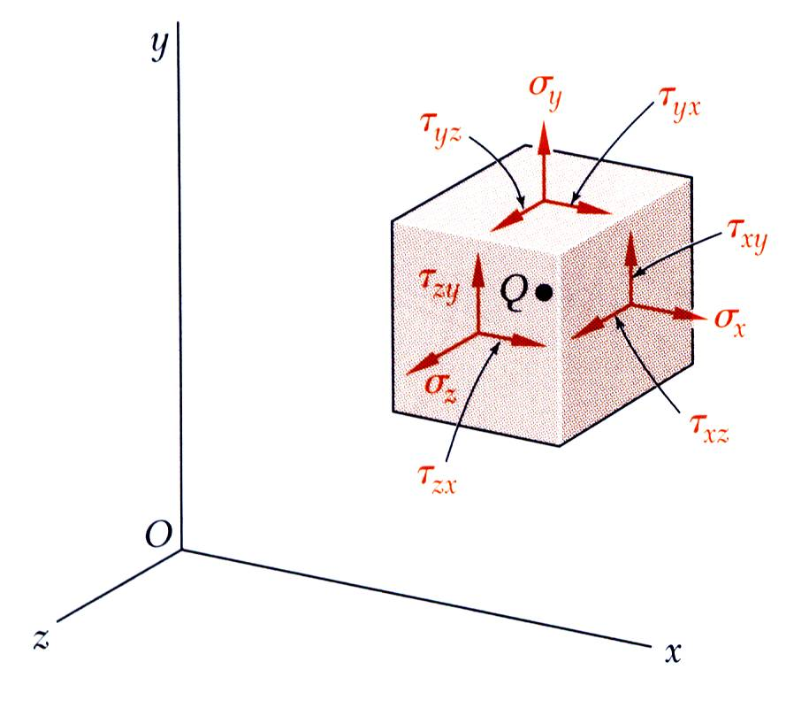
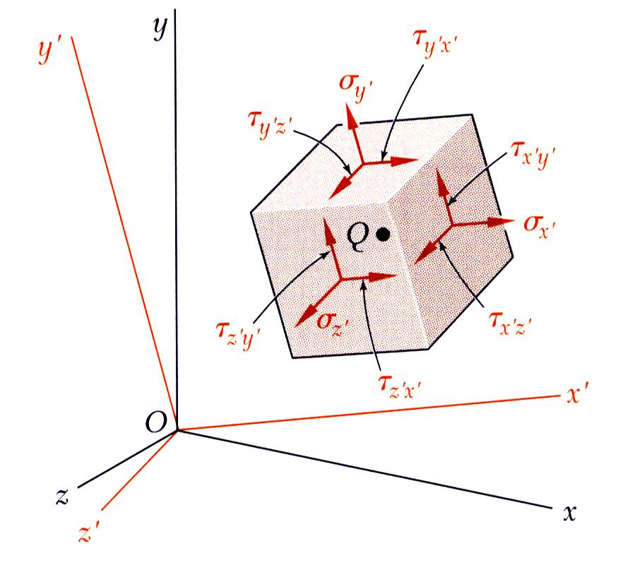
9.1 PLANE-STRESS TRANSFORMATION
The most general state of stress at a point may be represented by 6 components,
Same state of stress is represented by a different set of components if axes are rotated.

Slide 8
9.1 PLANE-STRESS TRANSFORMATION
Transforming stress components from one orientation to the other is similar in concept to how we transform force components from one system of axes to the other.
Note that for stress-component transformation, we need to account for
  the magnitude and direction of each stress component, and
  the orientation of the area upon which each component acts.

Slide 9
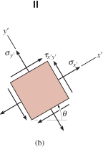
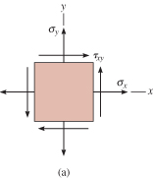
9.1 PLANE-STRESS TRANSFORMATION
Procedure for Analysis
If state of stress at a pt is known for a given orientation of an element of material, then state of stress for another orientation can be determined

Slide 10
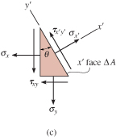
9.1 PLANE-STRESS TRANSFORMATION
Procedure for Analysis
Section element as shown.
Assume that the sectioned area is ∆A, then adjacent areas of the segment will be ∆A sinθ and ∆A cosθ.
Draw free-body diagram of segment,
showing the forces that act on the
element. (Tip: Multiply stress
components on each face by the
area upon which they act)

Slide 11
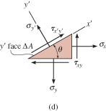
9.1 PLANE-STRESS TRANSFORMATION
Procedure for Analysis
Apply equations of force equilibrium in the x’ and y’ directions to obtain the two unknown stress components σ_{x’}, and τ_{x’y’}.
To determine σ_{y’} (that acts on the +y’ face of the element), consider a segment of element shown below.
Follow the same procedure as
described previously.
Shear stress τ_{x’y’} need not be
determined as it is complementary.

Slide 12
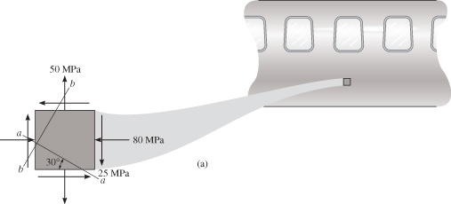
EXAMPLE 9.1
State of plane stress at a pt on surface of airplane fuselage is represented on the element oriented as shown. Represent the state of stress at the pt that is oriented 30° clockwise from the position shown.

Slide 13

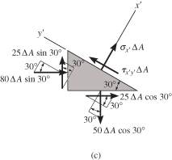
EXAMPLE 9.1 (SOLN)
CASE A (a-a section)
Section element by line a-a and
remove bottom segment.
Assume sectioned (inclined)
plane has an area of ∆A,
horizontal and vertical planes
have area as shown.
Free-body diagram of
segment is also shown.

Slide 14
EXAMPLE 9.1 (SOLN)
Apply equations of force equilibrium
in the x’ and y’ directions (to avoid
simultaneous solution for the two
unknowns)
+ ΣF_{x’} = 0;

Slide 15
EXAMPLE 9.1 (SOLN)
+ ΣF_{y’} = 0;
Since σ_{x’} is negative, it acts
in the opposite direction
we initially assumed.

Slide 16

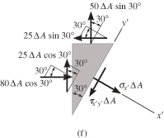
EXAMPLE 9.1 (SOLN)
CASE B (b-b section)
Repeat the procedure to obtain
the stress on the perpendicular
plane b-b.
Section element as shown
on the upper right.
Orientate the +x’ axis
outward, perpendicular to
the sectioned face, with
the free-body diagram
as shown.

Slide 17
EXAMPLE 9.1 (SOLN)
+ ΣF_{x’} = 0;

Slide 18
EXAMPLE 9.1 (SOLN)
+ ΣF_{y’} = 0;
Since σ_{x’} is negative, it acts opposite to its direction shown.

Slide 19
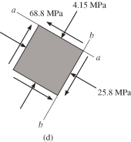
EXAMPLE 9.1 (SOLN)
The transformed stress
components are as shown.
From this analysis, we conclude
that the state of stress at the pt can
be represented by choosing an
element oriented as shown in the
Case A or by choosing a different
orientation in the Case B.
Stated simply, states of stress are equivalent.

Slide 20
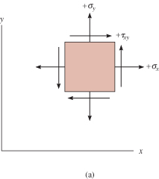
9.2 GENERAL EQNS OF PLANE-STRESS TRANSFORMATION
Sign Convention
We will adopt the same sign convention as discussed in chapter 1.3.
Positive normal stresses, σ_{x} and σ_{y}, acts outward from all faces
Positive shear stress τ_{xy} acts
upward on the right-hand
face of the element.

Slide 21
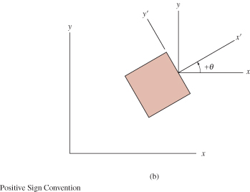
9.2 GENERAL EQNS OF PLANE-STRESS TRANSFORMATION
Sign Convention
The orientation of the inclined plane is determined using the angle θ.
Establish a positive x’ and y’ axes using the right-hand rule.
Angle θ is positive if it
moves counterclockwise
from the +x axis to
the +x’ axis.

Slide 22
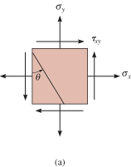
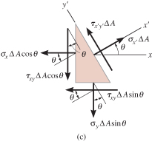
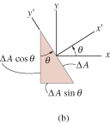
9.2 GENERAL EQNS OF PLANE-STRESS TRANSFORMATION
Normal and shear stress components
Section element as shown.
Assume sectioned area is ∆A.
Free-body diagram of element
is shown.

Slide 23
9.2 GENERAL EQNS OF PLANE-STRESS TRANSFORMATION
Normal and shear stress components
Apply equations of force
equilibrium to determine
unknown stress components:
+ ΣF_{x’} = 0;

Slide 24
9.2 GENERAL EQNS OF PLANE-STRESS TRANSFORMATION
Normal and shear stress components
+ ΣF_{y’} = 0;
Simplify the above two equations using trigonometric identities sin2θ = 2 sinθ cosθ,
sin²θ = (1 − cos2θ)/2, and cos²θ =(1+cos2θ)/2.

Slide 25
9.2 GENERAL EQNS OF PLANE-STRESS TRANSFORMATION
Normal and shear stress components
If σ_{y’} is needed, substitute (θ = θ + 90°) for θ into Eqn 9-1.

Slide 26
9.2 GENERAL EQNS OF PLANE-STRESS TRANSFORMATION
Procedure for Analysis
To apply equations 9-1 and 9-2, just substitute the known data for σ_{x}, σ_{y}, τ_{xy}, and θ according to established sign convention.
If σ_{x}’ and τx’y’ are calculated as positive quantities, then these stresses act in the positive direction of the x’ and y’ axes.
Tip: For your convenience, equations 9-1 to 9-3 can be programmed on your pocket calculator.

Slide 27
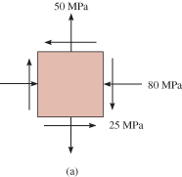
EXAMPLE 9.2
State of stress at a point is represented by the element shown. Determine the state of stress at the point on another element orientated 30° clockwise from the position shown.

Slide 28
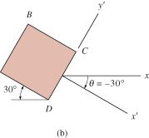
EXAMPLE 9.2 (SOLN)
This problem was solved in Example 9.1 using basic principles. Here we apply Eqns. 9-1 and 9-2.
From established sign convention,
Plane CD
+x’ axis is directed outward,
perpendicular to CD,
and +y’ axis directed along CD.
Angle measured
is θ = −30° (clockwise).

Slide 29
EXAMPLE 9.2 (SOLN)
Plane CD
Apply Eqns 9-1 and 9-2:
The negative signs indicate that σ_{x’} and τ_{x’y’} act in the negative x’ and y’ directions.

Slide 30
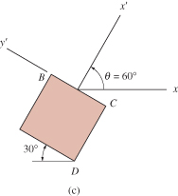
EXAMPLE 9.2 (SOLN)
Plane BC
Similarly, stress components
acting on face BC are
obtained using θ = 60°.

Slide 31
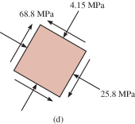
EXAMPLE 9.2 (SOLN)
As shown, shear stress τ_{x’y’} was computed twice to provide a check.
Negative sign for σ_{x’} indicates that stress acts in the negative x’ direction.
The results are shown below.

Slide 32
9.2 PRINCIPAL STRESSES AND MAXIMUM IN-PLANE SHEAR STRESS
In-plane principal stresses
Differentiate Eqn. 9-1 w.r.t. θ and equate to zero:
Solving the equation and let θ = θ_{P}, we get
Solution has two roots, θ _{p1}, and θ _{p2}.

Slide 33
9.2 PRINCIPAL STRESSES AND MAXIMUM IN-PLANE SHEAR STRESS
In-plane principal stresses
For θ _{p1},
For θ _{p2},

Slide 34
9.2 PRINCIPAL STRESSES AND MAXIMUM IN-PLANE SHEAR STRESS
In-plane principal stresses
Substituting either of the two sets of trigonometric relations into Eqn 9-1, we get
The Eqn gives the maximum/minimum in-plane normal stress acting at a pt, where σ₁ ≥ σ₂ .
The values obtained are the principal in-plane principal stresses, and the related planes are the principal planes of stress.

Slide 35
9.2 PRINCIPAL STRESSES AND MAXIMUM IN-PLANE SHEAR STRESS
In-plane principal stresses
If the trigonometric relations for θ_{p1} and θ_{p2} are substituted into Eqn 9-2, it can be seen that
τ_{x’y’} = 0.
No shear stress acts on the principal planes.
Maximum in-plane shear stress
Differentiate Eqn. 9-2 w.r.t. θ and equate to zero:

Slide 36
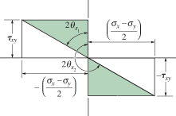
9.2 PRINCIPAL STRESSES AND MAXIMUM IN-PLANE SHEAR STRESS
Maximum in-plane shear stress
The two roots of this equation, θ_{s1} and θ_{s2} can be determined using the shaded triangles as shown.
The planes for maximum
shear stress can be
determined by orienting
an element 45° from the
position of an element
that defines the plane
of principal stress.

Slide 37
9.2 PRINCIPAL STRESSES AND MAXIMUM IN-PLANE SHEAR STRESS
Maximum in-plane shear stress
Using either one of the roots
θ_{s1} and θ_{s2}, and taking trigo
values of sin 2θ_{s} and cos 2θ_{s}
and substitute into Eqn 9-2:
Value calculated in Eqn 9-7 is referred to as the maximum in-plane shear stress.

Slide 38
9.2 PRINCIPAL STRESSES AND MAXIMUM IN-PLANE SHEAR STRESS
Maximum in-plane shear stress
Substitute values for sin 2θ_{s} and cos 2θ_{s} into
Eqn 9-1, we get a normal stress acting on the planes of maximum in-plane shear stress:
You can also program the above equations on your pocket calculator.

Slide 39
9.2 PRINCIPAL STRESSES AND MAXIMUM IN-PLANE SHEAR STRESS
IMPORTANT
Principals stresses represent the maximum and minimum normal stresses at the pt.
When state of stress is represented by principal stresses, no shear stress will act on element.
State of stress at the pt can also be represented in terms of the maximum in-plane shear stress. An average normal stress will also act on the element.
Element representing the maximum in-plane shear stress with associated average normal stresses is oriented 45° from element represented principal stresses.

Slide 40
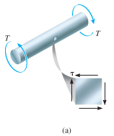
EXAMPLE 9.3
When torsional loading T is applied to bar, it produces a state of pure shear stress in the material. Determine (a) the maximum in-plane shear stress and associated average normal stress, and (b) the principal stress.

Slide 41
EXAMPLE 9.3 (SOLN)
From established sign convention:
Maximum in-plane shear stress
Apply Eqns 9-7 and 9-8,

Slide 42
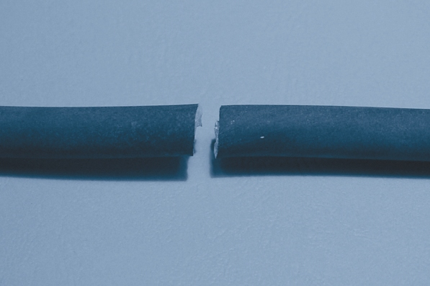
EXAMPLE 9.3 (SOLN)
Maximum in-plane shear stress
As expected, maximum in-plane shear stress represented by element shown initially.
Experimental results show that materials that are ductile will fail due to shear stress. Thus, with a torque applied to a bar
made from mild steel,
the maximum in-plane
shear stress will cause
failure as shown.

Slide 43
EXAMPLE 9.3 (SOLN)
Principal stress
Apply Eqns 9-4 and 9-5,

Slide 44
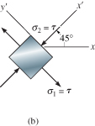
EXAMPLE 9.3 (SOLN)
Principal stress
Apply Eqn 9-1 with θ_{p2} = 45°
Thus, if σ₂ = −τ acts at θ_{p2} = 45°
as shown, and σ₁ = τ acts on
the other face, θ_{p1} = 135°.

Slide 45
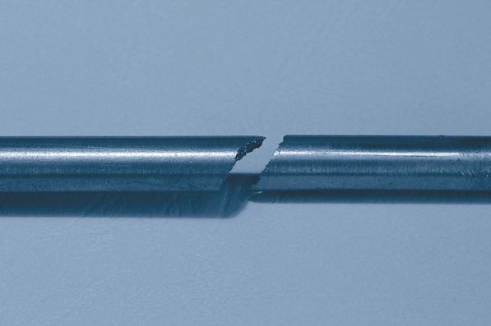
EXAMPLE 9.3 (SOLN)
Principal stress
Materials that are brittle fail due to normal stress. An example is cast iron when subjected to torsion, fails in tension at 45° inclination as shown below.

Slide 46
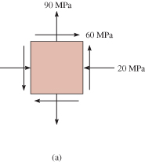
EXAMPLE 9.6
State of plane stress at a pt on a body is represented on the element shown. Represent this stress state in terms of the maximum in-plane shear stress and associated average normal stress.

Slide 47
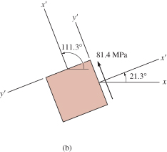
EXAMPLE 9.6 (SOLN)
Orientation of element
Since σ_{x} = −20 MPa, σy = 90 MPa, and
τ_{xy} = 60 MPa and applying Eqn 9-6,
Note that the angles are 45°
away from principal planes
of stress.

Slide 48
EXAMPLE 9.6 (SOLN)
Maximum in-plane shear stress
Applying Eqn 9-7,
Thus acts in the +y’ direction on this
face (θ = 21.3°).

Slide 49
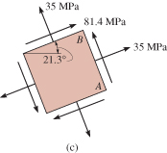
EXAMPLE 9.6 (SOLN)
Average normal stress
Besides the maximum shear stress, the element is also subjected to an average normal stress determined from Eqn. 9-8:
This is a tensile stress.

Slide 50
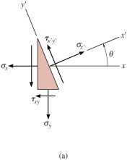
9.4 MOHR’S CIRCLE: PLANE STRESS
Equations for plane stress transformation have a graphical solution that is easy to remember and use.
This approach will help
you to “visualize” how the
normal and shear stress
components vary as the
plane acted on is oriented
in different directions.

Slide 51
9.4 MOHR’S CIRCLE: PLANE STRESS
Eqns 9-1 and 9-2 are rewritten as
Parameter can be eliminated by squaring each eqn and adding them together.

Slide 52
9.4 MOHR’S CIRCLE: PLANE STRESS
If σ_{x}, σ_{y}, τ_{xy} are known constants, thus we compact the Eqn as,

Slide 53
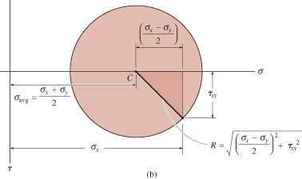
9.4 MOHR’S CIRCLE: PLANE STRESS
Establish coordinate axes; σ positive to the right and τ positive downward, Eqn 9-11 represents a circle having radius R and center on the σ axis at pt C (σ_{avg}, 0). This is called the Mohr’s Circle.

Slide 54
9.4 MOHR’S CIRCLE: PLANE STRESS
To draw the Mohr’s circle, we must establish
the σ and τ axes.
Center of circle C (σ_{avg}, 0) is plotted from the known stress components (σ_{x}, σ_{y}, τ_{xy}).
We need to know at least one pt on the circle to get the radius of circle.

Slide 55
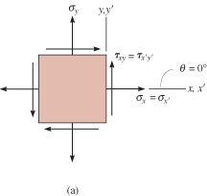
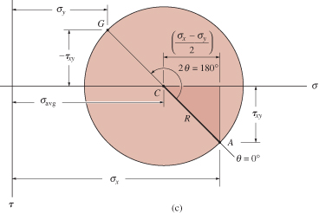
9.4 MOHR’S CIRCLE: PLANE STRESS
Case 1 (x’ axis coincident with x axis)
  θ = 0°
  σ_{x’} = σ_{x}
  τ_{x’y’} = τ_{xy}.
Consider this as reference pt A, and
plot its coordinates A (σ_{x}, τ_{xy}).
Apply Pythagoras theorem to shaded triangle to determine radius R.
Using pts C and A,
the circle can now
be drawn.

Slide 56
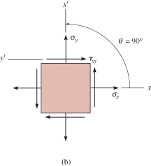
9.4 MOHR’S CIRCLE: PLANE STRESS
Case 2 (x’ axis rotated 90° counterclockwise)
  θ = 90°
  σ_{x’} = σ_{y}
  τ_{x’y’} = −τ_{xy}.
Its coordinates are G (σ_{y}, −τ_{xy}).
Hence radial line CG
is 180°
counterclockwise
from “reference
line” CA.

Slide 57
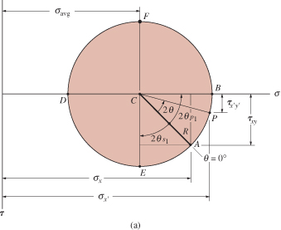
9.4 MOHR’S CIRCLE: PLANE STRESS
Procedure for Analysis
Construction of the circle
Establish coordinate
system where abscissa
represents the normal
stress σ, (+ve to the
right), and the ordinate
represents shear
stress τ, (+ve downward).
Use positive sign convention for σ_{x}, σ_{y}, τ_{xy}, plot the center of the circle C, located on the σ axis at a distance σ_{avg} = (σ_{x} + σ_{y})/2 from the origin.

Slide 58
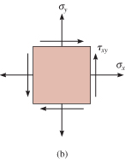
9.4 MOHR’S CIRCLE: PLANE STRESS
Procedure for Analysis
Construction of the circle
Plot reference pt A (σ_{x}, τ_{xy}). This pt represents the normal and shear stress components on the element’s right-hand vertical face. Since x’ axis coincides with x axis, θ = 0.

Slide 59
9.4 MOHR’S CIRCLE: PLANE STRESS
Procedure for Analysis
Construction of the circle
Connect pt A with center C of the circle and determine CA by trigonometry. The distance represents the radius R of the circle.
Once R has been
determined, sketch
the circle.

Slide 60
9.4 MOHR’S CIRCLE: PLANE STRESS
Procedure for Analysis
Principal stress
Principal stresses σ₁ and σ₂ (σ₁ ≥ σ₂) are represented by two pts B and D where the circle intersects the σ-axis.

Slide 61
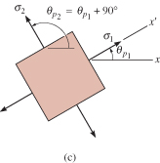
9.4 MOHR’S CIRCLE: PLANE STRESS
Procedure for Analysis
Principal stress
These stresses act on planes
defined by angles θ_{p1} and θ_{p2}.
They are represented on the
circle by angles 2θ_{p1} and 2θ_{p2}
and measured from radial
reference line CA to lines CB and CD respectively.

Slide 62
9.4 MOHR’S CIRCLE: PLANE STRESS
Procedure for Analysis
Principal stress
Using trigonometry, only one of
these angles needs to be
calculated from the circle,
since θ_{p1} and θ_{p2} are 90° apart.
Remember that direction of
rotation 2θ_{p} on the circle represents the same direction of rotation θ_{p} from reference axis (+x) to principal plane (+x’).

Slide 63
9.4 MOHR’S CIRCLE: PLANE STRESS
Procedure for Analysis
Maximum in-plane shear stress
The average normal stress
and maximum in-plane shear
stress components are
determined from the circle as
the coordinates of either pt E
or F.

Slide 64
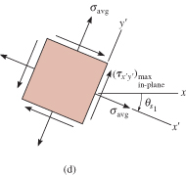
9.4 MOHR’S CIRCLE: PLANE STRESS
Procedure for Analysis
Maximum in-plane shear stress
The angles θ_{s1} and θ_{s2} give
the orientation of the planes
that contain these
components. The angle 2θ_{s}
can be determined using
trigonometry. Here rotation is
clockwise, and so θ_{s1} must be
clockwise on the element.

Slide 65
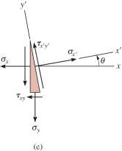
9.4 MOHR’S CIRCLE: PLANE STRESS
Procedure for Analysis
Stresses on arbitrary plane
Normal and shear stress
components σ_{x’} and τ_{x’y’}
acting on a specified plane
defined by the angle θ, can
be obtained from the circle
by using trigonometry to
determine the coordinates
of pt P.

Slide 66
9.4 MOHR’S CIRCLE: PLANE STRESS
Procedure for Analysis
Stresses on arbitrary plane
To locate pt P, known angle θ
for the plane (in this case
counterclockwise) must be
measured on the circle in
the same direction 2θ
(counterclockwise), from the
radial reference line CA to the
radial line CP.

Slide 67
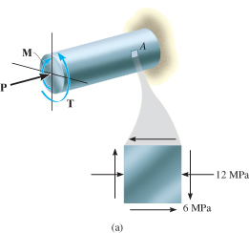
EXAMPLE 9.9
Due to applied loading, element at pt A on solid cylinder as shown is subjected to the state of stress. Determine the principal stresses acting at this pt.

Slide 68
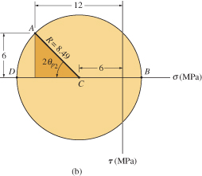
EXAMPLE 9.9 (SOLN)
Construction of the circle
Center of the circle is at
Initial pt A (−2, −6) and the
center C (−6, 0) are plotted
as shown. The circle having
a radius of

Slide 69
EXAMPLE 9.9 (SOLN)
Principal stresses
Principal stresses indicated at
pts B and D. For σ₁ > σ₂,
Obtain orientation of element by
calculating counterclockwise angle 2θ_{p2}, which defines the direction of θ_{p2} and σ₂ and its associated principal plane.

Slide 70
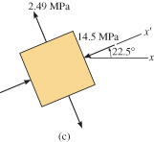
EXAMPLE 9.9 (SOLN)
Principal stresses
The element is orientated such that x’ axis or σ₂ is directed 22.5° counterclockwise from the horizontal x-axis.

Slide 71
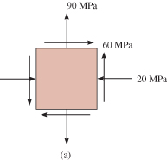
EXAMPLE 9.10
State of plane stress at a pt is shown on the element. Determine the maximum in-plane shear stresses and the orientation of the element upon which they act.

Slide 72
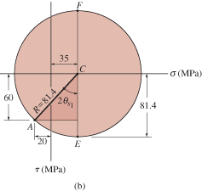
EXAMPLE 9.10 (SOLN)
Construction of circle
Establish the σ, τ axes as shown below. Center of circle C located on the σ-axis, at the pt:

Slide 73
EXAMPLE 9.10 (SOLN)
Construction of circle
Pt C and reference pt A (−20, 60) are plotted. Apply Pythagoras theorem to shaded triangle to get circle’s radius CA,

Slide 74
EXAMPLE 9.10 (SOLN)
Maximum in-plane shear stress
Maximum in-plane shear stress and average normal stress are identified by pt E or F on the circle. In particular, coordinates of pt E (35, 81.4) gives

Slide 75
EXAMPLE 9.10 (SOLN)
Maximum in-plane shear stress
Counterclockwise angle θ_{s1} can be found from the circle, identified as 2θ_{s1}.

Slide 76
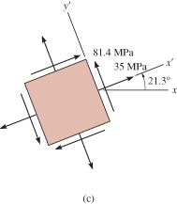
EXAMPLE 9.10 (SOLN)
Maximum in-plane shear stress
This counterclockwise angle defines the direction of the x’ axis. Since pt E has positive coordinates, then the average normal stress and maximum in-plane shear stress both act in the positive x’ and y’ directions as shown.

Slide 77
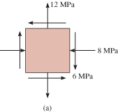
EXAMPLE 9.11
State of plane stress at a pt is shown on the element. Represent this state of stress on an element oriented 30° counterclockwise from position shown.

Slide 78
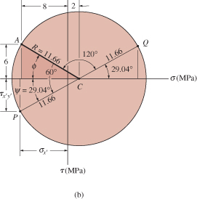
EXAMPLE 9.11 (SOLN)
Construction of circle
Establish the σ, τ axes
as shown.
Center of circle C
located on the
σ-axis, at the pt:

Slide 79
EXAMPLE 9.11 (SOLN)
Construction of circle
Initial pt for θ = 0° has coordinates A (−8, −6) are plotted. Apply
Pythagoras theorem
to shaded triangle
to get circle’s
radius CA,

Slide 80
EXAMPLE 9.11 (SOLN)
Stresses on 30° element
Since element is rotated 30° counterclockwise, we must construct a radial line CP, 2(30°) = 60° counterclockwise, measured
from CA (θ = 0°).
Coordinates of pt P (σ_{x’}, τ_{x’y’})
must be obtained. From
geometry of circle,

Slide 81
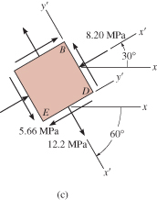
EXAMPLE 9.11 (SOLN)
Stresses on 30° element
The two stress components act on
face BD of element shown, since
the x’ axis for this face if oriented 30°
counterclockwise from the x-axis.
Stress components acting on adjacent face DE of element, which is 60° clockwise from +x-axis, are represented by the coordinates of pt Q on the circle.
This pt lies on the radial line CQ, which is 180° from CP.

Slide 82
EXAMPLE 9.11 (SOLN)
Stresses on 30° element
The coordinates of pt Q are
Note that here τ_{x’y’} acts in
the −y’ direction.

Slide 83
9.5 STRESS IN SHAFTS DUE TO AXIAL LOAD AND TORSION
Occasionally, circular shafts are subjected to combined effects of both an axial load and torsion.
Provided materials remain linear elastic, and subjected to small deformations, we use principle of superposition to obtain resultant stress in shaft due to both loadings.
Principal stress can be determined using either stress transformation equations or Mohr’s circle.

Slide 84
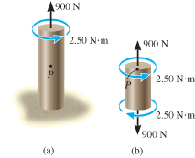
EXAMPLE 9.12
Axial force of 900 N and torque of 2.50 N⋅m are applied to shaft. If shaft has a diameter of 40 mm, determine the principal stresses at a pt P on its surface.

Slide 85
EXAMPLE 9.12 (SOLN)
Internal loadings
Consist of torque of 2.50 N⋅m and
axial load of 900 N.
Stress components
Stresses produced at pt P are
therefore

Slide 86


EXAMPLE 9.12 (SOLN)
Principal stresses
Using Mohr’s circle, center of circle C
at the pt is
Plotting C (358.1, 0) and
reference pt A (0, 198.9),
the radius found was
R = 409.7 kPA. Principal
stresses represented by
pts B and D.

Slide 87

EXAMPLE 9.12 (SOLN)
Principal stresses
Clockwise angle 2θ_{p2} can be
determined from the circle.
It is 2θ_{p2} = 29.1°. The element
is oriented such that the x’ axis
or σ₂ is directed clockwise
θ_{p1} = 14.5° with the x axis
as shown.

Slide 88
Question 5 Final Exam 2006
A rod in Figure 9 has a circular cross section with a diameter of 5 mm. It is subjected to a torque of 15 N. mm and a bending moment of 10 N. mm;
Determine the maximum normal stress and maximum shear stress. (4 marks)
Determine the principle stresses at the point of maximum flexural stress. (3 marks)
Sketch Mohr’s circle for this case with all the necessary points. (8 marks)
T = 15 N.mm
M = 10 N.mm

Slide 89


9.7 ABSOLUTE MAXIMUM SHEAR STRESS
A pt in a body subjected to a general
3-D state of stress will have a normal
stress and 2 shear-stress components
acting on each of its faces.
We can develop stress-transformation
equations to determine the
normal and shear stress
components acting on
ANY skewed plane of
the element.

Slide 90


9.7 ABSOLUTE MAXIMUM SHEAR STRESS
These principal stresses are assumed
to have maximum, intermediate and
minimum intensity: σ_{max} ≥ σ_{int} ≥ σ_{min}.
Assume that orientation of the element
and principal stress are known, thus
we have a condition known as triaxial
stress.

Slide 91



9.7 ABSOLUTE MAXIMUM SHEAR STRESS
Viewing the element in 2D (y’-z’, x’-z’,x’-y’) we then use Mohr’s circle to determine the maximum
in-plane shear stress for each case.

Slide 92




9.7 ABSOLUTE MAXIMUM SHEAR STRESS
As shown, the element have a
45° orientation and is subjected
to maximum in-plane shear
and average normal stress
components.

Slide 93
9.7 ABSOLUTE MAXIMUM SHEAR STRESS
Comparing the 3 circles,
we see that the absolute
maximum shear stress
is defined by the circle
having the largest radius.
This condition can also
be determined directly by choosing the maximum and minimum principal stresses:

Slide 94
9.7 ABSOLUTE MAXIMUM SHEAR STRESS
Associated average normal stress
We can show that regardless of the orientation of the plane, specific values of shear stress τ on the plane is always less than absolute maximum shear stress found from Eqn 9-13.
The normal stress acting on any plane will have a value lying between maximum and minimum principal stresses, σ_{max} ≥ σ ≥ σ_{min}.

Slide 95


9.7 ABSOLUTE MAXIMUM SHEAR STRESS
Plane stress
Consider a material subjected to plane
stress such that the in-plane principal
stresses are represented as σ_{max} and
σ_{int}, in the x’ and y’ directions respectively;
while the out-of-plane principal stress in the z’ direction is σ_{min} = 0.
By Mohr’s circle and Eqn. 9-13,

Slide 96


9.7 ABSOLUTE MAXIMUM SHEAR STRESS
Plane stress
If one of the principal stresses has
an opposite sign of the other, then
these stresses are represented as
σ_{max} and σ_{min}, and out-of-plane
principal stress σ_{int} = 0.
By Mohr’s circle and Eqn. 9-13,

Slide 97
9.7 ABSOLUTE MAXIMUM SHEAR STRESS
IMPORTANT
The general 3-D state of stress at a pt can be represented by an element oriented so that only three principal stresses act on it.
From this orientation, orientation of element representing the absolute maximum shear stress can be obtained by rotating element 45° about the axis defining the direction of int.
If in-plane principal stresses both have the same sign, the absolute maximum shear stress occurs out of the plane, and has a value of

Slide 98
9.7 ABSOLUTE MAXIMUM SHEAR STRESS
IMPORTANT
If in-plane principal stresses are of opposite signs, the absolute maximum shear stress equals the maximum in-plane shear stress; that is

Slide 99

EXAMPLE 9.14
Due to applied loading,
element at the pt on the
frame is subjected to the
state of plane stress shown.
Determine the principal
stresses and absolute
maximum shear stress
at the pt.

Slide 100

EXAMPLE 9.14 (SOLN)
Principal stresses
The in-plane principal stresses can be determined from Mohr’s circle. Center of circle is on the axis at σ_{avg} = (−20 + 20)/2 = −10 kPa. Plotting controlling pt
A (−20, −40), circle can be drawn as shown. The radius is

Slide 101
EXAMPLE 9.14 (SOLN)
Principal stresses
The principal stresses at the pt where the circle intersects the σ-axis:
From the circle, counterclockwise angle 2θ, measured from the CA to the −σ axis is,

Slide 102

EXAMPLE 9.14 (SOLN)
Principal stresses
This counterclockwise rotation defines
the direction of the x’ axis or min and
its associated principal plane. Since
there is no principal stress on the
element in the z direction, we have

Slide 103

EXAMPLE 9.14 (SOLN)
Absolute maximum shear stress
Applying Eqns. 9-13 and 9-14,

Slide 104

EXAMPLE 9.14 (SOLN)
Absolute maximum shear stress
These same results can be obtained by drawing Mohr’s circle for each orientation of an element about the x’, y’, and z’ axes. Since σ_{max} and σ_{min} are of opposite signs, then the absolute maximum shear stress equals the maximum in-plane
shear stress. This results from a 45°
rotation of the element about the z’
axis, so that the properly oriented
element is shown.

Slide 105
CHAPTER REVIEW
Plane stress occurs when the material at a pt is subjected to two normal stress components σ_{x} and σ_{y} and a shear stress τ_{xy}.
Provided these components are known, then the stress components acting on an element having a different orientation can be determined using the two force equations of equilibrium or the equations of stress transformation.

Slide 106
CHAPTER REVIEW
For design, it is important to determine the orientations of the element that produces the maximum principal normal stresses and the maximum in-plane shear stress.
Using the stress transformation equations, we find that no shear stress acts on the planes of principal stress.
The planes of maximum in-plane shear stress are oriented 45° from this orientation, and on these shear planes there is an associated average normal stress (σ_{x} + σy)/2.

Slide 107
CHAPTER REVIEW
Mohr’s circle provides a semi-graphical aid for finding the stress on any plane, the principal normal stresses, and the maximum in-plane shear stress.
To draw the circle, the σ and τ axes are established, the center of the circle [(σ_{x} + σ_{y})/2, 0], and the controlling pt (σ_{x}, τ_{xy}) are plotted.
The radius of the circle extends between these two points and is determined from trigonometry.

Slide 108
CHAPTER REVIEW
The absolute maximum shear stress will be equal to the maximum in-plane shear stress, provided the in-plane principal stresses have the opposite sign.
If they are of the same sign, then the absolute maximum shear stress will lie out of plane. Its value is

