Slide 1
SKTN 2123
Strength of Materials
Bending of Beam and
Beam Design
Mohsin Mohd Sies
Nuclear Engineering,
School of Chemical and Energy Engineering,
Universiti Teknologi Malaysia

Slide 2
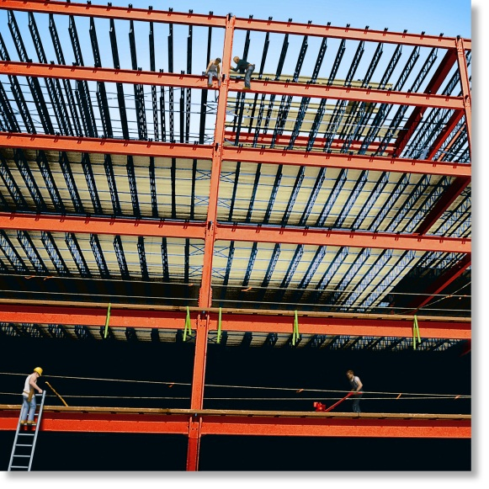
CHAPTER OBJECTIVES
Determine stress in members caused by bending
Discuss how to establish shear and moment diagrams for a beam or shaft
Determine largest shear and moment in a member, and specify where they occur
Consider members that are straight, symmetric x-section and homogeneous linear-elastic material
Consider special cases of unsymmetrical bending.

Slide 3
CHAPTER OUTLINE
Shear and Moment Diagrams
Graphical Method for Constructing Shear and Moment Diagrams
Bending Deformation of a Straight Member
The Flexure Formula
Unsymmetrical Bending
Stress Concentrations

Slide 4
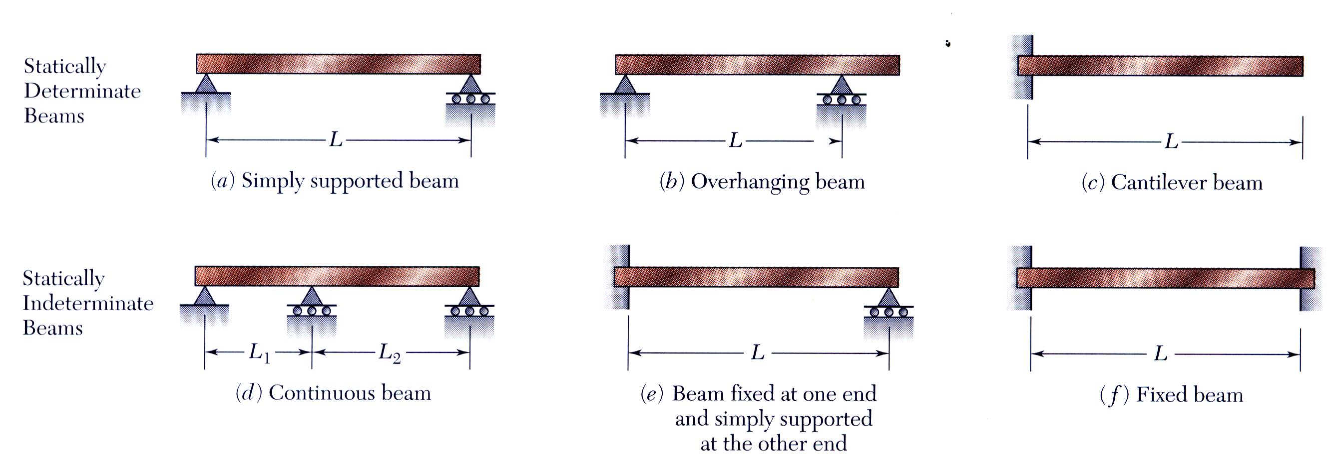
6.1 SHEAR AND MOMENT DIAGRAMS
Members that are slender and support loadings applied perpendicular to their longitudinal axis are called beams

Slide 5
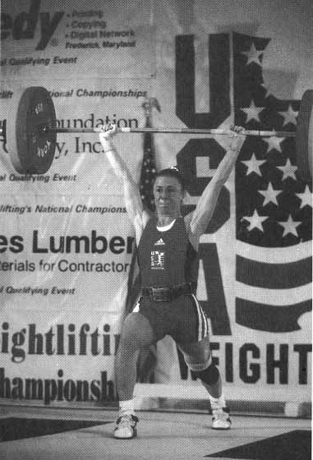
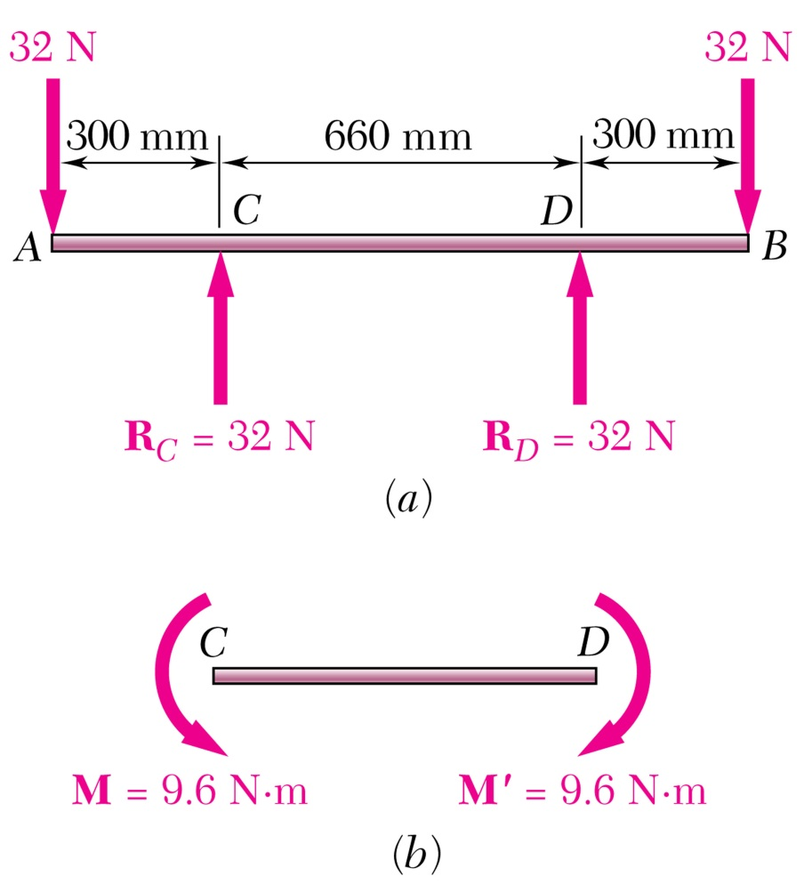
Pure Bending
Pure Bending: Prismatic members subjected to equal and opposite couples acting in the same longitudinal plane.

Slide 6
6.1 SHEAR AND MOMENT DIAGRAMS
In order to design a beam, it is necessary to determine the maximum shear and moment in the beam
Express V and M as functions of arbitrary position x along axis.
These functions can be represented by graphs called shear and moment diagrams
Engineers need to know the variation of shear and moment along the beam to know where to reinforce it

Slide 7
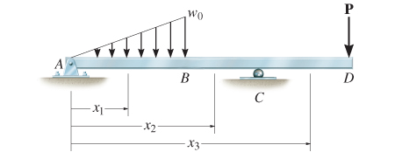
6.1 SHEAR AND MOMENT DIAGRAMS
Shear and bending-moment functions must be determined for each region of the beam between any two discontinuities of loading

Slide 8
6.1 SHEAR AND MOMENT DIAGRAMS
Beam sign convention
Although choice of sign convention is arbitrary, in this course, we adopt the one often used by engineers:

Slide 9
6.1 SHEAR AND MOMENT DIAGRAMS
IMPORTANT
Beams are long straight members that carry loads perpendicular to their longitudinal axis. They are classified according to how they are supported
To design a beam, we need to know the variation of the shear and moment along its axis in order to find the points where they are maximum
Establishing a sign convention for positive shear and moment will allow us to draw the shear and moment diagrams

Slide 10
6.1 SHEAR AND MOMENT DIAGRAMS
Procedure for analysis
Support reactions
Determine all reactive forces and couple moments acting on beam
Resolve all forces into components acting perpendicular and parallel to beam’s axis
Shear and moment functions
Specify separate coordinates x having an origin at beam’s left end, and extending to regions of beam between concentrated forces and/or couple moments, or where there is no discontinuity of distributed loading

Slide 11
6.1 SHEAR AND MOMENT DIAGRAMS
Procedure for analysis
Shear and moment functions
Section beam perpendicular to its axis at each distance x
Draw free-body diagram of one segment
Make sure V and M are shown acting in positive sense, according to sign convention
Sum forces perpendicular to beam’s axis to get shear
Sum moments about the sectioned end of segment to get moment

Slide 12
6.1 SHEAR AND MOMENT DIAGRAMS
Procedure for analysis
Shear and moment diagrams
Plot shear diagram (V vs. x) and moment diagram (M vs. x)
If numerical values are positive, values are plotted above axis, otherwise, negative values are plotted below axis
It is convenient to show the shear and moment diagrams directly below the free-body diagram

Slide 13
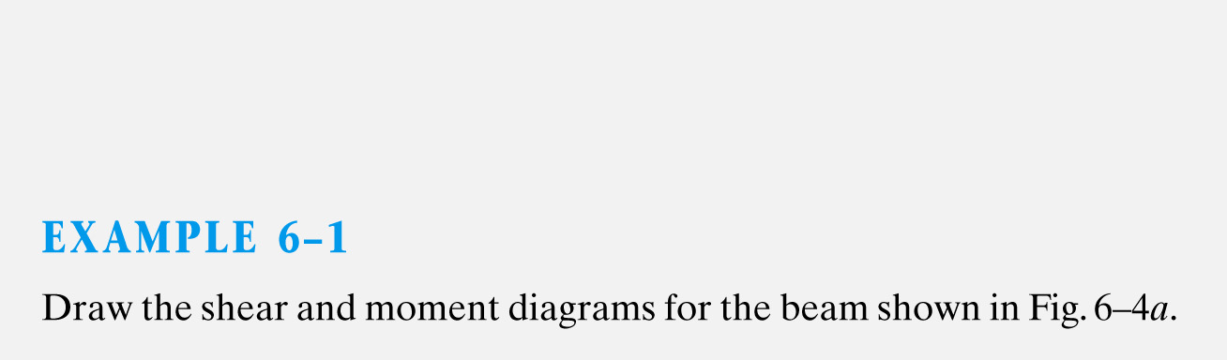
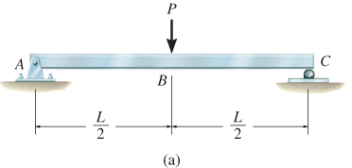

Slide 14
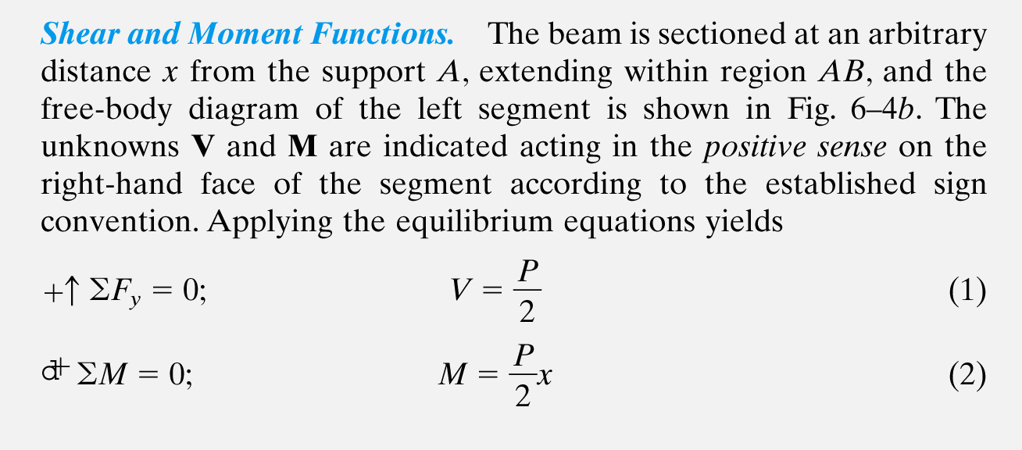
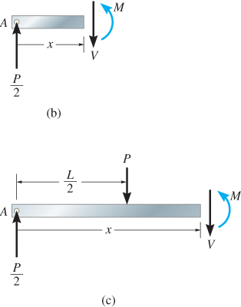

Slide 15
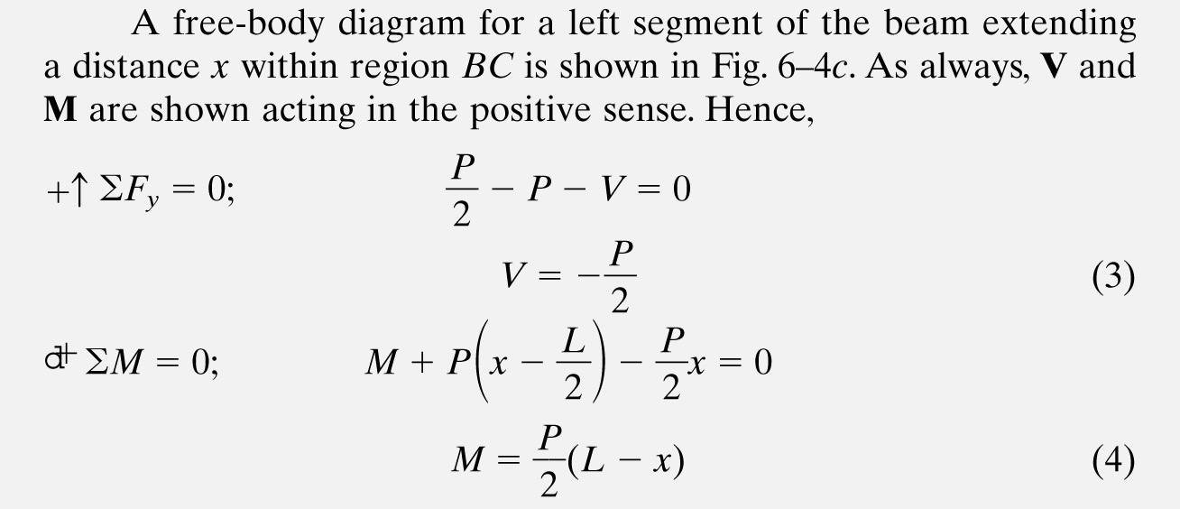

Slide 16
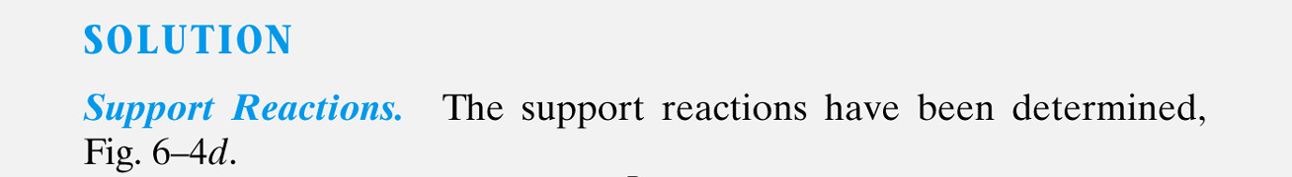
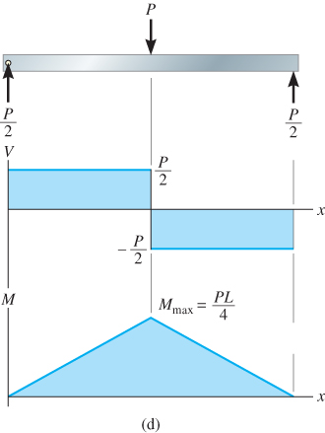

Slide 17
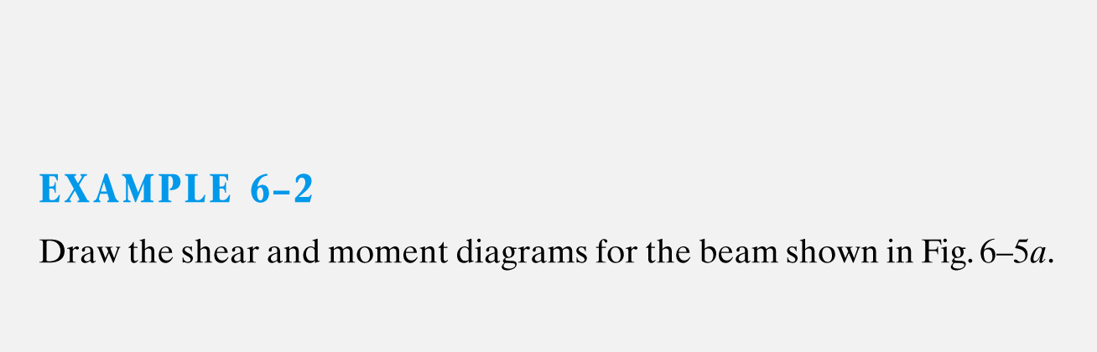
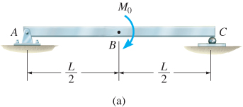

Slide 18
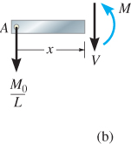
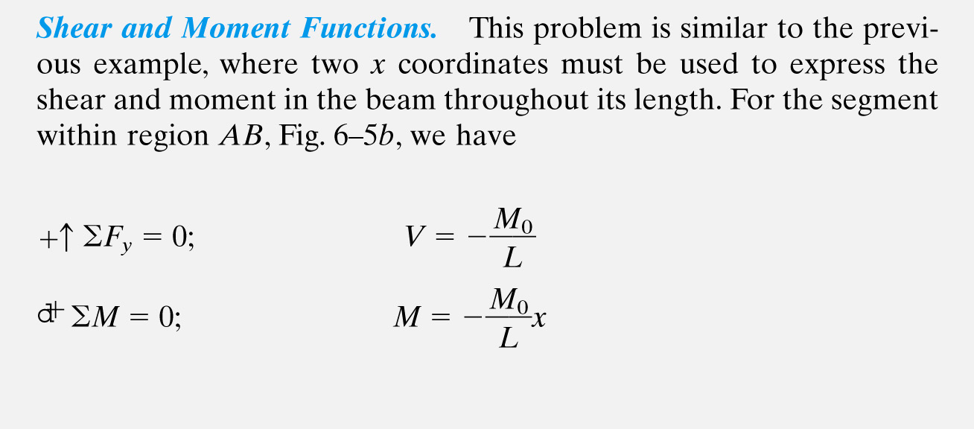

Slide 19
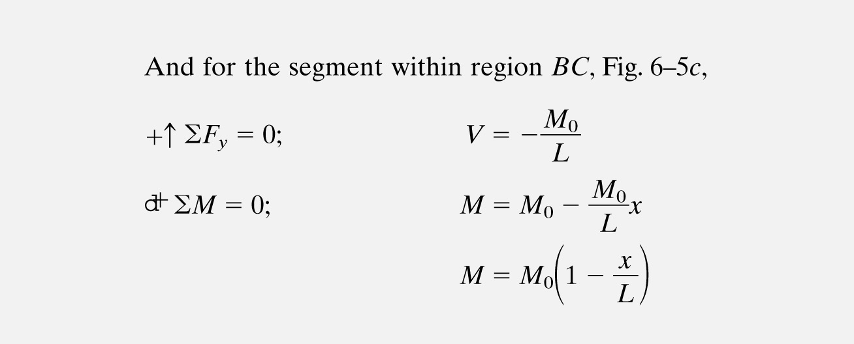
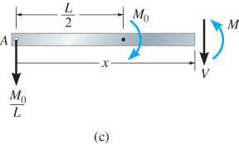

Slide 20
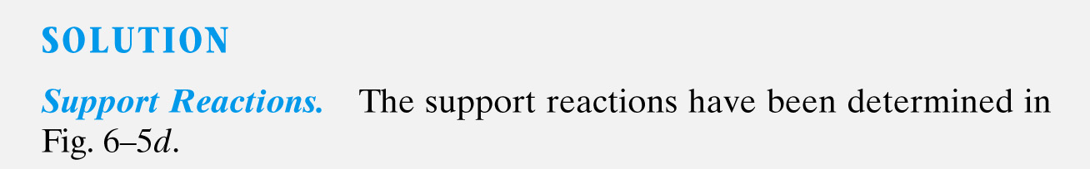
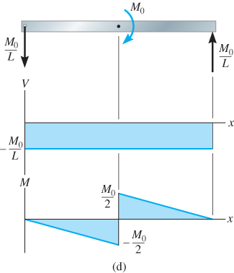

Slide 21
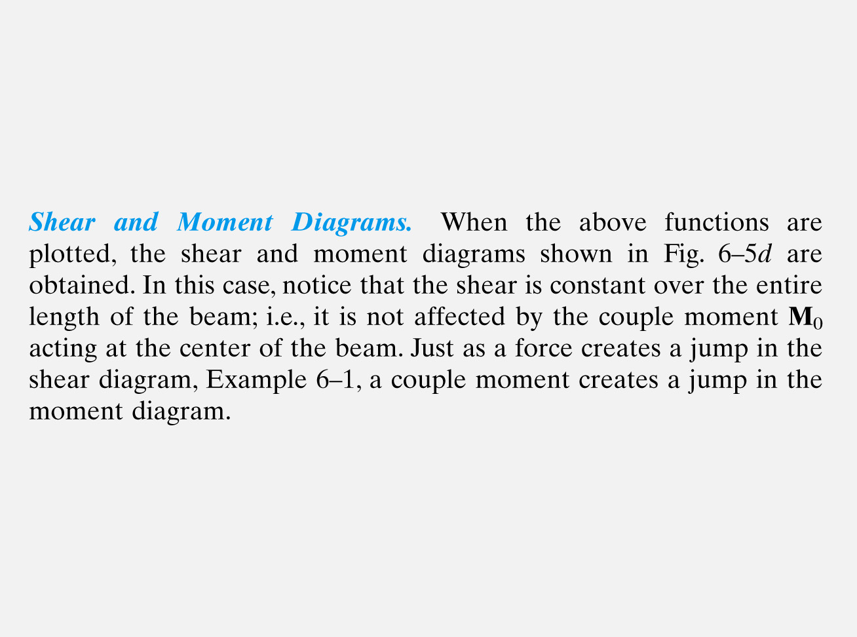

Slide 22
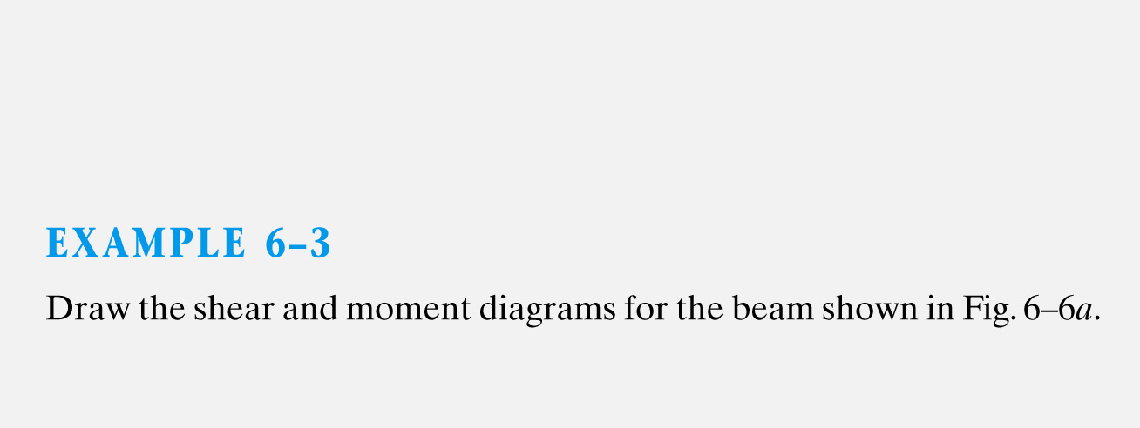
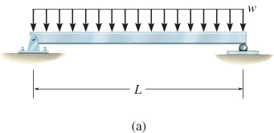

Slide 23
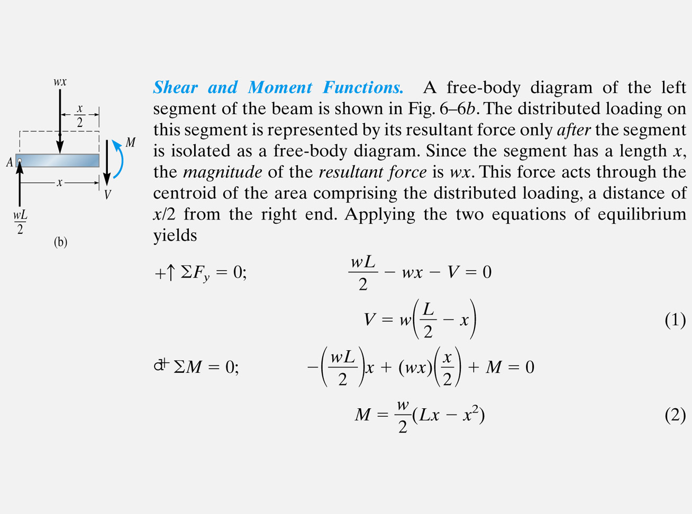
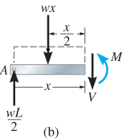

Slide 24
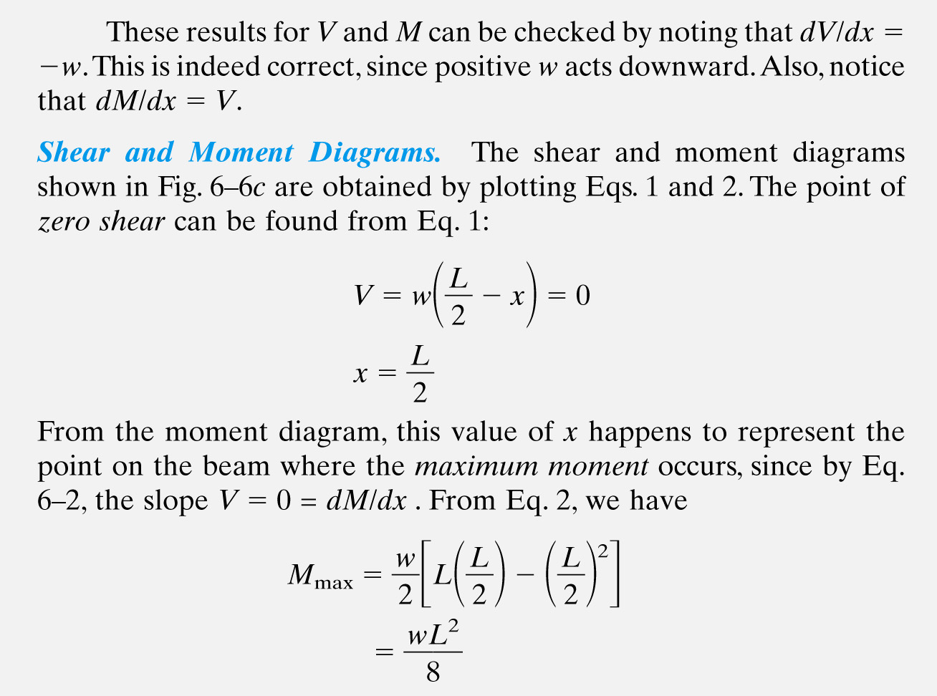

Slide 25
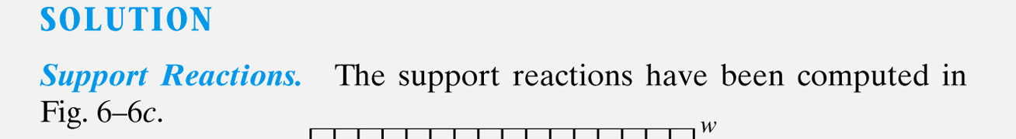
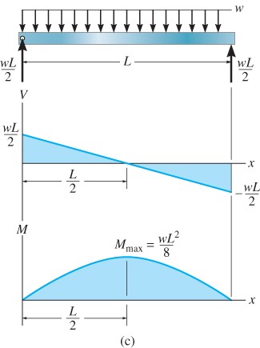

Slide 26
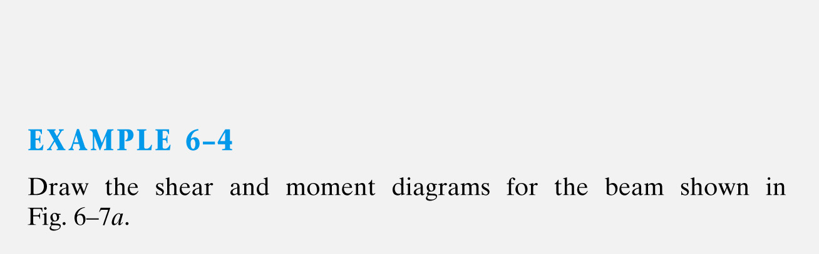
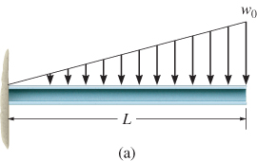

Slide 27
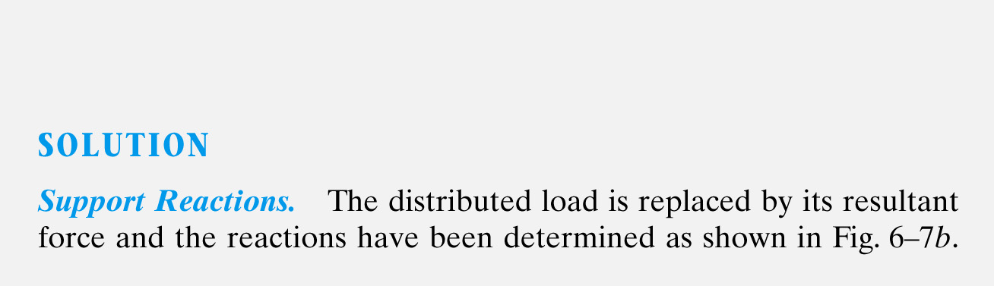
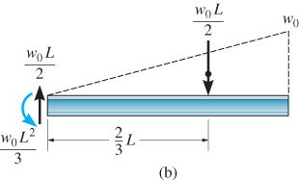

Slide 28
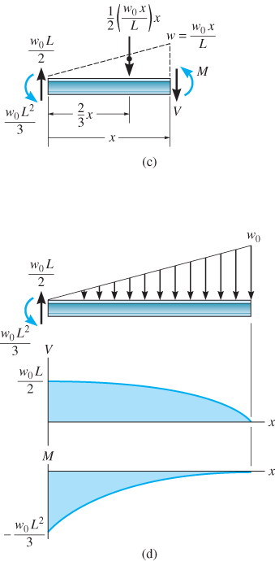
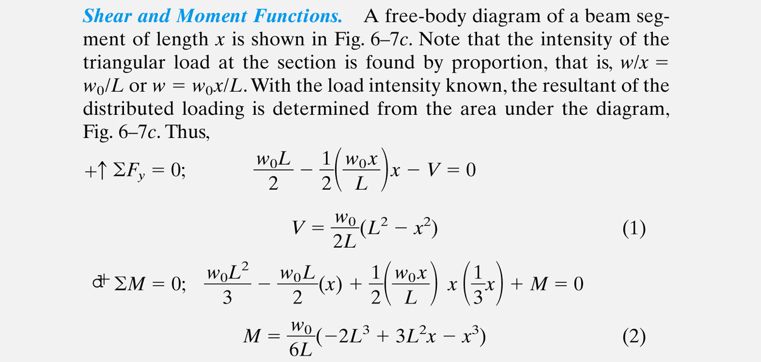

Slide 29
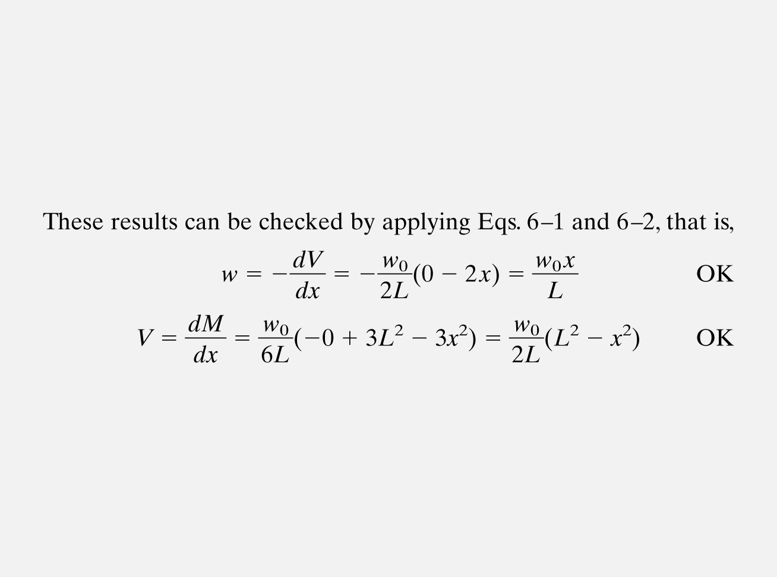

Slide 30
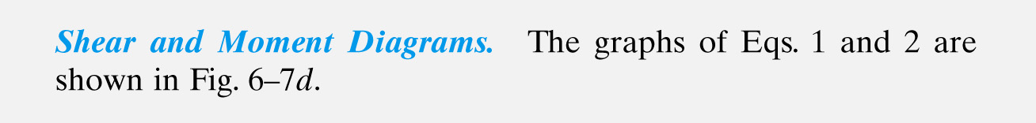

Slide 31
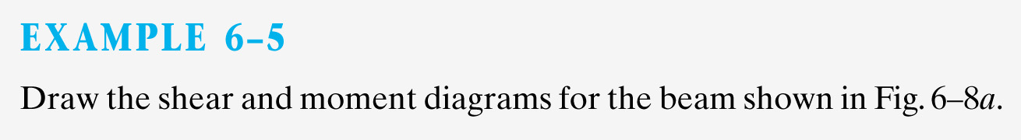
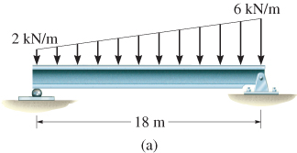

Slide 32
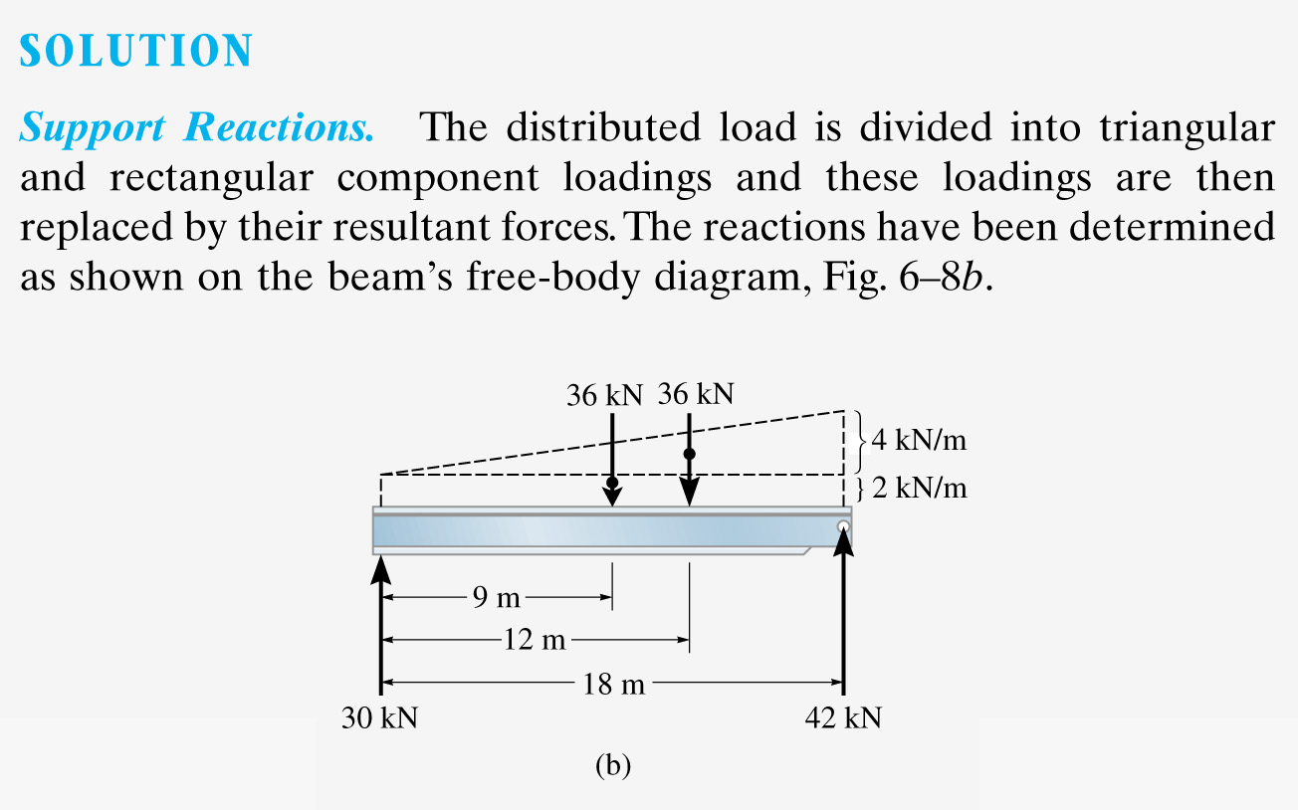

Slide 33
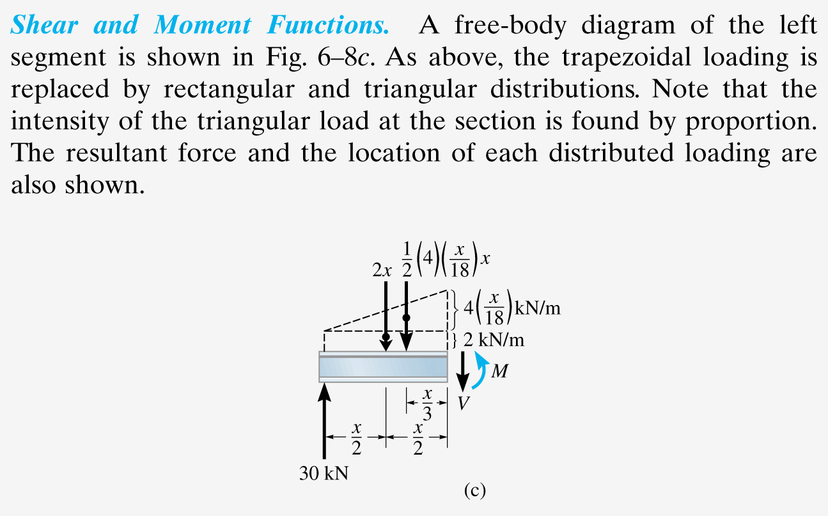

Slide 34
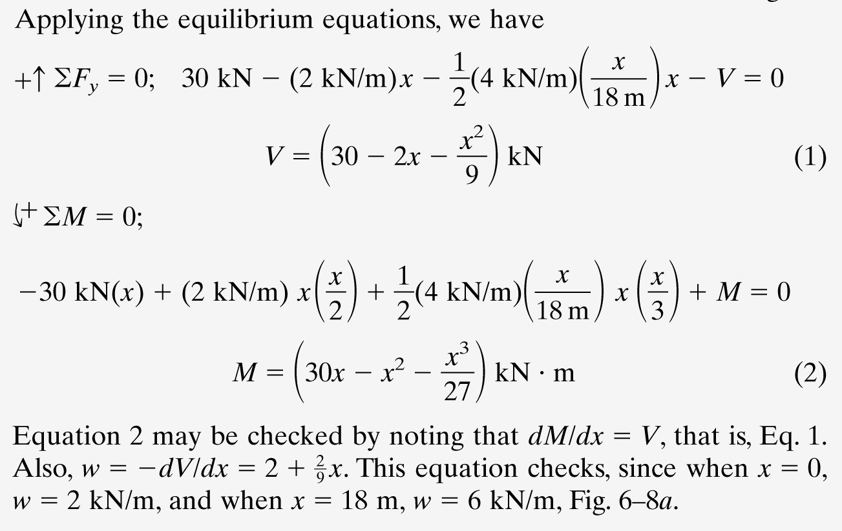

Slide 35
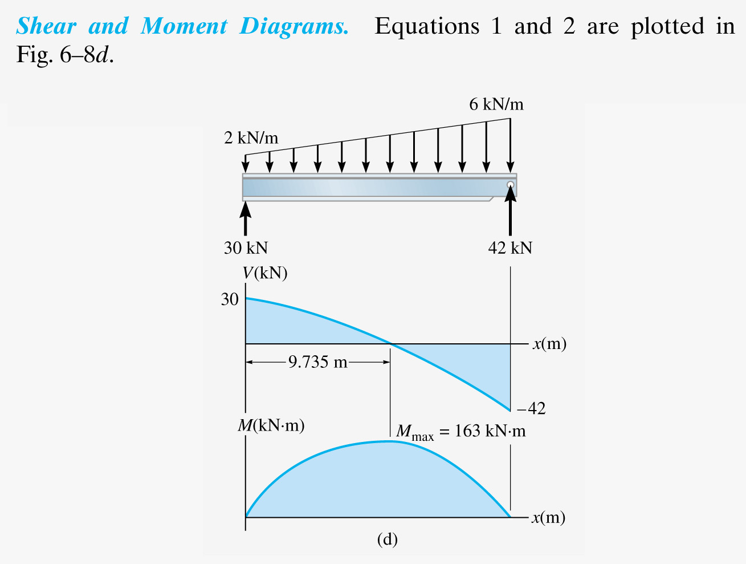

Slide 36
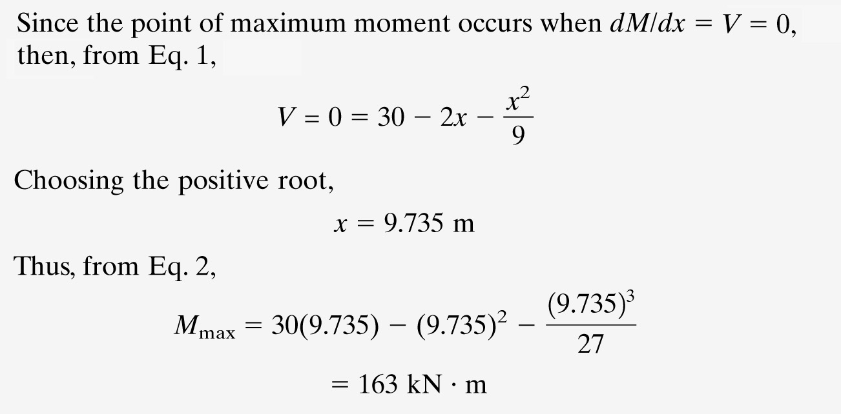

Slide 37
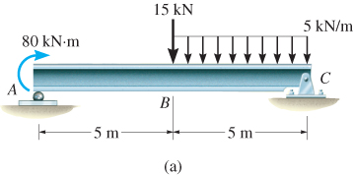
EXAMPLE 6.6
Draw the shear and moment diagrams for beam shown below.

Slide 38
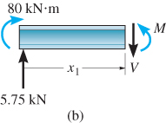
EXAMPLE 6.6 (SOLN)
Support reactions: Shown in free-body diagram.
Shear and moment functions
Since there is a discontinuity of distributed load and a concentrated load at beam’s center, two regions of x must be considered.
0 ≤ x₁ ≤ 5 m,
+↑ Σ F_{y} = 0; ... V = 5.75 N
+ Σ M = 0; ... M = (5.75x₁ + 80) kN·m

Slide 39
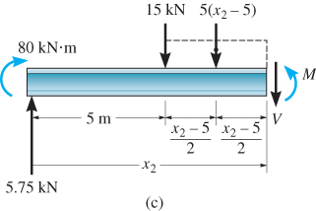
EXAMPLE 6.6 (SOLN)
Shear and moment functions
5 m ≤ x₂ ≤ 10 m,
+↑ Σ F_{y} = 0; ... V = (15.75 − 5x₂) kN
+ Σ M = 0; ... M = (−5.75x₂² + 15.75x₂ +92.5) kN·m
Check results by applying w = dV/dx and V = dM/dx.

Slide 40
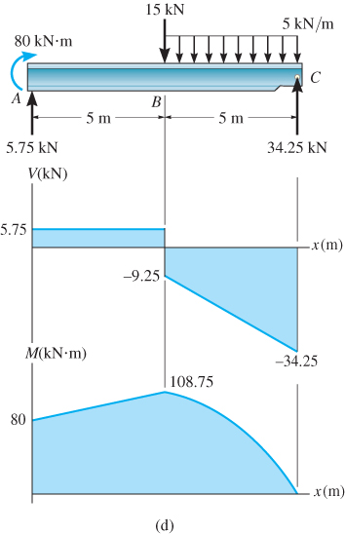
EXAMPLE 6.6 (SOLN)
Shear and moment diagrams

Slide 41
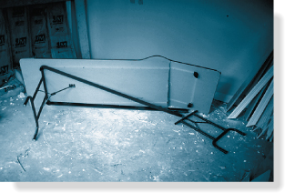
6.2 GRAPHICAL METHOD FOR CONSTRUCTING SHEAR AND MOMENT DIAGRAMS
A simpler method to construct shear and moment diagram, one that is based on two differential equations that exist among distributed load, shear and moment

Slide 42
6.2 GRAPHICAL METHOD FOR CONSTRUCTING SHEAR AND MOMENT DIAGRAMS
Regions of distributed load
dV
dx
dM
dx
= −w(x)
= V
Slope of shear diagram at each point
= −distributed load intensity at each point
Slope of moment diagram at each point
= shear at each point

Slide 43
6.2 GRAPHICAL METHOD FOR CONSTRUCTING SHEAR AND MOMENT DIAGRAMS
Regions of distributed load
ΔV = −∫ w(x) dx
ΔM = ∫ V(x) dx
Change in shear
= −area under distributed loading
Change in moment
= area under shear diagram

Slide 44
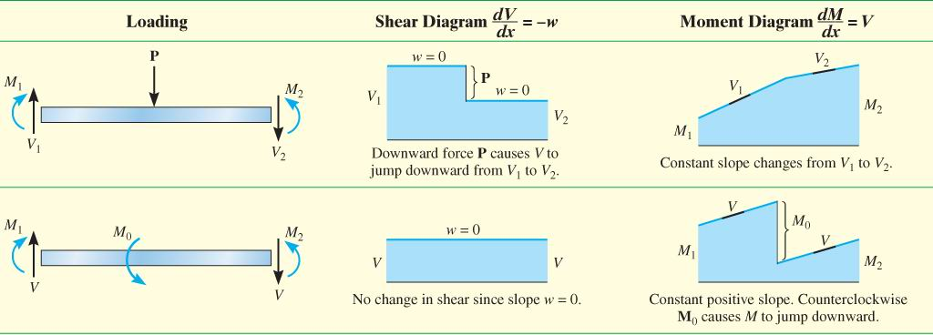
6.2 GRAPHICAL METHOD FOR CONSTRUCTING SHEAR AND MOMENT DIAGRAMS
Regions of concentrated force and moment

Slide 45
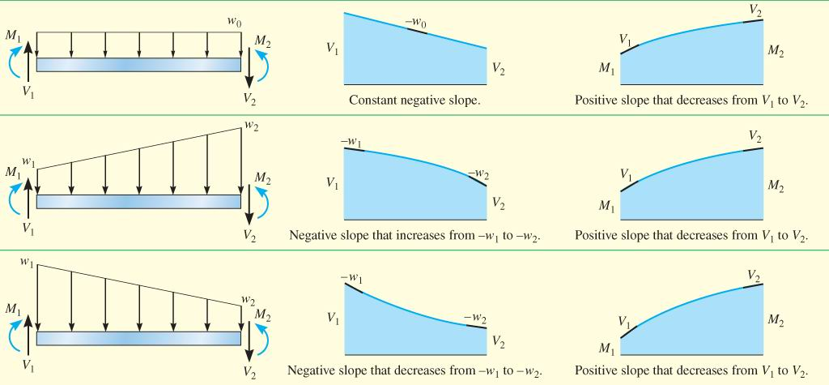
6.2 GRAPHICAL METHOD FOR CONSTRUCTING SHEAR AND MOMENT DIAGRAMS
Regions of concentrated force and moment

Slide 46
6.2 GRAPHICAL METHOD FOR CONSTRUCTING SHEAR AND MOMENT DIAGRAMS
Procedure for analysis
Support reactions
Determine support reactions and resolve forces acting on the beam into components that are perpendicular and parallel to beam’s axis
Shear diagram
Establish V and x axes
Plot known values of shear at two ends of the beam

Slide 47
6.2 GRAPHICAL METHOD FOR CONSTRUCTING SHEAR AND MOMENT DIAGRAMS
Procedure for analysis
Shear diagram
Since dV/dx = −w, slope of the shear diagram at any point is equal to the (-ve) intensity of the distributed loading at that point
To find numerical value of shear at a point, use method of sections and equation of equilibrium or by using ΔV = −∫ w(x) dx, i.e., change in the shear between any two points is equal to (-ve) area under the load diagram between the two points

Slide 48
6.2 GRAPHICAL METHOD FOR CONSTRUCTING SHEAR AND MOMENT DIAGRAMS
Procedure for analysis
Shear diagram
Since w(x) must be integrated to obtain ΔV, then if w(x) is a curve of degree n, V(x) will be a curve of degree n+1
Moment diagram
Establish M and x axes and plot known values of the moment at the ends of the beam
Since dM/dx = V, slope of the moment diagram at any point is equal to the shear at the point

Slide 49
6.2 GRAPHICAL METHOD FOR CONSTRUCTING SHEAR AND MOMENT DIAGRAMS
Procedure for analysis
Moment diagram
At point where shear is zero, dM/dx = 0 and therefore this will be a point of maximum or minimum moment
If numerical value of moment is to be determined at the point, use method of sections and equation of equilibrium, or by using ΔM = ∫ V(x) dx, i.e., change in moment between any two points is equal to area under shear diagram between the two points

Slide 50
6.2 GRAPHICAL METHOD FOR CONSTRUCTING SHEAR AND MOMENT DIAGRAMS
Procedure for analysis
Moment diagram
Since V(x) must be integrated to obtain ΔM, then if V(x) is a curve of degree n, M(x) will be a curve of degree n+1

Slide 51



Slide 52



Slide 53



Slide 54



Slide 55

EXAMPLE 6.11
Draw the shear and moment diagrams for beam shown below.

Slide 56


EXAMPLE 6.11 (SOLN)
Support reactions:
See free-body diagram.
Shear diagram
From behavior of distributed load, slope of shear diagram varies from zero at x = 0 to −2 at x = 4.5. Thus, its parabolic shape.
Use method of sections to find point of zero shear:
+↑ Σ F_{y} = 0; ... x = 2.6 m

Slide 57


EXAMPLE 6.11 (SOLN)
Moment diagram
From shear diagram, slope of moment diagram begin at +1.5, then decreases positively till it reaches zero at 2.6 m. Then it increases negatively and reaches −3 at x = 4.5 m. Moment diagram is a cubic function of x.
+ Σ M = 0; . . .
M = 2.6 kN·m

Slide 58



Slide 59



Slide 60



Slide 61


Slide 62


Slide 63
Old Exam Question
Referring to the Figure 7;
Draw the shear and bending moment diagram. (8 marks)
Determine the maximum absolute value of shear and bending moment. (2 marks)

Slide 64


6.3 BENDING DEFORMATION OF A STRAIGHT MEMBER
When a bending moment is applied to a straight prismatic beam, the longitudinal lines become curved and vertical transverse lines remain straight and yet undergo a rotation

Slide 65

6.3 BENDING DEFORMATION OF A STRAIGHT MEMBER
A neutral surface is where longitudinal fibers of the material will not undergo a change in length.

Slide 66
6.3 BENDING DEFORMATION OF A STRAIGHT MEMBER
Thus, we make the following assumptions:
  Longitudinal axis x (within neutral surface) does not experience any change in length
  All cross sections of the beam remain plane and perpendicular to longitudinal axis during the deformation
  Any deformation of the cross-section within its own plane will be neglected
In particular, the z axis, in plane of x-section and about which the x-section rotates, is called the neutral axis

Slide 67

6.3 BENDING DEFORMATION OF A STRAIGHT MEMBER
For any specific x-section, the longitudinal normal strain will vary linearly with y from the neutral axis
A contraction will occur (−ε) in fibers located above the neutral axis (+y)
An elongation will occur (+ε)
in fibers located below
the axis (−y)
Equation 6-8
ε = −(y/c)ε_{max}

Slide 68

6.4 THE FLEXURE FORMULA
Assume that material behaves in a linear-elastic manner so that Hooke’s law applies.
A linear variation of normal strain
must then be the consequence of
a linear variation in normal stress
Applying Hooke’s law to Eqn 6-8,
Equation 6-9
σ = −(y/c)σ_{max}

Slide 69

6.4 THE FLEXURE FORMULA
By mathematical expression, equilibrium equations of moment and forces, we get
Equation 6-10
∫_{A} y dF = 0
σ_{max}
c
Equation 6-11
M = ∫_{A} y² dA
The integral represents the moment of inertia of x-sectional area, computed about the neutral axis. We symbolize its value as I.

Slide 70
6.4 THE FLEXURE FORMULA
Hence, Eqn 6-11 can be solved and written as
Mc
I
Equation 6-12
σ_{max} =
σ_{max} = maximum normal stress in member, at a pt on x-sectional area farthest away from neutral axis
M = resultant internal moment, computed about neutral axis of x-section
I = moment of inertia of x-sectional area computed about neutral axis
c = perpendicular distance from neutral axis to a pt farthest away from neutral axis, where σ_{max} acts

Slide 71

6.4 THE FLEXURE FORMULA
The ratio $\frac{I}{c}$ is also defined as the
elastic section modulus, S
$$S=\frac{I}{c}$$
Thus, Eqn 6-12 can be written as
$$σ_{max}=\frac{M}{S}$$

Slide 72
6.4 THE FLEXURE FORMULA
Normal stress at intermediate distance y can be determined from
My
I
Equation 6-13
σ = −
σ is -ve as it acts in the -ve direction (compression)
Equations 6-12 and 6-13 are often referred to as the flexure formula.

Slide 73
6.4 THE FLEXURE FORMULA
IMPORTANT
X-section of straight beam remains plane when beam deforms due to bending.
The neutral axis is subjected to zero stress
Due to deformation, longitudinal strain varies linearly from zero at neutral axis to maximum at outer fibers of beam
Provided material is homogeneous and Hooke’s law applies, stress also varies linearly over the x-section

Slide 74
6.4 THE FLEXURE FORMULA
IMPORTANT
For linear-elastic material, neutral axis passes through centroid of x-sectional area. This is based on the fact that resultant normal force acting on x-section must be zero
Flexure formula is based on requirement that resultant moment on the x-section is equal to moment produced by linear normal stress distribution about neutral axis

Slide 75
6.4 THE FLEXURE FORMULA
Procedure for analysis
Internal moment
Section member at pt where bending or normal stress is to be determined and obtain internal moment M at the section
Centroidal or neutral axis for x-section must be known since M is computed about this axis
If absolute maximum bending stress is to be determined, then draw moment diagram in order to determine the maximum moment in the diagram

Slide 76
6.4 THE FLEXURE FORMULA
Procedure for analysis
Section property
Determine moment of inertia I, of x-sectional area about the neutral axis
Methods used are discussed in Textbook Appendix A
Refer to the course book’s inside front cover for the values of I for several common shapes

Slide 77
6.4 THE FLEXURE FORMULA
Procedure for analysis
Normal stress
Specify distance y, measured perpendicular to neutral axis to pt where normal stress is to be determined
Apply equation σ = My/I, or if maximum bending stress is needed, use σ_{max} = Mc/I
Ensure units are consistent when substituting values into the equations

Slide 78



Slide 79


Slide 80



Slide 81



Slide 82


Slide 83


Slide 84


Slide 85

EXAMPLE 6.16
Beam shown has x-sectional area in the shape of a channel. Determine the maximum bending stress that occurs in the beam at section a-a.

Slide 86

EXAMPLE 6.16 (SOLN)
Internal moment
Beam support reactions need not be determined. Instead, by the method of sections, the segment to the left of a-a can be used. Note that resultant internal axial force N passes through centroid of x-section.
The resultant internal moment must be computed about the beam’s neutral axis a section a-a.

Slide 87

EXAMPLE 6.16 (SOLN)
Internal moment
To find location of neutral axis, x-sectional area divided into 3 composite parts as shown. Then using Eqn. A-2 of Appendix A:
Σ y A
Σ A
y = = ... = 59.09 mm

Slide 88
EXAMPLE 6.16 (SOLN)
Internal moment
Apply moment equation of equilibrium about neutral axis,
+ Σ M_{NA} = 0; 24 kN(2 m) + 1.0 kN(0.05909 m) − M = 0
M = 4.859 kN·m

Slide 89
EXAMPLE 6.16 (SOLN)
Section property
Moment of inertia about neutral axis is determined using parallel-axis theorem applied to each of the three composite parts of the x-sectional area.
I = [1/12(0.250 m)(0.020 m)³
+ (0.250 m)(0.020 m)(0.05909 m − 0.010 m)²]
+ 2[1/12(0.015 m)(0.200 m)³
+ (0.015 m)(0.200 m)(0.100 m − 0.05909 m)²]
I = 42.26(10⁻⁶) m⁴

Slide 90
EXAMPLE 6.16 (SOLN)
Maximum bending stress
It occurs at points farthest away from neutral axis. At bottom of beam, c = 0.200 m − 0.05909 m = 0.1409 m. Thus,
Mc
I
4.859 kN·m(0.1409 m)
42.26(10⁻⁶) m⁴
σ_{max} = = = 16.2 MPa
At top of beam, σ’ = 6.79 MPa. In addition, normal force of N = 1 kN and shear force V = 2.4 kN will also contribute additional stress on x-section.

Slide 91

Sample Problem 5.1
SOLUTION:
Treating the entire beam as a rigid body, determine the reaction forces.
Section the beam at points near supports and load application points. Apply equilibrium analyses on resulting free bodies to determine internal shear forces and bending couples.
For the timber beam and loading shown, draw the shear and bend-moment diagrams and determine the maximum normal stress due to bending.
Identify the maximum shear and bending moment from plots of their distributions.
Apply the elastic flexure formulas to determine the corresponding maximum normal stress.

Slide 92

Sample Problem 5.1
SOLUTION:
Treating the entire beam as a rigid body, determine the reaction forces
Section the beam and apply equilibrium analyses on resulting free bodies

Slide 93


Sample Problem 5.1
Identify the maximum shear and bending moment from plots of their distributions.
Apply the elastic flexure formulas to determine the corresponding maximum normal stress.

Slide 94
Standard Beam Design
An I-beam is a beam with an I or H-shaped cross-section, also known as
H-beam (for universal column, UC)
W-beam (for "wide flange")
Universal beam (UB)
Rolled steel joist (RSJ)
or Double-T (especially in Polish, Bulgarian, Spanish, Italian and German).
The horizontal elements of the I are flanges, and the vertical element is the "web". I-beams are usually made of structural steel and are used in construction and civil engineering.
W-Beam calculator
https://www.amesweb.info/SectionalPropertiesTabs/StructuralSteelFabrication_Wshape.aspx

Slide 95


W-Beam Design

Slide 96

Sample W-Beam Dimensions (Appendix B)

Slide 97

Sample Problem 5.2
SOLUTION:
Replace the 45-kN load with an equivalent force-couple system at D. Find the reactions at B by considering the beam as a rigid body.
Section the beam at points near the support and load application points. Apply equilibrium analyses on resulting free bodies to determine internal shear forces and bending couples.
The structure shown is constructed of a W250 × 167 rolled-steel beam. (a) Draw the shear and bending-moment diagrams for the beam and the given loading. (b) Determine normal stress in sections just to the right and left of point D.
Apply the elastic flexure formulas to determine the maximum normal stress to the left and right of point D.

Slide 98


Sample Problem 5.2
SOLUTION:
Replace the 45-kN load with equivalent force-couple system at D. Find reactions at B.
Section the beam and apply equilibrium analyses on resulting free bodies.

Slide 99


Sample Problem 5.2
Apply the elastic flexure formulas to determine the maximum normal stress to the left and right of point D.
From Appendix C for a W250 × 167 rolled steel shape, S = I/c= 208 × 10⁶mm about the X−X axis.

Slide 100

Sample Problem 5.3
SOLUTION:
Taking the entire beam as a free body, determine the reactions at A and D.
Apply the relationship between shear and load to develop the shear diagram.
Draw the shear and bending-moment diagrams for the beam and loading shown.
Apply the relationship between bending moment and shear to develop the bending-moment diagram.

Slide 101


Sample Problem 5.3
SOLUTION:
Taking the entire beam as a free body, determine the reactions at A and D.
Apply the relationship between shear and load to develop the shear diagram.
− zero slope between concentrated loads
− linear variation over uniform load segment

Slide 102

Sample Problem 5.3
Apply the relationship between bending moment and shear to develop the bending-moment diagram.
− bending moment at A and E is zero
− bending moment variation between A, B, C, and D is linear
− bending moment variation between D and E is quadratic
− net change in bending moment is equal to areas under shear distribution segments
− total of all bending-moment changes across the beam should be zero

Slide 103


Sample Problem 4.2
SOLUTION:
Based on the cross-section geometry, calculate the location of the section centroid and moment of inertia.
Apply the elastic flexural formula to find the maximum tensile and compressive stresses.
A cast-iron machine part is acted upon by a 3 kN-m couple. Knowing E = 165 GPa and neglecting the effects of fillets, determine the maximum tensile and compressive stresses

Slide 104


Sample Problem 4.2
SOLUTION:
Based on the cross-section geometry, calculate the location of the section centroid and moment of inertia.

Slide 105

Sample Problem 4.2
Apply the elastic flexural formula to find the maximum tensile and compressive stresses.

Slide 106

Design of Prismatic Beams for Bending
The largest normal stress is found at the surface where the maximum bending moment occurs.

Slide 107

Design of Prismatic Beams for Bending
A safe design requires that the maximum normal stress be less than the allowable stress for the material used. This criteria leads to the determination of the minimum acceptable section modulus.

Slide 108
Design of Prismatic Beams for Bending
Among beam section choices which have an acceptable section modulus, the one with the smallest weight per unit length or cross sectional area will be the least expensive and the best choice.

Slide 109

Sample Problem 5.8

Slide 110

Sample Problem 5.8 (Sol’n)

Slide 111

Sample Problem 5.8 (Sol’n)

Slide 112


6.5 UNSYMMETRICAL BENDING
A condition for flexure formula is the symmetric x-sectional area of beam about an axis perpendicular to neutral axis
However, the flexure formula can also be applied either to a beam having x-sectional area of any shape OR to a beam having a resultant moment that acts in any direction

Slide 113
6.5 UNSYMMETRICAL BENDING
Moment applied along principal axis
Consider a beam with unsymmetrical shape
Establish coordinate system as per usual and that resultant moment M acts along +z axis
Conditions:
  Stress distribution acting over entire x-sectional area to be a zero force resultant,
  Resultant internal moment about y axis to be zero
  Resultant internal moment about z axis to be equal to M

Slide 114

6.5 UNSYMMETRICAL BENDING
Moment applied along principal axis
Express the 3 conditions mathematically by considering force acting on differential element dA located at (0, y, z). Force is dF = σ dA, therefore
F_{R} = F_{x}; 0 = ∫_{A} σ dA
Equation 6-14
(M_{R})_{y} = Σ M_{y}; 0 = ∫_{A} z σ dA
Equation 6-15
(M_{R})_{z} = Σ M_{z}; M = ∫_{A} −y σ dA
Equation 6-16

Slide 115


6.5 UNSYMMETRIC BENDING
Moment applied along principal axis
Eqn 6.14 is satisfied since z axis passes through centroid of x-sectional area
If material has linear-elastic behavior, then we can substitute σ = −(y/c)σ_{max} into Eqn 6-15 and after integration, we get
∫_{A} yz dA = 0

Slide 116
6.5 UNSYMMETRIC BENDING
Moment applied along principal axis
∫_{A} yz dA = 0
This integral is the product of inertia for the area. It will be zero if y and z axes are chosen as principal axes of inertia for the area.
Thus, Eqns 6-14 to 6-16 will always be satisfied regardless of the direction of applied moment M

Slide 117
6.5 UNSYMMETRIC BENDING
Moment arbitrarily applied
If a member is loaded such that resultant internal moment does not act about one of the principal axes of x-section, resolve the moment into components directed along the principal axes
Use flexure formula to determine normal stress caused by each moment component
Use principle of superposition to determine resultant normal stress at the pt

Slide 118
6.5 UNSYMMETRIC BENDING
Moment arbitrarily applied
Resultant normal stress at any pt on x-section is
M_{z}y
I_{z}
M_{y}z
I_{y}
σ = +
Equation 6-17
σ = normal stress at the pt
y, z = coordinates of pt measured from x, y, z axes having origin at centroid of x-sectional area and forming a right-handed coordinate system

Slide 119
6.5 UNSYMMETRIC BENDING
Moment arbitrarily applied
Resultant general normal stress at any pt on x-section is
M_{z}y
I_{z}
M_{y}z
I_{y}
σ = +
Equation 6-17
M_{y}, M_{z} = resultant internal moment components along principal y and z axes. Positive if directed along +y and +z axes. Can also be stated as M_{y} = M sin θ and M_{z} = M cos θ , where θ is measured positive from +z axis toward +y axis
I_{y}, I_{z} = principal moments of inertia computed about the y and z axes, respectively

Slide 120



6.5 UNSYMMETRIC BENDING
Moment arbitrarily applied
=
+

Slide 121
6.5 UNSYMMETRIC BENDING
Orientation of neutral axis
Angle α of neutral axis can be determined by applying Eqn 6-17 with σ = 0, since no normal stress acts on neutral axis. Finally, we get
I_{z}
I_{y}
tan α = tan θ
Equation 6-19
For unsymmetrical bending angle θ, defining direction of moment M is not equal to angle α, angle defining inclination of neutral axis unless I_{z} = I_{y}.
Thus, θ ≤ α ≤ 90º

Slide 122
6.5 UNSYMMETRIC BENDING
IMPORTANT
Flexure formula applied only when bending occurs about axes that represent the principal axes of inertia for x-section
These axes have their origin at centroid and are orientated along an axis of symmetry and perpendicular to it
If moment applied about arbitrary axis, then resolve moment into components along each of the principal axes, and stress at a pt is determined by superposition of stress caused by each moment component.

Slide 123



Slide 124


Slide 125


Slide 126



Slide 127


Slide 128



Slide 129


Slide 130
6.9 STRESS CONCENTRATIONS
Flexure formula can only be used to determine stress distribution within regions of a member where x-sectional area is constant or tapers slightly
If x-section suddenly changes, normal-stress and strain distributions become nonlinear and they can only be obtained via experiment or mathematical analysis using the theory of elasticity

Slide 131

6.9 STRESS CONCENTRATIONS
Common discontinuities include members having notches on their surfaces, holes for passage of fasteners or abrupt changes in outer dimensions of member’s x-section
The maximum normal stress at the discontinuities occur at the smallest x-sectional area

Slide 132
6.9 STRESS CONCENTRATIONS
For design, we only need to know the maximum normal stress developed at these sections, not the actual stress distribution
Thus, the maximum normal stress due to bending can be obtained using the stress-concentration factor K
Mc
I
σ = K
Equation 6-26

Slide 133
6.9 STRESS CONCENTRATIONS
IMPORTANT
Stress concentrations in members subjected to bending occur at pts of x-sectional change, such as notches and holes, because here the stress and strain become nonlinear.
The more severe the change, the larger the stress distribution
For design/analysis, not necessary to know the exact stress distribution around x-sectional change
The maximum normal stress occurs at the smallest x-sectional area

Slide 134
6.9 STRESS CONCENTRATIONS
IMPORTANT
The maximum normal stress can be obtained using stress concentration factor K, which is determined through experiment and is a function of the geometry of the member
If material is brittle or subjected to fatigue loading, stress concentrations in the member need to be considered in design

Slide 135

EXAMPLE 6.26
Transition in x-sectional area of steel bar is achieved using shoulder fillets as shown. If bar is subjected to a bending moment of 5kN·m, determine the maximum normal stress developed in the steel. σ_{Y} = 500 MPa.

Slide 136

EXAMPLE 6.26 (SOLN)
Moment creates largest stress in bar at base of fillet. Stress concentration factor can be determined from the graph.
r/h = ... = 0.2
w/h = ... = 1.5
From above values, we get K = 1.45

Slide 137

EXAMPLE 6.26 (SOLN)
Applying Eqn 6-26:
Mc
I
σ = K = ... = 340 MPa
Result indicates that steel remains elastic since stress is below yield stress.
Normal stress distribution is nonlinear.
However, by Saint-Venant’s principle, the localized stresses smooth out and become linear when one moves at a distance of 80 mm or more to right of transition.

Slide 138

EXAMPLE 6.26 (SOLN)
Thus, the flexure formula gives σ_{max} = 234 MPa.
Note that choice of a larger-radius fillet will significantly reduce σ_{max}, since as r increase, K will decrease.

Slide 139
CHAPTER REVIEW
Shear and moment diagrams are graphical representations of internal shear and moment within a beam.
They can be constructed by sectioning the beam an arbitrary distance x from the left end, finding V and M as functions of x, then plotting the results
Another method to plot the diagrams is to realize that at each pt, the slope of the shear diagram is a negative of the distributed loading, w = dV/dx; and slope of moment diagram is the shear,
V = dM/dx.

Slide 140
CHAPTER REVIEW
Also, the (-ve) area under the loading diagram represents the change in shear, ΔV = −∫ w dx.
The area under the shear diagram represents the change in moment, ΔM = ∫ V dx. Note that values of shear and moment at any pt can be obtained using the method of sections
A bending moment tends to produce a linear variation of normal strain within a beam.
Provided that material is homogeneous, Hooke’s law applies, and moment applied does not cause yielding, then equilibrium is used to relate the internal moment in the beam to its stress distribution

Slide 141
CHAPTER REVIEW
That results in the flexure formula, σ = Mc/I, where I and c are determined from the neutral axis that passes through the centroid of the x-section
If x-section of beam is not symmetric about an axis that is perpendicular to neutral axis, then unsymmetrical bending occurs
Maximum stress can be determined from formulas, or problem can be solved by considering the superposition of bending about two separate axes

Slide 142
CHAPTER REVIEW
Beams made from composite materials can be “transformed” so their x-section is assumed to be made from a single material
A transformation factor, n = E₁/E₂ is used to do this.
Once the “transformation” is done, the stress in the beam can be determined in the usual manner of the flexure formula
Curved beams deform such that normal strain does not vary linearly from the neutral axis

Slide 143
CHAPTER REVIEW
Provided that material of the curved beam is homogeneous, linear elastic and x-section has axis of symmetry, then curved beam formula can be used to determine the bending stress,
σ = My/[Ae(R− y)]
Stress concentrations occur in members having a sudden change in their x-section, such as holes and notches.
The maximum bending stresses in such locations is determined using a stress concentration factor K, that is found empirically, σ = Kσ_{avg}.

Slide 144
CHAPTER REVIEW
If bending moment causes material to exceed its elastic limit, then normal strain remains linear, however stress distribution varies in accordance with shear strain diagram and balance of force and moment equilibrium. Thus plastic and ultimate moments can be determined.
If an applied plastic or ultimate moment is released, it will cause the material to respond elastically, thereby inducing residual stresses in the beam

