Slide 1
SKTN 2123
Strength of Materials
Stress, Strain Under Axial Loading
Mohsin Mohd Sies
Nuclear Engineering,
School of Chemical and Energy Engineering,
Universiti Teknologi Malaysia

Slide 2
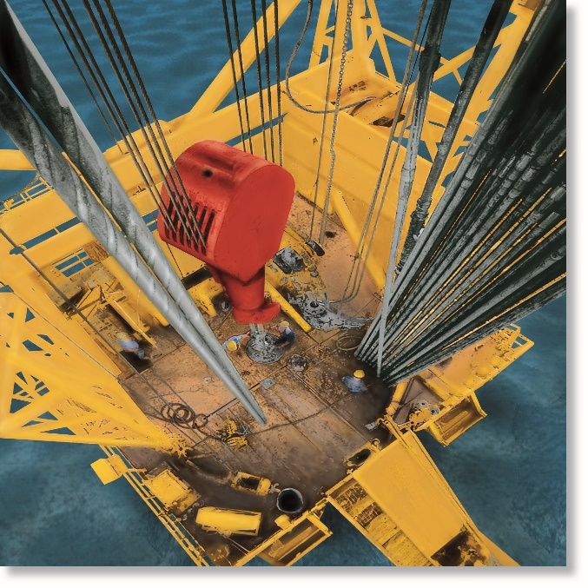
CHAPTER OBJECTIVES
Determine deformation of axially loaded members
Develop a method to find support reactions when it cannot be determined from equilibrium equations
Analyze the effects of thermal stress, stress concentrations, inelastic deformations, and residual stress

Slide 3
CHAPTER OUTLINE
Saint-Venant’s Principle
Elastic Deformation of an Axially Loaded Member
Principle of Superposition
Statically Indeterminate Axially Loaded Member
Force Method of Analysis for Axially Loaded Member
Thermal Stress

Slide 4
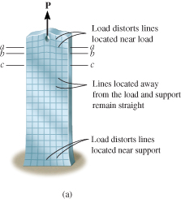
4.1 SAINT-VENANT’S PRINCIPLE
Localized deformation occurs at each end, and the deformations decrease as measurements are taken further away from the ends
At section c-c, stress reaches almost uniform value as compared to a-a, b-b
c-c is sufficiently far enough away from P so that localized deformation “vanishes”, i.e., minimum distance

Slide 5
4.1 SAINT-VENANT’S PRINCIPLE
General rule: min. distance is at least equal to largest dimension of loaded cross section. For the bar, the min. distance is equal to width of bar
This behavior discovered by Barré de Saint-Venant in 1855, thus the name of the principle
Saint-Venant Principle states that localized effects caused by any load acting on the body, will dissipate/smooth out within regions that are sufficiently removed from location of load
Thus, no need to study stress distributions at that points near application loads or support reactions

Slide 6
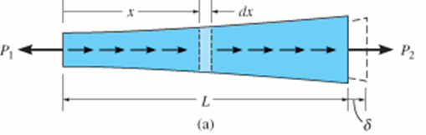
4.2 ELASTIC DEFORMATION OF AN AXIALLY LOADED MEMBER
Relative displacement (δ) of one end of bar with respect to other end caused by this loading
Applying Saint-Venant’s Principle, ignore localized deformations at points of concentrated loading and where x-section suddenly changes

Slide 7
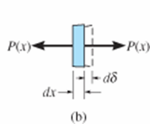
4.2 ELASTIC DEFORMATION OF AN AXIALLY LOADED MEMBER
Use method of sections, and draw free-body diagram
P(x)
A(x)
dδ
dx
σ =
ε =
Assume proportional limit not exceeded, thus apply Hooke’s Law
σ = Eε
P(x)
A(x)
dδ
dx
( )
= E
P(x) dx
A(x) E
dδ =

Slide 8
4.2 ELASTIC DEFORMATION OF AN AXIALLY LOADED MEMBER
Integrate the entire length, L to find required end disp.
∫₀
P(x) dx
A(x) E
Eqn. 4-1
^{L}
δ =
δ = displacement of one pt relative to another pt
L = distance between the two points
P(x) = internal axial force at the section, located a distance x from one end
A(x) = x-sectional area of the bar, expressed as a function of x
E = modulus of elasticity for material

Slide 9

4.2 ELASTIC DEFORMATION OF AN AXIALLY LOADED MEMBER
Constant load and cross-sectional area
For constant cross-sectional area A, and homogenous material, E is constant
With constant external force P, applied at each end, then internal force P throughout length of bar is constant
Thus, integrating Eqn 4-1 will yield
PL
AE
Eqn. 4-2
δ =

Slide 10
4.2 ELASTIC DEFORMATION OF AN AXIALLY LOADED MEMBER
Constant load and X-sectional area
If bar subjected to several different axial forces, or x-sectional area or E is not constant, then the equation can be applied to each segment of the bar and added algebraically to get
∑
PL
AE
δ =

Slide 11
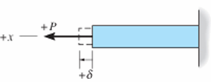
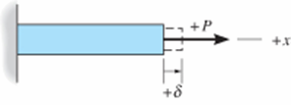
4.2 ELASTIC DEFORMATION OF AN AXIALLY LOADED MEMBER
Sign convention
Sign | Forces | Displacement
Positive (+) | Tension | Elongation
Negative (−) | Compression | Contraction

Slide 12
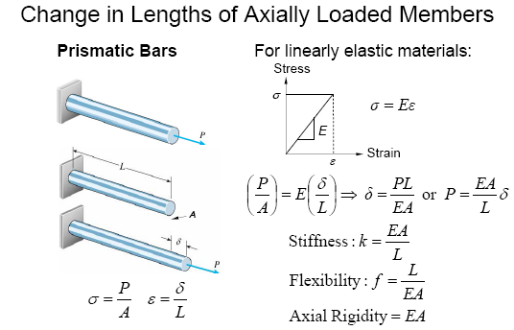
4.2 ELASTIC DEFORMATION OF AN AXIALLY LOADED MEMBER

Slide 13
4.2 ELASTIC DEFORMATION OF AN AXIALLY LOADED MEMBER
Procedure for analysis
Internal force
Use method of sections to determine internal axial force P in the member
If the force varies along member’s strength, section is made at the arbitrary location x from one end of member and force is represented as a function of x, i.e., P(x)
If several constant external forces act on member, internal force in each segment, between two external forces, must then be determined

Slide 14
4.2 ELASTIC DEFORMATION OF AN AXIALLY LOADED MEMBER
Procedure for analysis
Internal force
For any segment, internal tensile force is positive and internal compressive force is negative. Results of loading can be shown graphically by constructing the normal-force diagram
Displacement
When member’s x-sectional area varies along its axis, the area should be expressed as a function of its position x, i.e., A(x)

Slide 15
4.2 ELASTIC DEFORMATION OF AN AXIALLY LOADED MEMBER
Procedure for analysis
Displacement
If x-sectional area, modulus of elasticity, or internal loading suddenly changes, then Eqn 4-2 should be applied to each segment for which the qty are constant
When substituting data into equations, account for proper sign for P, tensile loadings +ve, compressive −ve. Use consistent set of units. If result is +ve, elongation occurs, −ve means it’s a contraction

Slide 16
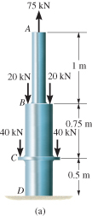
EXAMPLE 4.1
Composite A-36 steel bar shown made from two segments AB and BD. Area A_{AB} = 600 mm² and A_{BD} = 1200 mm².
Determine the vertical displacement of end A and displacement of B relative to C.

Slide 17
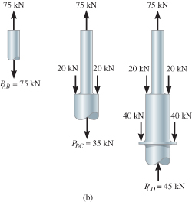
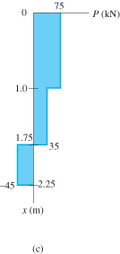
EXAMPLE 4.1 (SOLN)
Internal force
Due to external loadings, internal axial forces in regions AB, BC and CD are different.
Apply method of sections and equation of vertical force equilibrium as shown. Variation is also plotted.

Slide 18
EXAMPLE 4.1 (SOLN)
Displacement
From tables, E_{st} = 210(10³) MPa.
Use sign convention, vertical displacement of A relative to fixed support D is
∑
PL
AE
[+75 kN](1 m)(10⁶)
[600 mm² (210)(10³) kN/m²]
δ_{A} =
=
[+35 kN](0.75 m)(10⁶)
[1200 mm² (210)(10³) kN/m²]
+
[−45 kN](0.5 m)(10⁶)
[1200 mm² (210)(10³) kN/m²]
+
= +0.61 mm

Slide 19
EXAMPLE 4.1 (SOLN)
Displacement
Since result is positive, the bar elongates and so displacement at A is upward
Apply Equation 4-2 between B and C,
P_{BC} L_{BC}
A_{BC} E
[+35 kN](0.75 m)(10⁶)
[1200 mm² (210)(10³) kN/m²]
δ_{A} =
=
= +0.104 mm
Here, B moves away from C, since segment elongates

Slide 20
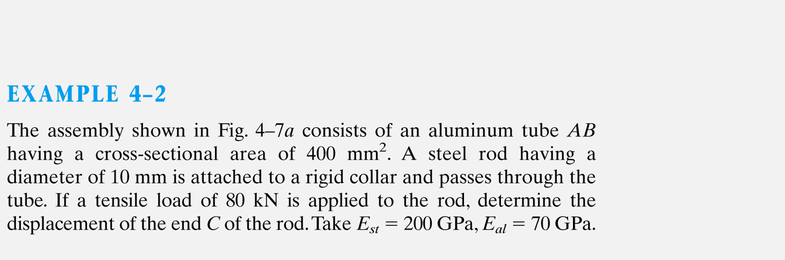
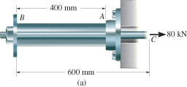


Slide 21
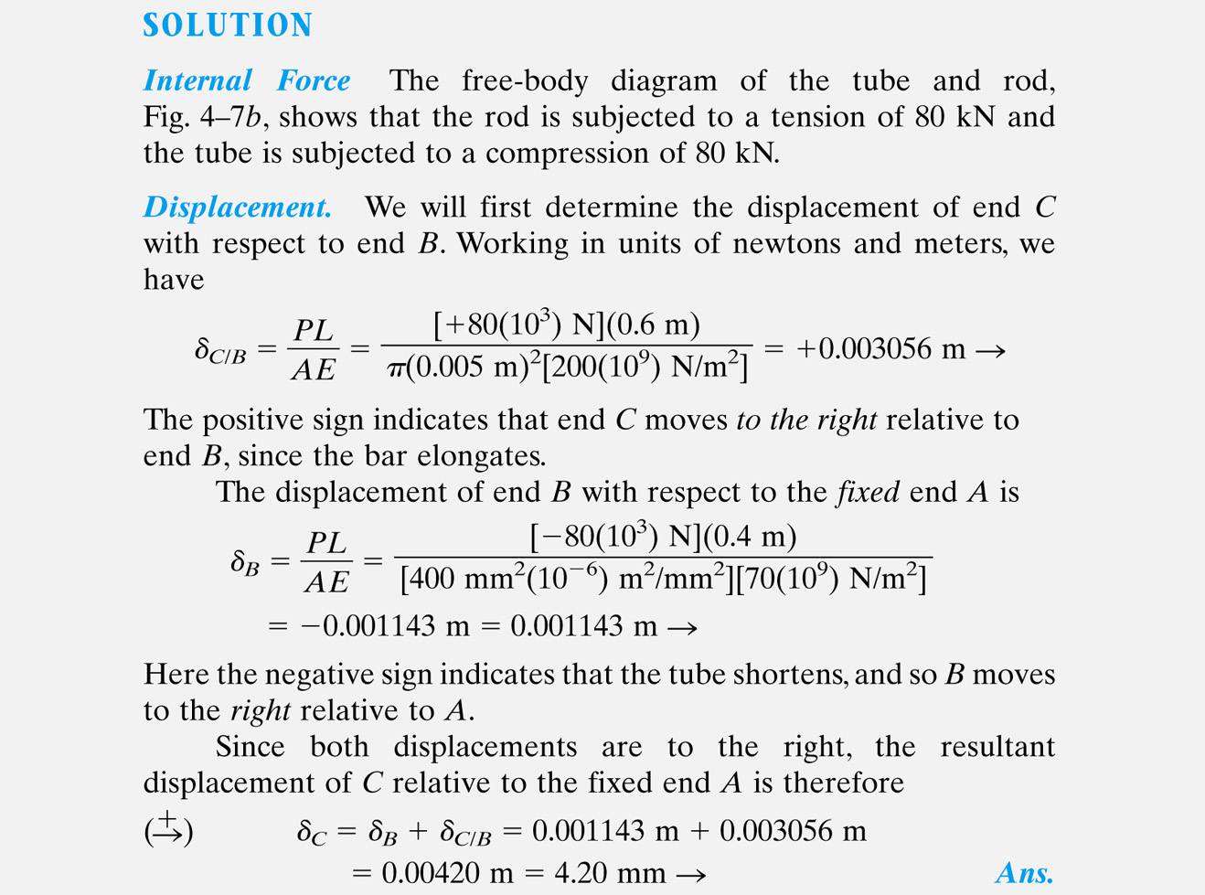

Slide 22
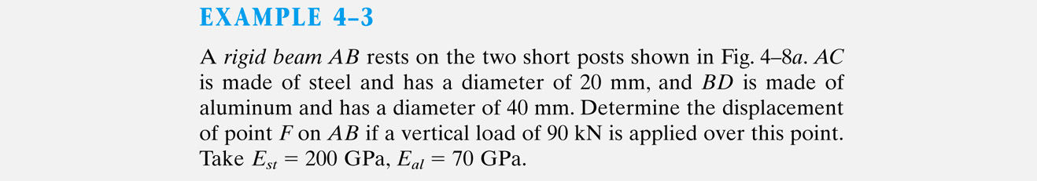

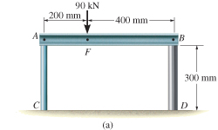
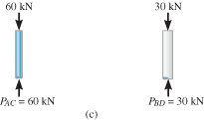

Slide 23
Support reaction at C and D were determined from equilibrium of AB
Displacement of the top of each post;
Post AC
Post BD

Slide 24

The displacement of point F is therefore;

Slide 25
4.3 PRINCIPLE OF SUPERPOSITION
After subdividing the load into components, the principle of superposition states that the resultant stress or displacement at the point can be determined by first finding the stress or displacement caused by each component load acting separately on the member.
Resultant stress/displacement determined algebraically by adding the contributions of each component

Slide 26
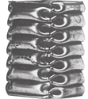
4.3 PRINCIPLE OF SUPERPOSITION
Conditions
The loading must be linearly related to the stress or displacement that is to be determined.
The loading must not significantly change the original geometry or configuration of the member
When to ignore deformations?
Most loaded members will produce deformations so small that change in position and direction of loading will be insignificant and can be neglected
Exception to this rule is a column carrying axial load, discussed in Chapter 13

Slide 27
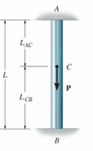
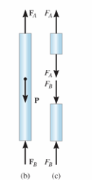
4.4 STATICALLY INDETERMINATE AXIALLY LOADED MEMBER
For a bar fixed-supported at one end, equilibrium equations is sufficient to find the reaction at the support. Such a problem is statically determinate
If bar is fixed at both ends, then two unknown axial reactions occur, and the bar is statically indeterminate
+↑∑ F = 0;
F_{B} + F_{A} − P = 0

Slide 28
4.4 STATICALLY INDETERMINATE AXIALLY LOADED MEMBER

Slide 29
4.4 STATICALLY INDETERMINATE AXIALLY LOADED MEMBER
To establish addition equation, consider geometry of deformation. Such an equation is referred to as a compatibility or kinematic condition
Since relative displacement of one end of bar to the other end is equal to zero, since end supports fixed,
δ_{A/B} = 0
This equation can be expressed in terms of applied loads using a load-displacement relationship, which depends on the material behavior

Slide 30
4.4 STATICALLY INDETERMINATE AXIALLY LOADED MEMBER
For linear elastic behavior, compatibility equation can be written as
F_{A} L_{AC}
AE
F_{B} L_{CB}
AE
−
= 0
Assume AE is constant, solve equations simultaneously,
L_{CB}
L
L_{AC}
L
( )
( )
F_{A} = P
F_{B} = P

Slide 31
4.4 STATICALLY INDETERMINATE AXIALLY LOADED MEMBER
Procedure for analysis
Equilibrium
Draw a free-body diagram of member to identify all forces acting on it
If unknown reactions on free-body diagram greater than no. of equations, then problem is statically indeterminate
Write the equations of equilibrium for the member

Slide 32
4.4 STATICALLY INDETERMINATE AXIALLY LOADED MEMBER
Procedure for analysis
Compatibility
Draw a diagram to investigate elongation or contraction of loaded member
Express compatibility conditions in terms of displacements caused by forces
Use load-displacement relations (δ=PL/AE) to relate unknown displacements to reactions
Solve the equations. If result is negative, this means the force acts in opposite direction of that indicated on free-body diagram

Slide 33

EXAMPLE 4.5
Steel rod shown has diameter of 5 mm. Attached to fixed wall at A, and before it is loaded, there is a gap between the wall at B’ and the rod of 1 mm.
Determine reactions at A and B’ if rod is subjected to axial force of P = 20 kN.
Neglect size of collar at C. Take E_{st} = 200 GPa

Slide 34

EXAMPLE 4.5 (SOLN)
Equilibrium
Assume force P large enough to cause rod’s end B to contact wall at B’. Equilibrium requires
+ F = 0;
− F_{A} − F_{B} + 20(10³) N = 0
Compatibility
Compatibility equation:
δ_{B/A} = 0.001 m

Slide 35

EXAMPLE 4.5 (SOLN)
Compatibility
Use load-displacement equations (Eqn 4-2), apply to AC and CB
F_{A} L_{AC}
AE
F_{B} L_{CB}
AE
δ_{B/A} = 0.001 m =
−
F_{A} (0.4 m) − F_{B} (0.8 m) = 3927.0 N·m
Solving simultaneously,
F_{A} = 16.6 kN F_{B} = 3.39 kN

Slide 36
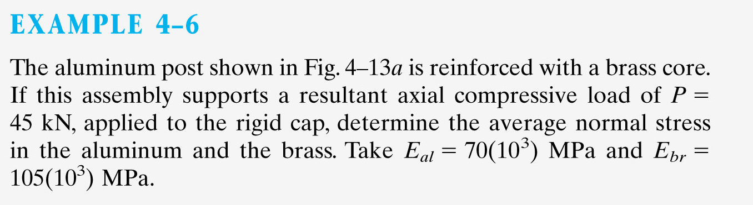
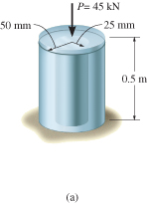
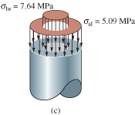

Slide 39
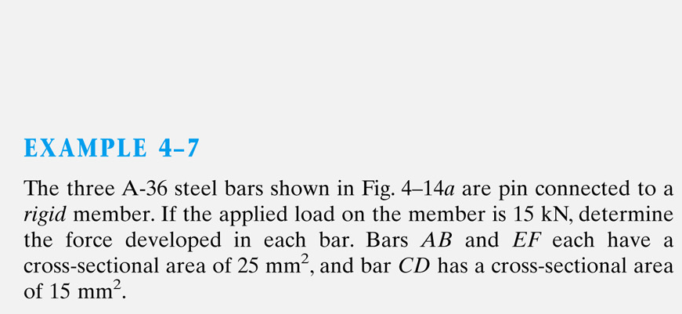
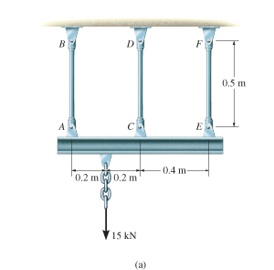

Slide 40
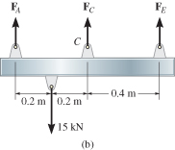

Slide 41
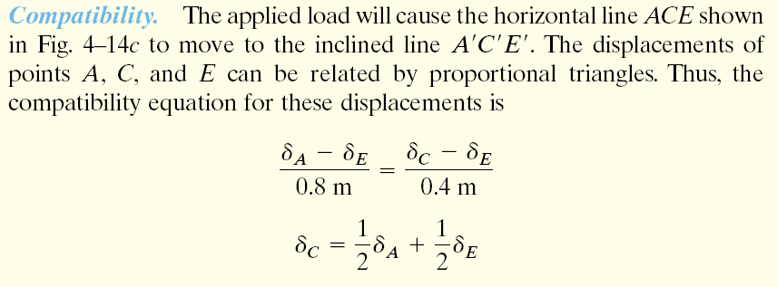

Slide 42
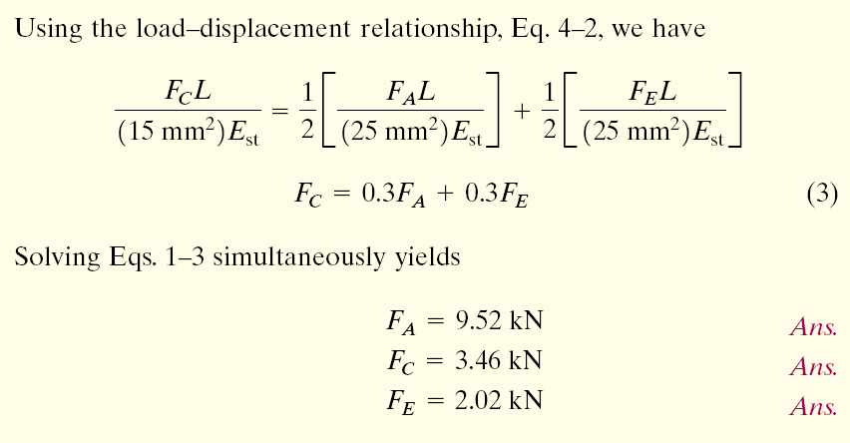

Slide 43
4.5 FORCE METHOD OF ANALYSIS FOR AXIALLY LOADED MEMBERS
Used to also solve statically indeterminate problems by using superposition of the forces acting on the free-body diagram
First, choose any one of the two supports as “redundant” and remove its effect on the bar
Thus, the bar becomes statically determinate
Apply principle of superposition and solve the equations simultaneously

Slide 44
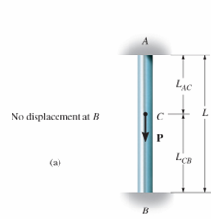
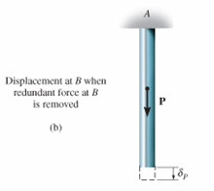
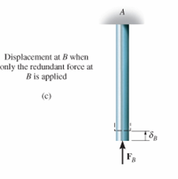
4.5 FORCE METHOD OF ANALYSIS FOR AXIALLY LOADED MEMBERS
From free-body diagram, we can determine the reaction at A
=
+

Slide 45
4.5 FORCE METHOD OF ANALYSIS FOR AXIALLY LOADED MEMBERS
Procedure for Analysis
Compatibility
Choose one of the supports as redundant and write the equation of compatibility.
Known displacement at redundant support (usually zero), equated to displacement at support caused only by external loads acting on the member plus the displacement at the support caused only by the redundant reaction acting on the member.

Slide 46
4.5 FORCE METHOD OF ANALYSIS FOR AXIALLY LOADED MEMBERS
Procedure for Analysis
Compatibility
Express external load and redundant displacements in terms of the loadings using load-displacement relationship
Use compatibility equation to solve for magnitude of redundant force

Slide 47
4.5 FORCE METHOD OF ANALYSIS FOR AXIALLY LOADED MEMBERS
Procedure for Analysis
Equilibrium
Draw a free-body diagram and write appropriate equations of equilibrium for member using calculated result for redundant force.
Solve the equations for other reactions

Slide 48
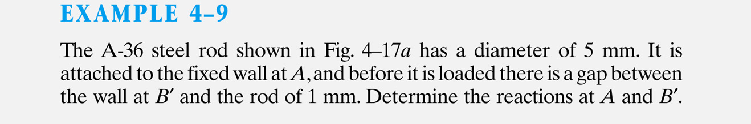
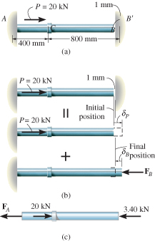


Slide 49
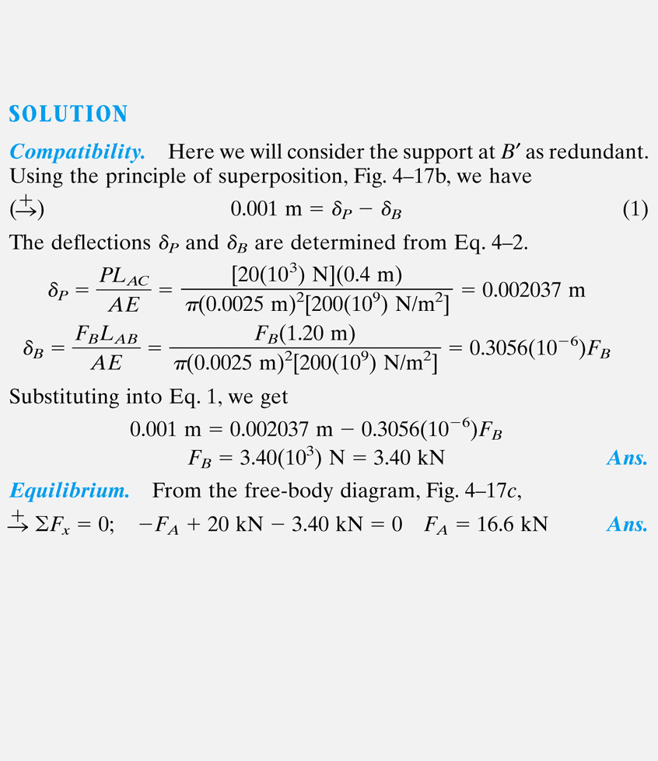

Slide 50
4.6 THERMAL STRESS
Expansion or contraction of material is linearly related to temperature increase or decrease that occurs (for homogenous and isotropic material)
From experiment, deformation of a member having length L is
δ_{T} = α ∆T L
α = linear coefficient of thermal expansion. Unit measure strain per degree of temperature: 1/ºC (Celsius) or 1/ºK (Kelvin)
∆T = algebraic change in temperature of member
δT = algebraic change in length of member

Slide 51
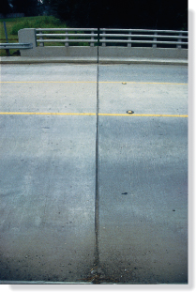
4.6 THERMAL STRESS
A temperature change results in a change in length or thermal strain. There is no stress associated with the thermal strain unless the elongation is restrained by the supports.
For a statically indeterminate member, the thermal displacements can be constrained by the supports, producing thermal stresses that must be considered in design.

Slide 52

EXAMPLE 4.10
A-36 steel bar shown is constrained to just fit between two fixed supports when T₁ = 30ºC.
If temperature is raised to T₂ = 60ºC, determine the average normal thermal stress developed in the bar.

Slide 53

EXAMPLE 4.10 (SOLN)
Equilibrium
As shown in free-body diagram,
+↑ ∑ Fy = 0;
F_{A} = F_{B} = F
Problem is statically indeterminate since the force cannot be determined from equilibrium.
Compatibility
Since δ_{A/B} =0, thermal displacement δ_{T} at A occur. Thus compatibility condition at A becomes
+↑
δ_{A/B} = 0 = δ_{T} − δ_{F}

Slide 54
EXAMPLE 4.10 (SOLN)
Compatibility
Apply thermal and load-displacement relationship,
FL
AE
0 = α ∆TL −
F = α ∆TAE = … = 7.2 kN
From magnitude of F, it’s clear that changes in temperature causes large reaction forces in statically indeterminate members.
Average normal compressive stress is
F
A
σ =
= … = 72 MPa

Slide 55

A steel rod is stretched between two rigid walls and carries a tensile load of 5000 N at 20°C. If the allowable stress is not to exceed 130 MPa at -20°C, what is the minimum diameter of the rod? Assume α = 11.7 µm/(m·°C) and E = 200 GPa

Slide 56
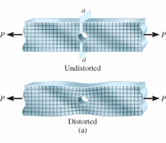
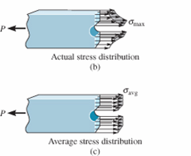
4.7 STRESS CONCENTRATIONS
Force equilibrium requires magnitude of resultant force developed by the stress distribution to be equal to P. In other words,
P = ∫_{A} σ dA
This integral represents graphically the volume under each of the stress-distribution diagrams shown.

Slide 57
4.7 STRESS CONCENTRATIONS
In engineering practice, actual stress distribution not needed, only maximum stress at these sections must be known. Member is designed to resist this stress when axial load P is applied.
K is defined as a ratio of the maximum stress to the average stress acting at the smallest cross section:
σ_{max}
σ_{avg}
K =
Equation 4-7

Slide 58
4.7 STRESS CONCENTRATIONS
K is independent of the bar’s material properties, only on the bar’s geometry and the type of discontinuity.
As size r of the discontinuity is decreased, stress concentration is increased.
It is important to use stress-concentration factors in design when using brittle materials, but not necessary for ductile materials
Stress concentrations also cause failure structural members or mechanical elements subjected to fatigue loadings

Slide 59
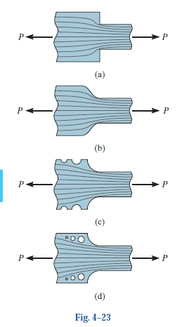

Slide 60
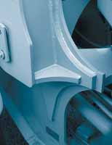
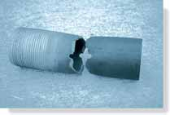

Slide 61
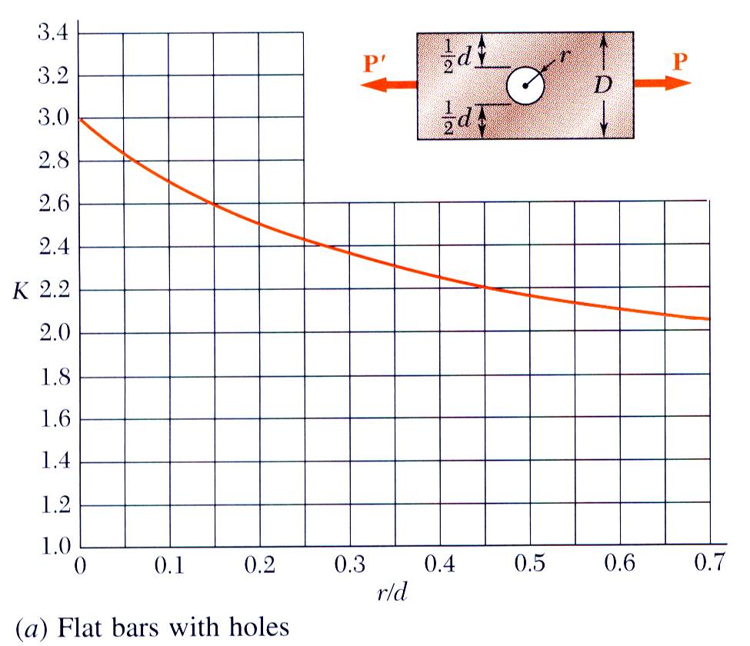
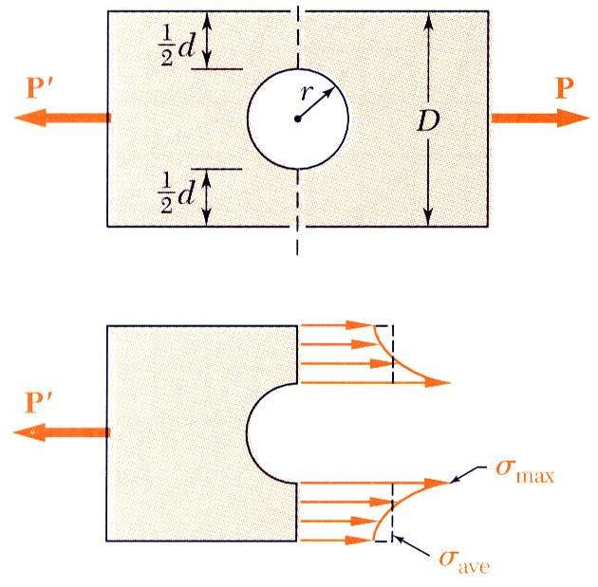
Stress Concentration: Hole
Discontinuities of cross section may result in high localized or concentrated stresses.

Slide 62
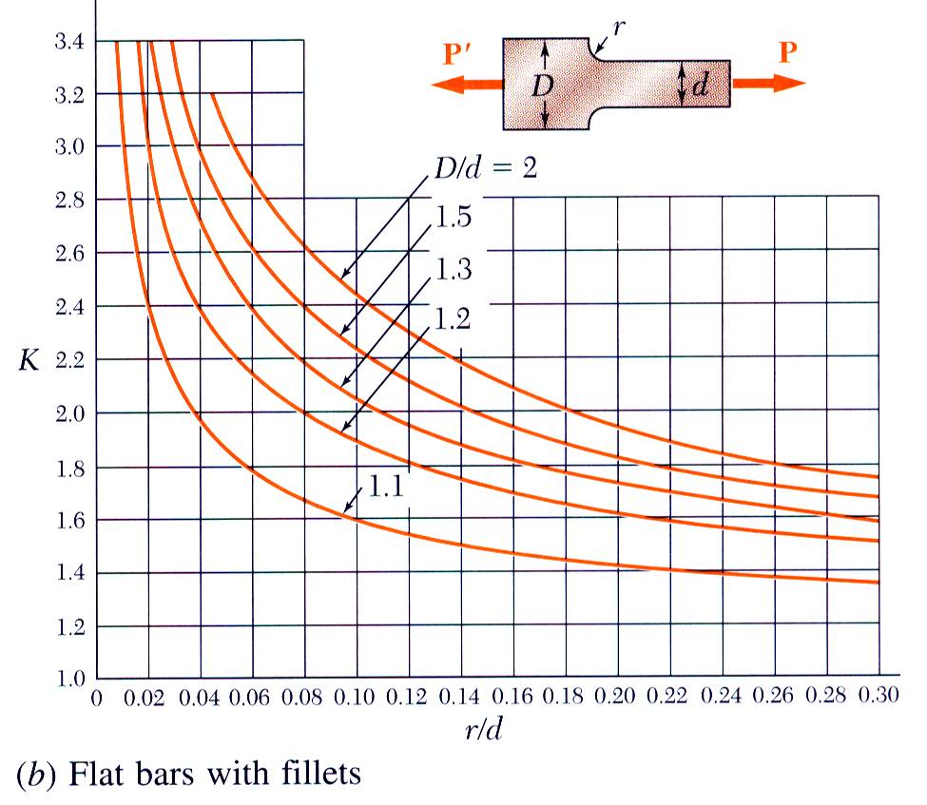
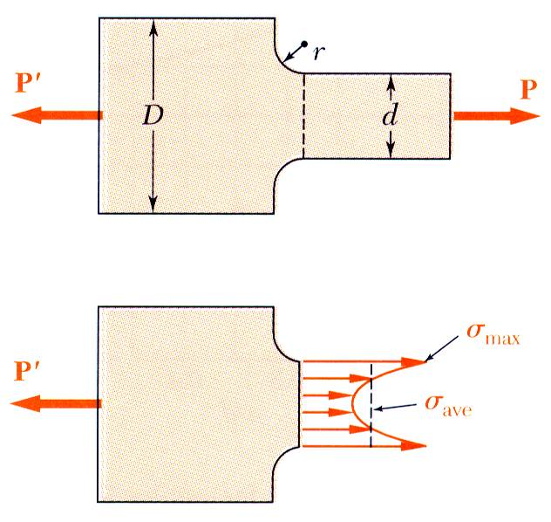
Stress Concentration: Fillet

Slide 63
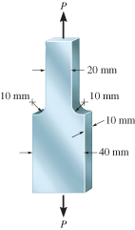
EXAMPLE 4.13
Steel bar shown below has allowable stress,
σ_{allow} = 115 MPa. Determine largest axial force P that the bar can carry.

Slide 64
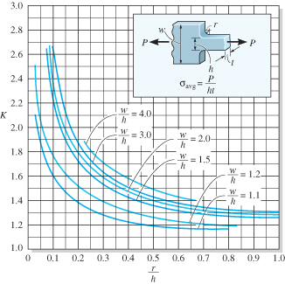
EXAMPLE 4.13 (SOLN)
Because there is a shoulder fillet, stress-concentrating factor determined using the graph below

Slide 65
EXAMPLE 4.13 (SOLN)
Calculating the necessary geometric parameters yields
r
h
10 mm
20 mm
w
h
40 mm
20 mm
=
= 0.50
=
= 2
Thus, from the graph, K = 1.4
Average normal stress at smallest x-section,
P
(20 mm)(10 mm)
σ_{avg} =
= 0.005P N/mm²

Slide 66
EXAMPLE 4.13 (SOLN)
Applying Eqn 4-7 with σ_{allow} = Kσ_{max} yields
σ_{allow} = K σ_{max}
115 N/mm² = 1.4(0.005P)
P = 16.43(10³) N = 16.43 kN

Slide 67
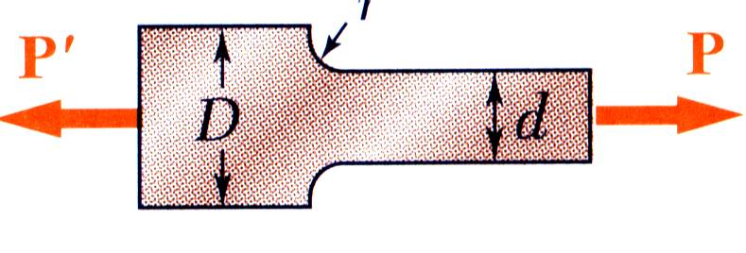
Example
SOLUTION:
Determine the geometric ratios and find the stress concentration factor from Figure.
Find the allowable average normal stress using the material allowable normal stress and the stress concentration factor.
Determine the largest axial load P that can be safely supported by a flat steel bar consisting of two portions, both 10 mm thick, and respectively 40 and 60 mm wide, connected by fillets of radius r = 8 mm. Assume an allowable normal stress of 165 MPa.
Apply the definition of normal stress to find the allowable load.
Determine the geometric ratios and find the stress concentration factor from Fig. 2.64b.

Slide 68
Find the allowable average normal stress using the material allowable normal stress and the stress concentration factor.
Apply the definition of normal stress to find the allowable load.

Slide 69
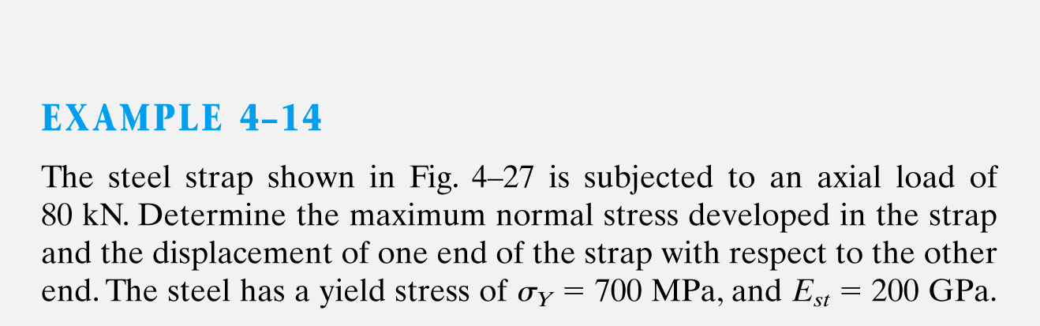
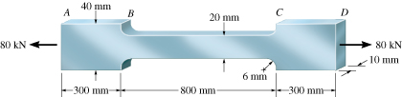

Slide 70
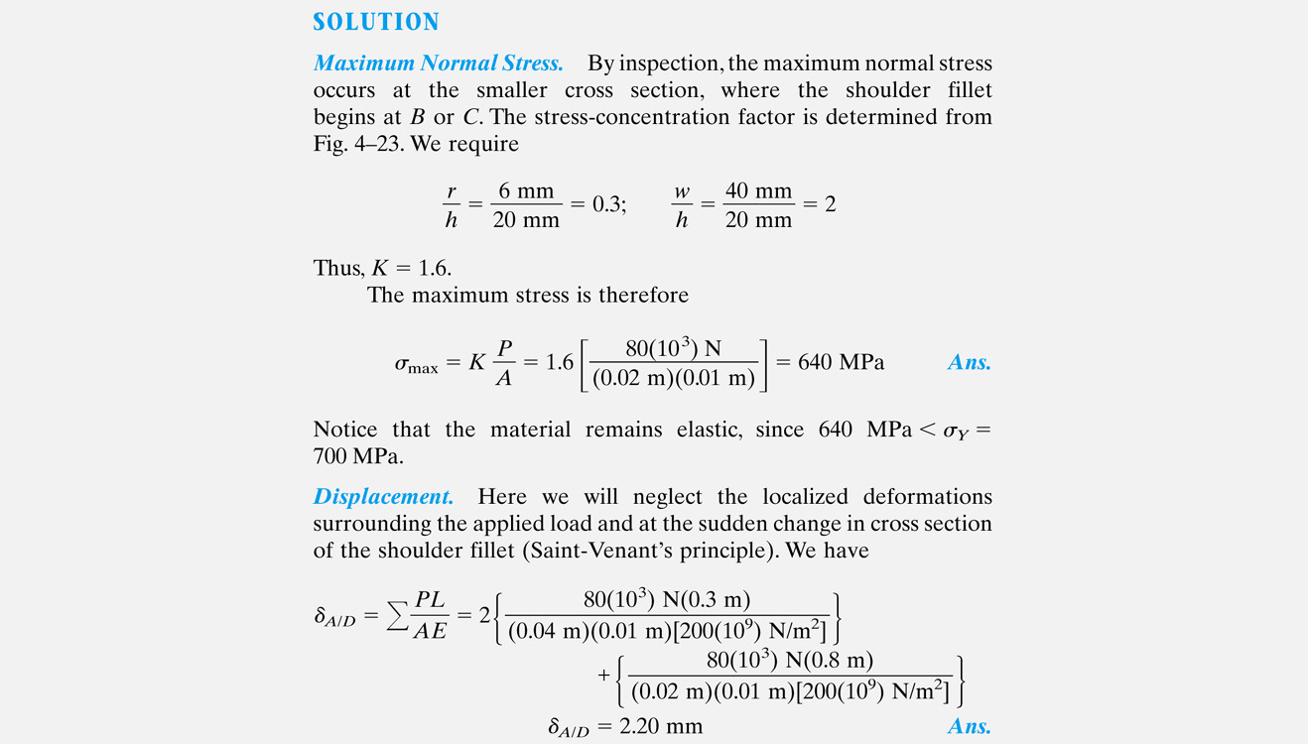

Slide 71
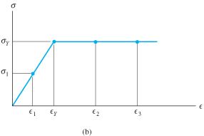
*4.8 INELASTIC AXIAL DEFORMATION
Sometimes, a member is designed so that the loading causes the material to yield and thereby permanently deform.
Such members are made from highly ductile material such as annealed low-carbon steel having a stress-strain diagram shown below.
Such material is referred to as being
elastic-perfectly plastic or elastoplastic

Slide 72


*4.8 INELASTIC AXIAL DEFORMATION
Plastic load P_{P} is the maximum load that an elastoplastic member can support

Slide 73

EXAMPLE 4.16
Steel bar shown assumed to be elastic-perfectly plastic with σ_{Y} = 250 MPa.
Determine (a) maximum value of applied load P that can be applied without causing the steel to yield, (b) the maximum value of P that bar can support. Sketch the stress distribution at the critical section for each case.

Slide 74
EXAMPLE 4.16 (SOLN)
(a) When material behaves elastically, we must use a stress-concentration that is unique for the bar’s geometry.
r
h
4 mm
(40 mm − 8 mm)
=
= 0.125
w
h
40 mm
(40 mm − 8 mm)
=
= 1.25
When σ_{max} = σ_{Y}. Average normal stress is σ_{avg} = P/A
P_{Y}
A
σ_{max} = K σ_{avg};
K ≈ 1.75
σ_{Y} = K
( )
…
P_{Y} ≈ 9.14 kN

Slide 75

EXAMPLE 4.16 (SOLN)
Load P_{Y} was calculated using the smallest x-section. Resulting stress distribution is shown. For equilibrium, the “volume” contained within this distribution must equal 9.14 kN.

Slide 76

EXAMPLE 4.16 (SOLN)
Maximum load sustained by the bar causes all material at smallest x-section to yield. As P is increased to plastic load P_{P}, the stress distribution changes as shown.
When σ_{max} = σ_{avg}. Average normal stress is σ_{avg} = P/A
P_{P}
A
( )
σ_{avg} =
…
P_{P} = 16.0 kN
Here, P_{P} equals the “volume” contained within the stress distribution, i.e., P_{P} = σ_{Y} A

Slide 77
*4.9 RESIDUAL STRESS
For axially loaded member or group of such members, that form a statically indeterminate system that can support both tensile and compressive loads,
Then, excessive external loadings which cause yielding of the material, creates residual stresses in the members when loads are removed.
Reason is the elastic recovery of the material during unloading

Slide 78

*4.9 RESIDUAL STRESS
To solve such problem, complete cycle of loading and unloading of member is considered as the superposition of a positive load (loading) on a negative load (unloading).
Loading (OAC) results in a plastic stress distribution
Unloading (CD) results only in elastic stress distribution
Superposition requires loads to cancel, however, stress distributions will not cancel, thus residual stresses remain

Slide 79

EXAMPLE 4.17
Steel rod has radius of 5 mm, made from an elastic-perfectly plastic material for which σ_{Y} = 420 MPa, E = 70 GPa.
If P = 60 kN applied to rod and then removed, determine residual stress in rod and permanent displacement of collar at C.

Slide 80

EXAMPLE 4.17 (SOLN)
By inspection, rod statically indeterminate.
An elastic analysis (discussed in 4.4) produces:
F_{A} = 45 kN F_{B} = 15 kN
Thus, this result in stress of
45 kN
π(0.005 m)²
σ_{AC} =
= 573 MPa (compression)
> σ_{Y} = 420 MPa
And
15 kN
π(0.005 m)²
σ_{CB} =
= 191 MPa

Slide 81
EXAMPLE 4.17 (SOLN)
Since AC will yield, assume AC become plastic, while CB remains elastic
(F_{A})_{Y} = σ_{Y} A = ... = 33.0 kN
Thus, F_{B} = 60 kN − 33.0 kN = 27.0 kN
σ_{AC} = σ_{Y} = 420 MPa (compression)
27 kN
π(0.005 m)²
σ_{CB} =
= 344 MPa (tension)
< 420 MPa (OK!)

Slide 82

EXAMPLE 4.17 (SOLN)
Residual Stress.
Since CB responds elastically,
F_{B} L_{CB}
AE
δ_{C} =
= ... = 0.001474 m
Thus,
ε_{CB} = δ_{C} / L_{CB}
= +0.004913
ε_{AC} = δ_{C} / L_{AC}
= −0.01474

Slide 83
EXAMPLE 4.17 (SOLN)
Residual Stress.
(σ_{AC})_{r} = −420 MPa + 573 MPa = 153 MPa
(σ_{CB})_{r} = 344 MPa − 191 MPa = 153 MPa
Both tensile stress is the same, which is to be expected.

Slide 84
EXAMPLE 4.17 (SOLN)
Permanent Displacement
Residual strain in CB is
ε’_{CB} = σ/E = ... = 0.0022185
So permanent displacement of C is
δ_{C} = ε’_{CB} L_{CB} = 0.002185(300 mm) = 0.656 mm
Alternative solution is to determine residual strain ε’_{AC}, and ε’_{AC} = ε_{AC} + δε_{AC} and
δC = ε’_{AC} L_{AC} = ... = 0.656 mm

Slide 85
CHAPTER REVIEW
When load applied on a body, a stress distribution is created within the body that becomes more uniformly distributed at regions farther from point of application. This is the Saint-Venant’s principle.
Relative displacement at end of axially loaded member relative to other end is determined from
If series of constant external forces are applied and AE is constant, then
∫₀
P(x) dx
A(x) E
^{L}
δ =
∑
PL
AE
δ =

Slide 86
CHAPTER REVIEW
Make sure to use sign convention for internal load P and that material does not yield, but remains linear elastic
Superposition of load & displacement is possible provided material remains linear elastic and no changes in geometry occur
Reactions on statically indeterminate bar determined using equilibrium and compatibility conditions that specify displacement at the supports. Use the load-displacement relationship, δ = PL/AE

Slide 87
CHAPTER REVIEW
Change in temperature can cause member made from homogenous isotropic material to change its length by δ = αΔTL . If member is confined, expansion will produce thermal stress in the member
Holes and sharp transitions at x-section create stress concentrations. For design, obtain stress concentration factor K from graph, which is determined empirically. The K value is multiplied by average stress to obtain maximum stress at x-section, σ_{max} = Kσ_{avg}

