Slide 1
SKTN 2123
Strength of Materials
Mechanical Properties of Materials
Mohsin Mohd Sies
Nuclear Engineering,
School of Chemical and Energy Engineering,
Universiti Teknologi Malaysia

Slide 2

CHAPTER OBJECTIVES
Show relationship of stress and strain using experimental methods to determine stress-strain diagram of a specific material
Discuss the behavior described in the diagram for commonly used engineering materials
Discuss the mechanical properties and other test related to the development of mechanics of materials

Slide 3
CHAPTER OUTLINE
Tension and Compression Test
Stress-Strain Diagram
Stress-Strain Behavior of Ductile and Brittle Materials
Hooke’s Law
Strain Energy
Poission’s Ratio
Shear Stress-Strain Diagram
Failure of Materials Due to Creep and Fatigue

Slide 4
3.1 TENSION & COMPRESSION TEST
Strength of a material can only be determined by experiment
One test used by engineers is the tension or compression test
This test is used primarily to determine the relationship between the average normal stress and average normal strain in common engineering materials, such as metals, ceramics, polymers and composites

Slide 5
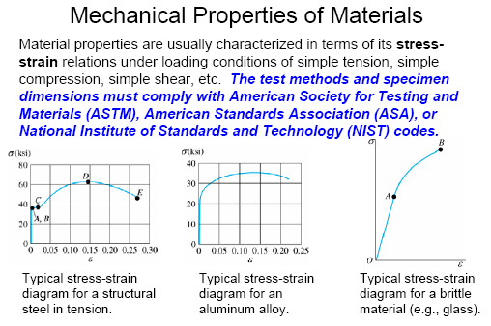

Slide 6

3.1 TENSION & COMPRESSION TEST
Performing the tension or compression test
Specimen of material is made into “standard” shape and size
Before testing, 2 small punch marks identified along specimen’s length
Measurements are taken of both specimen’s initial x-sectional area A₀ and gauge-length distance L₀; between the two marks
Seat the specimen into a testing machine shown below.

Slide 7
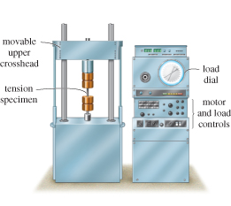
3.1 TENSION & COMPRESSION TEST
Performing the tension or compression test
Seat the specimen into a testing machine shown below
The machine will stretch specimen at slow constant rate until breaking point
At frequent intervals during test, data is recorded of the applied load P.

Slide 8

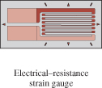
3.1 TENSION & COMPRESSION TEST
Performing the tension or compression test
Elongation δ = L − L₀ is measured using either a caliper or an extensometer
δ is used to calculate the normal strain in the specimen
Sometimes, strain can also be read directly using an electrical-resistance strain gauge (strain rosette)

Slide 9
3.2 STRESS-STRAIN DIAGRAM
A stress-strain diagram is obtained by plotting the various values of the stress and corresponding strain in the specimen
Conventional stress-strain diagram
Using recorded data, we can determine nominal or engineering stress by
P
A₀
σ =
Assumption: Stress is constant over the x-section and throughout region between gauge points

Slide 10
3.2 STRESS-STRAIN DIAGRAM
Conventional Stress-Strain Diagram
Likewise, nominal or engineering strain is found directly from strain gauge reading, or by
δ
L₀
ε =
Assumption: Strain is constant throughout region between gauge points
By plotting σ (ordinate) against ε (abscissa), we get a conventional stress-strain diagram

Slide 11
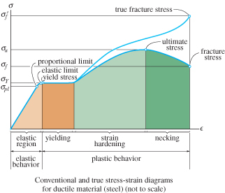
3.2 STRESS-STRAIN DIAGRAM
Conventional stress-strain diagram
Figure shows the characteristic stress-strain diagram for steel, a commonly used material for structural members and mechanical elements

Slide 12
3.2 STRESS-STRAIN DIAGRAM
Conventional stress-strain diagram
Elastic behavior.
A straight line
Stress is proportional to strain, i.e., linearly elastic
Upper stress limit, or proportional limit; σ_{pl}
If load is removed upon reaching elastic limit, specimen will return to its original shape

Slide 13
3.2 STRESS-STRAIN DIAGRAM
Conventional stress-strain diagram
Yielding.
Material deforms permanently; yielding; plastic deformation
Yield stress, σ_{Y}
Figure 3-4
Once yield point reached, specimen continues to elongate (strain) without any increase in load
Note figure not drawn to scale, otherwise induced strains is 10-40 times larger than in elastic limit
Material is referred to as being perfectly plastic

Slide 14
3.2 STRESS-STRAIN DIAGRAM
Conventional stress-strain diagram
Strain hardening.
Ultimate stress, σ_{u}
While specimen is elongating, its x-sectional area will decrease
Figure 3-4
Decrease in area is fairly uniform over entire gauge length

Slide 15
3.2 STRESS-STRAIN DIAGRAM
Conventional stress-strain diagram
Necking.
At ultimate stress, x-sectional area begins to decrease in a localized region
Figure 3-4
As a result, a constriction or “neck” tends to form in this region as specimen elongates further
Specimen finally breaks at fracture stress, σ_{f}

Slide 16
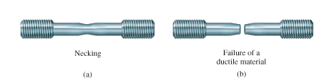
3.2 STRESS-STRAIN DIAGRAM
Conventional stress-strain diagram
Necking.
Specimen finally breaks at fracture stress, σ_{f}
Figure 3-4

Slide 17
3.2 STRESS-STRAIN DIAGRAM
True stress-strain diagram
Instead of using original cross-sectional area and length, we can use the actual cross-sectional area and length at the instant the load is measured
Values of stress and strain thus calculated are called true stress and true strain, and a plot of their values is the true stress-strain diagram

Slide 19
3.2 STRESS-STRAIN DIAGRAM
True stress-strain diagram
In strain-hardening range, conventional σ-ε diagram shows specimen supporting decreasing load
While true σ-ε diagram shows material to be sustaining increasing stress

Slide 20
3.2 STRESS-STRAIN DIAGRAM
True stress-strain diagram
Although both diagrams are different, most engineering design is done within elastic range provided
  Material is “stiff,” like most metals
  Strain to elastic limit remains small
  Error in using engineering values of σ and ε is very small (0.1 %) compared to true values

Slide 21
3.3 STRESS-STRAIN BEHAVIOR OF DUCTILE & BRITTLE MATERIALS
Ductile materials
Defined as any material that can be subjected to large strains before it ruptures, e.g., mild steel
Such materials are used because it is capable of absorbing shock or energy, and if before becoming overloaded, will exhibit large deformation before failing
Ductility of material is to report its percent elongation or percent reduction in area at time of fracture

Slide 22
3.3 STRESS-STRAIN BEHAVIOR OF DUCTILE & BRITTLE MATERIALS
Ductile materials
Percent elongation is the specimen’s fracture strain expressed as a percent
Percent reduction in area is defined within necking region as
L_{f} − L₀
Percent elongation =
(100%)
L₀
A₀ − A_{f}
Percent reduction in area =
(100%)
A₀

Slide 23
3.3 STRESS-STRAIN BEHAVIOR OF DUCTILE & BRITTLE MATERIALS
Ductile materials
Most metals do not exhibit constant yielding behavior beyond the elastic range, e.g. aluminum
It does not have well-defined yield point, thus it is standard practice to define its yield strength using a graphical procedure called the offset method

Slide 24
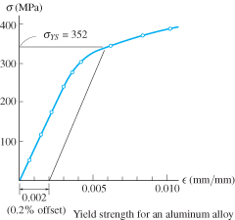
3.3 STRESS-STRAIN BEHAVIOR OF DUCTILE & BRITTLE MATERIALS
Ductile materials
Offset method to determine yield strength
Normally, a 0.2 % strain is chosen.
From this point on the ε axis, a line parallel to initial straight-line portion of stress-strain diagram is drawn.
The point where this line intersects the curve defines the yield strength.

Slide 25
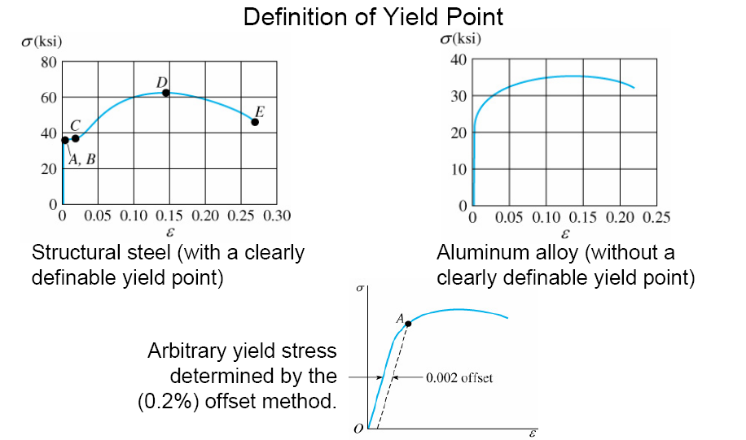
3.3 STRESS-STRAIN BEHAVIOR OF DUCTILE & BRITTLE MATERIALS

Slide 26
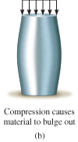
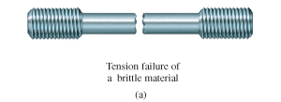
3.3 STRESS-STRAIN BEHAVIOR OF DUCTILE & BRITTLE MATERIALS
Brittle Materials
Material that exhibit little or no yielding before failure are referred to as brittle materials, e.g., gray cast iron
Brittle materials do not have a well-defined tensile fracture stress, since appearance of initial cracks in a specimen is quite random

Slide 27
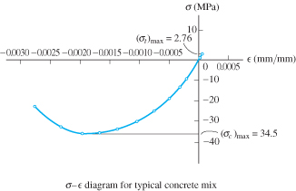
3.3 STRESS-STRAIN BEHAVIOR OF DUCTILE & BRITTLE MATERIALS
Brittle Materials
Instead, the average fracture stress from a set of observed tests is generally reported

Slide 28
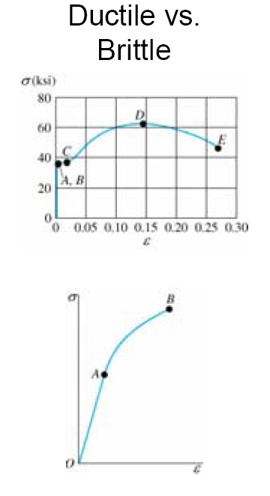

3.3 STRESS-STRAIN BEHAVIOR OF DUCTILE & BRITTLE MATERIALS

Slide 29
3.4 HOOKE’S LAW
Most engineering materials exhibit a linear relationship between stress and strain with the elastic region
Discovered by Robert Hooke in 1676 using springs, known as Hooke’s law
σ = Eε
E represents the constant of proportionality, also called the modulus of elasticity or Young’s modulus
E has units of stress, i.e., pascals, MPa or GPa.

Slide 30
3.4 HOOKE’S LAW
E is a mechanical property that indicates the stiffness of a material.
Materials that are very stiff exhibits large values of E (E_{steel} = 200GPa.
E only valid in linear elastic behavior and no longer valid once the σ–ε diagram ceases to be a straight line

Slide 31
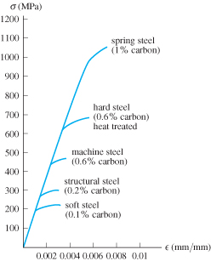
3.4 HOOKE’S LAW
As shown above, most grades of steel have same modulus of elasticity, E_{st} = 200 GPa
Modulus of elasticity is a mechanical property that indicates the stiffness of a material
Materials that are still have large E values, while spongy materials (vulcanized rubber) have low values

Slide 32
3.4 HOOKE’S LAW
IMPORTANT
Modulus of elasticity E, can be used only if a material has linear-elastic behavior.
Also, if stress in material is greater than the proportional limit, the stress-strain diagram ceases to be a straight line and the equation is not valid

Slide 33
3.4 HOOKE’S LAW
Strain hardening
If a specimen of ductile material (steel) is loaded into the plastic region and then unloaded, elastic strain is recovered as material returns to its equilibrium state
However, plastic strain remains, thus material is subjected to a permanent set

Slide 34
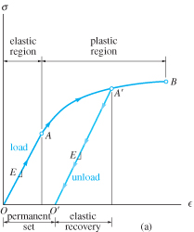
3.4 HOOKE’S LAW
Strain hardening
Specimen loaded beyond yield point A to A’
Inter-atomic forces have to be overcome to elongate specimen elastically, these same forces pull atoms back together when load is removed
Since E is the same, slope of line O’A’ is the same as line OA.
However, upon reloading, specimen will exhibit new and higher yield strength.

Slide 35
3.4 HOOKE’S LAW
Strain hardening
Load reapplied, atoms will be displaced until yielding occurs at or near A’, and stress-strain diagram continues along same path as before
New stress-strain diagram has higher yield point (A’), a result of strain-hardening
Specimen has a greater elastic region and less ductility

Slide 36
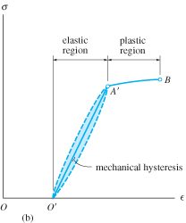
3.4 HOOKE’S LAW
Strain hardening
As specimen is unloaded and loaded, heat or energy may be lost
Colored area between the curves represents lost energy and is called mechanical hysteresis
It’s an important consideration when selecting materials to serve as dampers for vibrating structures and equipment

Slide 37
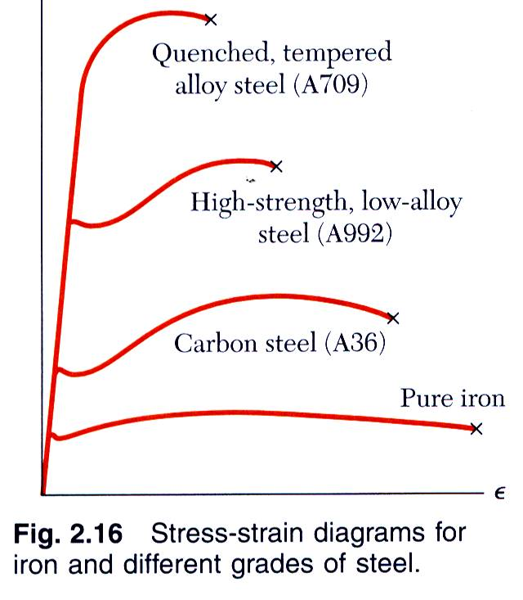
Hooke’s Law: Modulus of Elasticity
Below the yield stress
Strength is affected by alloying, heat treating, and manufacturing process but stiffness (Modulus of Elasticity) is not.

Slide 38

3.5 STRAIN ENERGY
When material is deformed by external loading, energy is stored internally throughout its volume
Internal energy is also referred to as strain energy
Stress develops a force,
ΔF = σ ΔA = σ (Δx Δy)

Slide 39
3.5 STRAIN ENERGY
Strain-energy density is strain energy per unit volume of material
∆U
∆V
σε
2
u =
=
If material behavior is linear elastic, Hooke’s law applies,
σ
2
σ
ε
σ²
2E
( )
u =
=

Slide 40
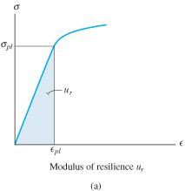
3.5 STRAIN ENERGY
Modulus of resilience
When stress reaches proportional limit, strain-energy-energy density is called modulus of resilience
σ_{pl} ε_{pl}
2
σ_{pl}²
2E
u_{r} =
=
A material’s resilience represents its ability to absorb energy without any permanent damage

Slide 41
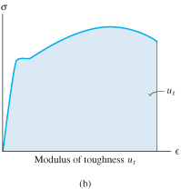
3.5 STRAIN ENERGY
Modulus of toughness
Modulus of toughness u_{t}, indicates the strain-energy density of material before it fractures
Shaded area under stress-strain diagram is the modulus of toughness
Used for designing members that may be accidentally overloaded
Higher u_{t} is preferable as distortion is noticeable before failure

Slide 42
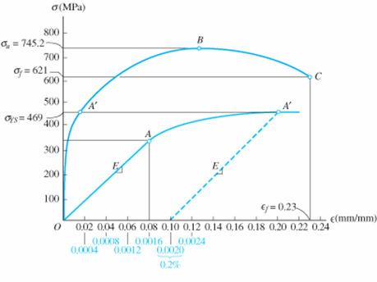
EXAMPLE 3.1
Tension test for a steel alloy results in the stress-strain diagram below.
Calculate the modulus of elasticity and the yield strength based on a 0.2%.

Slide 43
EXAMPLE 3.1 (SOLN)
Modulus of elasticity
Calculate the slope of initial straight-line portion of the graph. Use magnified curve and scale shown in light blue, line extends from O to A, with coordinates (0.0016 mm, 345 MPa)
345 MPa
0.0016 mm/mm
E =
= 215 GPa

Slide 44
EXAMPLE 3.1 (SOLN)
Yield strength
At 0.2% strain, extrapolate line (dashed) parallel to OA till it intersects stress-strain curve at A’
σ_{YS} = 469 MPa

Slide 45
EXAMPLE 3.1 (SOLN)
Ultimate stress
Defined at peak of graph, point B,
σ_{u} = 745.2 MPa

Slide 46
EXAMPLE 3.1 (SOLN)
Fracture stress
When specimen strained to maximum of ε_{f} = 0.23 mm/mm, fractures occur at C.
Thus,
σ_{f} = 621 MPa

Slide 47
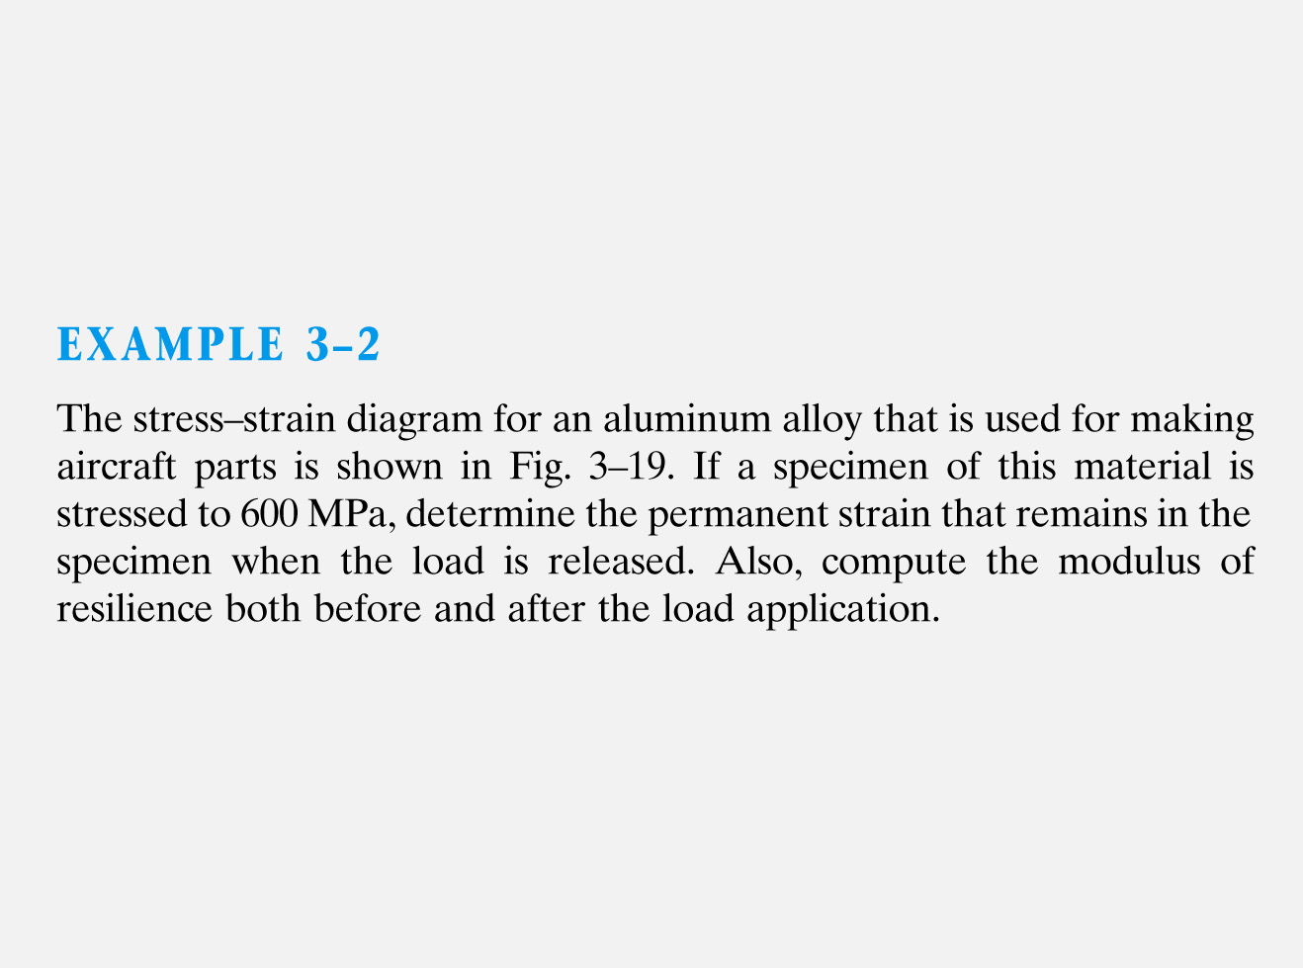
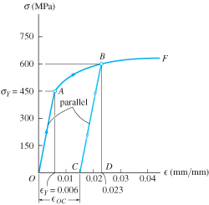

Slide 48
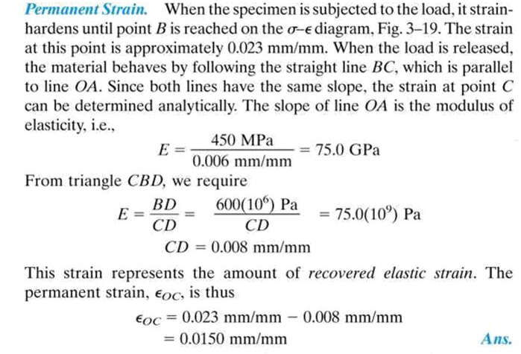

Slide 49
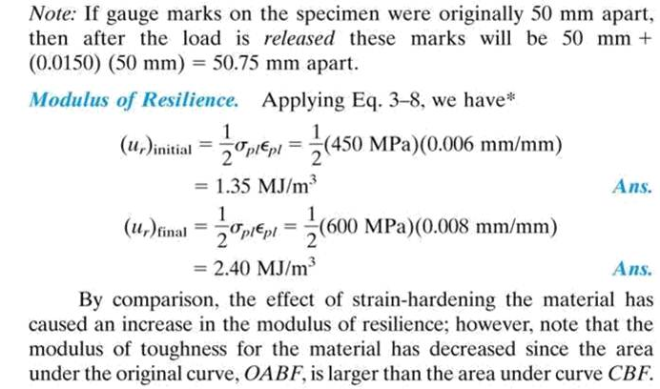

Slide 50
EXAMPLE 3.3 (SOLN)
Determine the approx. Δ, of the rod when 10kN axial load is applied? Use given stress-strain diagram to calculate the permanent elongation of the rod if the load is removed.

Slide 51
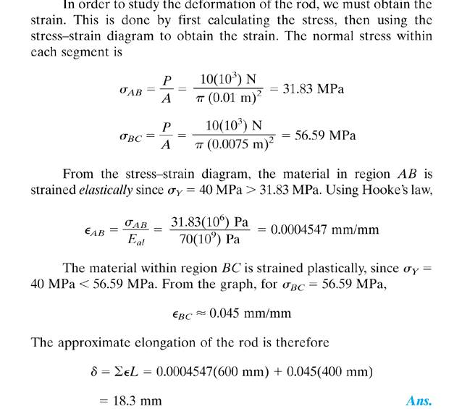

Slide 52
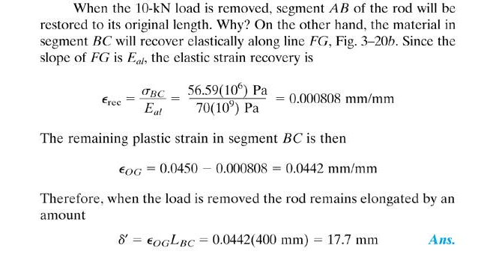

Slide 53
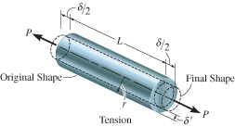
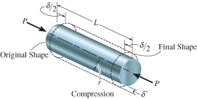
3.6 POISSON’S RATIO
When body subjected to axial tensile force, it elongates and contracts laterally
Similarly, it will contract and its sides expand laterally when subjected to an axial compressive force

Slide 54
3.6 POISSON’S RATIO
Strains of the bar are:
δ
L
δ’
r
ε_{long} =
ε_{lat} =
Early 1800s, S.D. Poisson realized that within elastic range, ratio of the two strains is a constant value, since both are proportional.
ε_{lat}
ε_{long}
Poisson’s ratio, ν = −

Slide 55
3.6 POISSON’S RATIO
ν is unique for homogenous and isotropic material
Why negative sign? Longitudinal elongation cause lateral contraction (-ve strain) and vice versa
Lateral strain is the same in all lateral (radial) directions
Note that, no force or stress acts in a lateral direction in order to strain the material; the strain is caused only by axial force.
Poisson’s ratio is dimensionless, 0 ≤ ν ≤ 0.5

Slide 56
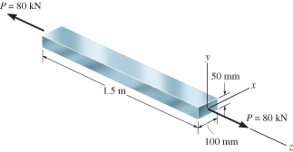
EXAMPLE 3.4
Bar is made of A-36 steel and behaves elastically.
Determine change in its length and change in dimensions of its cross section after load is applied.

Slide 57
EXAMPLE 3.4 (SOLN)
Normal stress in the bar is
P
A
σ_{z} =
= 16.0(10⁶) Pa
From tables, E_{st} = 200 GPa, strain in z-direction is
σ_{z}
E_{st}
ε_{z} =
= 80(10⁻⁶) mm/mm
Axial elongation of the bar is,
δ_{z} = ε_{z}L_{z} = [80(10⁻⁶)](1.5 m) = −25.6 μm/m

Slide 58
EXAMPLE 3.4 (SOLN)
Using ν_{st} = 0.32, contraction strains in both x and y directions are
ε_{x} = ε_{y} = −ν_{st}ε_{z} = −0.32[80(10⁻⁶)] = −25.6 μm/m
Thus changes in dimensions of cross-section are
δ_{x} = ε_{x}L_{x} = −[25.6(10⁻⁶)](0.1 m) = −25.6 μm
δ_{y} = ε_{y}L_{y} = −[25.6(10⁻⁶)](0.05 m) = −1.28 μm

Slide 59
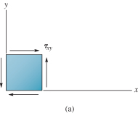
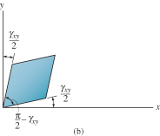
3.6 SHEAR STRESS-STRAIN DIAGRAM
Use thin-tube specimens and subject it to torsional loading
If the material is homogeneous and isotropic, then the shear stress as a result of torsional loading will caused uniform distortion.
Record measurements of applied torque and resulting angle of twist to construct shear stress and shear strain diagram.

Slide 60
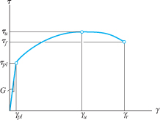
3.6 SHEAR STRESS-STRAIN DIAGRAM
Material will exhibit linear-elastic behavior till its proportional limit, τ_{pl}
Strain-hardening continues till it reaches ultimate shear stress, τ_{u}
Material loses shear strength till it fractures, at stress of τ_{f}

Slide 61
3.6 SHEAR STRESS-STRAIN DIAGRAM
Hooke’s law for shear
τ = Gγ
G is shear modulus of elasticity or modulus of rigidity
G can be measured as slope of line on τ-γ diagram, G = τ_{pl}/ γ_{pl}
The three material constants E, ν, and G is related by
E
2(1 + ν)
G =

Slide 62
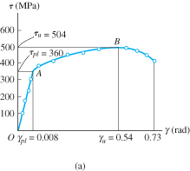
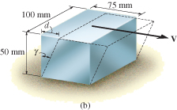
EXAMPLE 3.5
Specimen of titanium alloy tested in torsion & shear stress-strain diagram shown below.
Determine shear modulus G, proportional limit, and ultimate shear stress.
Also, determine the maximum distance d that the top of the block shown, could be displaced horizontally if material behaves elastically when acted upon by V. Find magnitude of V necessary to cause this displacement.

Slide 63
EXAMPLE 3.5 (SOLN)
Shear modulus
Obtained from the slope of the straight-line portion OA of the τ-γ diagram. Coordinates of A are (0.008 rad, 360 MPa)
360 MPa
0.008 rad
G =
= 45(10³) MPa

Slide 64
EXAMPLE 3.5 (SOLN)
Proportional limit
By inspection, graph ceases to be linear at point A, thus,
τ_{pl} = 360 MPa
Ultimate stress
From graph,
τ_{u} = 504 MPa

Slide 65
EXAMPLE 3.5 (SOLN)
Maximum elastic displacement and shear force
By inspection, graph ceases to be linear at point A, thus,
d
50 mm
tan (0.008 rad) ≈ 0.008 rad =
d = 0.4 mm
V
A
V
(75 mm)(100 mm)
τ_{avg} =
360 MPa =
V = 2700 kN

Slide 66
EXAMPLE 3.6 (SOLN)

Slide 67
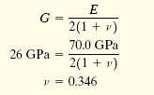
EXAMPLE 3.6 (SOLN)

Slide 68
3.7 FAILURE OF MATERIALS DUE TO CREEP & FATIGUE
Creep
Occurs when material supports a load for very long period of time, and continues to deform until a sudden fracture or usefulness is impaired
Is only considered when metals and ceramics are used for structural members or mechanical parts subjected to high temperatures
Other materials (such as polymers & composites) are also affected by creep without influence of temperature

Slide 69
*3.7 FAILURE OF MATERIALS DUE TO CREEP & FATIGUE
Creep
Stress and/or temperature significantly affects the rate of creep of a material
Creep strength represents the highest initial stress the material can withstand during given time without causing specified creep strain
Simple method to determine creep strength
Test several specimens simultaneously
  At constant temperature, but
  Each specimen subjected to different axial stress

Slide 70
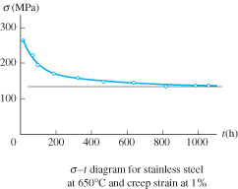
*3.7 FAILURE OF MATERIALS DUE TO CREEP & FATIGUE
Creep
Simple method to determine creep strength
Measure time taken to produce allowable strain or rupture strain for each specimen
Plot stress vs. strain
Creep strength inversely proportional to temperature and applied stresses

Slide 71
*3.7 FAILURE OF MATERIALS DUE TO CREEP & FATIGUE
Fatigue
Defined as gradual deterioration of a material that is subjected to time varying loads.
Needs to be accounted for in design of connecting rods (e.g. steam/gas turbine blades, connections/supports for bridges, railroad wheels/axles and parts subjected to cyclic loading)
Fatigue occurs at a stress lesser than the material’s yield stress

Slide 72
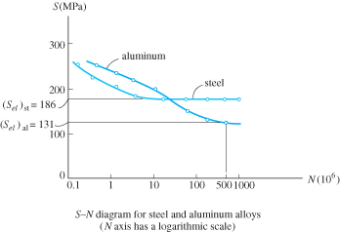
*3.7 FAILURE OF MATERIALS DUE TO CREEP & FATIGUE
Fatigue
Also referred to as the endurance or fatigue limit
Method to get value of fatigue
Series of specimens are subjected to a specified stress and cycled to failure.
Plot stress (S) against number of cycles-to-failure N
(S-N diagram) on logarithmic scale – also known as stress-cycled diagram.

Slide 73
CHAPTER REVIEW
Tension test is the most important test for determining material strengths. Results of normal stress and normal strain can then be plotted.
Many engineering materials behave in a linear-elastic manner, where stress is proportional to strain, defined by Hooke’s law, σ = Eε. E is the modulus of elasticity, and is measured from slope of a stress-strain diagram
When material stressed beyond yield point, permanent deformation will occur.

Slide 74
CHAPTER REVIEW
Strain hardening causes further yielding of material with increasing stress
At ultimate stress, localized region on specimen begin to constrict, and starts “necking”. Fracture occurs.
Ductile materials exhibit both plastic and elastic behavior. Ductility specified by permanent elongation to failure or by the permanent reduction in cross-sectional area
Brittle materials exhibit little or no yielding before failure

Slide 75
CHAPTER REVIEW
Yield point for material can be increased by strain hardening, by applying load great enough to cause increase in stress causing yielding, then releasing the load. The larger stress produced becomes the new yield point for the material
Deformations of material under load causes strain energy to be stored. Strain energy per unit volume/strain energy density is equivalent to area under stress-strain curve.

Slide 76
CHAPTER REVIEW
The area up to the yield point of stress-strain diagram is referred to as the modulus of resilience
The entire area under the stress-strain diagram is referred to as the modulus of toughness
Poisson’s ratio (ν), a dimensionless property that measures the lateral strain to the longitudinal strain [0 ≤ ν ≤ 0.5]
For shear stress vs. strain diagram: within elastic region, τ = Gγ, where G is the shearing modulus, found from the slope of the line within elastic region

Slide 77
CHAPTER REVIEW
G can also be obtained from the relationship of
G = E/[2(1+ ν)]
When materials are in service for long periods of time, creep and fatigue are important.
Creep is the time rate of deformation, which occurs at high stress and/or high temperature. Design the material not to exceed a predetermined stress called the creep strength

Slide 78
CHAPTER REVIEW
Fatigue occur when material undergoes a large number of cycles of loading. Will cause micro-cracks to occur and lead to brittle failure.
Stress in material must not exceed specified endurance or fatigue limit

