Slide 1
SKTN 2123
Strength of Materials
Mohsin Mohd Sies
Nuclear Engineering,
School of Chemical and Energy Engineering,
Universiti Teknologi Malaysia

Slide 2
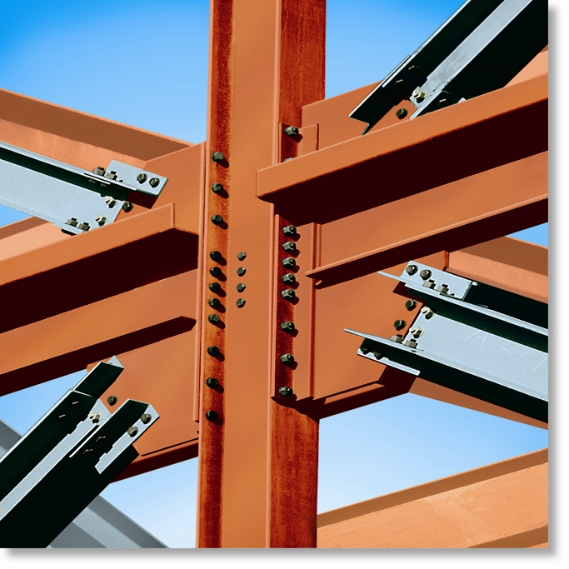
CHAPTER OBJECTIVES
Use the principles to determine internal resultant loadings in a body
Introduce concepts of normal and shear stress
Discuss applications of analysis and design of members subjected to an axial load or direct shear

Slide 3
CHAPTER OUTLINE
Introduction
Equilibrium of a deformable body
Stress
Average normal stress in an axially loaded bar
Average shear stress
Allowable stress
Design of simple connections

Slide 4
The main objective of the course is to provide the future engineer with the means of analyzing and designing various machines and load bearing structures.
Both the analysis and design of a given structure involve the determination of stresses and deformations. This chapter is devoted to the concept of stress.

Slide 5
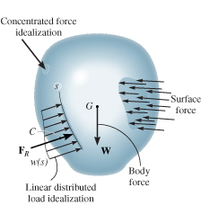
1.2 EQUILIBRIUM OF A DEFORMABLE BODY
External loads
Surface forces – caused by the direct contact of one body with the surface of another.
  Area of contact
  Concentrated force
  Linear distributed force
  Centroid C (or geometric center)
Body force (e.g., weight) – one body exerts a force on another without direct physical contact.

Slide 6
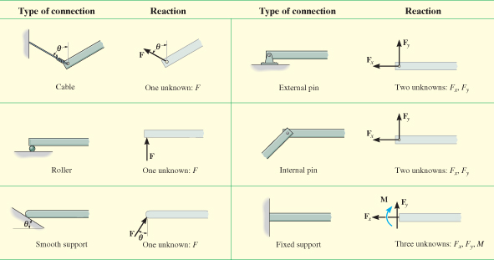
1.2 EQUILIBRIUM OF A DEFORMABLE BODY
Support reactions
for 2D problems

Slide 7
1.2 EQUILIBRIUM OF A DEFORMABLE BODY
Equations of equilibrium
For equilibrium
  balance of forces
  balance of moments
Draw a free-body diagram to account for all forces acting on the body
Apply the two equations to achieve equilibrium state
∑ F = 0
∑ M_{O} = 0

Slide 8
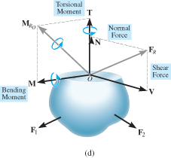
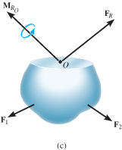
1.2 EQUILIBRIUM OF A DEFORMABLE BODY
Internal resultant loadings
Define resultant force (F_{R}) and moment (M_{Ro}) acting within the body (3D):
  Normal force, N
  Shear force, V
  Torsional moment or torque, T
  Bending moment, M

Slide 9
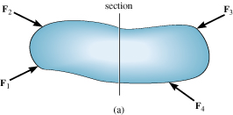
1.2 EQUILIBRIUM OF A DEFORMABLE BODY
Internal resultant loadings
For coplanar (2D) loadings:
  Normal force, N
  Shear force, V
  Bending moment, M

Slide 10
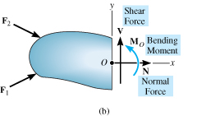
1.2 EQUILIBRIUM OF A DEFORMABLE BODY
Internal resultant loadings
For coplanar loadings:
  Apply ∑ F_{x} = 0 to solve for N
  Apply ∑ F_{y} = 0 to solve for V
  Apply ∑ M_{O} = 0 to solve for M

Slide 11
1.2 EQUILIBRIUM OF A DEFORMABLE BODY
Procedure for Analysis
Method of sections
  Choose segment to analyze
  Determine Support Reactions
  Draw free-body diagram for whole body
  Apply equations of equilibrium

Slide 12
1.2 EQUILIBRIUM OF A DEFORMABLE BODY
Procedure for analysis
Free-body diagram
  Keep all external loadings in exact locations before “sectioning”
  Indicate unknown resultants, N, V, M, and T at the section, normally at centroid C of sectioned area
  Coplanar system of forces only include N, V, and M
  Establish x, y, z coordinate axes with origin at centroid

Slide 13
1.2 EQUILIBRIUM OF A DEFORMABLE BODY
Procedure for analysis
Equations of equilibrium
  Sum moments at section, about each coordinate axes where resultants act
  This will eliminate unknown forces N and V, with direct solution for M (and T)
  Resultant force with negative value implies that assumed direction is opposite to that shown on free-body diagram

Slide 14
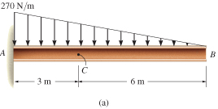
EXAMPLE 1.1
Determine resultant loadings acting on cross section at C of beam.

Slide 15
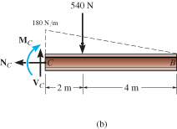
EXAMPLE 1.1 (SOLN)
Support Reactions
Consider segment CB
Free-Body Diagram:
Keep distributed loading exactly where it is on segment CB after “cutting” the section.
Replace it with a single resultant force, F.

Slide 16
EXAMPLE 1.1 (SOLN)
Free-Body Diagram:
Intensity (w) of loading at C (by proportion)
w/6 m = (270 N/m)/9 m
w = 180 N/m
F = ½ (180 N/m)(6 m) = 540 N
F acts 1/3(6 m) = 2 m from C.

Slide 17
EXAMPLE 1.1 (SOLN)
Equilibrium equations:
+
∑ F_{x} = 0;
− N_{c} = 0
N_{c} = 0
+
∑ F_{y} = 0;
V_{c} − 540 N = 0
V_{c} = 540 N
+
∑ M_{c} = 0;
−M_{c} − 504 N (2 m) = 0
M_{c} = −1080 N·m

Slide 18
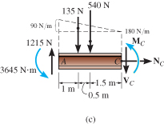
EXAMPLE 1.1 (SOLN)
Equilibrium equations:
Negative sign of M_{c} means it acts in the opposite direction to that shown below

Slide 19
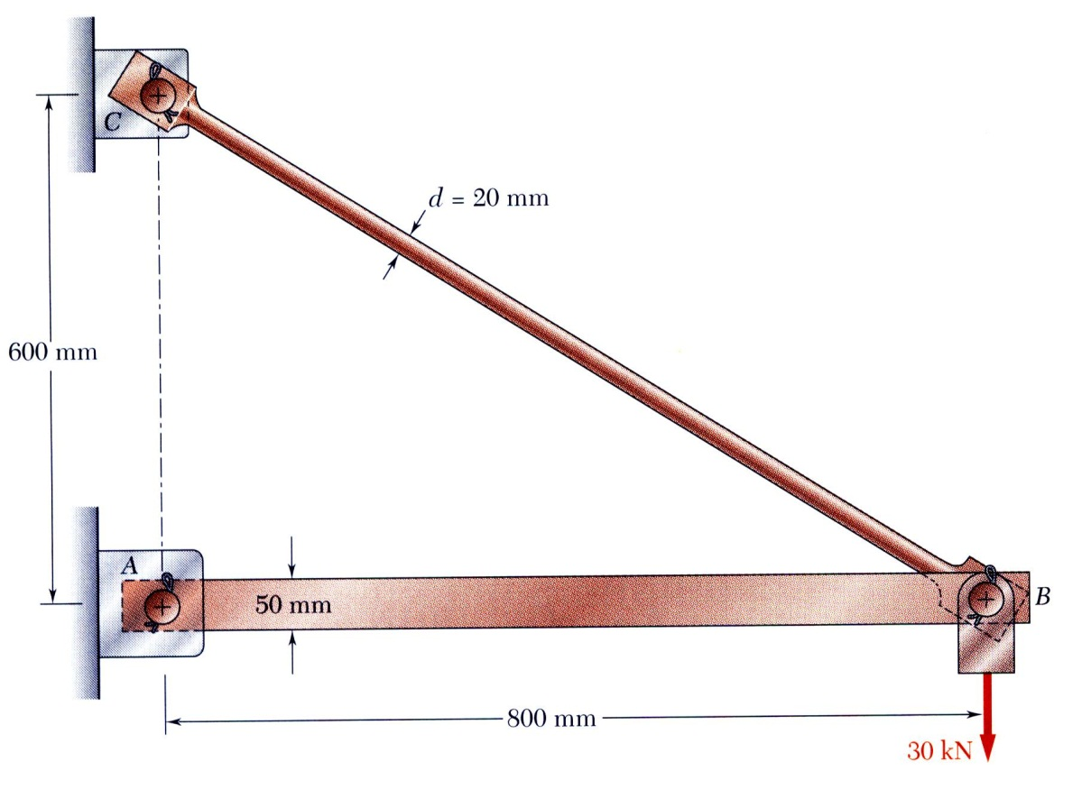
Review of Statics
The structure is designed to support a 30 kN load
The structure consists of a beam and rod joined by pins (zero moment connections) at the junctions and supports
Perform a static analysis to determine the internal force in each structural member and the reaction forces at the supports

Slide 20
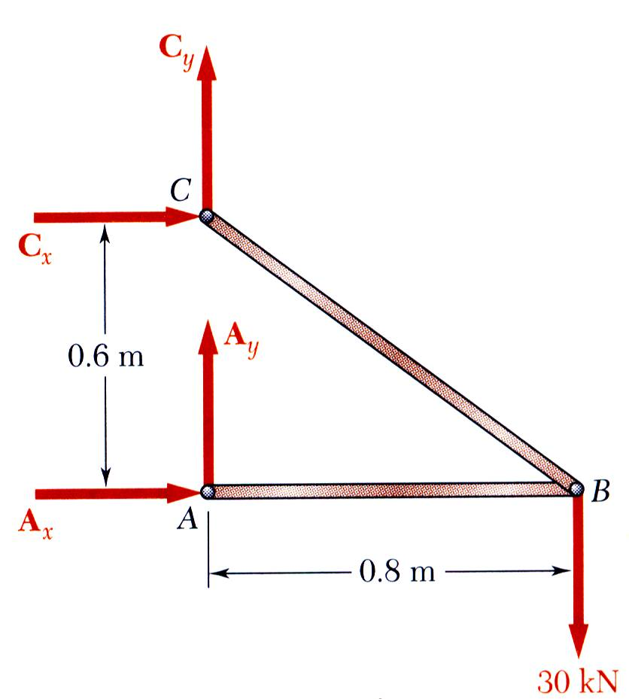
Structure Free-Body Diagram
Structure is detached from supports and the loads and reaction forces are indicated
Conditions for static equilibrium:
A_{y} and C_{y} can not be determined from these equations

Slide 21
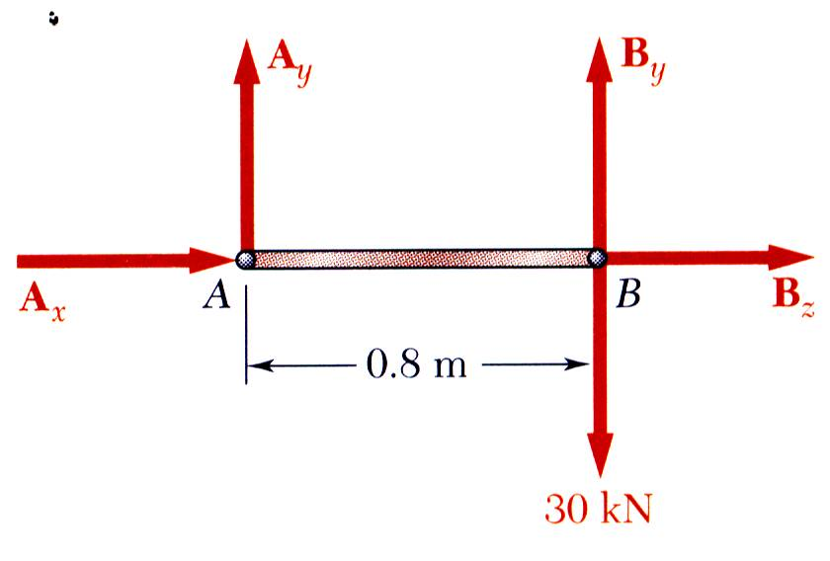
Component Free-Body Diagram
In addition to the complete structure, each component must satisfy the conditions for static equilibrium
Consider a free-body diagram of the boom;
substitute into the structure equilibrium equation
Results:
Reaction forces are directed along boom and rod

Slide 22
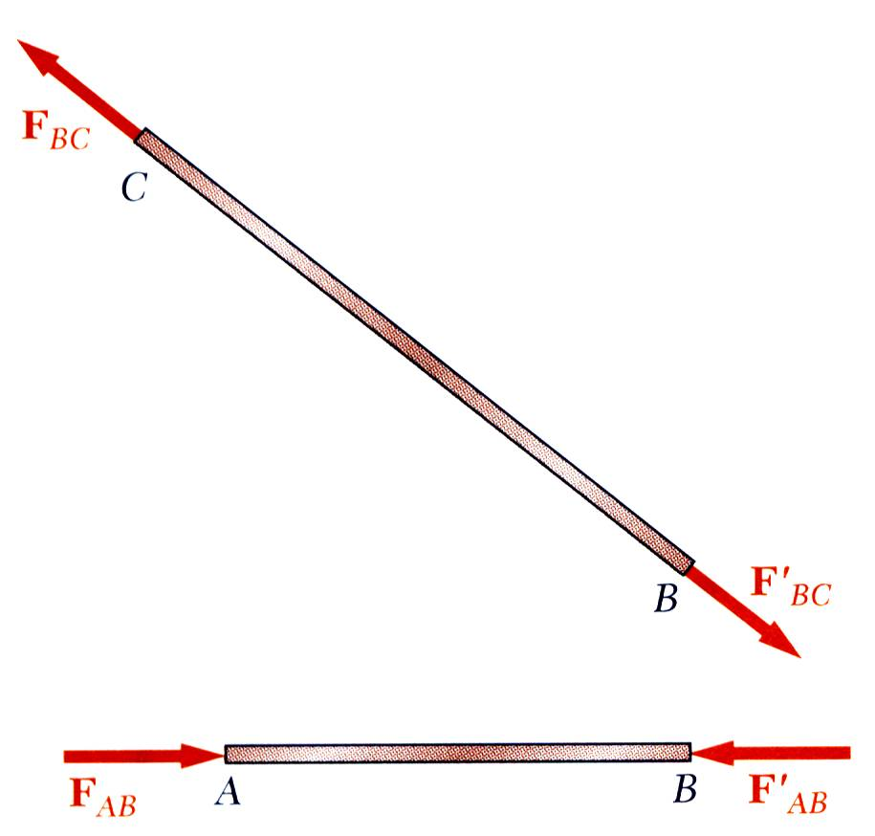
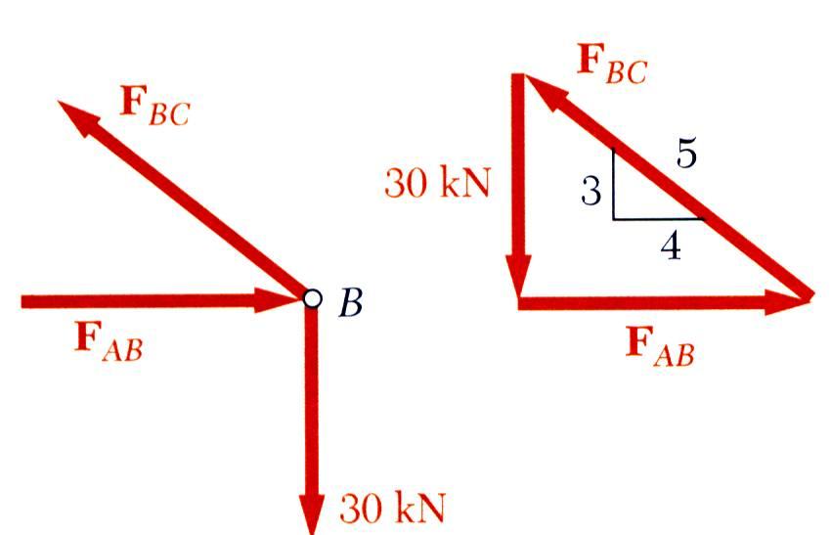
Method of Joints
The boom and rod are 2-force members, i.e., the members are subjected to only two forces which are applied at member ends
For equilibrium, the forces must be parallel to to an axis between the force application points, equal in magnitude, and in opposite directions
Joints must satisfy the conditions for static equilibrium which may be expressed in the form of a force triangle:

Slide 23

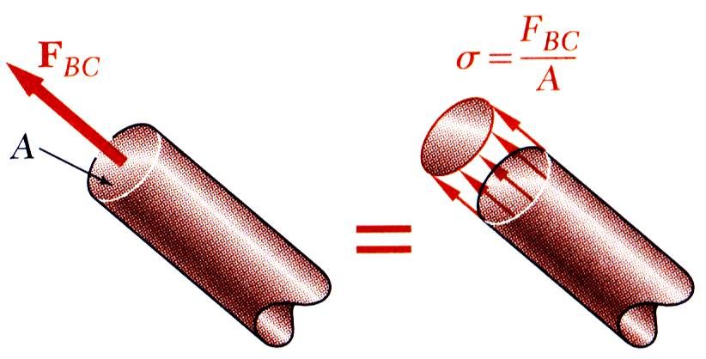
Stress Analysis
Can the structure safely support the 30 kN load?
From a statics analysis
F_{AB} = 40 kN (compression)
F_{BC} = 50 kN (tension)
At any section through member BC, the internal force is 50 kN with a force intensity or stress of
d_{BC} = 20 mm
From the material properties for steel, the allowable stress is
Conclusion: the strength of member BC is adequate

Slide 24
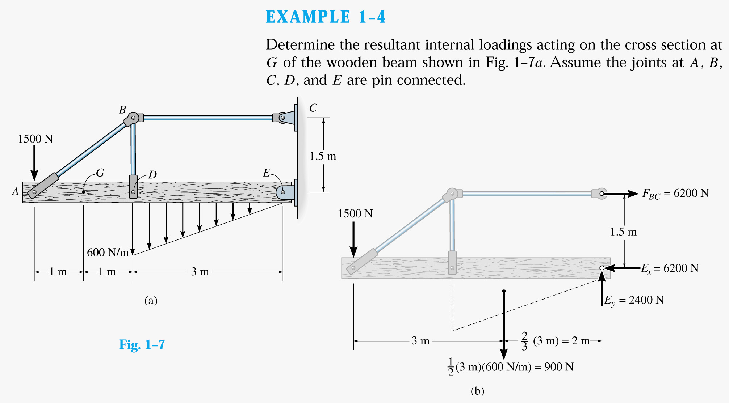
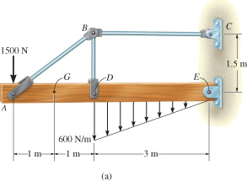
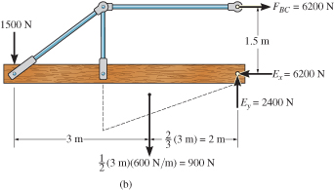
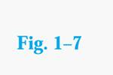

Slide 25
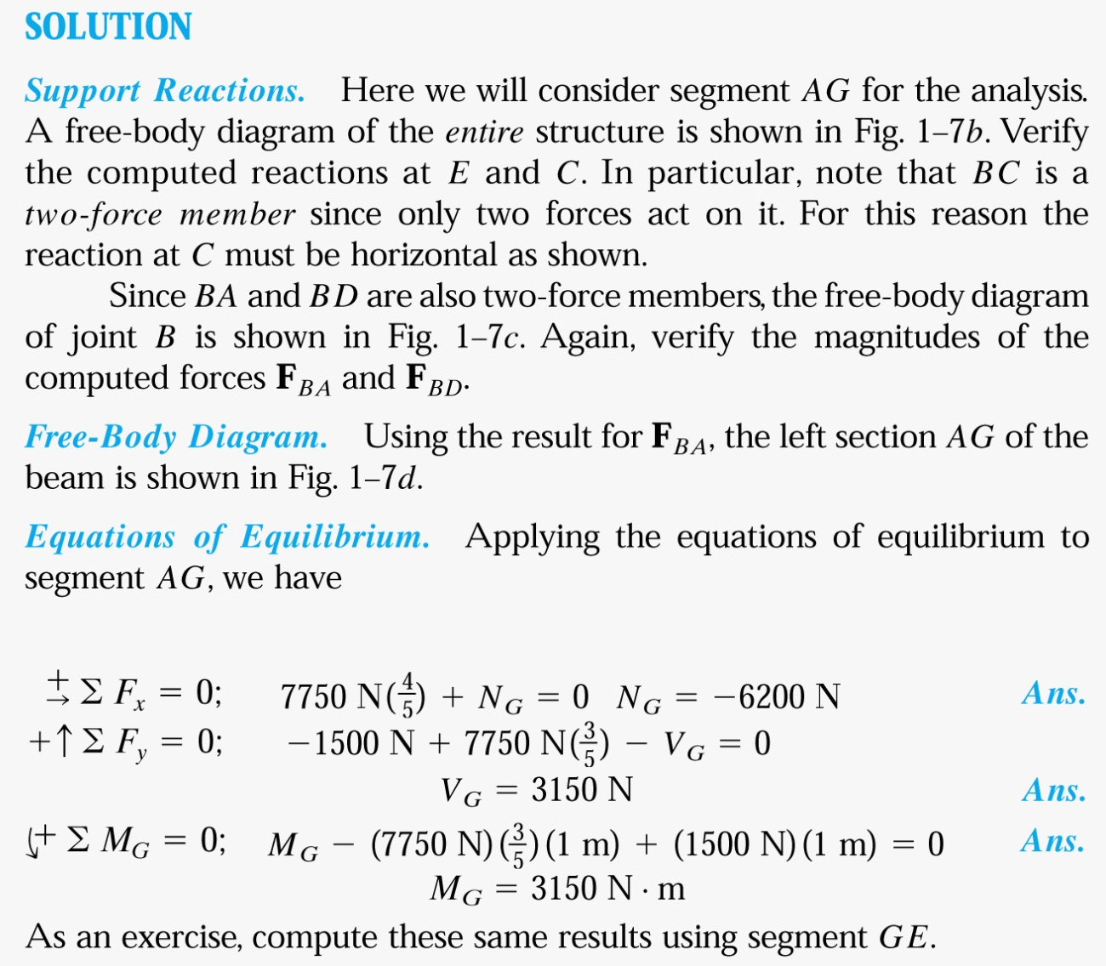
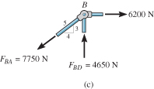
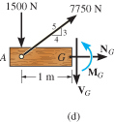

Slide 26
1.3 STRESS
Concept of stress
To obtain distribution of force acting over a sectioned area
Assumptions of material:
  It is continuous (uniform distribution of matter)
  It is cohesive (all portions are connected together)

Slide 27
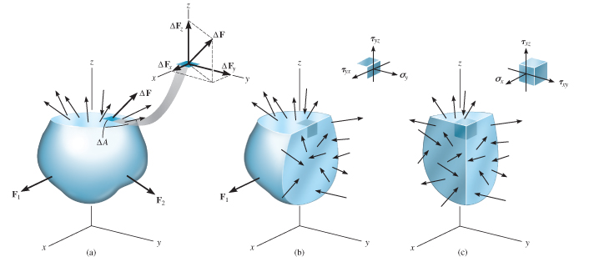
1.3 STRESS
Concept of stress
Consider ΔA in figure below
Small finite force, ΔF acts on ΔA

Slide 28
1.3 STRESS
Normal stress
Intensity of force, or force per unit area, acting normal to ΔA
Symbol used for normal stress, is σ (sigma)
lim
_{ΔA →0}
ΔF_{z}
ΔA
σ_{z} =
Tensile stress: normal force “pulls” or “stretches” the area element ΔA
Compressive stress: normal force “pushes” or “compresses” area element ΔA

Slide 29
1.3 STRESS
Shear stress
Intensity of force, or force per unit area, acting tangent to ΔA
Symbol used for normal stress is τ (tau)
lim
_{ΔA →0}
ΔF_{x}
ΔA
τ_{zx} =
lim
_{ΔA →0}
ΔF_{y}
ΔA
τ_{zy} =

Slide 30
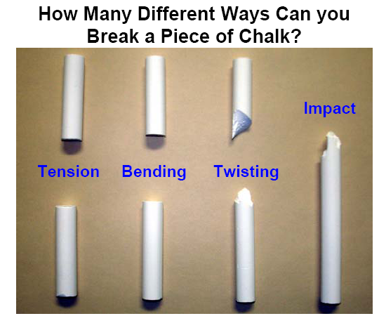

Slide 32
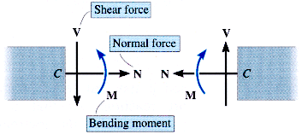
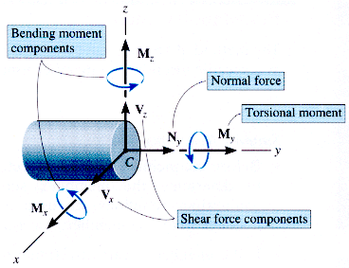

Slide 33
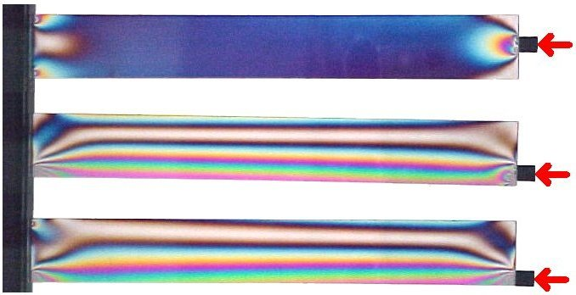

Slide 34
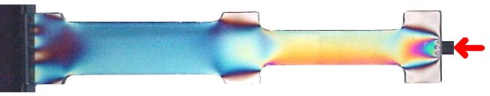
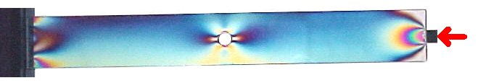
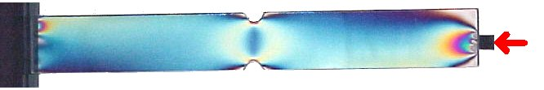

Slide 35
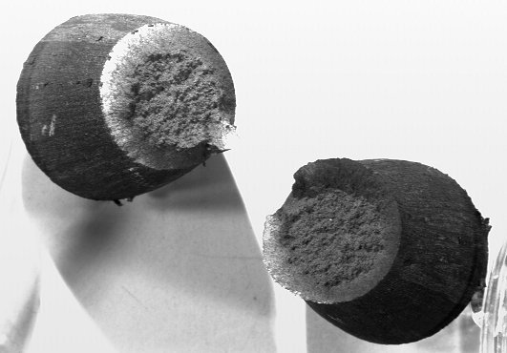

Slide 36
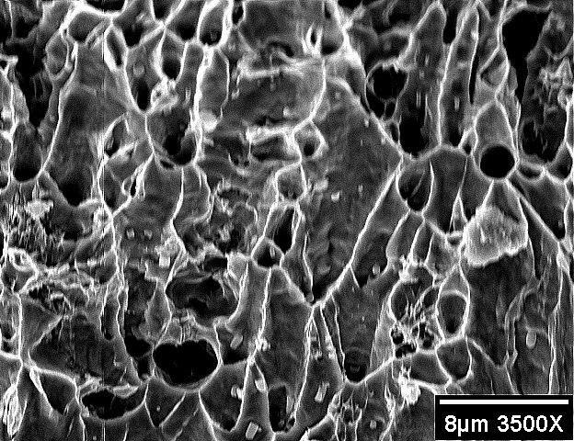

Slide 37
Prismatic bar
A prismatic bar or beam is a straight structural piece that has the same cross-section throughout its length

Slide 38
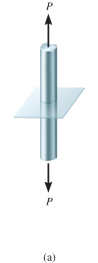
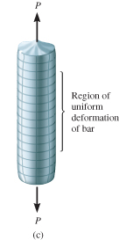
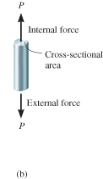
1.4 AVERAGE NORMAL STRESS IN AXIALLY LOADED BAR
Examples of axially loaded bar
Usually long and slender structural members
Truss members, hangers, bolts
Prismatic means all the cross sections are the same

Slide 39
1.4 AVERAGE NORMAL STRESS IN AXIALLY LOADED BAR
Assumptions
Uniform deformation: Bar remains straight before and after load is applied, and cross section remains flat or plane during deformation
In order for uniform deformation, force P be applied along centroidal axis of cross section

Slide 40
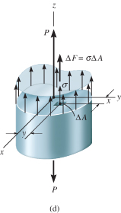
1.4 AVERAGE NORMAL STRESS IN AXIALLY LOADED BAR
Average normal stress distribution
+
F_{Rz} = ∑ F_{xz}
∫ dF = ∫_{A} σ dA
P = σ A
P
A
σ =
σ = average normal stress at any point on cross sectional area
P = internal resultant normal force
A = x-sectional area of the bar

Slide 41
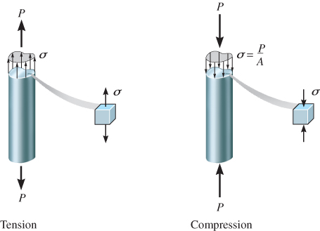
1.4 AVERAGE NORMAL STRESS IN AXIALLY LOADED BAR
Equilibrium
Consider vertical equilibrium of the element
When the bar is stretched by the force P, the resulting stresses are tensile stresses
If the force P cause the bar to be compressed, we obtain compressive stresses

Slide 42
1.4 AVERAGE NORMAL STRESS IN AXIALLY LOADED BAR
Sign convention for normal stresses is:
    (+) for tensile stresses and
    (-) for compressive stresses
Because the normal stress σ is obtained by dividing the axial force by the cross–sectional area, it has units of force per unit of area.
In SI units:
Force is expressed in newtons (N) and area in square meters (m2). A N/m2 is a pascals (Pa).

Slide 43
1.4 AVERAGE NORMAL STRESS IN AXIALLY LOADED BAR
Maximum average normal stress
For problems where internal force P and x-sectional A were constant along the longitudinal axis of the bar, normal stress σ = P/A is also constant
If the bar is subjected to several external loads along its axis, change in x-sectional area may occur
Thus, it is important to find the maximum average normal stress
To determine that, we need to find the location where ratio P/A is a maximum

Slide 44
1.4 AVERAGE NORMAL STRESS IN AXIALLY LOADED BAR
Maximum average normal stress
Draw an axial or normal force diagram (plot of P vs. its position x along bar’s length)
Sign convention:
  P is positive (+) if it causes tension in the member
  P is negative (−) if it causes compression
Identify the maximum average normal stress from the plot

Slide 45
1.4 AVERAGE NORMAL STRESS IN AXIALLY LOADED BAR
Procedure for Analysis
Average normal stress
Use equation of σ = P/A for x-sectional area of a member when section subjected to internal resultant force P

Slide 46
1.4 AVERAGE NORMAL STRESS IN AXIALLY LOADED BAR
Procedure for Analysis
Axially loaded members
Internal Loading:
Section member perpendicular to its longitudinal axis at pt where normal stress is to be determined
Draw free-body diagram
Use equation of force equilibrium to obtain internal axial force P at the section

Slide 47
1.4 AVERAGE NORMAL STRESS IN AXIALLY LOADED BAR
Procedure for Analysis
Axially loaded members
Average Normal Stress:
Determine member’s x-sectional area at the section
Compute average normal stress σ = P/A

Slide 48

EXAMPLE 1.6
Bar width = 35 mm, thickness = 10 mm
Determine max. average normal stress in bar when subjected to loading shown.

Slide 49
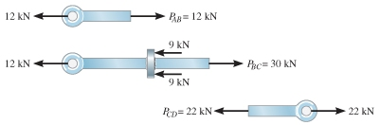

EXAMPLE 1.6 (SOLN)
Internal loading
Normal force diagram
By inspection, largest loading area is BC, where P_{BC} = 30 kN

Slide 50
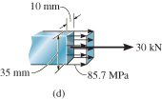
EXAMPLE 1.6 (SOLN)
Average normal stress
P_{BC}
A
30(10³) N
(0.035 m)(0.010 m)
σ_{BC} =
=
= 85.7 MPa

Slide 51
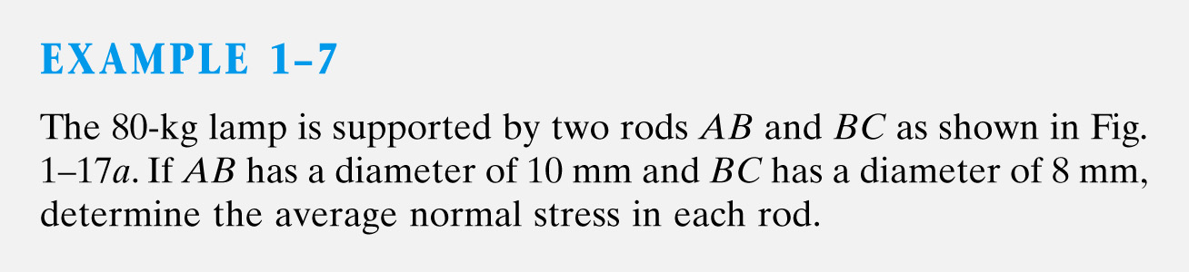
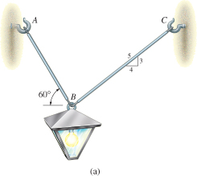
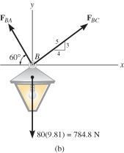


Slide 52
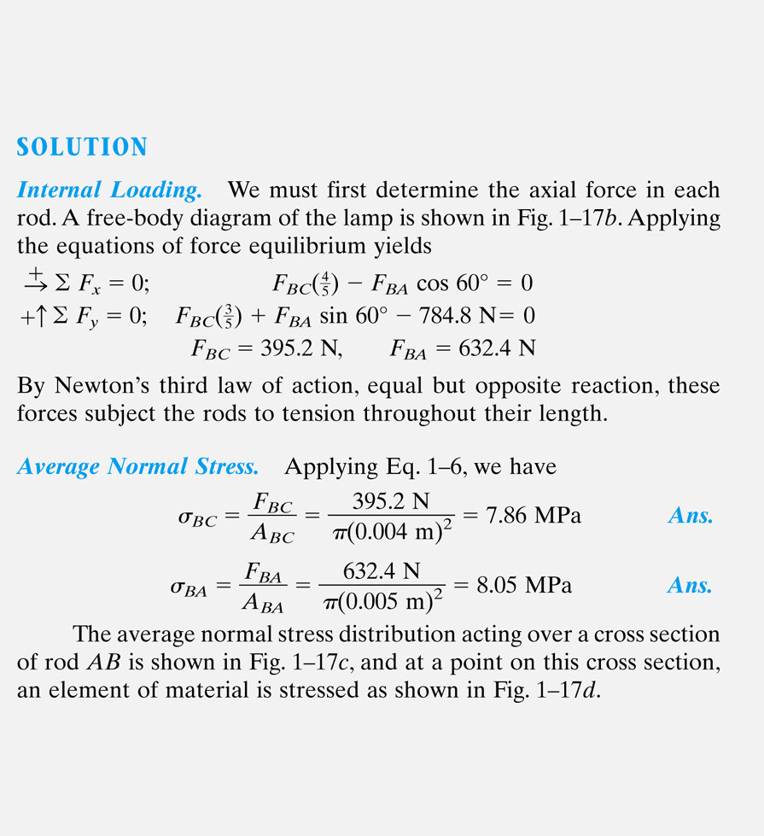
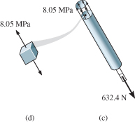

Slide 53
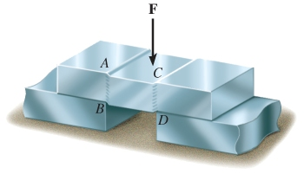
1.5 AVERAGE SHEAR STRESS
Shear stress is the stress component that act in the plane of the sectioned area.
Consider a force F acting to the bar
For rigid supports, and F is large enough, bar will deform and fail along the planes identified by AB and CD
Free-body diagram indicates that shear force, V = F/2 be applied at both sections to ensure equilibrium

Slide 54
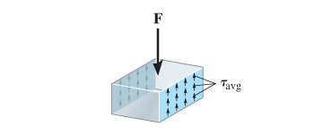
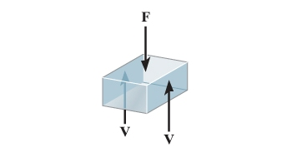
1.5 AVERAGE SHEAR STRESS
Average shear stress over each section is:
P
A
τ_{avg} =
τ_{avg} = average shear stress at section, assumed to be same at each pt on the section
V = internal resultant shear force at section determined from equations of equilibrium
A = area of section

Slide 55
1.5 AVERAGE SHEAR STRESS
Case discussed above is example of simple or direct shear
Caused by the direct action of applied load F
Occurs in various types of simple connections, e.g., bolts, pins, welded material

Slide 56
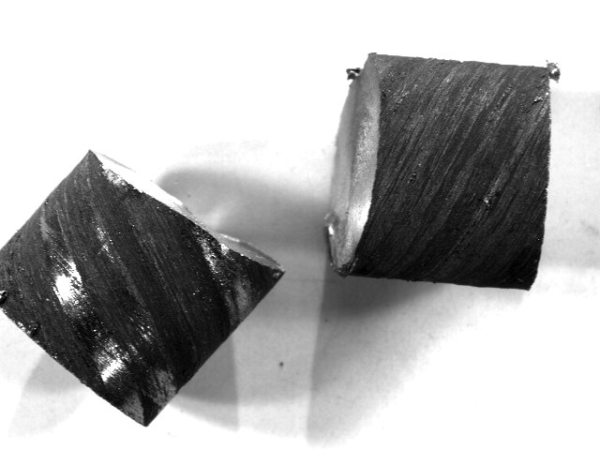

Slide 57
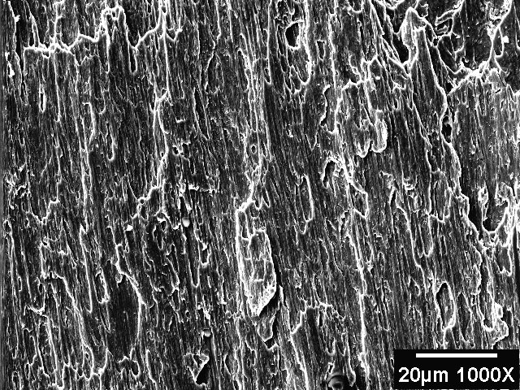

Slide 58

1.5 AVERAGE SHEAR STRESS
Single shear
Steel and wood joints shown below are examples of single-shear connections, also known as lap joints.
Since we assume members are thin, there are no moments caused by F

Slide 59
1.5 AVERAGE SHEAR STRESS
Single shear
For equilibrium, x-sectional area of bolt and bonding surface between the two members are subjected to single shear force, V = F
The average shear stress equation can be applied to determine average shear stress acting on colored section in (d).

Slide 60

1.5 AVERAGE SHEAR STRESS
Double shear
The joints shown below are examples of double-shear connections, often called double lap joints.
For equilibrium, x-sectional area of bolt and bonding surface between two members subjected to double shear force, V = F/2
Apply average shear stress equation to determine average shear stress acting on colored section in (d).

Slide 61




Shearing Stress Examples
Single Shear
Double Shear

Slide 62



Slide 63



Slide 64
1.5 AVERAGE SHEAR STRESS
Procedure for analysis
Internal shear
Section member at the pt where the τ_{avg} is to be determined
Draw free-body diagram
Calculate the internal shear force V
Average shear stress
Determine sectioned area A
Compute average shear stress τ_{avg} = V/A

Slide 65

EXAMPLE 1.10
Depth and thickness = 40 mm
Determine average normal stress and average shear stress acting along (a) section planes a-a, and (b) section plane b-b.

Slide 66

EXAMPLE 1.10 (SOLN)
Part (a)
Internal loading
Based on free-body diagram, Resultant loading of axial force, P = 800 N

Slide 67

EXAMPLE 1.10 (SOLN)
Part (a)
Average stress
Average normal stress, σ
P
A
800 N
(0.04 m)(0.04 m)
σ =
=
= 500 kPa

Slide 68
EXAMPLE 1.10 (SOLN)
Part (a)
Internal loading
No shear stress on section, since shear force at section is zero.
τ_{avg} = 0

Slide 69

EXAMPLE 1.10 (SOLN)
Part (b)
Internal loading
− 800 N + N sin 60° + V cos 60° = 0
+
∑ F_{x} = 0;
∑ F_{y} = 0;
V sin 60° − N cos 60° = 0
+

Slide 70
EXAMPLE 1.10 (SOLN)
Part (b)
Internal loading
Or directly using x’, y’ axes,
∑ F_{x’} = 0;
N − 800 N cos 30° = 0
+
∑ F_{y’} = 0;
V − 800 N sin 30° = 0
+

Slide 71
EXAMPLE 1.10 (SOLN)
Part (b)
Average normal stress
N
A
692.8 N
(0.04 m)(0.04 m/sin 60°)
σ =
=
= 375 kPa

Slide 72

EXAMPLE 1.10 (SOLN)
Part (b)
Average shear stress
V
A
400 N
(0.04 m)(0.04 m/sin 60°)
τ_{avg} =
=
= 217 kPa
Stress distribution shown below

Slide 73



EXAMPLE 1.11 (SOLN)

Slide 74

EXAMPLE 1.11 (SOLN)

Slide 75


Bearing Stress in Connections
Bolts, rivets, and pins create stresses on the points of contact or bearing surfaces of the members they connect.
The resultant of the force distribution on the surface is equal and opposite to the force exerted on the pin.
Corresponding average force intensity is called the bearing stress,

Slide 76


Slide 77

Pin Bearing Stresses
To determine the bearing stress at A in the boom AB, we have t = 30 mm and d = 25 mm,
To determine the bearing stress at A in the bracket, we have t = 2(25 mm) = 50 mm and d = 25 mm,

Slide 78

1.6 ALLOWABLE STRESS
Factor of safety considerations:
uncertainty in material properties
uncertainty of loadings
uncertainty of analyses
number of loading cycles
types of failure
maintenance requirements and deterioration effects
importance of member to structures integrity
risk to life and property
influence on machine function

Slide 79

1.6 ALLOWABLE STRESS
When designing a structural member or mechanical element, the stress in it must be restricted to safe level
Choose an allowable load that is less than the load the member can fully support
One method used is the factor of safety (F.S.)
F_{fail}
F_{allow}
F.S. =

Slide 80
1.6 ALLOWABLE STRESS
If load applied is linearly related to stress developed within member, then F.S. can also be expressed as:
σ_{fail}
σ_{allow}
τ_{fail}
τ_{allow}
F.S. =
F.S. =
In all the equations, F.S. is chosen to be greater than 1, to avoid potential for failure.
Specific values will depend on types of material used and its intended purpose.

Slide 81
1.7 DESIGN OF SIMPLE CONNECTIONS
To determine area of section subjected to a normal force, use
P
σ_{allow}
A =
To determine area of section subjected to a shear force, use
V
τ_{allow}
A =

Slide 82


1.7 DESIGN OF SIMPLE CONNECTIONS
Cross-sectional area of a tension member
Condition:
The force has a line of action that passes through the centroid of the cross section.

Slide 83


1.7 DESIGN OF SIMPLE CONNECTIONS
Cross-sectional area of a connecter subjected to shear
Assumption:
If bolt is loose or clamping force of bolt is unknown, assume frictional force between plates to be negligible.

Slide 84

1.7 DESIGN OF SIMPLE CONNECTIONS
Required area to resist bearing
Bearing stress is normal stress produced by the compression of one surface against another.
Assumptions:
(σ_{b})_{allow} of concrete < (σ_{b})_{allow} of base plate
Bearing stress is uniformly distributed between plate and concrete

Slide 85


1.7 DESIGN OF SIMPLE CONNECTIONS
Required area to resist shear caused by axial load
Although actual shear-stress distribution along rod difficult to determine, we assume it is uniform.
Thus use A = V / τ_{allow} to calculate l, provided d and τ_{allow} is known.

Slide 86
1.7 DESIGN OF SIMPLE CONNECTIONS
Procedure for analysis
When using average normal stress and shear stress equations, consider first the section over which the critical stress is acting
Internal Loading
  Section member through x-sectional area
  Draw a free-body diagram of segment of member
  Use equations of equilibrium to determine internal resultant force

Slide 87
1.7 DESIGN OF SIMPLE CONNECTIONS
Procedure for Analysis
Required Area
Based on known allowable stress, calculate required area needed to sustain load from
A = P/τ_{allow} or A = V/τ_{allow}

Slide 88

EXAMPLE 1.13
The two members pinned together at B. If the pins have an allowable shear stress of τ_{allow} = 90 MPa, and allowable tensile stress of rod CB is
(σ_{t})_{allow} = 115 MPa
Determine to nearest mm the smallest diameter of pins A and B and the diameter of rod CB necessary to support the load.

Slide 89

EXAMPLE 1.13 (SOLN)
Draw free-body diagram:

Slide 90

EXAMPLE 1.13 (SOLN)
Diameter of pins:
V_{A}
T_{allow}
2.84 kN
90 × 10³ kPa
A_{A} =
= 31.56 × 10⁻⁶ m² = π(d_{A}²/4)
=
d_{A} = 6.3 mm
V_{B}
T_{allow}
6.67 kN
90 × 10³ kPa
A_{B} =
=
= 74.11 × 10⁻⁶ m² = π(d_{B}²/4)
d_{B} = 9.7 mm

Slide 91
EXAMPLE 1.13 (SOLN)
Diameter of pins:
Choose a size larger to nearest millimeter.
d_{A} = 7 mm
d_{B} = 10 mm

Slide 92
EXAMPLE 1.13 (SOLN)
Diameter of rod:
P
(σ_{t})_{allow}
6.67 kN
115 × 10³ kPa
A_{BC} =
=
= 58 × 10⁻⁶ m² = π(d_{BC}²/4)
d_{BC} = 8.59 mm
Choose a size larger to nearest millimeter.
d_{BC} = 9 mm

Slide 93




Slide 94




Slide 95





Slide 96


Slide 97


Slide 98






Slide 99


Slide 100



Slide 101



Slide 102




Slide 103


Slide 107
CHAPTER REVIEW
Internal loadings consist of
  Normal force, N
  Shear force, V
  Bending moments, M
  Torsional moments, T
Get the resultants using
  method of sections
  Equations of equilibrium

Slide 108
CHAPTER REVIEW
Assumptions for a uniform normal stress distribution over x-section of member (σ = P/A)
  Member made from homogeneous isotropic material
  Subjected to a series of external axial loads that,
  The loads must pass through centroid of cross-section

Slide 109
CHAPTER REVIEW
Determine average shear stress by using τ = V/A equation
  V is the resultant shear force on cross-sectional area A
  Formula is used mostly to find average shear stress in fasteners or in parts for connections

Slide 110
CHAPTER REVIEW
Design of any simple connection requires that
  Average stress along any cross-section not exceed a factor of safety (F.S.) or
  Allowable value of σallow or τallow
  These values are reported in codes or standards and are deemed safe on basis of experiments or through experience

