Slide 1
SKTN 2123
Strength of Materials
Mohsin Mohd Sies
Nuclear Engineering,
School of Chemical and Energy Engineering,
Universiti Teknologi Malaysia

Slide 2
Credits
These notes are compiled from various sources. Major credits go to
UNIMAP lecture notes
Pablo G. Caceres
UMP lecture notes
Other sources are also gratefully credited

Slide 3
Big Picture
This is a fundamental course in all Civil and Mechanical Engineering Programs, and also Nuclear Engineering Programs.
Sometimes it is called:
Strength of Materials or Mechanics of Materials

Slide 4
What is this course about
“How a body would deform under load”
A branch of mechanics
It studies the relationship of
  External loads applied to a deformable body, and
  The intensity of internal forces acting within the body
Deals with the behavior of solid bodies subjected to various types of loading
Study body’s stability when external forces are applied to it.
A thorough understanding of mechanical behavior is essential for the safe design of all structures.

Slide 5
What You Should Do
Learn the Vocabulary
Improve Your Skill at Drawing Free Body Diagrams
Learn About Material Behavior
Learn How To Solve Mechanics Problems. This is the largest part of the class. The solution procedure for most mechanics problems involves one or more of the following tasks:
  A statics analysis of a component to find the internal reactions (forces & moments)
  Determine stresses and strains in a component based on internal reactions
  Find the deformation of the component
  Compare calculated values of stress & deformation with known acceptable values
Improve Your Engineering Design Skills

Slide 6
Vocabulary
This is a sampling of terms used in this subject
You are expected to understand the meaning of these terms.
You are also expected to know the correct units for material properties and other variables.

Slide 7
Vocabulary
Rigid Body
Deformable Body
Link
Truss
Normal Stress
Shear Stress
Bearing Stress
Ultimate Stress
Yield Stress
Failure Stress
Principal Stresses
Normal Strain
Shear Strain
Failure Strain
Yield Strain
Shear Modulus
Poisson’s Ratio
True Stress
Engineering Stress
True Strain
Elastic Behavior
Plastic Behavior
Thermal Expansion
Torsion
Torque
Angle of Twist
Static Indeterminacy
Power
Pure Bending
Area Moment of Inertia
Polar Moment of Inertia
Shear Force Diagram
Bending Moment Diagram
Transverse Shear
Cantilever Beam
Simply Supported Beam
Clamped Beam
Isotropic
Anisotropic
Homogeneous
Prismatic
Thin-Walled Member
Pressure Vessel

Slide 8
Vocabulary
Combined Loading
Stress Transformation
Mohr’s Circle
Plane Stress
Superposition
Elastic Curve
Column
Buckling
Euler Buckling
Plane Strain
Ductile Behavior
Brittle Behavior
Axial Stiffness
3-point Bending
4-point Bending
Modulus of Elasticity
Young’s Modulus
Modulus of Rigidity
Principal Strains
Flexural Stiffness

Slide 9
Types of structural members
Types of Structure
  Rigid Frame
    It is that type of structure in which the members are joined together by rigid joints e.g. welded joints.
  Truss (Pin connected joints)
    A type of structure formed by members in triangular form, the resulting figure is called a truss. In trusses, joints are pin connected and loads are applied at joints. No shear force & bending moment are produced. Only axial compression and axial tension is to be determined while analyzing a truss.

Slide 10
Types of structural members
Structural Members - Those parts that are interconnected in such a way so as to constitute a structure are called structural members.
  Beam
    Beam is a flexure member of the structure. It is subjected to transverse loading such as vertical loads, and gravity loads. These loads create shear and bending within the beam.
  Columns
    A long vertical member mostly subjected to compressive loads is called column

Slide 11
Types of structural members
  Rod
    Axial load member in tension.
  Strut
    A compressive member of a structure is called strut.
  Beam-Column
    A structural member subjected to compression as well as flexure is called beam column
  Grid
    A network of beam intersecting each other at right angles and subjected to vertical loads is called grid.

Slide 12
Types of structural members
  Cables and Arches
    Cables are usually suspended at their ends and are allowed to sag. The forces are then pure tension and are directed along the axis of the cable. Arches are similar to cables except hath they are inverted. They carry compressive loads that are directed along the axis of the arch.
  Plates and Slabs
    Plates are three dimensional flat structural components usually made of metal that are often found in floors and roofs of structures. Slabs are similar to plates except that they are usually made of concrete.

Slide 13
Chain of effects
Force
Stress
Deformation

Slide 14
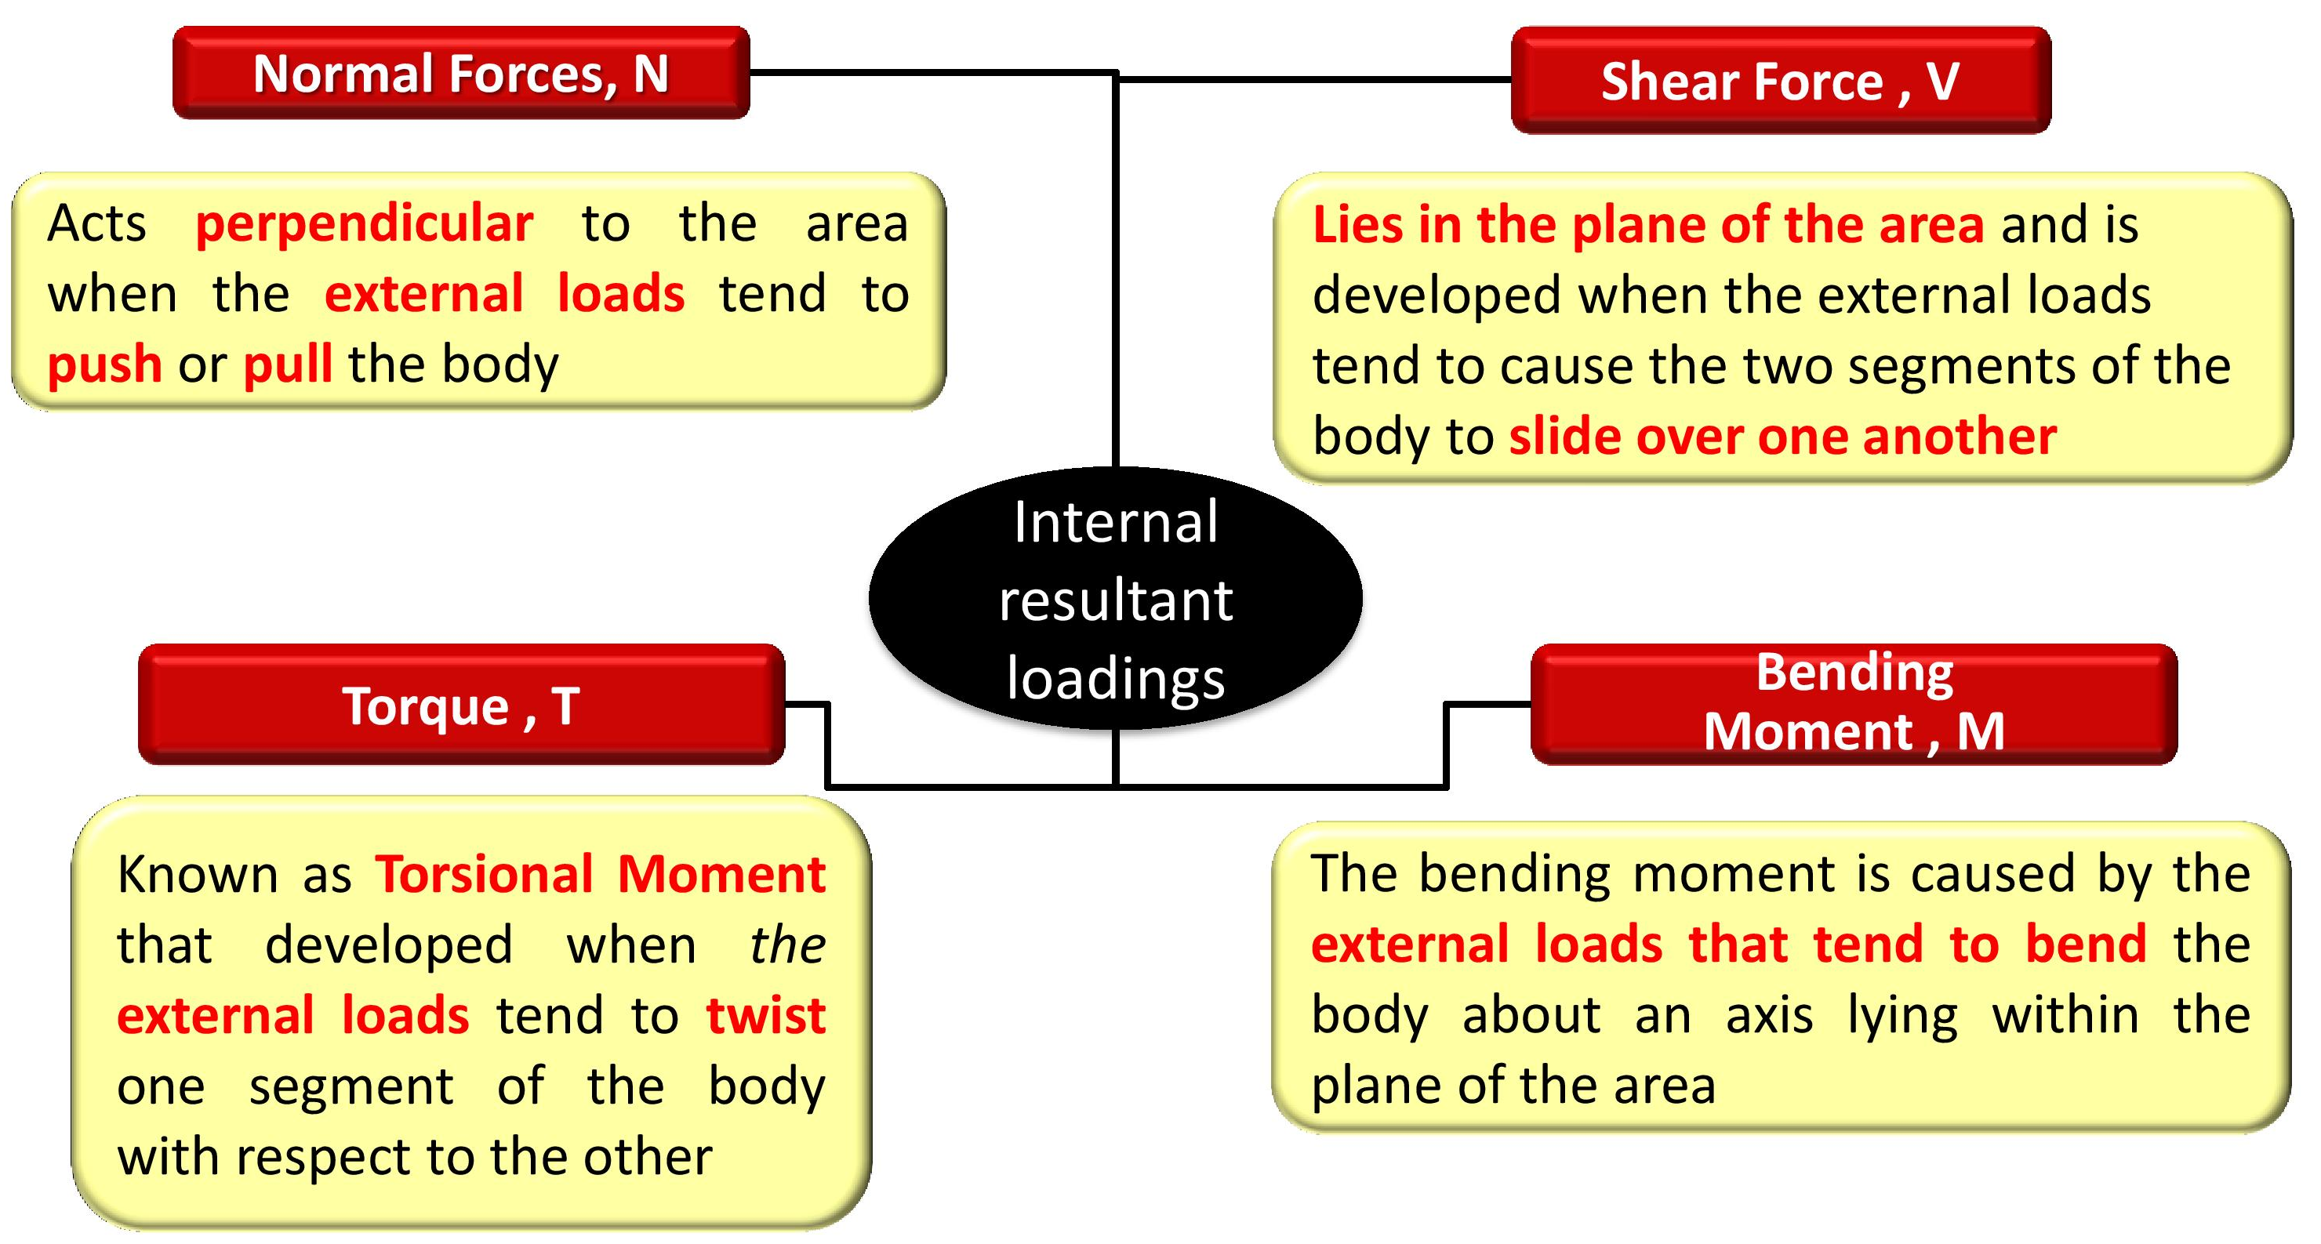
Types of loading forces

Slide 15
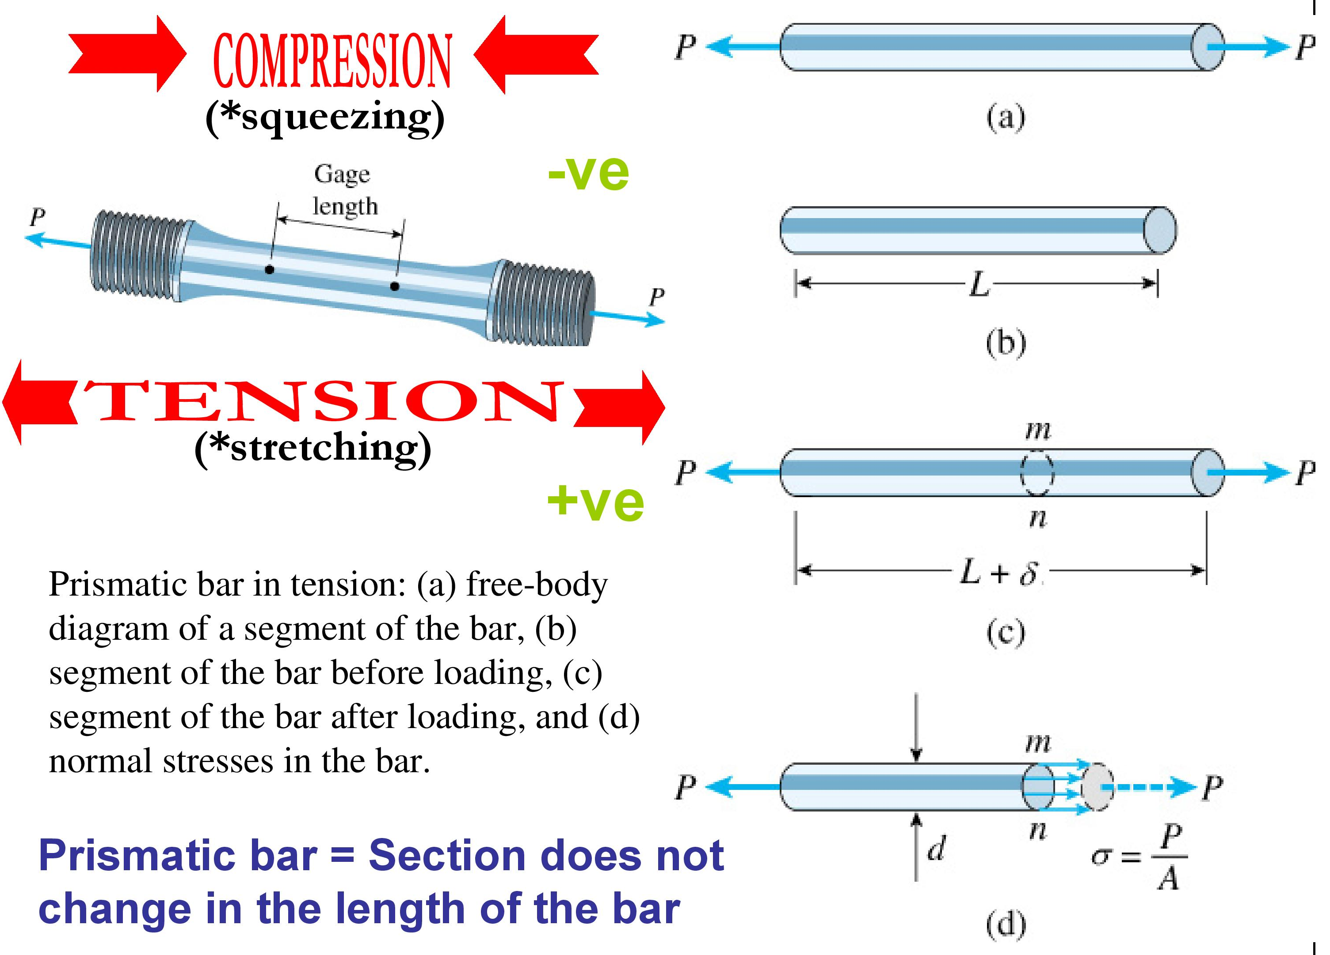
Types of stress and deformations

Slide 16
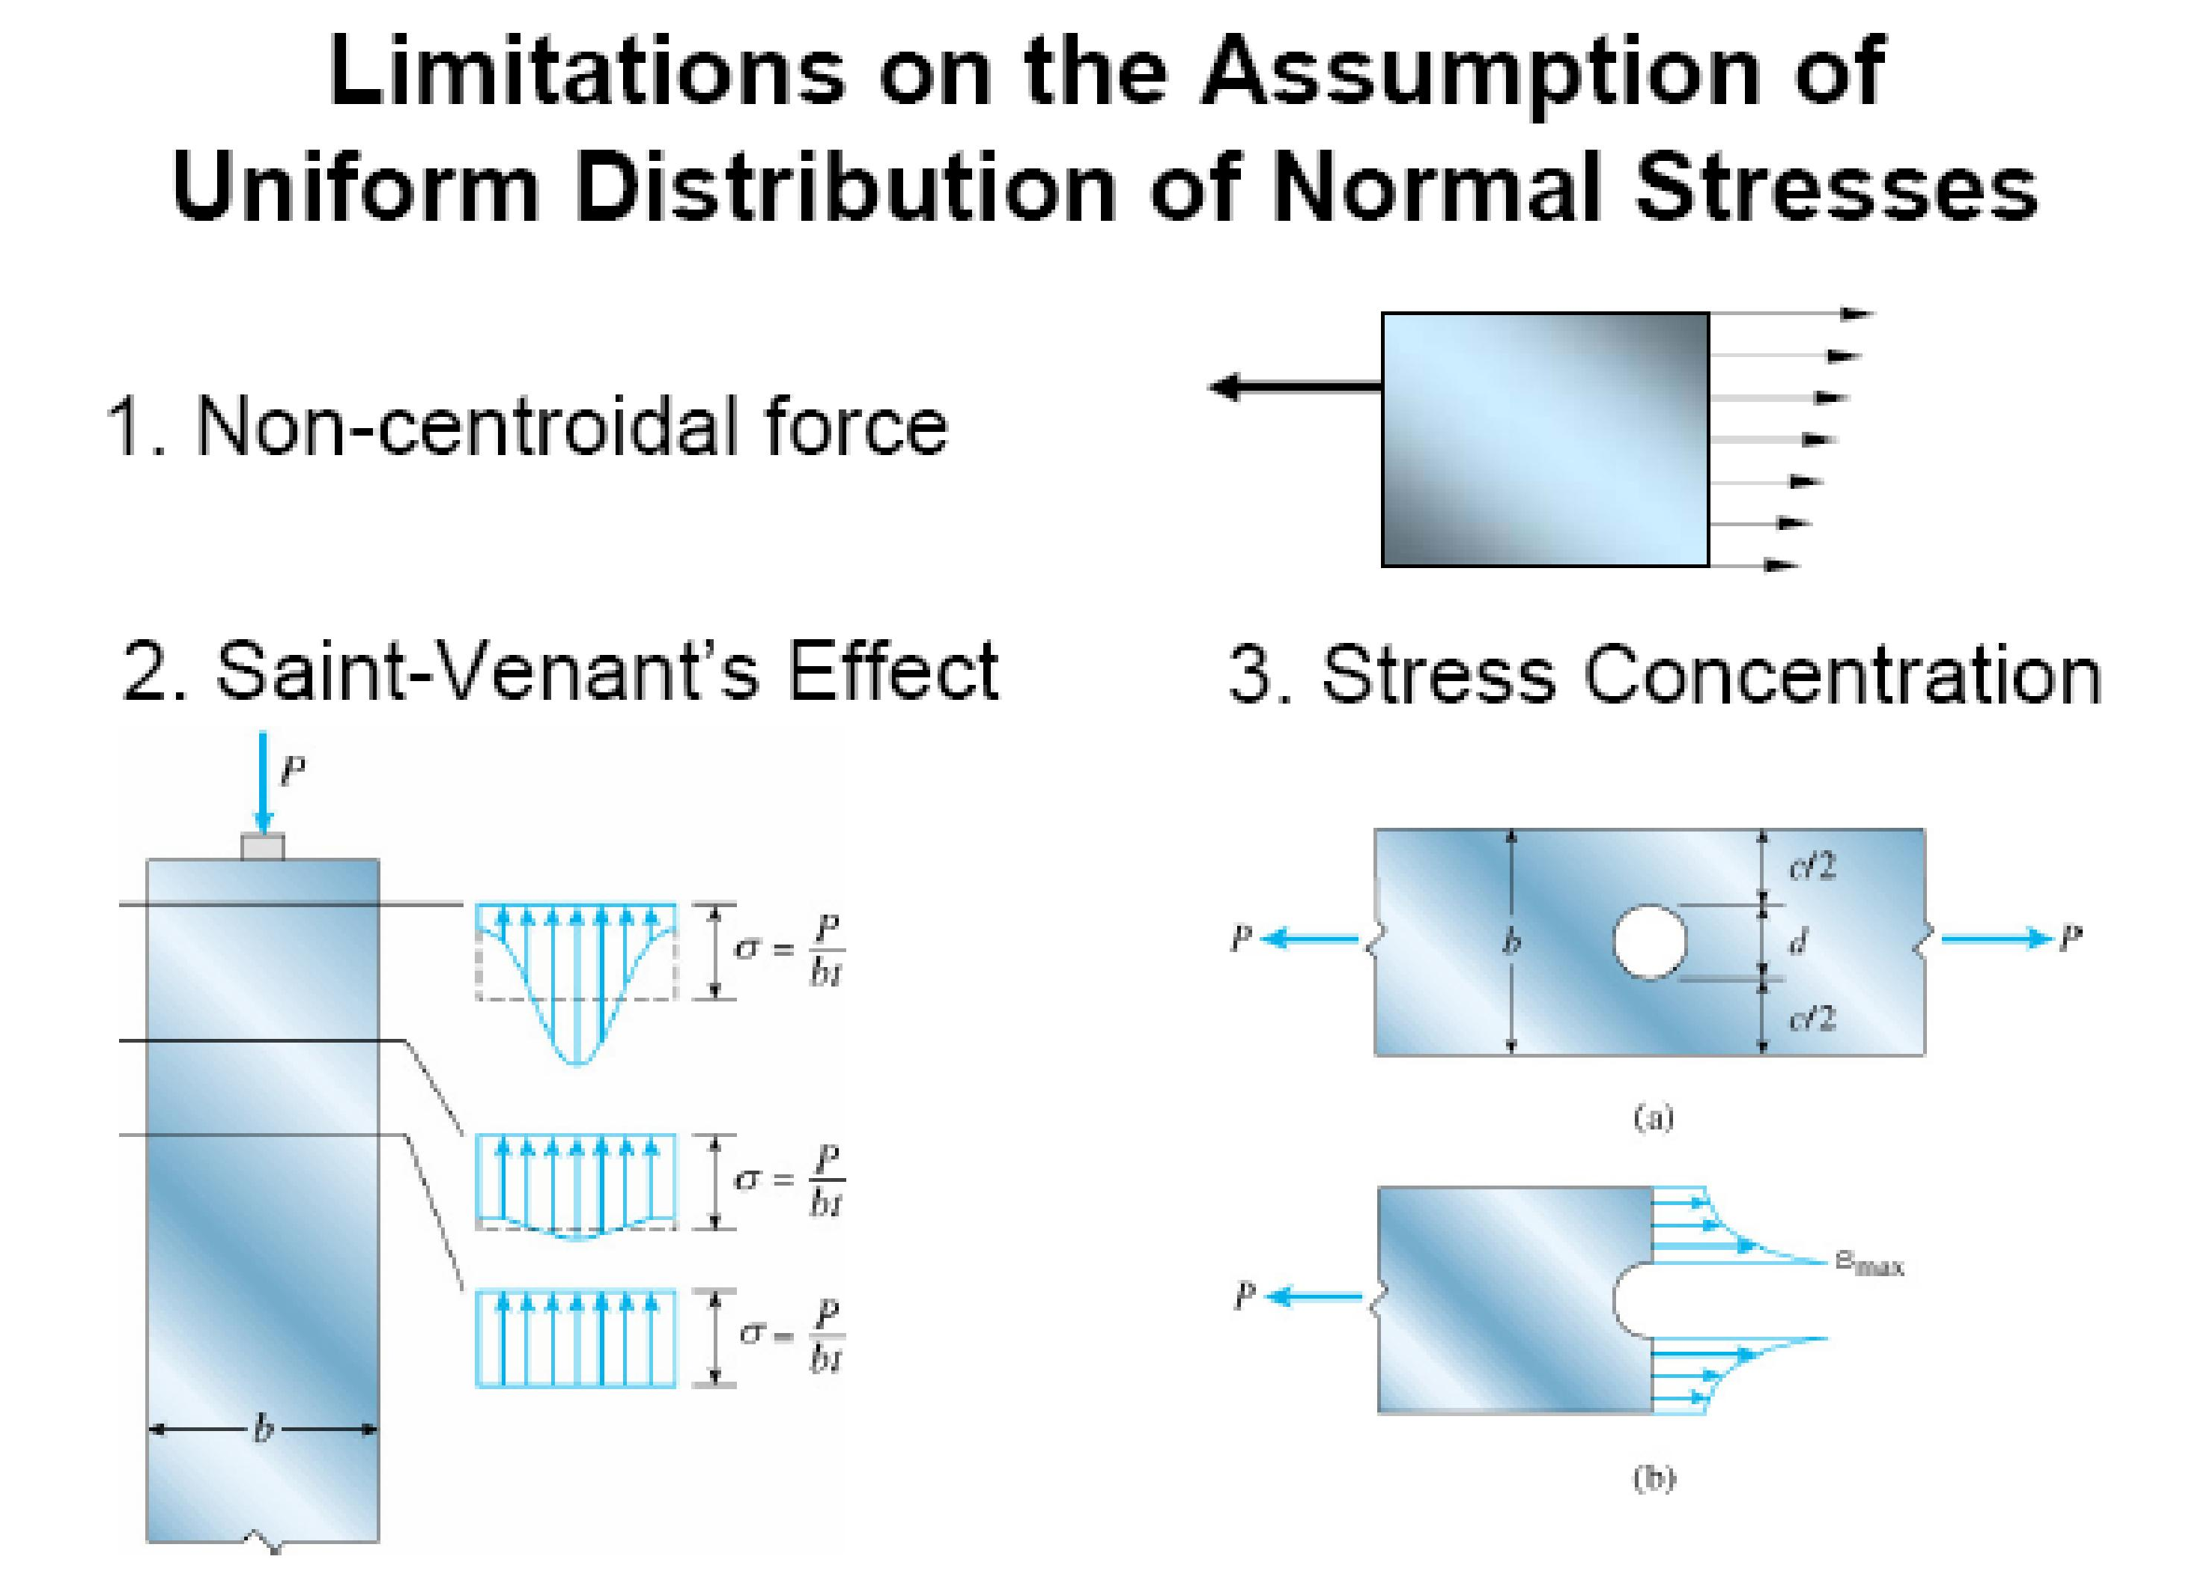

Slide 17
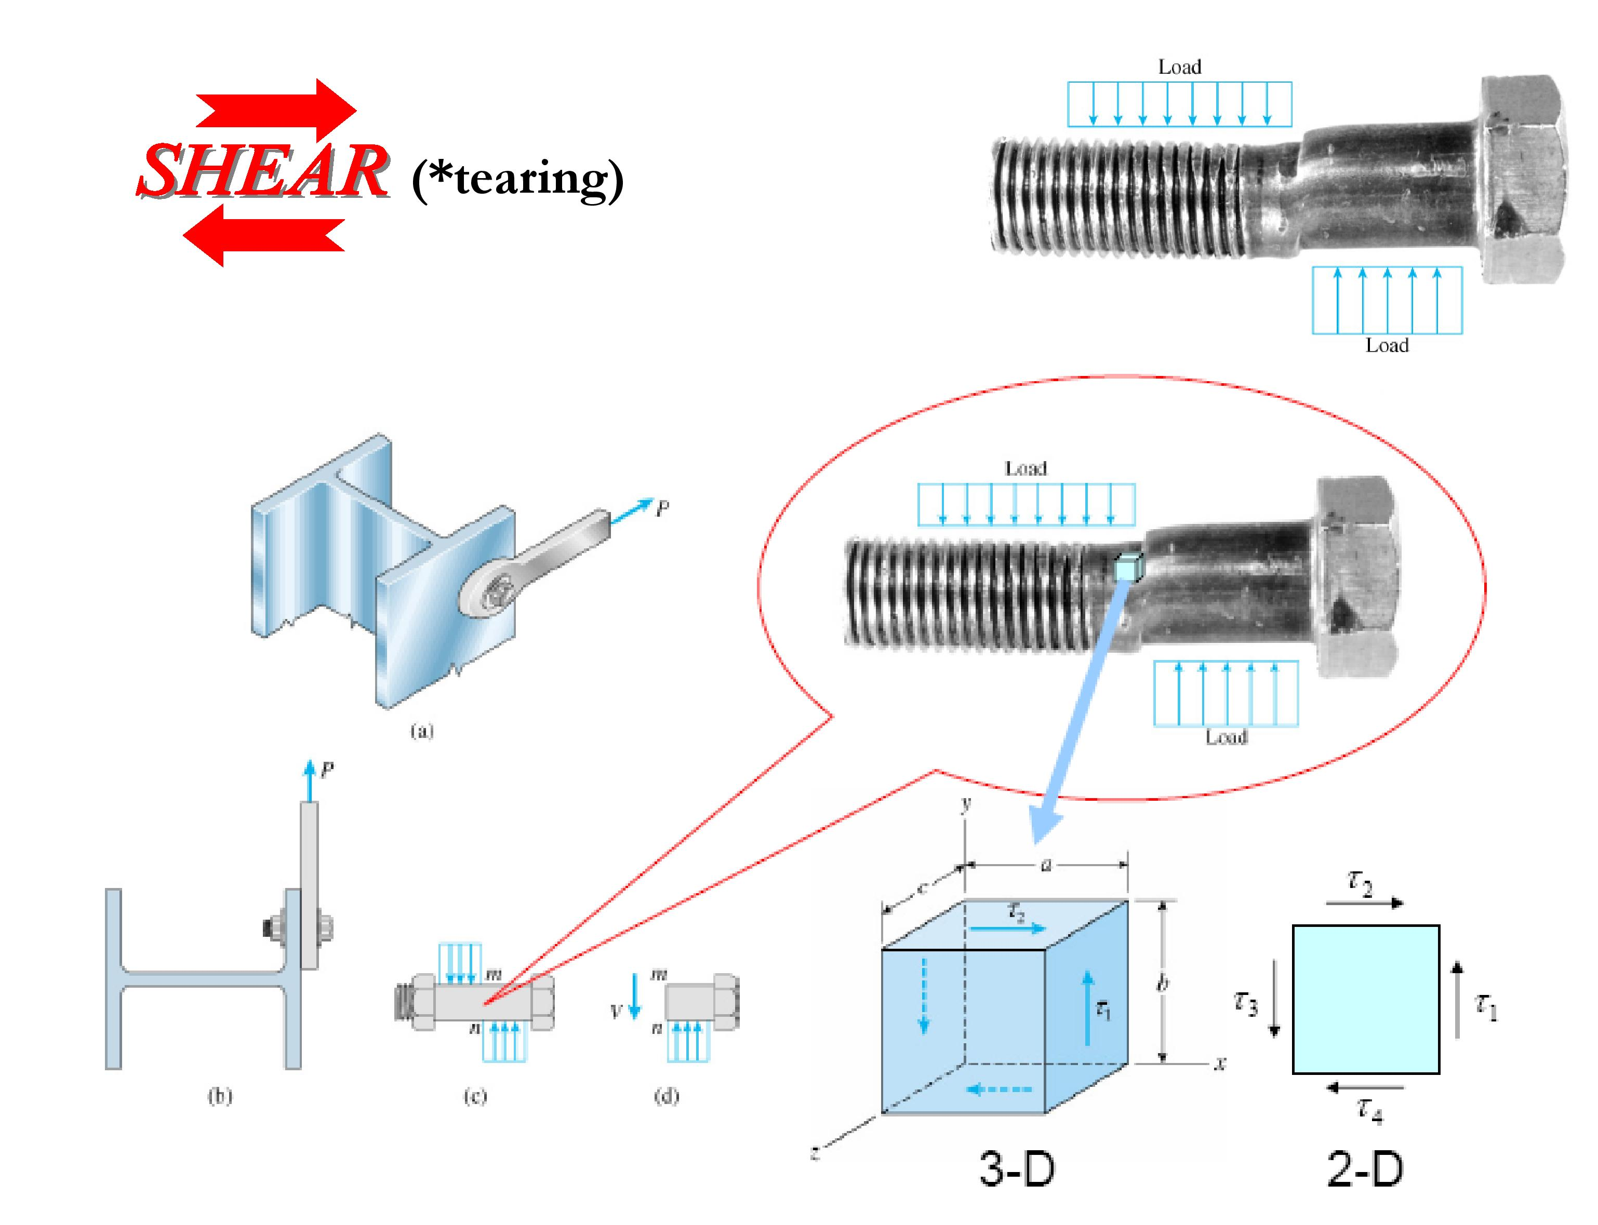

Slide 18
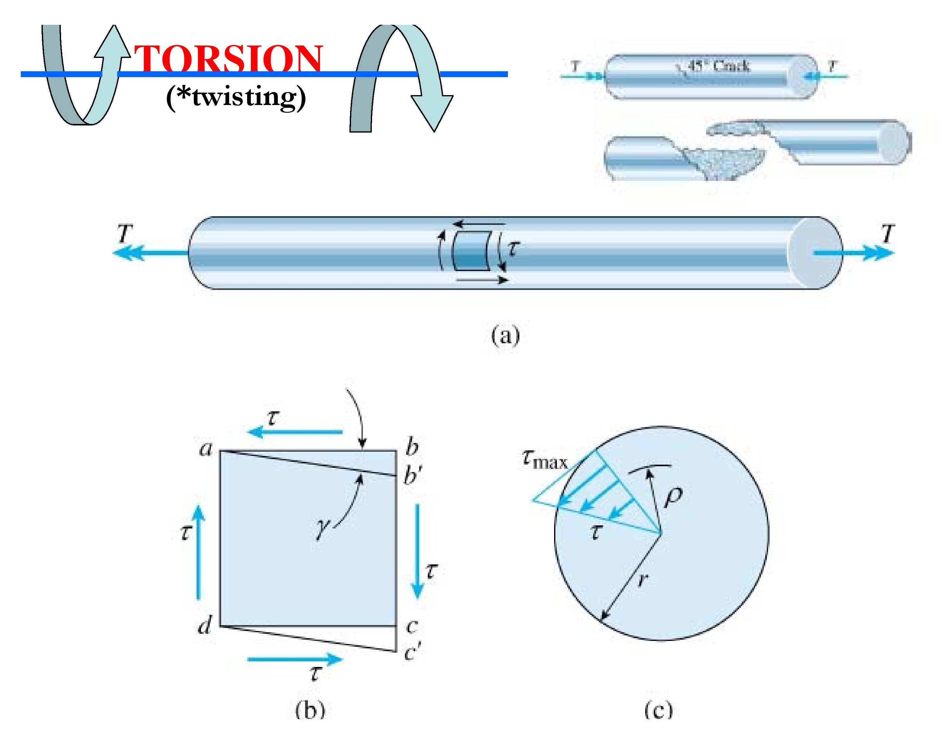

Slide 19
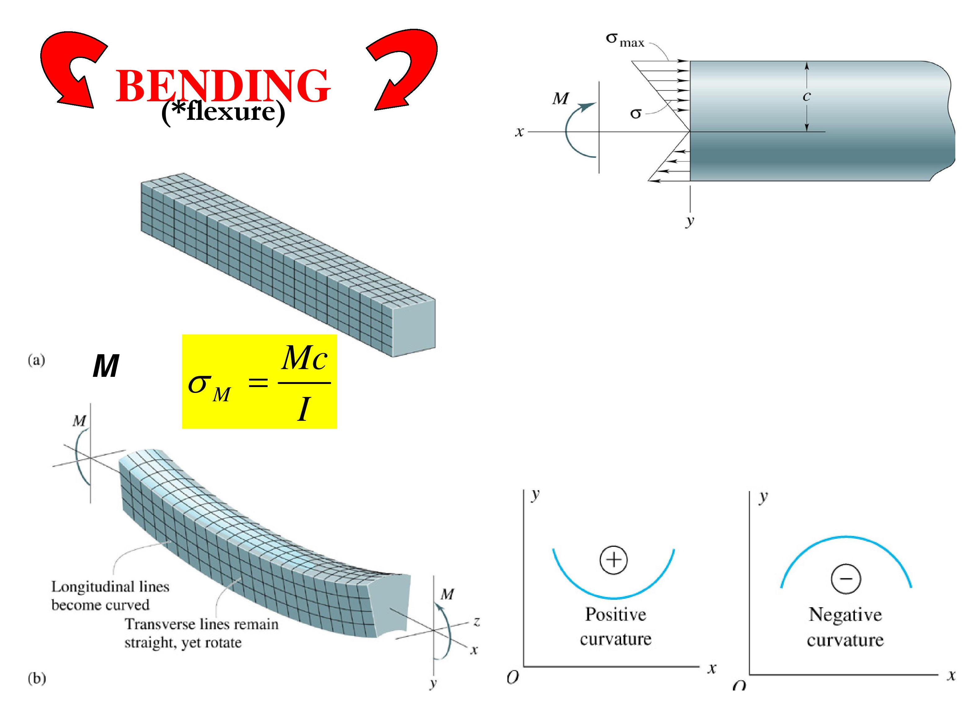

Slide 20
