Slide 1
Thermodynamics
Chapter 7
POWER AND REFRIGERATION CYCLES
Mohsin Mohd Sies
Fakulti Kejuruteraan Mekanikal, Universiti Teknologi Malaysia

Slide 2
Vapor Power Cycles

Slide 3
Coverage
Analyze vapor power cycles in which the working fluid is alternately vaporized and condensed.
Investigate ways to modify the basic Rankine vapor power cycle to increase the cycle thermal efficiency.

Slide 4
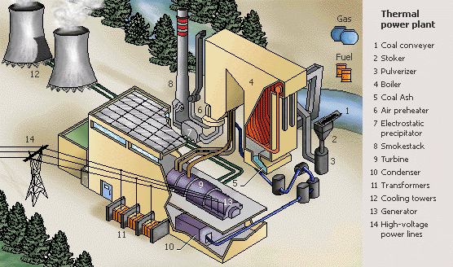
Thermal Power Plant

Slide 5
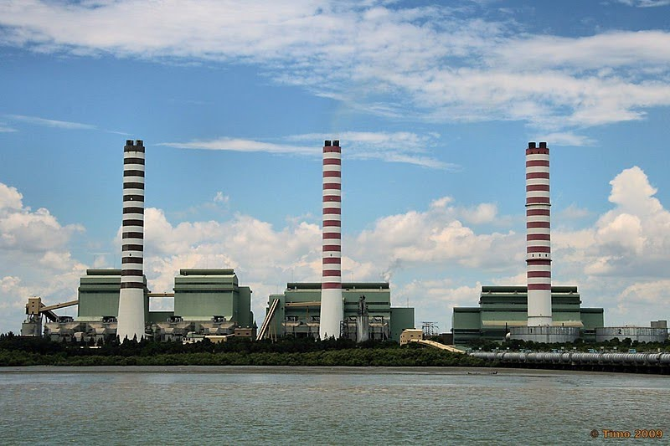
Kapar Power Station

Slide 6
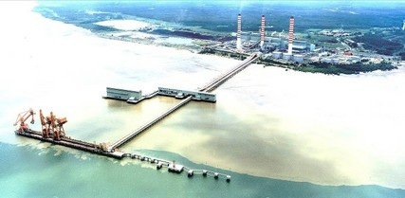
Kapar Power Station

Slide 7
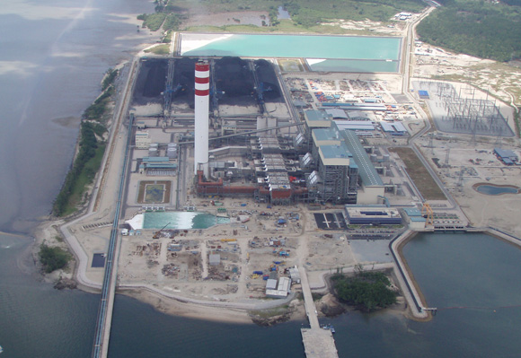
Tanjung Bin Power Station

Slide 8
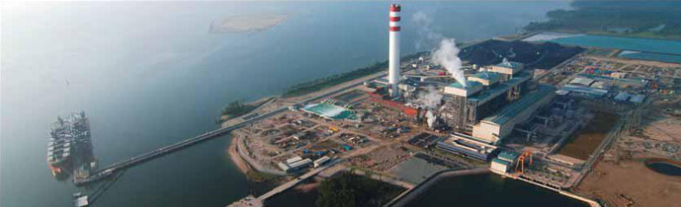
Tanjung Bin Power Station

Slide 9
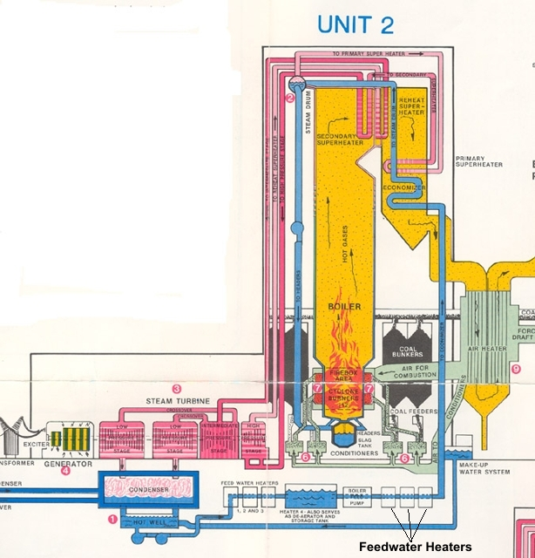
Schematic Diagram

Slide 10
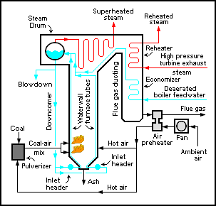

Slide 11
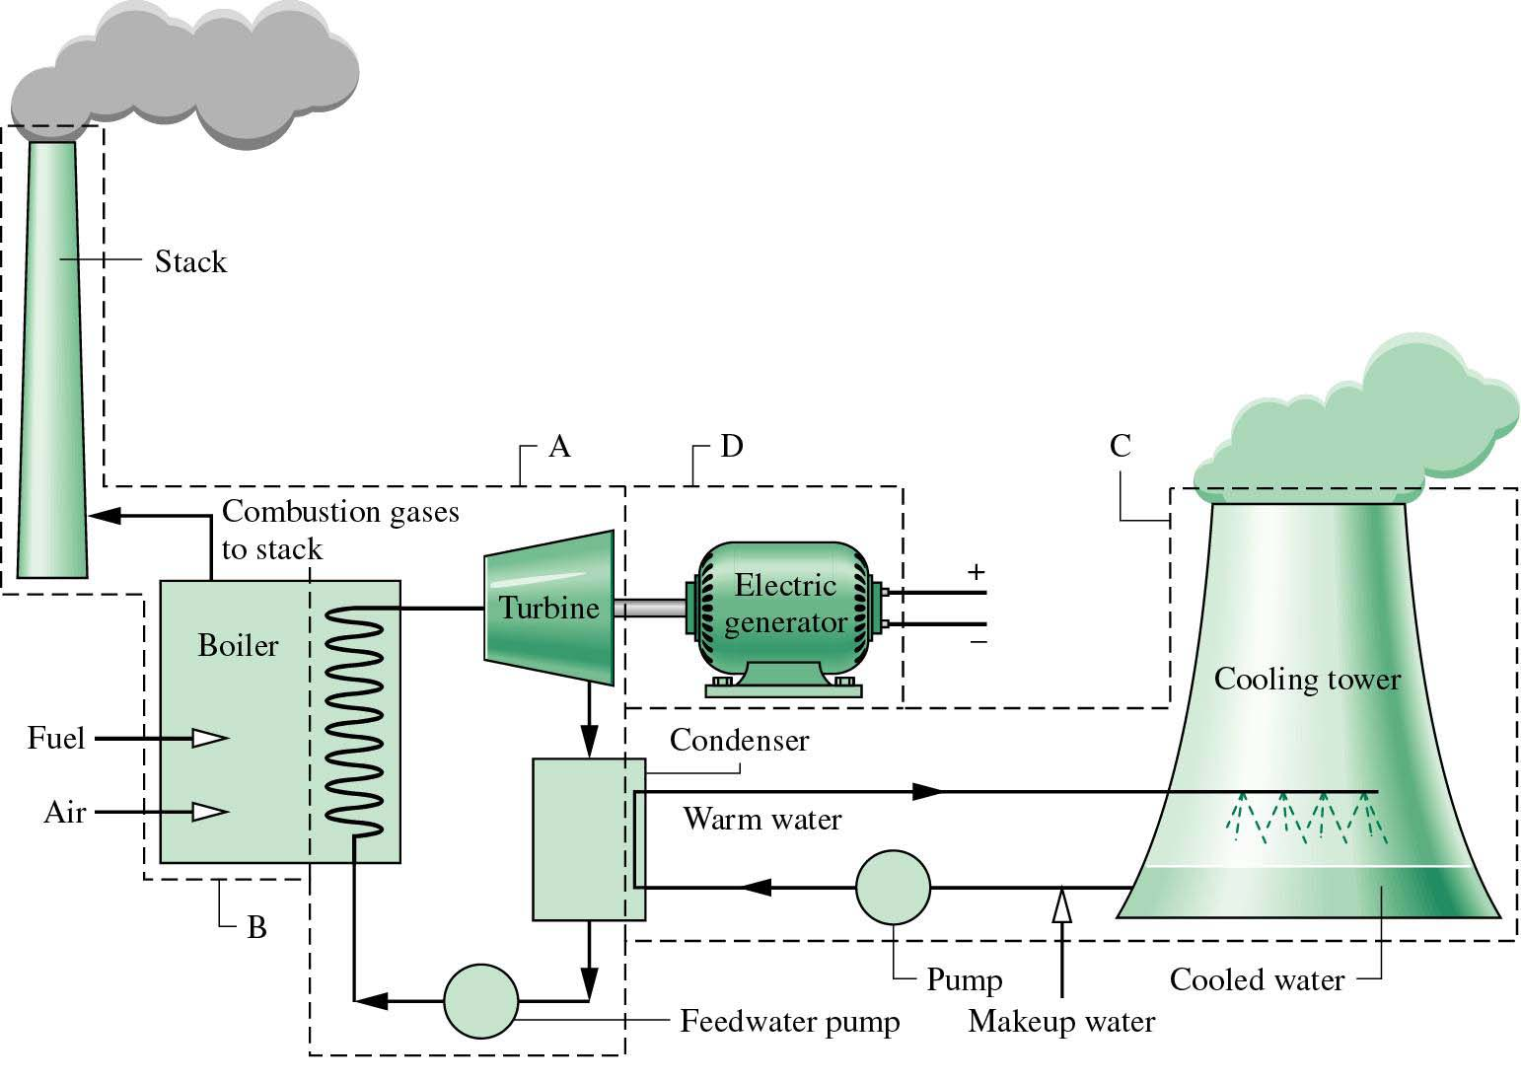
Sub-Systems in a Vapor Power Plant
Our focus will be on sub-system A.

Slide 12
Introduction
Steam (Water Vapor)
Steam is the most common working fluid used in vapor power cycles because of its many desirable characteristics, such as: (a) low cost, (b) availability, and (c) high enthalpy of vaporization#.
Steam power plants are commonly referred to as: (a) coal plants, (b) nuclear plants, or (c) natural gas plants, depending on the type of fuel used to supply heat to the steam.
The steam goes through the same basic cycle in all of them. Therefore, all can be analyzed in the same manner.
# The amount of energy needed to vaporize a unit mass of saturated liquid at a given temperature or pressure, h_{fg}.

Slide 13
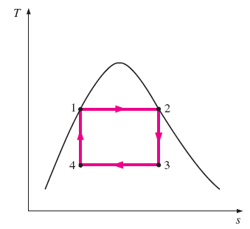


Carnot Vapor Cycle
Carnot cycle is the most efficient power cycle operating between two specified temperature limits (Fig. 10-1).
We can adopt the Carnot cycle first as a prospective ideal cycle for vapor power plants.
Sequence of Processes:
1-2 Reversible and isothermal heating (in a boiler);
2-3 Isentropic expansion (in a turbine);
3-4 Reversible and isothermal condensation (in a condenser); and
4-2 Isentropic compression (in a compressor).
$$η_{Carnot}=\frac{W_{net}}{Q_{in}}=1−\frac{Q_{L}}{Q_{H}}=1−\frac{T_{L}}{T_{H}}$$

Slide 14
Is Carnot Cycle Practical?
The Carnot cycle is NOT a suitable model for actual power cycles because of several impracticalities associated with it:
Process 1-2
Limiting the heat transfer processes to two-phase systems severely limits the maximum temperature that can be used in the cycle (374°C for water).
Process 2-3
The turbine cannot handle steam with a high moisture content because of the impingement of liquid droplets on the turbine blades causing erosion and wear.
Process 4-1
It is not practical to design a compressor that handles two phases.

Slide 15
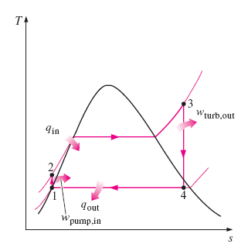

The Rankine Cycle
Many of the impracticalities associated with the Carnot cycle can be eliminated by: (a) superheating the steam in the boiler, and (b) condensing the steam completely in the condenser.
The modified Carnot cycle is called the Rankine cycle, where the isothermal processes are replaced with constant pressure processes to facilitate doing (a) and (b) above. This is the ideal and practical cycle for vapor power plants (Figure 10-2).
This ideal cycle does not involve any internal irreversibilities.

Slide 16
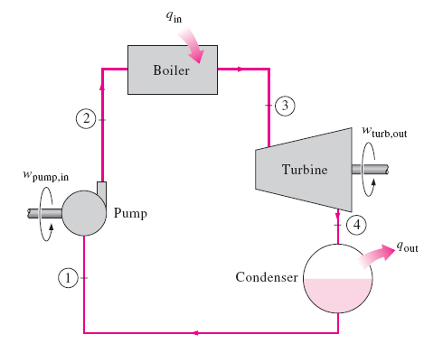
Sequence of Processes
The ideal Rankine cycle consists of four processes:
1-2 Isentropic compression in a water pump;
2-3 Constant pressure heat addition in a boiler;
3-4 Isentropic expansion in a turbine;
4-1 Constant pressure heat rejection
in a condenser.

Slide 17
Energy Analysis of Ideal Rankine Cycle
The pump, boiler, turbine, and condenser are steady-flow devices. Thus all four processes that make up the ideal Rankine cycle can be analyzed as steady-flow processes.
The kinetic and potential energy changes of the steam are usually small. Thus the Steady-flow Energy Equation per unit mass of steam reduces to:
Energy Interactions
The boiler and condenser do not involve any work but both involve with heat interactions.
The pump and the turbine are assumed to be isentropic and both involve work interactions.

Slide 18





Energy Interactions in Each Device
Pump: The work needed to operate the water pump,
where,
Boiler: The amount of heat supplied
in the steam boiler,
Turbine: The amount of work produced by the turbine,
Condenser: The amount of heat
rejected to cooling medium in the condenser,

Slide 19


Performance of Ideal Rankine Cycle
Thermal Efficiency
The thermal efficiency of the Rankine cycle is determined from,
where the net work output,
Note: +ve quantities only!
Thermal efficiency of Rankine cycle can also be interpreted as the ratio of the area enclosed by the cycle on a T-s diagram to the area under the heat-addition process.

Slide 20
Problem
The Simple Rankine Cycle
10–16
Consider a 210-MW steam power plant that operates on a simple ideal Rankine cycle. Steam enters the turbine at 10 MPa and 500°C and is cooled in the condenser at a pressure of 10 kPa. Show the cycle on a T-s diagram with respect to saturation lines, and determine:
the quality of the steam at the turbine exit,
the thermal efficiency of the cycle, and
the mass flow rate of the steam.
Answers: (a) 0.793, (b) 40.2 percent, (c) 165 kg/s

Slide 21
Problem
The Simple Rankine Cycle
10-16
Solve Prob. 10-16.
Answers: (a) 0.793, (b) 40.2 percent, (c) 165 kg/s
10–17
Repeat Prob. 10–16 assuming an isentropic efficiency of 85 percent for both the turbine and the pump.
Answers: (a) 0.874, (b) 34.1 percent, (c) 194 kg/s

Slide 22
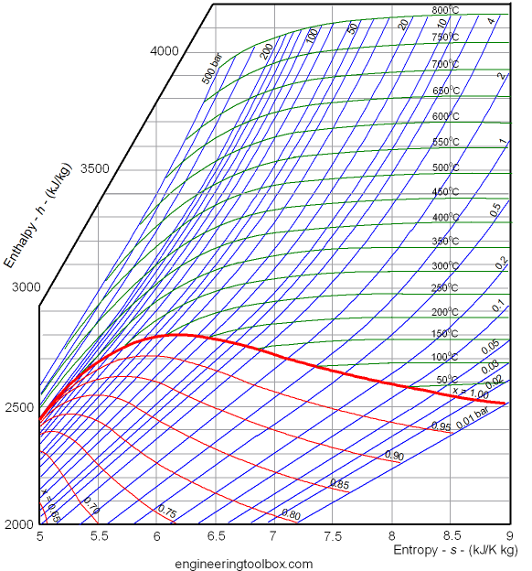
Mollier Diagram (h-s diagram)

Slide 23
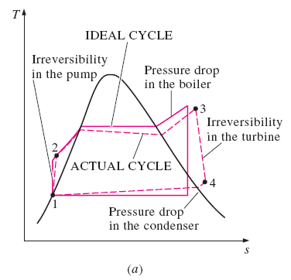
Actual Vapor Power Cycles
The actual vapor power cycle differs from the ideal Rankine cycle as a result of irreversibilities in various components. Two common sources of irreversibilities are: (a) fluid friction, and (b) heat loss to the surroundings.
Fluid friction causes pressure drops in the boiler, condenser, and the piping between various components. Water must be pumped to a higher pressure - requires a larger pump and larger work input.
More heat needs to be transferred to the steam in the boiler to compensate for the undesired heat losses from the steam to the surroundings.
As a result, the cycle thermal efficiency decreases.

Slide 24
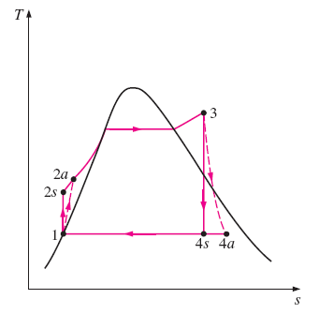
Isentropic Efficiencies
A pump requires a greater work input, and a turbine produces a smaller work output as a result of irreversibilities.
The deviation of actual pumps and turbines from the isentropic ones can be accounted for by utilizing isentropic efficiencies, defined as,
Pump:
Turbine:
In actual condensers, the liquid is usually sub-cooled to prevent the onset of cavitation, which may damage the water pump. Additional losses occur at the bearings between the moving parts as a result of friction. Two other factors are the steam that leaks out during the cycle and air that leaks into the condenser.

Slide 25
Problem
The Simple Rankine Cycle
Homework Exercise
10–22
Consider a steam power plant that operates on a simple ideal Rankine cycle and has a net power output of 45 MW. Steam enters the turbine at 7 MPa and 500°C and is cooled in the condenser at a pressure of 10 kPa by running cooling water from a lake through the tubes of the condenser at a rate of 2000 kg/s. Show the cycle on a T-s diagram with respect to saturation lines, and determine:
the thermal efficiency of the cycle,
the mass flow rate of the steam, and
the temperature rise of the cooling water.
Answers: (a) 38.9 percent, (b) 36 kg/s, (c) 8.4°C

Slide 26
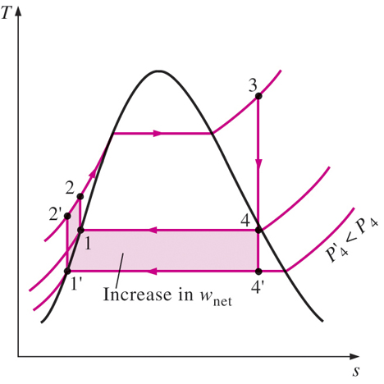

Increasing Efficiency of Rankine Cycle
Thermal efficiency of the ideal Rankine cycle can be increased by: (a) Increasing the average temperature at which heat is transferred to the working fluid in the boiler, or (b) decreasing the average temperature at which heat is rejected from the working fluid in the condenser.
Lowering the Condenser Pressure
The condensers of steam power plants usually operate well below the atmospheric pressure. There is a lower limit to this pressure depending on the temperature of the cooling medium.
Side effect: Lowering the condenser pressure increases the moisture content of the steam at the final stages of the turbine – can cause blade damage, decreasing isentropic efficiency.

Slide 27
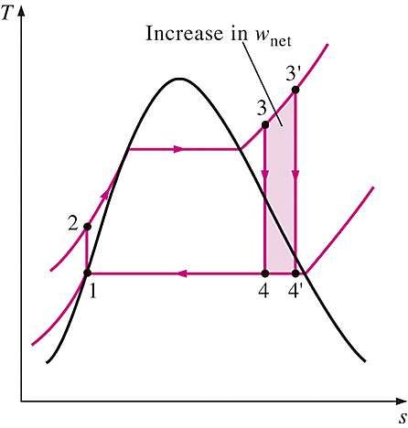
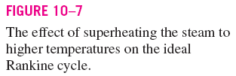
Superheating the Steam to High Temperatures
Superheating the steam increases both the net work output and heat input to the cycle. The overall effect is an increase in thermal efficiency of the cycle.
Superheating to higher temperatures will decrease the moisture content of the steam at the turbine exit, which is desirable – avoid erosion of turbine blades.
The superheating temperature is limited by metallurgical considerations. Presently the highest steam temperature allowed at the turbine inlet is about 620°C.

Slide 28
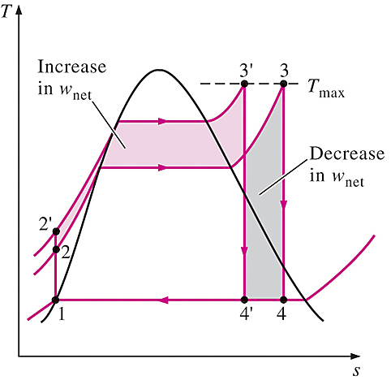

Increasing the Boiler Pressure
Increasing the boiler pressure raises the average temperature at which heat is transferred to the steam. This, in turns increases the thermal efficiency of the cycle.
Note:
For a fixed turbine inlet temperature, the cycle shifts to the left and the moisture content of steam at the turbine exit increases.
This side effect can be corrected by reheating the steam.

Slide 29
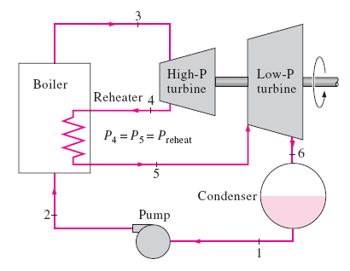
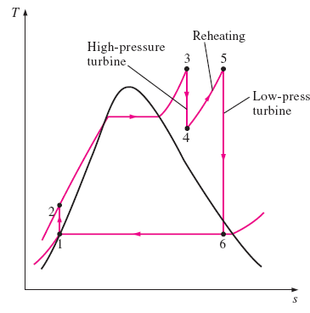

The Ideal Reheat Rankine Cycle
Reheating is a practical solution to the excessive moisture problem in turbines, and it is commonly used in modern steam power plants. This is done by expanding the steam in two-stage turbine, and reheat the steam in between the stages.
Note: Incorporation of the single reheat in a modern power plant improves the cycle efficiency by 4 ~ 5 percent.

Slide 30

With a single reheating process, the total heat input and the total turbine work output for the ideal cycle become,

Slide 31
Problem
The Reheat Rankine Cycle
10–34
Consider a steam power plant that operates on a reheat Rankine cycle and has a net power output of 80 MW. Steam enters the high-pressure turbine at 10 MPa and 500°C and the low-pressure turbine at 1 MPa and 500°C. Steam leaves the condenser as a saturated liquid at a pressure of 10 kPa. The isentropic efficiency of the turbine is 80 percent, and that of the pump is 95 percent. Show the cycle on a T-s diagram with respect to saturation lines, and determine:
the quality of the steam at the turbine exit,
the thermal efficiency of the cycle, and
the mass flow rate of the steam.
Answers: (a) 88.1°C, (b) 34.1 percent, (c) 62.7 kg/s

Slide 32
Problem
The Reheat Rankine Cycle
10–38
A steam power plant operates on the reheat Rankine cycle. Steam enters the high-pressure turbine at 12.5 MPa and 550°C at a rate of 7.7 kg/s and leaves at 2 MPa. Steam is then reheated at constant pressure to 450°C before it expands in the low-pressure turbine. The isentropic efficiencies of the turbine and the pump are 85 percent and 90 percent, respectively. Steam leaves the condenser as a saturated liquid. If the moisture content of the steam at the exit of the turbine is not to exceed 5 percent, determine:
the condenser pressure,
the net power output, and
the thermal efficiency.
Answers: (a) 9.73 kPa, (b) 10.2 MW, (c) 36.9 percent.

Slide 33
Problem
The Regenerative Rankine Cycle
10–44
A steam power plant operates on an ideal regenerative Rankine cycle. Steam enters the turbine at 6 MPa and 450°C and is condensed in the condenser at 20 kPa. Steam is extracted from the turbine at 0.4 MPa to heat the feedwater in an open feedwater heater. Water leaves the feedwater heater as a saturated liquid. Show the cycle on a T-s diagram, and determine:
(a) the net work output per kg of steam flowing through the boiler, and
(b) the thermal efficiency of the cycle.
Answers: (a) 1017 kJ/kg, (b) 37.8 percent

Slide 34
Refrigeration

Slide 35
Objectives
Introduce the concepts of refrigerators and heat pumps and the measure of their performance.
Analyze the ideal vapor-compression refrigeration cycle.
Analyze the actual vapor-compression refrigeration cycle.

Slide 36
Introduction
Refrigeration is the process of removing heat from an enclosed space, or from a substance, and rejecting it to an environment.
The primary purpose of refrigeration is lowering the temperature of the enclosed space or substance and then maintaining that lower temperature.
The term cooling refers generally to any natural or artificial process by which heat is dissipated. The process of artificially producing extreme cold temperatures is referred to as cryogenics

Slide 37
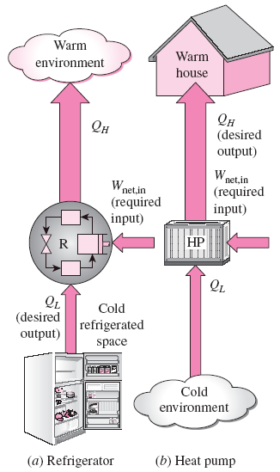
REFRIGERATORS AND HEAT PUMPS
The transfer of heat from a low-temperature region to a high-temperature one requires special devices called refrigerators.
Another device that transfers heat from a low-temperature medium to a high-temperature one is the heat pump.
Refrigerators and heat pumps are essentially the same devices; they differ in their objectives only.
The objective of a refrigerator is to remove heat (Q_{L}) from the cold medium
The objective of a heat pump is to supply heat (Q_{H}) to a warm medium.

Slide 38
Methods of refrigeration
Can be classified as non-cyclic, cyclic and thermoelectric.
Non-cyclic refrigeration - cooling is accomplished by melting ice or by subliming dry ice (frozen carbon dioxide). Are used for small-scale refrigeration i.e. laboratories and workshops, or in portable coolers.
Cyclic refrigeration - Consists of a refrigeration cycle, heat is removed from a low-temperature space/source and rejected to a high-temperature sink with the help of external work
Cyclic refrigeration can be classified as Vapor cycle and Gas cycle
Vapor cycle refrigeration can further be classified as:
  Vapor-compression refrigeration
  Vapor-absorption refrigeration

Slide 39
Methods of refrigeration
Gas cycle - Air is most often the working fluid. The hot and cold gas-to-gas heat exchangers are used. Less efficient than the vapor compression cycle because the gas cycle works on the reverse Brayton cycle instead of the reverse Rankine cycle
Thermoelectric refrigeration - Thermoelectric cooling uses the Peltier effect to create a heat flux between the junction of two different types of materials. Commonly used in camping and portable coolers
Thermoacoustic refrigeration uses sound waves in place of a compressor to create cooling power.

Slide 40
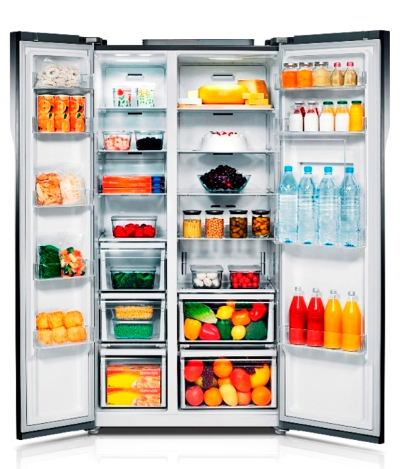
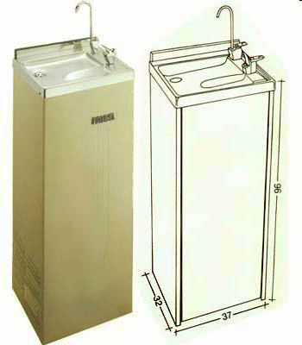
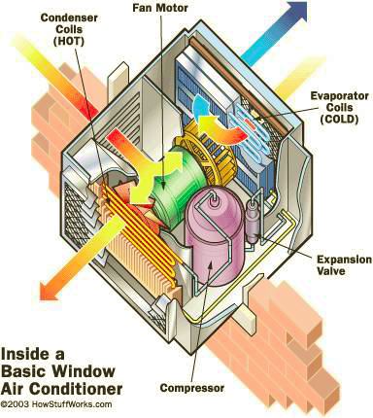
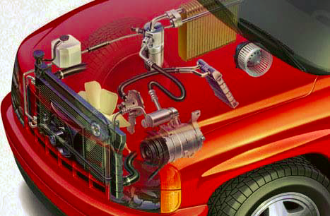
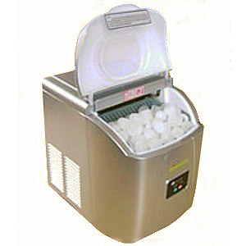
VAPOR COMPRESSION REFRIGERATION SYSTEM (VCRS)
Food Processing and storage -Refrigerator
Building air conditioning system
Car air conditioning system
Water cooler
Ice cube maker
Low temperature drying process

Slide 41
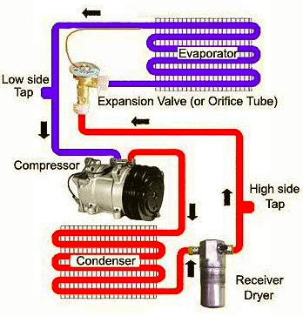
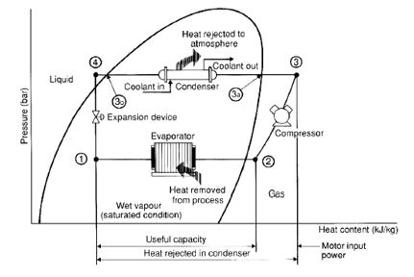
Operation of VCRS

Slide 42
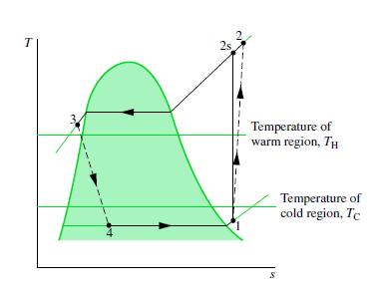
Refrigerated Space, Ambient Temperatures vs Cycle Temperatures
Need to have delta_T to allow heat transfer
Evaporator temperature lower than refrigerated space temperature
Condenser temperature higher than ambient temperature

Slide 43
Coefficient of Performance
The performance of refrigerators and heat pumps is expressed in terms of the coefficient of performance (COP), defined as,
$${COP}_{R}=\frac{Desired Output}{Required Input}=\frac{Cooling Effect}{Work Input}=\frac{Q_{L}}{W_{net,in}}$$
$${COP}_{HP}=\frac{Desired Output}{Required Input}=\frac{Heating Effect}{Work Input}=\frac{Q_{H}}{W_{net,in}}$$
Both COP_{R} and COP_{HP} can be greater than 1.
For fixed values of Q_{L} and Q_{H}
COP_{HP} = COP_{R} + 1

Slide 44
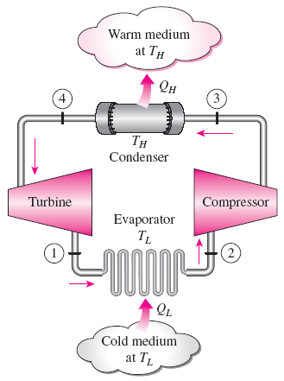

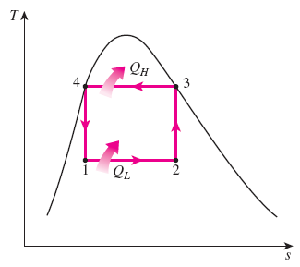
THE REVERSED CARNOT CYCLE
The reversed Carnot cycle is the most efficient refrig. cycle operating between T_{L} and T_{H}.
It is not a suitable model for refrigeration cycles since processes 2-3 and 4-1 are not practical because Process 2-3 involves the compression of a liquid–vapor mixture, which requires a compressor that will handle two phases, and process 4-1 involves the expansion of high-moisture-content refrigerant in a turbine.
Both COPs increase as the difference between the two temperatures
decreases, that is, as T_{L} rises or T_{H} falls.
Schematic of a Carnot refrigerator and T-s diagram of the reversed Carnot cycle.

Slide 45

REFERENCE COP
The maximum COP of a refrigeration cycle operating between temperature limits of T_{L} and T_{H}
Actual refrigeration cycles are not as efficient as ideal ones like the Carnot cycle because of the irreversibilities involved. But the conclusion we can draw from the equation above that the COP is inversely proportional to the temperature difference T_{H} - T_{L} is equally valid for actual refrigeration cycles.

Slide 46
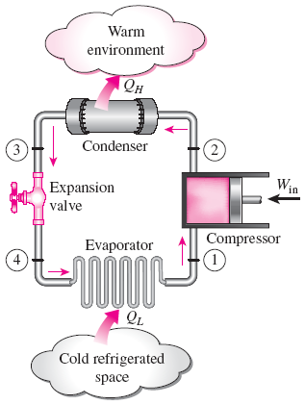
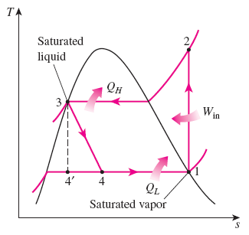
THE IDEAL VAPOR-COMPRESSION REFRIGERATION CYCLE
Unlike the reversed Carnot cycle,
The refrigerant is vaporized completely before it is compressed
The turbine is replaced with a throttling device.
This is the most widely used cycle for refrigerators, A-C systems, and heat pumps.
Schematic and T-s diagram for the ideal vapor-compression refrigeration cycle.

Slide 47
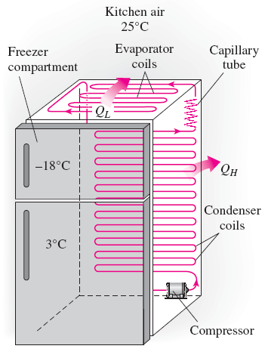
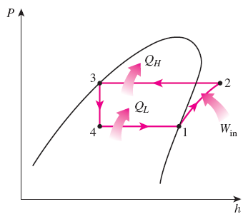
Analysis
Each component is treated separately as open system with steady flow
Steady-flow energy balance
An ordinary household refrigerator.
The P-h diagram of an ideal vapor-compression refrigeration cycle.

Slide 48
Problem
Ideal and Actual Vapor-Compression Refrigeration Cycles
11–12
A refrigerator uses refrigerant-134a as the working fluid and operates on an ideal vapor-compression refrigeration cycle between 0.12 and 0.7 MPa. The mass flow rate of the refrigerant is 0.05 kg/s. Show the cycle on a T-s diagram with respect to saturation lines. Determine:
a) the rate of heat removal from the refrigerated space,
b) the power input to the compressor,
c) the rate of heat rejection to the environment, and
d) the coefficient of performance.
Answers: (a) 7.41 kW, 1.83 kW, (b) 9.23 kW, (c) 4.06

Slide 49
Problem – Class Exercise
Ideal and Actual Vapor-Compression Refrigeration Cycles
11–15
Consider a 300 kJ/min refrigeration system that operates on an ideal vapor-compression refrigeration cycle with refrigerant-134a as the working fluid. The refrigerant enters the compressor as saturated vapor at 140 kPa and is compressed to 800 kPa. Show the cycle on a T-s diagram with respect to saturation lines, and determine the:
quality of the refrigerant at evaporator inlet,
coefficient of performance, and
power input to the compressor.

Slide 50
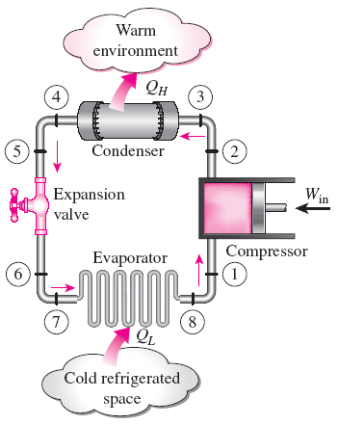
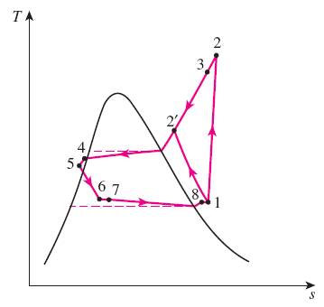
ACTUAL VAPOR-COMPRESSION REFRIGERATION CYCLE
An actual vapor-compression refrigeration cycle differs from the ideal one owing mostly to the irreversibilities that occur in various components, mainly due to fluid friction (causes pressure drops) and heat transfer to or from the surroundings. As a result, the COP decreases.
DIFFERENCES
Non-isentropic compression
Superheated vapor at evaporator exit
Subcooled liquid at condenser exit
Pressure drops in condenser and evaporator
Schematic and T-s diagram for the actual vapor-compression refrigeration cycle.

Slide 51
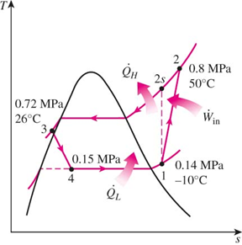
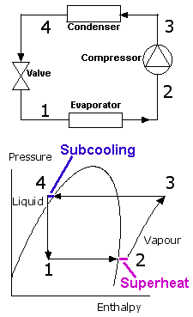
Superheating and Subcooling
Superheating (at evaporator exit) – to ensure no liquid droplets enters compressor to damage it
Subcooling (at condenser exit) – to increase cooling capacity
ΔT- Degree of superheating

Slide 52
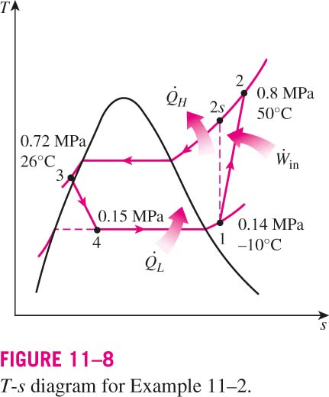
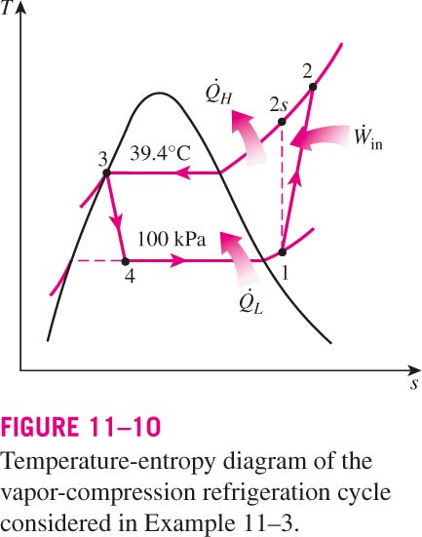
ACTUAL VAPOR-COMPRESSION REFRIGERATION CYCLE
We will only focus on non-isentropic compression.
T-s diagram for the actual vapor-compression refrigeration cycle.

Slide 53
11–19 Refrigerant-134a enters the compressor of a refrigerator at 100 kPa and -20 ºC at a rate of 0.5 m³/min and leaves at 0.8 MPa. The isentropic efficiency of the compressor is 78 percent. The refrigerant enters the throttling valve at 0.75 MPa and 26 ºC and leaves the evaporator as saturated vapor at -26 ºC.
Show the cycle on a T-s diagram with respect to saturation lines, and determine
the power input to the compressor,
the rate of heat removal from the refrigerated space, and
the pressure drop and rate of heat gain in the line between the evaporator and the compressor.
Answers:
(a) 2.40 kW, (b) 6.17 kW, (c) 1.73 kPa, 0.203 kW

Slide 54
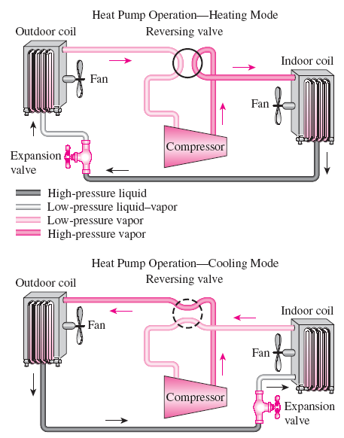
REVERSIBLE SYSTEMS
The most common energy source for heat pumps is atmospheric air (air-to- air systems).
Water-source systems usually use well water and ground-source (geothermal) heat pumps use earth as the energy source. They typically have higher COPs but are more complex and more expensive to install.
Both the capacity and the efficiency of a heat pump fall significantly at low temperatures. Therefore, most air-source heat pumps require a supplementary heating system such as electric resistance heaters or a gas furnace.
Heat pumps are most competitive in areas that have a large cooling load during the cooling season and a relatively small heating load during the heating season. In these areas, the heat pump can meet the entire cooling and heating needs of residential or commercial buildings.
A heat pump can be used to heat a house in winter and to cool it in summer.

