Slide 1
Thermodynamics I
Chapter 3
Energy, Heat and Work
Mohsin Mohd Sies
Fakulti Kejuruteraan Mekanikal, Universiti Teknologi Malaysia

Slide 2
Energy, Heat and Work
(Motivation)
A system changes due to interaction with its surroundings.
Energy interaction is a major factor.
This chapter studies the nature of energy and its various forms and transfers so that we are able to follow its interaction with a system.

Slide 3
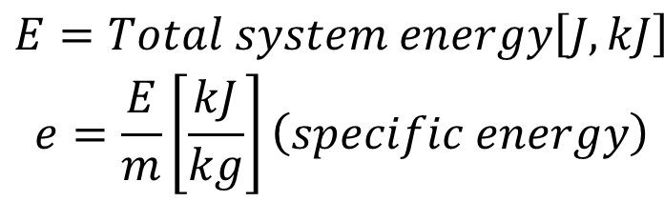
ENERGY & THE 1st LAW OF THERMO.
1st Law : concerning quantity of energy
Energy is conserved
(Amount of energy is constant, but can change forms)
(e.g. potential, kinetic, electrical, chemical, etc.)
$$\begin{matrix}E=Total system energy\left[J,kJ\right] \\ e=\frac{E}{m}\left[\frac{kJ}{kg}\right]\left(specific energy\right)\end{matrix}$$

Slide 4
Energy
Macroscopic – system energy which value depends on a reference point (Kinetic Energy (KE), Potential Energy (PE)
Microscopic – energy due to molecular interactions & activity (independent of any reference point) (Internal Energy, U)
Total System Energy

Slide 5
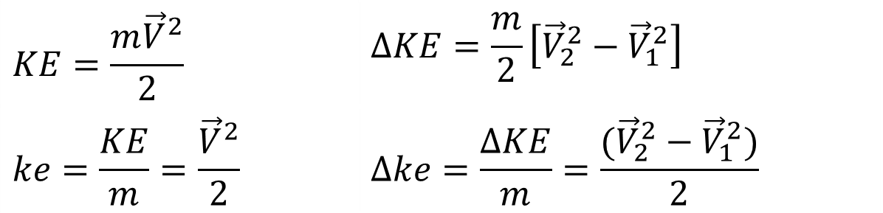
Kinetic Energy (KE)
$$KE=\frac{m{\vec{V}}^{2}}{2}$$ | $$∆KE=\frac{m}{2}\left[{\vec{V}}_{2}^{2}−{\vec{V}}_{1}^{2}\right]$$
$$ke=\frac{KE}{m}=\frac{{\vec{V}}^{2}}{2}$$ | $$∆ke=\frac{∆KE}{m}=\frac{({\vec{V}}_{2}^{2}−{\vec{V}}_{1}^{2})}{2}$$
Potential Energy (PE)

Slide 6
Internal Energy, U
Molecular movement (vibration, collision, etc)
sensible energy (molecular activity temperature)
Bond Energy between molecules (phase change)
latent energy (constant temperature)
Bond Energy between atoms in a molecule
chemical energy
Bond Energy between protons & neutrons in the nucleus
nuclear energy

Slide 7
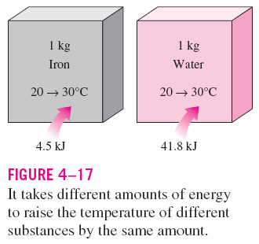
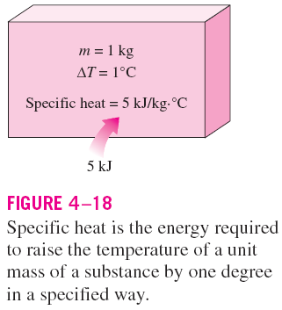
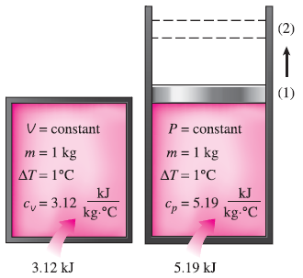
Specific Heats
Specific heat at constant volume, c_{v}: The energy required to raise the temperature of the unit mass of a substance by one degree as the volume is maintained constant.
Specific heat at constant pressure, c_{p}: The energy required to raise the temperature of the unit mass of a substance by one degree as the pressure is maintained constant.
Constant-volume and constant-pressure specific heats c_{v} and c_{p}
(values are for helium gas).

Slide 8
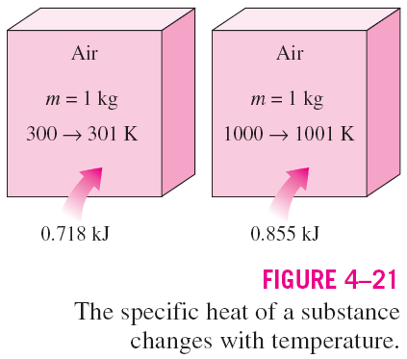
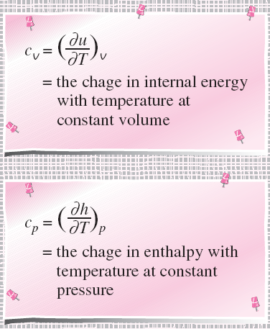
True or False?
c_{p} is always greater than c_{v}
The equations in the figure are valid for any substance undergoing any process.
c_{v} and c_{p} are properties.
c_{v} is related to the changes in internal energy and c_{p} to the changes in enthalpy.
A common unit for specific heats is kJ/kg·°C or kJ/kg·K. Are these units identical?
Formal definitions of c_{v} and c_{p}.

Slide 9
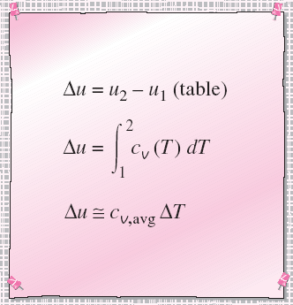
Three ways of calculating Δu and Δh
By using the tabulated u and h data. This is the easiest and most accurate way when tables are readily available.
By using the c_{v} or c_{p} relations (Table A-2c) as a function of temperature and performing the integrations. This is very inconvenient for hand calculations but quite desirable for computerized calculations. The results obtained are very accurate.
By using average specific heats. This is very simple and certainly very convenient when property tables are not available. The results obtained are reasonably accurate if the temperature interval is not very large.
Three ways of calculating Δu.

Slide 10
Specific Heats for Solids & Liquids
For incompressible substances (solids & liquids)
c_{v} = c_{p}
Thus it can just be stated as c.

Slide 11
Modes of Energy Transfer
Energy Interaction between System and Surrounding
Energy can cross the boundary (transferred) of a closed system by 2 methods;
HEAT & WORK

Slide 12
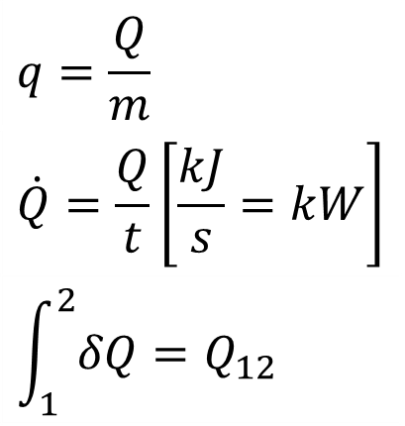
HEAT, Q [J, kJ]
Heat - Energy that is being transferred due to a temperature difference
Heat is a mode of energy transfer
Heat is not a property
Energy is related to states (property)
Heat is related to processes (not a property, depends on the path)
$$q=\frac{Q}{m}$$
$$\dot{Q}=\frac{Q}{t}\left[\frac{kJ}{s}=kW\right]$$
$$\int_{1}^{2}{δQ}=Q_{12}$$
= rate of heat transfer
Amount of heat transferred during a process (depends on the path)

Slide 13
Heat (ctd.)
system
Q_{in}= +ve
Q_{out}= -ve
Adiabatic Process (Q = 0)
insulated
T_{system} = T_{surrounding}
Adiabatic ≠ Isothermal!
(T can change by other methods; energy can enter system by work)

Slide 14
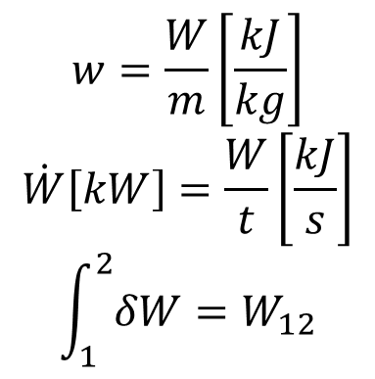
WORK, W [J, kJ]
Work -–Energy that is crossing the boundary other than heat
(electrical, stirrer, shaft, moving piston, etc.)
Also stated as the energy transfer associated with a
force acting for a distance.
Not a property (related to process)
Mode of energy transfer
W_{in}= -ve
system
W_{out}= +ve
$$w=\frac{W}{m}\left[\frac{kJ}{kg}\right]$$
$$\dot{W}\left[kW\right]=\frac{W}{t}\left[\frac{kJ}{s}\right]$$
$$\int_{1}^{2}{δW}=W_{12}$$
= rate of work = power
Depends on path

Slide 15
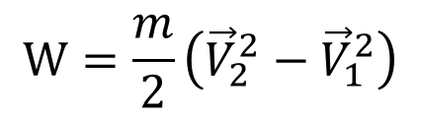
Types of Work
Work
Electrical
Mechanical
Boundary
Gravitational
Acceleration
Shaft
Spring
$$W=\frac{m}{2}\left({\vec{V}}_{2}^{2}−{\vec{V}}_{1}^{2}\right)$$

Slide 16
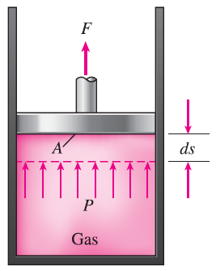
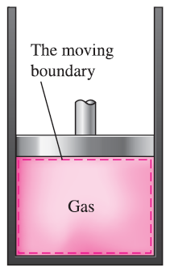
MOVING BOUNDARY WORK
Moving boundary work (P dV work): The expansion and compression work in a piston-cylinder device.
Quasi-equilibrium process: A process during which the system remains nearly in equilibrium at all times.
W_{b} is positive → for expansion
W_{b} is negative → for compression
The work associated with a moving
boundary is called boundary work.
A gas does a differential amount of work δW_{b} as it forces the piston to move by a differential amount ds.

Slide 17
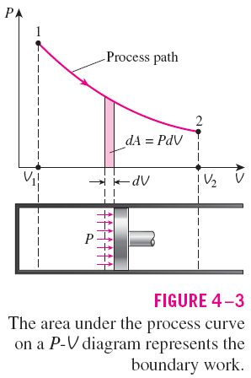
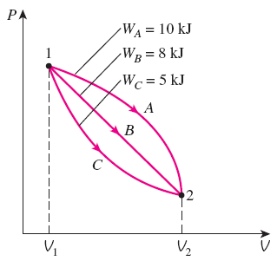
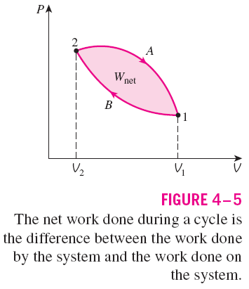
The boundary work done during a process depends on the path followed as well as the end states.
The area under the process curve on a P-V diagram is equal, in magnitude, to the work done during a quasi-equilibrium expansion or compression process of a closed system.

Slide 18

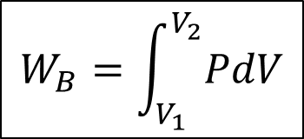
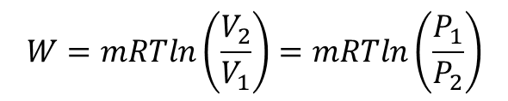
Boundary Work for Polytropic Processes
Boundary Work
$$W_{B}=\int_{V_{1}}^{V_{2}}{PdV}$$
Area under P-v graph
General Polytropic Work
( n ≠ 1 )
Const. Pressure Work (n=0)
Isothermal Work (n=1) ideal gas
$$W=mRTln\left(\frac{V_{2}}{V_{1}}\right)=mRTln\left(\frac{P_{1}}{P_{2}}\right)$$
Const. Volume Work (dv=0)
$$W_{\text{b} \text{const}\text{. }\text{vol}}=0$$

Slide 19
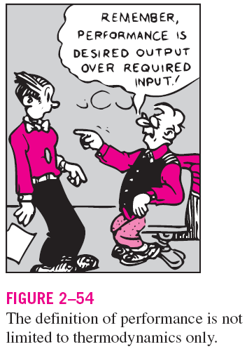
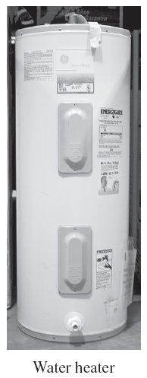
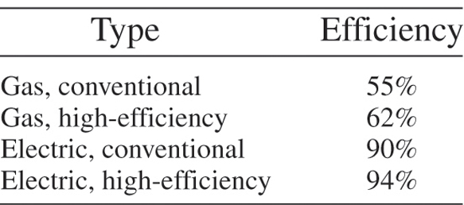
ENERGY CONVERSION & TRANSMISSION EFFICIENCIES
Efficiency is one of the most frequently used terms in thermodynamics, and it indicates how well an energy conversion or transfer process is accomplished.
Efficiency of a water heater: The ratio of the energy delivered to the house by hot water to the energy supplied to the water heater.

Slide 20
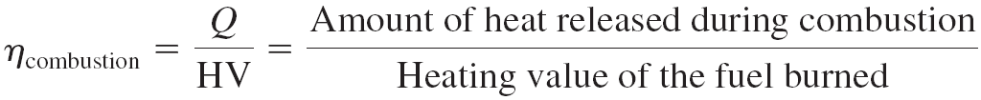
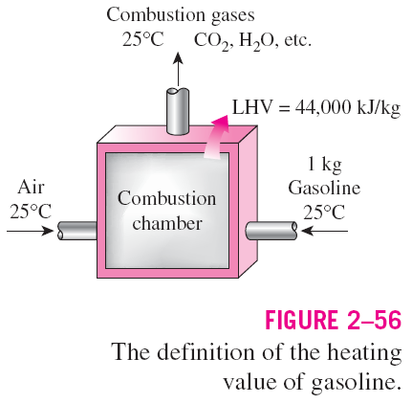
Heating value of the fuel: The amount of heat released when a unit amount of fuel at room temperature is completely burned and the combustion products are cooled to the room temperature.
Lower heating value (LHV): When the water leaves as a vapor.
Higher heating value (HHV): When the water in the combustion gases is completely condensed and thus the heat of vaporization is also recovered.
The efficiency of space heating systems of residential and commercial buildings is usually expressed in terms of the annual fuel utilization efficiency (AFUE), which accounts for the combustion efficiency as well as other losses such as heat losses to unheated areas and start-up and cool down losses.

Slide 21
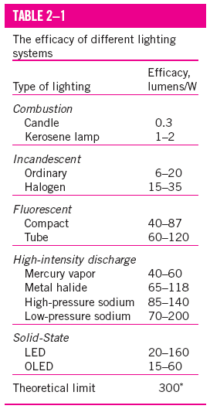
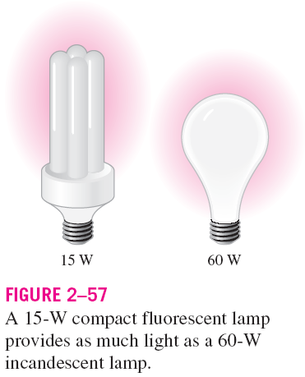
Generator: A device that converts mechanical energy to electrical energy.
Generator efficiency: The ratio of the electrical power output to the mechanical power input.
Thermal efficiency of a power plant: The ratio of the net electrical power output to the rate of fuel energy input.
Overall efficiency of a power plant
Lighting efficacy: The amount of light output in lumens per W of electricity consumed.

Slide 22
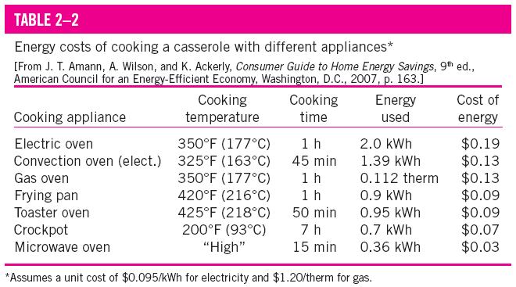
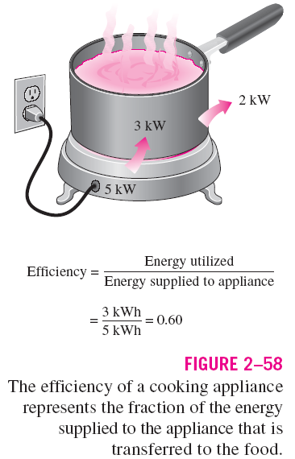
Using energy-efficient appliances conserve energy.
It helps the environment by reducing the amount of pollutants emitted to the atmosphere during the combustion of fuel.
The combustion of fuel produces
  carbon dioxide, causes global warming
  nitrogen oxides and hydrocarbons, cause smog
  carbon monoxide, toxic
  sulfur dioxide, causes acid rain.

Slide 23
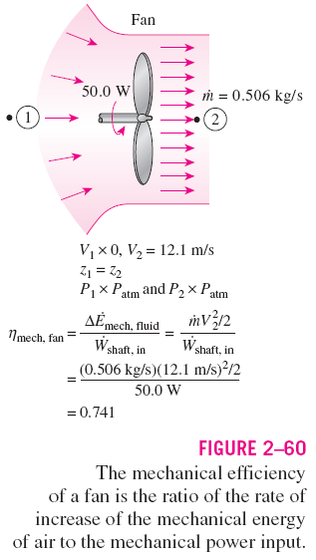
Efficiencies of Mechanical and Electrical Devices
Mechanical efficiency
The effectiveness of the conversion process between the mechanical work supplied or extracted and the mechanical energy of the fluid is expressed by the pump efficiency and turbine efficiency,

Slide 24
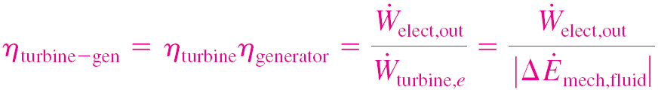
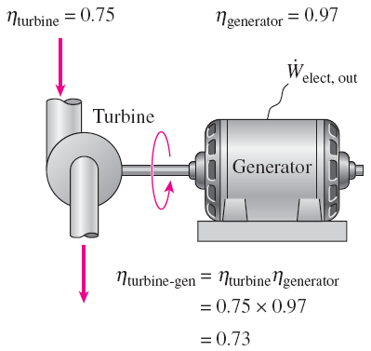
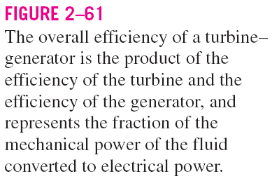
Pump efficiency
Generator efficiency
Pump-Motor overall efficiency
Turbine-Generator overall efficiency

Slide 25
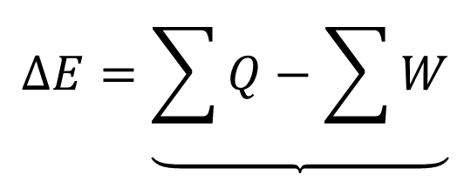
1st Law Closed System
W_{out}
Q_{out}
W_{in}
Q_{in}
$$∆E=\underbrace{\sum{Q}−\sum{W}}$$
Net change of system energy
Net total energy transfer in the form of heat and work

Slide 26
- Recall that System Energy consists of:
E_{system}= U + KE + PE
or
ΔE_{system}= ΔU + ΔKE + ΔPE
thus;
Q – W = ΔE_{system}= ΔU + ΔKE + ΔPE
Or can be called as the
1st Law/Energy Balance of a Closed System;
Q – W = ΔU + ΔKE + ΔPE
Net transfer of energy
Energy storage in different modes

Slide 27
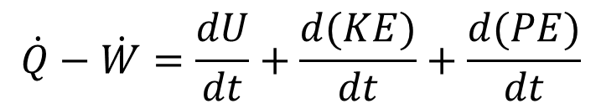
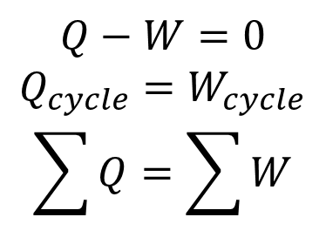
1st Law for Closed System in different forms;
Q – W = ΔU + ΔKE + ΔPE [kJ]
per unit mass;
q – w = Δu + Δke + Δpe [kJ/kg]
Rate form;
$$\dot{Q}−\dot{W}=\frac{dU}{dt}+\frac{d(KE)}{dt}+\frac{d(PE)}{dt}$$
[kW]
Cyclic Process ΔE =0
$$Q−W=0$$
$$Q_{cycle}=W_{cycle}$$
$$\sum{Q}=\sum{W}$$

Slide 28
summary;
Q – W = ΔU + ΔKE + ΔPE
mg(z₂-z₁)
m(u₂-u₁) water (Table)
mC_{v}(T₂-T₁) ideal gas
Electrical
Mechanical
  Boundary
  etc…

