Slide 1
Thermodynamics I
Chapter 2
Properties of Pure Substances
Mohsin Mohd Sies
Fakulti Kejuruteraan Mekanikal, Universiti Teknologi Malaysia

Slide 2
Properties of Pure Substances
(Motivation)
To quantify the changes in the system, we have to be able to describe the substances which make up the system.
The substance is characterized by its properties.
This chapter shows how this is done for two major behavioral classes of substance covered in this course; phase-change fluids, and gases.

Slide 3
PURE SUBSTANCE
3 major phases of pure substances;
Solid
Liquid
Gas
  plasma

Slide 4
Phase Change of Pure Substances
ex. Water at 1 atm of pressure
Not about to evaporate
Heat added T
Compressed liquid phase
T=25ºC
About to evaporate
Heat added evaporation starts
Saturated liquid phase
T=100ºC
T=100ºC
Heat added continues evap.
T unchanged
Wet steam or
Saturated liquid-vapor mixture
Saturated vapor
Saturated liquid

Slide 5
Phase Change of Pure Substances (ctd.)
ex. Water at 1 atm of pressure
T=100oC
All liquid evaporated
(about to condense)
Heat removed condensation
Saturated vapor phase
T=110oC
Not about to condense
Heat added T
Superheated vapor phase

Slide 6
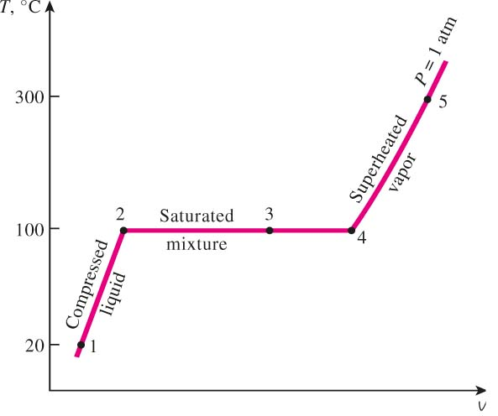
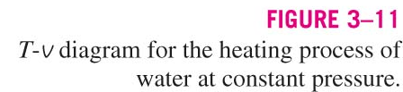

Slide 7
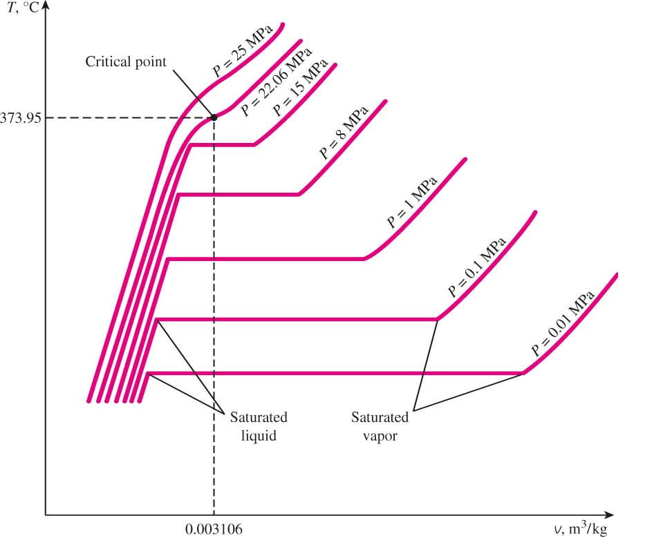
Evaporation temperature changes with pressure
During phase change, temperature and pressure are not independent T_{sat} <-> P_{sat}
Energy needed to vaporize (latent heat of vaporization) decreases with increasing pressure

Slide 8
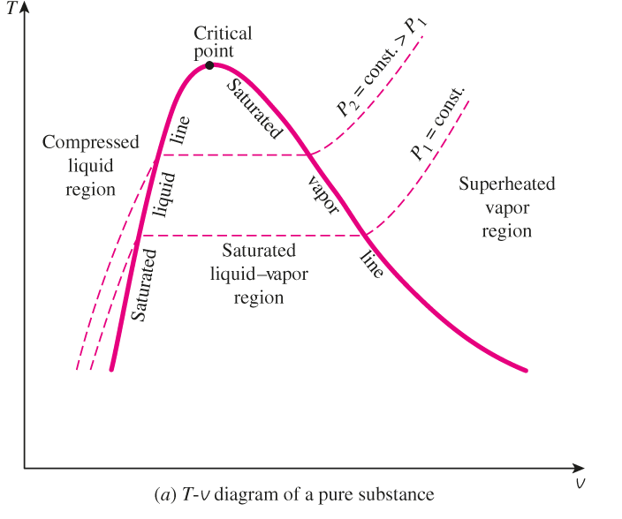

Slide 9
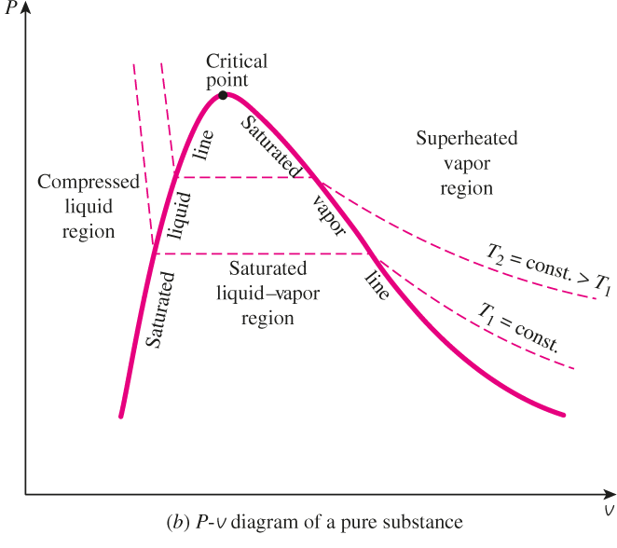

Slide 10
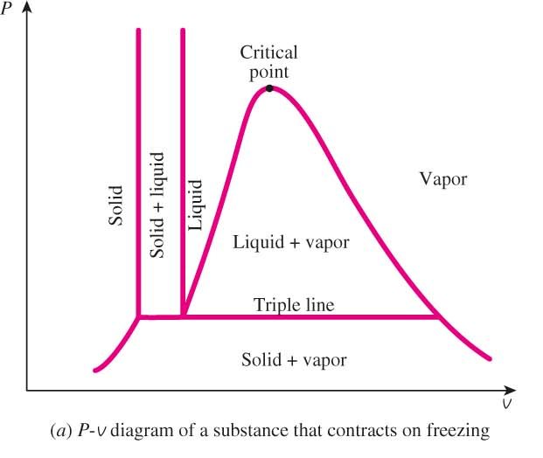

Slide 11
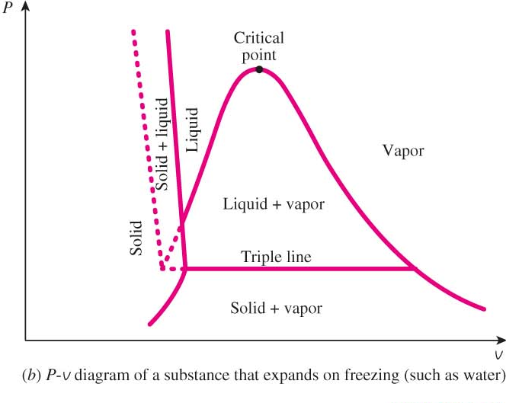

Slide 12
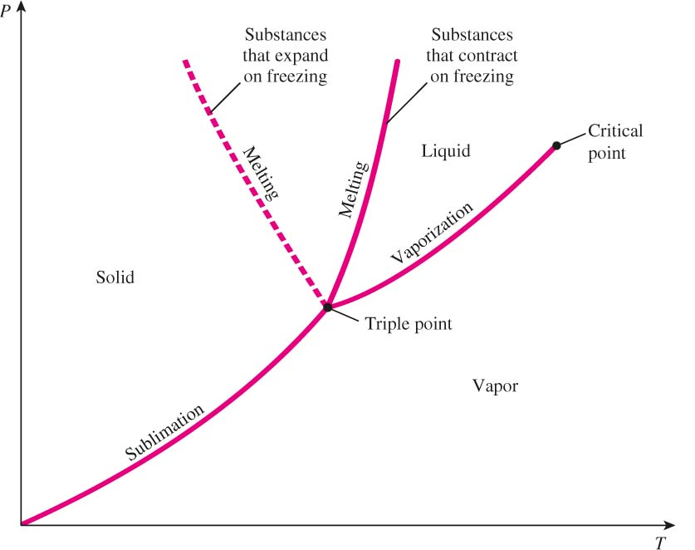


Slide 13
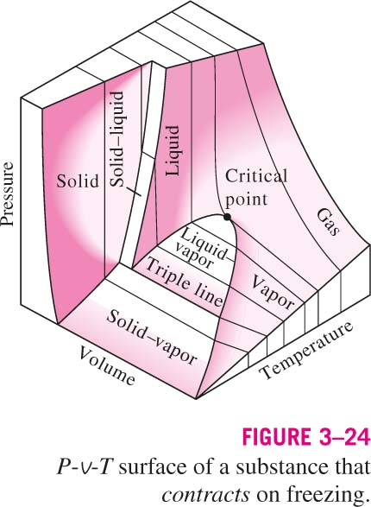

Slide 14
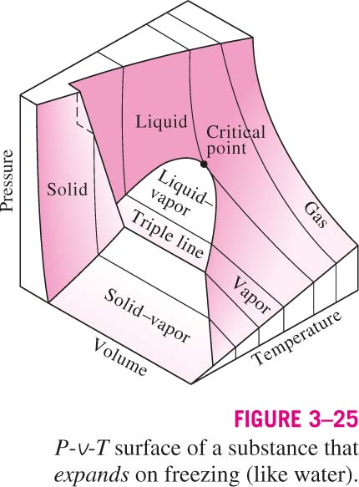

Slide 15
QUALITY, x (2 phase condition)
Saturated liquid-vapor mixture condition
x is a thermodynamic property
x exists only in the liquid-vapor mixture region
m_{vapor}
m_{liquid}
m_{vapor}
Degree of evaporation
Dryness fraction
quality
x
=
=
≡
=
m_{total}
0 ≤ x ≤ 1
(wet)
100% liquid
(dry)
100% vapor

Slide 16
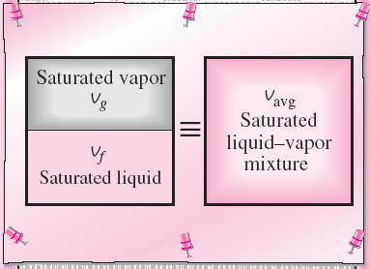
QUALITY, x (2 phase condition)
A two-phase system can be treated as a homogeneous mixture for convenience.

Slide 17
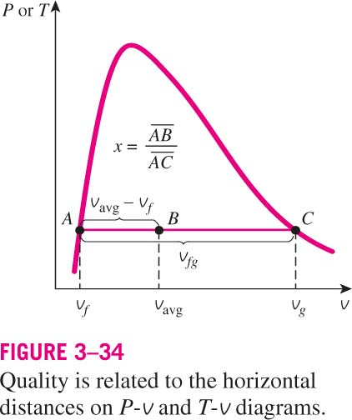
Enthalpy of vaporization, h_{fg} (Latent heat of vaporization): The amount of energy needed to vaporize a unit mass of saturated liquid at a given temperature or pressure.

Slide 18

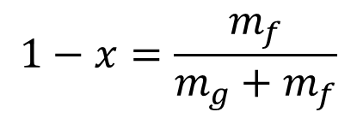





Quality (cont.)
$$x=\frac{m_{g}}{m_{g}+m_{f}}$$
$$1−x=\frac{m_{f}}{m_{g}+m_{f}}$$
$$x≡\frac{m_{g}}{m_{g}+m_{f}}$$
By employing the
additive behavior
of extensive properties
$$=\frac{{v−v}_{f}}{v_{g}−v_{f}}$$
$$=\frac{{h−h}_{f}}{h_{g}−h_{f}}$$
$$=\frac{{u−u}_{f}}{u_{g}−u_{f}}$$
$$=\frac{{s−s}_{f}}{s_{g}−s_{f}}$$

Slide 19
Some Additional Thermodynamic Properties
Internal Energy, U [kJ]
Specific Internal Energy, u [kJ/kg]
Enthalpy, H [kJ]
H ≡ U + PV
Specific Enthalpy, h [kJ/kg]
h = u + Pv
Entropy, S [kJ/K]
Specific Entropy, s [kJ/kg.K]

Slide 20
PROPERTY TABLES
3 types of tables
Compressed liquid table
Saturated table
Superheated table
Saturated tables
Temperature table – T in easy to read numbers
Pressure table – P in easy to read numbers

Slide 21
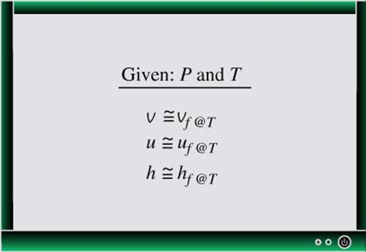
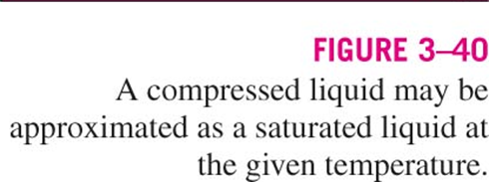
Compressed Liquid Approximation
Because liquid is more sensitive to
changes of temperature than that of pressure

Slide 22
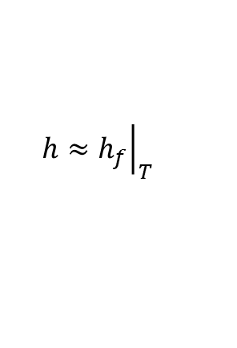
Choosing which table to use
Determine state (phase) first!
How? Compare the given properties against the saturated table
(ex. given h & T)
If h_{f} ≤ h ≤ h_{g} at the given T
→Mixture phase
→ use saturated table
If h > h_{g} at the given T
→ Superheated phase
→ use superheated table
If h < h_{f} at the given T
→ Compressed liquid phase
→ use saturated table
$$h≈{\left.h_{f}\right|}_{T}$$

Slide 23
Choice of tables (cont.)
If P & T is given
P ↔ T_{sat}
T ↔ P_{sat}
P > P_{sat} at the given T
T < T_{sat} at the given P
P < P_{sat} at the given T
T > T_{sat} at the given P
Compressed liquid
Superheated vapor
Best determined by simple sketching of
the P-v or T-v diagram

Slide 24

Choice of tables (additional)
(ex. given h & P)
If h_{f} ≤ h ≤ h_{g} at the given P
→Mixture phase
→ use saturated table
If h > h_{g} at the given P
→ Superheated vapor phase
→ use superheated vapor table
If h < h_{f} at the given P
→ Compressed liquid phase
→ use saturated table
P ↔ Tsat
$$h≠{\left.h_{f}\right|}_{P}$$
$$h≈{\left.h_{f}\right|}_{Tsat}$$

Slide 25
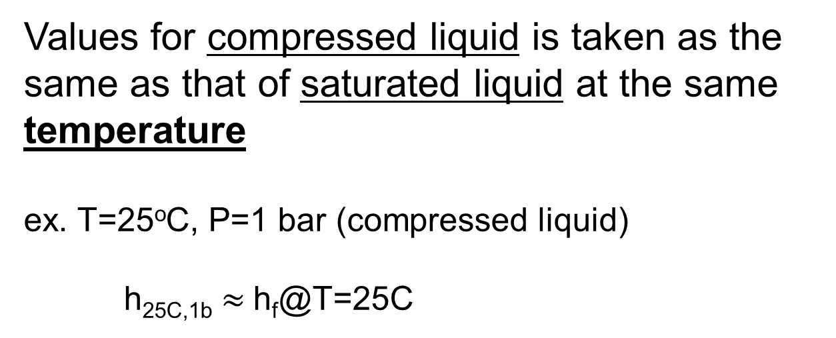
Notes on Using Property Tables
Some tables do not list h (or u)
→ u (or h) can be obtained from h = u + Pv
Values for compressed liquid is taken as the same as that of saturated liquid at the same temperature
ex. T=25ºC, P=1 bar (compressed liquid)
h_{25C,1b} $≈$h_{f}@T=25C

Slide 26
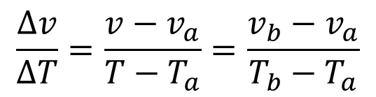
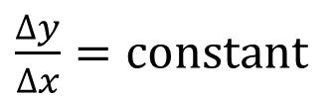
Interpolation (Linear Interpolation)
b
Tb
Assume a & b connected by a straight line
T
a
Ta
va
v=?
vb
$\frac{∆y}{∆x}=\text{constant}$
Employ concept of slope
$$\frac{∆v}{∆T}=\frac{v−v_{a}}{T−T_{a}}=\frac{v_{b}−v_{a}}{T_{b}−T_{a}}$$

Slide 27
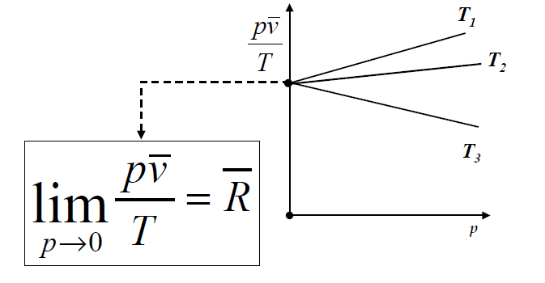
Ideal Gas
(Initial Observations)
As pressure approaches zero, (pv/T) approaches a constant value.
Equation of state is an equation that relates P, V, and T at a state
for a given substance.

Slide 28
IDEAL GAS
Real gases behave as an ideal gas at
low densities (i.e., low pressure, high temperature)
pressures much lower than critical pressure

Slide 29
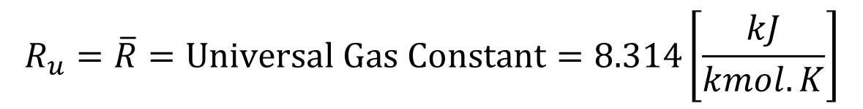


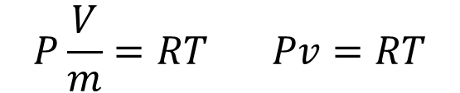
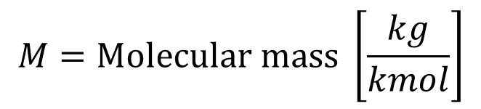
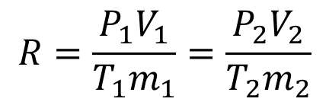
IDEAL GAS
Equation of state for ideal gas
$$PV=mRT$$
R = Gas Constant [kJ/kg.K]
$$P\frac{V}{m}=RT Pv=RT$$
(constant for a gas, value depends on type of gas)
$$R=\frac{R_{u}}{M}$$
$$M=\text{Molecular} \text{mass} \left[\frac{kg}{kmol}\right]$$
$$R_{u}=\overline{R}=\text{Universal} \text{Gas} \text{Constant}=8.314\left[\frac{kJ}{kmol.K}\right]$$
$$R=\frac{P_{1}V_{1}}{{T_{1}m}_{1}}=\frac{P_{2}V_{2}}{{T_{2}m}_{2}}$$
Can be used to relate between different states

Slide 30


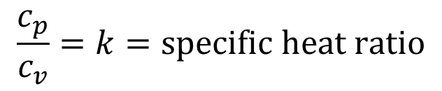





Ideal gas u, h, c_{p}, c_{v} relationship
Constant Volume Specific Heat Capacity c_{v}
$$c_{v}=\frac{du}{dT}$$
Constant Pressure Specific Heat Capacity, c_{p}
$$c_{p}=\frac{dh}{dT}$$
$$du=c_{v}dT$$
$$c_{p}=\frac{kR}{k−1}$$
$$dh=c_{p}dT$$
$$c_{p}=c_{v}+R$$
h = u + Pv
$$c_{v}=\frac{R}{k−1}$$
$$\frac{c_{p}}{c_{v}}=k=\text{specific} \text{heat} \text{ratio}$$

Slide 31

POLYTROPIC PROCESS
-Processes that obey/follow the path
pv^{n} = c
n = polytropic index
$$−∞≤n≤∞$$
p
1
pv^{n} = c
2
v
p₁v₁^{n} = p₂v₂^{n}
Can be used to relate between two states

Slide 32

Some special cases for polytropic processes
n = 1 isothermal
n = 0 isobaric
n = const. volume
$$±∞$$
Ideal Gas & Polytropic Process combined
Can be used to relate between two states

Slide 33
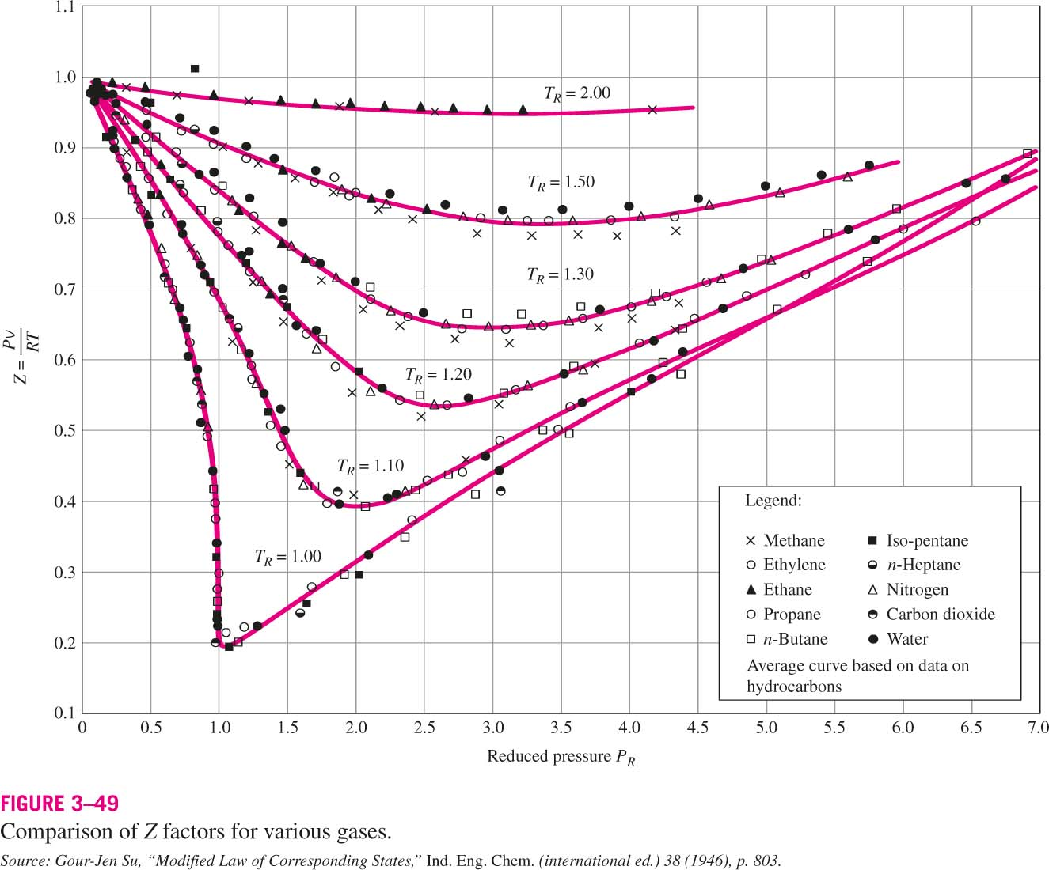
Real Gases & Compressibility Factor

Slide 34
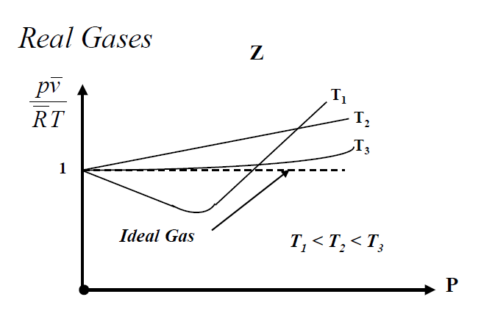

Slide 35
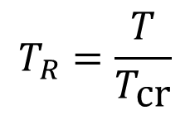
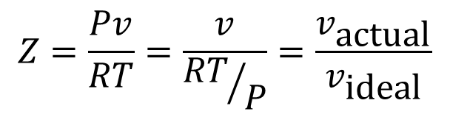
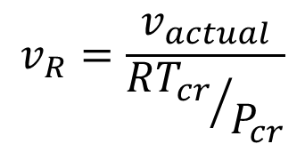
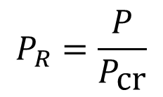
Compressibility Factor
$$Z=\frac{Pv}{RT}=\frac{v}{{RT}/P}=\frac{v_{\text{actual}}}{v_{\text{ideal}}}$$
Reduced temperature
$$T_{R}=\frac{T}{T_{\text{cr}}}$$
$$v_{R}=\frac{v_{actual}}{{RT_{cr}}/{P_{cr}}}$$
Pseudo-reduced specific volume
Reduced pressure
$$P_{R}=\frac{P}{P_{\text{cr}}}$$

Slide 36
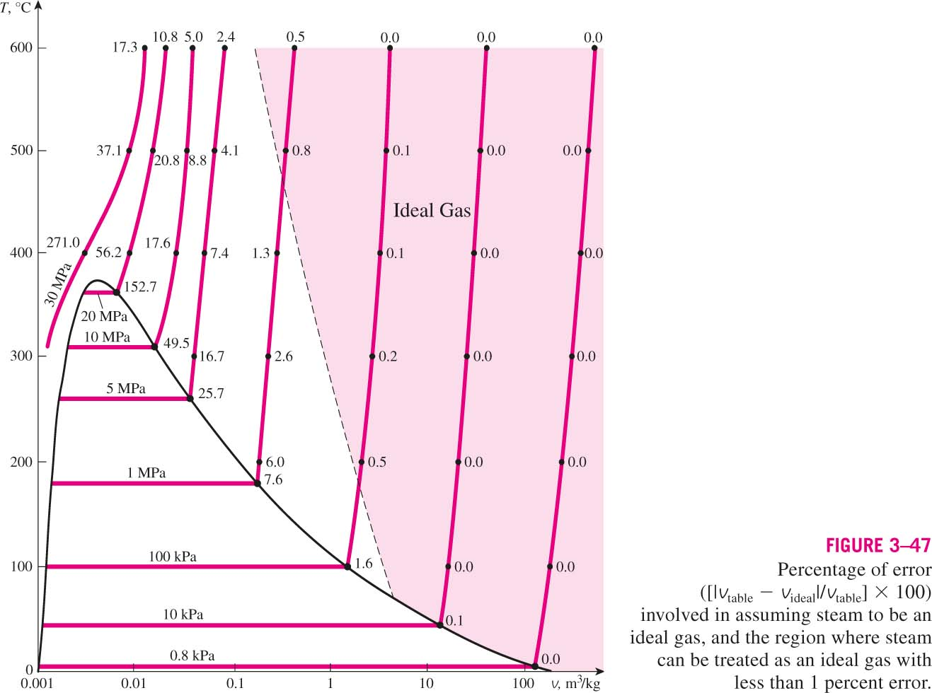
Is water an ideal gas?

Slide 37
Air,
N2 , He, etc.
H2O (Water, Steam)
Ideal Gas
Property Tables !!!
pV = mRT
& other relations
h = cpT
u = cvT
etc.

Slide 38

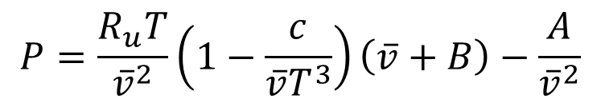
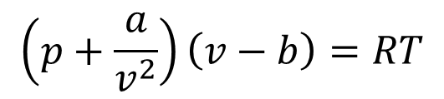
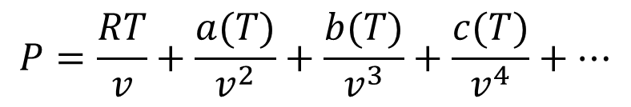
Other Equations of State
Van der Waal’s :
$$\left(p+\frac{a}{v^{2}}\right)\left(v−b\right)=RT$$
Beattie-Bridgeman :
$$P=\frac{R_{u}T}{{\overline{v}}^{2}}\left(1−\frac{c}{{\overline{v}T}^{3}}\right)\left(\overline{v}+B\right)−\frac{A}{{\overline{v}}^{2}}$$
Benedict-Webb-Rubin :
Virial equations of state:
$$P=\frac{RT}{v}+\frac{a(T)}{v^{2}}+\frac{b(T)}{v^{3}}+\frac{c(T)}{v^{4}}+⋯$$

Slide 39
The apparent and the implied
Some examples…
The Apparent
The Implied
Rigid tank
Frictionless cylinder, freely moving piston
Constant volume (V=c)
Constant pressure (p=c)

