Slide 1
NUCLEAR REACTOR MATERIALS
2. Materials in Bwr

Slide 2
In this Chapter
Design and Materials of BWR Components
Corrosion-Related Issues in BWR

Slide 3
1. Design and Materials of BWR Components

Slide 4
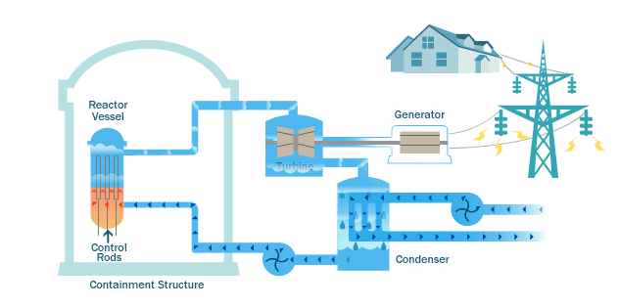
BWR

Slide 5
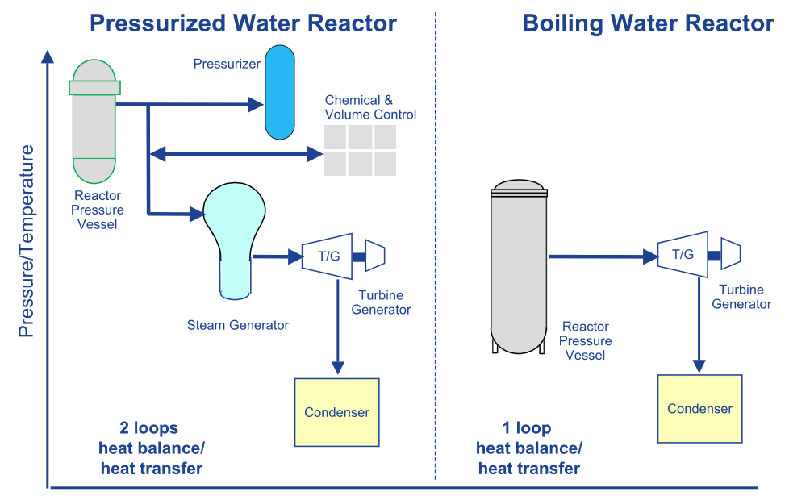
BWR and PWR

Slide 6
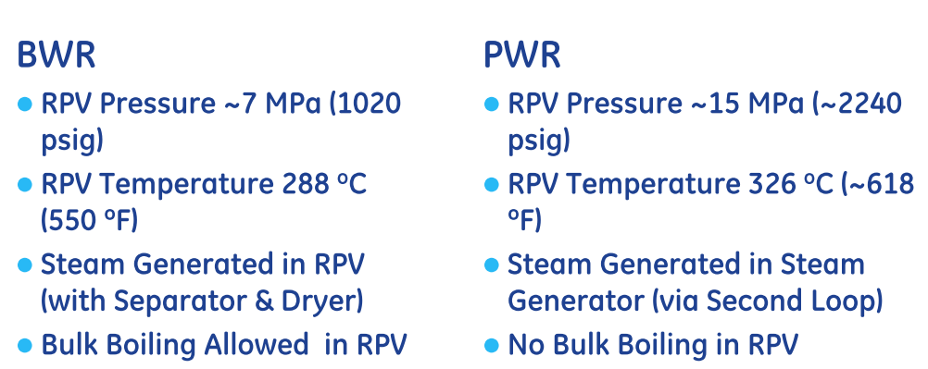
Principle of Steam Generation

Slide 7
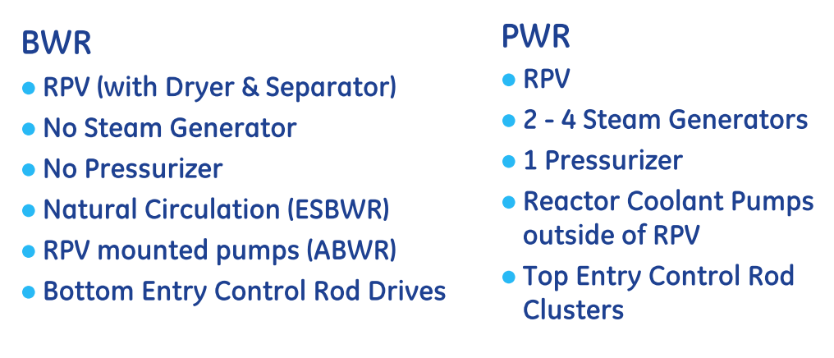
Major Components

Slide 8
BWR Design
Selected by GE due to its inherent advantages in control and design simplicity.
Single loop system; steam and associated secondary systems are radioactive.
Operating pressure is approximately half that of a PWR
H₂O as coolant and moderator
Boiling of water in the core
Temperature about 300

Slide 9
BWR Advantages
Single loop eliminates steam generator
Bottom entry control rods reduce refueling outage time/cost; also provide adequate shutdown margin during refueling.
Lower operating pressure lowers cost to obtain safety margin against piping rupture.
Notes:
The control rods consist of stainless steel absorber tubes filled with boron carbide (B4C) powder.

Slide 10
BWR Disadvantages
More radiation/contamination areas; increased cost associated with radiation waste.
Piping susceptible stress corrosion cracking
Off-gas issues (e.g. - H₂ gas presents explosion potential, low levels of radioactive noble gases are continuously released).

Slide 11
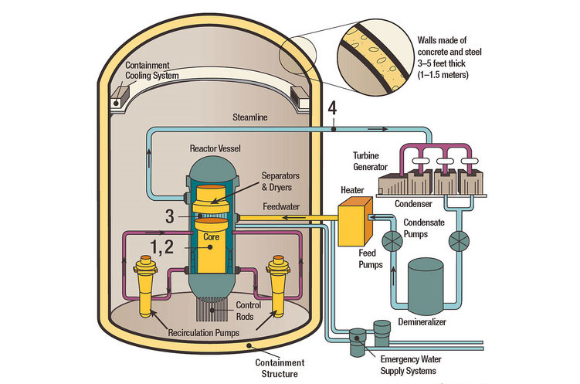
Primary loop Recirculation Piping
.
The Recirculation System is used in the Boiling Water Reactor design. This system provides the following functions:
Control of reactor power level through the variable speed recirculation pumps
Cooling of the reactor during off-normal modes
Paths for emergency makeup and chemical purification
Notes:
Primary loop recirculation

Slide 12
Penetrations providing water to the recirculation system include:
  low pressure coolant injection to provide emergency makeup to cool the reactor at low pressure and high flowrate (~2000-3000 gpm),
  shutdown cooling system to return cooled water back to the reactor,
  isolation condenser, if used, to return cooled water back to the reactor. The isolation condenser is used to cool steam from the reactor if the main steam isolation valves close. The water is returned to the reactor by natural circulation. Pumped flow is not required.

Slide 13
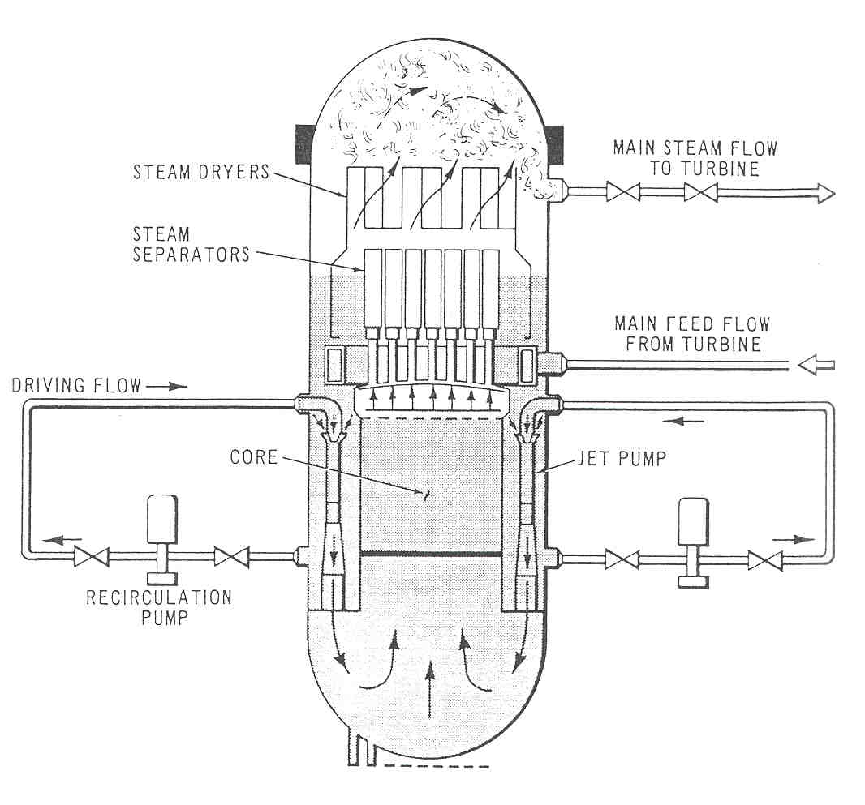
BWR Design- Internal Flow
Feedwater enters downcomer.
Recirculation loops provide forced circulation.
Moisture removed by separators and dryers.
Steam exits steam dome.

Slide 14
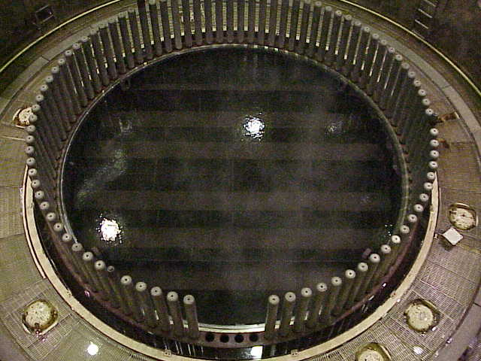
BWR Design- Internal Flow
Steam Dryer installed in Reactor Pressure Vessel
10
Notes:
The addition of reactor internal pumps (RIP) mounted on the bottom of the reactor pressure vessel (RPV) - 10 in total - which achieve improved performance while eliminating large recirculation pumps in containment and associated large-diameter and complex piping interfaces with the RPV (e.g. the recirculation loop found in earlier BWR models)

Slide 15
BWR Plant Layout
The entire Reactor Coolant System (RCS) and other primary support systems are located within containment (the drywell) and reactor buildings.
Main Steam, Condensate and Feedwater (all radioactive) are housed within the turbine building.
The reactor is operated remotely from the control building.
Steam generated by the reactor is admitted to four main steam lines.
One high pressure and three low pressure turbines convert thermodynamic energy into mechanical energy to drive the main generator.

Slide 16
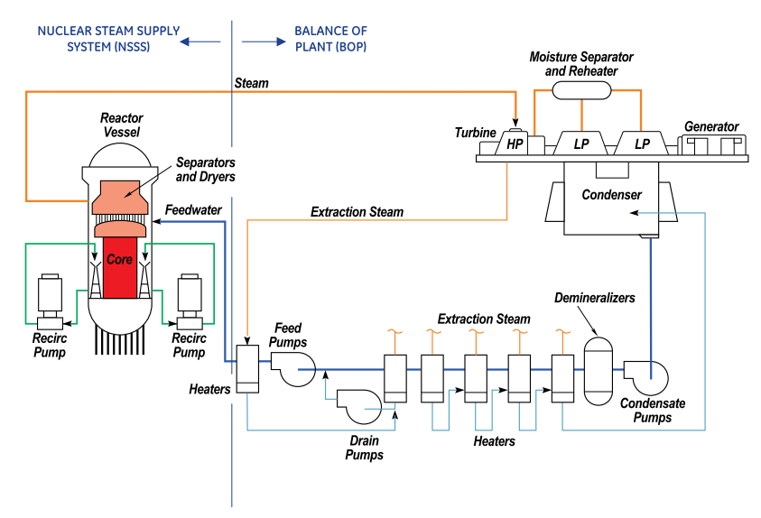

Slide 17
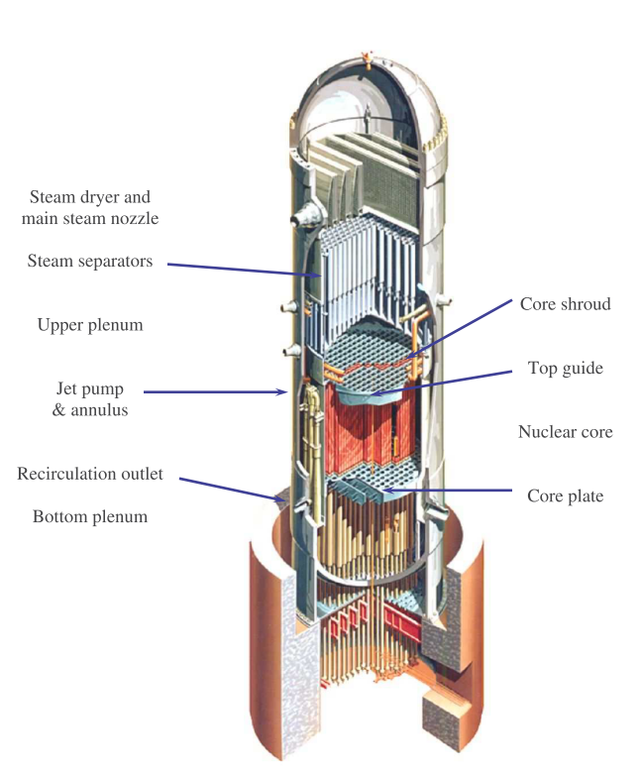
General
At the top of the core there is a dome or upper plenum at the top of which are steam separators, then steam dryers.
The separators produce a rotating vortex flow, and the liquid water is centrifugally forced to the outside, where it is routed outside the separator and falls on the top of the dome, then into the annulus.
Most structural materials (the vessel, the external piping, the outside of the shroud, the bottom plenum and the core support plate, etc.) are exposed to 274°C water.

Slide 18
Fuel Assembly
Fuel rods are fabricated into fuel bundles.
Once these fuel bundles are sheathed in a rigid casing called the channel, they are referred to as fuel assemblies.
The mechanical design process for nuclear fuel emphasizes that the fuel assembly will provide substantial fission product retention capability during all potential operational modes
The purposes of the reactor fuel assemblies include:
• Energy generation
• Fission Product Barrier
• Distribution of water flow to the fuel assemblies and bypass regions

Slide 19
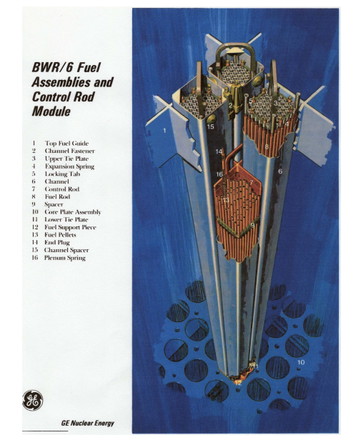
BWR fuel rods are enclosed in “channels” or zirconium alloy wrappers around the fuel bundle
About 90% of the water flows through the fuel channel, and 10% flows in the “bypass” regions between fuel bundles or around the periphery of the core along the inside of the shroud.

Slide 20
Fuel assemblies assemblies:
– Number of fuel assemblies assemblies: 840
– Total length: 4.47 m
– Active length: 3.71 m
– Lattice Lattice: 9 x 9
– Number of rods per assembly assembly: 81

Slide 21
Fuel rods:
– Outer diameter diameter 9.62 mm
– Wall thickness thickness 0.72 mm
– Fuel: up to 4.02 % enriched UO2, sintered to ceramic pellets of 92% theoretical density
– Cladding material: Zircaloy 4 (99% Zr, Sn,Fe,Ni)

Slide 22
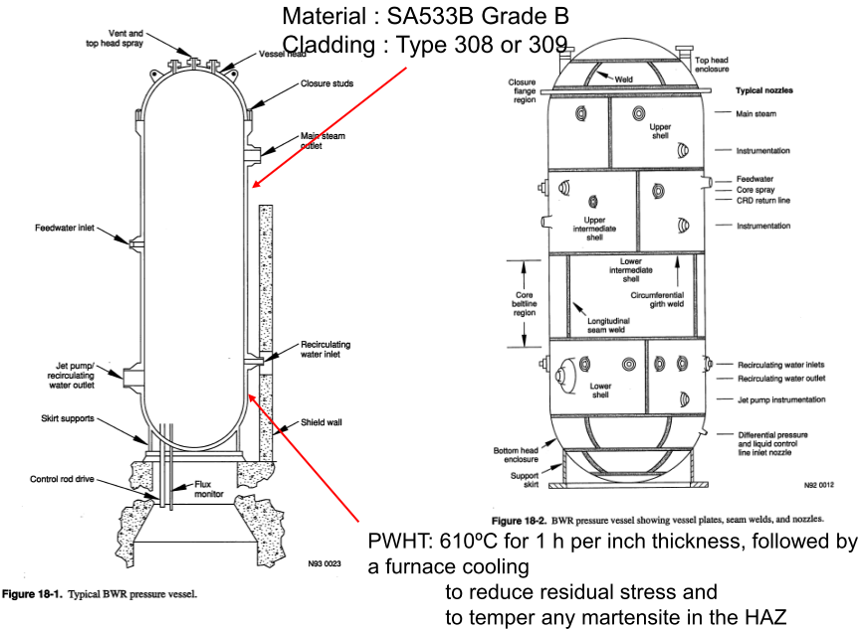
Reactor Pressure Vessel

Slide 23
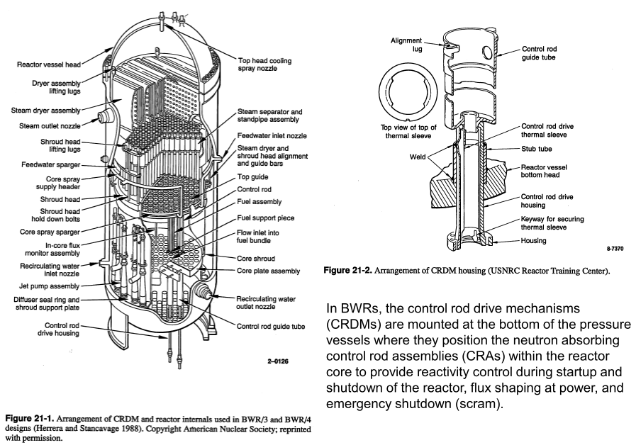

Slide 24
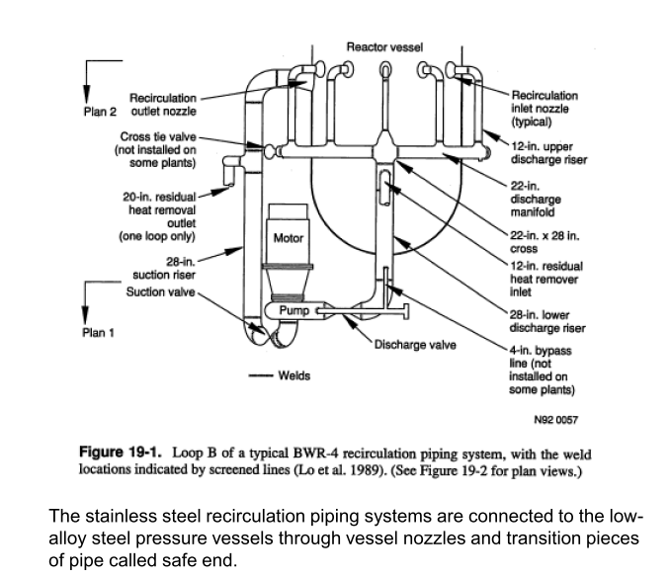
Recirculation Piping

Slide 25
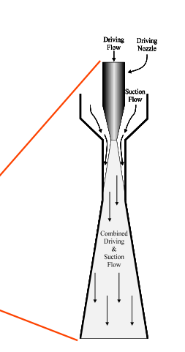
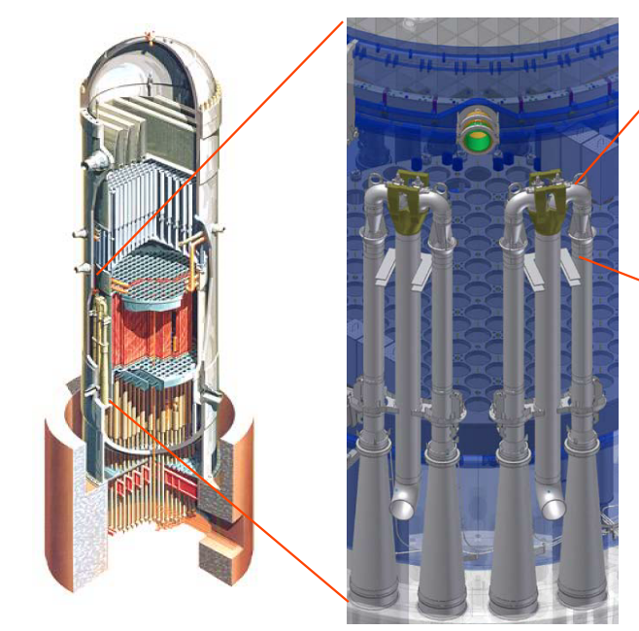
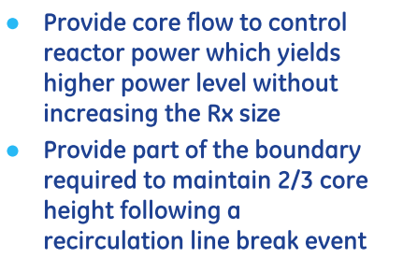
Jet Pump
Notes:
Jet pumps are considered as part of the reactor cooling system. The pumps are installed in the annular region between the core barrel and the outside reactor vessel. The driving head for these jet pumps is provided by the pressure head provided by the discharge of the recirculation pumps.

Slide 26
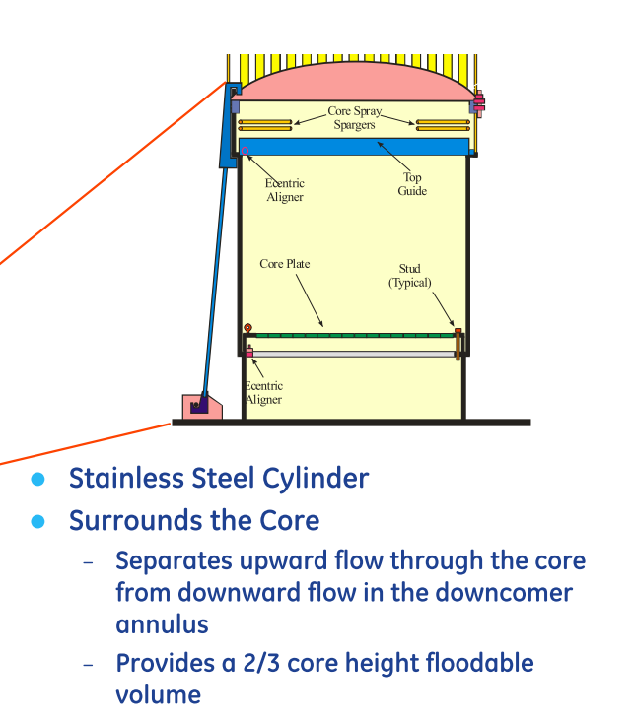
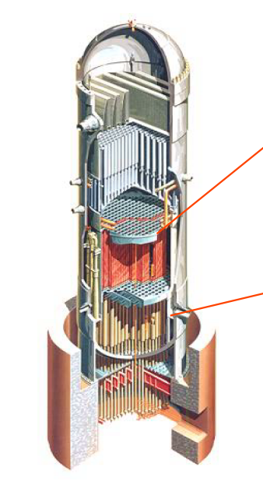
Core Shroud

Slide 27
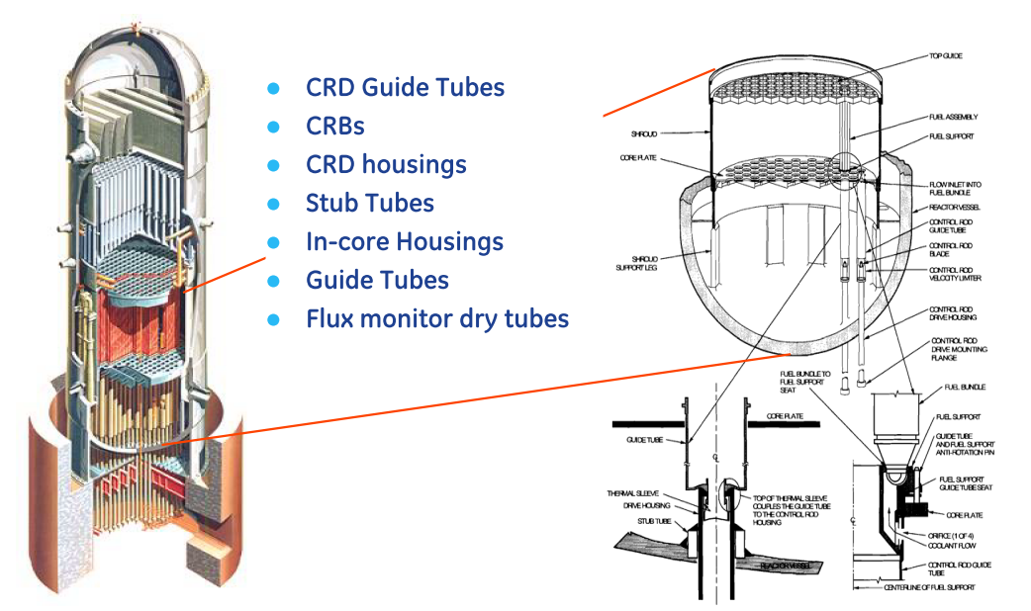
Lower Plenum

Slide 28
EMERGENCY CORE COOLING
SYSTEMS (ECCS)
Prevent fuel cladding fragmentation for any failure including a design basis accident.
Independent, automatically actuated cooling systems.
Function with or without off-site power.
Protection provided for extended time periods.
Consists of:
  High Pressure Coolant Injection (HPCI)
  Low Pressure Coolant Injection (LPCI)
  Core Spray
  Automatic Depressurization System
Notes:
a boiling water reactor has a negative void coefficient, that is, the neutron (and the thermal) output of the reactor decreases as the proportion of steam to liquid water increases inside the reactor.

Slide 29
Boiling water reactor (BWR) water chemistry is necessarily of high purity because boiling occurs on the fuel rods and the resulting steam directly drives the turbine.
If high purity were not maintained then high concentrations of aggressive species would be formed on the heat transfer surface where boiling occurs.
While the condensate from the turbine is fully demineralized before returning to the reactor pressure vessel as feed water, the reactor water must also be cleaned up, because otherwise nonvolatile impurities would concentrate because of boiling.
The reactor water clean up system typically runs at 0.5 to 1% of the feed water flow rate, cooling the water before running it through demineralizers.

Slide 30
2.Corrosion-Related Issues in BWR

Slide 31
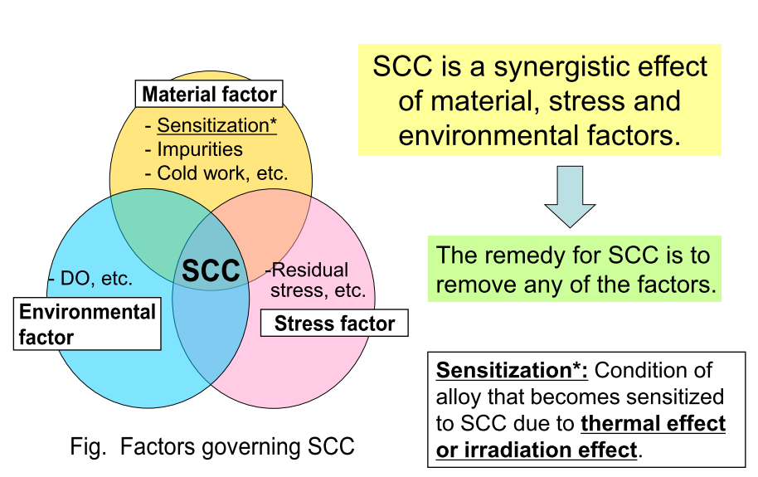
SCC in BWR

Slide 32
Water Chemistry
As water flows through the core and is exposed to ionizing radiation (esp. neutrons, which are slowed by their collisions with water and eventually reach “thermal” energies, a wide variety of radiolysis products are produced.
The primary species can be considered to be H₂ and H₂O₂ .
H₂ partitions to the steam phase, so the recirculated water is always oxidant rich.
H₂O₂ decomposes to H₂O and O₂ , and the relative proportions of O₂ and H₂O₂ changes with time and distance away from the core.
Typical recirculation water has ≈ 200 ppb O₂ and ≈10 ppb H₂.
Notes:
(esp. H) , at which
point they are most effective in producing fission reactions),

Slide 33
Water Chemistry
In the core, some ¹⁶ O is transmuted to ¹⁶ N, which has a half-life of 7.13 seconds.
In normal water chemistry, the stable form of N is NO₃ – , which remains soluble.
However, when sufficiently high H₂ is injected into BWRs, the stable form becomes NH₃, which are volatile.
Thus, rather than remaining in the recirculated reactor water as it decays, ¹⁶ N becomes volatile and can cause a large increase (up to (10X) in the turbine radiation level.
Notes:
(n,p)

Slide 34
Water Chemistry
Impurities in BWR water are ionic as well as non-ionic. However, only ionic impurities have to be considered when discussing SCC.
-corrosion products
--chloride
--carbon dioxide and carbonate
--sulfate
--nitrate and nitrite
--fluoride
--boric acid and borate

Slide 35
Water Chemistry
The most general and important effects of impurities are:
Anions inside the crack lower pH and thereby increase solubility of steel corrosion products in the crack environment. This leads to enhancement of crack propagation.
Oxidizing species raise the cathode potential of the operating corrosion cell-this will enhance IGSCC.
Some impurities may affect stability of the protective passive film, cause catalytic dissolution of hydrogen in the steel and enhance cracking.

Slide 36
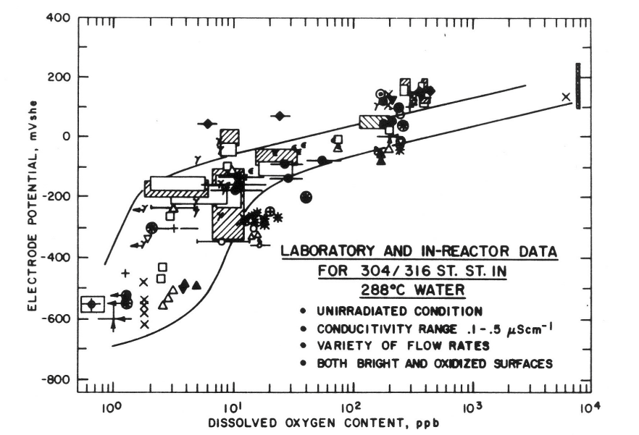
The presence of oxidants like H2O2 and O2 in the water cause an increase in the corrosion potential of metals
Relationship between corrosion potential of 304 SS and dissolved oxygen content as a function of water temperature

Slide 37
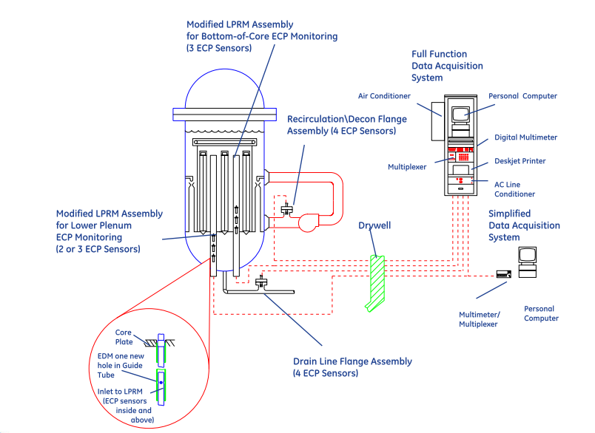
ECP Monitoring Locations
Notes:
local power region monitor (LPRM) assembly capable of suppressing temperature elevation in the vicinity of an incore housing at the lower portion of a pressure vessel of an ABWR type reactor.

Slide 38
Water Chemistry
Control of water purity is particularly important in BWRs because the higher corrosion potential due to anionic impurities like Cl– and SO₄²⁻
Until the late 1980s, many BWRs operated at solution conductivities between 0.3 and 0.8 (S/cm, which corresponds to 30 – 90 ppb of (usually acidic) impurities
These were often Cl– and SO₄²⁻ which are particularly damaging and were responsible for extensive cracking
some ions, like chromate, nitrate and silicate anions have little effect on SCC unless their concentrations exceed 25 ppb, 100 ppb or 1000 ppb respectively

Slide 39
Water Chemistry
A conductivity of 0.10 µS/cm represents only about 6 ppb Cl – as HCl (1.7 x 10 ^{–7} N).
There is a limited value in striving for theoretical purity water because OH– is present at 2.3 x 10 ^{–6} N in pure water
Both logic and modern data support the idea that, when the “foreign” anions concentration is well below a tenth of the OH– concentration, their role in carrying ionic current and thereby changing crack chemistry diminishes.

Slide 40
Stress Aspects
Almost all SCC cases in BWR components occur in the vicinity of welds where the level of residual stresses produced by weld shrinkage is a very important factor having an impact on both crack initiation and crack propagation.
For austenitic steels, SCC cracks propagate mainly through the heat affected zone (HAZ) of the base metal.
Notes:
here are three major groups in the family of stainless steels: austenitic, ferritic, and martensitic. Austenitic steels, which contain 16 to 26 percent chromium and up to 35 percent nickel, usually have the highest corrosion resistance. They are not hardenable by heat treatment and are nonmagnetic.

Slide 41
Stress Aspects-HAZ
HAZ- is the area of base material, either a metal or thermoplastic, which is not melted and has had its microstructure and properties altered by welding or heat intensive cutting operations.
The extent and magnitude of property change depends primarily on the base material, the weld filler metal, and the amount and concentration of heat input by the welding process.
The thermal diffusivity of the base material plays a large role—if the diffusivity is high, the material cooling rate is high and the HAZ is relatively small.
Alternatively, a low diffusivity leads to slower cooling and a larger HAZ. The amount of heat input during the welding process also plays an important role as well
Processes like oxyfuel welding use high heat input and increase the size of the HAZ. Processes like laser beam welding give a highly concentrated, limited amount of heat, resulting in a small HAZ.

Slide 42
Stress Aspects
The stress level at the surface triggers the process of crack initiation and these stresses may be either applied or residual.
Flaws and other surface imperfection can act as stress raisers increasing local stresses at the (near) surface.
Thus, corrosion attack (pitting or intergranular corrosion) or fabrication/welding defects/imperfections can act as a starting point for SCC.
Not only residual stresses but also cold work of the material can have pronounced effects on crack initiation and crack propagation.
Very high surface stresses may also result from cold work introduced by fabrication processes such as machining, grinding or other surface finishing operations.

Slide 43
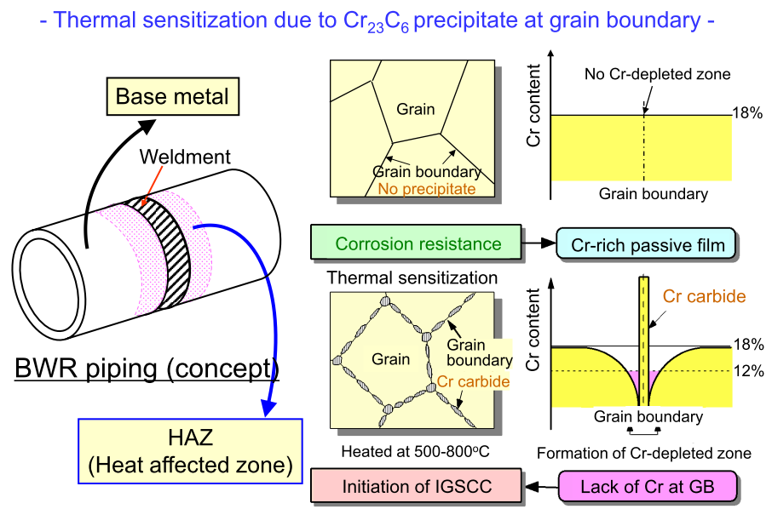

Slide 44
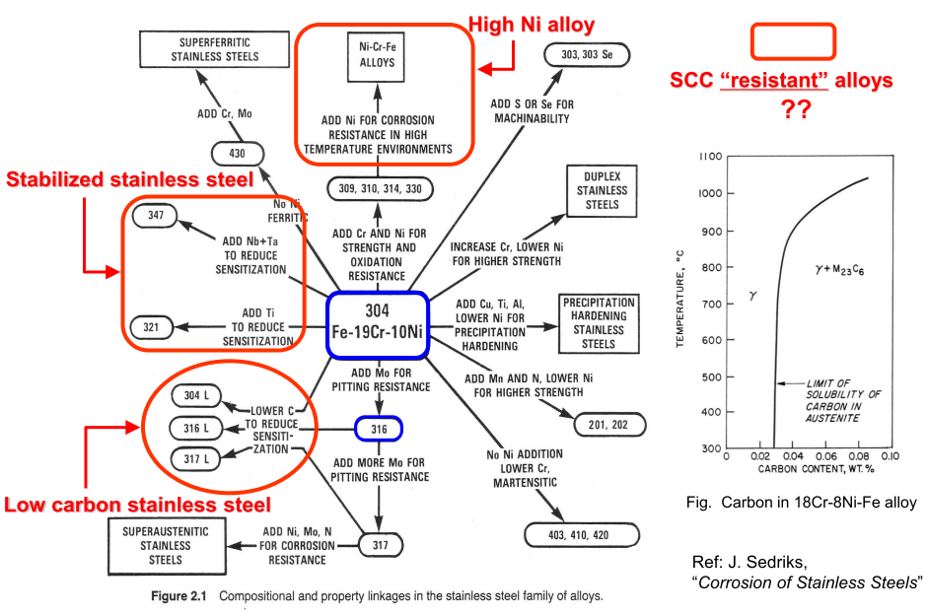
Notes:
The most common austenitic alloys are iron-chromium-nickel steels and are widely known as the 300 series.

Slide 45
Material Aspects
Stress corrosion cracking (SCC) frequently occurred in BWR plants in the heat-affected zone of the welds in PLR (Primary Loop Recirculation) piping fabricated from type 304 SS.
The adoption of low-carbon SS was considered to be the one of the solutions to SCC, as such 316L has been developed.
Typically, the shrouds made from type 304 SS have been progressively replaced with those made from type 316L SS
Notes:
The “L” grades are used to provide extra corrosion resistance after welding. The letter “L” after a stainless steel type indicates low carbon (as in 304L). The carbon is kept to .03% or under to avoid carbide precipitation.

Slide 46
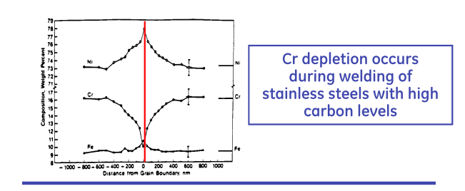
Low Carbon SS
Notes:
Since 2001, however, SCC that is not associated with sensitization has been found in core shrouds and
recirculation piping made of low-carbon stainless steel. To counter this problem, techniques including the removal of surface cold working and stress improvement have begun to be adopted.

Slide 47
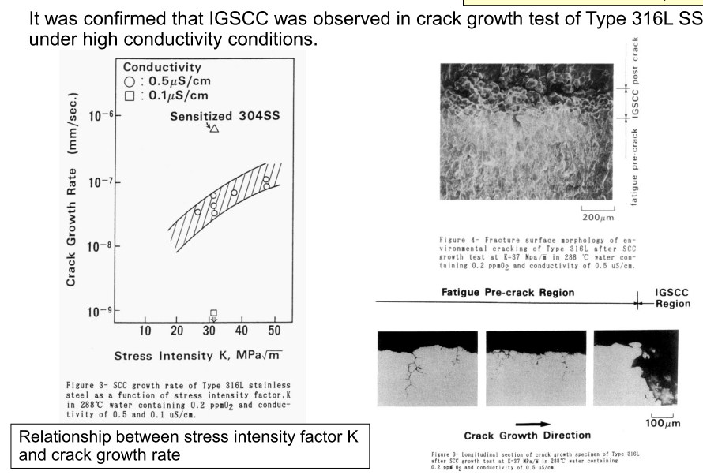

Slide 48
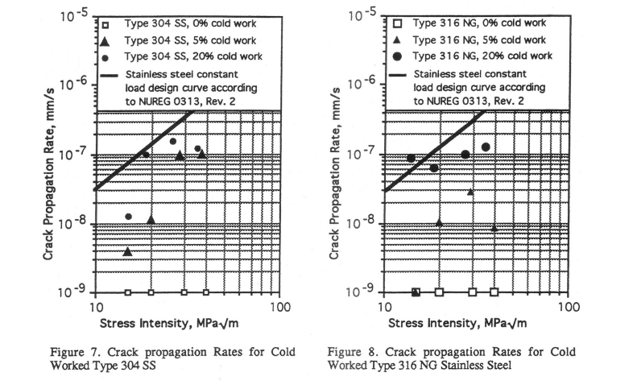
It was confirmed that SCC growth rate highly increased with increase of cold work in Type 316NG SS.
Notes:
Alloys not amenable to heat treatment, including low-carbon steel, are often work-hardened
Cold working (rolling, bending, drawing)is the strengthening of a metal by plastic deformation. This strengthening occurs because of dislocation movements and dislocation generation within the crystal structure of the material

Slide 49
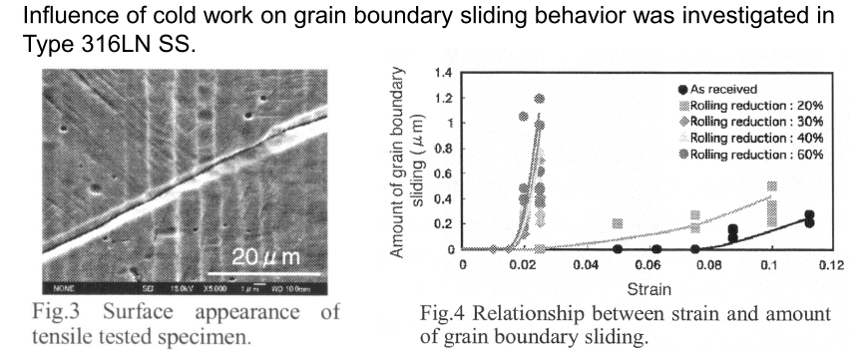
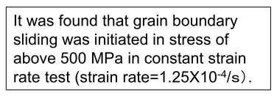
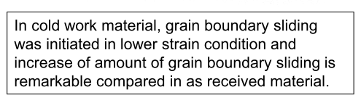
Notes:
It is considered that grain boundary energy increase with increase of amount of grain boundary sliding and encourage grain boundary corrosion.

Slide 50
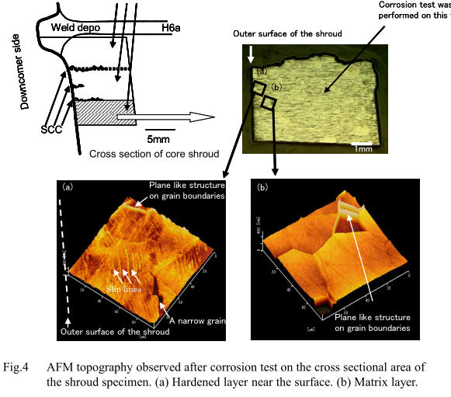
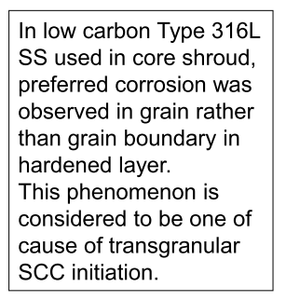

Slide 51
Case Study-SCC in Core Shroud
A core shroud is a stainless steel cylinder surrounding a nuclear reactor core whose main function is to support core and direct the cooling water flow inside of the reactor pressure vessel
The core shroud is composed of multiple cylindrical thermal shields stacked on top of each other.
In between each thermal shield is a horizontal, stainless steel cylindrical plate that helps keep the thermal shields in place.
The plates are then welded together with the thermal shields so that they create one solid structure. Vertical tie bolts are then used to reinforce each horizontal plate with their adjacent thermal shields, stabilizing the cylindrical core shroud.
The cracks on the shroud surface were mainly verified near the shroud ring weld line and core region weld line.
The crack shape could be classified into two types: one type was circumferential cracking in the shroud ring, and the other was isolated occurrences of radial cracking in the core region.
Notes:
The thermal shields are needed because the core shroud exists near the nuclear reactor core where heat is constantly present. The thermal shields prevent heat from damaging the core shroud by absorbing or reflecting the heat.

Slide 52
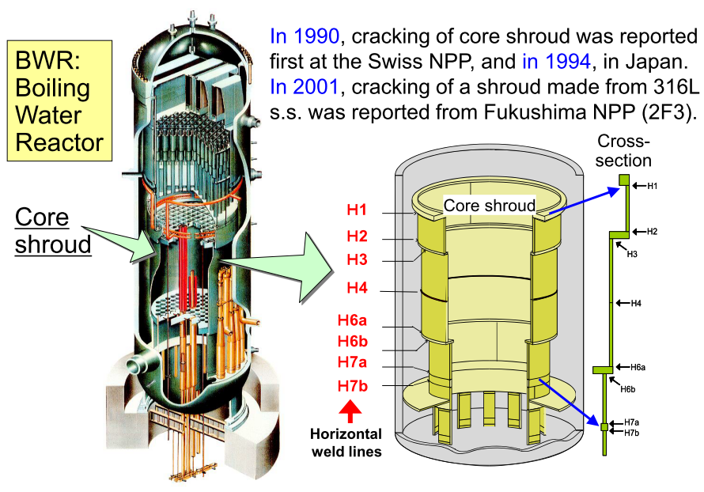
Notes:
In 1990, Stress Corrosion Cracking (SCC) was discovered in core shrouds, resulting in a heightened awareness of core shroud maintenance.^{[1]} Routine core shroud inspections became mandatory in most nuclear power plants worldwide because if a core shroud were to collapse, a nuclear meltdown could occur.
In the Fukushima Daiichi nuclear disaster, cracks had been discovered in their core shrouds

Slide 53
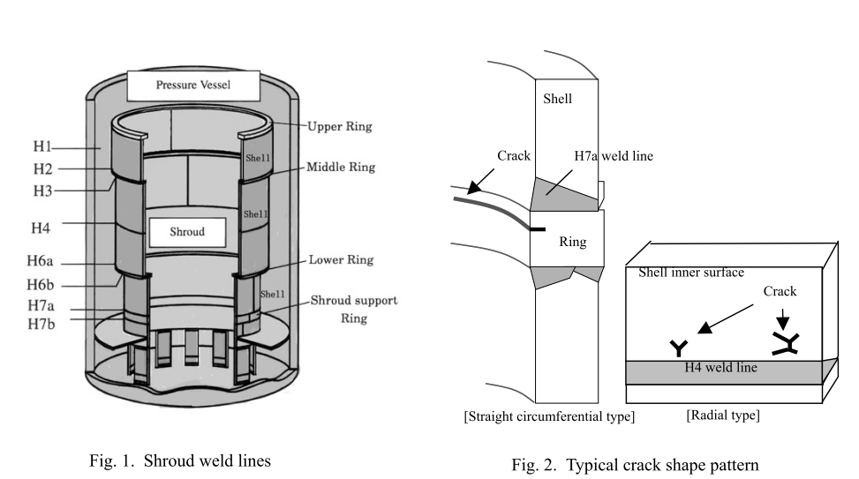
Inspection of Shroud

Slide 54
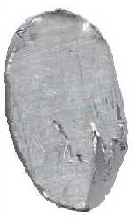
Boat Sampling Technique
Boat Sampling Technique (BST) has been developed for obtaining in situ samples (boat shaped) from the core shroud of BWR for determination of sensitization level of HAZ of the material by metallurgical analysis.
The BST incorporates mainly Sampling Module, mechanical, pneumatic and electrical subsystems. This technique can be used, remotely and under water, to obtain samples from a desired location, from the core shroud of BWRs.
The weight of boat sample would be 4 grams and the time required for obtaining each sample would be 90 minutes.
Boat Sample
(42mm x 26mm x 3mm)

Slide 55
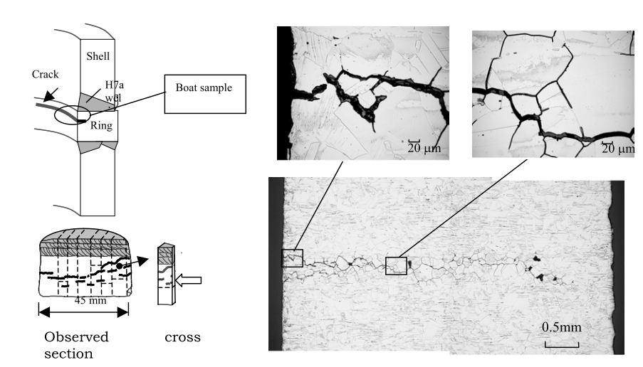
SEM observations indicate the mechanism common to low-carbon stainless steel SCC of the initiation of cracking occurring in a hardened layer of the surface as TGSCC, and TGSCC subsequently changing into IGSCC.

Slide 56
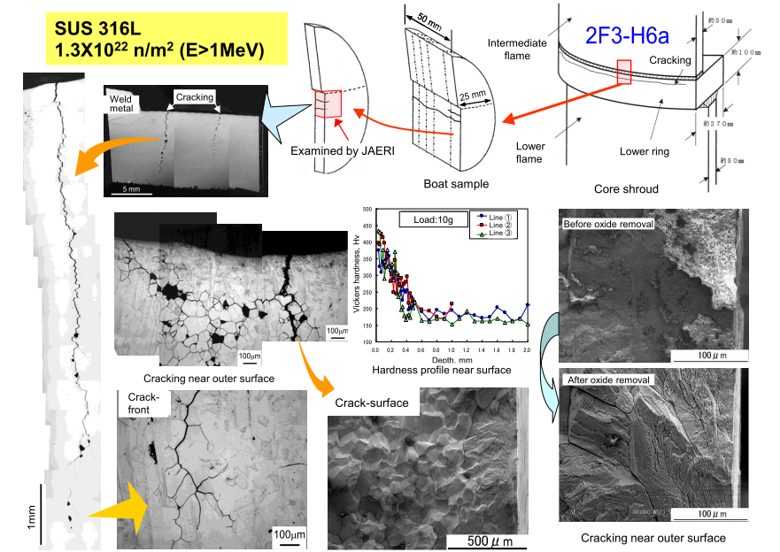

Slide 57
Transgranular SCC (TGSCC)
A SCC issue common to both types of light water reactors is transgranular stress corrosion cracking (TGSCC) of austenitic stainless steels.
It is primarily due to chloride contamination although other halide anions such as fluoride can also cause TGSCC.
It is generally a problem that initiates on the outside surfaces of austenitic stainless steel components mainly due to lack of attention to adequate cleanliness.
Wetting due to condensation or nearby water leaks can allow an aqueous environment to form that leads to TGSCC that is usually accompanied by pitting corrosion

Slide 58
Transgranular SCC (TGSCC)
Transgranular corrosion is a type of localized corrosion which occurs along cracks or faults across the crystals in metals and alloys. It follows the pattern of grains in the individual lattices of the material.
The fracture changes direction from grain to grain due to the different lattice orientation of atoms in each grain.
when the fracture or crack reaches a new grain, it may have to find a new path or plane of atoms to travel on because it is easier to change direction for the crack than it is to rip through.

Slide 59
Solution
One method used to fix the core shroud crack is reinforcing the core shroud plates.
This is done using an anchor bolt, which is used to attach additional steel plates to the core shroud surface, thereby reinforcing the structure.
This is the most common method used to fix cracks in the core shroud since it is easy and relatively safe.
Replacement of the core shroud is also an option, but it is not recommended because the cracked plates must be removed manually, leaving the laborers susceptible to radiation.
Notes:
The crack angle is defined as the angle between the load direction and the crack direction on the surface.

Slide 60
IASCC of In-Core Materials
Reactor vessel internals of both BWR and PWR plants are mainly fabricated from austenitic stainless steels.
Unlike the fuel elements, which are removed after a few years of service, the internals are intended to remain for the full life of the plant
With such high radiation doses, the material microstructure and mechanical properties change considerably; which have a significant impact on the stress corrosion susceptibility in both reactor types.
Irradiation assisted stress corrosion cracking (IASCC) is therefore an important potential ageing degradation mechanism affecting the internals.

Slide 61
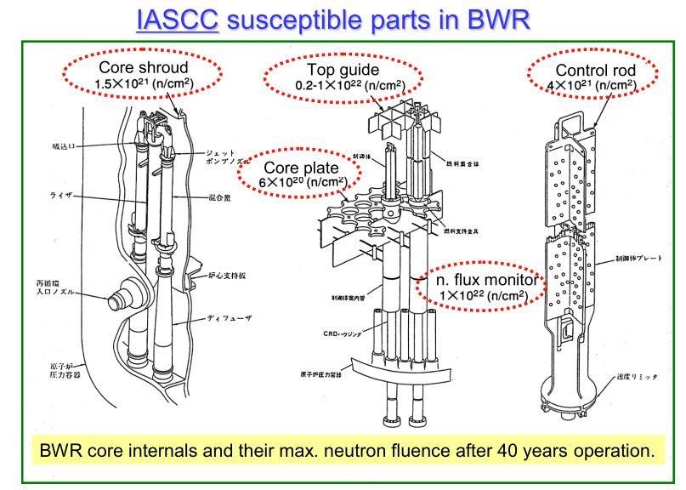
IASCC of In-Core Materials

Slide 62
IASCC of In-Core Materials
IGSCC can occur and propagate in all grades and conditions of stainless steel and nickel alloys if the environment and electrochemical corrosion potential (ECP) are conducive to SCC.
However, from a practical point of view, the commonly agreed threshold for the possible occurrence of IGSCC in BWRs, based on laboratory results and field experience, is an ECP ≥ -230 mV_{SHE}
Under BWR normal water chemistry (NWC) conditions, the ECP is mainly influenced by the presence of oxidizing radiolysis products, O₂ and H₂O₂, dissolved in the high temperature water.
Other environmental conditions such as flow conditions, temperature and presence of impurities such as sulphate and chloride also influence the occurrence of IGSCC.

Slide 63
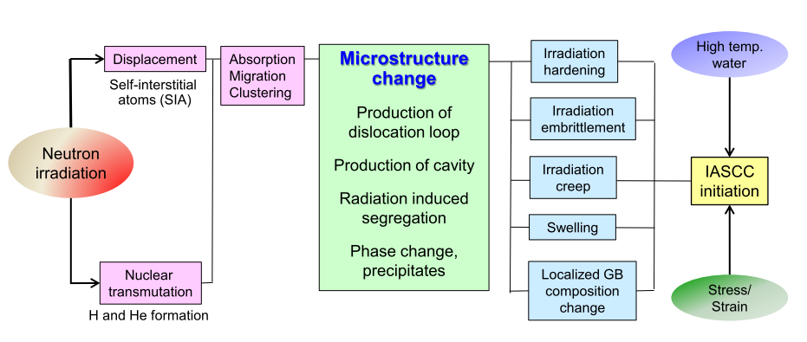
Notes:
Mechanism of IASCC initiation have been already investigated above 20 years. It is found that radiation induced segregation and irradiation hardening
are important factors, but several influences of irradiation on IASCC cannot be comprehensively explained. stems
from the simultaneous occurrence of several effects.

Slide 64
Mechanism of IASCC
Existing theories fall into five categories:
(1) RIS chromium depletion
(2) Irradiation hardening
(3) Localized deformation
(4) Selective internal oxidation
(5) Irradiation creep

Slide 65
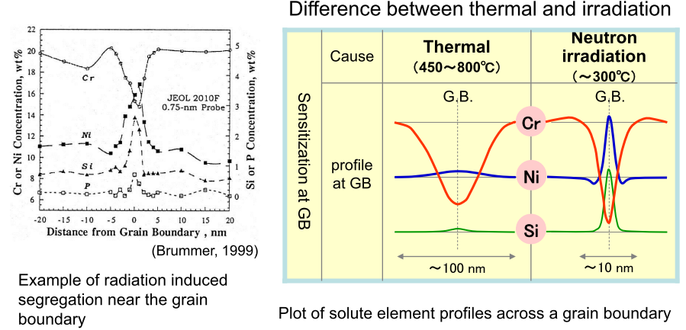
(1) RIS chromium depletion

Slide 66
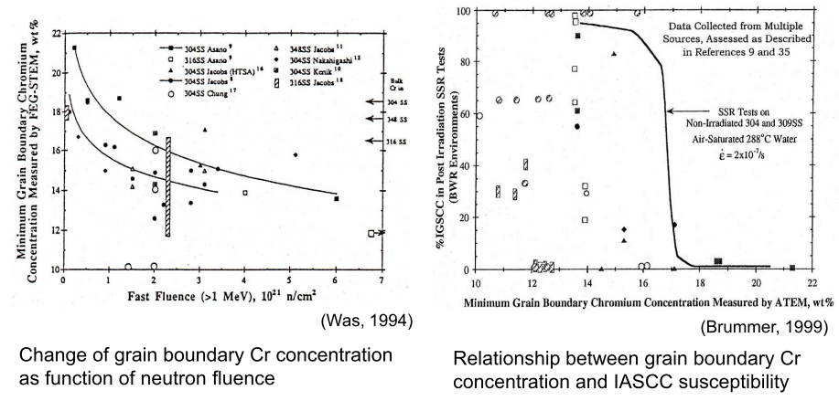
Notes:
It is necessary to consider both local solute element change at grain boundary (RIS) and change of microstructure by formation of radiation defects at the
same time.

Slide 67
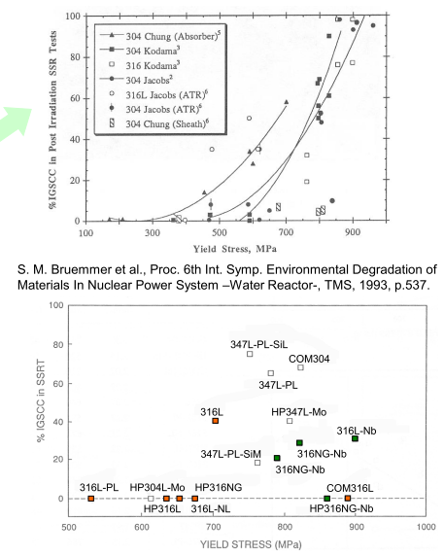
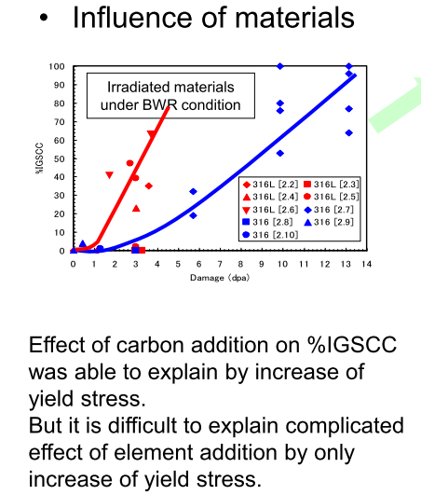
(2) Irradiation hardening
Notes:
Irradiation increases yield stress, decreases the ductility

Slide 68
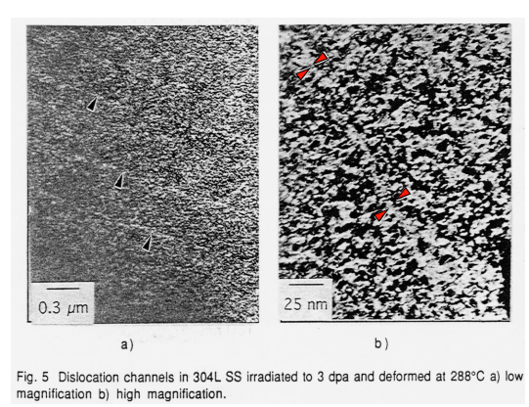
(3) Localized deformation

Slide 69
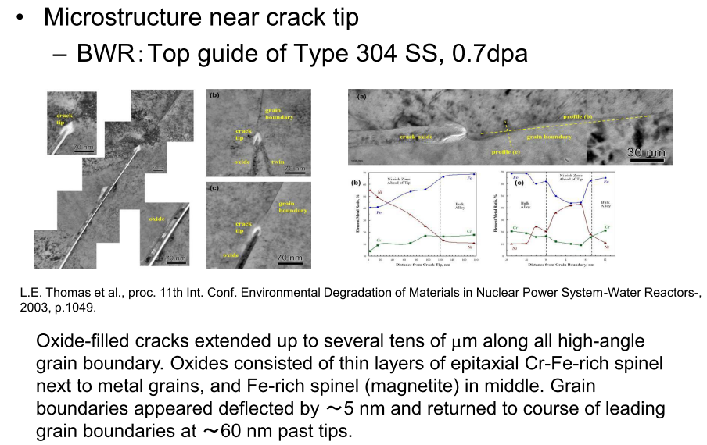
(4) Selective internal oxidation

Slide 70
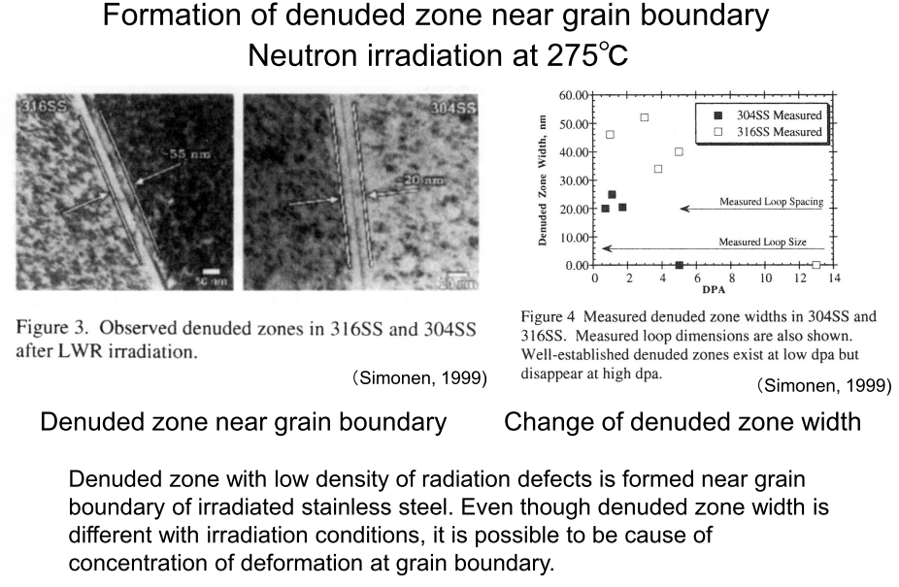
Notes:
Creep-deformation

Slide 71
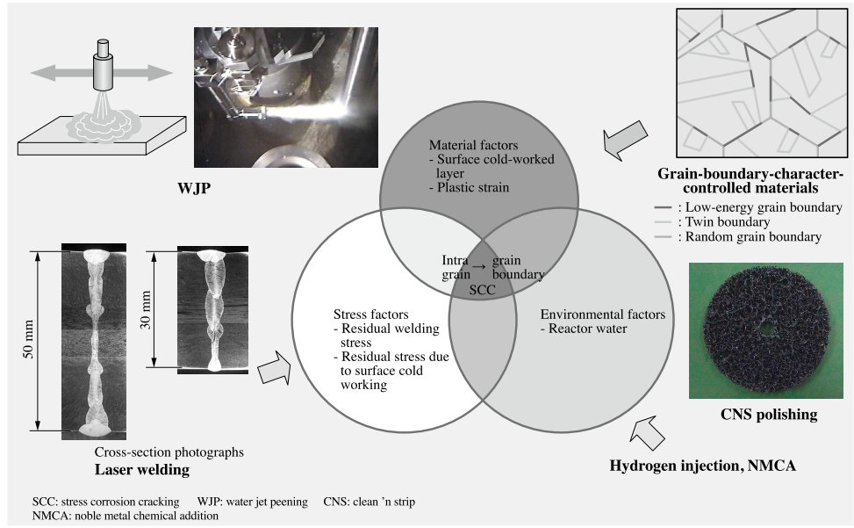
Summary for SCC Mitigation

Slide 72
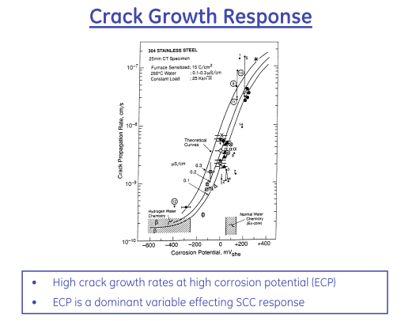
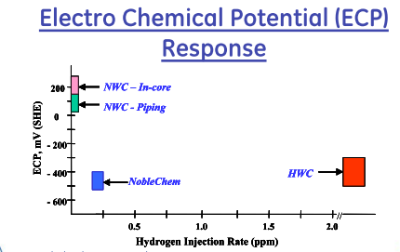
SCC Mitigation by Water Purity Control

Slide 73
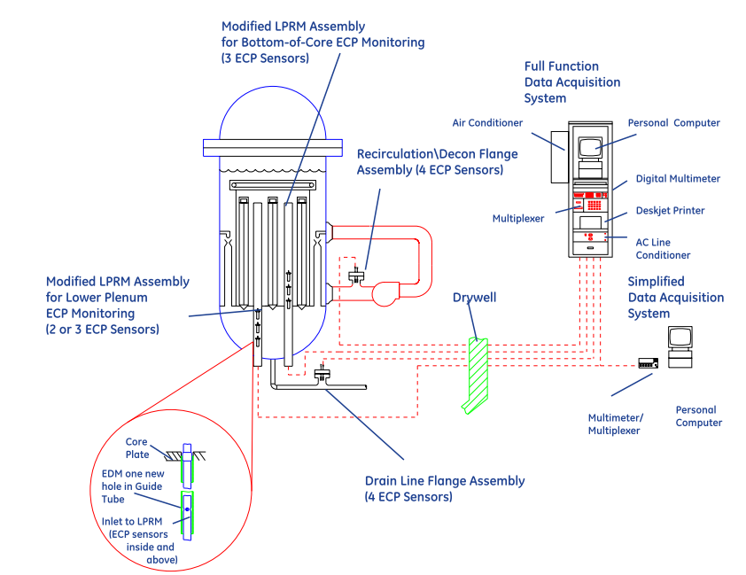
ECP Monitoring Locations

Slide 74


Slide 75

SCC Mitigation by Hydrogen Water Chemistry
The most effective way to mitigate SCC in BWRs is to modify the water chemistry by reducing the corrosion potential.
Hydrogen Water Chemistry (HWC) does this by injecting H₂ into the feed water. H₂ levels above ≈500 ppb effectively suppresses radiolysis
PWRs use ≈3 ppm H₂, but such levels are not economically achievable in BWRs, the feed water in BWR would need to have more H2. Why?
“protection potential” of -230 mV she
Relation between corrosion potential and injected feedwater hydrogen content observed in feedwater line at a specific BWR.
Notes:
because most of the H2 is lost to the steam during each pass through the core
Figure: the addition of some H 2 to the feed water is effective in reducing the oxidant levels and therefore the corrosion potential (Figure B.10.7) enough to effectively suppress stress corrosion cracking when the corrosion potential reaches a “protection potential” of -230 mV she

Slide 76
SCC Mitigation by Hydrogen Water Chemistry
The addition of some H₂ to the feed water is effective in reducing the oxidant levels and therefore the corrosion potential enough to effectively suppress stress corrosion cracking when the corrosion potential reaches a “protection potential” of -230 mV_{she}
The decrease in corrosion potential occurs not by suppressing radiolysis but by gamma-radiation enhanced recombination in the annulus.
Notes:
because most of the H2 is lost to the steam during each pass through the core
Figure: the addition of some H 2 to the feed water is effective in reducing the oxidant levels and therefore the corrosion potential (Figure B.10.7) enough to effectively suppress stress corrosion cracking when the corrosion potential reaches a “protection potential” of -230 mV she

Slide 77
The gamma level in the downcomer varies with reactor design, and some wide annulus plants have insufficient gamma radiation at the outside of the annulus to produce very effective recombination.
thus, the effectiveness of a given H2 injection rate varies from plant-to-plant.
In the best plants, HWC drops the oxidant levels from ≈200 ppb to < 1-2 ppb at the bottom of the annulus, which feeds the recirculation piping.
However, since two-thirds of the jet pump flow is drawn from an area closer to the top of the annulus, the water that flows into the bottom plenum has a higher oxidant concentration.
Notes:
thus, the effectiveness of a given H2 injection rate varies from plant-to-plant.

Slide 78
Attempts to improve the coverage of HWC considered the obvious option of increasing the H2 to higher levels.
In many plants, this produces an adequately low corrosion potential in the bottom plenum and perhaps along the inside of the shroud. At such high H₂ levels, all plants see a large increase in “turbine shine” ( 16 N in the steam).
However, once boiling occurs, the H₂ level in the water drops significantly.
Thus, components exposed to this water remain at high corrosion potential and remain unprotected from stress corrosion cracking
Notes:
(there are uncertainties in the measurements and models that make this less than certain).

Slide 79

Regions of the pressure vessel internals and recirculation piping protected by hydrogen water chemistry.

Slide 80
Chemistry of Radioactive Nitrogen
Nitrogen-16 is the most dominant radioisotope which causes gamma-radiation from the primary system of BWR under plant operation.
A number of radioactive nitrogen species are evolved from chemical reactions among radiolytic species of water and nitrogen species.
Among nitrogen species, chemically stable compounds, such as nitrogen molecule (N2), nitric oxide (NO), and ammonia (NH3), are released into the main steam line and determine the gamma-radiation level in the turbine building.
Notes:
Radioactive nitrogen (1 8 N/ 6 N) is generated in nuclear reactor systems through high energy nuclear reactions

Slide 81
Numerical model calculations and plant experience related to chemical behaviors of radioactive nitrogen (13-N and 16-N) in BWR primary systems have suggested the following:
Calculated results suggest that the major radioactive nitrogen species released to the vapor phase was nitrogen mono-oxide.
Based on 13 N measurement in the main steam of a BWR, 85% of 13 N was found to be anion.
Chemical behaviors of 13 N and 16 N from calculations were not the same because of the difference in half-lives of 13 N and 16 N.
Since the half-life of 16 N is short, the main source of 16 N was the boiling channels in the reactor core and 13 N was easily accumulated in the core by-pass channels where the residence time was several times longer than in fuel channels.

Slide 82

Increase in dose rate in main steam lines of commercial BWRs under HWC
Chemical behavior of 16-N in the BWR primary system is rarely quantified because it decays rapidly with a half-life of 7.13 s, so that 13 N (half-life: 9.97 min) is measured as the representative of radioactive nitrogen in the BWR primary system.

Slide 83


Slide 84


SCC Mitigation by NobleChem

Slide 85

HWC vs. NobleChem TM Technology

Slide 86

ECP Reduction With NobleChem
Notes:
Provides Low ECPs At All Internal Locations

Slide 87
NobleChem
NobleChem was developed by GE in which all wetted surfaces could be made catalytic.
Metals such as Pt, Pd, Rh, Ru are electro-catalytic; i.e., reactions (esp. H₂ and O₂ or H₂O₂ reactions) are dramatically accelerated.
Pt can be added through:
  can be added to alloys and used in thermal spray powders
  introduce low concentrations of Pt salts (e.g., Na₂Pt(OH)₆ ) into BWR water, which results in Pt depositing on the surfaces of all wetted parts.
Pt concentrations below 1% of a monolayer are adequate. An “OnLine NobleChem” is being developed that introduces Pt during full-power operation.

Slide 88

Electrocatalytic processes are developed for improving the efficiency of the oxygen/ hydrogen recombination process and thereby extending the region of protection to the reactor core region
Advantage of NobleChem:
Under the Noblechem process protection of the core internals from stress corrosion cracking can be achieved at lower feedwater hydrogen concentrations that do not give rise to accelerated 16 N offgas rates and increases in the main steam line radiation

Slide 89
Effectiveness of NobleChem
1) Stoichiometry of H₂ and O₂
To achieve low corrosion potential at all locations of interest, H₂ must be in stoichiometric excess. Considering only O₂, there must be two moles of H₂ per mole of O₂.
This is easily achieved at fairly low levels of H₂ injection to the feed water at all locations until boiling occurs. Additionally, there may be areas in the upper regions of the annulus where the (H2 -rich) feed water does not adequately mix with the core water, and stoichiometric excess H₂ might not exist in some local regions.
Thus, areas above the fuel channel are not protected.
Notes:
Above fuel channel>(upper plenum, steam separators, core spray lines, etc.)

Slide 90
2) Limitation of Materials
Low corrosion potential does not guarantee total mitigation of SCC.
Higher yield strength materials, such as alloy 182/82 weld metal, irradiated stainless steel, cold worked stainless steel or alloy 600, benefit less than sensitized stainless steel, because cold work causes higher growth rates at both low and high corrosion potential

Slide 91
3) Development of crack
If cracks grow extensive in between NobleChem applications, O₂ can get to areas of the crack that are not catalytic, so no catalytic benefit is observed.
This is a well-understood limitation, and where it has occurred in the operational reactors, it has been associated with a digression from operational procedure and the inadequate control of the hydrogen feed rate.

Slide 92

Removal of Surface Cold Working
Relationship between SCC Crack Depth and Surface Hardness.
Notes:
The graph shows how the SCC crack depth increases
dramatically after machining of the surface increases
the surface hardness beyond 300 HV (vickers
hardness).

Slide 93
If the surface of stainless steel is machined, fine grains with a diameter of 0.5 μm or less form in the surface-most region due to recrystallization induced by the machining.
A further cold-worked layer forms beneath this due to slip deformation, also caused by the machining. It has been identified that these microstructural changes play a significant role in non-sensitized SCC
To eliminate this surface cold-worked layer as a cause of SCC, the flap wheel and CNS (clean ’n strip) polishing techniques have been used on the reactor shroud and other components for recent plants.

Slide 94

EBSD (electron back scattering diffraction) to analyze the structure of SUS316L that has been subject to various types of surface finishing.
The black regions indicate the cold-worked layer.
Notes:
After roughing (for the 300-HV and above materials in Fig. 4), finishing machining, and grinding, the materials were finished by using
first flap wheel and then CNS polishing to remove the surface layer of machining.

Slide 95
Material Improvement
It is believed that grain boundary separation can progress easily at grain boundaries where the orientation of the adjacent crystals is not aligned (random grain boundaries).
Grain-boundary-character-controlled materials are materials in which the microstructure is controlled to increase the proportion of matched grain boundaries at which the adjacent crystals are oriented in a particular way.
It is anticipated that this will improve SCC resistance by isolating regions of joined-up random grain boundaries.
Notes:
(Grain-boundary-character-controlled Materials)

Slide 96

Evaluation of SCC Resistance of Grain-boundary-character-controlled Material
The results show that, compared to the non-controlled material, the SCC crack length is much shorter for the controlled material.

Slide 97
SCC IN PLR (Primary Loop Recirculation) PIPING
Existing BWR nuclear power plants PLR piping have large and many welded seams, because the conventional PLR have been mainly constructed by welding of straight pipes and standard fittings such as elbows, crosses, tees, reducers, and nozzles.
The piping is made up of low-carbon stainless steel (SUS316LC) as it was thought that SCC generated by sensitization would be prevented by using low-carbon material. However, the results of later mock-up tests and experiments confirmed that hardened surfaces increased susceptibility to TGSCC, which progressed to IGSCC in crack growth.
Notes:
Primary loop recirculation

Slide 98
Case Study
Many cracks in PLR piping were found during March 2003 in several plants.
The welds in the PLR piping were inspected by an ultrasonic test from the external surface.
Cracks were found near the welds inside the piping. This cracking was distributed throughout the whole of the recirculation piping and there was no specific pattern

Slide 99



Slide 100
Analysis
The thickness of the hardened layer was found to be 20µm on the inner surface of the PLR piping. It was found that TGSCC had been initiated from this surface layer and propagated to the inside of the pipe material by IGSCC.
In some cases, the crack had penetrated the welding metal itself.
The deteriorated layer also formed on the inner surface of the pipe joints that had been machine-finished during the manufacturing process. It was found that the amount of ferrite had decreased to 5% or less in the boundary part of the weld metal due to the dilution of ferrite between the pipe materials, which hardly included any ferrite, and the weld metal, which contained a large amount of ferrite.
This resulted in the shortage of ferrite in the weld metal.
No obvious sensitization at the grain boundaries was apparent, and the shape of most of the cracks also dependant on the local residual stress distribution on the surface

Slide 101



Slide 102
Repair/ Maintenance Techniques for SCC in PLR Piping
Repair methods and preventive maintenance techniques related to material improvement and residual stress relaxation for SCC in PLR piping.
Corrosion Resistant Cladding
Internal Polishing
Induction Heating Stress Improvement
Solution Heat Treatment
Heat Sink Welding
Weld Overlay

Slide 103


Corrosion Resistant Cladding
The CRC method is used to reduce SCC susceptibility by cladding the wetted inner-surface of sensitized portions near the welded joints of piping with non-sensitized deposited metal (Fig. 1).
There are various methods to clad the wetted part inside the piping with deposited metal (inside weld overlays) and the method typically used is shown in Fig. 2.

Slide 104

The SCC susceptibility is reduced by securing high ferrite content on the wetted inner-surface of the piping’s welded joints.
It is shown that generally in the low-carbon zone, no SCC is observed in the area where ferrite content is over about 5%
SCC Susceptibility vs. Ferrite Content

Slide 105

Internal Polishing
To relieve residual stress of the inner-surfaces of piping, top surface stress is shifted to compressed sides by polishing the inside surface. This reduction in residual stress results in the suppression of SCC generation.
Relief of Residual Stress on Surfaces by Polishing
and its Effect on SCC Suppression

Slide 106

Induction Heating Stress Improvement (IHSI)
To generate the same temperature difference found at the heat affected zone that goes through the thickness of the pipe, the outer-surface is heated by the high-frequency induction heating method and the inner-surface is simultaneously cooled by water.
The thermal stress generated by this process relieves the inner-surface residual stress of the piping.

Slide 107
Solution Heat Treatment (SHT)
Chromium rich carbide precipitation from the grain boundary is decomposed when heated by high temperature ( over 1000℃ ) and dissolves uniformly into the base material, which causes the chromium-depleted-layer around the grain boundary to disappear.
This heating method, called solution heat treatment (SHT), can eliminate sensitized areas in the material formed by welding and reduces residual stress at the same time
A furnace is needed for this method and it is recommended that it is applied to welded joints at factories.

Slide 108

Heat Sink Welding (HSW)
HSW is a method which the inside of pipes are welded while cooled by flowing water or sprays after partitions are formed by the in gas welding for up to two or three layers.
Using this method, thermal stress is generated by the temperature difference of the outside and inside of piping that goes through the thickness of the material.
This thermal stress reduces tensile residual stress, which is the cause of SCC around the inside surface of the welded pipes.

Slide 109

Weld Overlay
In weld overlays, high ferrite welded metal that is superior in SCC resistance is overlaid in a belt around the outside of welded joints in piping with SCC.
Strength was secured in the belt-shaped overlay welded part of the piping, thus covering up for lost strength in the part of the piping where the crack occurred

Slide 110


