Slide 1
The Science and Engineering of Materials, 4th ed
Donald R. Askeland – Pradeep P. Phulé
Chapter 7 – Strain (Work) Hardening and Annealing

Slide 2
Objectives of Chapter 7
To learn how the strength of metals and alloys is influenced by mechanical processing and heat treatments.
To learn how to enhance the strength of metals and alloys using cold working.
To learn how to enhance ductility using annealing heat treatment.

Slide 3
Chapter Outline
7.1 Relationship of Cold Working to the Stress-Strain Curve
7.2 Strain-Hardening Mechanisms
7.3 Properties versus Percent Cold Work
7.4 Microstructure, Texture Strengthening, and Residual Stresses
7.5 Characteristics of Cold Working
7.6 The Three Stages of Annealing
7.7 Control of Annealing
7.8 Annealing and Materials Processing
7.9 Hot Working

Slide 4
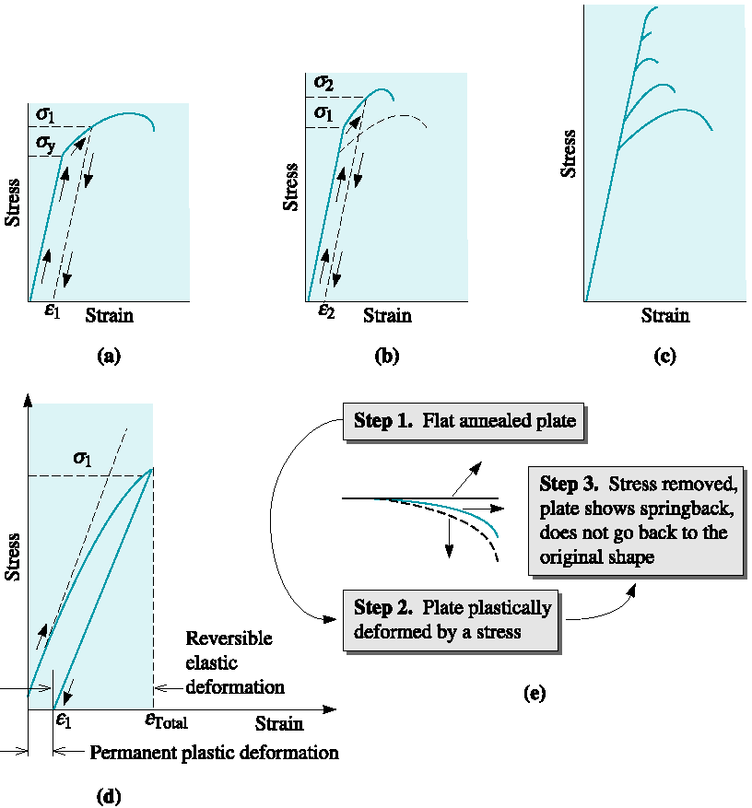
Figure 7.1 Development of strain hardening from the stress-strain diagram

Slide 5
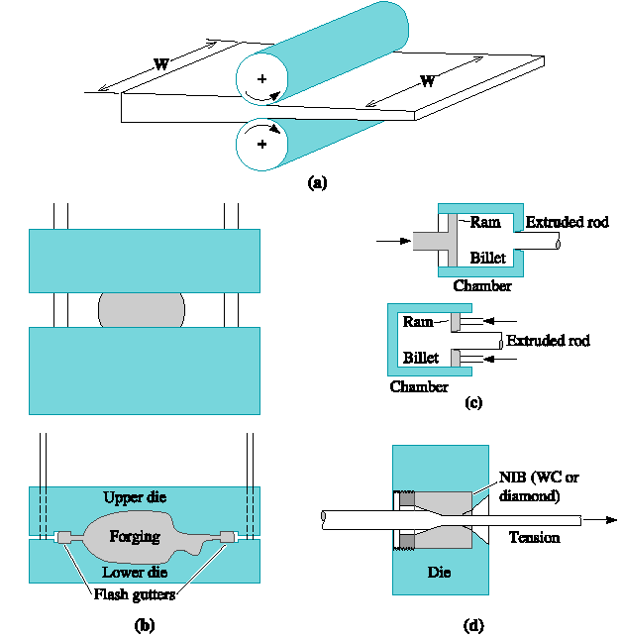
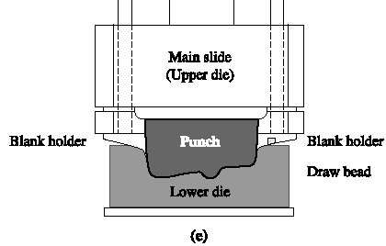
Figure 7.2 Manufacturing processes that make use of cold working as well as hot working. Common metalworking methods

Slide 6
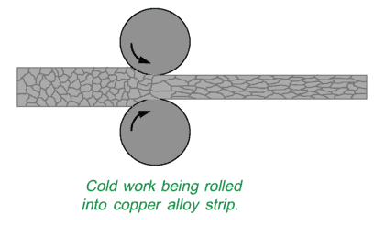
Cold Work
Elongated grain structure

Slide 7
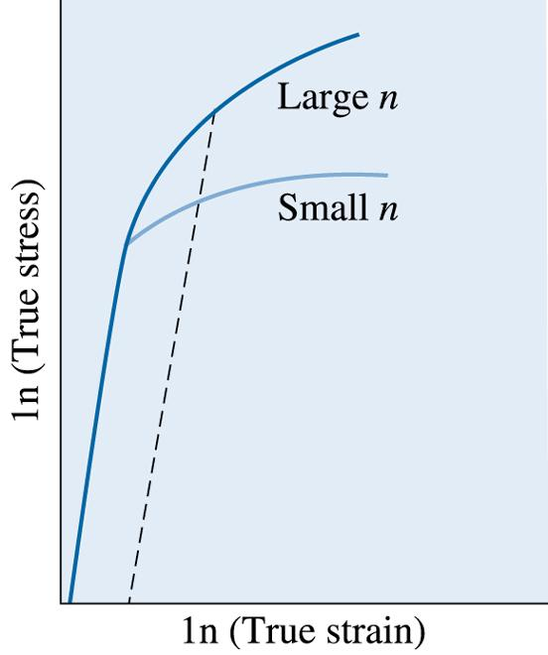
Figure 7.3 The true stress-true strain curves for metals with large and small strain-hardening exponents. Larger degrees of strengthening are obtained for a given strain for the metal with the larger n
©2003 Brooks/Cole, a division of Thomson Learning, Inc. Thomson Learning™ is a trademark used herein under license.

Slide 8
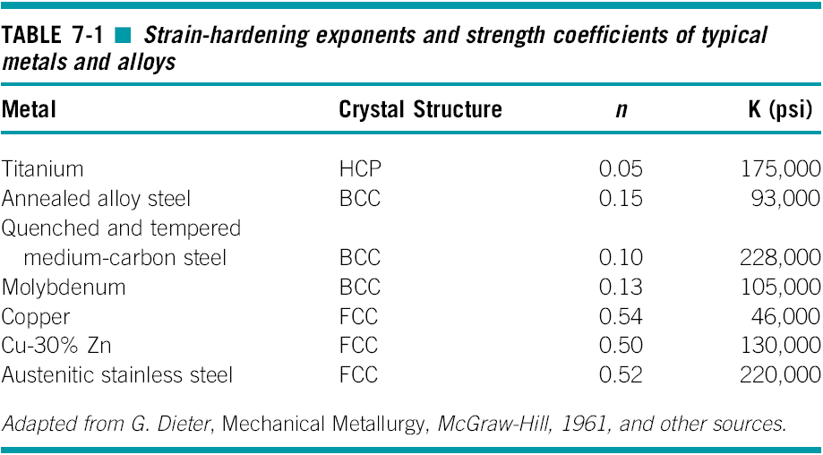

Slide 9
Section 7.2
Strain-Hardening Mechanisms
Frank-Read source - A pinned dislocation that, under an applied stress, produces additional dislocations. This mechanism is at least partly responsible for strain hardening.
Thermoplastics - A class of polymers that consist of large, long spaghetti-like molecules that are intertwined (e.g., polyethylene, nylon, PET, etc.).

Slide 10
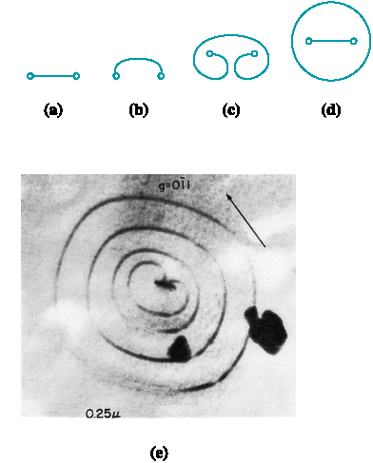
Figure 7.5 The Frank-Read source can generate dislocations. (a) A dislocation is pinned at its ends by lattice defects. (b) As the dislocation continues to move, the dislocation bows, eventually bending back on itself. (c) finally the dislocation loop forms, and (d) a new dislocation is created. (e) Electron micrograph of a Frank-Read source (330,000). (Adapted from Brittain, J., ‘‘Climb Sources in Beta Prime-NiAl,’’ Metallurgical Transactions, Vol. 6A, April 1975.)

Slide 11
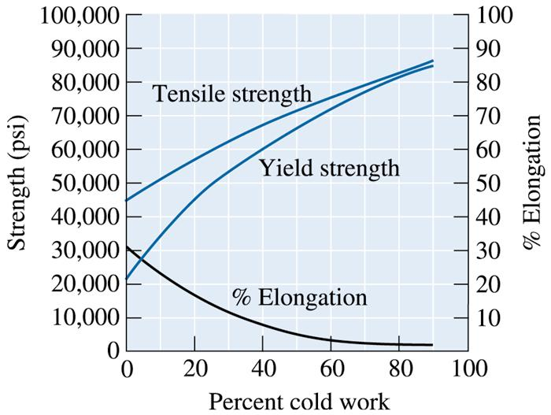
Section 7.3
Properties versus Percent Cold Work
©2003 Brooks/Cole, a division of Thomson Learning, Inc. Thomson Learning™ is a trademark used herein under license.
Figure 7.7 The effect of cold work on the mechanical properties of copper

Slide 12
Example 7.1
Cold Working a Copper Plate
A 1-cm-thick copper plate is cold-reduced to 0.50 cm, and later further reduced to 0.16 cm. Determine the total percent cold work and the tensile strength of the 0.16-cm plate. (See Figure 7.8.)

Slide 13
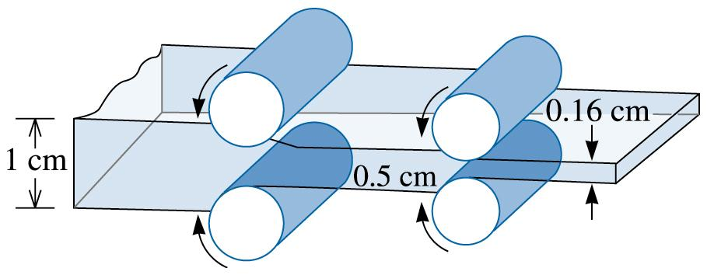
©2003 Brooks/Cole, a division of Thomson Learning, Inc. Thomson Learning™ is a trademark used herein under license.
Figure 7.8 Diagram showing the rolling of a 1-cm plate (for Example 7.1)

Slide 14
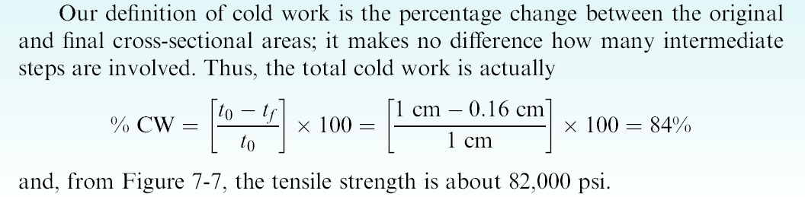
Example 7.1 SOLUTION

Slide 15
Section 7.4
Microstructure, Texture Strengthening, and Residual Stresses
Fiber texture, Sheet texture
Pole figure analysis, Orientation microscopy
Residual stresses, Stress-relief anneal
Annealing glass, Tempered glass

Slide 16
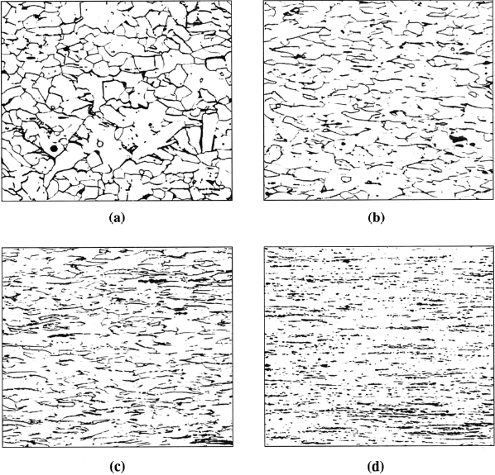
Figure 7.9 The fibrous grain structure of a low carbon steel produced by cold working: (a) 10% cold work, (b) 30% cold work, (c) 60% cold work, and (d) 90% cold work (250). (Source: From ASM Handbook Vol. 9, Metallography and Microstructure, (1985) ASM International, Materials Park, OH 44073. Used with permission.)

Slide 17
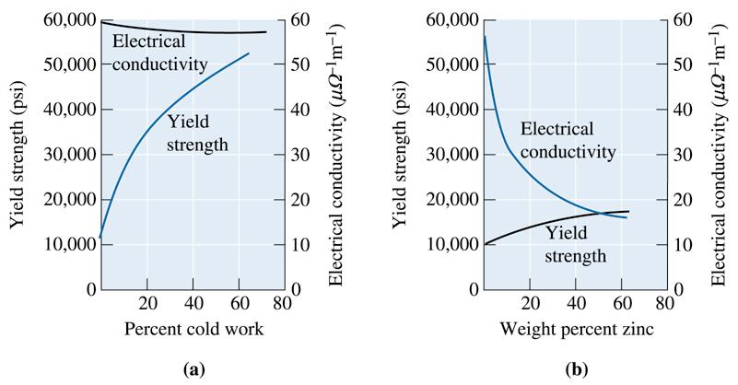
Section 7.5
Characteristics of Cold Working
©2003 Brooks/Cole, a division of Thomson Learning, Inc. Thomson Learning™ is a trademark used herein under license.
Figure 7.13 A comparison of strengthening copper by (a) cold working and (b) alloying with zinc. Note that cold working produces greater strengthening, yet has little effect on electrical conductivity

Slide 18
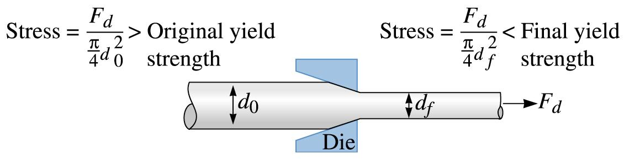
©2003 Brooks/Cole, a division of Thomson Learning, Inc. Thomson Learning™ is a trademark used herein under license.
Figure 7.14 The wire-drawing process. The force F_{d} acts on both the original and final diameters. Thus, the stress produced in the final wire is greater than that in the original. If the wire did not strain harden during drawing, the final wire would beak before the original wire was drawn through the die

Slide 19
Section 7.6
The Three Stages of Annealing
Recovery - A low-temperature annealing heat treatment designed to eliminate residual stresses introduced during deformation without reducing the strength of the cold-worked material.
Recrystallization - A medium-temperature annealing heat treatment designed to eliminate all of the effects of the strain hardening produced during cold working.
Grain growth - Movement of grain boundaries by diffusion in order to reduce the amount of grain boundary area.

Slide 20
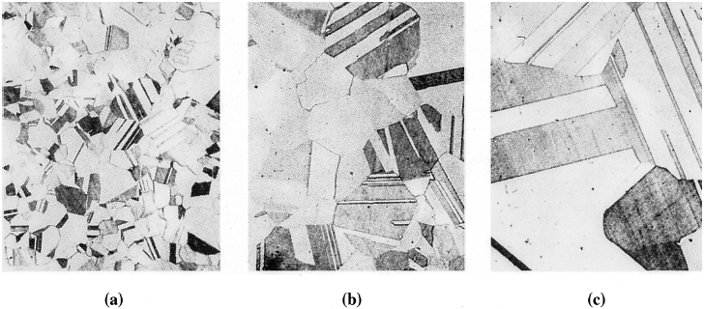
Figure 7.16 Photomicrographs showing the effect of annealing temperature on grain size in brass. Twin boundaries can also be observed in the structures. (a) Annealed at 400ºC, (b) annealed at 650ºC, and (c) annealed at 800ºC (75). (Adapted from Brick, R. and Phillips, A., The Structure and Properties of Alloys, 1949: McGraw-Hill.)

Slide 21
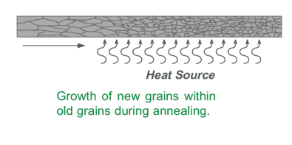
Annealing

Slide 22
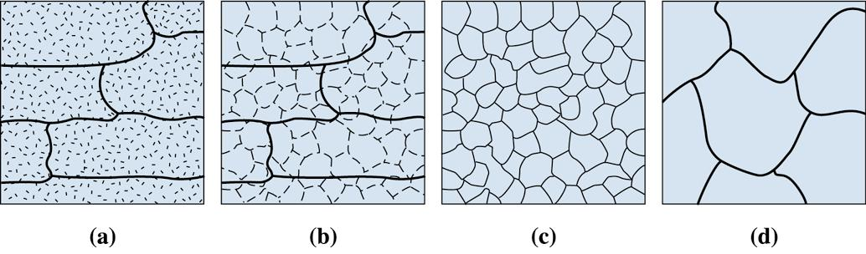
©2003 Brooks/Cole, a division of Thomson Learning, Inc. Thomson Learning™ is a trademark used herein under license.
Figure 7.17 The effect of annealing temperature on the microstructure of cold-worked metals. (a) cold-worked, (b) after recovery, (c) after recrystallization, and (d) after grain growth

Slide 23
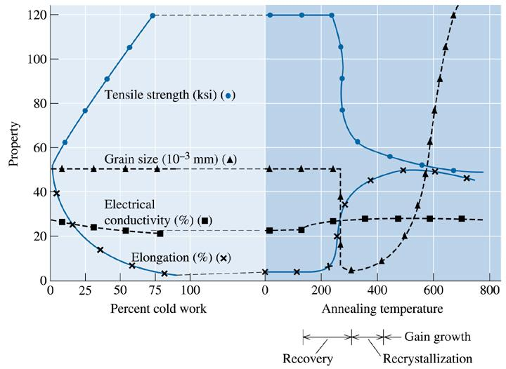
©2003 Brooks/Cole, a division of Thomson Learning, Inc. Thomson Learning™ is a trademark used herein under license.
Figure 7.18 The effect of cold work on the properties of a Cu-35% Zn alloy and the effect of annealing temperature on the properties of a Cu-35% Zn alloy that is cold-worked 75%

Slide 24
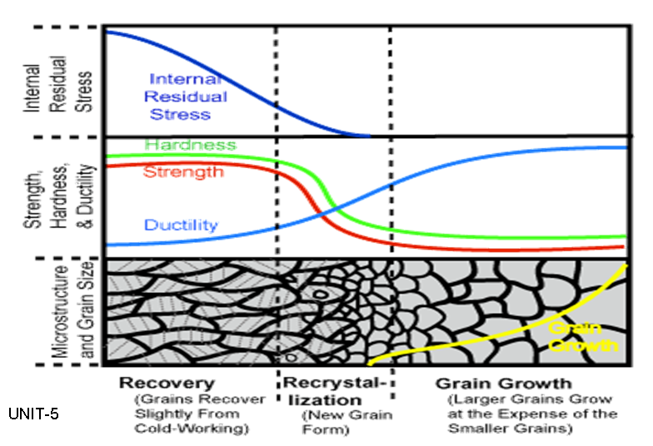

Slide 25
Section 7.8
Annealing and Materials Processing
Heat-affected zone (HAZ) - The volume of material adjacent to a weld that is heated during the welding process above some critical temperature at which a change in the structure, such as grain growth or recrystallization, occurs.

Slide 26
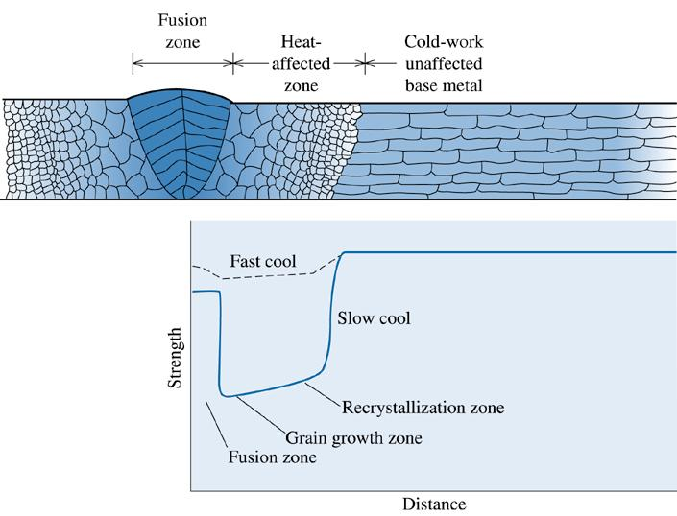
©2003 Brooks/Cole, a division of Thomson Learning, Inc. Thomson Learning™ is a trademark used herein under license.
Figure 7.20 The structure and properties surrounding a fusion weld in a cold-worked metal. Note: only the right-hand side of the heat-affected zone is marked on the diagram. Note the loss in strength caused by recrystallization and grain growth in the heat-affected zone

Slide 27
Section 7.9
Hot Working
Lack of Strengthening
Elimination of Imperfections
Anisotropic Behavior
Surface Finish and Dimensional Accuracy

Slide 28
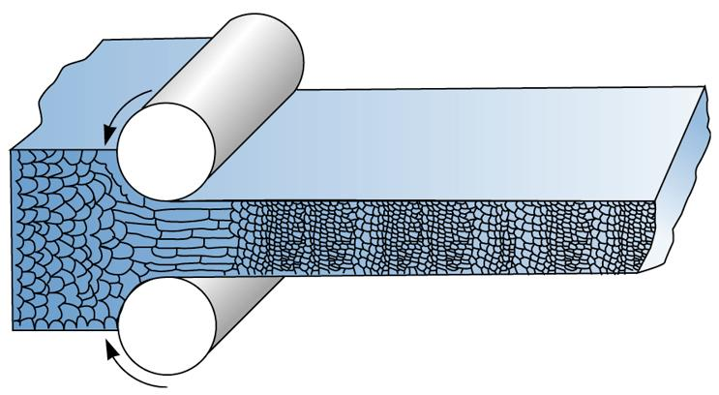
©2003 Brooks/Cole, a division of Thomson Learning, Inc. Thomson Learning™ is a trademark used herein under license.
Figure 7.21 During hot working, the elongated anisotropic grains immediately recrystallize. If the hot-working temperature is properly controlled, the final hot-worked grain size can be very fine

Slide 29
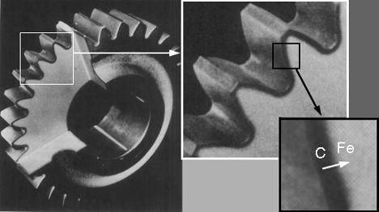
Diffusion Hardening (Case Hardening)
Case-hardening or surface hardening is the process of hardening the surface of a metal object while allowing the metal deeper underneath to remain soft, thus forming a thin layer of harder metal (called the "case") at the surface

