Slide 1
SKPN 4123 Nuclear Reactor Materials
Chapter 2
Exercises
Mohsin Mohd Sies
Nuclear Engineering,
School of Chemical and Energy Engineering,
Universiti Teknologi Malaysia

Slide 2
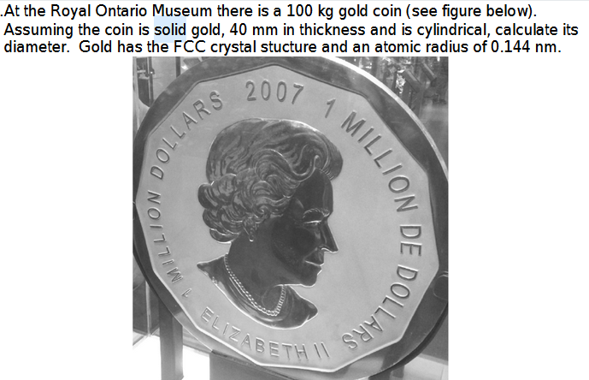

Slide 3
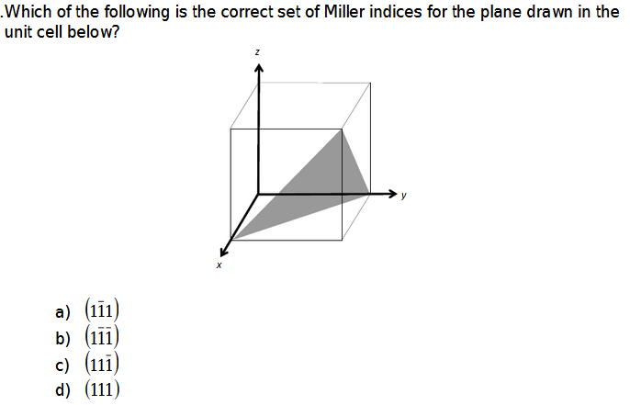

Slide 4
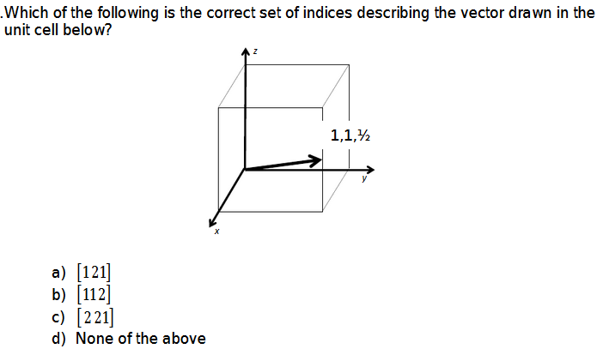

Slide 5
