Slide 1
The Science and Engineering of Materials, 4th ed
Donald R. Askeland – Pradeep P. Phulé
Chapter 7 – Strain Hardening and Annealing

Slide 2
Objectives of Chapter 7
To learn how the strength of metals and alloys is influenced by mechanical processing and heat treatments.
To learn how to enhance the strength of metals and alloys using cold working.
To learn how to enhance ductility using annealing heat treatment.

Slide 3
Chapter Outline
7.1 Relationship of Cold Working to the Stress-Strain Curve
7.2 Strain-Hardening Mechanisms
7.3 Properties versus Percent Cold Work
7.4 Microstructure, Texture Strengthening, and Residual Stresses
7.5 Characteristics of Cold Working
7.6 The Three Stages of Annealing
7.7 Control of Annealing
7.8 Annealing and Materials Processing
7.9 Hot Working
7.10 Superplastic Forming (SPF)

Slide 4
Section 7.1
Relationship of Cold Working to the Stress-Strain Curve
Flow stress
Strain hardening
Strain hardening exponent (n)
Strain-rate sensitivity (m)
Bauschinger effect

Slide 5
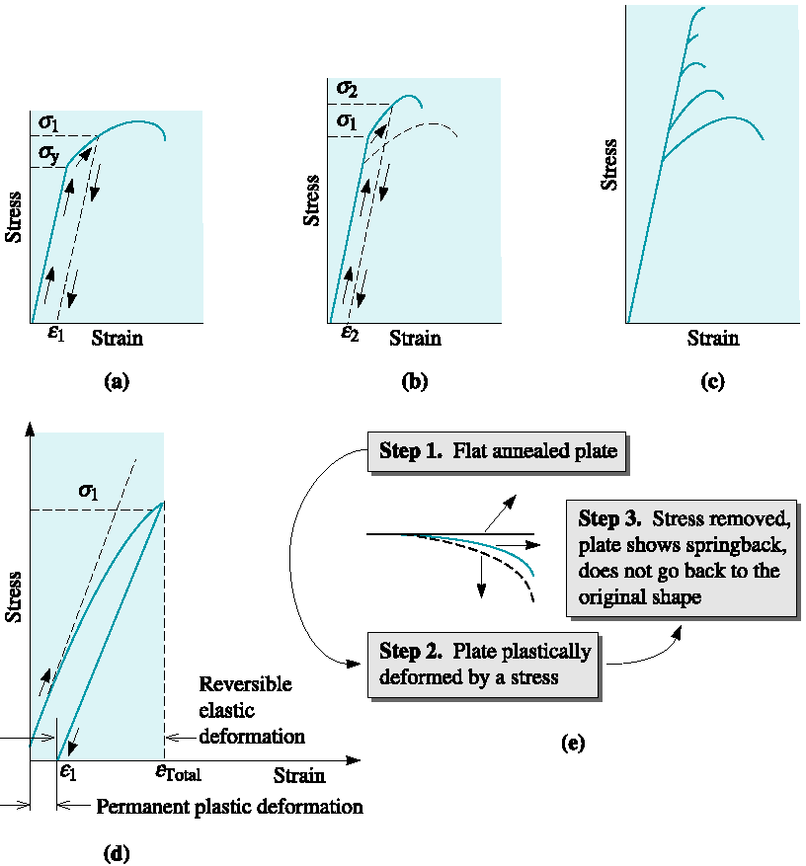
Figure 7.1 Development of strain hardening from the stress-strain diagram

Slide 6
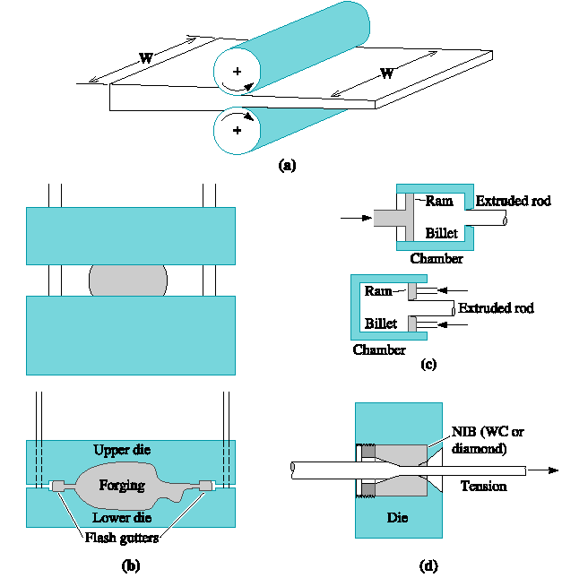
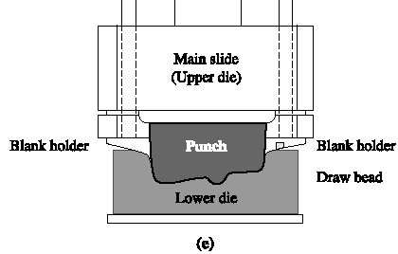
Figure 7.2 Manufacturing processes that make use of cold working as well as hot working. Common metalworking methods

Slide 7
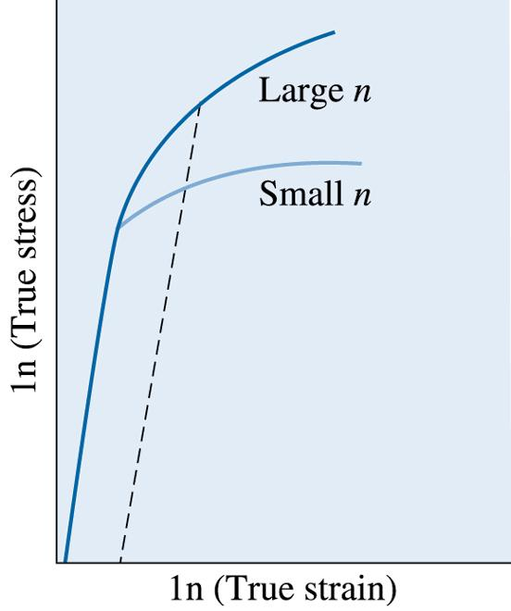
Figure 7.3 The true stress-true strain curves for metals with large and small strain-hardening exponents. Larger degrees of strengthening are obtained for a given strain for the metal with the larger n
©2003 Brooks/Cole, a division of Thomson Learning, Inc. Thomson Learning™ is a trademark used herein under license.

Slide 8
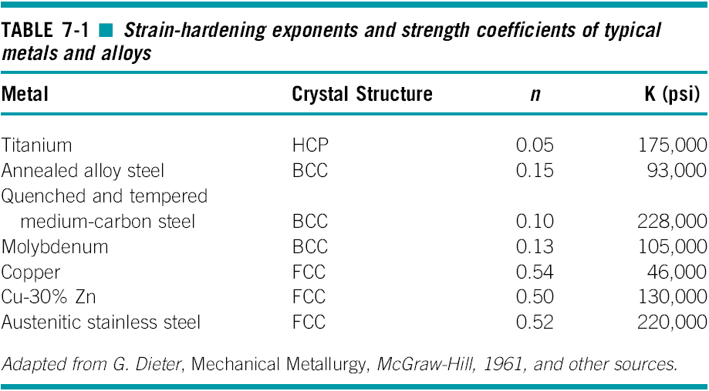

Slide 9
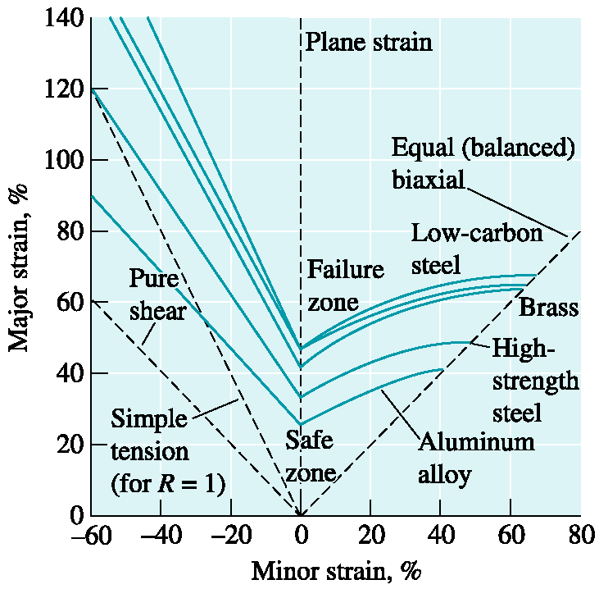
Figure 7.4 Forming limit diagram for different materials. (Source: Reprinted from Metals Handbook—Desk Edition, Second Edition, ASM International, Materials Park, OH 44073, p. 146, Fig. 5 © 1998 ASM International. Reprinted by permission.)

Slide 10
Section 7.2
Strain-Hardening Mechanisms
Frank-Read source - A pinned dislocation that, under an applied stress, produces additional dislocations. This mechanism is at least partly responsible for strain hardening.
Thermoplastics - A class of polymers that consist of large, long spaghetti-like molecules that are intertwined (e.g., polyethylene, nylon, PET, etc.).

Slide 11
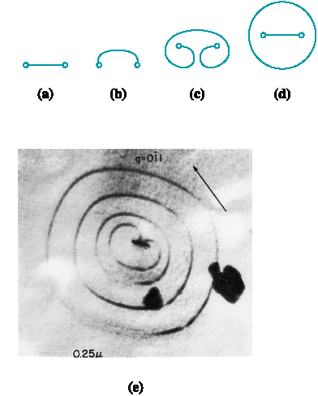
Figure 7.5 The Frank-Read source can generate dislocations. (a) A dislocation is pinned at its ends by lattice defects. (b) As the dislocation continues to move, the dislocation bows, eventually bending back on itself. (c) finally the dislocation loop forms, and (d) a new dislocation is created. (e) Electron micrograph of a Frank-Read source (330,000). (Adapted from Brittain, J., ‘‘Climb Sources in Beta Prime-NiAl,’’ Metallurgical Transactions, Vol. 6A, April 1975.)

Slide 12
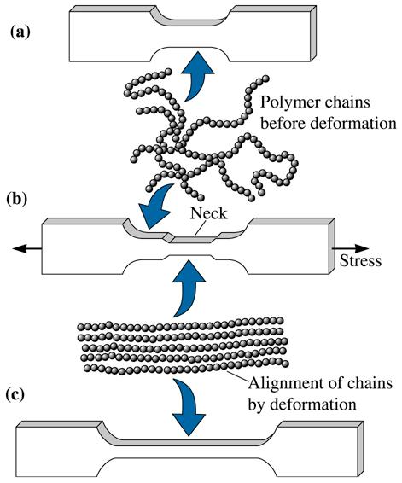
Figure 7.6 In an undeformed thermoplastic polymer tensile bar, (a) the polymer chains are randomly oriented. (b) When a stress is applied, a neck develops as chains become aligned locally. The neck continues to grow until the chains in the entire gage length have aligned. (c) The strength of the polymer is increased
©2003 Brooks/Cole, a division of Thomson Learning, Inc. Thomson Learning™ is a trademark used herein under license.

Slide 13
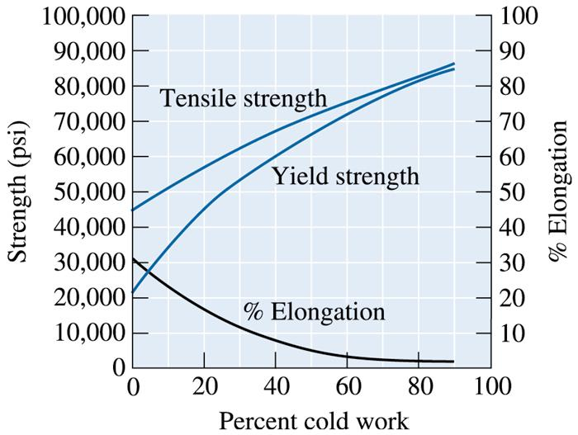
Section 7.3
Properties versus Percent Cold Work
©2003 Brooks/Cole, a division of Thomson Learning, Inc. Thomson Learning™ is a trademark used herein under license.
Figure 7.7 The effect of cold work on the mechanical properties of copper

Slide 14
Example 7.1
Cold Working a Copper Plate
A 1-cm-thick copper plate is cold-reduced to 0.50 cm, and later further reduced to 0.16 cm. Determine the total percent cold work and the tensile strength of the 0.16-cm plate. (See Figure 7.8.)

Slide 15
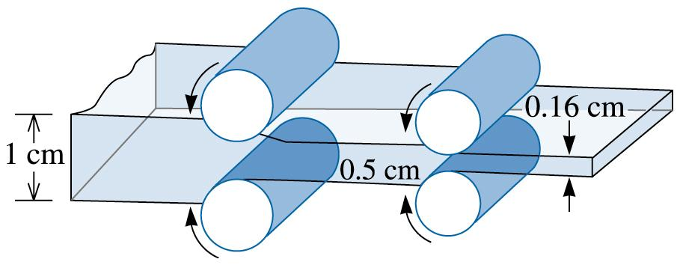
©2003 Brooks/Cole, a division of Thomson Learning, Inc. Thomson Learning™ is a trademark used herein under license.
Figure 7.8 Diagram showing the rolling of a 1-cm plate (for Example 7.1)

Slide 16
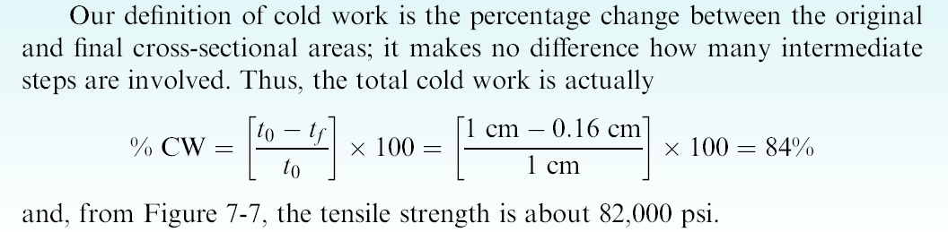
Example 7.1 SOLUTION

Slide 17
Example 7.2 Design of a Cold Working Process
Design a manufacturing process to produce a 0.1-cm-thick copper plate having at least 65,000 psi tensile strength, 60,000 psi yield strength, and 5% elongation.
Example 7.2 SOLUTION
To produce the plate, a cold-rolling process would be appropriate. The original thickness of the copper plate prior to rolling can be calculated from Equation 7-4, assuming that the width of the plate does not change. Because
there is a range of allowable cold work—between 40% and 45%—there is a range of initial plate thicknesses:

Slide 18
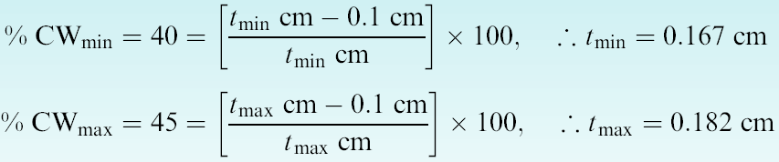
Example 7.2 SOLUTION (Continued)
To produce the 0.1-cm copper plate, we begin with a 0.167- to 0.182-cm copper plate in the softest possible condition, then cold roll the plate 40% to 45% to achieve the 0.1 cm thickness.

Slide 19
Section 7.4
Microstructure, Texture Strengthening, and Residual Stresses
Fiber texture, Sheet texture
Pole figure analysis, Orientation microscopy
Residual stresses, Stress-relief anneal
Annealing glass, Tempered glass

Slide 20
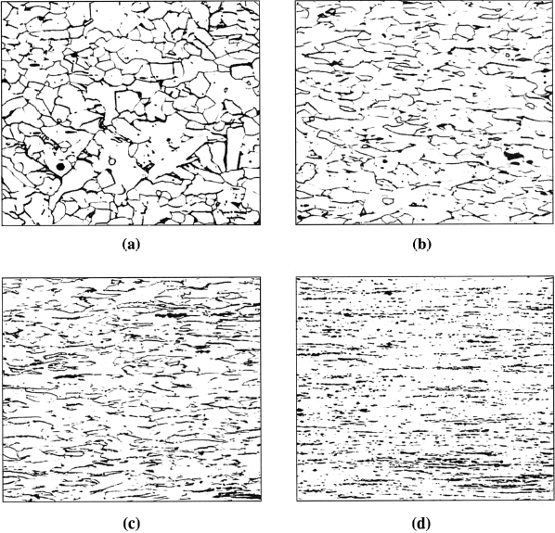
Figure 7.9 The fibrous grain structure of a low carbon steel produced by cold working: (a) 10% cold work, (b) 30% cold work, (c) 60% cold work, and (d) 90% cold work (250). (Source: From ASM Handbook Vol. 9, Metallography and Microstructure, (1985) ASM International, Materials Park, OH 44073. Used with permission.)

Slide 21
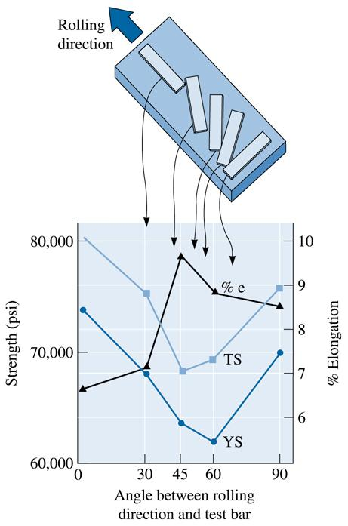
Figure 7.10 Anisotropic behavior in a rolled aluminum-lithium sheet material used in aerospace applications. The sketch relates the position of tensile bars to the mechanical properties that are obtained
©2003 Brooks/Cole, a division of Thomson Learning, Inc. Thomson Learning™ is a trademark used herein under license.

Slide 22
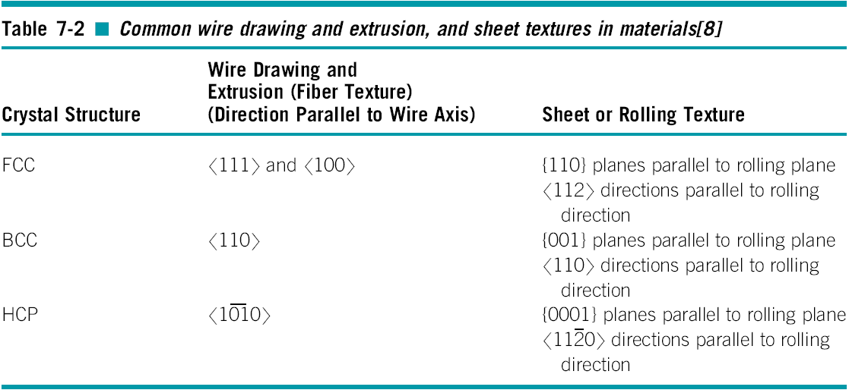

Slide 23
Example 7.3 Design of a Stamping Process
One method for producing fans for cooling automotive and truck engines is to stamp the blades from cold-rolled steel sheet, then attach the blades to a “spider’’ that holds the blades in the proper position. A number of fan blades, all produced at the same time, have failed by the initiation and propagation of a fatigue crack transverse to the axis of the blade (Figure 7.11). All other fan blades perform satisfactorily. Provide an explanation for the failure of the blades and redesign the manufacturing process to prevent these failures.

Slide 24
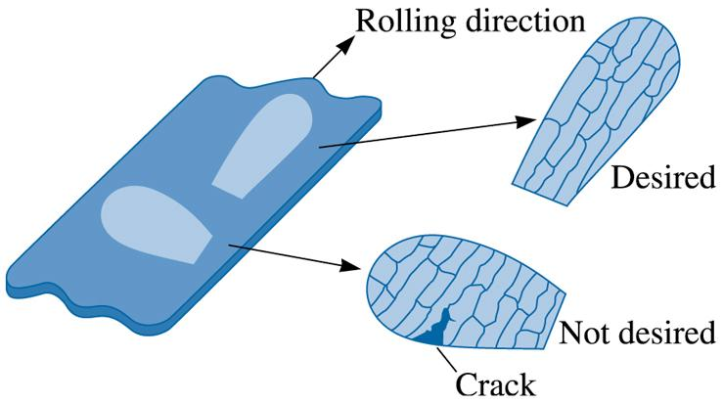
Example 7.3 (continued)
©2003 Brooks/Cole, a division of Thomson Learning, Inc. Thomson Learning™ is a trademark used herein under license.
Figure 7.11 Orientations of samples (for Example 7.3)

Slide 25
Example 7.3 SOLUTION
The wrong type of steel may have been selected.
The dies used to stamp the blades from the sheet may be worn.
The clearance between the parts of the dies may be incorrect, producing defects that initiate fatigue failure.
The failures could also be related to the anisotropic behavior of the steel sheet caused by rolling.

Slide 26
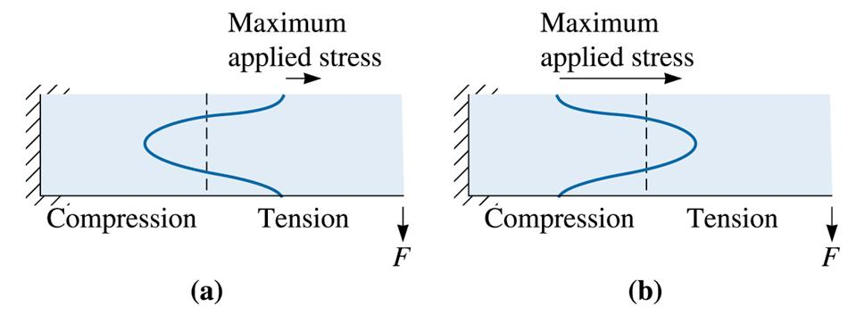
©2003 Brooks/Cole, a division of Thomson Learning, Inc. Thomson Learning™ is a trademark used herein under license.
Figure 7.12 The compressive residual stresses can be harmful or beneficial. (a) A bending force applies a tensile stress on the top of the beam. Since there are already tensile residual stresses at the top, the load-carrying characteristics are poor. (b) The top contains compressive residual stresses. Now the load-carrying characteristics are very goods

Slide 27
Example 7.4 Design of a Fatigue-Resistant Shaft
Your company has produced several thousand shafts that have a fatigue strength of 20,000 psi. The shafts are subjected to high-bending loads during rotation. Your sales engineers report that the first few shafts placed into service failed in a short period of time by fatigue. Design a process by which the remaining shafts can be salvaged by improving their fatigue properties.

Slide 28
Example 7.4 SOLUTION
Increasing the strength at the surface improves the fatigue life of the shaft – carburizing
Cold working the shaft
Shot peen the shaft

Slide 29
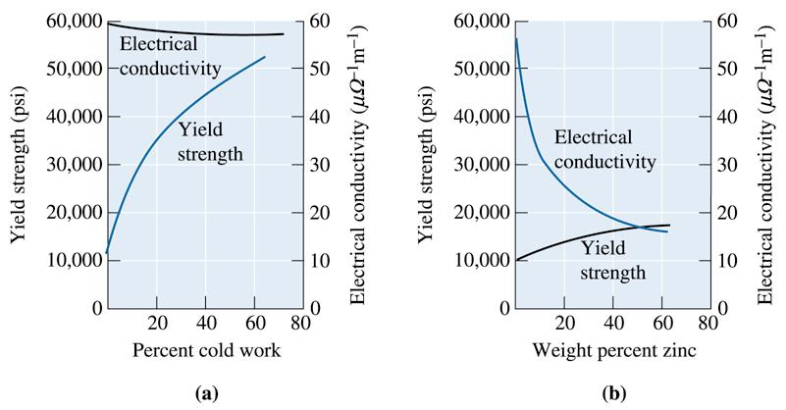
Section 7.5
Characteristics of Cold Working
©2003 Brooks/Cole, a division of Thomson Learning, Inc. Thomson Learning™ is a trademark used herein under license.
Figure 7.13 A comparison of strengthening copper by (a) cold working and (b) alloying with zinc. Note that cold working produces greater strengthening, yet has little effect on electrical conductivity

Slide 30
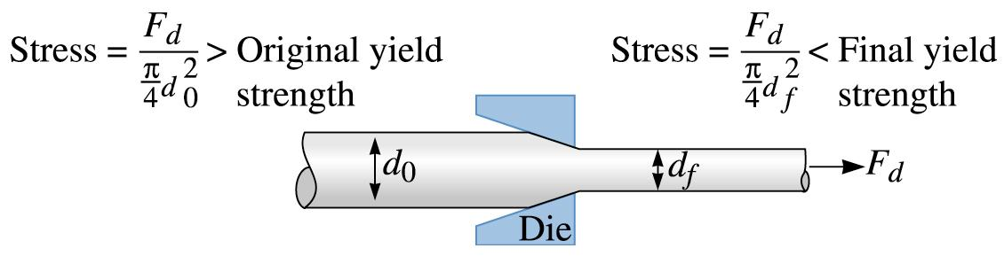
©2003 Brooks/Cole, a division of Thomson Learning, Inc. Thomson Learning™ is a trademark used herein under license.
Figure 7.14 The wire-drawing process. The force F_{d} acts on both the original and final diameters. Thus, the stress produced in the final wire is greater than that in the original. If the wire did not strain harden during drawing, the final wire would beak before the original wire was drawn through the die

Slide 31
Example 7.5 Design of a Wire Drawing Process
Design a process to produce 0.20-in. diameter copper wire. The mechanical properties of copper are to be assumed as those shown in Figure 7.7.

Slide 32
©2003 Brooks/Cole, a division of Thomson Learning, Inc. Thomson Learning™ is a trademark used herein under license.
Figure 7.7 The effect of cold work on the mechanical properties of copper

Slide 33
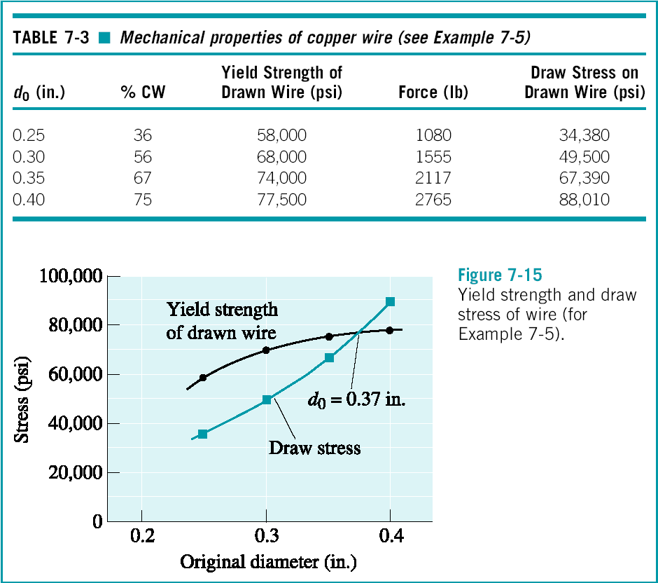
Example 7.5 SOLUTION

Slide 34
Section 7.6
The Three Stages of Annealing
Recovery - A low-temperature annealing heat treatment designed to eliminate residual stresses introduced during deformation without reducing the strength of the cold-worked material.
Recrystallization - A medium-temperature annealing heat treatment designed to eliminate all of the effects of the strain hardening produced during cold working.
Grain growth - Movement of grain boundaries by diffusion in order to reduce the amount of grain boundary area.

Slide 35
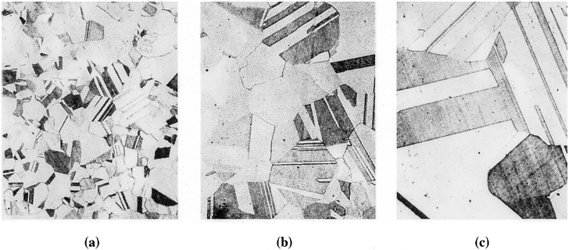
Figure 7.16 Photomicrographs showing the effect of annealing temperature on grain size in brass. Twin boundaries can also be observed in the structures. (a) Annealed at 400ºC, (b) annealed at 650ºC, and (c) annealed at 800ºC (75). (Adapted from Brick, R. and Phillips, A., The Structure and Properties of Alloys, 1949: McGraw-Hill.)

Slide 36
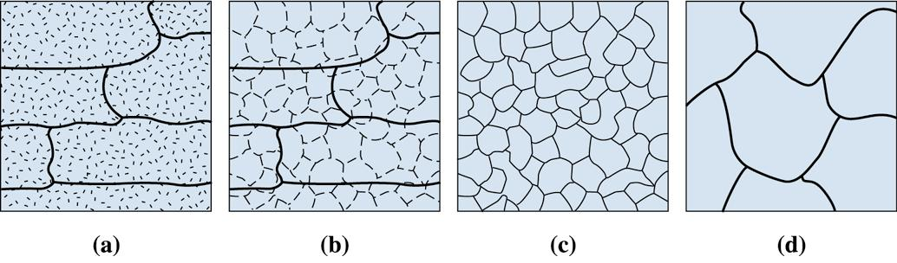
©2003 Brooks/Cole, a division of Thomson Learning, Inc. Thomson Learning™ is a trademark used herein under license.
Figure 7.17 The effect of annealing temperature on the microstructure of cold-worked metals. (a) cold-worked, (b) after recovery, (c) after recrystallization, and (d) after grain growth

Slide 37
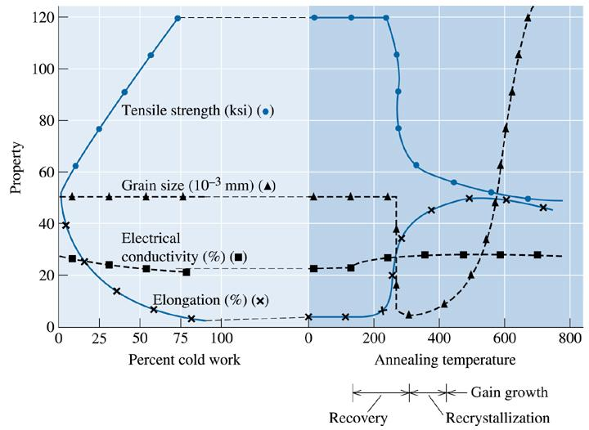
©2003 Brooks/Cole, a division of Thomson Learning, Inc. Thomson Learning™ is a trademark used herein under license.
Figure 7.18 The effect of cold work on the properties of a Cu-35% Zn alloy and the effect of annealing temperature on the properties of a Cu-35% Zn alloy that is cold-worked 75%

Slide 38
Section 7.7
Control of Annealing
Warm working - A term used to indicate the processing of metallic materials in a temperature range that is between those that define cold and hot working (usually a temperature between 0.3 to 0.6 of melting temperature in K).

Slide 39
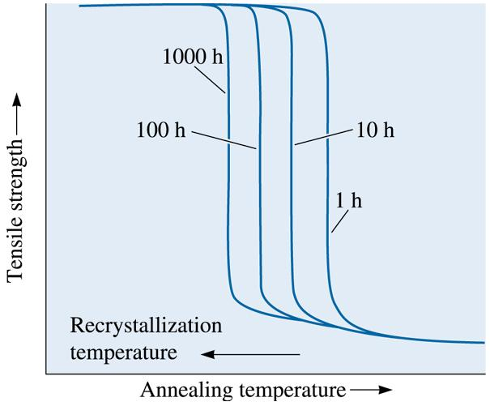
©2003 Brooks/Cole, a division of Thomson Learning, Inc. Thomson Learning™ is a trademark used herein under license.
Figure 7.19 Longer annealing times reduce the recrystallization temperature. Note that the recrystallization temperature is not a fixed temperature

Slide 40
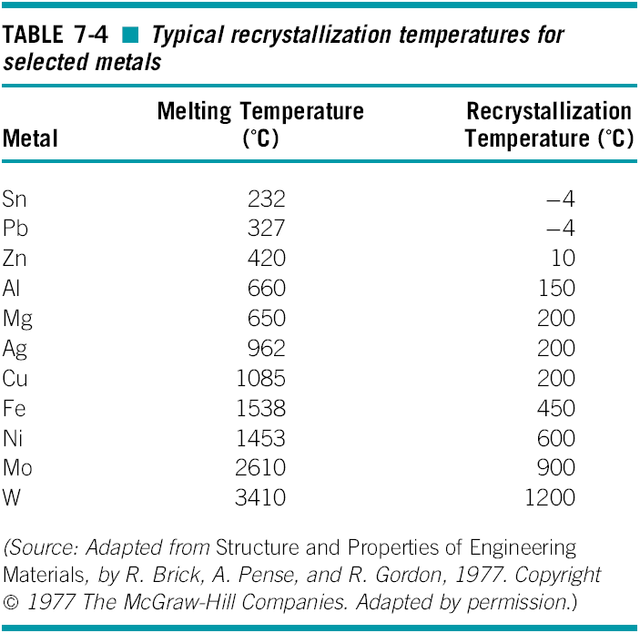

Slide 41
Section 7.8
Annealing and Materials Processing
Heat-affected zone (HAZ) - The volume of material adjacent to a weld that is heated during the welding process above some critical temperature at which a change in the structure, such as grain growth or recrystallization, occurs.

Slide 42
Example 7.6 Design of a Process to Produce Copper Strip
We wish to produce a 0.1-cm-thick, 6-cm-wide copper strip having at least 60,000 psi yield strength and at least 5% elongation. We are able to purchase 6-cm-wide strip only in thicknesses of 5 cm. Design a process to produce the product we need.

Slide 43
©2003 Brooks/Cole, a division of Thomson Learning, Inc. Thomson Learning™ is a trademark used herein under license.
Figure 7.7 The effect of cold work on the mechanical properties of copper

Slide 44

Example 7.6 SOLUTION
In Example 7-2, we found that the required properties can be obtained with a cold work of 40 to 45%. Therefore, the starting thickness must be between 0.167 cm and 0.182 cm, and this starting material must be as soft as possible— that is, in the annealed condition. Since we are able to purchase only 5-cm thick stock, we must reduce the thickness of the 5-cm strip to between 0.167 and 0.182 cm, then anneal the strip prior to final cold working. But can we successfully cold work from 5 cm to 0.182 cm?
Based on Figure 7.7, a maximum of about 90% cold work is permitted. Therefore, we must do a series of cold work and anneal cycles.

Slide 45
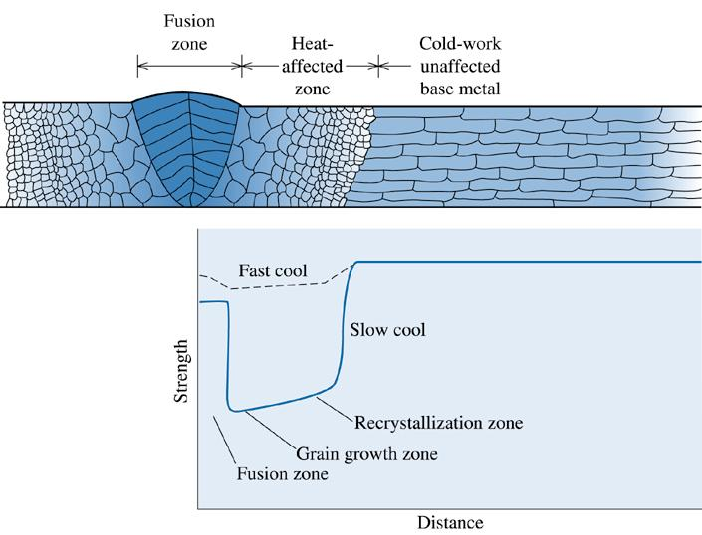
©2003 Brooks/Cole, a division of Thomson Learning, Inc. Thomson Learning™ is a trademark used herein under license.
Figure 7.20 The structure and properties surrounding a fusion weld in a cold-worked metal. Note: only the right-hand side of the heat-affected zone is marked on the diagram. Note the loss in strength caused by recrystallization and grain growth in the heat-affected zone

Slide 46
Section 7.9
Hot Working
Lack of Strengthening
Elimination of Imperfections
Anisotropic Behavior
Surface Finish and Dimensional Accuracy

Slide 47
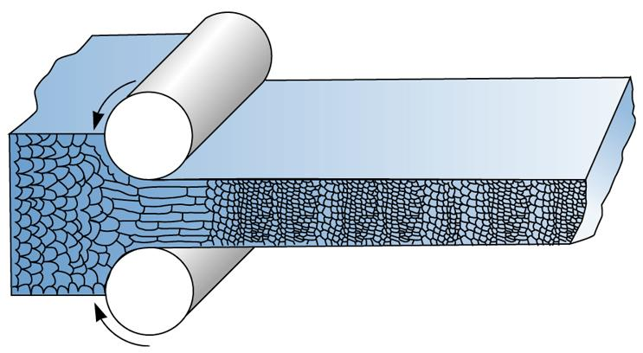
©2003 Brooks/Cole, a division of Thomson Learning, Inc. Thomson Learning™ is a trademark used herein under license.
Figure 7.21 During hot working, the elongated anisotropic grains immediately recrystallize. If the hot-working temperature is properly controlled, the final hot-worked grain size can be very fine

Slide 48
Example 7.7 Design of a Process to Produce a Copper Strip
We want to produce a 0.1-cm-thick, 6-cm-wide copper strip having at least 60,000 psi yield strength and at least 5% elongation. We are able to purchase 6-cm-wide strip only in thicknesses of 5 cm. Design a process to produce the product we need, but in fewer steps than were required in Example 7.6.

Slide 49
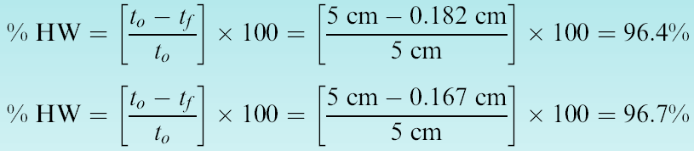
Example 7.7 SOLUTION
In Example 7.6, we relied on a series of cold work-anneal cycles to obtain the required thickness. We could reduce the steps by hot rolling to the required intermediate thickness:
Thus our design might be:
1. Hot work the 5-cm strip 96.4% to the intermediate thickness of 0.182 cm.
2. Cold work 45% from 0.182 cm to the final dimension of 0.1 cm. This design gives the correct dimensions and properties.

Slide 50
Section 7.10
Superplastic Forming (SPF)
Superplasticity - The ability of a metallic or ceramic material to deform uniformly by an exceptionally large amount.
Strain rate - The rate at which a material is deformed.

Slide 51
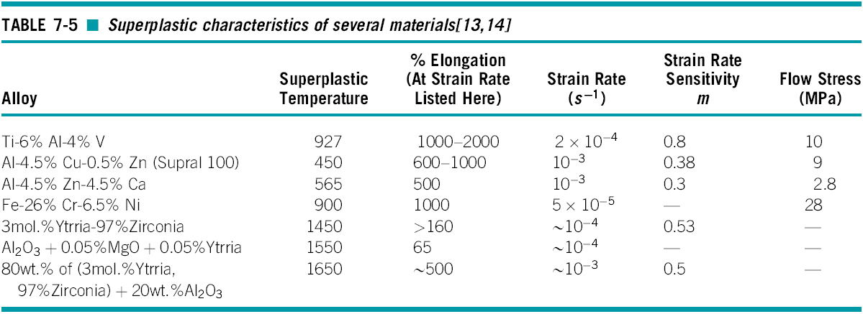

Slide 52
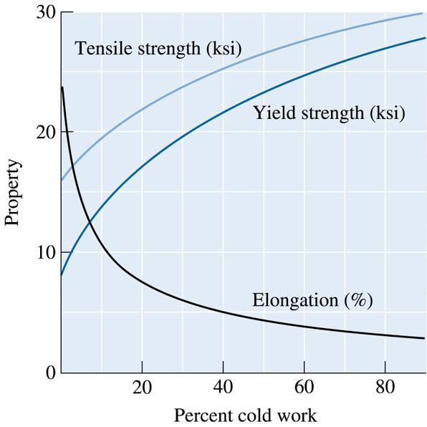
©2003 Brooks/Cole, a division of Thomson Learning, Inc. Thomson Learning™ is a trademark used herein under license.
Figure 7.22 True stress-true strain curve (for Problem 7.9)

Slide 53
©2003 Brooks/Cole, a division of Thomson Learning, Inc. Thomson Learning™ is a trademark used herein under license.
Figure 7.23 The effect of percent cold work on the properties of a 3105 aluminum alloy (for Problems 7.22 and 7.24)

Slide 54
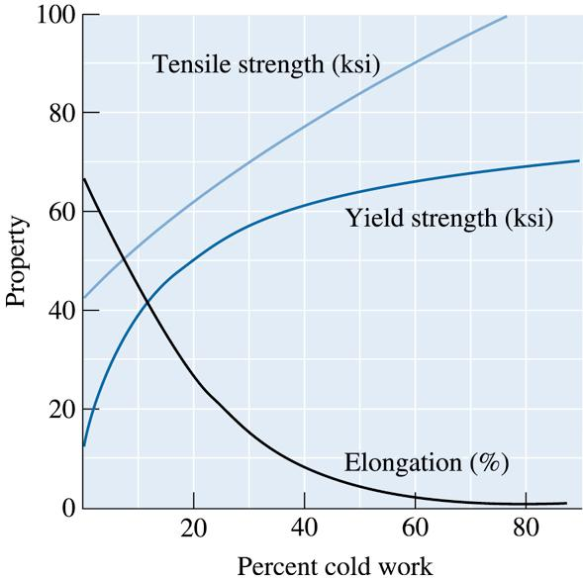
©2003 Brooks/Cole, a division of Thomson Learning, Inc. Thomson Learning™ is a trademark used herein under license.
Figure 7.24 The effect of percent cold work on the properties of a Cu-30% Zn brass (for Problems 7.23 and 7.26)

Slide 55

©2003 Brooks/Cole, a division of Thomson Learning, Inc. Thomson Learning™ is a trademark used herein under license.
Figure 7.7 (Repeated for Problems 7.25 and 7.27 and 7.43) The effect of cold work on the mechanical properties of copper

Slide 56

Figure 7.10 (Repeated for Problem 7.29) Anistropic behavior in a rolled aluminum-lithium sheet material used in aerospace applications. The sketch relates the position of tensile bars to the mechanical properties that are obtained
©2003 Brooks/Cole, a division of Thomson Learning, Inc. Thomson Learning™ is a trademark used herein under license.

