Slide 1
NUCLEAR REACTOR MATERIALS
INTRODUCTION TO NUCLEAR REACTORS AND MATERIALS
Notes compiled by:
Dr goh pei sean
Mohsin mohd sies

Slide 2
Materials science in nuclear engineering
Materials is an old technology and
has a long history before nuclear.
We know much about …..
strength
electric properties
cost
corrosion resistance
・・etc
For nuclear applications, we should also consider followings.
nuclear properties
radiation damage
reliability
Zircalloy clad tubes for LWR requires Hf-free Zr for the expected low neutron-absorption cross-sections.

Slide 3
Course Goals
Obtain a basic knowledge of key degradation phenomena and material limitations in nuclear energy technologies
Obtain basic knowledge in key materials science concepts; crystal structure, crystal grains
Obtain a basic knowledge of mechanical properties; stress-strain relationship, plasticity, slip, fracture
Understand and quantify radiation damage; energy transfer, displacement cross-sections, displacement rate
Understand radiation effect mechanisms; radiation induced segregation, swelling, hardening, embrittlement, stress corrosion cracking
Notes:
The more fundamental aspects of radiation effects can be described on the atomic
scale.

Slide 4
The Big Picture
Reactor Components
Materials Science and Engineering
Nuclear Reactor Integrity
Radiation Effects
Remediation and Monitoring

Slide 5
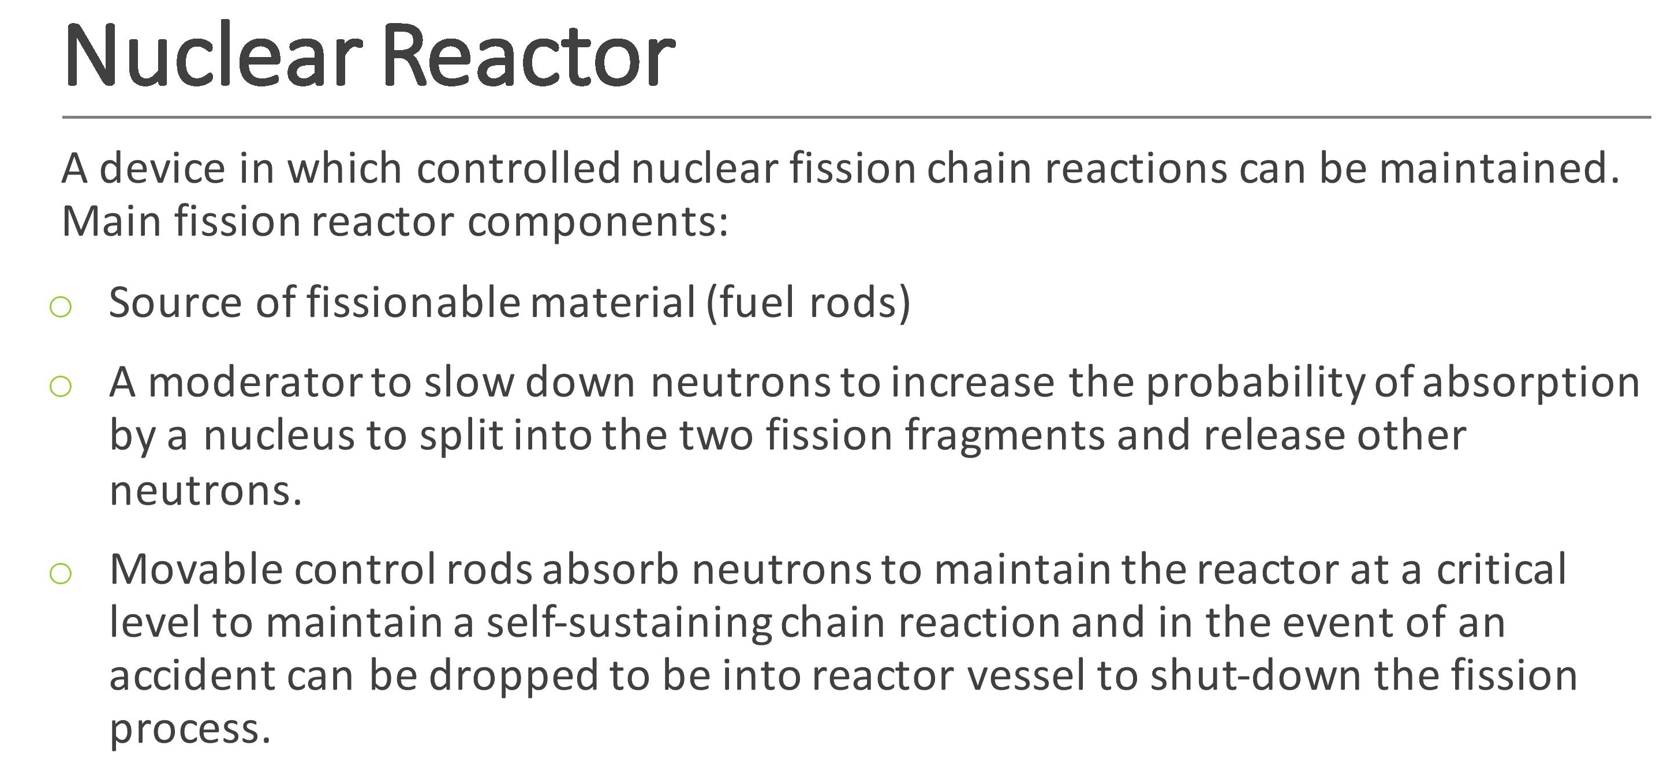

Slide 6
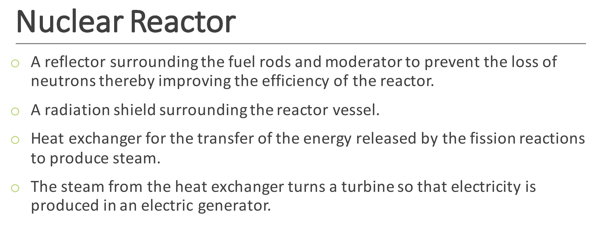

Slide 7
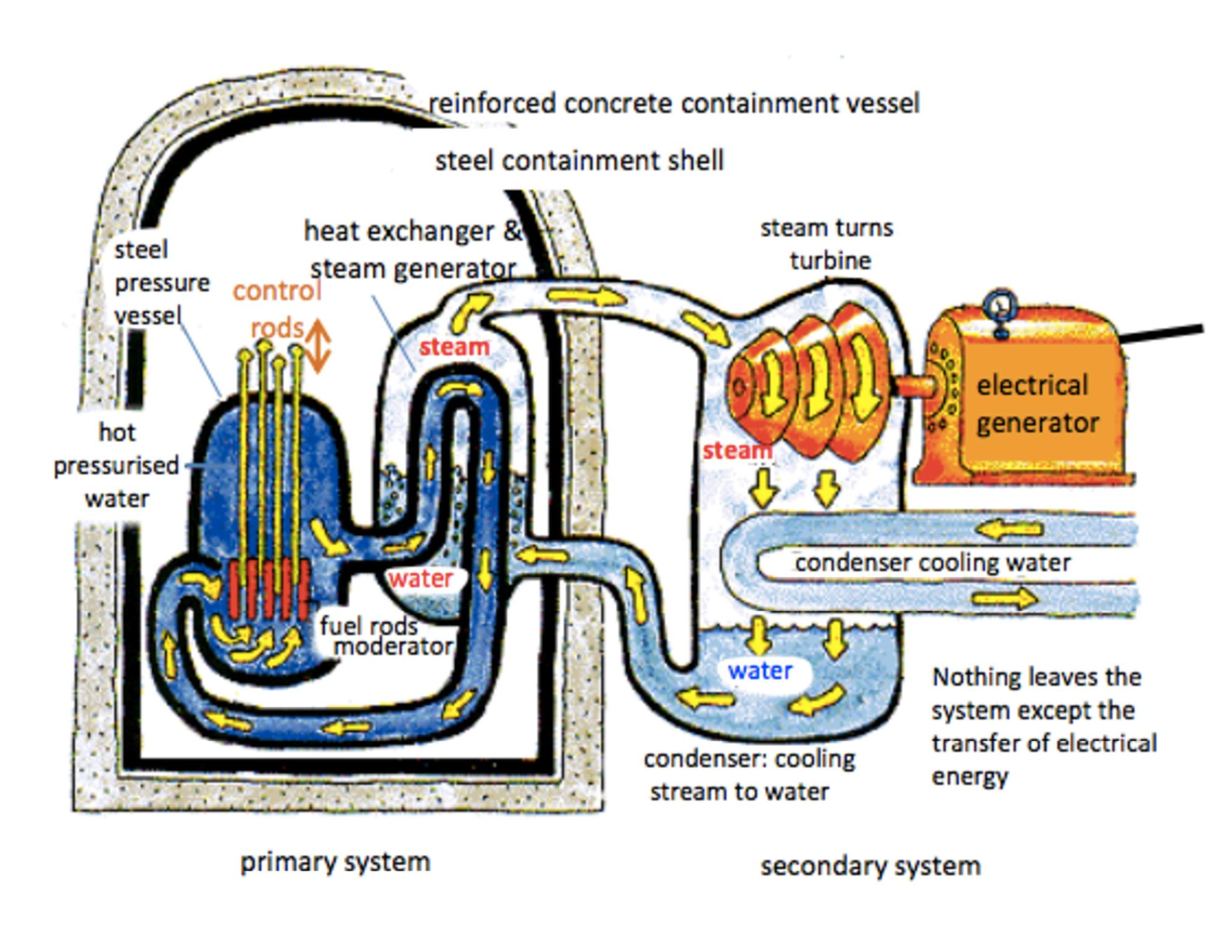

Slide 8
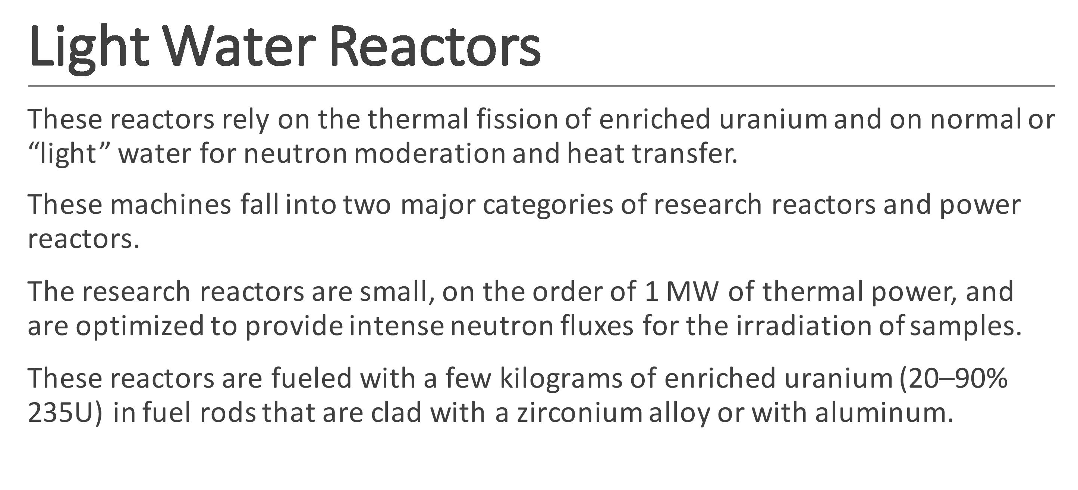

Slide 9
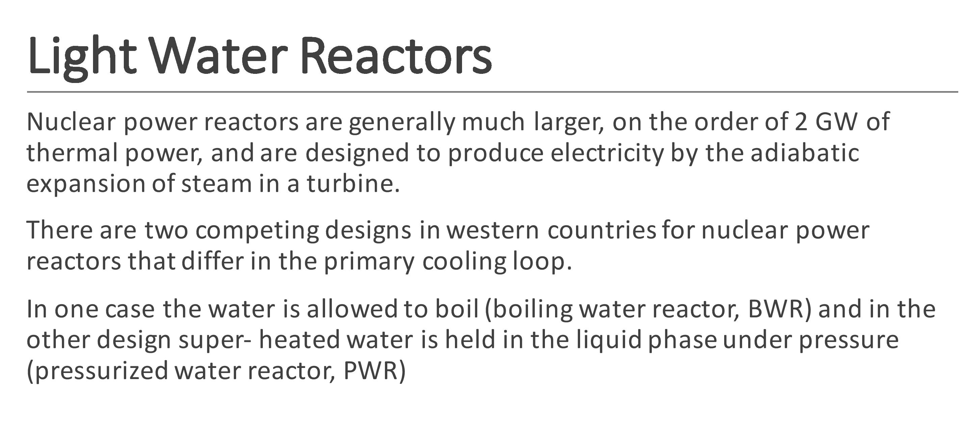

Slide 10
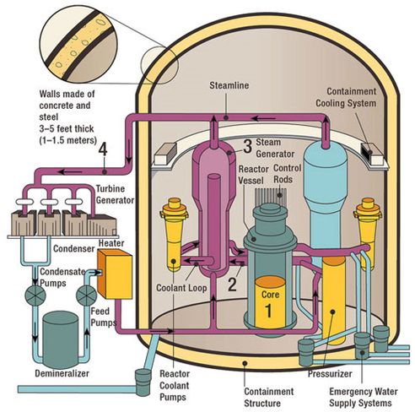
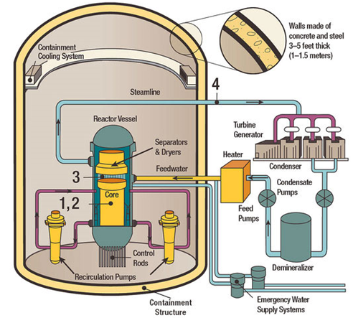
Know Your Reactors - LWR
Typical PWR
Typical BWR

Slide 11
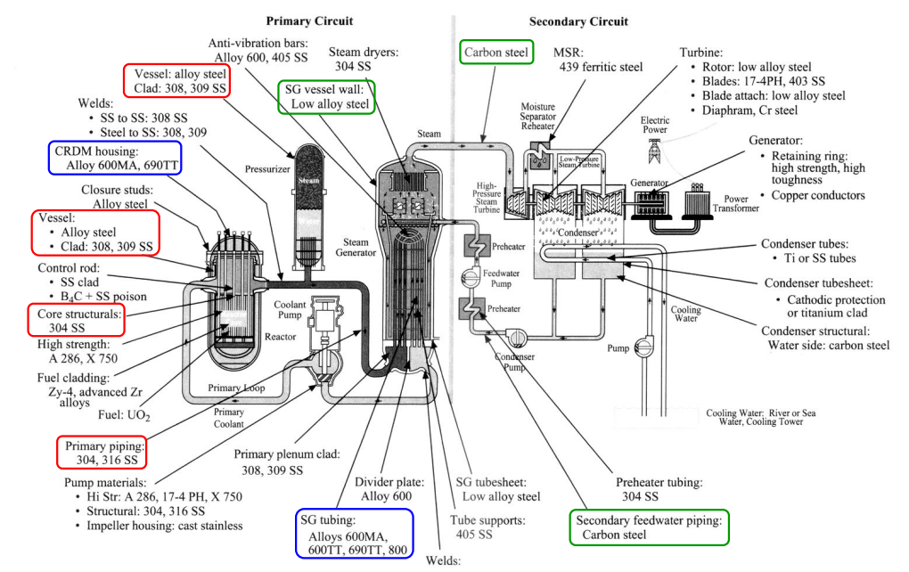
PWR Material Map

Slide 12
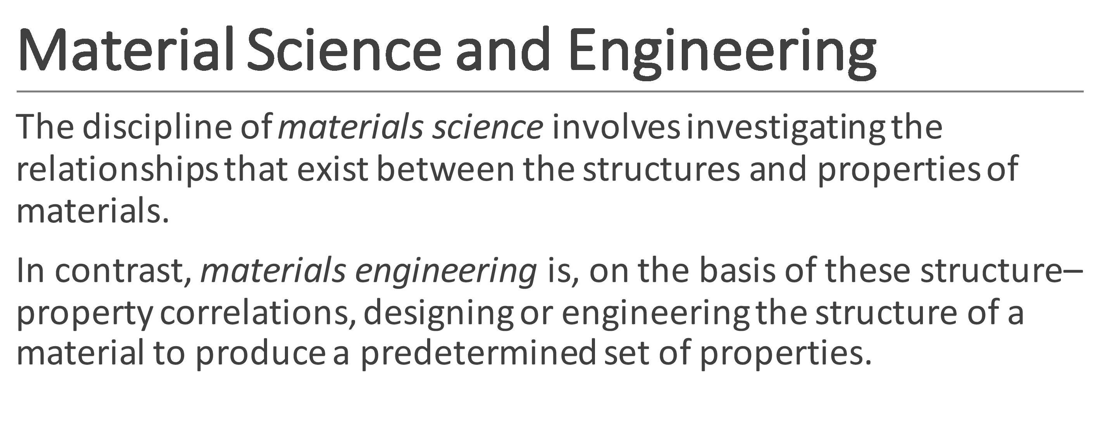

Slide 13
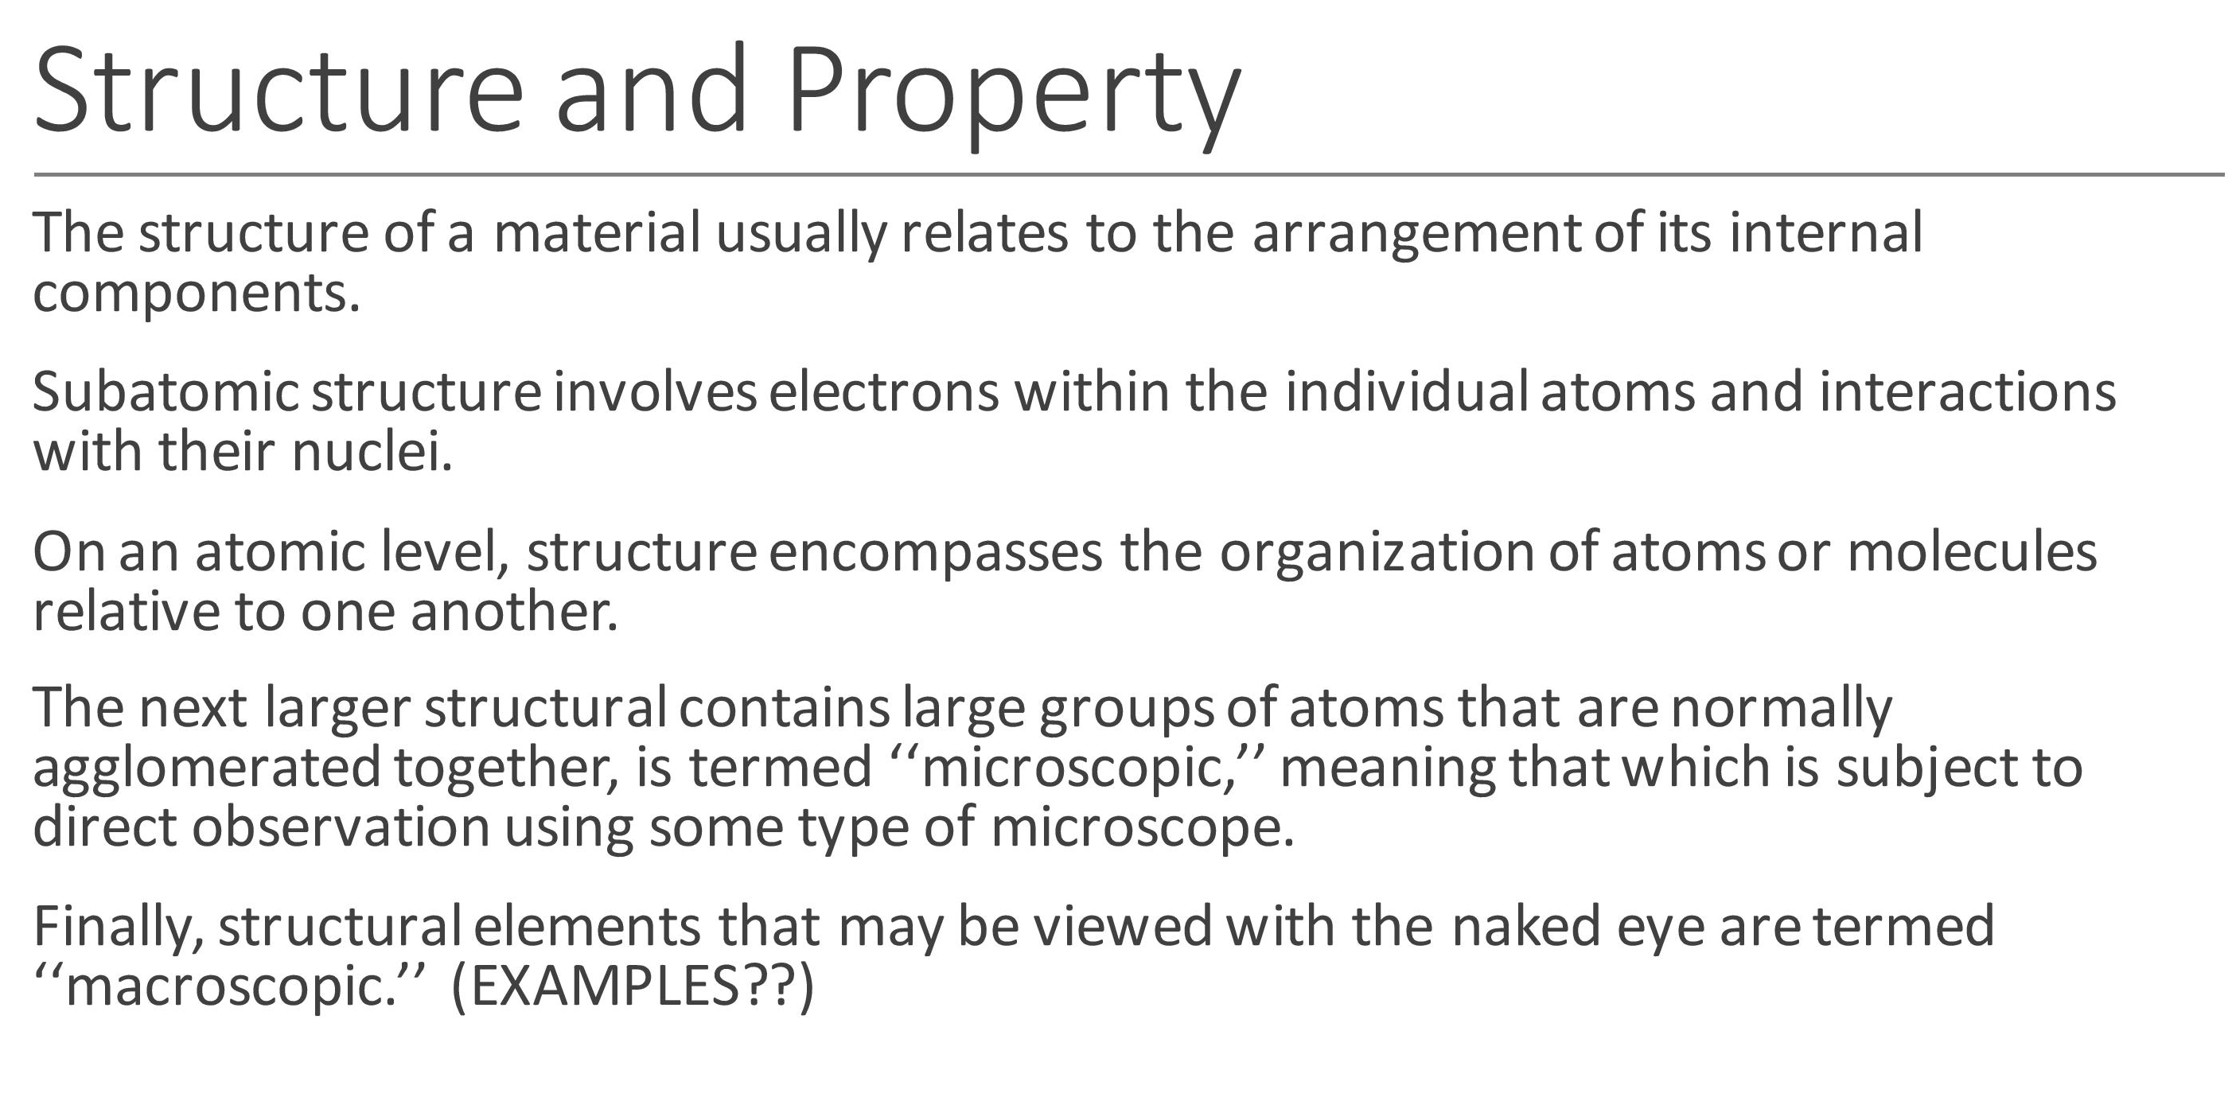

Slide 14
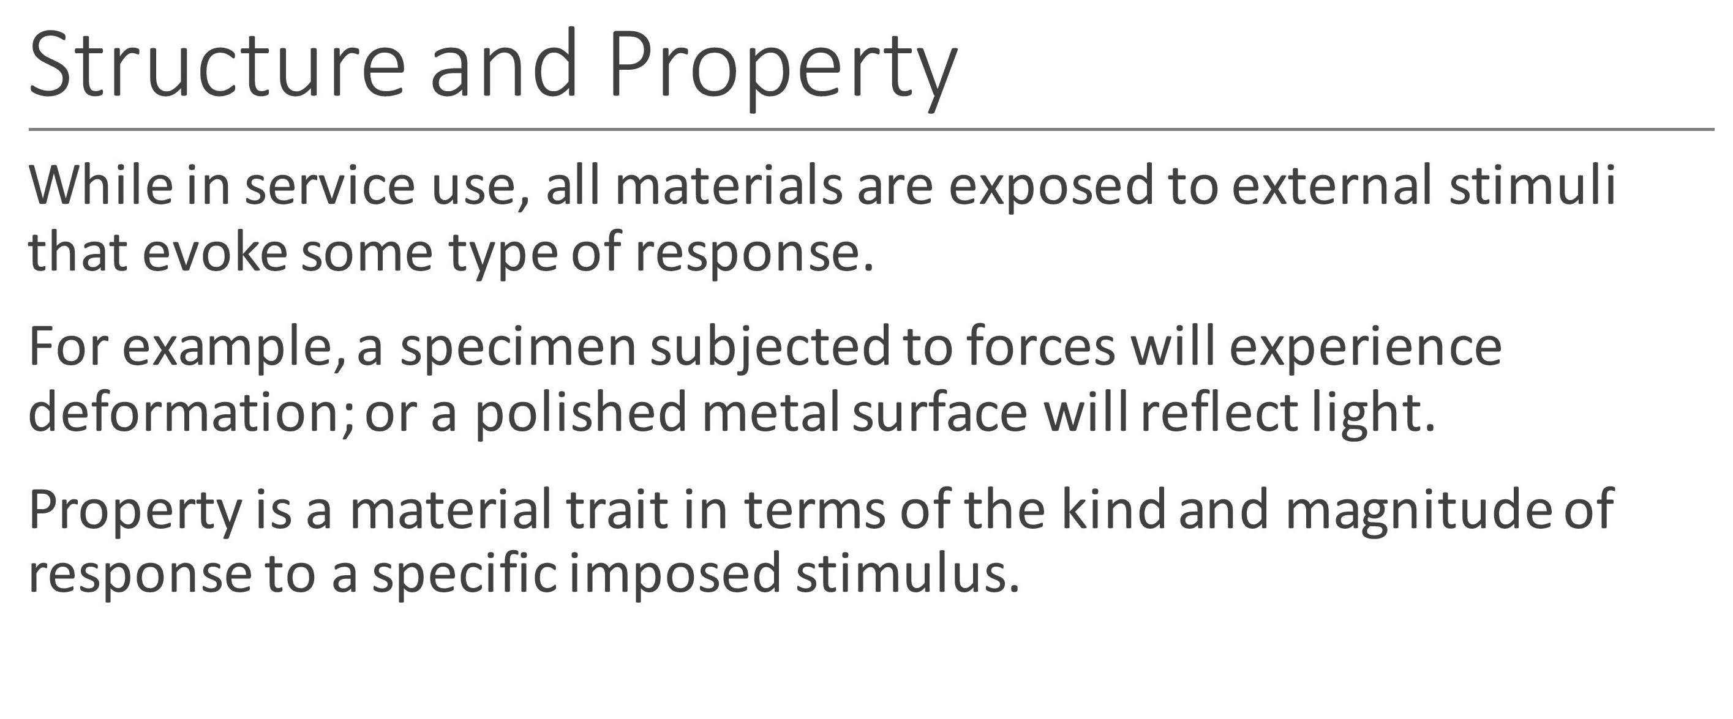

Slide 15
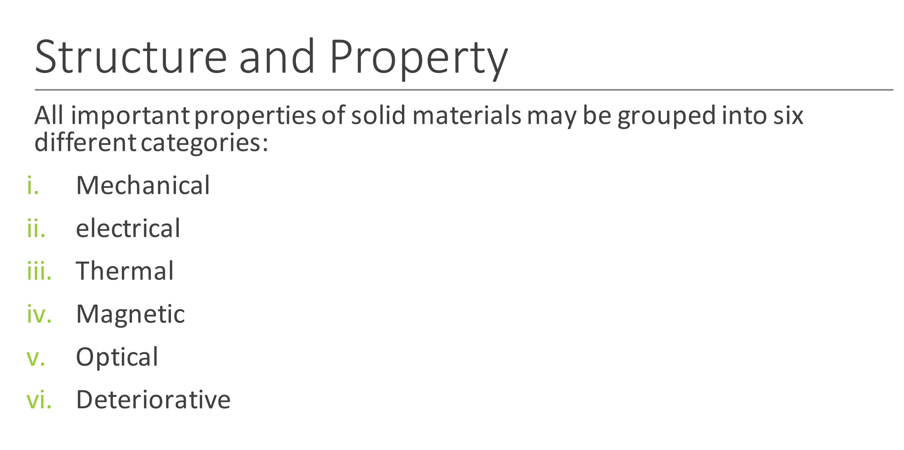

Slide 16
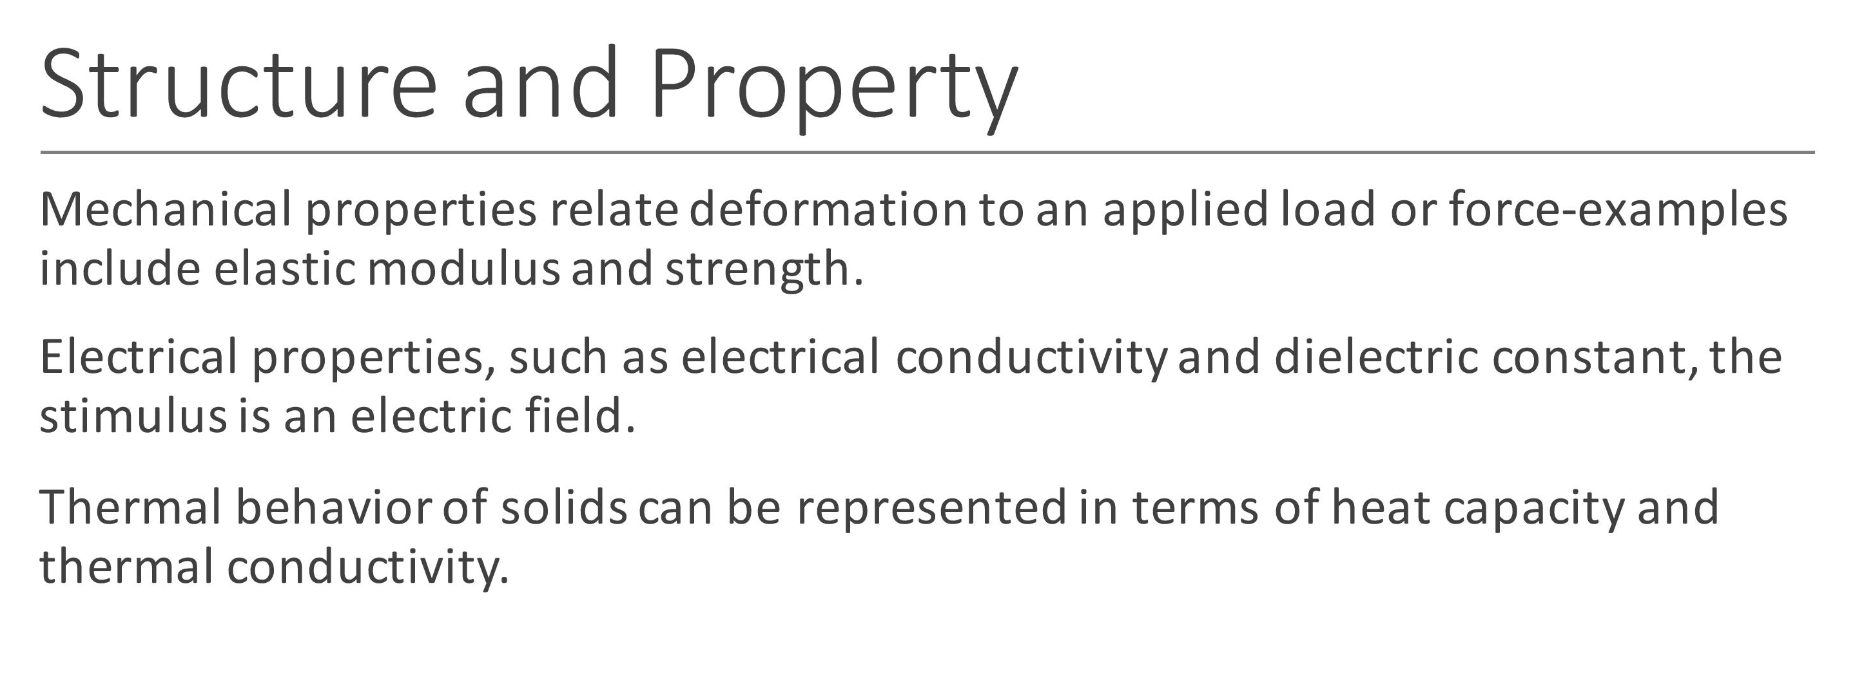

Slide 17
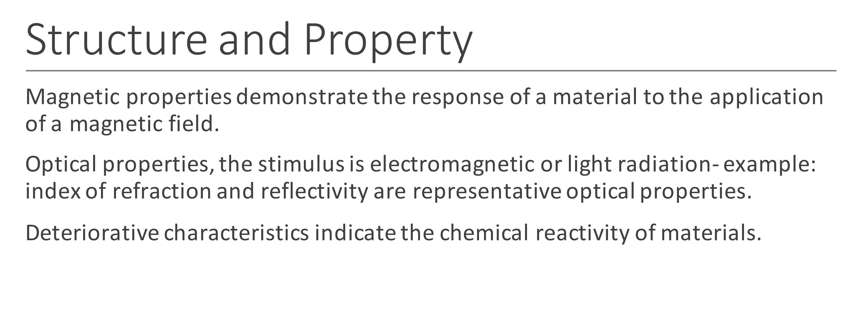

Slide 18
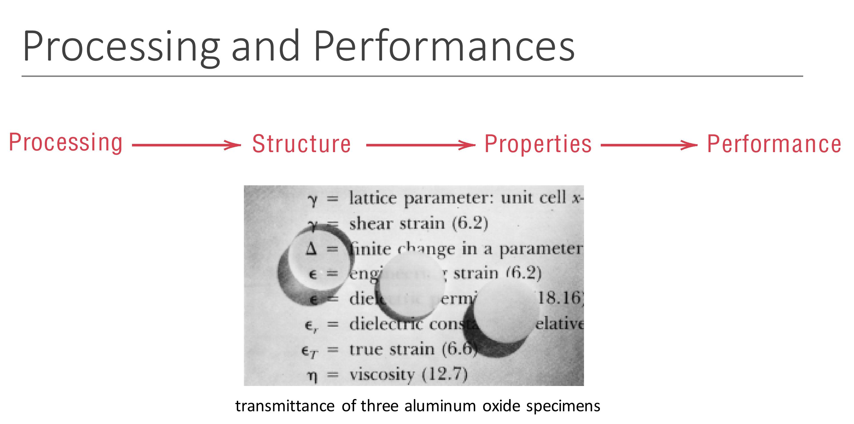

Slide 19
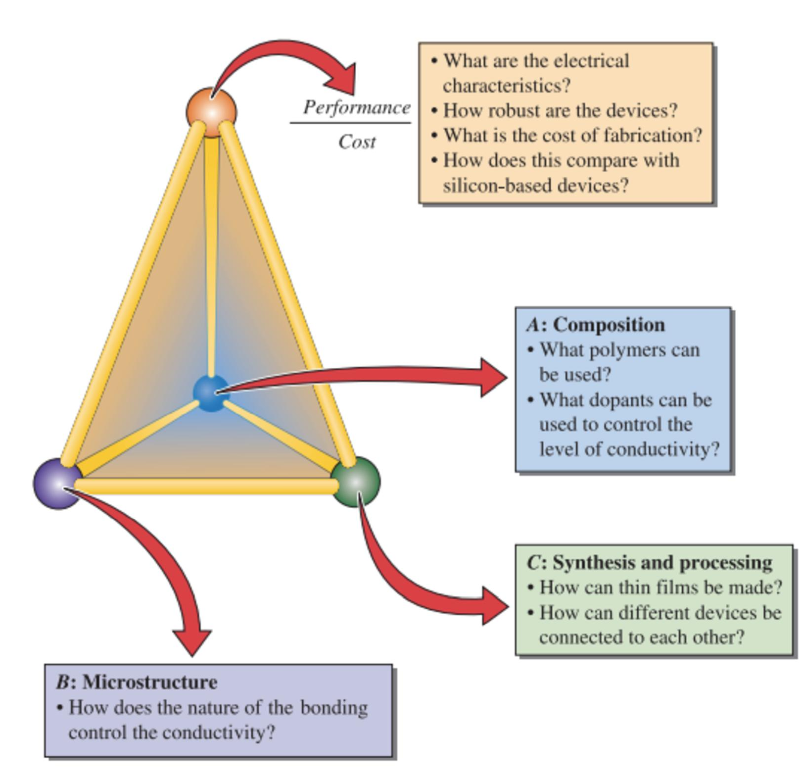

Slide 20
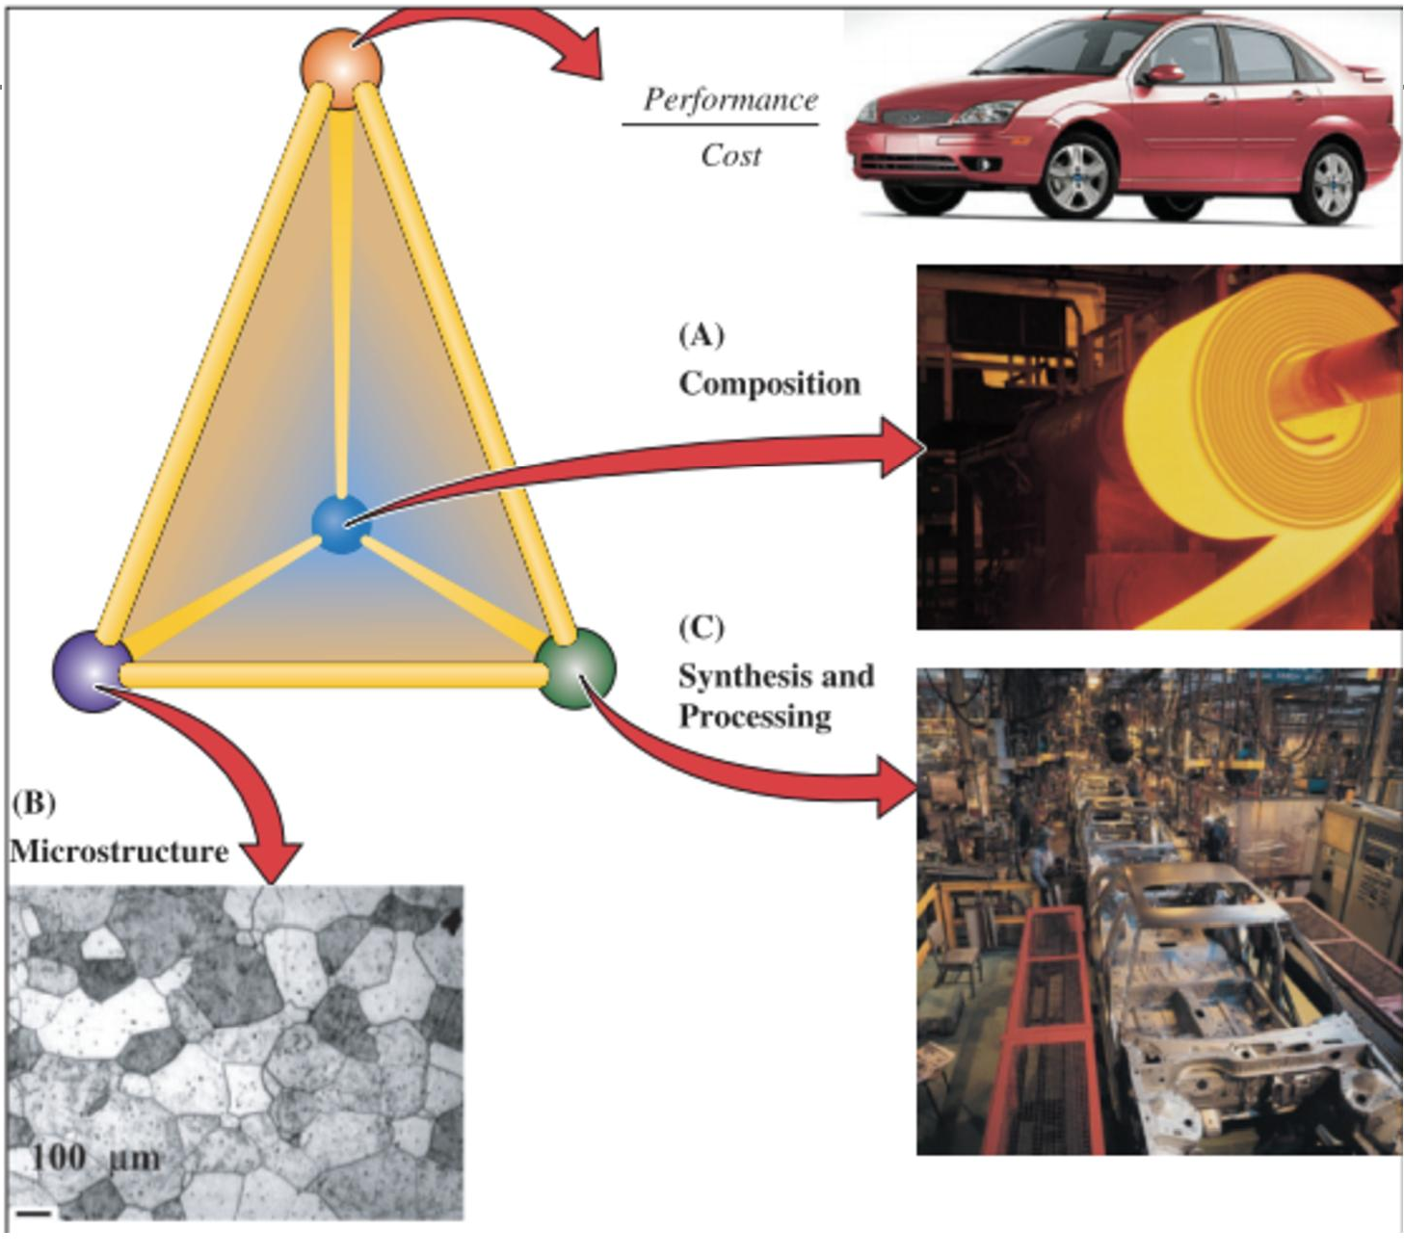

Slide 21
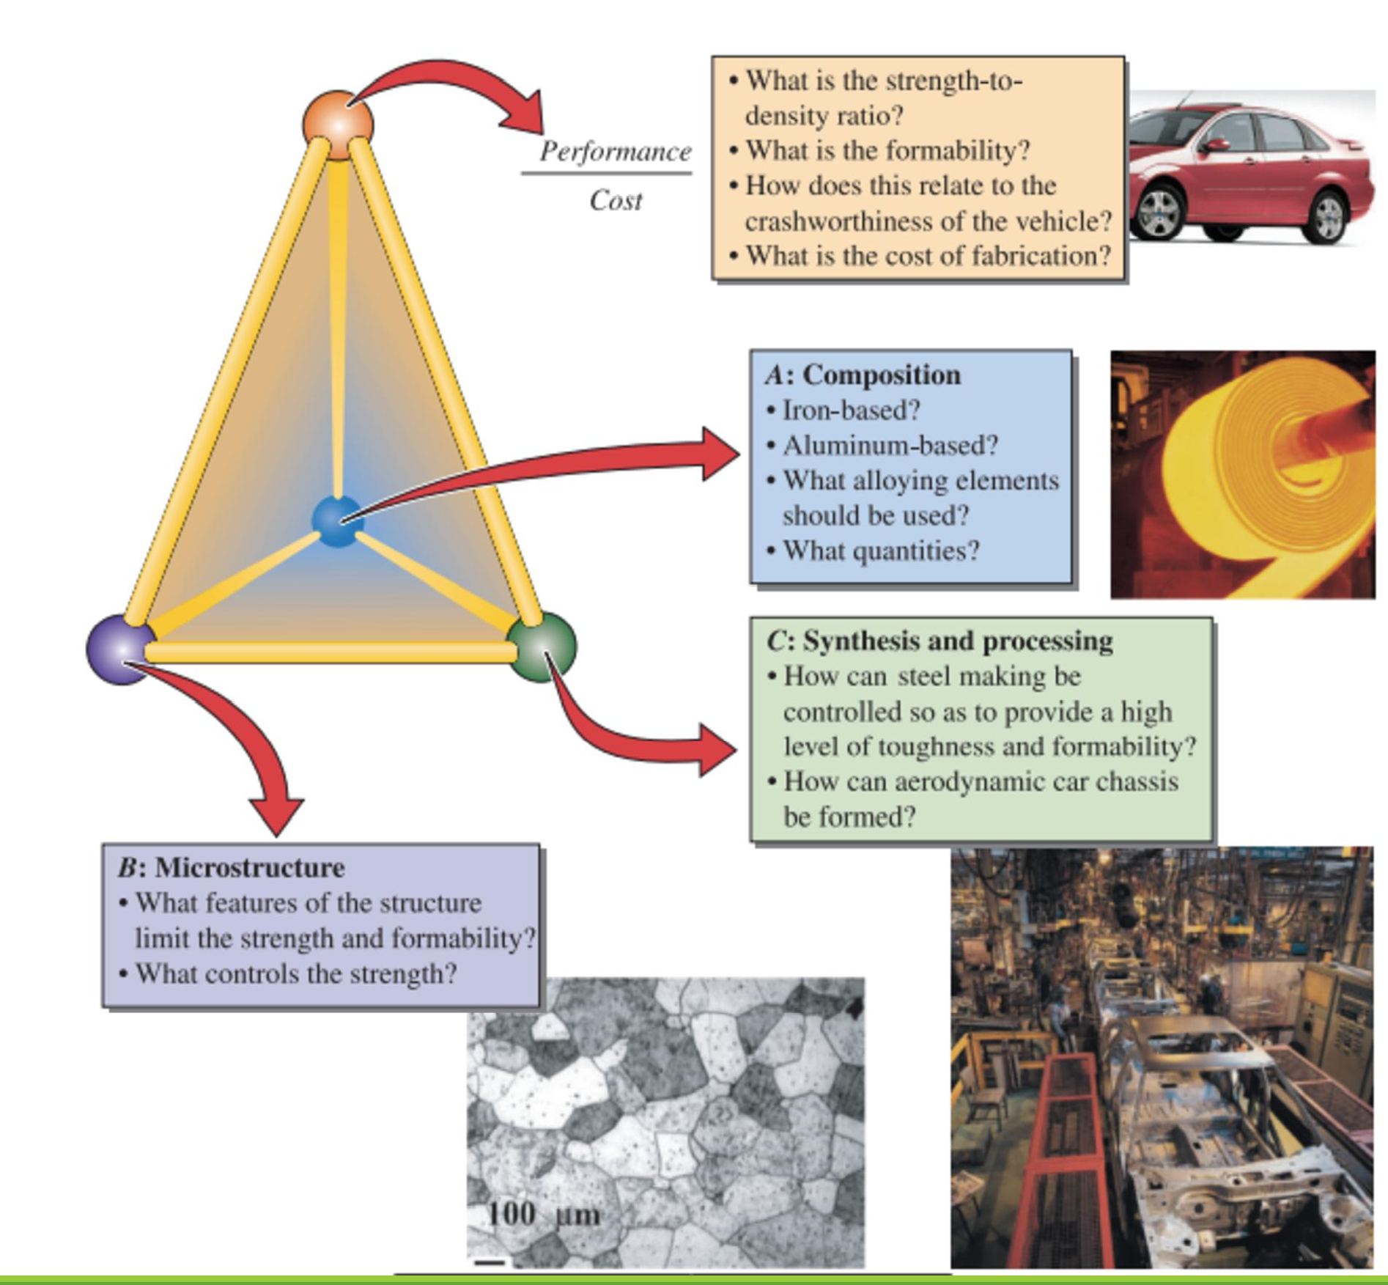

Slide 22
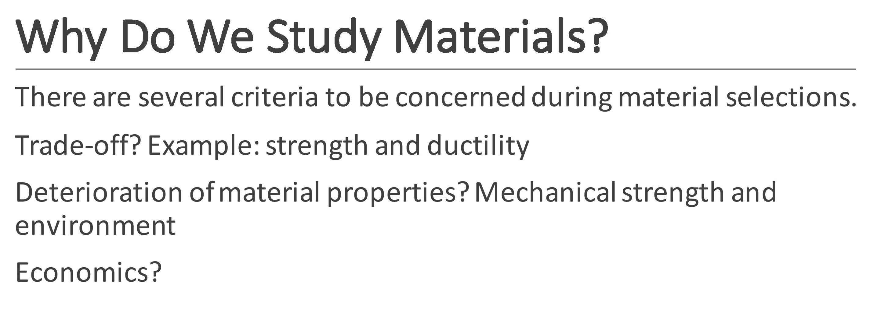

Slide 23
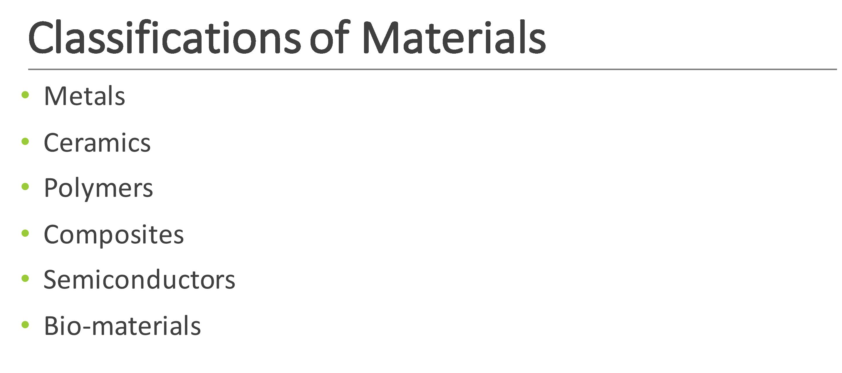

Slide 24
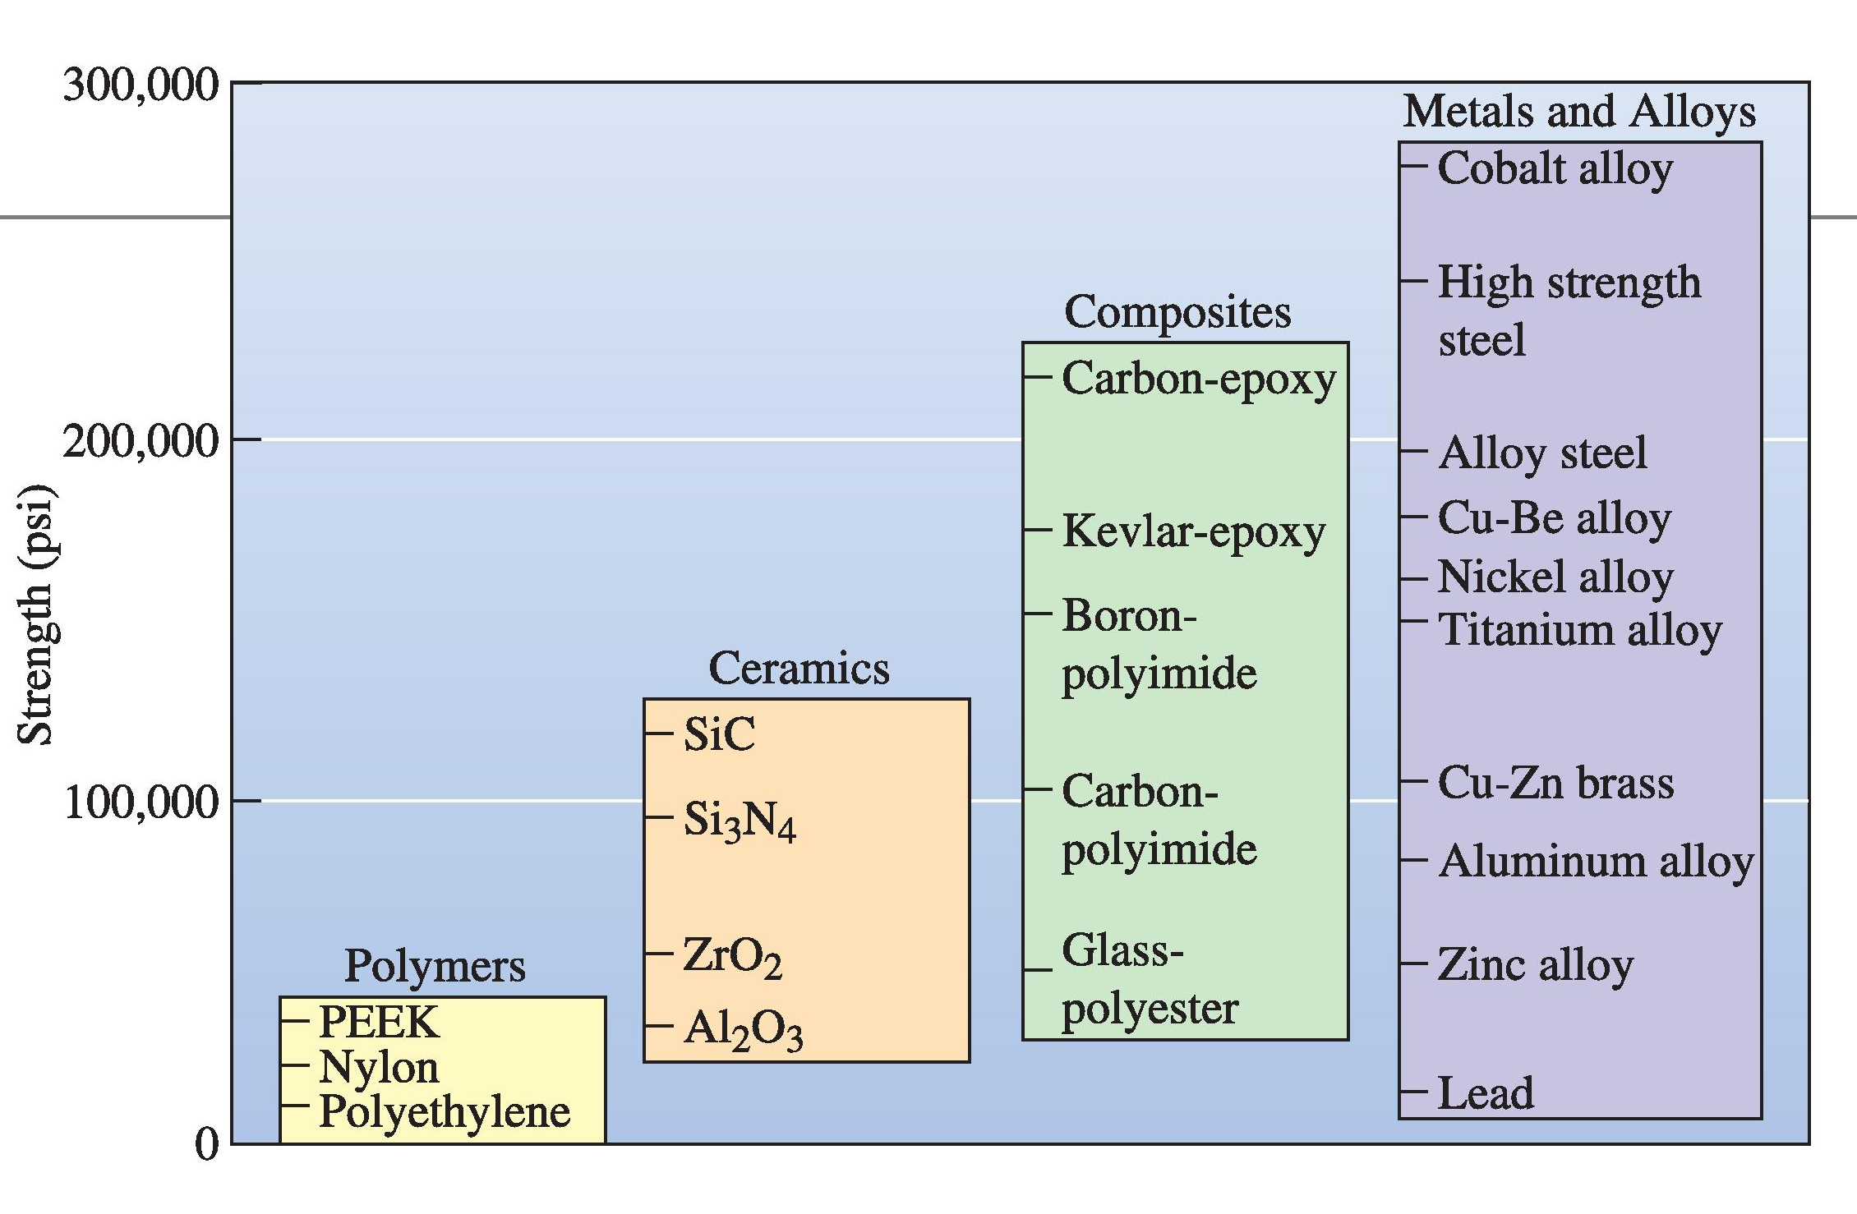

Slide 25
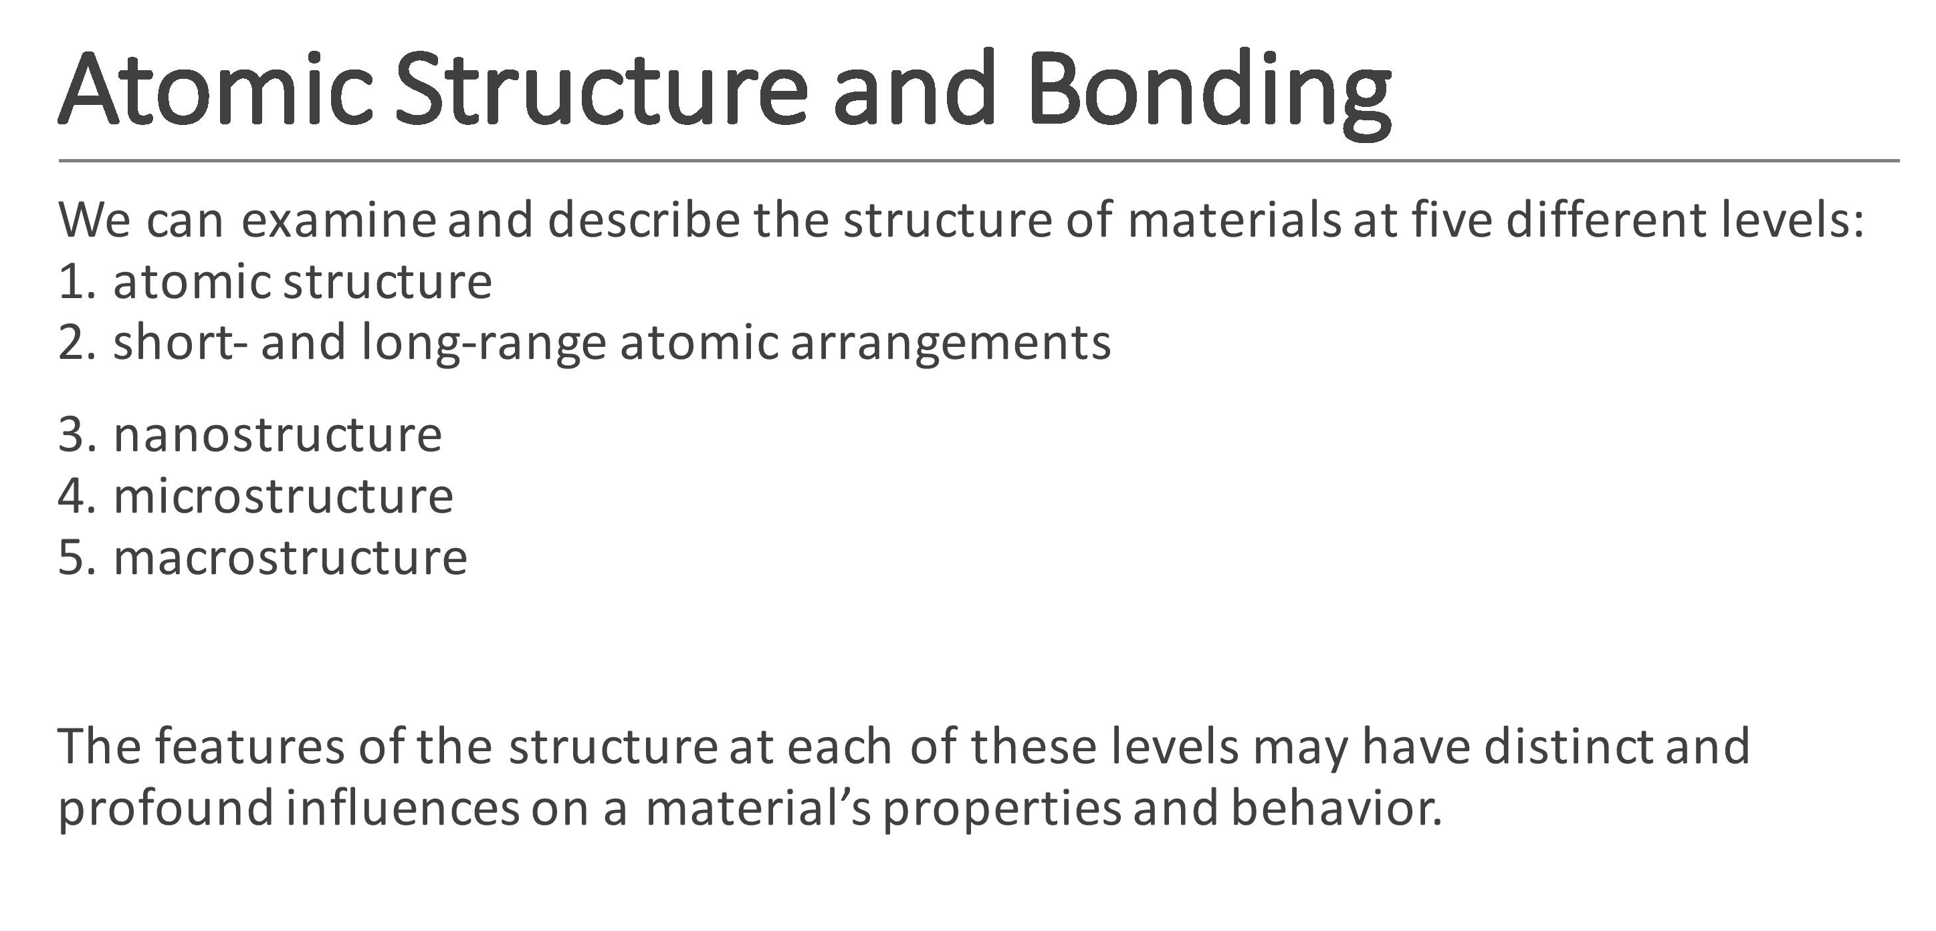

Slide 26
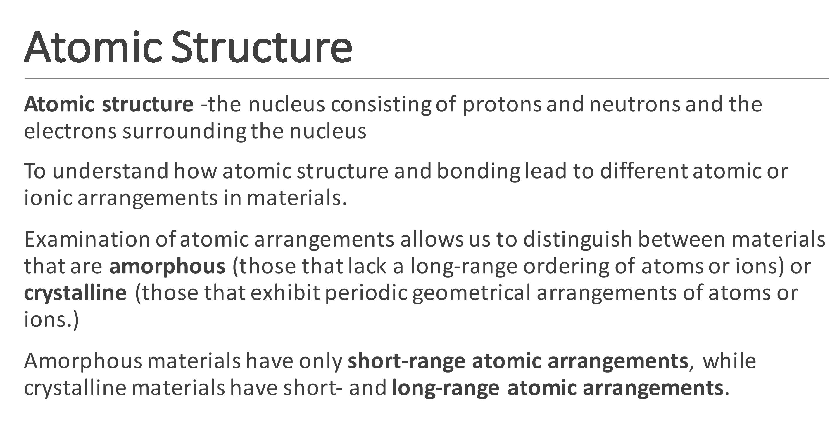

Slide 27
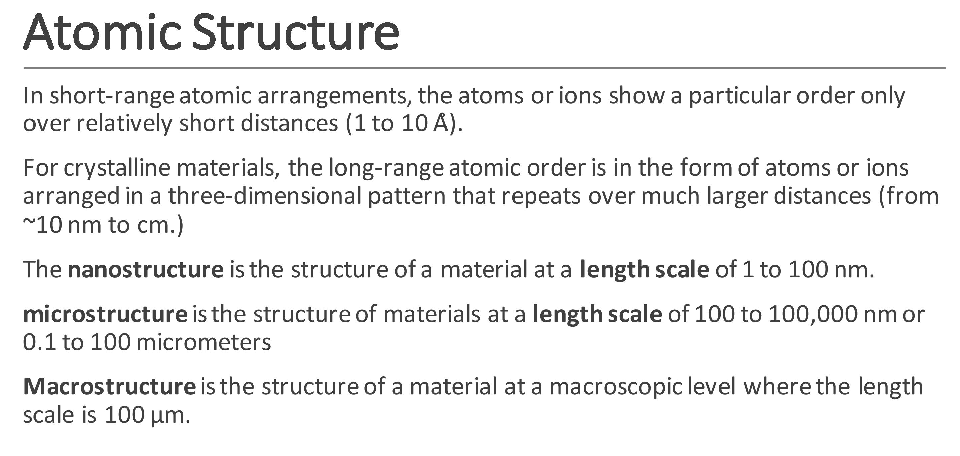

Slide 28
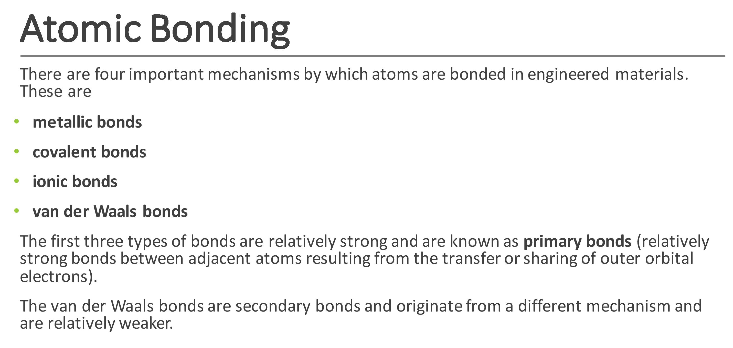

Slide 29
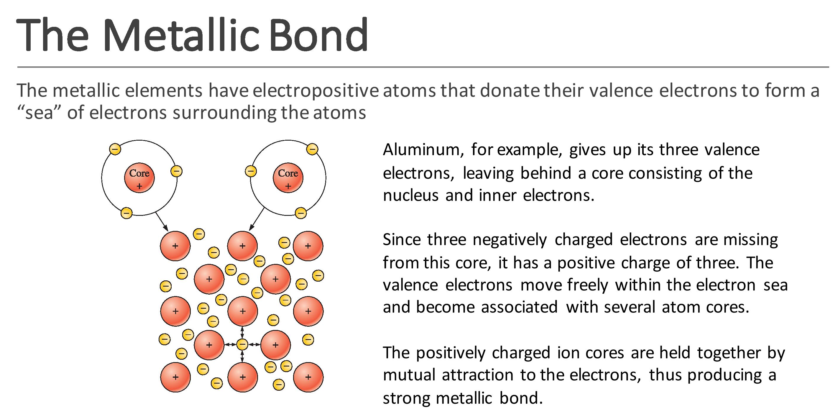

Slide 30
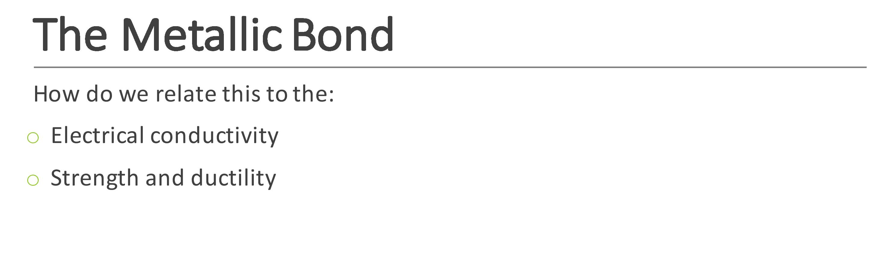

Slide 31
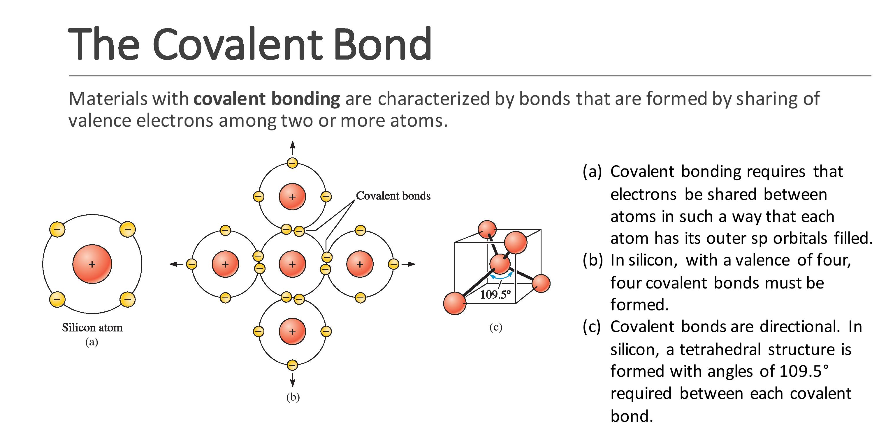

Slide 32
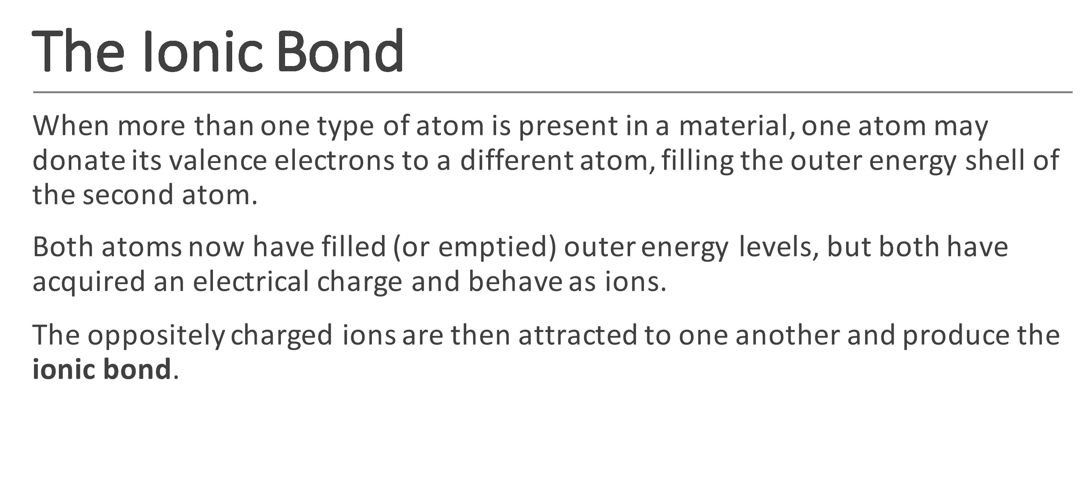

Slide 33
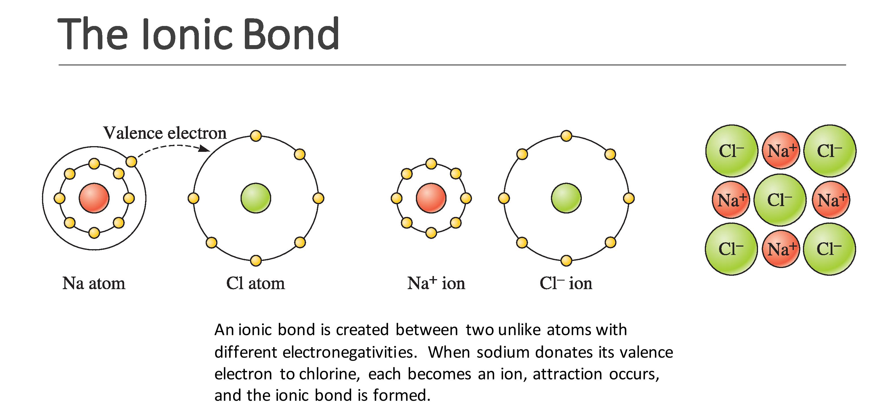

Slide 34
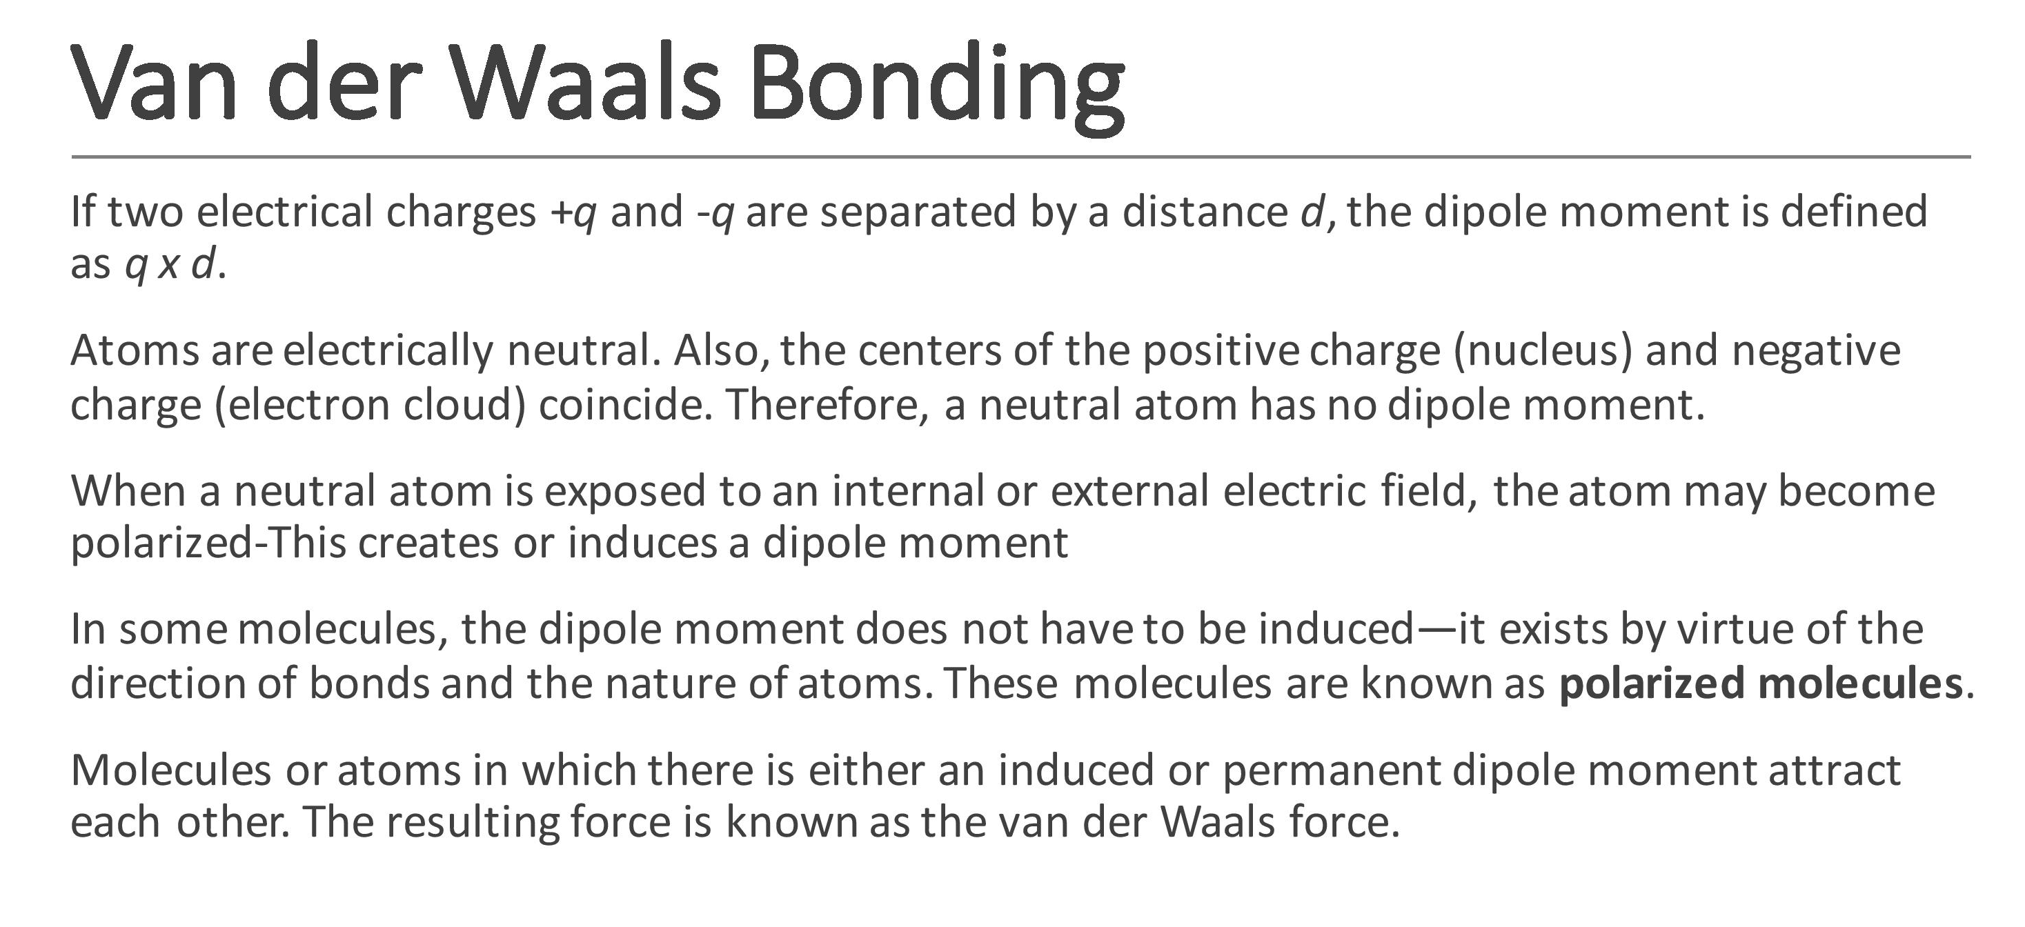

Slide 35
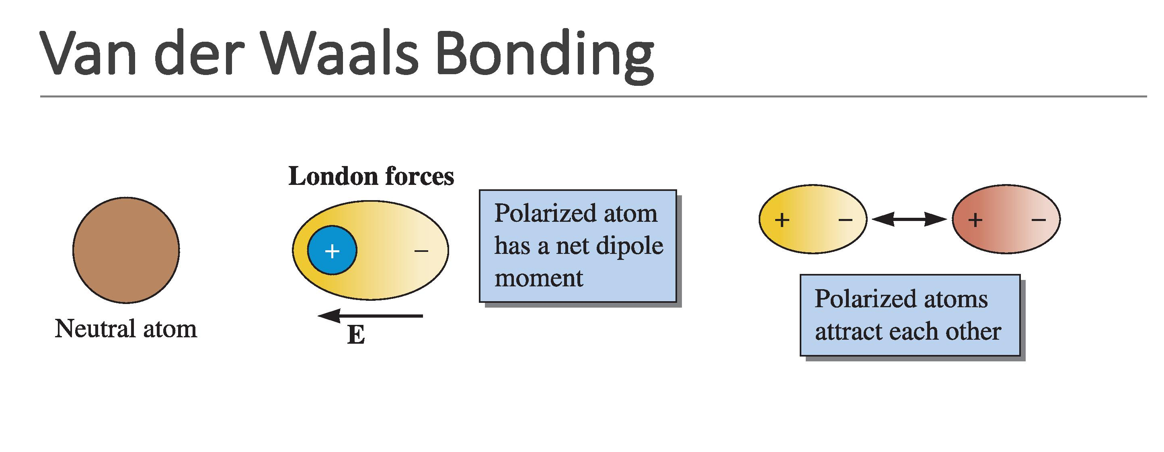

Slide 36
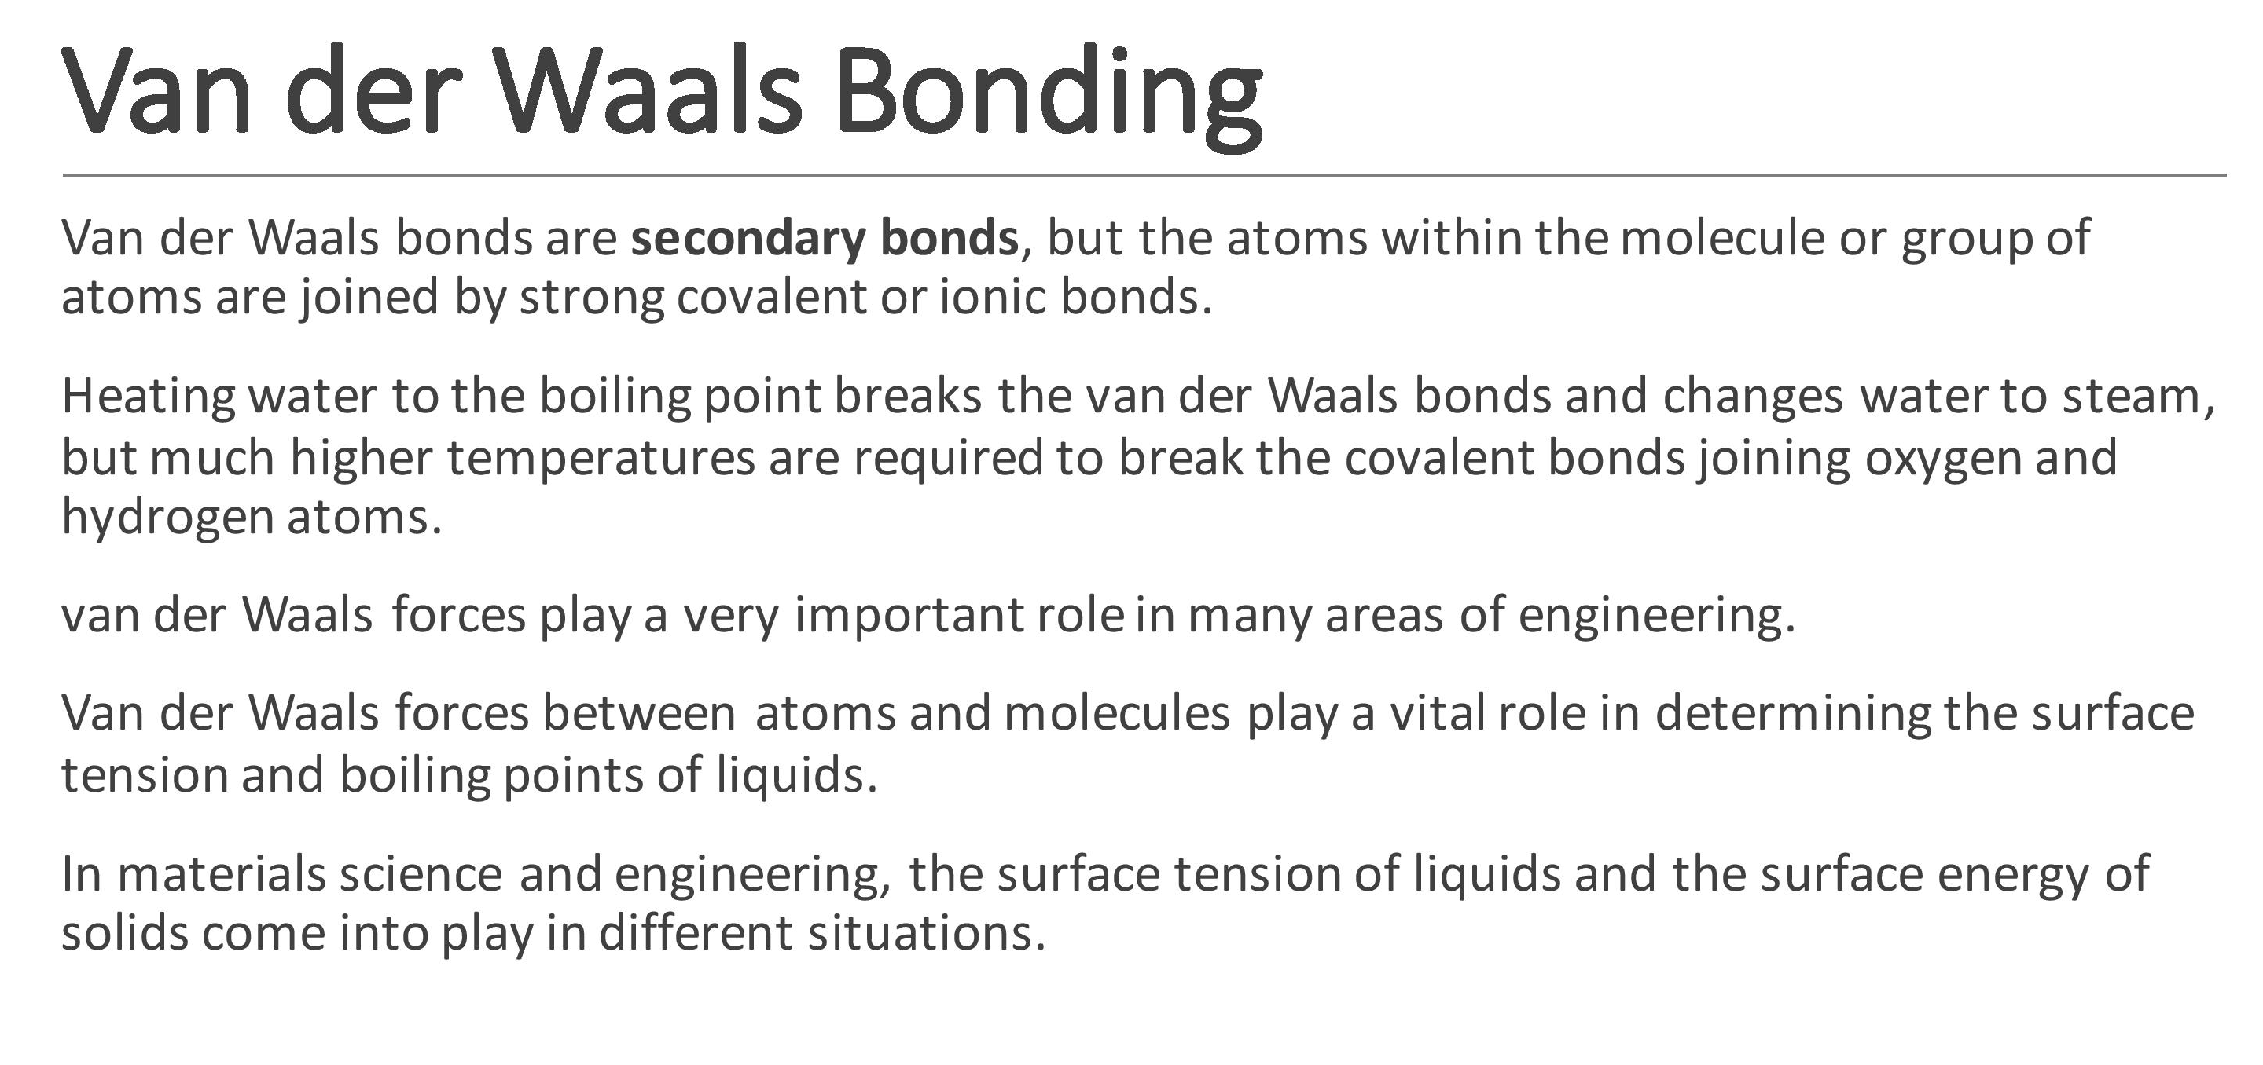

Slide 37
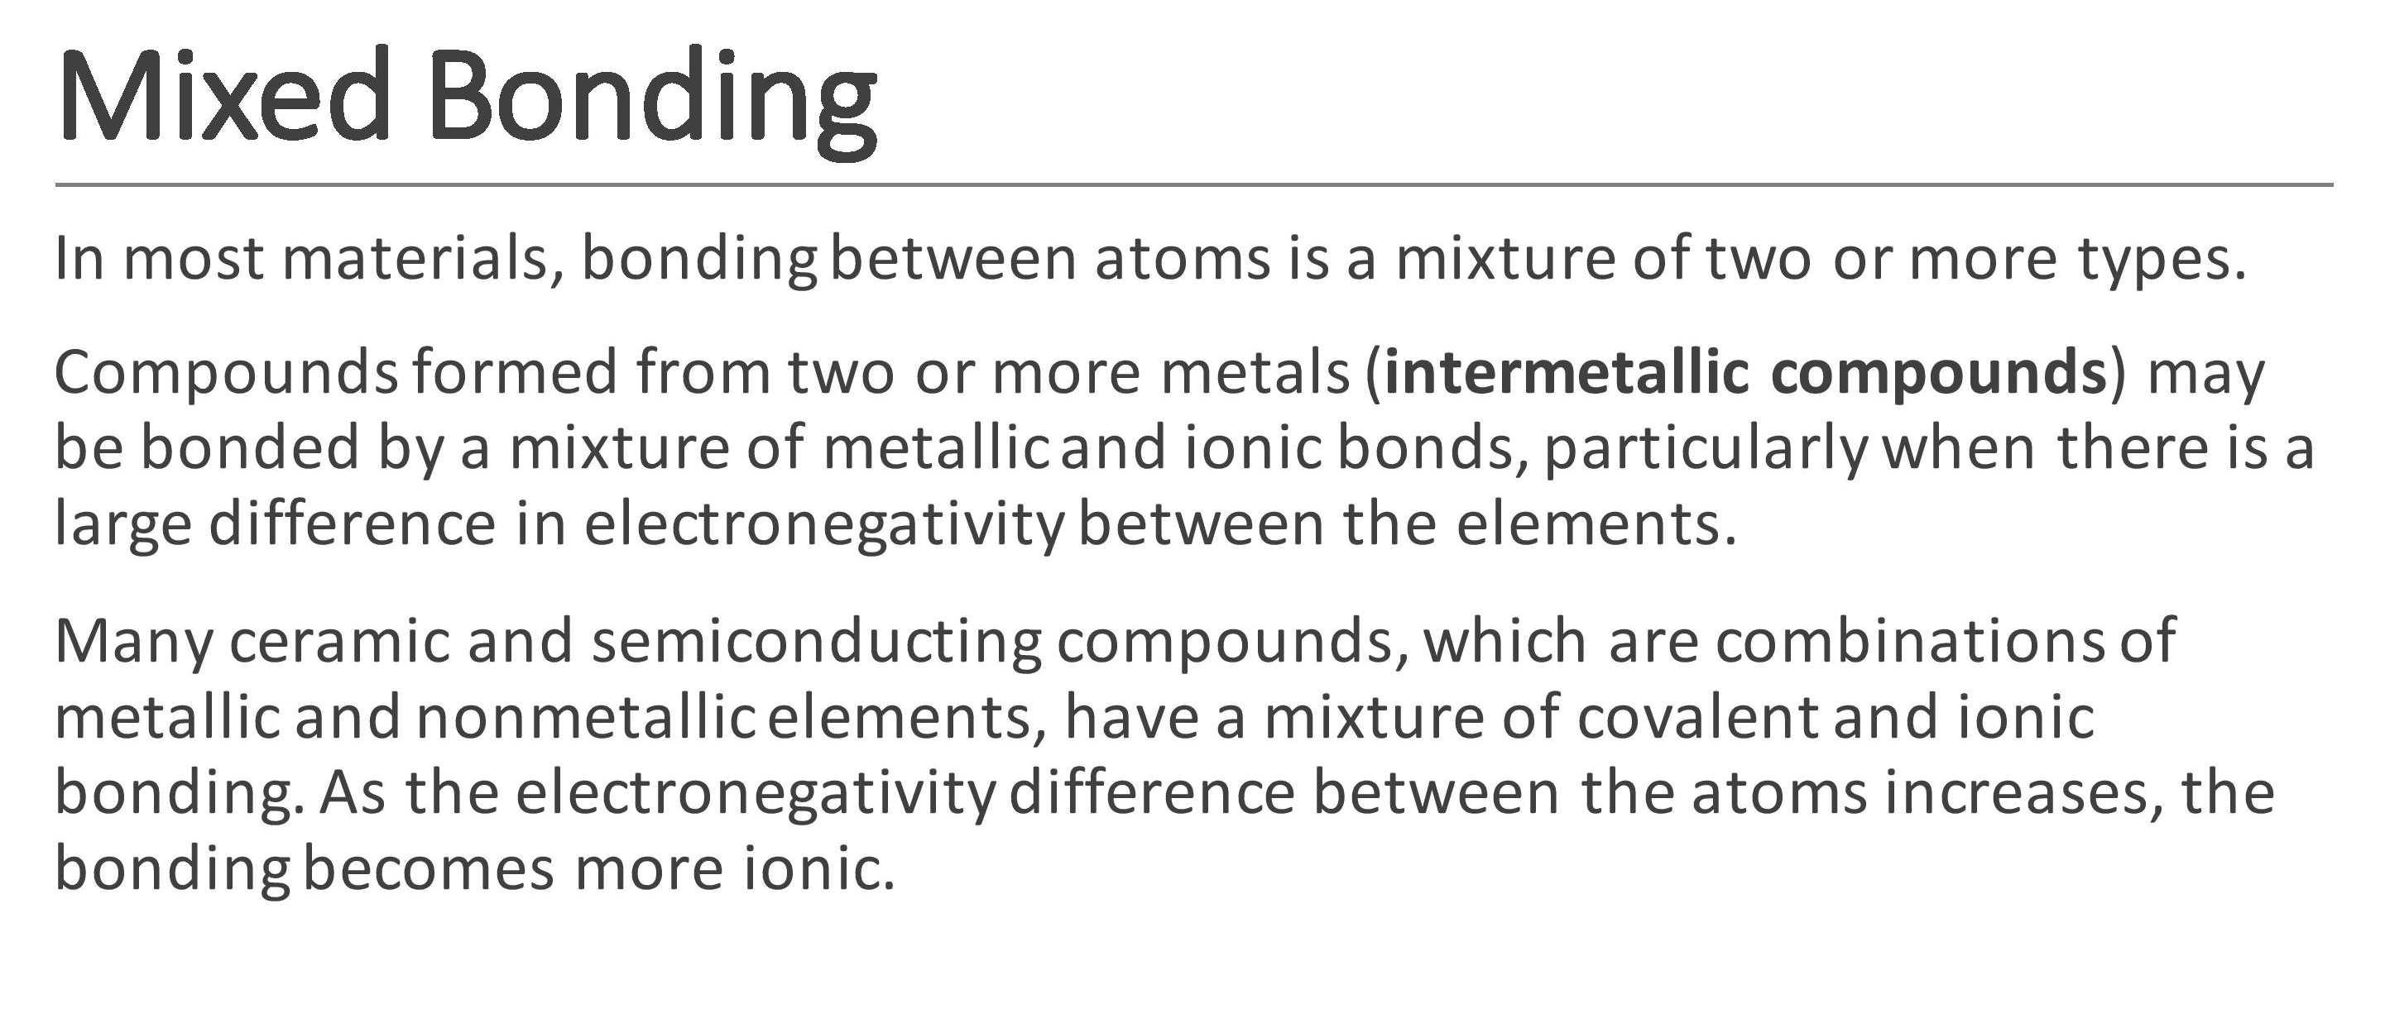

Slide 38
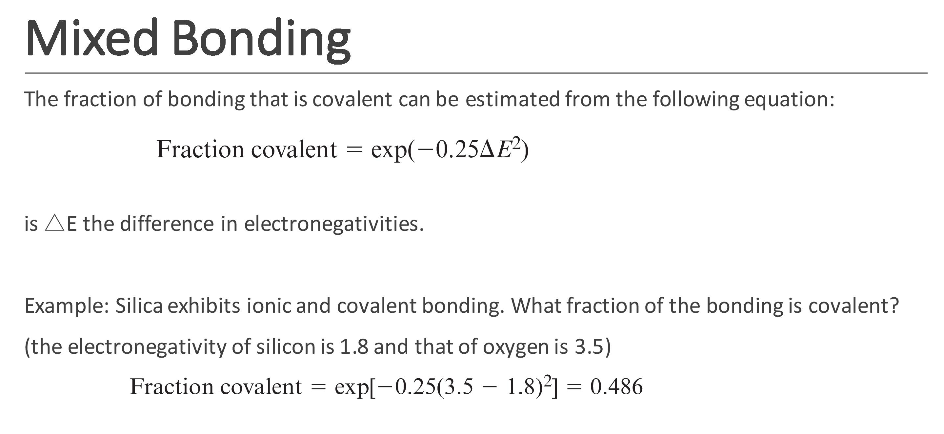

Slide 39
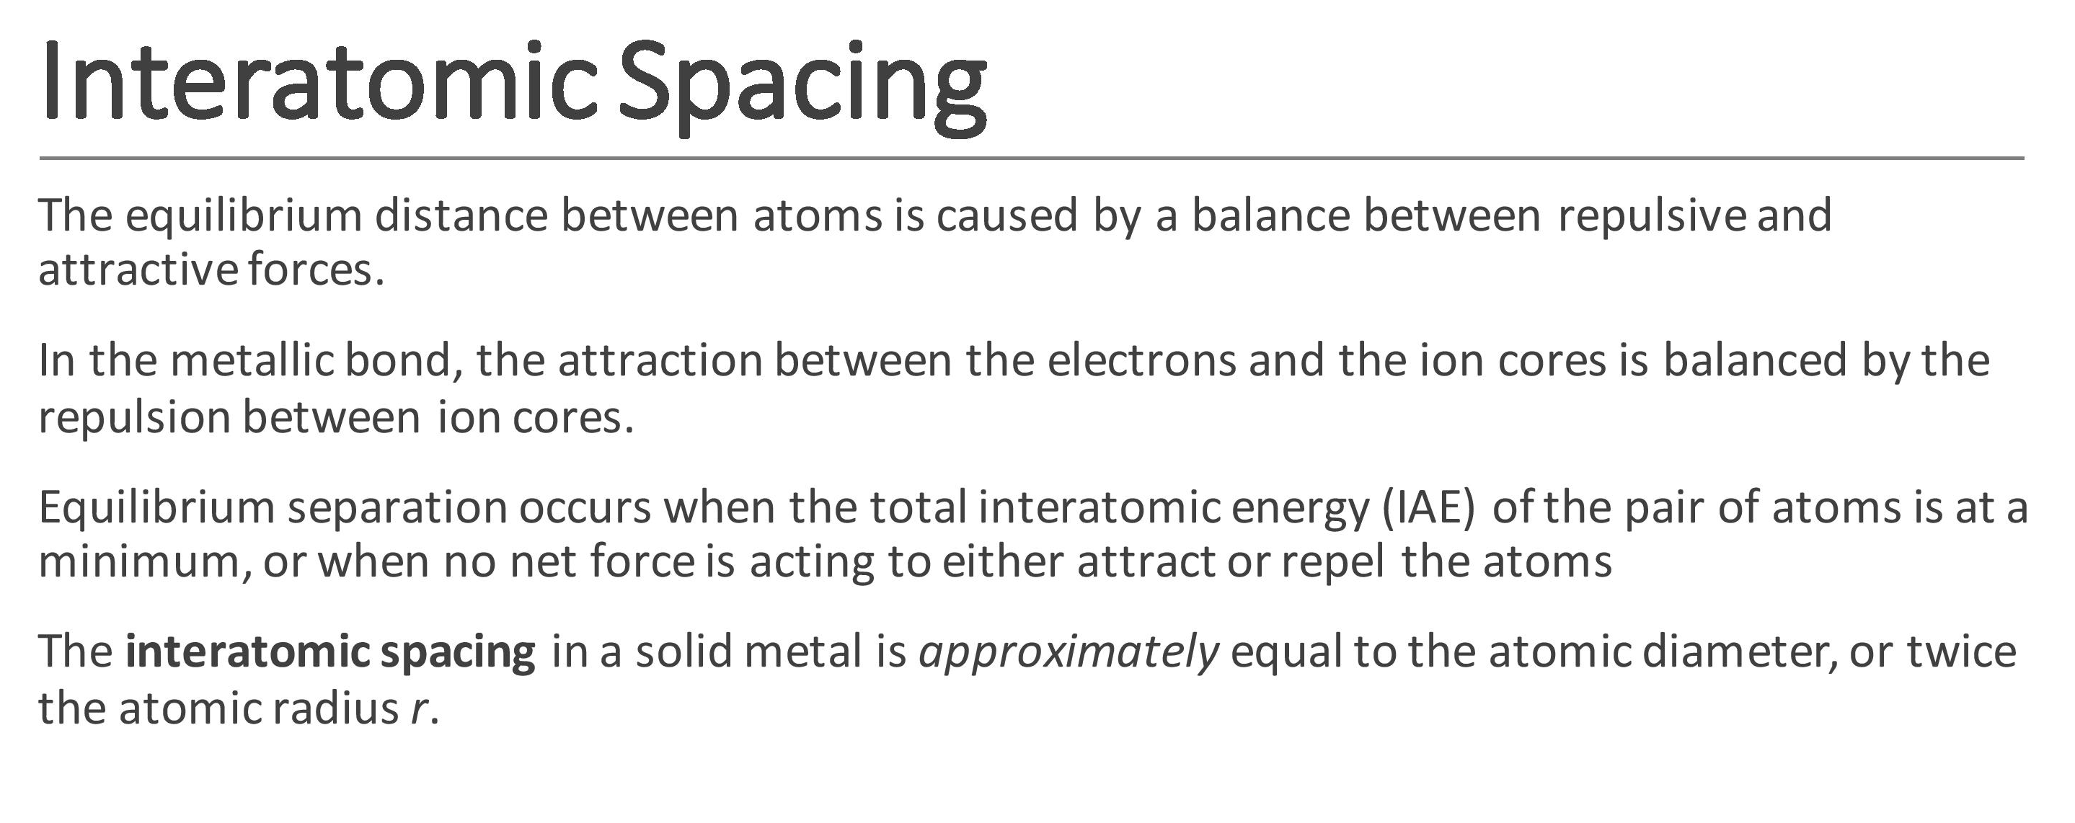

Slide 40
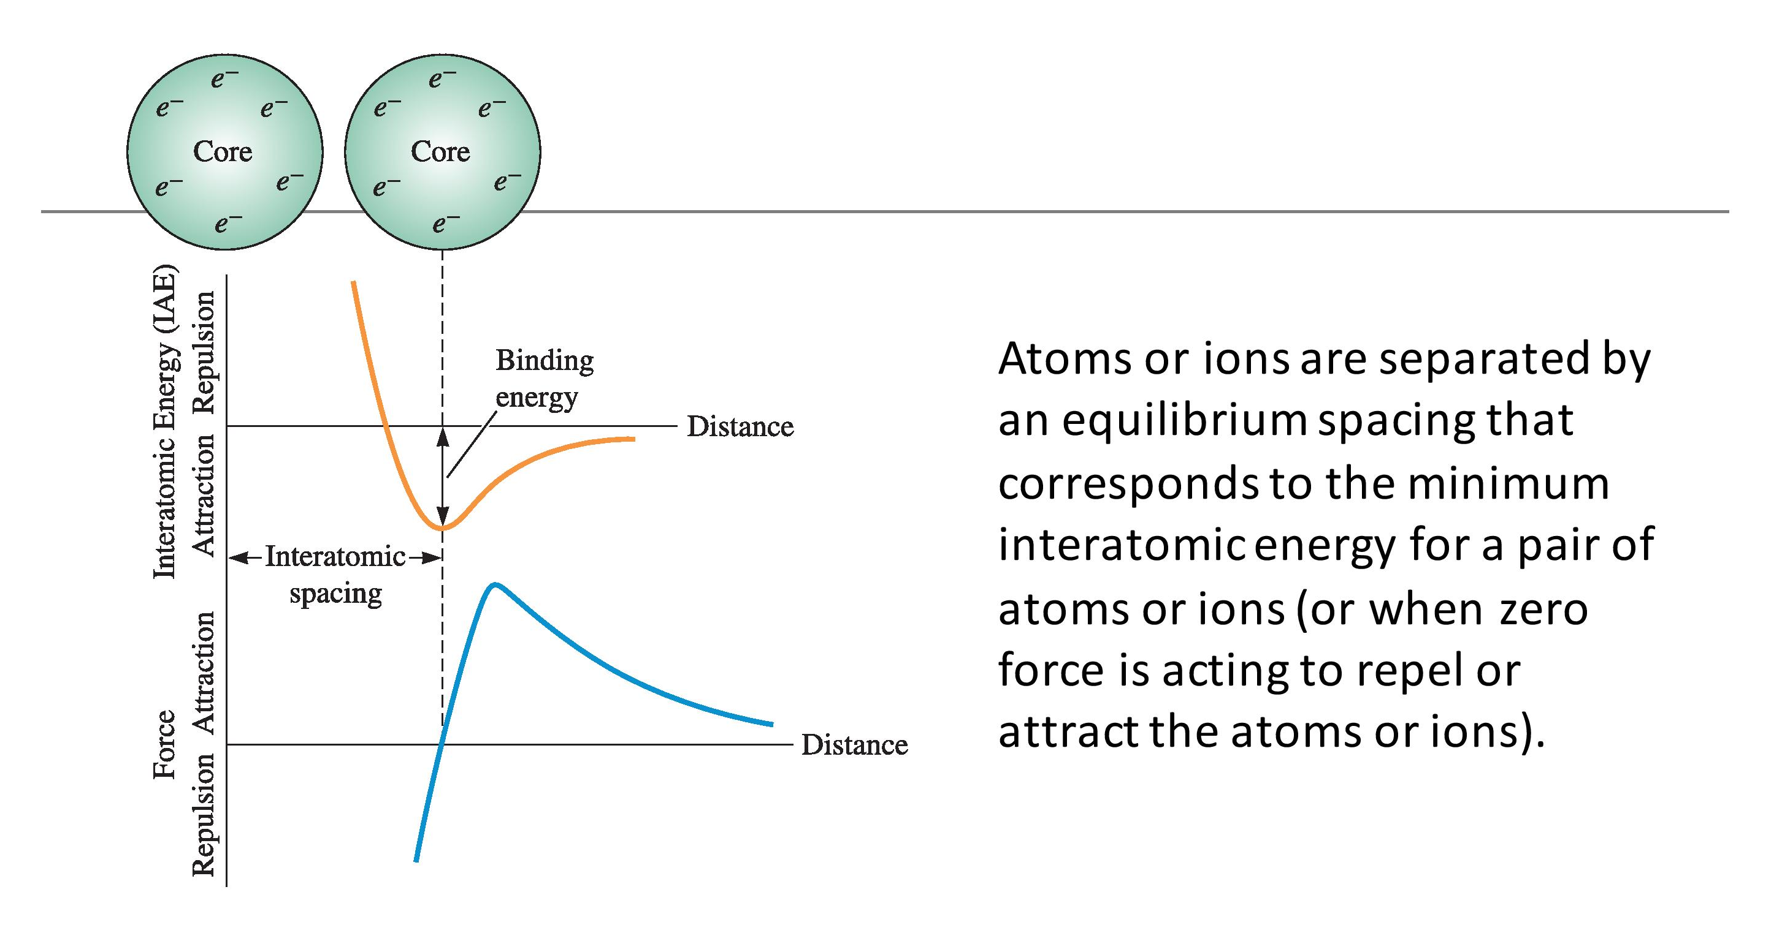

Slide 41
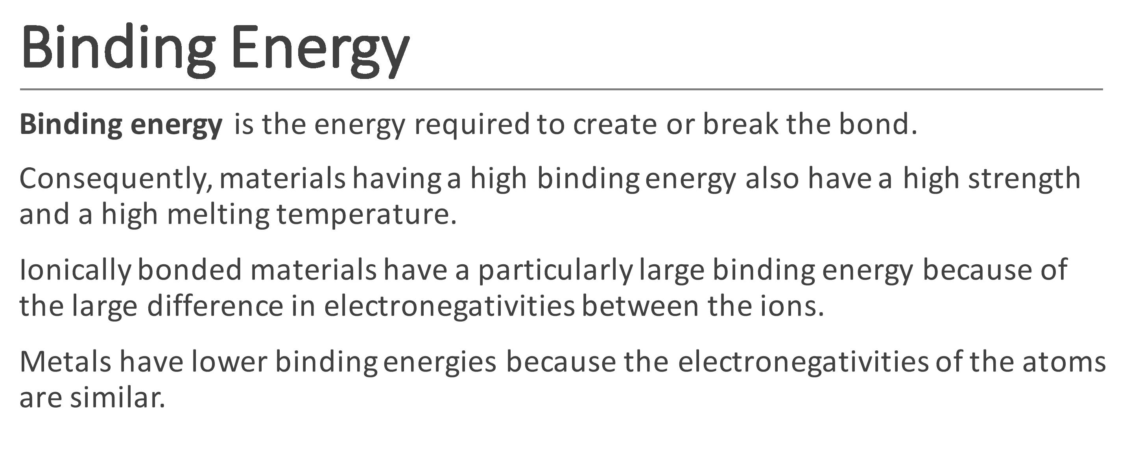

Slide 42
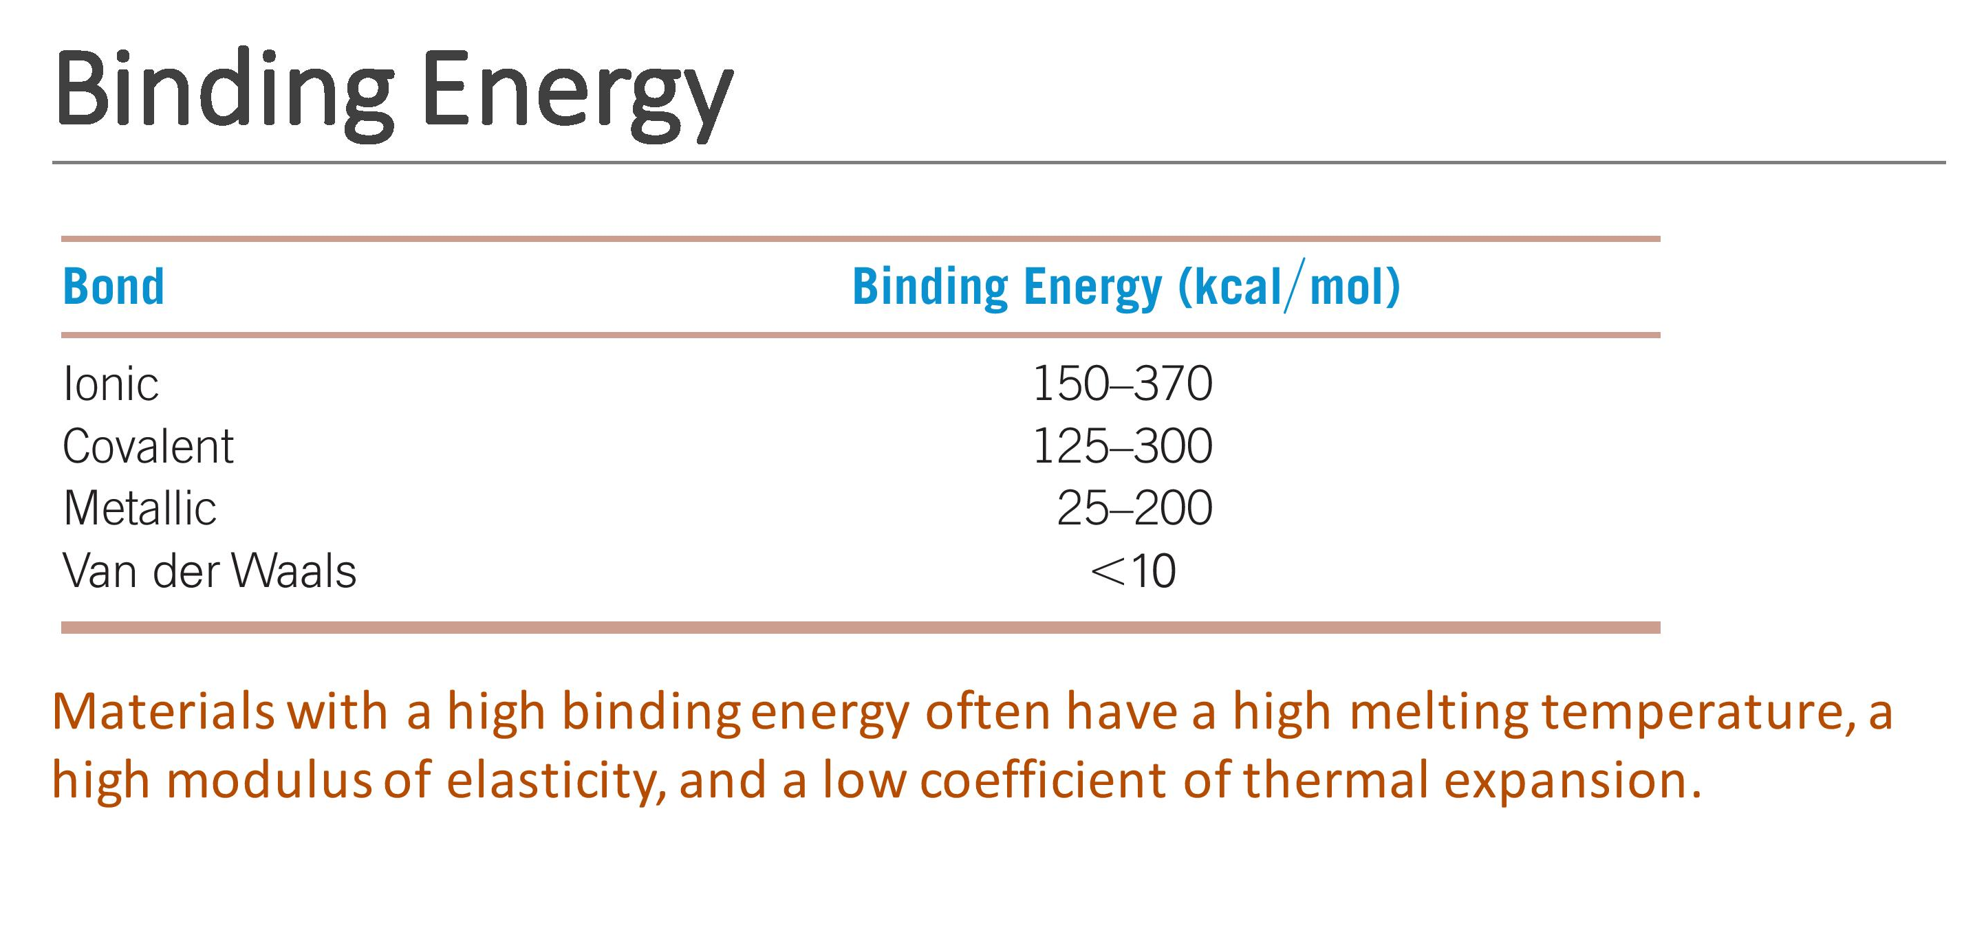

Slide 43
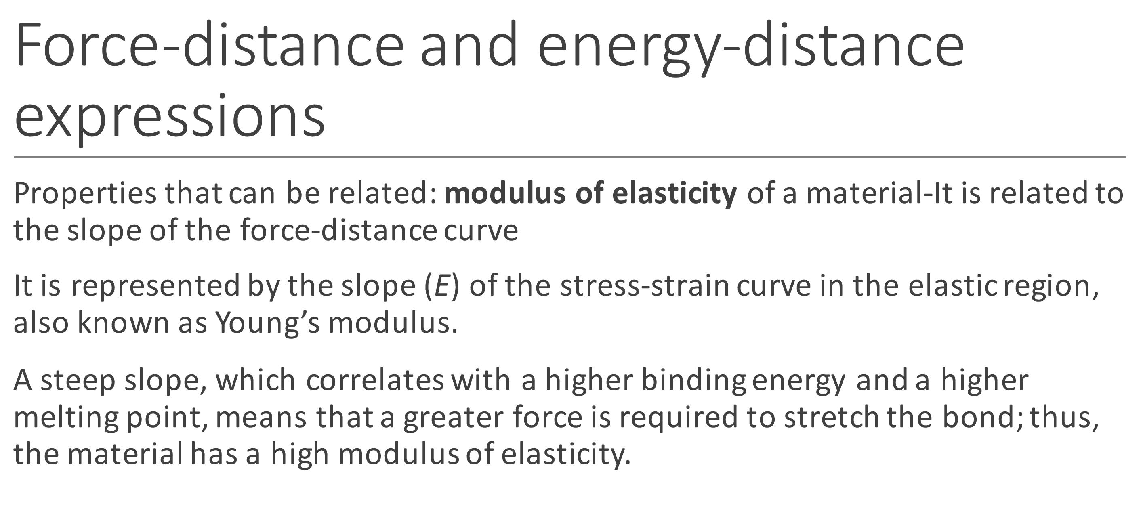

Slide 44
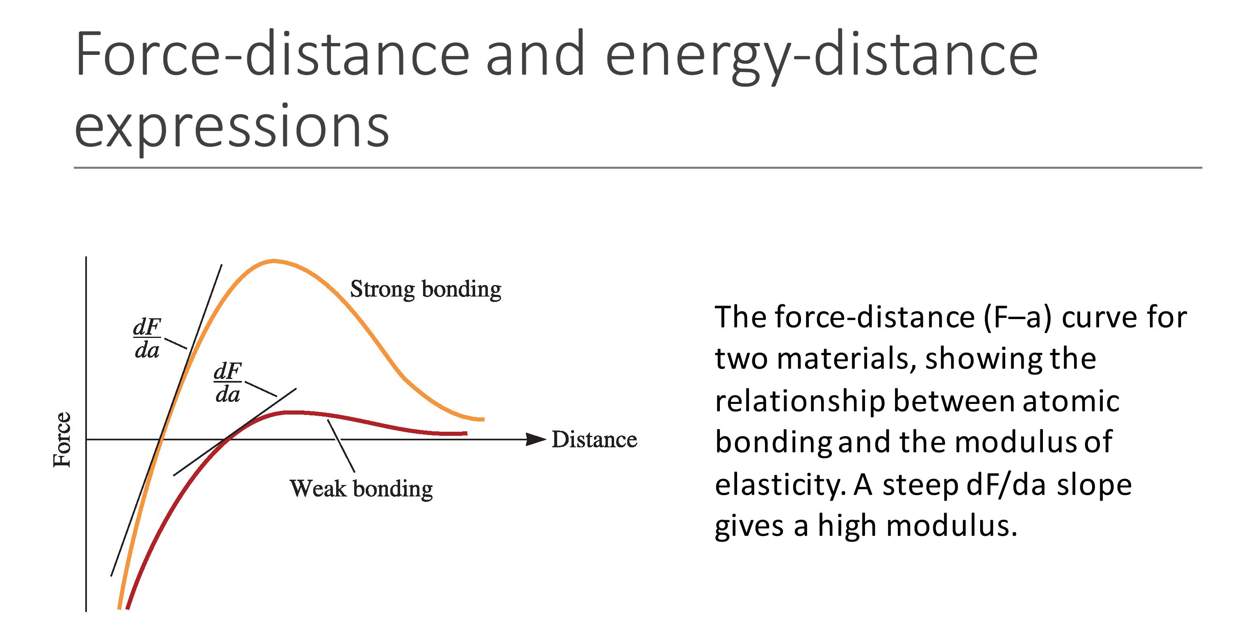

Slide 45
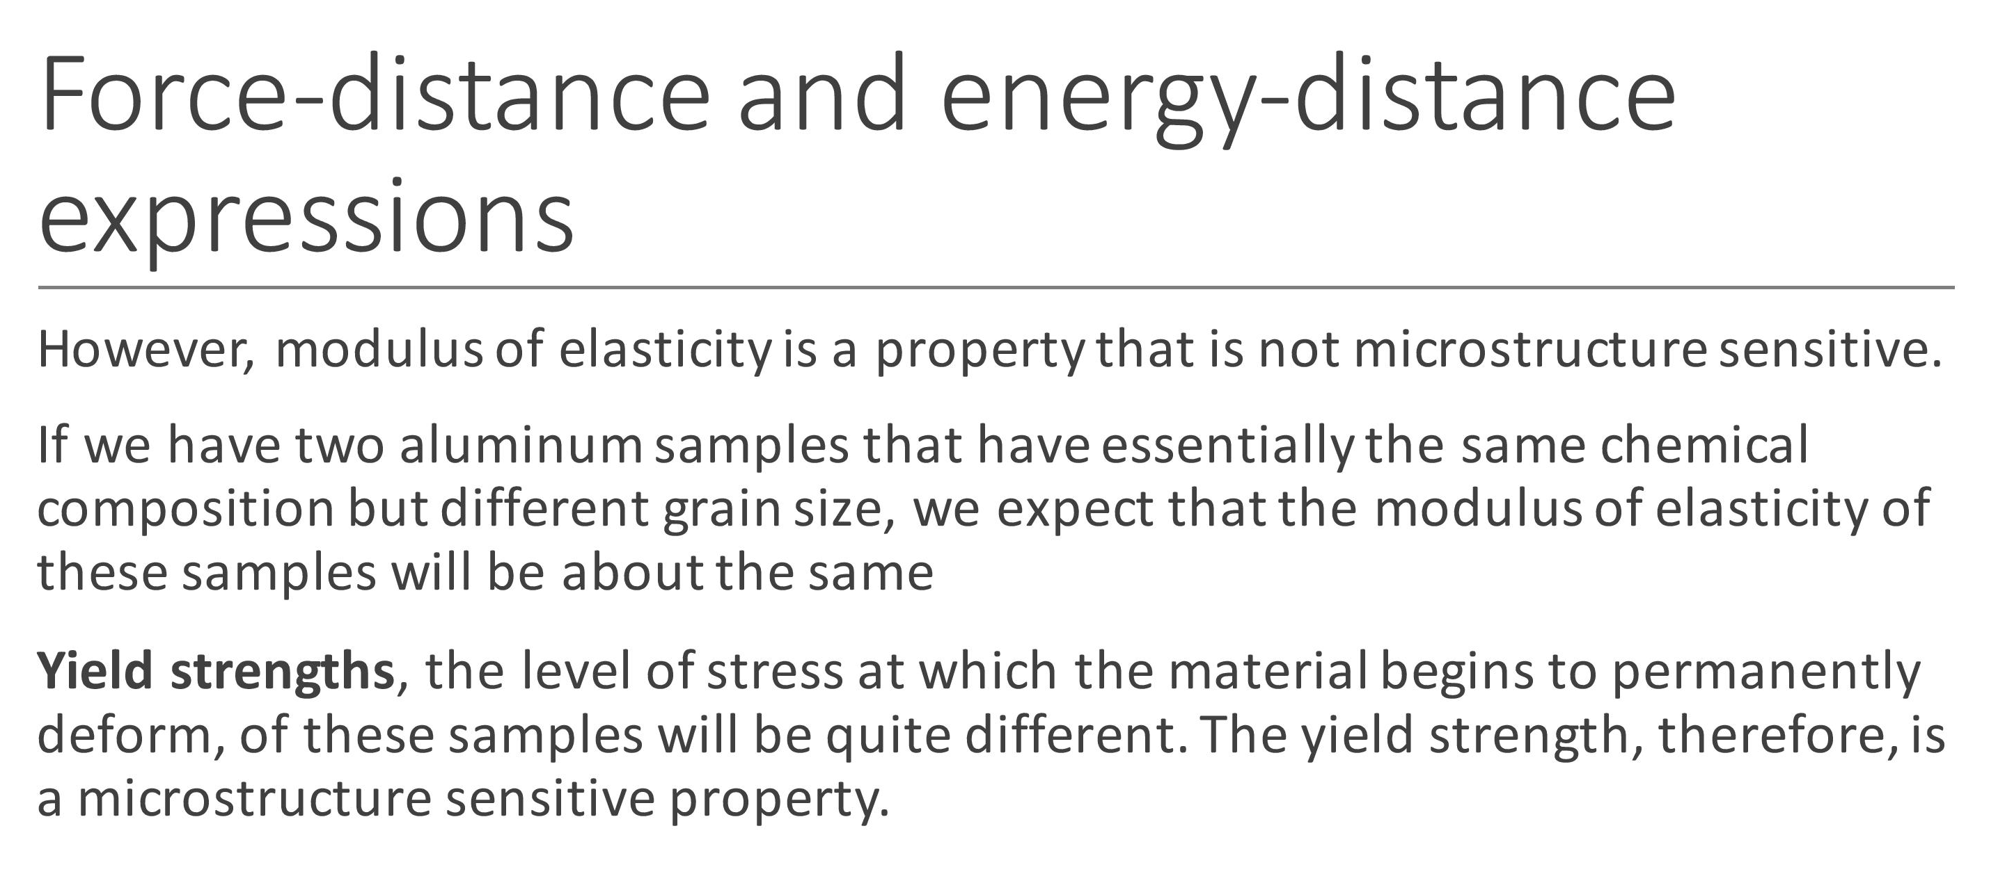

Slide 46
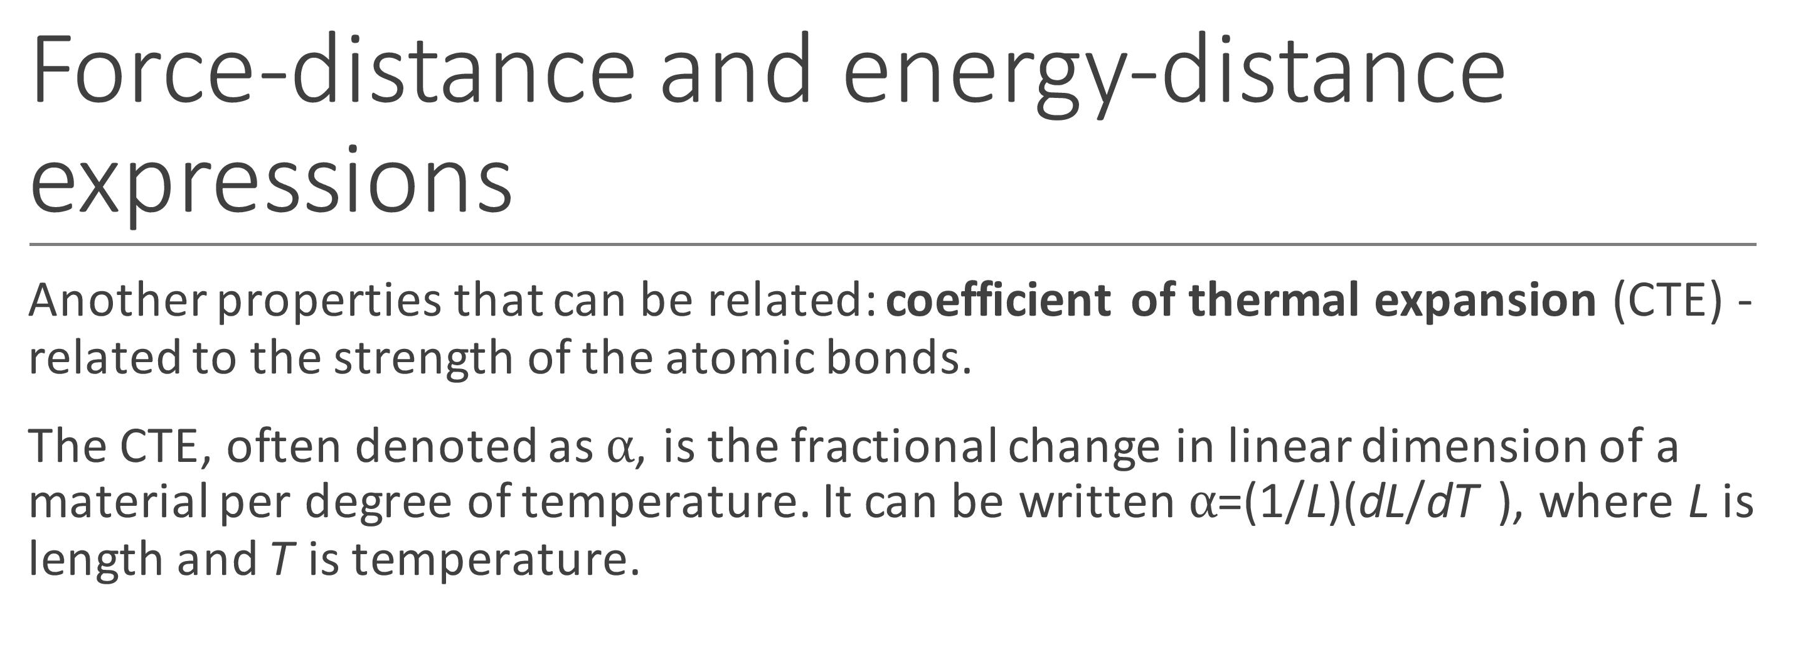

Slide 47
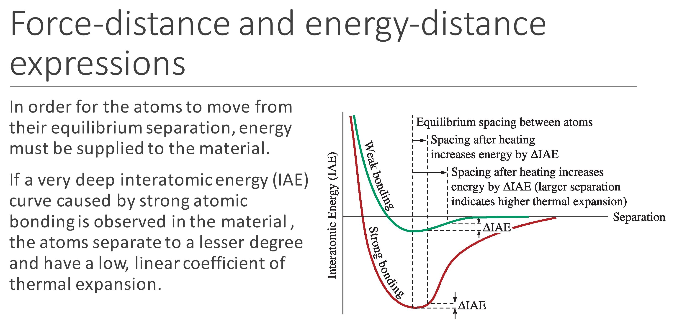

Slide 48
