Slide 1
1. Materials in nuclear engineering
2. Basic Concepts of Radiation Damage
2-1 particle/target interactions
2-2 displacement damage
2-3 microstructural evolution
3. Practical Effects of Radiation Damage

Slide 2

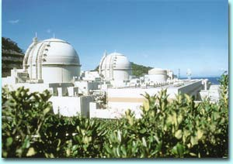
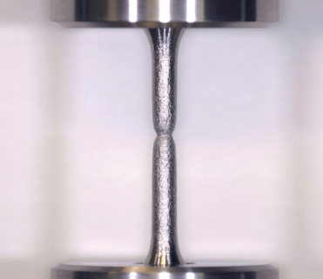
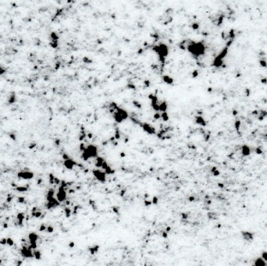
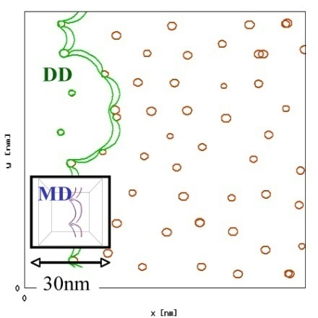
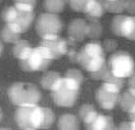
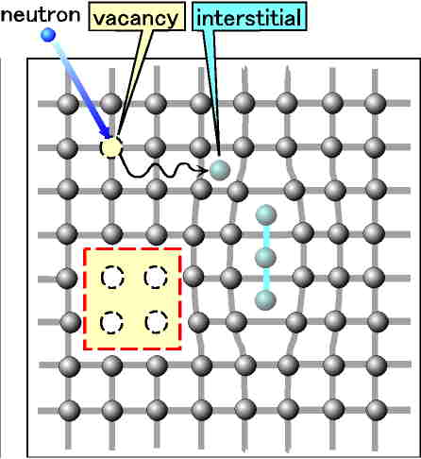
2-3 microstructural evolution
Plant Life
1Gs
Time
1Ms
1s
Mechanical
properties
1μs
next step
Microstructural
evolution
Displacement
(Atom/Lattice)
Length
done
1E-10 1E-8 1E-6 --- 1E-3 --- 1m

Slide 3
nucleation of i-loops
Activation energies for migration of point defects are;
interstitials: <0.1 eV / vacancies: ~1 eV (Fe and steel).
Interstitials can move much easier than vacancies.
Interstitial clusters are formed in the very early stage of irradiation, and they are dislocation loops.
Why dislocation loops?
Interstitials form a planar shape of cluster in the lattice with a minimum thickness or just one atomic layer.
Larger lattice strain energy prohibits thicker shape of clusters.
The edge of the planar extra atoms become a dislocation.
i-loop
too large lattice strain

Slide 4
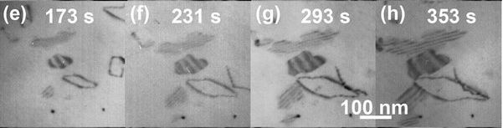
i-loop growth and further
Dislocations are point defect sinks, and due to their strain field, they attract interstitials and absorb them slightly more than vacancies. This is called the bias effect, or dislocation bias.
I-loops also absorb more interstitials, and grow.
This is the main driving force of further microstructural evolution under irradiation, and vacancy clusters, such as cavities, are formed due to vacancy oversaturation due to the preferential absorption of interstitials by dislocations.
Why “oversaturation” ?
Details in the next slide.
Growth of i-loops in an austenitic stainless steel under electron irradiation.
Transmission electron microscopes with a high accelerating voltage (>1MeV) can be used for the in-situ observation of displacement damage of steels.
(200keV TEM can be used to do this experiment for Al.)

Slide 5
thermal vacancies and v-loops
By the way, v-loops. In “Point Defects” research field, i-loops are new comers and researchers have been more familiar with v-loops formed by rapid cooling. (quenched-in vacancies)
Although the migration energy of vacancies is much higher than that of interstitials, their formation energy is lower and we have always certain concentration of thermal vacancies in a equilibrium state.
Yes, we have some vacancies even before irradiation, and that’s why I’ve called “vacancy oversaturation” those caused by irradiation.
Exchange of lattice sites via thermal vacancies is an important diffusion mechanism.

Slide 6
enhanced precipitation, segregation
Thermal vacancies play an important role in diffusion.
Flow of radiation induced point defects also enhances diffusion and precipitation.
Enhanced precipitation has an important effect on the embrittlement of reactor pressure vessels. (details later)
Flow of radiation induced point defects to sinks make solute segregation at these sinks.
Modification of grain boundary composition due to radiation induced segregation affects irradiation assisted stress-corrosion cracking (IA-SCC). (details later)

Slide 7
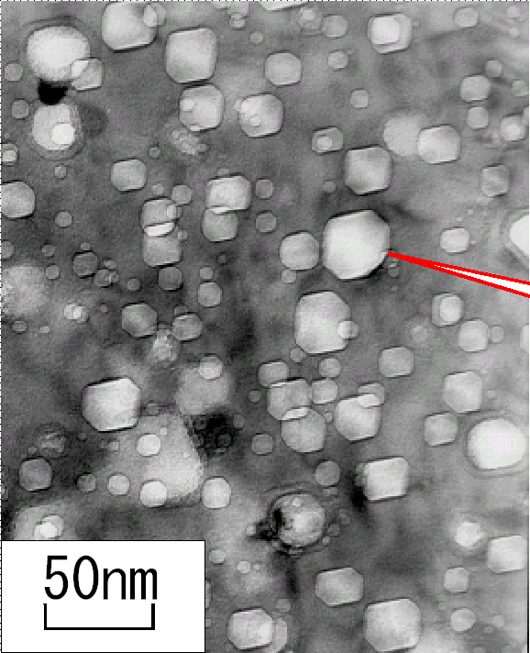
summary of 2-3 further effects
Interstitials form i-loops.
Sometimes vacancies make cavities.
Some loops in FCC metals have a specific contrast in TEM images due to stacking fault.
cavity
formation of defect clusters
other microstructural effects
Radiation induced excess point defects also make,
enhanced precipitation,
segregation at the point defect sinks
(such as grain boundaries and even
precipitates itself -> modification).
Swelling in austenitic stainless steels used in FBR and fusion reactors is a critical issue.

Slide 8
1. Materials in nuclear engineering
2. Basic Concepts of Radiation Damage
3. Practical Effects of Radiation Damage
3-1 review of mechanical engineering
3-2 practical issues due to radiation

Slide 9
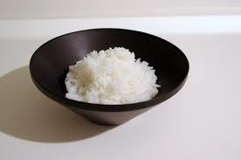
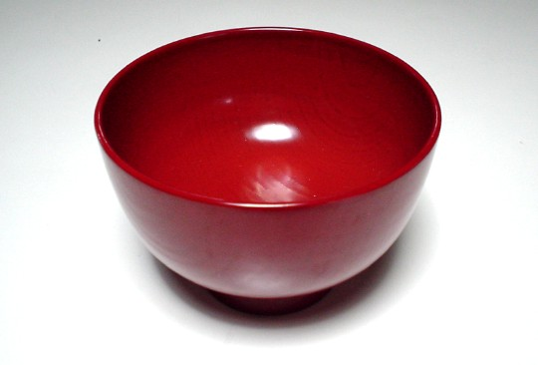
3-1 review of mechanical engineering
Do you think that strong material is good material?
The main purpose of this section is to
obtain the right answer to this question.
Rice bowl
Miso soup bowl
made of china
made of wood
Which material (not food!) is better ?

Slide 10
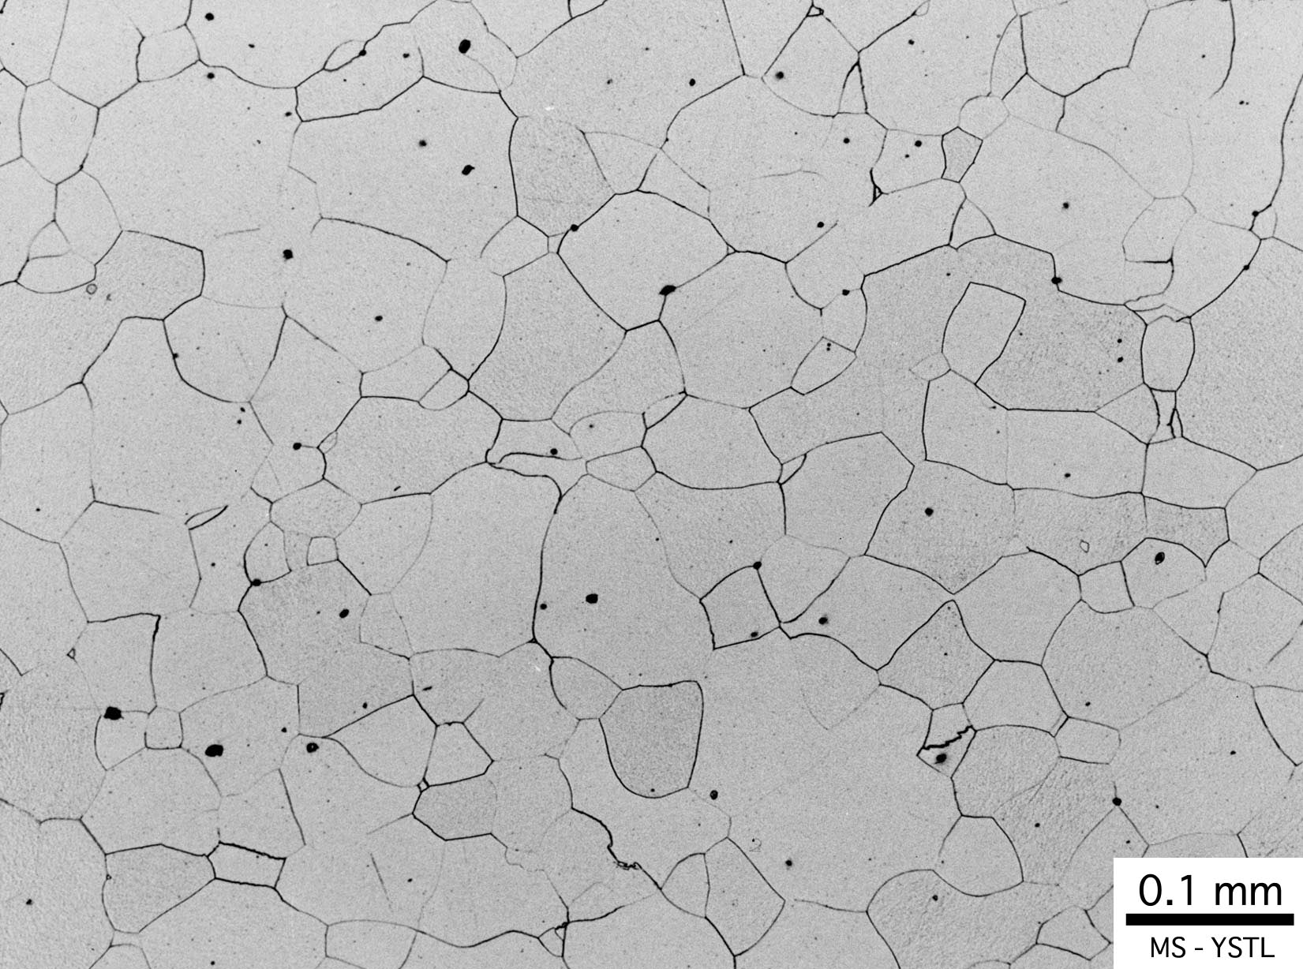
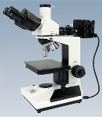
polycrystalline structure
Metal can be deformed easily
due to its polycristalline structure.
Optical micrograph of well-annealed iron.
Grains have same
crystalline structure
but different orientations.
observation
Light
Grain boundaries are preferentially etched.
Half mirror
Light
Mechanical polish
Chemical Etching
Metallurgical microscope

Slide 11
stress-strain diagram
Stress- Strain diagram
important
(3) Deformation stress peaks at a certain strain.
Lord to deform materials (stress)
(4) break
(2) Plastic deformation starts at a certain stress level.
(1) The first step of deformation is elastic, where the material goes back to the original shape without plastic deformation.
Deformation (strain)

Slide 12
Dislocation glide and strength
Ultimate (tensile) strength
Stress- Strain diagram
σ_{ts}
Yield strength
σ_{y}
(2) Plastic deformation starts at a certain stress level.
Or in microstructural words, …..
stress
Dislocation glide starts at this stress level.
strain
If we can increase the stress level (σ_{y}) where dislocation glide starts, then …..
Material reinforcement

Slide 13
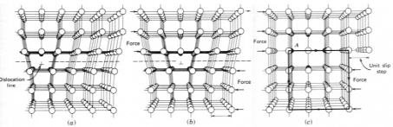
Reinforcement in18-carat gold
24K gold
irregular potential
18K gold
including 25%-impurities
alloying element atom (i.e. Ag, Cu)
Alloying element atoms make irregular potentials, where resistance for the dislocation glide is higher.

Slide 14
Various strengthening
Metallic materials are, in general, ductile due to easy glide of dislocations.
If you want to prevent plastic deformation (higher strength),
stop dislocation glide with various obstacles.
Various strengthening methods
Solid solution strengthening
18K gold. as mentioned previously
Duralumin. Al added with a slight amount of Cu forms small intermetalic compounds after a heat treatment. Such small precipitates block dislocation glide.
Precipitation hardening
Work hardening
thin steel plates used in automobile. The dislocation density is too high due to heavy deformation. These dislocations prevent other ones to glide and cut them.
・・・
Radiation hardening
pressure vessel of LWR’s. Various defects generated by irradiation stop dislocation glides.

Slide 15
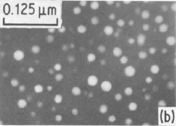
precipitates
Many alloys are not uniform material and contain some secondary phases. They are precipitates.
A typical precipitates are AlCu compound formed in duralumin.
By the way, duralumin was invented in 1906, just before the experiment of Rutherford scattering(1909).
Intentional formation of precipitates is an important technique in metallurgy.
γ’-precipitates in heat resisting high nickel alloy PE-16, which was used in some reactors developed in UK.

Slide 16
properties of china and wood
Rice bowl
Miso soup bowl
made of china
made of wood
If you drop them on the floor, then? (It occasionally happens!)
Rice bowls will break.
Miso soup bowls will hardly break.
Thanh
Thanh
advantage of wood
If you scratch one with a peace of the other material, then?
Miso soup bowls can be easily scratched by a piece of china.
Rice bowls cannot be scratched
by a wooden piece.
Trung
Trung
advantage of china
Which material is the better one?

Slide 17
“Strength” and “Toughness”
Rice bowl
Miso soup bowl
made of china
made of wood
Rice bowls cannot be scratched
by wooden pieces.
Miso soup bowls hardly break
if you drop them on floor.
Larger force is required to start
plastic deformation in rice bowls.
Larger energy is required to break miso soup bowls.
The material is strong.
The material is tough.
Do you want to use strong materials to construct nuclear reactors?

Slide 18
s-s diagrams for china and wood
Rice bowl
Miso soup bowl
made of china
made of wood
Larger force is required to start
plastic deformation in rice bowls.
Larger energy is required to break miso soup bowls.
Wood has a low σy, but breaks after some energy absorption during plastic deformation.
China has a high σy (deformation starting stress), but breaks with no plastic deformation.
stress
stress
Absorbed energy during plastic deformation
strain
strain

Slide 19
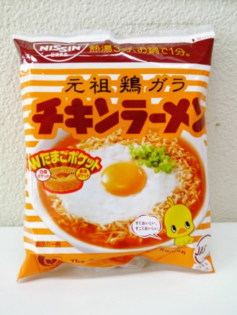

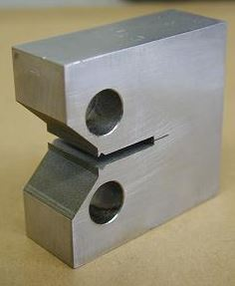
crack
A food package should be teared easily (with a slight effort), while food wrap films should not be.
Fracture tip is sharp.
Fracture tip is dull.
Material with a small fracture elongation keeps the tip sharp, while enough fracture elongation weaken the effect of a crack.
Fracture toughness is measured by specimens with cracks.
compact tension (CT) specimen

Slide 20
stress intensity factor K
Fracture toughness of the material (K_{IC}) is defined in fracture mechanics and has a curious unit, [Pa m^{1/2}].
Subscript “I” represents the fracture mode.
If K_{IC} > K (stress and crack environment), then the material will not break, like σ_{y} > σ.
Pa m^{1/2} ?
2σ
σ
The “crack propagation environment” is defined both by the stress and the crack length.
2a
then,
8a
2σ
σ
If the material break at 2σ, and crack length 2a,
it will break under σ
and 8a condition.

Slide 21
strength/stress, toughness/ ???
If the target component has no defect (sharp crack), the battle between
material defense vs. offensive force
is judged as follows:
DEFESE (material):
the defense ability is called strength, (σ_{y})
measured in unit [N/m²(Pa)].
OEFESE (force)
the offensive force to break material is called stress, (σ)
also in unit [N/m²(Pa)].
With a defect (sharp crack),
DEFESE (material):
the defense ability is called toughness, (K_{IC})
measured in unit [Pa m^{1/2}].
stress intensity factor, (K)
measured in unit [Pa m^{1/2}].
OEFESE (force and crack)
the offense level is called

Slide 22
1. Materials in nuclear engineering
2. Basic Concepts of Radiation Damage
3. Practical Effects of Radiation Damage
3-1 review of mechanical engineering
3-2 practical issues due to radiation

Slide 23
3-2 practical issues due to radiation
Plant Life
1Gs
Time
1Ms
1s
Mechanical
properties
1μs
Microstructural
evolution
Length
Displacement
(Atom/Lattice)
1E-10 1E-8 1E-6 --- 1E-3 --- 1m

Slide 24
two major radiation effects in LWR’s
Probably you have to think about just two major issues, for the material problems caused by radiation in LWR’s.
They are;
and
radiation embrittlement of reactor pressure vessels (ferritic steels)
irradiation assisted SCC of reactor core components
(stainless steels).
Effects of transmutation damage in LWR’s will be also explained in this section.

Slide 25
radiation embrittlement of RPV
Various strengthening methods
Solid solution strengthening
18K gold. as mentioned previously
Duralumin. Al added with a slight amount of Cu forms small intermetalic compounds after a heat treatment. Such small precipitates block dislocation glide.
Precipitation hardening
Work hardening
thin steel plates used in automobile. The dislocation density is too high due to heavy deformation. These dislocations prevent other ones to glide and cut them.
・・・
Radiation hardening
pressure vessel of LWR’s. Various defects generated by irradiation stop dislocation glides.
Radiation hardening is mostly due to the increase of dislocation density and this is similar to work hardening. But radiation enhanced precipitates also have a special effects on RPV embrittlement.

Slide 26
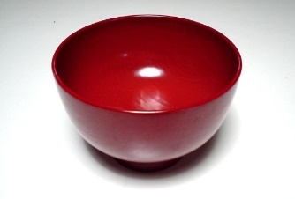
radiation hardening in s-s diagram
Before
After
radiation
σ_{yrad}
stress
stress
σ_{y0}
ε₀:elongation
ε_{rad}:elongation
strain
strain
σ_{y0}:strength increases but ε₀:elongation decreases!

Slide 27

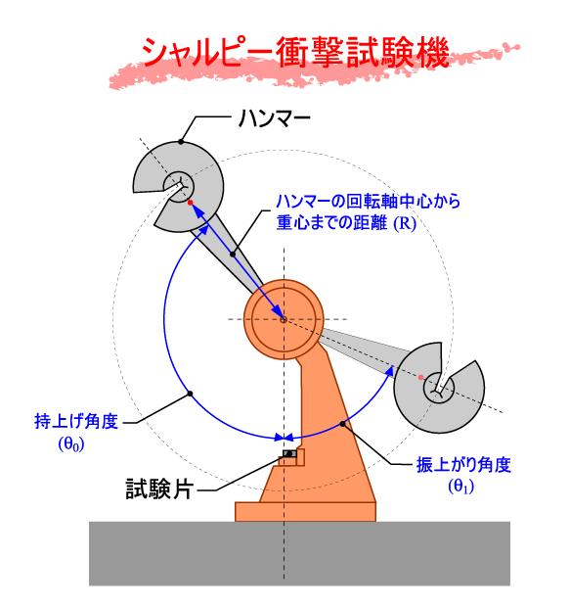
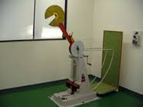
Charpy impact test
Large energy is required to break wooden bowls.
The toughness test measures the energy to break the test piece.
Charpy impact test
The highest position of the impact hammer after the test.
The absorbed energy is measured by the difference of hammer height before and after the test.
START position
test piece

Slide 28
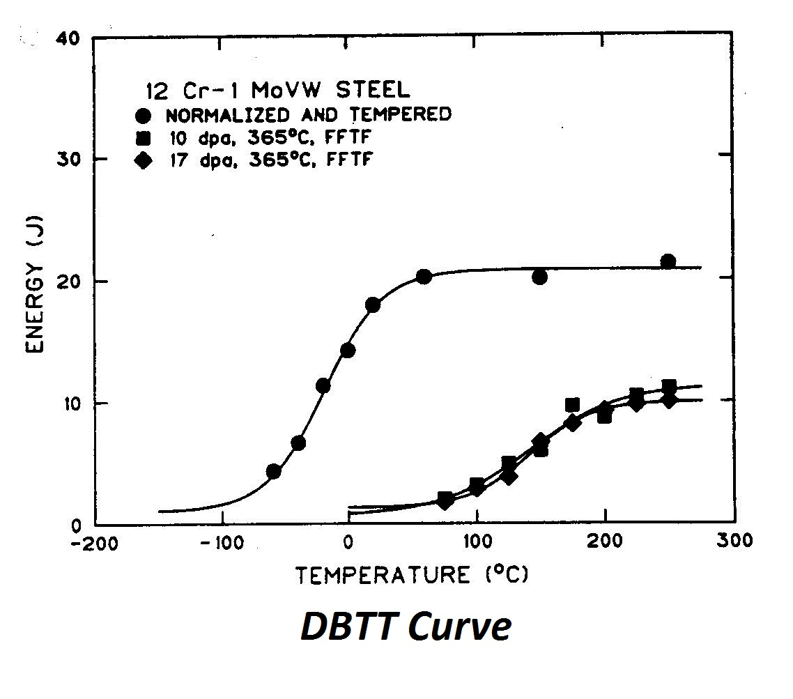
Ductile-Brittle Transition Temperature
Analysis of Charpy impact tests
Absorbed energy of steels depends on the test temperature.
Steels show more brittle behavior at a lower temperature.
The typical transition temperature is called DBTT;
Ductile-Brittle Transition Temperature.
DBTT before irradiation
DBTT after irradiation
DBTT goes up

Slide 29
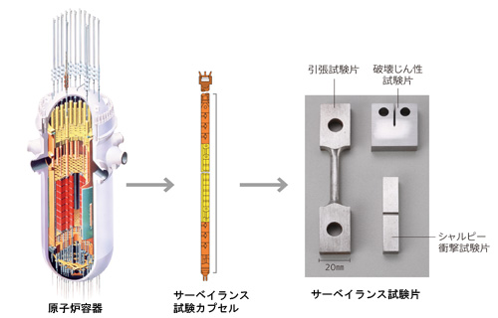
monitoring the radiation damage
fracture toughness
tensile
charpy impact
Reactor pressure vessel (RPV)
capsule for surveillance test
Various surveillance test pieces
Surveillance pieces made of the same material are irradiated in the RPV, and the test results can predict the degradation of the vessel in future.

Slide 30
evaluation of RPV integrity
Operation of ECCS (emergency core cooling system) cools core and the RPV rapidly. RPV integrity under induced thermal stress is predicted using stress intensity factor as shown below.
Temperature dependence of material toughness. Radiation hardening shifts the curve to the higher temperature.
before irradiation
after irradiation
Fracture toughness / K_{Ic} or stress intensity factor / K
Stress intensity factor (K) assuming conservative crack length and thermal stress.
Curves should not cross!
ECCS starts here.
time
K becomes smaller due to less temperature gradient after enough time .
temperature

Slide 31
precipitation hardening of RPV’s
RPV steel : SA533B cl.1 (Mn-Mo-Ni-bal Fe)
Radiation effects depends on the irradiation condition and the material condition. Some RPV’s showed accelerated degradation.
Accelerated degradation was first observed in RPV steels with a certain level of Cu and P impurity, and Cu was the most effective element for embrittlement.
Further analysis using such as a 3D-atom-probe has shown “Cu-rich clusters” in these steels (precipitation hardening).
Recent studies show, however, Cu-free clusters (they call solute-clusters with Mn, Ni and Si) are also formed and degrade steels during irradiation. Our knowledge for this effect is insufficient particularly in high fluences.

Slide 32
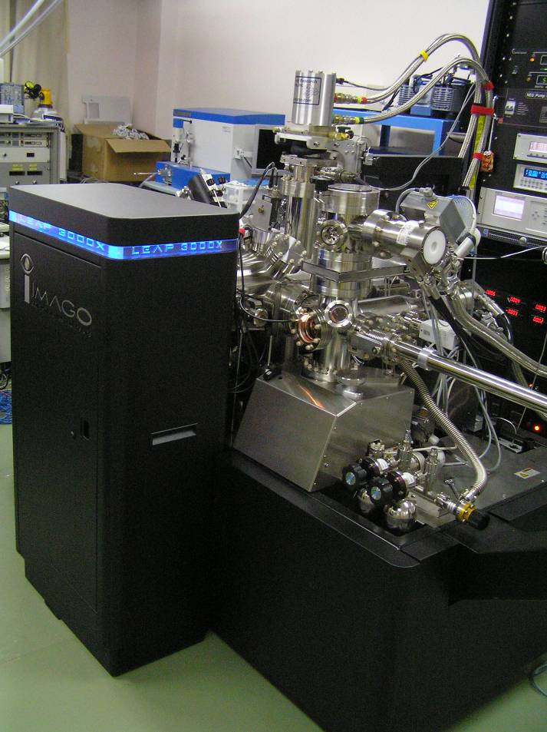
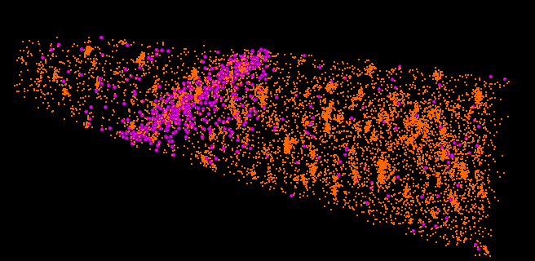
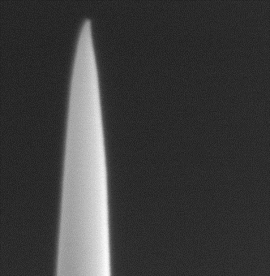
Atom Probe Tomography
stop
position sensitive detector
time-of-flight
timer
X
pulsed laser
start
Y
grain boundary segregation
Z
Cu rich clusters
analytical region
Cu
300 nm
P
50 nm
SEM image of specimen
Atom probe tomography employs a Field Ion Microscope equipped with a time-of-flight type mass analyzer. Evaporation of atoms is assisted by laser irradiation for stable depth analysis (z-direction), and the position sensitive detector enables area analysis (x- and y-directions).
32

Slide 33
solute cluster vs. temp. shift
It is also known that these clusters show Ostwald ripening during irradiation.
The size increases and the number density decreases.
Empirical data suggest shift of transition temperature (ΔRT_{NDT}) is proportional to the square root of cluster volume fraction (Vf).
N. Soneda et al, J ASTM Int. 2010(7), JAI102127

Slide 34
prevention of RPV embrittlement
Eliminating harmful impurities such as P, Cu, S from the steel is important. Don’t forget about welding wires!
Embrittlement of RPV steel is a hot issue, but current efforts in this area seems to be mostly for the life prediction of RPV’s we are now using.
Note that neutron irradiation to vital components depends on the design.
Even in current design, neutron damage in BWR’s is much lower in PWR’s.
K. Fukuya,
J. Nucl. Sci. and Technolo. 50(2013) pp.213-254.
Maximum fluence or dose and typical temperature for 40-years operation of a reactor pressure vessel and core internals.
reactor pressure vessel
core internals
BWR
<280 C
PWR
<300 C
BWR
~290 C
PWR
290~370 C
dpa
0.001
0.01
0.1
1
10
100
Fluence
(n/cm2, E>1MeV)
1E18
1E19
1E20
1E21
1E22
1E23

Slide 35
RPV irradiation in new PWR’s
Eliminating harmful impurities such as P, Cu, S from the steel is important. Don’t forget about welding wires!
Embrittlement of RPV steel is a hot issue, but current efforts in this area seems to be mostly for the life prediction of RPV’s we are now using.
Note that neutron irradiation to vital components depends on the design.
Even in current design, neutron damage in BWR’s is much lower in PWR’s.
Recent Mitsubishi PWR design employs a neutron reflector between reactor core and RPV. Main purpose of this component is to enhance the core neutron efficiency and neutron irradiation of RPV will be largely decreased, down to almost one third of current PRV’s.
Its your advantage that you need not worry
about this issue in your new plants.

Slide 36
irradiation assisted SCC (IASCC)
A quick review of normal SCC
Stress-corrosion-cracking (SCC) of austenitic stainless steels and high-Ni alloys has been a large material issue in various components of reactors, including those out of the reactor core, such as steam generator pipes in PWR.
SCC is the results of the combination
of three major factors;
material, stress and environment.
material
SCC
Radiation affects them !
environment
stress

Slide 37
typical SCC conditions
material
sensitization of stainless steels (Cr-depletion at the grain boundary due to preferential precipitation of M₂₃C₆ (Cr-rich carbide) at GB).
surface hardened layer due to machining
stress
Welding and machining affect both material and stress.
residual stress after welding, or machining,
thermal stress
environment
dissolved oxygen or hydrogen
impurities (Cl⁻ etc.)

Slide 38
sensitization due to weld
In some types of precipitates, they are formed at grain boundaries first due to their surface energy. (heterogeneous precipitation)
->Remember a cloud-chamber !
Cr-rich M₂₃C₆ precipitates consume matrix Cr, leaving a less corrosion-resistant Cr-depletion zone along GB.
Cr concentration profile
grain
grain
M₂₃C₆
Driving ΔG is not enough.
weld
metal
base
metal
temperature
HAZ
Diffusion is not enough.
time
The highest sensitization sometimes occurs at HAZ (heat affected zone).
A Time-temperature-precipitation (TTP) diagram for M₂₃C_{6,} showing a typical “C” shape.

Slide 39
radiation effects on SCC conditions
material
radiation hardening mostly due to fine dislocation loops.
change of deformation mode due to dislocation channeling (formation of localized heterogeneous deformation band)
local compositional change at grain boundary due to radiation induced segregation
very fine bubbles due to transmutation helium -> then?
Recent studies have shown that hardening, localized deformation due to fine i-loops, GB segregation are the major reasons of IASCC
stress
IASCC shows always inter-granular cracking, while normal SCC shows both TG and IG cracking.
relaxation of residual stress due to radiation creep
environment
Radiation may relax the stress conditions in general but may increase the stress at the crack tip in some cases.
- radiolosys, formation of H₂O₂

Slide 40
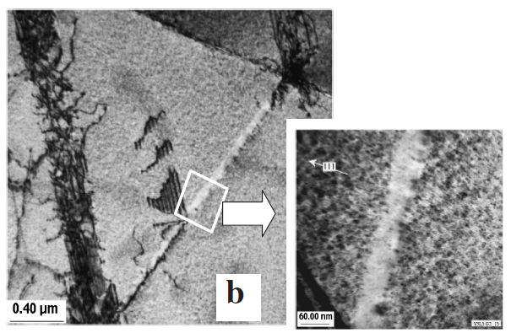
dislocation channeling
Austenitic stainless steels irradiated in LWR conditions have a microstructure with high number densities of fine dislocation loops.
Once a dislocation glides on a slip plane, these fine loops interact with the gliding dislocation and disappear. Then the cleared slip plane has less obstacles than others and next dislocation will slip the same plane. LWR-irradiated SS’s show thus localized deformation mode.
TEM micrograph showing dislocation channeling in irradiated Type 304 SS.
T. Onchi et. al. J. Nucl. Sci. and Technolo., 43(2006), pp851-865

Slide 41
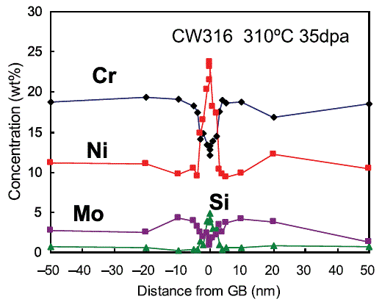
radiation-induced segregation (RIS)
Solute elements with smaller size are enriched at point defect sinks by the flow of interstitial atoms, and over-sized elements are depleted.
Cr
Mn
Fe
Co
Ni
smaller atom due to higher positive charge of nucleus
TEM-EDS analyses have revealed Ni enrichment and Cr depletion at GB and the width of compositional change zone is less than 10 nm.
(K. Fukuya, J. Nucl. Sci. and Technolo. 50(2013) pp.213-254.)
Recent 3D-atom-probe data support these results.

Slide 42
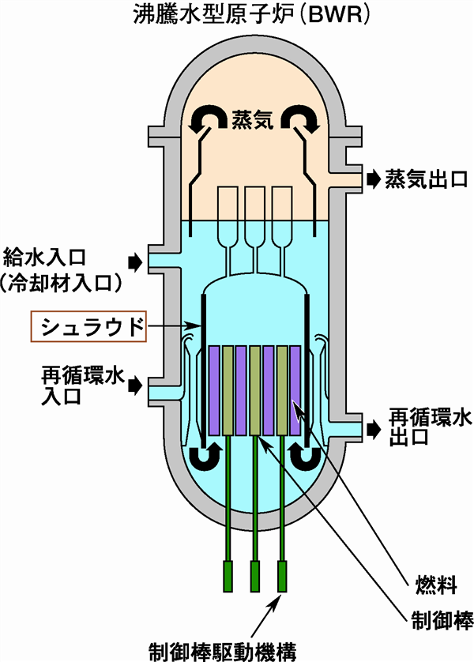
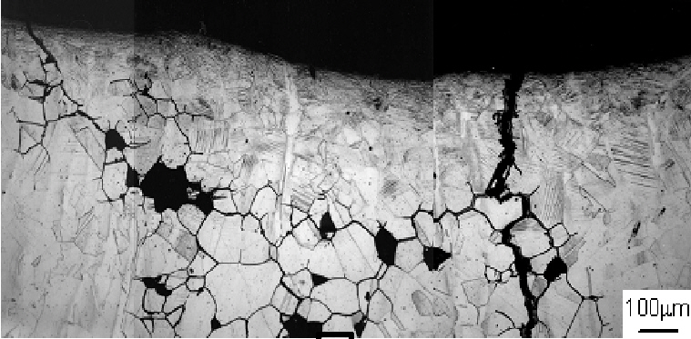
SCC at BWR shroud
The core shroud in BWR is a large stainless steel cylinder within the RPV that srounds the fuel assemblies.
The core shroud controls water flows as shown in the figure.
The cracks started at the surface layer highly work-hardened due to machining, followed by inter-granular crack growth.
This cracking is considered to be normal SCC rather than IASCC because of the low irradiation dose.
JAEA report on Fukushima daini #3 shroud
BWR
to turbine
from turbine
shroud
from reclt’n. pump
to reclt’n pump
fuel
control rod

Slide 43
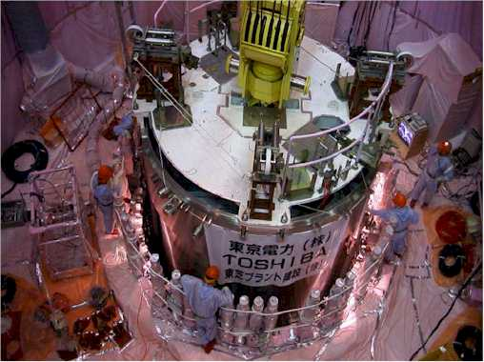
evaluation of shroud integrity
First SCC crack in the core shroud was found in 1990 (Switzerland), followed by many other reactors including those in Japan.
We had no standard for the shroud integrity with cracks at that time, and people allowed no scratch on them. Fukushima daiichi #3 was the first reactor in the world where the shroud was replaced (1998).
Pressure difference between both sides of this cylindrical component is very small unlike RPV, we have adopted a standard of shroud integrity with cracks (2002).
careful inspection of crack length,
evaluation of crack propagation by the next inspection,
integrity evaluation under anticipated seismic motion.
Shroud replacement at TEPCO plant. The material is also changed from Type 304 to low carbon Type 316.
Toshiba web site

Slide 44
prevention of (IA)-SCC
Prevention of (IA)-SCC should be also considered in three conditions.
material
more SCC-resistant materials such as low carbon type 316 (but still has some susceptibility to SCC).
careful welding and machining (also effective to reduce stress) .
stress
careful welding and machining
environment
The first countermeasure you have to do !
elimination of Cl⁻ from the water
controlling of other water chemistry, especially hydrogen injection
LWR’s have experienced many SCC issues in various components, but most of them are overcome by the combination of countermeasures.

Slide 45
transmutation damage
From the practical stand point, you should also know some minor effects of transmutation damage.
Ni usually contains Co as impurity and irradiated austenitic stainless steels become very radioactive due to ⁶⁰Co. Dissolved Co deposits various part of the piping and increases the radioactivity of the system including the piping out of the reactor.
Ni has a special transmutation chain ⁵⁸Ni (n, γ) ⁵⁹Ni (n, α) ⁵⁶Fe and generates helium under thermal neutron environment. Helium will not affect the material properties very much at the operation temperature of LWR’s but over 600 C, helium “precipitates” at grain boundaries(GB) and weaken GB. Welding of irradiated austenitic stainless steels become, therefore, very difficult.

Slide 46
END
Thank you for you attention.
precipitation hardening

