Slide 1
Irradiation damage in materials
^{61, 62, 63rd} ITC on Basic Reactor Engineering at Tokai
2015 Sept. 18
Tomotsugu Sawai
Director
Nuclear Human Resource Development Center
Japan Atomic Energy Agency(JAEA)

Slide 2

Your knowledge spectrum
 |  | course | 1 | 2 | 3 | total | 2014
 |  | number of trainee | 7 | 6 | 5 | 18 | 19
radiation | 1 | Rutherford Scattering | 6 | 4 | 3 | 13 | 10
 | 2 | charged particle therapy | 6 | 5 | 4 | 15 | 11
 | 3 | Bragg Peak | 3 | 2 | 3 | 8 | 6
 | 4 | BNCT | 4 | 1 | 3 | 8 | 8
microstructure | 5 | Fe is BCC and FCC. | 2 | 6 | 2 | 10 | 9
 | 6 | HCP | 1 | 5 | 1 | 7 | 5
 | 7 | polycrystal | 0 | 6 | 2 | 8 | 11
 | 8 | vacancy | 3 | 6 | 3 | 12 | 11
 | 9 | thermal vacancy | 3 | 6 | 2 | 11 | 7
 | 10 | diffusion by vacancy | 5 | 6 | 3 | 14 | 11
 | 11 | interstitial impurities | 2 | 6 | 3 | 11 | 7
 | 12 | dislocation | 2 | 6 | 3 | 11 | 9
 | 13 | edge and screw | 0 | 5 | 2 | 7 | 5
 | 14 | dislocation glide and deformation | 1 | 5 | 0 | 6 | 4
mechanical | 15 | stress-strain diagram | 2 | 6 | 2 | 10 | 11
 | 16 | strength, stiffness, toughness | 1 | 6 | 2 | 9 | 10
 | 17 | yield strength, ultimate strength | 1 | 6 | 1 | 8 | 8
hardening | 18 | work hardening | 0 | 6 | 3 | 9 | 4
 | 19 | precipitation hardening | 0 | 4 | 0 | 4 | 2
 | 20 | solid solution hardening | 0 | 3 | 0 | 3 | 2
Knowledge of BNCT is less common than that of charged particle therapy.
Knowledge of microstructure and materials science is almost 50%, but the students in course 1 and 3 hardly know the important role of dislocations in mechanical properties.
Few knows the mechanism of hardening.
Students in course 2 know quite well about materials science, while students in course 1 have better understandings in physics.

Slide 3
1. Materials in nuclear engineering
2. Basic Concepts of Radiation Damage
3. Practical Effects of Radiation Damage
A view point of multi scale modeling will be introduced.
It is mostly physics and applied mathematics. You will have some review tests.
It is mostly engineering. Knowledge obtained during Prof. Suzuki’s lecture on materials science is expected. It includes some review tests.

Slide 4
Integrated Engineering
Nuclear Engineering
Reactor Phys./Nucl. Data/Nucl. Phys.
Nuclear Fuel Technology
Mech. Eng. /Materials Sci.
Rad. Protection
Environment Sci.
Nuclear Engineering is supported by many fields of basic science and technology. This is relatively well-known.
Each field has a layered structure, from basic science to application engineering.

Slide 5
Layered structure in Nucl. Phys.
A typical layered-structure is seen in nuclear physics-reactor design field.
Reactor design/
criticality safety
Computer codes which can evaluate chain reactions in a reactor core assembly, based on nuclear data sets and neutron transportation calculations. Experiments to verify these calculations are also included.
Reactor Phys.
Nucl. Data compilation
Mearued nuclear data are insuficienrt in accuracy and quantity. Evaluated nuclear data sets, such as JENDL, are generated according to use requirements.
Nucl. Data measurement
Nuclear data are engineering data and experimentally measured using reactors and accelerators.
Nucl. Physics
Nuclear physics is a science which gives us a new uderstanding on nuclei.
Notes:
5

Slide 6
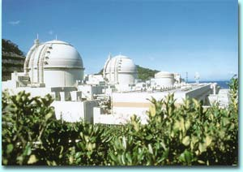
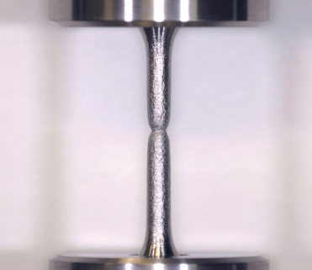
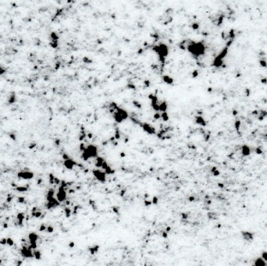
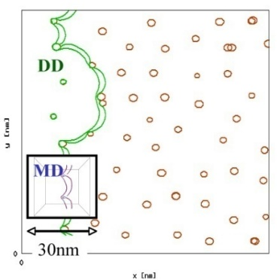
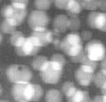
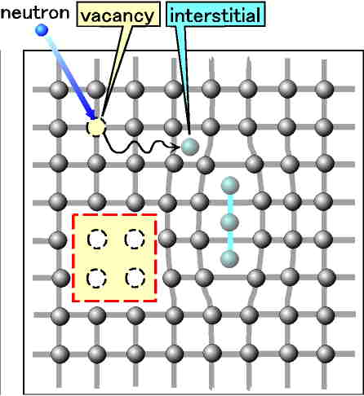
Multi-scale Modeling in nuclear materials
Plant Life
1Gs
Time
1Ms
Mechanical
properties
mechanical engineering
1s
1μs
Microstructural
evolution
materials science
Length
Displacement
(Atom/Lattice) Physics
1E-10 1E-8 1E-6 --- 1E-3 --- 1m

Slide 7
Materials science in nuclear
Material is an old technology and
has a long history before nuclear.
We know much about …..
strength
electric properties
cost
corrosion resistance
・・etc
For nuclear applications, we should also consider followings.
nuclear properties
radiation damage
reliability
Zircalloy clad tubes for LWR requires Hf-free Zr for the expected low neutron-absorption cross-sections.

Slide 8
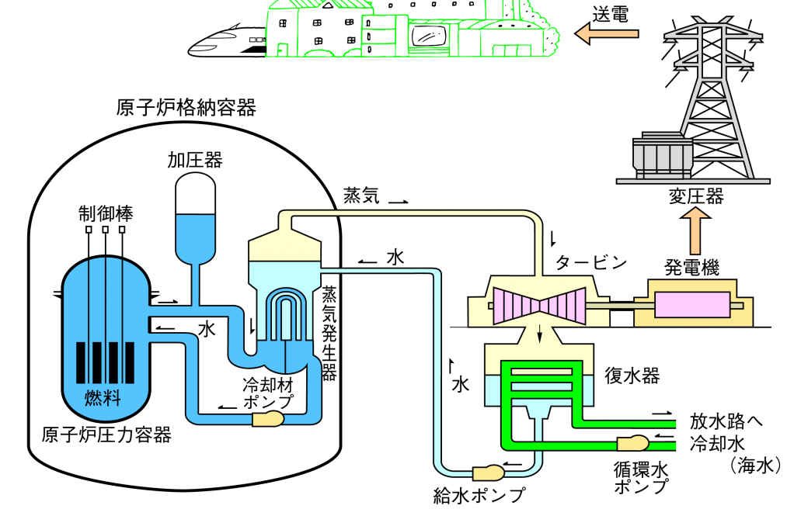
accidents due to material failure
Mihama-3 accident
The worst nuclear power plant accident before Fukushima in Japan
（2004年）
Rupture of a hot-water pipe in the secondary system killed five workers.
The wall thickness of the pipe made of carbon steel was very thin at the time due to corrosion for 28 years service without check or replacement.
Ｘ
B-747 crash at Mt. Osutaka
Incorrect repair of cabin pressure wall caused fatigue fracture, resulting 520 casualities.
（1985年）
The secondary system of a PWR or cabin pressure wall in a airplane may not be considered as an important one, but, it would cause a severe accident.

Slide 9
1. Materials in nuclear engineering
2. Basic Concepts of Radiation Damage
2-1 particle/target interactions
2-2 displacement damage
2-3 microstructural evolution
3. Practical Effects of Radiation Damage

Slide 10
2-1 particle/target interactions
As the introduction to “Basic Concepts of Radiation Damage”, three important phenomena (interactions) in radiation will be explained. They are,
Rutherford Scattering, Bragg Peak, BNCT cancer therapy.
Radiation -
I know how RUTHERFORD SCATTERING happens where most of energetic alpha particles injected into a thin gold foil pass through but a few particles are reflected back to the injection side.
I know high energy particles (mostly C and H ions) are used for the cancer therapy.
I know that the advantage of high energy particles in cancer therapy is their characteristic energy deposition along depth, called BRAGG PEAK.
I know another cancer therapy method, BNCT, where ¹⁰B(n, α) reaction is used to kill cancer cells by the localized fission energy deposition.

Slide 11
Rutherford scattering
Nuclei of atoms have been thus discovered.
In 1909, Ernest Rutherford’s research group conducted a scattering experiment of α particle beam from Ra through gold foil.
Scattering was, in general, very small
but they also found that
few α particles were reflected back to the source side.
gold foil
α source
α particles
It was very surprising because structure of a atom was not well known at that time, while negative charge particles (electrons) were well recognized.
J. J. Thomson proposed a “plum pudding model” where electrons are in homogeneous positive charge distribution (positive charge cloud), while Nagaoka’s model had a concentrated positive charge at the center and surrounding electrons like rings of Saturn (called as a Saturnian model).

Slide 12
α’s are reflected by the nuclei
Based on this results, Rutherford proposed an atom model with a nucleus in 1911, where
the atom has a heavy nuclei with a large positive charge (planetary model).
α particles passing near the nucleus are largely deflected.
electron
α particles
nucleus
Au atom
Most α particles go through Au foil with no or slight deflection.
This result is caused by collision with the nucleus.

Slide 13
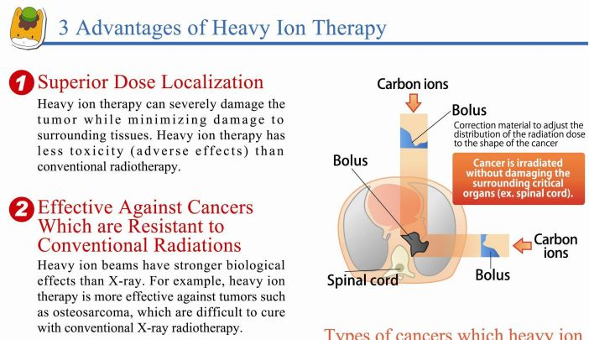
charged particle cancer therapy
from web-site of Gunma Univ.,
Heavy Ion Medical Center

Slide 14
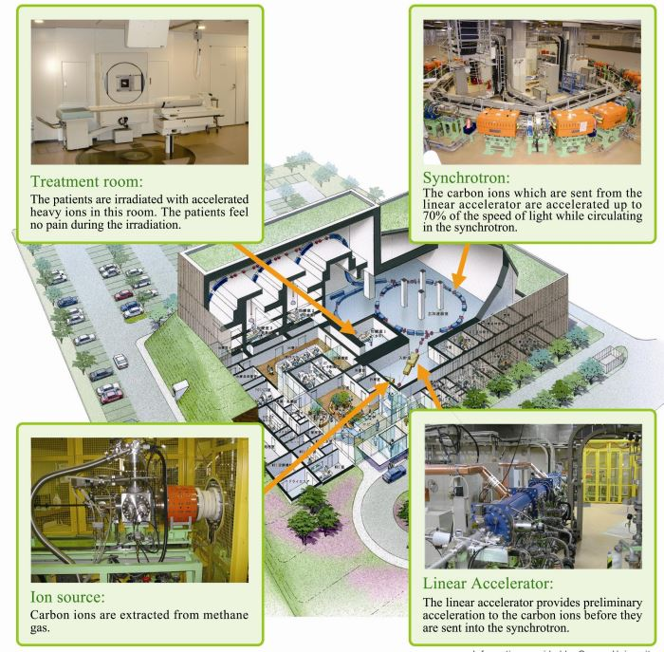

charged particle cancer therapy
We have several facilities for this therapy in Japan.
from web-site of Gunma Univ.,
Heavy Ion Medical Center

Slide 15
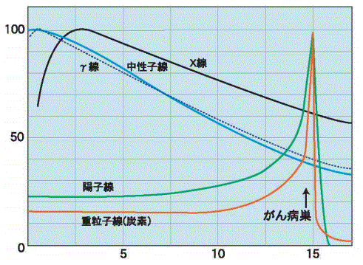
charged particle cancer therapy-2
X-ray or γ-ray irradiation is often used for the cancer therapy.
Radiation induced free radicals attack the DNA of cancer cells.
In this method, however, normal cells are also heavily irradiated.
human body
γ-ray
cancer
Normal organs or cells are also heavily damaged by the conventional radiation therapy.
Energetic charged particles are used for the most advanced radiation cancer therapy, where energy deposition is largest at the cancer depth (Bragg peak ).
X-ray
γ-ray
Deposited energy (%)
neutrons
proton
carbon ion
cancer
Less radiation damage to normal area
Depth from the body surface (cm)

Slide 16
Bragg peak
high energy region where Bethe-Bloch
eq. can be applied
Se=k (E^{1/2})
region
electronic stopping
power (Se)
Deposited energy
particle energy (log (E))
depth
Electronic stopping Se (energy loss due to electron excitation) is a function of projectile energy and the profile peaks at intermediate energy region as shown in above left.
The energy deposition profile along the depth has, therefore, a peak at the end of the penetration depth. Note that horizontal energy scale in the left diagram is in log scale.
This result is caused by collision with electrons.

Slide 17
BNCT cancer therapy
Large (n, α) cross-section of ¹⁰B with thermal neutrons are well known. ¹⁰B(n, α)⁷Li, 3595 barn,
1. ¹⁰B containing chemicals go to cancer cells.
2. Irradiate the organ with thermal neutrons.
α, Li
B
3. Fission energy carried by α and ⁷Li is deposited to the cancer cell leaving a slight side effects to healthy cells.
α, Li
B
4. Cancer cells are killed.
cancer cell
This result is caused by nuclear reaction.

Slide 18
Summary of three phenomena
phenomena | type of interactions | effects to metallic targets | irradiated particle
Rutherford scattering | collision with nuclei | displacement damage * | ions (Neutrons can also make this effect)
Bragg peak in charged particle therapy | collision with electrons | heating | ions
BNCT therapy | nuclear reaction | transmutation damage | neutrons
* Details of displacement mechanism will be given later.
To understand radiation effects in NPP materials, you can forget about
- nuclear reaction caused by high energy ions ( ), and
- neutron to electron collision ( ).

Slide 19
electron excitation in metals
type of interactions | effects to metallic targets | Irradiated particle
collision with nuclei | displacement damage | ions, neutrons
collision with electrons | heating | ions
nuclear reaction | transmutation damage | neutrons
Metallic materials include many free electrons with various energy states.
That’s why they are conductive due to the free movement of these electrons.
metallic bonding
Many atoms share many electrons in various energy states.
covalent bonding
Two atoms share some electrons in a specific energy state.
Fe^{+n}
C^{+n}
Electron excitation does not affect the metallic bonding of these solids.
Polymers, for example, are very sensitive to electron excitations.

Slide 20
2-2 displacement damage
α particles passing near the nucleus are largely deflected.
electron
α particles
Au nucleus
Au atom
In α irradiation to Au foil, Rutherford was interested in the deflected α particles,
but let’s think about the irradiated Au nuclei.
What will happen?

Slide 21
particle/particle collision
nucleus
α particle
Conservation of momentum requires that the irradiated Au nucleus should move after the collision, receiving some energy from the α. (Also remind the low of action and reaction!)
The amount of transferred energy varies depending on collisions.
The maximum energy transfer occurs in a head-on collision.
E_{max} = E₀
m₁ : projectile mass
m₂ : target mass
E₀ : projectile irradiation energy
4 m₁ m₂
(m₁ + m₂)²

Slide 22
maximum energy transfer
m₁ : projectile mass
m₂ : target mass
v₁₀ : projectile speed before collision v₁₁ : projectile speed after collision
v₂₁ : target speed after collision
(v₁₁ and v₂₁ are unknown.)
projectile:m₁
target:m₂
v₁₁
v₁₀
v₂₁
conservation of energy
m₁ v₁₀² = m₁ v₁₁² + m₂ v₂₁²
conservation of momentum
m₁ v₁₀ = - m₁ v₁₁ + m₂ v₂₁
1
2
1
2
1
2
v₂₁ ₌ v₁₀
and so on….
2 m₁
m₁ + m₂
before
after collision
With two unknown parameters and two given equations, we can solve the equations (high school level physics) and the following equation is obtained.
E_{max} = E₀
4 m₁ m₂
(m₁ + m₂)²

Slide 23
Screened Coulomb potential
Rutherford scattering is the result of ion/ion collisions.
The real potential between projectile and target nuclei is described by screened Coulomb potential, which has relatively a shorter tail than that of simple Coulomb potential.
Screened Coulomb potential:
When distance between projectile and target nuclei is large, the projectile “feels” less positive charge of the target nuclei due to electrons around the target nucleus.
screened Coulomb potential
Coulomb potential
potential
shielding by
target electrons
distance between projectile and target

Slide 24
neutron collision
Because neutrons have no electric charge, they do not “feel” the positive charge of target nuclei. They do not “feel” each other until the distance become very close.
Although high energy neutrons (>1MeV) show complicated collision behaviors, hard shere potential model shown in right figure is enough for most of LWR neutrons.
hard sphere potential
Neutrons “feel” or “see” smaller target nuclei.
Due to this smaller cross-section, neutrons have deeper penetration into materials.
screened Coulomb potential
potential
distance between projectile and target

Slide 25
hard sphere collision in laboratory coordinate
impact parameter b
v₁’
m₁
v₁
φ
r₁
ψ
r₂
hard sphere collision : Just an impulse on collision and no interactions before that.
m₂
v₂’
not moving v₂=0
many players are in laboratory coordinate...
geometory in collision
ψ = sin⁻¹ ( b/(r₁+r₂) )
energy conservation
½ m₁v₁² = ½ m₁v₁’² + ½ m₂v₂’²
momentum conservation (x)
m₁v₁ = m₁v₁’ cosφ + m₂v₂’ cosψ
momentum conservation (y)
0 = m₁v₁’ sinφ – m₂v₂’ sinψ

Slide 26
hard sphere collision in center of mass coordinate 1
center of mass coordinate: The origin of this coordinate is always at the center of mass of two objects, m₁ and m₂. The origin moves in the laboratory coordinate, but the motion has no acceleration. No strange forces will, therefore, apply in the COM coordinate and normal mechanics will be employed. You can play Japanese bilbo quet in a running shinkansen train while it is running at a constant speed through a strait pass.
The velocity of the COM origin in the laboratory coordinate Vc is;
Vc = m₁v₁ / (m₁ + m₂) .
Paths L₁, L₂ of two objects travel in the COM coordinate during time t are;
L₁ = u₁ t, and L₂=u₂ t . ------(1)
(u is designated for the velocity in the COM coordinate, in stead of v in the laboratory coordinate)
The origin of the COM coordinate stays at the COM. Then,
L₁m₁ = L₂m₂ . ------(2)
From (1) and (2), m₁u₁ = m₂u₂ = P₀ and u₁ = P₀/m₁, u₂ = P₀/m₂
The heavier object moves slower. Or, the magnitudes of momentum of two objects are equivalent in COM coordinate and the direction is opposite.

Slide 27
hard sphere collision in center of mass coordinate 2
m₁
u₁’
u₁
θ₁
b
ψ
θ₂
u₂’
u₂
m₂
At the collision, two objects affect
inpulse P each other along the red line.
The velocity change after the collision will be showen in the right figures.
Considereing
u_{i} = P₀ / m_{i} and Δu_{i} = P / m_{i} (i=1,2) ,
two triangle figures for the velocity changes of m₁ and m₂ are similar and scattering angles of each objects are same, （θ₁=θ₂）.
Velocities after the collision (ui’) are also
|u1’| = C |u1|, |u2’| = C |u2|.
Considering the conservation of kinetic energy before and after the collision, C must be unity.
It means that the velocity and kinetic energy of each particles do not change before and after the collision.
figure for m₁
u₁’
Δu₁ = P/m₁
θ₁
ψ
u₁ = P₀/m₁
∽
u₂ = P₀/m₂
figure for m₂
ψ
θ₂
Δu₂
= P/m₂
u₂’

Slide 28
Advantage of COM coordinate
mass: m₁, m₂
velocity: v₁, v₁’, v₂’
angle: φ, ψ
laboratory coordinate
The advantage of COM coordinate is to reduce the number of variables, from 7 to 5. It enables us to handle this issue with less complexity.
You can imagine Ptolemaic system with laboratory coordinate, and heliocentric system with COM coordinate. Ptolemaic system is easy to understand at the first stage but motion of planets in this system is complicated.
mass: m₁, m₂
velocity:|u₁|, |u₂|
angle: θ
center of mass coordinate

Slide 29
transferred energy in collision
Lab. Coor.
m₁
v₁’
m₁
v₁
m₂
φ
V_{c}=
ψ
COM G
V_{c}
m₁v₁
m₂
v₂’
m₁+m₂
COM Coor.
m₁
u₁’
=v₁’-V_{c}
m₁
u₁
=v₁-V_{c}
m₂
θ
m₂
u₂’
u₂
=v₂-V_{c}= - V_{c}
=v₂’-V_{c}
transferred energy
E_{tr} = ½ m₂ v₂’²
In the right figure, note that |u2| = |u2’| = |Vc| ,
∠QRS = ∠R, and v₂’ =u2’ + Vc
v₂’ = 2 Vc sin (θ/2)
∴ E_{tr} = ½ m₂ (2V_{c} sin (θ/2))²
=4 E₀ sin² , where E₀ = ½ m₁v₁²
Q
u₂
P
V_{c}
θ
S
u₂’
½ θ
m₁m₂
v₂’
θ
R
(m₁+m₂)²
2
T

Slide 30
transferred energy spectrum
m₁m₂
θ
small cross-section Δs
E_{tr} = 4 E₀ sin²
(m₁+m₂)²
2
Δr’
Let E_{tr max} = 4 E₀ , then
E_{tr} = E_{tr max} sin² .
Relationship between ψ and θ is ;
2ψ + θ = π
∴ θ = π – 2ψ
E_{tr} = E_{tr max} sin²(π/2 – ψ)
While sin(π/2 – ψ) = cos (ψ) , then
E_{tr} = E_{tr max} cos²(ψ)
dE_{tr}
∴ = -2E_{tr max} cosψ sinψ
dψ
Δψ
m₁m₂
(m₁+m₂)²
θ
r’
2
ψ
ψ
Δu₁
R =r₁ + r₂
u₁’
θ
ψ
u₁
r’ = R sin ψ ,
dr’
= R cos ψ
dψ
∴ Δr’ = R cos ψ ・ Δψ
Δs = 2 π r’ ・ Δr’
= 2πR² sin ψ ・ R cos ψ ・ Δψ
E_{tr} change due to the change of ψ is,
ΔE_{tr} = (dE_{tr} / dψ) Δψ = -2E_{tr max} cosψ sinψ Δψ
Differential cross section σ is, therefore,
(considering E_{tr} < 0）
σ = Δs / -ΔE_{tr} = π R² /E_{tr max} ; ψ independent!
π R² / E_{tr max}
Scattering behavior of neutrons less than 1 MeV is close to this.
total cross section
πR²
Diff. cross section σ
E_{tr max}
transferred energy E_{tr}

Slide 31
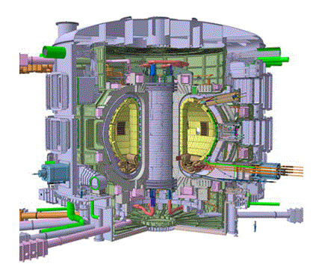
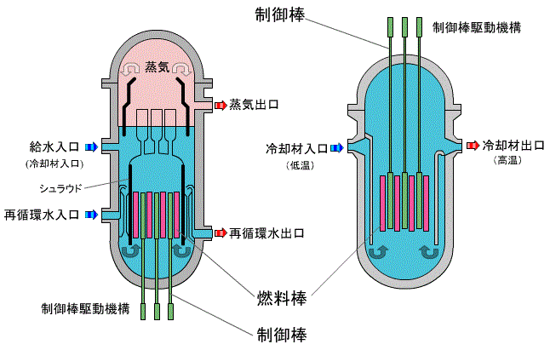
Neutrons need no vacuum!
Due to this smaller cross-section, neutrons have deeper penetration into materials.
By the way, ….
from CRT’s, electron microscopes, to accelerators, and fusion devices
Facilities and apparatus using flying particles need, in most cases, vacuum, because most particles can travel freely only in vacuum.
Here in Tokai, a lot of vacuum pumps are working to keep many facilities in a good vacuum, but reactors are filled with water!
ITER
BWR
PWR
fission products
Fusion reactors using D + T ->He + n reaction require high vacuum.
Fission reactors using ²³⁵U + n ->fp + n reaction require no vacuum.

Slide 32
1. Materials in nuclear engineering
2. Basic Concepts of Radiation Damage
2-1 particle/target interactions
2-2 displacement damage
2-3 microstructural evolution
3. Practical Effects of Radiation Damage

Slide 33
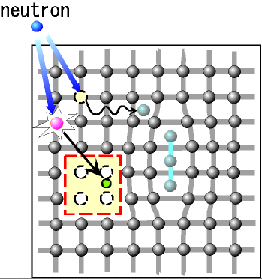
2-2 displacement damage
If a target atom receives enough energy from the projectile by a collision, the atom go away from it original lattice site.
This is called as displacement.
If the receiving energy is too low, the hit atom will not be displaced.
The “threshold energy ” for displacement, Ed, is almost 40 eV in many metals.
A simple displacement makes an interstitial atom and a vacancy.
The set of these two point defects is called a Frenkel pair.
displacement damage
vacancy
Interstitial atom
neutron

Slide 34
defect clusters, transmutation
transmutation
damage
Dislocation loop
induced activity
He, H
Neutrons also make transmutations.
The target become radioactive and generated He and H affect further microstructural evolutions.
cavity
Interstitial atoms and vacancies move around the target material and, mostly, disappear by mutual recombinations (v + i).
Some defects form defect clusters, such as dislocation loops and cavities, collecting same type of point defects (v + v, or i + i).

Slide 35
cascade damage
neutrons:
small cross-section
self ions:
high cross-section
The lattice atom directly hit by the neutron is called PKA, primary knock-on atom.
Remember that neutrons have less collision cross-sections than ions. When some energy of neutron is transferred to a target atom, it will generates the next ion to ion collision very soon.
Cascade damage is thus formed.
Cascade damage enhances mutual recombination.
Weak particles, such as electrons, can not make cascade damage and the effect is relatively large due to less mutual recombination in these cases.

Slide 36
DPA
100 lattice atoms
1 vacancy and
1 interstitial atom
0.01 dpa
The unit of displacement damage is DPA, displacement per atom.
If 1% of target lattice atoms have experienced displacement, the damage level is called 0.01 dpa.
Remember that most of point defects disappear by mutual recombination.
The material can survive even after 1 dpa damage!
Reactor internal components of PWR experience up to ~100 dpa.
meaningful expression!

Slide 37
Kinchin-Peace model for cascade efficiency
Ep
collision to other lattice atoms
neutron
collision to the lattice atom (PKA).
collision to electrons
transmutation
cascade damage
How many displacements are generated by a PKA with initial energy Ep?
A well-known approach is Kinchin-Peace mode.
The number of displacements ν caused by a PKA with an initial energy E_{p} is;
0, E_{p}<E_{d} , E_{d} is the threshold energy for displacement,
ν(E_{p}) = 1, E_{d}<E_{p}<2E_{d} ,
E_{p}/2E_{d} , 2E_{d}<E_{p}<E_{I} , E_{I} is upper limit,
E_{I}/2E_{d} , E_{I}<E_{p}
In this mode, ν(E_{p}) = E_{p}/2E_{d} in most energy range
but in case of PKA’s with too high energy, the
particle energy is only used for ionization down to E_{I}.
E_{I}
2E_{d}
ν(E_{p})
E_{p} / 2E_{d}
1
E_{I}
Ep
0
E_{d}
2E_{d}

Slide 38
advanced model for cascade efficiency
Ep
collision to other lattice atoms
E_{D}
collision to the lattice atom (PKA).
collision to electrons
The advanced model for cascade efficiency developed by Lindhard describes “damage energy” (E_{D}) within a cascade as follows;
E_{D}=E_{p} / ( 1+k g(ε) ) , k=0.1334 Z^{1/6}(Z/M)^{1/2} , g(ε)=3.4008ε^{1/6} + 0.40244ε^{3/4} + ε
Recent computer codes mostly use Lindhard model rather than K-P but, the K-P is, of course, much easier to calculate.
JAEA PHITS code also employs Lindhard.
1
Kinchin-Peace
efficiency (E_{D}/E_{p})
Lindhard
Understanding of Lindhard equation requires a high level of atom/atom collision physics, which is far beyond this seminar level.
But some information would be useful for you, I’ll just try to describe a brief review.
1
0.1
1
10
100
log (Ep)
keV
A sample calculation of damage efficiencies in two models (Al).

Slide 39
dimensionless energy and range
dimensionless energy ε = E
where a = a₀
a₀ = 0.5291771 x 10⁻⁸ cm ：Bohr radius
e : charge of an electron (4.80325 x 10⁻¹⁰ esu)
E : irradiation energy (in erg unit, 1eV = 1.6 x 10⁻¹²erg）
dimensionless range： ρ = R N_{a} M₂ 4π a²
where, Na : atomic density of irradiated material (cm⁻³)
R : range（cm）
Of course, Z: atomic number, M:mass（amu）, subscript 1：projectile, 2：target.
a M₂
Z₁ Z₂ e²( M₁ + M₂ )
0.8853
(Z₁^{2/3} + Z₂^{2/3} )^{1/2}
M₁
(M₁+M₂)²
nuclear
The advantage of this unit conversion is that the nuclear stopping is expressed by one function in all combination of projectile and target elements.
On the other hand, electronic stopping is expressed in the following equation,
S_{e} = （dε/dρ）_{e} = k ε^{1/2} ( proportional to the ion speed)
where k = ξ_{e} ; ξ_{e} = Z₁^{1/6}
The “k” in the cascade efficiency equation is a special case of this for self ions, M₁=M₂ and Z₁=Z₂.
electronic
0.0793 Z₁^{1/2} Z₂^{1/2} (M₁+M₂)^{3/2}
(Z₁^{2/3} + Z₂^{2/3} )^{3/4} M₁ ^{3/2} M₂^{1/2}

Slide 40
stoppings in dimensionless units
nuclear stopping power Sn, (dε/dρ)_{n}, and electronic stopping power Se, (dε/dρ)_{e}
100keV
500keV
1MeV
0.6
real projectile energy for Ni to Ni irradiation
Se=Sn at around 500keV
0.5
electronic stopping power calculated for Ni self ion
0.4
dimensionless stopping power, (dε/dρ)
0.3
nuclear stopping power for all projectile and target elements
0.2
0.1
0
1
2
3
4
ε^{1/2}
Note that the Sn curve has a similar peak like Se curve, but at much lower energy.
Ion irradiation also makes a dpa profile along the depth
(another type of Bragg Peak).
→ Collision cross-section is very low for high energy ions, and they can
simulate separate cascade damages generated by neutrons.
Se=k (E^{1/2})
region
Bethe-Bloch
eq. region
electronic stopping
power (Se)
particle energy (log (E))

