Slide 1
Basic Metallurgy
^{61, 62, 63rd} ITC on Basic Reactor Engineering at Tokai
2015 Sept. 18
Tomotsugu Sawai
Director
Nuclear Human Resource Development Center
Japan Atomic Energy Agency(JAEA)

Slide 2

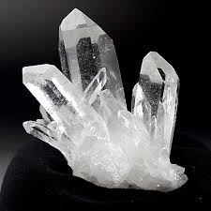
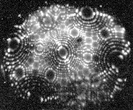
Deformation of CRYSTAL !?
What kind of materials do you imagine with the word “CRYSTAL” ?
We can bend steel wires easily and can you believe that they are made of CRYSTALs ?
Field Ion Microscope Image of very sharp W needle surface. Bright dots represent atoms on the surface with small sphere. Characteristic pattern suggests that they have some periodic structure, .....CRYSTAL !

Slide 3
What is “metal” ?
Solid with metallic bonding
covelent bond
DIAMOND. Four valence electrons of a carbon atom forms pairs with electrons of other carbon atoms and make closed shell structure.
C
C
C
C
C
ionic bond
SOLT (NaCl). A Na atom releases one electron and a Cl atom accepts it, making closed shell in both atoms. Na ions with + charge and Cl ions with – charge make an ionic crystal.
-
+
Na
Cl
GRAPHITE(between layers). Fluctuating polarizations of neutral particles causes attractive force
+
-
+
-
van der Waals bond
-
+
-
+
metallic bonding
GOLD. Many atoms releasing their electrons share these electrons, forming lower energy state. Energy states of these electrons have some width (band structure).
Energy state of these electrons is free , then ..
They can move in the crystal freely, and metals are electrically conductive.

Slide 4
Typical crystal structure of metals
BCC
(body centered Cubic)
Fe(at room temperature), W, Mo, Na, K
FCC
(face centered Cubic)
Au, Ag, Cu, Ni, Al
Fe (at high temperature)
Austenitic stainless steel
HCP
(hexagonal close packed)
Zn, Mg, Be
Note: Difference in color is just for explanation.

Slide 5
FCC: Combination of triangle makes...
FCC
stacking sequence
one layer
so-called (111) plane
Basic structure of FCC is a tetrahedron, or triangles.
Their combination makes a cubic.

Slide 6
difference between FCC and HCP
Planar atomic structure of the highest density is triangle-based honey comb structure.
HCP
B
A
A
3D
We have two choices to add one more layer on this plane; atoms in positions, or atoms in positions.
C
C
B
B
A
A
FCC
Let’s designate positions of the first layer atom, A, and positions of two triangles, B , C.
Atomic layers of ABCABC・・・ forms FCC, and ABAB・・・ forms HCP structure.

Slide 7
crystalline defects：point defect
This is a perfect crystal.
A lattice site without the atom is called as a vacancy.
An extra atom locating among other atoms in normal lattice site is called an interstitial atom.
This is not a perfect crystal, including crystalline defects.
Vacancies and interstitial atoms are colled point defects.

Slide 8
line defect : dislocation 1: edge type
Imagin that ....
Difference in color is just for explanation. Orange and green atoms are of same element.
This area is also perfect crystal.
A cheese bar
with a slit
extra plane of same atoms
This area is perfect crystal
insertion of another cheese slice into the slit.
Cross-section of the crystal including edge dislocation.

Slide 9
micro deformation due to dislocation glide
The dislocation passes through the crystal.
If we apply share force to a crystal including an edge dislocation, then, ...
plastic deformation due to dislocation glide
Due to its the nature of metallic bonding, dislocations can glide easily and metals are thus ductile.

Slide 10
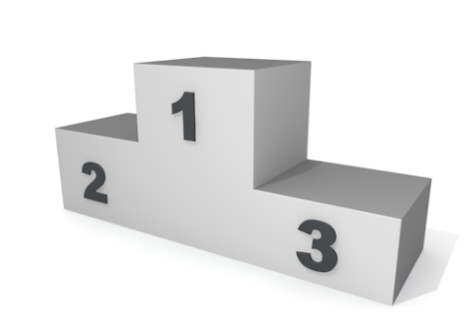
moving a carpet by the dislocation glide
How will you move and relocate a long heavy carpet ?
Oh ...!!
To move it at once is ...
impossible !!
Repeated movement of small wrinkles can make a large advance.

Slide 11
another type: screw dislocation
Imagin that
This is very difficult to understand this completely and I think it is enough to know the name, screw dislocation and its practical importance in deformation mechanism.
A cheese bar ...
with a slit.
screw dislocation
twist and re-conect

