Slide 1
NUCLEAR REACTOR MATERIALS
2. FUNDAMENTAL OF LWR MATERIALS

Slide 2
In This Chapter:
Major Structural Materials
Mechanical Properties of Materials
Welding
Radiation Effects in Materials

Slide 3
Introduction
In selection of nuclear materials required, the material properties, or considerations, and the changes of material properties in an intense radiation environment must be taken into account.
The requirements of material properties in nuclear reactors can be divided into two main categories:
A. general properties, or basic considerations
B. special properties, or particular considerations
The mechanical processes, heat treatments, etc., used in the production and fabrication of nuclear reactor materials can also modify their general and special properties.

Slide 4
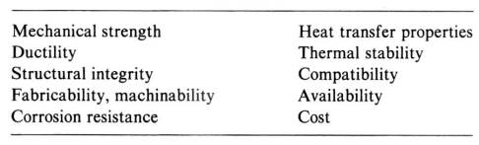
General Properties of Materials
The general properties are similar to the conventional engineering properties of materials, which are required in most engineering designs.

Slide 5
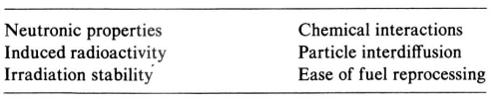
Special Properties of Materials
The special properties required for nuclear reactor materials arise from nuclear radiation, or irradiation, sources and circumstances of the reactor system. Material properties of a reactor component can have a tremendous change under severe radiation.

Slide 6
1.Major Structural Materials

Slide 7
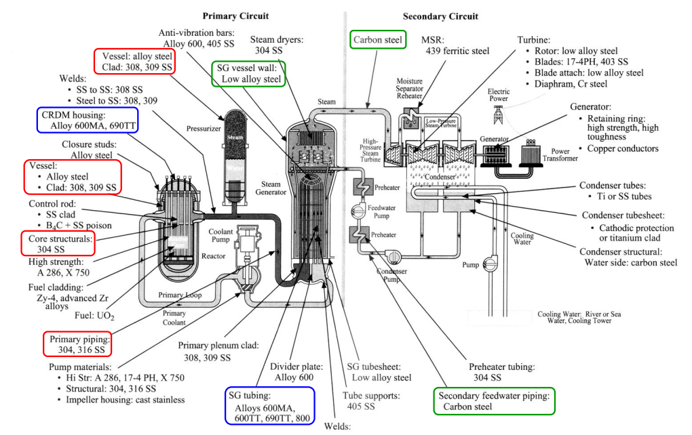
Materials used in LWR

Slide 8
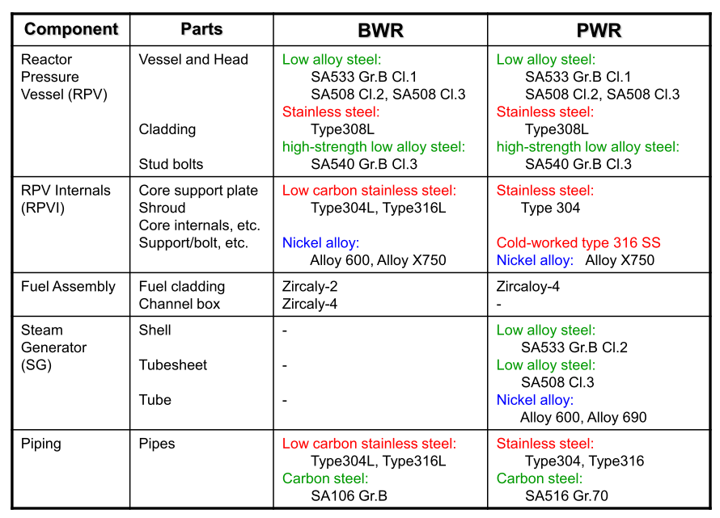

Slide 9
POP QUIZ – THINK PAIR SHARE
1. Get a partner (2 person per group – total 4 groups)
2. Each group will be assigned to different parts of reactors:
  Group 1 – Reactor core
  Group 2 – Pressurizer and steam generator
  Group 3 – Turbine, electric generator and condenser
  Group 4 – Primary and secondary loop coolant system
3. Question – Based on the figure, think about the reason why specific types of steels is needed for the reactor parts assigned to your group. (You can google to find the information about the steels and its purposes) (5 minutes)
4. Share your findings with your partner. (3 minutes)
5. Share your findings with the class. (3 minutes per group)

Slide 10
a) Carbon Steels
The American Iron and Steel Institute (AISI) defines carbon steel as follows:
Steel is considered to be carbon steel when no minimum content is specified or required for chromium, cobalt, columbium [niobium], molybdenum, nickel, titanium, tungsten, vanadium or zirconium, or any other element to be added to obtain a desired alloying effect; when the specified minimum for copper does not exceed 0.40 per cent; or when the maximum content specified for any of the following elements does not exceed the percentages noted: manganese 1.65, silicon 0.60, copper 0.60.

Slide 11
Low-alloy Steels
Low-alloy steels constitute a category of ferrous materials that exhibit mechanical properties superior to plain carbon steels as the result of additions of alloying elements such as nickel, chromium, and molybdenum.
Total alloy content can range from 2.07% up to levels just below that of stainless steels, which contain a minimum of 10% Cr.
For many low-alloy steels, the primary function of the alloying elements is to increase hardenability in order to optimize mechanical properties and toughness after heat treatment.
Low-alloy carbon steel is an important reactor material for use in pressure vessels and miscellaneous components. Why?
Notes:
The corrosion resistance of stainless steels is not required but an ability to withstand thermal stress is desirable.

Slide 12
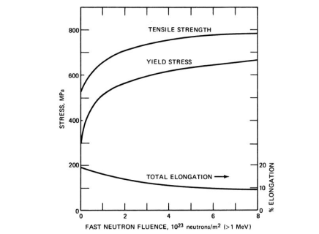

The effect of exposure to fast neutrons (energy>1 MeV) on the mechanical properties of ASTM A 533-B steel
The increase in the yield and tensile strengths and the decrease in elongation are consistent with a decrease in the ductility of the steel with increasing fluence.
The loss of ductility reduces the ability of the metal to
accommodate thermal stresses
Notes:
American Society for Testing and Materials (ASTM)

Slide 13
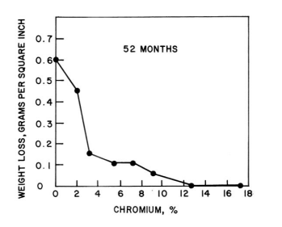
b) Stainless Steel
Stainless steels are iron alloys containing a minimum of approximately 11% chromium.
This amount of chromium prevents the formation of rust in unpolluted atmospheres.
Their corrosion resistance is provided by a very thin surface film, known as the "passive film," which is self-healing in a wide variety of environments.
Influence of Cr on the atmospheric corrosion of low-carbon steel.
Notes:
, it is from this characteristic that their popular designation "stainless" is derived.

Slide 14
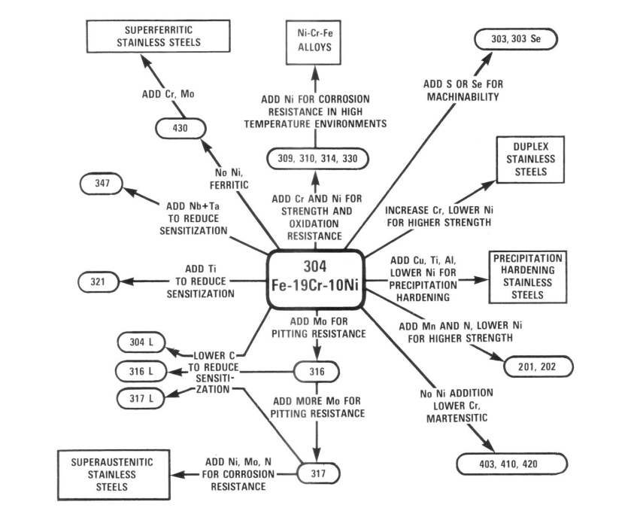
Compositional and property linkages in the stainless steel family of alloys

Slide 15
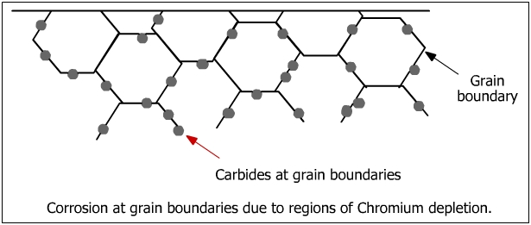
Sensitization
The exposure of austenitic stainless steels to elevated temperatures for long periods of time can result in the formation of various precipitates.
The formation of such precipitates is generally described in the metallurgical literature by time-temperature-precipitation (TTP) diagrams.
Carbide precipitation can give rise to a phenomenon known as "sensitization" which can cause intergranular corrosion and intergranular stress corrosion cracking (IGSCC) in certain BWR environments.
Notes:
also known as gamma-phase iron (γ-Fe), is a metallic, non-magnetic allotrope of iron

Slide 16
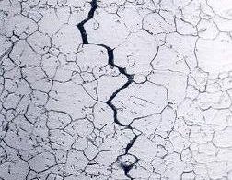
Intergranular Corrosion
is a form of corrosion where the boundaries of crystallites of the material are more susceptible to corrosion than their insides.

Slide 17
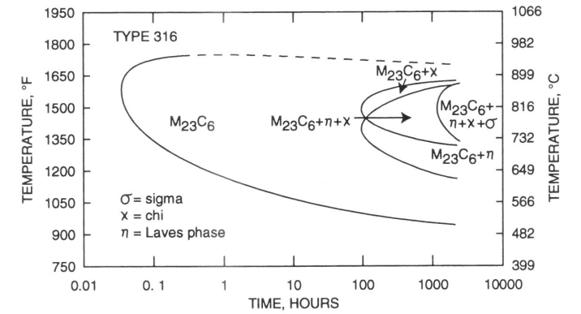
TTP Diagram for SS 316 (0.066% C)
Notes:
where it is seen that carbide , chi, Laves phase, and sigma can be precipitated at certain elevated temperatures. This
figure also shows that the precipitation of carbide can occur in relatively short times or at relatively fast cooling rates compared to the other precipitates.

Slide 18
c) Nickel Alloys
Nickel-based alloys of interest in reactor systems are primarily those in the Inconel family, because of their corrosion resistance at high temperatures.
However the presence of Co as an impurity in the nickel requires that these alloys be used outside the core, such as in heat exchangers or parts of the pressure vessel. Why?
Inconel 600 (16 percent chromium, 7.6 percent iron, and smaller amounts of other elements) has been widely used for PWR steam generator tubing. It is also used at the ends of pressure vessel nozzles to improve weldability.
Inconel 800 (21 percent chromium) is also used in PWR steam generators. It has better high-temperature strength than Inconel 600, and is of interest for fast-reactor heat exchangers.
Inconel 690 (30 percent chromium) has been specified for steam generator tubing in the advanced AP600 reactor because of its superior resistance to stress-corrosion cracking.
Notes:
the large thermal-neutron absorption cross section of cobalt

Slide 19
2.Mechanical Properties of Materials

Slide 20
Mechanical Properties of Materials
Purpose of components and structural systems is to support and resist various loads not only during long time operation but also at construction and at in-service inspection, and even at emergency and faulted conditions.
Therefore, knowledge of mechanical properties and corrosion behavior complement design (including selection of materials) and protective maintenance.
Notes:
Mechanical Properties refers to the behavior of material when external forces are applied
At construction, when heavy components is transported and suspended, a load and bending moments is applied on the components at air temperature.
At over pressure test in in-service inspection, a pressure vessel and pipes made of steels are failed with brittle manner at cool air temperature.
At severe accident, such as TMI, structural materials and systems must shut and dissipate explosion energy.

Slide 21
Materials’ Deformation and Failure
When we control materials’ deformation and failure, we must control stress, strain, stress concentration, stress intensity, temperature, loading modes, and environment.
Notes:
Stress represents the intensity of the reaction force at any point in the body as imposed by service loads, assembly condition, fabrication, and thermal changes. Stress is measured as the force acting per unit area of a plane. The alternation in the shape or deformations of a body resulting from
stress is called strain.

Slide 22
Failure Modes and Mechanisms
Metal piece is subjected to a uniaxial force ⇒ deformation occurs
When force is removed:
metal returns to its original dimensions ⇒ elastic deformation (atoms return to their original position)
OR
metal deformed to an extent that it cannot fully recover its original dimensions ⇒ plastic deformation (shape of the material changes, atoms are permanently displaced from their positions)

Slide 23
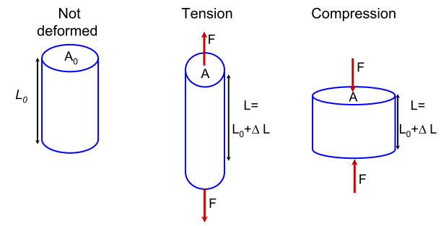
Concept of Stress and Strain
Load can be applied to the material by applying axial forces:
∆L can be measured as a function of the applied force; area A 0 changes in response

Slide 24


Stress (σ) and Strain (ε)
Stress (σ)
• defining F is not enough ( F and A can vary)
• Stress σ stays constant:
• Units: Force / area = N / m 2 = Pa (usually in MPa or Gpa)
Strain (ε) – result of stress
• For tension and compression: change in length of a sample divided by the original length of sample

Slide 25
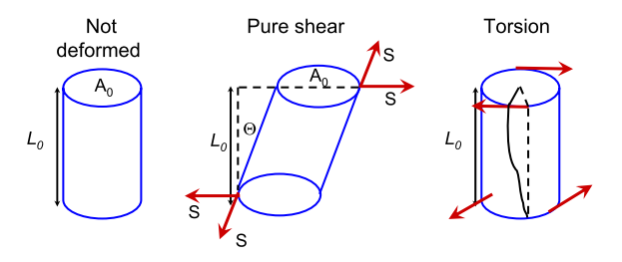
Shear and Torsion
If the forces are applied along the faces of the material, they are called shear forces

Slide 26
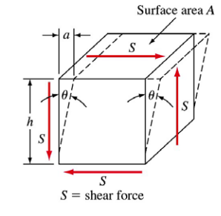


Shear Stress and Shear Strain
If the shear force S acts over an area A,
the shear stress τ:
The shear strain γ is defined in terms of the
amount of the shear displacement a divided
by distance over which the shear acts:

Slide 27

Elastic Properties of Materials
Most materials will get narrow when stretched and thicken when compressed
This behaviour is qualified by Poisson’s ratio, which is defined as the ratio of lateral and axial strain

Slide 28
Poisson’s Ratio, ν
For isotropic materials (i.e. material composed of many randomly - oriented grains) ν= 0.25
For most metals: 0.25 < ν < 0.35
If ν = 0 :means that the width of the material doesn’t change when it is stretched or compressed
IF ν < 0 , what does it mean??
Notes:
(i.e. the material gets thicker when stretched)

Slide 29

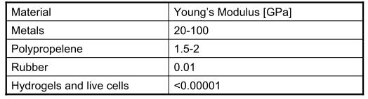
Young’s Modulus (Tensile Modulus)
Stress and strain are properties that don’t depend on the dimensions of the material (for small ε), just type of the material
Behavior is related to atomic bonding between the atoms
A material whose Young's modulus is very high can be approximated as rigid

Slide 30
Young’s Modulus (Tensile Modulus)
A stiff material needs more force to deform compared to a soft material. Therefore, the Young's modulus is a measure of the stiffness of a solid material.
Now think about this…
stiffness and strength
stiffness and hardness
stiffness and toughness
Notes:
the strength of material is the amount of force it can withstand and still recover its original shape;
the hardness of a material defines the relative resistance that its surface imposes against the penetration of a harder body;
toughness is the amount of energy that a material can absorb before fracturing.

Slide 31
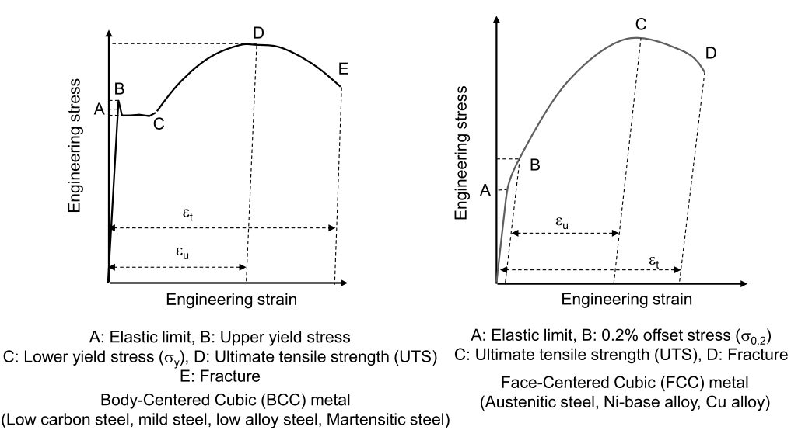
Tensile properties
The ability of a material to resist breaking under tensile stress is one of the most important and widely measured properties of materials used in structural applications.

Slide 32
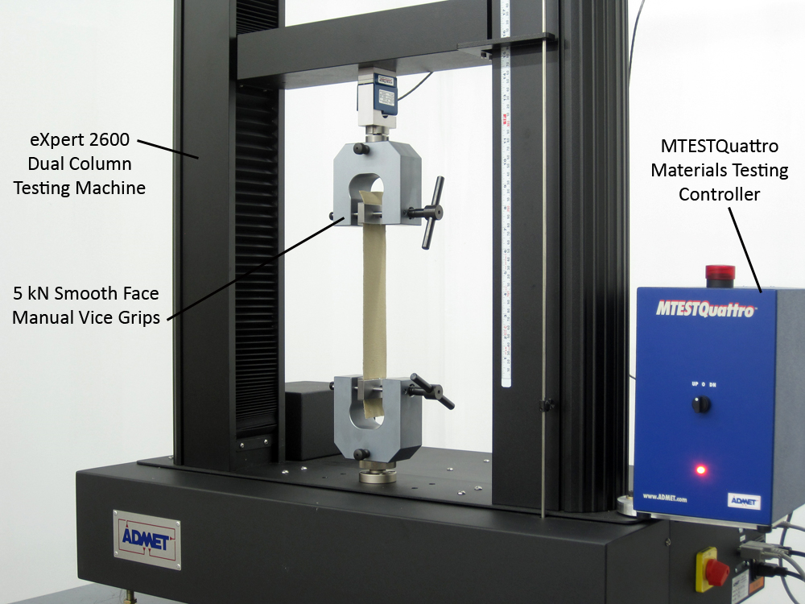
Tensile Test

Slide 33
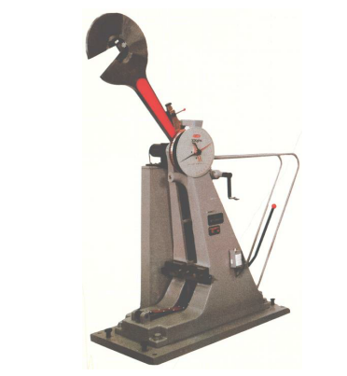
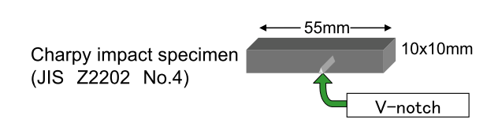
Impact property
Charpy impact test -Impact loading by hammer to break specimen at a certain temperature
– Charpy specimen of 10mm square with 2mm V-notch

Slide 34
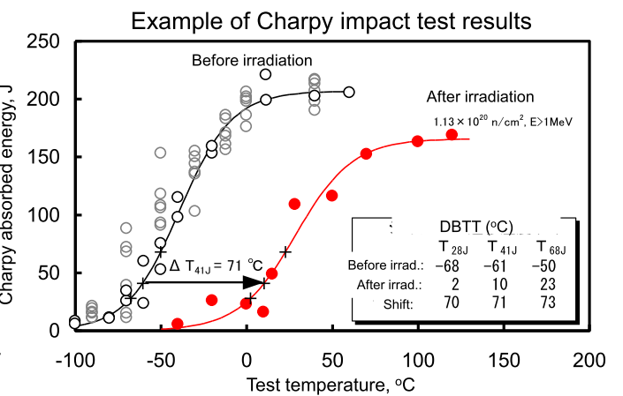
Charpy impact test
Measurements of absorbed energy, lateral expansion and percent shear fracture
– Calculate the absorbed energy from the angle of the hammer after specimen broken
– Measure lateral expansion and shear area from the broken specimen

Slide 35
Thermal embrittlement
Cast austenitic-ferritic (duplex) stainless steels with significant amount of delta ferrite will experience a reduction of toughness when aged at around 475ºC.
DBTT (ductile–brittle transition temperature) increases, and both room-temperature and operating temperature toughness decrease.
This temperature is well above the maximum temperature of BWR and PWR, nevertheless, a reduction of toughness dose take place at the BWR and PWR operating temperature but requires longer times.
Notes:
ductile–brittle transition temperature

Slide 36
Fracture toughness
Fracture processes are enhanced by the presence of cracks since they concentrate stress and strain at the crack tip.
Fracture mechanics is concerned with a description of stress and strain distribution at crack tips and the mechanism of crack propagation.
Thus, fracture mechanics provides a basis for predicting conditions that could lead to component failure and which should be avoided.

Slide 37
Fatigue Property
In materials science, fatigue is the weakening of a material caused by repeatedly applied loads.
It is the progressive and localized structural damage that occurs when a material is subjected to cyclic loading.
The nominal maximum stress values that cause such damage may be much less than the strength of the material typically quoted as the ultimate tensile stress limit or the yield stress limit.
If the loads are above a certain threshold, microscopic cracks will begin to form at the stress concentrators such as the surface, persistent slip bands (PSBs), and grain interfaces.
Eventually a crack will reach a critical size, the crack will propagate suddenly, and the structure will fracture.

Slide 38
Fatigue Property
The shape of the structure will significantly affect the fatigue life:
Square holes or sharp corners will lead to elevated local stresses where fatigue cracks can initiate.
Round holes and smooth transitions or fillets will therefore increase the fatigue strength of the structure.
In nuclear reactor plant, examples of
Low cycle fatigue: well-defined thermal transients such as plant startup and shutdown.
High cycle fatigue: The turbulence in the mixing layer at the interface between the hot and cold coolant layer introduces cyclic thermal stress at the inside surface of the pipe in the vicinity of the mixing layer.

Slide 39
Creep Property
Creep (sometimes called cold flow) is the tendency of a solid material to move slowly or deform permanently under the influence of mechanical stresses.
It can occur as a result of long-term exposure to high levels of stress that are still below the yield strength of the material.
Creep is more severe in materials that are subjected to heat for long periods (eg: SG, boiler, steamline)
The rate of deformation is a function of the material properties, exposure time, exposure temperature and the applied structural load.
Depending on the magnitude of the applied stress and its duration, the deformation may become so large that a component can no longer perform its function
Notes:
At high temperature atomic bonding starts to fail, causing
movement of atoms and atomic planes.
• Restructuring of atoms also occur at high temperature.
• Movements of dislocations also more likely at high
temperature through diffusion.

Slide 40
In ASME code section III, the use of ferritic steel and austenitic steel is restricted below 371 and 427 ºC, respectively, where the creep is ignored.
Usually creep is not considered in LWR conditions
In some circumstances, creep can be advantageous in the relief of thermal stress resulting from temperature differences.
Notes:
American Society of Mechanical Engineers

Slide 41
Cold Working and Annealing
To learn how the strength of metals and alloys is influenced by mechanical processing and heat treatments.
To learn how to enhance the strength of metals and alloys using cold working.
To learn how to enhance ductility using annealing heat treatment.

Slide 42
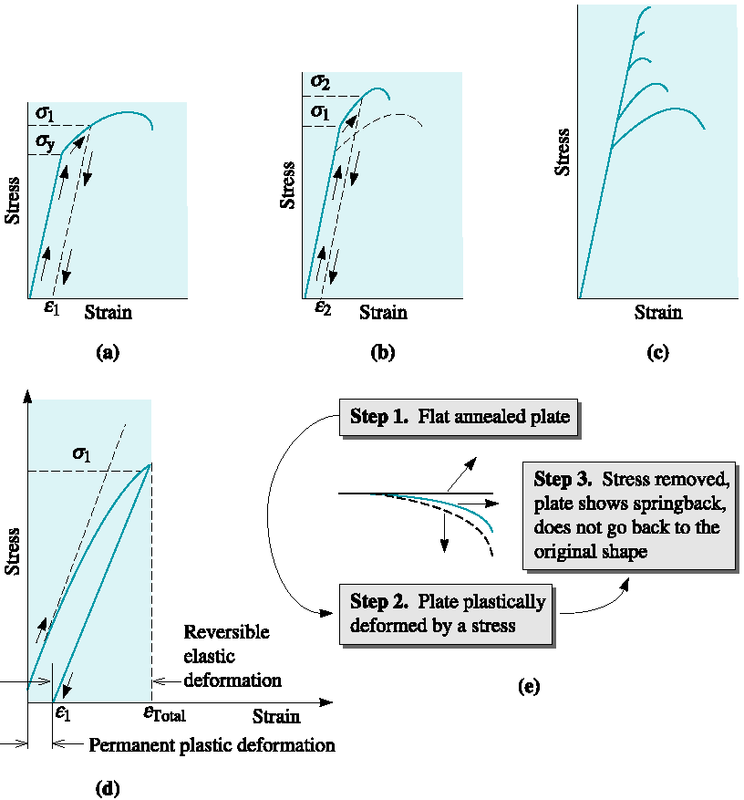
Figure 7.1 Development of strain hardening from the stress-strain diagram

Slide 43
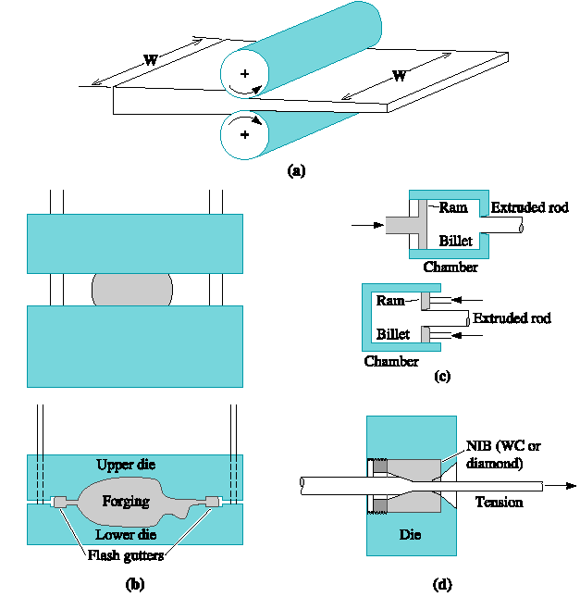
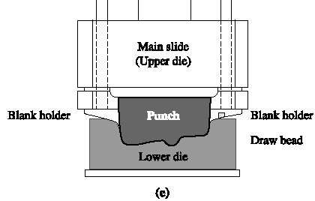
Figure 7.2 Manufacturing processes that make use of cold working as well as hot working. Common metalworking methods

Slide 44
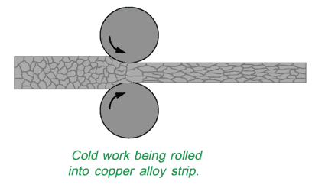
Cold Work
Elongated grain structure

Slide 45
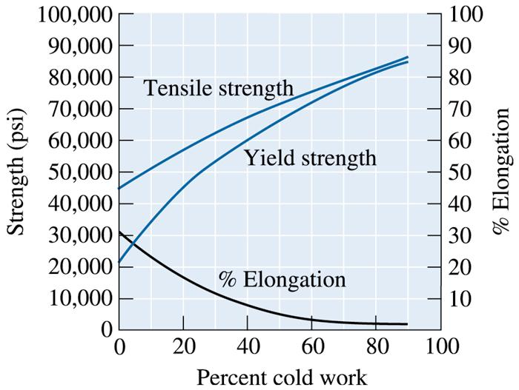
Section 7.3
Properties versus Percent Cold Work
©2003 Brooks/Cole, a division of Thomson Learning, Inc. Thomson Learning™ is a trademark used herein under license.
Figure 7.7 The effect of cold work on the mechanical properties of copper

Slide 46
Example 7.1
Cold Working a Copper Plate
A 1-cm-thick copper plate is cold-reduced to 0.50 cm, and later further reduced to 0.16 cm. Determine the total percent cold work and the tensile strength of the 0.16-cm plate. (See Figure 7.8.)

Slide 47
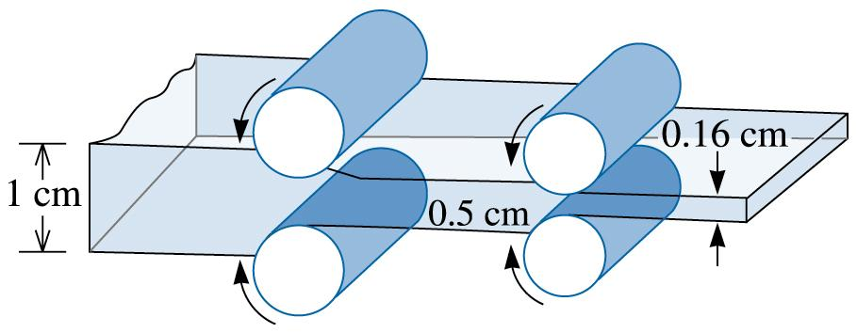
©2003 Brooks/Cole, a division of Thomson Learning, Inc. Thomson Learning™ is a trademark used herein under license.
Figure 7.8 Diagram showing the rolling of a 1-cm plate (for Example 7.1)

Slide 48
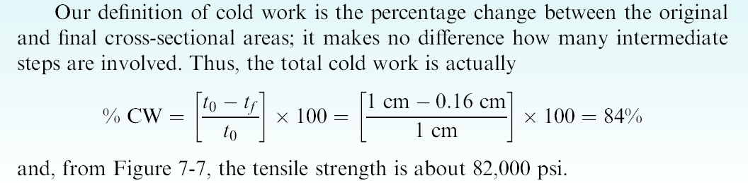
Example 7.1 SOLUTION

Slide 49
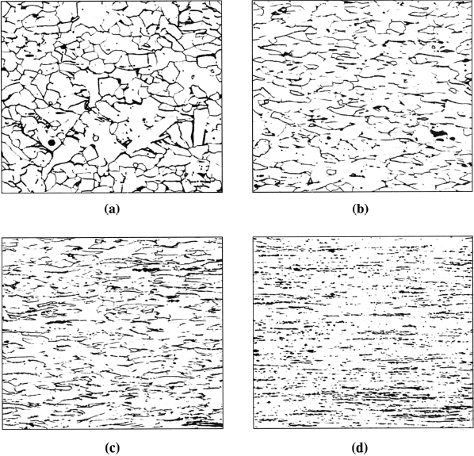
Figure 7.9 The fibrous grain structure of a low carbon steel produced by cold working: (a) 10% cold work, (b) 30% cold work, (c) 60% cold work, and (d) 90% cold work (250). (Source: From ASM Handbook Vol. 9, Metallography and Microstructure, (1985) ASM International, Materials Park, OH 44073. Used with permission.)

Slide 50
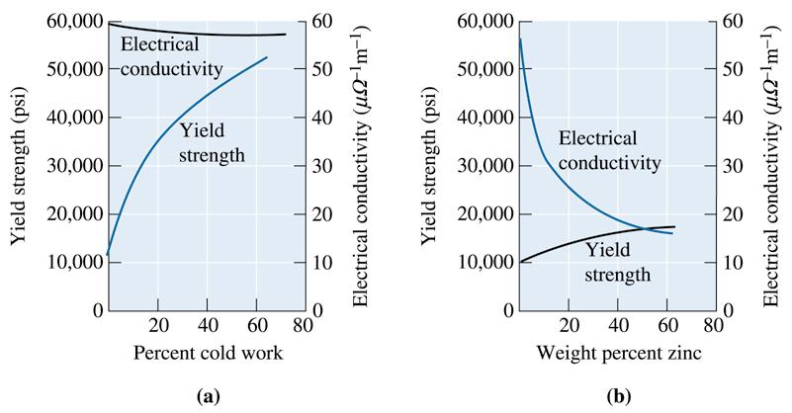
Section 7.5
Characteristics of Cold Working
©2003 Brooks/Cole, a division of Thomson Learning, Inc. Thomson Learning™ is a trademark used herein under license.
Figure 7.13 A comparison of strengthening copper by (a) cold working and (b) alloying with zinc. Note that cold working produces greater strengthening, yet has little effect on electrical conductivity

Slide 51
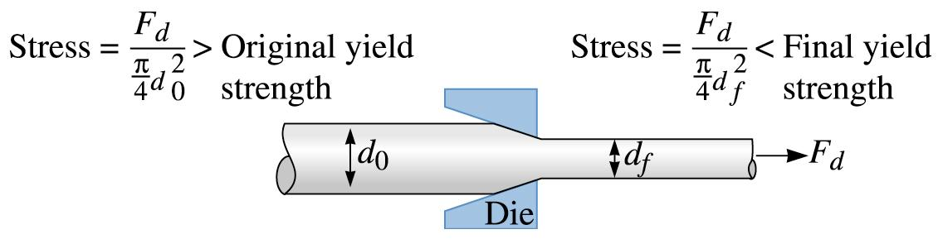
©2003 Brooks/Cole, a division of Thomson Learning, Inc. Thomson Learning™ is a trademark used herein under license.
Figure 7.14 The wire-drawing process. The force F_{d} acts on both the original and final diameters. Thus, the stress produced in the final wire is greater than that in the original. If the wire did not strain harden during drawing, the final wire would beak before the original wire was drawn through the die

Slide 52
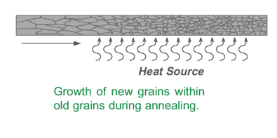
Annealing
to increase ductility and reduce hardness, making it more workable. The process involves heating the material to a specific temperature, holding it at that temperature for a certain period, and then slowly cooling it.

Slide 53
Section 7.6
The Three Stages of Annealing
Recovery - A low-temperature annealing heat treatment designed to eliminate residual stresses introduced during deformation without reducing the strength of the cold-worked material.
Recrystallization - A medium-temperature annealing heat treatment designed to eliminate all of the effects of the strain hardening produced during cold working.
Grain growth - Movement of grain boundaries by diffusion in order to reduce the amount of grain boundary area.

Slide 54
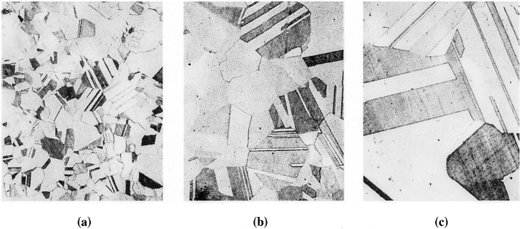
Figure 7.16 Photomicrographs showing the effect of annealing temperature on grain size in brass. Twin boundaries can also be observed in the structures. (a) Annealed at 400ºC, (b) annealed at 650ºC, and (c) annealed at 800ºC (75). (Adapted from Brick, R. and Phillips, A., The Structure and Properties of Alloys, 1949: McGraw-Hill.)

Slide 55
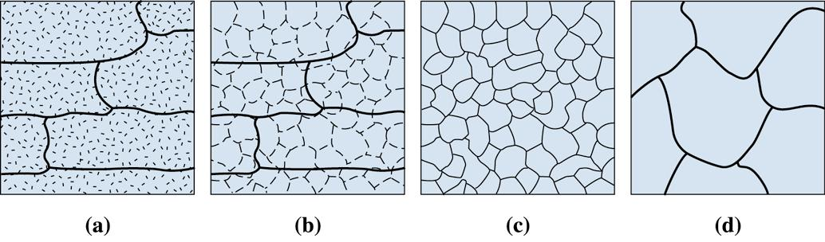
©2003 Brooks/Cole, a division of Thomson Learning, Inc. Thomson Learning™ is a trademark used herein under license.
Figure 7.17 The effect of annealing temperature on the microstructure of cold-worked metals. (a) cold-worked, (b) after recovery, (c) after recrystallization, and (d) after grain growth

Slide 56
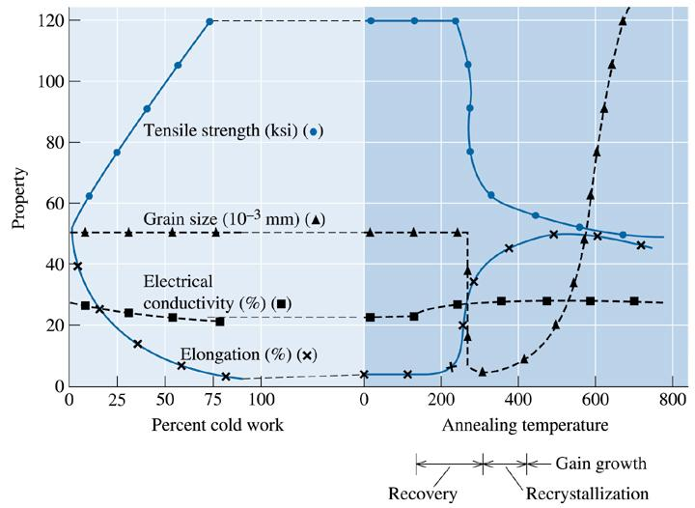
©2003 Brooks/Cole, a division of Thomson Learning, Inc. Thomson Learning™ is a trademark used herein under license.
Figure 7.18 The effect of cold work on the properties of a Cu-35% Zn alloy and the effect of annealing temperature on the properties of a Cu-35% Zn alloy that is cold-worked 75%

Slide 57
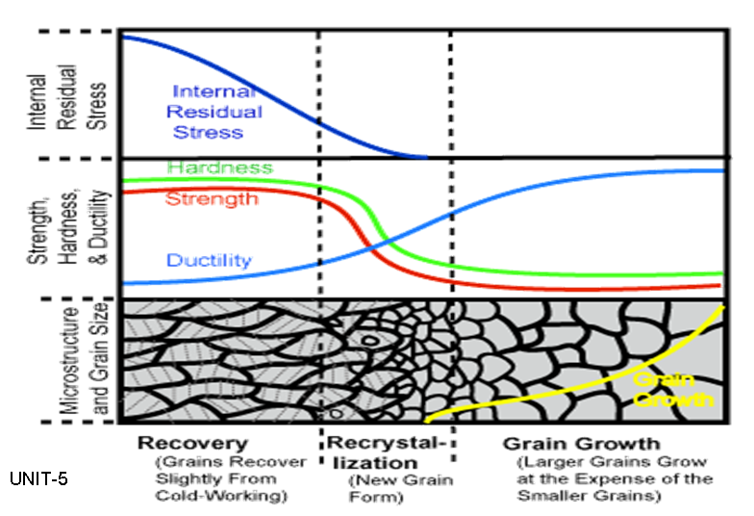

Slide 58
Section 7.8
Annealing and Materials Processing
Heat-affected zone (HAZ) - The volume of material adjacent to a weld that is heated during the welding process above some critical temperature at which a change in the structure, such as grain growth or recrystallization, occurs.

Slide 59
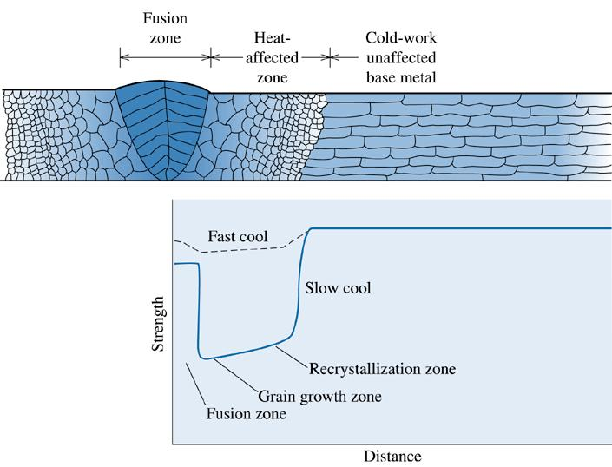
©2003 Brooks/Cole, a division of Thomson Learning, Inc. Thomson Learning™ is a trademark used herein under license.
Figure 7.20 The structure and properties surrounding a fusion weld in a cold-worked metal. Note: only the right-hand side of the heat-affected zone is marked on the diagram. Note the loss in strength caused by recrystallization and grain growth in the heat-affected zone

Slide 60
Section 7.9
Hot Working
Lack of Strengthening
Elimination of Imperfections
Anisotropic Behavior
Surface Finish and Dimensional Accuracy

Slide 61
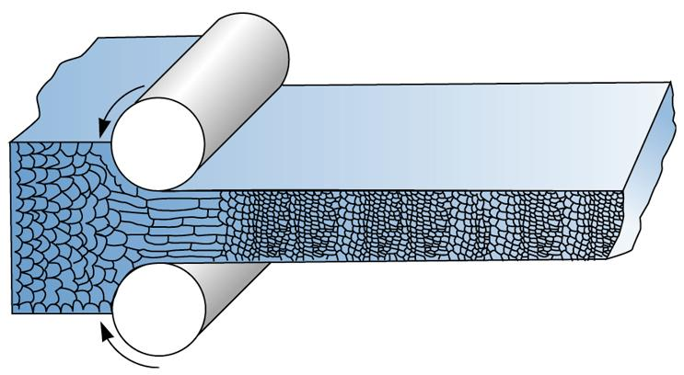
©2003 Brooks/Cole, a division of Thomson Learning, Inc. Thomson Learning™ is a trademark used herein under license.
Figure 7.21 During hot working, the elongated anisotropic grains immediately recrystallize. If the hot-working temperature is properly controlled, the final hot-worked grain size can be very fine

Slide 62
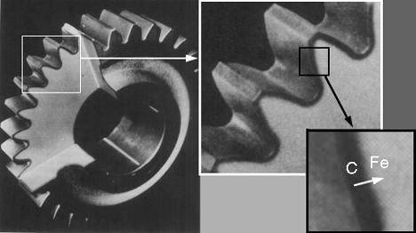
Diffusion Hardening (Case Hardening)
Case-hardening or surface hardening is the process of hardening the surface of a metal object while allowing the metal deeper underneath to remain soft, thus forming a thin layer of harder metal (called the "case") at the surface

Slide 63
3. Welding in Nuclear Reactor Components

Slide 64
Welding
Why welding matters: Integral to reactor pressure vessels, piping, fuel rod assembly structures.
Welding is important not only for construction but also for maintenance (repair, replacement of component).
Welding metallurgy: Fusion of base metals + filler → solidification microstructure
In addition to melting the base metal, a filler material is often added to the joint to form a pool of molten material (the weld pool) that cools to form a joint that can be as strong as the base material.

Slide 65
Joining Techniques
Method | Mechanism | Application Area | Pros | Cons
Welding | Melting + fusion | Structural components, pressure vessels | Strong joints, permanent | Residual stress, HAZ issues
Brazing | Filler melts < base metal (melting temp) | Heat exchangers, thin-walled parts | Dissimilar metals, no fusion | Lower strength than welding
Soldering | Low-temp filler alloy | Electronics, small joints | Low heat required | Weak joints, not structural
Adhesive Bonding | Epoxy or polymer interface | Composites, aerospace panels | Flexible, corrosion resistant | Limited strength, aging
Mechanical Fastening | Bolts, rivets, screws | Modular systems, maintenance parts | Easy to disassemble | Stress concentration zones

Slide 66
Types of Welding Processes
Type | Description | Typical Use
Arc Welding | Electric arc generates heat | Structural steel, pipelines
Resistance Welding | Heat by resistance to electric current | Automotive sheet metal
Gas Welding (Oxyfuel) | Combustion of gas and oxygen | Thin sheet metals, artistic work
Laser Beam Welding | Concentrated laser beam melts metal | Precision, small HAZ, aerospace
Electron Beam Welding | High-velocity electron beam | Deep penetration, vacuum required
Friction Stir Welding | Mechanical stirring + heat by friction | Aluminum alloys, aerospace panels

Slide 67
Types of Arc Welding
Method | Electrode Type | Shielding Type | Notes
SMAW (Shielded Metal Arc / Stick) | Consumable stick | Flux coating (solidifies into slag) | Low cost, all-position, portable
GTAW (Gas Tungsten Arc / TIG) | Non-consumable tungsten | External inert gas (argon) | Precise, clean welds, slow
GMAW (Gas Metal Arc / MIG) | Consumable wire | Continuous shielding gas | Fast, good for automation
FCAW (Flux Cored Arc) | Tubular wire electrode | Internal flux or dual shielding | High deposition rate
SAW (Submerged Arc) | Consumable wire | Granular flux covers arc | Thick sections, high productivity

Slide 68
Some Methods of Welding
Shielded metal arc welding (SMAW) - also known as "stick welding or electric welding", uses an electrode that has flux, the protectant for the puddle, around it. The electrode holder holds the electrode as it slowly melts away. Slag protects the weld puddle from atmospheric contamination.
Gas tungsten arc welding (GTAW) - also known as TIG (tungsten, inert gas), uses a non-consumable tungsten electrode to produce the weld. The weld area is protected from atmospheric contamination by an inert shielding gas such as Argon or Helium.
Gas metal arc welding (GMAW) - commonly termed MIG (metal, inert gas), uses a wire feeding gun that feeds wire at an adjustable speed and flows an argon-based shielding gas or a mix of argon and carbon dioxide (CO2) over the weld puddle to protect it from atmospheric contamination.
Flux-cored arc welding (FCAW) - almost identical to MIG welding except it uses a special tubular wire filled with flux; it can be used with or without shielding gas, depending on the filler.
Submerged arc welding (SAW) - uses an automatically fed consumable electrode and a blanket of granular fusible flux. The molten weld and the arc zone are protected from atmospheric contamination by being "submerged" under the flux blanket.
Electroslag welding (ESW) - a highly productive, single pass welding process for thicker materials between 1 inch (25 mm) and 12 inches (300 mm) in a vertical or close to vertical position

Slide 69
Critical regions
  Weld Metal (WM)
  Heat-Affected Zone (HAZ)
  Base Metal (BM)

Slide 70
Heat Affected Zone
Is the area of base material, either a metal, which is not melted and has had its microstructure and properties altered by welding or heat intensive cutting operations
The heat from the welding process and subsequent re-cooling causes this change from the weld interface
The heat-affected zone adjacent to weld fusion line has known to give lower toughness value than other regions, since the local temperature peak from the welding process rise above1200ºC and the zone is cooled slowly.
The extent and magnitude of property change depends primarily on the base material, the weld filler metal, and the amount and concentration of heat input by the welding process.
Notes:
The thermal diffusivity of the base material plays a large role—if the diffusivity is high, the material cooling rate is high and the HAZ is relatively small. Alternatively, a low diffusivity leads to slower cooling and a larger HAZ. The amount of heat input during the welding process also plays an important role as well, as processes like oxyfuel welding use high heat input and increase the size of the HAZ. Processes like laser beam welding and electron beam welding give a highly concentrated, limited amount of heat, resulting in a small HAZ.

Slide 71
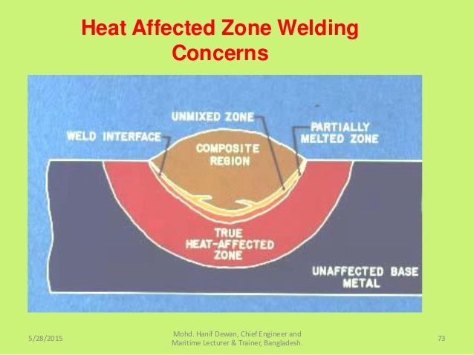
Heat Affected Zone

Slide 72
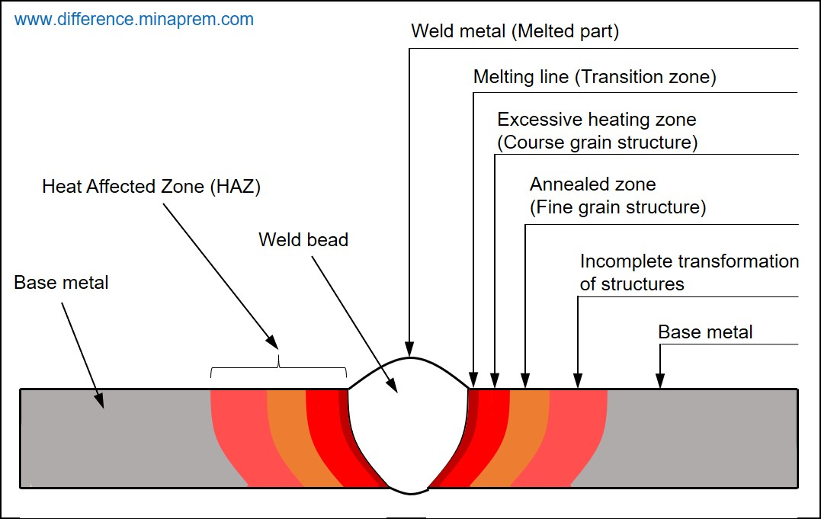
Heat Affected Zone

Slide 73
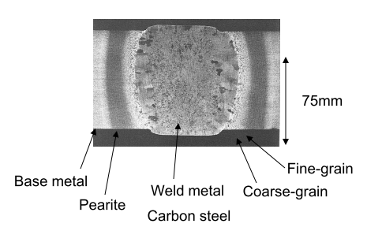
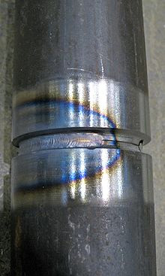
Heat-affected zone (HAZ)

Slide 74
Residual Stress
Residual stresses are stresses that remain in a solid material after the original cause of the stresses has been removed. Residual stress may be desirable or undesirable.
Residual stresses can occur through a variety of mechanisms including plastic deformations, temperature gradients (during thermal cycle) or structural changes (phase transformation).
Heat from welding may cause localized expansion, which is taken up during welding by either the molten metal or the placement of parts being welded.
When the finished weldment cools, some areas cool and contract more than others, leaving residual stresses.
Notes:
Laser peening (LP), or laser shock peening (LSP), is a surface engineering processes used to impart beneficial residual stresses in materials. The deep, high magnitude compressive residual stresses induced by laser peening increase the resistance of materials to surface-related failures, such as fatigue, fretting fatigue and stress corrosion cracking.

Slide 75
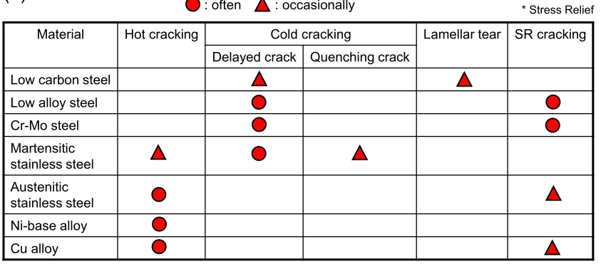
Weld defects

Slide 76
A welding defect is any flaw that compromises the usefulness of a weldment. There is a great variety of welding defects. Welding imperfections are classified according to ISO 6520 while their acceptable limits are specified in ISO 5817 and ISO 10042.

Slide 77
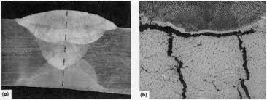
Hot cracking
Hot cracking, also known as solidification cracking, can occur with all metals, and happens in the fusion zone of a weld.
To diminish the probability of this type of cracking, excess material restraint should be avoided, and a proper filler material should be utilized.
Other causes include too high welding current, poor joint design that does not diffuse heat, impurities (such as sulfur and phosphorus), preheating, speed is too fast, and long arcs.
Both solidification cracking and hot cracking refer to the formation of shrinkage cracks during the solidification of weld metal
Solidification cracks can appear in several locations, and orientations, but most commonly are longitudinal centreline cracks

Slide 78
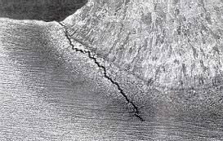
Cold cracking
Residual stresses can reduce the strength of the base material, and can lead to catastrophic failure through cold cracking
The cracking occurs in the heat-affected zone of the base material.
To reduce the amount of distortion and residual stresses, the amount of heat input should be limited, and the welding sequence used should not be from one end directly to the other, but rather in segments.
Cold cracking only occurs when all the following preconditions are met:
susceptible microstructure (e.g. martensite)
hydrogen present in the microstructure (hydrogen embrittlement)
service temperature environment (normal atmospheric pressure): -100 to +100°F

Slide 79
Lamellar tear
Lamellar tearing can occur beneath the weld especially in rolled steel plate which has poor through-thickness ductility.
The principal distinguishing feature of lamellar tearing is that it occurs in T-butt and fillet welds normally observed in the parent metal parallel to the weld fusion boundary and the plate surface
Lamellar tearing is caused mainly by sulfurous inclusions in the material. Other causes include an excess of hydrogen in the alloy.
This defect can be mitigated by keeping the amount of sulfur in the steel alloy below 0.005%.
Adding rare earth elements, zirconium, or calcium to the alloy to control the configuration of sulfur inclusions throughout the metal lattice can also mitigate the problem

Slide 80
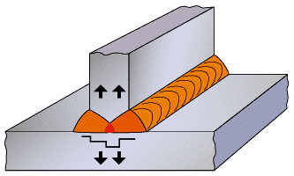
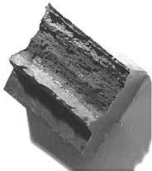
Lamellar tear
It is generally recognised that there are three conditions which must be satisfied for lamellar tearing to occur:
1.Transverse strain - the shrinkage strains on welding must act in the short direction of the plate ie through the plate thickness
2.Weld orientation - the fusion boundary will be roughly parallel to the plane of the inclusions
3.Material susceptibility - the plate must have poor ductility in the through-thickness direction

Slide 81
Lamellar tear : Mitigation Strategies
Use Z-quality plates (improved through-thickness ductility).
Redesign weld to reduce stress direction across the plate thickness.
Use butter layers or multi-pass welds to relieve constraint.
Control welding parameters to reduce heat input.

Slide 82
SR (Stress Relief) Cracking
Stress-relief cracking occurs only in metals that can precipitation-harden during such elevated-temperature exposure. It usually intergranular in nature, and is generally observed in the coarse-grained region of the weld heat-affected zone.
Stress-relief cracking is a major cause of weld failures in creep-resistant, precipitation-strengthened materials such as ferrite alloy steels, stainless steels, and Ni-based alloys
Different metals or alloys exhibit different types of stress relief mechanisms
Occurs during PWHT

Slide 83
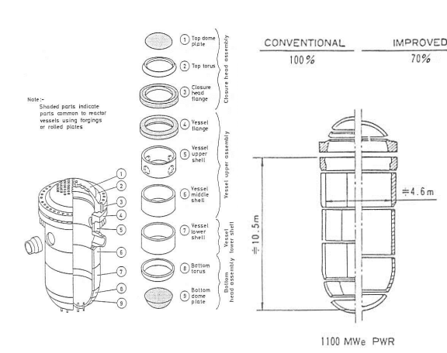
Welding in RPV
No longitudinal weld lines

Slide 84
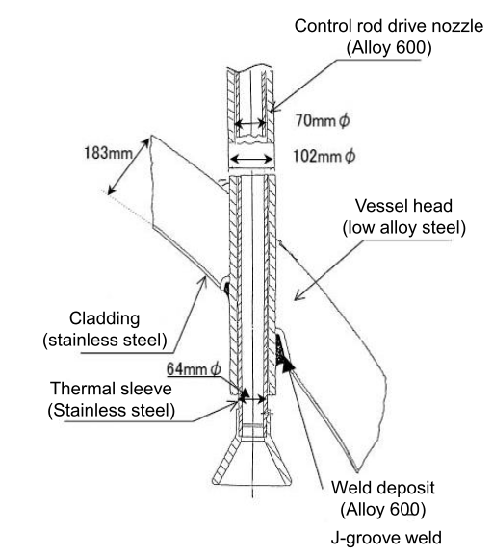
Welding in RPV head, control rod drive nozzle

Slide 85
Welding Dilution
The dilution in welding terms is defined as the weight of the base metal melted divided by the total weight of the weld metal.
For example, if we have a dilution of 0.40, the fraction of the weld metal that came from the consumable electrode is 0.60.

Slide 86
Thermal Cycle
There is an influence of localized reheating and chilling during the overlapping of successive weld metal.
Regions adjacent to each new weld bead experience short-time, high-temperature reheats.
Then considerable variations in dislocation density also occur depending upon position in the welds, resulting in the heterogeneous hardness distribution.
Shrinkage and thermal stresses experienced on welding cause significant deformation of inner weld bead compared to surface bead. These also affect on the surrounding parent metals.

Slide 87
Post Weld Heat Treatment
Post Weld Heat Treatment is performed after welding, generally at a higher temperature and with different objectives than Preheat/Interpass heating.
PWHT method is applied with the work piece at temperatures up to 600° F (316° C).
Local PWHT of carbon and low alloy steels is typically performed below the lower critical transformation temperature and is therefore referred to as subcritical.
The lower and upper critical transformation temperatures indicate where the crystal structure of steel begins and finally completes a change from body centered cubic (BCC) to face centered cubic (FCC) upon heating (the reverse upon cooling).
Notes:
This may be necessary to avoid cracking of the weld metal or heat affected zone. The need for preheat increases with steel thickness, weld restraint, the carbon/alloy content of the steel, and the diffusible hydrogen of the weld metal.
And what this is saying, the molecules of the alloy will rearrange them self to a different configuration if we allow the temperature to reach the upper critical transformation. That will cause the properties of the metal to change, such as hardness and ductility.

Slide 88
There are several reasons why local supercritical PWHT (above the upper critical transformation temperature) such as annealing is not desirable.
The temperature gradients inherent to local PWHT would produce subcritical, intercritical and supercritical temperature regions.
Depending upon the prior heat treatment of the material, this could result in a detrimental effect upon properties (tensile/yield strength and impact toughness) and/or local inhomogeneity (irregularity).
Additionally, reduced material strength at supercritical temperatures creates a greater likelihood for distortion.

Slide 89
Benefits
Three primary benefits of PWHT are recognized.
These are tempering, relaxation of residual stresses and hydrogen removal.
Consequential benefits such as avoidance of hydrogen induced cracking, dimensional stability, and improved ductility toughness and corrosion resistance result from the primary benefits.
It is important that PWHT conditions be determined based upon the desired objectives. With regard to local PWHT this is especially true for stress relaxation.
Notes:
Residual stresses are locked-in stresses within a metal object, even though the object is free of external forces or thermal gradients. These stresses are the result of one region of the metal being constrained from expanding or contracting by adjacent regions.

Slide 90
Adverse effects
The adverse effects can include decreased tensile strength, reduced creep strength and generally caused by embrittlement due to precipitate formation
The influence of PWHT on properties primarily depends upon the composition of the weld metal and base metal and prior thermal and mechanical processing of the base metal.
If PWHT is run at higher than specified temperatures and / or longer specified soak times the work piece can become more brittle than desired.

Slide 91
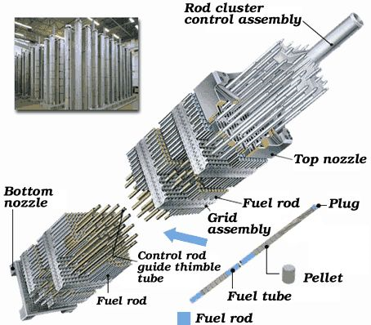
RS (Residual Stress) in Cladding
The profile and magnitude of the cladding residual stresses depend mainly upon cladding composition, cladding thickness, clad component geometry and temperature.
The peak of the cladding residual stresses is about 2-3 mm under the surface of the clad layer, and values in the range of 150 and 500 MPa are reported.

Slide 92
A peak value of cladding residual stresses in the whole clad layer to be equal to the yield strength of the cladding material (around 300 MPa) at room temperature.
Providing that the clad component has received PWHT, it can be assumed no residual stresses in the underlying base material.
For the nuclear pressure vessel, it is also reasonable to assume that the cladding stress free temperature is at the operation temperature of the vessel (around 300 °C).
The cladding residual stresses have negligible influence on subclad crack behaviour in clad components (receiving PWHT).
It has also been shown that the crack growth for subclad cracks would be towards the base material direction, and the clad layer mainly remains intact during the loading.

Slide 93
4. Radiation Effects in Materials

Slide 94
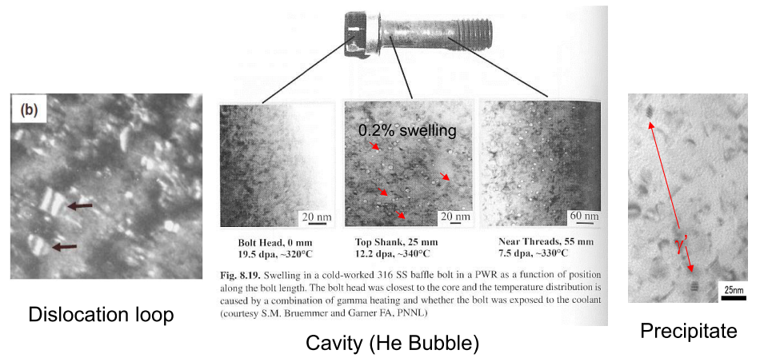
Formation of radiation defects
Interstitial cluster, dislocation loop , Vacancy cluster, Stacking fault tetrahedron, Cavity (He bubble, void), Precipitates
Notes:
Stacking fault tetrahedra (SFTs) are formed under irradiation of fcc metals and alloys with low stacking
fault energy. The high number density of SFTs observed suggests that they should contribute to
radiation-induced hardening

Slide 95


Irradiation Hardening
In austenitic stainless steels, 0.2% offset stress increases with increasing dose
Notes:
The strength increase usually saturates at relatively low exposure levels (<10 dpa) as shown in Figure 19, reflecting a similar saturation of microstructural
densities.
316LN (UNS S31653) is a lowcarbon, nitrogen-enhanced version of Type 316

Slide 96

Flat faces due to softening of alloy along the path
Loss of ductility
Notes:
● Concurrent with an increase in radiation-induced hardening is a loss of ductility.
● The flat faces observed at highest exposure are often referred to as ‘channel fracture’, but they are not
cleavage faces. They are the result of intense flow localization, resulting from the first moving dislocations
clearing a path of radiation produced obstacles, especially Frank loops, and thereby softening the alloy
along that path.

Slide 97

Fatigue Property
The lifetimes of irradiated and unirradiated materials are almost the same. The observed difference is the result of degradation due to irradiation, and improvement due to hardening.
Fig. Fatigue life of cold-worked AISI 316 stainless steel irradiated
in HFIR to a maximum dose of 15 dpa and 900 appm He.
Notes:
High Flux Isotope Reactor

Slide 98

The lower the plastic strain, the greater the decrease in lifetime. Under conditions where the crack initiation phase controls the lifetime of the unirradiated material, irradiation will result in much earlier crack formation and much earlier failure.

Slide 99

Irradiation Creep
While the irradiation creep rate is much higher than that of thermal creep at relatively low temperatures, the difference decreases between the two as the temperature increases
Notes:
Creep is the time-dependent deformation of a metal under constant load and at high temperature
Thermal creep-heated above 30% of the melting point-high diffusivity of vacancies and interstitial, allow absorption by dislocation
Sink-recombination-
Induced by irradiation growth, grain size restricted by the neighbouring grains and causes the stress induced creep

Slide 100
Radiation Induced Segregation (RIS)
In alloys, the defect fluxes produced by irradiation could cause segregation of alloying elements to or away from defect sinks such as dislocation, voids and grain boundaries．
RIS occurs prominently on materials at a condition of high displacement per atom.
This RIS occasionally causes solute enrichment which exceeds the solubility limit of alloying elements at the defect sinks and precipitation of the second phases occurs．
Therefore, the RIS produces not only a large change in composition on a local scale but also phase changes or transformation which are not observed under thermal conditions．

Slide 101
Radiation Induced Segregation (RIS)
The non－equilibrium compositional change has also given an important influence on void formation through some mechanisms such as stabilization of void nucleation and recombination．
Furthermore, due to the occurrence of the compositional change of alloying elements which were added for a specific purpose, mechanical properties of the alloys such as ductility, toughness will also be altered.

Slide 102

Radiation Induced Segregation (RIS)

Slide 103


Slide 104

Cr Depletion (TEM Images)

Slide 105

High Temperature Embrittlement
He embrittlement
He: formed by transmutation reaction- insoluble to steels
Notes:
the changing of one element into another by radioactive decay, nuclear bombardment, or similar processes.
Transmutation technology has the potential to greatly reduce the long-term negative effects of radioactive wastes on human populations by reducing its radioactive half-life

Slide 106

Notes:
The temperature shifts in impact energy due to irradiation are all that is available to determine the shift in fracture toughness due to irradiation.

Slide 107
Pressurized Thermal Shock
The pressurized thermal shock (PTS) issue is concerned with the possibility of failure of PWR pressure vessels under a very specific set of conditions.
These conditions include:
— Occurrence of reactor transients that subject the vessel to severe thermal shock as well as the normal pressure loading;
— Existence of sharp, crack-like defects (flaws) at the inner surface of the vessel wall; and
— High enough fast neutron fluence and concentrations of copper and nickel in the vessel wall to result in a extensive radiation-included reduction in the fracture toughness of the vessel material

Slide 108
PTS, which is characterized by a rapid cooling (i.e. thermal shock) of the down-comer and internal RPV surface, followed sometime by repressurization of the RPV.
Thus, a PTS event poses a potentially significant challenge to the structural integrity of the RPV in a PWR

