Slide 1
NUCLEAR REACTOR MATERIALS
1. EFFECT OF RADIATION (PART 2)

Slide 2
Radiation Effects on materials and devices
Causing the materials to become radioactive
-mainly by neutron activation, or in presence of high-energy gamma radiation by photodisintegration.
Nuclear transmutation of the elements within the material.
-for example, the production of Hydrogen and Helium which can in turn alter the mechanical properties of the materials and cause swelling and embrittlement.
Radiolysis within the material, which can weaken it, cause it to swell, polymerize, promote corrosion, cause belittlements, promote cracking or otherwise change its desirable mechanical, optical, or electronic properties.
Formation of reactive compounds, affecting other materials
-for example: ozone cracking by ozone formed by ionization of air
Ionization causing electrical breakdown, particularly in semiconductors employed in electronic equipment, with subsequent currents introducing operation errors or even permanently damaging the devices.

Slide 3
Radiation Damages on Materials
The damage can be described by the following groupings:
  Vacancies or Knock-ons
  Interstitials
  Ionization
  Thermal Spikes
  Impurity Atoms

Slide 4
Ionization
Ionization is the process by which an atom or a molecule acquires a negative or positive charge by gaining or losing electrons to form ions, often in conjunction with other chemical changes
Ionization occurs when the radiation carries enough energy to remove an electron from an atom or molecule.
Ionization can result from the loss of an electron after collisions with sub atomic particles, collisions with other atoms, molecules and ions, or through the interaction with light.
Ionization can occur through radioactive decay by the internal conversion process, in which an excited nucleus transfers its energy to one of the inner-shell electrons causing it to be ejected.

Slide 5
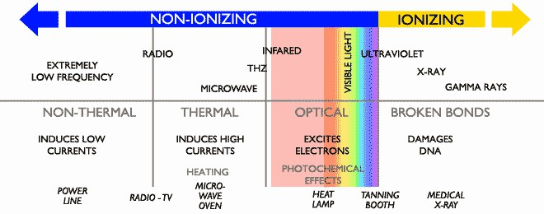
Ionizing Radiation

Slide 6
Excitation and Ionization
The various types of penetrating radiation impart their energy to matter primarily through excitation and ionization of orbital electrons.
Excitation: Ionization
describe an interaction where electrons acquire energy from a passing charged particle but are not removed completely from their atom.
complete removal of an electron from an atom following the transfer of energy from a passing charged particle.
In describing the intensity of ionization, the term "specific ionization" is often used.
Excited electrons may subsequently emit energy in the form of x-rays during the process of returning to a lower energy state.

Slide 7
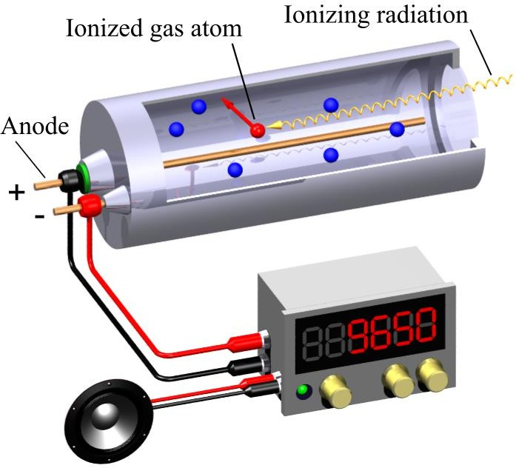
Application of Ionization
Geiger Counter detects ionizing radiation such as alpha particles, beta particles and gamma rays using the ionization effect produced in a Geiger–Müller tube.
The Geiger-Müller tube is filled with an inert gas such as helium, neon, or argon at low pressure, to which a high voltage is applied. The tube briefly conducts electrical charge when a particle or photon of incident radiation makes the gas conductive by ionization.
The ionization is considerably amplified within the tube to produce an easily measured detection pulse, which is fed to the processing and display electronics

Slide 8
Thermal Spike
This term identifies localized high temperature domains caused by the deposition of energy from neutrons and fission fragments.
When the ion is heavy and energetic enough, and the material is dense, the collisions between the ions may occur so near to each other that they can not be considered independent of each other.
Typically, a heat spike is characterized by the formation of a transient underdense region in the center of the cascade, and an overdense region around it.
After the cascade, the overdense region becomes interstitial defects, and the underdense region typically becomes a region of vacancies.

Slide 9
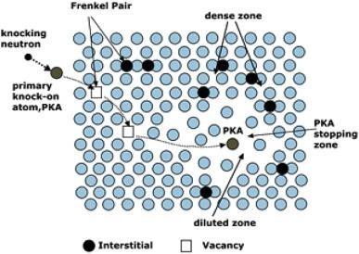

Slide 10
Impurity Atom
The capture of neutrons and nuclear reactions induced by various radiations has the effect of transmuting an atom into an element which is foreign to the material.

Slide 11









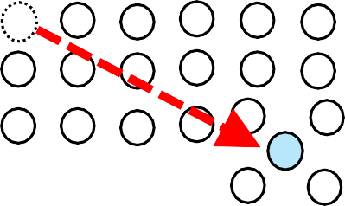




DPA
100 lattice atoms
1 vacancy and
1 interstitial atom
0.01 dpa
The unit of displacement damage is DPA, displacement per atom. If 1% of target lattice atoms have experienced displacement, the damage level is called 0.01 dpa. meaningful expression!
Remember that most of point defects disappear by mutual recombination.
The material can survive even after 1 dpa damage!
Reactor internal components of PWR experience up to ~100 dpa.
11

Slide 12





Kinchin-Peace model for cascade efficiency
Ep
collision to other
lattice atoms
neutron
collision to the
lattice atom (PKA).
collision to
electrons
transmutation
cascade damage
How many displacements are generated by a PKA with initial energy Ep?
A well-known approach is Kinchin-Peace mode.
The number of displacements ν caused by a PKA with an initial energy E_{p} is;
0,
1,
E_{p}/2E_{d} , E_{I}/2E_{d} ,
E_{p}<E_{d} , E_{d} is the threshold energy for displacement,
ν(E_{p}) =
E_{d}<E_{p}<2E_{d} ,
2E_{d}<E_{p}<E_{I} , E_{I} is upper limit, E_{I}<E_{p}
E_{I}
2E_{d}
ν(E_{p})
In this mode, ν(E_{p}) = E_{p}/2E_{d} in most energy range but in case of PKA’s with too high energy, the particle energy is only used for ionization down to E_{I}.
1
E_{I}
Ep
0 E_{d} 2E_{d}
12

Slide 13

advanced model for cascade efficiency
Ep
collision to other
lattice atoms
E
collision to the lattice
atom (PKA).
D
collision to electrons
The advanced model for cascade efficiency developed by Lindhard describes “damage energy” (E_{D}) within a cascade as follows;
E_{D}=E_{p} / ( 1+k g(ε) ) , k=0.1334 Z^{1/6}(Z/M)^{1/2} , g(ε)=3.4008ε^{1/6} + 0.40244ε^{3/4} + ε
Recent computer codes mostly use Lindhard model rather than K-P but, the K-P is, of course, much easier to calculate.
Kinchin-Peace
efficiency (E_{D}/E_{p})
1
Lindhard
1 0.1 1 10 100
log (Ep)
keV
A sample calculation of damage
efficiencies in two models (Al).
13

