Slide 1
NUCLEAR REACTOR MATERIALS
2. THE NATURE OF MATERIALS

Slide 2
In the Previous Lecture…
Structure of materials can be understood at various levels: atomic structure, long-­‐ and short-­‐range atomic arrangements, nanostructure, microstructure, and macrostructure.
There are 3 primary bonding and 1 secondary bonding to be considered.
The binding energy is related to the strength of the bonds and is particularly high in ionically and covalently bonded materials.
In designing components with materials, we need to pay attention to the base composition of the material, understand the bonding in the material, the cost of raw materials, manufacturing costs, environmental impact, and factors affecting durability.

Slide 3
In this Chapter…
Crystal Structure
Imperfections
Diffusion in Solids
Dislocation theory
Cascade collision

Slide 4






Short-­‐ and Long-­‐Range Order
In different states of matter, we can find four types of atomic or ionic arrangements
Levels of atomic arrangements in materials:
(a) Inert monoatomic gases have no regular ordering of atoms.
(b) and (c) Some materials, including water
vapor, nitrogen gas, amorphous silicon, and silicate glass, have short-­‐range order.
(d) Metals, alloys, many ceramics and some polymers have regular ordering of atoms or
ions that extends through the material.

Slide 5









Short-­‐Range Order (SRO)
A material displays short-­‐range order (SRO) if the special arrangement of the atoms extends only to the atom’s nearest neighbors.
Example:
Water molecule
Tetrahedral structure in silica
Polymer such as PE
(a)
(b)
(a) Basic Si-­‐O tetrahedron in silicate glass. (b) Tetrahedral arrangement of C-­‐H bonds in polyethylene.

Slide 6
Long-­‐Range Order (LRO)
The special atomic arrangement extends over much larger length scales >100 nm.
The atoms or ions in these materials form a regular repetitive, grid-­‐like pattern, in three dimensions.
Most metals and alloys, semiconductors, ceramics, and some polymers have a crystalline structure in which the atoms or ions display LRO
We refer to these materials as crystalline materials.

Slide 7
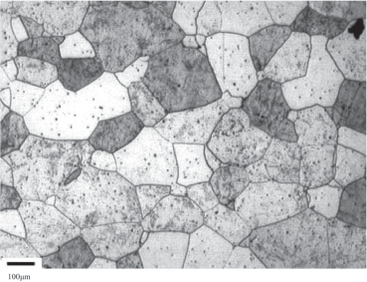
Long-­‐Range Order (LRO)
If a crystalline material consists of only one large crystal, we refer to it as a single crystal. Single crystals are useful in many electronic and optical applications.
A polycrystalline material is composed of many small crystals with varying orientations in space.
These smaller crystals are known as grains. The borders between crystals, where the crystals are in misalignment, are known as grain boundaries.
Micrograph of a polycrystalline stainless steel showing grains and grain boundaries

Slide 8
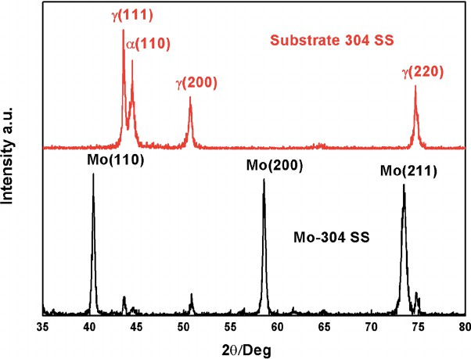
Long-­‐Range Order (LRO)
Long-­‐range order in crystalline materials can be detected and measured using techniques such as x-­‐ray diffraction or electron diffraction
XRD patterns of Mo-­‐304 SS and untreated 304 SS.

Slide 9
Amorphous Materials
Any material that exhibits only a short-­‐range order of atoms or ions is an amorphous material; that is, a noncrystalline one.
Glasses, which typically form in ceramic and polymer systems, are good examples of amorphous materials.
Amorphous materials often offer a unique blend of properties since the atoms or ions are not assembled into their “regular” and periodic arrangements.
Scientists use neutron scattering and other methods to investigate the short-­‐range order in amorphous materials.

Slide 10

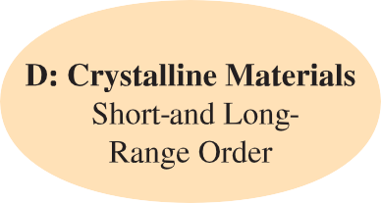
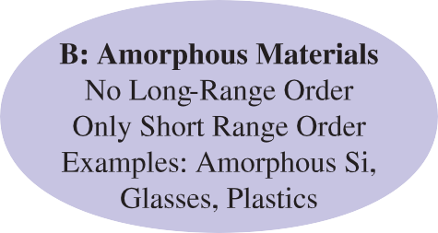
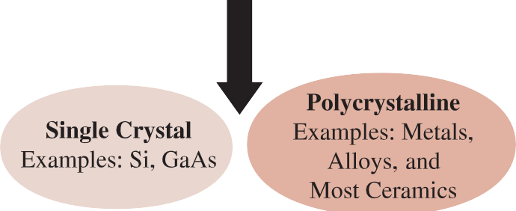
Summary
-

Slide 11
Lattice and Basis
A typical solid contains on the order of 10²³ atoms/cm³. In order to communicate the spatial arrangements of atoms in a crystal, it is clearly not necessary or practical to specify the position of each atom.
A lattice is a collection of points, called lattice points, which are arranged in a periodic pattern so that the surroundings of each point in the lattice are identical.
A lattice may be one-­‐, two-­‐, or three-­‐dimensional.
In one dimension, there is only one possible lattice: It is a line of points with the points separated from each other by an equal distance

Slide 12












Lattice and Basis
Lattice and basis.
A one-­‐dimensional lattice. The lattice points are separated by an equal distance.
A basis of one atom.
A crystal structure formed by placing the basis of (b) on
every lattice point in (a).
A crystal structure formed by placing a basis of two atoms of different types on the lattice in (a).
The same crystal as shown in (d); however, the basis has been shifted relative to each lattice point.
(a)
(b)
(c)
(d)
(e)

Slide 13
Crystal System
Difference lattices are grouped into seven crystal systems.
The seven crystal systems are known as cubic, tetragonal, orthorhombic, rhombohedral (also known as trigonal), hexagonal, monoclinic, and triclinic.
Example: for the cubic crystal system, we have simple cubic (SC), face-­‐centered cubic (FCC), and body-­‐centered cubic (BCC) lattices.

Slide 14


Crystal System

Slide 15



Crystal System

Slide 16

































Unit Cell
The single repeat unit that, when duplicated and translated, reproduces the entire crystal structure.
The unit cell.
A two-­‐dimensional crystal.
The crystal with an overlay of a grid that reflects the symmetry of the crystal.
The repeat unit of the grid known as the unit cell. Each
unit cell has its own origin.
(a)
(b)
(c)

Slide 17

Lattice Parameters
The lattice parameters are the axial lengths or dimensions of the unit cell and are denoted by convention as a, b, and c.
β α
Definition of the lattice parameters and their use in cubic, orthorhombic, and hexagonal crystal systems.

Slide 18
Lattice Parameters
In a cubic crystal system, only the length of one of the sides of the cube need be specified (it is sometimes designated a₀).
The length is often given in nanometers (nm) or angstrom (Å) units, where
1 nanometer (nm) = 10⁻⁹ m = 10⁻⁷ cm = 10 Å
1 angstrom (Å) = 0.1 nm = 10⁻¹⁰ m = 10⁻⁸ cm

Slide 19
Lattice Parameters
To fully define a unit cell, the lattice parameters or ratios between the axial lengths, interaxial angles, and atomic coordinates must be specified.
Axial lengths: a = b Interaxial angle: γ = 90° Atomic coordinate: (0, 0)
A cubic unit cell with an atom at each corner is fully specified by
Axial lengths: a = b = c Interaxial angles: α = β = γ = 90° Atomic coordinate: (0, 0, 0)

Slide 20
Lattice Parameters
Structure
Axes
Angles between Axes
Volume of the Unit Cell
Cubic Tetragonal Orthorhombic Hexagonal
a = b = c a = b ? c a ? b ? c a = b ? c
All angles equal 90°. All angles equal 90°. All angles equal 90°. Two angles equal 90°.
The angle between
a and b equals 120°.
All angles are equal
and none equals 90°.
Two angles equal 90°.
One angle (β)
is not equal to 90°.
All angles are different and none equals 90°.
_{a}3
a²c abc
0.866a²c
Rhombohedral or trigonal
Monoclinic
a = b = c
a³ 21 - 3cos²a + 2cos³a
abc sin β
a ? b ? c
abc 21 - cos²a - cos²b - cos²g + 2cosacosbcosg
Triclinic
a ? b ? c

Slide 21
Number of Atoms per Unit Cell
Each unit cell contains a specific number of lattice points.
When counting the number of lattice points belonging to each unit cell, we must recognize that, like atoms, lattice points may be shared by more than one unit cell.
A lattice point at a corner of one unit cell is shared by seven adjacent unit cells (thus a total of eight cells); only one-­‐eighth of each corner belongs to one particular cell.

Slide 22












































Number of Atoms per Unit Cell
Corners contribute 1/8 of a point, faces contribute 1/2, and body-­‐centered positions contribute a whole point

Slide 23
































Number of Atoms per unit
In the SC unit cell, lattice points are located only at the corners of the cube:
lattice points 1
= (8 corners) a ₈ b = 1
unit cell
In BCC unit cells, lattice points are located at the corners and the center of the cube:
lattice points 1
= (8 corners) a ₈ b + (1 body-center)(1) = 2
unit cell

Slide 24
Number of Atoms per unit
In FCC unit cells, lattice points are located at the corners and faces of the cube:
lattice points 1
= (8 corners)
1
unit cell
a ₈ b + (6 faces) a ₂ b = 4

Slide 25






Example
Cesium chloride (CsCl) is an ionic, crystalline compound. Chlorine anions are located at the corners of the unit cell, and a cesium cation is located at the body-­‐ centered position of each unit cell. Describe this structure as a lattice and basis and also fully define the unit cell for cesium chloride.
Cs
Cl

Slide 26






The simple cubic lattice has lattice points only at the corners of the unit cell. The cesium chloride crystal structure can be described as a simple cubic lattice with a basis of two atoms, Cl (0, 0, 0) and Cs (1/2, 1/2, 1/2).
There are two atoms per unit cell in CsCl:
To fully define a unit cell, the lattice parameters or ratios between the axial lengths, interaxial angles, and atomic coordinates must be specified. The CsCl unit cell is cubic; therefore
Axial lengths: a = b = c
Interaxial angles: α = β = γ = 90°
Cs
Cl

Slide 27












Atomic Radius versus Lattice Parameter
₌ 4r
_{a0 =} 4r
a₀ = 2r
a
0
13
12

Slide 28
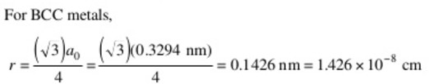
Example
Calculate the atomic radius in cm for a BCC metal with a₀ = 0.3294 nm

Slide 29
Packing Factor
The packing factor or atomic packing fraction is the fraction of space occupied by atoms, assuming that the atoms are hard spheres. The general expression for the packing factor is
( number of atoms/cell)( volume of each atom)
Packing factor =
volume of unit cell

Slide 30
Example
Calculate the packing factor for the FCC unit cell.
( number of atoms/cell)( volume of each atom)
Packing factor =
volume of unit cell
(4 atoms/cell) a ⁴pr³ b
Packing factor =
3
_{a}3
0
Since for FCC unit cells, a₀ = 4r/ 12 :
(4) a ⁴pr³ b
Packing factor =
3
=
p
≅ 0.74
(4r/ 12)³
118

Slide 31
FCC unit cell is the most efficient packing possible. BCC cells have a packing factor of 0.68, and SC cells have a packing factor of 0.52.
The FCC arrangement represents a close-­‐packed structure (CP) (i.e., the packing fraction is the highest possible with atoms of one size).
The SC and BCC structures are relatively open.

Slide 32
Density
The theoretical density of a material can be calculated using the properties of the crystal structure. The general formula is
(number of atoms/cell)(atomic mass)
Density r =
(volume of unit cell)(Avogadro constant)

Slide 33
Example
Determine the density of BCC iron, which has a lattice parameter of 0.2866 nm. Atomic mass = 55.847 g/mol
Atoms>cell = 2
a₀ = 0.2866 nm = 2.866 * 10⁻⁸ cm
Atomic mass = 55.847 g>mol
Volume of unit cell = a₀ = (2.866 * 10⁻⁸ cm)³ = 23.54 * 10⁻²⁴ cm³>cell Avogadro constant N_{A} = 6.022 * 10²³ atoms>mol
(number of atoms/cell)(atomic mass of iron)
Density r =
(volume of unit cell)(Avogadro constant)
(2)(55.847)
(23.54 * 10⁻²⁴)(6.022 * 10²³)
r =
= 7.879 g/cm³

Slide 34
The measured density is 7.870 g/cm3. Why there is a slight discrepancy?
The slight discrepancy between the theoretical and measured densities is a consequence of defects in the material. The term “defect” in this context means imperfections with regard to the atomic arrangement.

Slide 35
Allotropic or Polymorphic Transformations
Materials that can have more than one crystal structure are called allotropic or polymorphic.
The term allotropy is normally reserved for this behavior in pure elements, while the term polymorphism is used for compounds.
Examples: Many ceramic materials, such as silica (SiO2) and zirconia (ZrO2), also are polymorphic.
A volume change may accompany the transformation during heating or cooling; if not properly controlled, this volume change causes the brittle ceramic material to crack and fail.

Slide 36
Example
Calculate the percent volume change as zirconia transforms from a tetragonal to monoclinic structure. The lattice constants for the monoclinic unit cells are a = 5.156, b = 5.191, and c = 5.304 Å, respectively. The angle β for the monoclinic unit cell is 98.9°. The lattice constants for the tetragonal unit cell are a = 5.094 and c = 5.304 Å.
Does the zirconia expand or contract during this transformation?
What is the implication of this transformation on the mechanical properties of zirconia ceramics?

Slide 37
Example
From the Table, the volume of a tetragonal unit cell is given by
V = a²c = (5.094)²(5.304) = 137.63 Å³
and the volume of a monoclinic unit cell is given by
V = abc sin β = (5.156)(5.191)(5.304) sin(98.9) = 140.25 Å³
Thus, there is an expansion of the unit cell as ZrO₂ transforms from a tetragonal to monoclinic form.
The percent change in volume = (final volume -­‐ initial volume)> (initial volume) * 100 = 1.9%
Most ceramics are very brittle and cannot withstand more than a 0.1% change in volume. So it will become fracture

Slide 38
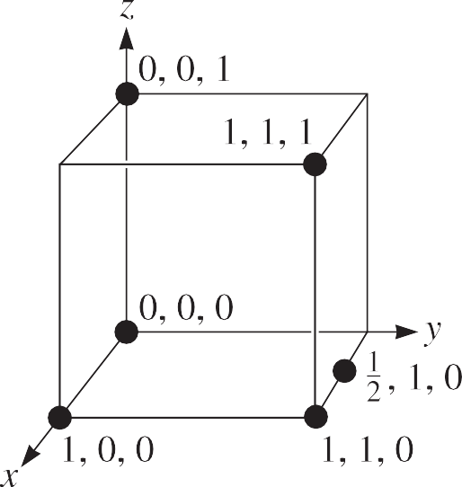
Points and Directions in the Unit Cell
We can locate certain points, such as atom positions, in the lattice or unit cell by constructing the right-­‐handed coordinate system in Figure.

Slide 39
Points and Directions in the Unit Cell
Certain directions in the unit cell are of particular importance.
Miller indices for directions are the shorthand notation used to describe these directions. The procedure for finding the Miller indices for directions is as follows:
Using aright-­‐handed coordinate system, determine the coordinates of two points that lie on the direction.
Subtract the coordinates of the “tail” point from the coordinates of the “head” point to obtain the number of lattice parameters traveled in the direction of each axis of the coordinate system.
Clear fractions and>or reduce the results obtained from the subtraction to lowest integers.
Enclose the numbers in square brackets [ ]. If a negative sign is produced, represent the negative sign with a bar over the number.

Slide 40
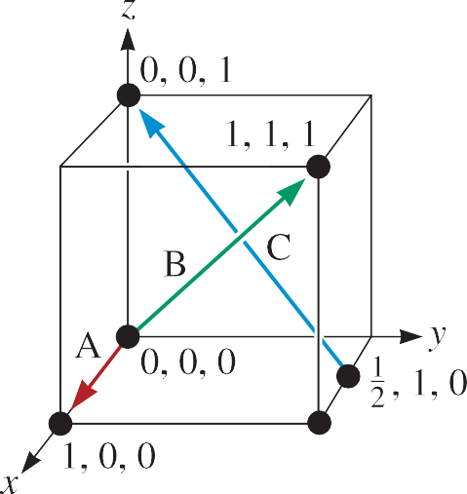
Example-­‐Determine the Miller indices of directions
Direction A
1.Two points are 1, 0, 0, and 0, 0, 0
2.1, 0, 0 -­‐ 0, 0, 0 = 1, 0, 0
3.No fractions to clear or integers to reduce 4.[100]
Direction B
1.Two points are 1, 1, 1 and 0, 0, 0
2.1, 1, 1 -­‐ 0, 0, 0 = 1, 1, 1
3.No fractions to clear or integers to reduce 4.[111]

Slide 41
Example-­‐Determine the Miller indices of directions
Direction C
1. Two points are 0, 0, 1 and ¹, 1, 0
2
2. 0, 0, 1 -¹, 1, 0 = - ¹, -1, 1
2 2
3. 2 (- ¹ , -1, 1) = -1, -2, 2
2
4. [1^{q}2^{q}2]

Slide 42
Significance of Crystallographic Directions
Used to indicate a particular orientation of a single crystal or of an oriented polycrystalline material
Application: the dependence of the magnetic properties of iron and other magnetic materials on the crystallographic directions. It is much easier to magnetize iron in the [100] direction compared to the [111] or [110] directions.
This is why the grains in Fe-­‐Si steels used in magnetic applications (e.g., transformer cores) are oriented in the [100] or equivalent directions.

Slide 43
Isotropic and Anisotropic Behavior
Because of differences in atomic arrangement in the planes and directions within a crystal, some properties also vary with direction.
A material is crystallographically anisotropic if its properties depend on the crystallographic direction along which the property is measured.
For example, the modulus of elasticity of aluminum is 75.9 GPa (11 x 10⁶ psi) in
[111] directions, but only 63.4 GPa (9.2 x 10⁶ psi) in [100] directions.
If the properties are identical in all directions, the material is crystallographically
isotropic.

Slide 44
Interplanar Spacing
The distance between two adjacent parallel planes of atoms with the same Miller indices is called the interplanar spacing (d_{hkl}).
The interplanar spacing in cubic materials is given by the general equation
a₀
d =
,
hkl
¹h ² + k² + l ²
where a₀ is the lattice parameter and h, k, and l represent the Miller indices of the adjacent planes being considered. The interplanar spacings for non-­‐cubic materials are given by more complex expressions.

Slide 45
Interstitial Sites
In all crystal structures, there are small holes between the usual atoms into which smaller atoms may be placed. These locations are called interstitial sites.
An atom, when placed into an interstitial site, touches two or more atoms in the lattice. This interstitial atom has a coordination number equal to the number of atoms it touches.
Interstitial atoms or ions whose radii are slightly larger than the radius of the interstitial site may enter that site, pushing the surrounding atoms slightly apart.
Atoms with radii smaller than the radius of the hole are not allowed to fit into the interstitial site because the ion would “rattle” around in the site.

Slide 46
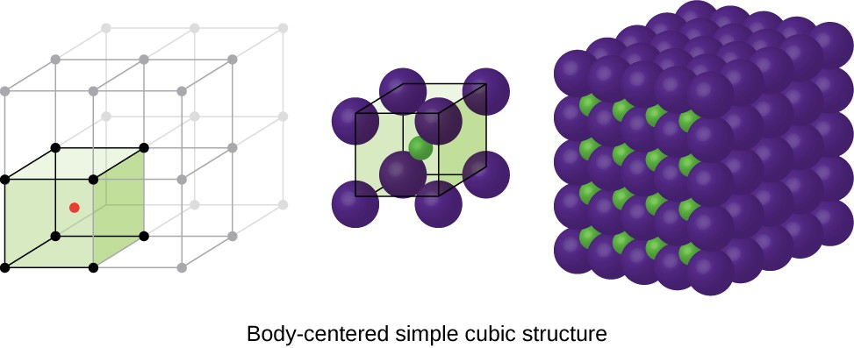
Crystal Structure of Ionic Materials
Ionic materials must have crystal structures that ensure electrical neutrality, yet permit ions of different sizes to be packed efficiently.
Ionic crystal structures can be viewed as close-­‐packed structures of anions.
Anions form tetrahedra or octahedra, allowing the cations to fit into their appropriate interstitial sites.

Slide 47
Ionic Radii
The crystal structures of ionically bonded compounds often can be described by placing the anions at the normal lattice points of a unit cell, with the cations then located at one or more of the interstitial sites
The ratio of the sizes of the ionic radii of anions and cations influences both the manner of packing and the coordination number
The radii of atoms and ions are different.
For example, the radius of an oxygen atom is 0.6 Å; however, the radius of an oxygen anion (O^{2-­‐}) is 1.32 Å. This is because an oxygen anion has acquired two additional electrons and has become larger.
As a general rule, anions are larger than cations.

Slide 48
Ionic Radii
Cations, having acquired a positive charge by losing electrons, are expected to be smaller.
The radii of cations and anions also depend upon the coordination number.
For example, the radius of an Al³⁺ ion is 0.39 Å when the coordination number is four (tetrahedral coordination); however, the radius of Al³⁺ is 0.53 Å when the coordination number is 6 (octahedral coordination).
The radius of an atom also depends on the crystal system. For example, the radius of an iron atom in the FCC and BCC polymorphs is different

Slide 49
Electrical Neutrality
The overall material has to be electrically neutral.
If the charges on the anion and the cation are identical and the coordination number for each ion is identical to ensure a proper balance of charge, then the compound will have a formula AX (A: cation, X: anion).

Slide 50
Diffraction Technique for Crystal Structure
A crystal structure of a crystalline material can be analyzed using x-­‐ray diffraction (XRD) or electron diffraction.
When a beam of x-­‐rays having a single wavelength on the same order of magnitude as the atomic spacing in the material strikes that material, x-­‐rays are scattered in all directions.
x-­‐rays that strike certain crystallographic planes at specific angles are reinforced rather than annihilated. This phenomenon is called diffraction.
The x-­‐rays are diffracted, or the beam is reinforced, when conditions satisfy
Bragg’s law:

Slide 51
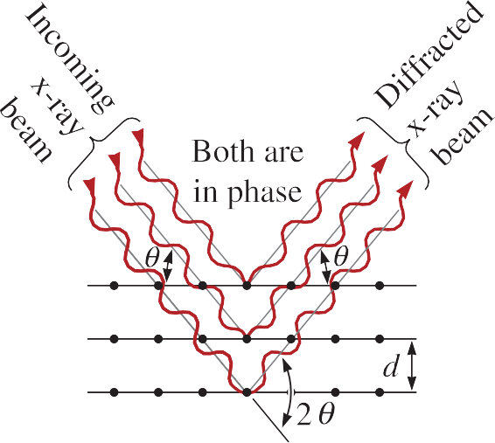
sin u = ^{l}
^{2d}hkl
where the angle θ is half the angle between the diffracted beam and the original beam direction, λ is the wavelength of the x-­‐rays, and d_{hkl} is the interplanar spacing between the planes that cause constructive reinforcement of the beam
a₀
d =
,
hkl
¹h ² + k² + l ²

Slide 52
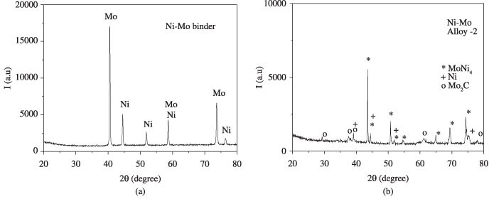
XRD Patterns-­‐Crystalline Materials

Slide 53
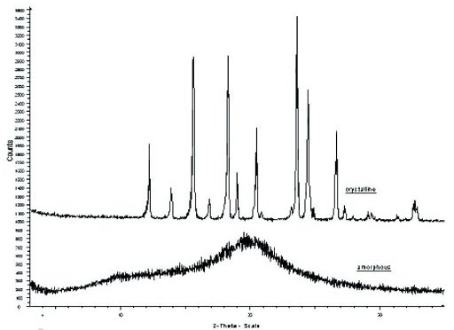
XRD Patterns-­‐Amorphous Materials

Slide 54
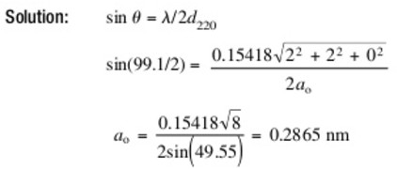
Exercise
A diffracted x-­‐ray beam is observed from the (220) planes of iron at a 2-­‐theta angle of 99.1° when x-­‐rays of 0.15418 nm wavelength are used. Calculate the lattice parameter of the iron.

Slide 55
Diffraction Technique for Crystal Structure
In a diffractometer, a moving x-­‐ray detector records the 2θ angles at which the beam is diffracted, giving a characteristic diffraction pattern.
If we know the wavelength of the x-­‐rays, we can determine the interplanar spacings and, eventually, the identity of the planes that cause the diffraction.
In an XRD instrument, x-­‐rays are produced by bombarding a metal target with a beam of high-­‐energy electrons.

Slide 56
Electron Diffraction and Microscopy
In electron diffraction, we make use of high-­‐energy (~100,000 to 400,000 eV) electrons.
These electrons are diffracted from electron transparent samples of materials.
The electron beam that exits from the sample is also used to form an image of the sample.
Thus, transmission electron microscopy (TEM) and electron diffraction are used for imaging microstructural features and determining crystal structures.

Slide 57
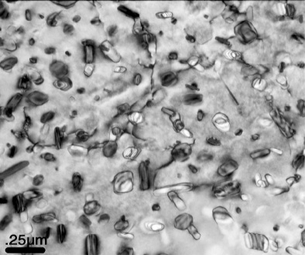
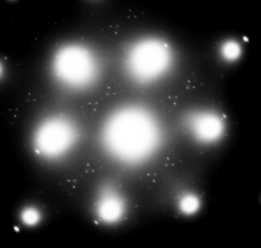
A TEM micrograph of an aluminum alloy (Al-­‐7055) sample. The diffraction pattern at the right shows large bright spots that represent diffraction from the main aluminum matrix grains. The smaller spots originate from the nanoscale crystals of another compound that is present in the aluminum alloy.

Slide 58
Transmission Electron Microscope (TEM)
Using TEM, it is possible to determine differences between different crystalline regions and between amorphous and crystalline regions at very small length scales (~1–10 nm).
High-­‐resolution electron microscopy (HREM), scanning transmission electron microscopy (STEM) are also used to determine the orientation of different grains and other microstructural features
Advanced and specialized features associated with TEM also allow chemical mapping of elements in a given material.

Slide 59
ASSIGNMENT 2

